Slide 1
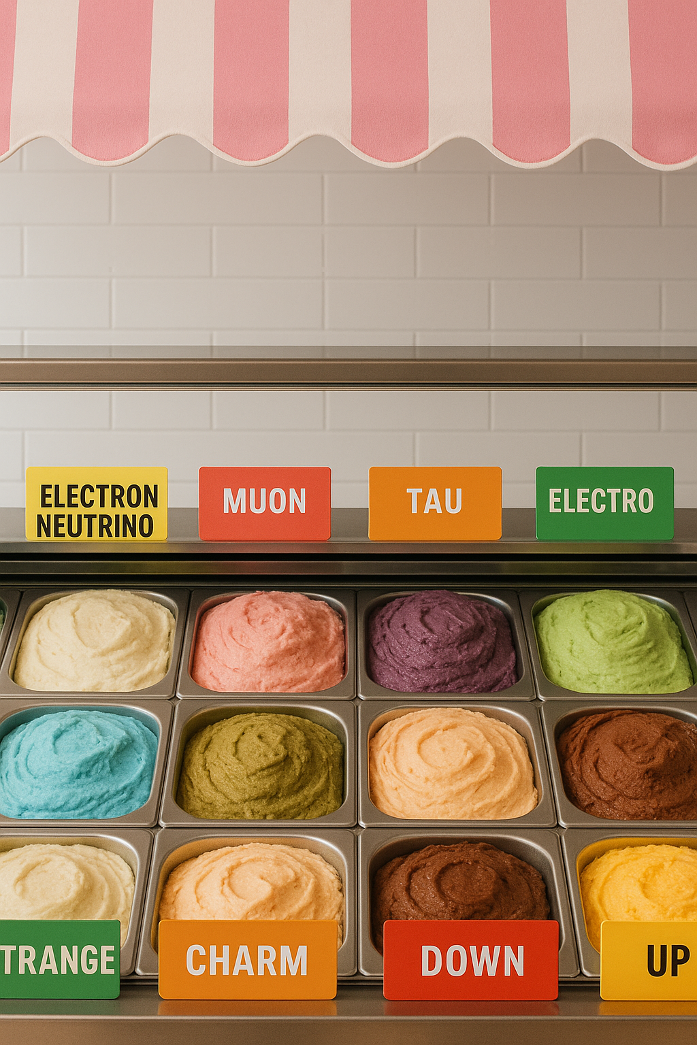


Physics of Particle Flavors
Belle II Explorer
Valeria Fioroni
23 June 2025
N

Slide 2






What is flavor?
Fermions
I
generation
II
generation
III
generation
u
c
t
Quarks
up
charm
top
d
s
b
down
strange
bottom
$$e^{−}$$
$$μ^{−}$$
$${ τ}^{−}$$
Leptons
electron
muon
tau
$$ν_{e}$$
$$ν_{μ}$$
$$ν_{τ}$$
electron neutrino
muon neutrino
tau neutrino
Flavor: The type of quark or lepton.

Slide 3





Why do we study flavor physics?
  To answer open questions of the Standard Model, for example:
    The Big Bang should have produced the same amount of matter and antimatter
$${ e}^{−}$$
$${ e}^{−}$$
$${ e}^{+}$$
$${ e}^{+}$$
particle-antiparticle pair production from energetic radiation
particle-antiparticle annihilation
into energy
    But the Universe is not empty, and everything we see is made mostly of matter:
    Where did all the antimatter go?

Slide 4





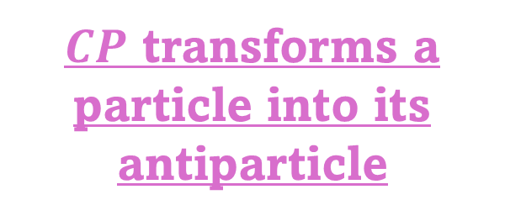
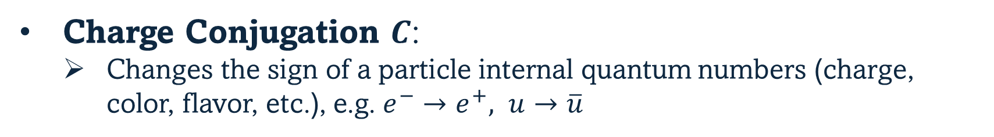



One key ingredient: $CP$ violation
$$\vec{S}$$
$$\vec{S}$$
$CP$ transforms a particle into its antiparticle
$$\vec{p}$$
$$−\vec{p}$$
$$electron$$
$$positron$$
$$CP$$
Charge Conjugation $C$:
  Changes the sign of a particle internal quantum numbers (charge, color, flavor, etc.), e.g. $e^{−}→e^{+}, u→\overline{u}$
Parity $P$, or spatial inversion:
  $\vec{x}→−\vec{x}, \vec{p}→−\vec{p}$ but $\vec{S}→\vec{S}$
If particles and antiparticles behave differently, $CP$ is violated

Slide 5










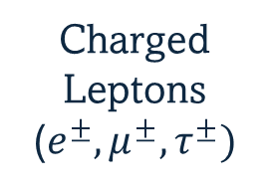
Standard Model Interactions
Gauge Bosons
(force mediators)
Interaction of gauge bosons with fermions:
Electromagnetic interaction
Electromagnetic interaction vertices:
$$γ$$
photon
$$e^{−}$$
$$e^{−}$$
Charged
Leptons ($e^{±}, μ^{±},τ^{±})$
Weak interaction
$$γ$$
$${ W}^{±}$$
$$Z^{0}$$
$W^{±},Z^{0}$ bosons
Strong interaction
g
gluon
$$c$$
$$c$$
Quarks
(and anti-quarks)
$$γ$$
  No flavor change

Slide 6



Standard Model Interactions
Gauge Bosons
(force mediators)
Interaction of gauge bosons with fermions:
Electromagnetic interaction
Never changes flavor
$$γ$$
photon
Strong interaction vertex:
Weak interaction
$$q$$
$$q$$
$${ W}^{±}$$
$$Z^{0}$$
$W^{±},Z^{0}$ bosons
Quarks
(and anti-quarks)
$$g$$
Strong interaction
g
gluon
  No flavor change

Slide 7


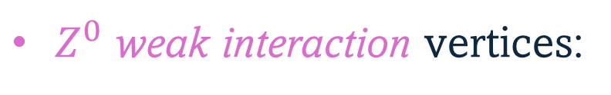

Standard Model Interactions
Gauge Bosons
(force mediators)
Interaction of gauge bosons with fermions:
Electromagnetic interaction
Never changes flavor
$Z^{0}$ weak interaction vertices:
$$γ$$
photon
Weak interaction
$$f$$
$$f$$
$${ W}^{±}$$
$$Z^{0}$$
$W^{±},Z^{0}$ bosons
All fermions
(leptons and quarks)
Strong interaction
$$Z^{0}$$
Never changes flavor
g
gluon
  No flavor change

Slide 8








Standard Model Interactions
Gauge Bosons
(force mediators)
Interaction of gauge bosons with fermions:
Electromagnetic interaction
Never changes flavor
$W^{±}$ weak interaction vertices:
$$γ$$
photon
$$e^{−}$$
$$ν_{e}$$
Weak interaction
Can change flavor
$$W^{−}$$
$${ W}^{±}$$
$$Z^{0}$$
$W^{±},Z^{0}$ bosons
All fermions
(leptons and quarks)
Strong interaction
Never changes flavor
$$d$$
$$u$$
g
gluon
$$W^{−}$$
We will focus on these
Flavor Changing Interactions
  Always changes flavor
  Violates $CP$

Slide 9
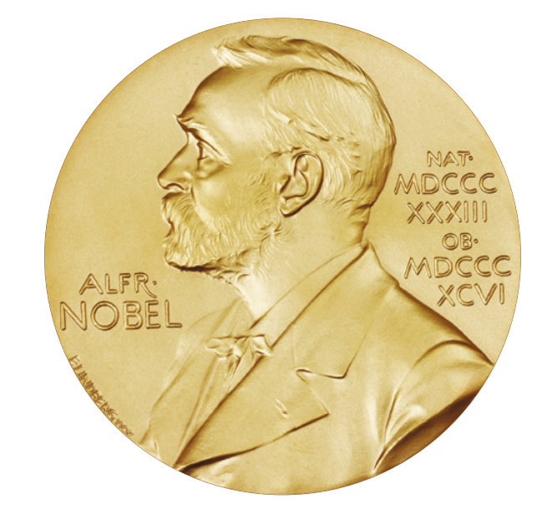


















Flavor Changing Interactions
Lepton vertices
$$e^{−}$$
$$ν_{e}$$
Flavor changing processes within the same generation*
$$g$$
$$W^{−}$$
Same strength for all generations
$$μ^{−}$$
$$ν_{μ}$$
$$g$$
$$W^{−}$$
$$e^{−}$$
$$μ^{−}$$
$$τ^{−}$$
$$τ^{−}$$
$$ν_{τ}$$
$$g$$
$$ν_{e}$$
$$ν_{μ}$$
$$ν_{τ}$$
$$W^{−}$$
*but neutrino oscillations have been observed:
Discovery of Atmospheric Neutrino Oscillations
2015 Nobel Prize

Slide 10












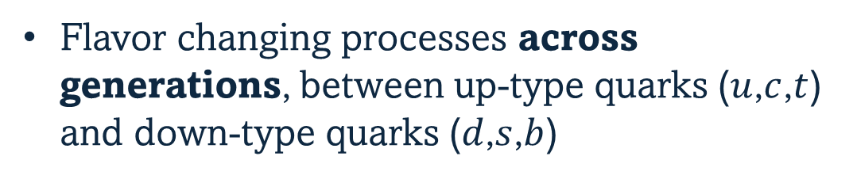








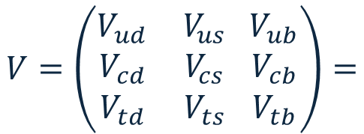
















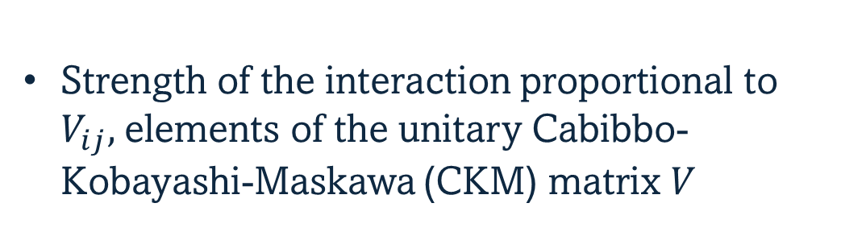
Flavor Changing Interactions
Quark vertices:
Flavor changing processes across generations, between up-type quarks ($u$,$c$,$t$) and down-type quarks ($d$,$s$,$b$)
$$u$$
$$d$$
$$u$$
$$s$$
$$u$$
$$b$$
$$V_{ud}$$
$$V_{us}$$
$$V_{ub}$$
$$W^{+}$$
$$W^{+}$$
$$W^{+}$$
Strength of the interaction proportional to $V_{ij},$elements of the unitary Cabibbo-Kobayashi-Maskawa (CKM) matrix $V$
$$c$$
$$d$$
$$c$$
$$s$$
$$c$$
$$b$$
$$V_{cd}$$
$$V_{cs}$$
$$V_{cb}$$
$$W^{+}$$
$$W^{+}$$
$$W^{+}$$
$$V=\left(\begin{matrix}V_{ud} & V_{us} \\ \begin{aligned}V_{cd} \\ V_{td}\end{aligned} & \begin{aligned}V_{cs} \\ V_{ts}\end{aligned}\end{matrix} \begin{matrix}V_{ub} \\ V_{cb} \\ V_{tb}\end{matrix}\right)=$$
$$t$$
$$d$$
$$t$$
$$s$$
$$t$$
$$b$$
$$V_{td}$$
$$V_{ts}$$
$$V_{tb}$$
$$W^{+}$$
$$W^{+}$$
$$W^{+}$$

Slide 11
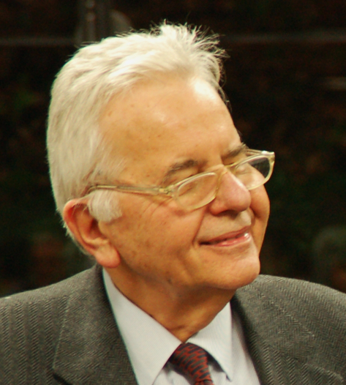
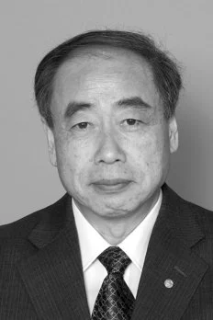
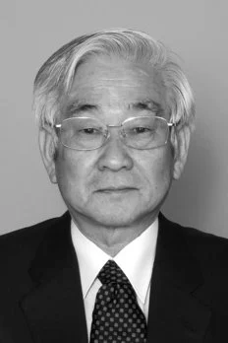
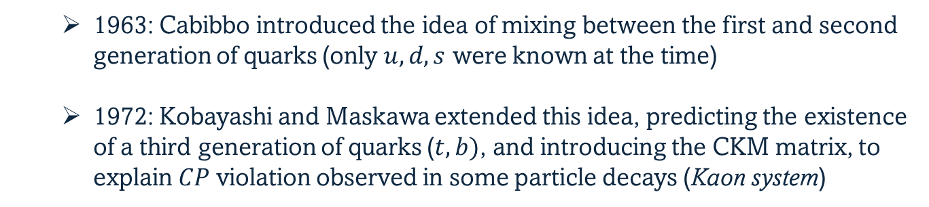

CKM Matrix
$$V=\left(\begin{matrix}V_{ud} & V_{us} \\ \begin{aligned}V_{cd} \\ V_{td}\end{aligned} & \begin{aligned}V_{cs} \\ V_{ts}\end{aligned}\end{matrix} \begin{matrix}V_{ub} \\ V_{cb} \\ V_{tb}\end{matrix}\right)=$$
The CKM matrix $V$ is non-diagonal, and describes mixing between the generations of quarks
  1963: Cabibbo introduced the idea of mixing between the first and second generation of quarks (only $u,d,s$ were known at the time)
  1972: Kobayashi and Maskawa extended this idea, predicting the existence of a third generation of quarks ($t,b)$, and introducing the CKM matrix, to explain $CP$ violation observed in some particle decays (Kaon system)

Slide 12







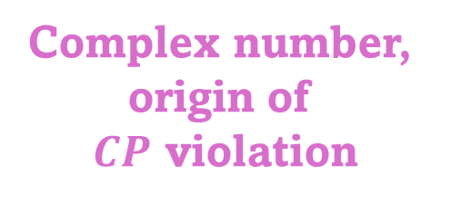

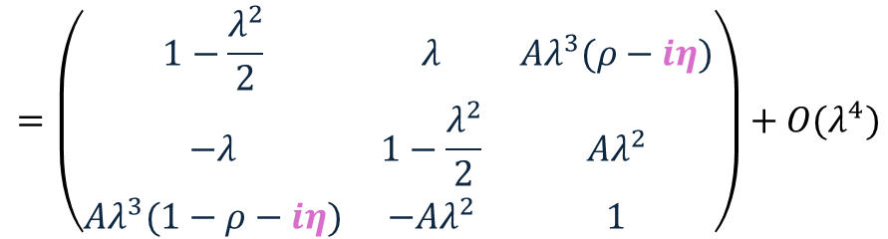





$CP$ Violation in the Standard Model
Wolfenstein parametrization, $λ\sim 0.22$
$$=\left(\begin{matrix}1−\frac{λ^{2}}{2} & λ & Aλ^{3}(ρ−iη) \\ −λ & 1−\frac{λ^{2}}{2} & Aλ^{2} \\ Aλ^{3}(1−ρ−iη) & −Aλ^{2} & 1\end{matrix}\right)+O(λ^{4})$$
$$V=\left(\begin{matrix}V_{ud} & V_{us} \\ \begin{aligned}V_{cd} \\ V_{td}\end{aligned} & \begin{aligned}V_{cs} \\ V_{ts}\end{aligned}\end{matrix} \begin{matrix}V_{ub} \\ V_{cb} \\ V_{tb}\end{matrix}\right)=$$
Relative magnitude
Complex number,
origin of
$CP$ violation
$$b$$
$$u$$
$$\overline{b}$$
$$\overline{u}$$
$$V_{ub}$$
$$V_{ub}^{∗}$$
$V_{ub}$ and $V_{ub}^{∗}$ can be different
$$W^{−}$$
$$W^{+}$$
$$CP$$

Slide 13
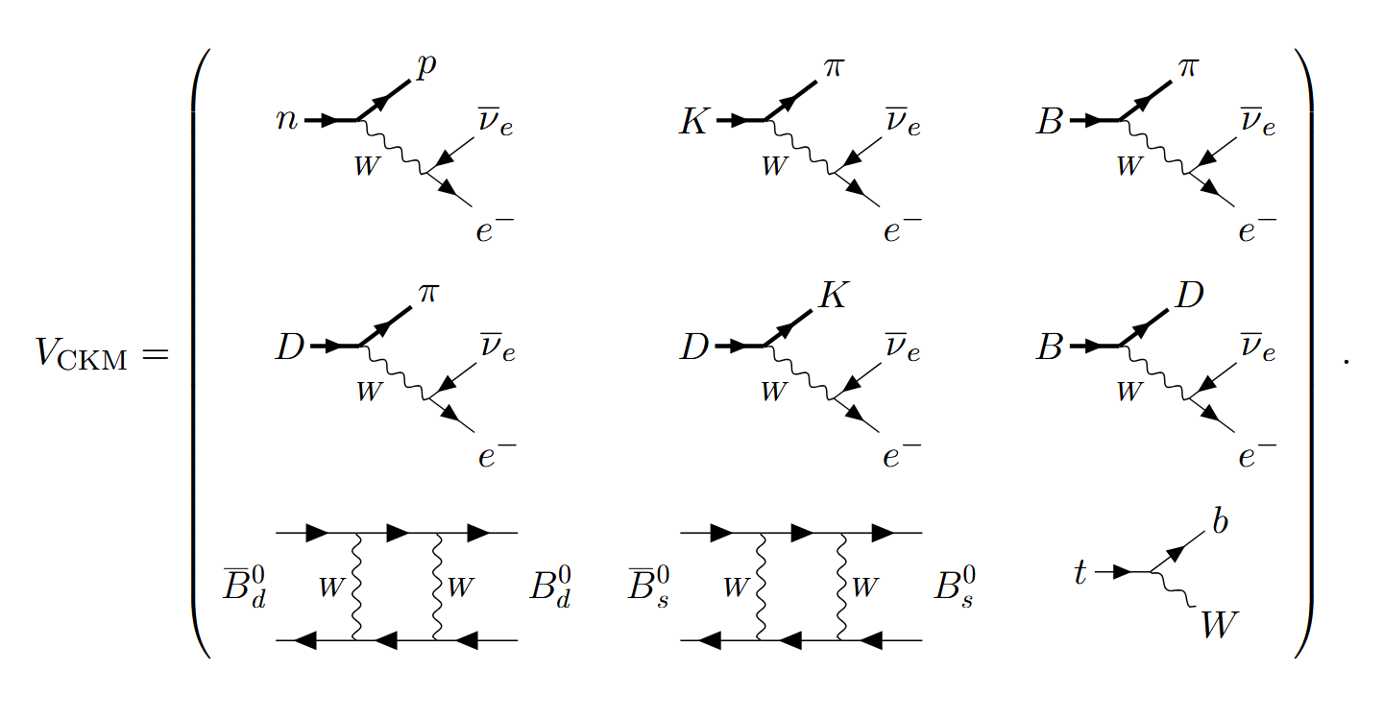
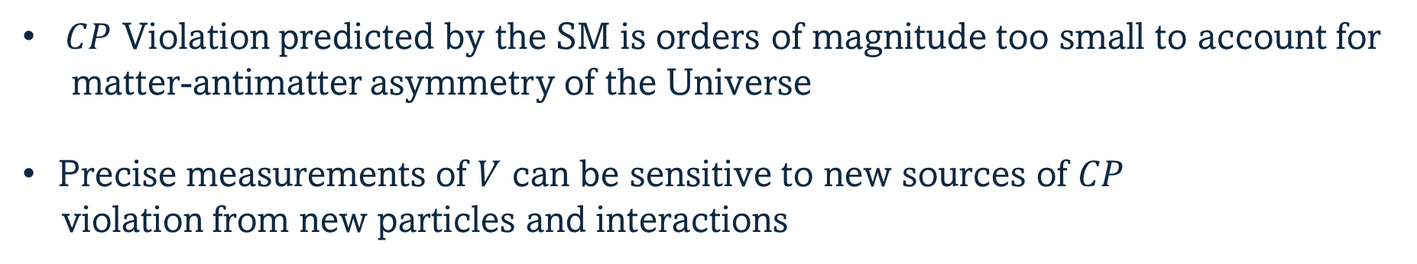
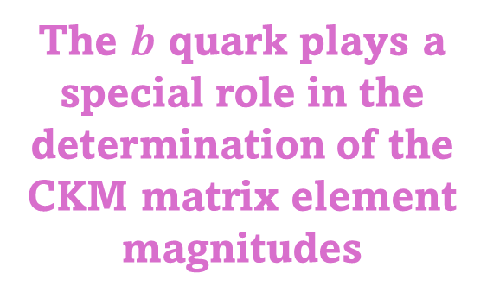
Measurement of CKM matrix elements
$CP$ Violation predicted by the SM is orders of magnitude too small to account for
matter-antimatter asymmetry of the Universe
Precise measurements of $V$ can be sensitive to new sources of $CP$
violation from new particles and interactions
The $b$ quark plays a special role in the determination of the CKM matrix element magnitudes

Slide 14
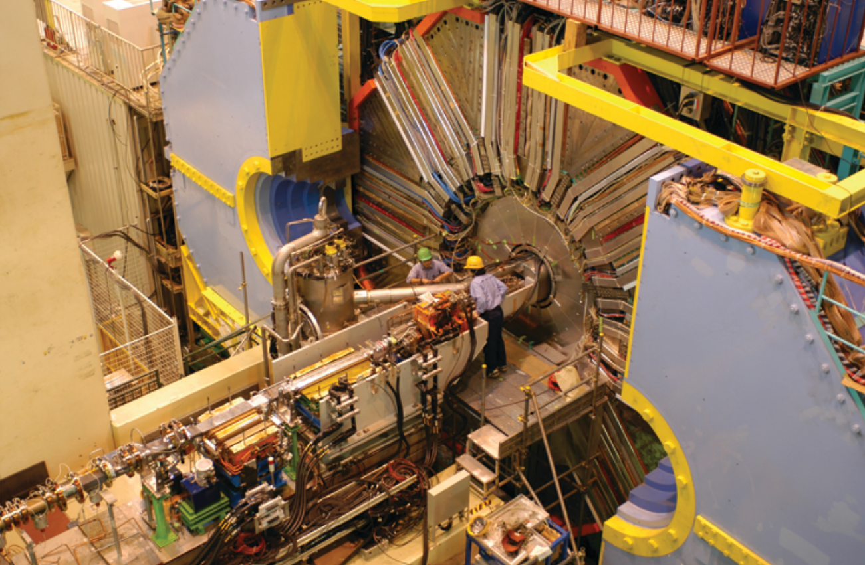


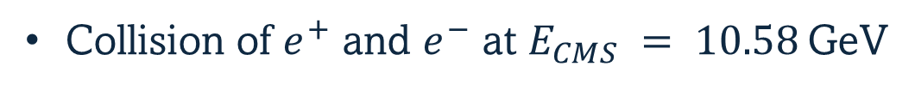

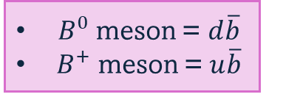

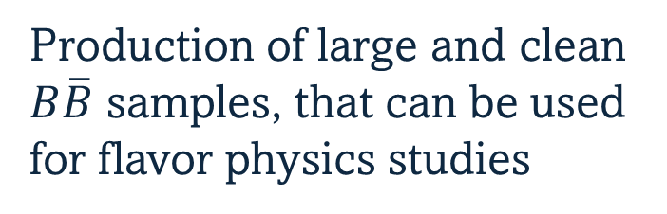
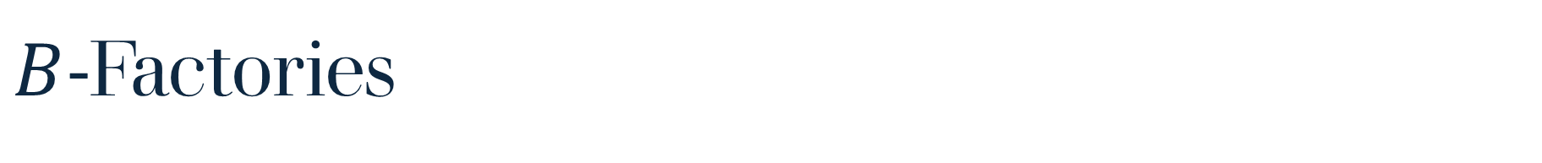




$B$-Factories
$B^{0}$ meson = $d\overline{b}$
${ B}^{+}$ meson = $u\overline{b}$
Collision of $e^{+}$ and $e^{−}$ at $E_{CMS} = 10.58$GeV
$${B^{0}\overline{B}}^{0}$$
Production of large and clean
$B\overline{B}$ samples, that can be used
for flavor physics studies
$$\overline{b}$$
$$e^{+}e^{−}→$$
$$b$$
or
$$B^{+}B^{−}$$
$$Υ\left(4s\right)$$
Experiments at the B-Factories:
More on the Belle II Experiment after the break,
in Dr Haruki Kindo’s talk!
Ongoing
Belle detector upgrade
Goal: ~50x the amount of data collected by Belle
BaBar at SLAC, U.S.
1999-2008
Belle at KEK, Japan
1999-2010

Slide 15
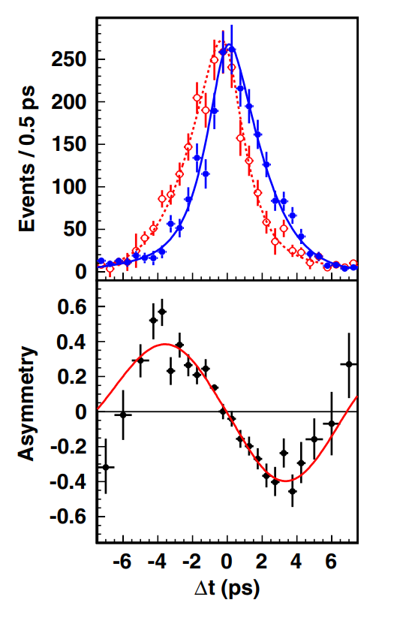
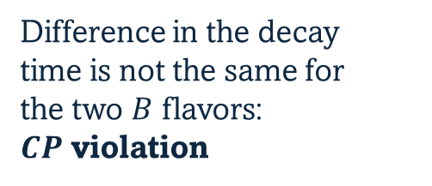
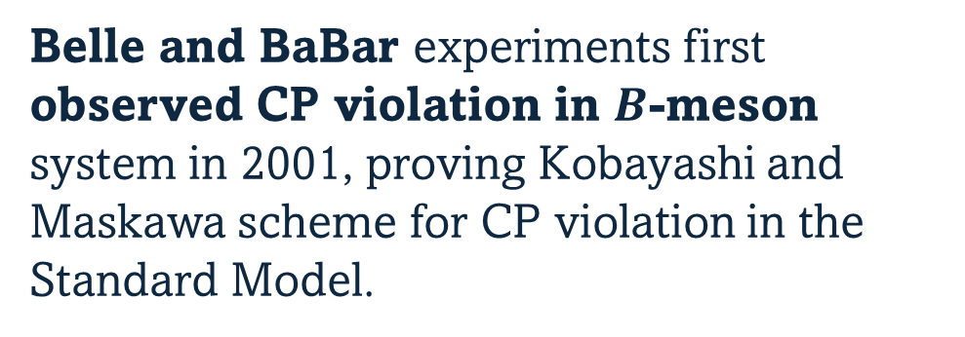
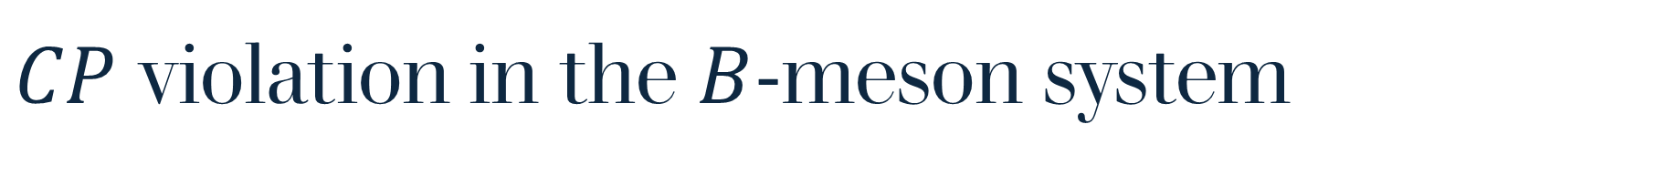


$CP$ violation in the $B$-meson system
Belle and BaBar experiments first observed CP violation in $B$-meson system in 2001, proving Kobayashi and Maskawa scheme for CP violation in the Standard Model.
$$B^{0}$$
$${\overline{B}}^{0}$$
Difference in the decay
time is not the same for
the two $B$ flavors:
$CP$ violation
Kobayashi and Maskawa were awarded the
Nobel Prize in 2008, "for the discovery of the origin of the broken symmetry which predicts the existence of at least three families of quarks in nature"
Phys. Rev. Lett. 108, 171802

Slide 16
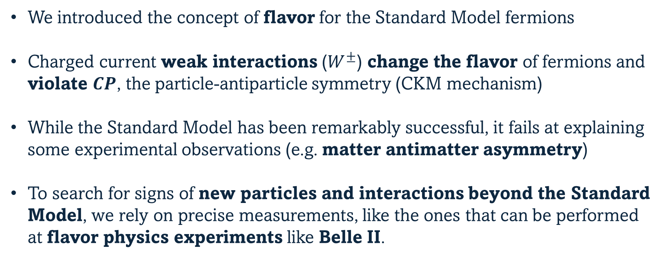
Summary
We introduced the concept of flavor for the Standard Model fermions
Charged current weak interactions ($W^{±}$) change the flavor of fermions and violate $CP$, the particle-antiparticle symmetry (CKM mechanism)
While the Standard Model has been remarkably successful, it fails at explaining some experimental observations (e.g. matter antimatter asymmetry)
To search for signs of new particles and interactions beyond the Standard Model, we rely on precise measurements, like the ones that can be performed at flavor physics experiments like Belle II.
Thank you! ☺

Slide 17
Backup

Slide 18
Why “flavor”?
  The term flavor was first used in particle physics in the context of the quark model of hadrons.
  It was coined in 1971 by Murray Gell-Mann and his student at the time, Harald Fritzsch, at a Baskin-Robbins ice-cream store in Pasadena.
  Just as ice cream has both color and flavor so do quarks. (Fritzsch, 2008)
N
Rev. Mod. Phys. 81, 1887

Slide 19
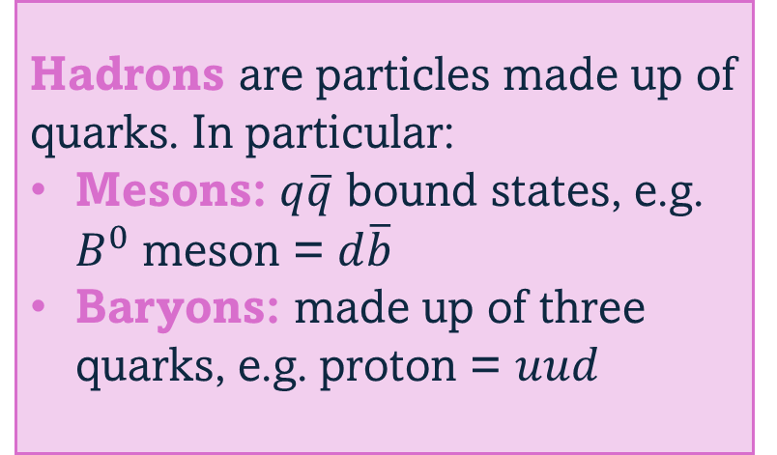
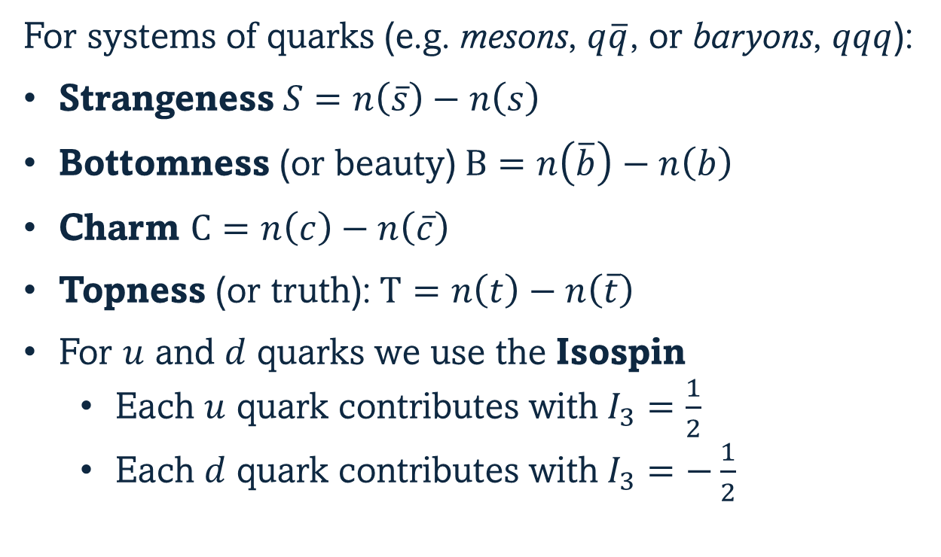
Flavor of hadrons
For systems of quarks (e.g. mesons, $q\overline{q}$, or baryons, $qqq$):
Strangeness $S=n\left(\overline{s}\right)−n\left(s\right)$
Bottomness (or beauty) $B=n\left(\overline{b}\right)−n\left(b\right)$
Charm $C=n\left(c\right)−n\left(\overline{c}\right)$
Topness (or truth): $T=n\left(t\right)−n\left(\overline{t}\right)$
For $u$ and $d$ quarks we use the Isospin
  Each $u$ quark contributes with $I_{3}=\frac{1}{2}$
  Each $d$ quark contributes with $I_{3}=−\frac{1}{2}$
Hadrons are particles made up of quarks. In particular:
Mesons: $q\overline{q}$ bound states, e.g. $B^{0}$ meson = $d\overline{b}$
Baryons: made up of three quarks, e.g. proton = $uud$

Slide 20
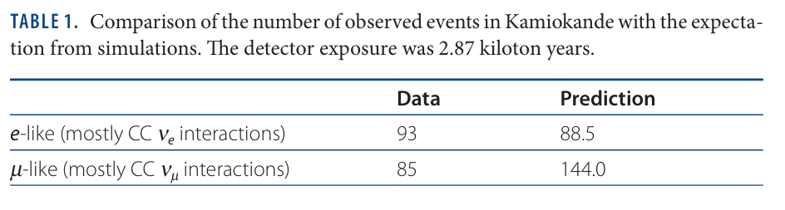
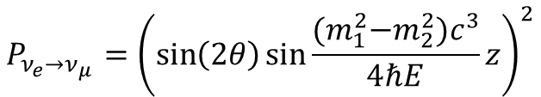
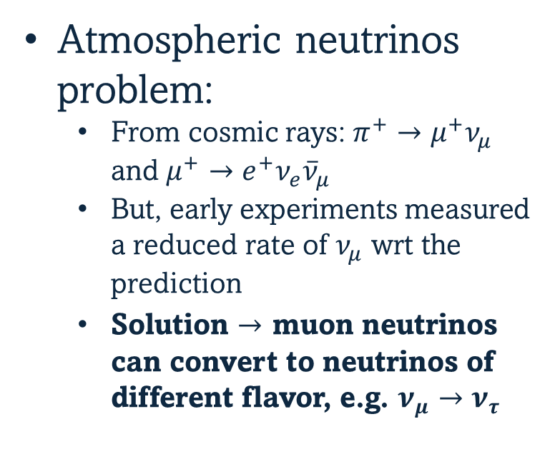
Neutrino Oscillations
Neutrinos are hard to detect, since they do not interact much
  100 billion neutrinos pass through your thumbnail every second
  And yet, you can expect one/two neutrino interactions in your body during your entire lifetime
Atmospheric neutrinos problem:
  From cosmic rays: $π^{+}→μ^{+}ν_{μ}$ and $μ^{+}→e^{+}ν_{e}{\overline{ν}}_{μ}$
  But, early experiments measured a reduced rate of $ν_{μ}$ wrt the prediction
  Solution $→$ muon neutrinos can convert to neutrinos of different flavor, e.g. $ν_{μ}→ν_{τ}$
$$P_{ν_{e}→ν_{μ}}={\left(\sin\left(2θ\right)\sin{\frac{{(m}_{1}^{2}−m_{2}^{2})c^{3}}{4ℏE}z}\right)}^{2}$$
non-zero mixing between the flavors
non-zero mass difference

Slide 21




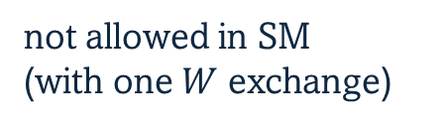



Flavor Changing Interactions
Quark vertices
Flavor changing processes across generations
$$u$$
$$c$$
$$t$$
favored
suppressed
$$d$$
$$s$$
$$b$$
not allowed in SM
(with one $W$ exchange)
$$V=\left(\begin{matrix}V_{ud} & V_{us} \\ \begin{aligned}V_{cd} \\ V_{td}\end{aligned} & \begin{aligned}V_{cs} \\ V_{ts}\end{aligned}\end{matrix} \begin{matrix}V_{ub} \\ V_{cb} \\ V_{tb}\end{matrix}\right)=$$

Slide 22
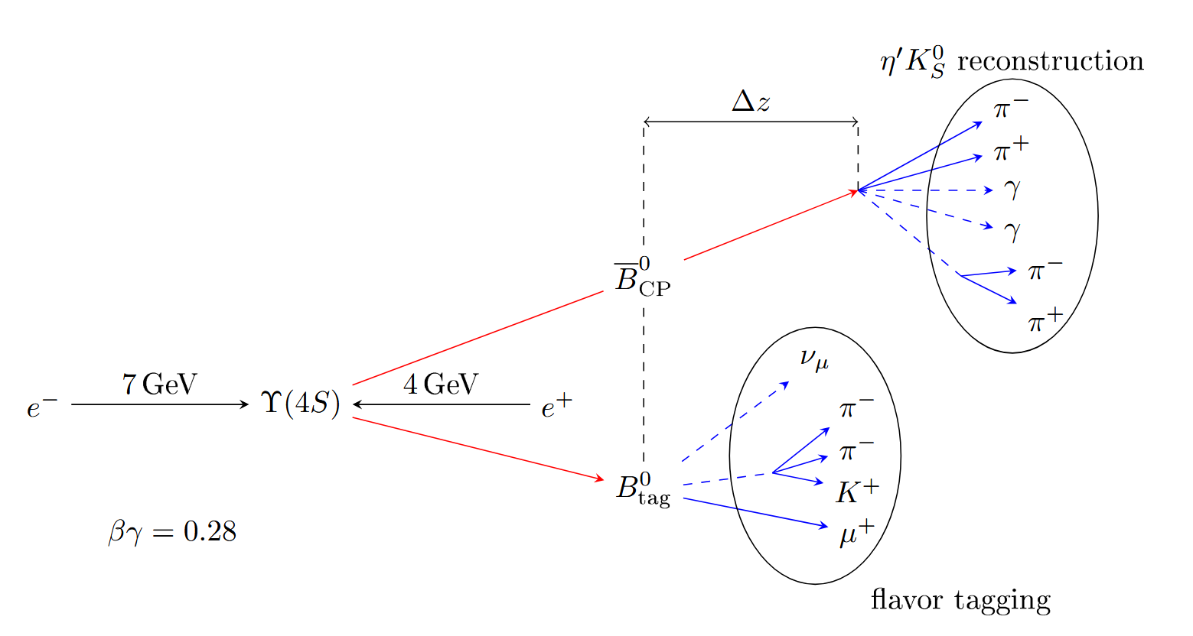

Time-dependent CP violation
$$Δt \sim \frac{Δz}{βγc}$$
this is the quantity in the histogram of slide 15

Slide 23
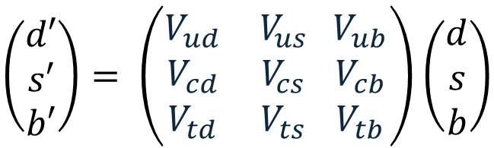
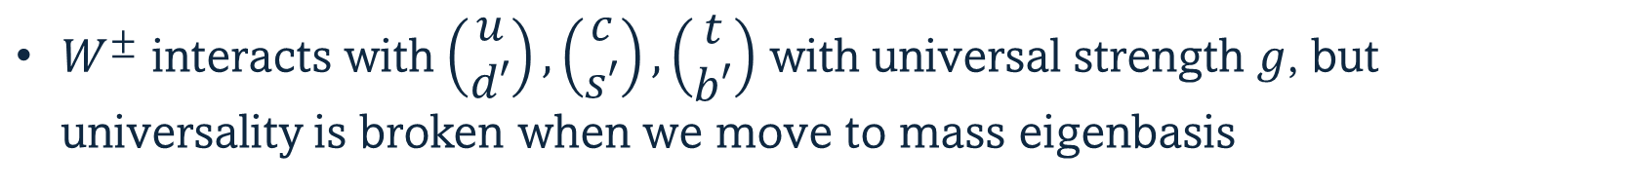
CKM Matrix
The origin of the CKM matrix $V$ is the difference between mass eigenstates and weak interaction eigenstates, i.e. flavor eigenstates
$\left(\begin{aligned}d′ \\ s′ \\ b′\end{aligned}\right)= \left(\begin{matrix}V_{ud} & V_{us} \\ \begin{aligned}V_{cd} \\ V_{td}\end{aligned} & \begin{aligned}V_{cs} \\ V_{ts}\end{aligned}\end{matrix} \begin{matrix}V_{ub} \\ V_{cb} \\ V_{tb}\end{matrix}\right)$ $\left(\begin{aligned}d \\ s \\ b\end{aligned}\right)$
Flavor eigenstates
Mass eigenstates
$W^{±}$ interacts with $\left(\begin{aligned}u \\ d′\end{aligned}\right),\left(\begin{aligned}c \\ s′\end{aligned}\right),\left(\begin{aligned}t \\ b′\end{aligned}\right)$ with universal strength $g$, but universality is broken when we move to mass eigenbasis

Slide 24
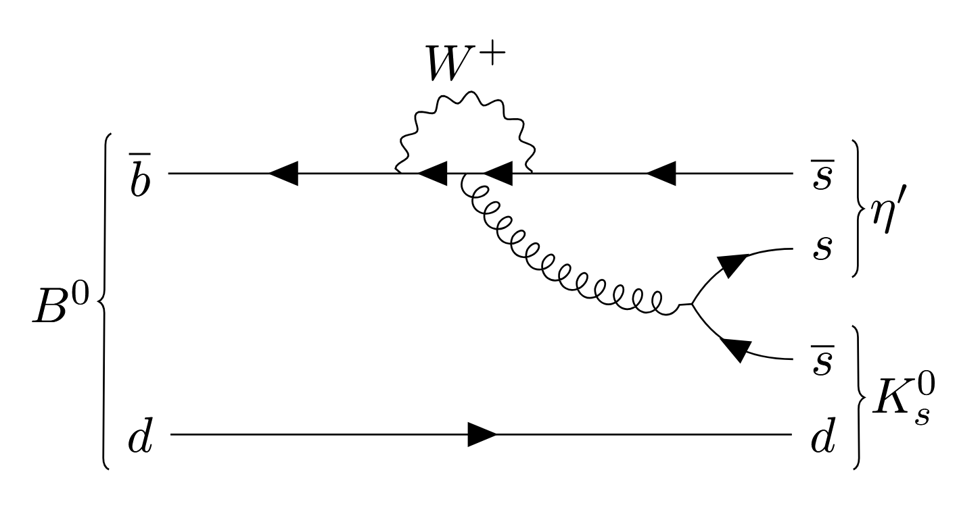

CP violation in loop processes
$$\overline{u}, \overline{c}, \overline{t}$$
Comparing CP violation in these transitions to the one in transitions with no loops we are potentially sensitive to new physics occurring in the loop

Slide 25
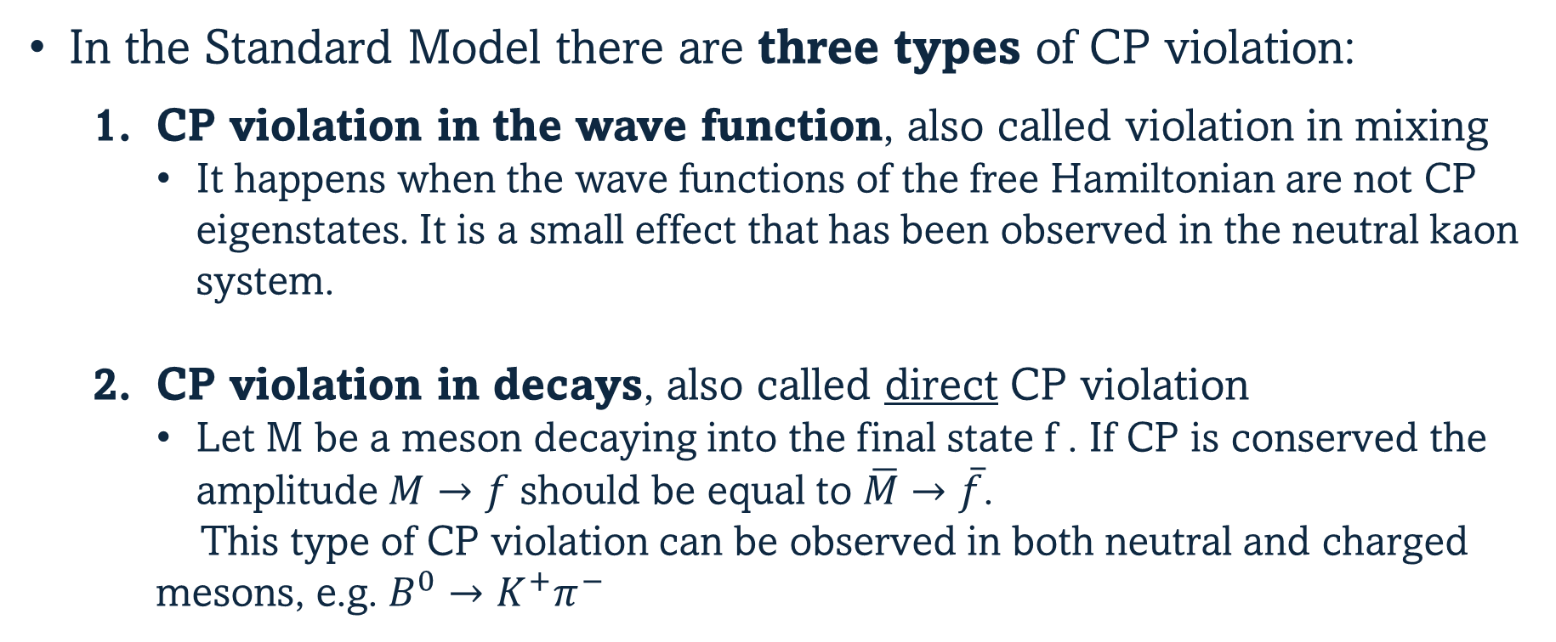
Types of CP Violation
In the Standard Model there are three types of CP violation:
  CP violation in the wave function, also called violation in mixing
    It happens when the wave functions of the free Hamiltonian are not CP eigenstates. It is a small effect that has been observed in the neutral kaon system.
  CP violation in decays, also called direct CP violation
    Let M be a meson decaying into the final state f . If CP is conserved the amplitude $M→f$ should be equal to $\overline{M}→\overline{f}$.
    This type of CP violation can be observed in both neutral and charged mesons, e.g. $B^{0}→K^{+}π^{−}$

Slide 26

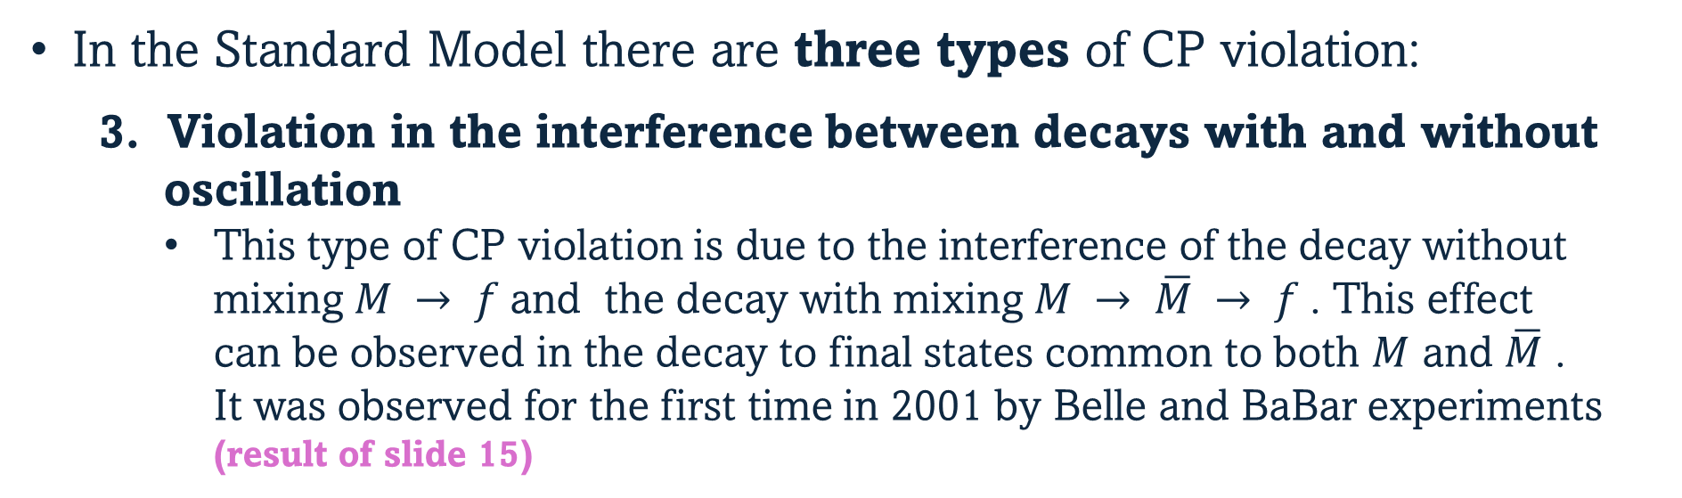

Types of CP Violation
In the Standard Model there are three types of CP violation:
3. Violation in the interference between decays with and without oscillation
    This type of CP violation is due to the interference of the decay without mixing $M → f$and the decay with mixing $M → \overline{M} → f$. This effect can be observed in the decay to final states common to both $M$ and $\overline{M}$ . It was observed for the first time in 2001 by Belle and BaBar experiments (result of slide 15)
$B^{0}→J/ψK_{S}^{0}$
$B^{0}→{\overline{B}}^{0}→J/ψK_{S}^{0}$
Decay without oscillation
Decay with oscillation

