Slide 1
First-principles Spin and Optical Properties of Vacancy Clusters in Lithium Fluoride
January 16, 2025
Vsevolod Ivanov
Virginia Tech NSI & Department of Physics

Slide 2
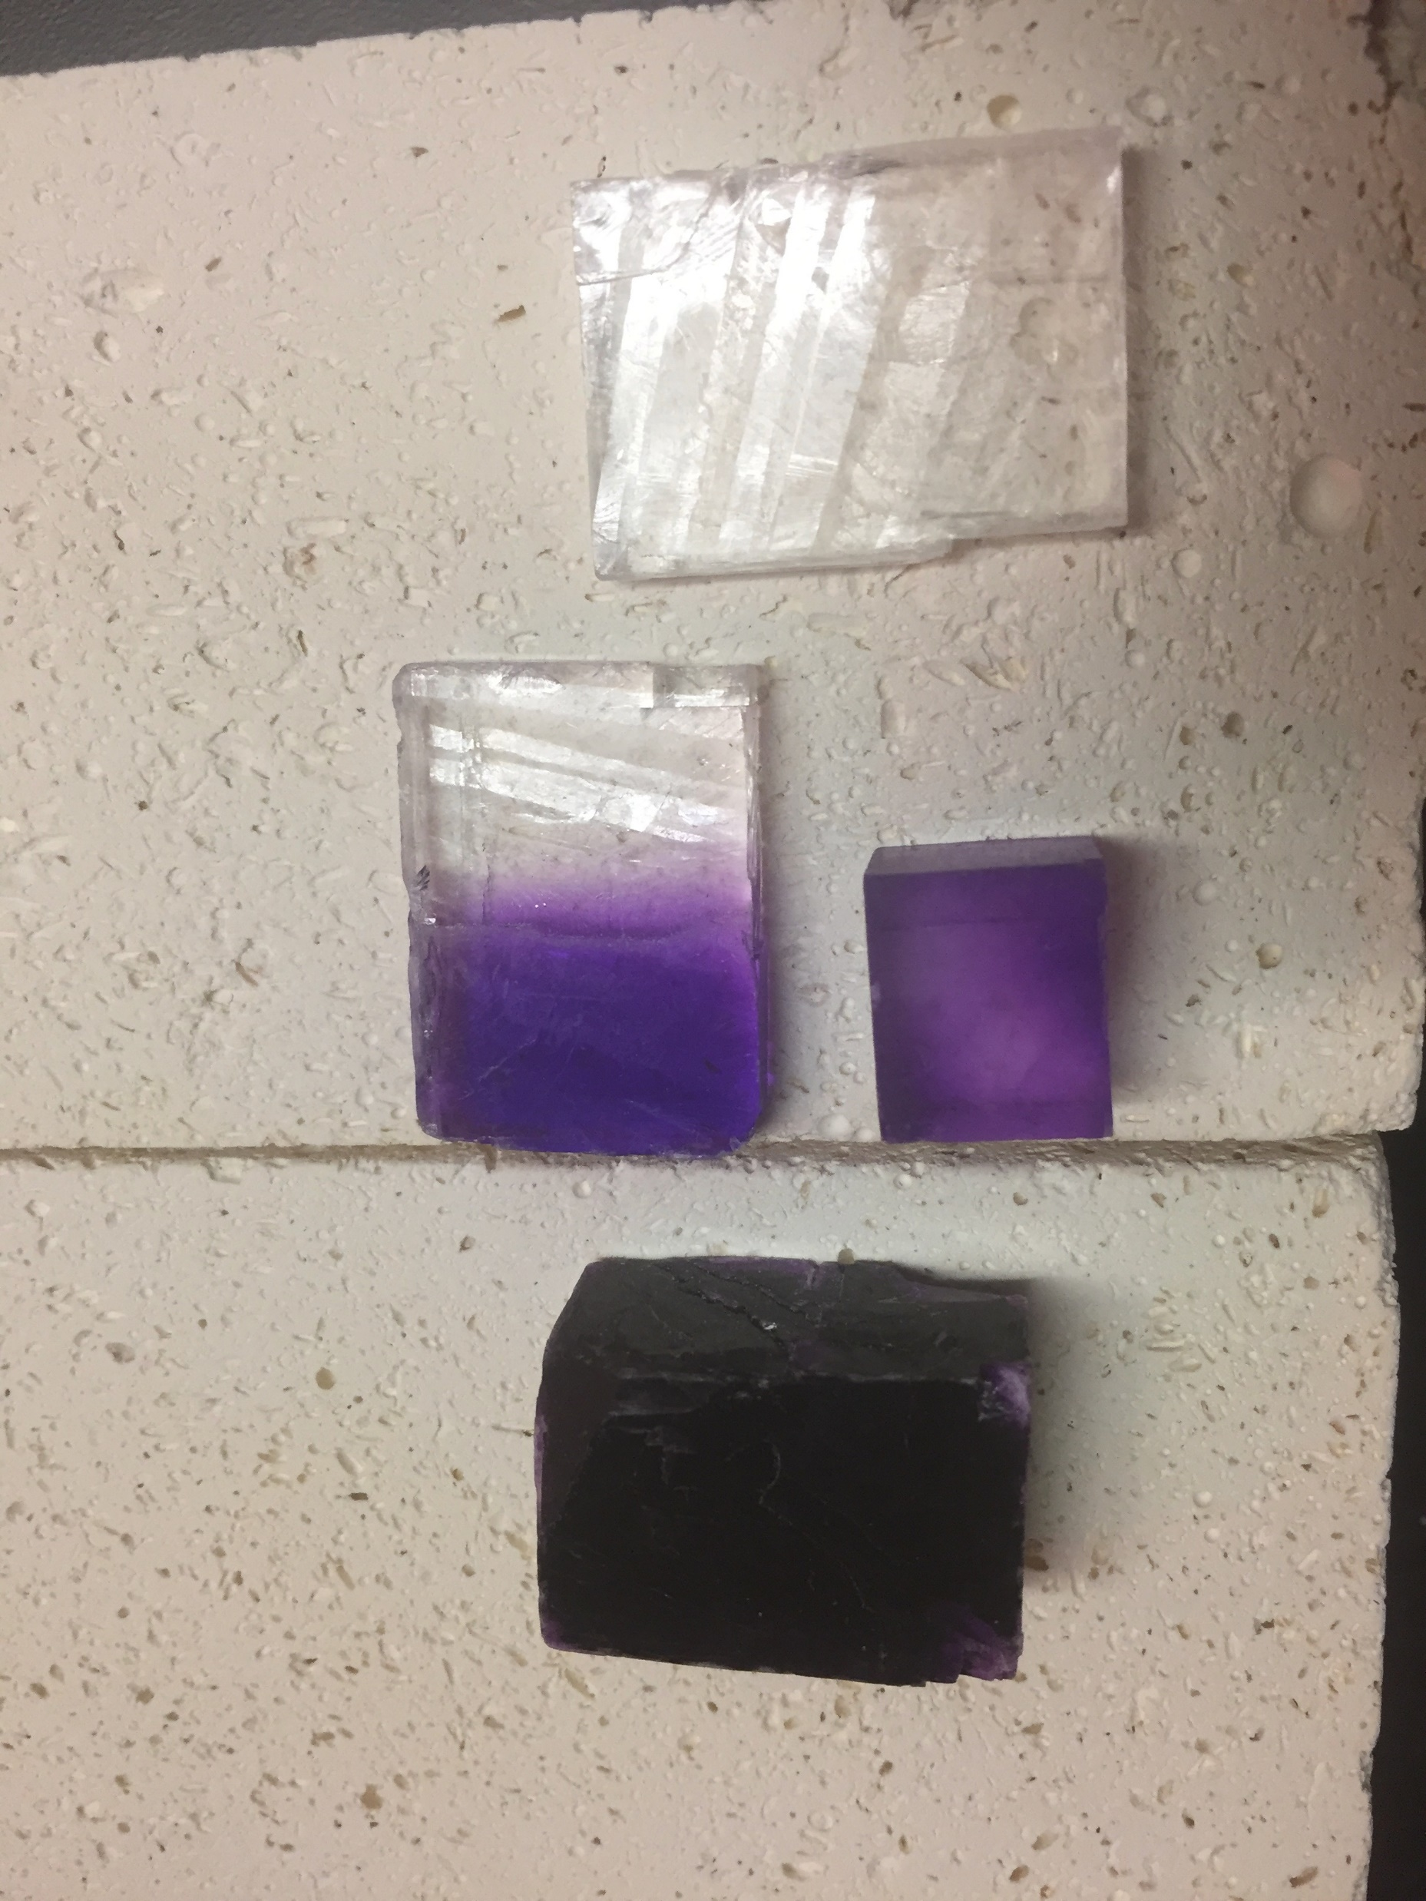
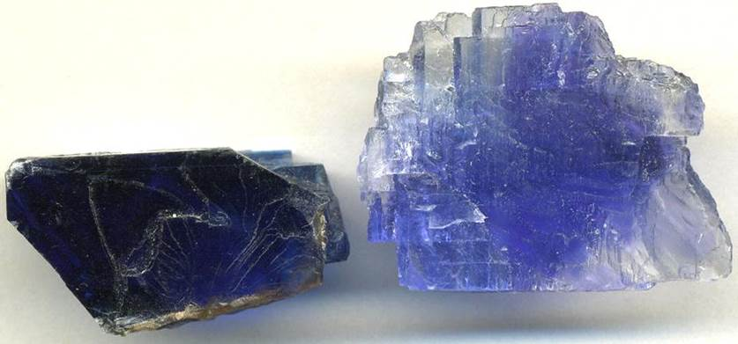
Irradiated Alkali Halides
Goldstein (1896) – alkali halides bombarded by cathode rays change color!
Mineral Detection of Dark Matter Meeting
1/13-1/17 2025

Slide 3
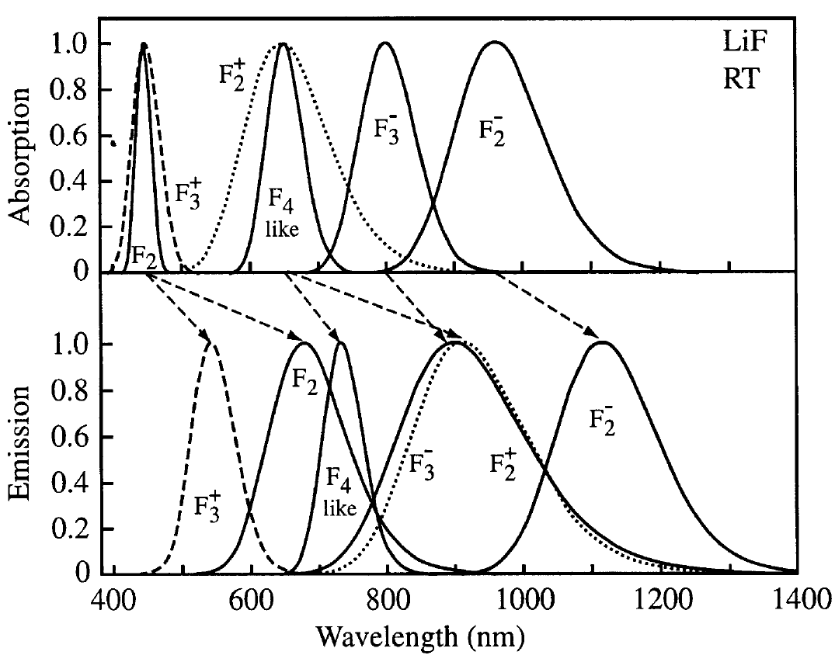
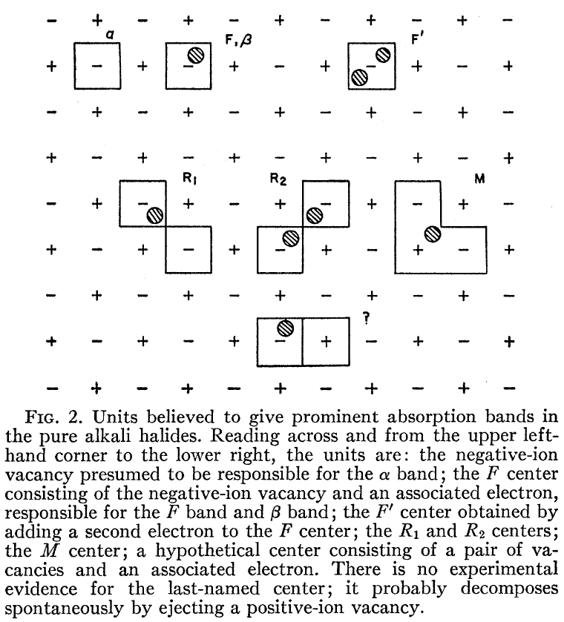
Abundance of Color Centers!
Journal of Luminescence 100 (2002) 333–343
Mineral Detection of Dark Matter Meeting
1/13-1/17 2025

Slide 4
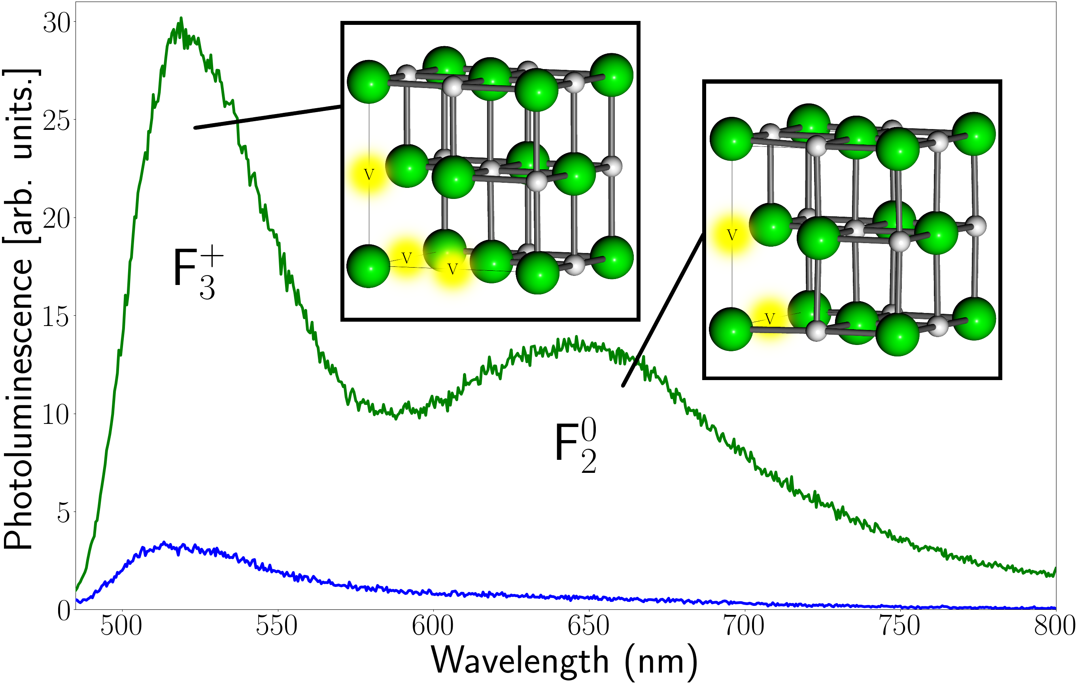
Photoluminescence Spectrum
https://arxiv.org/abs/2412.21060
Mineral Detection of Dark Matter Meeting
1/13-1/17 2025

Slide 5
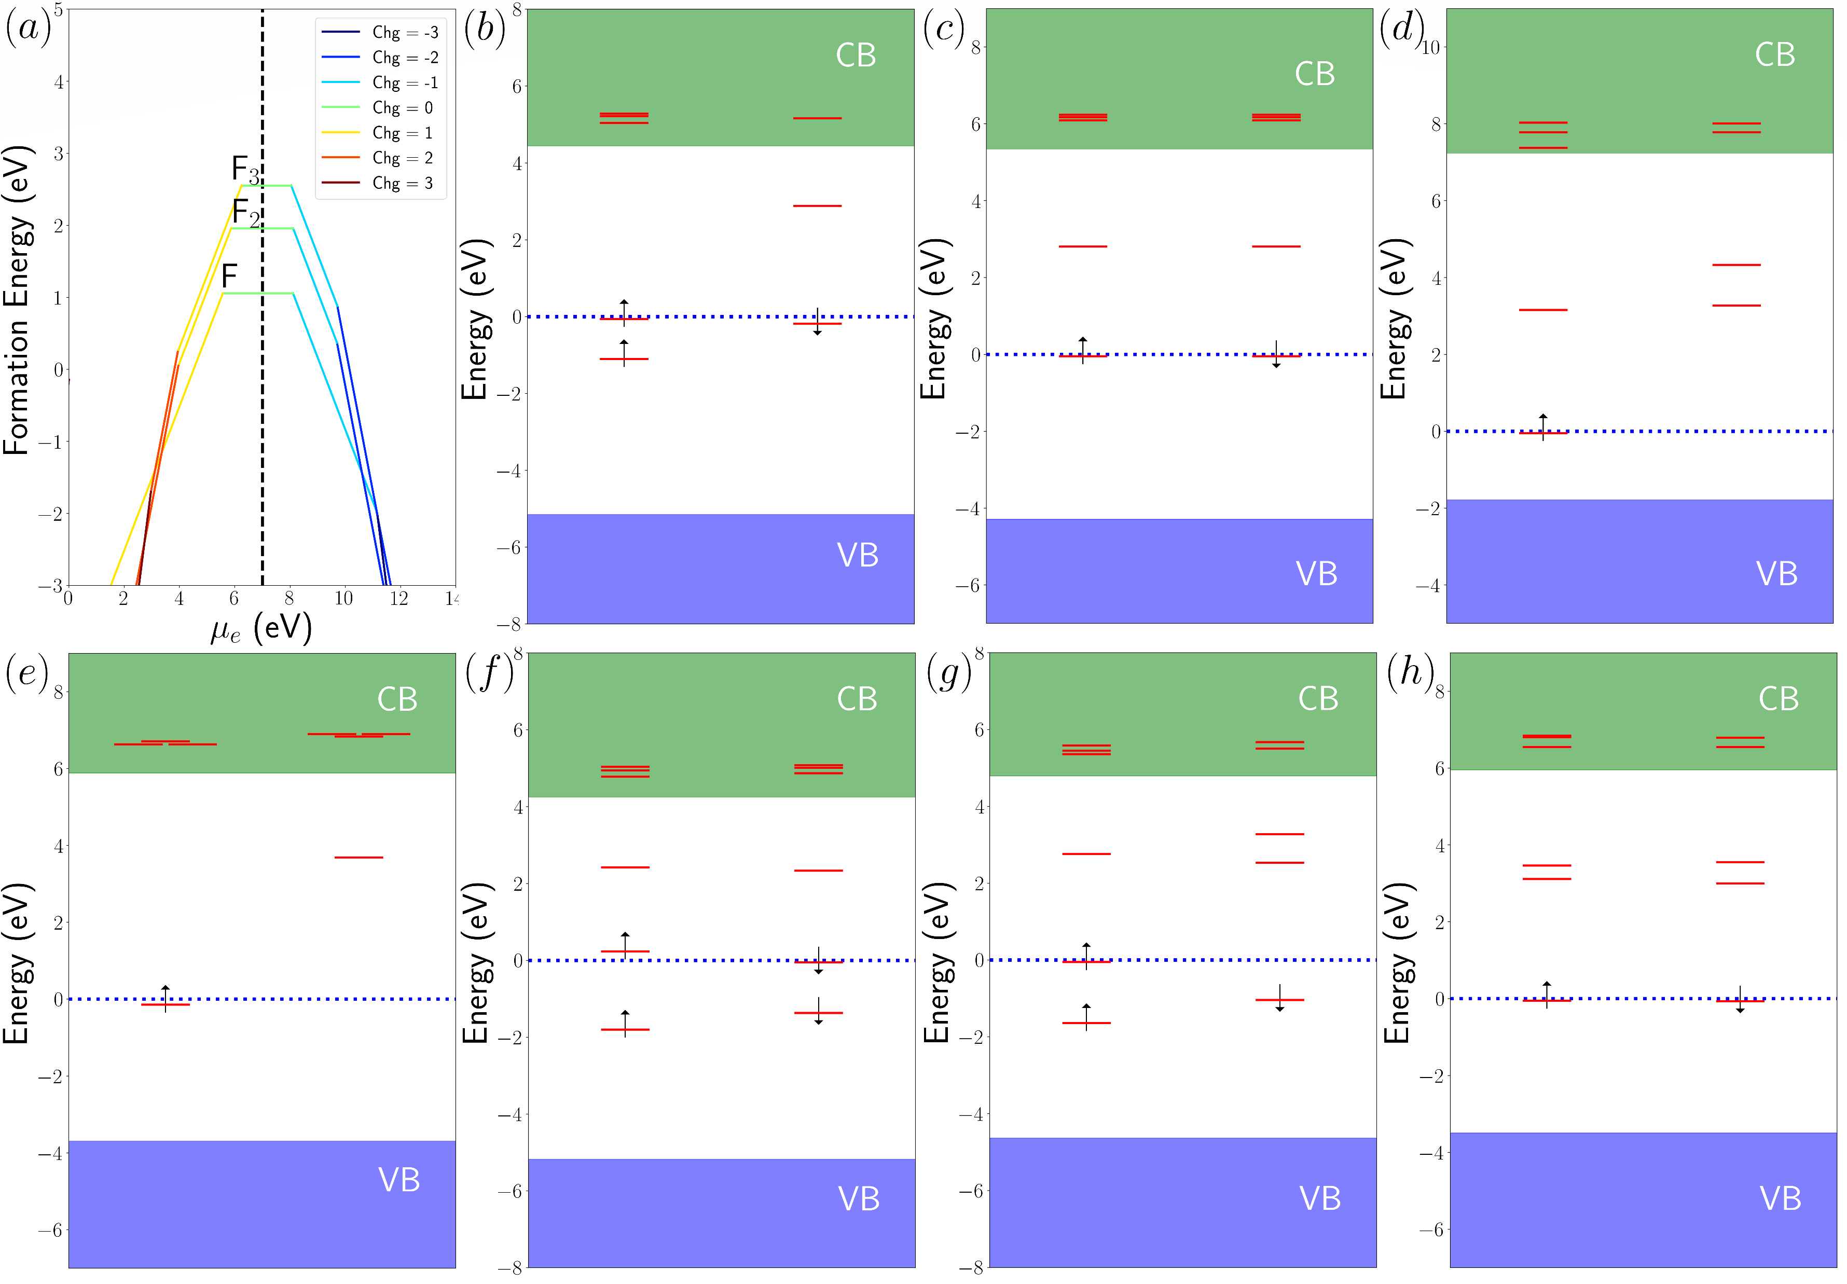
Electronic Structures
Electronic structures – great!
How do we get accurate absorption/emission and formation energies?
F₂⁻
F₂⁰
F₂⁺
F₃⁰
F₃⁺
F
F₃⁻
https://arxiv.org/abs/2412.21060
Mineral Detection of Dark Matter Meeting
1/13-1/17 2025

Slide 6
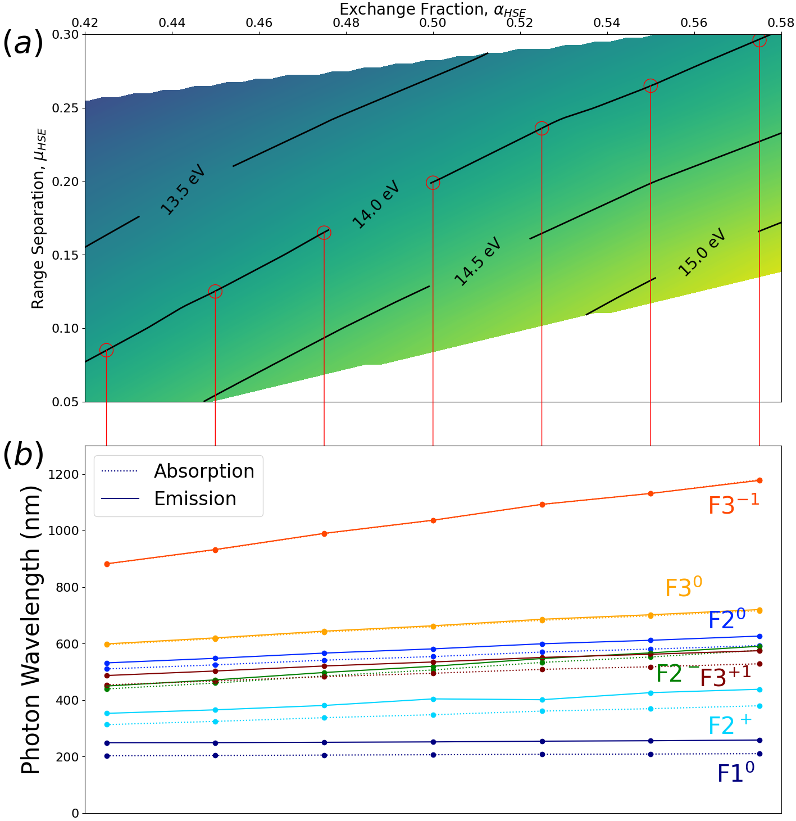
Generalized Koopmans’ Theorem
Generalized Koopmans Theorem:
∆HOMO – position of the highest occupied level relative to the conduction band
∆LUMO – position of the lowest unoccupied level relative to the conduction band
∆IE – vertical ionization energy
gKT: ∆HOMO = ∆LUMO = ∆IE
https://arxiv.org/abs/2412.21060
Mineral Detection of Dark Matter Meeting
1/13-1/17 2025

Slide 7
Generalized Koopmans’ Theorem
Generalized Koopmans Theorem:
∆HOMO – position of the highest occupied level relative to the conduction band
∆LUMO – position of the lowest unoccupied level relative to the conduction band
∆IE – vertical ionization energy
gKT: ∆HOMO = ∆LUMO = ∆IE
https://arxiv.org/abs/2412.21060
Mineral Detection of Dark Matter Meeting
1/13-1/17 2025

Slide 8
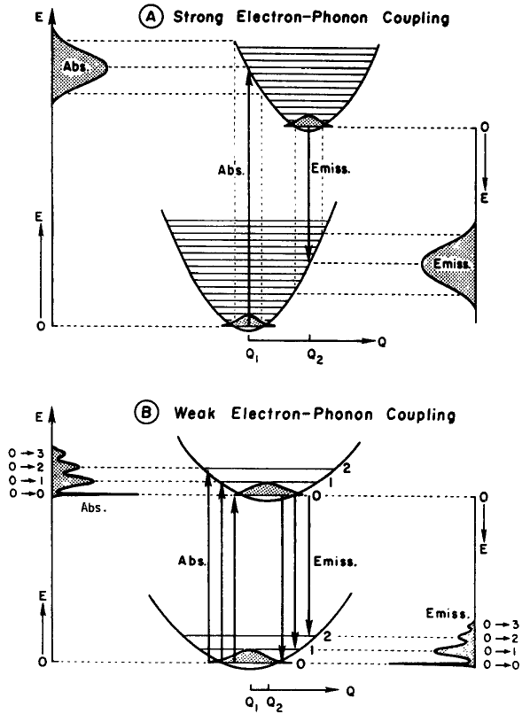
Strong el-ph Coupling!
J. Phys. Chem. Solids Vol. 52, No. I. pp. 249-297. 1991
Mineral Detection of Dark Matter Meeting
1/13-1/17 2025

Slide 9
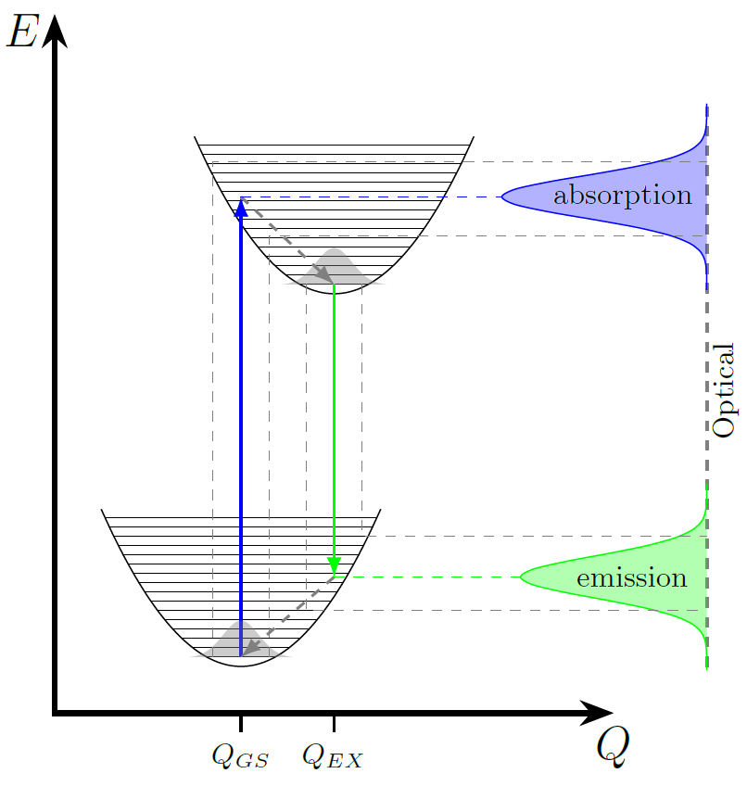
Strong el-ph Coupling!
J. Phys. Chem. Solids Vol. 52, No. I. pp. 249-297. 1991
Mineral Detection of Dark Matter Meeting
1/13-1/17 2025

Slide 10
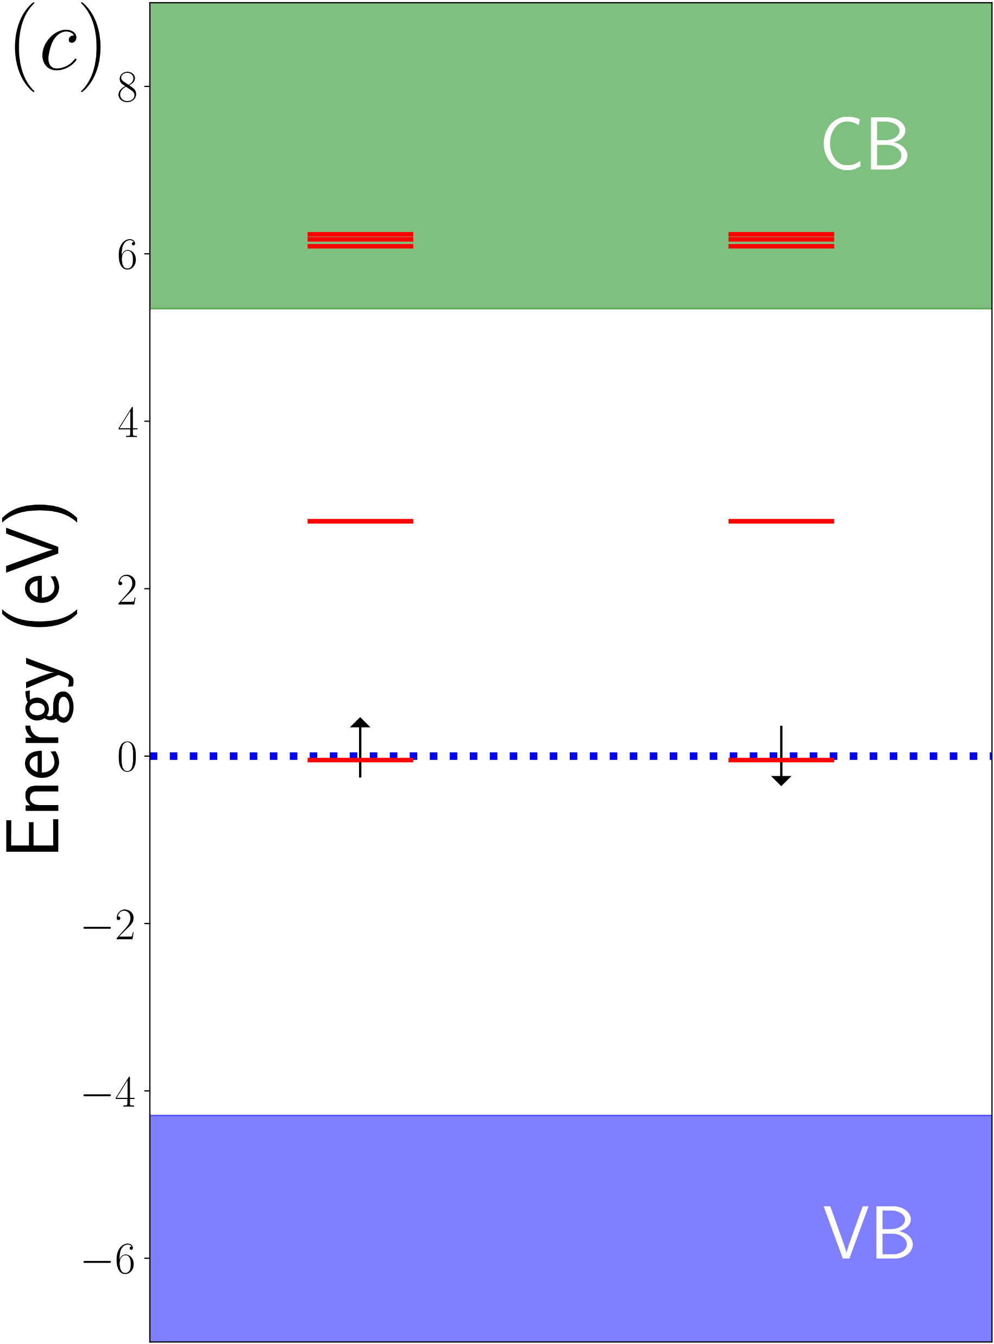
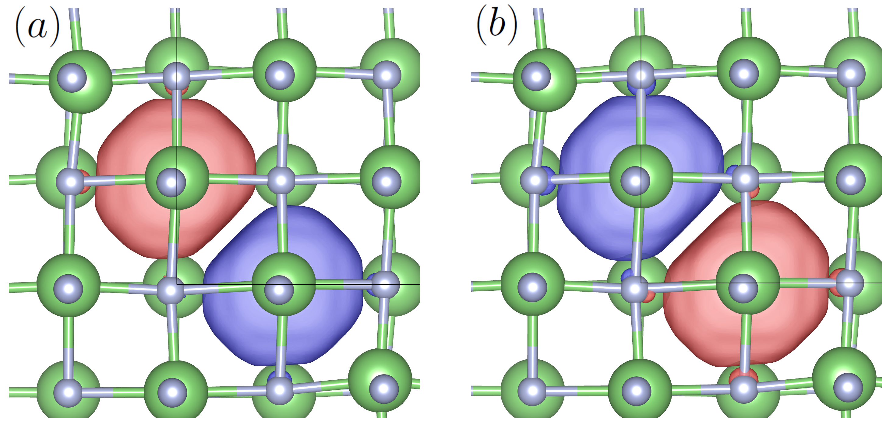
Spin-dependent Jahn-Teller (excited state)
Exciting electrons using ∆SCF → charge transfer that leads to instability in electronic convergence
https://arxiv.org/abs/2412.21060
Mineral Detection of Dark Matter Meeting
1/13-1/17 2025

Slide 11
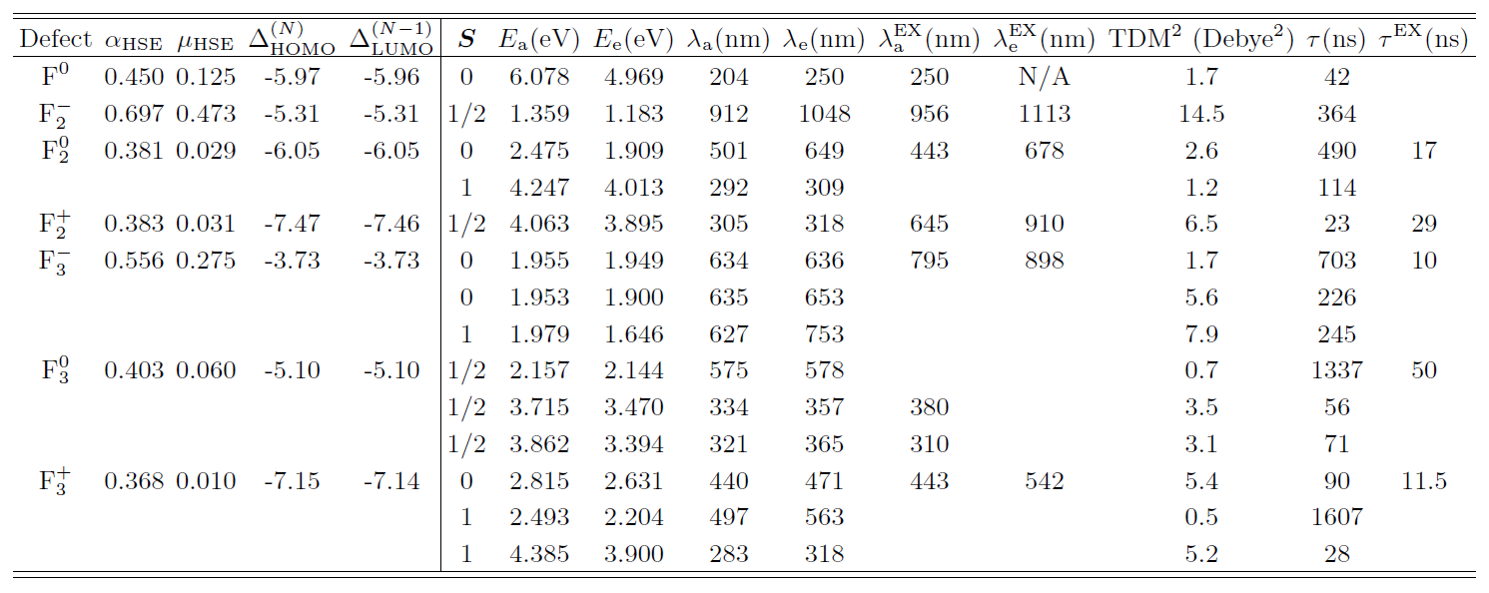
Defect Data
https://arxiv.org/abs/2412.21060
Mineral Detection of Dark Matter Meeting
1/13-1/17 2025

Slide 12
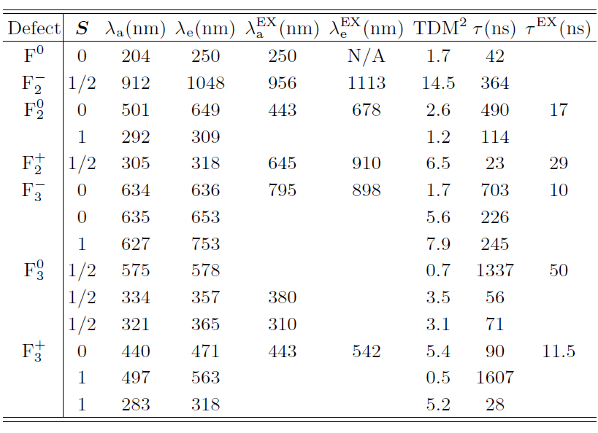
Defect Data: The Good
https://arxiv.org/abs/2412.21060
Mineral Detection of Dark Matter Meeting
1/13-1/17 2025

Slide 13
Defect Data: The Bad
https://arxiv.org/abs/2412.21060
Mineral Detection of Dark Matter Meeting
1/13-1/17 2025

Slide 14
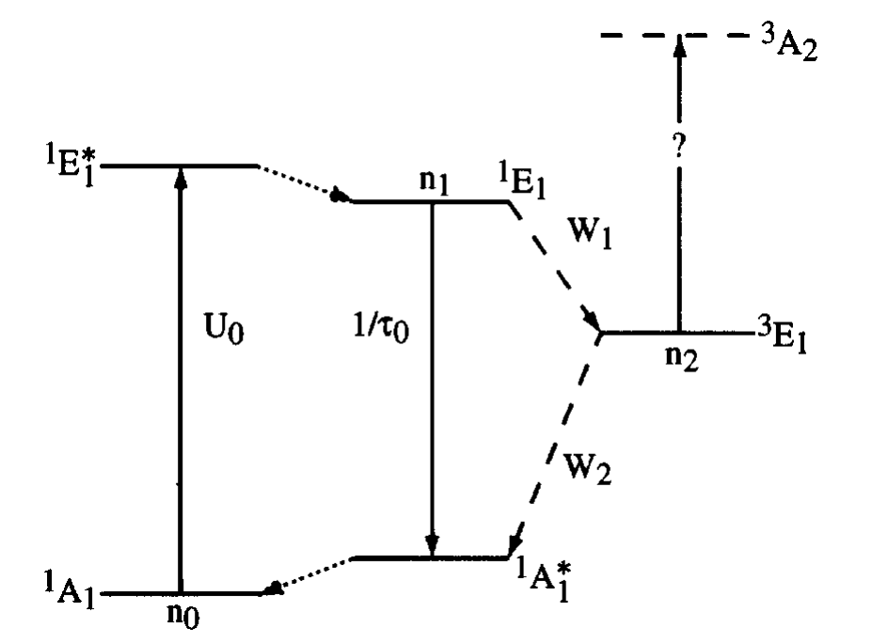
Defect Data: The Triplets
Phys. Rev. B 54, 17508
Mineral Detection of Dark Matter Meeting
1/13-1/17 2025

Slide 15
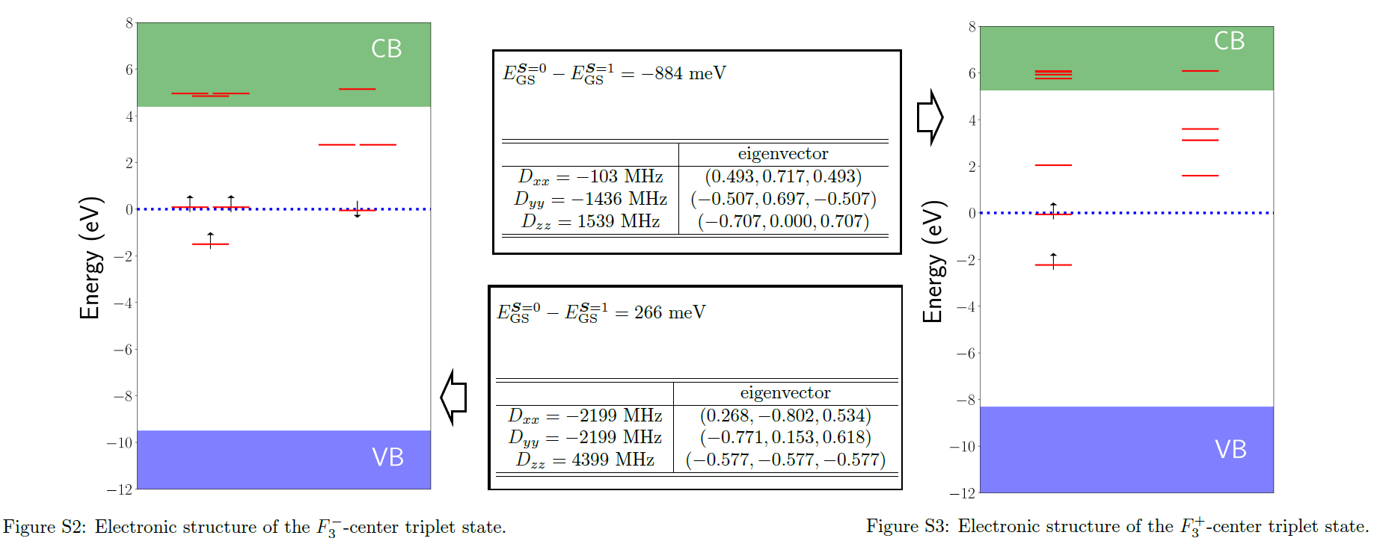
Defect Data: The Triplets
F₃⁻ triplet is actually the ground state!
Other two triplets are < 1 eV in energy -> may be involved in optics through ISC
Mineral Detection of Dark Matter Meeting
1/13-1/17 2025

Slide 16
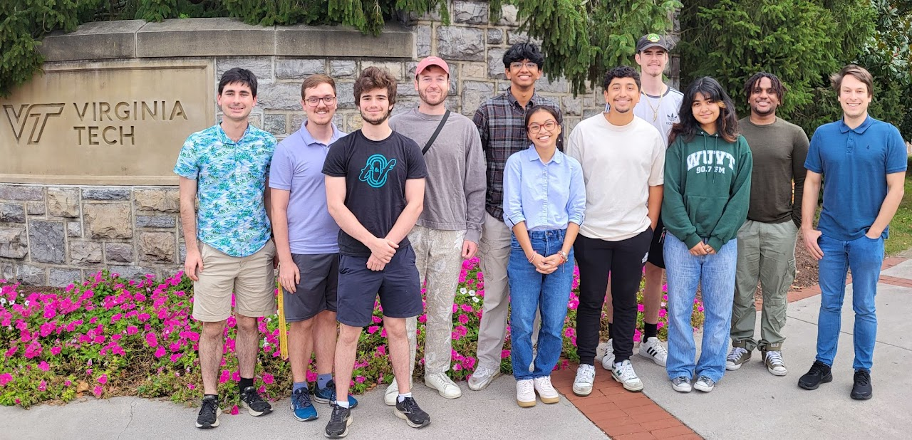
Thanks for Listening!
https://www.condensedmatters.com/
The group!
https://arxiv.org/abs/2412.21060
Mariano Guerrero-Perez
Pranshu Baumik
(W & M)
Jordan Chapman
Thank you Keegan, Giti, Brenden, & Patrick for the experimental portion
Mineral Detection of Dark Matter Meeting
1/13-1/17 2025

