Slide 1
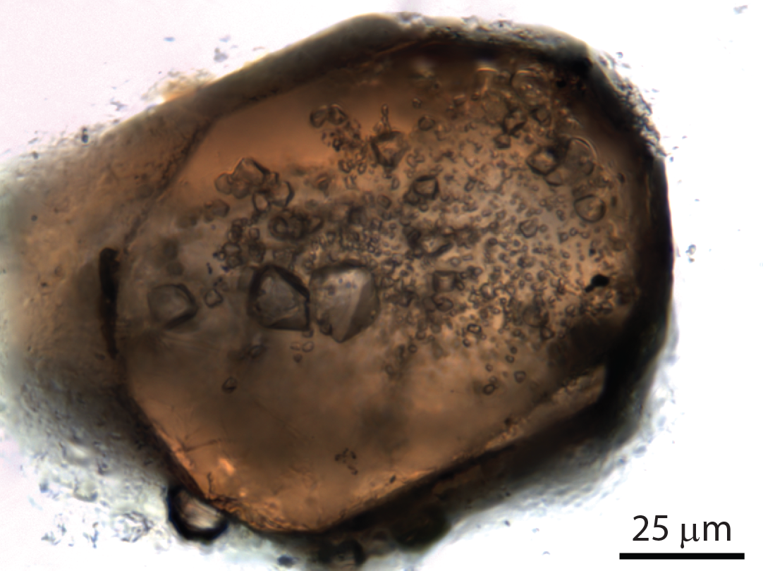
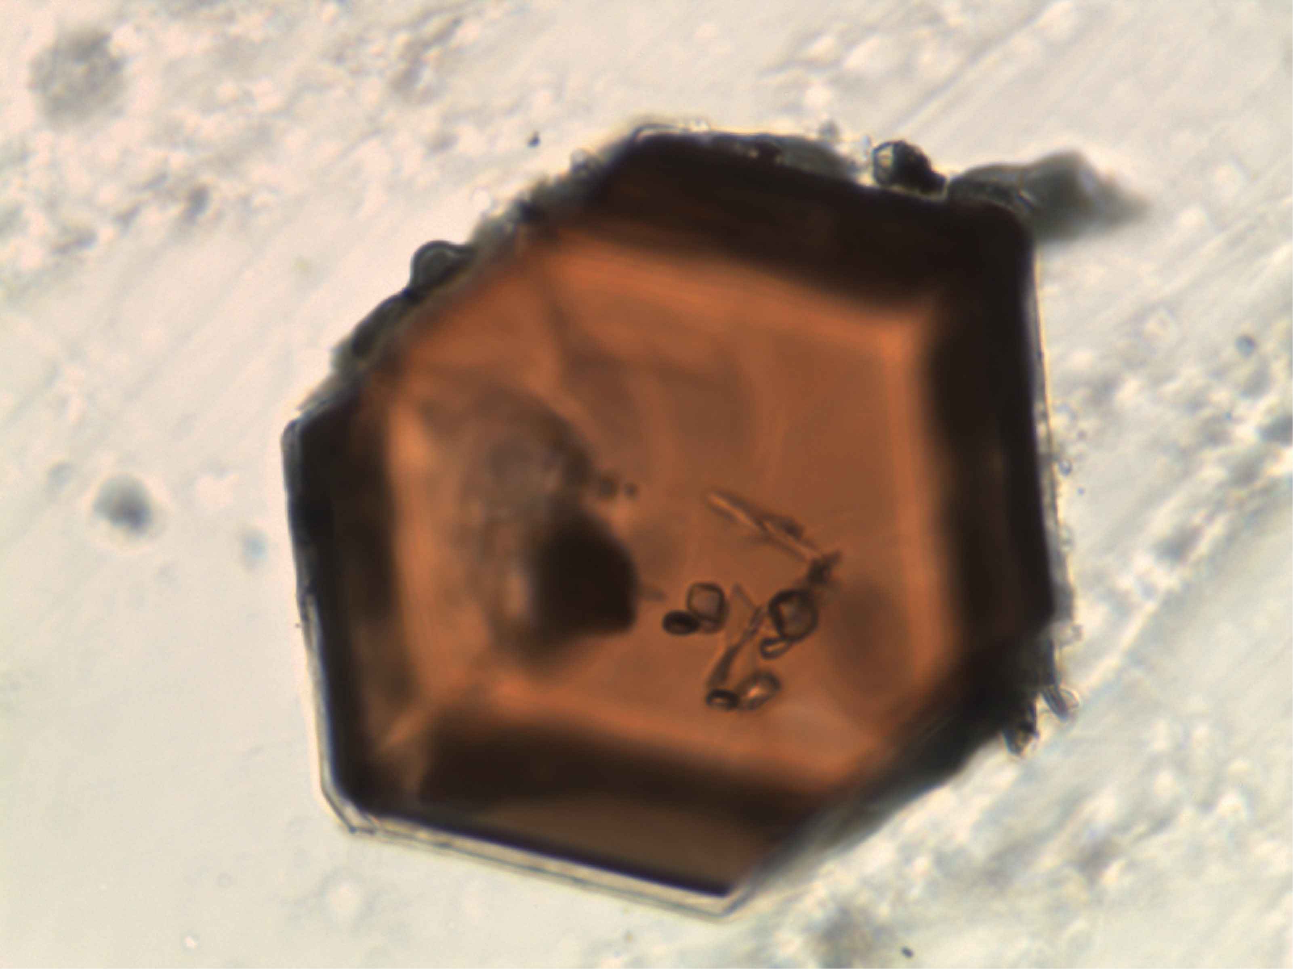
Mineral synthesis methods to control crystal chemistry (and other properties!)
Jay B. Thomas
Syracuse University
Garnet (almandine; Fe₃Al₂Si₃O₁₂) with strained quartz (SiO₂) inclusions
Kyanite, biotite, chloritoid, rutile, and magnetite
P=10 kbar
T=800°C
t=2 days
Notes:
Fe²⁺Al₂O(SiO₄)(OH)₂
K(Mg, Fe)₃AlSi₃O₁₀(F, OH)₂

Slide 2
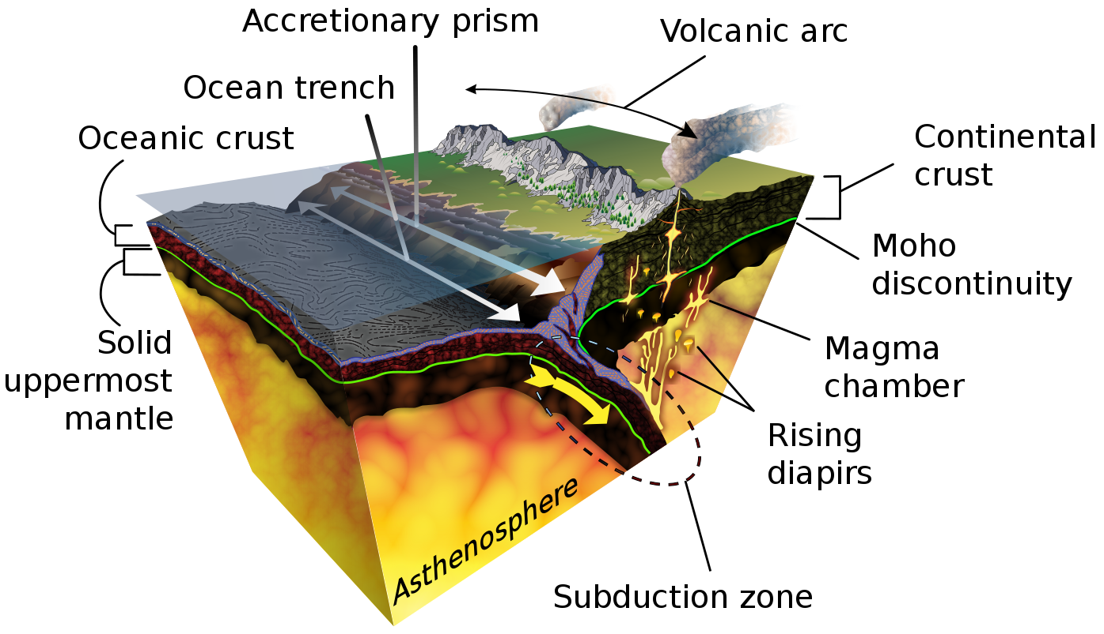
Geologic environments from which we can obtain minerals
Kola Superdeep Borehole (Russia)
12 km≈4 kbar
Minerals from kimberlites (e.g., diamonds) are samples from the deepest regions of Earth we have (~100-400 km)
(~30-45 km=10-15 kbar)
Current P limits at SU
K. D. Schroeder
Notes:
Credit: "Subduction-en.svg from Wikimedia Commons by K. D. Schroeder, CC-BY-SA 4.0
The Kola Superdeep Borehole was just 9 inches in diameter, but at 40,230 feet (12,262 meters) reigns as the deepest hole. It took almost 20 years to reach that 7.5-mile depth—only half the distance or less to the mantle.
The main target depth was set at 15,000 m (49,000 ft). On 6 June 1979, the world depth record held by the Bertha Rogers hole in Washita County, Oklahoma, United States, at 9,583 m (31,440 ft)^{[3]} was broken. In 1983, the drill passed 12,000 m (39,000 ft), and drilling was stopped for about a year for numerous scientific and celebratory visits to the site.^{[4]} This idle period may have contributed to a breakdown on 27 September 1984: after drilling to 12,066 m (39,587 ft), a 5,000 m (16,000 ft) section of the drill string twisted off and was left in the hole. Drilling was later restarted from 7,000 m (23,000 ft).^{[4]}
The hole reached 12,262 m (40,230 ft) in 1989. In that year, the hole depth was expected to reach 13,500 m (44,300 ft) by the end of 1990 and 15,000 m (49,000 ft) by 1993.^{[5][6]} Because of higher-than-expected temperatures at this depth and location, 180 °C (356 °F) instead of the expected 100 °C (212 °F), drilling deeper was deemed unfeasible and the drilling was stopped in 1992.^{[4]}
The Kola borehole penetrated about a third of the way through the Baltic Shield continental crust, estimated to be around 35 kilometres (22 mi) deep, reaching Archaean rocks at the bottom.^{[7]} The project has been a site of extensive geophysical studies. The stated areas of study were the deep structure of the Baltic Shield, seismic discontinuities and the thermal regime in the Earth's crust, the physical and chemical composition of the deep crust and the transition from upper to lower crust, lithospheric geophysics, and to create and develop technologies for deep geophysical study.
To scientists, one of the more fascinating findings to emerge from this well is that no transition from granite to basalt was found at the depth of about 7 km (4.3 mi), where the velocity of seismic waves has a discontinuity. Instead the change in the seismic wave velocity is caused by a metamorphic transition in the granite rock. In addition, the rock at that depth had been thoroughly fractured and was saturated with water, which was surprising. This water, unlike surface water, must have come from deep-crust minerals and had been unable to reach the surface because of a layer of impermeable rock.^{[8]}
Microscopic plankton fossils were found 6 kilometers (4 mi) below the surface.^{[1]}
Another unexpected discovery was a large quantity of hydrogen gas. The mud that flowed out of the hole was described as "boiling" with hydrogen.^{[9]}
Moho, or Mohorovičić discontinuity, boundary between the Earth's crust and its mantle. The Moho lies at a depth of about 22 mi (35 km) below continents and about 4.5 mi (7 km) beneath the oceanic crust.

Slide 3
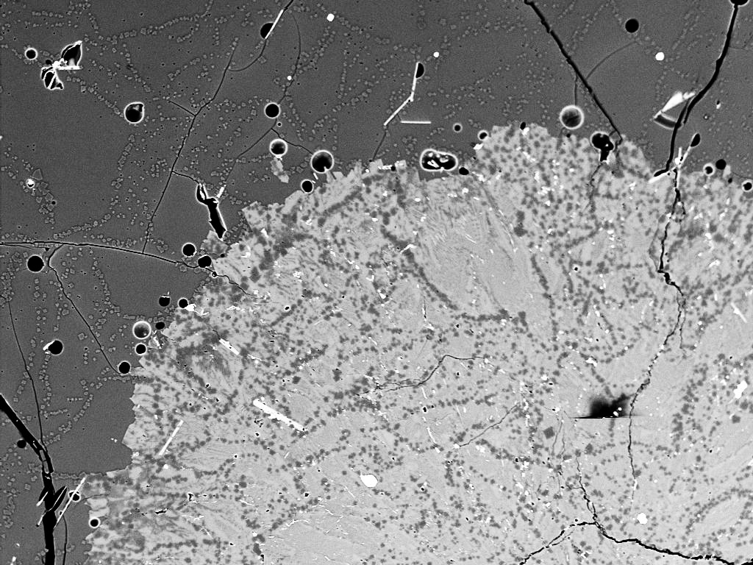
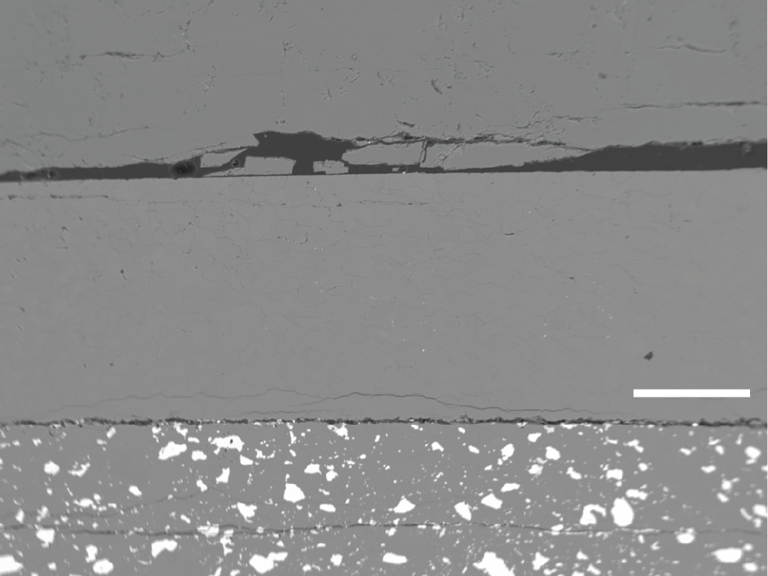
bubble
Outline
mica
melt
(glass)
Types of crystallization
Melt crystallization
Solid-state crystallization
Flux crystallization
Hydrothermal crystallization
Chemical and physical characterization
Electron microscopy and X-ray analysis
Vibrational spectroscopy (FTIR and Raman)
(FIB-TEM, X-ray absorption spectroscopy, SIMS)
Experimental Methods
Piston-cylinder devices
Cold-seal devices
Some examples
SiO₂-TiO₂-ZrO₂
SiO₂-TiO₂-Al₂O₃
Crystallizing pelitic (shale) compositions (if there’s time)
quartz
Focus on these approaches because they produce relatively large, free-standing crystals.
P=5 kbar
T=625°C
Two feldspars and quartz intergrowths
Quartz
MgF₂
Quartzite
fluid
Enstatite
MgSiO₃
250 μm
quartz +
olivine (Fe₂SiO₄)
150 μm

Slide 4
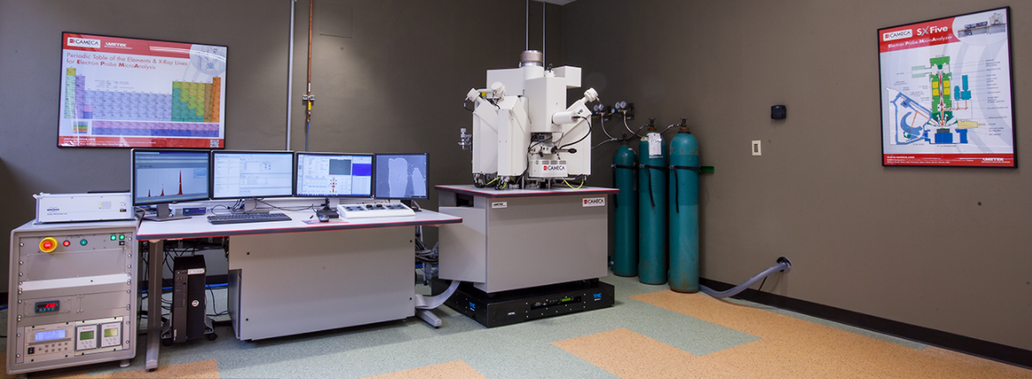
Syracuse University Microanalytical Facilities in the Dept. of Earth & Environmental Sciences
Cameca SX Five electron microprobe used for imaging and chemical analysis.
Scanning electron microscopy (backscattered electron, secondary electron, and cathodoluminescence imaging).
Five wavelength dispersive spectrometers and an energy dispersive spectrometer for quantitative X-ray analysis of all elements heavier than Be.

Slide 5
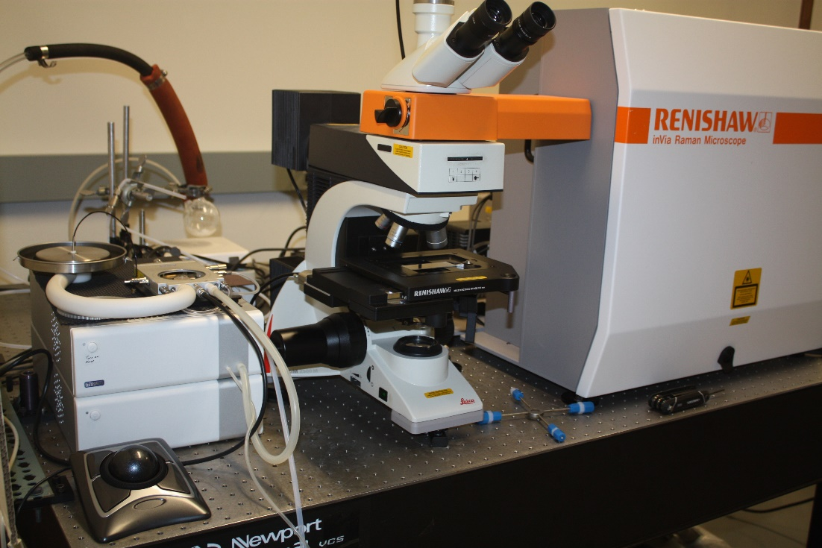
Syracuse University Microanalytical Facilities in the Dept. of Earth & Environmental Sciences
Renishaw InVia Raman microprobe spectrometer system equipped with 785 and 532 nm lasers
Used to analyze molecular vibrations to characterize material structures and quantify chemical compositions

Slide 6
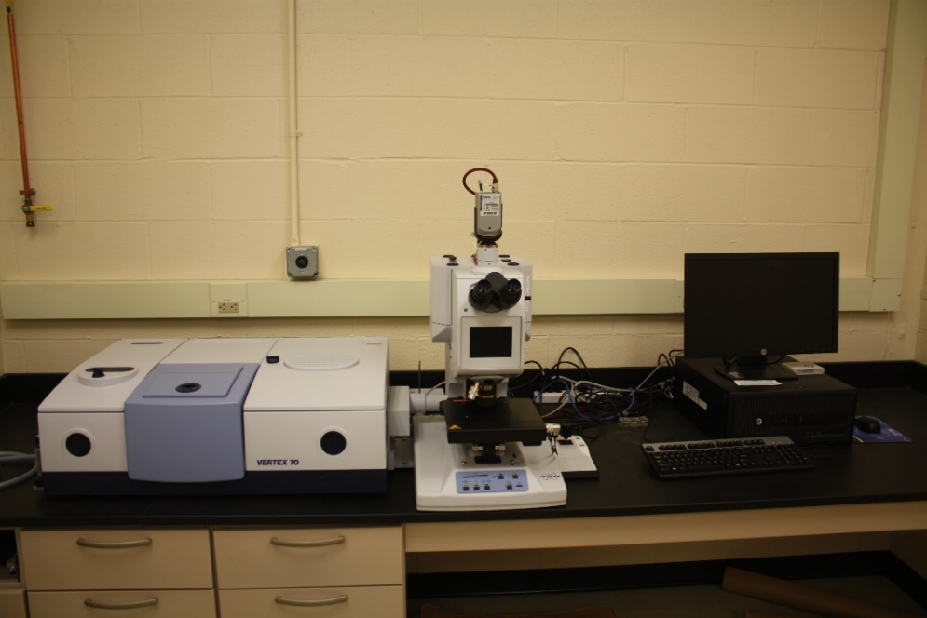
Syracuse University Microanalytical Facilities in the Dept. of Earth & Environmental Sciences
Bruker Vertex 70/Hyperion 2000 FTIR with globar source and mid- to near-IR (400 to 7000 cm⁻¹)
Used to measure molecular vibrations to quantify H₂O, OH⁻ and CO₂, and for characterizing molecular structures

Slide 7
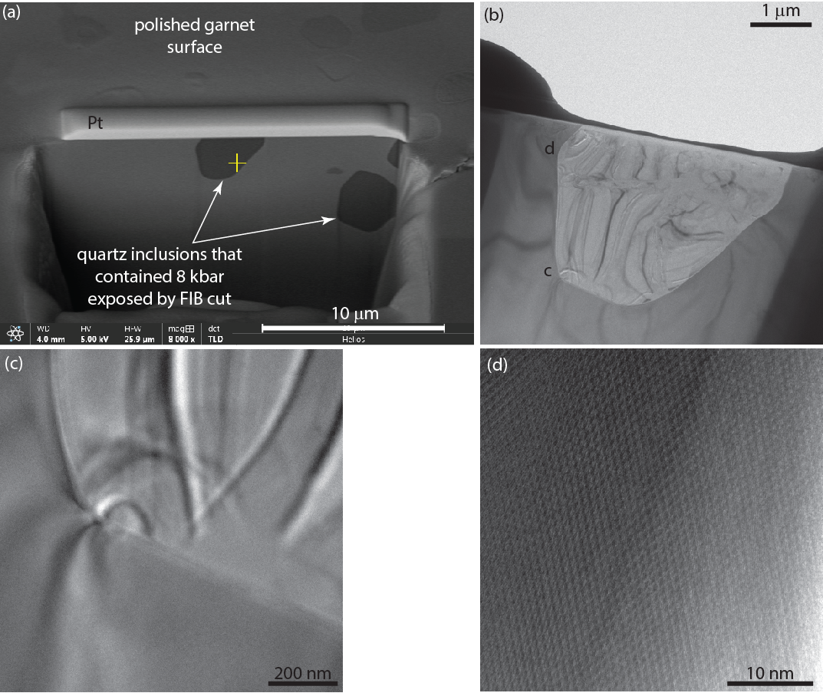
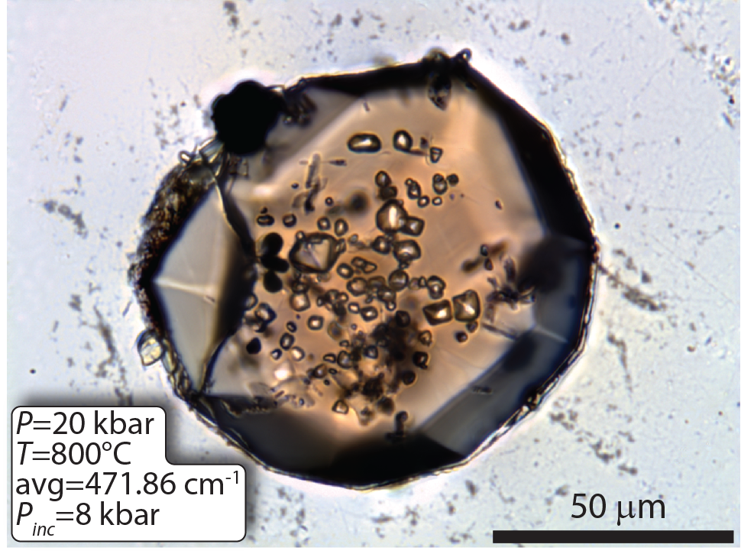
FIB-TEM characterization of strained quartz inclusions in garnet

Slide 8
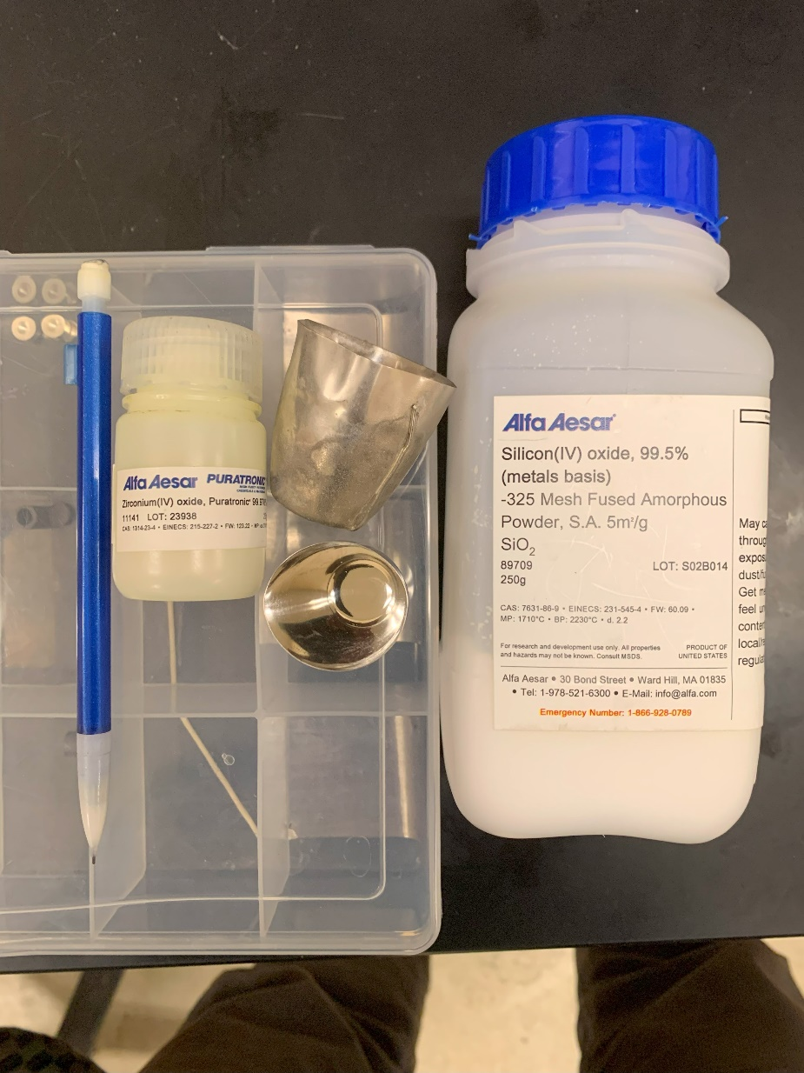
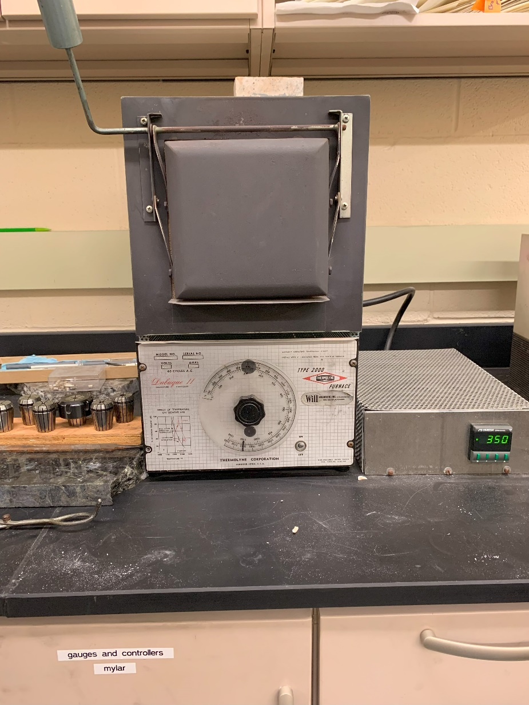
Experimental Methods for Crystal Growth: Crystallization From Fluxes
Commonly used to grow zircon (ZrSiO₄) crystals from lithium-molybdate fluxes.
Measure out stoichiometric proportions of SiO₂ and ZrO₂.
Add Li₂MoO₄ flux to give a solvent-solute ratio of 96:4.
Melt in open Pt crucible at ~1000°C in 1-atmosphere furnace.
Volatilize the flux, then cool at 2°C/h to 600°C to crystallize zircon.
Could use a flux method to grow ZrO₂ and many other minerals.
Flux methods at 1 atmosphere can grow very large crystals, but it’s difficult to control crystal chemistry and other properties.
Starting Materials and Pt crucibles
1-atmosphere furnace

Slide 9
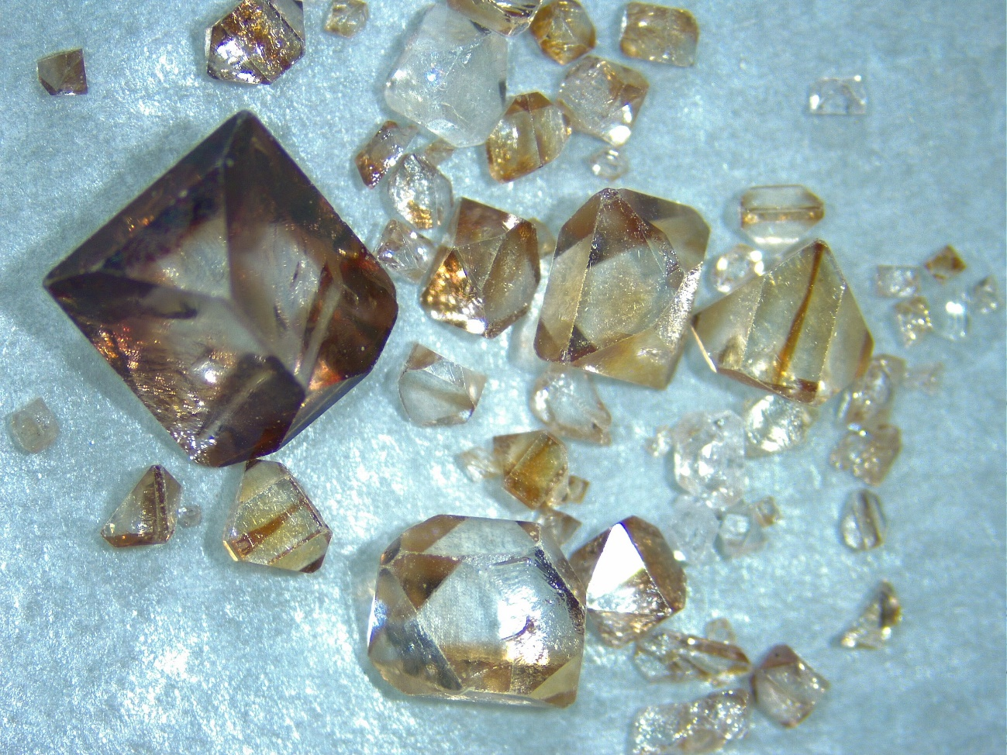
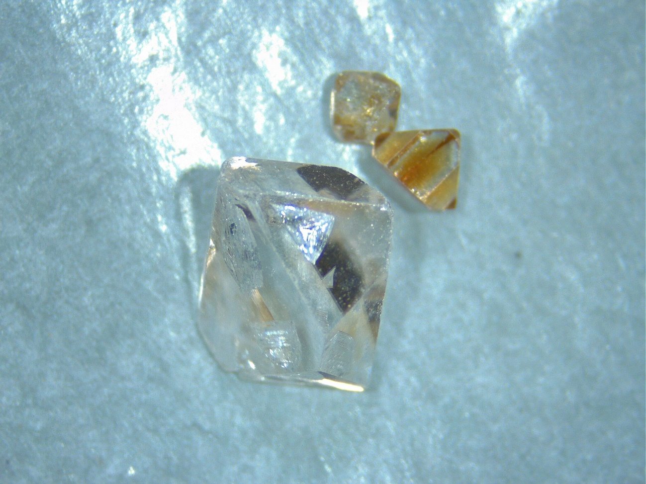
Experimental Methods for Crystal Growth: Crystallization From Fluxes
It’s easy to grow big and beautiful crystals in a few days.
The downside is they have highly variable compositions that affect all physical properties of the minerals.
Strong chemical zonation of trace elements and fluxing elements (Li, Mo, W) indicate chemical disequilibrium during growth.
Numerous inclusions of flux and any additives (e.g., REE, UO₂, ThO₂).
Measurements across crystals show that minor elements commonly vary by >100%, likely because crystal growth is controlled by flux volatilization.
Zircon (ZrSiO₄)
Hf-rich zircon (1-8% HfO₂)
5 mm

Slide 10
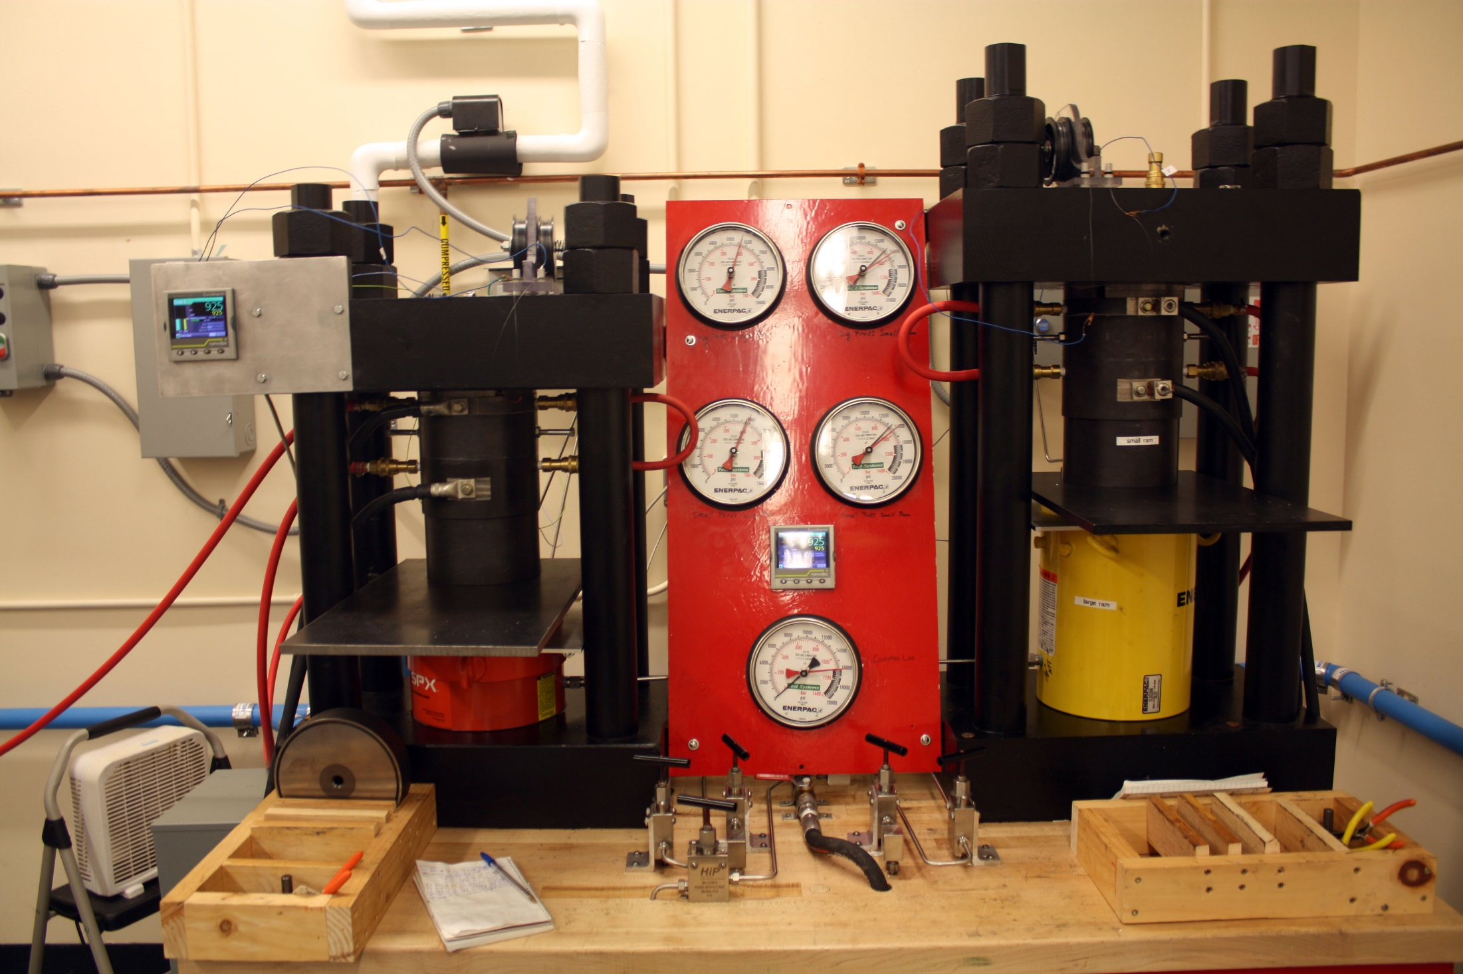
Experimental Methods for Hydrothermal Crystal Growth: Piston-Cylinder Devices
Piston-cylinder methods are preferred for most of my group’s research because:
Two of three piston-cylinder devices at Syracuse
We can control most experimental parameters to closely mimic conditions in the Earth.
Compared to other high P-T devices, experimental volumes are significantly larger.
Can grow most rock-forming minerals in a few days
Aqueous fluid-rich experiments promote chemical equilibrium during crystal growth.
Solubilities of minerals in aqueous fluids are significantly higher at high P, which promotes chemical equilibrium during crystallization.
Can be combined with the flux method described earlier to grow large crystals (from abnormal starting materials).
P up to ~50 kbar (~150 km), T up to ~2200°C
Virtually any P-T path
Large volume capsules
Versatile experimental assembly

Slide 11
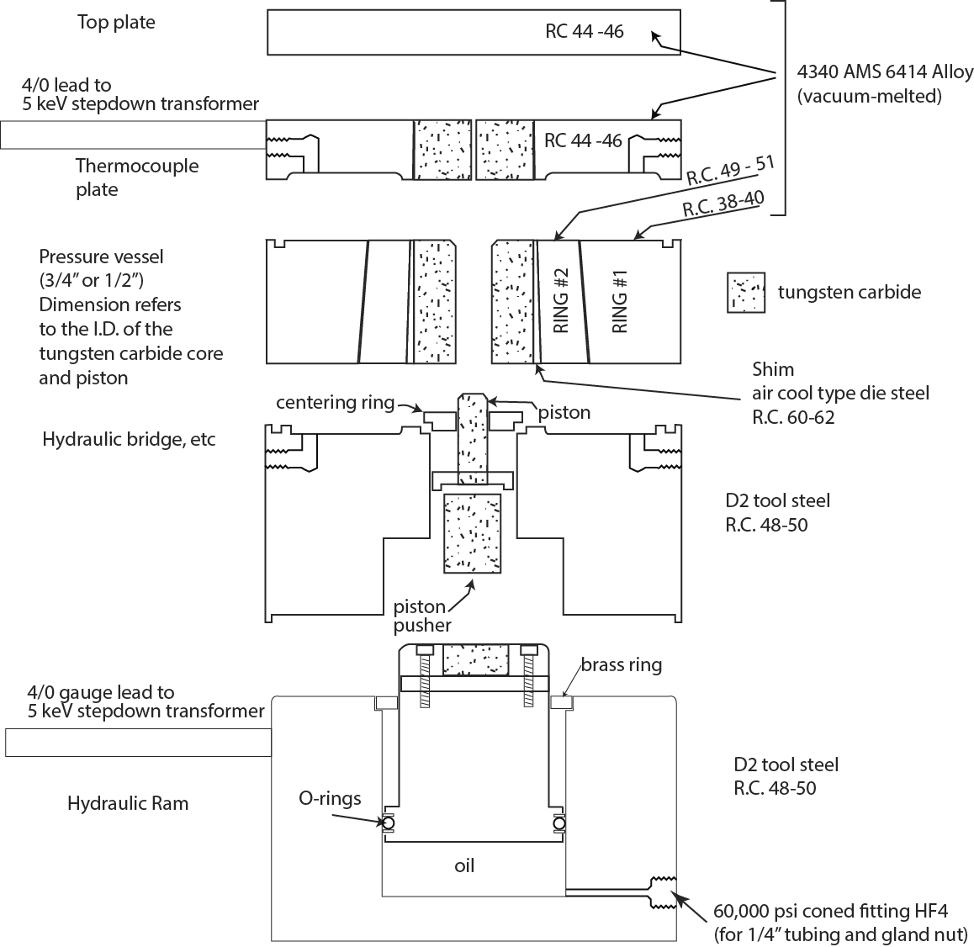
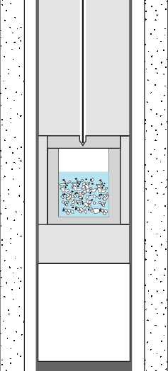

Piston-cylinder details: Some Details on How it Works
Water is a
thermocouple
Solid media
NaCl
MgO
pyrex
SiO₂ (glass)
TiO₂, ZrO₂
distilled water
Ag
Water is the solvent in these types of runs
No water, no crystals
MgO
graphite
heater
Pyrex
10 mm

Slide 12
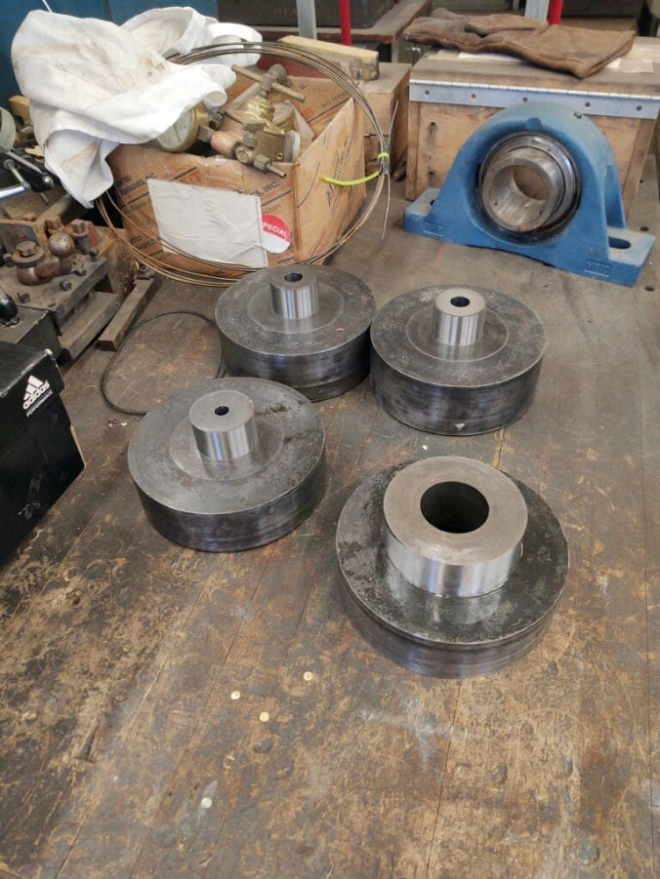
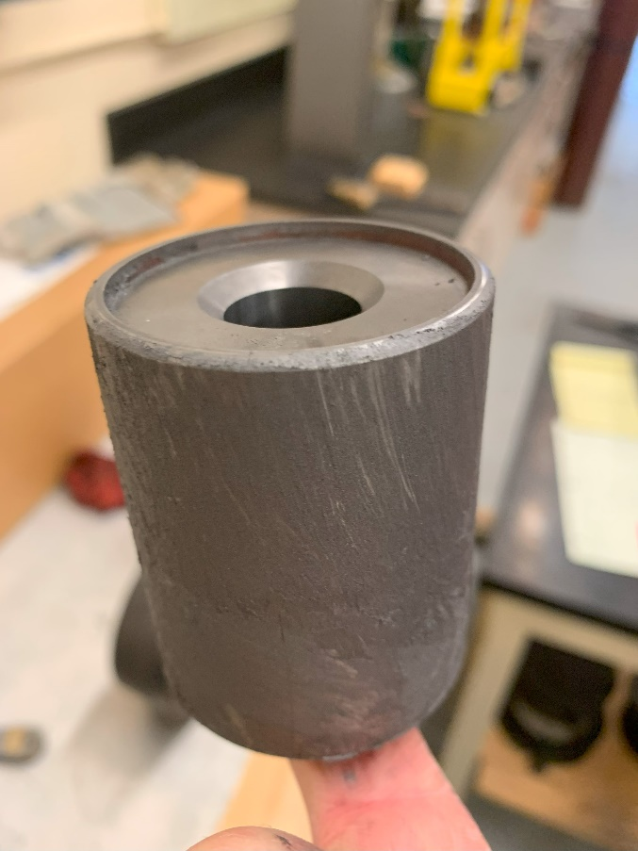
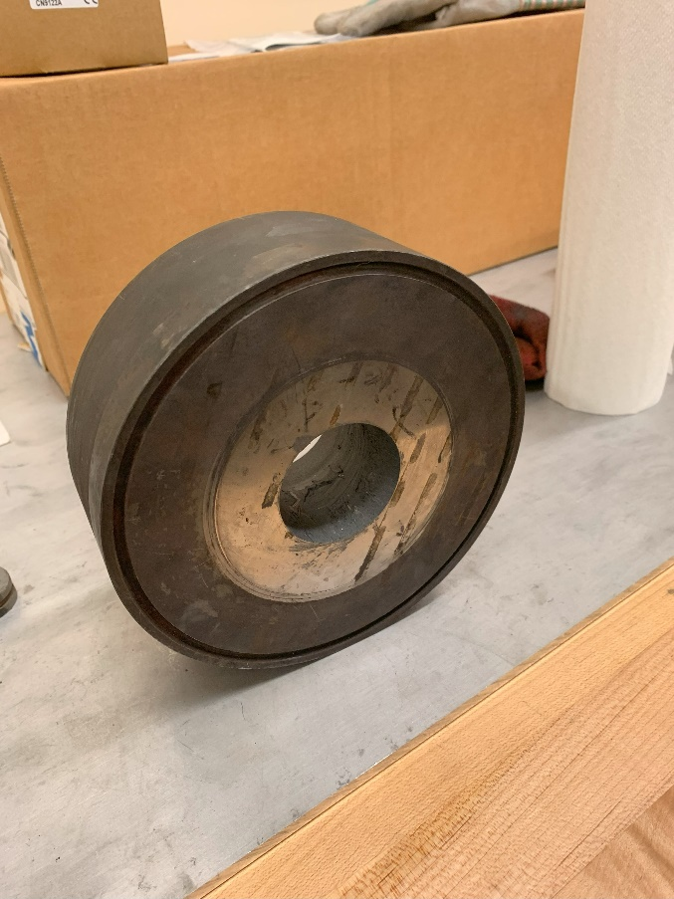
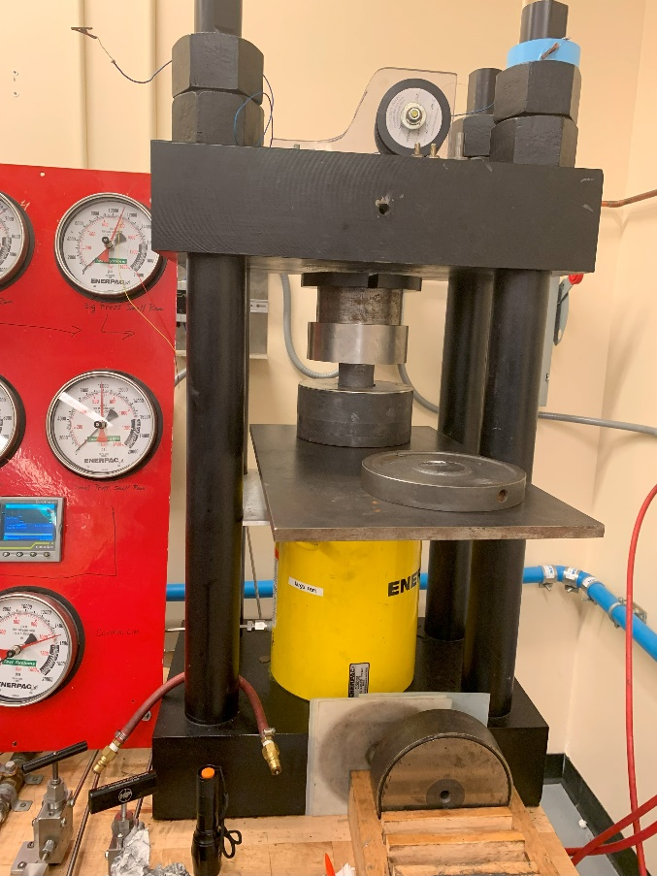
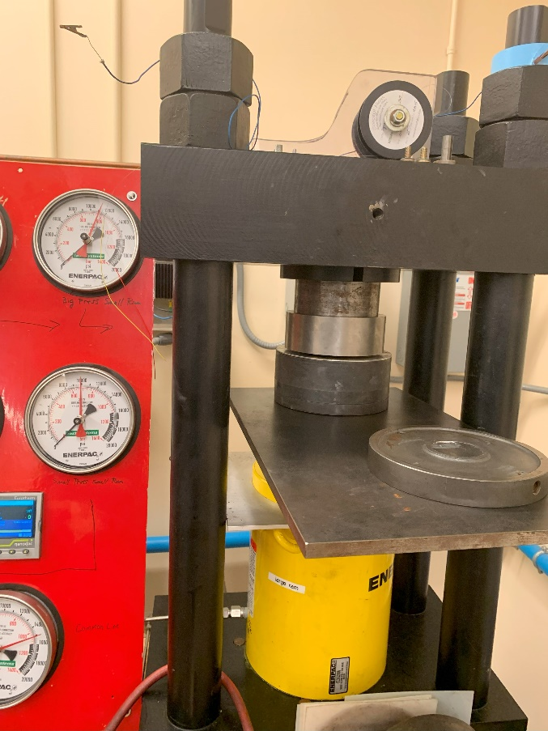
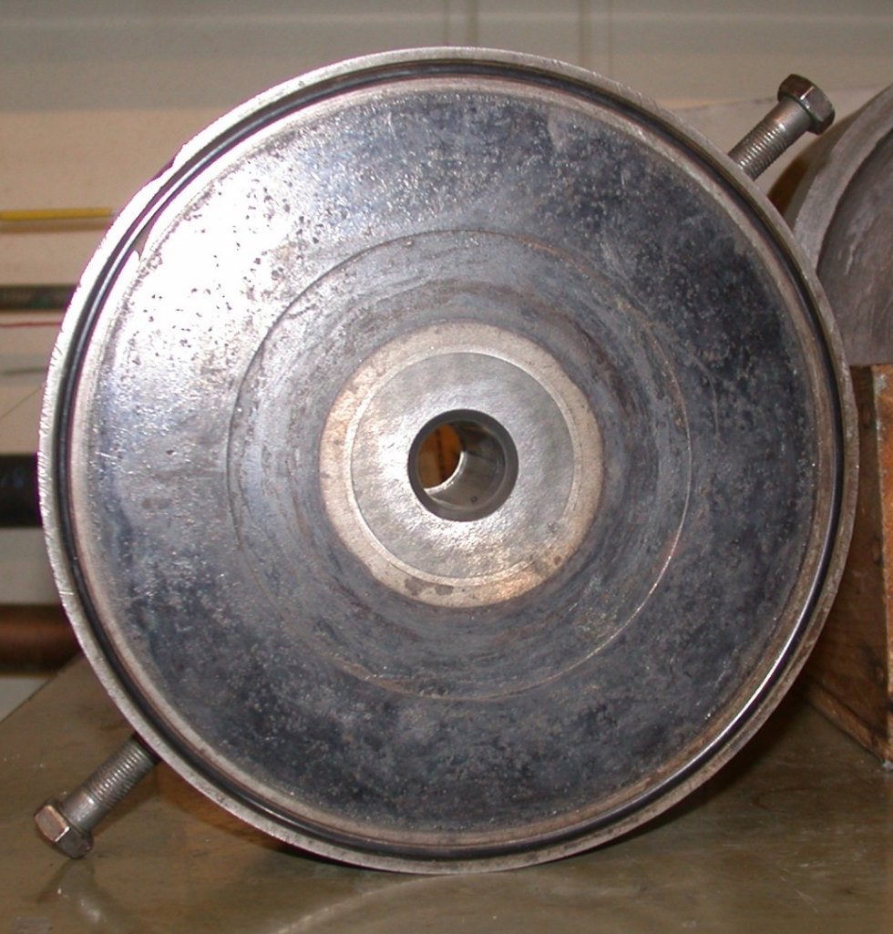
Fabricating piston-cylinder pressure vessels
Fine machining to produce interference with 1° included angle
It requires ~100 tons to push the carbide core into ring #2
Finished pressure vessel
Use the big press with 200-ton ram and 6-inch stroke to push in the core

Slide 13
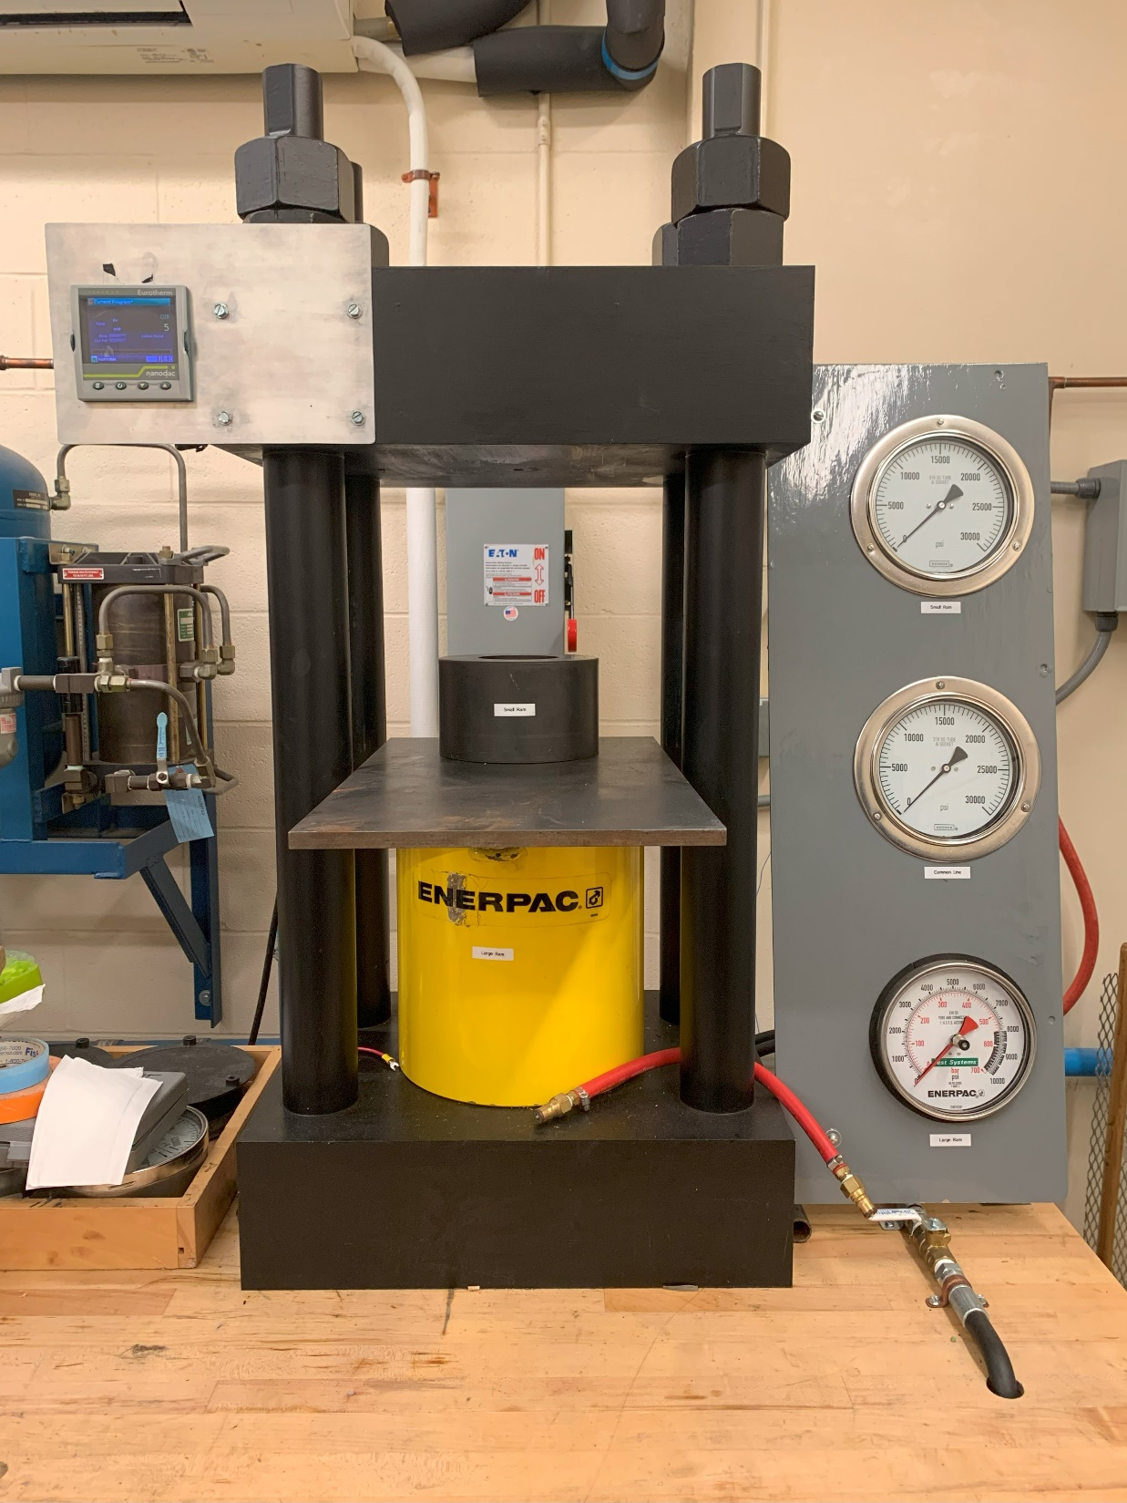
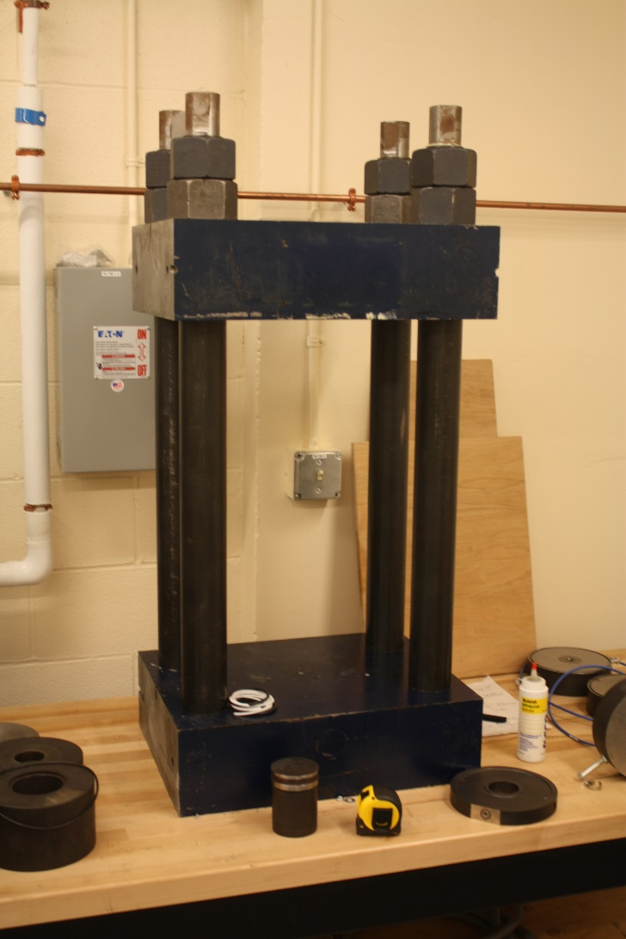

New Piston-Cylinder Device Designed to Work in the Diamond Field
Larger press frame.
400-ton ram to provide more end load and greater support to the tungsten carbide core
One goal is to crystallize diamond to develop a garnet-in-diamond thermobarometer
What is the upper pressure limit for piston-cylinder devices?

Slide 14
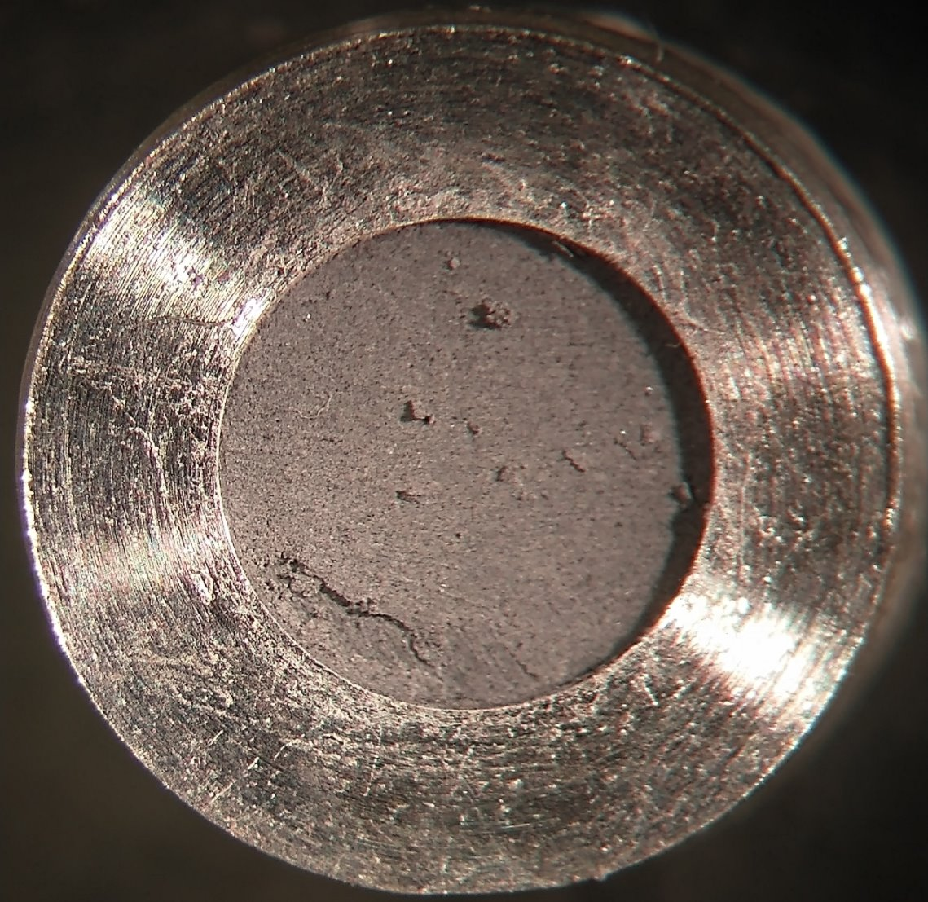
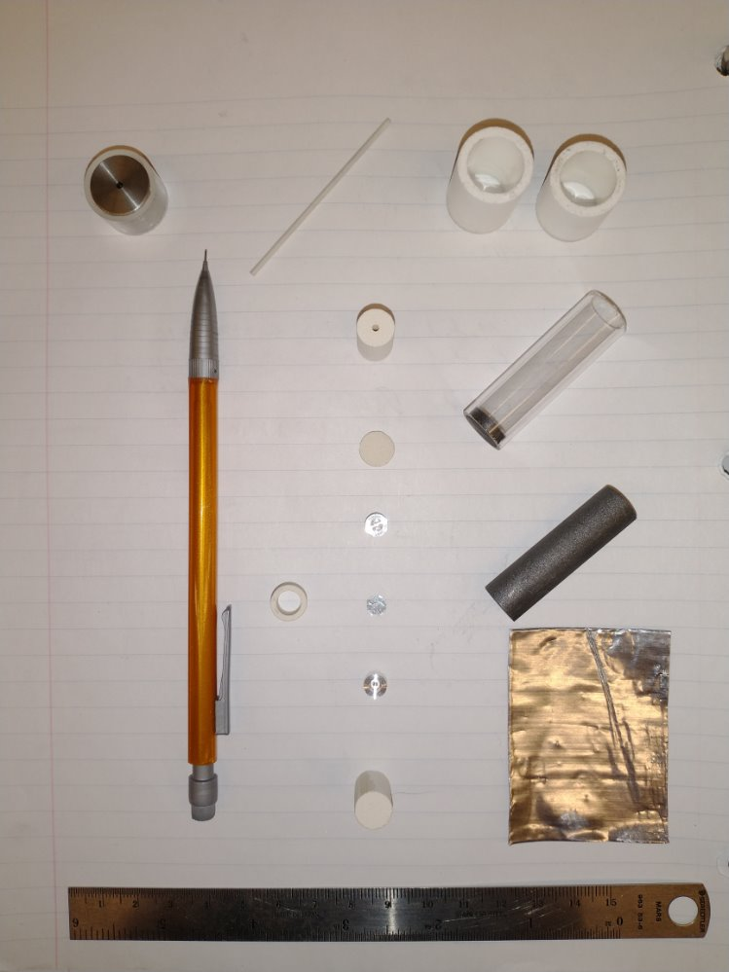
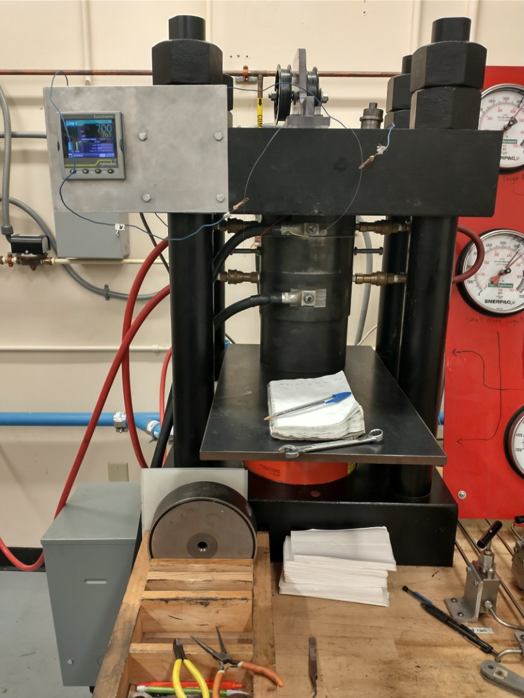
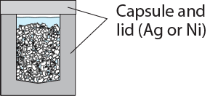
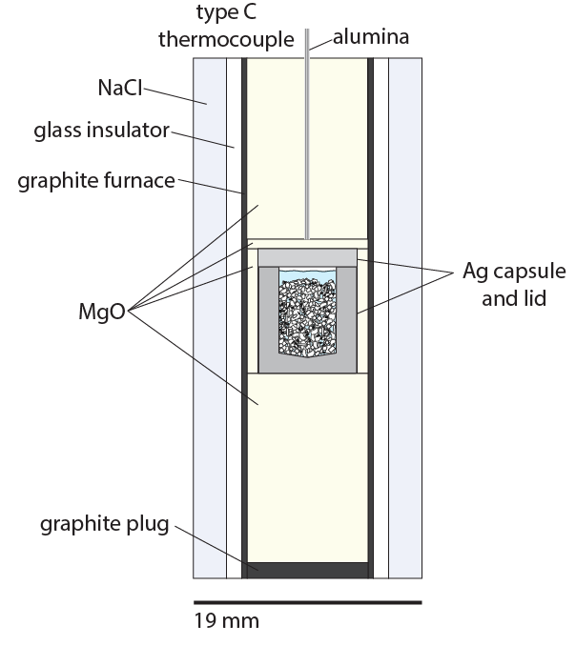
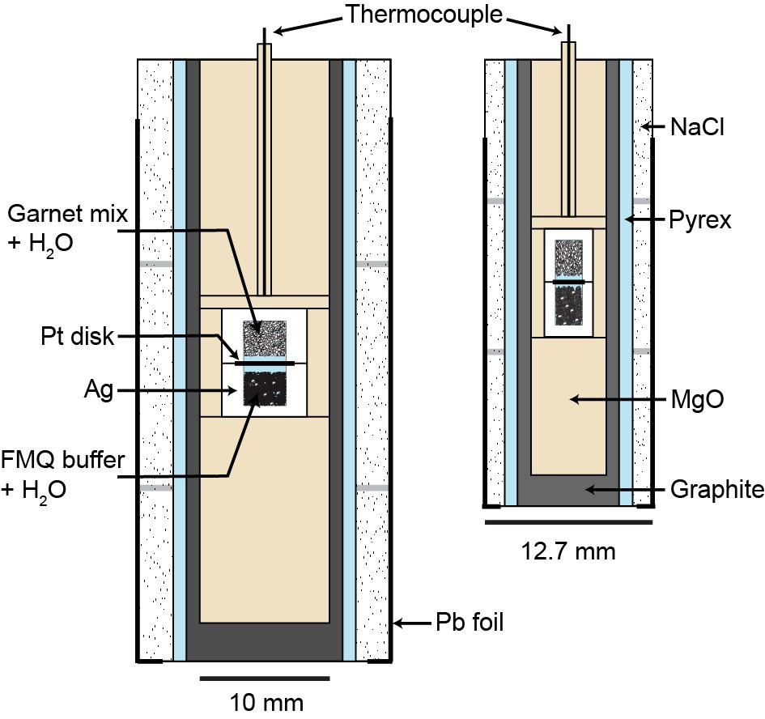
Piston-cylinder experimental assemblies
Assembly components
Oxide starting material
Up to ~200 mg
Thousands of crystals per run
Ag or Ni
We use these types of assemblies with double capsules to control oxygen fugacity and oxidation state of multivalent ions (e.g., Fe²⁺/Fe³⁺)
Can offset the capsule to induce a thermal gradient to promote crystallizing large crystals, and vice versa.
Only one’s imagination limits capsule designs and experimental components!
For experiments at P<4 kbar, we use other experimental devices

Slide 15
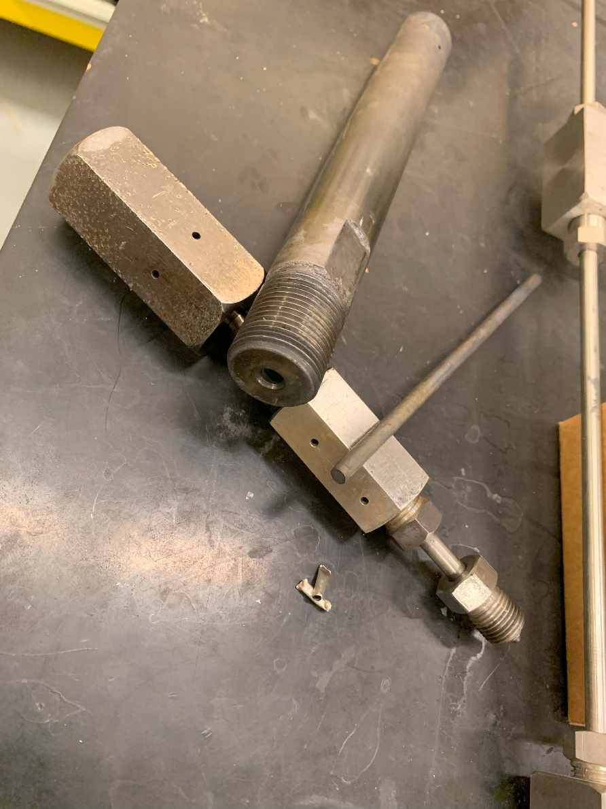
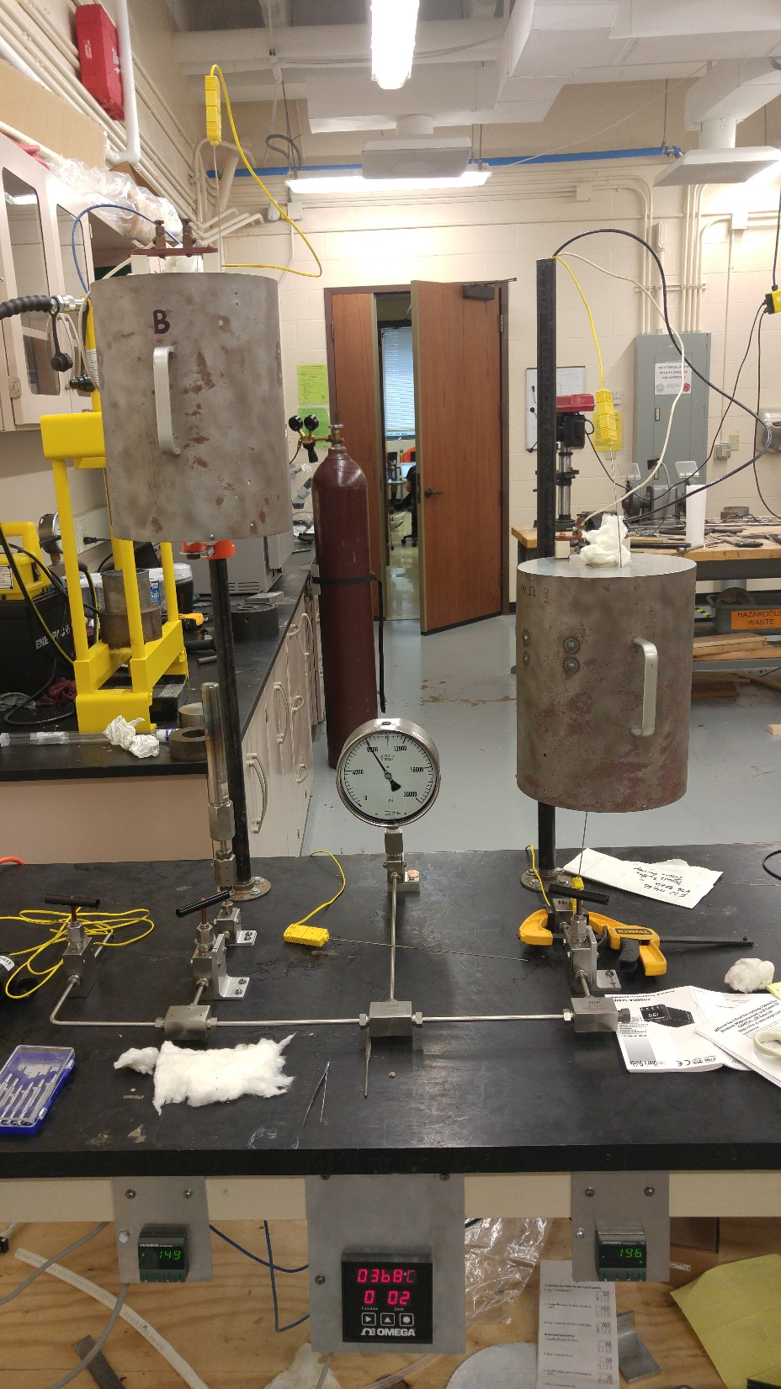
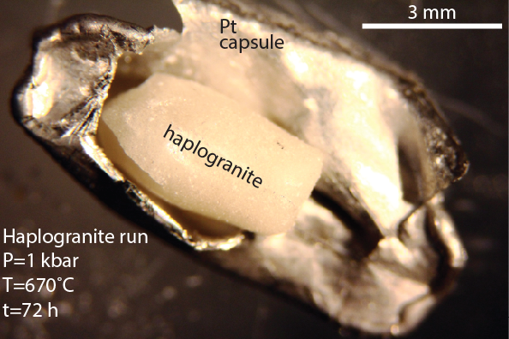
Experimental Methods for Crystal Growth: Cold-seal Devices
Pressure vessel
We use these devices to explore a limited, but critical P-T range. P up to ~3 kbar (depending on T), and T up to ~900°C.
Load starting materials in metal tubes (e.g., Pt, Au, Ag) with ~100-μm thick walls, welded shut.
Limited capsule designs compared to piston-cylinder devices.
Vessels are Ni-rich steel, Ni filler rods.
Furnaces fabricated using Al₂O₃ tubes wrapped with Kanthal wire.
Pressurized with water (or gas) and externally heated by furnace.
Gas-pressure media.
Furnace
Notes:
Chromium: 18.0–20.0%
Cobalt: 10.0–12.0%
Molybdenum: 9.0–10.5%
Iron: 5% maximum
Titanium: 3.0–3.3%
Aluminum: 1.4–1.8%
Nickel=balance
Kanthal AF wire is a ferritic iron-chromium-aluminium alloy (FeCrAl alloy) for use at temperatures up to 1300°C (2370°F). The alloy is characterized by excellent oxidation resistance and very good form stability resulting in long element life.

Slide 16

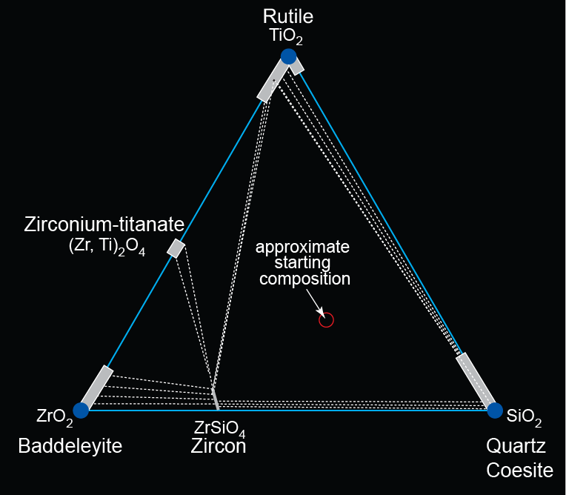
Hydrothermal Crystallization in the SiO₂-TiO₂-ZrO₂ System
Development of Trace Element Thermobarometers
The solubility of Ti in zircon, Ti in quartz, and Zr in rutile systematically increases with increasing temperature and decreasing pressure
The SiO₂-TiO₂-ZrO₂
System
Ti in zircon (ZrSiO4)
Ti in quartz (SiO₂)
Zr in rutile (TiO₂)
Ti in baddeleyite (ZrO₂)
Geologists use P-T dependencies of trace element solubilities to estimate the pressure and temperature at which rocks crystallize
Notes:
Zr⁴⁺ CN 6=0.72
Ti⁴⁺ CN 6=0.61
Si4+=
Development of methods to determine P and T of Earth systems (thermobarometry)

Slide 17
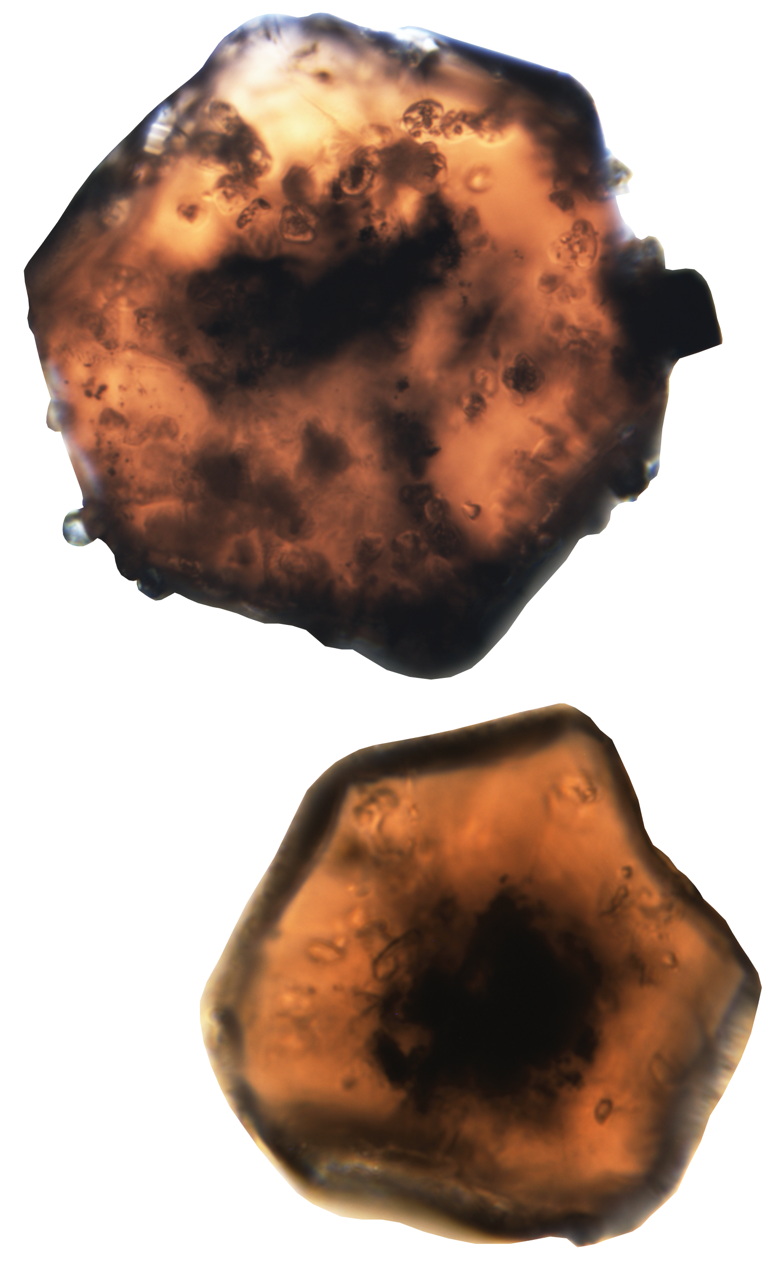
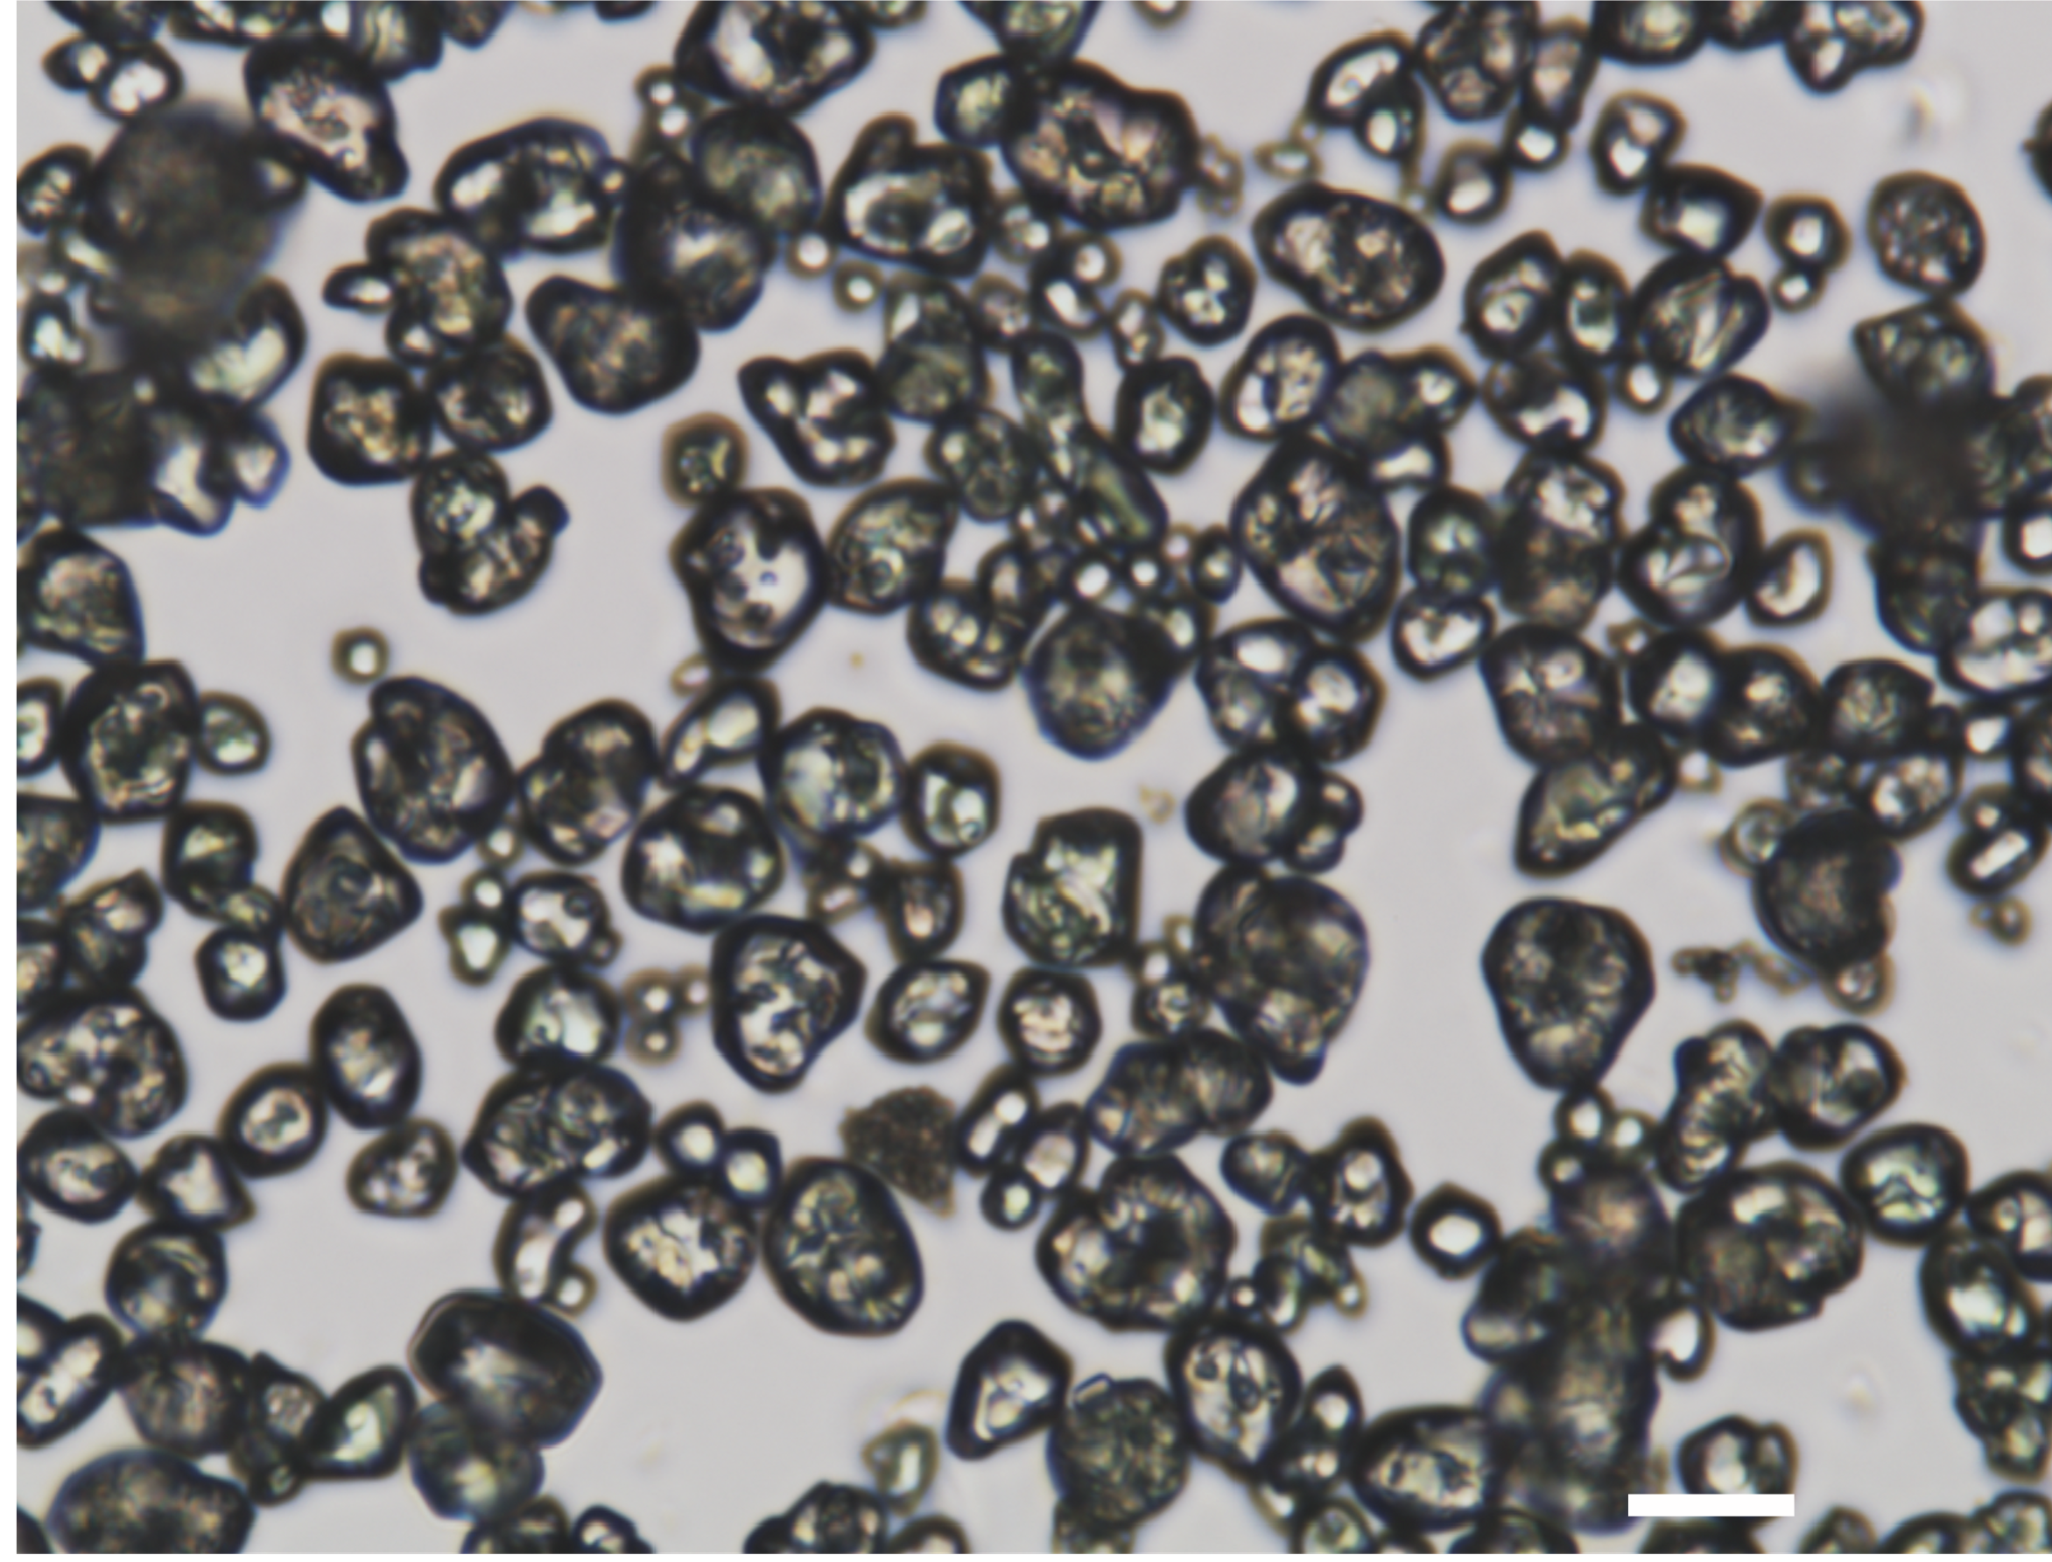
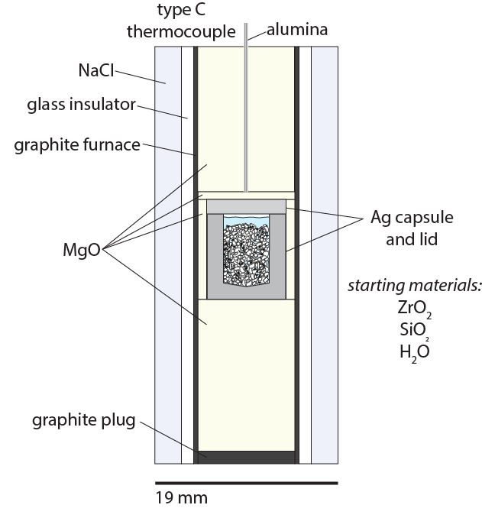
Hydrothermal Crystallization: making zircon inclusions in garnet
Experimental development of a mechanical thermobarometer that uses the mineral equations of state and elastic properties to estimate crystallization pressure and temperature conditions at which garnet-bearing rocks form.
Need zircons with pure compositions that are free of radiation damage.
Experiment at 900°C to synthesize zircons that are approx. <10 μm because they need to be smaller than the garnets. Higher T makes larger crystals.
Can systematically control U, Th, REE, Hf, Ti, and other trace elements.
zircons
10 μm
10 μm
zircons

Slide 18
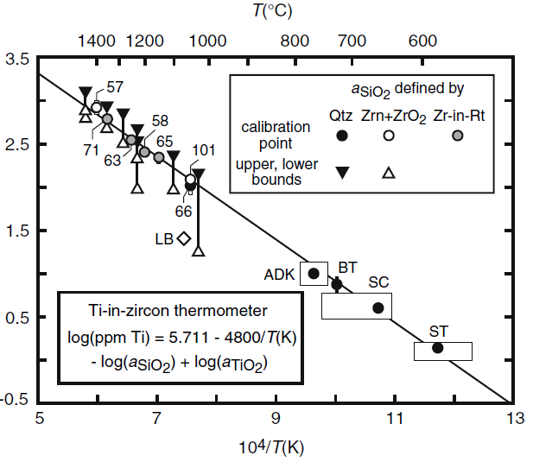
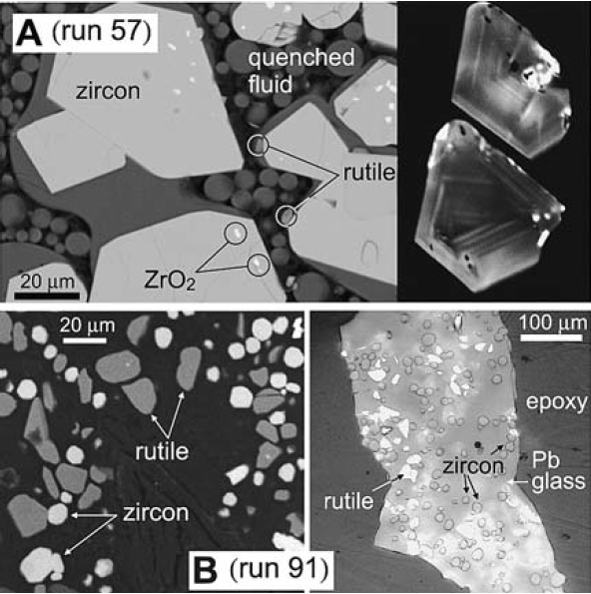
Hydrothermal Crystallization: Controlling Trace Element Incorporation in Zircon (ZrSiO₄)
Log Ti in zircon (ppm)
Log(ppm Ti in zircon)=5.711-4800/T (K)
Co-crystallize zircon, rutile (TiO₂) and quartz (SiO₂) from aqueous fluids over a range of temperatures at P=10 kbar.
Measure large range of Ti in zircon to develop a “thermometer”.
Larger crystals grow at higher temperatures.
A zircon with 100 ppm Ti formed at ~1000°C.
Notes:
Watson, Wark, & Thomas (2006); Ferry & Watson (2007)
100 ppm Ti=1015C
~1900 references
The linear fit is really
lnX=DG/RT
And DG can be expanded to include ΔH-TDS+PDV. If there’s no pressure effect, then it can be simplified.

Slide 19
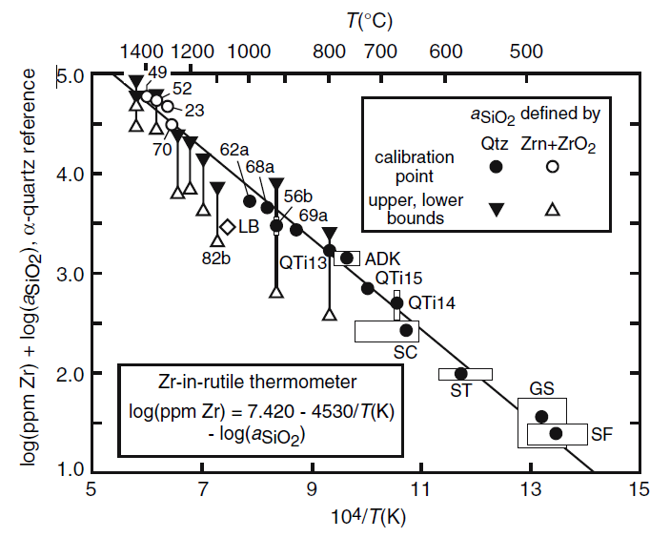
Hydrothermal Crystallization: Controlling Trace Element Incorporation in Rutile (TiO₂)
Log Zr in rutile (ppm)
Co-crystallize zircon, rutile (TiO₂) and quartz (SiO₂) from aqueous fluids over a range of temperatures at P=10 kbar.
Measure a large range of Zr in rutile to develop “thermometer”.
Log(ppm Zr in rutile)=7.420-4530/T (K)
A rutile with 8000 ppm Zr formed at ~1000°C.
*Very high Zr-in-rutile solubility at high T.
Notes:
Watson, Wark, & Thomas (2006); Ferry & Watson (2007)
Log(3.95)=8913 ppm Zr in rutile=1015C
ADK
SC=Santa Catalina
ST=Stillup Tal (Tauern Window, Eastern Alps)
GS=greenschist from Vermont
SF=blueschist from Sifnos, Greece

Slide 20
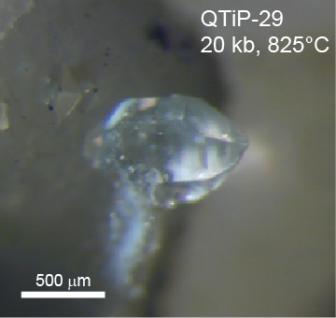
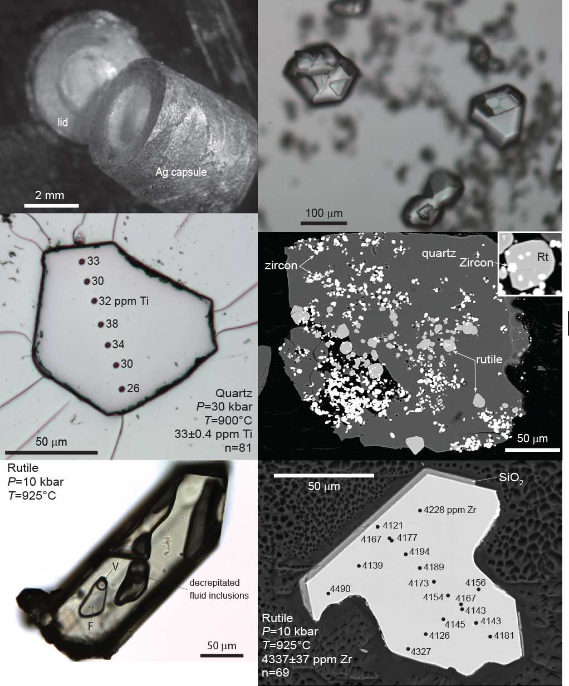
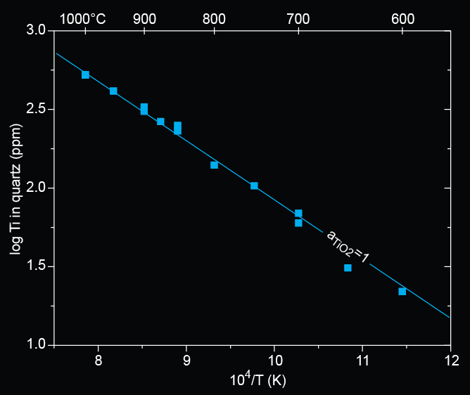
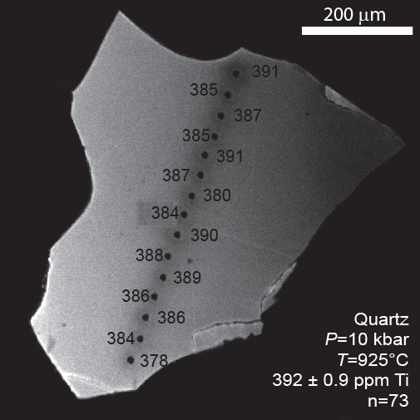
Hydrothermal Crystallization: Controlling Trace Element Incorporation in quartz (SiO₂)
10 kb calibration (2006)
A quartz crystal with 100 ppm Ti crystallized at 765°C

Slide 21
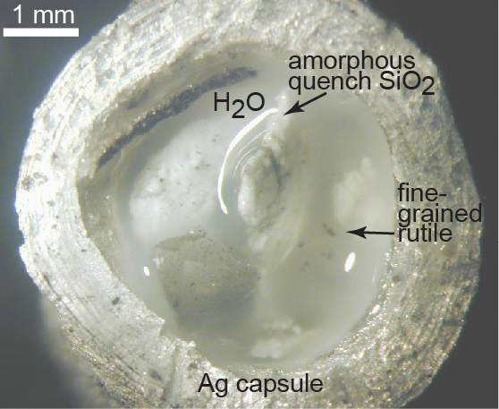
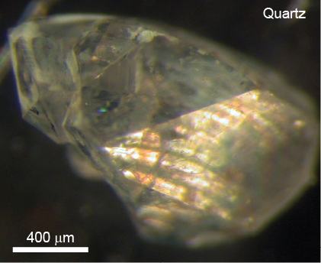
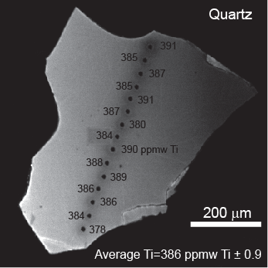
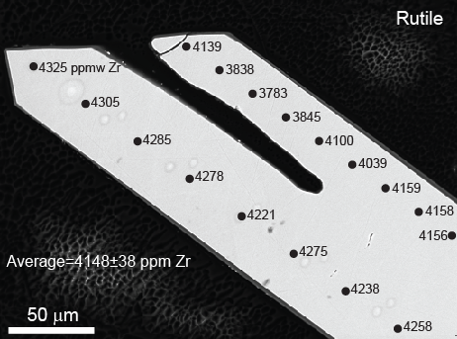
Hydrothermal Crystallization Run Products are Chemically Homogenous
The crystals grow from mineral-saturated aqueous fluids.
Rapid transport of essential structural constituents in fluids to the growth surfaces promotes chemical equilibrium.
Flexible experimental design permits growing pure endmember minerals free of inclusions.
Minerals that grow from fluids can have very low hydrogen concentrations (see later slides).
CL image of quartz
BSE image of rutile
P=10 kbar
T=925°C
T=120 hours

Slide 22
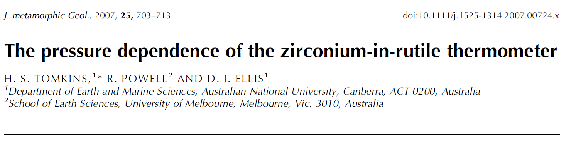
Effect of pressure and temperature on Zr solubility in rutile
1500
1400
1300
1200
1100
1000
1 bar
Tomkins et al. (2007) demonstrated that pressure strongly affects Zr solubility in rutile
Ln Zr in rutile (ppmw)
30 kbar

Slide 23

Hydrothermal Crystallization: Controlling Trace Element Incorporation in quartz (SiO₂)
Measured Ti in coesite from 27 experiments in the coesite field
Ti-in-coesite calibration in 2019
Measured Ti in quartz from 86 experiments at 2-30 kbar in the quartz field
Performed experiments across the α−β quartz transition and the quartz-coesite boundary
$RT lnX_{{TiO}_{2}}^{quartz}=$ $−∆\overline{H}°+T∆\overline{S}°−P\left({∆\overline{V}}^{∗}+d∙P\right)$
We can control experimental parameters to systematically change point defects and trace element mineral chemistry concentrations
Notes:
More Ti in coesite at lower T than predicted from the TiQ calibrations. For example, 10 ppm Ti in coesite gives P-T of 700 and 30 kbar, and using the TiQ cal it predicts about 750 and 30 kbar. This means that the same amount of Ti can go into coesite but at lower T.
Interesting that Ivanov mentioned that S should be zero, which is exactly what we found.

Slide 24



Determining Defect Type and Solubility Mechanism(s)
When a quartz (SiO₂) crystal grows in the presence of Ti, some Ti⁴⁺ substitutes for Si⁴⁺
Ti K-edge XANES Spectra
Si⁴⁺ (C.N. 4)=0.26 Å
Ti⁴⁺ (C.N. 4)=0.42 Å
Ti⁴⁺ replaces Si⁴⁺ in quartz (SiO₂) at all conditions
Ti⁴⁺ replaces Si⁴⁺ and Zr⁴⁺ in zircon (ZrSiO₄)
Zr⁴⁺ replaces Ti⁴⁺ in rutile (TiO₂) at all conditions
Notes:
38% difference between sizes
Ti is 62% larger than Si

Slide 25



Controlling Ti concentrations in quartz
Cathodoluminescence images can show distribution of impurities in minerals
Produced by decreasing P
Produced by decreasing T
Sectoral zoning in α quartz

Slide 26



Hydrothermal Crystallization in the SiO₂-TiO₂-Al₂O₃ System
Making an Al-in-quartz thermobarometer
Simple solubility mechanisms for substituting Al³⁺ for Si⁴⁺ in the quartz structure requires charge balance such as H⁺ + Al³⁺=Si⁴⁺, Li⁺ + Al³⁺=Si⁴⁺, etc.
Kyanite (Al₂SiO₅) and quartz
SiO₂-TiO₂-Al₂O₃
System
kyanite
1 mm
100 μm
Notes:
Structure, igneous, metamorphic, sedimentary, geochemistry

Slide 27




Hydrothermal Crystallization in the SiO₂-TiO₂-Al₂O₃ System: Aluminum and Hydrogen in Quartz
How does Al dissolve into quartz?
(SiO₄)⁴⁻
(Al³⁺H⁺O₄)⁴⁻
(H₄O₄)⁴⁻
Si⁴⁺
Al³⁺
H⁺
Correlation of H⁺ (FTIR) with Al (EPMA) measurements in quartz shows that coupled substitution is the dominant solubility mechanism for incorporating Al in quartz in our experiments

Slide 28


Hydrothermal Crystallization in the SiO₂-TiO₂-Al₂O₃ System
SiO₂-TiO₂-Al₂O₃
System
Growing corundum requires SiO₂-poor compositions in the lower left triangular region.
Could probably grow corundum (Al₂O₃) and baddeleyite (ZrO₂) in the same experiments.
Aluminum incorporation in baddeleyite would likely affect H⁺ defects.
Kyanite (Al₂SiO₅)
P1 = 25 kbar-48 h
P2 = 40 kbar -48 h
T = 700°C
Notes:
Kyanite=triclinic
Sillimanite=orthorhombic
Andalusite=orthorhombic

Slide 29




Hydrothermal Crystallization of real rock compositions
Fe²⁺ and Fe3⁺
Quartz + feldspar matrix
Effects on nucleation density and crystal size in synthesized garnet
 |  |  | fO₂ mix
Oxide (wt%) | Normal Metapelite | Spessartine mix | QIF | FMQ
SiO₂ | 65.12 | 36.4 | 63.55 | 43.87
TiO₂ | 0.80 | - | - | -
Al₂O₃ | 17.55 | 20.6 | - | -
Fe | - | - | 36.45 | -
FeO | 1.16 | - | - | 26.05
Fe₂O₃ | 5.28 | - | - | 30.09
MnO | 0.09 | 43 | - | -
MnO₂ | - | -
MgO | 2.79 | -
CaO | 2.33 | -
Na₂O | 1.21 | -
K₂O | 3.67 | -
Fe²⁺
20 μm
QuiG-TR-13
T = 700°C
P = 20 kbar
t = 48 h
Fe²⁺ and Fe³⁺
20 μm
GN-4 pure spessartine
300 μm

Slide 30

Hydrothermal Crystallization of real rock compositions
Reflected light
X-ray maps
Reflected light
Oxidized starting material
50% MnO₂, 50% FeO in experimental mix run at FMQ oxygen buffer
Reduced starting material
0.886 wt% MnO and FeO

Slide 31


Hydrothermal Crystallization of Real Rock Compositions
Vikings’ Compass
Cordierite ((Mg,Fe)₂Al₄Si₅O₁₈)
P = 5 kbar
T = 700°C
t = 48 h
Biotite=K(Mg, Fe)₃AlSi₃O₁₀(F, OH)₂
1 mm
500 μm
1 mm
Notes:
Ring silicate, common in pelitic rocks, especially hornsfels.
As the transparent variety iolite, it is often used as a gemstone. The name "iolite" comes from the Greek word for violet. Another old name is dichroite, a Greek word meaning "two-colored rock", a reference to cordierite's strong pleochroism. It has also been called "water-sapphire" and "Vikings' Compass" because of its usefulness in determining the direction of the sun on overcast days, the Vikings having used it for this purpose. This works by determining the direction of polarization of the sky overhead. Light scattered by air molecules is polarized, and the direction of the polarization is at right angles to a line to the sun, even when the sun's disk itself is obscured by dense fog or lies just below the horizon.

Slide 32



Hydrothermal Crystallization of Real Rock Compositions
Staurolite
P = 15 kbar
T = 800 C
t = 24 h
Staurolite
P = 15 kbar
T = 700 C
t = 24 h
Fairy Stones
Staurolite
Fe₂Al₉Si₄O₂₃(OH)₂
1 mm
Notes:
Staurolite=Fe²⁺₂Al₉O₆(SiO₄)₄(O,OH)₂

Slide 33

Summary
There are many methods to grow crystals and each method has limitations.
Flux growth methods produce large crystals, but they have heterogeneous compositions.
Piston-cylinder devices provide great experimental flexibility to grow most any mineral.
Hydrothermal methods can produce relatively large crystals with exceptionally uniform compositions.
Hydrothermal methods can produce endmember mineral compositions largely free of other minerals and inclusions.
Hydrothermal methods can be controlled to systematically adjust mineral compositions and point defects.
Apatite in garnet
What other minerals have we synthesized that may be of interest for MDDM?
Corundum—Al₂O₃
Baddeleyite—ZrO₂
Apatite—Ca₅(PO₄)₃(OH,F,Cl)
Monazite —(Ce, La, Th)PO₄
Feldspars—KAlSi₃O₈ to NaAlSi₃O₈ to CaAl2Si₂O₈
Pyroxenes—MgSiO₃ to FeSiO₃ to CaMgSi₂O₆
Diamond is on the “to do” list.
965.418
965.462
965.678
965.479
965.493
965.473
965.539
965.457 cm-1 ±0.08

Slide 34
Apatite in garnet
965.418
965.462
965.678
965.479
965.493
965.473
965.539
965.457 cm-1 ±0.08

Slide 35


Al³⁺ substitution for Ti⁴⁺ in rutile (TiO₂) requires charge balance
Fourier transform infrared spectrum of hydrogen in rutile

Slide 36



Run Products

Slide 37



Experimental Run Products
P=10 kbar
T=925°C
t=120 h
quartz
rutile

Slide 38

Thermobarometry basics
When quartz grows in the presence of rutile the solubility of Ti is governed by the equilibrium
$${TiO}_{2}^{rutile}={TiO}_{2}^{quartz}$$
Si
0 b/c rutile
was present
2022
At equilibrium
$$∆\overline{G}°=∆\overline{H}°−T∆\overline{S}°+P\left({∆\overline{V}}^{∗}+d∙P\right)+RT lnX_{{TiO}_{2}}^{quartz}−RT lna_{{TiO}_{2}}^{rutile}=0$$
Rearrange
$$RTlnX_{{TiO}_{2}}^{quartz}=−a+\left[b∙T\left(K\right)\right]−[P(kbar)∙(c+d∙P\left(kbar\right)]$$
This relation is used to calibrate the thermobarometers!
Notes:
Since rutile is present in all experiments, and the equilibrium constant is . The low Ti concentrations found in experimental and natural quartz crystals (Table 1), justifies the assumption that , where k is the Henry’s Law coefficient and is the mole fraction of TiO₂ in quartz
The temperature dependence of Ti solubility is a function of delta H (i.e., it is the slope on a plot of vs. 1/T) and delta S controls the slopes of isopleths in P-T space.

Slide 39

A new Ti-in-Quartz solubility model based on the extended dataset
The Ti concentration in quartz decreases nonlinearly with pressure
Developed the Ti-in-quartz solubility model that has a nonlinear volume term
$RT lnX_{{TiO}_{2}}^{quartz}=$ $−∆\overline{H}°+T∆\overline{S}°−P\left({∆\overline{V}}^{∗}+d∙P\right)$
The solubility model fits most of the data reasonably well
The quartz α−β transition does not affect Ti solubility in quartz

Slide 40


