Slide 1
Defect Formation: Dynamics
NSF GCR: Mineral Detection of Dark Matter School
January 14, 2025
Vsevolod Ivanov
Virginia Tech NSI & Department of Physics

Slide 2
Outline
Defect Fabrication Techniques
Simulating defect dynamics
Electron/Ion/Laser Irradiation
CVD
Nudged Elastic Band
Molecular Dynamics
Empirical Models
Semi-classical Monte-Carlo

Slide 3
Outline
Defect Fabrication Techniques
Simulating defect dynamics
Electron/Ion/Laser Irradiation
CVD
Nudged Elastic Band
Molecular Dynamics
Empirical Models
Semi-classical Monte-Carlo

Slide 4
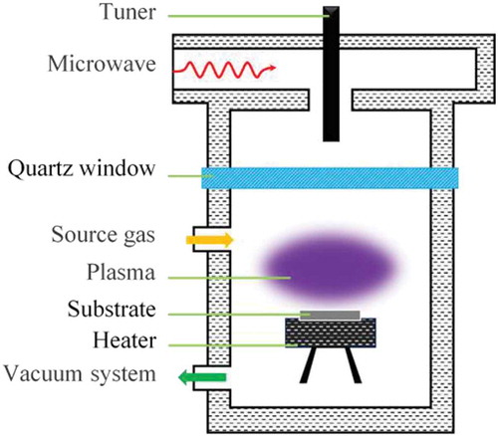
Defect Fabrication: Chemical Vapor Deposition
CVD, Chemical Vapor Deposition
Common method for crystal growth; plasma generated and deposited onto substrate under vacuum
Impurity defects can be introduced uniformly by mixing them into the plasma
Controlling source type can be used to localize defects to bulk or surface
Mineral Detection of Dark Matter Meeting
1/13-1/17 2025

Slide 5
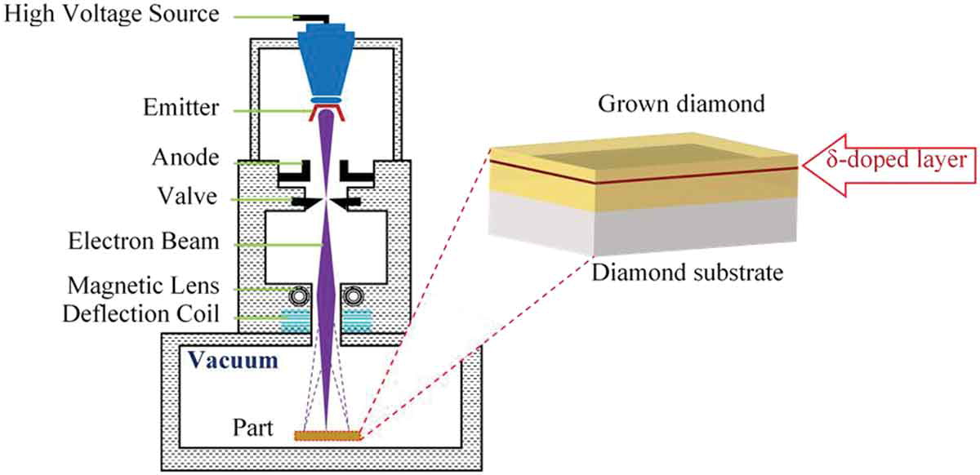
Defect Fabrication: Electron Beam Irradiation
e-beam generates large number of vacancies
Usually followed by annealing step to allow vacancies to diffuse
Need existing dopants to form composite defects, such as NV-centers
Mineral Detection of Dark Matter Meeting
1/13-1/17 2025

Slide 6
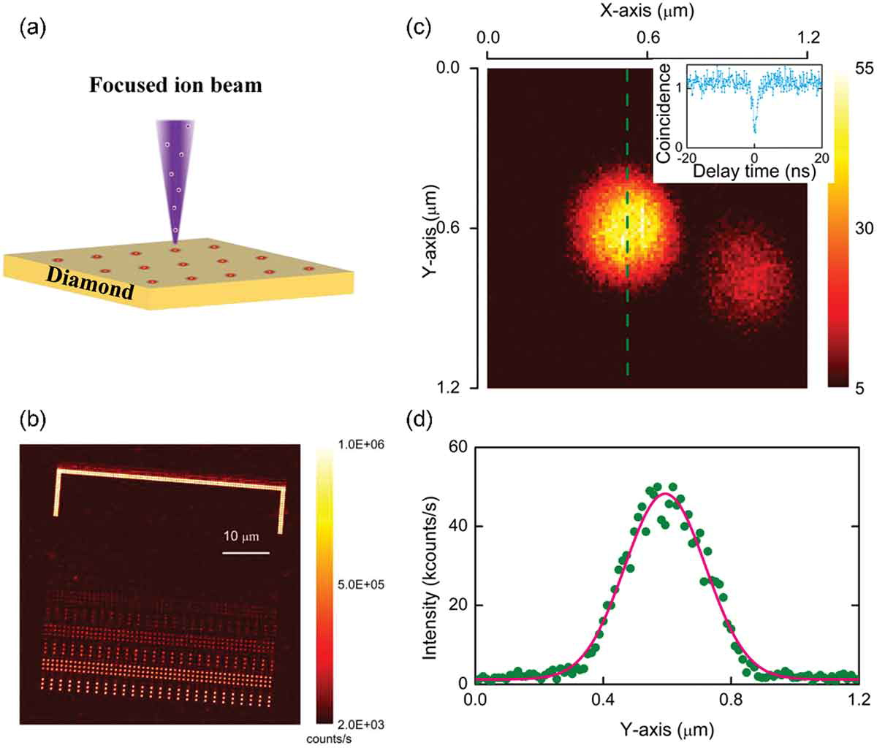
Defect Fabrication: Ion Irradiation
An alternative to electron beam is ion irradiation. For heavy ions/high energies the primary result is crystal damage/vacancies. (ions may become trapped and affect resulting defects)
At lower energies/fluence, ions can be implanted directly to form defects
Lower limit – annealing in a gas to promote diffusion into lattice
Mineral Detection of Dark Matter Meeting
1/13-1/17 2025

Slide 7
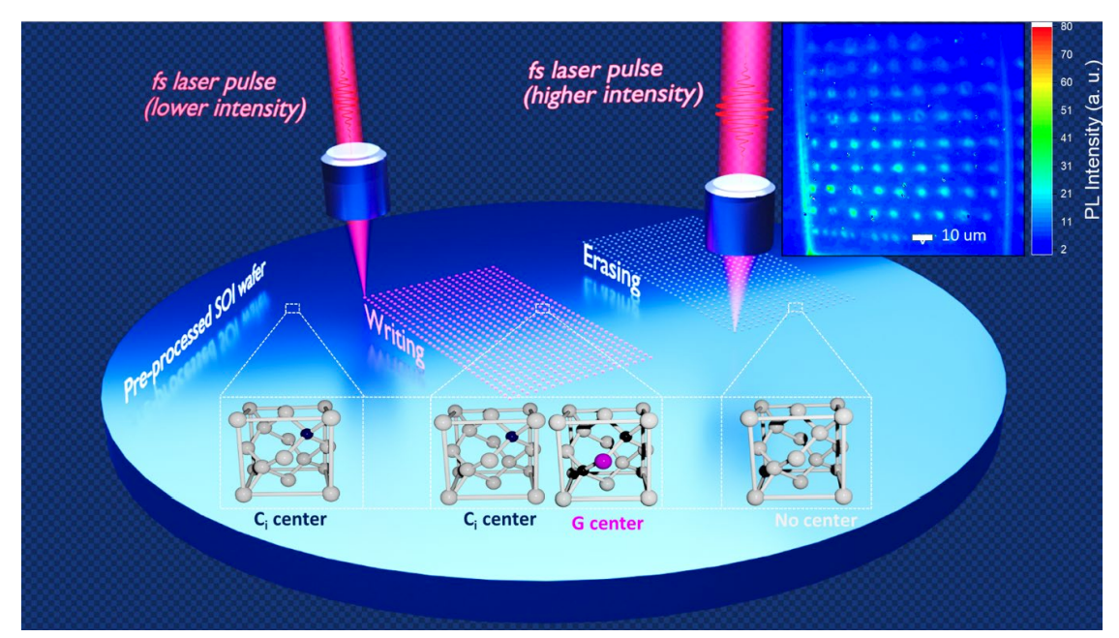
Defect Fabrication: Laser irradiation
Defects can also be created by local “heating” with a femtosecond laser pulse
Again, need existing dopants/ impurities to create anything besides vacancies
Can be used to both “write” and “erase” defects
Mineral Detection of Dark Matter Meeting
1/13-1/17 2025

Slide 8
Outline
Defect Fabrication Techniques
Simulating defect dynamics
Electron/Ion/Laser Irradiation
CVD
Nudged Elastic Band
Molecular Dynamics
Empirical Models
Semi-classical Monte-Carlo

Slide 9
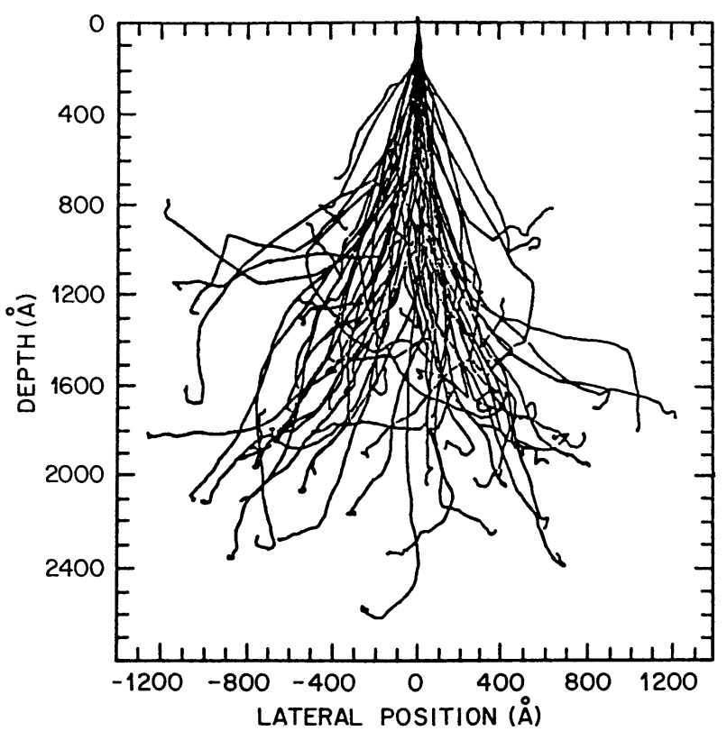
How can we model defect dynamics?
Various schemes for modeling dynamics:
Empirical models
Semi-classical Monte-Carlo
Classical / Quantum Molecular Dynamics
Nudged Elastic Band
Mineral Detection of Dark Matter Meeting
1/13-1/17 2025

Slide 10
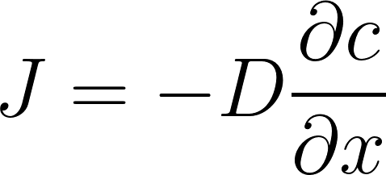
Diffusion of Ions (Fick’s Laws)
For a 1D flow in the x-direction (Fick’s 1st Law), we have:
where J – dopant flux, c – dopant concentration, D – diffusion coefficient
Since matter is conserved, change in concentration over time must equal local decrease in diffusion flux:
If dopant concentration (and velocity) is low, D should not change over time/space
Fick’s 2nd Law
Mineral Detection of Dark Matter Meeting
1/13-1/17 2025

Slide 11
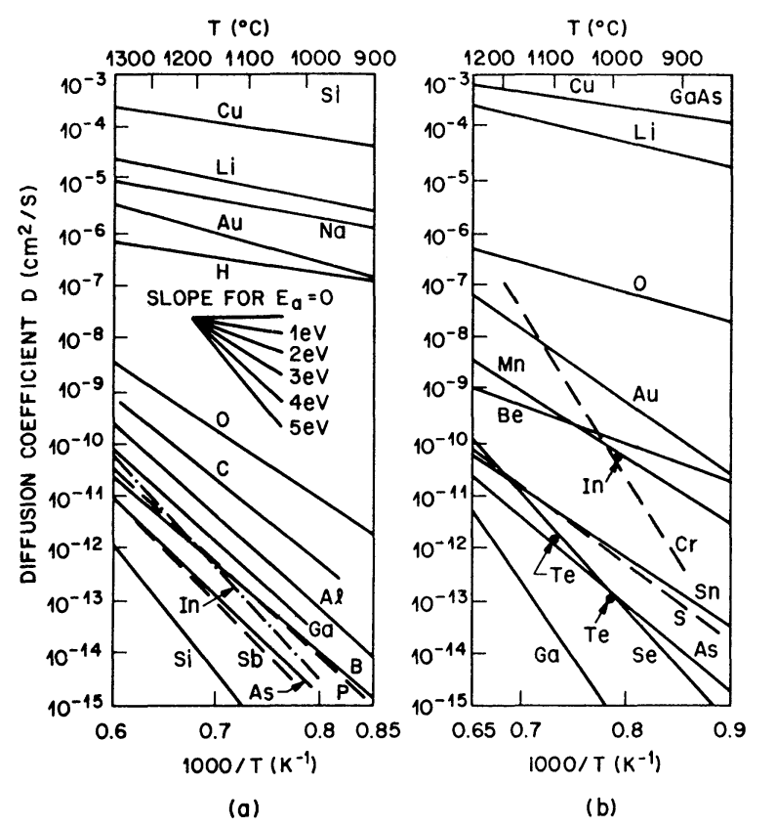
Diffusion of Ions (example solutions)
We can solve this for several cases. Ex: with a infinite material beyond x = 0, and constant surface concentration c₀, we find:
where erfc is the complimentary error function.
For a fixed material amount M deposited at surface, we have:
Diffusion coefficients are found from experiment.
Silicon (a) and GaAs (b)
Ex: annealing in gas
Ex: v. low E implantation
Mineral Detection of Dark Matter Meeting
1/13-1/17 2025

Slide 12
Diffusion of Ions (T dependence)
Notice that log plot of Diffusion coefficient vs temperature is a straight line!
Implies that the Diffusion coefficient obeys an Arrhenius relation:
where D₀ is a constant (effectively diffusion extrapolated to infinite temperature), and E_{b} is the activation energy barrier that must be overcome
Mineral Detection of Dark Matter Meeting
1/13-1/17 2025

Slide 13
Diffusion Mechanisms
Vacancy/Interstitial Diffusion
Vacancies “hop” by exchanging with atom sites
Self-interstitials can also “hop” OR exchange with nearby sites through interstitialcy mechanism
Dissociative/Kick-out Mechanisms
Dopant interstitial forms by escaping a lattice site
Translates by exchanging with another lattice atom
New self-interstitial recombines with vacancy
Ex: dopant Z in silicon:
Mineral Detection of Dark Matter Meeting
1/13-1/17 2025

Slide 14
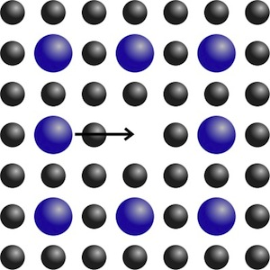
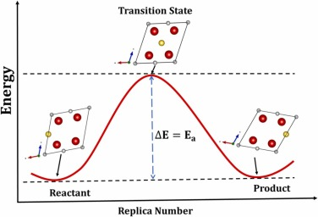
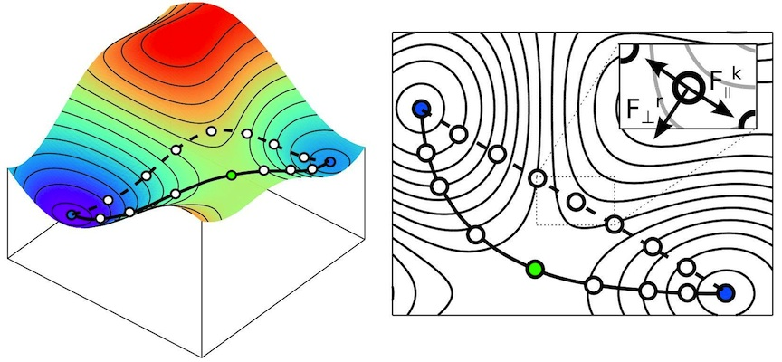
Nudged Elastic Band (computing E_{b})
Use atoms-on-springs to connect initial + final states of atom hopping sites
Compute total energy of each intermediate state
Nice tool exists for VASP!
https://theory.cm.utexas.edu/vtsttools/neb.html
Mineral Detection of Dark Matter Meeting
1/13-1/17 2025

Slide 15
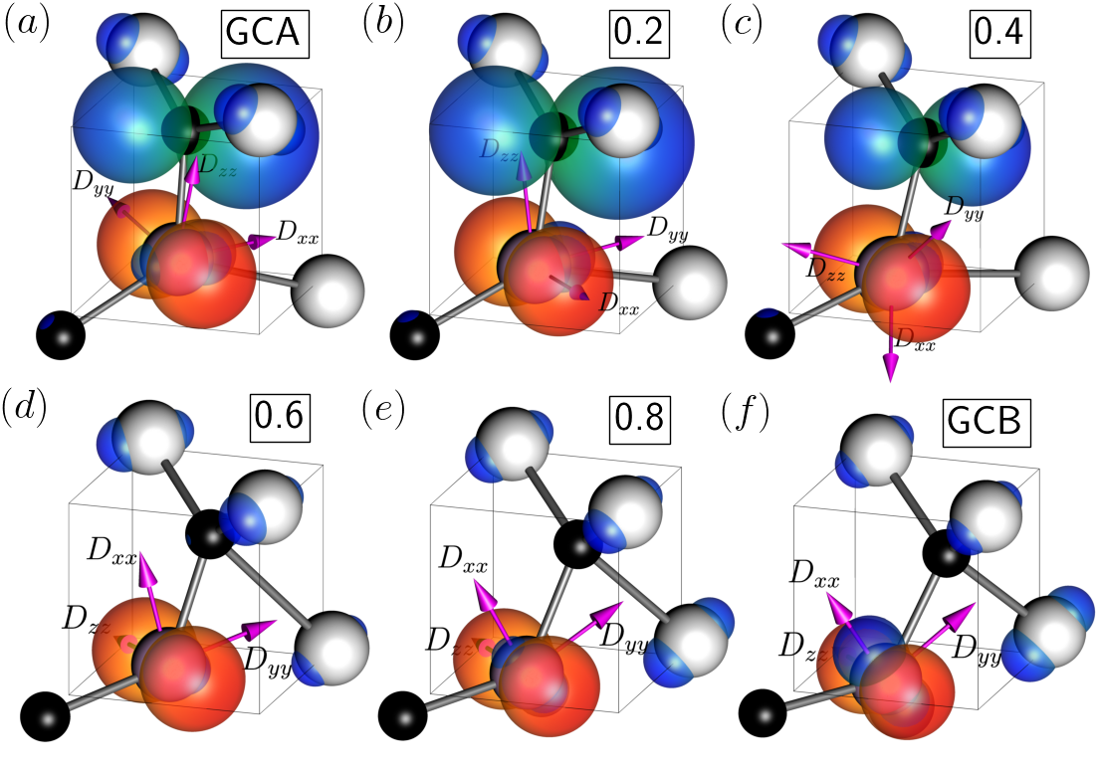
Nudged Elastic Band (computing E_{b})
Same idea can be used for any kind of defect transformations. Ex: Silicon G-center transformation from A to B configuration
Mineral Detection of Dark Matter Meeting
1/13-1/17 2025

Slide 16
Molecular Dynamics (Quantum)
What if we don’t know the final state we want to reach?
Can sample nearby configurations using molecular dynamics!
Initialize Boltzmann distribution of atom velocities
At each time step (~ fs), converge electronic structure, compute forces, update positions and velocities of atoms
Mineral Detection of Dark Matter Meeting
1/13-1/17 2025

Slide 17
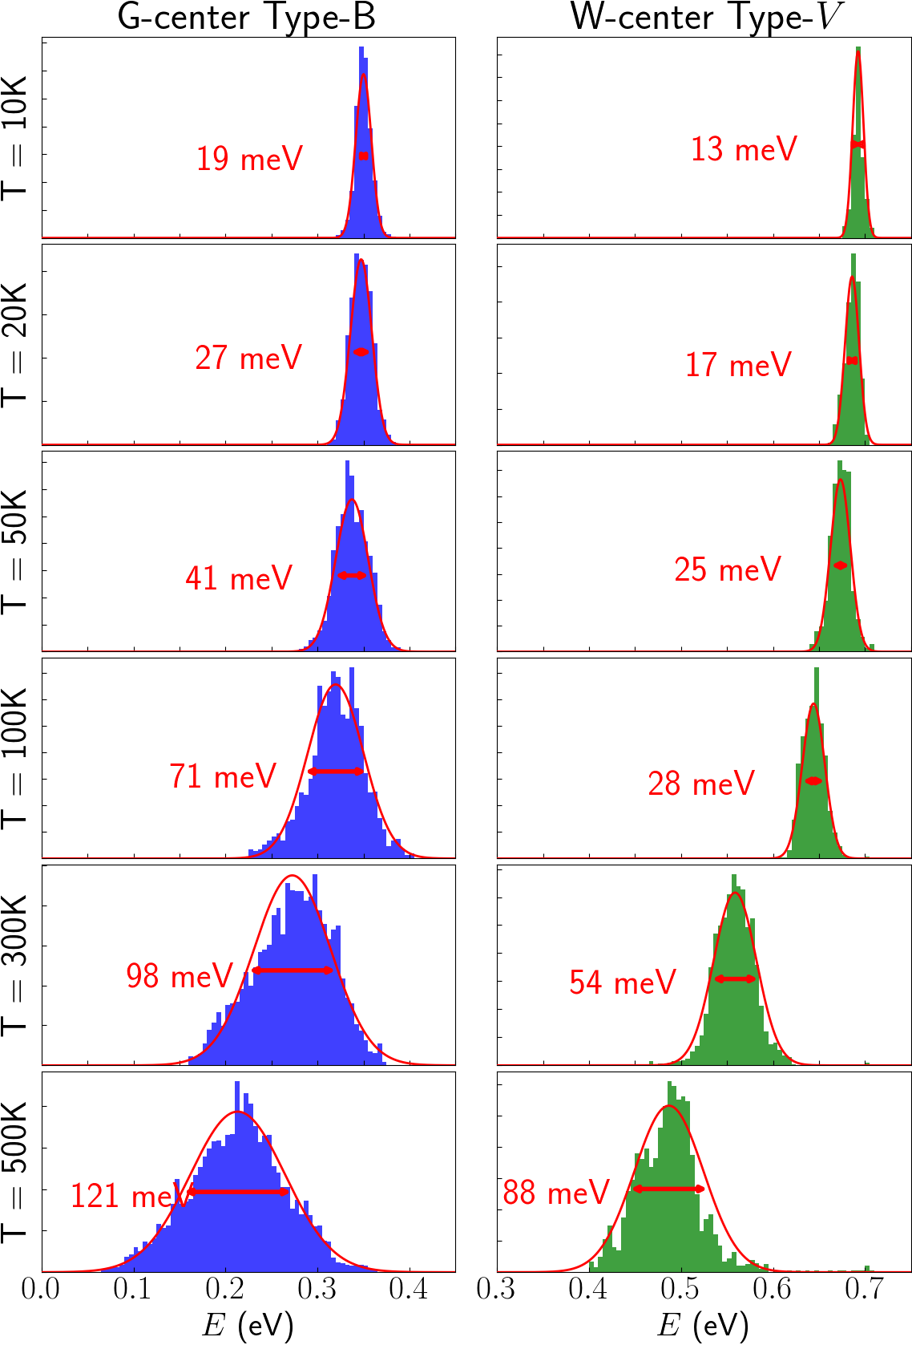
Molecular Dynamics (Quantum)
What if we don’t know the final state we want to reach?
Can sample nearby configurations using molecular dynamics!
Initialize Boltzmann distribution of atom velocities
At each time step (~ fs), converge electronic structure, compute forces, update positions and velocities of atoms
Mineral Detection of Dark Matter Meeting
1/13-1/17 2025

Slide 18
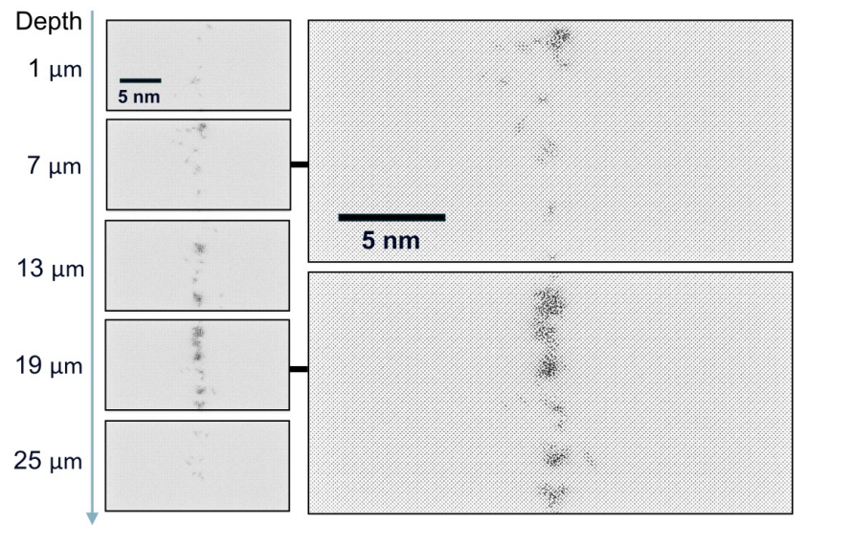
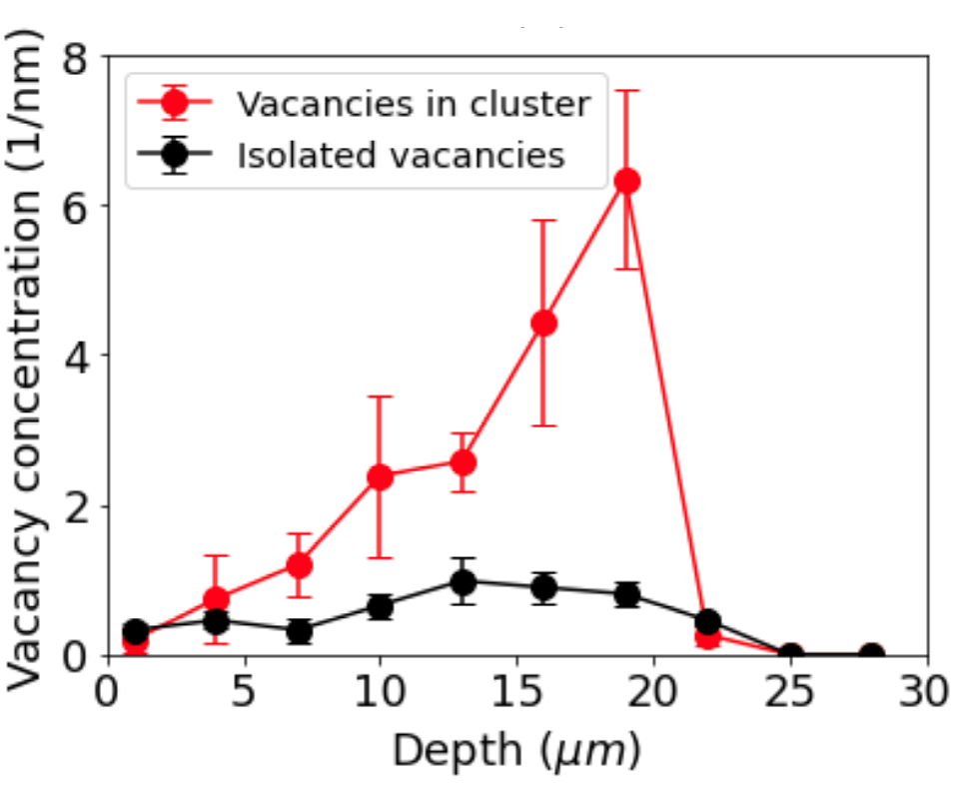
Molecular Dynamics (Semi-classical)
If we don’t compute electronic structure at each step, just use effective potential, can simulate many more atoms
Ex: Damage tracks Au in diamond
Mineral Detection of Dark Matter Meeting
1/13-1/17 2025

Slide 19
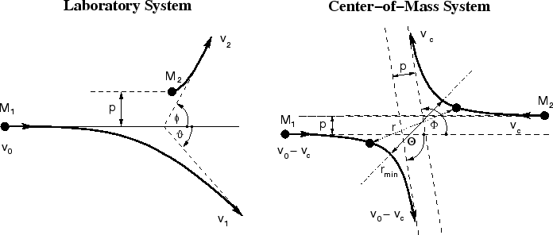
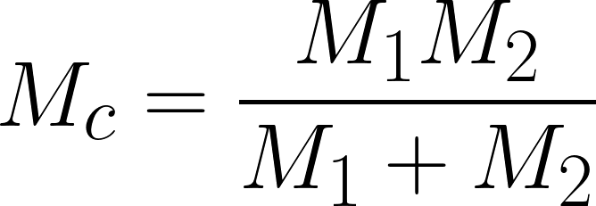
Binary Collision Approximation
Classical Collision
Shift to COM frame
Mineral Detection of Dark Matter Meeting
1/13-1/17 2025

Slide 20
Binary Collision Approximation
Recover Deflection Angles and
Scattering Angle Integral
Mineral Detection of Dark Matter Meeting
1/13-1/17 2025

Slide 21
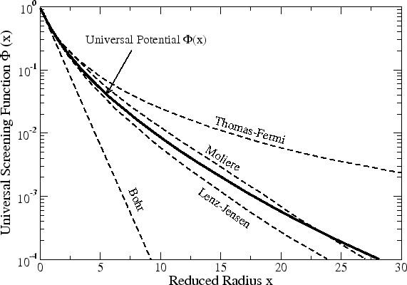
Binary Collision Approximation
How to handle the potential, V(r) ?
Coulomb interaction w/ screening
Ziegler et al. derive a “universal screening” based on exact calculations for 522 atom pair potentials
Ziegler, Biersack, and Littmark (1996)
Mineral Detection of Dark Matter Meeting
1/13-1/17 2025

Slide 22
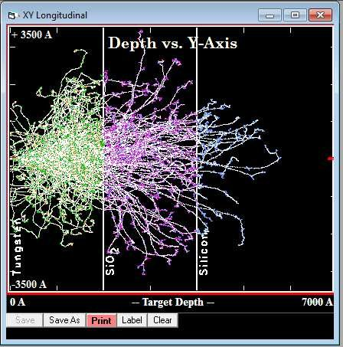
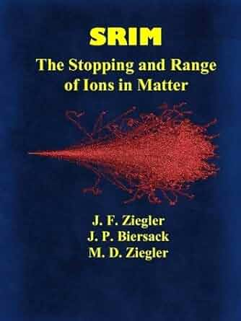
SRIM (Stopping and Range of Ions in Matter)
Uses semi-classical Monte Carlo with Binary Collision Approximation
Can do uniform or mixed element compositions. Also, layers now available
Note! Only statistical! No crystal structure, ion channeling, recombination, defect clustering, etc.
srim.org
Mineral Detection of Dark Matter Meeting
1/13-1/17 2025

Slide 23
Thank You for Your Attention!
Questions?
Mineral Detection of Dark Matter Meeting
1/13-1/17 2025

