Slide 1
Defect Formation: Energy & Equilibrium
NSF GCR: Mineral Detection of Dark Matter School
January 13, 2025
Vsevolod Ivanov
Virginia Tech NSI & Department of Physics

Slide 2
Outline
Preliminaries on Defects
Defect formation energy
Notation/charge conventions
Types of Defects
Computational details/tools
Estimating defect concentration from formation energy
Formation energy equation
Additional Considerations

Slide 3
Outline
Preliminaries on Defects
Defect formation energy
Notation/charge conventions
Types of Defects
Computational details/tools
Estimating defect concentration from formation energy
Formation energy equation
Additional Considerations

Slide 4
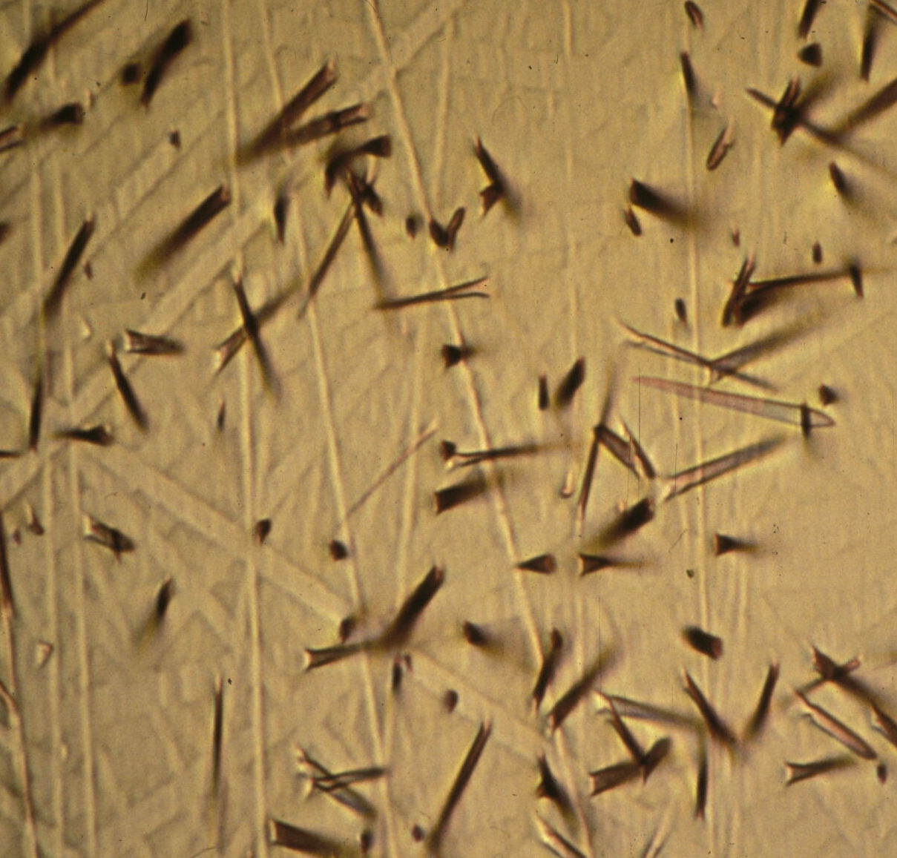
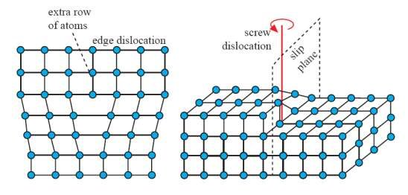
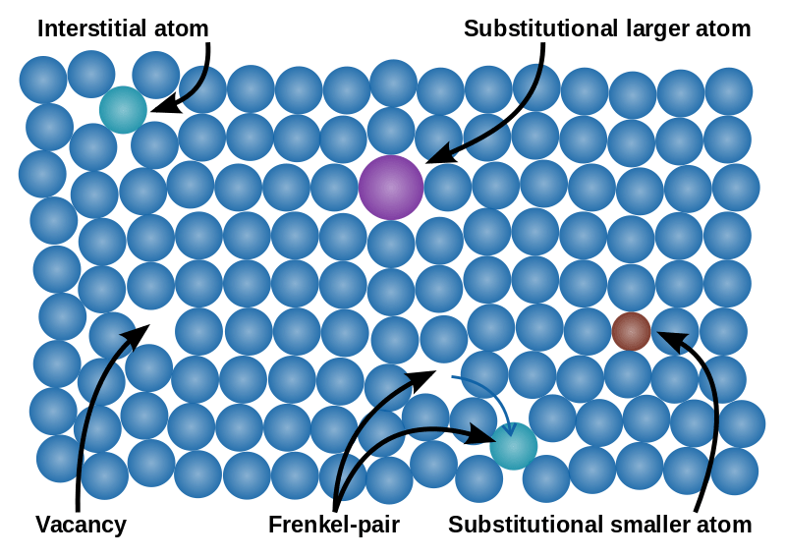
Beginning with Basics
What are crystalline defects? Defects are generally any kind of “error” or imperfection in a crystal. Can be classified into four basic types:
Volume defects – cracks, tracks, holes, foreign inclusions, any kind of macroscopic damage
Planar defects – grain boundaries, interfaces, slip planes
Line defects – linear dislocations
Point defects – 0-dimensional, atom or molecule-like imperfections in the crystal. The main focus today!
Mineral Detection of Dark Matter Meeting
1/13-1/17 2025

Slide 5
Point Defects
Types of point defects:
Vacancy – atom removed
Self-interstitial – crystal atom moved to lattice void
Interstitial – non-crystal atom inserted into a lattice void
Substitutional – crystal atom replaced by a non-crystal atom
Frenkel-pair – combined vacancy and self-interstitial
Q: Can we have a self-substitutional?
Mineral Detection of Dark Matter Meeting
1/13-1/17 2025

Slide 6
Point Defects
Types of point defects:
Vacancy – atom removed
Self-interstitial – crystal atom moved to lattice void
Interstitial – non-crystal atom inserted into a lattice void
Substitutional – crystal atom replaced by a non-crystal atom
Frenkel-pair – combined vacancy and self-interstitial
Q: Can we have a self-substitutional?
A: Yes! Called “antisite” defect, like in SiC
Mineral Detection of Dark Matter Meeting
1/13-1/17 2025

Slide 7
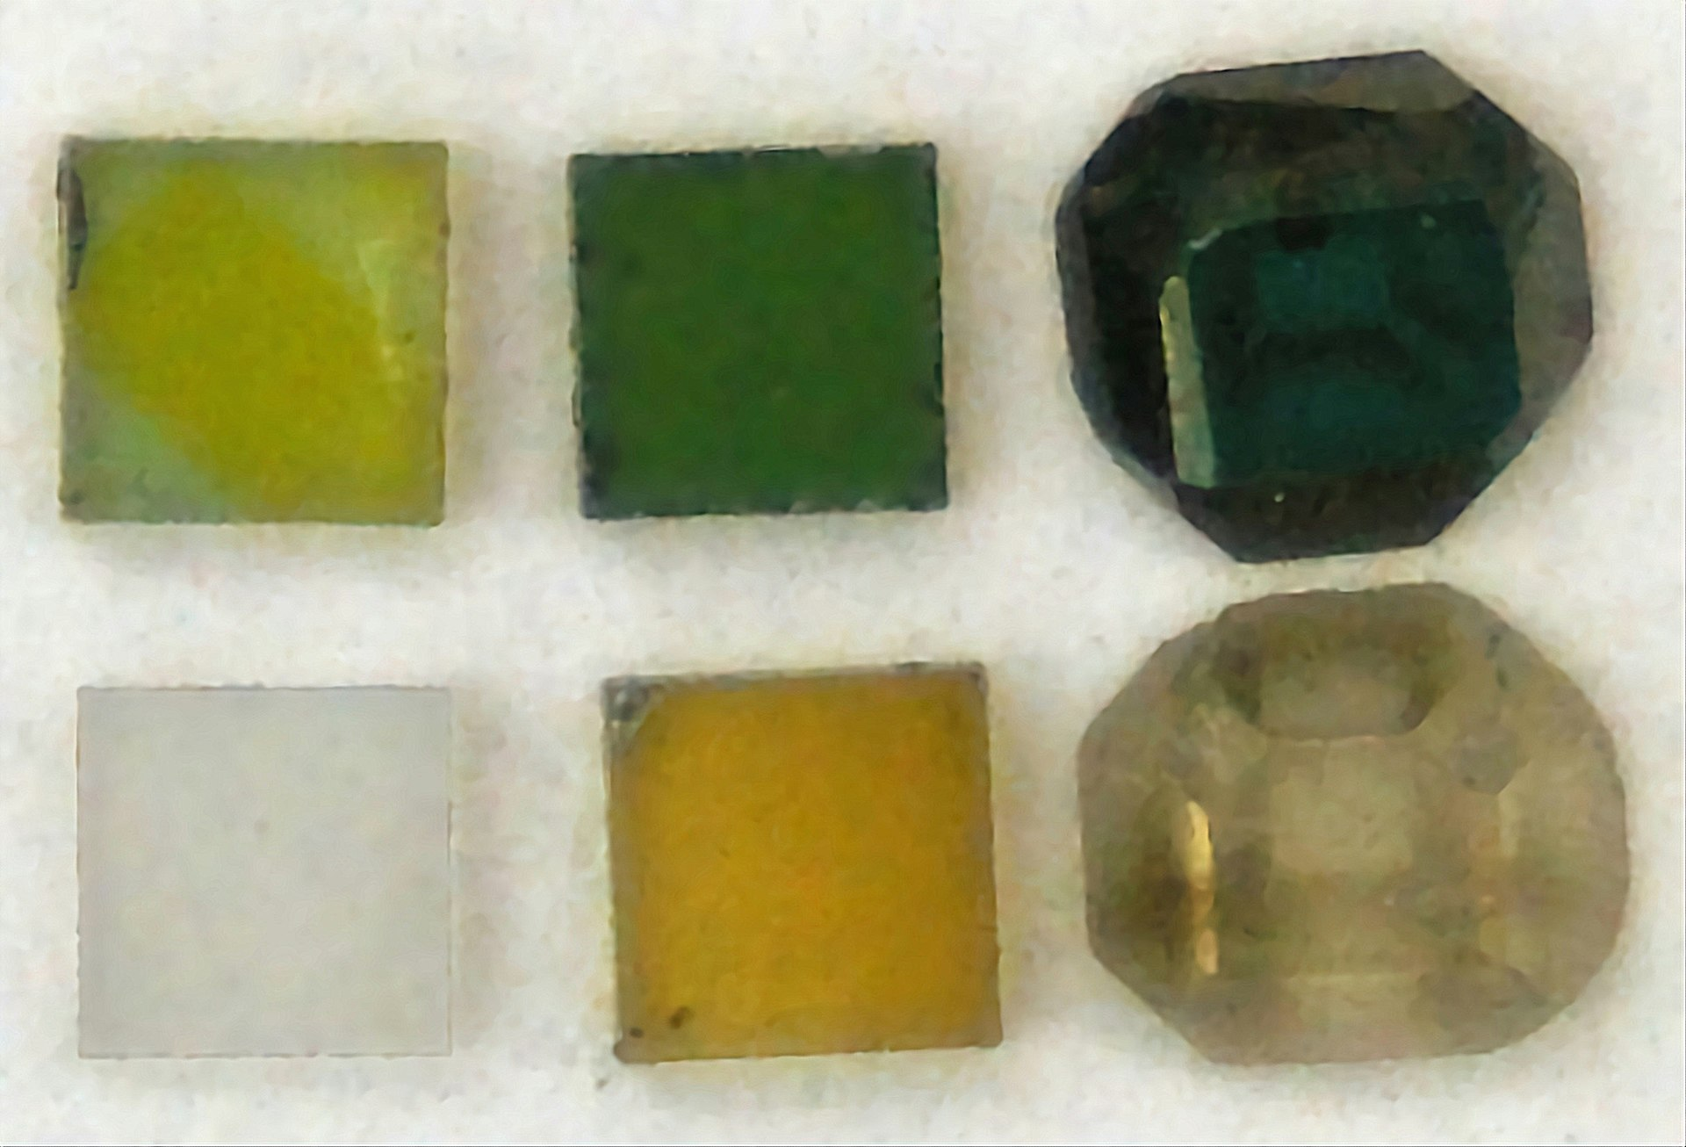
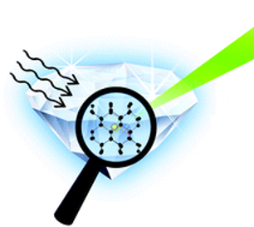
Aside: Color Centers
Defects that absorb and emit light are called color centers.
Note!! All color centers are defects, but only some defects are color centers!
In this talk we will use the terms “defect” , “point-defect” , and “color-center” interchangeably.
Mineral Detection of Dark Matter Meeting
1/13-1/17 2025

Slide 8
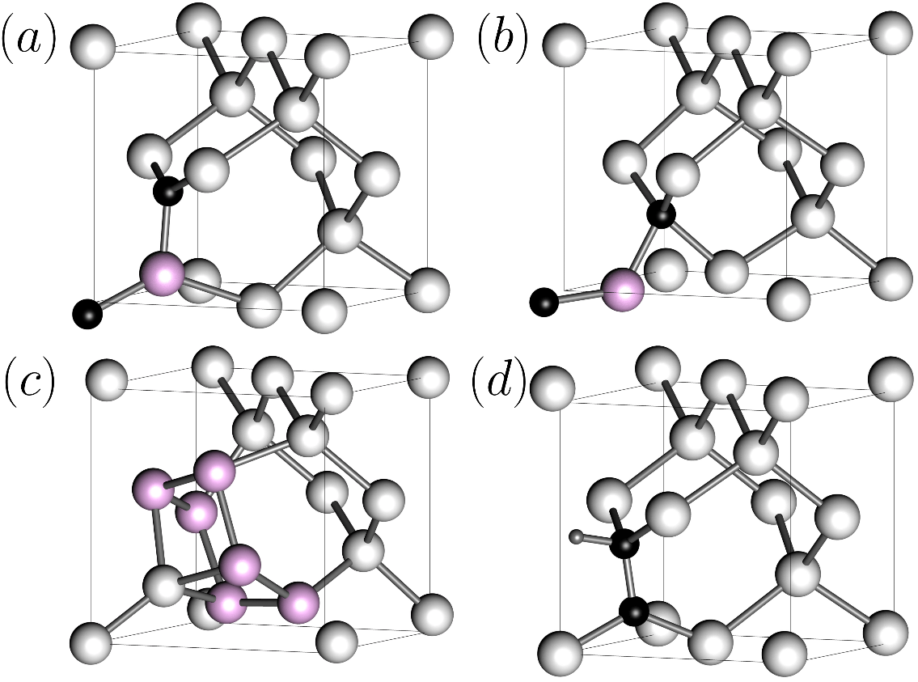
Notation
No standard convention for naming defects exists
In silicon, named alphabetically, G-, T-, W- centers
In diamond, literal description, NV – nitrogen vacancy
In alkali halides, F, F₂, F₃ … for the German Farbe (color)
G-A
G-B
W
T
Kroger-Vink Notation:
A – identity, chemical symbol or v for vacancy
S – site, chemical symbol for site (Li or F in LiF) or i for interstitial
C – charge, either real (-,+,0) or effective (.., //, x) charge relative to the lattice (site charge – replaced charge)
A_{S}
^{C}
Mineral Detection of Dark Matter Meeting
1/13-1/17 2025

Slide 9
Charge Examples
Consider Defects in LiF
Oxide (O2-) interstitial:
Real charge: -2 Effective charge: -2 –(0) = -2
Fluoride ion (F-) vacancy:
Real charge: 0 Effective charge: 0 – (-1) = +1
Oxide (O2-) substituting Fluoride (F-)
Real charge: -2 Effective charge: -2-(-1) = -1
O_{i}
O_{i}
//
²⁻
.
v_{F}
v_{F}
⁰
O_{F}
O_{F}
²⁻
/
Mineral Detection of Dark Matter Meeting
1/13-1/17 2025

Slide 10
Charge Examples
Other examples
Electrons/holes:
Modern/theory convention tends to use the real defect charge, but old literature will use effective charge - so a positively charged fluorine trivacancy, F₃ would be referred to as a “triple F-center (vacancy) with two bound electrons”
Side note: I am using lowercase v/i instead of uppercase V/I to avoid confusion with vanadium (V) and iodine (I), though both appear in papers
h.
e/
+
Mineral Detection of Dark Matter Meeting
1/13-1/17 2025

Slide 11
Charge Examples
Other examples
Electrons/holes:
Modern/theory convention tends to use the real defect charge, but old literature will use effective charge - so a positively charged fluorine trivacancy, F₃ would be referred to as a “triple F-center (vacancy) with two bound electrons”
Side note: I am using lowercase v/i instead of uppercase V/I to avoid confusion with vanadium (V) and iodine (I), though both appear in papers
h.
e/
+
v_{3F}
3v_{F}
⁰
⁰
Mineral Detection of Dark Matter Meeting
1/13-1/17 2025

Slide 12
Outline
Preliminaries on Defects
Defect formation energy
Notation/charge conventions
Types of Defects
Computational details/tools
Estimating defect concentration from formation energy
Formation energy equation
Additional Considerations

Slide 13
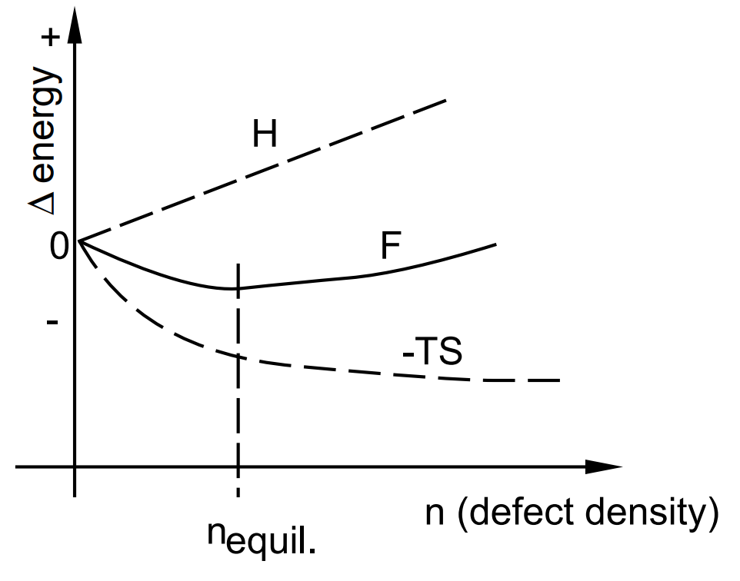
Defect formation equilibrium
Formation can be understood from Second Law of Thermodynamics:
∆F = ∆H – T ∆S
F: Free energy, also denoted ∆G
H: Enthalpy, heat content of system
S: Entropy, or disorder
T: Temperature
Creating defects requires energy, results in lattice strain, so ∆H – positive
Defects cause disorder ∆S – positive, but increases less and less as crystal becomes more disordered
Mineral Detection of Dark Matter Meeting
1/13-1/17 2025

Slide 14
Defect formation equilibrium
The defects will be balanced by the carrier concentrations of holes (p) and electrons (n):
If we know the free energy of formation ∆G_{f}, we can find the equilibrium defect concentration:
Here g – spin/orientation degeneracy. The 2nd vibrational term tends to be small → neglected
Mineral Detection of Dark Matter Meeting
1/13-1/17 2025

Slide 15
Defect formation energy
So, how to compute defect formation energy, E_{f} (∆H_{f}) ?
For a defect X^{q} with charge q :
First 2 terms – total DFT computed energy of the crystal with and without the defect
3rd term – energy cost of adding/removing the atoms forming the defect
4th term – defect charge times Fermi level ϵ_{F} , energy of electron/hole reservoir
5th term – correction term for finite size of simulation cell
Mineral Detection of Dark Matter Meeting
1/13-1/17 2025

Slide 16
Defect formation energy
So, how to compute defect formation energy, E_{f} (∆H_{f}) ?
For a defect X^{q} with charge q :
Mineral Detection of Dark Matter Meeting
1/13-1/17 2025

Slide 17
Defect formation energy
So, how to compute defect formation energy, E_{f} (∆H_{f}) ?
For a defect X^{q} with charge q :
h.
e/
h.
e/
h.
e/
Mineral Detection of Dark Matter Meeting
1/13-1/17 2025

Slide 18
Defect formation energy
So, how to compute defect formation energy, E_{f} (∆H_{f}) ?
For a defect X^{q} with charge q :
To compute formation energies from first principles, we simulate a finite number of atoms into which we embed a defect. This leads to spurious “finite-size” effects, that need to be corrected.
Mineral Detection of Dark Matter Meeting
1/13-1/17 2025

Slide 19
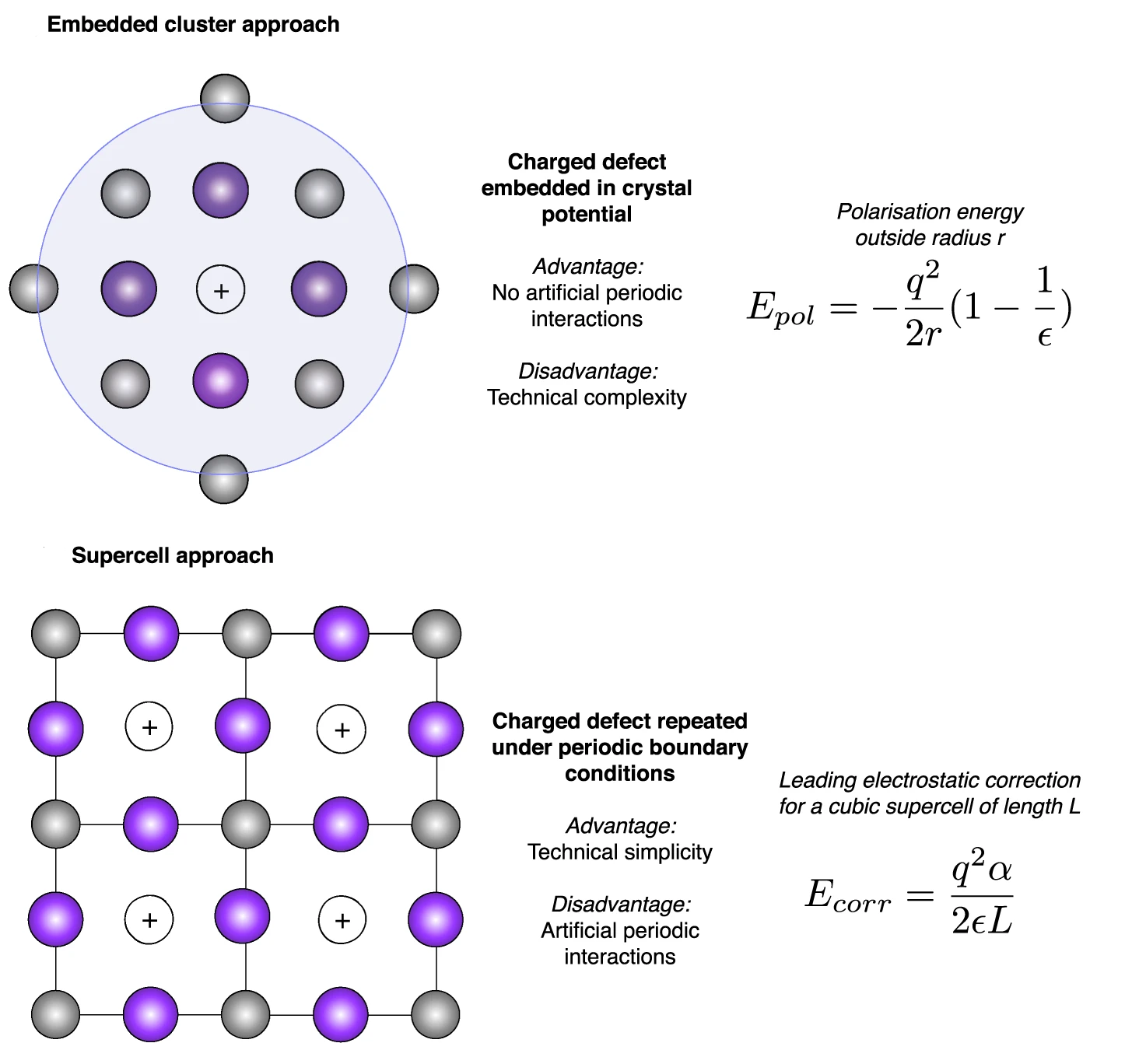
DFT simulation methods
Mineral Detection of Dark Matter Meeting
1/13-1/17 2025

Slide 20
DFT simulation methods
Mineral Detection of Dark Matter Meeting
1/13-1/17 2025

Slide 21
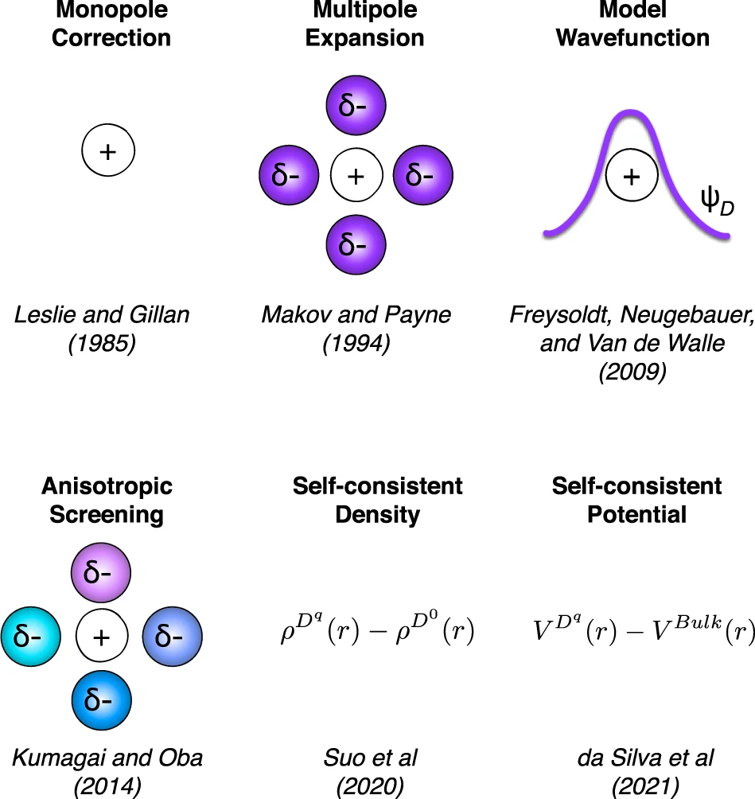
Charge Correction Approaches
In periodic DFT calculations, charge imbalances lead to instabilities/divergence
To ensure convergence, uniform “jellium” introduced to balance charge
Electrostatic potential and total energy need to be corrected → need to have some idea of the charge distribution
Mineral Detection of Dark Matter Meeting
1/13-1/17 2025

Slide 22
Codes for computing formation energies+corrections
Tools that interface with VASP (Vienna ab initio Simulation Package)
Spinney (https://spinney.readthedocs.io/en/latest/tutorial/defform.html)
→ Has all correction schemes available up to Kumagai & Oba (2014)
PyDEF2.0 (https://github.com/PyDEF2/PyDEF-2.0)
→ Convenient GUI interface
pydefect (https://kumagai-group.github.io/pydefect/tutorial.html)
doped (https://doped.readthedocs.io/en/latest/)
→ Modern tool with all correction schemes + defect prediction and symmetry analysis for degeneracy factors
Mineral Detection of Dark Matter Meeting
1/13-1/17 2025

Slide 23
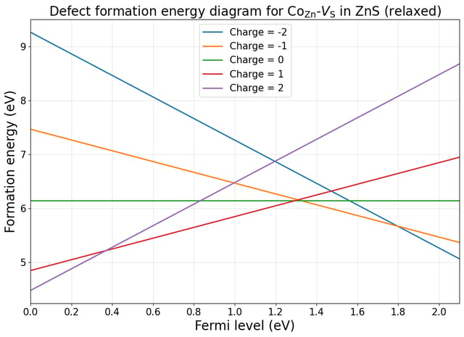
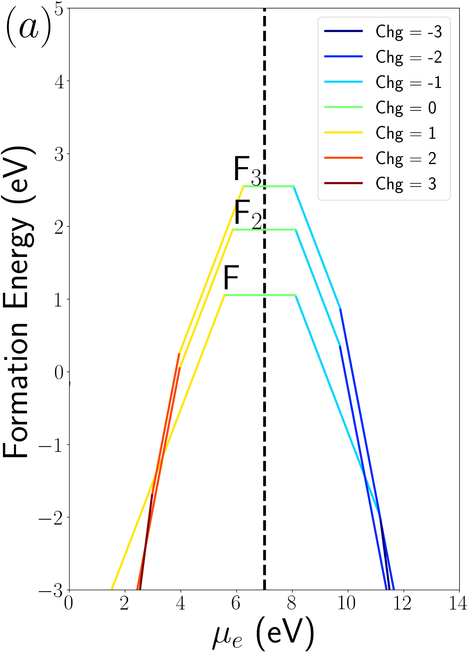
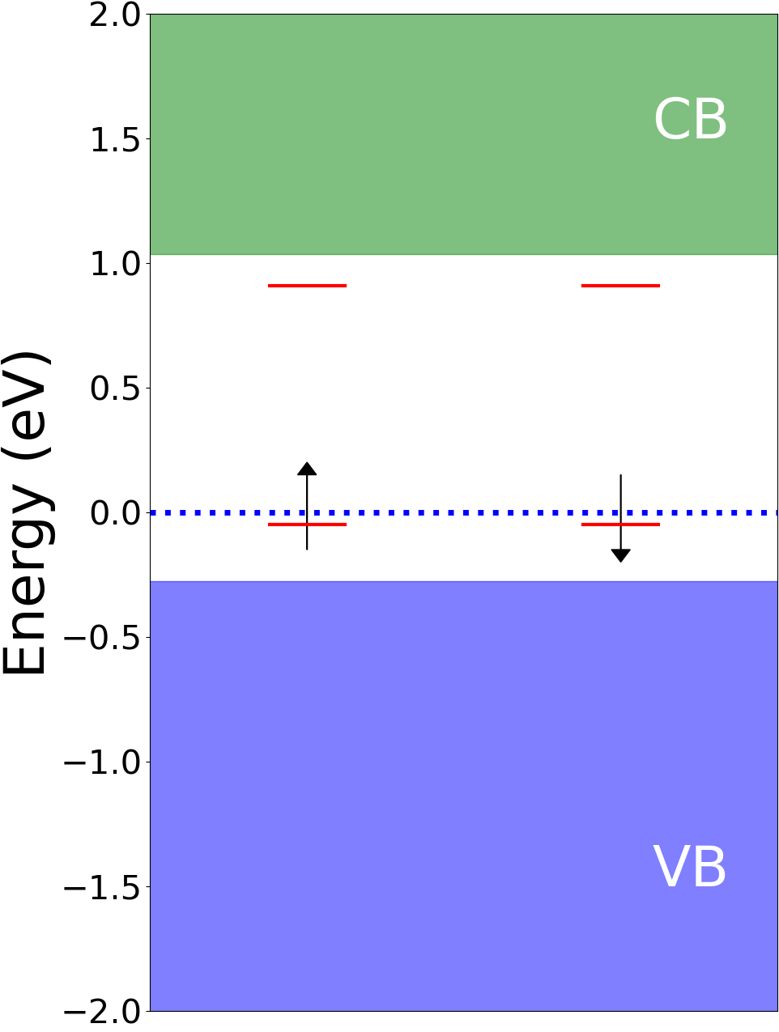
Interpreting Formation Energy Diagrams
Horizontal axis – moving Fermi level up or down
Negatively charged defects become more stable as electrons are added
Intersections are doping/Fermi levels where defect charge transition occurs
Circles → dopability limit. Negative formation energy implies instability
Mineral Detection of Dark Matter Meeting
1/13-1/17 2025

Slide 24
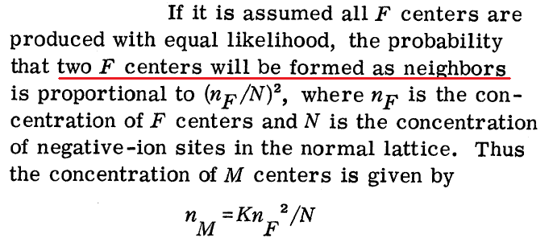
Defect Equilibrium Concentration
With formation energy known, we can now compute defect concentrations:
Degeneracy factor requires some group-theory analysis, instead → can compare relative concentrations of defects so g and N_{site} factors cancel
Mineral Detection of Dark Matter Meeting
1/13-1/17 2025

Slide 25
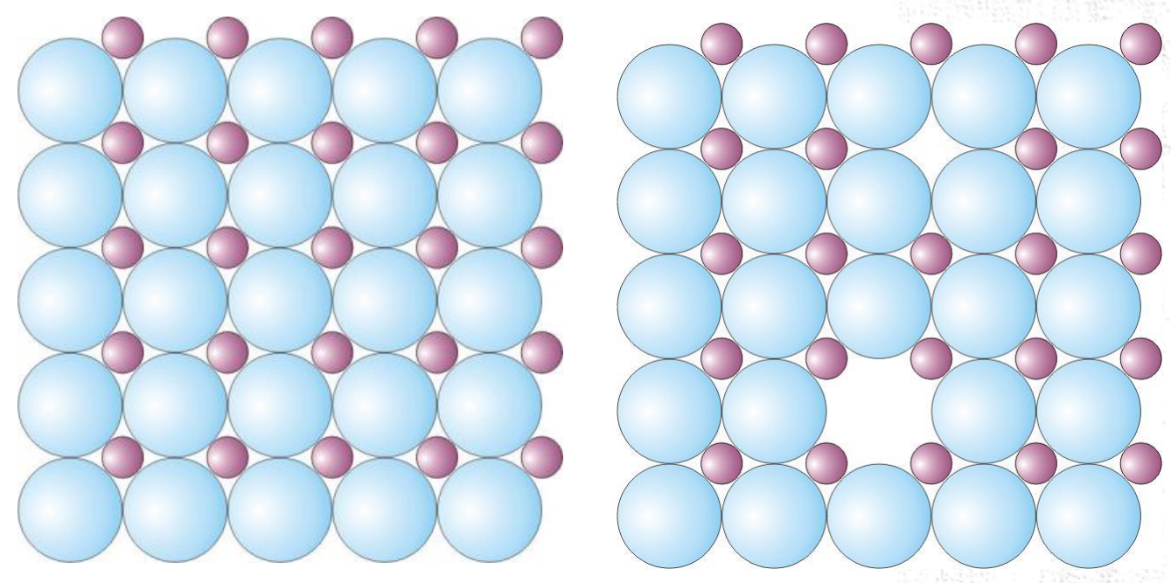
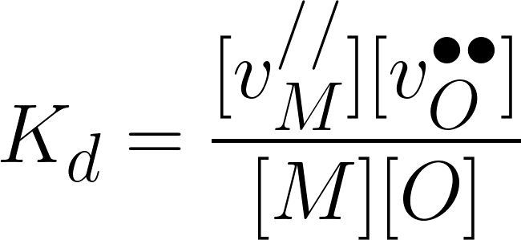
Defect Equilibrium Concentration (Schottky defect)
Things can get more complicated for composite defects. Let’s look at a simple metal oxide MO
Consider a Schottky defect (anion vacancy + cation vacancy) :
Which can be simplified:
Then the equilibrium coefficient is:
Mineral Detection of Dark Matter Meeting
1/13-1/17 2025

Slide 26
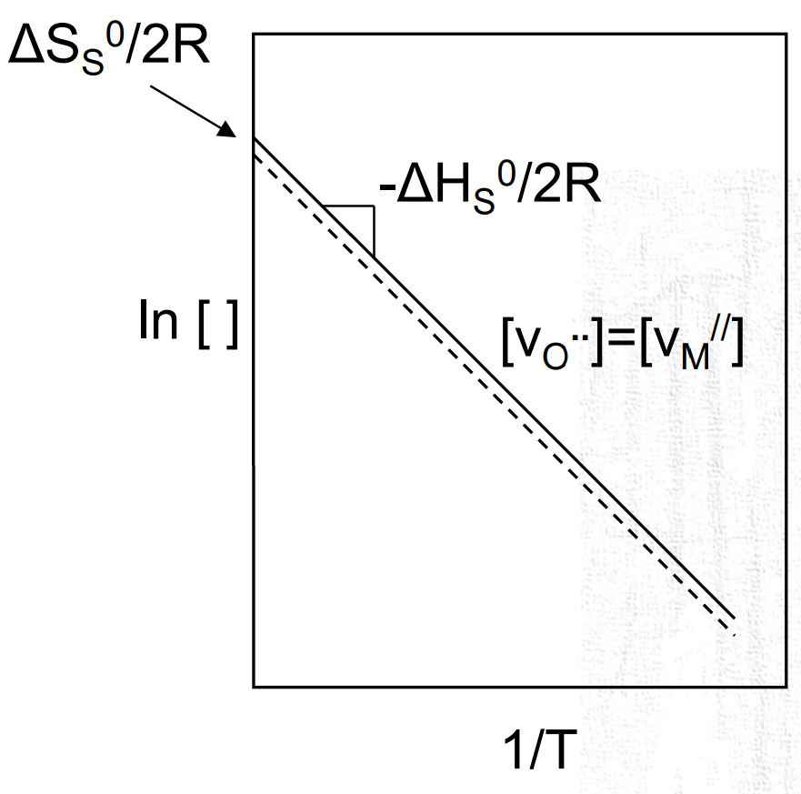
Defect Equilibrium Concentration (Schottky defect)
Writing concentrations as molar fractions of lattice atoms (mol/mol M or O), this simplifies:
Now, we also know from charge balance that
Therefore:
Mineral Detection of Dark Matter Meeting
1/13-1/17 2025

Slide 27
Outline
Preliminaries on Defects
Defect formation energy
Notation/charge conventions
Types of Defects
Computational details/tools
Estimating defect concentration from formation energy
Formation energy equation
Additional Considerations

Slide 28
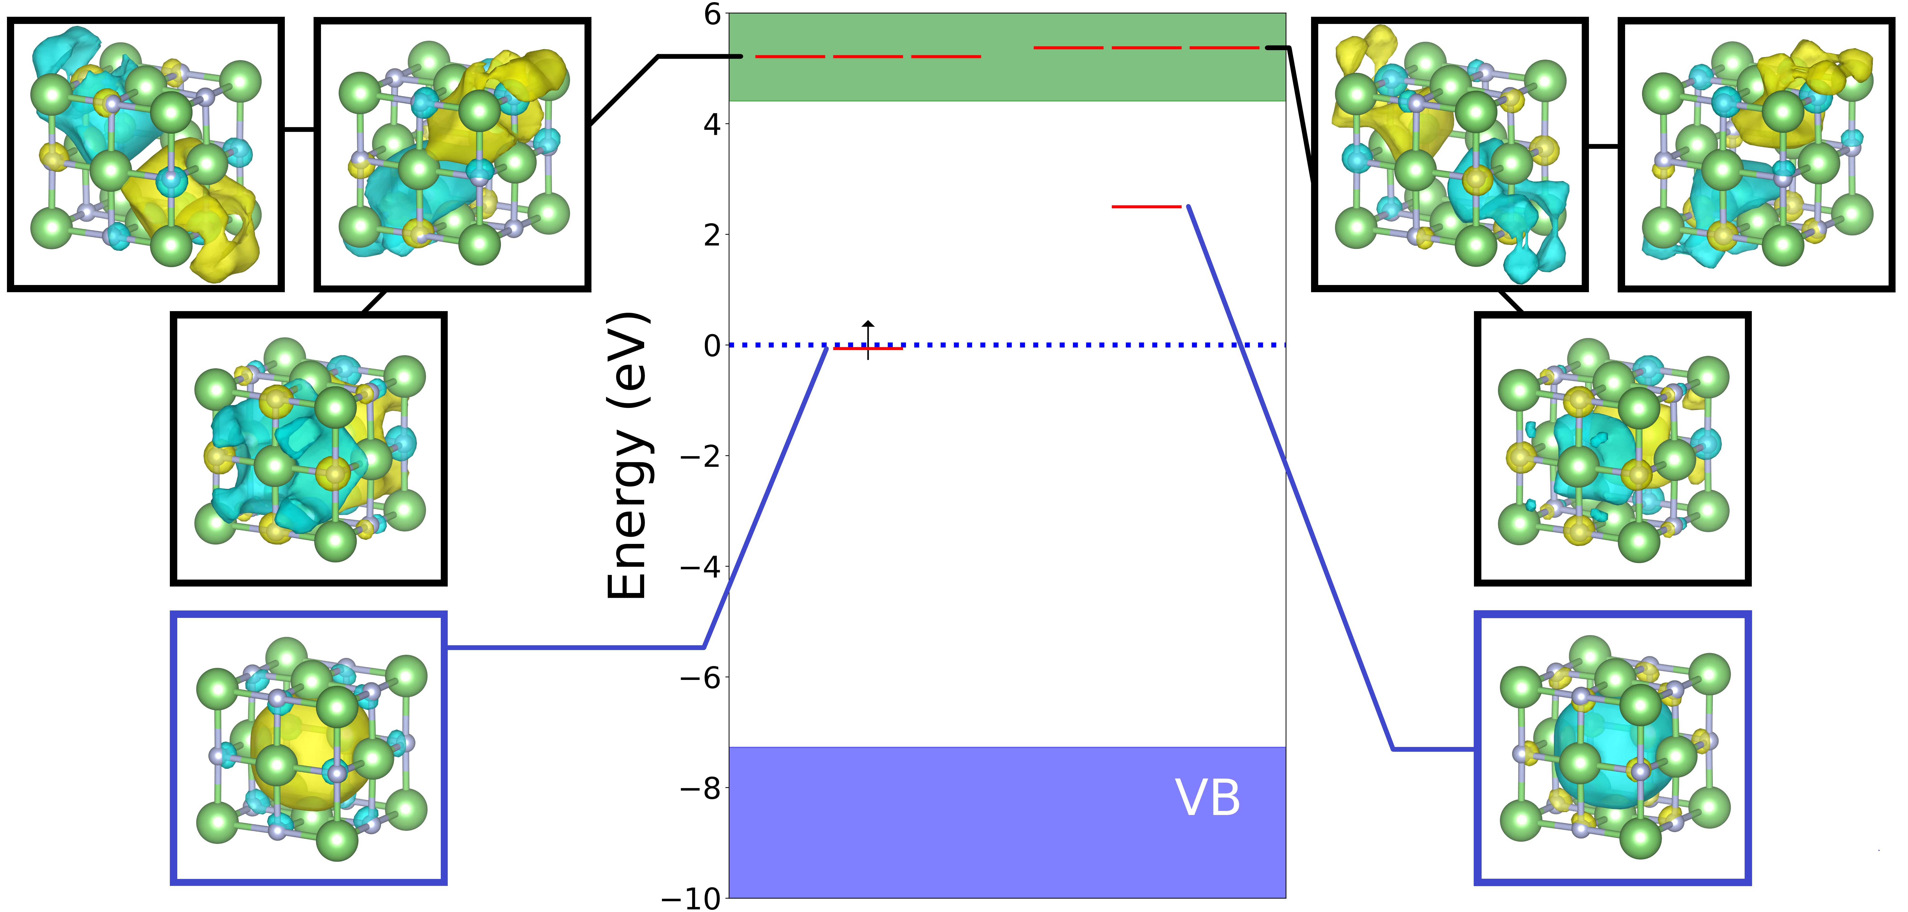
Impact of Defect Electronic Structure on Formation Energy
Local orbitals are built from combinations of delocalized plane waves
Hybridization with bulk CB/VB states shifts energy levels → error in total energy
Mineral Detection of Dark Matter Meeting
1/13-1/17 2025

Slide 29
Wavefunction Overlaps
While we have corrected for charge interactions, there is also an error due to finite wavefunction overlap
No easy correction, but can use scaling relation. For instance, charge transition energy:
1st term – Coulomb
2nd term – volume
3rd term – true value
Mineral Detection of Dark Matter Meeting
1/13-1/17 2025

Slide 30
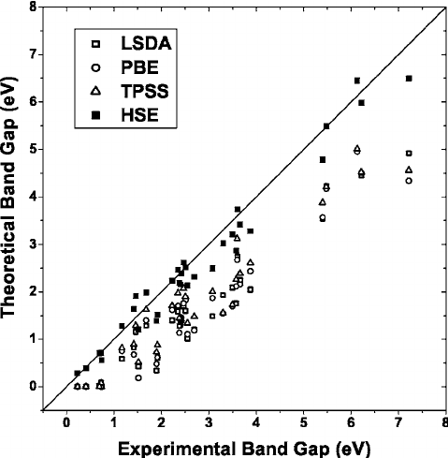
DFT Bandgap Underestimation
Density functional theory is known to severely underestimate band gaps
Since defect levels can hybridize with bulk bands, the position of the conduction/valence bands is critical
Correcting the band gap would shift the conduction/valence bands, dragging defect levels along
Mineral Detection of Dark Matter Meeting
1/13-1/17 2025

Slide 31
DFT Bandgap Underestimation
Solution – hybrid functionals.
During the self-consistency procedure, we can mix the exchange energy of DFT with that of Hartree-Fock theory. Two params:
α – fraction of HF
μ – screening (attenuation) parameter
For most non-polar materials (Si, diamond), α=0.25, μ=0.2
Mineral Detection of Dark Matter Meeting
1/13-1/17 2025

Slide 32
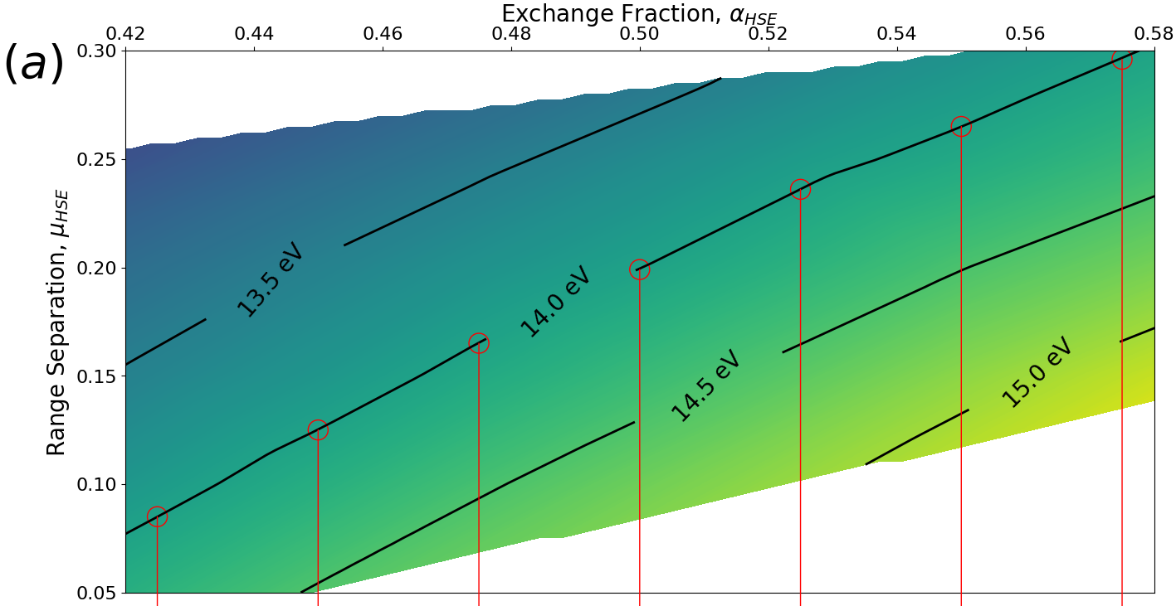
DFT Bandgap Underestimation
In general, can choose α/μ to reproduce the band gap. Many solutions!
How do we pick a self-consistent solution? Generalized Koopman’s theorem!
Vertical ionization energy should align with defect level relative to CB.
These two constraints uniquely determine α/μ. More on Thursday!
Mineral Detection of Dark Matter Meeting
1/13-1/17 2025

Slide 33
Thank You for Your Attention!
Questions?
Mineral Detection of Dark Matter Meeting
1/13-1/17 2025

