Slide 1
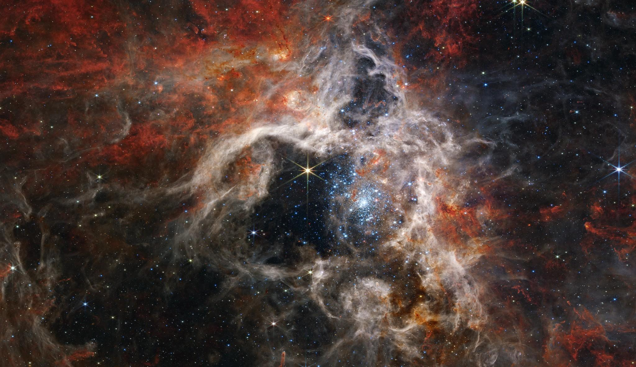
Red Supergiants to Supernovae: Exploring the Crucial Links Between Dust, Neutrinos, and Stellar Explosions
Sarah Healy
Advisor: Shunsaku Horiuchi
CNP Day 12/13/2024
Notes:
https://indico.fnal.gov/event/60639/contributions/274914/attachments/170936/230261/sn_pointing-overview.pdf

Slide 2
Outline
Supernovae
Introduction
Multimessenger Astronomy
Massive Stars
Current Issues
Preparing for the next Galactic supernova
Notes:
As Seen from the Local Group’s Red Supergiant Populations, in Prep]
[The Story of all Galactic Core-collapse Progenitors, in prep]
[https://doi.org/10.1093/mnras/stae738]

Slide 3
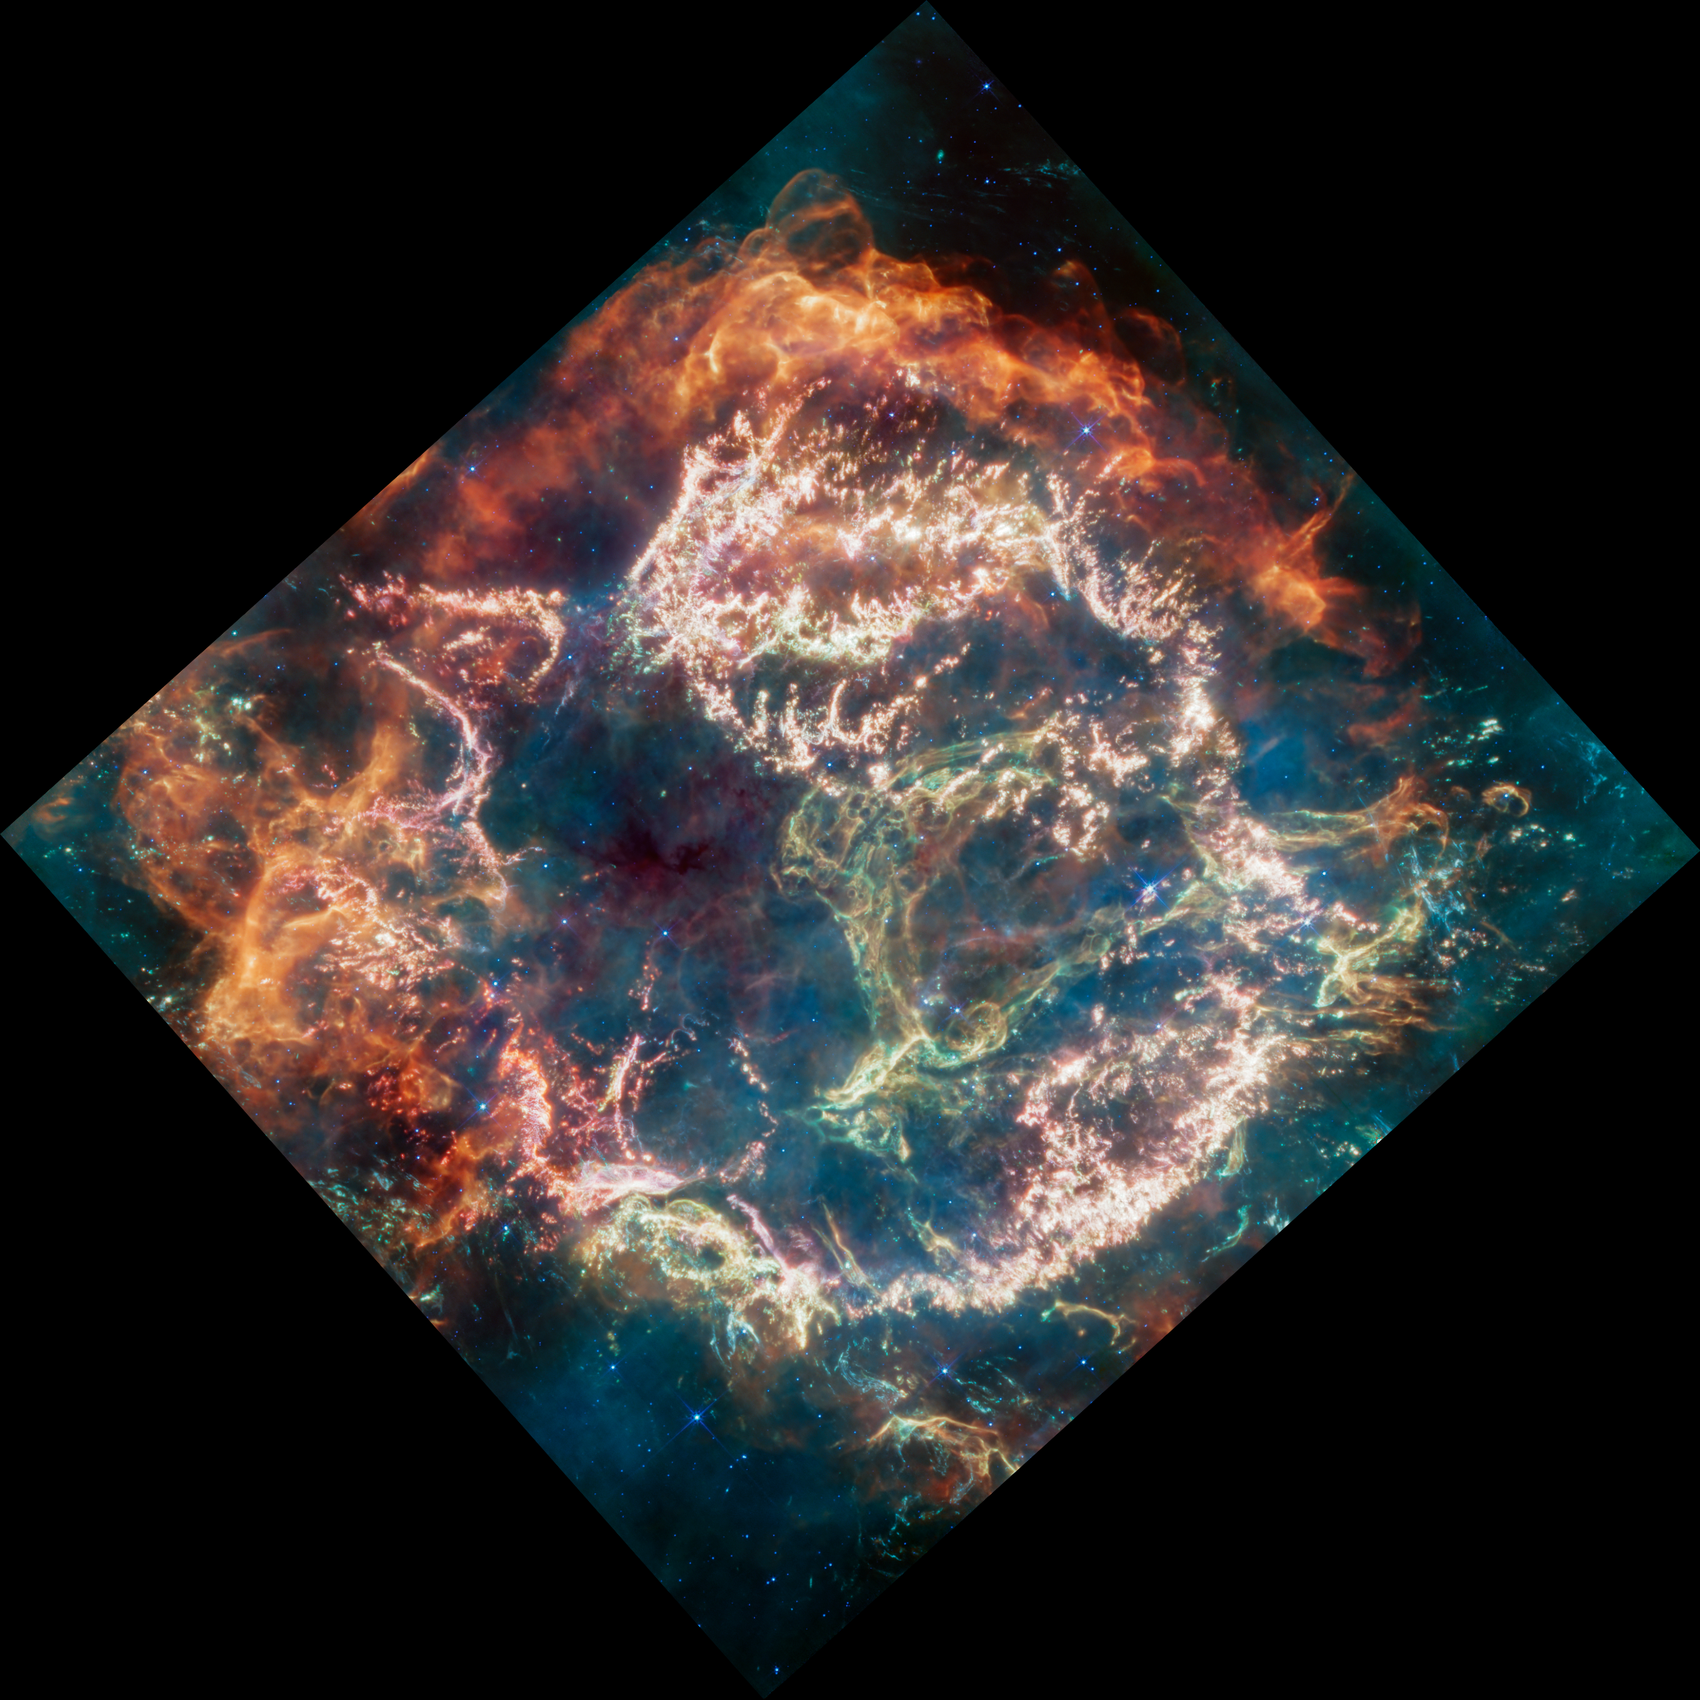
Supernovae
Two main subgroups
Thermonuclear
White dwarf star gains enough mass from a companion to trigger runaway nuclear chain reaction
Core-collapse (CCSNe) ← My focus
Explosions of massive stars neutron star or black hole
Among the most energetic phenomena
Resulting in significant dust formation and production of chemical elements
Triggers the formation of new stars
Credits: NASA, ESA, CSA, D. D. Milisavljevic (Purdue), T. Temim (Princeton), I. De Looze (Ghent University). Image Processing: J. DePasquale (STScI)
Direct information about the CCSN "engine" is from
Neutrinos [99% of the emitted energy ]
Gravitational Waves
Notes:
Direct information about the supernova "engine" is from
Neutrinos emitted by the forming neutron star
gravitational waves which are emitted when the collapse does not proceed perfectly symmetrically because of rotation, violent turbulent mass motions, and anisotropic neutrino emission.
Hence, astro-physicists have a strong interest to understand which stars do explode as supernovae, which physical processes cause the explosion, and which are the observable consequences of these cataclysmic events.
The blues represent data from the Chandra Observatory, the turquoise is from NASA's Imaging X-ray Polarimetry Explorer (called IXPE), and the gold is courtesy of the Hubble Telescope.
When a massive star collapsed in the Cassiopeia constellation, it generated a supernova explosion with some of the fastest shockwaves in the Milky Way. These speedy shock waves are one of the reasons the Cassiopeia A (Cas A) supernova remnant was chosen to be our Imaging X-ray Polarimetry Explorer’s (IXPE) first observed object.
This composite image, made of data from IXPE (X-ray) , the Chandra Observatory (x-rays), and the Hubble Telescope (ultraviolet, visible, and near-infrared regions), shows Cas A
thermonuclear supernovae—exploding white dwarf stars resulting from the stellar evolution of low-mass stars in close binary systems
The burst of neutrino from supernovae actually start a few hours to days before collapse and provide a warning system
Hours to days
Neutronization burst - hours to days
neutronization neutrino burst with a peak luminosity ∼ 4×1053 erg·s −1 , which emerges during the first ∼ 25 ms after the core bounce as a result of sudden breakout of a flood of neutrinos freshly produced in shock-heated matter (and some νe produced previously that have diffused to the neutrinosphere) when the bounce shock penetrates the neutrinosphere and reaches the neutrinotransparent regime at sufficiently low densities. This shock-breakout burst mainly comprises νe from electron captures on free protons in the shock-heated matter.

Slide 4
What needs to be done do?
Better understanding of SNe mechanisms and Progenitor behavior

Slide 5
Core-Collapse Supernovae (CCSNe) and Multi-Messenger Astronomy (MMA)
Healy et al. 2024 [https://doi.org/10.1093/mnras/stae738]

Slide 6
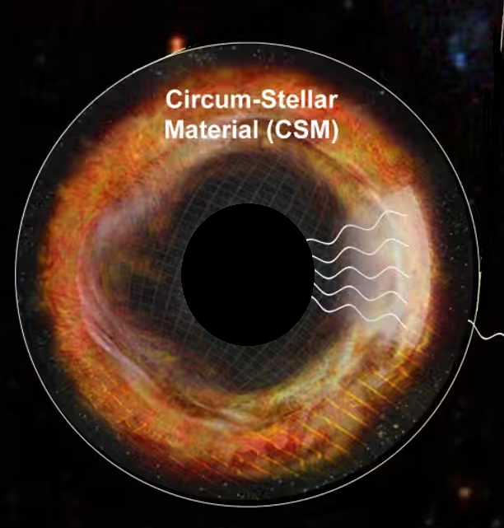
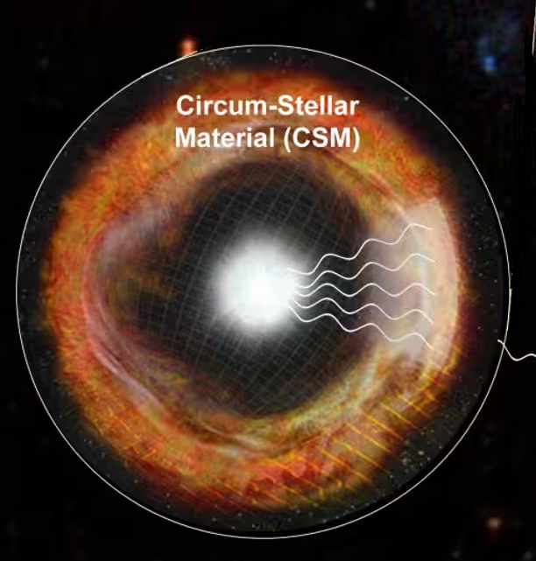
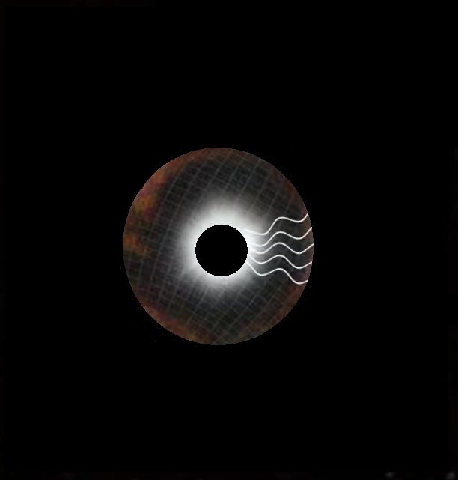
Completing the Picture
Electromagnetic
Waves
Mass loss, Dust, Wind
The absolute majority of the supernovae have so far been observed only through their EM signature
Gravitational
Waves
Rotation rates, production methods
This science has an extremely limited distance range
Neutrinos
Insights into the unobservable physical processes that initiate the blast
Notes:
A full, multi-messenger, multi-wavelength characterization of this rare event would revolutionize our understanding of stellar astrophysics, nuclear physics, and beyond by directly linking neutrino and gravitational wave signals which probe the stellar interior to the electromagnetic signals that reveal the supernova ejecta and the surrounding environment. Such a data-set will enable the most complete test yet of our knowledge regarding the mechanism that drives core collapse and our models of core-collapse supernova (CCSN) explosions.

Slide 7
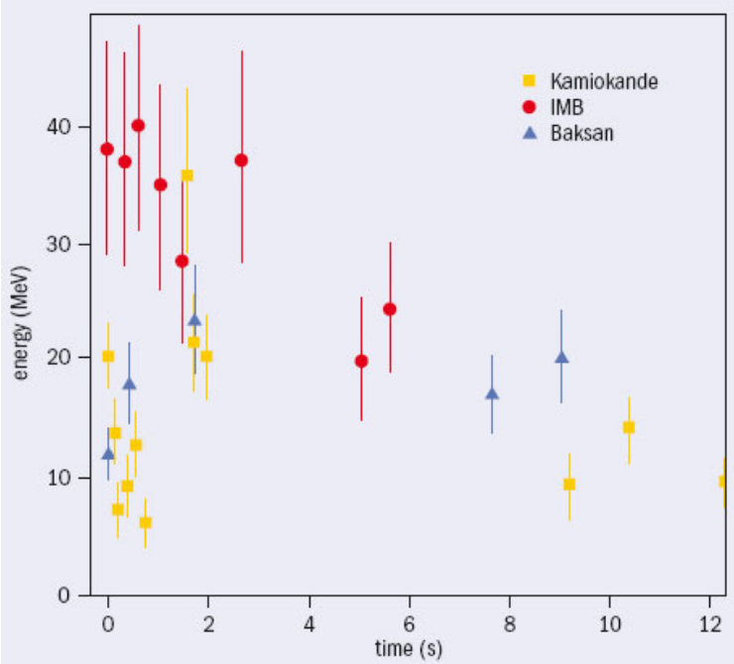
Supernova 1987A
Exploded in LMC
Blue supergiant progenitor
HST, NASA, ESA
Detections in EM waves including X-rays, 𝛾-rays, and neutrinos
CERN courier
Notes:
https://science.nasa.gov/missions/chandra/the-dawn-of-a-new-era-for-supernova-1987a/
https://iopscience.iop.org/article/10.1088/0954-3899/29/11/009/pdf
The energies and arrival times of the neutrino events from SN 1987A detected in the IMB and Kamiokande detectors.

Slide 8
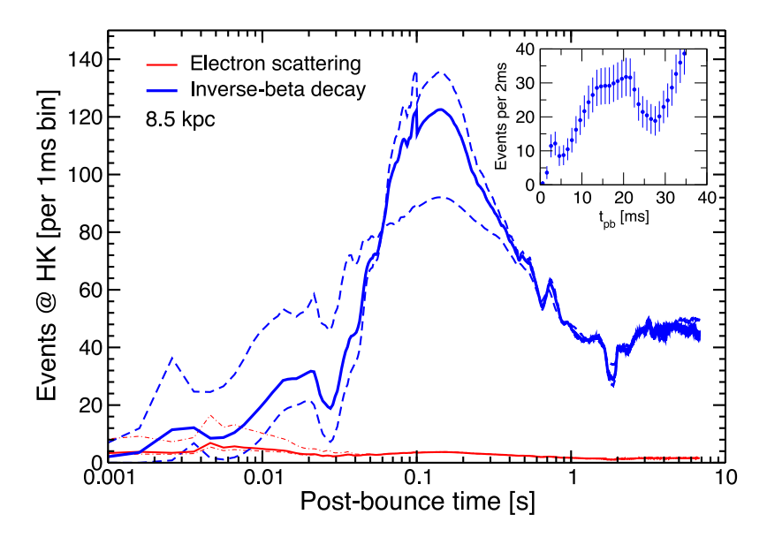
Supernova 1987A
Exploded in LMC
Blue supergiant progenitor
HST, NASA, ESA
Nakamura et al. 2016
Detections in EM waves including X-rays, 𝛾-rays, and neutrinos
CERN courier
Notes:
https://science.nasa.gov/missions/chandra/the-dawn-of-a-new-era-for-supernova-1987a/
https://iopscience.iop.org/article/10.1088/0954-3899/29/11/009/pdf
The energies and arrival times of the neutrino events from SN 1987A detected in the IMB and Kamiokande detectors.

Slide 9
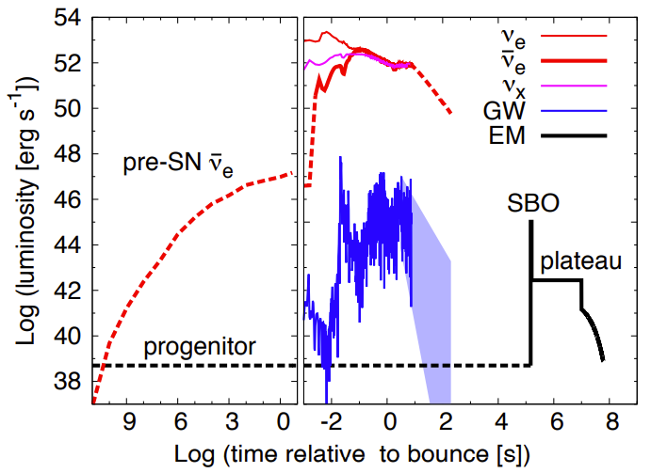
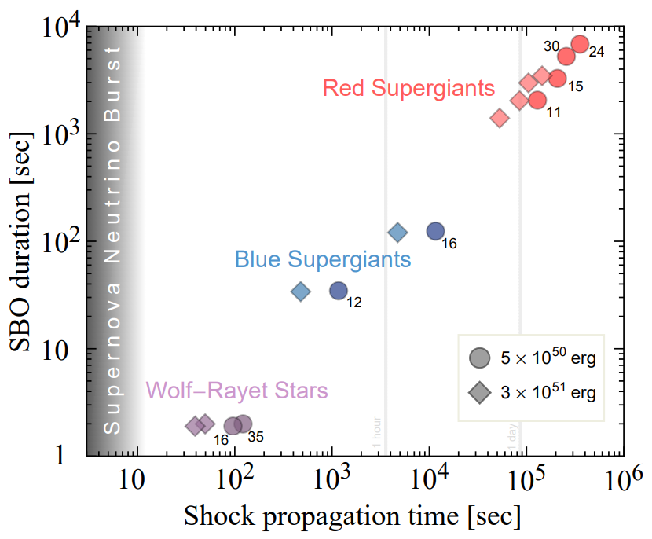
Multi-messenger Astronomy
Interpretation of joint observation of multiple messengers to optimize science
Warning is imperative to getting complete observations of progenitors and SNe
Nakamura et al. 2016
Early warning can
Help us find unexpected behaviors
Correct stellar models
Detect even in areas of the Milky Way with excess dust
First Detected SN photon [sec]
|epoch_{neutrino burst}- epoch_{1st detected photon}| [sec]
Kistler et al. 2018
Notes:
Time sequence for neutrino (red lines for νe and ¯νe and magenta line for νx; νx represents heavy lepton neutrino νµ, ντ , ¯νµ, or ν¯τ ), GW (blue line), and electromagnetic (EM, black line) signals based on our neutrino-driven core-collapse simulation of a non-rotating 17 M⊙ progenitor. The solid lines are direct or indirect results of our CCSN simulation, whereas the dashed lines are from literatures or rough speculations. The left (right) panel x-axis shows time before (after) core bounce. Emissions of pre-CCSN neutrinos as well as the core-collapse neutrino burst are shown as labeled. For the EM signal, the optical output of the progenitor, the SBO emission, the optical plateau, and the decay tail are shown as labeled. The GW luminosity is highly fluctuating during our simulation and the blue shaded area presents the region between the two straight lines fitting the high and low peaks during 3 – 5 seconds postbounce. The hight of the curves does not reflect the energy output in each messenger; total energy emitted after bounce in the form of anti-electron neutrino, photons, and GW is ∼ 6 × 1052 erg, ∼ 4 × 1049 erg, and ∼ 7 × 1046 erg, respectively. See the text for details.
Early Warning using Neutrinos
Helps find unexpected behaviors
Detect even in areas of the Milky Way with excess dust
Shock Breakout (SBO)
First detectable photon signal to arrive from a SN
Shock propagation time
Is the amount of time between the neutrino burst and the first instance of SB0

Slide 10
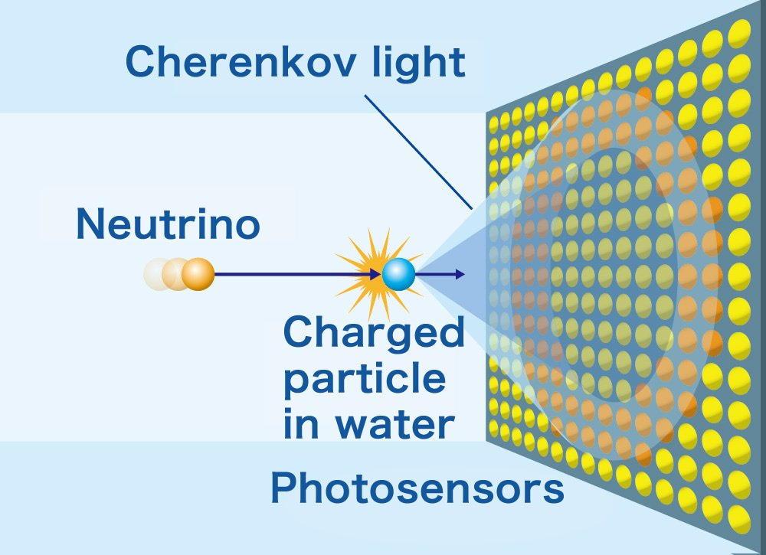
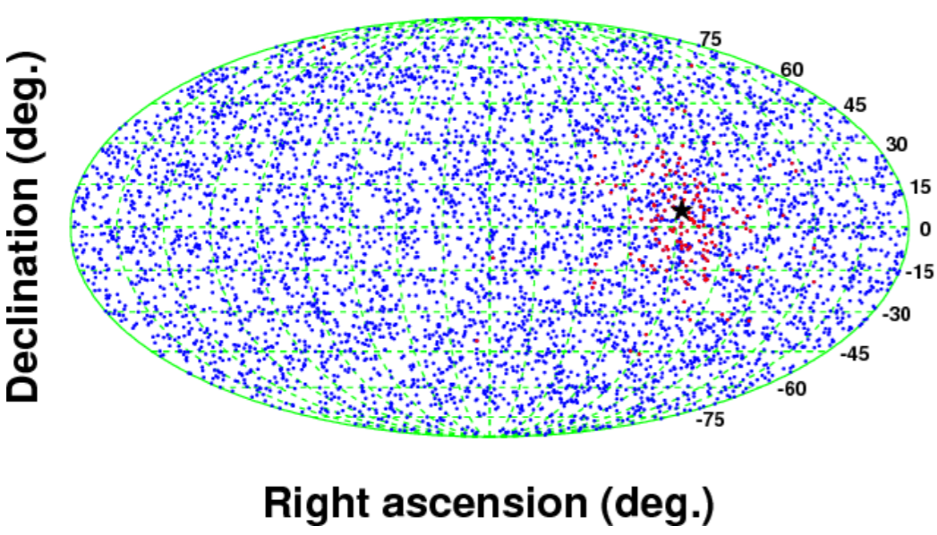
Neutrino Pointing
physicsopenlab.org
Neutrino burst signal can be used for pointing
Does require two things:
The interaction detected to have an intrinsic directionality
The detector being able to exploit that directionality
Most promising method
Neutrino-Electron elastic scattering
Abe et al. 2016
Notes:
https://arxiv.org/pdf/1601.04778
Reconstructed direction on a sky map in the equatorial system obtained by a MC simulation with the Wilson model at 10 kpc. Red points are the directions of elastic scattering events, blue points are event directions of inverse beta decay and charged currents on oxygen, and the star point is the reconstructed SN direction.
electron scatters preferentially along the neutrino direction in neutrino-electron elastic scattering.
Electron gets kicked in the direction of the neutrino
Photon can be detected
Relatively small cross section
Order of hours -
3-8 degrees uncertainty for super k at 10 kpc

Slide 11
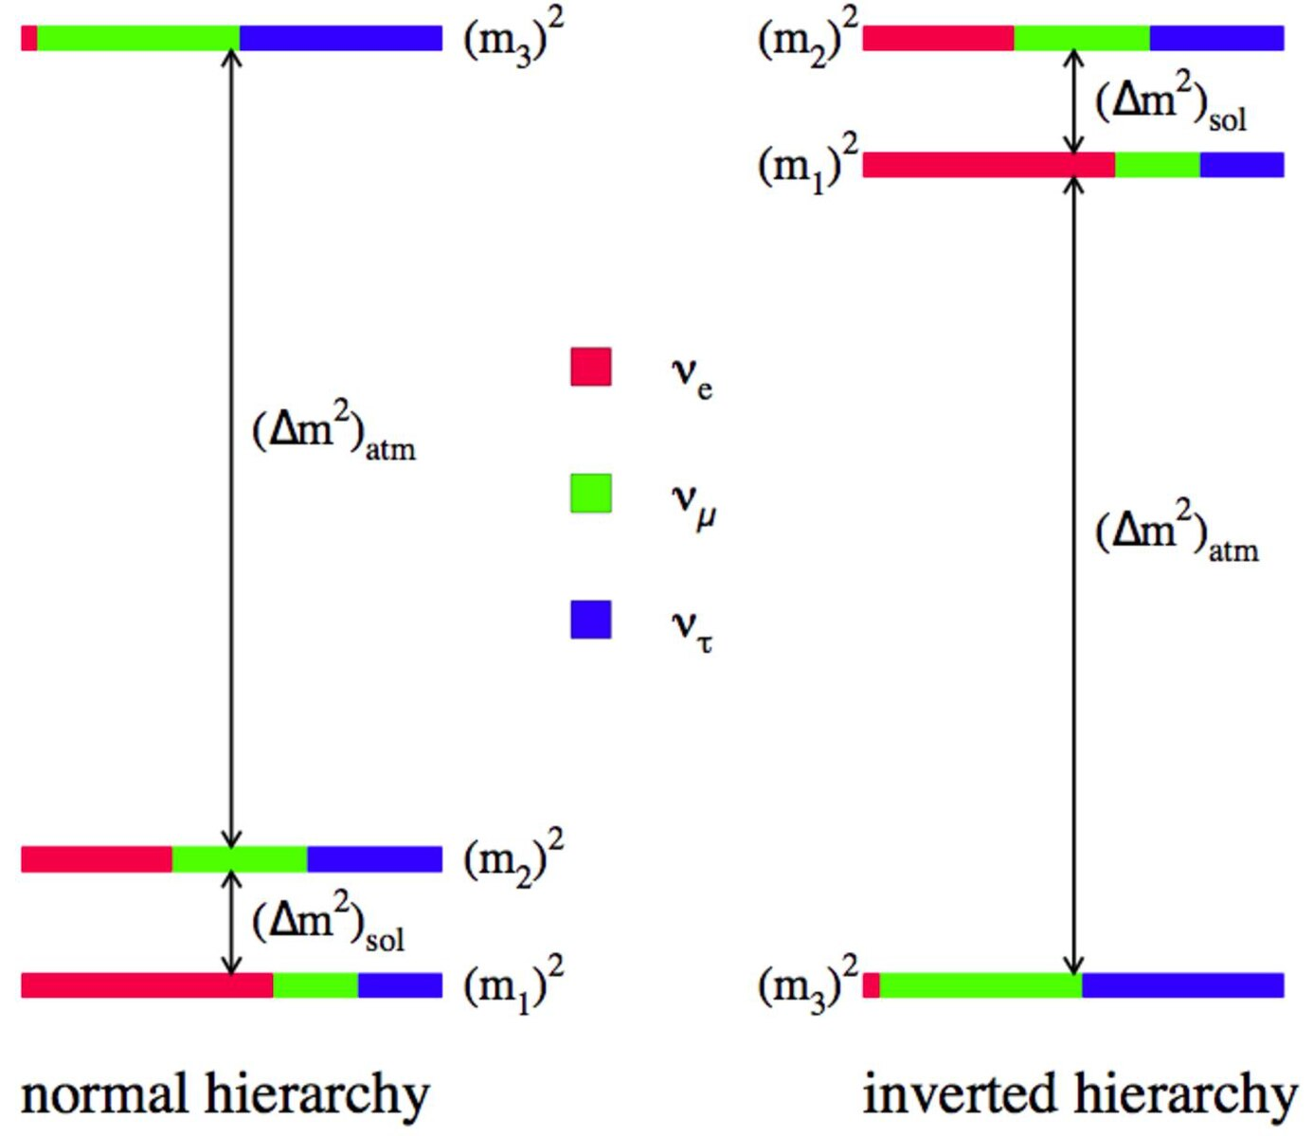
Cahn et al. 2013
Neutrino Triangulation
The supernova can be pointed to by use of multiple detectors around the earth and relative timing of signals
Calculation requires
Large statistics
High flux component of the signal
Detection requires
coordination between multiple detectors or future mega-detectors
Inverse Ordering
JUNO + DUNE + Super-K
Normal Ordering
Linzer, N. B., & Scholberg, K. 2019
Notes:
Success of the triangulation approach, therefore, depends on detectors registering samples of neutrino events large enough to achieve sufficient burst timing precision, or to have a very low background so as to precisely tell which is the first signal event
snews : Including Super k , icecube, km3net, kamland, sno+, nova, halo, xenon, LS PANDAX-
Similar to how GPS find your location on earth, Neutrino triangulation use the relative signals of neutrino through multiple detectors to match up possible location in the sky which the neutrino could have originated from.
However triangulation is likely difficult in practice, at least on a short timescale. Times of flight through the Earth are on the order of milliseconds; because the neutrino signal is spread over ∼10 s, it requires large statistics [130] or else a relatively high flux short-timescale component of the signal.
Nevertheless, the triangulation technique may be feasible for future megadetectors. At this time and in the near future, the best bet for supernova neutrino pointing is elastic scattering in a water Cherenkov detector.

Slide 12
How do the direct Progenitors Behave?
[https://doi.org/10.1093/mnras/stae738]

Slide 13
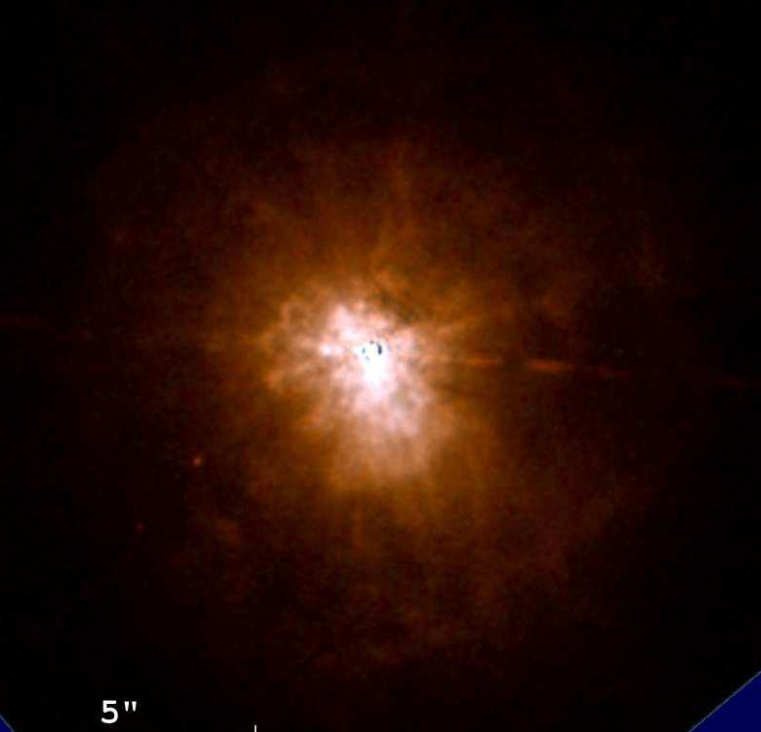
What determines how stars die?
?
Nebula
Supernova
Yellow Supergiants
Red Supergiants
Blue Supergiants

Slide 14
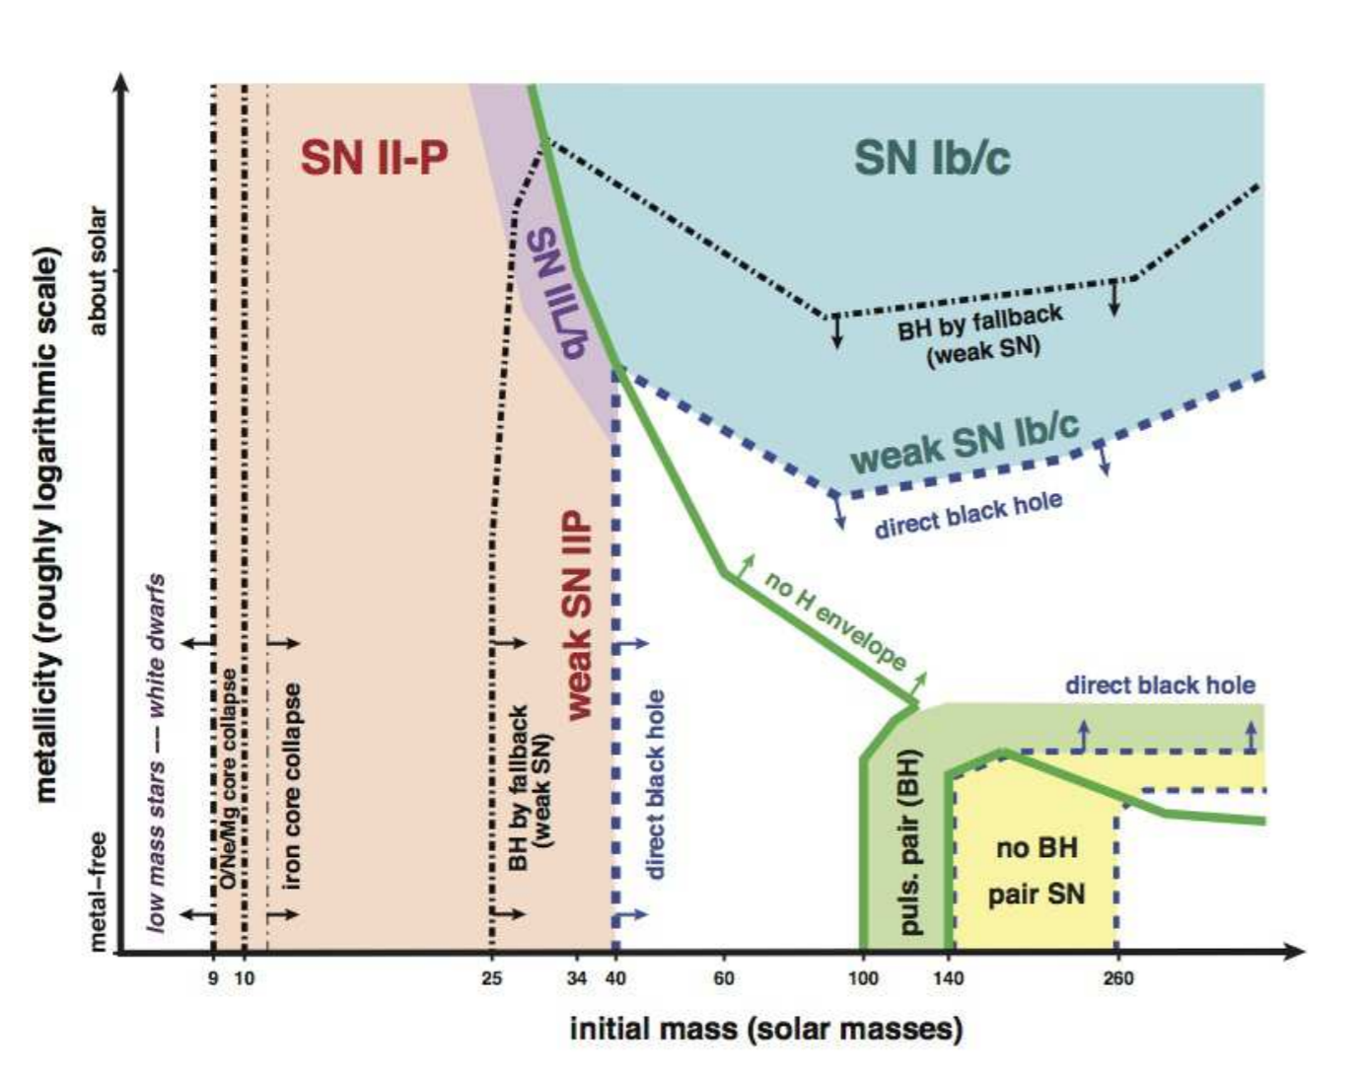
Mapping CCSNe to Progenitors
II-P
II-L
II-pec
IIb
Ib
Ic
IIn
Stellar Phase –> SN Type
Mass –> SN Type
BSG
LBV
WR
YSG
RSG
Smith 2014
*disagreement between observations and theory*

Slide 15
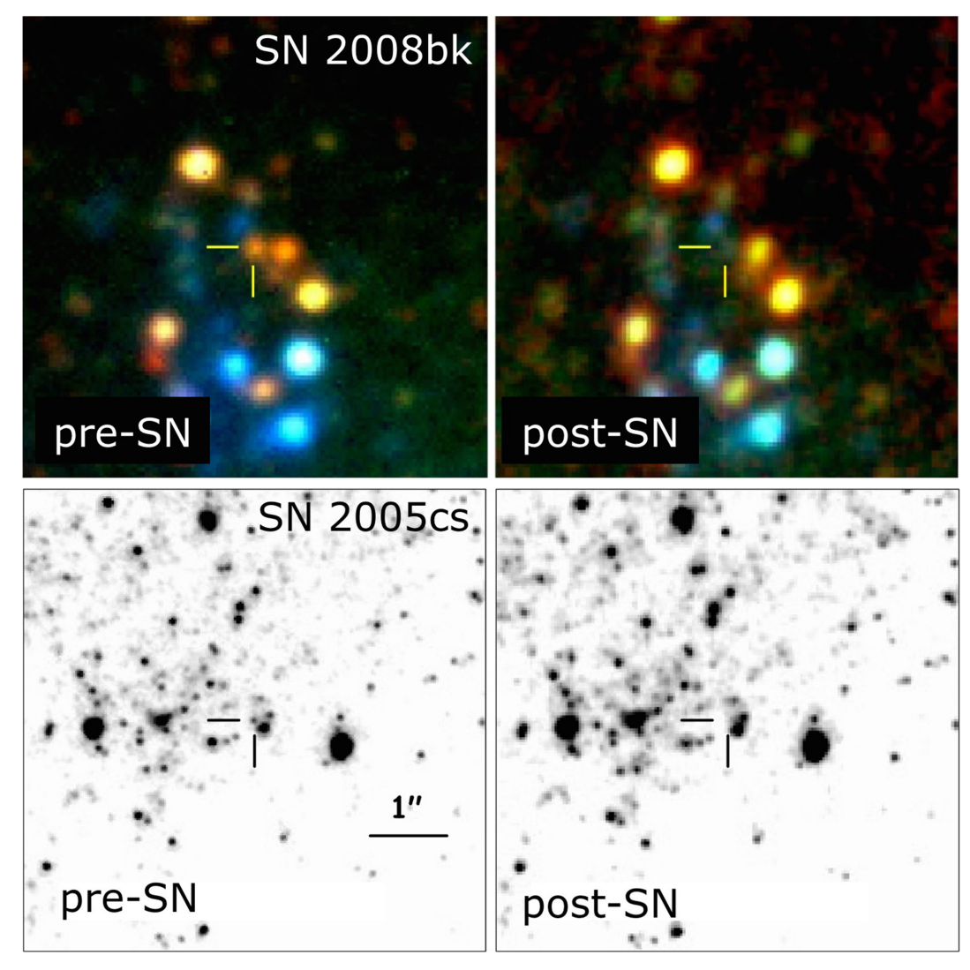
Red Supergiants
(RSGs)
Cool massive stellar phase lasting ~0.5-2 Myr
Pre-explosion imaging confirms RSG are the direct progenitors of Type-IIP/L supernova (e.g. Maund et al. 2004)
Most of a massive star’s mass loss occurs in this stage
Dictates the onward evolutionary (effects resulting SNe)
Can remove the entire envelope
Levesque, E. M., 2017
O B A F G K M

Slide 16
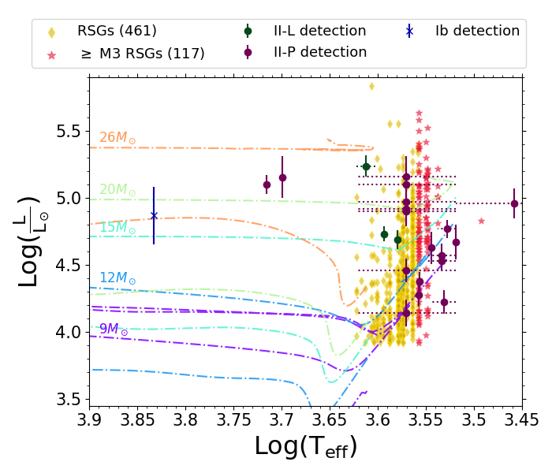
There is a Problem with IIP/L Progenitors
Why are we missing detected IIP/L progenitors brighter than ~5.3?
Smartt 2015
Healy et al. 2024
Healy et al. 2024, in prep

Slide 17
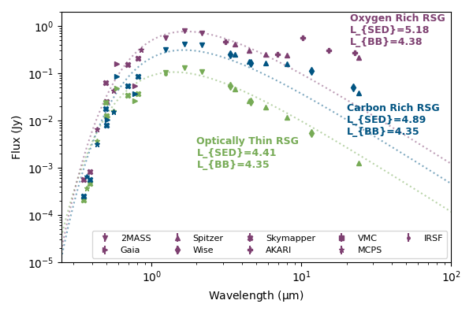
Deriving Luminosity
Observed Stellar Energy Distribution (SEDs) or complete Spectrum best way to get star’s ‘True’ luminosity
Complete RSG populations with well sampled SEDs or spectrum are currently not available
Instead use Single Band Methods
Various RSG SEDs
Optical
Near-Infrared
F814W | I
NIR | K_{S}
Healy et al. 2024 JWST Proposal #9205

Slide 18
Detected Progenitors
Bolometric Corrections to Optical (F814W) bands
Healy et al. 2024
Adapted from Beasor et al. 2024
Difference in L_{F814W} - L_{SED} varies with spectral type
M0
Uncertainties larger than previously adopted
M5+
Uncertainty in Progenitor Luminosity for the 22/30 is underestimated
Adapted from Beasor et al. 2024

Slide 19
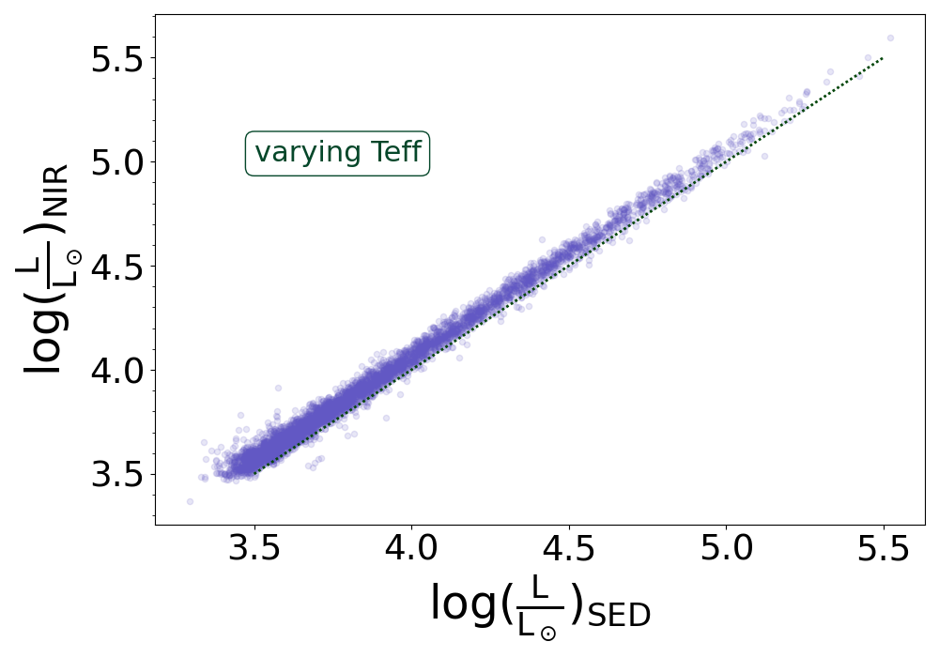
Observed Red Supergiants
Bolometric Corrections to Near-Infrared (K_{S}) bands
Luminosity of the RSGs are overestimated ~0.05 dex
BC_{NIR} varies with T_{eff}/Spectral types
Healy et al. 2024, in prep
Healy et al. 2024, in prep
Beasor et al. 2024

Slide 20
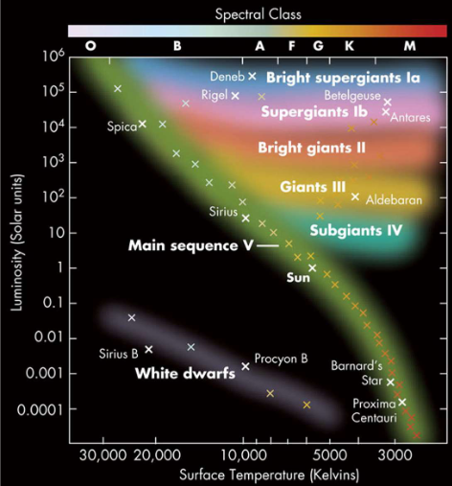
Method 1: Collection of Literature
Use stars with pre-classified spectral types
Assemble list of K and M stars with luminosity class I
Used 46 different catalogues
Largest contribution ~2100 stars
Smallest contributor 2 stars
Adopt a mean spectral type for each object
http://www.atlasoftheuniverse.com/hr.html
boyce-astro.org

Slide 21
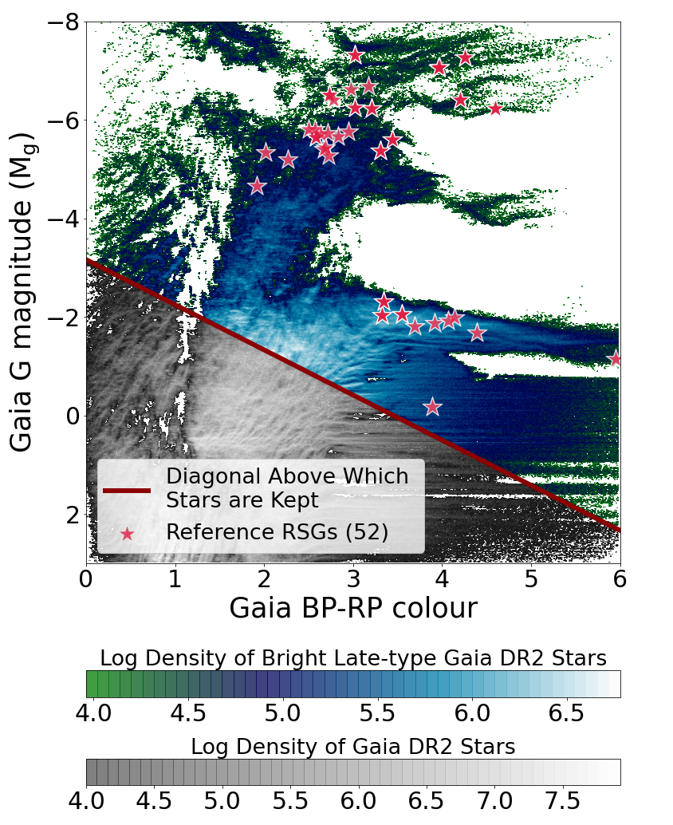
Method 2: Gaia CMD
Determine a general location for supergiant branch in G mag vs BP_RP
Restrict the sample to that region
Match remaining Gaia objects to Henry Draper spectral catalog
Why Henry Draper?
One of the largest spectral catalogues available with ~300,000 objects.
Large portion has been converted to Morgan-Keenan (MK) spectral type classification
Healy et al. 2024

Slide 22
Determining Stellar Characteristics
Compilation Method
Intrinsic Magnitudes
Distance
(Gaia
DR3/DR2)
Photometry
(2MASS JHK_{s})
Dust Extinction
Bolometric Luminosity
Gaia
DR2/DR3
Method
Stellar Radii
MWDust
(3D Dust Map)
Bright Late-Type
Extinction Ratios
Notes:
(T_{eff}) effective temperature derived from Spectral Types
(D) Distance determined by Gaia
(m) Apparent magnitude comes from 2MASS and 3D Galactic dust maps
(BC_{ks}) Bolometric Correction to absolute magnitude is found with an equation tailored to use of Ks magnitude and RSGs
All in effort to get to Luminosity (L) which gives us estimation of Mass and combined with Teff shows us where on the HR diagram they are

Slide 23
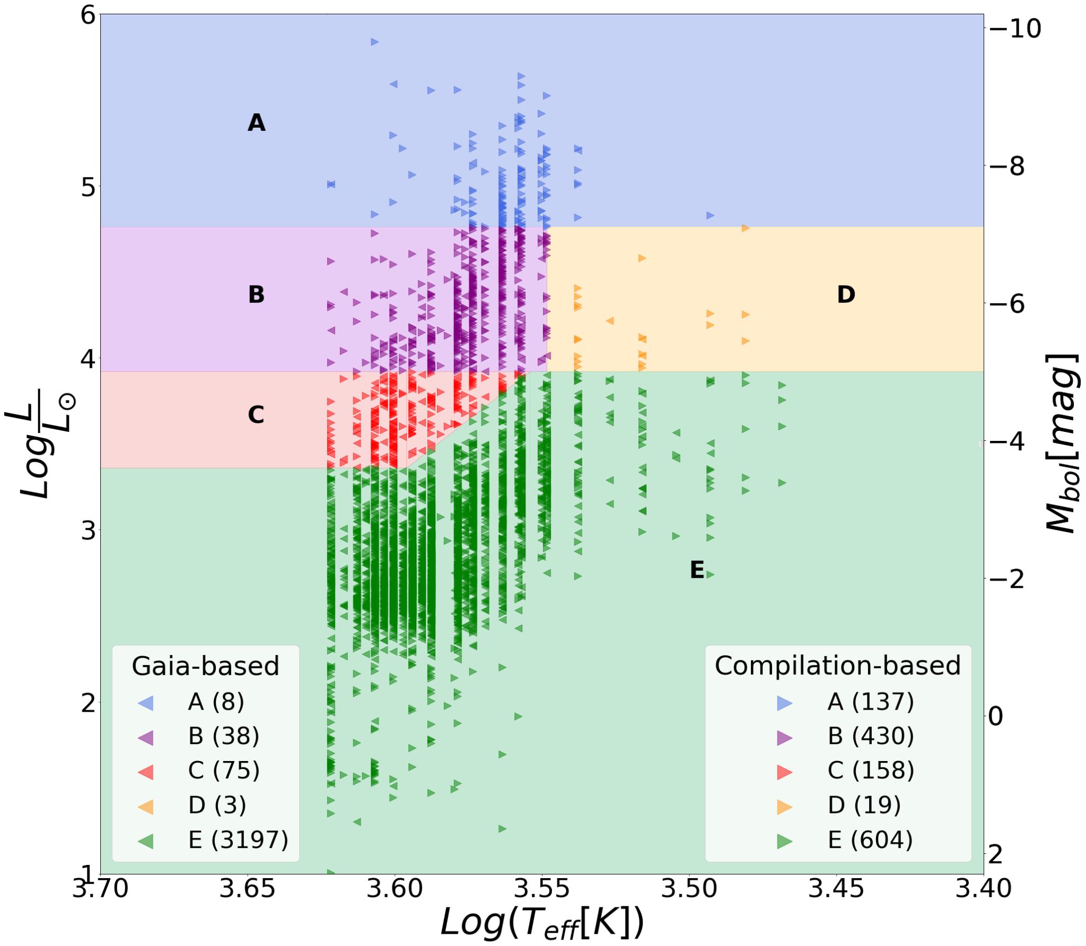
578 Milky Way Red Supergiants
Healy et al. 2024
Notes:
Area RED is believed to contain only RSGs at Mbol ≲ −7.1 mag.
Area ORAGNE contains both RSGs and extreme (O-rich and C-rich) AGBs. This area is restricted to Mbol between −5 and −7.1 mag and whose spectral type is earlier than M4.
Area PURPLE which should be largely AGBs, of masses greater than the 4 M⊙, defined by Mbol between −5 and −7.1 mag and later than M4.
Area BLUE contains more AGBs, of intermediate-mass as well late M and K type stars with solar masses around 9M⊙. The region is restricted by Mbol between -3.6 and
-5.0 and is bluer than our Eq. 1.
Area GREEN limited to Mbol between -3.6 and -5 mag and redder than our Eq 1, gives a region that should be dominated by low mass AGBs.
Area GRAY which is anything with Mbol > −3.6 mag contains mostly faint and M type stars

Slide 24
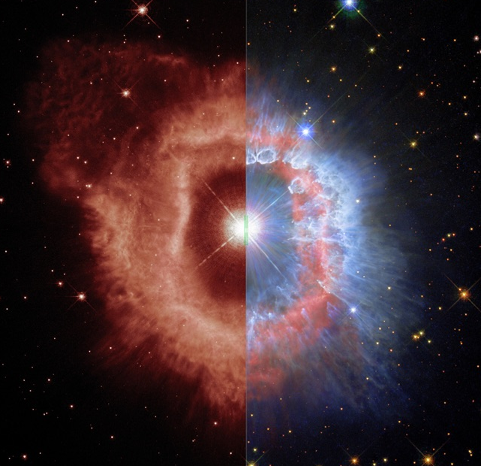
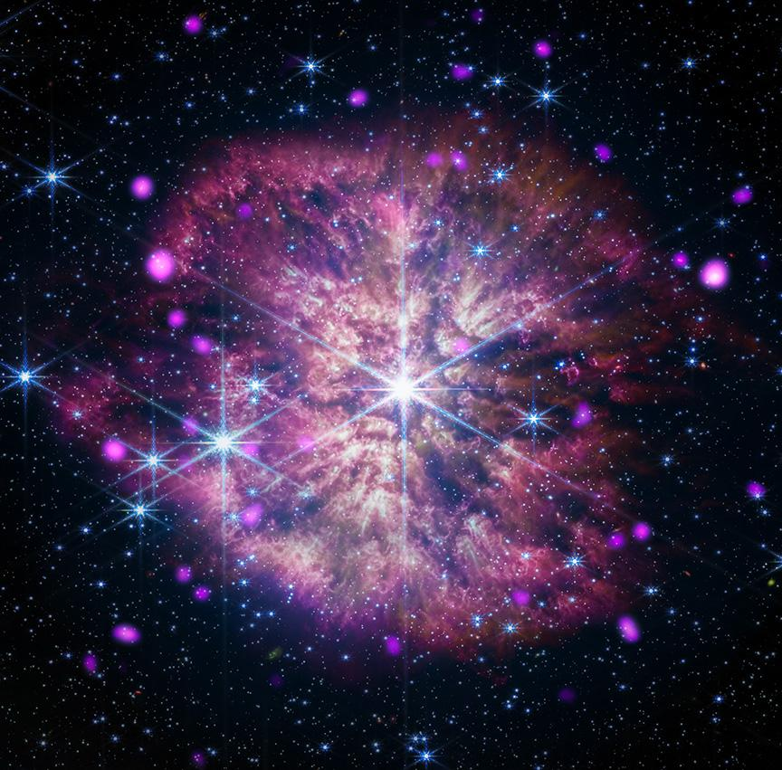
Other Galactic CCSNe progenitors
LBV Catalog: 72 LBVs and cLBVs
Issues
Variable nature means a range of temperature and luminosity more accurately depicts the behavior
Wolf Rayet Catalog: 703 WRs
Issues
Distance Uncertain
Bolometric Corrections not well defined
Lum ✔ | T_{eff} ✔ | Spectral Class ✔
Lum ~✔ | T_{eff} ~✔
Blue SG Catalog: 826 BSGs
Yellow SG Catalog: 43 YSGs
Issues
Finding as YSGs as they spend such a short amount of time in this stellar evolution phase
Lum ✖ | T_{eff} ✖ | Spectral Class ✔
Lum ✖ | T_{eff} ✖
Notes:
LBV and WR in isolation https://doi.org/10.1093/mnras/stu2430
LBVs and WRs have issues of current research showing they are found in relative isolation *particularly a problem for surveys when looking within our galaxy*
Based on their relatively isolated environments, we argue that luminous blue variables (LBVs) must be primarily the product of binary evolution, challenging the traditional single-star view wherein LBVs mark a brief transition between massive O-type stars and Wolf–Rayet (WR) stars. If the latter were true, then LBVs should be concentrated in young massive clusters like early O-type stars. This is decidedly not the case. Examining locations of LBVs in our Galaxy and the Magellanic Clouds reveals that, with only a few exceptions, LBVs systematically avoid clusters of O-type stars. In the Large Magellanic Cloud, LBVs are statistically much more isolated than O-type stars, and (perhaps most surprisingly) even more isolated than WR stars. This makes it impossible for LBVs to be single ‘massive stars in transition’ to WR stars. Instead, we propose that massive stars and supernova (SN) subtypes are dominated by bifurcated evolutionary paths in interacting binaries, wherein most WR stars and Type Ibc supernovae (SNe Ibc) correspond to the mass donors, while LBVs (and their lower mass analogues like B[e] supergiants, which are even more isolated) are the mass gainers.

Slide 25
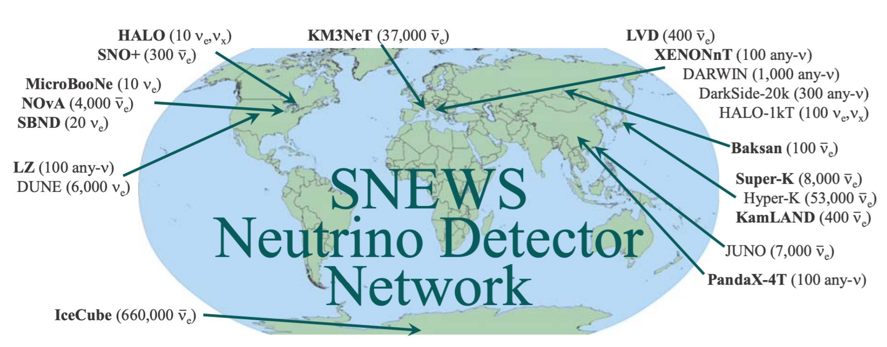
Implementation of Sample
Supernova Early Warning System 2.0
Utilizes pre-supernova neutrinos to provide early alerts to the astronomy and gravitational wave communities
Allows observers to turn towards the event and notify other detectors to retain their recent data.
American Association of Variable Star Observers (AAVSO)
Monitoring candidates long before collapse
Notes:
Multimessenger astronomy is based on coordinating
multiple means of observation and interpretation of the
resulting messenger signals, including electromagnetic
radiation, gravitational waves, neutrino, and cosmic
rays, to optimize the science attained. If a coordinated
effort is successful it means that both detection and non-
detection of various sources can lead to useful informa-
tion. The use of multimessenger astronomy provides the
opportunity for the scientific community to witness vio-
lent events in our universe as completely as our current
technology allows.
Simple 10-sec coincidence → email alert + socket connection +GCN Running in automated mode since 2005 (no nearby CCSNe...) - SNEWS 1.0
SNEWS 2.0 • improved latency • neutrino-based pointing, including triangulation • "fire drills" • presupernova
One of the first established multi-messenger networks
SuperNova Early Warning System network’s (SNEWS,
Antonioli et al. 2004) successor, SNEWS 2.0, utilizes
presupernova neutrinos to provide early alerts to the as-
tronomy and gravitational wave communities as well the
scientific community at large. By simply tracking co-
incidences between neutrino experiments, SNEWS can
provide an early warning which allows observers to turn
towards the event while also notifying other detectors
with significant backgrounds to retain their recent data.
Successful observations of impending CCSN will allow
for numerous tests of stellar and neutrino physics and if
very early would allow for observations of an envelope-
free stellar progenitor
SNEWs’ system utilizes citizen astronomers to pur-
posefully look at the most likely candidates for CCNSe
long before they collapse and allows for details on the de-
velopment as they move through the RSG branch. This
list is used to increase the accuracy and scope of those
observed. Even as the first neutrino signals are received
and positional location is determined, our list means
that even for the worst-case scenario in terms of location
resolution we can exclude a large number of candidates
and focus on those most likely to be the progenitor

Slide 26
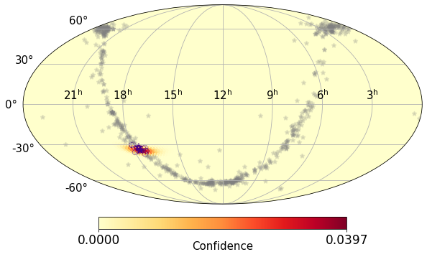
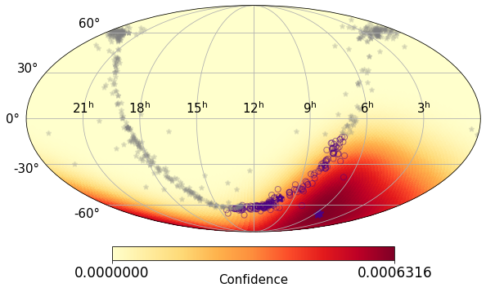
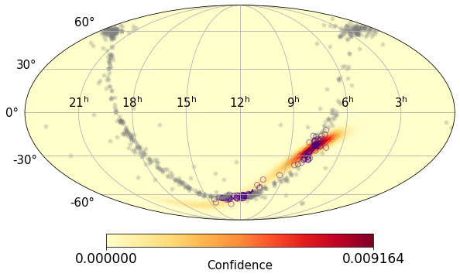
SNEWS Network + Galactic Red Supergiant Sample
13 Stars
105 Stars
2 within distance
2 within distance
Together, we implemented neutrino point, neutrino burst distance estimates, and my MW RSGs sample to prepare for the next Galactic SNe
186 Stars
Combination significantly reduces the number of possible targets
3 within distance
Healy et al. 2024
Notes:
Two main methods for determine angular pointing information with neutrino data
Using anisotropic interaction and 2. traingulation
SNEWS and our these figures utilize triangulation
SNO+, SK, IceCube, and JUNO

Slide 27
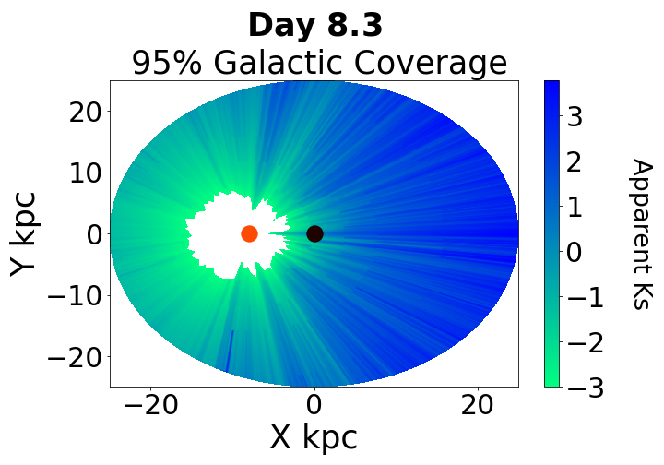
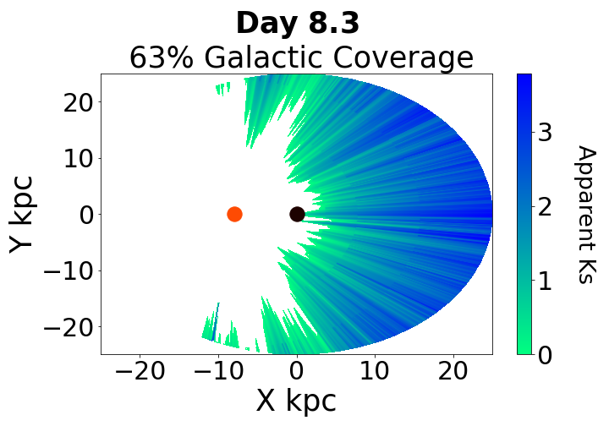
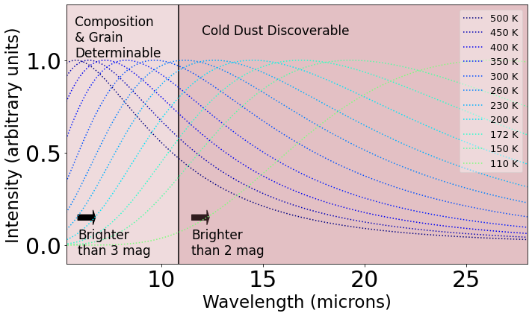
JWST Proposal: Ready, Set, .... : Preparing for the Next Galactic Supernova
Obtain up to 4 observations of the next Galactic SN to characterize the immediate environment of the SN
MIRI-MRS spectra to determine a baseline for pre-existing molecules (e.g. SiO) as well as pre-existing hot dust in the system.
To directly link the information about the core of the progenitor (obtained for the neutrinos) with the presence of pre-existing molecules and dust as well as freshly formed molecules and dust (obtained from JWST)
Notes:
will have profound consequences on not only our understanding of how stars explode but also the nature of early universe cosmic dust
Figure 2. Bolometric corrections (BCs) for each of the stars in each cluster. The panels show the BCs in V, R, I and K bands (top-left, top-right, bottom-left and bottom-right, respectively). The grey dashed lines show the BCs adopted by S09 and S15 in each band. The dotted line with ‘+’ symbols shows the BCs measured by Elias et al. (1985), which only go as far as M4.

Slide 28
Summary:
Multimessenger Astronomy provides early warning system and the way to determine the internal mechanism of CCSNe
The most common direct progenitors are known but full mapping is needed
Determining pre-explosion parameters still have unresolved issues

Slide 29
Which RSGs are the direct progenitors?
How does Age affect Luminosity
Healy et al. 2024, in prep
Healy et al. 2024, in prep
Notes:
Teff scales to a degree incomplete
Be careful about teff derived from SEDs vs NIR as can be 150K coolor

Slide 30
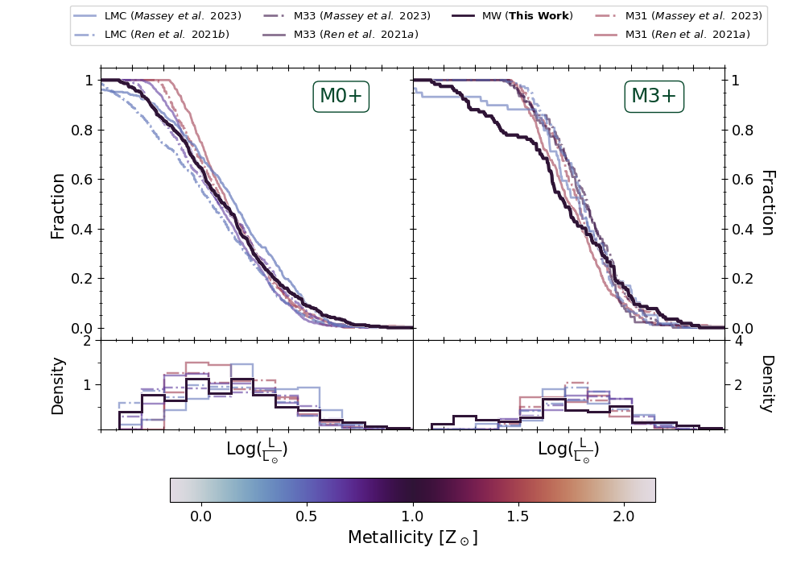
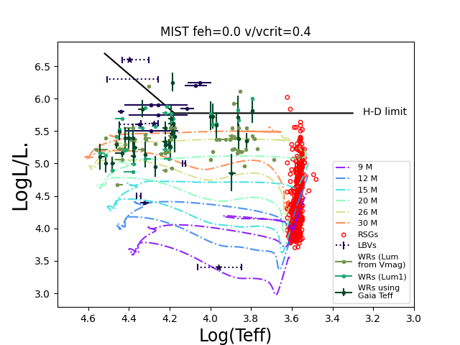
Humphreys-Davidson Limit and Metallicity
Implies that above a certain luminosity, massive stars do not evolve to the cool supergiant phase but remain compact, evolving towards a blue supergiant (BSG) or Wolf–Rayet (WR) star.
Metallicity: Z☉ abundance of elements (Oxygen) present in an object that are heavier than hydrogen
Lmax of red supergiants (RSGs) is an important tracer for luminous stellar populations of galaxies
Healy et al. 2024, in prep

Slide 31
Healy et al. 2024, in prep
Progenitor CLD accounting for Measurement Errors
Progenitor CLD accounting for Measurement Errors & Telescope Sensitivity
Galactic RSGs CLD includes AGB contaminants
More dusty RSGs and contaminants Z weighted CLD
~6-8 M☉
Less contaminants and dusty RSGs Z weighted CLD
Resolved the Low mass progenitor Issue
No evidence of disagreement in CLDs or missing CCSNe progenitors

Slide 32
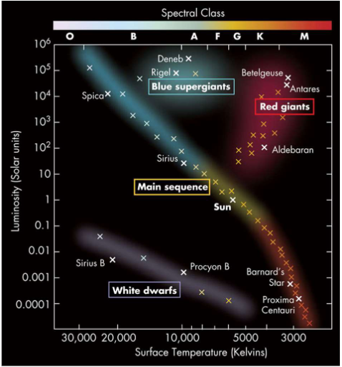
How are Stars Characterized
Luminosity & Effective (Surface) Temperatures
Mass, Age, Radius, etc.
Hertzsprung-Russell (HR) Diagram
boyce-astro.org
Notes:
https://boyce-astro.org/hr-diagram-overview/
https://boyce-astro.org/stellar-death-high-mass-stars/

Slide 33
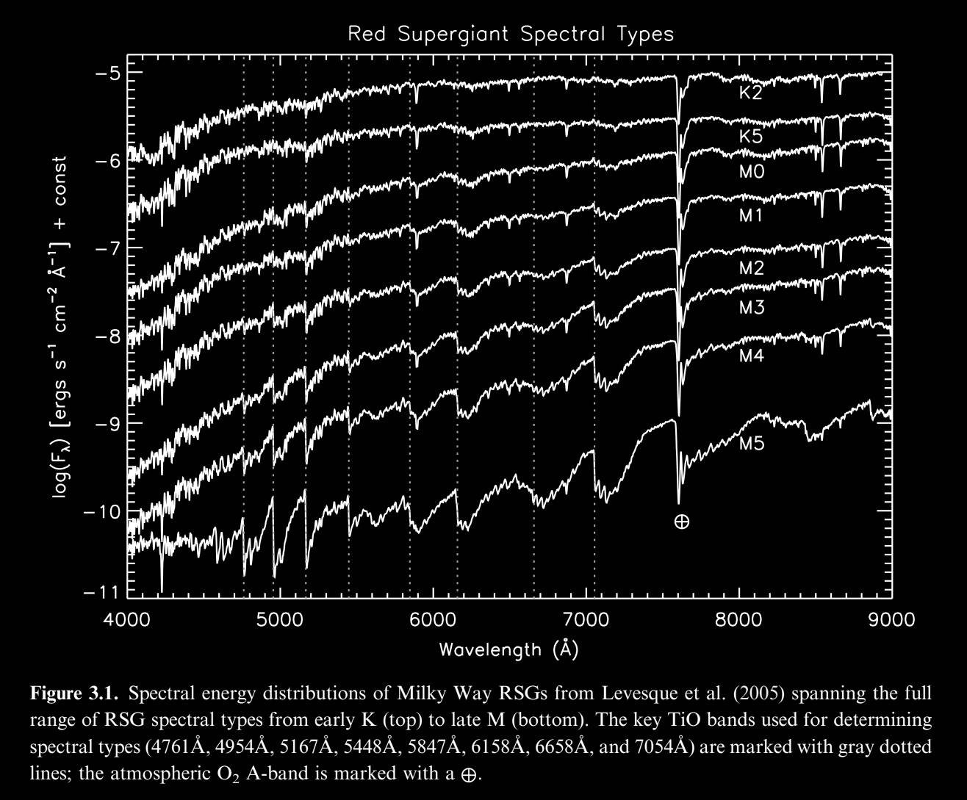
How are Massive Stars Characterized
Spectral Lines:
Interactions between light and matter
Used to classify stellar objects
Issues:
Not all spectral types are well defined
Massive stars are variable
Expensive
boyce-astro.org
Levesque, E. M., 2017
Notes:
https://boyce-astro.org/hr-diagram-overview/
https://boyce-astro.org/stellar-death-high-mass-stars/

Slide 34
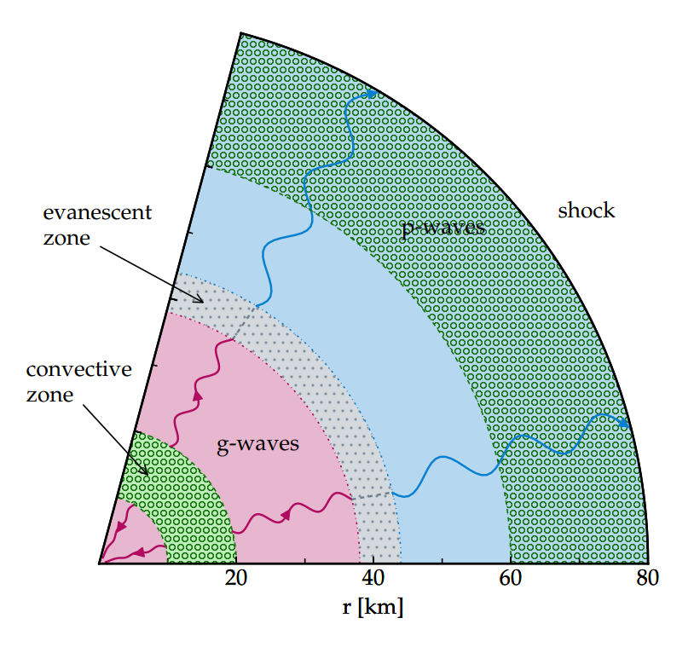
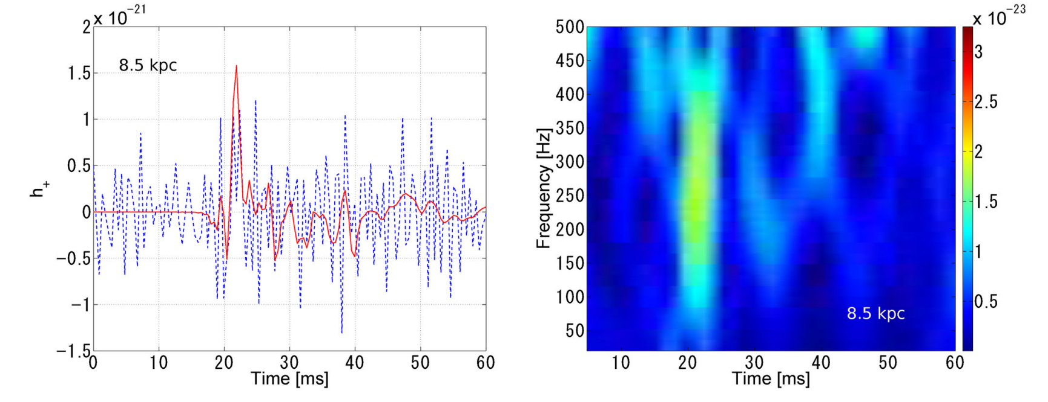
Gravitational Waves
Only a few times 10⁴⁶ erg released as GW
S. E. Gossan et al. 2019
Frequency range of GWs
Mechanism of production
Epoch of first emitted GWs
Estimates of progenitor’s rotation rates
Nakamura et al. 2016
Notes:
Wave heating from proto-neutron star convection and the core-collapse supernova explosion mechanism
https://arxiv.org/pdf/1910.07599.pdf
GWs production
Convection
Neutrino-driven convection
Asymmetric flows inside/outside the PNS
Instabilities
Gravity waves are excited by turbulent convection (green hatched regions) in the PNS and propagate outward (pink regions). At evanescent zones (grey region), the waves either reflect back towards the PNS, or they tunnel through the evanescent region to generate outgoing acoustic waves. These waves propagate outwards until they are damped or they encounter the shock, beyond which they cannot propagate. Both wave pressure on the shock and dissipation of wave energy in the gain region may aid shock revival

Slide 35
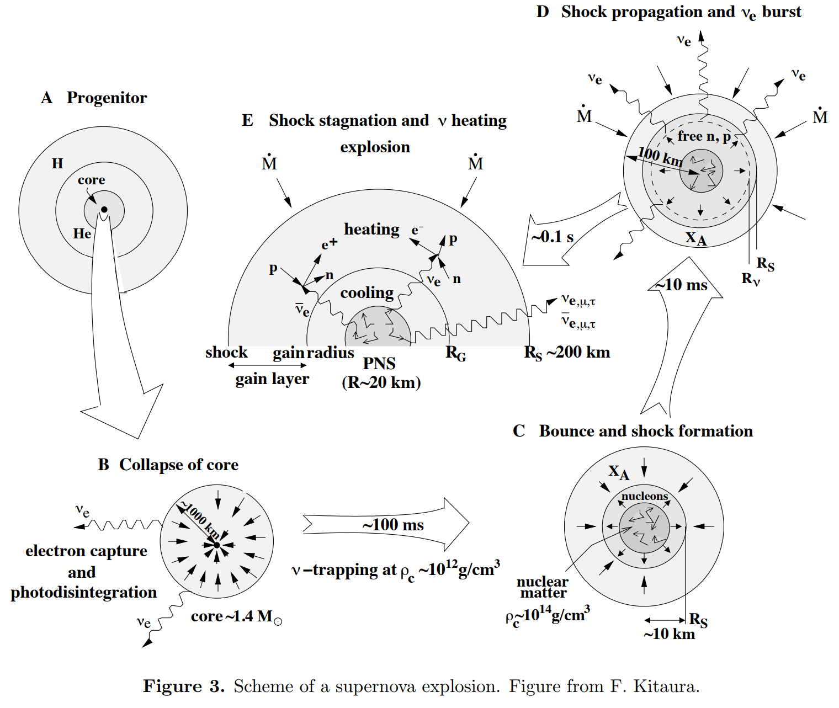
Neutrinos
Properties of nuclear burning stages in a 15 M⊙ star
Stage | Time Scale | Fuel or Product | Ash or Product | Temperature (10^9K) | Density (gm/cm^3) | Luminosity (solar units) | Neutrino Losses (solar units)
Hydrogen | 11 My | H | He | 0.035 | 5.8 | 28,000 | 1800
Helium | 2.0 My | He | C,O | 0.18 | 1390 | 44,000 | 1900
Carbon | 2000 y | C | Ne,Mg | 0.81 | 2.8 x 10⁵ | 72,000 | 3.7 x 10⁵
Neon | 0.7 y | Ne | O,Mg | 1.6 | 1.2 x 10⁷ | 75,000 | 1.4 x 10⁸
Oxygen | 2.6 y | o,Mg | Si,S,Ar,Ca | 1.9 | 8.8 x 10⁶ | 75,000 | 9.1 x 10⁸
Silicon | 18 d | Si,S,Ar,Ca | Fe,Ni,Cr,Ti,… | 3.3 | 4.8 x 10⁷ | 75,000 | 1.3 x 10¹¹
Iron core collapse | ~1 s | Fe,Ni,Cr,Ti… | Neutron Star | > 7.1 | >7.3 x 10⁹ | 75,000 | >3.6x 10¹⁵
Woosley and Janka 2005
Synthesized in the hot, innermost regions
Insights into the unobservable physical processes that initiate the blast
Notes:
Woosley, S., Janka, T. The physics of core-collapse supernovae. Nature Phys 1, 147–154 (2005). https://doi.org/10.1038/nphys172
https://www.mpi-hd.mpg.de/manitop/Neutrino/sheets/Lecture7_SS21.pdf
What do we know
neutrino and gravitational wave signals which probe the stellar interior
How do we know this
Hard stuff
Neutrios and their importance here
Properties of nuclear burning stages in a 15 M⊙ star

Slide 36
EM Waves
Reveal information about the SN ejecta and the environment
IR
Nature and spatial distribution of the dust grains
Radio and X-ray
Mass-loss rates of the progenitor
Spectra
Line width - wind velocity of the progenitor
Line strength - relative abundances of the elements in the wind
Adapted from Ofer Yaron
Notes:
GET VISUAL OF THE SN TO SHOW HOW PHOTONS ONLY COME OUT OF THE DUST SURROUNDING AS IT DECAYS AND INTERACTS
Observing dust formation in the next Galactic SN offers us a unique chance to examine the formation and evolution of SNe as dust producer
Electromagnetic signals reveal the supernova ejecta and the surrounding environment
density of the circumstellar matter is proportional to the mass-loss rate, inversely proportional to the wind velocity, and inversely proportional to the square of the distance from the star
The interaction between the supernova photons and the circumstellar matter is called a radiative interaction. These interactions can have observable consequences in various parts of the electromagnetic spectrum.
Observing dust formation in the next Galactic SN offers us a unique chance to examine the formation and evolution of SNe as dust producer
IR observations provide information on the nature and spatial distribution of the dust grains.
observation of the radio and X-ray emission combined with modeling of the interaction provides valuable information on the mass-loss rate of the progenitor star
The widths of the circumstellar lines provide information on the wind velocity of the progenitor, and analysis of the line strengths provides information on the relative abundances of the elements in the wind. The ionization state of the circumstellar matter also provides information on the amount of ionizing radiation that was emitted by the explosion, something that is not observable directly.

Slide 37
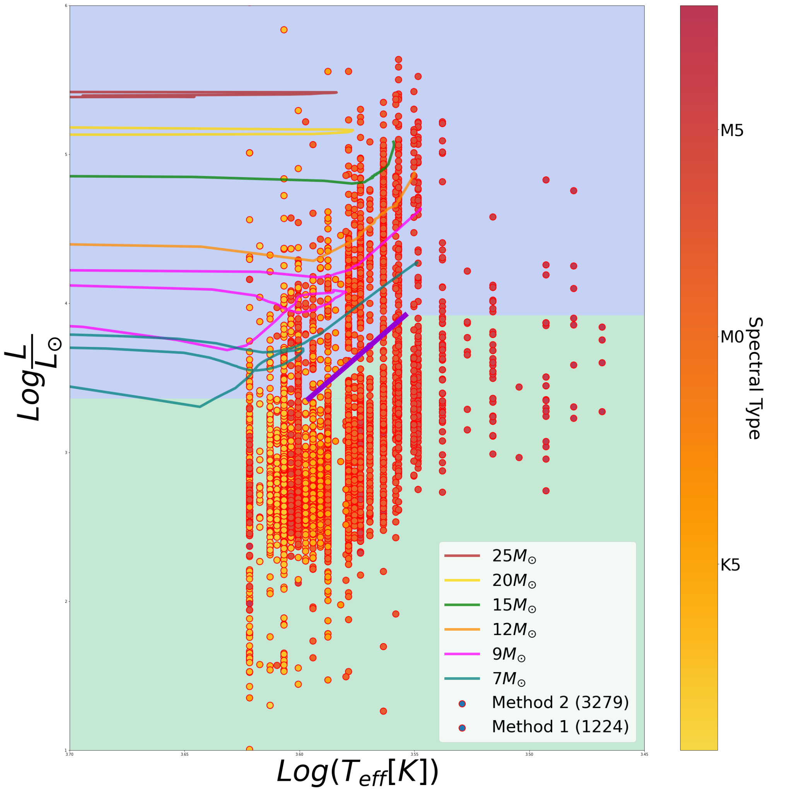
Luminosity vs Temperature : Stellar Evolutionary Tracks
Predicted evolution across the HR diagram for stars
Tracks for single star evolution
Range between 7-25 M☉
7-9 M☉ are not well defined
Healy et al. 2024

Slide 38
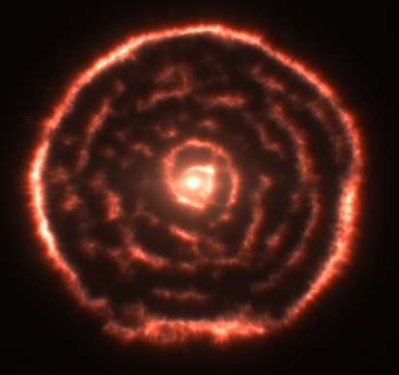
AGBs: Asymptotic Giant Branch Stars
Low to intermediate-mass star
In final stage of its life
Burning nuclear fuel
Does not result in a CCSNe
Super-AGB stars may explode as an electron capture supernova, but most will end as oxygen–neon white dwarfs
O B A F G K M
Notes:
Observations using the Atacama Large Millimeter/submillimeter Array (ALMA) have revealed an unexpected spiral structure in the material around the old star R Sculptoris. This feature has never been seen before and is probably caused by a hidden companion star orbiting the star. This slice through the new ALMA data reveals the shell around the star, which shows up as the outer circular ring, as well as a very clear spiral structure in the inner material.
Credit:
ALMA (ESO/NAOJ/NRAO)/M. Maercker et al.

Slide 39
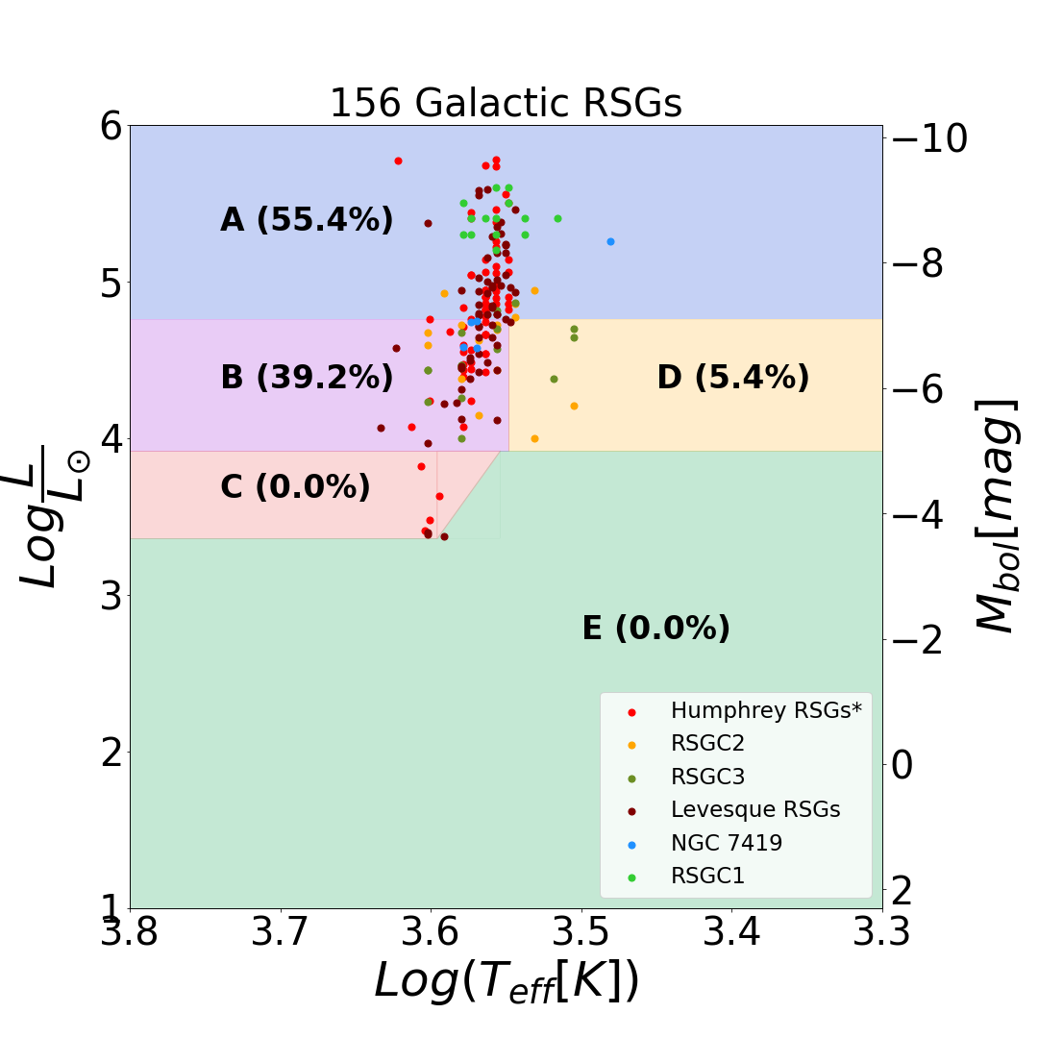
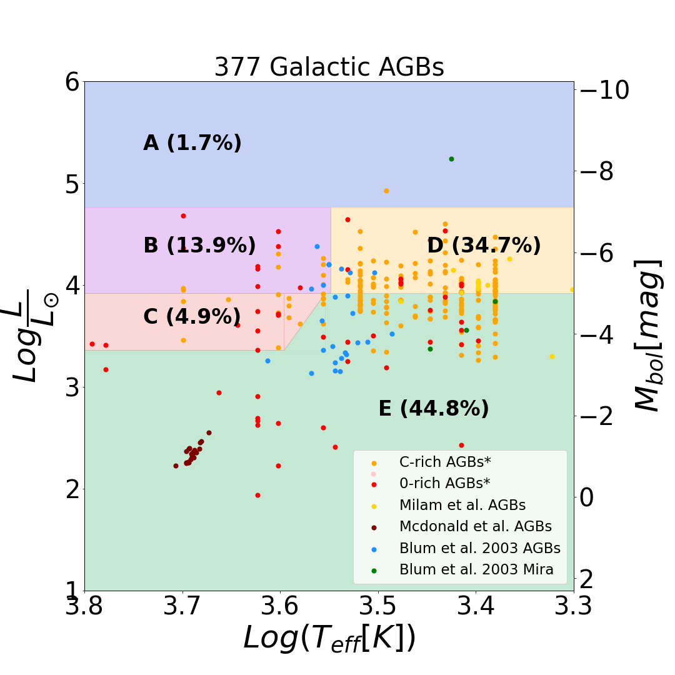
Luminosity vs Temperature: Contaminants
Want to regions with high % of red supergiants but low % of asymptotic branch stars
Healy et al. 2024
Notes:
Huge cut used to cut out lower mass stars as well as AGBs (it does mean that we biase are sample to stars that are on the higher mass than ~9 solar mass, even though there are chances for lower mass RSGs however we do not have stellar tracks with enough certainty to use as lower limits and most of these stars are lost to contamination from the more prevalent types of lower mass stars.
We sourced a collection from the literature of galactic AGBs catalogs that include calculations of both T_{eff} and luminosity
in order to quantify the number of AGBs in each region defined roughly by massives star evolutionary tracks.
in order to include extreme cases of AGBs, we include a list of C-rich and O-rich AGBS which include supplements
from Magellanic Clouds. A similar collection is produced for the figure on the right of galactic RSGs which was
designed to cover the range of expected luminosity masses between 9 to 25 solar masses.
produce white dwarfs and planetary nebulae following the end of hydrogen and helium fusion
. Their higher initial masses, shorter main-sequence lifetimes, and luminosity and temperature evolution prior to the start of their red phase are all markedly different from the evolution of low-mass stars, which spend billions of years fusing hydrogen before progressing through the red giant branch, horizontal branch, and asymptotic giant branch (AGB) after leaving the main sequence, experiencing multiple dredge-up events during this latter phase that bring fusion products to the star’s surface. Their subsequent evolution is also drastically different: RSGs, like other massive stars, will proceed through later stages of core fusion (C fusion and beyond) before undergoing core collapse, while the vast majority of red giants and AGB stars produce white dwarfs and planetary nebulae following the end of hydrogen and helium fusion
With their lower initial masses (≲8M⊙), red giants and AGB stars have much longer main core H fusion lifetimes and can attribute their position as luminous red stars on the HRD to very different interior physics. While RSGs climb vertically during core He fusion as a consequence of the μ-effect, the vertical evolution of giants along their parallel red branches is driven by the combination of shell fusion and a degenerate He (red giants) or CO (AGB stars) core. As shell fusion progresses, mass is deposited onto the degenerate core, causing it to shrink and producing an expanding radius via the mirror effect, which manifests as an increase in L rather than a decrease inTeff (as seen in the pos
So one for
Equations
AGB contaimtaion
HR diagram, and our HR diagram as comparisons as well as our Gaia cuts
HR diagram (8.2)
What are all the arises
Point out RSGs how they are cooler and redder and how move negative Mbol means brighter
Huge cut used to cut out lower mass stars as well as AGBs (it does mean that we biase are sample to stars that are on the higher mass than ~9 solar mass, even though there are chances for lower mass RSGs however we do not have stellar tracks with enough certainty to use as lower limits and most of these stars are lost to contamination from the more prevalent types of lower mass stars.
What has happened to the massive stars as it transitions of the main sequence
How do we use this in our determination of RSGs, what important characteristics of RSGs do we think about when making these cuts
This conservative lower cut for mbol as done throughout many papers does mean that the completeness is limited( which is why we include stars whose error bars place it into are groups) since lower mass stars (the most numerous members of the population) are filtered out but

Slide 40
Other Galactic CCSNe progenitors
[The Story of all Galactic Core-collapse Progenitors, in prep]

Slide 41
Hot Massive Stars
Wolf Rayet Stars (WRs)
Blue Supergiants
(BSGs)
Luminous Blue Variables
(LBVs)
Highly luminous
Very high surface enhancement of heavy elements
Strong stellar winds
Hot
Luminous
Also known as OB supergiant
Massive
Evolved
Unpredictable and significant variations in spectra and brightness
O B A F G K M

Slide 42
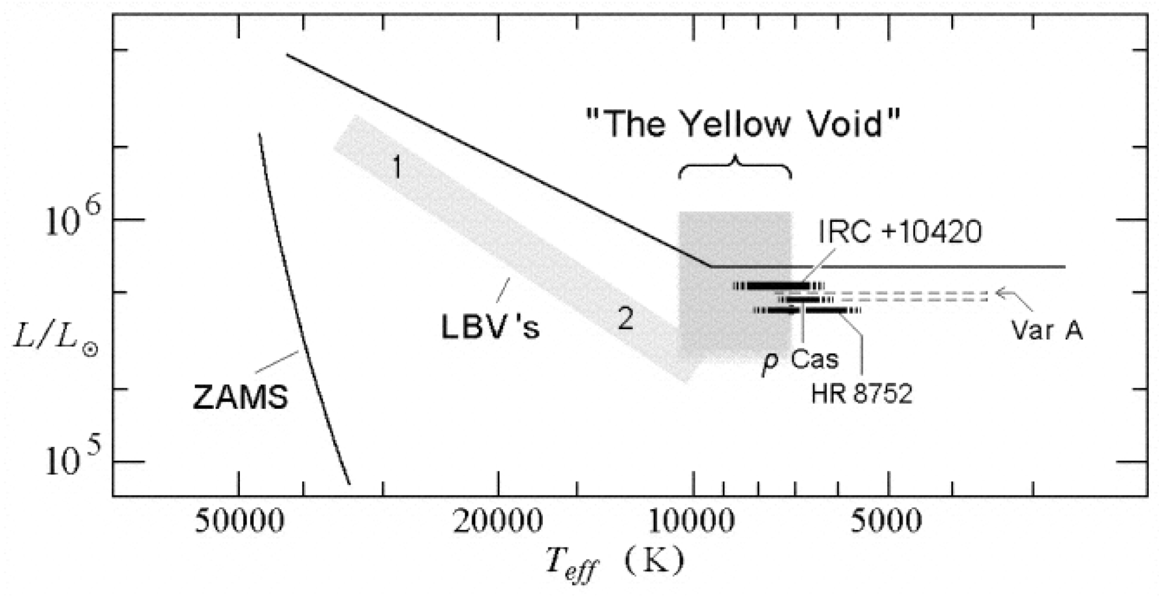
Yellow Supergiants
(YSGs)
The Yellow Void
Bridge the gap between the hot, massive stars and the cool red supergiants
More high-mass YSGs predicted than those are actually observed
Phase is ∼3000 years
Gordon and Humphreys 2019
O B A F G K M
Notes:
IRC +10420 and its circumstellar material
Roberta M Humphreys - http://iopscience.iop.org/article/10.1088/1742-6596/728/2/022007
Yellow void : https://doi.org/10.3390/galaxies7040092

Slide 43
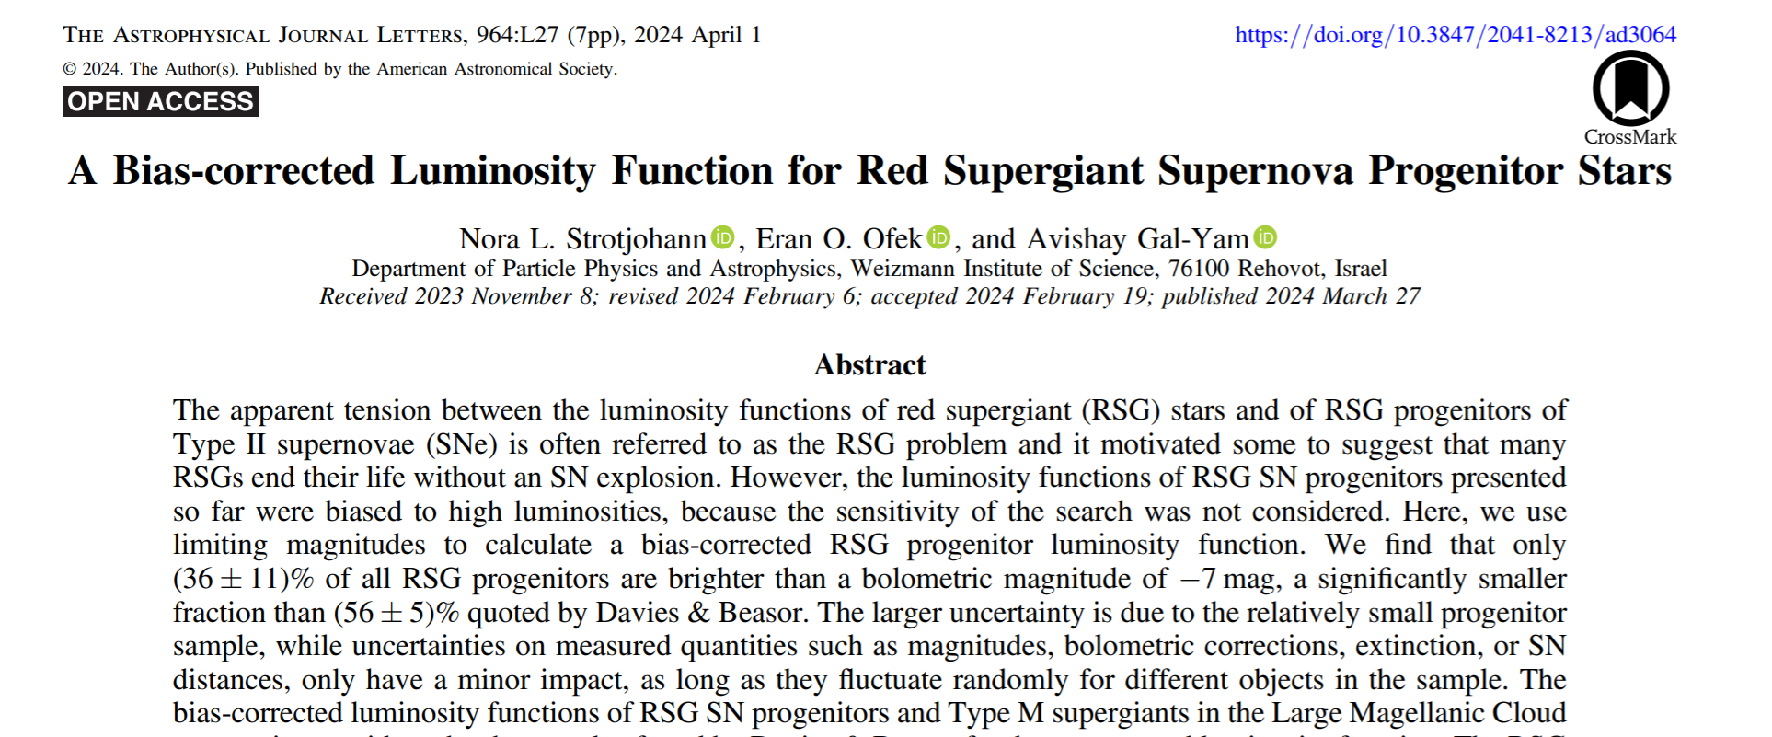
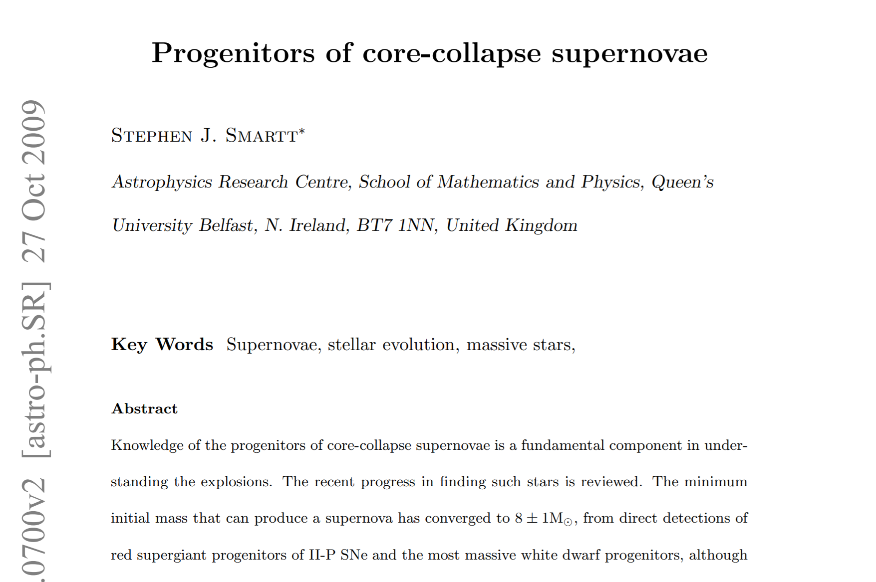
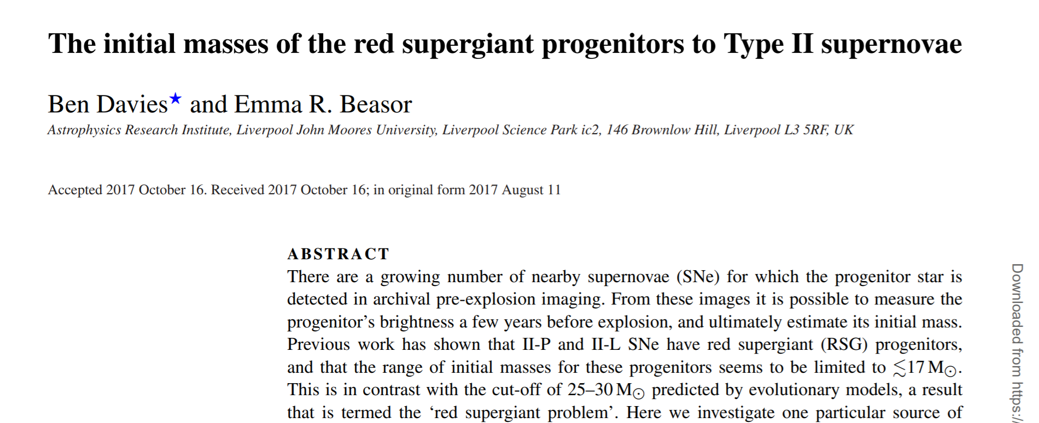
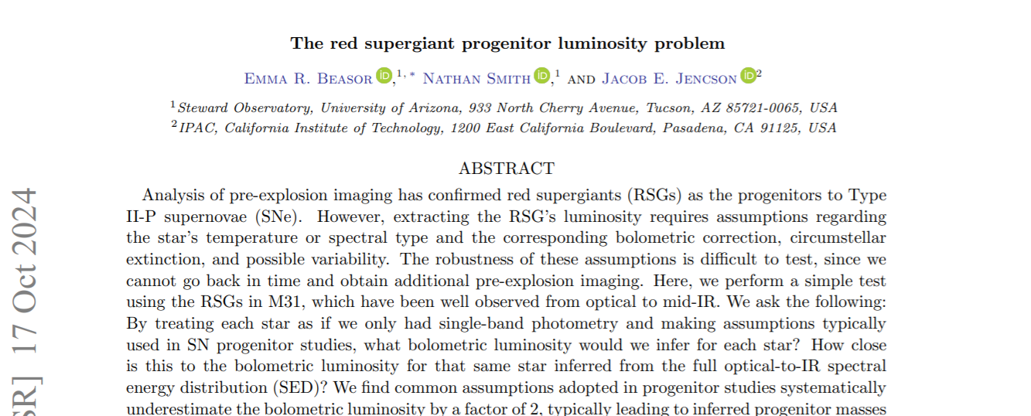
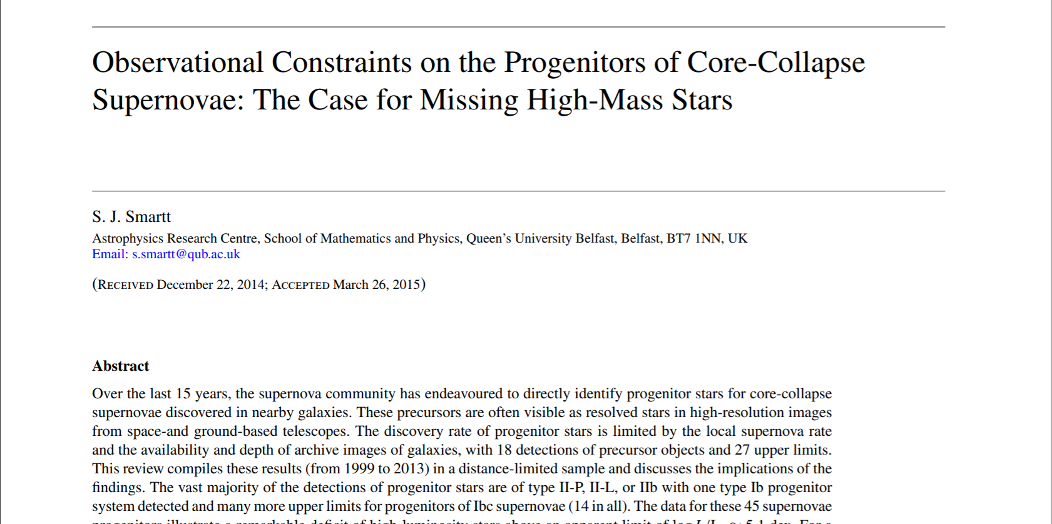
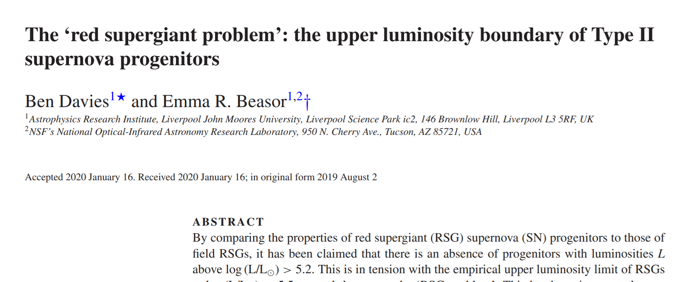
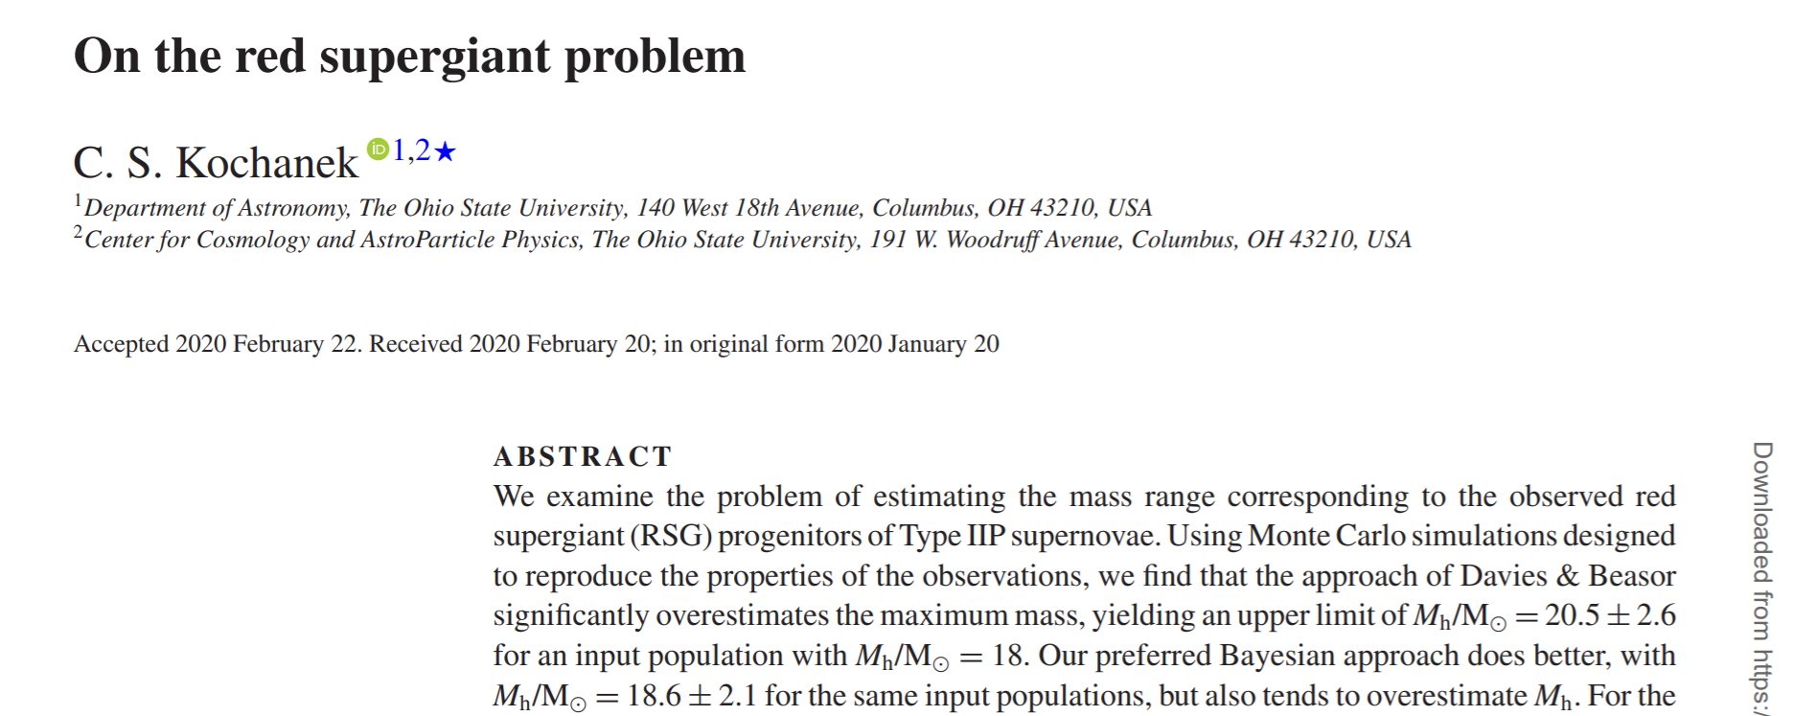
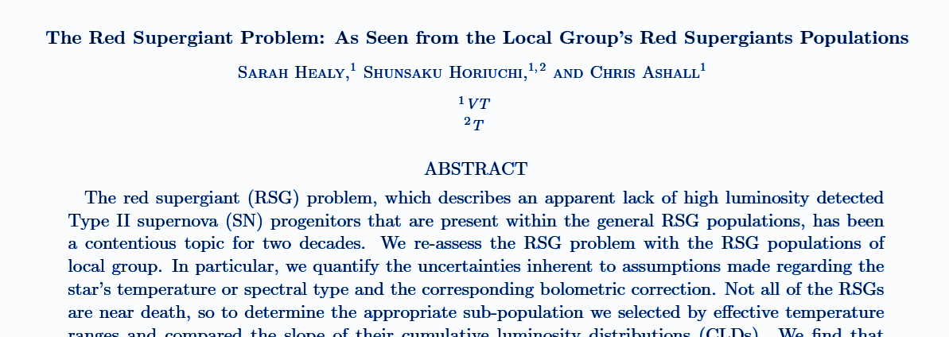
Red Supergiant Problem
(A Debate)
In prep

Slide 44
Red Supergiant Problem
(A Debate)
Path to solution?
We need more and better characterized stars
In prep

Slide 45
Overview of supernova multi-messenger

Slide 46
Your work

Slide 47
Discuss impacts: monitoring via AAVSO, integrated into followup of SNEWS alerts

Slide 48
Luminosity Distribution of Pre-Explosion Imaged Progenitors
CLD: Cumulative Luminosity Distribution
Detected Progenitors’ CLD build with “ordering method”
Corrections:
Davies-Beasor (Davies & Beasor 2020)
Uses Monte Carlo to account for measurement errors not taken into account with ordering method
Strotjohann (Strotjohann et al. 2024)
incorporates measurement errors and sensitivity of the search into account
Healy et al. 2024, in prep

Slide 49
Contradiction to Stellar Theory
Healy et al. 2024, in prep
~10% of estimated stars and ~3 detected progenitors’ luminosity is low enough to imply their mass is below the predicted limit for CCSNe
What is going on?
~6-8 M☉
Ordered Detected Progenitors of Type II SNe
Progenitor CLD accounting for Measurement Errors
Progenitor CLD accounting for Measurement Errors & Telescope Sensitivity

Slide 50
Issues with Bolometric Corrections
[The Red Supergiant Problem: As Seen from the Local Group’s Red Supergiant Populations, Healy et al., in Prep*]

Slide 51
Healy et al. 2024, in prep
Updated corrections and progenitors luminosity estimates based on update uncertainties
Ordered Detected Progenitors of Type II SNe
Progenitor CLD accounting for Measurement Errors
Progenitor CLD accounting for Measurement Errors & Telescope Sensitivity
Increased uncertainties widen and change the shape of previously estimated progenitor confidence intervals
Notes:
. Cumulative luminosity distributions for Type II progenitors with standard errors (top panel) and additional systematic uncertainty of 0.2 dex added to I-band observations (bottom panel). In each case, the symbols represent the following; filled circles - multi-waveband, open squares - F555W, open diamonds - F814W, open crosses - K-band. We also show the luminosity measurements from Smartt et al. (2009) in via the green symbols. One might expect that the older estimates from Smartt et al. (green) should all be fainter by 0.36dex as compared to the revised estimates (blue). While the newer estimates are corrected by this factor, they also have updated photometry, distance, and extinction estimates as detailed in DB18, so they are not all offset by the same amount. Finally, we show the luminosities that would have been estimated for SN 2017eaw, SN 2023ixf, and SN 2024ggi if only I-band photometry were available using the BCs for both an M0 and an M5 RSG via the red diamonds.

Slide 52
Local Group vs Galactic
[The Red Supergiant Problem: As Seen from the Local Group’s Red Supergiant Populations, in Prep*]

Slide 53
Supernova Progenitors (AKA Red Supergiants)
MW, M31, M33, LMC, and SMC
Healy et al. 2024: MW Sample
Known AGB contamination
Ren et al. 2021: [Luminosity needed to be derived]
Moderate color cuts:
Retained faint and red objects
Left contamination from foreground stars
and AGBs
Massey et al. 2023: [Constant Av ]
Strict color cuts:
less contamination from AGBs
removed RSGs with high reddening
M31 M33
M31 M33

Slide 54
Red Supergiants’ Cumulative Luminosity Distributions
As RSG evolve significantly changes their luminosity distributions
Healy et al. 2024, in prep
Young RSGs
Late-Stage RSGs
Notes:
Teff scales to a degree incomplete
Be careful about teff derived from SEDs vs NIR as can be 150K coolor

Slide 55
Metallicity Weighted CLDs
Resolved the High mass progenitor Issue
Stars > 5.2
Progenitor CLD accounting for Measurement Errors
Progenitor CLD accounting for Measurement Errors & Telescope Sensitivity
Galactic RSGs CLD includes AGB contaminants
More dusty RSGs and contaminants Z weighted CLD
Less contaminants and dusty RSGs Z weighted CLD
Healy et al. 2024, in prep

Slide 56
Future Work

Slide 57
JWST Proposals
[The Hidden Lives of Red Supergiants: JWST’s Role in Uncovering Circumstellar Material & Ready, Set, .... : Preparing for the Next Galactic Supernova]

Slide 58
JWST Proposal: The Hidden Lives of Red Supergiants: JWST’s Role in Uncovering Circumstellar Material
We have complete RSG samples but no all have complete SEDs
Determine reliable bolometric luminosity for the most luminous and dusty objects
Detailing the dust composition and features
Better informing current work on the evolution and mass loss of RSGs
Notes:
Figure 2. Bolometric corrections (BCs) for each of the stars in each cluster. The panels show the BCs in V, R, I and K bands (top-left, top-right, bottom-left and bottom-right, respectively). The grey dashed lines show the BCs adopted by S09 and S15 in each band. The dotted line with ‘+’ symbols shows the BCs measured by Elias et al. (1985), which only go as far as M4.

Slide 59
Machine Learning and All-Sky Surveys
[...]

Slide 60
Expanding Known Milky Way Red Supergiant
Utilize all-sky spectral surveys and Machine learning
Current versions combines principle component analysis and Gaia high resolution spectra
Dorda et al. 2016
Notes:
Figure 2. Bolometric corrections (BCs) for each of the stars in each cluster. The panels show the BCs in V, R, I and K bands (top-left, top-right, bottom-left and bottom-right, respectively). The grey dashed lines show the BCs adopted by S09 and S15 in each band. The dotted line with ‘+’ symbols shows the BCs measured by Elias et al. (1985), which only go as far as M4.

Slide 61
Reference Slides

Slide 62
Supernovae
Explosion of a star
Shines for a few months producing an overall ~10⁵⁰ ergs
Peak luminosity is comparable to entire galaxy
Two main subgroups
Thermonuclear
Core-collapse (CCSNe) ← my focus
Both enrich their surrounding environments with the heavy metals
Credits: NASA, ESA, CSA, D. D. Milisavljevic (Purdue), T. Temim (Princeton), I. De Looze (Ghent University). Image Processing: J. DePasquale (STScI)
Supernovae produce enormous burst of neutrinos of all flavors in the few tens-of-MeV range
99% of the emitted energy is released by neutrinos and antineutrinos
Notes:
The blues represent data from the Chandra Observatory, the turquoise is from NASA's Imaging X-ray Polarimetry Explorer (called IXPE), and the gold is courtesy of the Hubble Telescope.
When a massive star collapsed in the Cassiopeia constellation, it generated a supernova explosion with some of the fastest shockwaves in the Milky Way. These speedy shock waves are one of the reasons the Cassiopeia A (Cas A) supernova remnant was chosen to be our Imaging X-ray Polarimetry Explorer’s (IXPE) first observed object.
This composite image, made of data from IXPE (X-ray) , the Chandra Observatory (x-rays), and the Hubble Telescope (ultraviolet, visible, and near-infrared regions), shows Cas A
thermonuclear supernovae—exploding white dwarf stars resulting from the stellar evolution of low-mass stars in close binary systems
The burst of neutrino from supernovae actually start a few hours to days before collapse and provide a warning system
Hours to days
Neutronization burst - hours to days
neutronization neutrino burst with a peak luminosity ∼ 4×1053 erg·s −1 , which emerges during the first ∼ 25 ms after the core bounce as a result of sudden breakout of a flood of neutrinos freshly produced in shock-heated matter (and some νe produced previously that have diffused to the neutrinosphere) when the bounce shock penetrates the neutrinosphere and reaches the neutrinotransparent regime at sufficiently low densities. This shock-breakout burst mainly comprises νe from electron captures on free protons in the shock-heated matter.

Slide 63
Wolf Rayet Stars
(WRs)
Highly luminous
Very high surface enhancement of heavy elements
Strong stellar winds
O B A F G K M

Slide 64
Blue Supergiants
(BSGs)
Hot
Luminous
Also known as OB supergiant
O B A F G K M

Slide 65
Luminous Blue Variables
(LBVs)
Massive
Evolved
Unpredictable and significant variations in spectra and brightness
O B A F G K M

Slide 66
Notes:
GW communities - did same for mergers

Slide 67
Healy et al. 2024 and Drimmel et al. 2022

Slide 68
ADD KEY TAKEAWAY
Metallicity - spectral cut off etc.
Progenitor CLD accounting for Measurement Errors
Progenitor CLD accounting for Measurement Errors & Telescope Sensitivity
Galactic RSGs CLD includes AGB contaminants
More dusty RSGs and contaminants Z weighted CLD
Less contaminants and dusty RSGs Z weighted CLD

Slide 69
Red Supergiant Problem: Underlying Problem
There is no evidence of missing high mass progenitors
Progenitor mass estimated to be below the limit for producing CCSNe can be explained with the increased uncertainty inherent to F814W derived luminosity
The disagreement between local group late type RSGs and progenitors CLD can be explained with the increased uncertainty of bolometric corrections

Slide 70
From Cool Supergiants to Cosmic Catastrophes: Analyzing Red Supergiants, Supernova Mechanisms, and Neutrino Signatures
Sarah Healy
Advisor: Shunsaku Horiuchi
Pre-Defense 11/21/2024.

Slide 71
Close Star Addendum
Gaia has a large magnitude range, but bright stars can lead to saturation
Extreme widths of massive stars can limit accuracy measurement
There are 12 stars in this category
Those who are in Gaia DR3 but whose accuracy is reduced below our threshold
𝜃 Del 𝜇 Cep
S Per VX Sgr
NML Cyg
Those who are not in Gaia DR3 due to some combination of
distance, brightness, and radii
alf Ori (aka Betelgeuse) alf Her
alf Sco eps Peg
𝜁 Cep lam Vel
VY CMa is excluded as its radius hinders accurate distance
measurements

Slide 72
Sample Characteristics
Collection made from combination of general literature search, AAVSO, and ASAS-SN
Notes:
Include stars who with the use of errors will make it into one of our regions
Calculate stellar radius
Note whether these stars have high resolution spectral follow-up
Look into possibilities as binaries
Literature, spectra, or others
Look to see if a star has shown variability
Photometric or Spectroscopic
Is it a member of cluster or 0B association
Are there other observations to add which could inform those using the catalog
What do we want from this sample and what is the purpose
We get radius from teff and luminosity - L=4pi sigma R^3 T^4
Direct measurement of radius is challenging, but those done do confirm general agreement with the above
We calculate surface gravity through equations
We allow for errors in our sample as they will intrinsically happened
Either through our calculations or issues with brightness affection observations, or just lack of correction understanding
We add in flags, and
Discussion about follow
How often has this star been viewed and do the spectral types determined match?
This shows us whether or not an object has confirmation of the determined spectral type (which has various methods for determine with various errors)
High resolution follow up is logistically impraction for sorting through large samples but it is good to know for those in our list if there has or has not been
Chances of binaries
One there is not a comprehensive list of Milk way binaries (again to my knowledge)
Currently there are no clear examples of RSGs in true mass transfer binaries, though there are a sample of confirmed companions
Consequence of observation limitations
Significant fraction of binaries on the main sequence, with 35 percent of all O stars show some signature of a binary companion, and it is reasonable due to their size and likelihood to in high stellar forming regions that there would be an increase in this percentage for RSGs.
There are two very likely candidates VVcephei and zeta aur
We discuss if an object has been determined to have variability,
Images of different types of variability in Red Supergiants
Red supergiants are expected to be radial pulators with luminosity dependent pulsational periods
Convection-driven surface effects
Hot spots, shocks, cell turnover
Mass loss maybe effect optical variation
Variation in dust composition and distribution can impact extinction or cause vieling effects
Binary companions can also effect
Spectroscopic variability
Extended atmosphere, optical depth effect near the hayashi limit and others that contribute to optical variation
White and wang look into this and found 28
True spectroscopic variation has only been documented in a small number
Photometric variability
Long period and short period variation
is it in a cluster or association
What are is other measurements in photometry,
How likely AGB contamination is for an area

Slide 73
DUST: issues
Dust reddens our observations
Not uniform
Adds another step between observational magnitude and apparent magnitude
ESA/Gaia/DPAC/CU6, N. Leclerc, P. Sartoretti and the CU6 team
Notes:
Interstellar dust and circumstellar
In Messino 2005, the dust extinction of RSGs was calculated by using the extinction power law with an index 1.9 and the intrinsic colors expected for each spectral type (which can be found in the same papers listed for Tef f ). This choice is based on how RSGs in general show excess circumstellar extinction to that of OB stars in the same region (Massey et al. 2005), causing the extinction ratios are different than the main sequence or other stars. This increase in extinction for brighter massive stars is seen in Neugent et al. (2020) which takes direct measurements for AV for a sample of RSGs in M31.
However, when compared to three dimension galactic dust extinction maps, the difference between those and calculated using intrinsic colors from Tef f varies widely. It also means that uncertainties in the extinction would be dependent on uncertainties in Tef f and intrinsic color estimations. Since we determine Tef f from the spectral type of each star which comes from adopting one spectral type generally from a range rather than the true value, this increases as well as complicates the final uncertainty we will see in bolometric luminosity. While a linear relationship between intrinsic (J − K)0 and effective temperature does work well for RSGs, metallicity in the models does cause discrepancies as well as can introduce unlikely large extinction values. For these reasons and those described in the next section, we decided to use dust maps for the estimation of reddening while keeping the extinction ratios from Messineo 2005.

Slide 74
DUST: 3D galactic Maps
Utilize 3D models of the milky way which define how much extinction would occur between us and the object
Currently no 3D model covers all, so combination is needed
We do have to convert from the most commonly used v band extinction to our K_{s}-band taken from 2mass
Bovy, J., Rix, H.-W., Green, G. M., Schlafly, E. F., & Finkbeiner, D. P. 2016, ApJ, 818, 130, doi: 10.3847/0004-637X/818/2/130

Slide 75
Spectra
Spectral Lines:
Interactions between light and matter
help classify stellar objects
Issues:
K spectral type not well defined
Expensive
Variability of RSGs complicates
Levesque, E. M., 2017
Notes:
strengths of the TiO bands (which themselves are sensitive to physical properties such as temperature and metallicity), with stronger bands corresponding to later spectral types. Specifically, the types are primarily determined from the 6158 Å, 6658 Å, and 7054 Å bands following Jaschek & Jaschek (1987), with TiO bands further in the blue (5167 Å, 5448 Å, 5847 Å) serving as secondary confirmations of the quality of the fit.
Spectroscopy is the study of the spectra produced when material interacts with or emits light. It is the key to revealing details that cannot be uncovered through a picture. A spectrograph — sometimes called a spectroscope or spectrometer — breaks the light from a single material into its component colors the way a prism splits white light into a rainbow.
Continuous spectrum of light
Interaction between light and matter - spectral lines (5.1)
The classification of stellar spectra
Maybe have a bit of a discussion of how we see absorption of lines and how that relates to it current evolutionary state
Generally use the 8-band method for most certain but other methods which use only a band or two have been used and show enough agreement that these determinations can be used.
Levesque has a great spectral energy figure in 3.1
Discusses issues with determine K spectral types
They evolve with time
Add in as an extra slide the figure 3.4 which shows determine luminosity classes
Issues - expensive, only certain bands give reliable spectral types but
expensive instruments
You are trying to get light from a range of energies not just a single one
many spectrometers for small telescopes have low efficiency, limiting observations to bright stars
Not a lot to compare to sooooo
Photometric and spectroscopic variability of RSGs complicates this
Restrictions to Collection/ cluster/ associations locational limitations

Slide 76
Distances + Gaia DR2
Requirement for most (if not all) experimental astronomy
Distance is challenging to get with high certainty
Global Astrometric Interferometer for Astrophysics (Gaia)
largest, most precise three-dimensional map of the Milky Way
Total number of sources: 1,692,919,135
(includes only ~1 % of galactic stars)
Moitinho, A. et al. 2017
Notes:
1 billion
a dark nebula, a dense cloud of gas and dust in the constellation of Orion
not visible to the naked eye
These views are not photographs but were compiled by mapping the total density of stars (left) and the total amount of radiation, or flux (right), detected by Gaia in each pixel.
5-foot-wide (2.3 meters) Gaia satellite is attached to a 33-foot-wide (10 m) circular sunshield and is fitted with two telescopes that sit 106 degrees apart. The telescopes project the light they capture onto a 1-billion-pixel camera, which distinguishes the faintest details of the surrounding universe. Rather than create spectacular images, these telescopes enable astronomers to determine a few key parameters that reveal the distances of stars from Gaia, as wellas their positions and motions on the plane of the sky.

Slide 77
Magnitude + 2MASS
Use near-infrared photometry as not variable for RSGs
J-band (1.235 µm)
H-band (1.662 µm)
Ks-band (2.159 µm)
Two Micron All Sky Survey (2MASS)
1.3-m telescopes at Mt. Hopkins and CTIO, Chile
https://www.photonics.com/Articles/2MASS_Telescope_Online_Archive_Completed/a15774
Notes:
Equations (absolute versus apparent)
Red supergiant characteristics - Levesque
Variable in the V band by at least a magnitude
Reason we use K band , which is not variable, to determine luminosity
Bring back all the reason for dust interference before
Reason for this loss has still yet to be determined 4.1
Main one is dust drive stellar winds, which start on the biases that there is already dust present at close raised to the stellar photosphere
This was the reasons for all their circumstellar dust excess
One reason we have trouble determine true luminosity,
All our measurements have to be corrected to account for this,
Show figure 4.3 to show how our understanding of dust is flawed
Dust absorbs and scatters blue light more then red so our observations will show an object to be redder than it actually is and so we must correct for that (dereddened)
However standard method have to be adjusted for this excess
Teff can give insight on what a star’s intrinsic brightness is, we decide that this add more error than we would like into our calculations
Include calculations of extinction, BC correction, and others
Also included Gaia dust map
We already adopt a mean spectral type and see that there is a decent amount of variation between spectral classifications, so use of Teff to determine instinction brightness which is dependent on an already tentative measurement seemed
Any error will affect our luminosity calculations, where are connected major cuts
Discuss our use of 3D maps and how we feel this is better use for large samples, as well as incorporating the extinction ratios for RSGs.
Specific bands and photometry
What do we see from this
Might be helpful to show that pick of bands and near infrared stuff
Which are the most informative and the lease affected by dust extinction
Photometric and spectroscopic variability of RSGs complicates this
Issues with red supergiants have various amounts of excess
circumstellar dust right before explosion further affecting measurements
Optically they look similar to Red giant stars and so hard to separate
super-AGBs have (o rich and c -rich) have luminosity that overlap with starn low mass RSGs
This leads to no clear photometric diagnostic for distinguishing between luminous giant and lower-mass RSGs

Slide 78
Red Supergiant Selection

Slide 79
Luminosity class determination
Using the with of of absorption lines
http://spiff.rit.edu/classes/phys440/lectures/lumclass/lumclass.html

Slide 80
More on spectra
ILLUSTRATION: NASA, ESA, Leah Hustak (STScI)
https://scienceatyourdoorstep.com/2017/10/21/the-atomic-spectrum/

Slide 81
Red supergiant problem
Use of archival images shows a clear lack of high mass (> 17 solar masses) red supergiants (enough to make the large error bars seem like an unlikely solution)
Odd as the most massive and luminous progenitors should be the easiest to find in images not directed at them
Possible solutions
RSG wind producing excess dust
When not accounted for in extinction measurements
Causes progenitors to be to heavily reddened to be detected
Massive RSGs not being the direct progenitors
Possible progenitors for different types of supernovae
Explosion collapse into black hole
Davies B., 2017
Notes:
What are explanations for what we see?
Possible modification to stellar physics theories and models, including mass-loss rate changes
Incorrect about the mass threshold at which black-holes (BH) form
Issue in the derivation of progenitor mass,
Circumstellar dust extinction?
Bolometric correction?

Slide 82
Supernova 1987a
Example of great multi-messenger astronomy
Electromagnetic radiation
Before and after, including ultraviolet and visual bands
Neutrinos
24 events seen from three detectors
Kamiokande in Japan, Irvine-Michigan-Brookhaven in the US, and Baksan in the then USSR
Sanduleak −69 202 (Sk -69 202): a blue supergiant
Credits: NASA, ESA, and A. Angelich (NRAO/AUI/NSF); Hubble credit: NASA, ESA, and R. Kirshner (Harvard-Smithsonian Center for Astrophysics and Gordon and Betty Moore Foundation) Chandra credit: NASA/CXC/Penn State/K. Frank et al.; ALMA credit: ALMA (ESO/NAOJ/NRAO) and R. Indebetouw (NRAO/AUI/NSF
Notes:
transformative radio telescope that can study cosmic light that straddles the boundary between radio and infrared
SN1987A as a great example of multi-messenger. in sn1987A the progenitor was a blue supergiant, which was not expected to be a supernova progenitor
• These are the only known CCSNe neutrino events measured

Slide 83
AGBs: Asymptotic giant branch stars
O B A F G K M
Notes:
Observations using the Atacama Large Millimeter/submillimeter Array (ALMA) have revealed an unexpected spiral structure in the material around the old star R Sculptoris. This feature has never been seen before and is probably caused by a hidden companion star orbiting the star. This slice through the new ALMA data reveals the shell around the star, which shows up as the outer circular ring, as well as a very clear spiral structure in the inner material.
Credit:
ALMA (ESO/NAOJ/NRAO)/M. Maercker et al.

Slide 84
Problems: Stellar Evolution for Massive stars needs to be better Constrained - especially towards end of life
Mapping massive stars - SNe type (RSGs + Galactic Progenitors)
Uncertain Luminosity (RSG Problem - stage RSG explode and Luminosity Function comparison)
Mechanism of Core-collapse (MMA)
Next Steps:
JWST Proposals: Next Galactic SNe and Complete SEDs for better Lum estimates
Machine learning and All-sky Spectra

Slide 85
Blue SG | LBV | Wolf Rayet (WR) | Yellow SG | Red SG | Asymptotic Giant Branch (AGB)
Hot | Hot and Variable | Hot with extended envelope | Short lifetime | Cool and evolved | Contaminant
Notes:
Ysg : http://arxiv.org/pdf/1401.2628v2.pdf
https://earthsky.org/brightest-stars/polaris-the-present-day-north-star/

Slide 86
Why Add On?
Comparison
~220 RSGs M0+ spectral type
Covers ~50% of CLD
incomplete in low lum problem area
~6-8 M☉
Strotjohann et al. 2024

Slide 87
Extra Slides

Slide 88
Hertzsprung-Russell Diagram. Credit: ESO.

Slide 90
O B A F G K M
Increasing Age

Slide 91
Wolf Rayets

Slide 92
Polaris (Alpha Ursae Minoris) – the North Star, image: Wikisky (DSS2)

