Slide 1
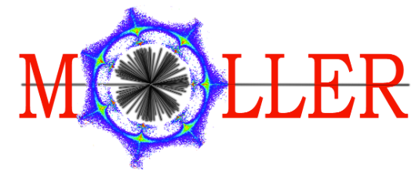



Scattered Beam Monitors
Daniel Valmassei
with Mark Pitt, Devi L. Adhikari, Andrew Gunsch, and Jaden Minnick

Slide 2

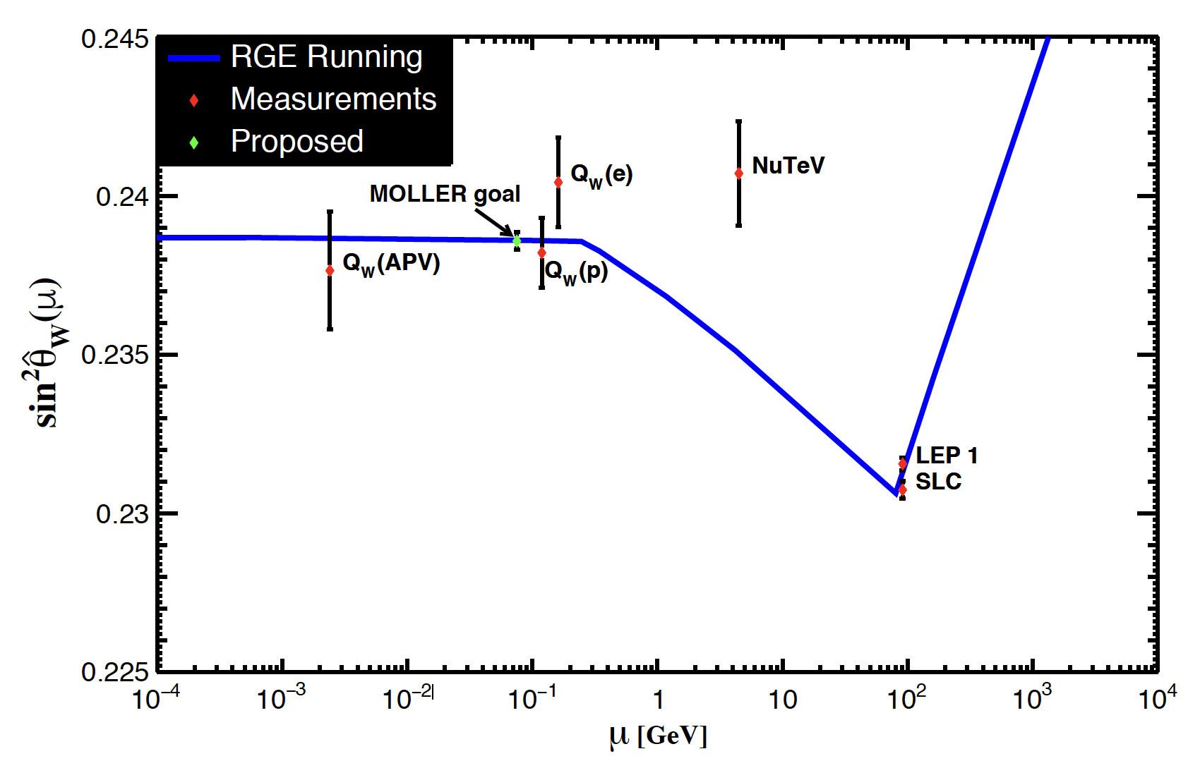
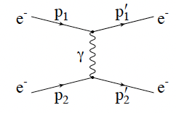
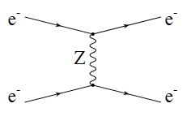
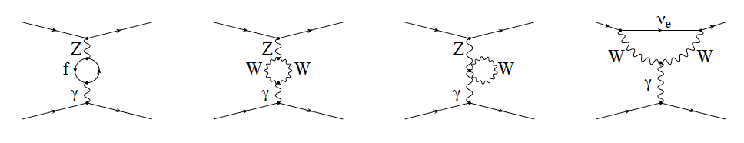
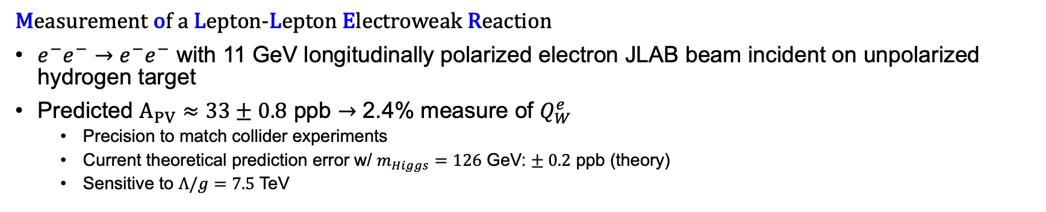
The MOLLER Experiment
Measurement of a Lepton-Lepton Electroweak Reaction
$e^{−}e^{−}→e^{−}e^{−}$ with 11 GeV longitudinally polarized electron JLAB beam incident on unpolarized hydrogen target
Predicted $A_{PV}≈33±0.8$ ppb $→$ 2.4% measure of $Q_{W}^{e}$
  Precision to match collider experiments
  Current theoretical prediction error w/ $m_{Higgs}=126$ GeV: $± 0.2$ ppb (theory)
  Sensitive to $Λ/g=7.5$ TeV
$A_{PV}= \frac{F_{R}−F_{L}}{F_{R}+F_{L}}∝\frac{σ_{R}−σ_{L}}{σ_{R}+σ_{L}}=mE\frac{G_{F}}{\sqrt{2}πα} \frac{4sinθ_{CM}^{2}}{{\left(3+cosθ_{CM}^{2}\right)}^{2}}{ Q}_{W}^{e},{ Q}_{W}^{e}≡−(1−4\sin^{2}{Θ_{W}})$
Tree level:
One-loop corrections:
Notes:
MOLLER is a modern PVES experiment, which will study e-e interactions using the 11 GeV longitudinally polarized electron beam at JLAB. The left/right asymmetry in møller scattering arises from the interference of the electromagnetic and weak interactions at tree level, but loop corrections must be considered to obtain the precision of the MOLLER measurement. Experimentally, the parity violating asymmetry is defined as the difference over the sum of scattering cross sections for left and right handed beams and is a measurement of the weak charge. We predict an asymmetry of 33 ppb +/- 0.8 ppb, which is the most precise measure of the weak mixing angle proposed within the next decade and will be the first low Q^2 measurement to match the precision of measurements made at the Z-pole. Between the precision goal and the understanding of electroweak theory, MOLLER will be sensitive to new physics on the multi-TeV scale.
- ee->ee w/ 11 GeV
- Feynman diagrams -> asymmetry from interference of EM and weak interactions
- experimental measure
- running
- MOLLER prediction
- precision goal is FIRST to match collider experiments at z-pole and is on the same order as the theoretical uncertainty after the measurement od M_higgs in 2012
DIFFERENCE OVER SUM OF SCATTERED FLUX
The asymmetry also runs with energy due to the loop corrections.
New Physics up to 7.5 TeV

Slide 3
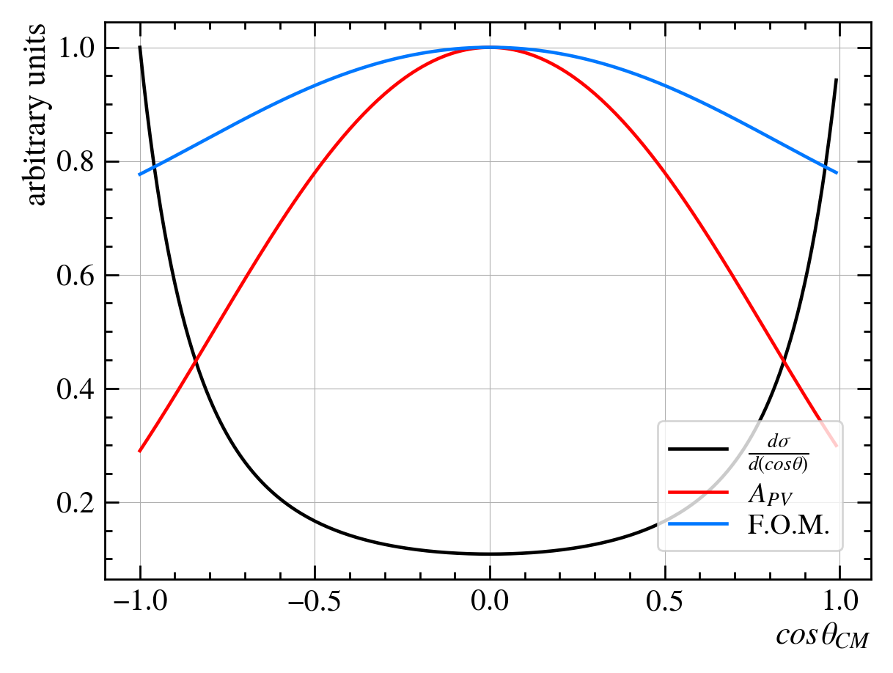
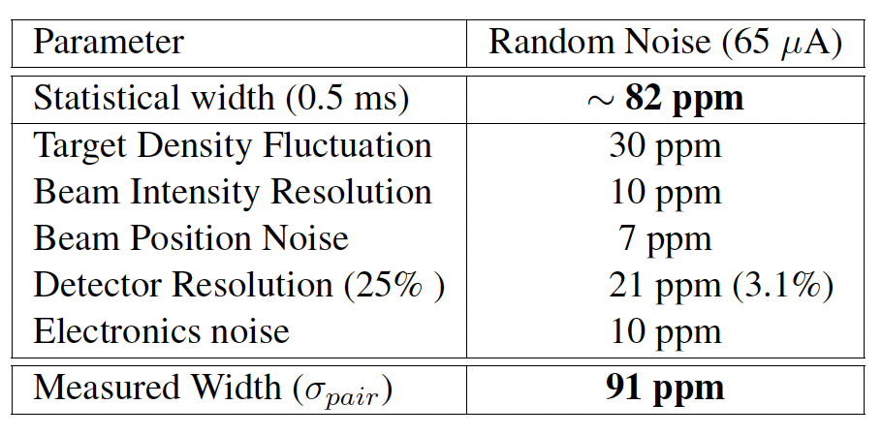

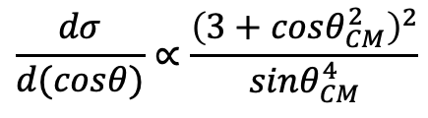
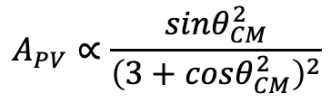
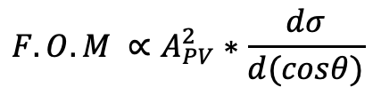
The MOLLER Apparatus
How to meet the precision goal
Highly polarized beam incident on high power target ($65μA$, 90% polarized beam)
Large acceptance of scattered particles ($60°<θ_{CM}<120°$)
  Figure of Merit maximized at $90°$
  guarantees detection of at least one of the two scattered particles
Rapid Helicity flipping (1.92 kHz, $520μs$ windows reduce systematic error)
All of this and we still need 344 PAC days of beam time!!!
$$F.O.M ∝A_{PV}^{2}∗\frac{dσ}{d(cosθ)}$$
$$A_{PV}^{}∝\frac{sinθ_{CM}^{2}}{{\left(3+cosθ_{CM}^{2}\right)}^{2}}$$
$$\frac{dσ}{d(cosθ)}∝\frac{{\left(3+cosθ_{CM}^{2}\right)}^{2}}{sinθ_{CM}^{4}}$$
Notes:
The MOLLER experiment will meet the proposed precision by making 30 billion individual asymmetry measurements. This requires a highly polarized beam incident of a high power target and accepting 60-120 degrees of the scattered flux in the COM frame. We also require the beam helicity to flip at ~2 kHz to reduce systematic errors.
One metric used to evaluate PVES experiments is the Figure of Merit. It is defined by the product of the parity violating asymmetry squared and the differential cross-section. These are both values which have scattering angle dependance, and are maximized at 90 degrees for MOLLER. By extending the acceptance, we guarantee the detection of at least one of the two scattered particles due to the identical particle interactions and can increase the FOM.
Figure of merit: minimizes uncertainty on asymmetry measurement. FOM = A/(delta A)

Slide 4
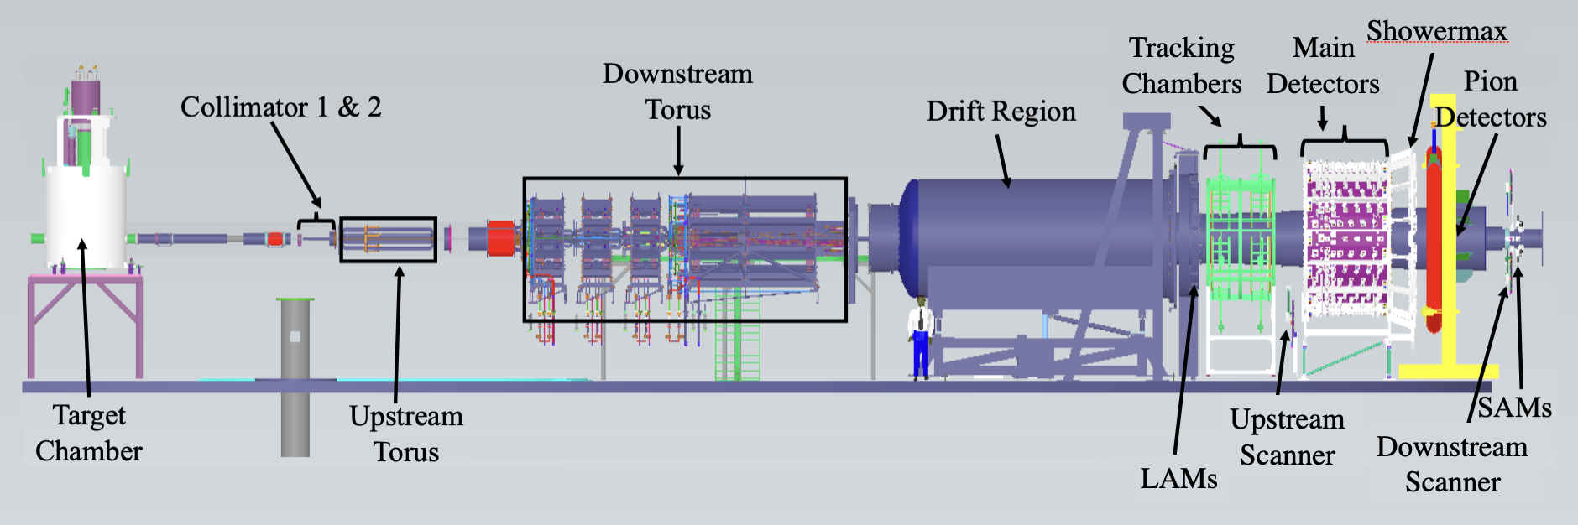
The MOLLER Apparatus
DBMs
Scattered Beam Monitors
Large Angle Monitors (x7)
Small Angle Monitors (x8)
Diffuse Beam Monitors (x14)
  Integrating Cerenkov detectors
  Sensitive to potential false asymmetries
Notes:
The Virginia Tech group is responsible for the auxiliary detector system known as the Scattered Beam Monitors. This system includes the Large Angle Monitors, Small Angle Monitors, and Diffuse Beam Monitors, all of which are various geometries of integrating Cherenkov detector and designed to be sensitive to potential false or non-physics asymmetries.

Slide 5
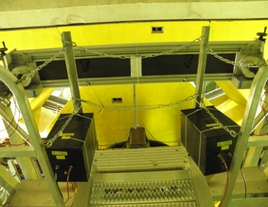


An Example
The Q_{weak} Experiment saw a small beamline background
  ~0.19% of total signal
Scattered beam monitors measured highly correlated asymmetries up to 20 ppm
Net Correction: $A_{bb}=3.9±4.5$ppb (Run 1), $A_{bb}=−2.4±1.1$ppb (Run 2)
Tungsten Shutter Blocking Octant 5 & 1
Tungsten ”Plug”
Q_{weak} Diffuse Beam Monitors
Notes:
An example of a scattered beam monitor system in use occurred during the Qweak Experiment. Qweak observed a large, unexpected asymmetry. By blocking certain octants of the acceptance and taking measurements with the Diffuse Beam Monitors, it was determined that scattering off the beamline accounted for a very small fraction of the total signal but had an asymmetry which was orders of magnitude larger than the physics asymmetry. Thus, a correction was made to the measurement to account for the background. Considering the precision goals of MOLLER, careful steps will be taken to eliminate and reduce such background, but unforeseen things happen, and we must be ready for them.

Slide 6
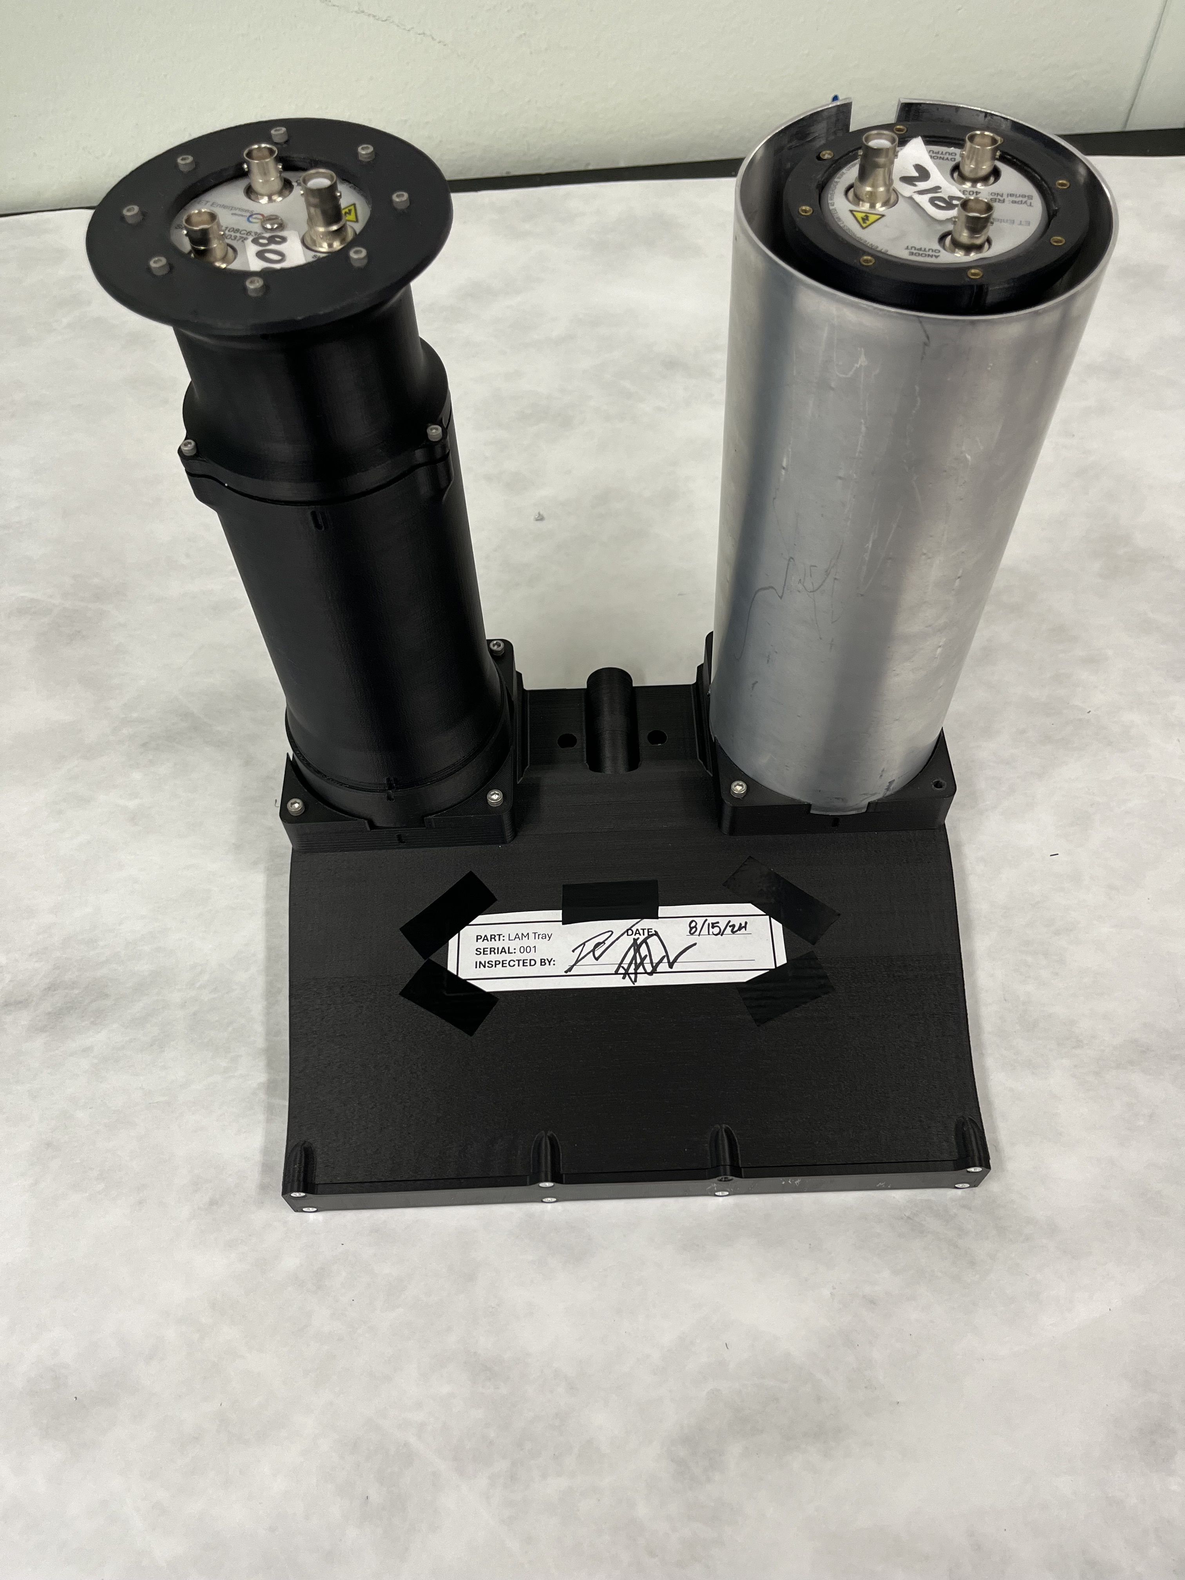
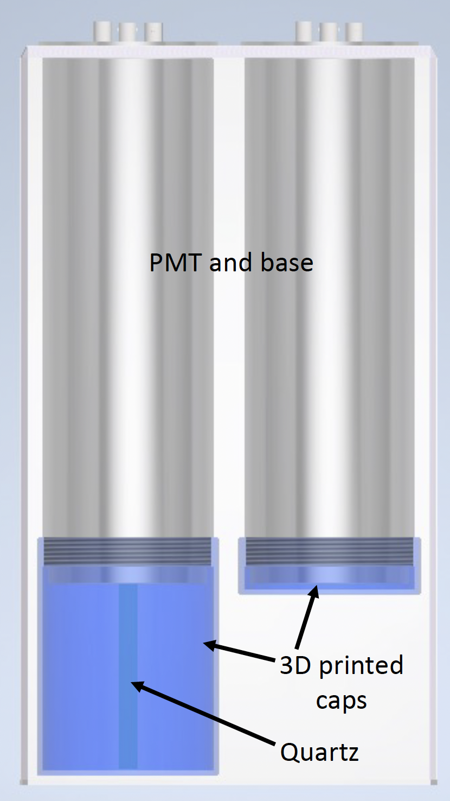
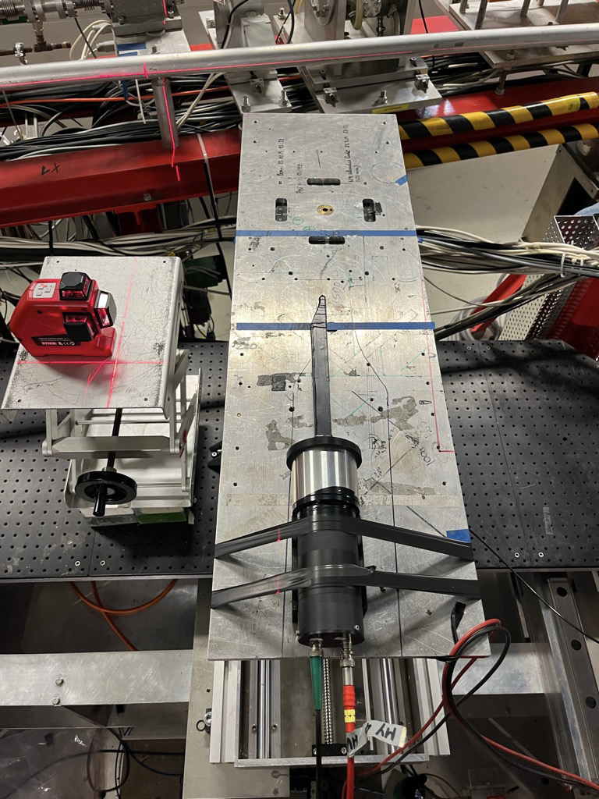
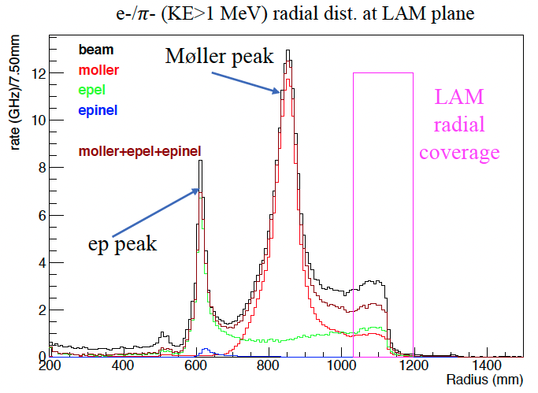
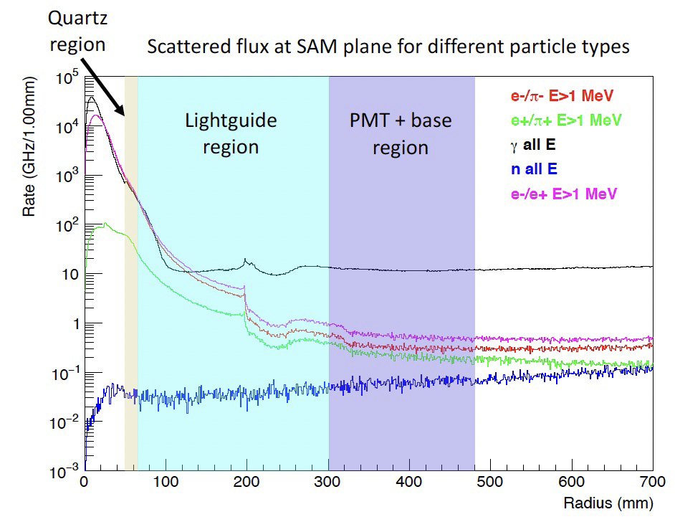
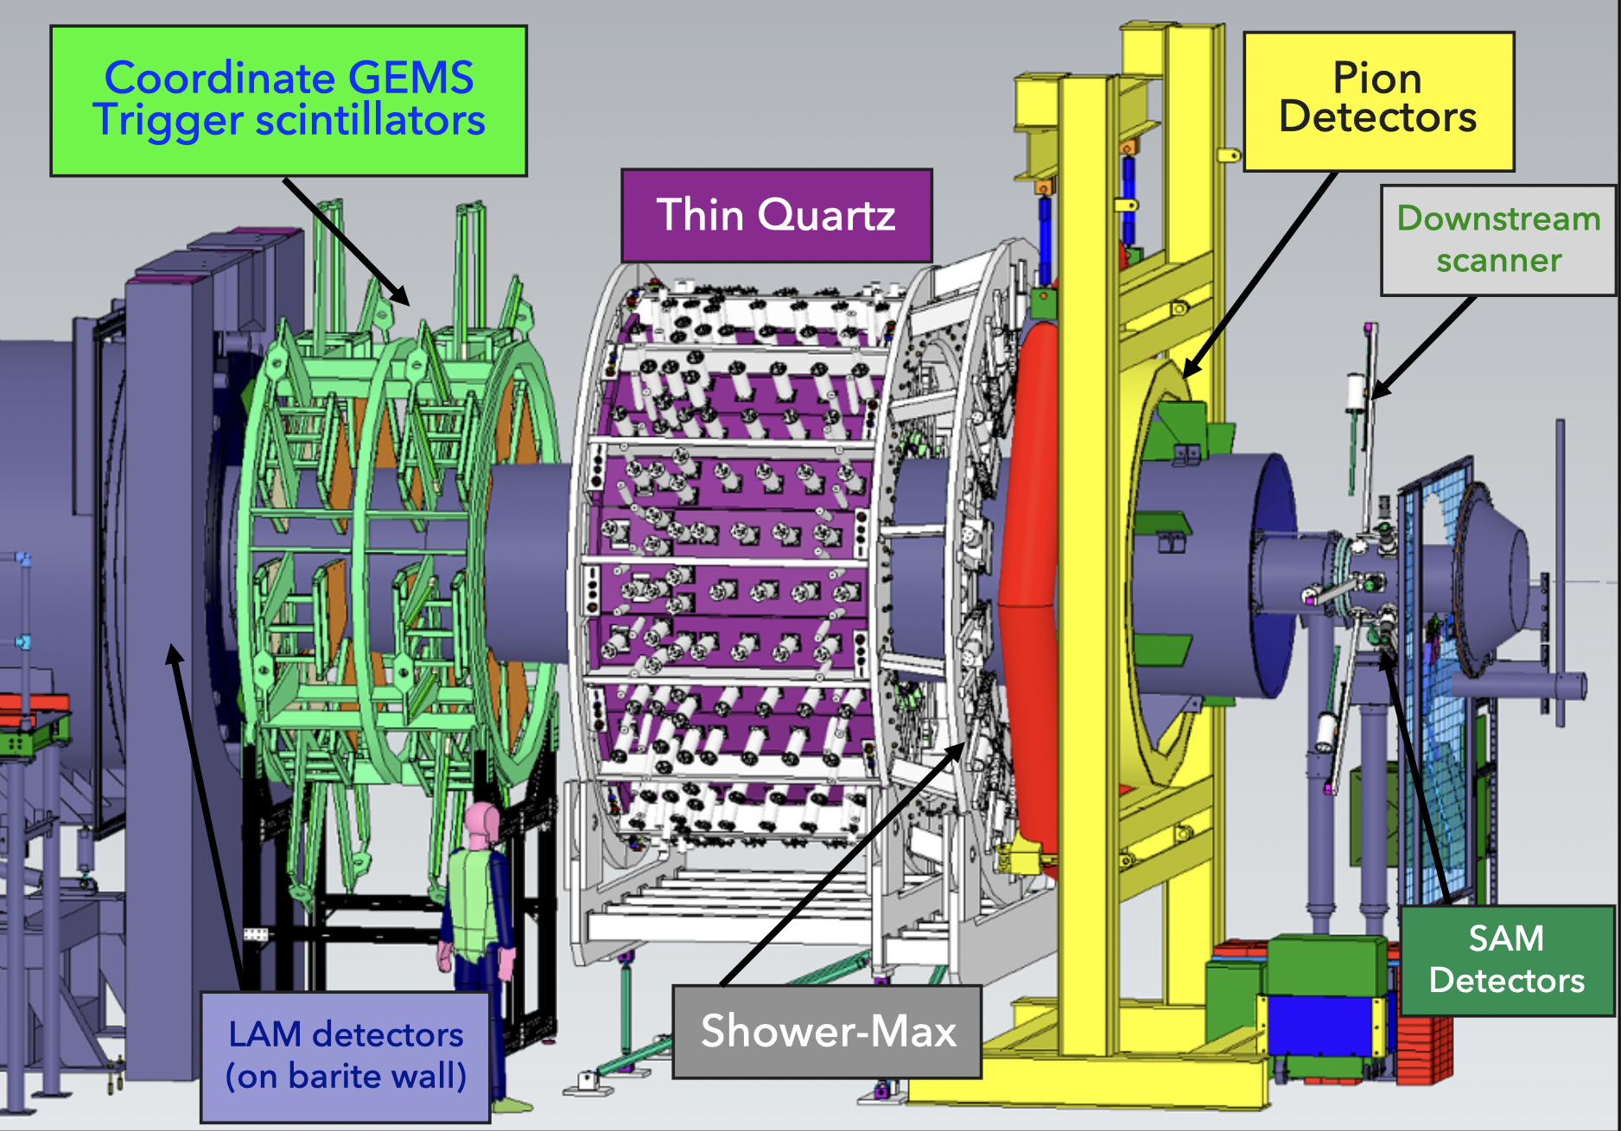
Scattered Beam Monitors
Monitors for potential false asymmetries from re-scattered backgrounds
“Null” asymmetry monitors as a check of helicity-correlated beam correction procedure
  LAM and SAM lie in high rate regions where the expected physics asymmetry is low
  DBMs reside in regions where direct target and secondary signals are small
DBM
LAM
SAM @ MAMI
Notes:
The scattered beam monitors are mostly concerned with re-scattered beamline backgrounds and serve as a “null” asymmetry monitor, meaning the expected asymmetry for each of these detectors is small when compared to the main detector. For the LAM and SAM this means that the incident rate on the detectors is comparable to the main detector, but the kinematics are such that there is little asymmetry between left- and right-handed scattering. Alternatively, the DBMs reside in regions where the expected flux is low, so any major signal in these detectors should be associated with tertiary processes.

Slide 7
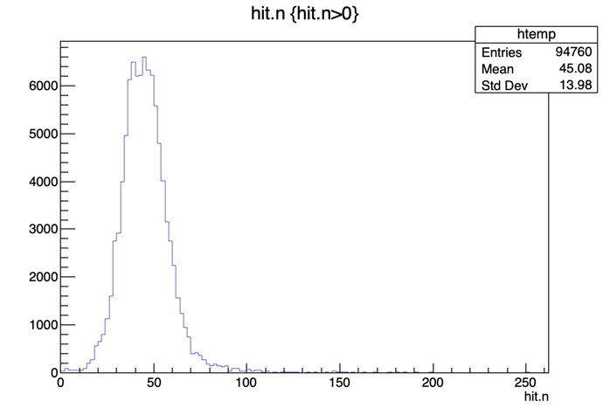
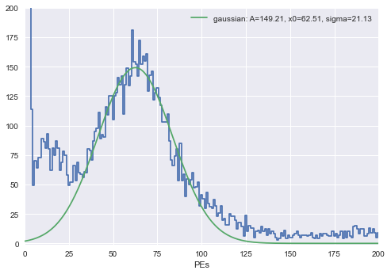
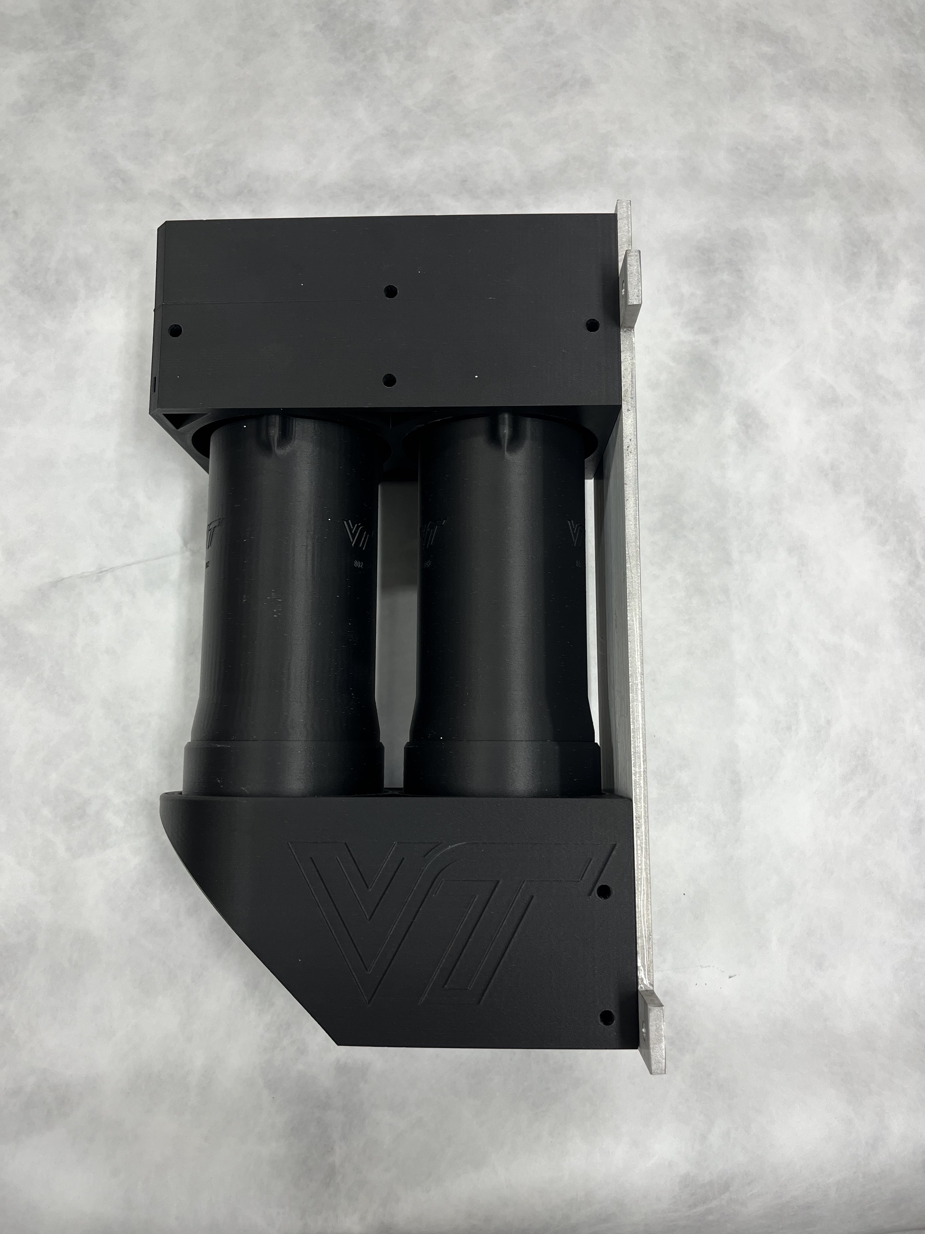
DBM Cosmic Stand Testing
events
events
45 PE/event (31%)
DBM
60 PE/event (35%)
PEs
DBM
Notes:
Our group is approaching the the start of production manufacture for each of these modules, and recently finished testing of the final prototypes of the detectors. The DBM is our simplest geometry, and is just a 100x76x10 mm quartz block glued to a 3-inch PMT. Before prototype construction, each detectors design is run through an optical GEANT4 simulation. My Monte Carlo simulation underestimates the photo electron yield by ~25%. Though the resolution is relatively similar.
The keen-eyed among you may notice there are actually two PMTs in this design and that I haven’t mentioned the bare pmt to this point. In the experiment, the bare PMT will be used to make a measurement of the flux of scattered particles through the PMT window and make a correction for the main detector.

Slide 8
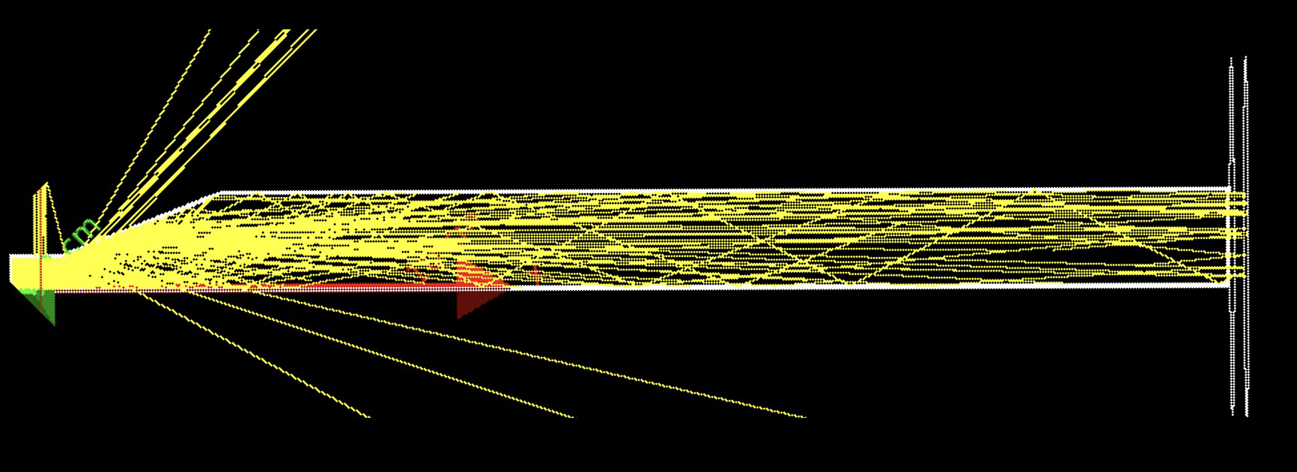
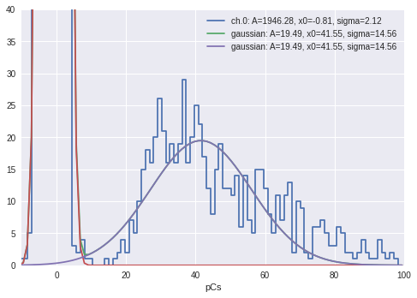
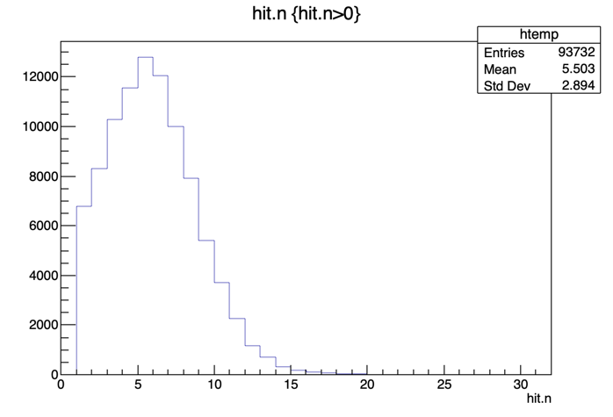
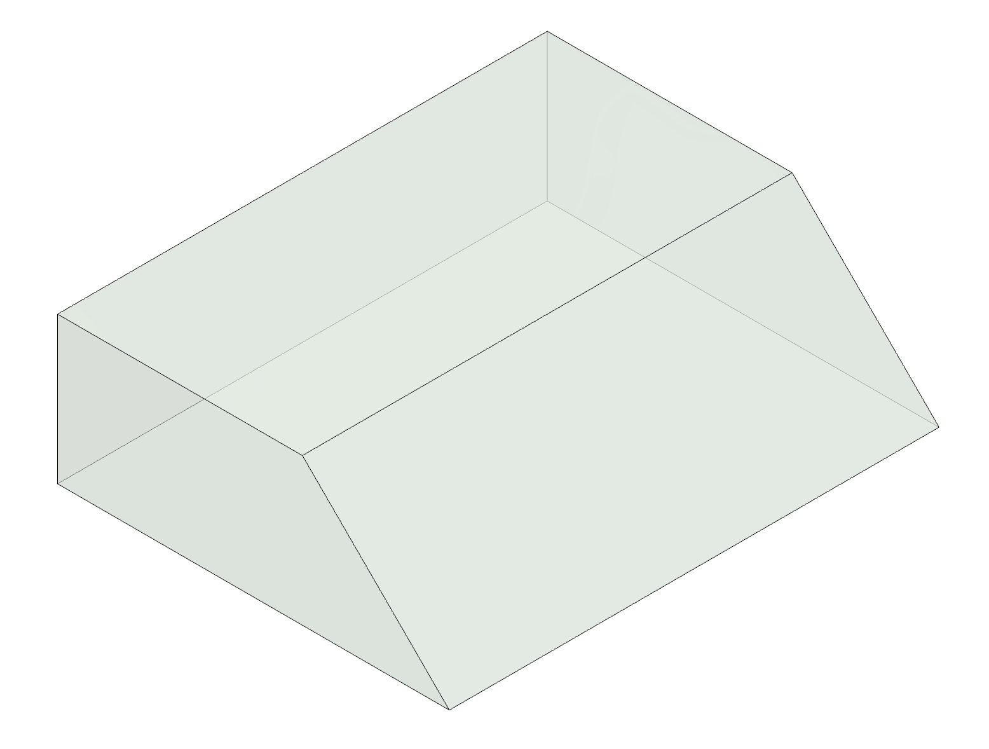
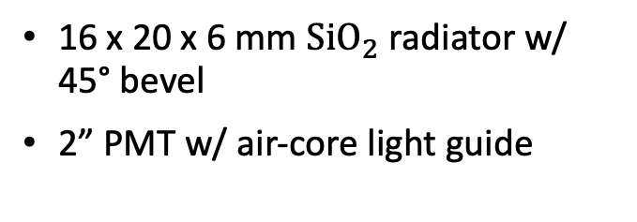

Small Angle Monitors
$$e^{−}$$
SAM Cosmic Test
events
4.6 PE (33%)
SAM Geant4 Simulation
SAM 1 GeV Sim
SAM @ MAMI
events
QDC Channel
5.5 PE (52%)
16 x 20 x 6 mm ${\text{SiO}}_{2}$ radiator w/ 45° bevel
2” PMT w/ air-core light guide
Notes:
Our second subsystem, the SAM, lives just upstream of the beam dump and has an active regions just 43 mm from the beamline, thus the rate through the quartz is very high. This provides us with an interesting challenge where we must have a good resolution at low photo electron yield. Because of this, we use a more tradition Cherenkov detector design, where the quartz radiator is beveled at 45 degrees to direct most of the Cherenkov photons to a reflective surface. In testing, we’ve found that our design results in better resolution than simulation, but similar yield. We currently have an undergrad working to understand this detector further.

Slide 9
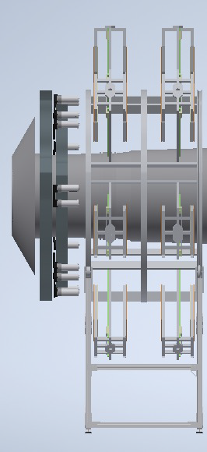
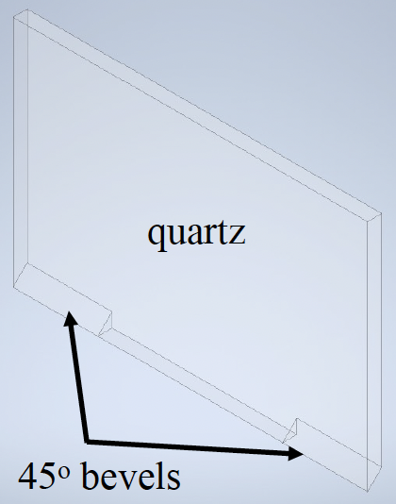
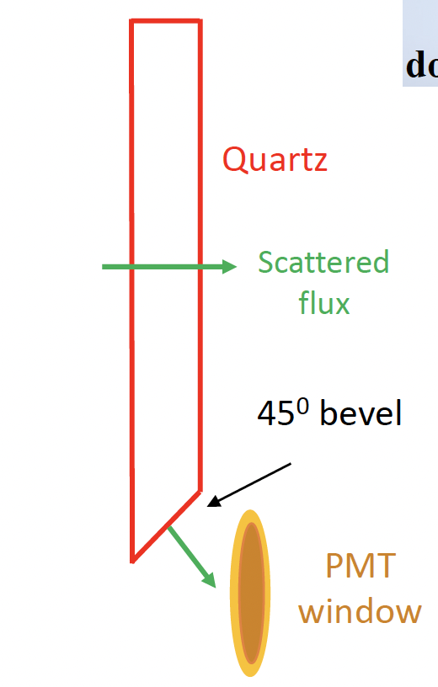
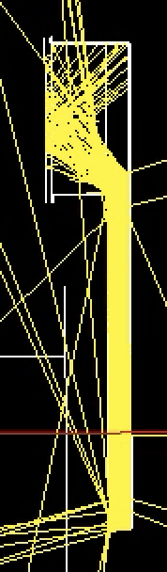

Large Angle Monitor
$25×16.5×1{\text{cm}}^{3}$quartz radiators embedded between Pb collars in open sectors
2x 3-inch PMT
100% 3D printed housing
Al flange
LAMs
Pb collars
Notes:
Lastly, our most complicated detector when considering response, the LAM. As the name implies, the LAM detects large angle scattered events. These mostly come from the e-p radiative tail, energies which are not well defined by the MOLLER spectrometer, thus resulting in the large radiator and active area for this detector. All that said, about half of this detector’s radiator is blocked by a lead collar when in situ.

Slide 10
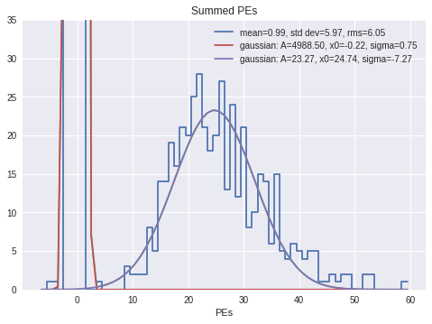
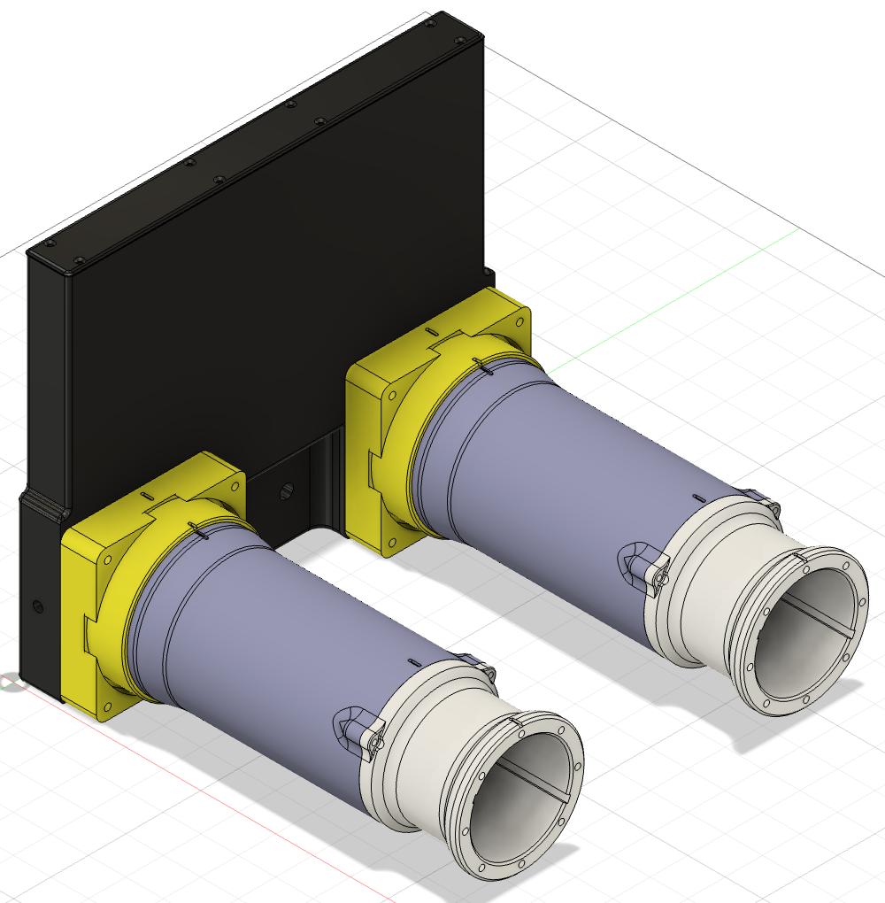
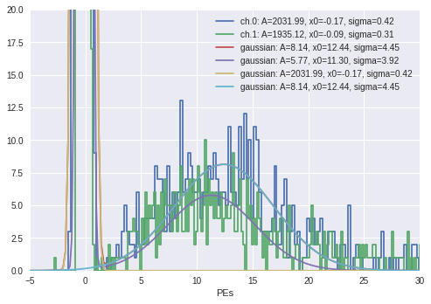
LAM Cosmic Stand Testing (Two PMT Sum)
25.0 PE/event (29%)
Single PMT yield
Avg: 11.9 PE/event (35%)
Notes:
First, we have the overall response when the yield is summed for the two PMTs.

Slide 11
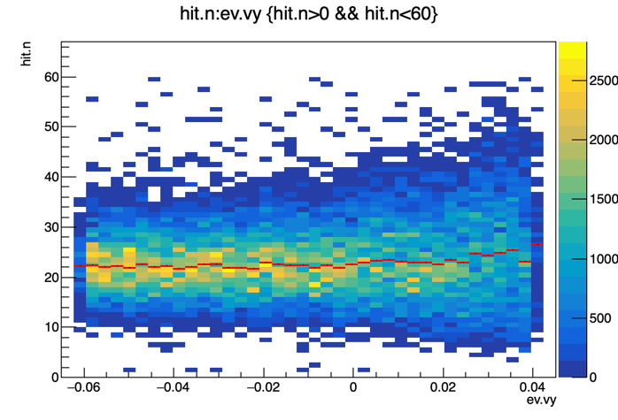
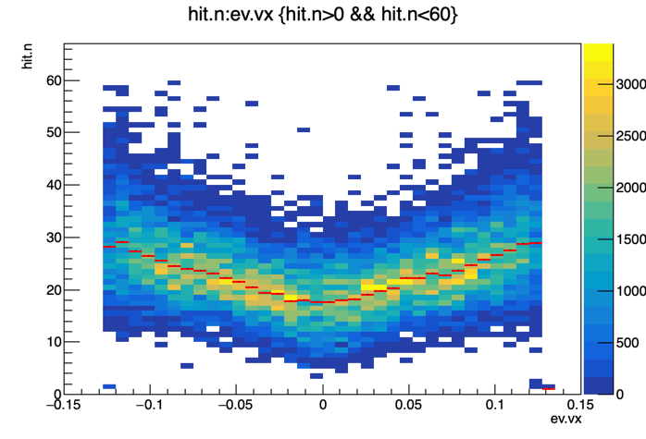
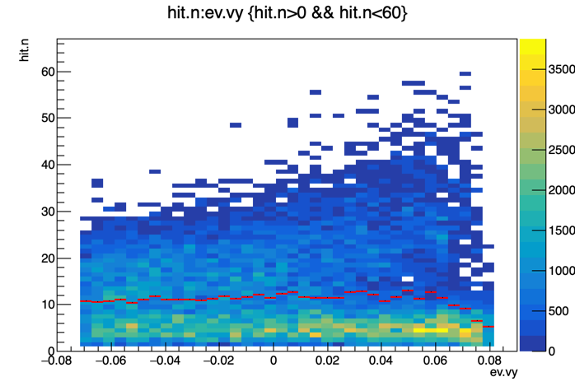
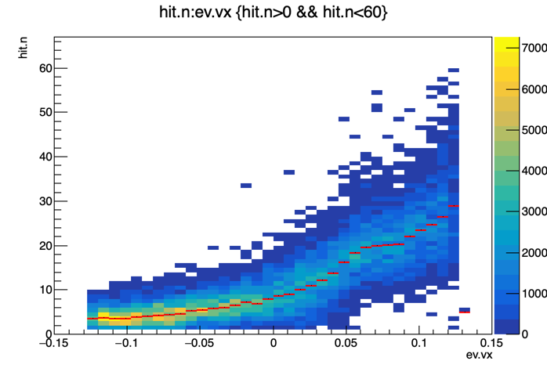

Large Angle Monitor
Position dependent response in simulation
Two PMTs
One PMT
Notes:
More interestingly though, we can look at the response vs. incident particle location. On the left is yield vs. incident y-position on the front face of the radiator, where we’ll see a damped oscillation in the yield as the incident position moves away from the PMT. And, on the right see about ~30% lower response in the center in comparison to the response directly below either PMT. While the deviation in the x-direction was expected, we were surprised by the oscillatory nature of the response in the y-direction when we first looked at the simulation results a couple years ago. It should also be noted that we first saw this response when simulating an acrylic radiator, where the oscillations were mush more pronounced, likely due to the lower mean yield of the acrylic. Nonetheless, we initially questioned whether simulation properly implemented the dynamics of a radiator with a somewhat complicated shape.

Slide 12
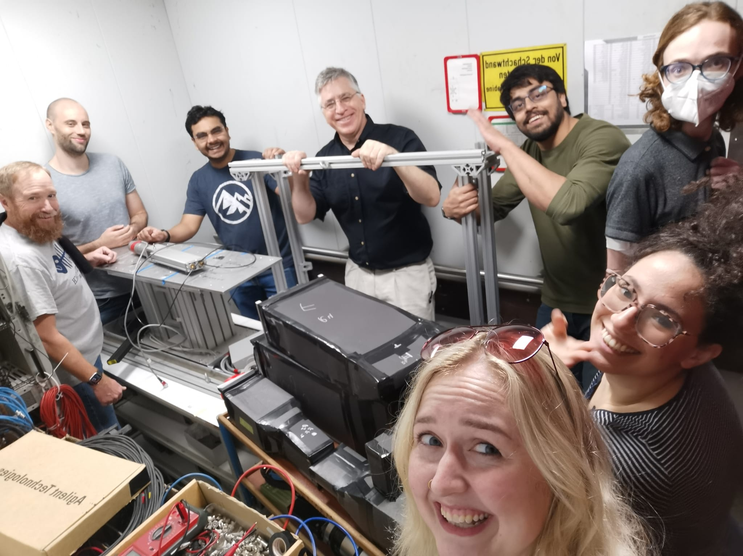
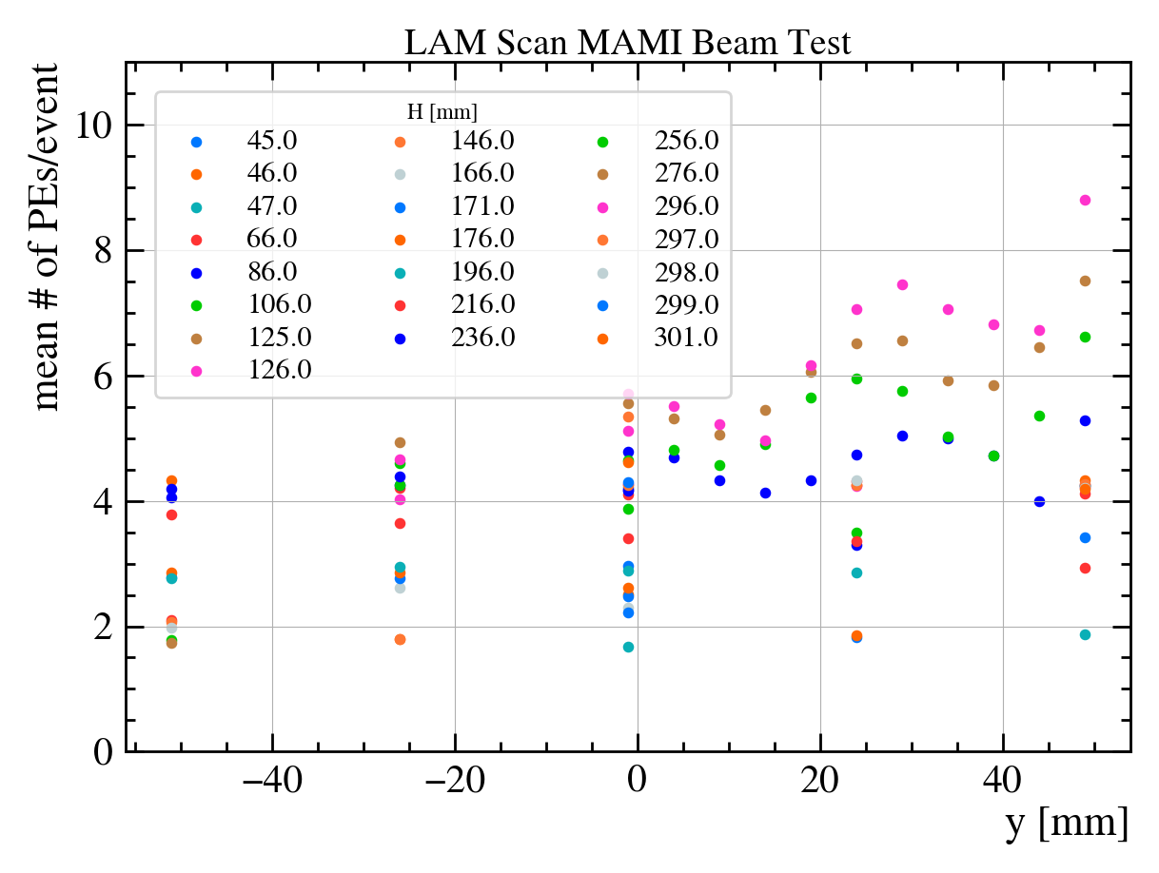
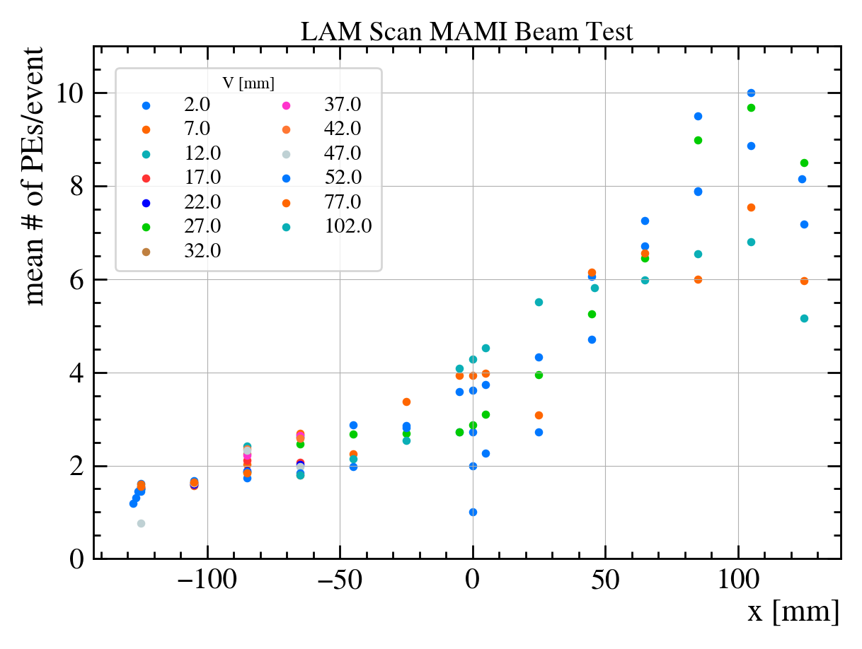
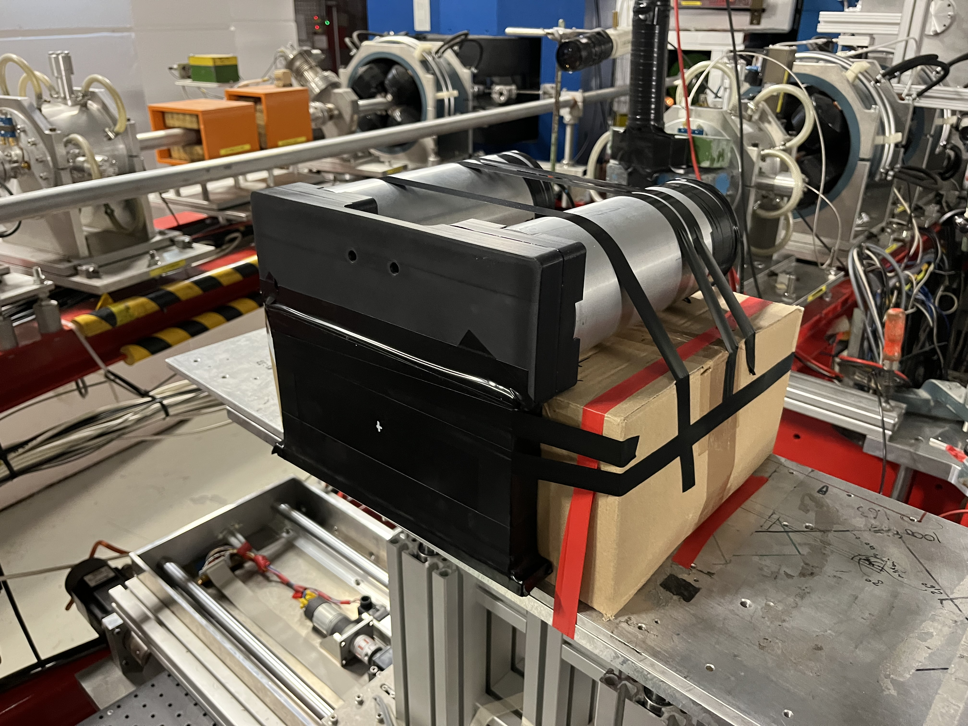
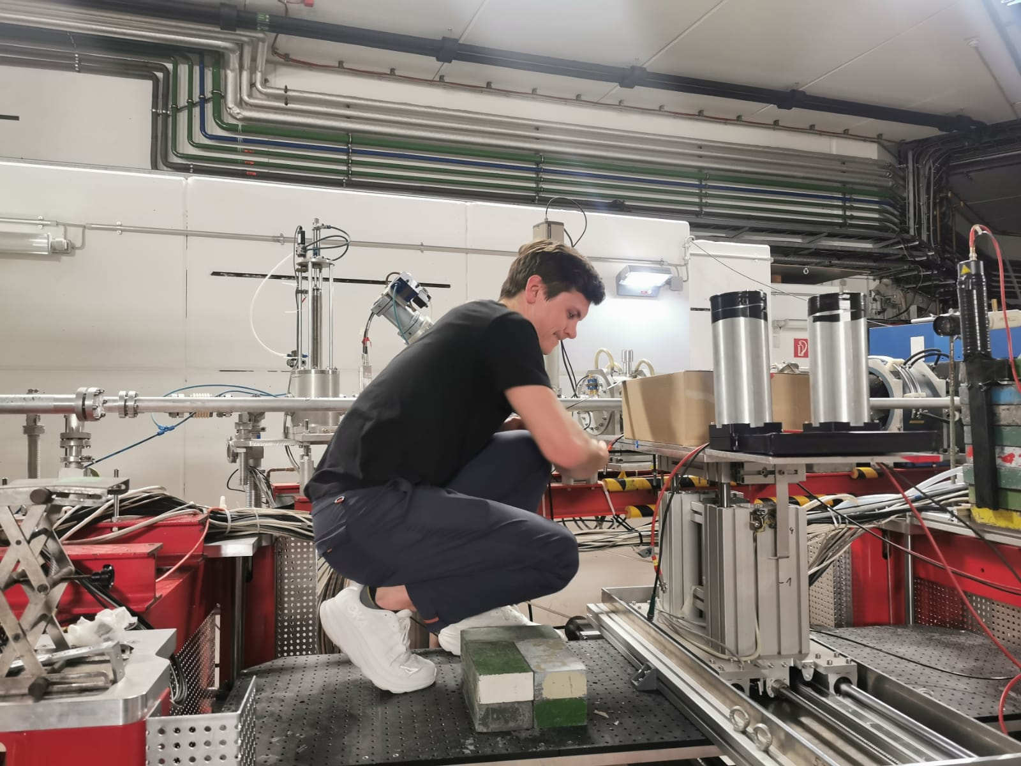
Large Angle Monitor
PRELIMINARY
PRELIMINARY
Note: Lucite prototype radiator used for this test
Notes:
We were fortunate enough to travel to Mainz, Germany and use the MAMI Test Beam to test the results we saw in simulation. By scanning a 50 mm x 50 mm sector directly below one of PMTs in 1mm increments, we found a clear oscillatory trend in the y-direction! We believe that this phenomena is due to the path length of Cherenkov photons produced at varying y positions, though this has not been thoroughly investigated due to the inconsequential nature of how these detectors are used for the MOLLER Experiment.

Slide 13
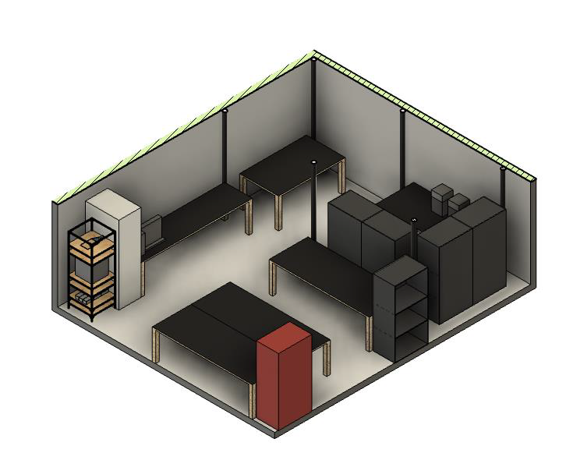
Production
Recently moved to Room 10 to facilitate construction of production modules
Facilities:
  Cosmic Muon Telescope
  3D Printing
  Laminar Flow hood for clean assembly
Full order due to JLab Fall 2025

Slide 14
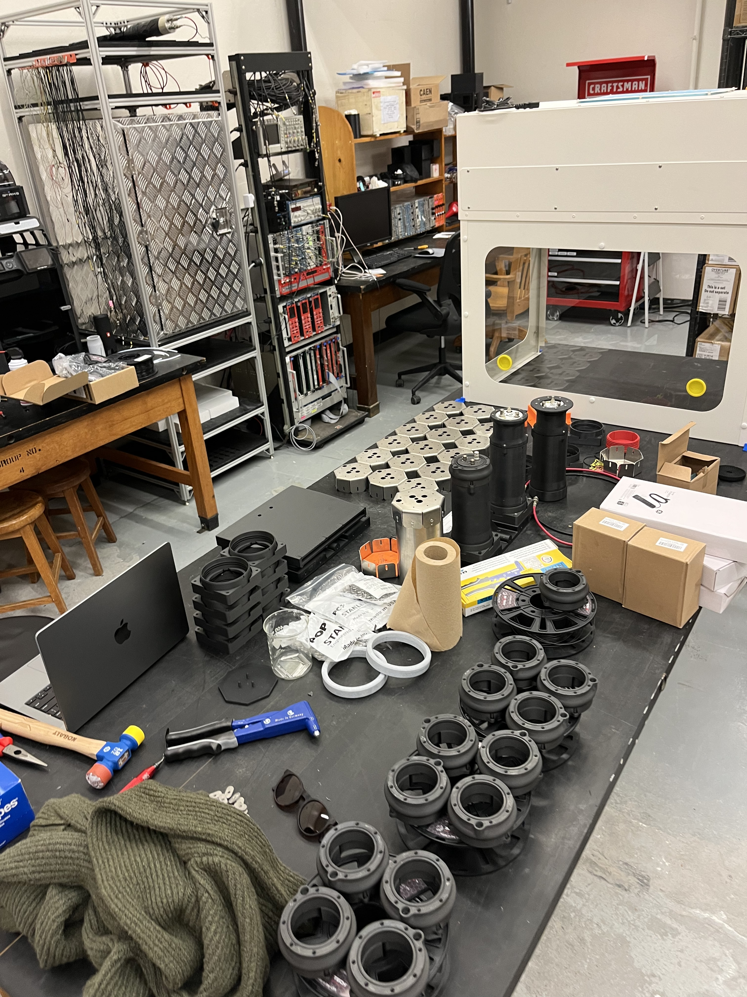
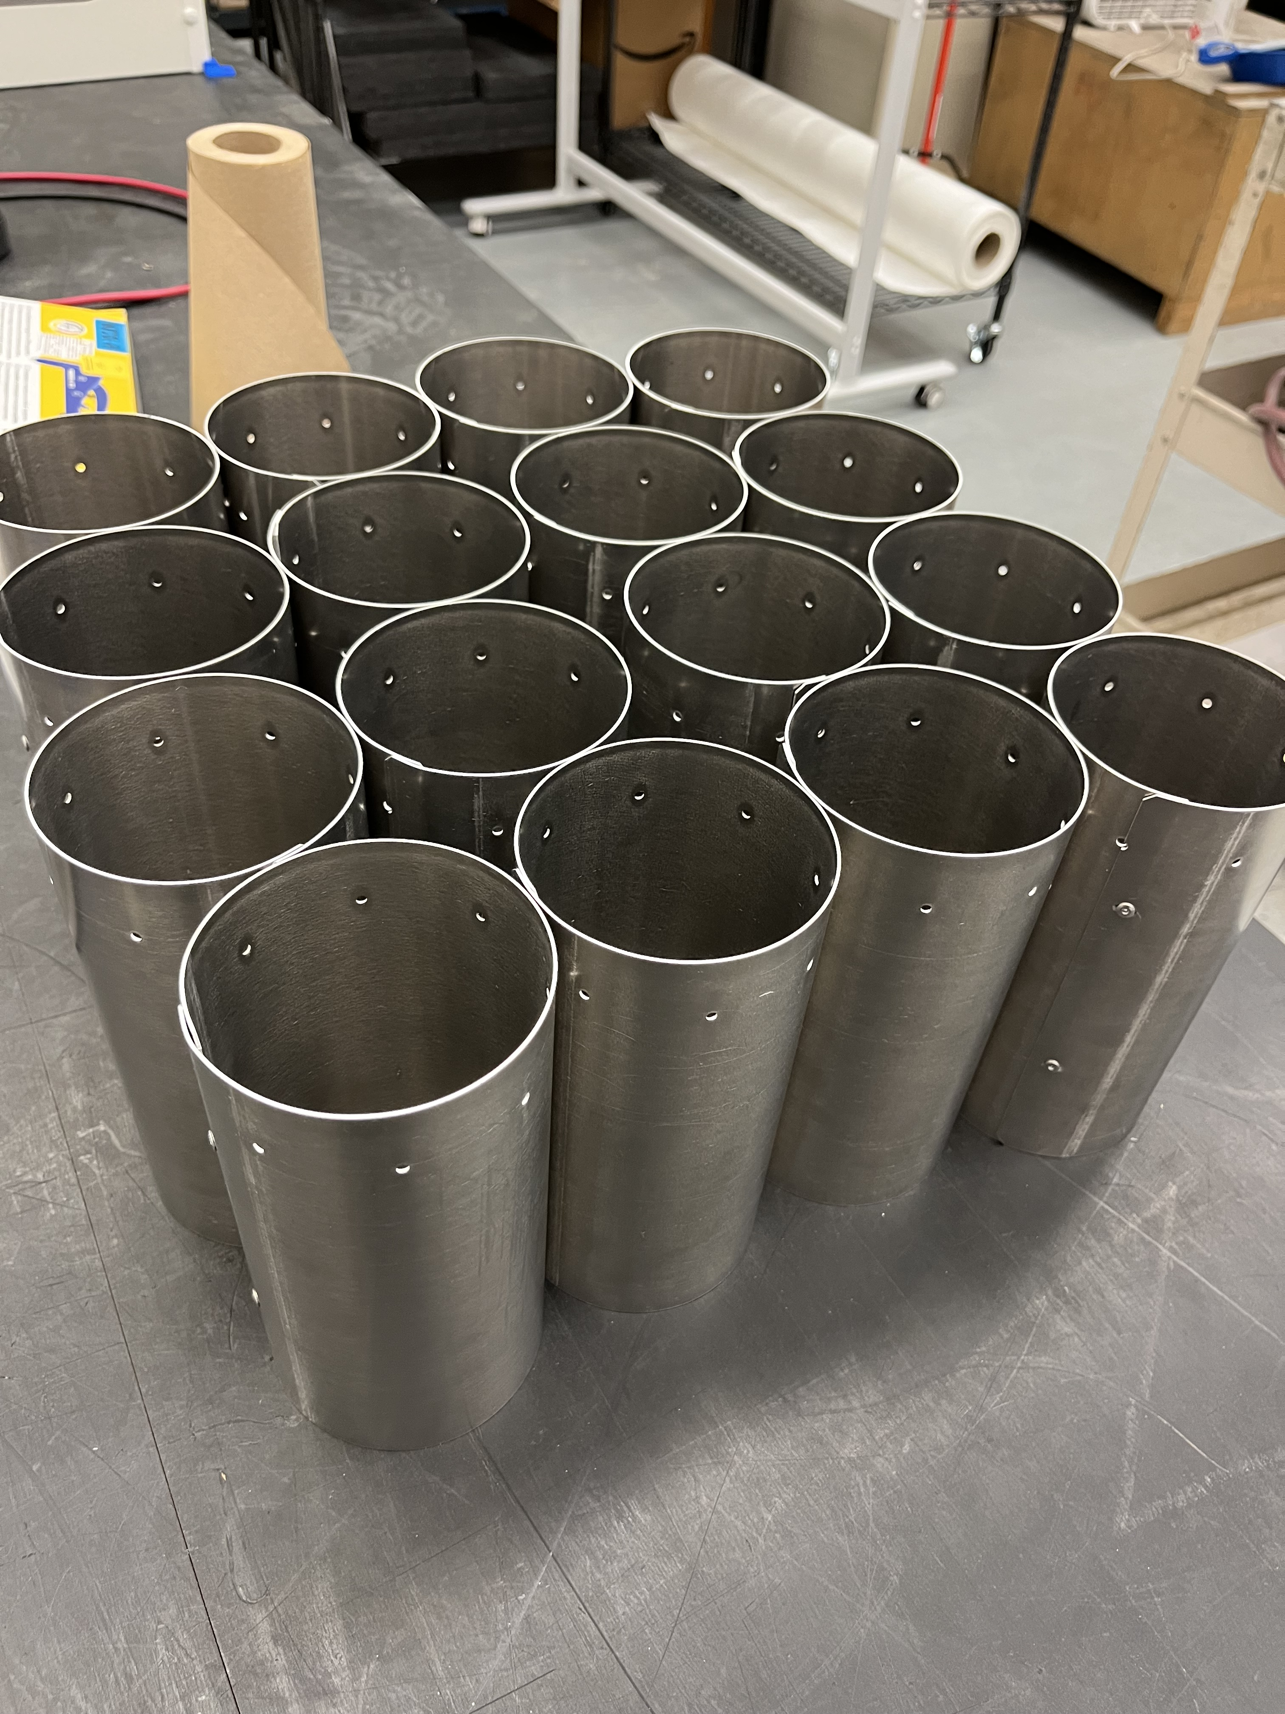
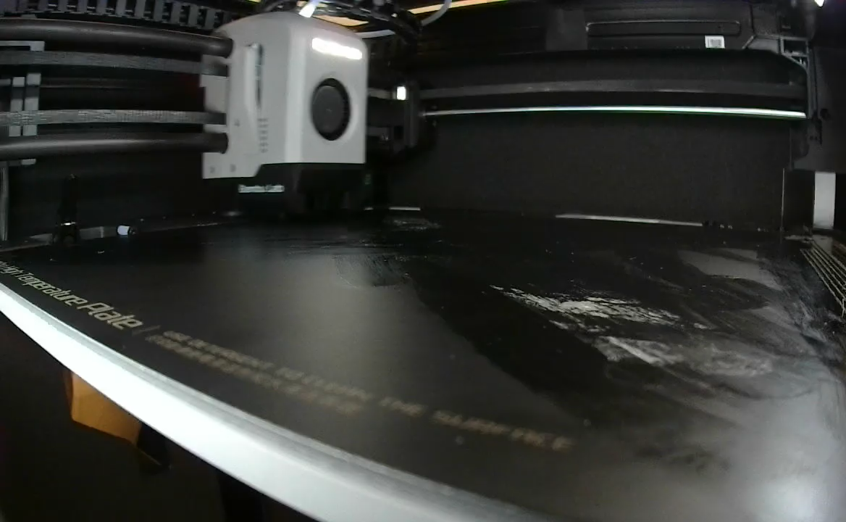


Production

Slide 15
Thank you!

Slide 16
Backup Slides

Slide 17
Yield Summary
 | Cosmic Test |  | 1 GeV Simulation
System | Mean PEs | Std Dev/Mean | Mean PEs | Std Dev/Mean
LAM (2 PMT sum) | 25.0 | 29% | 22.8 | 30%
LAM (single PMT) | 11.9 | 35% | 12.4 | 100%
SAM | 4.6 | 33% | 7.2 | 39%
DBM | 60.0 | 35% | 54.8 | 19%
- Cosmic Simulation: Qsim cosmics on quartz uniformly distributed in cosmic stand acceptance
- Cosmic Test: Quartz in cosmic stand
- 1 Gev Simulation: Qsim normally incident beam on quartz uniformly distributed across entire acceptance region
Notes:
I will leave you with a summary of the three detectors I’ve shown today and their expected performance for the experiment. Thank you for your time and I now open the floor to any questions.

Slide 18




Measurement Technique
Integrating Cerenkov Detectors (~300 used in MOLLER)
Highly polarized beam incident on high power target ($65μA$, 90% polarized beam)
  Rate at main detector ~150 GHz
Rapid Helicity flipping (1.92 kHz, $520μs$ windows reduce systematic error)
For MOLLER: $N=30B$
$$A±\frac{σ}{\sqrt{N}}$$
Notes:
In production running… 65 uA @ 90% polarization… ~150 Ghz
–necessary to reach statistical goal in reasonable time. We use Cerenkov detectors because of their fast response to events
- ~1 event every couple pic seconds -> typical response time ~10 ns
- Accumulate charge over integration period
- flip helicity of beam reduces systematic error
- associate integration windows with beam helicity -> extract asymmetry measurements from integrated signals
The high beam current and target result in a main detector rate of ~150 GHz(or an event every couple picoseconds). This rate is necessary to give the desired statistics; however, the typical detector response for our thin quartz Cerenkov detectors is ~ 10 ns. Thus, we have severe pileup. We solve this by integrating the charge accumulated over a specified window of time, rather than trying to collect data for a specific event. These integration windows are correlated to beam helicity. So, the experiment implements a pseudo-random ordering of 32 helicity windows to calculate one asymmetry measurement. Here you can see a toy example from the PREX experiment…

Slide 19


ET 9305KB Single PE Measurement
Measured w/ x100 gain
802 @ 900V: 56.9 fC/PE
  ${3.55×10}^{5}$
828 @ 1000V: 53.4 fC/PE
  $3.33×{10}^{5}$
https://drive.google.com/drive/u/0/folders/1QG75AULUsXvcZD8CDGR6FNTij93U5iQ8

Slide 20








DBM Estimation
Cerenkov Radiation in Quartz (${SO}_{2}$) – Back of the envelope calculation
$$\frac{d^{2}N}{dEdx}= \frac{αz^{2}}{ℏc}\sin^{2}{θ_{c}}≈370\sin^{2}{θ_{c}}$$
$$\cos{θ_{C}}=\frac{1}{βn(λ)}$$
For $β≈1$ particles through 1 cm${SO}_{2}, n≈1.55,$ assume constant $QE=30\%$:
$$θ_{C}=49.8°$$
N =$\int_{2.0 eV}^{4.4 eV}{\left(0.3\right)\left(216 ev^{−1}cm^{−1}\right)dE}$
Source: https://et-enterprises.com/images/data_sheets/9305KB.pdf
Upper Limit: N = 156 Photo-Electrons
Divide by 2 for attenuation and absorption = 78
Source: https://pdg.lbl.gov/2021/reviews/rpp2020-rev-passage-particles-matter.pdf

Slide 21

Diffuse Beam Monitor
14 Units located just upstream of the main detector
Two ET 9305KB PMTs
  One bare, connected to a 100 x 71 x 10 mm quartz radiator via SES406 Optical Cement
Monitor for large False Asymmetries
Picture of DBM

Slide 22
Large Angle Monitor
Large angle, high rate, and small asymmetry
“Null” asymmetry monitors as a check of helicity-correlated beam correction procedure
Monitor for potential false asymmetries from re-scattered backgrounds
Accepted flux is dominated by e-p elastic radiative tail
Total rate gives stat. width ~3.3 x Ring 5 (main physics); smaller (7 vs. 32 ppb) asymmetry
Process | Rate (GHz) | <A> (ppb) | <E> (GeV)
Møller | 10.5 | 10 | 1.3
Elastic ep | 21.2 | 4 | 1.1
Inelastic ep | 0.1 | 332
Total | 31.8 | 7

Slide 23



Large Angle Monitor
At the LAM plane:
50% of relative rate from target (1 e- w/ >1MeV)
25% from Al flange (1.3 e- w/ >1MeV)
25% from Pb collars (3 e- w/ >1MeV)
  Corrected primary rate: 70 GHz
  Stat. width / integration window: 176 ppm
Al flange
LAMs
Long tail due to EM showers in Pb
radius (m)
EM Showers and betas seen by LAM PMTs
Pb collars
Notes:
Stat width is error on single asymmetry measurement for 2 helicity windows
Add left fig to 17

Slide 24


Large Angle Monitor
Cosmic
1GeV Beam

Slide 25


Large Angle Monitor (single PMT)
Cosmic
1GeV Beam

Slide 26
Large Angle Monitor
Position dependent response in simulation
  Effects minimized by 2 PMTs and acceptance region in situ
Damped oscillations in vertical response
~30% deviation in x

Slide 27


Small Angle Monitors
beampipe
~0.1° Scattering Angle
~450 GHz/SAM
Small asymmetry (~3ppb), null asymmetry monitor
Notes:
The small angle monitors live just in front of the beam dump in a region of ~500 GHz 43mm from the beamline. This is a region in which the physics asymmetry is small (nothing new should be happening), thus it is a good region for diagnostics.

Slide 28



Small Angle Monitor
Cosmic
1GeV Beam
Beam on Center
Beam on Center
Active Area
Active Area

