Slide 1
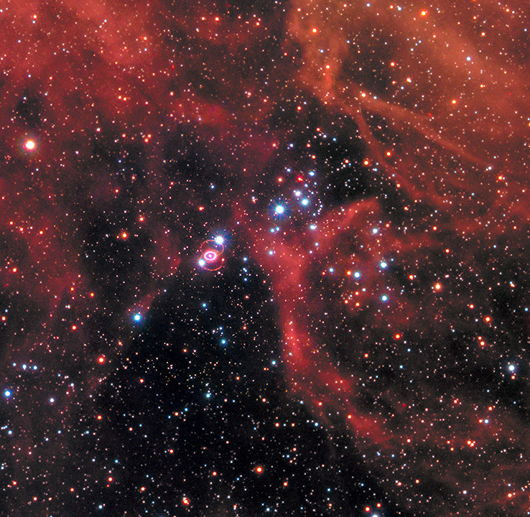
Predicting The Diffuse Supernova Neutrino Background
Andrew Caruso
In Collaboration with Shunsaku Horiuchi, Volodymyr Takhistov, & Tomoya Kinugawa
Hubble 2017 [1]
Center for Neutrino Physics Day
December 13, 2024

Slide 2
Core-collapse Supernovae
Death of Star
Massive star (M_{star} ≳ 8 M☉)
Explosion (supernova)
Neutron star

Slide 3
Core-collapse Supernovae
Death of Star
Lots of neutrinos and some photons
Massive star (M_{star} ≳ 8 M☉)
Neutrinos luminosity ~ Photon luminosity x 10⁶
Explosion (supernova)
Outshine entire visible universe!
Carry away ~10⁵³ erg (99% of gravitational binding energy)
Neutron star

Slide 4
Core-collapse Supernovae
Death of Star
Lots of neutrinos and some photons
Massive star (M_{star} ≳ 8 M☉)
Neutrinos luminosity ~ Photon luminosity x 10⁶
Explosion (supernova)
Outshine entire visible universe!
Carry away ~10⁵³ erg (99% of gravitational binding energy)
Neutron star
Have we detected supernova neutrinos?

Slide 5
Supernova Neutrino Detection
Yes!

Slide 6
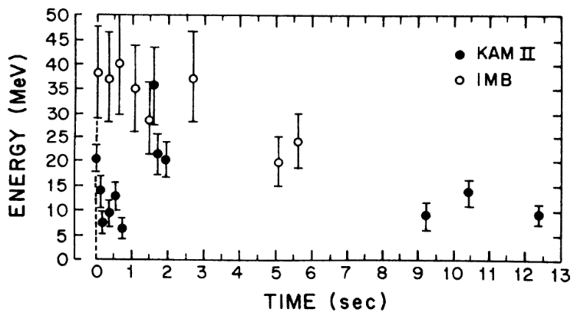
Supernova Neutrino Detection
Yes!
SN1987a
55 kpc away from Large Magellanic Cloud
12 events at Kamiokande-II
8 events at Irvine-Michigan-Brookhaven
Hirata et al. 1988 [2]

Slide 7
Supernova Neutrino Detection
Yes!
SN1987a
55 kpc away from Large Magellanic Cloud
12 events at Kamiokande-II
8 events at Irvine-Michigan-Brookhaven
Hirata et al. 1988 [2]
Confirms average neutrino energy ~15 MeV for total energy ~3x10⁵³ erg
But there is a slight issue…

Slide 8
Issue and Resolution
We have not detected supernova neutrinos ever since then!
Predicted local rate of supernova: ~1-2 per century
Supernova yields neutrinos

Slide 9
Issue and Resolution
We have not detected supernova neutrinos ever since then!
Predicted local rate of supernova: ~1-2 per century
Supernova yields neutrinos
Solution:
Look at ALL supernovae in past
Diffuse Supernova Neutrino Background (DSNB)
Expected:
Exist
Isotropic
Time independent

Slide 10
Issue and Resolution
We have not detected supernova neutrinos ever since then!
Predicted local rate of supernova: ~1-2 per century
Supernova yields neutrinos
Solution:
Look at ALL supernovae in past
Diffuse Supernova Neutrino Background (DSNB)
Expected:
Exist
Isotropic
Time independent
Not yet detected but can we do it?

Slide 11
Hunt for the DSNB
Super-Kamiokande
Water Cherenkov neutrino detector
Gadolinium (Gd) doped water
$\overline{\text{ν}\text{e}}+p→e^{+}+n$
Detect with Gd
Detect already
Super-Kamiokande Collaboration 2021 [3]

Slide 12
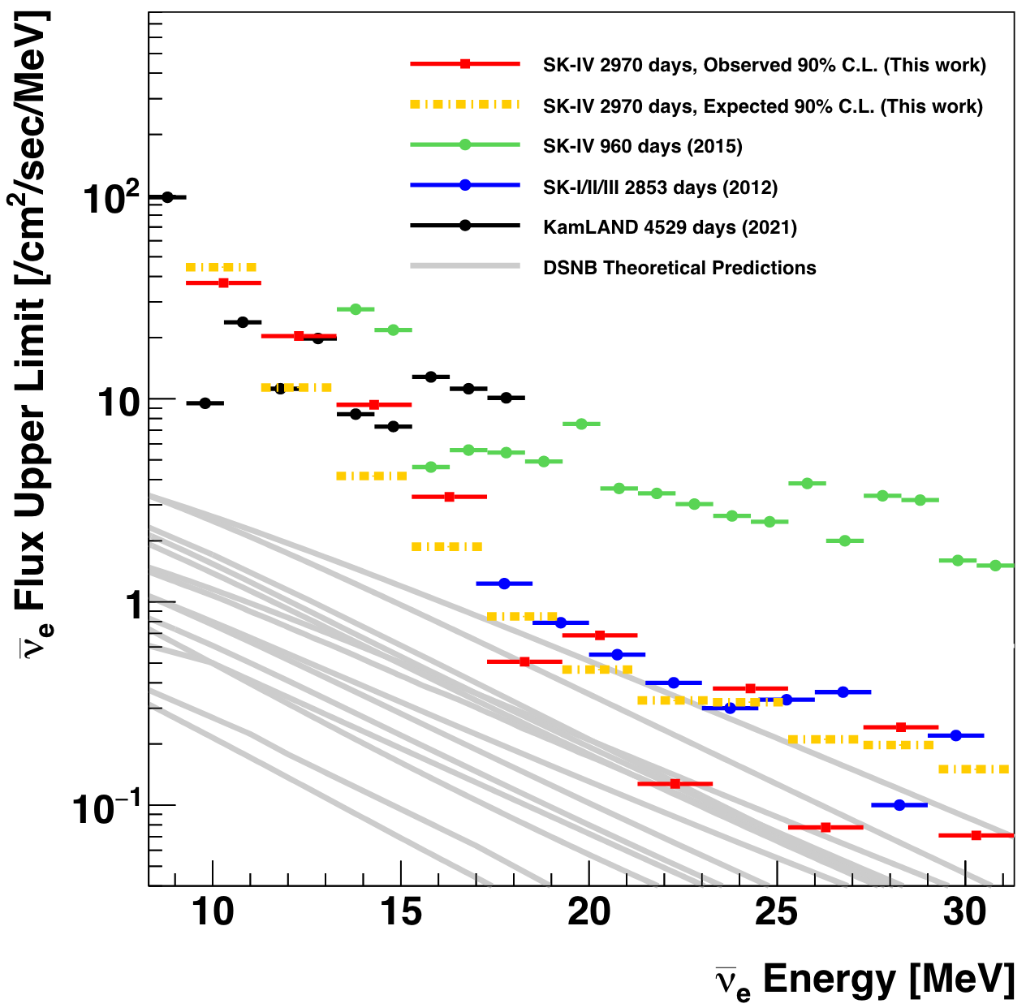
Hunt for the DSNB
Super-Kamiokande
Water Cherenkov neutrino detector
Gadolinium (Gd) doped water
$\overline{\text{ν}\text{e}}+p→e^{+}+n$
Detect with Gd
Detect already
Already excluding some theoretical models!
Super-Kamiokande Collaboration 2021 [3]

Slide 13
Hunt for the DSNB
Super-Kamiokande
Water Cherenkov neutrino detector
Gadolinium (Gd) doped water
$\overline{\text{ν}\text{e}}+p→e^{+}+n$
Detect with Gd
Detect already
Already excluding some theoretical models!
But supernovae are NOT that simple.
Super-Kamiokande Collaboration 2021 [3]

Slide 14
Previous DSNB Prediction
Recent prediction by Horiuchi et al. 2021
Included binary systems since most stars are in pairs
[4]

Slide 15
Previous DSNB Prediction
Recent prediction by Horiuchi et al. 2021
Included binary systems since most stars are in pairs
[4]
Merging Case
Non-merging Case

Slide 16
Previous DSNB Prediction
Recent prediction by Horiuchi et al. 2021
Included binary systems since most stars are in pairs
[4]
Merging Case
Massive Stars
Single Supernova
M_{star} ≳ 8 M☉
Non-merging Case

Slide 17
Previous DSNB Prediction
Recent prediction by Horiuchi et al. 2021
Included binary systems since most stars are in pairs
[4]
Merging Case
Massive Stars
Single Supernova
M_{star} ≳ 8 M☉
Non-merging Case
Two Supernovae

Slide 18
Previous DSNB Prediction
Recent prediction by Horiuchi et al. 2021
Included binary systems since most stars are in pairs
[4]
Merging Case
Massive Stars
Single Supernova
M_{star} ≳ 8 M☉
Non-merging Case
Two Supernovae
M_{star} < 8 M☉

Slide 19
Previous DSNB Prediction
Recent prediction by Horiuchi et al. 2021
Included binary systems since most stars are in pairs
[4]
Merging Case
Massive Stars
Single Supernova
M_{star} ≳ 8 M☉
Non-merging Case
Two Supernovae
How to make the prediction?
M_{star} < 8 M☉

Slide 20
Previous DSNB Prediction
By calculating the DSNB flux
Has three ingredients:
$$\frac{dφ}{dE}(E)=\int_{0}^{z_{max}}{R_{cc}\left(z\right)∗f_{ν}\left(E\left(1+z\right)\right)∗\frac{c}{\sqrt{Ω_{m}{\left(1+z\right)}^{3}+{ Ω}_{Λ}}}dz }$$

Slide 21
Previous DSNB Prediction
By calculating the DSNB flux
Has three ingredients:
$$\frac{dφ}{dE}(E)=\int_{0}^{z_{max}}{R_{cc}\left(z\right)∗f_{ν}\left(E\left(1+z\right)\right)∗\frac{c}{\sqrt{Ω_{m}{\left(1+z\right)}^{3}+{ Ω}_{Λ}}}dz }$$

Slide 22
Previous DSNB Prediction
By calculating the DSNB flux
Has three ingredients:
$$\frac{dφ}{dE}(E)=\int_{0}^{z_{max}}{R_{cc}\left(z\right)∗f_{ν}\left(E\left(1+z\right)\right)∗\frac{c}{\sqrt{Ω_{m}{\left(1+z\right)}^{3}+{ Ω}_{Λ}}}dz }$$
Supernova rate

Slide 23
Previous DSNB Prediction
By calculating the DSNB flux
Neutrino spectrum
Has three ingredients:
$$\frac{dφ}{dE}(E)=\int_{0}^{z_{max}}{R_{cc}\left(z\right)∗f_{ν}\left(E\left(1+z\right)\right)∗\frac{c}{\sqrt{Ω_{m}{\left(1+z\right)}^{3}+{ Ω}_{Λ}}}dz }$$
Supernova rate

Slide 24
Previous DSNB Prediction
By calculating the DSNB flux
Neutrino spectrum
Has three ingredients:
$$\frac{dφ}{dE}(E)=\int_{0}^{z_{max}}{R_{cc}\left(z\right)∗f_{ν}\left(E\left(1+z\right)\right)∗\frac{c}{\sqrt{Ω_{m}{\left(1+z\right)}^{3}+{ Ω}_{Λ}}}dz }$$
Supernova rate
Cosmological factor

Slide 25
Previous DSNB Prediction
By calculating the DSNB flux
Neutrino spectrum
Has three ingredients:
$$\frac{dφ}{dE}(E)=\int_{0}^{z_{max}}{R_{cc}\left(z\right)∗f_{ν}\left(E\left(1+z\right)\right)∗\frac{c}{\sqrt{Ω_{m}{\left(1+z\right)}^{3}+{ Ω}_{Λ}}}dz }$$
Incorporate binary populations into average neutrino spectrum

Slide 26
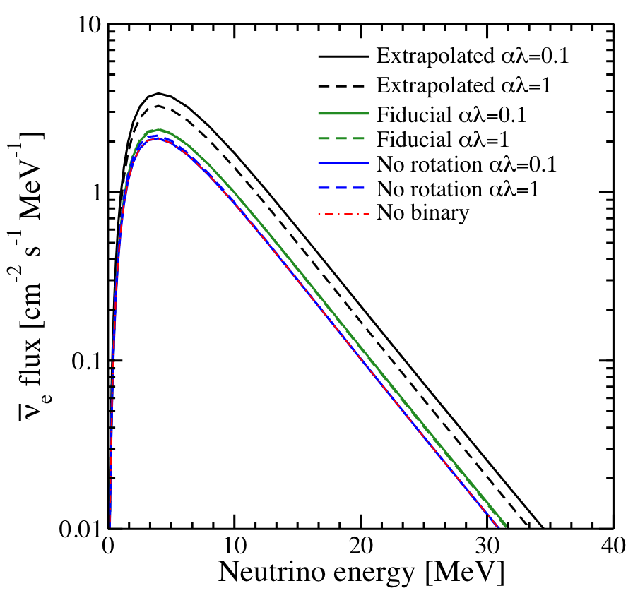
Previous DSNB Prediction
DSNB flux from $\overline{\text{ν}\text{e}}$
Horiuchi et al. 2020 [4]

Slide 27
Previous DSNB Prediction
DSNB flux from $\overline{\text{ν}\text{e}}$
Without binaries
Horiuchi et al. 2020 [4]

Slide 28
Previous DSNB Prediction
DSNB flux from $\overline{\text{ν}\text{e}}$
With binaries
Without binaries
Horiuchi et al. 2020 [4]

Slide 29
Previous DSNB Prediction
DSNB flux from $\overline{\text{ν}\text{e}}$
With binaries DSNB flux increases
With binaries
Without binaries
Horiuchi et al. 2020 [4]

Slide 30
Previous DSNB Prediction
DSNB flux from $\overline{\text{ν}\text{e}}$
What if black holes form instead of neutron star?
With binaries DSNB flux increases
With binaries
Without binaries
Horiuchi et al. 2020 [4]

Slide 31
Core-collapse Supernovae Evolution III
Massive Star (M_{star} ≳ 8 M☉)
Supernova
Failed Supernova
Neutron Star
(less neutrinos)
Black Hole
(more neutrinos)

Slide 32
Core-collapse Supernovae Evolution III
Massive Star (M_{star} ≳ 8 M☉)
Can include with binaries for new prediction
via the average neutrino spectrum
$$\frac{dφ}{dE}(E)=\int_{0}^{z_{max}}{R_{cc}\left(z\right)∗f_{ν}\left(E\left(1+z\right)\right)∗\frac{c}{\sqrt{Ω_{m}{\left(1+z\right)}^{3}+{ Ω}_{Λ}}}dz }$$
Supernova
Failed Supernova
Neutron Star
(less neutrinos)
Black Hole
(more neutrinos)

Slide 33
Core-collapse Supernovae Evolution III
Massive Star (M_{star} ≳ 8 M☉)
Can include with binaries for new prediction
via the average neutrino spectrum
$$\frac{dφ}{dE}(E)=\int_{0}^{z_{max}}{R_{cc}\left(z\right)∗f_{ν}\left(E\left(1+z\right)\right)∗\frac{c}{\sqrt{Ω_{m}{\left(1+z\right)}^{3}+{ Ω}_{Λ}}}dz }$$
Supernova
Failed Supernova
But we do not know how many supernovae form black holes vs neutron stars?
Neutron Star
(less neutrinos)
Black Hole
(more neutrinos)

Slide 34
Current Project
Use two sets of simulated data:
Supernova simulations
Knows remnant type
(Sukhbold et al. 2015)
[5]
[4]

Slide 35
Current Project
Use two sets of simulated data:
Supernova simulations
Knows remnant type
(Sukhbold et al. 2015)
Criterion
To distinguish progenitors
[5]
[4]

Slide 36
Current Project
Use two sets of simulated data:
Supernova simulations
Knows remnant type
(Sukhbold et al. 2015)
Criterion
To distinguish progenitors
[5]
Binary synthesis
Blind to remnant type
(used in Horiuchi et al. 2021)
[4]
[4]

Slide 37
Current Project
Use two sets of simulated data:
Supernova simulations
Knows remnant type
(Sukhbold et al. 2015)
Criterion
To distinguish progenitors
[5]
Neutrino spectra
And
DSNB flux
Binary synthesis
Blind to remnant type
(used in Horiuchi et al. 2021)
[4]
[4]

Slide 38
Current Project
Preliminary result (not at Earth):
Criterion:
> 5 M☉ form black hole
Progenitors with M_{co}
≤ 5 M☉ form neutron star
[4]

Slide 39
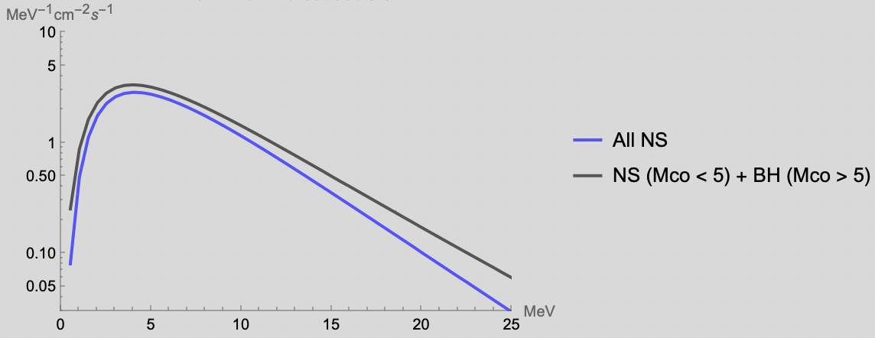
Current Project
Preliminary result (not at Earth):
Criterion:
> 5 M☉ form black hole
Progenitors with M_{co}
≤ 5 M☉ form neutron star
[4]

Slide 40
Current Project
Preliminary result (not at Earth):
Criterion:
With criterion
> 5 M☉ form black hole
Progenitors with M_{co}
≤ 5 M☉ form neutron star
Without criterion
[4]

Slide 41
Current Project
Preliminary result (not at Earth):
Criterion:
With criterion
> 5 M☉ form black hole
Progenitors with M_{co}
≤ 5 M☉ form neutron star
Without criterion
Inclusion of black hole formation with binary population may increase DSNB flux
[4]

Slide 42
Summary

Slide 43
Summary
1. The diffuse supernova neutrino background is worth the search

Slide 44
Summary
1. The diffuse supernova neutrino background is worth the search
2. Better theoretical predictions are necessary

Slide 45
Summary
1. The diffuse supernova neutrino background is worth the search
2. Better theoretical predictions are necessary
3. On verge of discovery of the DSNB

Slide 46
Summary
1. The diffuse supernova neutrino background is worth the search
2. Better theoretical predictions are necessary
3. On verge of discovery of the DSNB
Questions?

Slide 48
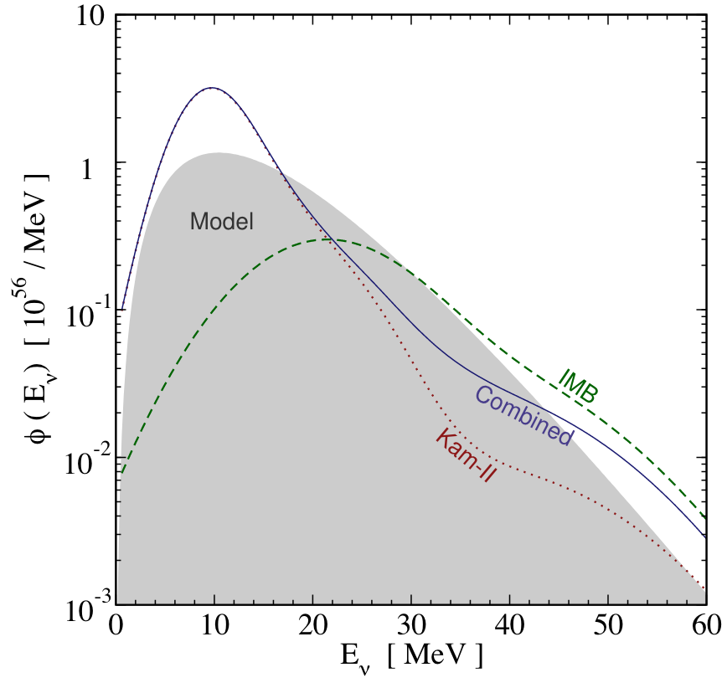
Supernova Neutrino Detect (EXTRA)
Model assumes:
Fermi-Dirac spectrum
Neutrino energy = 15 MeV
Time integrated Luminosity = 5x10⁵² erg
[2]
Yüksel & Beacom 2007 [a]

Slide 49
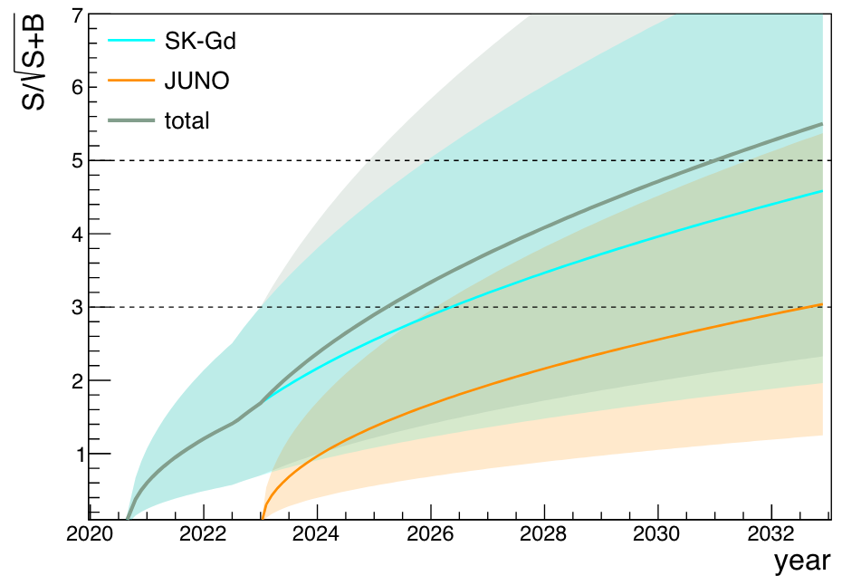
Hunt for the DSNB (EXTRA)
Reach ~5σ by 2030s with SK-Gd and JUNO
Li et al. 2022 [b]

Slide 50
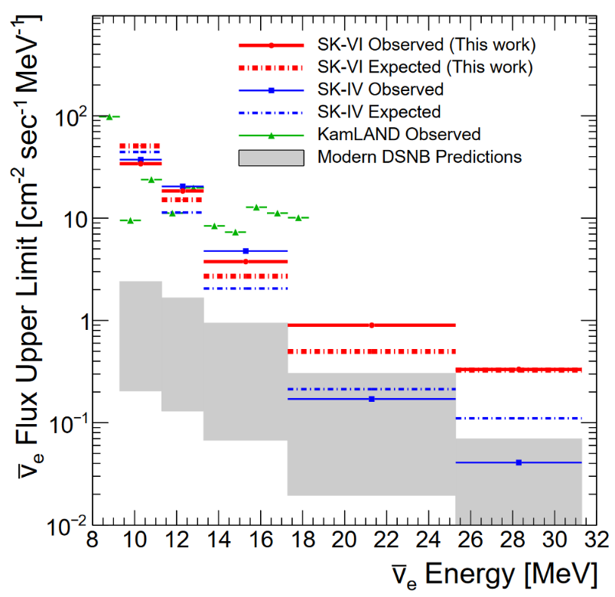
Hunt for the DSNB (EXTRA)
SK-IV bounds are stronger than SK-VI
Santos 2022 [b]

Slide 51
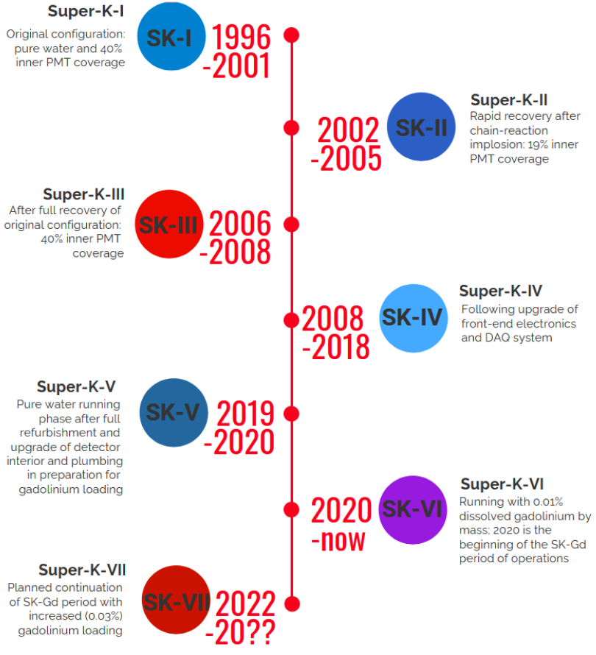
Hunt for the DSNB (EXTRA)
Santos 2022 [b]

Slide 52
References
[1] https://hubblesite.org/contents/media/images/2017/08/3987-Image.html
[2] https://arxiv.org/abs/astro-ph/0702613v3
[3] https://arxiv.org/abs/2109.11174
[4] https://arxiv.org/abs/2012.08524
[5] https://wwwmpa.mpagarching.mpg.de/ccsnarchive/data/SEWBJ_2015/index.html
[a] https://arxiv.org/abs/astro-ph/0702613
[b] https://arxiv.org/abs/2201.12920
[c] https://arxiv.org/abs/2405.07900

