Slide 1
A Simple Model to Explain A Photon
Maajida Murdock
Randallstown High School
Morgan State. University

Slide 2
Abstract
I will present a model that illustrates the behavior of photons for K-12 students. The model of the photon I used combines both the 'wave' and 'particle' nature of light. We will incorporate a hands-on activity using pipe cleaners to represent the wave properties, while play dough will symbolize energy. We will share our experiences teaching this model and highlight some observations we made with students in grades 6 to 12. Additionally, we will demonstrate how this model utilizes the matching photon properties and discuss its limitations.

Slide 3
Art Picture: Two image/ One picture

Slide 4
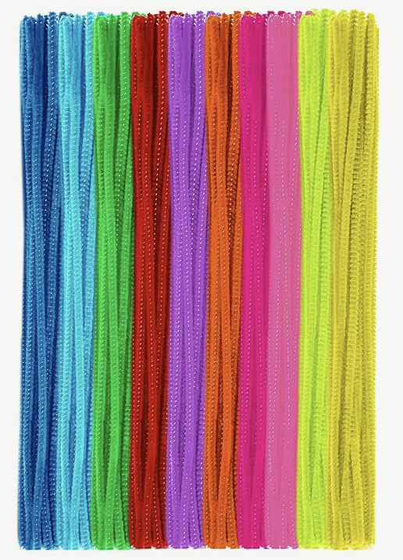
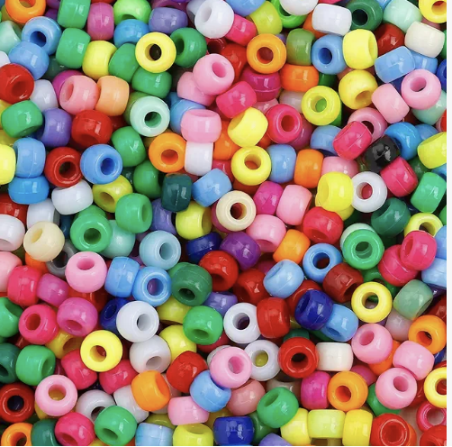
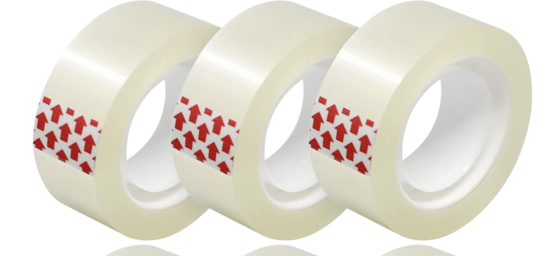
Materials
Pipe cleaners
Hair Beads
Tape
Graph Paper

Slide 5
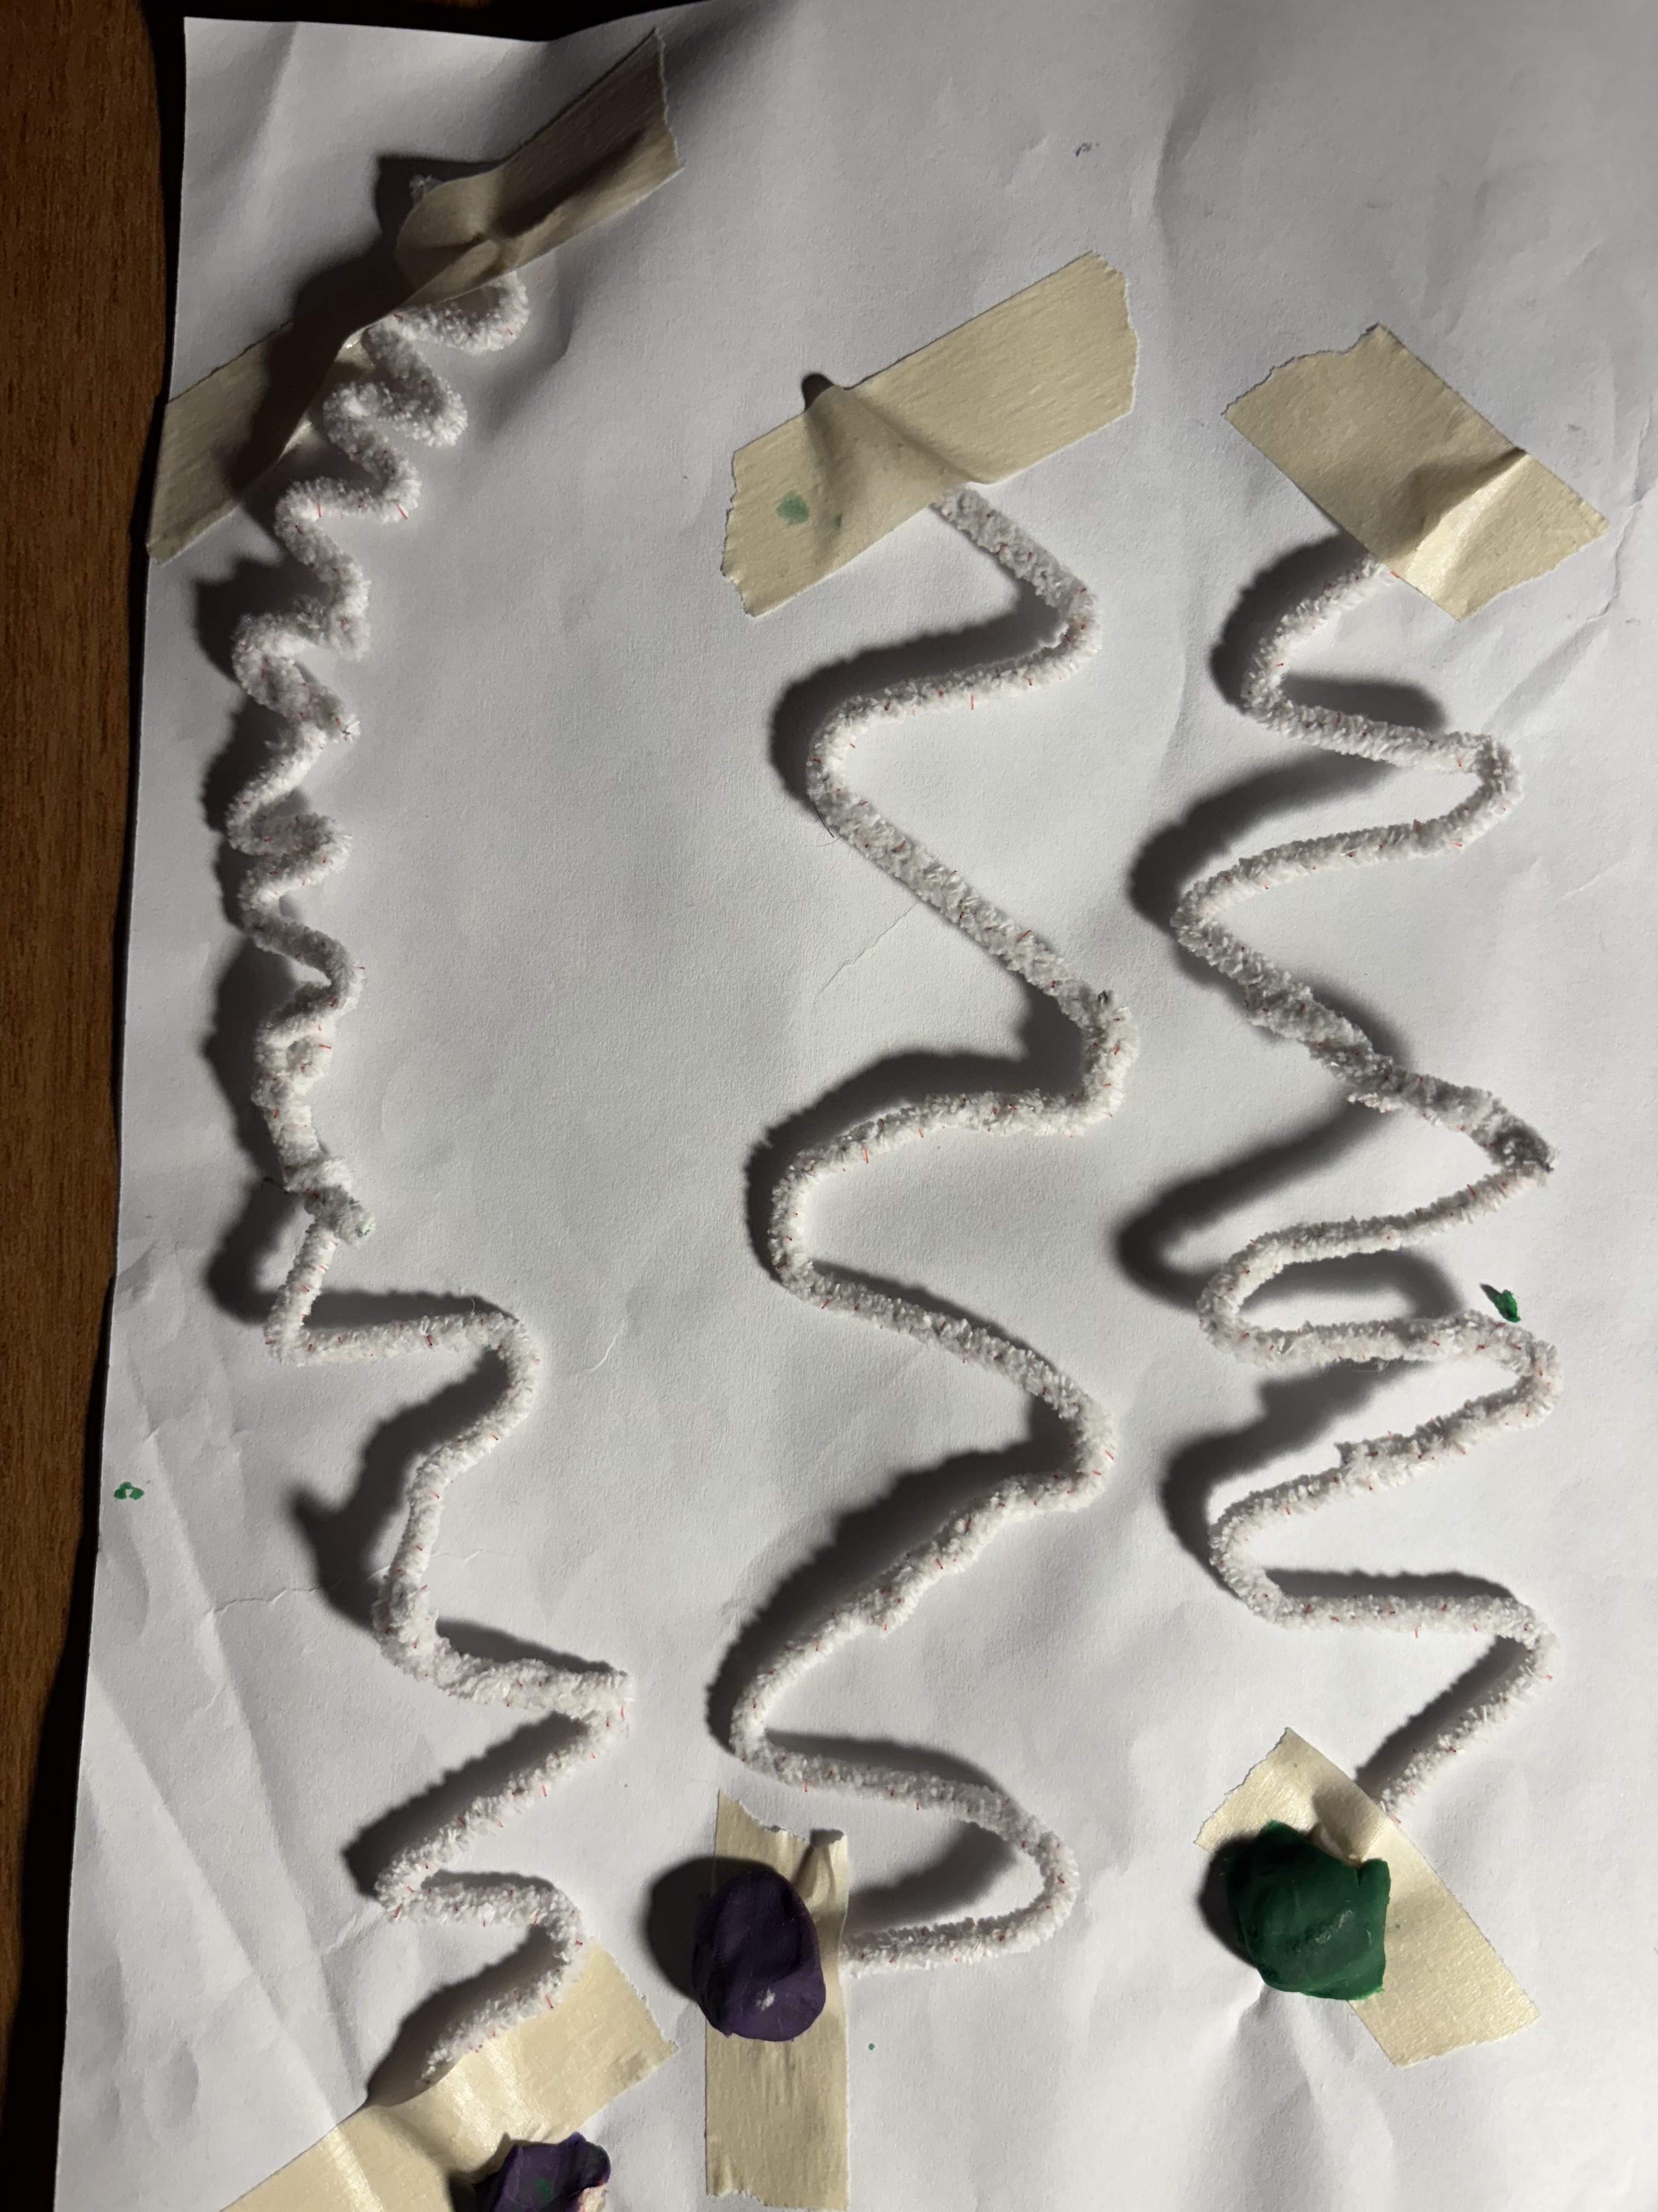
The simple model of the nature of a photon combines both the “waviness” and “bulletiness”

Slide 6
Model Observation | Photon Property | Limitation
The pipe cleaner has a wave shape | Photons have a waviness | Photon waviness while similar to classical waves Instead the waviness is a description of the probability of interaction with a photon
Hair Bead has a mass | Photons have bulletiness | Photon bulletiness is not contained in a localized position Photon bulletiness is related to photon momentum Photons have no rest mass Photon momentum is completely defined by their energy Photon’s energy is related to the frequency
The waviness and bulletness are inversely related | Increasing the wavelength of the photon decrease the photon energy | Student can visualize the inverse relation Wavelength = 1/energy
Models with the same wavelength can have a different amplitude | The amplitude of photon waviness is not related to the bulletiness | The students can choose the amplitude of the pipe cleaner. Amplitude of the waviness does nor affect th model photon’s properties. Larger the amplitude direct propotion to the probability

Slide 7
Thank you
Acknowledgment
Walbrook Enoch free Pratt library, Baltimore MD
The Einstein – The University of Western Australia
Randallstowns High School, BCPS Randallstown MD

