Slide 1
Aiding Student Learning Through Recorded Solution Videos
Rebecca Grouchy

Slide 2
Motivation
Resources Provided
TA Led Office Hours
Professor Led Office Hours
Pre-Lecture Videos
In-class Demos and Recordings
Why aren’t the resources used?
Time constraints
Schedule conflicts
Uncomfortable asking for help

Slide 3
Choosing Textbook Problems
Assignments
Resource Provided
Homework
Weekly Reports
Exam Prep/Study
Don’t know where to start?
Conceptual Questions
Solutions

Slide 4
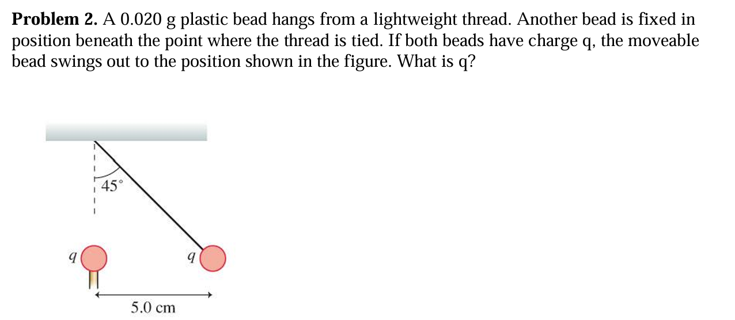
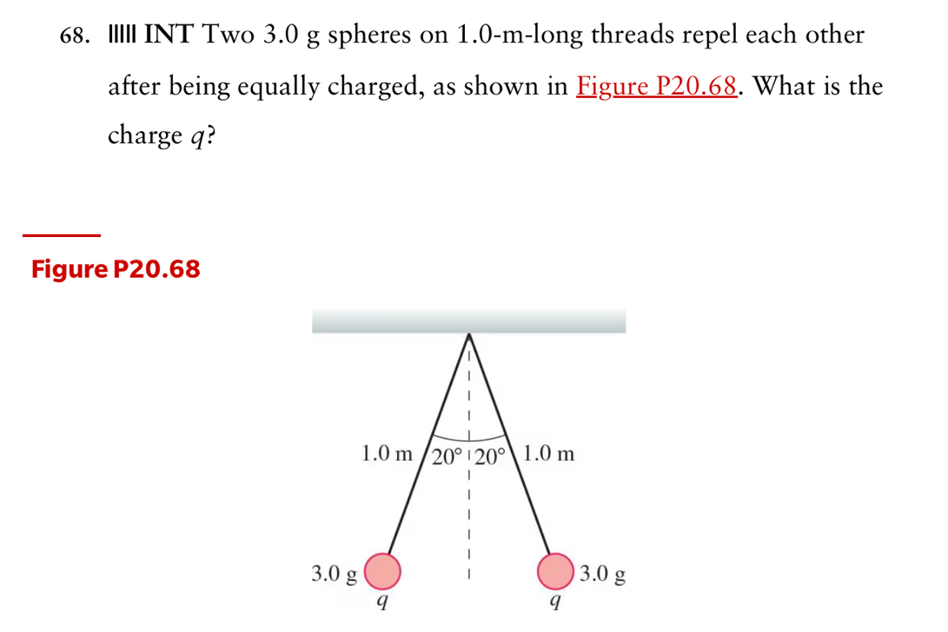
Don’t Know Where to Start?

Slide 5
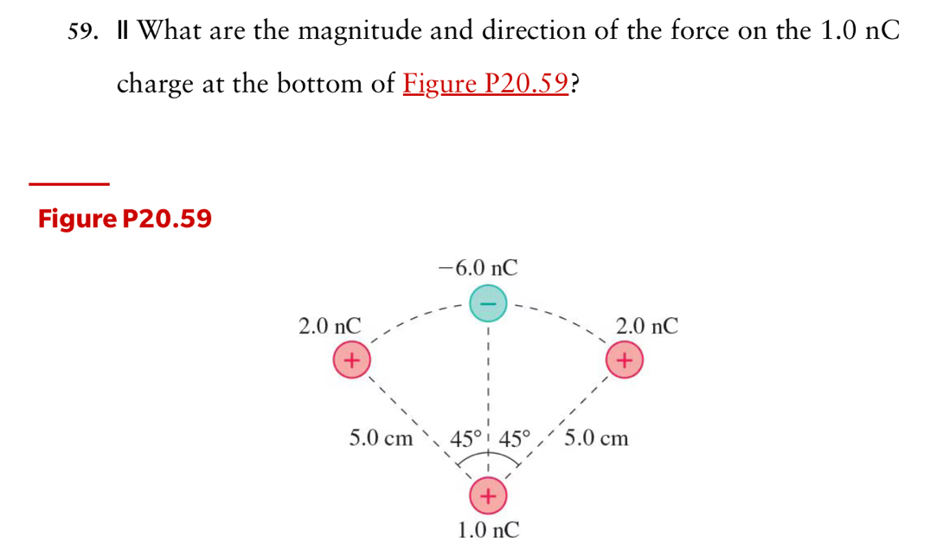
Don’t Know Where to Start?

Slide 6
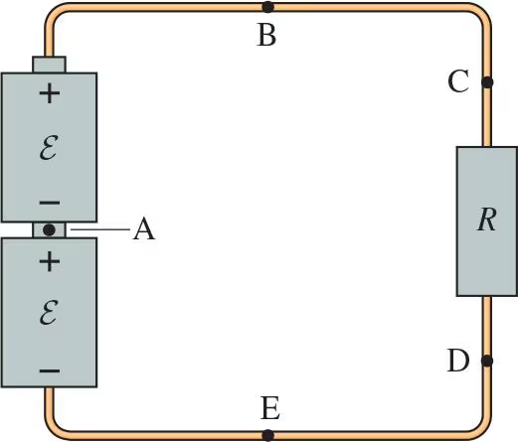
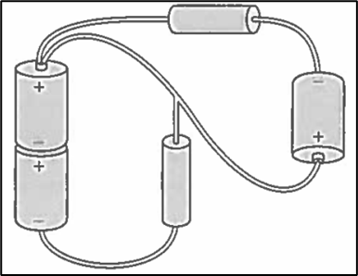
Stop To Think: Help with Weekly Reports
Rank in order, from highest to lowest, the potentials 𝑉A to 𝑉E at the labeled points, noting any ties. Assume the wires are ideal.
Redraw the circuits shown using standard circuit symbols with only right-angle corners. Clearly indicate direction of current flow and mark the circuit components.

Slide 7
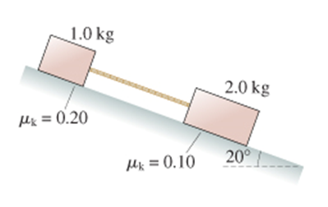
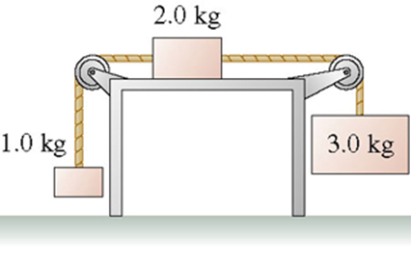
Exam Prep
2. The coefficient of kinetic friction between the 2.0 kg block in figure and the table is 0.26. What is the acceleration of the 2.0 kg block?
1. The two blocks in the figure are sliding down the incline. What is the tension in the massless string?

Slide 8
Pros to Video Solutions
Vetted Solutions
Immediate Access
Watch Real Time Solutions (don’t have to decipher a static solution)
Inclusive and Equitable (people learn differently and at different rates)
Keeps students off homework help sites (wishful thinking?)
Supports TA learning
Evergreen Content

Slide 9
Cons to Video Solutions
Resource requirements
Tablets vs cell phones
TAs versus Instructor
Online Access for Students
Potentially encourages procrastination and lack of engagement

Slide 10
Thank You
Questions?

