Slide 1
Course Management, Administration and Challenges in Teaching Large Classrooms in Active Learning Format
Jency Sundararajan
University of Virginia

Slide 2
Background
Course: Intro Physics 1 and 2 for Pre-health
Enrollment: 6 sections of 115 students each
(690 students). I teach 3 sections!
Classroom: 15 round tables that can accommodate a max of 9 students
Lecture format:
Traditional until Spring 2022
Active Learning since Fall 2022
4 UTAs per section
1 GTA per instructor

Slide 3
Enrollment since Fall 2022
Year | Fall semester |  |  | Spring semester
 | Sections | Students per section | Total number of students | Sections | Students per section | Total number of students
2022-23 | 3 1 | 99 54 | 292 | 3 1 | 99 63 | 303
2023-24 | 4 1 | 99 63 | 424 | 4 1 | 99 63 | 411
2024-25 | 6 | 112 | 632 | 6 | 115 | 623
2025-26 | 6 | 120 | - | TBD | TBD | -

Slide 4
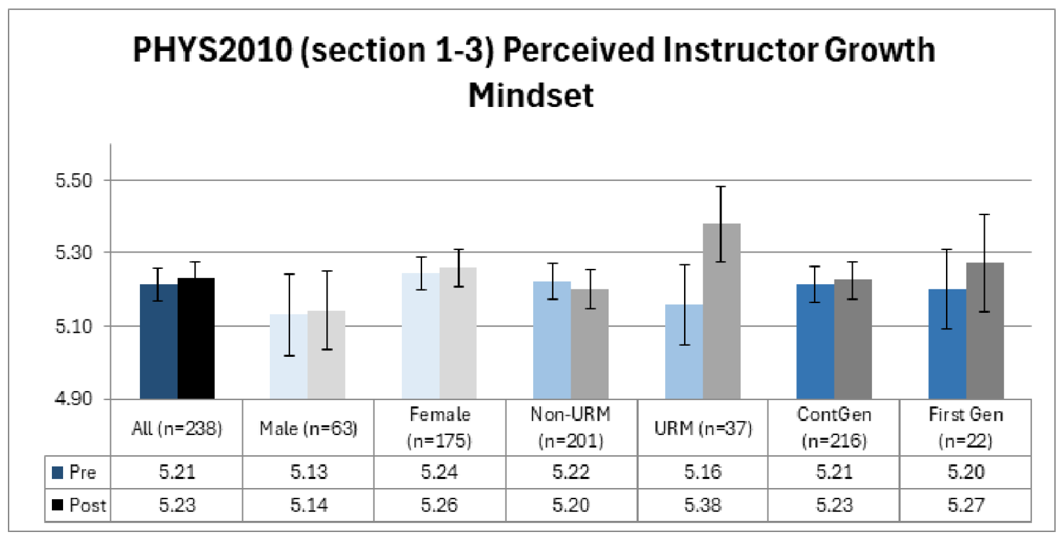
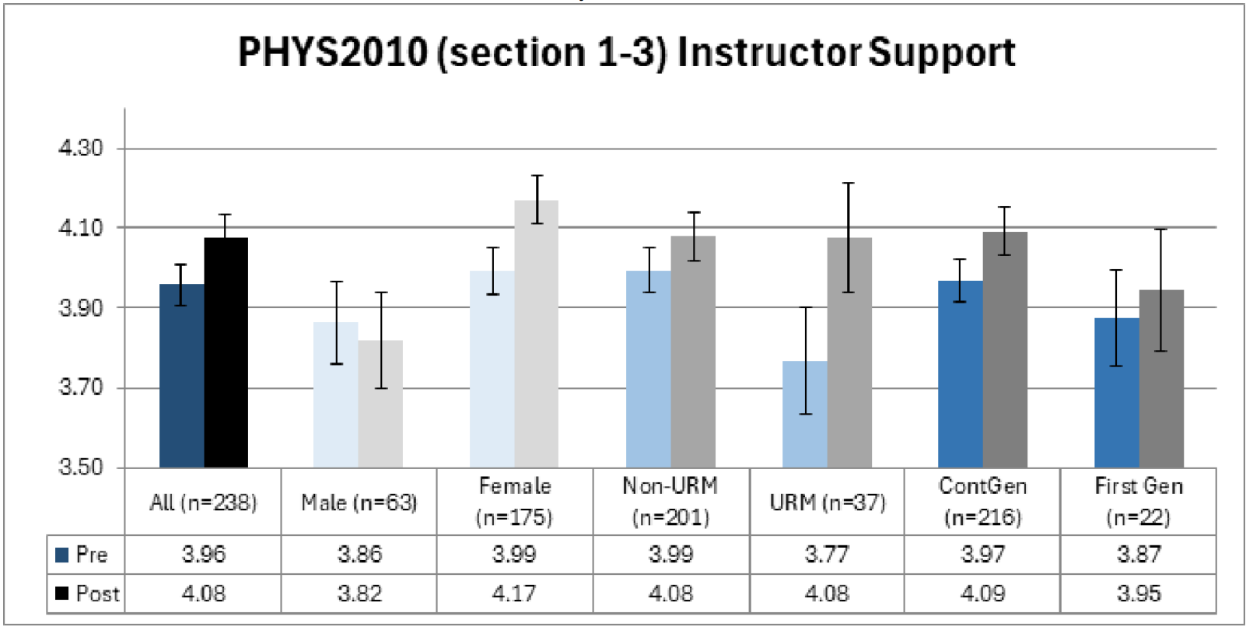
HHMI IE3 Fall 2024 Survey results
Improved perceptions of support over time
URM students made significant positive gains in their perceptions of instructor mindset and instructor support over the semester.

Slide 5
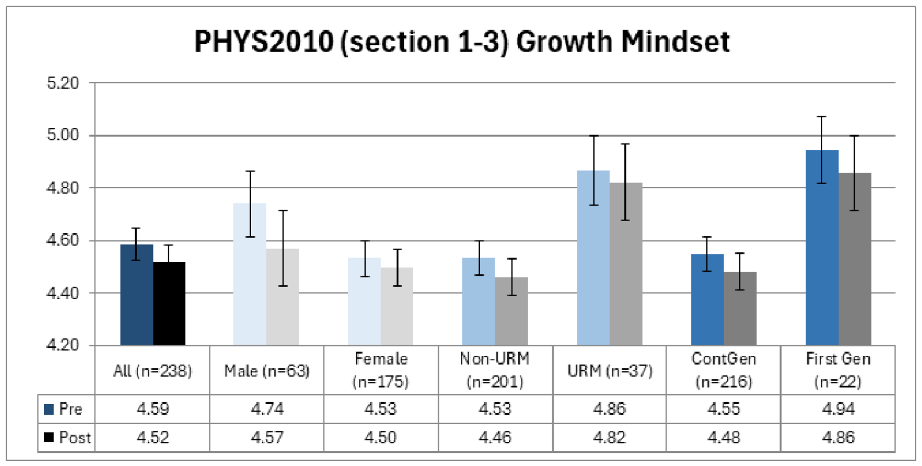
HHMI IE3 Fall 2024 Survey results
Growth mindset
URM and first-generation students held growth minded beliefs that were significantly higher than their non-URM and continuing generation peers, respectively, at both beginning and end of the semester.

Slide 6
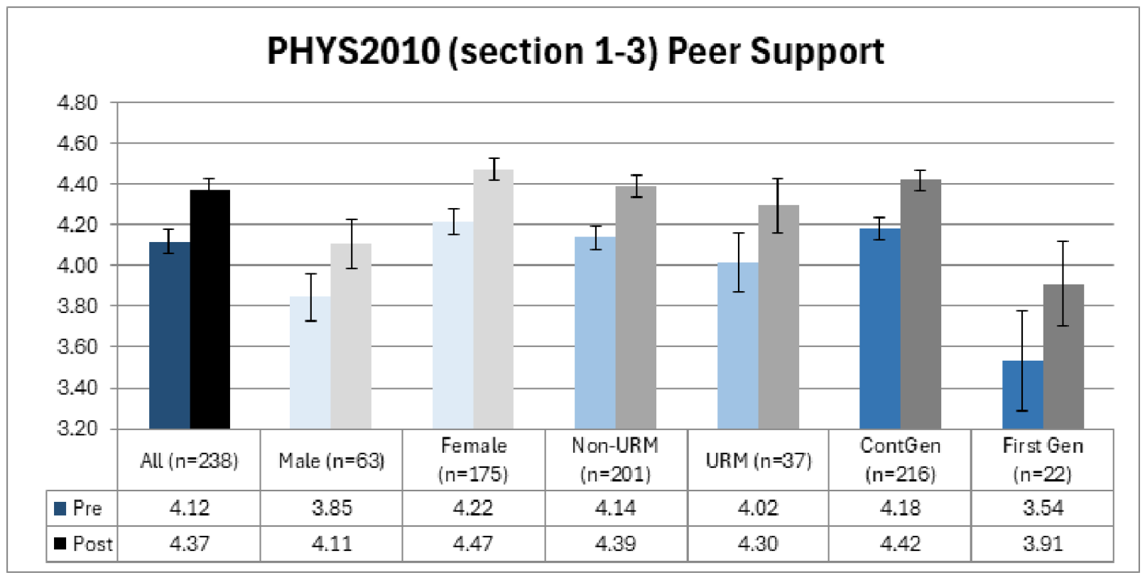
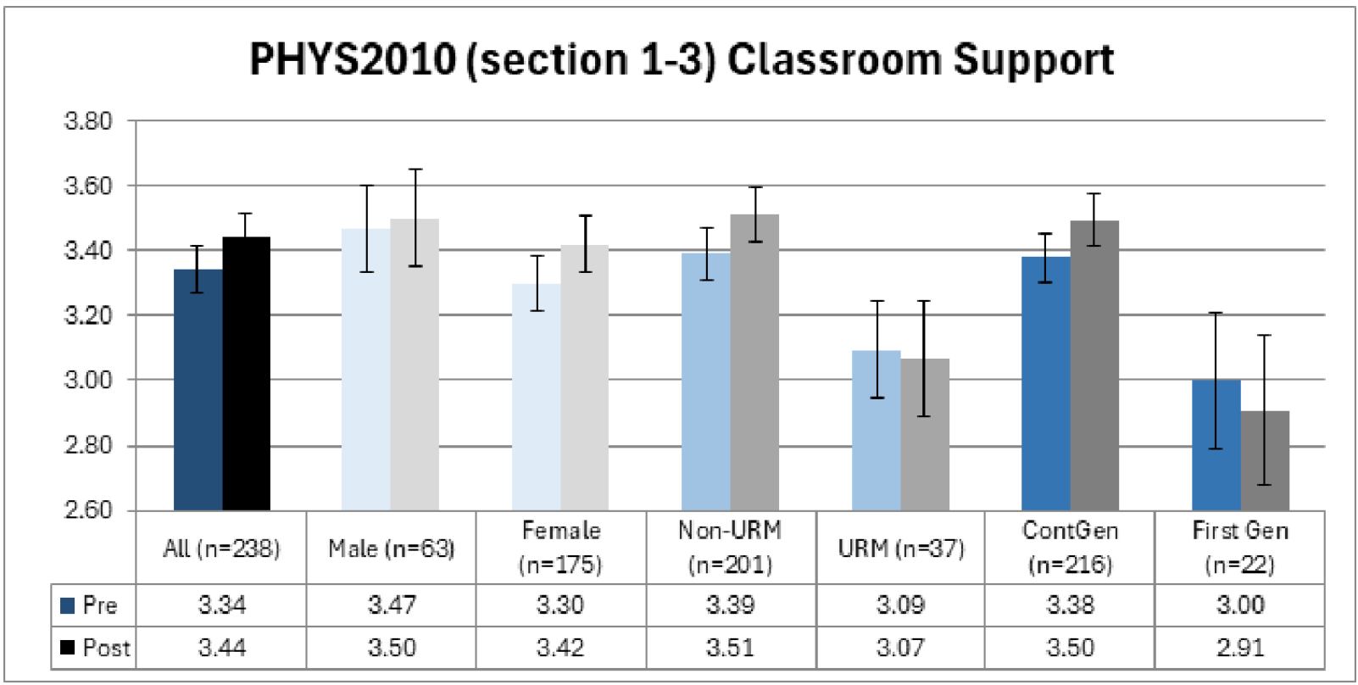
HHMI IE3 Fall 2024 Survey results
Peer and Classroom support
All students recognize the support from peers and the classroom environment being beneficial in improving their learning.

Slide 7
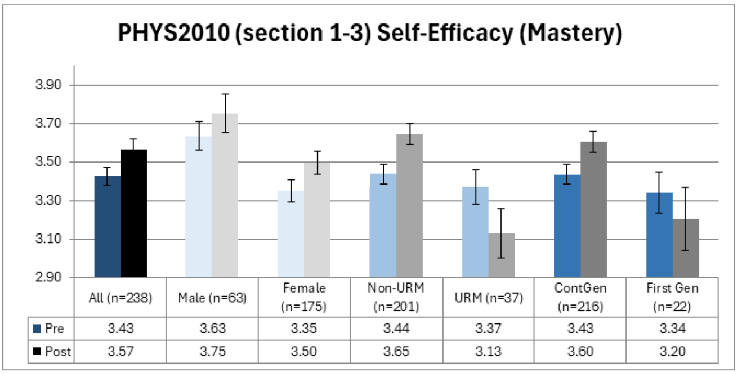
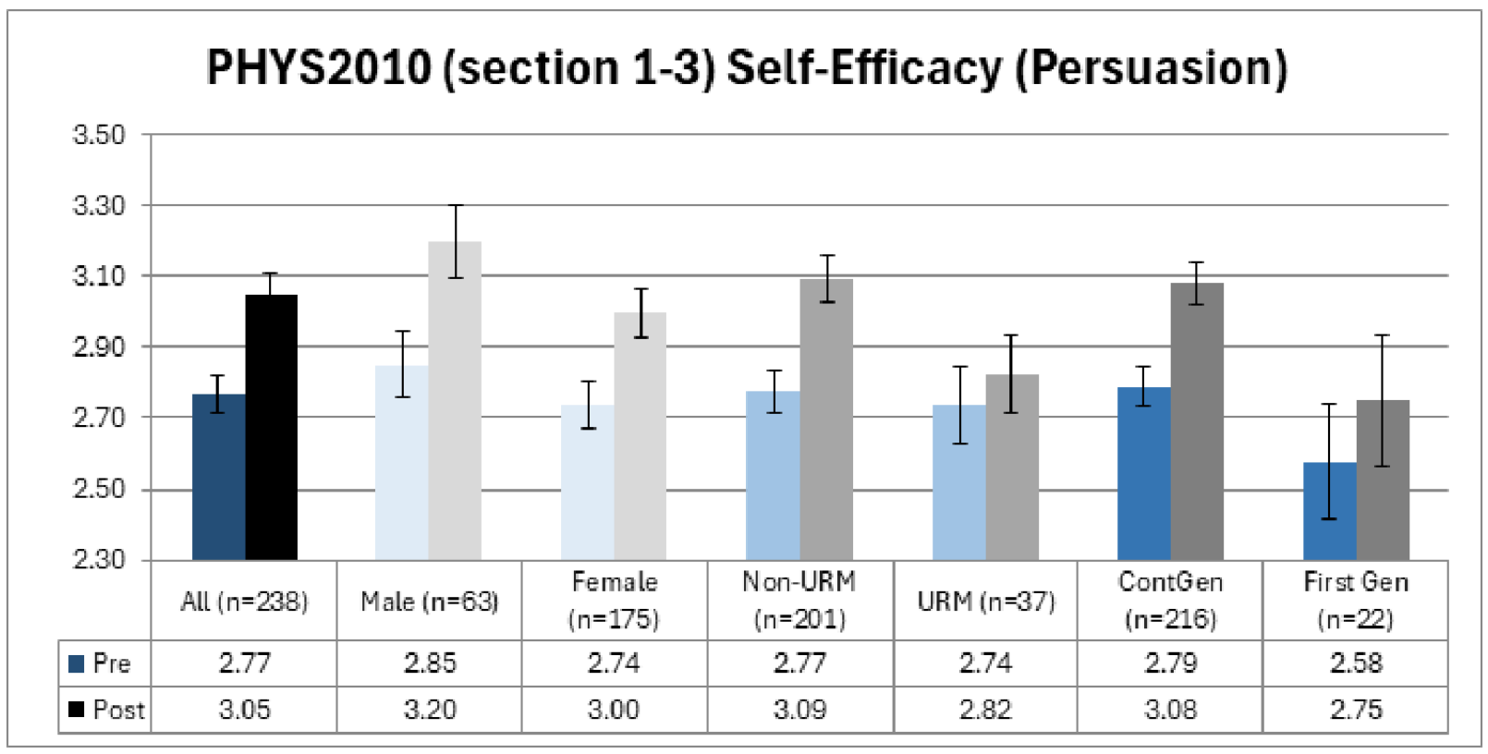
HHMI IE3 Fall 2024 Survey results
Parity in outcomes
All students significantly increased content knowledge over time, with the highest gains being for women and first-generation students, which led to closing the gaps with their male and continuing generation peers.

Slide 8
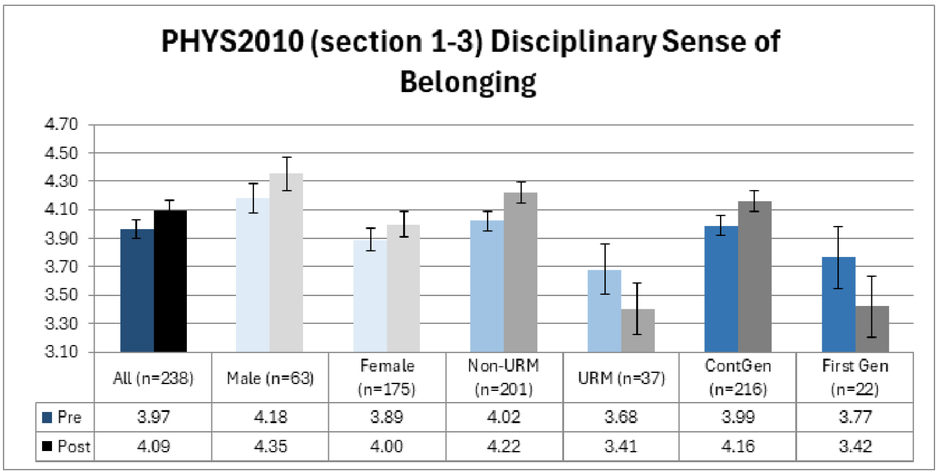
Areas for Growth
Differences over time
Disciplinary belonging and self-efficacy (mastery) for URM and first-generation students’ perceptions declined slightly over time.

Slide 9
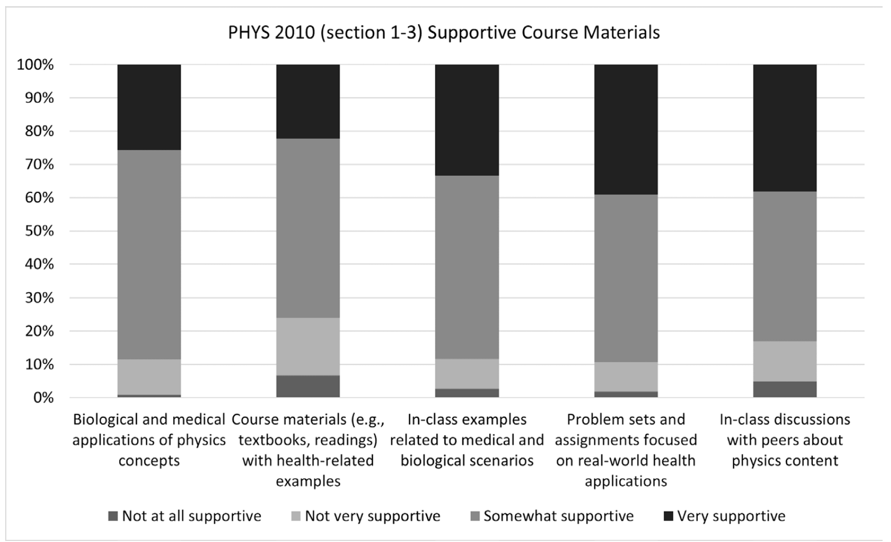
LTI Summer 2024 Grant - Outcomes

Slide 10
Course Activities and Management
Exams 50%
Midterms (12.5% each) – 25%
Final Exam – 25%
In-class (15%) | Outside the class (35%)
Poll Ev Quizzes (BOL/EOL) | Weekly quizzes/report
Problems/concepts | Homework

Slide 11
Course Activities and Management
In-class (15%) | Outside the class (35%)
Poll Ev Quizzes (BOL/EOL) (Autograded) BOL – 4 MC - (based on pre-lecture) EOL – 1 MC - (based on the worksheet) | Weekly quizzes (Autograded) 10 MC – mostly conceptual Weekly report (Graded by TAs) 4 pages of conceptual questions/ranking
Problems/concepts (Not graded) 2-3 problems | Homework (Graded by TAs) 5 problems per week

Slide 12
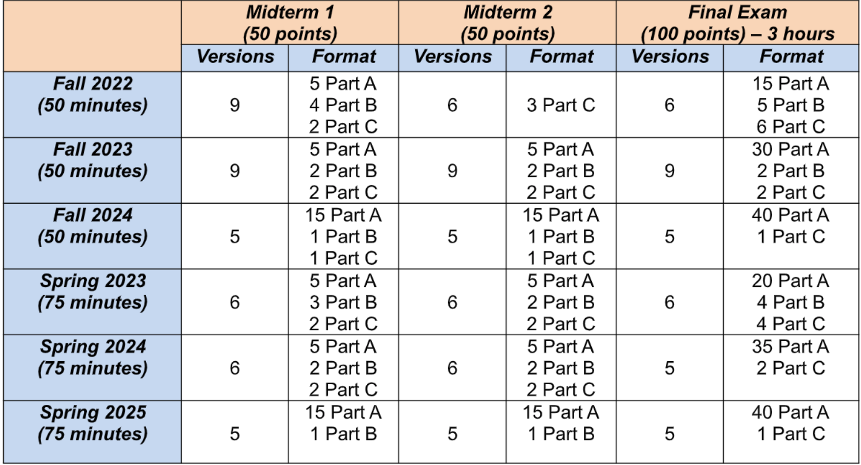
Course Activities and Management
Part A – Multiple Choice
Part B – Conceptual Question
Part C – Multi-section problem
Part A – AI graded
Part B & C – Grad TA and the Instructor
Major Issues: Time allocation, Variation in difficulty levels, Weightage to each part

Slide 13
TA Assistance in Course Management
HEAD TA
Meets with Lead TAs from each section regularly to discuss and maintain course management
Creating and managing a Phys 2020-Spring 2025 TA Groupme page (15 UTAs and 1 GTA)
Creating and managing a spreadsheet for TA OH for all 3 sections.
Oversee grading
LEAD TA
Work closely with "Rubric TA" and instructor, finalize the rubrics every week
Work closely with "Proctor TA" and instructor, to monitor midterms, make-up exams and the final exam.
Make sure the exams are sorted/scanned within a week from the scheduled exam day.
Work closely with “SDAC/Piazza representatives".

Slide 14
TA Assistance in Course Management
Instructor
Head TA
Lead TA
Lead TA
Lead TA
Proctor TA
SDAC TA
Piazza TA
Proctor TA
SDAC TA
Piazza TA
Proctor TA
SDAC TA
Piazza TA
Sort TA
Sort TA
Sort TA
Rubric TAs

Slide 15
TA Assistance in Course Management
Position | Section 4 | Section 5 | Section 6
Head TA | Monitor workload, Answer emails, Manage spreadsheet
Proctor TA | Schedule and proctor make-up exams
Exam sort/scan TA | Help with sorting and scanning midterms and final exam
SDAC/ Piazza TA | Keep track of SDAC accommodations and answer all piazza questions
WR Rubric TA | Write and upload rubric to Gradescope
HW Rubric TA

Slide 16
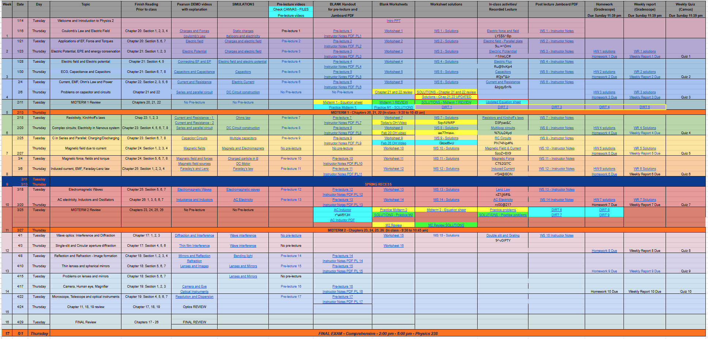
Spreadsheet Management

Slide 17
Conclusions
Active learning teaching methods are found to be effective, cultivates a sense of belonging in classroom, supports peer learning, and facilitates better performance.
Classroom management and administration could be improved with support from teaching assistants and by setting clear course policies.

Slide 18
Acknowledgement
UVA Learning Technology incubator GRANT
UVA Inclusive Excellence GRANT

