Slide 2
CSAAPT
Make-&-Take
Welcome to the CSAAPT Make-and Take Workshop

Slide 3
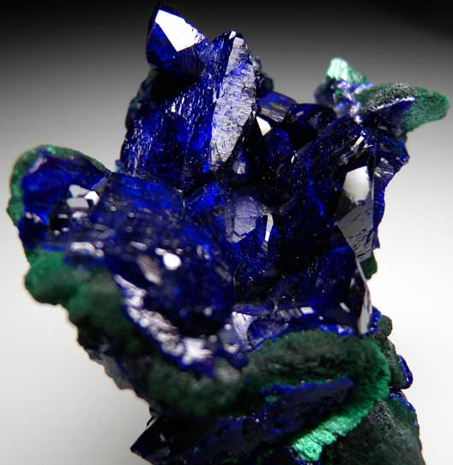
Richard Terwilliger
BabyBlueAzurite@aol.com
The workshop is presented by
AZURITE
Cu₃(CO₃)₂(OH)₂

Slide 4
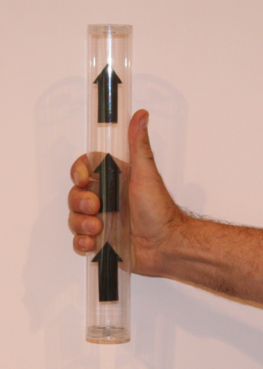
Vector Tubes

Slide 5
st
Magnetic field
1
Right Hand Rule
Direction of Magnetic Field
Direction of Magnetic Field
Positive current flow
positive flow
Grasp the wire with your right hand so your thumb points in the direction of positive current flow.
Fingers curl around the wire in the direction of the magnetic field.
CLICK

Slide 6
Here is another example.
Determine the direction of the magnetic field around the red enlarged section of wire.
CLICK

Slide 7
Conventional + current flow comes out of the positive side of the potential source, through the circuit and back to the negative side of the potential source.
CLICK

Slide 8
Grab the wire with the thumb of the right hand pointing in the direction of positive flow.
The fingers curl around the wire in the direction of the magnetic field.
CLICK

Slide 9
The magnetic field on the left side of the wire is pointed back into the page.
Behind the wire the magnetic field is pointed to the right.
And on the right side of the wire the magnetic field is pointed out of the page.
The magnetic field in front of the wire is pointed to the left.
Positive current flow
CLICK

Slide 10
X
Out of the page is shown by a dot
X
Into the page is shown by an X
X
Positive current flow
CLICK

Slide 11
Practice
Positive current flow
Determine which diagrams show the correct magnetic field.
CLICK for Answers
CLICK

Slide 12
More Fun Stuff
Parallel Current Bearing
wires

Slide 13
Shown here is a wire with the positive current flow out of the page.
+i
Click

Slide 14
Again, the direction of the magnetic field around the wire can be determined by grabbing the wire with our right hand with our thumb pointing in the same direction as the positive current flow.
Magnetic Field
+i
Click

Slide 15
What would happen if another wire was placed parallel to the first with positive current flow also out of the page?
Notice the magnetic fields between the wires point in opposite directions.
Click

Slide 16
These opposing fields reduce the strength of the magnetic field between the wires.
Click

Slide 17
The wires are forced toward each other because the magnetic field is greater on the outside and less between the wires.
FORCE
FORCE
Click

Slide 18
An easy way to remember this is with opposite magnetic fields the wires attract.
N
S
S
N
OPPOSITES ATTRACT
Click

Slide 19
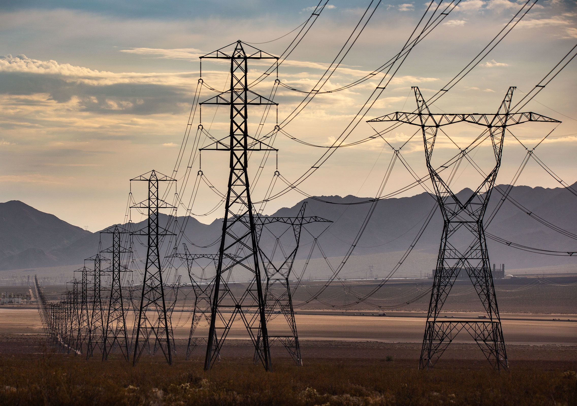
Notice the insulating rods that are preventing the wires from touching.

Slide 20
If the current flow in the wires is in opposite directions then the field is stronger between the wires and the wires are pushed away from each other.
Field stronger between wires
FORCE
N
N
FORCE
S
S
+i
Magnetic fields point in same direction between wires.
+i
Click

Slide 21
Another way of looking at this is, the current bearing wire on the right (wire #2) is placed in an external magnetic field that is created by the current bearing wire (wire #1) on the left.
External Magnetic Field
Created by current flowing in wire #1
Wire #1
Wire #2
+i
Click

Slide 22
The direction of the force on the current bearing wire can be determined using the 3rd Right Hand Rule.
FORCE
External Magnetic Field
FORCE
FORCE
+i
Click

Slide 23
The next few slides will cover the equation used to determine the force on a current bearing wire when placed parallel to a second current bearing wire.
Wire #1
Wire #2
B₁
B₂
?
FORCE
FORCE
+i₁
+i₂

Slide 24
We know the strength of the magnetic field near a current bearing wire is given by:
μ_{ο} Ι
B=
2π r
μ_{ο} Ι
Bat R from an infinitely long current bearing wire =
2π r
Wire #1
Wire #2
B₁
B₂
?
FORCE
FORCE
+i₁
+i₂

Slide 25
µ_{o} = 4π x 10 ⁻⁷ T∙m/A
In this equation µ_{o} is the permeability of free space and has a value of
μ_{ο} Ι
B =
2π r
4π x 10 ⁻⁷ T∙m/A
Wire #1
Wire #2
B₁
B₂
?
FORCE
FORCE
+i₁
+i₂

Slide 26
µ_{o} = 4π x 10 ⁻⁷ T∙m/A
μ_{ο} Ι₁
I is the current flowing in wire #1 so we will designate this as I₁
μ_{ο} Ι
B =
B =
2π r
2π r
Wire #1
Wire #2
B₁
B₂
?
FORCE
FORCE
+i₁
+i₂

Slide 27
µ_{o} = 4π x 10 ⁻⁷ T∙m/A
μ_{ο} Ι₁
r, is the perpendicular distance from wire #1.
B =
2π r
Wire #1
Wire #2
B₁
B₂
?
FORCE
FORCE
+i₁
+i₂

Slide 28
µ_{o} = 4π x 10 ⁻⁷ T∙m/A
So in this situation r is the distance between wire #1 and wire #2 which is designated as d
μ_{ο} Ι₁
μ_{ο} Ι₁
B =
B =
2π d
2π r
Wire #1
Wire #2
B₁
B₂
?
FORCE
FORCE
+i₁
+i₂
d

Slide 29
µ_{o} = 4π x 10 ⁻⁷ T∙m/A
Again, current bearing wire #2 is placed in the external magnetic field created by the current flowing in wire #1..
μ_{ο} Ι₁
B =
2π d
Wire #1
Wire #2
B₁
B₂
?
FORCE
FORCE
+i₁
+i₂
d

Slide 30
µ_{o} = 4π x 10 ⁻⁷ T∙m/A
..and therefore has a force acting on it. This force is given by:
μ_{ο} Ι₁
B =
2π d
F = BIL
F = BIL
Wire #1
Wire #2
B₁
B₂
?
FORCE
FORCE
+i₁
+i₂
d

Slide 31
µ_{o} = 4π x 10 ⁻⁷ T∙m/A
μ_{ο} Ι₁
B is the magnetic field created by the current flow in wire #1.
B₁ =
B =
2π d
F = BIL
F = B₁IL
Wire #1
Wire #2
B₁
B₂
?
FORCE
FORCE
+i₁
+i₂
d

Slide 32
µ_{o} = 4π x 10 ⁻⁷ T∙m/A
μ_{ο} Ι₁
I is the current flow in wire #2 so we will name it I₂
B₁ =
2π d
F = B₁I₂L
F = B₁IL
Wire #1
Wire #2
B₁
B₂
?
FORCE
FORCE
+i₁
+i₂
d

Slide 33
µ_{o} = 4π x 10 ⁻⁷ T∙m/A
μ_{ο} Ι₁
…and L is the length of wire #2 that is in the magnetic field.
B₁ =
2π d
F = B₁I₂L
Wire #1
Wire #2
B₁
B₂
?
FORCE
FORCE
+i₁
+i₂
d

Slide 34
µ_{o} = 4π x 10 ⁻⁷ T∙m/A
μ_{ο} Ι₁
So the force on wire #2 is
B₁ =
μ_{ο} Ι₁Ι₂L
2π d
F =
2π d
F = B₁I₂L
μ_{ο} Ι₁Ι₂L
F =
2π d
Wire #1
Wire #2
B₁
B₂
?
FORCE
FORCE
+i₁
+i₂
d
Click

Slide 35
Standing Wave
Thumb Tacks
Click for answer
N
N
N
N
S
S
S
S
S
N
Which situation above has the STRONGEST magnetic field?
CLICK

Slide 36
What is the direction and the strength of the magnetic field at a perpendicular distance R from an infinitely long current bearing wire?
Shown here is an infinitely long wire with + current flowing into the page.
+I
CLICK

Slide 37
What is the direction and the strength of the magnetic field at a perpendicular distance R from an infinitely long current bearing wire?
We want to determine the direction and the magnitude of the magnetic field at point P
R
P
B = ?
+I
CLICK

Slide 38
What is the direction and the strength of the magnetic field at a perpendicular distance R from an infinitely long current bearing wire?
We will determine the direction of the magnetic field at point P using the 1st Right Hand Rule
R
P
B = ?
+I
CLICK

Slide 39
What is the direction and the strength of the magnetic field at a perpendicular distance R from an infinitely long current bearing wire?
Grab the wire with your right hand with your thumb pointing in the direction of + current flow.
R
P
B = ?
+I
CLICK

Slide 40
What is the direction and the strength of the magnetic field at a perpendicular distance R from an infinitely long current bearing wire?
The magnetic field curls around the wire in the same direction as your fingers.
R
P
B = ?
+I
CLICK

Slide 41
What is the direction and the strength of the magnetic field at a perpendicular distance R from an infinitely long current bearing wire?
…so the magnetic field at point P is pointed down.
The magnetic field on the right side of the wire is down.
R
P
B = ?
+I
→
B
CLICK

Slide 42
What is the direction and the strength of the magnetic field at a perpendicular distance R from an infinitely long current bearing wire?
Bat R from infinitely long wire = μ_{ο} Ι
2π R
Here is the equation for the magnetic field near a current bearing wire.
R
P
B = ?
+I
μ_{o} = permeability of free space = 4 π X 10⁻⁷ Wb/A-m,
I = current flow.
CLICK
R = distance from wire

Slide 43
What is the direction and the strength of the magnetic field at a perpendicular distance R from an infinitely long current bearing wire?
Bat R from infinitely long wire = μ_{ο} Ι
So the strength of the magnetic field at point P is given by
2π R
μ_{ο} Ι
2π R
R
P
B = ?
..and in this scenario the direction of the magnetic field at point P is down.
+I
μ_{o} = permeability of free space = 4 π X 10⁻⁷ Wb/A-m,
I = current flow.
CLICK
R = distance from wire

Slide 44
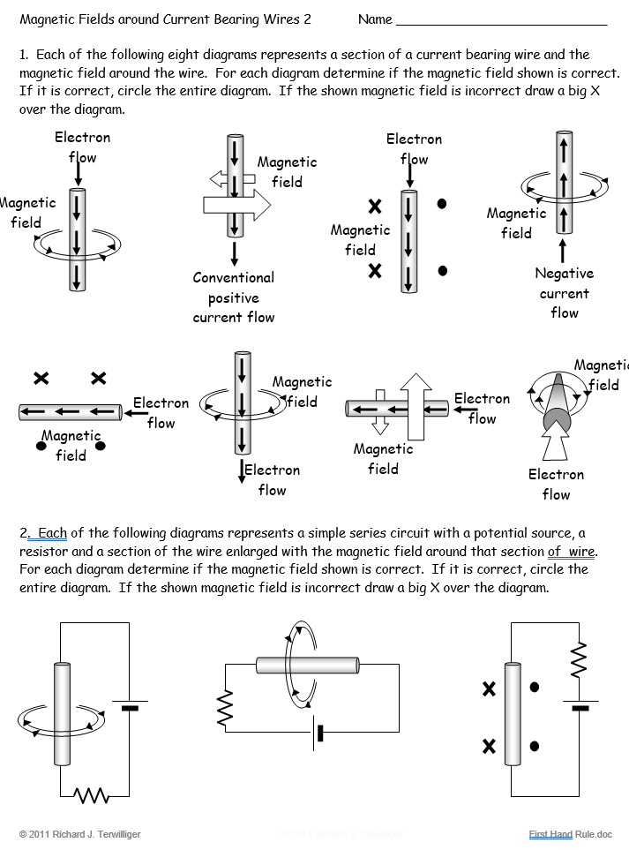

Slide 45
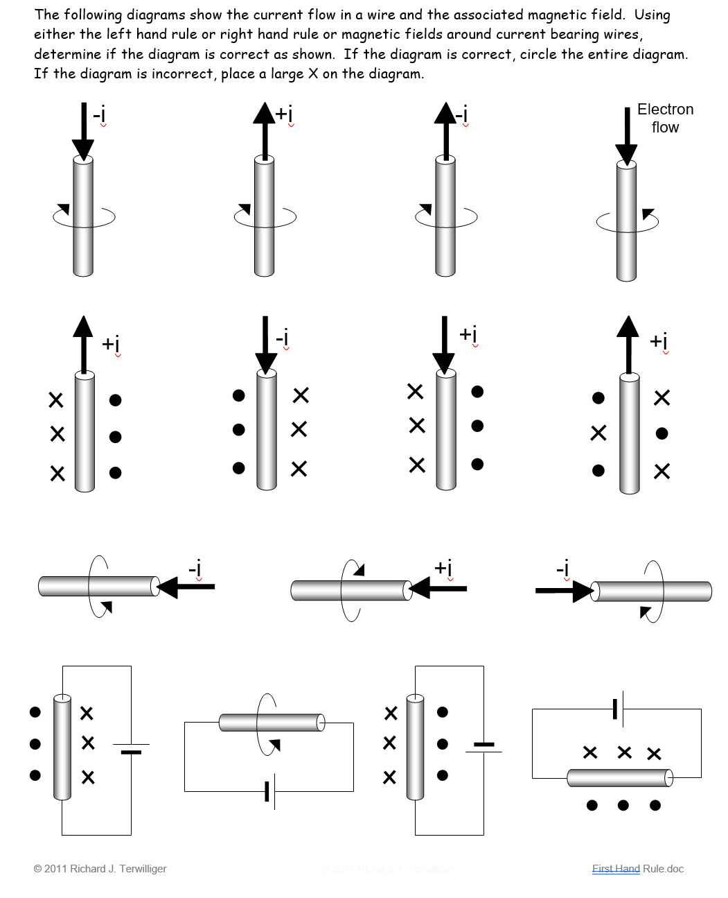

Slide 46
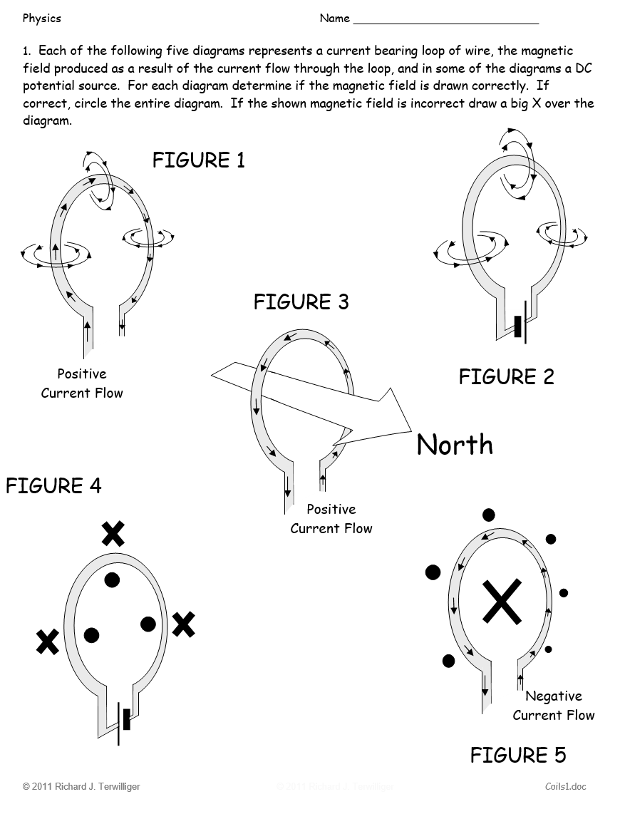

Slide 47
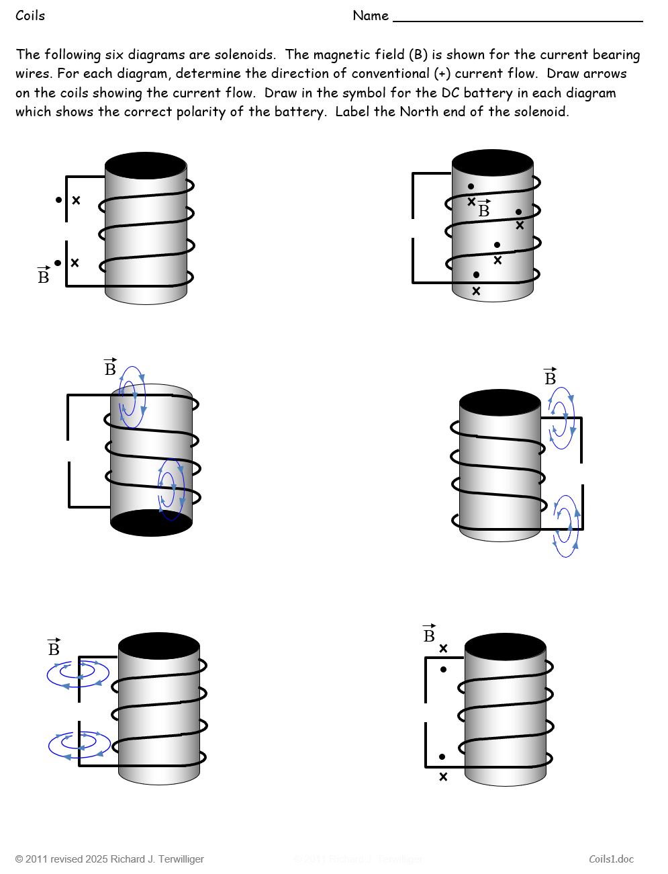

Slide 49
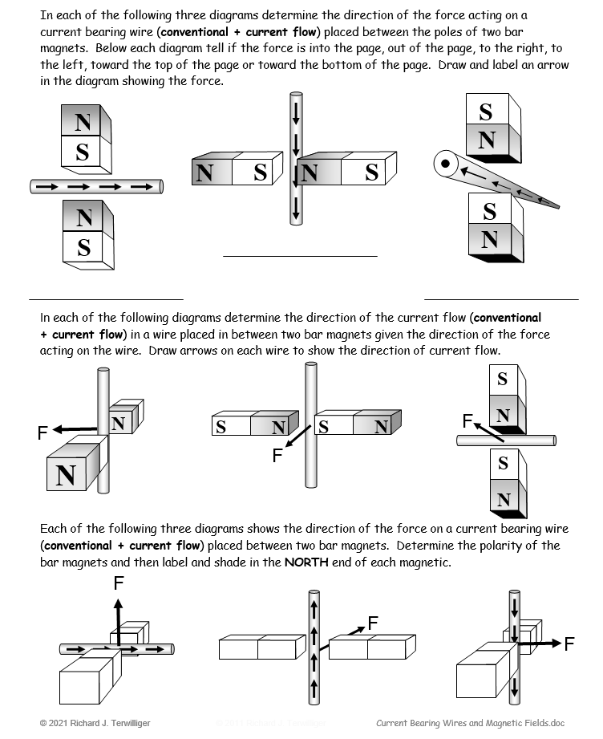

Slide 50
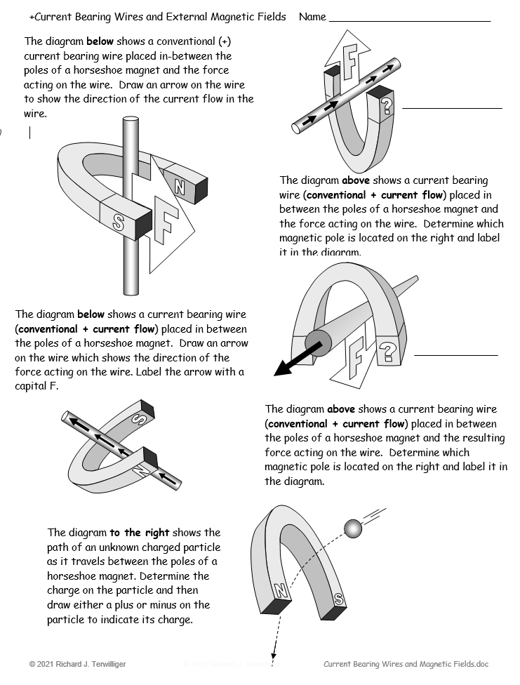

Slide 51
Law of Reflection
i
=
R
Angle of Incidence = Angle of Reflection

Slide 52
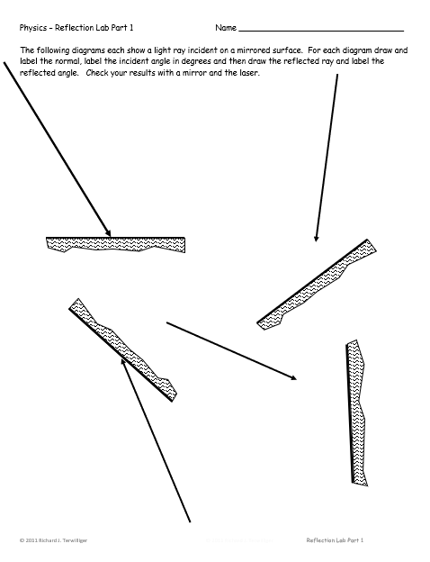
Mirror Lab - Part 1

Slide 53
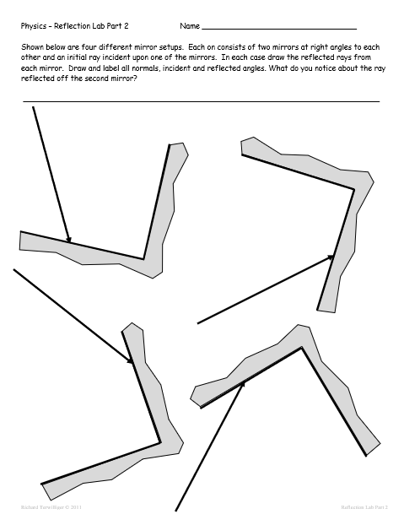
Mirror Lab – Part 2

Slide 54
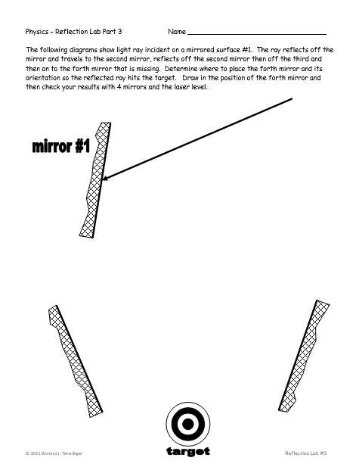
Mirror Lab – Part 3

Slide 55
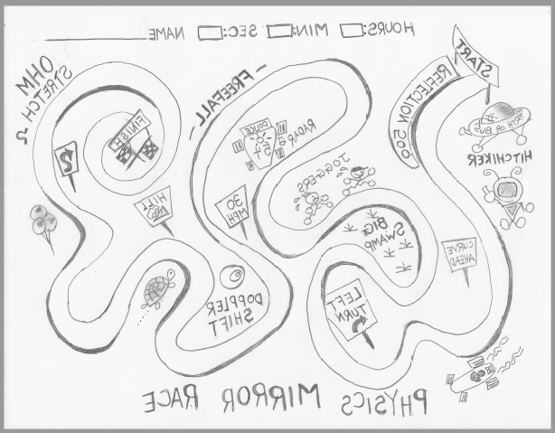
Mirror Lab part 4 – Physics Mirror Race
Notes:
This is SO MUCH FUN!
Procedure:

Slide 56
Richard Terwilliger
BabyBlueAzurite@aol.com
Thank You!
AZURITE
Cu₃(CO₃)₂(OH)₂

