Slide 1
Balancing Mathematical Formalism and Experimentation Discussions in Quantum Mechanics: Student Perspectives on Learning and Quantum Measurement
By: Jason Tran, James Freericks, Leanne Doughty
Supported by AFOSR Grant FA9550-23-1-0378
Notes:
Hello everyone! Thank you so much for attending my talk! Today, I will be discussing a set of one-on-one interviews that we conducted on Georgetown quantum mechanics students, where we assess student’s perspectives on learning through a mathematical and experimental lens.

Slide 2
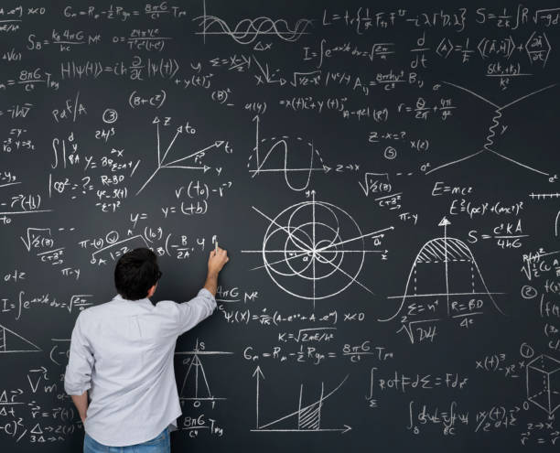
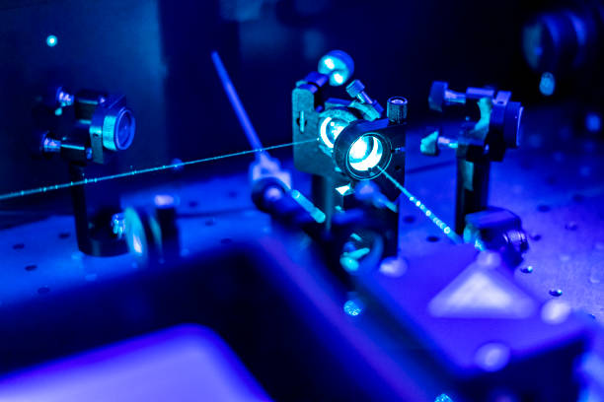
How Should a Physics Instructor Spend Their Class Time?
Mathematical Framework
Experimental Understanding
Balancing Mathematical Formalism and Experimentation Discussions in Quantum Mechanics: Student Perspectives on Learning and Quantum Measurement
CSAAPT Spring 2025 Meeting - George Mason University
Notes:
Physics educators constantly need to evaluate the balance between the amount of time dedicated to building the theoretical mathematical framework to explain physics principles versus the application of those principles in the form of experiments

Slide 3
Difficulties with Experiments in Quantum Mechanics
Typically lecture-based with overloaded curriculum to teach quantum basics
Difficulty in finding “true” quantum experiments that are:
Easily reproducible
Cheap
Engaging to students
Balancing Mathematical Formalism and Experimentation Discussions in Quantum Mechanics: Student Perspectives on Learning and Quantum Measurement
CSAAPT Spring 2025 Meeting - George Mason University
Notes:
Like other physics courses, quantum mechanics is typically lecture-based with an overloaded curriculum that struggles to contain all of the important quantum content in just one small digestible, neatly packaged course. But even furthermore, quantum mechanics has unique limitations in experimentation due to the lack of easily conductible experiments, the lack of affordable equipment needed to conduct true quantum experiments, and the lack of physicality present in existing quantum experiments for students.

Slide 4
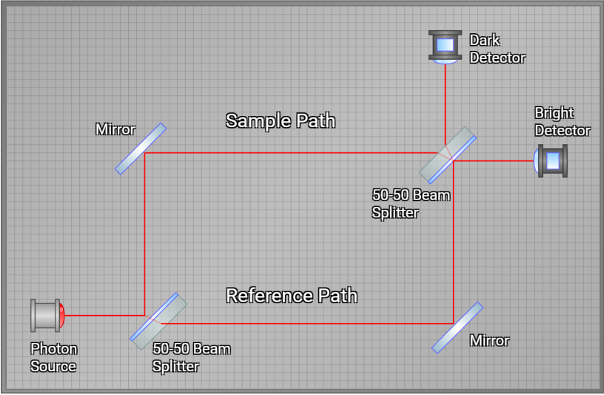
Quantum Mechanics Course with Simulations
Conceptually motivated “spins-first” approach with lecture material focused on learning about quantum experiments through tutorial-style simulations
Balancing Mathematical Formalism and Experimentation Discussions in Quantum Mechanics: Student Perspectives on Learning and Quantum Measurement
CSAAPT Spring 2025 Meeting - George Mason University
Notes:
To combat this, this study is centered around a junior level quantum mechanics course offered to Georgetown students that is conceptually motivated through a “spins-first” approach, where this “spins-first” approach follows a matrix mechanics, operator mechanics based mathematical approach that is focused specifically on learning quantum mechanics and important quantum ideas through quantum experiments from tutorial style simulations as shown on the right

Slide 5
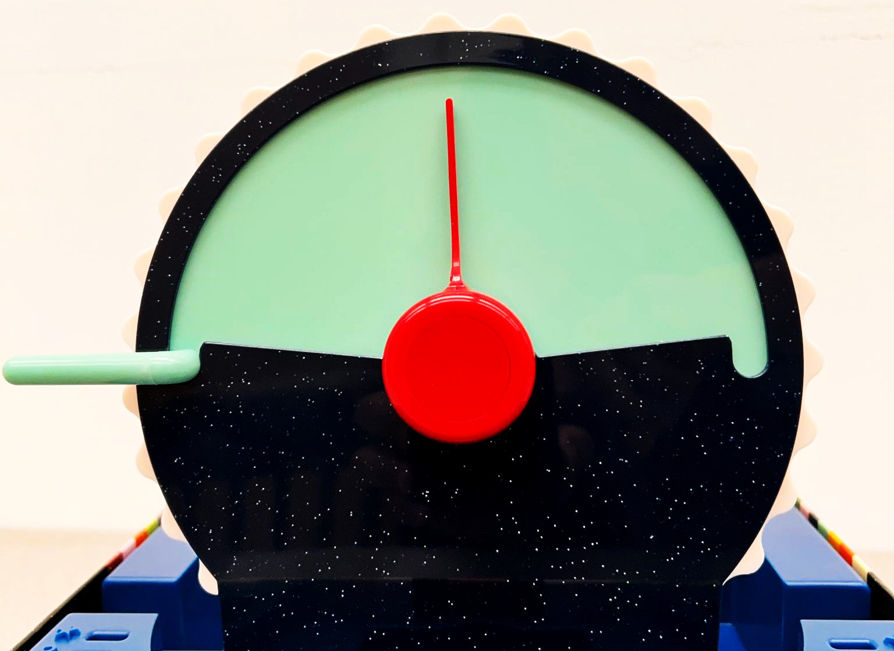
Interview Questions
Interview 8 physics undergraduates at Georgetown
Mixture of survey style questions with interview-style questioning
Cold← →Hot
Balancing Mathematical Formalism and Experimentation Discussions in Quantum Mechanics: Student Perspectives on Learning and Quantum Measurement
CSAAPT Spring 2025 Meeting - George Mason University
Notes:
For this study, all 8 students of the quantum mechanics course volunteered for our interview that was focused on students answering survey style question, but with interview-style questioning around an interactive dial from a popularized board game, Wavelength. Our questions were modelled after this popular style of survey questioning as seen on the left, however, it is modified with an interactive dial where students place their ideas onto a two sided spectrum and give their justification for their placements, which allowed students to be more fluid with their answer responses while giving real time feedback on their thought processes. An example of a question given to the students was on the dial where the left is the coldest possible in our solar system and the right is the hottest possible in our solar system, how hot is a cup of coffee?

Slide 6
Interview Structure
Benchmark Questions
Perceptions on Understanding Questions
Comparison Questions
Quantum vs. Intermediate
Perceptions on Course Pedagogy Questions
Comparison Questions
Mathematical vs. Experimental
Balancing Mathematical Formalism and Experimentation Discussions in Quantum Mechanics: Student Perspectives on Learning and Quantum Measurement
CSAAPT Spring 2025 Meeting - George Mason University
Notes:
While the entirety of the interview was an hour long consisting on various number of parts, due to the time constraints of this talk, we will only focus on a small portion near the end of the interview that focused specifically on students comparing their mathematical and experimental understandings.

Slide 7
Questions
Given the boundaries “Hate” and “Love,” where would the “Mathematical Formalism” or “Experimental Discussions” presented in the course fit on the Wavelength scale?
Given the boundaries “Completely Lost” and “Complete Understanding,” where would the “Mathematical Formalism” or “Experimental Discussions” presented in the course fit on the Wavelength scale?
Given the boundaries “Mathematical” and “Experimental,” where would “Quantum Measurement” fit on the Wavelength scale?
How would you relate the idea of “Quantum Measurement” with the Mathematical Formalism or Experimental Discussions presented in the course and how it relates to Quantum Mechanics. Elaborate.
Balancing Mathematical Formalism and Experimentation Discussions in Quantum Mechanics: Student Perspectives on Learning and Quantum Measurement
CSAAPT Spring 2025 Meeting - George Mason University
Notes:
Here are the 4 questions that we will focus on for this talk. First, we will assess students’ preferences for how the mathematical formalism and the experimentation presented in the course. Second, we will see how students assess their own levels of understanding, both mathematically, and experimentally. Next, we will try a specific example where students try to place the idea of “quantum measurement” on a mathematical to experimental scale. And finally, we will see how students relate the idea of quantum measurement to their mathematical and experimental understandings.

Slide 8
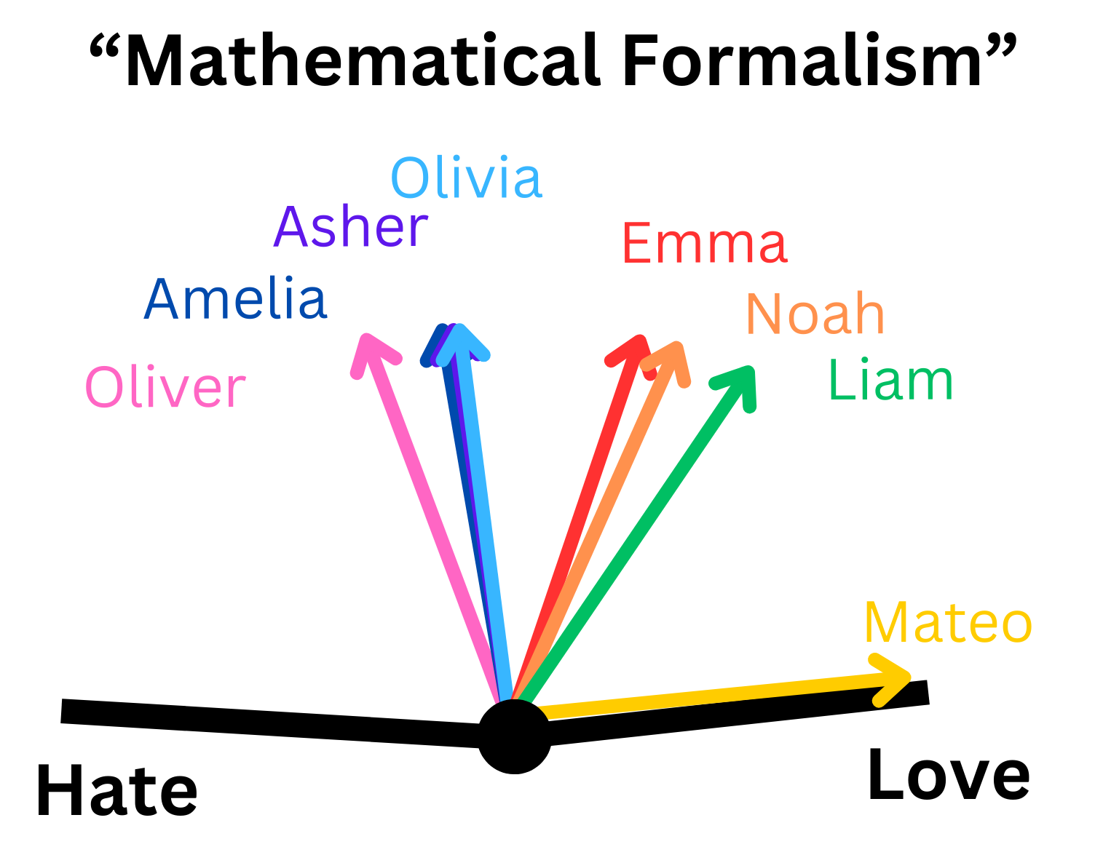
Assessing Students’ Preferences
Question 1: Given the boundaries “Hate” and “Love,” where would the “Mathematical Formalism” or “Experimental Discussions” presented in the course fit on the Wavelength scale?
Students generally prefer to learn quantum through experiments
“And I think the only thing I don't like about it is just that it just feels like abstract. Sometimes it feels like abstract math. Okay…And so there just needs to be a way to make that clear or see more. At least in the beginning, before we start really going to just the pure abstraction.”
Balancing Mathematical Formalism and Experimentation Discussions in Quantum Mechanics: Student Perspectives on Learning and Quantum Measurement
CSAAPT Spring 2025 Meeting - George Mason University
Notes:
Let’s take a look at some of our data! Note that student aliases are presented here. Perhaps very unsurprisingly, students generally preferred to learn quantum mechanics through experiments rather than through mathematical proofs and equations. Note that every student rated experimental discussions positively, while having mixed reviews of the courses’ mathematical formalism. “From a student excerpt: And I think the only thing I don't like about it is just that it just feels like abstract. Sometimes it feels like abstract math.”

Slide 9
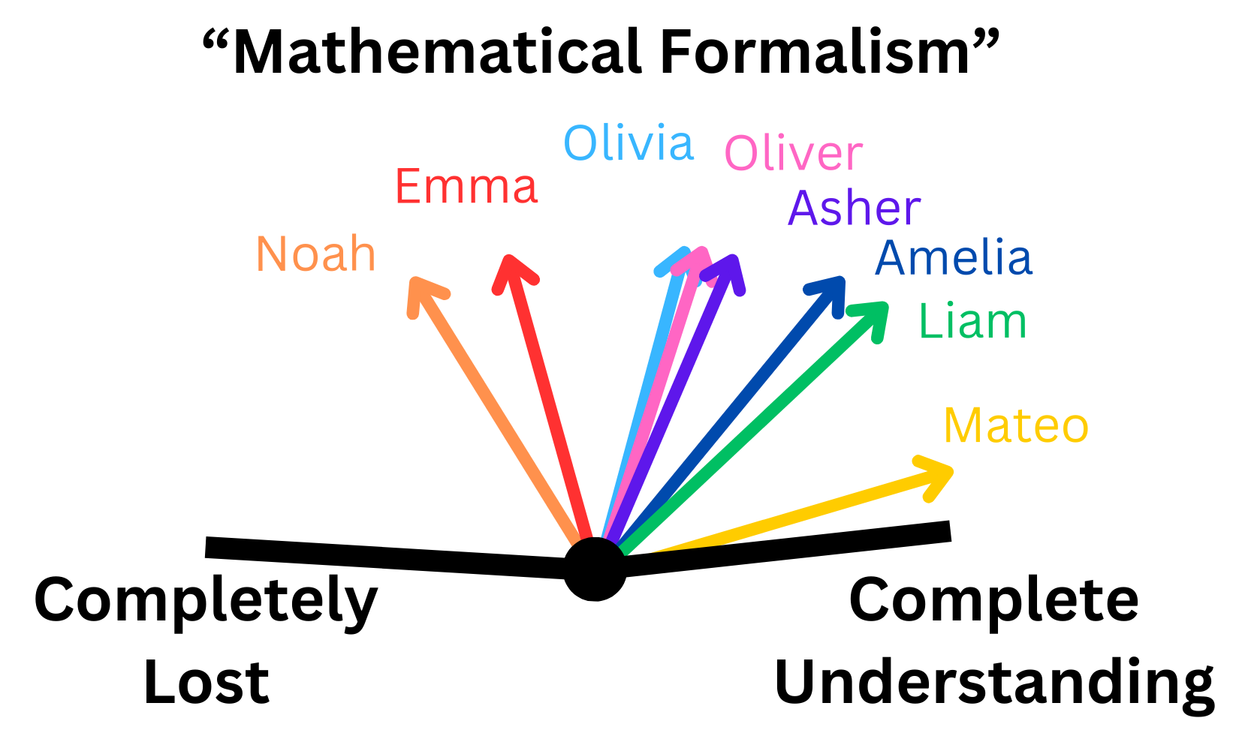
Assessing Students’ Self Perceptions
Question 2: Given the boundaries “Completely Lost” and “Complete Understanding,” where would the “Mathematical Formalism” or “Experimental Discussions” presented in the course fit on the Wavelength scale?
Looking at students’ placements holistically, students perceive their mathematical and experimental understanding at approximately the same levels
“So one cool thing was when I was doing homework for the double slit experiment…And like Stern-Gerlach, like my roommates would be there and was like, what's that? And I'd try to explain it to him. And I figured out that I actually could. Because I think of the tools that were used, the visuals and experiments, I could pretty much give like a decent overview of what's going on.”
Balancing Mathematical Formalism and Experimentation Discussions in Quantum Mechanics: Student Perspectives on Learning and Quantum Measurement
CSAAPT Spring 2025 Meeting - George Mason University
Notes:
However, what is interesting is that when evaluating our interviewed students holistically in this second question here, students felt that their mathematical understanding and experimental understanding are about equal. Unlike the previous slide, there is a clear rough spread that looks similar in both sets of data. Some students even specifically mentioned how the simulations were helping in their understanding: from the quote ““So one cool thing was when I was doing homework for the double slit experiment…And like Stern-Gerlach, like my roommates would be there and was like, what's that? And I'd try to explain it to him. And I figured out that I actually could. Because I think of the tools that were used, the visuals and experiments, I could pretty much give like a decent overview of what's going on.”

Slide 10
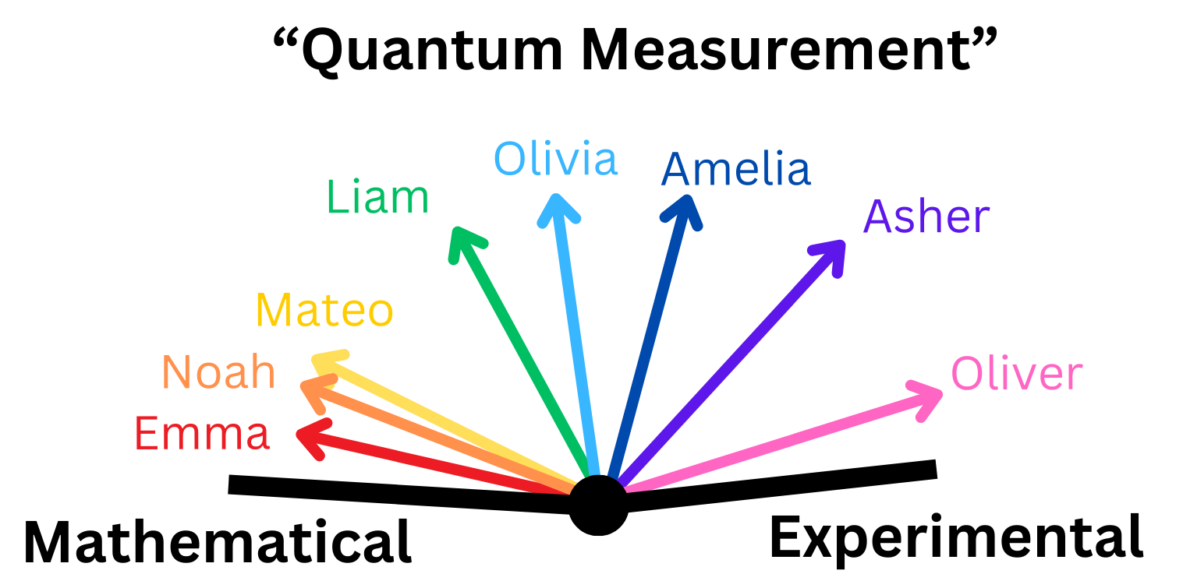
Quantum Measurement: More Mathematical or Experimental?
Question 3: Given the boundaries “Mathematical” and “Experimental” where would “Quantum Measurement” fit on the Wavelength scale?
Students are slightly more likely to associate Quantum Measurement with being more mathematical than experimental
“I think that like the measurement part makes the most sense in a physical experiment. Like, I think I have better experimentational descriptors of the measurement part rather than like the, like the overall process.”
Balancing Mathematical Formalism and Experimentation Discussions in Quantum Mechanics: Student Perspectives on Learning and Quantum Measurement
CSAAPT Spring 2025 Meeting - George Mason University
Notes:
Now let’s see how students apply a quantum concept on a mathematical to experimental scale. Although with a wide spread…On average, students were more slightly likely to associate quantum measurement with being more mathematical than experimental (and you can see a bit of a cluster of students near the mathematical end of the spectrum here), and this was an interesting and initially unexpected result for us. We expected most students to associate an idea like measurement to be much more experimental, but due to the high mathematical nature of the course, students shifted their view on measurement to be more mathematical for quantum mechanics specifically. This result might also suggest student’s higher comfort levels with the mathematics of the course over the experimental discussions, and may potentially list many key quantum concepts as more mathematical in nature if presented with other key quantum ideas. Also it seems like the few students who did place quantum measurement on the experimental side, would have always placed the idea of measurement on the this side regardless of the physics course as the student’s justification for their placement for students who placed it more on the experimental side tend to have thoughts that all types of measurement is experimental by nature, and the qualifier of being “quantum” measurement was not enough to push it to the mathematical side as in the student quote “I think that like the measurement part makes the most sense in a physical experiment. Like, I think I have better experimentational descriptors of the measurement part rather than like the, like the overall process.”

Slide 11
Experiment Verifies Theory
Question 4: How would you relate the idea of “Quantum Measurement” with the Mathematical Formalism or Experimental Discussions presented in the course and how it relates to Quantum Mechanics. Elaborate.
Experimentation | Mathematical Formalism
Verification that the theory is correct Shows the physical truth of the system Highly practical/applicational Students struggled to explain provided examples as it related to Quantum Measurement | Theory that explains why Is a list of possibilities to be explored Highly probabilistic Students were good at explaining provided examples as it related to Quantum Measurement
“Mean I guess… the Stern-Gerlach…like you just run the experiment to get to understand what's going on like with the spin states. So it provides I guess kind of a proofs…it shows you how it proves that it does it…”
“Hmmm….What does measurement and quantum measurement mean in experimentation? Well, I guess it would just be the same thing, right?...Yeah, it's just the same thing, but just with experiments. I think (the mathematical formalism) was just more like learning conceptual and then experimentation was more practical.”
Balancing Mathematical Formalism and Experimentation Discussions in Quantum Mechanics: Student Perspectives on Learning and Quantum Measurement
CSAAPT Spring 2025 Meeting - George Mason University
Notes:
So can student’s actually apply some of their mathematical and experimental understanding to a specific quantum idea? The last question responses evaluated in this talk illustrates how students related the idea of quantum measurement with the mathematical formalism and experimentation discussions given within the course. One of the ways students would discuss experiments was in contrast to their understanding of mathematical formalism. If the math is the theory that explains why, then the experimentation is the verification that the theory is upheld, illustrating the physical truth of the system as shown in the excerpt: “... So it provides I guess kind of a proofs…it shows you how it proves that it does it…” Another excerpt from a student quote, “I think (the mathematical formalism) was just more like learning conceptual and then experimentation was more practical.” However, when evaluating student responses we found that students had more difficulty with the nuances associated with applying connections from experiments to quantum measurement as compared to their mathematical connections.

Slide 12
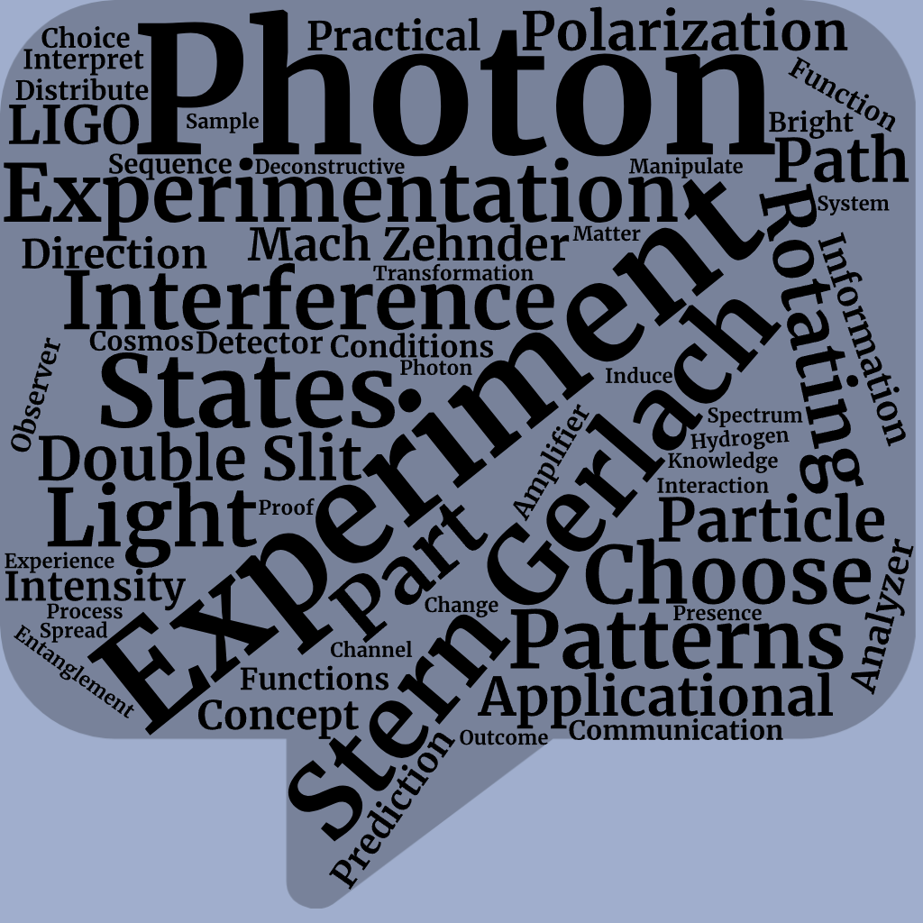
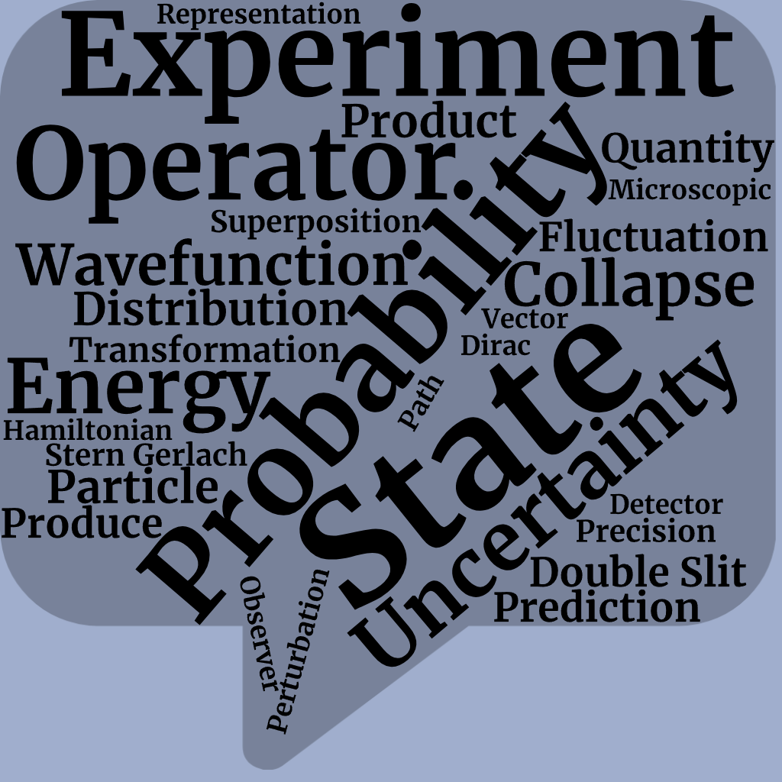
How Nuanced are Students Responses to Measurement?
When asked to relate measurement, students were more inclined to think out loud about experiments but not make an explicit response to the prompt
“Like, when there's a quantum measurement, we definitely need to consider the Heisenberg uncertainty. Or, like, we were… what comes to my mind is perturbations, or like fluctuations. Okay. Yeah. Like, that's what comes to my mind because I think of, like, I need to think about something mathematical in terms of the measurement.”
Relatings to Experiments | Relating to Mathematics
~800 words total | ~1100 words total
~100 words per student | ~140 words per student
Relating Measurement to Experiments
Relating Measurement to Mathematical Formalism
Balancing Mathematical Formalism and Experimentation Discussions in Quantum Mechanics: Student Perspectives on Learning and Quantum Measurement
CSAAPT Spring 2025 Meeting - George Mason University
Notes:
Many students to answer these questions mainly through a stream of consciousness where students were vocally going over their thought processes. Throughout the student responses, students were more inclined to just list off seemingly disjointed and disconnected terminology without properly connecting their ideas back to the original prompt. So, students were more confident in their descriptions of relating measurement to math, as shown in the table, students spent around approximately 140 words per student on their math connections, while conversely students spent around ~100 words per students on their experimental connections. Meaning students had more to talk about in their mathematical descriptions due to familiarity and comfortability. In addition to word usage, students were more concise on their language when discussing mathematical relationships illustrated by the number of technical vocabulary used in students’ descriptions compared to the plethora of words used in their experimental comparisons. An example is illustrated in the following student quote: “Like, when there's a quantum measurement, we definitely need to consider the Heisenberg uncertainty. Or, like, we were what comes to my mind is perturbations, or like fluctuations….”It is important to note, that students were still exceptionally good at picking out relevant and meaningful terminology, looking at the major points in the mathematical connections with probability, state, uncertainty, operator and the experimental connections with Photon, stern gerlach, interference

Slide 13
Summary of Key Ideas
Students taking an operator-based quantum mechanics class had strong levels of understanding of how the mathematical formalism relates to an important quantum concept
Even though students generally preferred learning their quantum concepts through experiments, the students did not necessarily assess their experimental understanding to be higher than their mathematical understanding
When students were asked to make connections, they relied heavily on their mathematical understanding and were not as comfortable with the conceptual ideas behind experiments even when they prefer learning through experimentation in a course with a conceptually-centered approach around simulations
Ultimately, the interviewed students were still able to illustrate meaningful connections between these complex quantum concepts and their conceptual understanding of quantum measurement
Balancing Mathematical Formalism and Experimentation Discussions in Quantum Mechanics: Student Perspectives on Learning and Quantum Measurement
CSAAPT Spring 2025 Meeting - George Mason University
Notes:
In summary, Students taking an operator-based quantum mechanics class had strong levels of understanding of how the mathematical formalism relates to an important quantum concept
Even though students generally preferred experiments through the simulations to learn their quantum concepts, the students did not necessarily assess their experimental understanding to be higher than their mathematical understanding
When students were asked to make connections, they relied heavily on their mathematical understanding and were not as comfortable with the conceptual ideas behind experiments even when they prefer learning through experimentation in a course with a conceptually-centered approach around simulations
Ultimately, the interviewed students were able to illustrate meaningful connections between these complex quantum concepts and their conceptual understanding of quantum measurement

Slide 14
Future Projects, Collaborators, and Funding
2nd Round of Undergraduate Interviews: Evaluating students’ quantum knowledge on quantum optical experiments
Fall 2025 will have next group of students taking Quantum both online and in-person at Georgetown
Surveys, Interviews, Evaluating Work
Focus on other quantum mechanical ideas like Superposition or Entanglement
Evaluating online repository of students assignments for those who took Quantum Mechanics For Everyone and Quantum Mechanics
Collaborators: James Freericks and Leanne Doughty
Supported by AFOSR Grant FA9550-23-1-0378
Balancing Mathematical Formalism and Experimentation Discussions in Quantum Mechanics: Student Perspectives on Learning and Quantum Measurement
CSAAPT Spring 2025 Meeting - George Mason University
Notes:
Here are a list of a few future projects related to this talk including a 2nd round of interviews with the same student base and the potential in evaluating student’s understanding in other important quantum mechanical concepts for the next iteration of quantum students in this upcoming fall. I would like to thank my advisers Jim Freericks and Leanne Doughty and the Air Force for our funding on these projects. Thank you for your time!

