Slide 1
Bernoulli Equation for Gases
Carl E. Mungan, Physics Dept, U.S. Naval Academy, Annapolis MD
Spring Meeting of the Chesapeake Section
of the American Association of Physics Teachers
Saturday 5 April 2025 George Mason University

Slide 2
Learning Objectives
To show you a first-principles mathematical modification of the Bernoulli equation to treat compressible fluids.
To discuss that theory in light of two previous experiments about gases escaping out of a small hole in a pressurized vessel.

Slide 3
Push a block of fluid of volume dV at speed υ through a distance dr in a time dt:
υ = dr/dt
(P+dP)A
A
dV =
Adr
PA
dr
dy
ρdVg
to get component of mg
in direction of motion

Slide 4
Bernoulli equation
for isothermal gas
extra factor due
to compressibility

Slide 5
1
2
y₁ = y₂
bottle pressurized
to P₁ = P
atmosphere
P₂ = P_{atm}
υ₂ = υ
υ₁ ≈ 0
Correctly implies υ → 0 as P → P_{atm}.

Slide 6
m
P
V
initially
ejected
mass
area of
hole
m + dm
P + dP
V
finally
dm < 0
dP < 0
-dm
A
υdt

Slide 8
Correctly simplifies to P = P₀ at t = 0.
Experiment: Pump up a 2 L soda bottle to 3 atm in a room at 20°C and let
the air flow out of a 0.5 mm diameter hole.
N₂
O₂
Ar

Slide 9
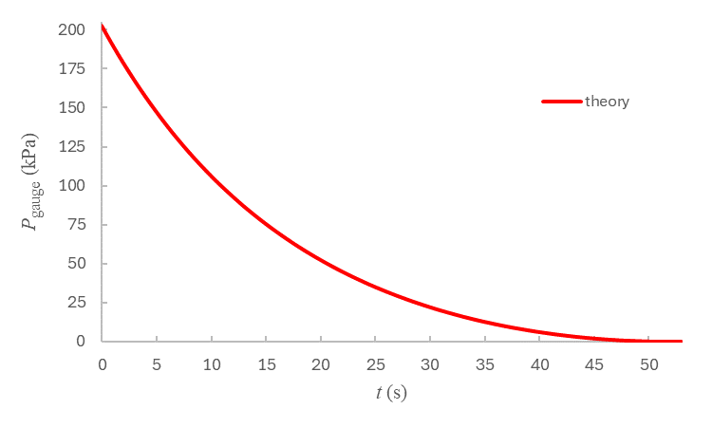
t_{f} = 52.1 s

Slide 10
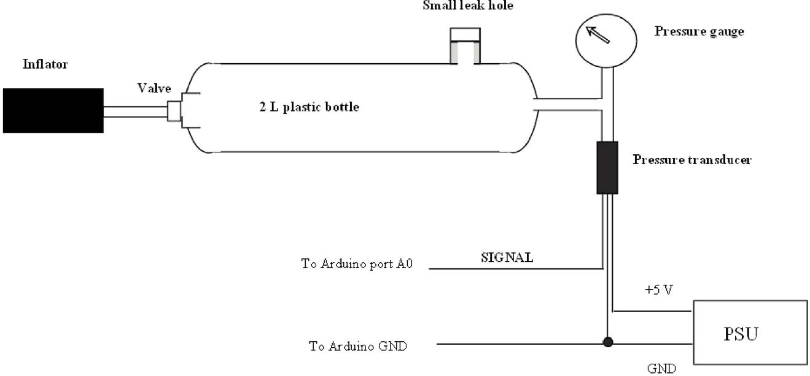
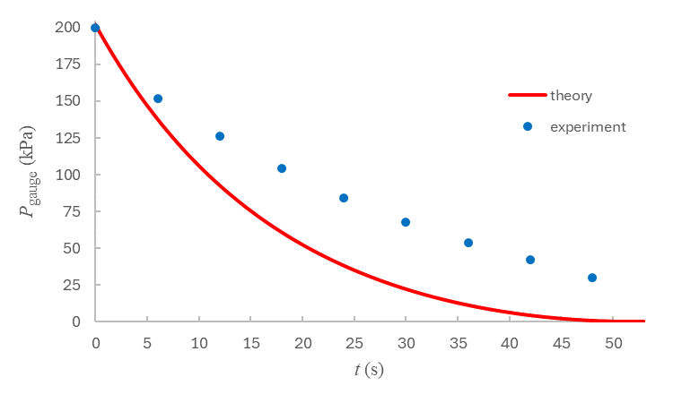
Experiment by Keith Atkin in
Physics Education 59, 015035 (2024).

Slide 11
To improve the fit, adjust two parameters to match those used by Atkin:
M = 30 g/mol (instead of 29.0 g/mol)
P_{atm} = 100 kPa (instead of 101.3 kPa)
and reduce the effective hole diameter to:
D = 0.38 mm (instead of 0.50 mm).
This corresponds to reducing the hole area to 58% of its actual area,
which is the discharge coefficient resulting from the vena contracta
and flow losses at the hole.
A_{actual}
A_{effective}

Slide 12
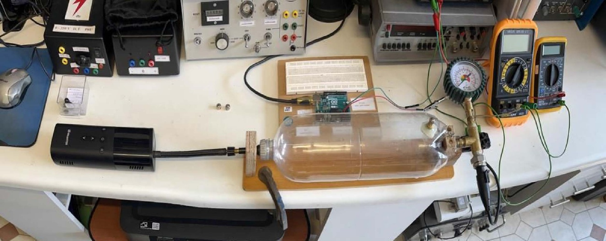
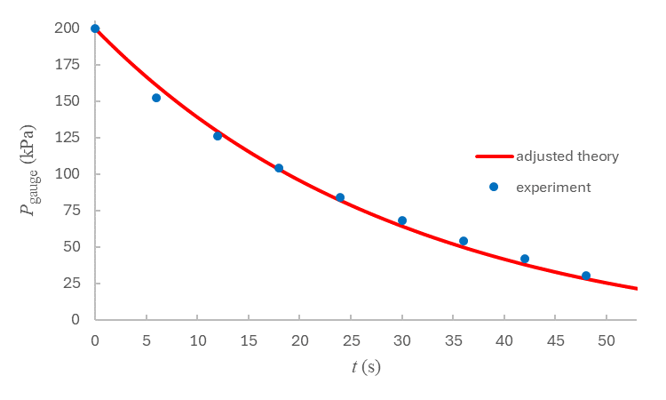

Slide 13
Application: Consider the depressurization of a spacecraft struck by a micrometeroid. Does the crew only have seconds to survive? Unfortunately, if we set the initial pressure to P₀ = 1 atm and the ambient surroundings to P_{atm} = 0, our key equation fails:
There are two issues. First, heat cannot be transferred from vacuum and so the gas expanding into the ambient surroundings cannot remain isothermal. Instead it must
cool down and we instead need the Bernoulli equation for an adiabatic gas. Secondly,
once the pressure inside the vessel gets sufficiently low (when the mean free path
becomes larger than the hole diameter) we need to model the flow as an effusion process
(as described in standard thermodynamics textbooks). Such a lab experiment has been
performed and analyzed in AJP 37, 39 (1969). The result is it takes a long 18 minutes for
the pressure to fall to 0.01 atm for a 3.5 L vessel with a 0.37 mm actual diameter hole.

Slide 14
Thoughts or questions?
email: mungan@usna.edu
webpage: usna.edu/Users/physics/mungan
where you can find the paper:
Comment on “The spacecraft decompression problem,”
Physics Education 59, 038003 (2024)

