Slide 1
Improved Pedagogical Introduction to Quantum Entangled States
Robert C. Hilborn
Department of Physics
University of Maryland
Supported in part by NSF 2120757 Robust Quantum Simulations

Slide 2
Introduction and Overview
Entangled States – what’s the big deal?
Need pedagogy that diminishes student misconceptions and misunderstandings
Prepares for QIS and QC Applications

Slide 3
Multi-particle Quantum States
Example: two qubits
Two spin-1/2 systems (not necessarily of the same type of particle)
Four-dimensional Hilbert space = # of basis states
Use basis states for spin along z axis.
For the composite system

Slide 4
1
Most general superposition state of the two-qubit composite system
State coefficient
Product State – special case
Independent qubits
Otherwise, the composite state is said to be entangled.
There are no quantum states describing the individual qubits.
Correlations among measurements on the individual qubits.

Slide 5

1
Traditional Approach to Entanglement
Tensor product space
Need to define operators in that tensor space
Operate on both qubits
Operate on only one qubit, leave the other alone
Need to specify the state of the system after measurement on only one part
Need correlation functions (expectation values of various operators) to extract entanglement features
Steep learning curve
Too many new ideas

Slide 6
Better Way: Focus on Probabilities
Entanglement correlation information
joint
total
conditional
Can be read off from composite system state vector
Bayes’s Rule (Theorem)

Slide 7
1

Slide 8
1
Three equivalent statements:
The two qubits are not independent.
There are correlations among the measurements of A and B.
The composite state is entangled.
“Alice’s observations affect the probability of Bob’s measurement outcomes.”
“Spooky action at a distance”?

Slide 9
1
Example
Is this an entangled state?

Slide 10
Summary
The composite system state vector contains all the information about measurement outcomes for the system: both collective and individual.
No need to invoke “collapse of the state vector.”
Once the basics are in place, students are ready to learn about tensor products of operators, states after measurements, correlation functions, etc.
Applications:
Quantum State Teleportation
Bell’s Theorem: (hidden variables vs quantum mechanics)
Entanglement Swapping
Superdense Coding

Slide 11
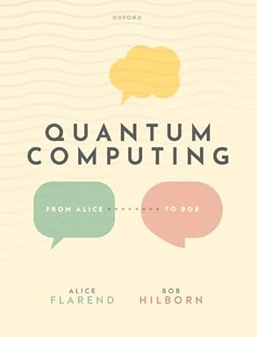
Book: Quantum Mechanics for Quantum Computing: A Linear Algebra Approach (fall 2025)
Based on Quantum Computing: From Alice to Bob, Alice Flarend and Bob Hilborn (Oxford University Press, 2022)
rhilborn@umd.edu

