Slide 1
Available Resources from the Organization for Physics at Two-Year Colleges
Kris Lui OPTYCs Director – AAPT
Chesapeake Section Meeting – 2025-Apr-05

Slide 2
What is OPTYCs?
To create and sustain a national community
To resurrect past successful initiatives for professional development
To develop new professional development programs
NSF IUSE grant: 4 years & $3M
Started July 1, 2022
Administered under AAPT

Slide 3
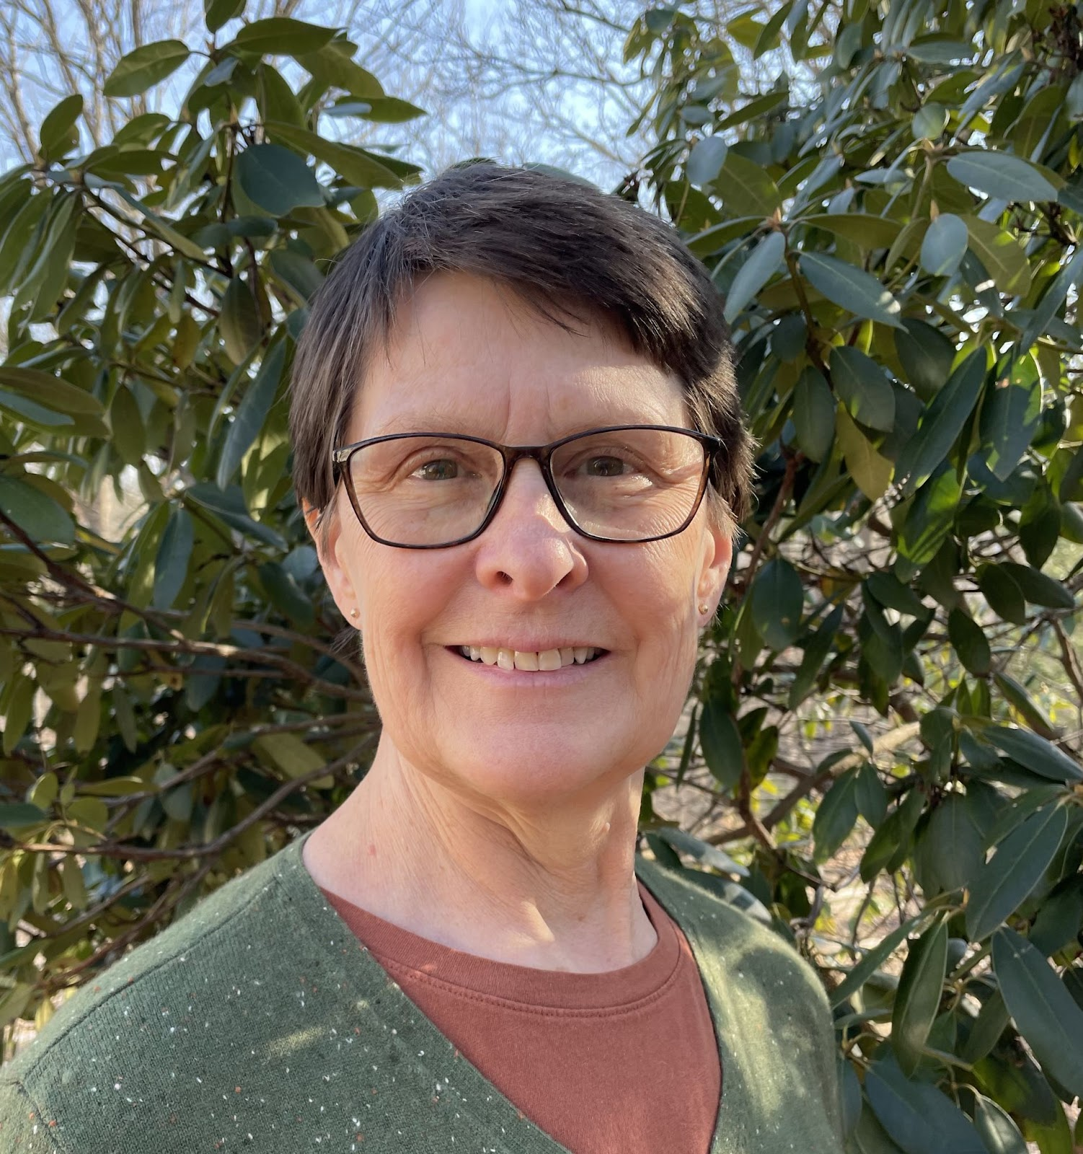
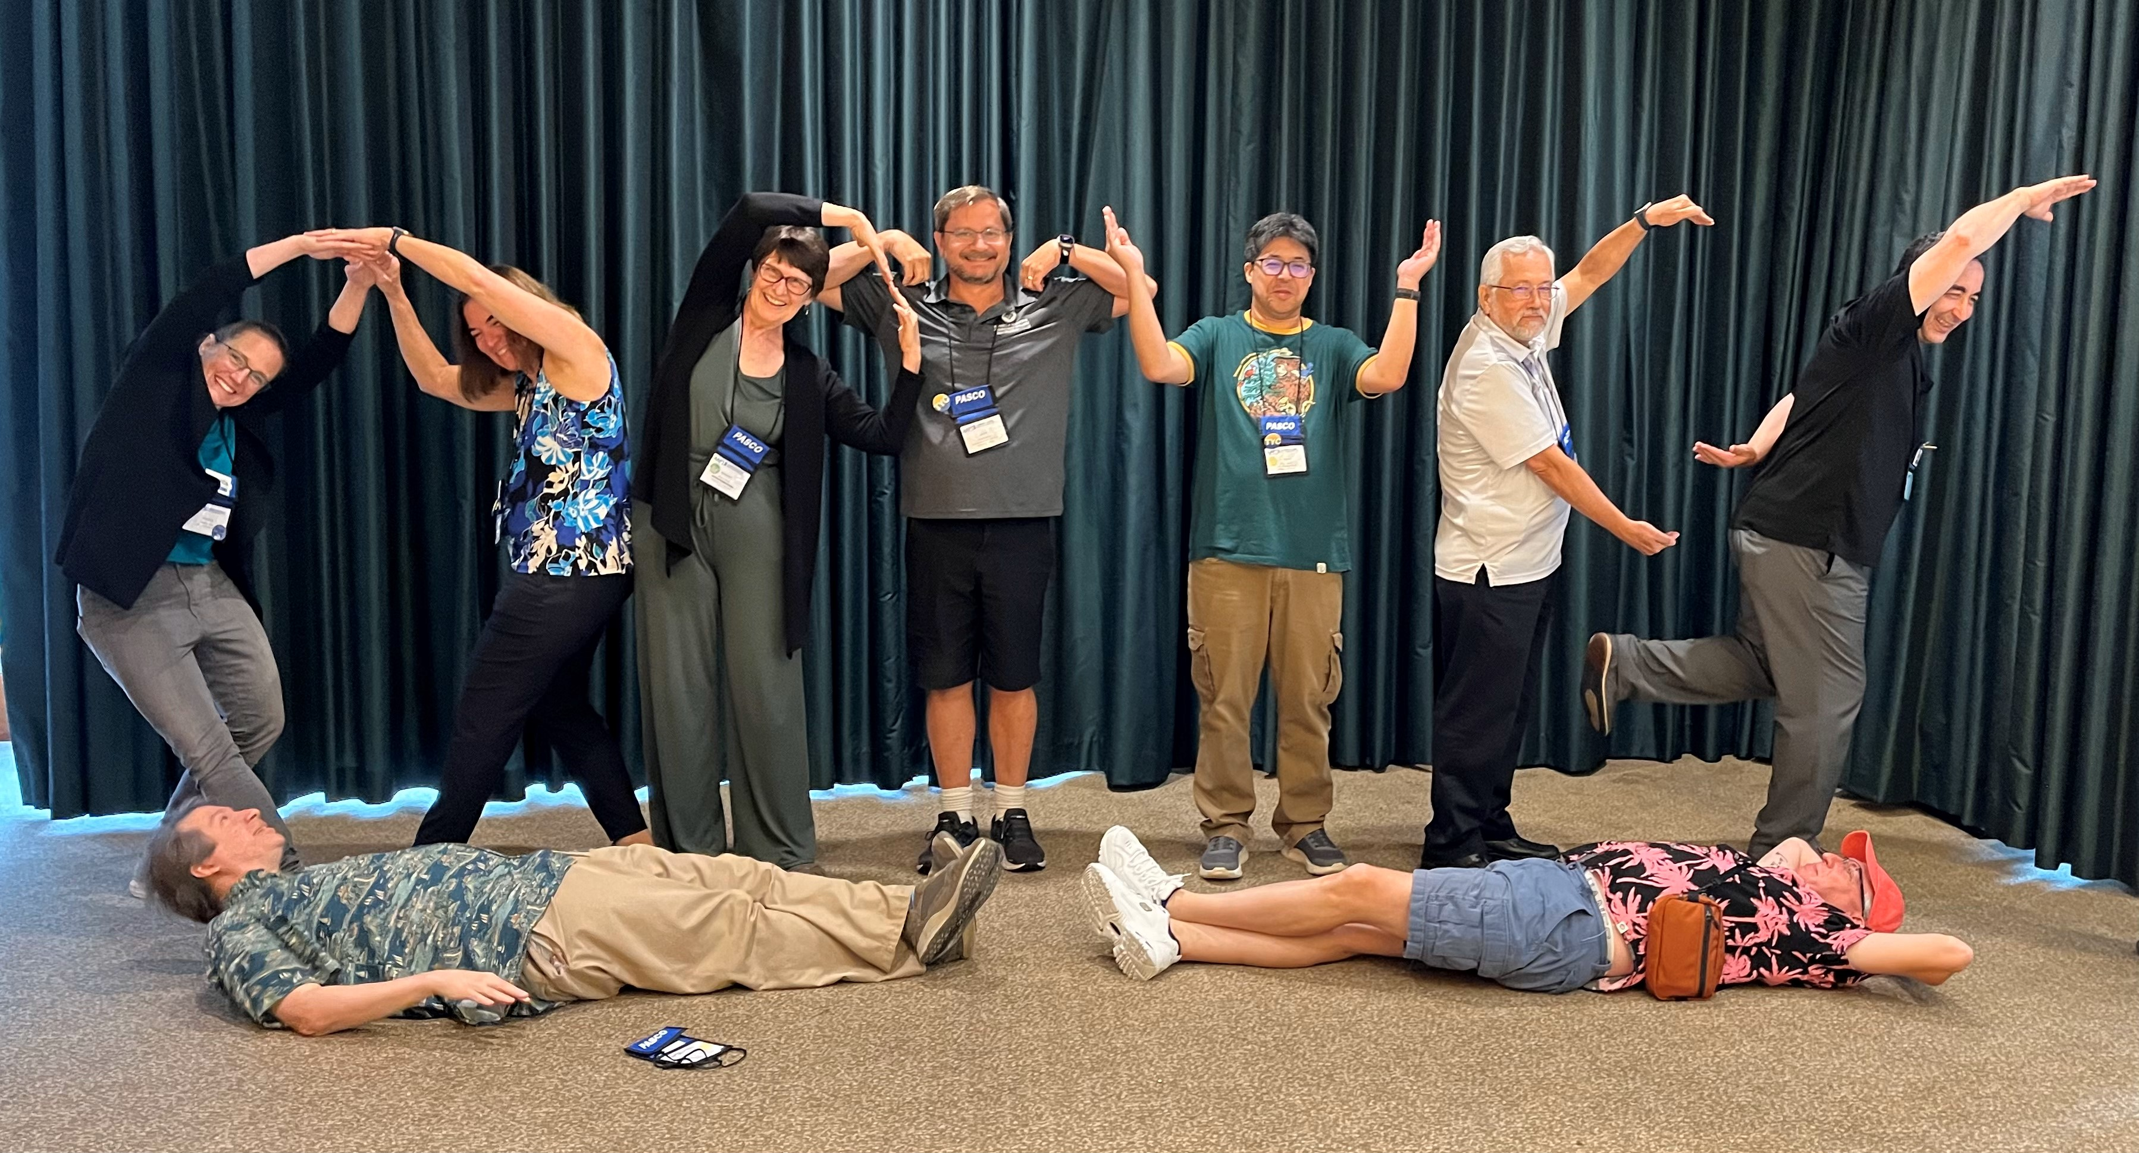
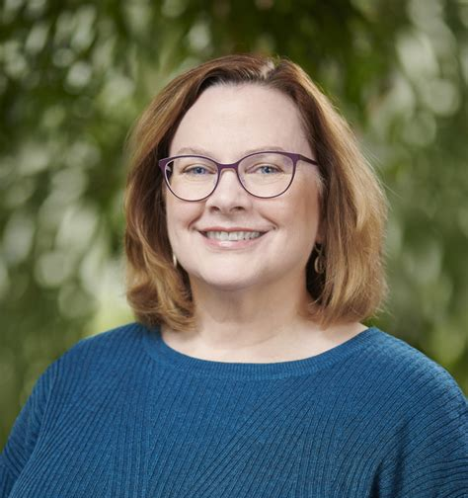
Who is OPTYCs?
Co-PIs
4 co-PIs + 9 Program Coordinators
5 Advisory Board Members
External Evaluation Team (Goshen)
Sherry Savrda
Some of the OPTYCs Team in Boston, MA. July 2024.
Dwain Desbien
Rachel Ivie

Slide 4
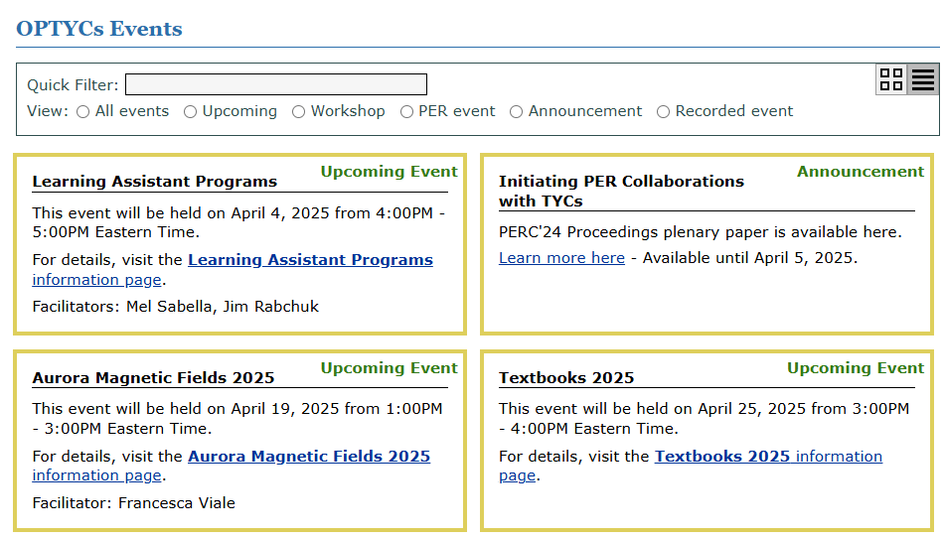
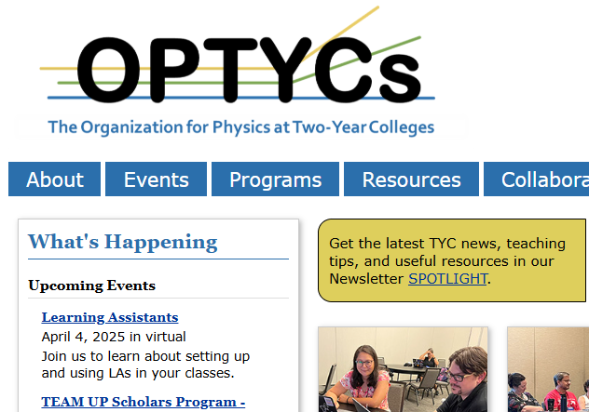
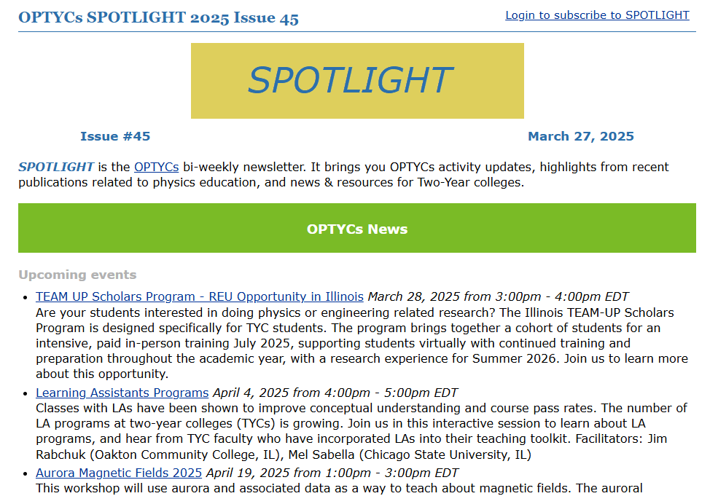
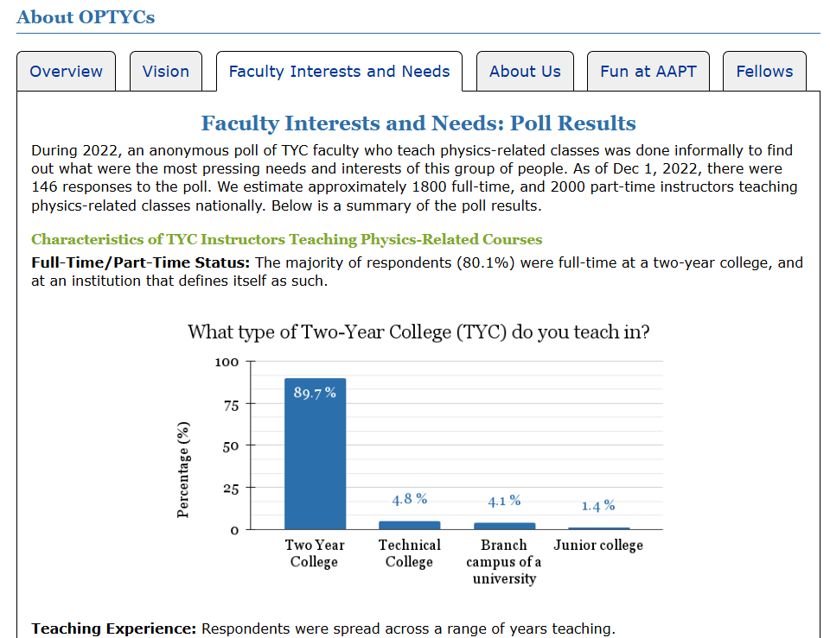
Events Archive
Website Landing Page
Newsletter
About OPTYCs

Slide 5
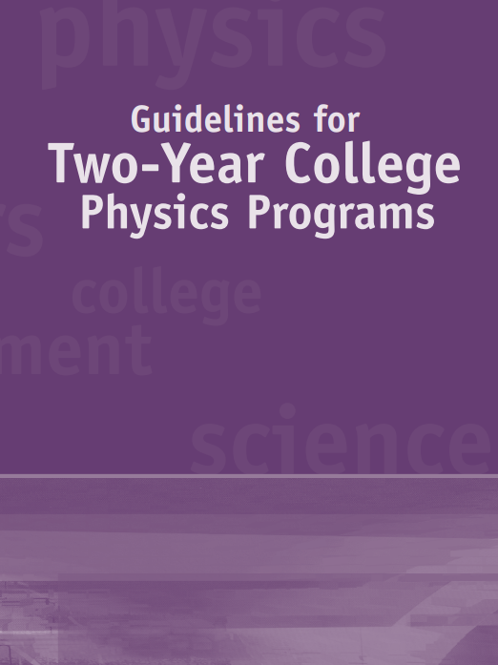
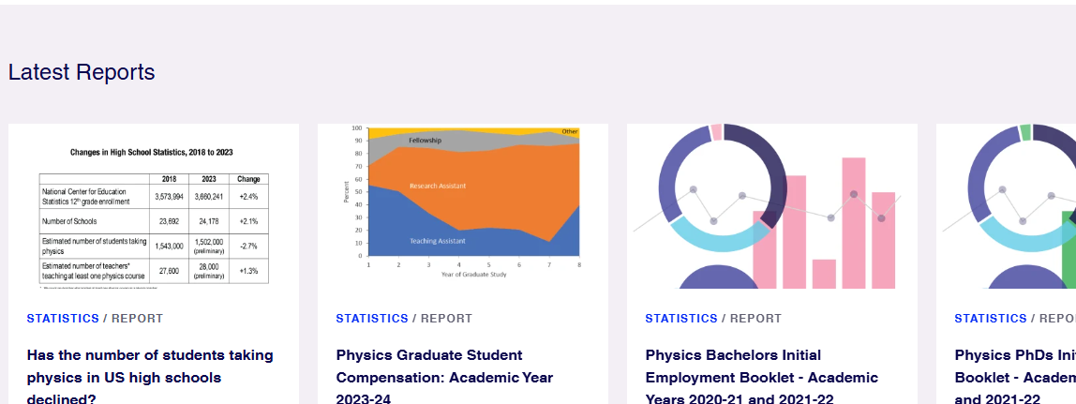
Coming Soon
Guidelines for Physics Programs at Two-Year Colleges (2nd Ed.)
Survey results about TYC physics programs, courses, faculty and students (with AIP’s Statistical Research)

Slide 6
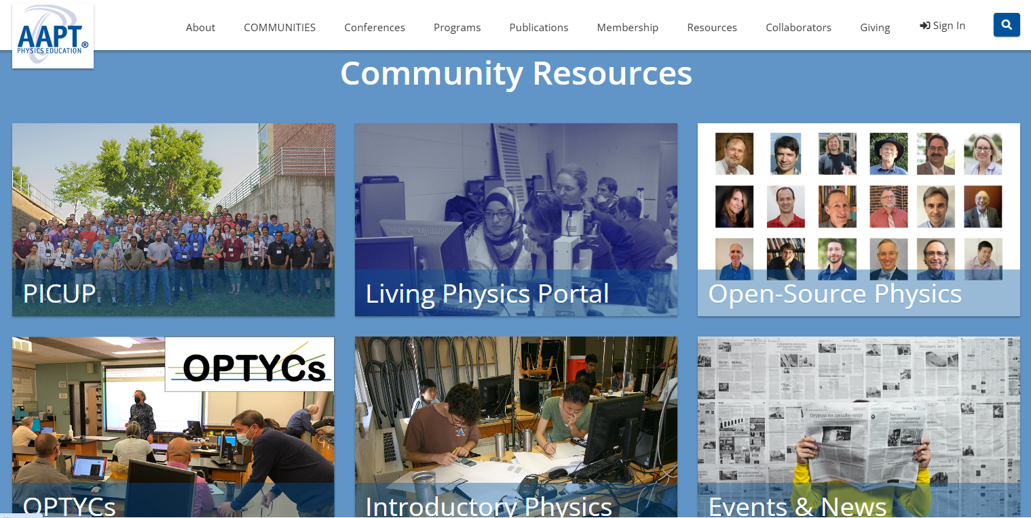
AAPT’s ComPADRE

Slide 7
TYC faculty are embraced within and empowered by an inclusive national physics community.
TYC students experience excellent evidence-based physics instruction which prepares them for their future endeavors.

Slide 8
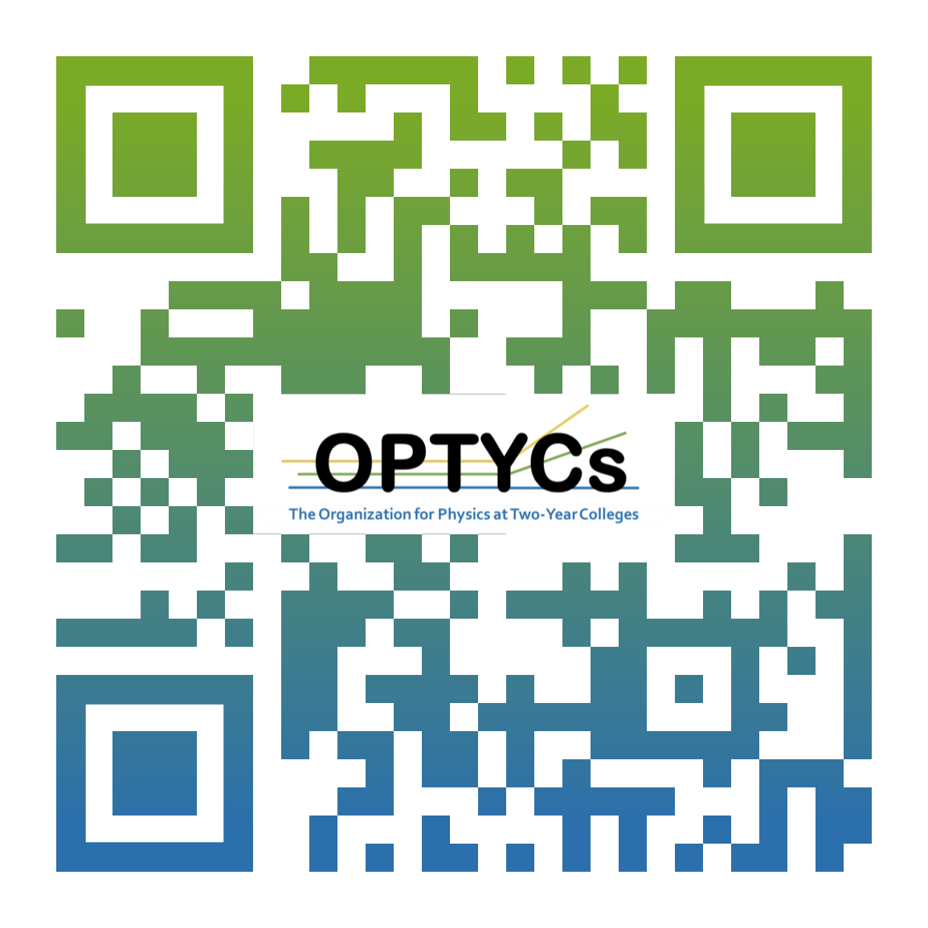
You do not need to be TYC-affiliated to participate
Email | OPTYCs@aapt.org
Website | https://OPTYCs.aapt.org/
YouTube | https://www.youtube.com/@optycs5337
Newsletter | https://optycs.aapt.org/spotlight/
Kris Lui – KLui@aapt.org
This material is based upon work supported by the National Science Foundation under Grant No. 2212807.

