Slide 1
Is it possible to improve your evaluations and still sleep well at night?
Maxim Bychkov
Elizabeth Larson
Jongsoo Yoon
University of Virginia
Physics Department

Slide 2
The work is supported by The UVa LTI grant
The Learning Technology Incubator (LTi) program promotes innovative projects that seek to solve common instructional challenges and show potential to improve teaching and learning broadly across the curriculum. LTi is an initiative of A&S Learning Design and Technology, a faculty support unit in the College and Graduate School of Arts & Sciences.

Slide 3
TOPICS to be covered
1. Overview of the courses
2. Learning objectives
3. Issues and proposed solution
4. Implementation of the solution with examples
5. Results from students’ evaluations
6. Lessons learned

Slide 4
1. Overview of the course(s)
PHYS1429/2030/2040/2419
1-credit introductory courses for engineers and pre-medical students. Run the same way. Separate grade from lecture
Large enrollment (~1200 in the Spring and ~800 in the Fall)
Split into ~35-50 sections of 26 students
Each section is led by 2 or 3 TA (grad and UG) ~40 TAs total
TAs are trained weekly for each experiment
3-4 graders per course (7 total) to ensure consistency. Trained weekly and checked weekly

Slide 5
Course evaluations are entirely student driven
The course Increased my enthusiasm for the topic = Enthusiasm
I gained a deeper understanding of the subject matter = Understanding
Average time spent outside the class = Time
The instructor fostered an environment where I felt valued as an individual and that I belonged in the class = Belong
The instructor created an environment that respected difference and welcomed diverse perspectives = Respect
Overall, the instructor was an effective teacher = Effective

Slide 6
2. Learning objectives
1. Teach a systematic way of solving problems
2. Provide practice in problem-solving in group setting
3. Connect your pure mathematical skills to constructing realistic physical models
4. Promote development of your oral and written communication skills
5. Demonstrate the applicability of physical principles to life-science-based problems
6. Inspire confidence in your ability to make measurements, and analyze and interpret data
Each learning objective is supported by either an individual lab and/or a consistent requirement throughout the semester

Slide 7
3. Identifying the issue(s)
Too many objectives for a 1-credit course!
What things can be dropped? What needs to be preserved? Are there other things we need to be looking at? For example, should math prep be of greater concern?

Slide 8
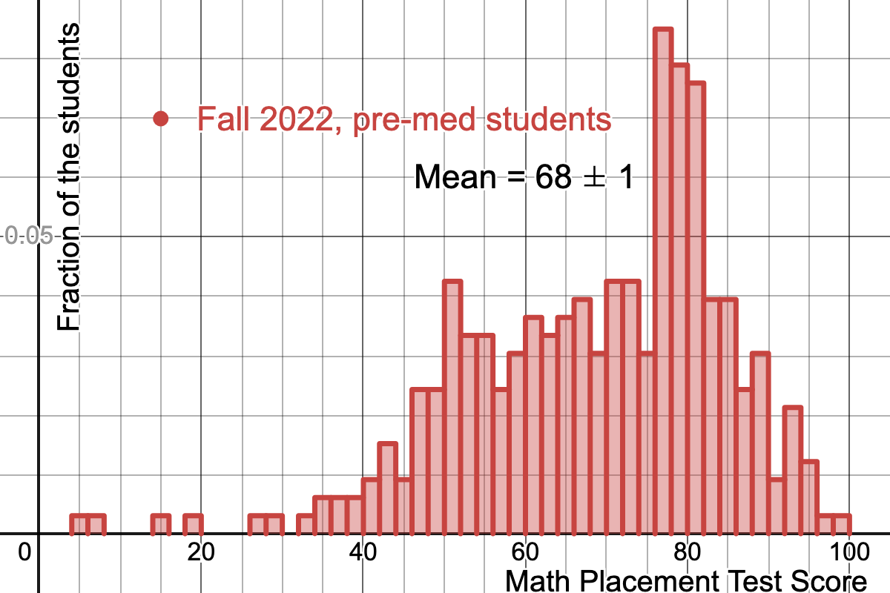
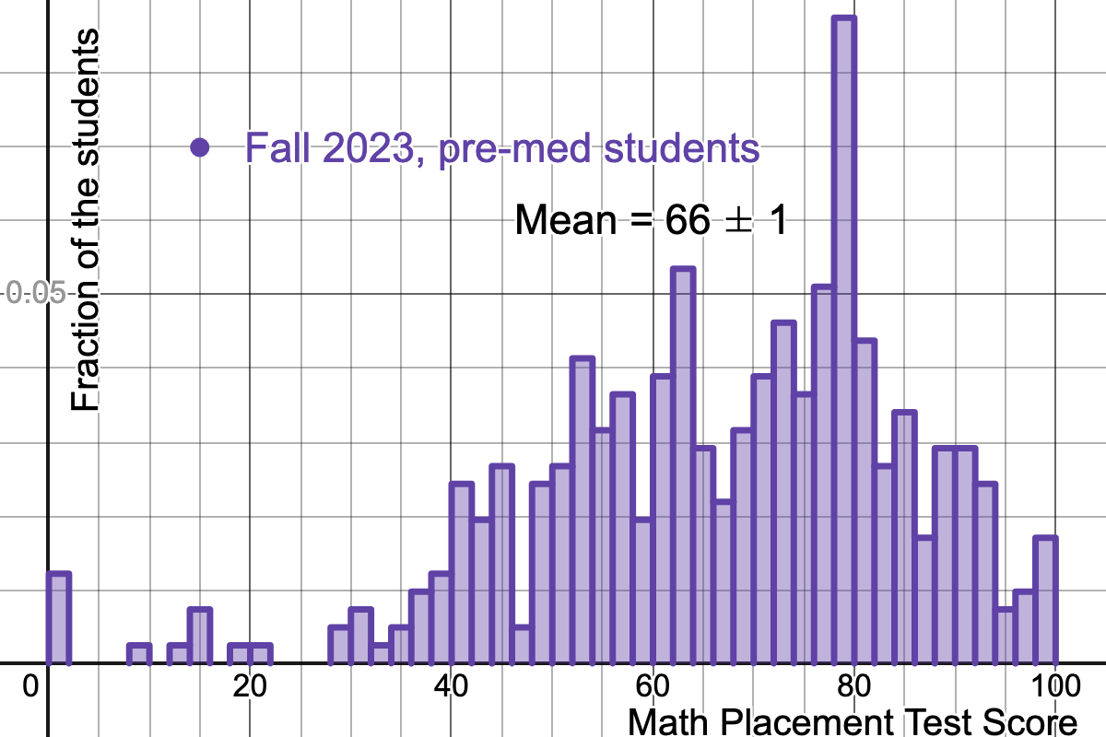
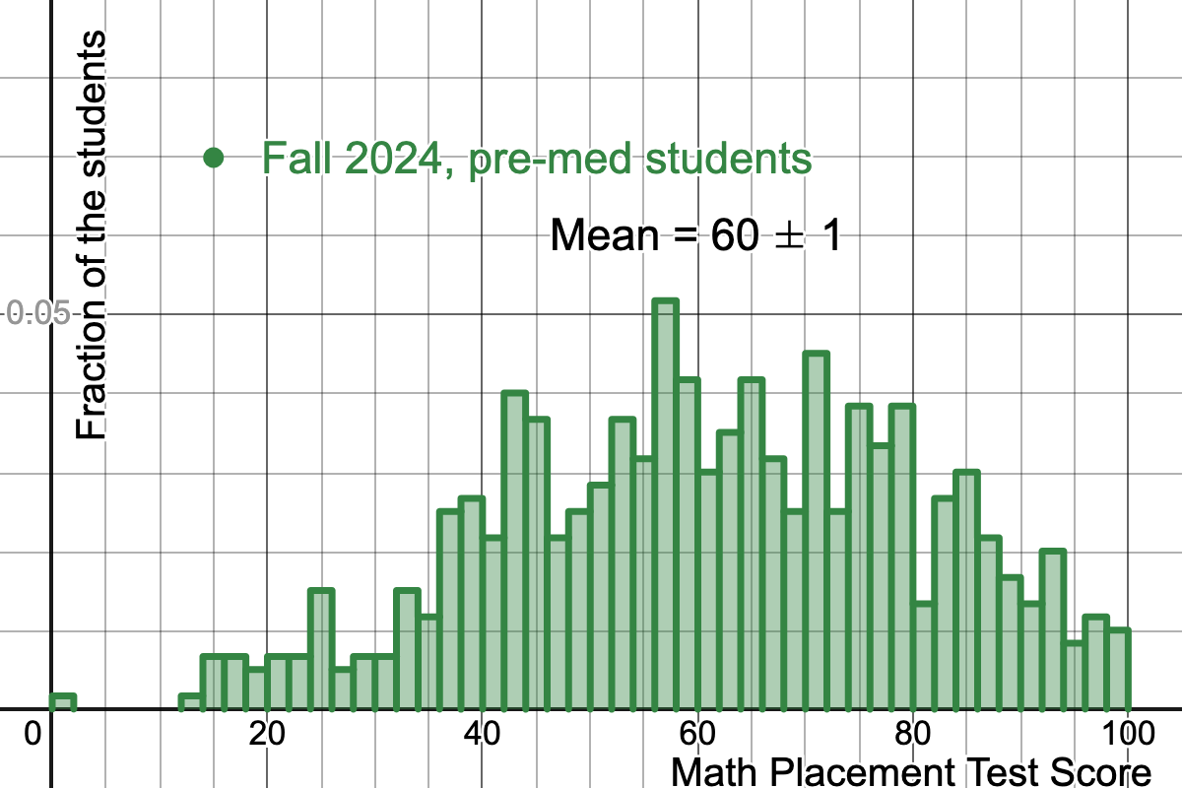
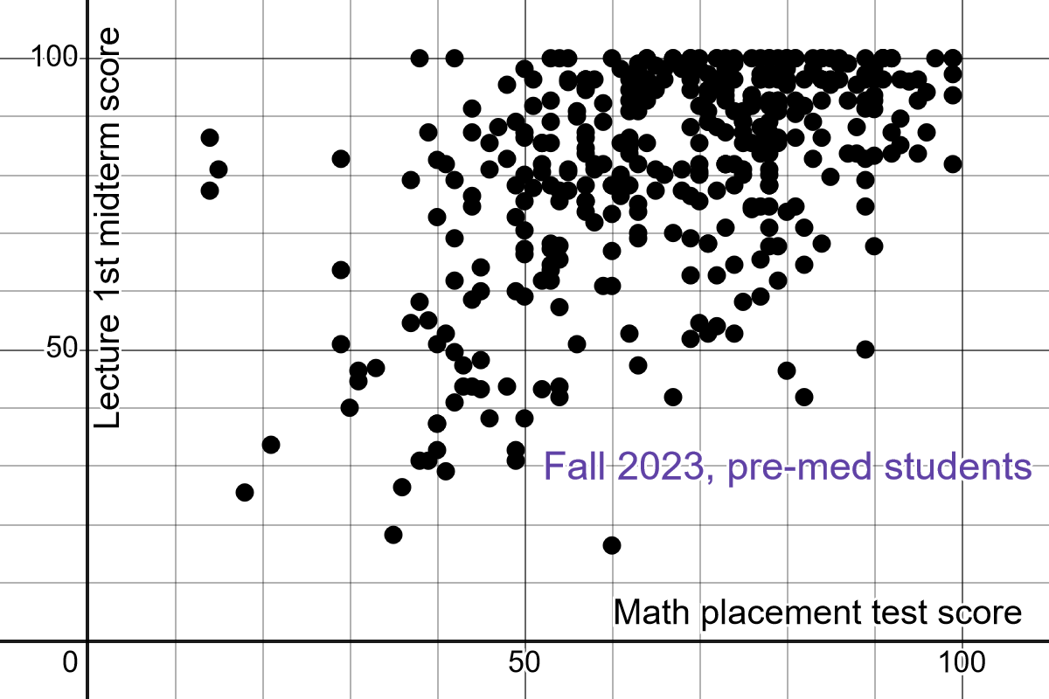
* Data from Jency Sundararajan and Rebecca Grouchy

Slide 9
After a lot of soul searching, we decided to sacrifice one learning objective
(4) - promote development of your oral and written communications skills
and to significantly ease up on goals
(2) - provide practice in problem-solving in a group setting and
(6) - inspire confidence in your ability to take measurements, and analyze and interpret data
by eliminating group free response lab reports and providing a more “cookie-cutter” approach to data analysis with more structured steps
We decided to “double down” on
- systematic problem solving
(3) - connecting pure mathematical skills to physical models
(5) - demonstrating the applicability of physical principles to life-science based problems and
keeping thorough uncertainty analysis in (6) - inspire confidence in your ability to take measurements, and analyze and interpret data

Slide 10
4. Implementation of the solution with examples
Instead of free response lab reports I wrote a series of “user-input” post-lab modules.
All answers are graded immediately by a computer so there is no grader subjectivity or delay. It also frees 7 GTAs to be in the classroom.
Free response portions were replaced with Multiple Choice or Multi Select, but all options are common misconceptions from hundreds of actual reports.
All analysis and conclusion questions are individualized based on the data entered by the students.
Show examples: “Ankle tackle” from phys-I and “Nervous breakdown” from phys-II

Slide 11
Ankle tackle problem (2030/1429 lab 6)
You are working in a sports medicine clinic and have been closely following the conversation surrounding concussions in football and the changes to the sport necessary to prevent them. Not being a neurologist, you decide to focus on another angle of the question and try to determine which injuries may appear in higher numbers if the sport evolves to mainly consist of plays that have not come under recent scrutiny for producing head trauma.
As a first step, you decide to investigate a move known as the “ankle tackle,” in which a defender brings a ball-carrying offensive player down by diving to the ground and pulling their feet out from under them. Your goal is to determine whether such a move is more likely to result in knee or ankle injuries, both of which already occur relatively often in football.
Your question can be summarized as follows: if a strong force is applied to a player’s feet, does he experience more damaging (greater) tension in the tendons and ligaments of his knees or of his ankles? To simulate this situation, you decide to use a system of connected carts to represent the sections of the player’s leg, a hanging mass to represent force applied to the foot, and connecting strings serving as a model for connective tendons and ligaments.

Slide 12
Nervous breakdown problem (2040/2419 Lab 2C)
You are doing research on damaged nerve cells and hope to gain a better understanding of how the damage can most easily be diagnosed and therefore addressed. You know that on a simple level, the transmission mechanism for signals in nerve cells is electrical in nature, and you aim to gain a deeper understanding of how the transmission of electrical signals through conductors originates.
Damage to the myelin sheath that insulates the axon can disrupt the transmission of signals and thus create major problems. Your goal is to determine a non-invasive method for diagnosing where along the axon the damage has occurred so that repair efforts can target the appropriate region with minimal disruption to healthy cells.
You will model the damaged axon and electrical ground with which it has come in contact using highly-resistive wires. An electrical short will represent the region of damage that affects the transmission of the signal.

Slide 13
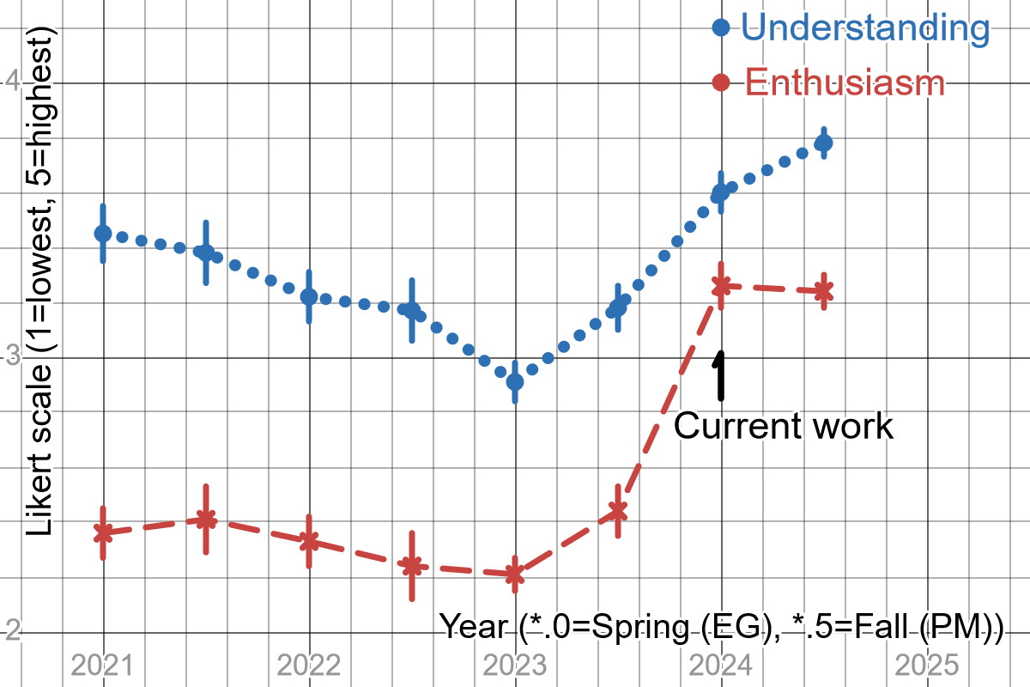
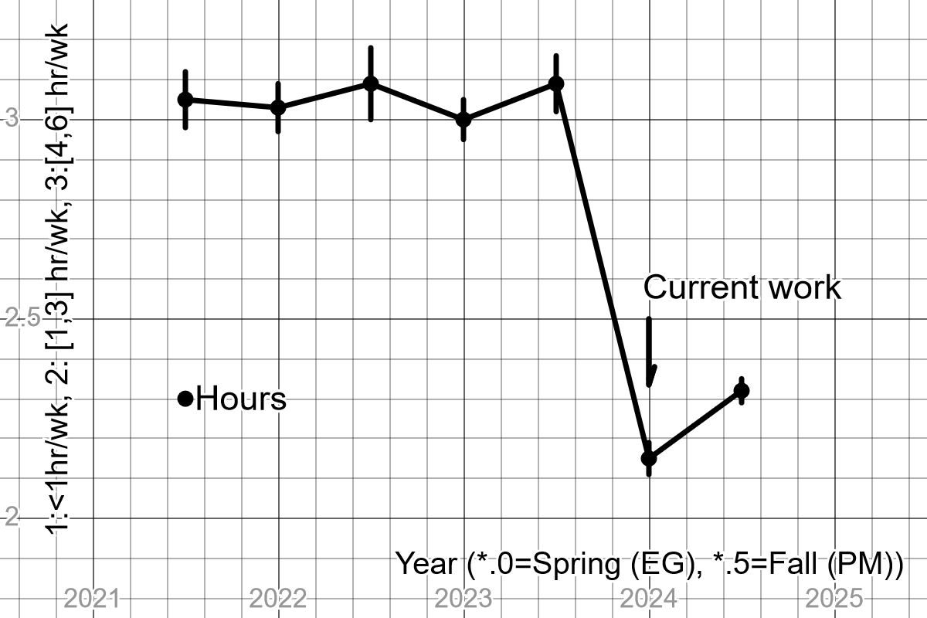
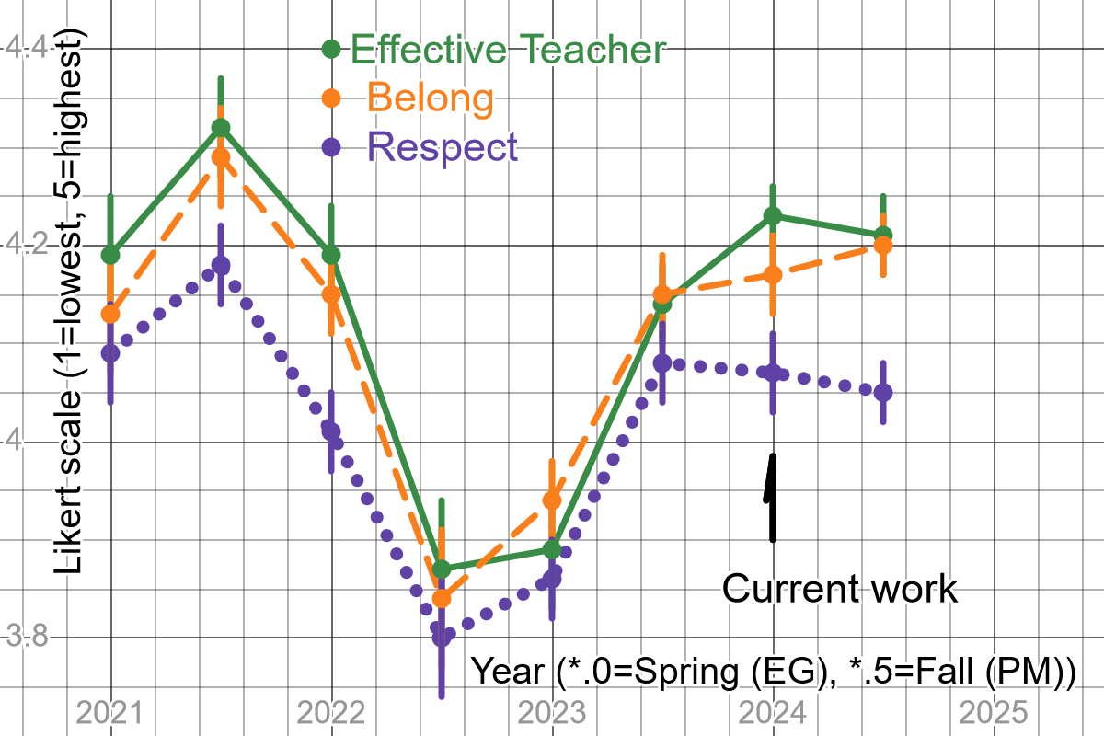
5. Results from students’ evaluations phys-I (implemented in Spring2024)

Slide 14
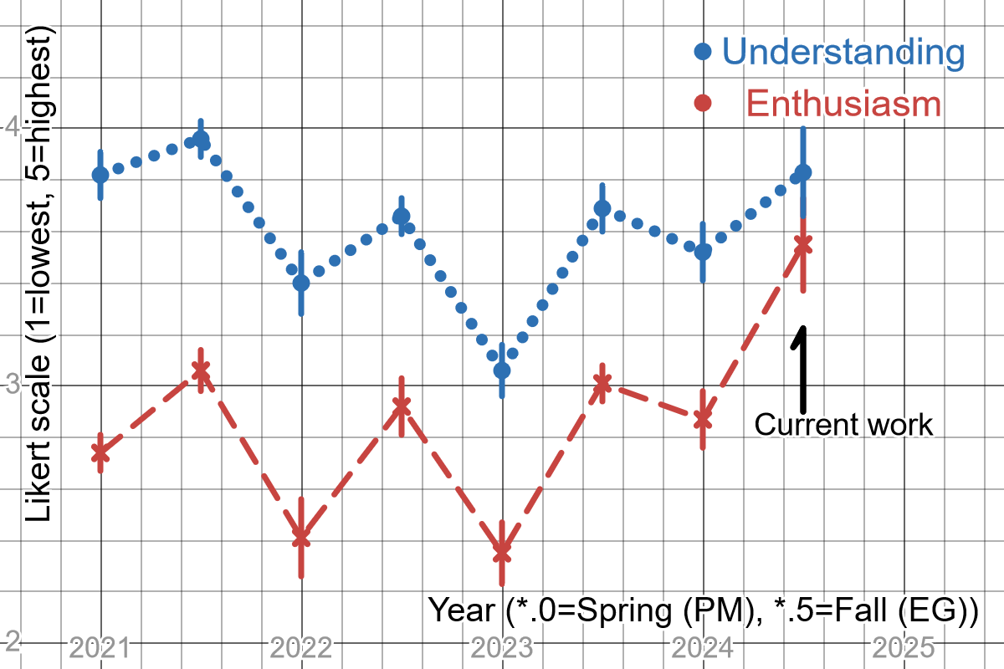
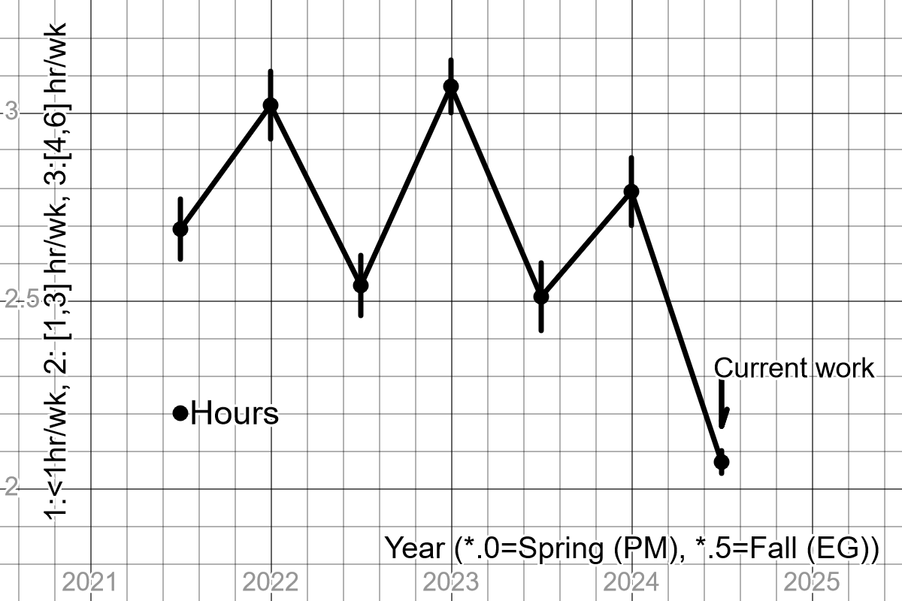
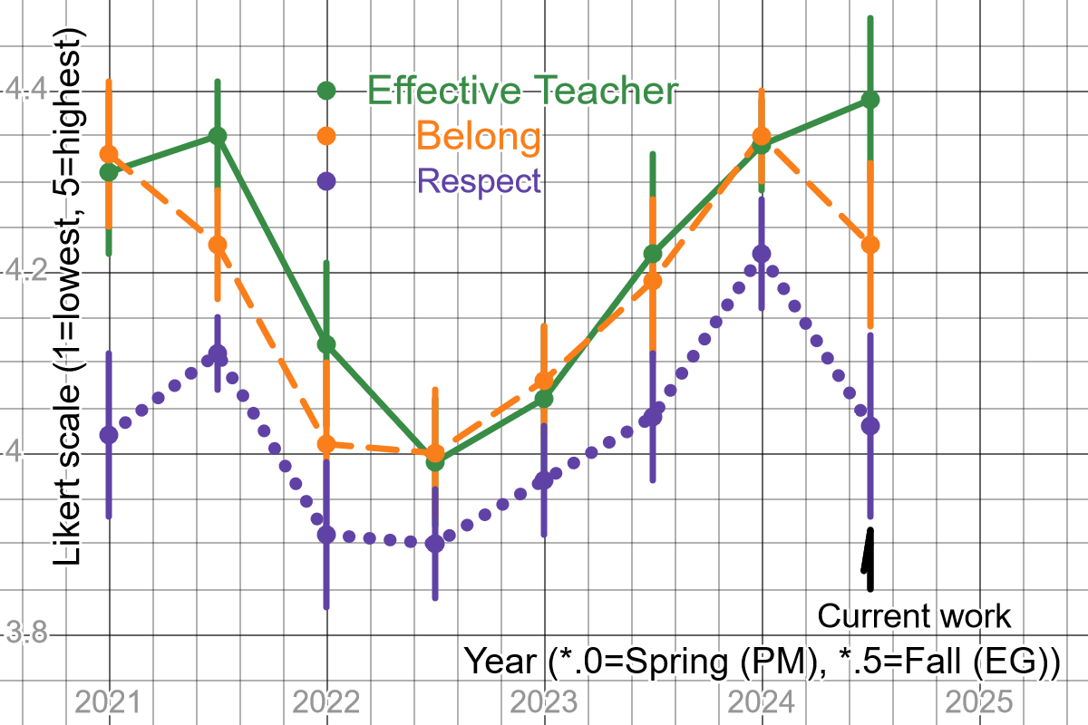
5. Results from students’ evaluations phys-II (implemented in Fall 2024)

Slide 15
6. Lessons learned
In my experience the following factors influence the evaluations negatively
High inquiry level of the assignments
a. Even slightly open-ended problem statements
b. Self-governed measurement plans
c. Generic instead of specific rubrics
e. Any perceived or actual subjectivity in grading
Truly collaborative/group work in and out of the class
Any amount of work outside the class (for 1-credit class)
Anything that resembles “grunt work” science: uncertainty calculations, data tabulation, lab journals (paper/electronic), proper graph/report formatting etc. = “busy work”
All of which are proven good pedagogical practices!! PICK YOUR HILL TO DIE ON and carry on!

