Slide 1
Rocket launches as a capstone project
Jeff Steele
Central Virginia Governor’s School for Science & Technology
Lynchburg, VA

Slide 2
School Description
The Central Virginia Governor’s School (CVGS) is a half-day program for gifted Juniors and Seniors in the Lynchburg Area
In the Junior year, students take physics, mathematics (pre-calculus or calculus), and research 4 days a week
75 students in each year from 5 school divisions/10 High Schools
Complete autonomy in our scheduling while students are on site (2 hours, 40 minutes)

Slide 3
Rationale for capstone
Attendance can be spotty at the end of the year due to testing in base schools
We wanted an advanced project that would be open ended, collaborative, and enjoyable for the students.
An essential element of the design was to include aspects from each of the three junior courses (physics, mathematics, and research).

Slide 4
Project Goals
Research topics related to rocketry
Perform Ground tests to gather data on rocket performance
Build a mathematical model to predict maximum height
Build and test a rocket
Present results

Slide 5
Teaming demographics
3-4 persons per team
1 student, if possible, from calculus
Grouping outside of normal peer groups

Slide 6
Timeline (12 days)
Days 1-4
Introduction of project
Instruction in numerical modeling, Euler’s Method, Physics of Rocket flight
Ground testing
Beginning of mathematical model
Rocket Construction
Days 5-8
Rocket Launch
Completion of Mathematical Model
Research Topics
Preparation for second launch
Days 9-12
Preparation and rehearsal of presentation
Second Launch
Presentations
End of year ceremony

Slide 7
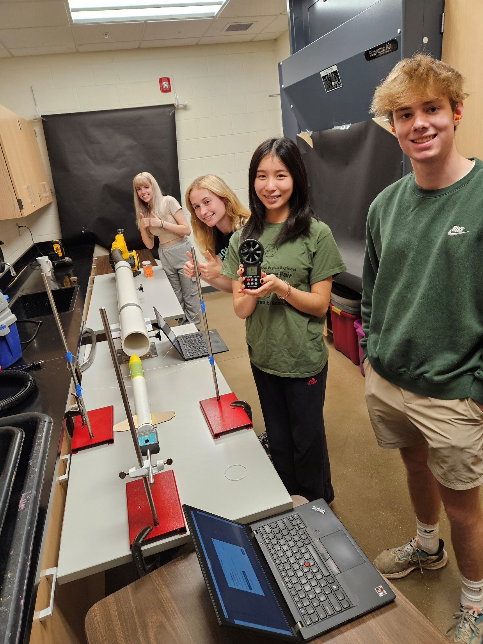
Ground Testing - Drag
Various ‘wind tunnels’ to gather data on drag
Windspeed & force is measured
BTMeter BT-100 Anemometer from Amazon
3D Printed part that inserts into the rocket engine cavity

Slide 8
Ground Testing - Thrust
Pasco force plates for rocket engines
Testing done outside
Students press the red button – always!
Force v. time graph produced
Students receive instruction on creating a piecewise function that will model the thrust as a function of time

Slide 9
Sample results
0
Modeling Results
Drag
Thrust
Mass
Predicted Max Height (ft) - 347.27
Photos created by group members

Slide 10
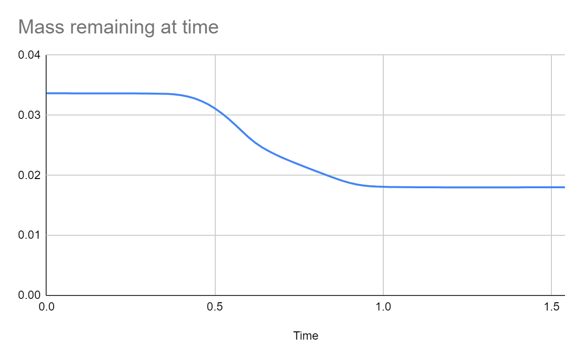
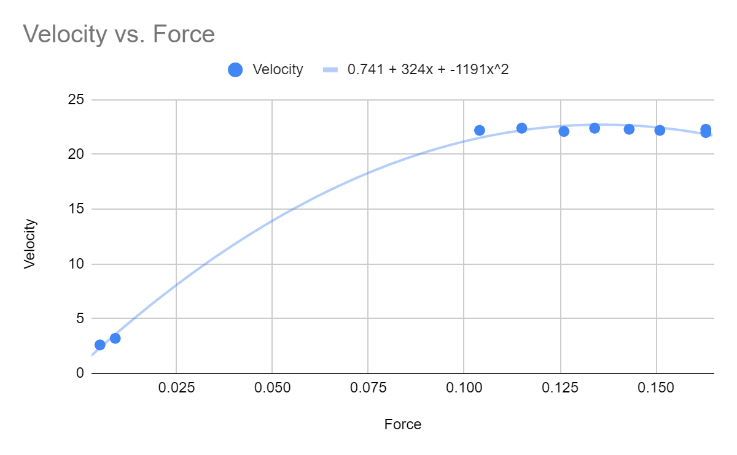
Sample results

Slide 11
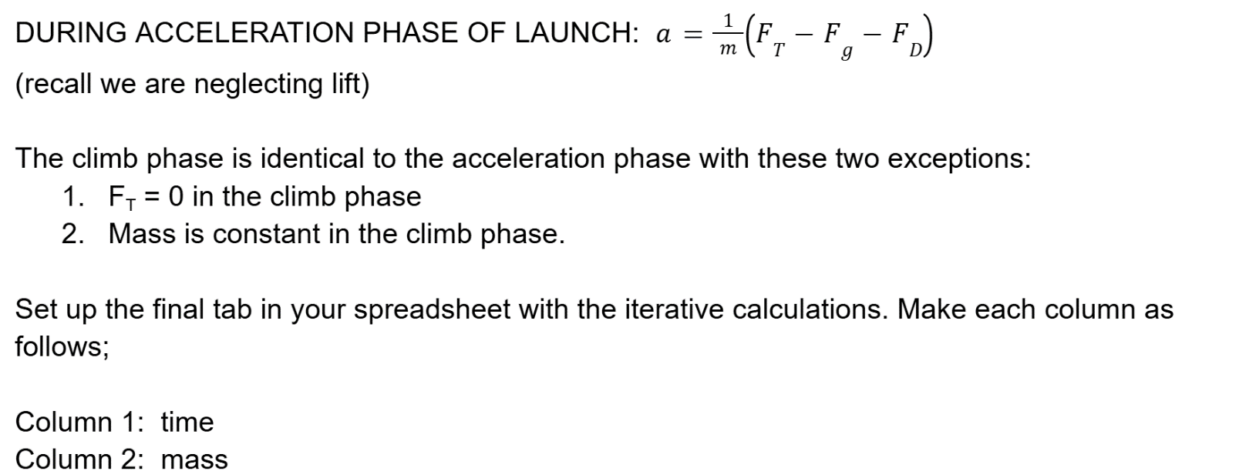
Mathematical Modeling
Initial practice with creating a piecewise function from data
Modeling the Drag Force with $F_{D}=\frac{1}{2}Cv^{2}$
Model the Thrust with a piecewise function
Model change of mass from mass difference of spent/unspent engine
Use Euler’s Method to calculate maximum height (spreadsheet) with recursive equations

Slide 12
Mathematical modeling

Slide 13
Launch day
Good weather is a must
Clear area – do not launch on artificial turf
Students press the button!
Altimeter prepacked into rocket – students recover and record maximum altitude. Mechanical backup
Consider launching in waves – a lot of standing around with multiple groups otherwise

Slide 14
Research topics
Each team must present at least one topic from each group, each member presents two topics
Category 1 - Physics & Mathematics
Drag Force
Impulse-Momentum Theorem
Numerical Modeling
Category 2 - Rocket Design and Physics
Center of Pressure
Fins
Nose/Rocket Shape
Weather Cocking
Model Rocket Motor function (emphasis on our motor - C11-3)
Rocket Guidance systems
Category 3 - Rockets in practice
Multi-stage Rockets
Solid Fuel Rocket Propellant
Liquid Fuel Rocket Propellant
Artemis (SLS Block II)
Apollo (Saturn V Rocket)
Parachutes for planetary entry
Robert Goddard
V2 Rocket

Slide 15
presentations
10 minute time limit
Each member presents their research
Divided up into small groups of presentations (otherwise repetitive)

Slide 16
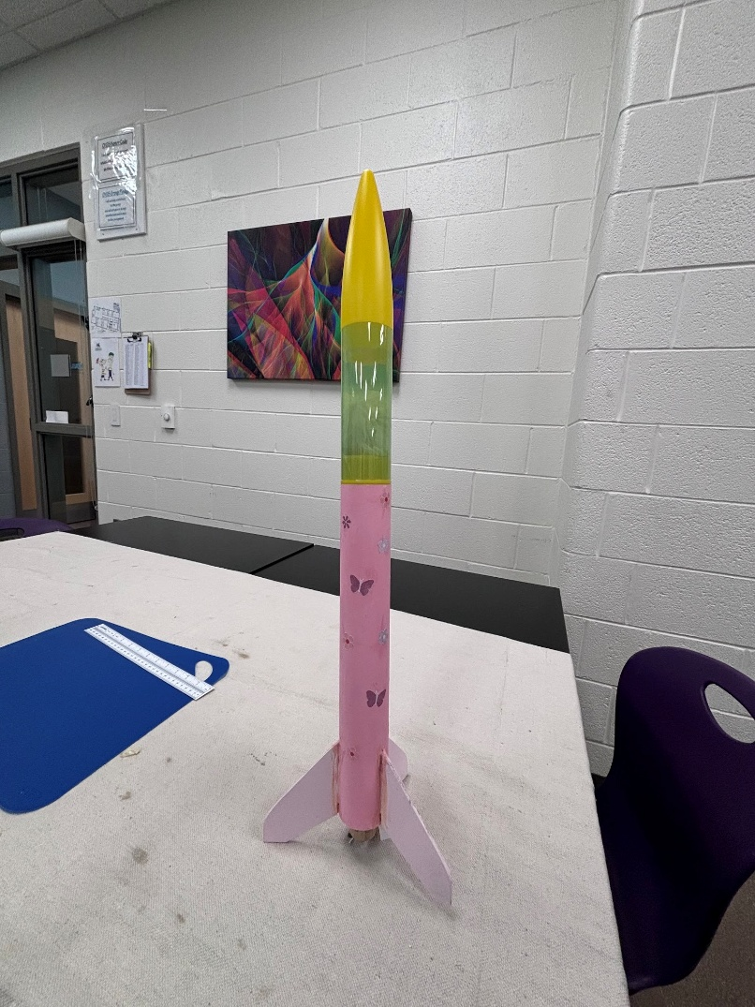
Odds and Ends
Grading is based on
Correct development of model, not accuracy of prediction
Creative Theme
Individual Research
Presentation
Payload survival of second launch
Team Grade

Slide 17
Potential Areas for improvement
Improved Wind Tunnels
Timing such that a research – test – build process is followed
Student choice in fin and nose cone shape
Additional Research topics
Incorporation of OpenRocket Software

Slide 18
Equipment List
From Estes Rockets
Green Eggs Rocket Kits
C11-3 Engines (3 per group)
Altimeters
Construction tools (optional)
From Other Sources
Construction tools
Anemometers
Pasco Rocket Engine Test Bracket
Force Probes

Slide 19
Acknowledgements
Dr. Melisa Shifflett for assistance in the creation of the capstone project
CVGS Foundation and Dr. Stephen Smith for funding support for the project
My students for their hard work shown in this presentation

Slide 20
Thank You!

