Slide 1
Quantum Education Experiment: Light Polarization for Level 1 English Learners in Active Physics
Russell Youmans
Annandale High School
Fairfax County Public Schools

Slide 2
ABSTRACT
Quantum Education Experiment: Active Physics for Level 1 English Learners
A Light Polarization Experiment was done in 5 Active Physics classes for level 1 English Learners. The purposes were to encourage experimentation, scientific thought, and public speaking, and it was the first “experiment” of the year. Of the approximate 75 total students, ~95% were intrigued and puzzled by how light passed through 2 and 3 polarization filters. About 50% continued experimentation without directions (trying 4 polarization filters, for example), about 50% seemed to master, in the short term, both verbally and written, the words: “prediction”, “observation”, “measure”: understanding the features of “quantum measurement” was not accomplished.

Slide 3
Teaching Approach Alpha
Students Follow Directions
Students do something, worksheet, classwork, solve problems
Show Academic Mastery
?
Exit Course/Final Exam/SOL

Slide 4
Teaching Approach Beta
}
Students Follow Directions
Experiment
Predict, hypothesize
Explain/Understand
observe
Become curious
measure

Slide 5
Goals:
Have students perform an experiment with puzzling results
Introduce “quantum science” early in the science curriculum

Slide 6
Background/Class Makeup
~15 students per class, 5 classes total, no team teacher, many students brand new to the country (USA).
~50 different native languages are spoken by Annandale High School students.
While special education students are supposed to be “filtered out” into special education classes, the process of assigning students the correct class is complex: there is a very wide range of student needs and abilities.

Slide 7
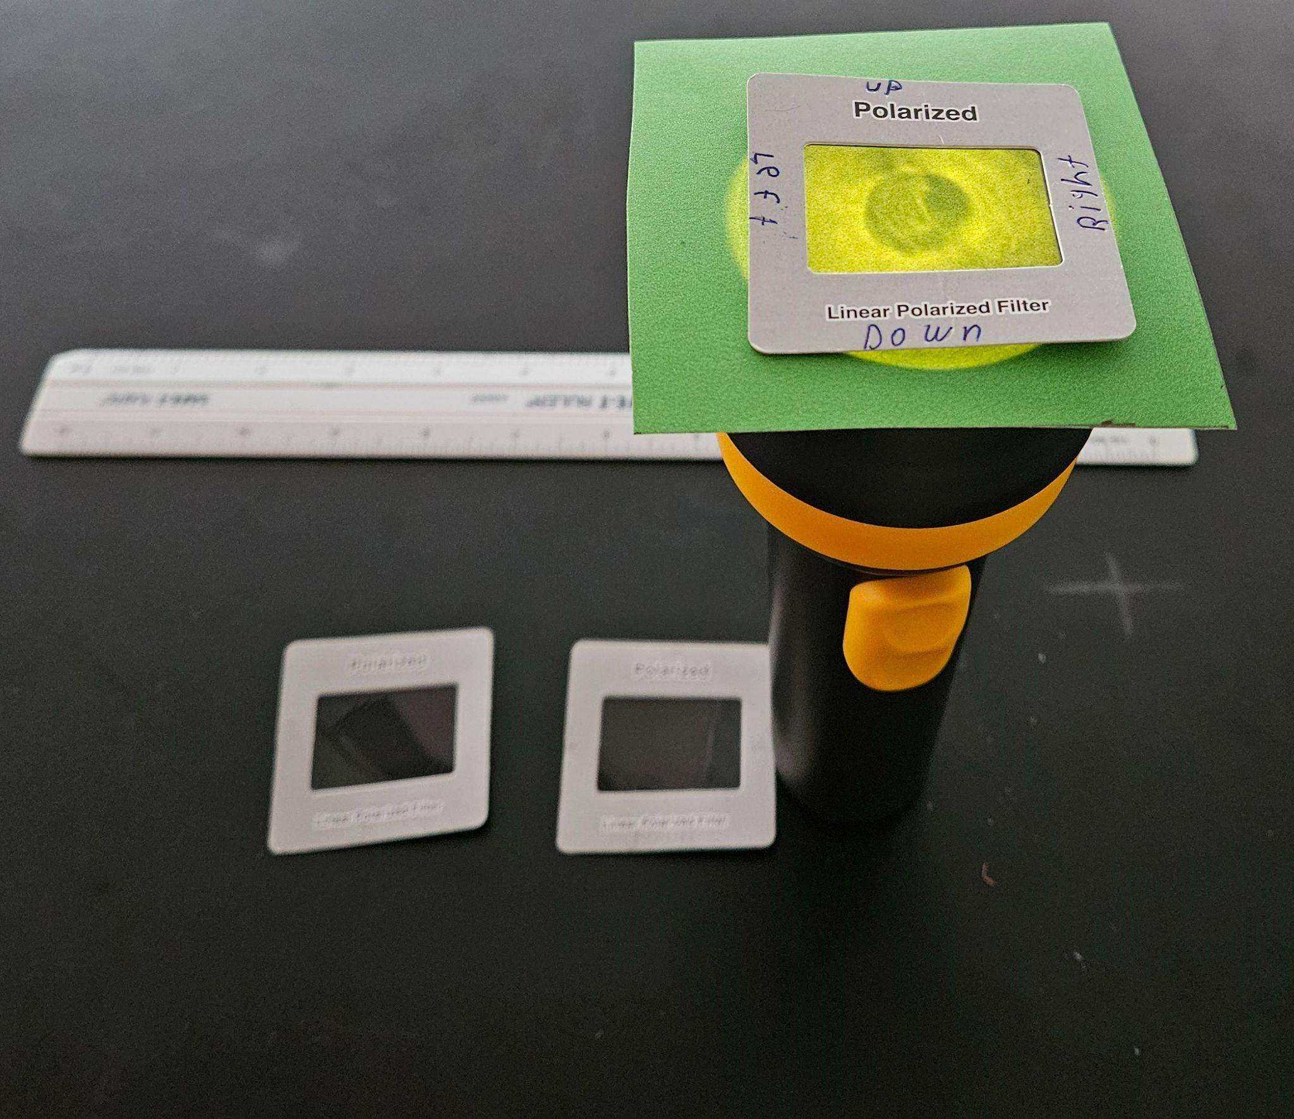
Equipment:
Flashlight, 2 D batteries, ruler, manilla folders, polarization filters

Slide 8
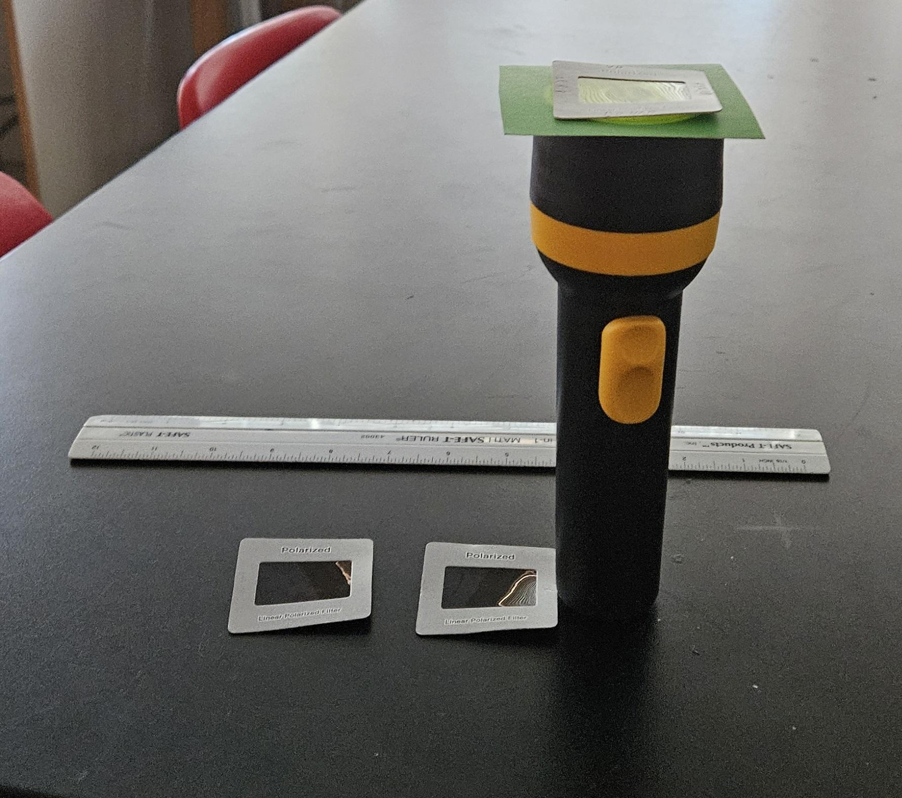
Shine light from a flashlight through:
3 inch x 3 inch green manilla folder
One polarization filter (rotate)
Write down observations, make predictions
Two polarization filters (rotate)
Write down observations, make predictions
Three polarization filters (rotate)
Write down observations.

Slide 9
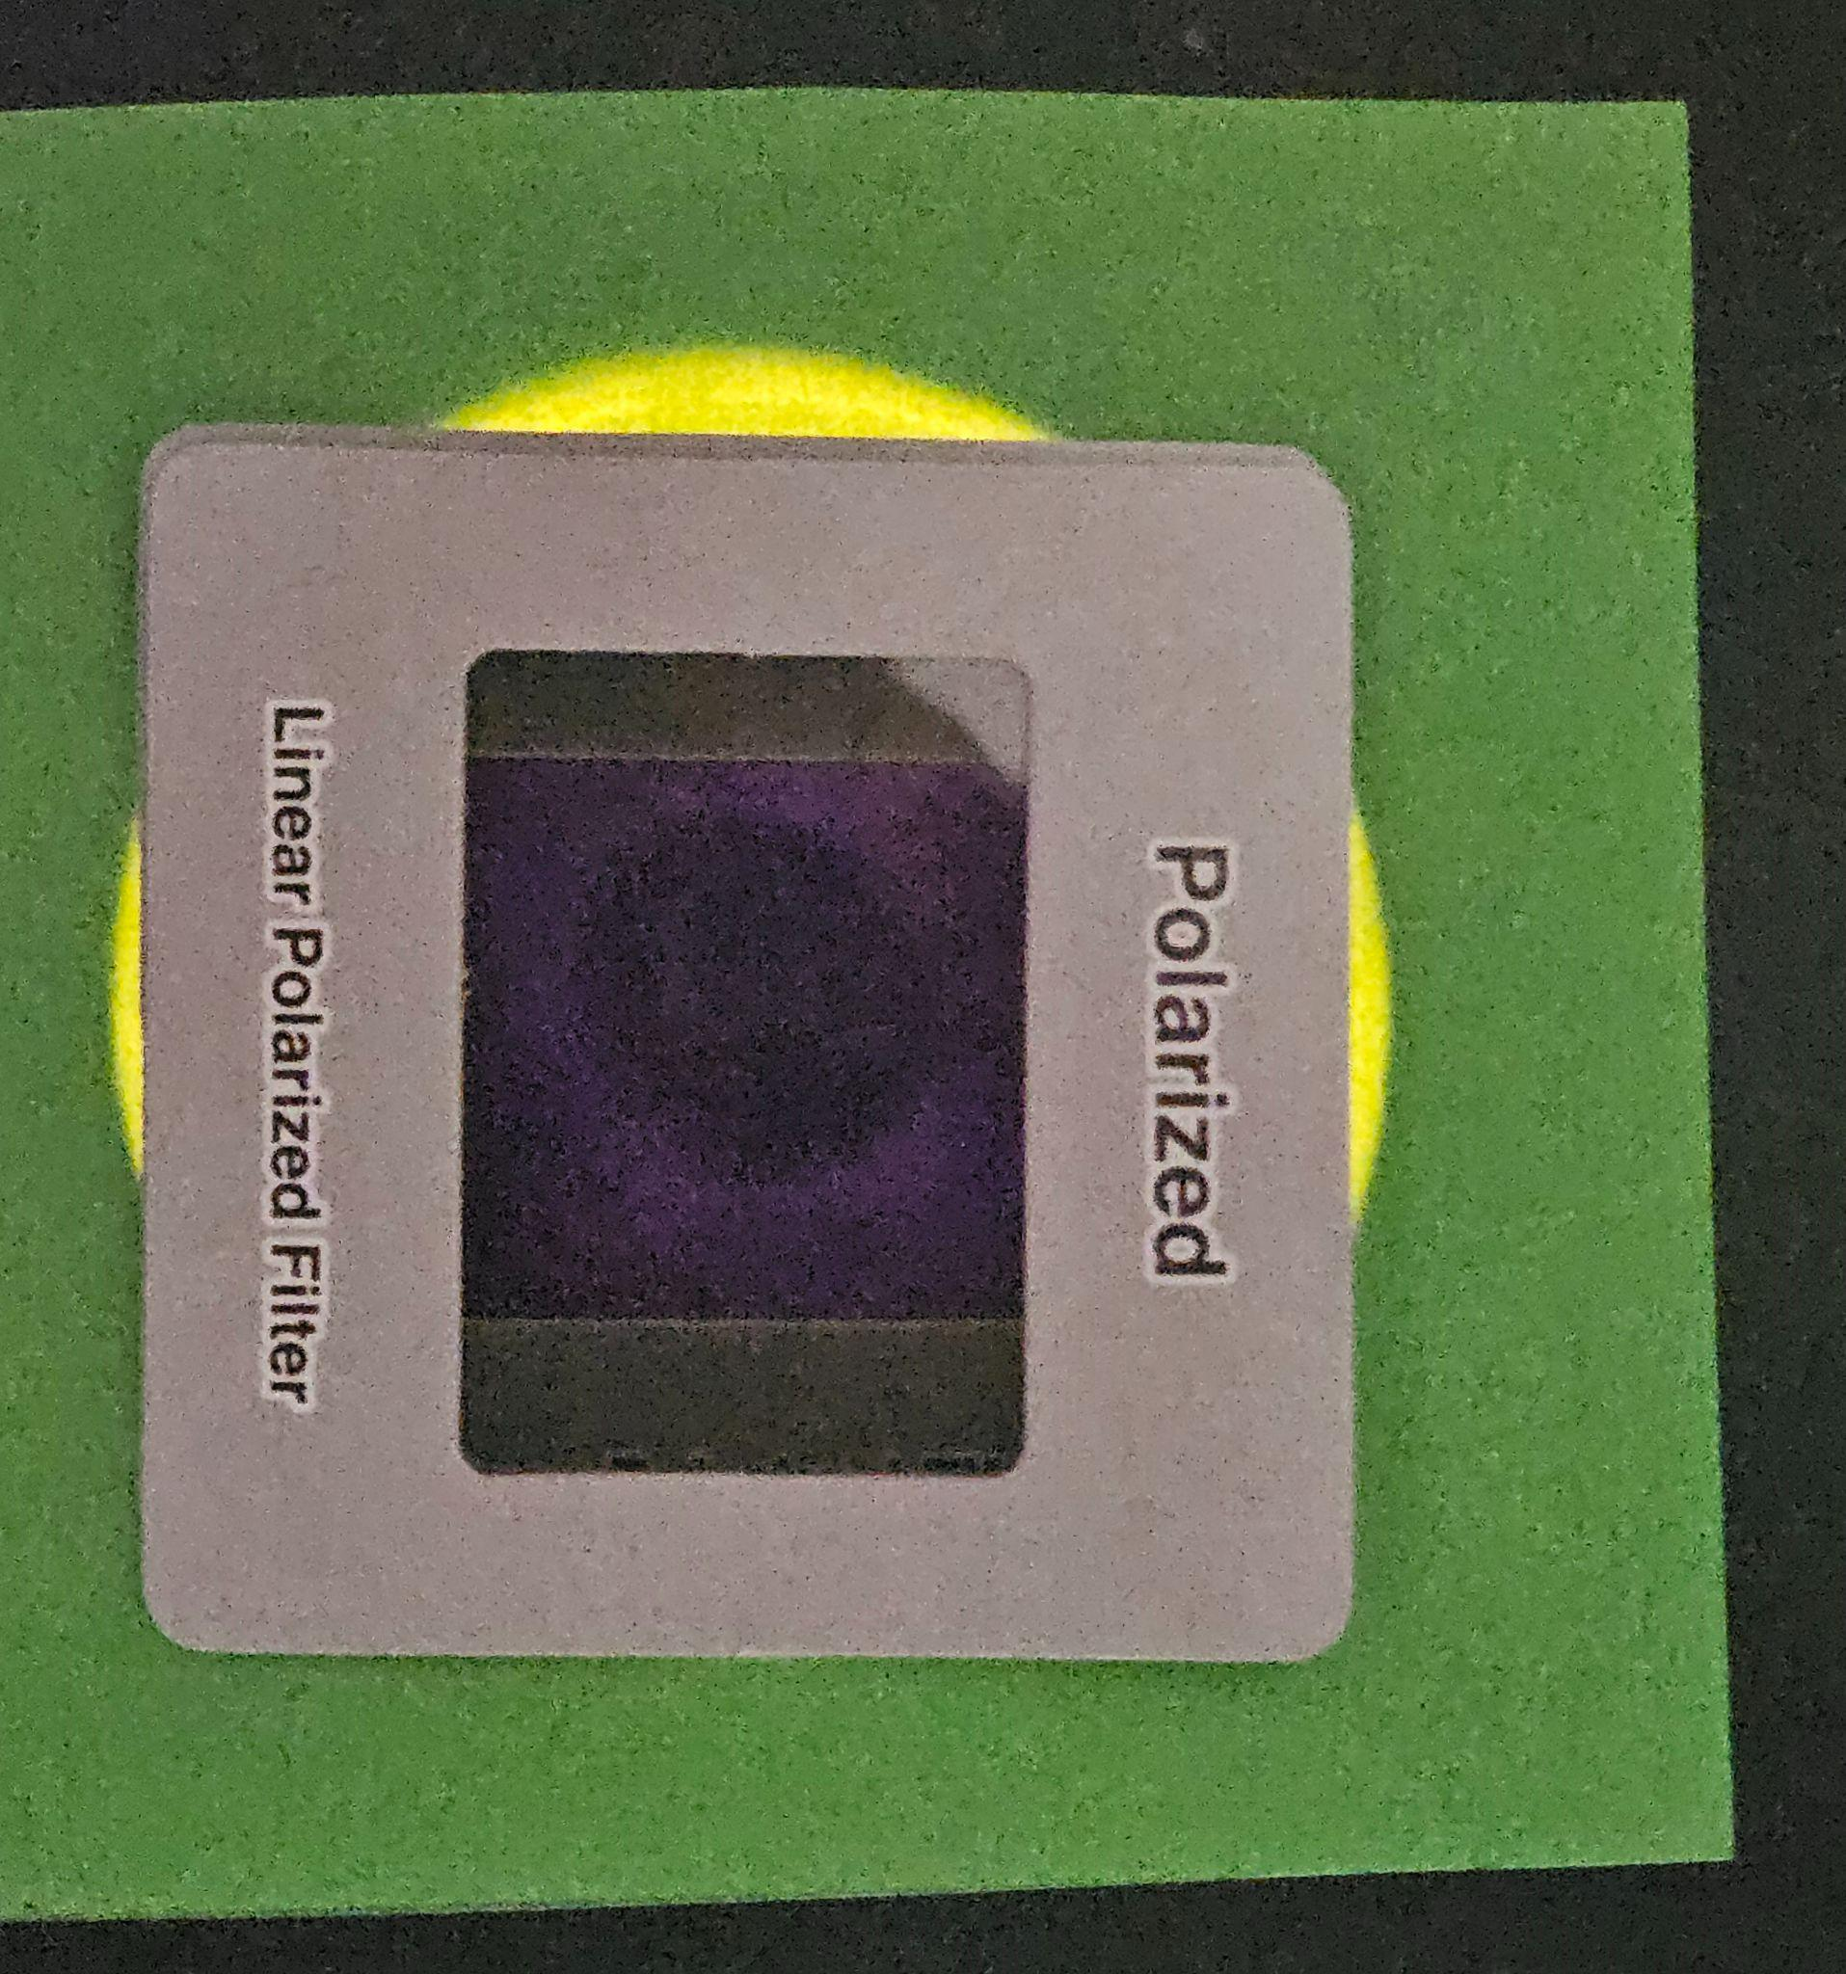
Three filters, about 0% light passes through. The approximate orientation of the filters is shown by the arrows.
To the human eye, 0% of the light is passing through. My cell phone camera’s “low light” mode is automatic, and my cell phone can detect the light that is passing through as a dark purple

Slide 10
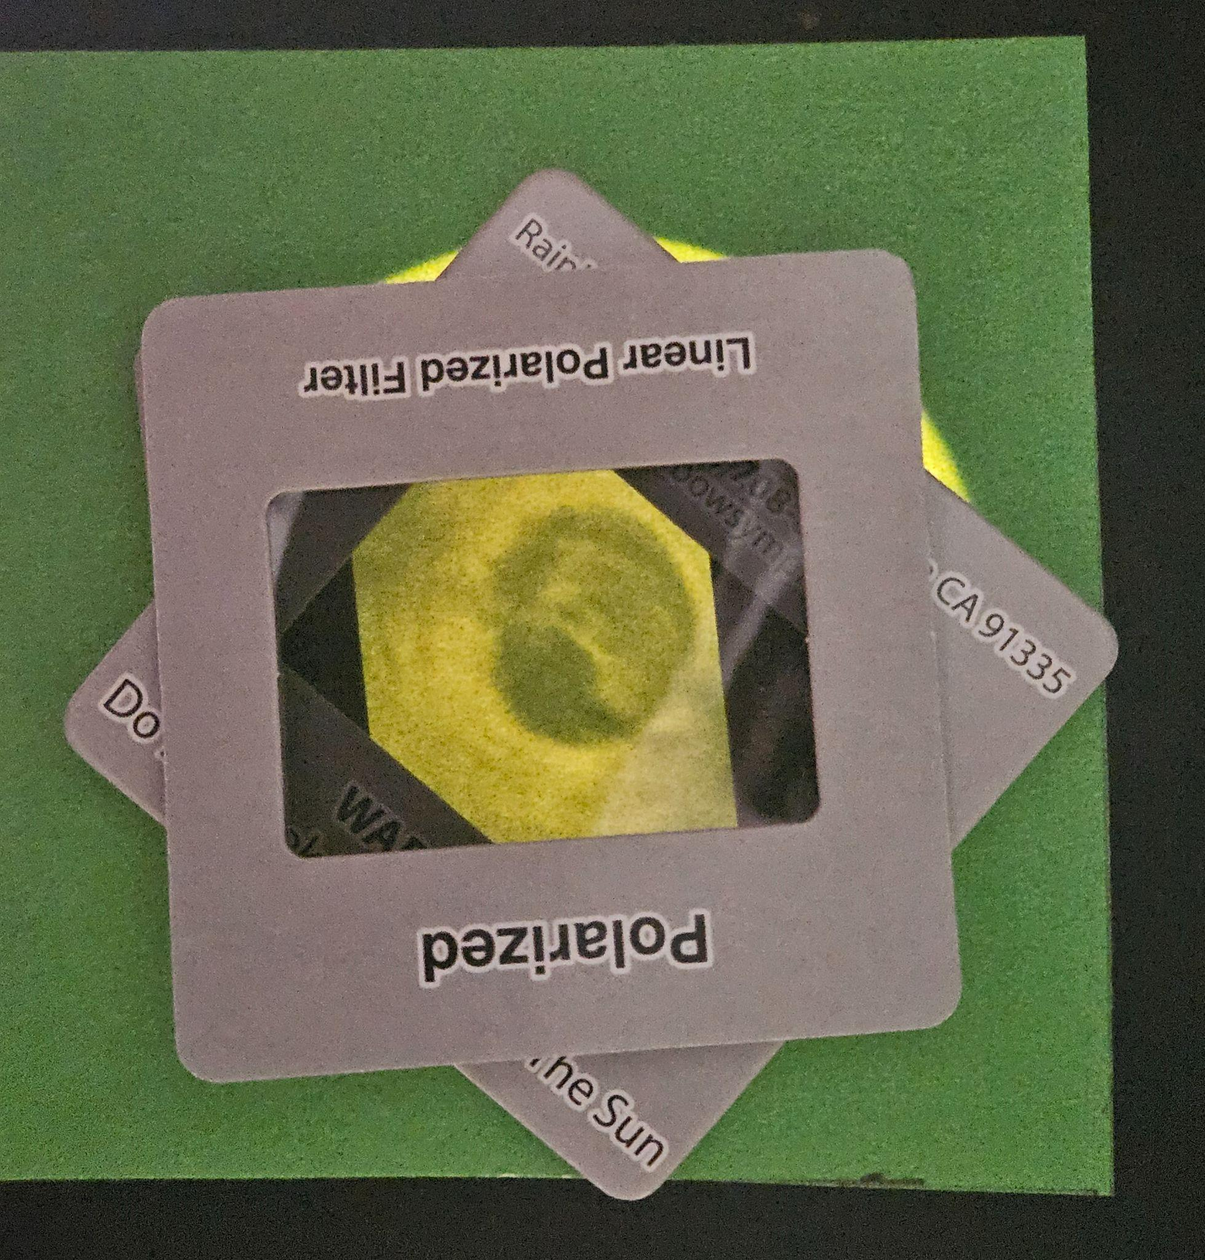
Three filters, about 50% light passes through. The approximate orientation of the filters is shown by the arrows.

Slide 11
Results
Students were engaged
Students master, at least in the short term, written and spoken vocabulary.
Students are intrigued and puzzled by light polarization.
No “full” understanding of quantum states, the act of measurement, light polarization states.
Statistics/Measurement Example:
95% of the students were intrigued and puzzled by how light passes through 2 and 3 polarization filters. (In other words, 3 students out of 75 were on their cell phone, everyone else was engaged/writing/discussing/experimenting)

Slide 12
The ambient light level is probably very important for student observations:
Darkened room, blinds down
Manilla folder to limit initial brightness
Green Manilla, greenish tinge to initial light seems to help students.
With good conditions, it is possible (to fool ourselves?) that we can clearly see a ~25%, ~50%, ~75% reduction in brightness

Slide 13
Mis-using Quantum Terminology One: Student Engagement
This proposed basis seems orthogonal, but it probably is not complete.
In this basis, about 50% of the students were found in the “engaged” state, 5% of the students were found in the “disengaged” state, and about 45% were in a mixed state. (Mixed state students are observed to do the lab/activities/questions, but nothing extra. They are minimally involved with learning.)
Basis State Label | Observation/Measurement
Engaged | Doing more than required
Disengaged | On cell phone

Slide 14
Mis-using Quantum Terminology Two:
About 50% of the students were observed to be entangled with independent learning.

Slide 16
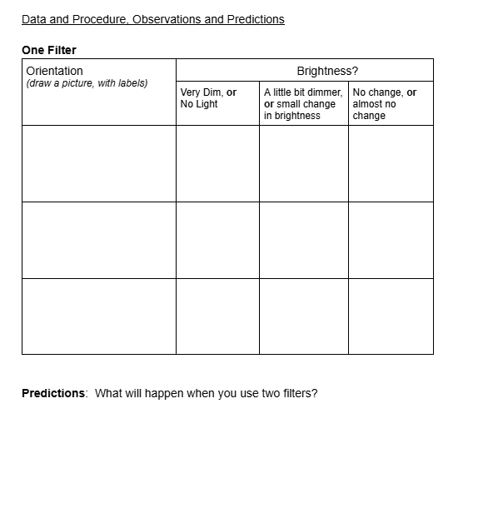

Slide 17
Direct Instruction over three days:
Day 1, Day 2, and Day 3
Each day the “direct instruction” slides presentation builds on the previous day. In addition to the “direct instruction”, students
a) come to the front of the room and write-things/draw on the whiteboard,
b) students had some short written classwork/notes, and
c) students did the one or more parts of the lab: day 1: one polarization filter, day 2 two polarization filters, day 3, three polarization filters.

Slide 18
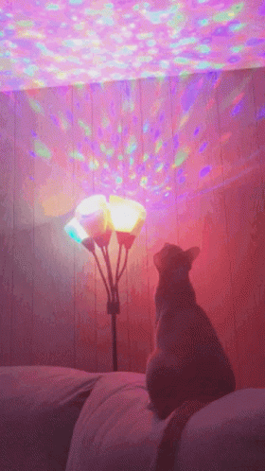
Light

Slide 19
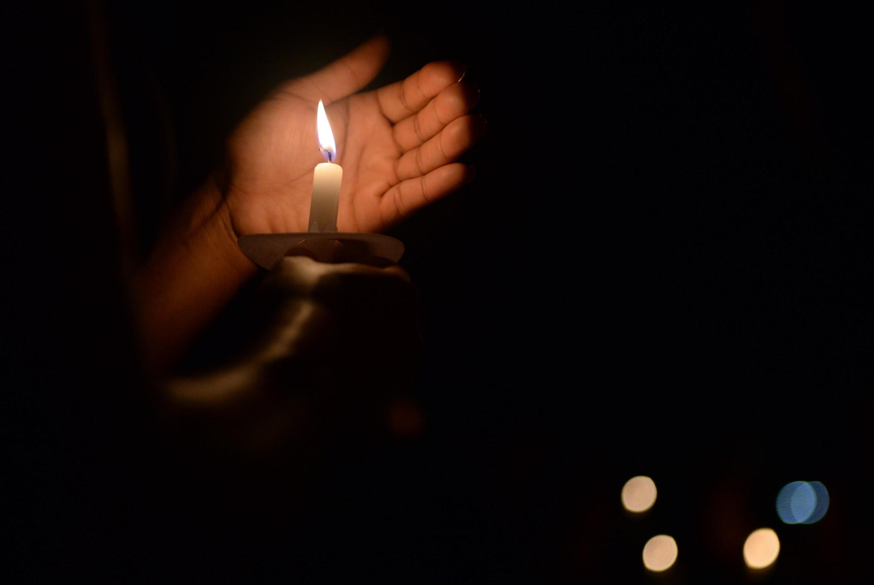
Light

Slide 20
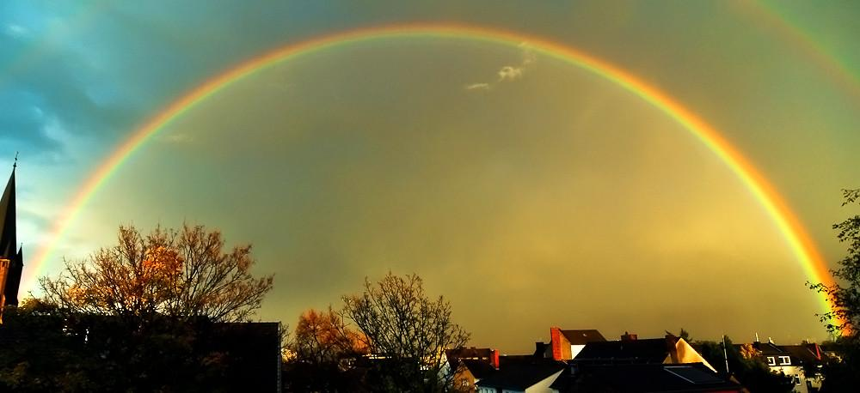
Light

Slide 21
Thanks to:
Annandale High School Physics Teachers, Mr. D. Tyndall and Ms. N. Saqib.
Thanks also to:
Dr. N. Holincheck and Dr. J. Rosenberg, at GMU, and the other staff and participants of “Building Quantum in Your Classroom Summer 2024”
Inspiration and supplies (~100 polarizing filters) came from GMU! Sincere thanks to Drs Holincheck and Rosenberg!

