Slide 1
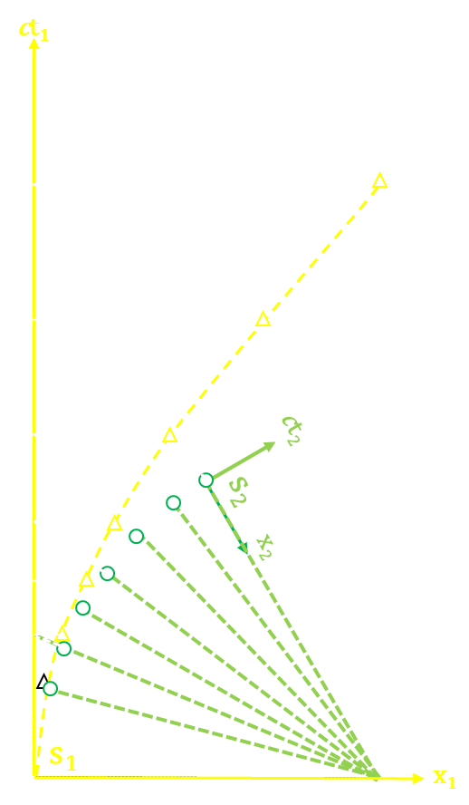
The Velocity Triangle and the Accelerating Universe
CS-AAPT Spring 2025
Lewis F. McIntyre
www.Lewis-McIntyre.com/light-beam
mcintyrel@verizon.net
β
Notes:
My name is Lewis McIntyre. I am going to talk to you about the accelerating universe, using the velocity triangle to analyze it. How is the universe accelerating, you say? Well … let’s get into it.

Slide 2
What is the Accelerating Universe?
β
www.Lewis-McIntyre.com/light-beam
mcintyrel@verizon.net
Notes:
The accelerating universe, or “Hubble Tension”, means that the universe today is expanding faster than it was for the oldest bodies we can observe.

Slide 3
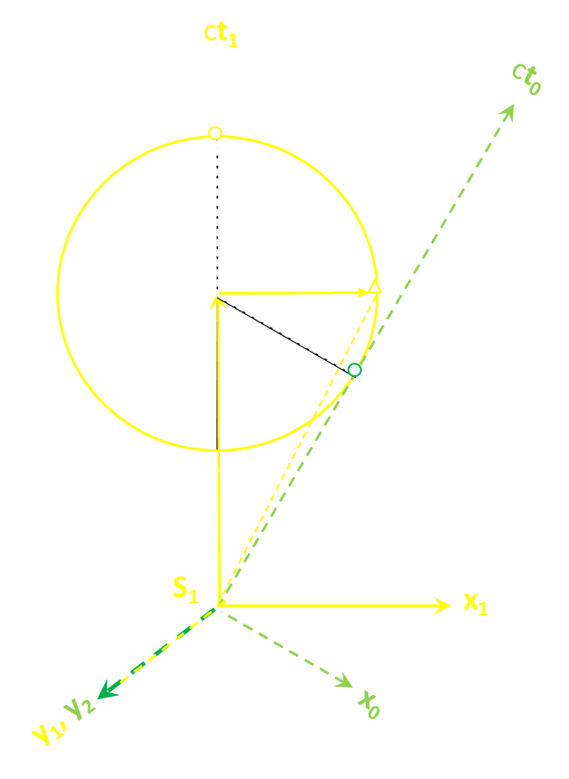
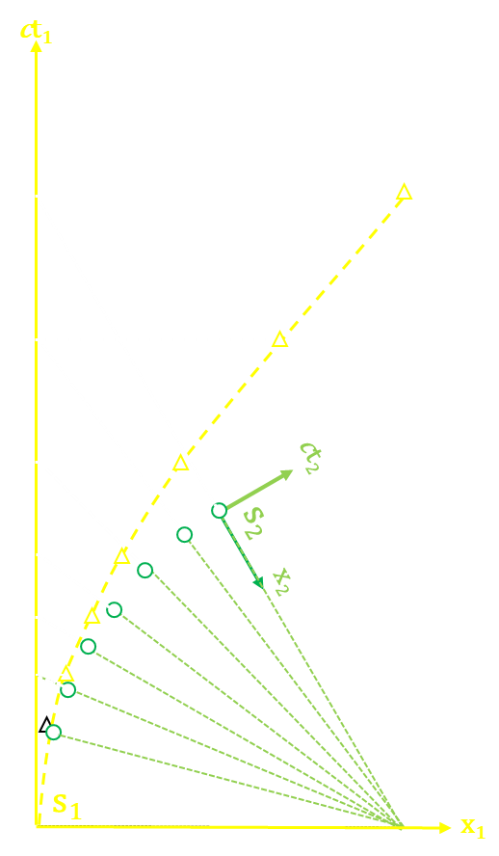
HUBBLE EXPANSION
DEVELOPED BY EDWIN HUBBLE IN THE 1920’s
Used Cepheid Variable Stars
Measured Distances to 46 Galaxies Up To ~326 Million Light Years
Observed Doppler Shift of Characteristic Spectra due to Velocity Proportional To Distance (V=h₀s)
Hubble Factor H Was Determined to be ~1/T, the Age of the Universe
ESTIMATES VARIED FROM 50-75 km/Mpc TO ABOUT 1975, NOW ABOUT 67 TO 75
Notes:
The Hubble Expansion was developed by Edwin Hubble in the 1920’s He used Cepheid Variable stars as standard candles to measure the distances to galaxies up to 326 million light years away. He observed that each galaxy had a down Doppler shift to the red end of the spectrum due to a receding velocity proportional to their distance. This proportionality H₀ is the Hubble parameter, now taken to be between 67 to 76 kilometers per second per Megaparsec, a Megaparsec being equal to 3.26 million light years. It was initially assumed to be a constant, but as we gained the ability to measure galaxies at much greater distances, H₀ was determined to be itself a function of distance, increasing for the more distant galaxies. Hence the apparently accelerating universe: we are receding faster from the most distant galaxies than just a linear constant times distance.

Slide 4
EXPANDING UNIVERSE
SUPERNOVA COSMOLOGY PROJECT & HIGH-Z SUPERNOVA SEARCH TIME, @1998
Determined that the Most Distant Bodies are Receding at an Accelerating Rate, Rather than Proportional To Distance
Compatible with Friedmann’s 1922 Derivation of Expanding Universe from the Einstein General Field Equations
Augmented by Dark Energy (λ) and Cold Dark Matter (CDM) (Both by Definition Unobservable) in the λ CDM Model to Account for the Redshifts Observed.
Notes:
At around 1998, we began to extend the range of observable galaxies to about 13.7 billion light years, using the Hubble and James Webb Telescopes, with supernova 1A stars replacing Cepheid variables as the standard candle for determining distance.
An explanation for the apparent acceleration is currently based on Friedmann’s derivation, based on Einstein’s General Field Theory, augmented by dark energy and cold dark matter, both by definition unobservable. Needless to say, this is very abtruse math, not comprehensible by most of us here.

Slide 5
LET’s GO FROM THE SIMPLE TO THE COMPLEX
β
www.Lewis-McIntyre.com/light-beam
mcintyrel@verizon.net
Notes:
My father was a cab driver in western North Carolina who left the eighth grade in 1916. But he left me with a very powerful paradigm for problem solving that I have carried with me all my life; “Always go from the simple to the complex.” So, let’s try that approach to explain the expanding universe.

Slide 6
EXPANDING UNIVERSE
Galaxy | Redshift z | Measured Distance, Gly
UDFj-39546284 | 11.900 | 13.370
MACS0647-JD | 10.700 | 13.300
SPT0615-JD | 9.900 | 13.270
GRB 090429B | 9.400 | 13.140
UDFy-33436598 | 8.600 | 13.100
BoRG-58 | 8.000 | 13.000
Quasar | 5.000 | 12.500
Quasar | 4.200 | 12.100
CL J1001+0220 | 2.506 | 11.100
DE516C2nm | 1.998 | 10.500
MACS J1149 | 1.490 | 9.000
3C 147 | 0.545 | 6.400
1C101 | 0.078 | 1.154
Hoag’s Object | 0.041 | 0.612
UGC 10214 | 0.031 | 0.4200
Notes:
This is the set of galaxies I used for analysis, ranging from 420 million to 13.37 billion light years distance, with redshift z varying from 0.031 to 11.3.

Slide 7
TIME-SPEED DISTANCE SOLUTION
RESTRICT OURSELVES TO MEASUREMENTS USING OUR OWN RULERS AND CLOCKS
NEITHER SPECIAL NOR GENERAL RELATIVITY AFFECT OUR OWN MEASUREMENTS
Notes:
We are going to reduce this problem to a high-school time speed distance problem. What about relativity, you say? You can’t do that! But yes, you can. Relativity involves determining a moving body’s clock and ruler and comparing it to your own. In a time-speed-distance problem, you don’t know or care about the other body’s clock and ruler, at least not yet. Therefore, relativity doesn’t apply.

Slide 8
TIME-SPEED DISTANCE SOLUTION
cT=AGE OF THE UNIVERSE, MEASURED ON EARTH
STAR OBSERVED AT A. @TIME=cT
STAR MEASURED AT B, @RADIUS r, @ cT-r
VELOCITY v/c=r/(cT-r)
VELOCITY TENDS TO c AS r TENDS TO cT/2
THEREFORE, THE AGE OF THE UNIVERSE IS TWICE THE DISTANCE TO THE MOST REMOTE OBSERVABLE BODY: @27.6gy
A
cT, 0
B
r , cT-r
r=v t
cT
cT-r
Worldline r=vt
O
“The Big Bang”
Notes:
We begin with all points in the universe being collocated at O, the quintessential t=0, the time of the “Big Bang.” We observe some star at A, c cap T, the age of the universe as measured on Earth, and determine its distance to be r, some distance from our timeline OA. We compute, due to the speed of light, that this light left that star at ct=c cap T –r, locating the star at B. It therefore has a velocity v equal to r over c cap T minus r.
This has an interesting implication: the Age of the universe is twice the age of the most distant observable bodies, which are receding with a velocity v over c approaching the unity, the speed of light. By our ruler and clock, if the body reached a distance of 13.8 billion light years 13.8 billion years ago, it had to travel an additional 13.8 billion years to get there from O, traveling at near the speed of light. And if we traveled in time back 13.8 billion years, we would find that body at half that distance, 6.9 billion light years, traveling at near the speed of light. The universe thus must be twice the age of the most distant observable bodies, about 27.6 billion years

Slide 9
AGE OF UNIVERSE
cT=27.6 YEARS, AS MEASURED ON EARTH
MONTHLY NOTICES OF THE ROYAL ASTRONOMICAL SOCIETY.
Rajendra Gupta, University of Ottawa
“Tired Light” Losing Energy in Transit
Time-Varying Coupling Constants
“Methuselah Star” HD 140283
@200 ly from Earth
Estimated 14-15 Billion Years Old.
A
cT, 0
B
ct , cT-r
r=v t
cT
cT-r
Worldline r=vt
O
“The Big Bang”
Notes:
It seems that others are coming to that same conclusion, most notably Rajendra Gupta, though using “tired light” losing energy through transmission, and unobservable dark matter and energy. Our simple time speed distance solution shows that the age of the universe has to be twice the most observable distance.
A nearby star Methuselah at about 200 light years has an estimated age of 14-15 billion years.

Slide 10
HUBBLE PARAMETER
HUBBLE PARAMETER H(r)=1/(cT-r)
v/c=r·H(r)
A
cT, 0
B
ct , cT-r
r=v t
cT
cT-r
Worldline r=vt
O
“The Big Bang”
Notes:
We can now define the Hubble parameter as shown, such that when multiplied by distance, will yield the velocity as v/c.

Slide 11
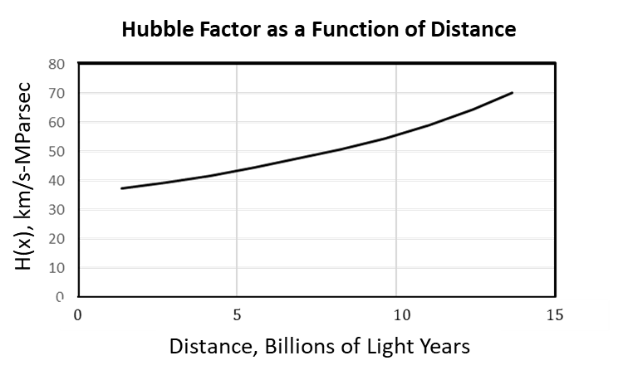
VALIDATING THE HUBBLE MODEL
HUBBLE PARAMETER H(r)=1/(cT-r)
(percent of c per light year)
cT=27.6 x 10⁹ light years
Multiply by
c=300x10³ km/sec
3.26x10⁶ light-years/megaparsec
for conventional Hubble units
(kilometers per second per megaparsec)
Current
Estimate
1970s Estimate
Notes:
So, we have developed a very simple model of the Hubble Factor and the expanding universe. As the Hubble Factor is expressed as kilometers per second per megaparsec, and our expression is percentage of the speed of light per light year, we must do some unit conversion, multiplying by the speed of light, and again by light years per megaparsec, to find that the initial value of our expression for the Hubble parameter is 37.5 km per second per megaparsec for values of r very much less than the age of the universe, doubling to 71 as r approaches 13.8 billion light years. This compares favorably with recent measurements that give a range 65 to 75 for the more distant bodies. The Hubble factor increases with increasing distance, giving rise to the apparent acceleration of the universe. That is not acceleration, just the geometry of the time speed distance solution.

Slide 12
REDSHIFT vs DISTANCE
HUBBLE PARAMETER H(r)=1/(cT-r)
v/c=r·H(r)
RELATIVISTIC DOPPLER SHIFT $λ/{λ_{0}}=\sqrt{\frac{1+v/c}{1−v/c}}$ $=\frac{1}{\sqrt{1−{2r}/{cT}}}$
$$z=\frac{λ−λ_{0}}{λ_{0}}=λ/{λ_{0}}−1$$
A
cT, 0
B
ct , cT-r
r=v t
cT
cT-r
Worldline r=vt
O
“The Big Bang”
Notes:
We now want to determine the redshift. Here we are determining the emitter’s clock interval and comparing it with our observed interval. We must therefore use the relativistic Doppler shift shown. Plugging the definition of v/c we have just derived, we express this in terms of cT and r as shown. Z is the change of wavelength divided by the base wavelength, which is the Doppler shift minus one.

Slide 13
REDSHIFT vs DISTANCE
Galaxy | Redshift z | Measured Distance, Gly | Velocity Triangle Distance
UDFj-39546284 | 11.900 | 13.370 | 13.717
MACS0647-JD | 10.700 | 13.300 | 13.699
SPT0615-JD | 9.900 | 13.270 | 13.684
GRB 090429B | 9.400 | 13.140 | 13.672
UDFy-33436598 | 8.600 | 13.100 | 13.650
BoRG-58 | 8.000 | 13.000 | 13.630
Quasar | 5.000 | 12.500 | 13.417
Quasar | 4.200 | 12.100 | 13.290
CL J1001+0220 | 2.506 | 11.100 | 12.667
DE516C2nm | 1.998 | 10.500 | 12.265
MACS J1149 | 1.490 | 9.000 | 11.574
3C 147 | 0.545 | 6.400 | 8.019
1C101 | 0.078 | 1.154 | 1.925
Hoag’s Object | 0.041 | 0.612 | 1.056
UGC 10214 | 0.031 | 0.4200 | 0.825
Notes:
Let’s see how this predicted redshift compares with those of our sample galaxies. Redshift is not subject to anything but measurement error, while distance estimation, especially at distance of billions of light years, is much less precise. Therefore, I have taken observed redshift as the independent variable, and calculated the predicted distance. As you can see, my model consistently understates the red shift for any given distance. That is because my model does not account for the gravitational redshift experienced by light in escaping a massive body.

Slide 14
GALACTIC AGES
HUBBLE PARAMETER H(r)=1/(cT-r)
v/c=r·H(r)
RELATIVISTIC DOPPLER SHIFT
$$λ/{λ_{0}}=\frac{1}{\sqrt{1−{2r}/{cT}}}$$
PROPER TIME OF TRANSMISSION AT C
$$cτ=\sqrt{{(cT−r)}^{2}−r^{2}}$$ $=cT\sqrt{1−{2r}/{cT}}$
A
cT, 0
B
ct , cT-r
r=v t
C
(cτ)²=(ct)²-r²
cT
cτ
Age of Universe
At Time of Emission
cT-r
Timeline
O
“The Big Bang”
Notes:
We know what time the light left the emitter, by our clock. What time did it actually leave the emitter, by its clock? Again, we are determining the proper time of the emitter’s clock from our measurement, using the invariant ct squared less r squared. This is also the time of observation on Earth, c capital T, divided by the relativistic Doppler shift.

Slide 15
GALACTIC AGES
A
cT, 0
Limit of the Observable Universe
~13.8 Gly
B₁: 3C147
r=6.4 Gly
cT-r=21.2 Gy
B₂: CL J1001+0220
r=11.1 Gly
cT-r=16.5 Gy
cT-r=13.23 Gy
cT=27.6 Gy
B₃: UDFj-39546284
r=13.37 Gly
O
“The Big Bang”
Notes:
We are going to demonstrate this with three emitters from our selection, identifiers as shown, at 6.4 billion light years, 11.1 billion years, and 13.4 billion years distance.

Slide 16
GALACTIC AGES
A
cT, 0
B₁: 3C147
r=6.4 Gly
cT-r=21.2 Gy
cT=27.6 Gy
O
“The Big Bang”
Notes:
We do this by drawing a circle about the time of B1’s emission, as measured by our clock.

Slide 17
GALACTIC AGES
A
cT, 0
B₁: 3C147
r=6.4 Gly
cT-r=21.2 Gy
C₁: cτ=20.2 Gy
cτ=20.2 Gy
cT=27.6 Gy
O
“The Big Bang”
Notes:
Next, we draw a line from O tangent to that circle. That tangency is the time light we now see actually left that body, the age of the universe as measured from O by the emitter at time of emission. The red line from O to C1 is the time vector ct for 3C147. This is 20.2 billion years, vs our measurement of 21.4 billion years.

Slide 18
GALACTIC AGES
A
cT, 0
B₁: 3C147
r=6.4 Gly
cT-r=21.2 Gy
C₁: cτ=20.2 Gy
cτ=20.2 Gy
cT=27.6 Gy
O
“The Big Bang”
Notes:
All bodies at that distance, regardless of direction, map to a circle about our timeline, all expanding with each tick of our clock by the Hubble factor. In the four-dimensional ct-x-y-z universe, this maps to an expanding sphere surrounding us.

Slide 19
GALACTIC AGES
A
cT, 0
B₁: 3C147
x=6.4 Gly
C₁: cτ=20.2 Gy
B₂: CL J1001+0220
x=11.1 Gly
cT-r=16.5 Gy
cT=27.6 Gy
ct=12.2
C₂: cτ=12.2 Gy
O
“The Big Bang”
Notes:
We repeat this process for B2 at 11.1 billion light years, to determine its measurement of the age of the universe at its emission to be 12.2 billion years.

Slide 20
GALACTIC AGES
A
cT, 0
Limit of the Observable Universe
~13.8 Gly
B₁: 3C147
x=6.4 Gly
B₂: CL J1001+0220
x=11.1 Gly
cτ=20.2 Gy
cT-r=14.23 Gy
cT=27.6 Gy
B₃: UDFj-39546284
x=13.37 Gly
C₃: cτ=4.87 Gy
cτ=4.87 Gy
O
“The Big Bang”
Notes:
And for B3 to determine the age of the universe at its emission to be 4.87 billion years, vs. our measurement of 15.4 billion years. Note that this is quite long enough for galactic formations, vs. the 200-million-year figure given for this body by the Dark Energy Cold Dark Matter model

Slide 21
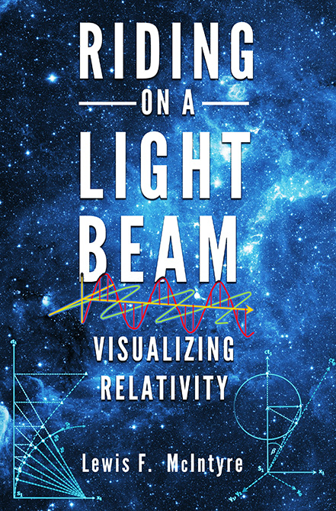
SUMMARY
SIMPLE MODEL: SURPRISINGLY GOOD RESULTS WITHOUT INVOKING GENERAL RELATIVITY AND DARK MATTER /ENERGY.
UNIVERSE EXPANDING IN THE DIRECTION OF LOCAL TIME
BIG BANG MAPS TO A SPHERE SURROUNDING US, RATHER THAN A POINT BEHIND US, AS IT DOES FOR ALL OTHER BODIES IN THE UNIVERSE.
MATTER EQUALLY DISTRIBUTED AROUND US: GRAVITY DOES NOT ACT TO SLOW EXPANSION.
www.lewis-mcintyre.com
Notes:
So, in summary, the velocity triangle provides a simple model with excellent results without invoking general relativity or dark matter and energy to explain the changes in velocity over time. The universe is expanding, but in the direction of time, not space. The Big Bang maps to a sphere surrounding us, rather than a point behind us. Therefore, if mass is uniformly distributed around us, except for the nearby galaxies, gravity will have no effect on our trajectories, as we are being attracted equally in all direction.
If you want to learn more, see my You Tube videos on my channel Lew McIntyre or buy my book Riding on a Light Beam. It is available on Amazon, or you can buy a signed copy any time today.
And thank you for choosing to hear my presentation.

