Slide 1
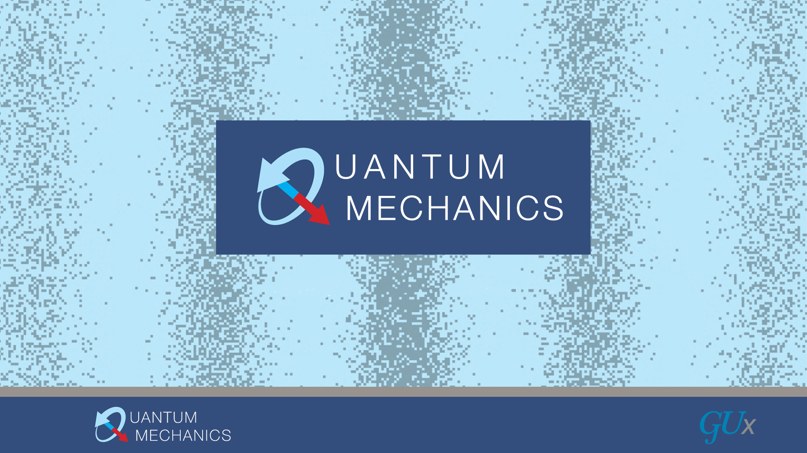
James Freericks, Department of Physics
Georgetown University
Work funded by the AFOSR and Georgetown

Slide 2
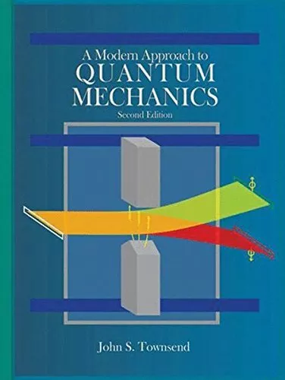
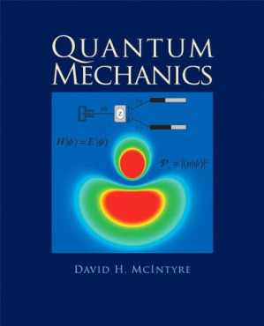
Spins first protocol

Slide 3
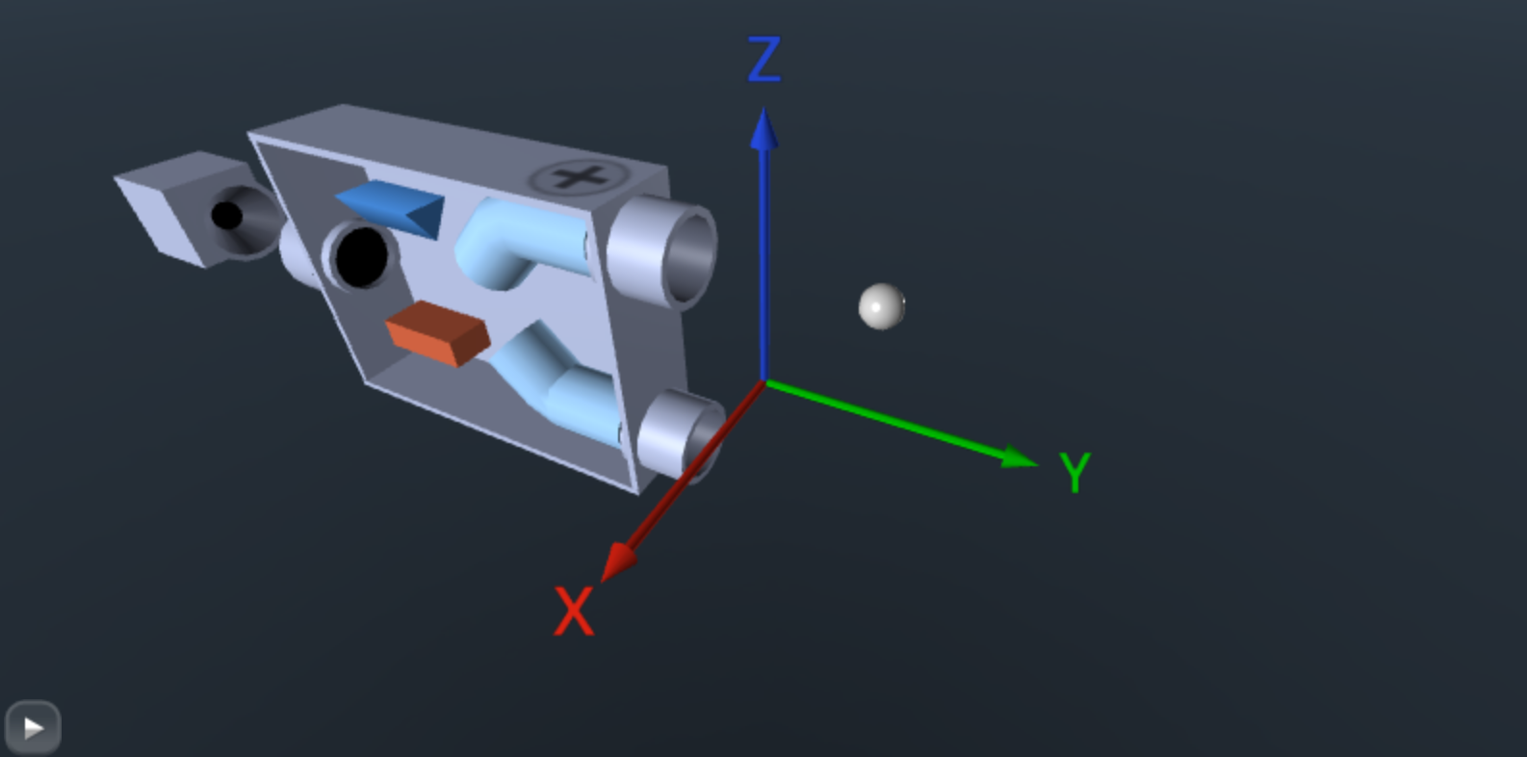
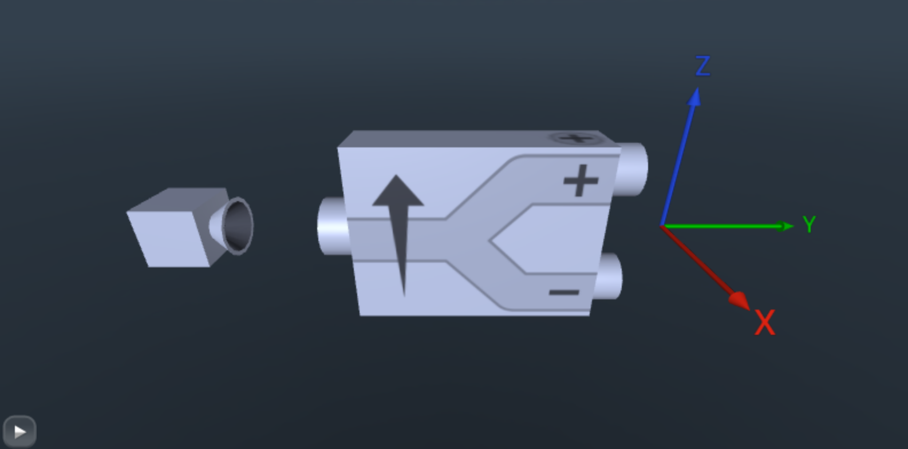
Stern-Gerlach analyzer

Slide 4
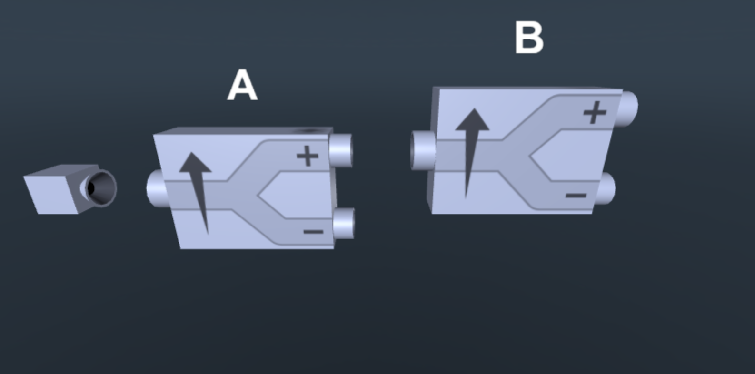
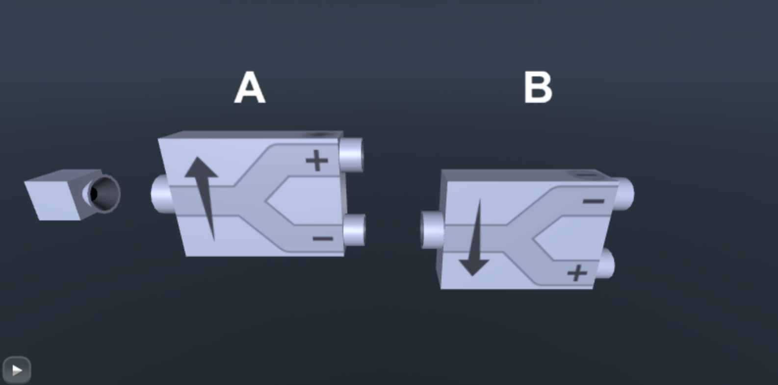
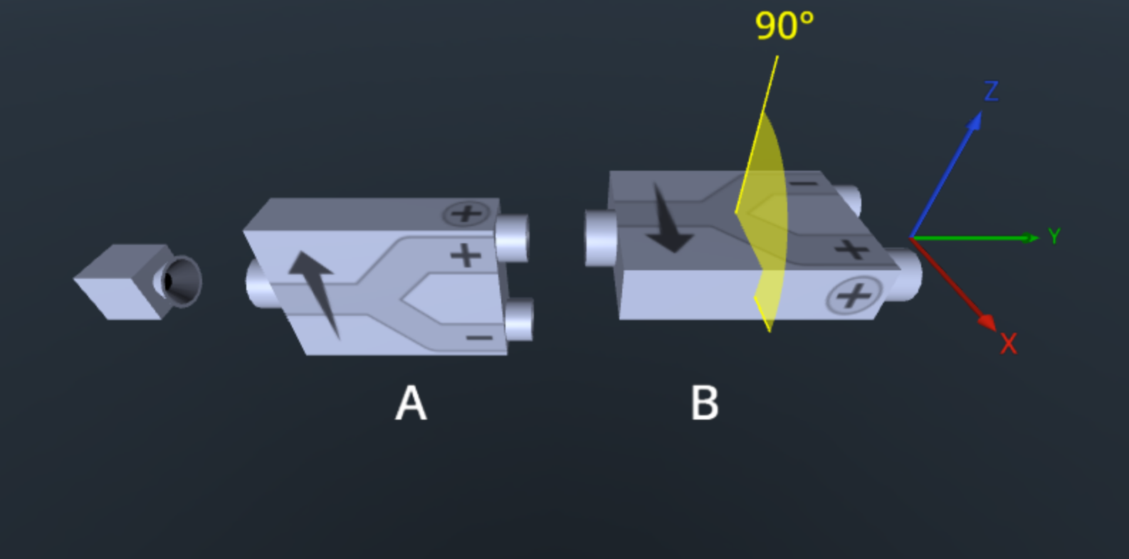
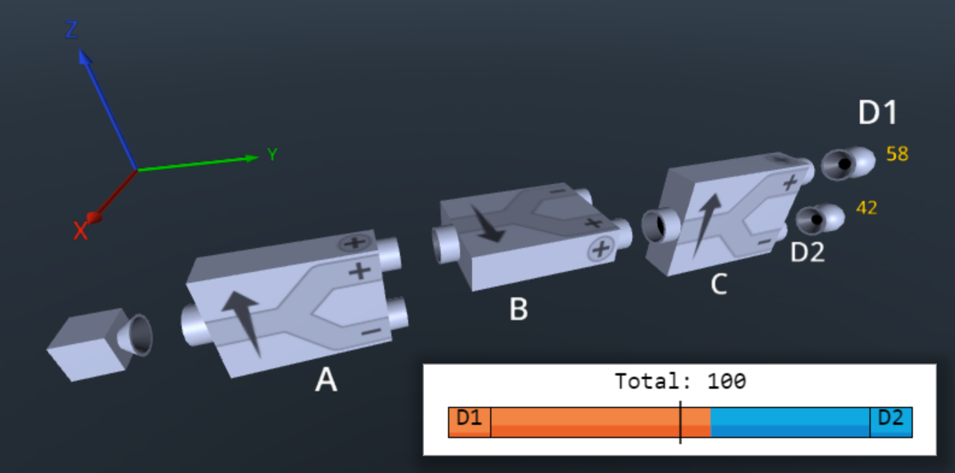
Repeated experiments

Slide 5
Actual demonstrations are challenging

Slide 6
Use quantum computers to illustrate them

Slide 7
They are real single quanta experiments

Slide 8
They involve state preparation followed by measurement

Slide 9
They involve state preparation followed by measurement
Source

Slide 10
They involve state preparation followed by measurement
Z-analyzer

Slide 11
They involve state preparation followed by measurement
X-analyzer

Slide 12
They involve state preparation followed by measurement
Z-analyzer

Slide 13
They involve state preparation followed by measurement
Detector

Slide 14
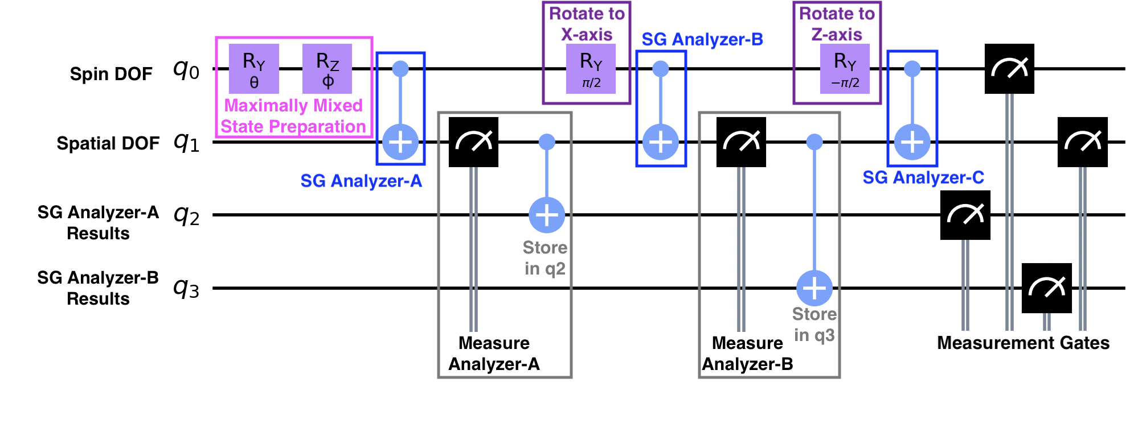
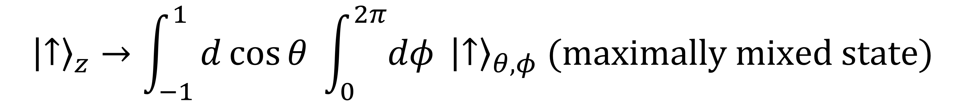
Quantum circuit and state
$${\left|↑\right\rangle }_{z}→\int_{−1}^{1}{d\cos{θ} \int_{0}^{2π}{dφ} {\left|↑\right\rangle }_{θ,φ} (maximally mixed state)}$$

Slide 15

Quantum circuit and state
$$\int_{−1}^{1}{d\cos{θ} \int_{0}^{2π}{dφ} {\left|↑\right\rangle }_{θ,φ}→{\left|↑\right\rangle }_{z}⊗\left|up\right\rangle ⊗|D_{z}⟩}$$

Slide 16
Quantum circuit and state
$${\left|↑\right\rangle }_{z}⊗\left|up\right\rangle ⊗\left|D_{z}\right\rangle →{\left|↑\right\rangle }_{x}⊗\left|right\right\rangle ⊗|D_{x}⟩$$

Slide 17

Quantum circuit and state
$${\left|↑\right\rangle }_{x}⊗\left|right\right\rangle ⊗\left|D_{x}\right\rangle →\frac{1}{\sqrt{2}}{\left({\left|↑\right\rangle }_{z}⊗\left|up\right\rangle + | ↓\right\rangle }_{z}⊗|down⟩)⊗|D_{0}⟩$$

Slide 18
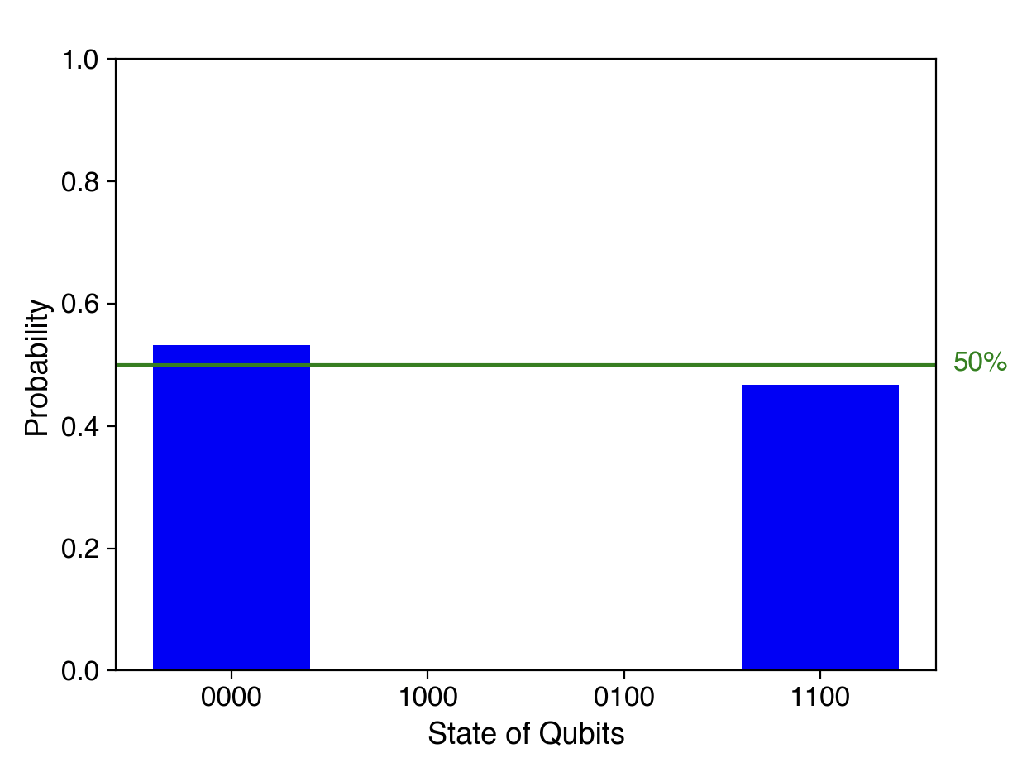
Quantum circuit and state

Slide 19
Analyzer loop

Slide 20
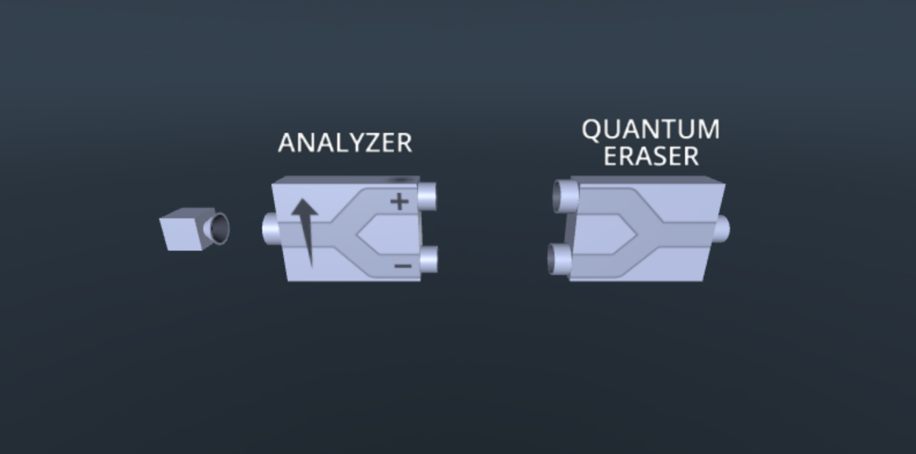
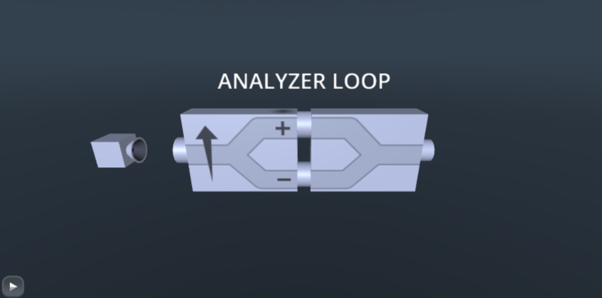
Analyzer loop

Slide 21
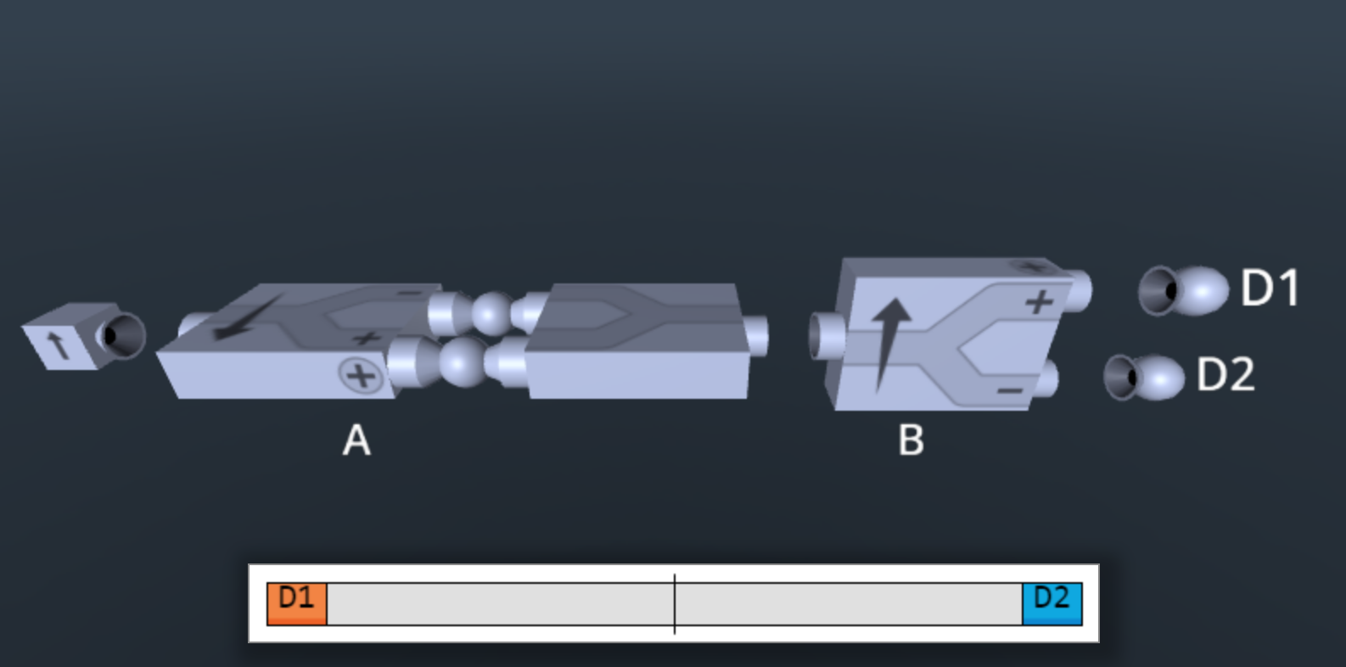
Analyzer loop with parity-check detectors

Slide 22
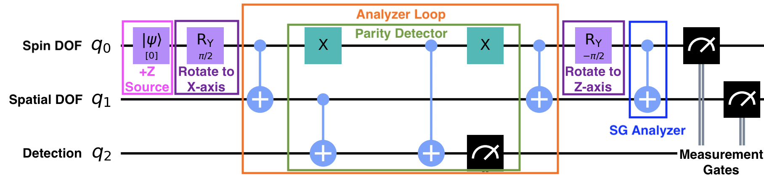
Parity detection
$${\left|↑\right\rangle }_{z}⊗\left|center beam\right\rangle ⊗\left|D_{0}\right\rangle$$

Slide 23
Parity detection
$${\left|↑\right\rangle }_{z}⊗\left|center beam\right\rangle ⊗\left|D_{0}\right\rangle →\frac{1}{2}\left({\left|↑\right\rangle }_{x}⊗\left|right\right\rangle +{\left|↓\right\rangle }_{x}⊗\left|left\right\rangle \right)⊗\left|P_{1}\right\rangle +\frac{1}{2}({\left|↑\right\rangle }_{x}⊗\left|left\right\rangle +{\left|↓\right\rangle }_{x}⊗|right⟩)⊗|P_{0}⟩$$

Slide 24
Parity detection
$${\left|↑\right\rangle }_{z}⊗\left|center beam\right\rangle ⊗\left|D_{0}\right\rangle →\frac{1}{2}\left({\left|↑\right\rangle }_{x}⊗\left|right\right\rangle +{\left|↓\right\rangle }_{x}⊗\left|left\right\rangle \right)⊗\left|P_{1}\right\rangle +\frac{1}{2}({\left|↑\right\rangle }_{x}⊗\left|left\right\rangle +{\left|↓\right\rangle }_{x}⊗|right⟩)⊗|P_{0}⟩$$

Slide 25

Parity detection
Post-selection
$${\left|↑\right\rangle }_{z}⊗\left|center beam\right\rangle ⊗\left|D_{0}\right\rangle →\frac{1}{2}\left({\left|↑\right\rangle }_{x}⊗\left|right\right\rangle +{\left|↓\right\rangle }_{x}⊗\left|left\right\rangle \right)⊗\left|P_{1}\right\rangle$$

Slide 26
Parity detection
$$\frac{1}{2}\left({\left|↑\right\rangle }_{x}⊗\left|right\right\rangle +{\left|↓\right\rangle }_{x}⊗\left|left\right\rangle \right)⊗\left|P_{1}\right\rangle →\frac{1}{\sqrt{2}}{\left|↑\right\rangle }_{z}⊗\left|up\right\rangle ⊗|P_{1}⟩$$

Slide 27
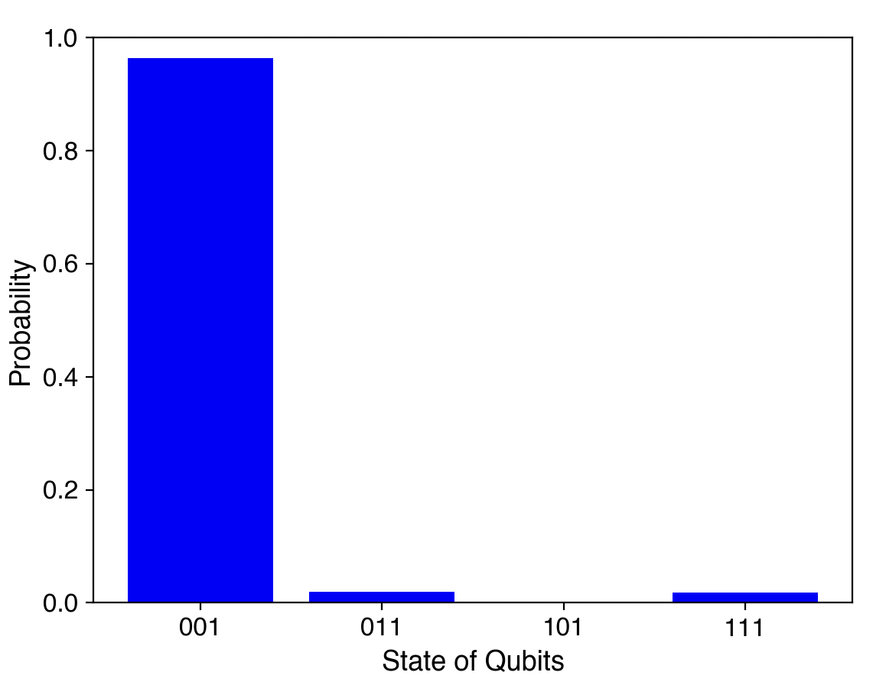
Parity detection

Slide 28
Parity detection:
Preserves the superposition and corrects errors

Slide 29
Additional experiments:
(1) Delayed choice experiments
(2) Watched versus unwatched
(3) Bell experiments

Slide 30
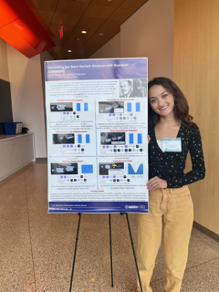
This talk is a partial summary of the undergraduate thesis work of Kyla Fraser

Slide 31
What are other experiments we can try:
Two and three slit experiments
Mach-Zehnder interferometer
Decoherence channels

Slide 32
What are other experiments we can try:
Two and three slit experiments
Mach-Zehnder interferometer
Decoherence channels

Slide 33
What are other experiments we can try:
Two and three slit experiments
Mach-Zehnder interferometer
Decoherence channels

Slide 34
What are other experiments we can try:
Two and three slit experiments
Mach-Zehnder interferometer
Decoherence channels

Slide 35

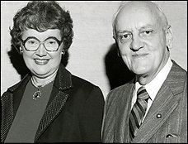


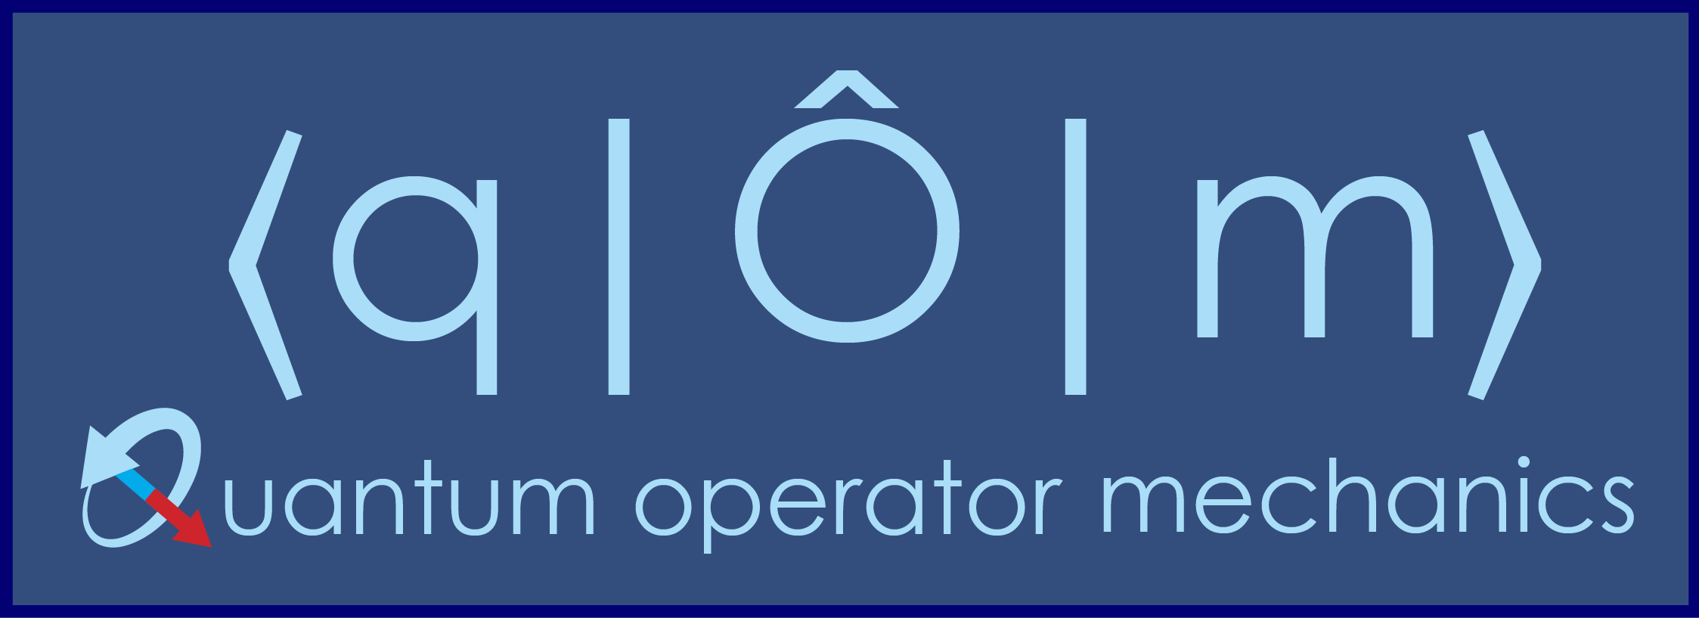
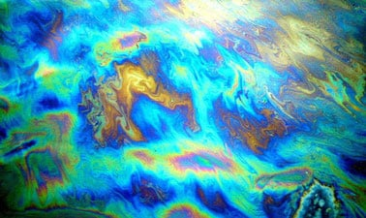
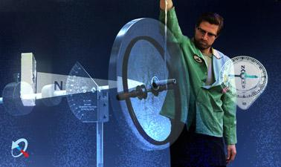
Thanks to
Resources
https://quantum.georgetown.domains
https://www.edx.org/course/quantum-mechanics
https://www.edx.org/course/quantum-mechanics-for-everyone

Slide 36
To be released this summer:
Quantum Mechanics Done Right
Both will be open access for the electronic versions

