Slide 1
CHANDLER: A Technology for Surface-level Reactor Neutrino Detection
Jonathan Link
Center for Neutrino Physics, Virginia Tech
WIN2023 AT SYSU ZHUHAI CAMPUS, CHINA
July 3 - July 8, 2023

Slide 2
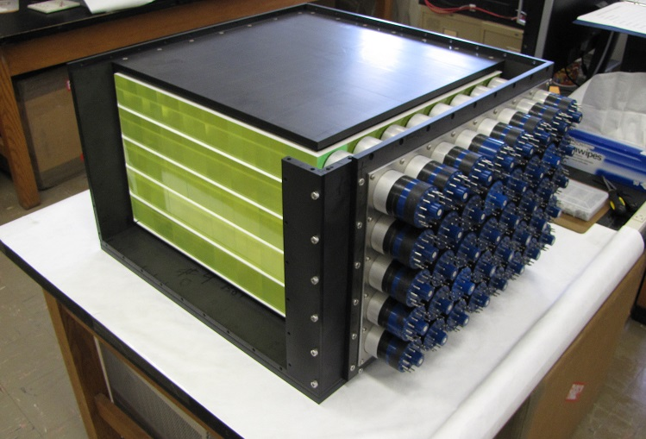
The CHANDLER* Reactor Neutrino Detector
CHANDLER was designed, from the start, to be a robust, mobile detector technology, suitable for a wide range of applications.
It uses a highly-segmented array of plastic scintillating cubes as the neutrino target and positron detector,
And thin sheets of lithium-6 doped zinc sulfide (ZnS) scintillator to tag the neutron capture.
The MiniCHANDLER Prototype, open during assembly to show the cubes and ⁶Li-doped ZnS sheets
*Carbon Hydrogen Anti-Neutrino Detector with a Lithium Enhanced Raghavan optical lattice

Slide 3
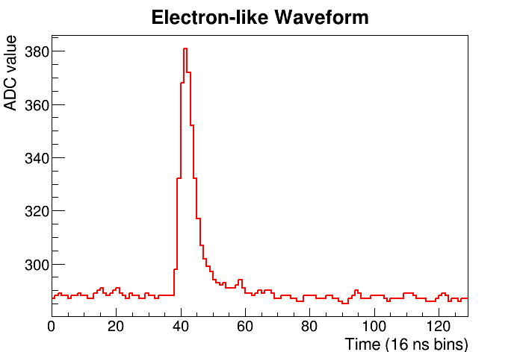
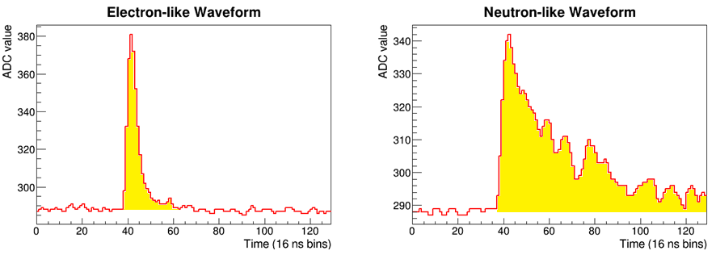
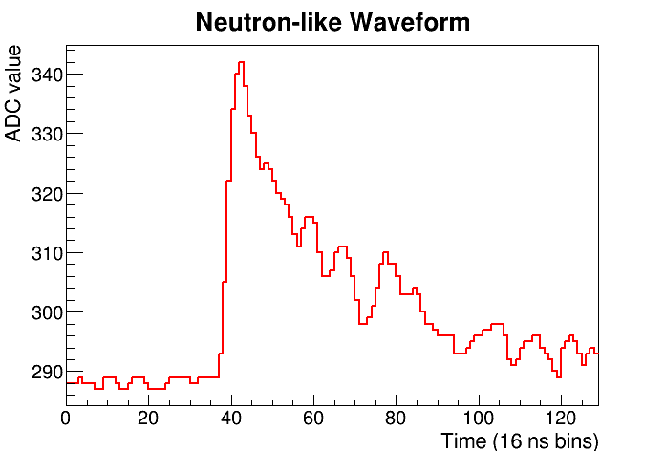
Neutron Identification in CHANDLER
The positron signal is formed in the cubes and gives short duration light pulse of about 10 ns,
Neutron capture light comes from the ZnS, which releases its scintillation light over much longer time scale (~200 ns)..
For each hit cell, we can compute a simple neutron ID variable as the ratio of the pulse integral to the pulse height.
Higher neutron ID means more neutron-like.
pulse integral
pulse height

Slide 4
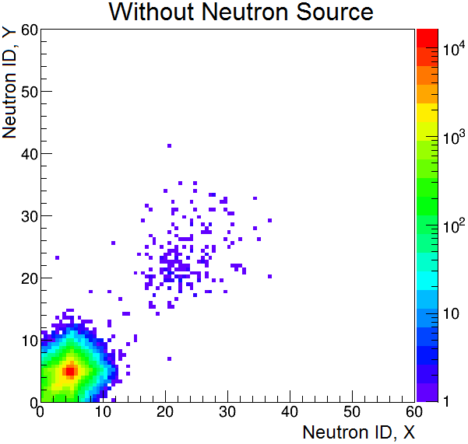
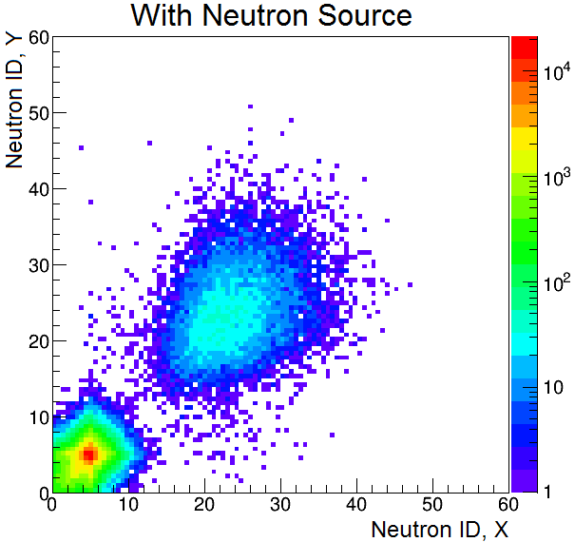
Neutron Identification in MicroCHANDLER
The x and y neutron IDs show a clear neutron/positron separation
When the source is removed the events in the neutron region mostly go away.
The neutrons candidates that remain are consistent with the cosmic ray flux.

Slide 5
The CHANDLER* Reactor Neutrino Detector
CHANDLER was designed, from the start, to be a robust, mobile detector technology, suitable for a wide range of applications.
It uses a highly-segmented array of plastic scintillating cubes as the neutrino target and positron detector,
And thin sheets of lithium-6 doped zinc sulfide (ZnS) scintillator to tag the neutron capture.
Light is transported along the rows and columns of cubes by total internal reflection, and readout by photomultiplier tubes.
The MiniCHANDLER Prototype, open during assembly to show the cubes and ⁶Li-doped ZnS sheets
*Carbon Hydrogen Anti-Neutrino Detector with a Lithium Enhanced Raghavan optical lattice

Slide 6
The Raghavan Optical Lattice
The cubes are optically connected in layers, and sandwiched between sheets of ⁶Li-loaded ZnS scintillator for neutron detection.
Light from the cubes is transported by total-internal-reflection, along the rows and columns of cubes, to the edge of the detector, where it is readout by photomultiplier tubes.
Light from the sheets is absorbed in the cubes and retransmitted by a wavelength-shifter so that it can also be captured by total-internal-reflection.
The Raghavan Optical Lattice allows us to achieve excellent energy and spatial resolution over a large, unbroken detector mass.
Jonathan Link

Slide 7
The CHANDLER* Reactor Neutrino Detector
CHANDLER was designed, from the start, to be a robust, mobile detector technology, suitable for a wide range of applications.
It uses a highly-segmented array of plastic scintillating cubes as the neutrino target and positron detector,
And thin sheets of lithium-6 doped zinc sulfide (ZnS) scintillator to tag the neutron capture.
Light is transported along the rows and columns of cubes by total internal reflection, and readout by photomultiplier tubes.
We use this high segmentation to tag the gammas from positron annihilation, and thus reject correlated backgrounds like fast neutrons.
The MiniCHANDLER Prototype, open during assembly to show the cubes and ⁶Li-doped ZnS sheets
*Carbon Hydrogen Anti-Neutrino Detector with a Lithium Enhanced Raghavan optical lattice

Slide 8



The Signal and the Noise
High segmentation allows us to tag the positron annihilation gammas interacting in neighboring cubes.
Neutrons are tagged by the slow scintillation decay time of the zinc sulfide scintillator (200 ns vs 10 ns).
The time ordered coincidence of the positron and the neutron tag separates IBDs from background.
$${\overline{ν}}_{e}$$
n
Inverse Beta Decay (IBD)
${\overline{ν}}_{e}+p→e^{+}+n$
$$e^{+}+e^{−}→γ+γ$$
$$n+{}_{ }^{6}{Li}→{}_{ }^{4}{He}+{}_{ }^{3}H$$
Cosmic-Ray Fast Neutron
$n+p→n+p$
$$n+{}_{ }^{6}{Li}→{}_{ }^{4}{He}+{}_{ }^{3}H$$
γ
γ
e⁺
p
p
n
n
⁶Li
⁴He
⁶Li
⁴He
Positron (e⁺)
Annihilation γs
³H
³H
Proton
Detected Light
Neutron Capture
Detected Light
Neutron Capture
In the field we saw 85 correlated fast neutrons for every IBD event, so we need powerful tools to reject them!
time
time
10 ns
50 μs
200 ns
10 ns
50 μs
200 ns

Slide 9
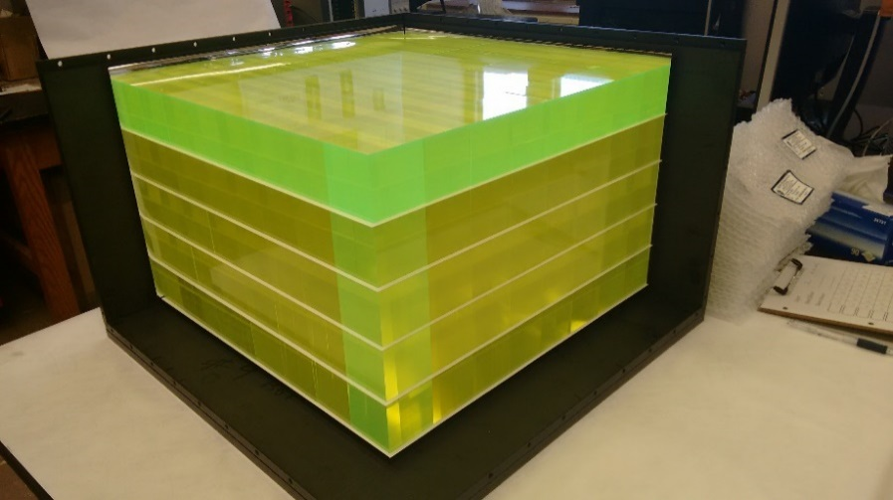
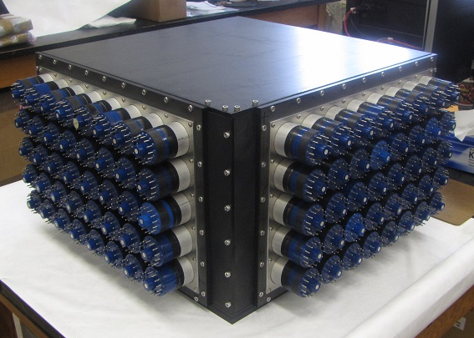
MiniCHANDLER in Pictures
The 80 kg, 80 channel MiniCHANDLER detector was completed in fall 2016.
It was commissioned and installed in our Mobile Neutrino Lab…

Slide 10
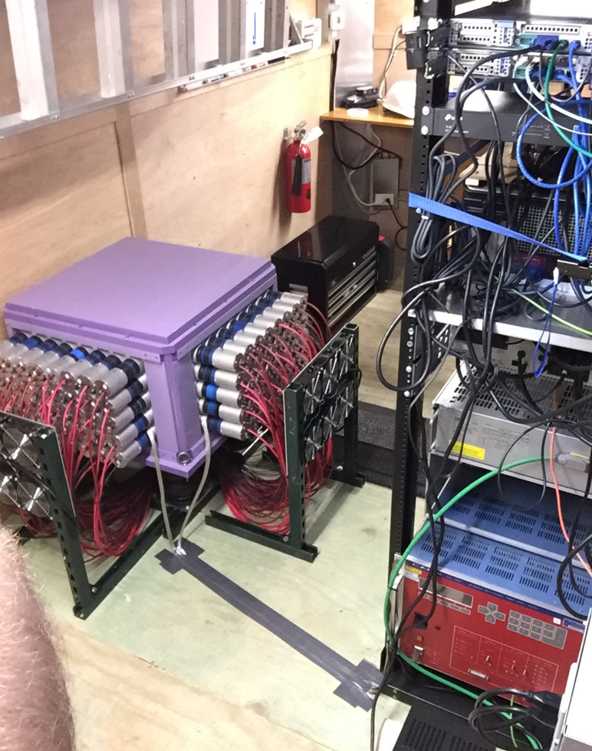
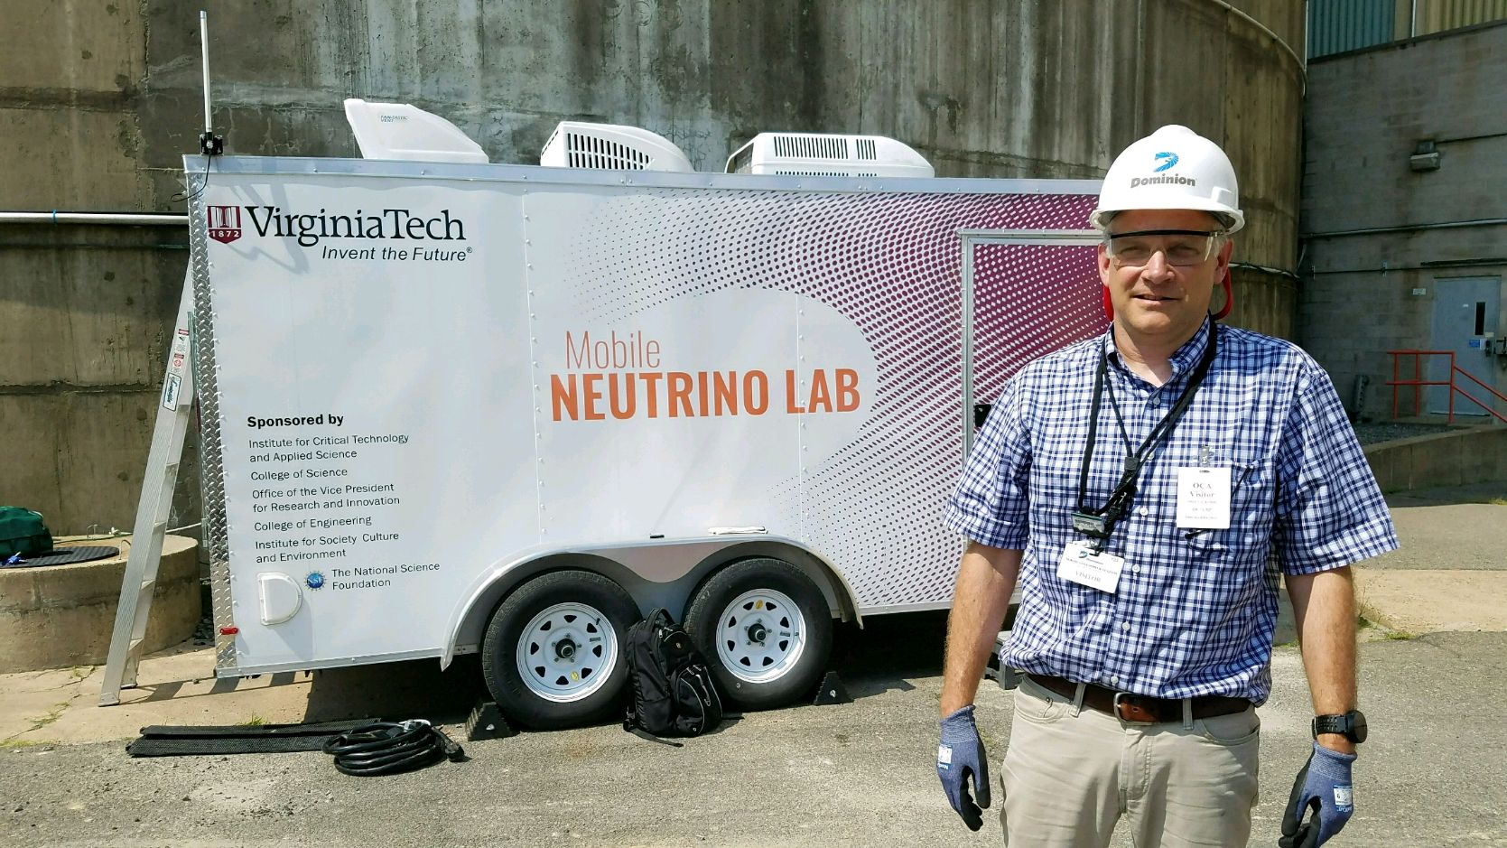
The Mobile Neutrino Lab
The MiniCHANDLER prototype was installed in our Mobile Neutrino Lab and deployed to the North Anna Nuclear Generating Station.

Slide 11
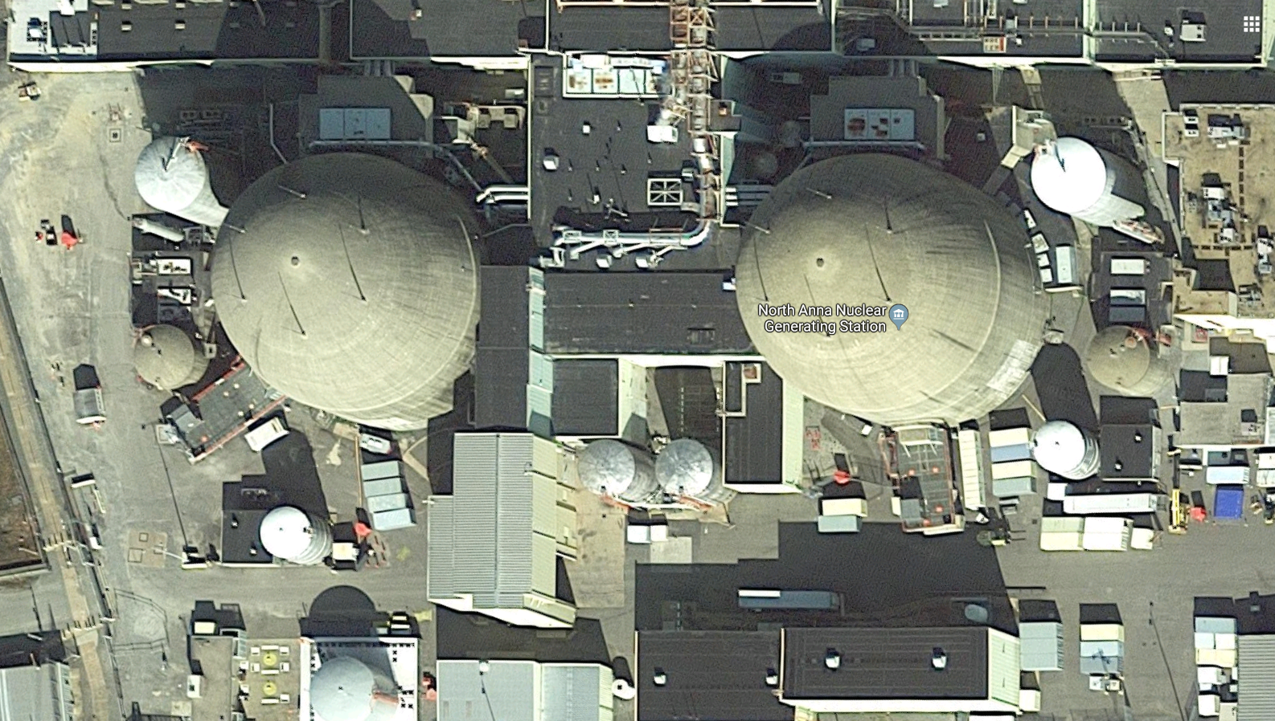

The Mobile Neutrino Lab at North Anna
Jonathan Link

Slide 12
The Mobile Neutrino Lab
The MiniCHANDLER prototype was installed in our Mobile Neutrino Lab and deployed to the North Anna Nuclear Generating Station.
MiniCHANDLER would become:
  The first demonstrated mobile neutrino detector,
  The first unshielded reactor neutrino detector, and
  One of the world’s smallest neutrino detectors.

Slide 13
The MiniCHANDLER Analysis
Phys. Rev. Applied 13, 034028 (2020)

Slide 14
The IBD Event Selection
The inverse beta decay candidates include all positron-like events in the 1000 μs preceding a neutron.
The positron candidate energy is reconstructed from the pattern of PMT light collected in each detector plane.
We apply a spatial separation cut between the positron and neutron.
Topological selections are used to reject multiple proton recoils and tag evidence of the annihilation gammas:
  Total energy outside the primary cube <1 MeV
  No single cube outside the primary cube with E>511 keV
  At least one cube outside the primary with energy >100 keV

Slide 15
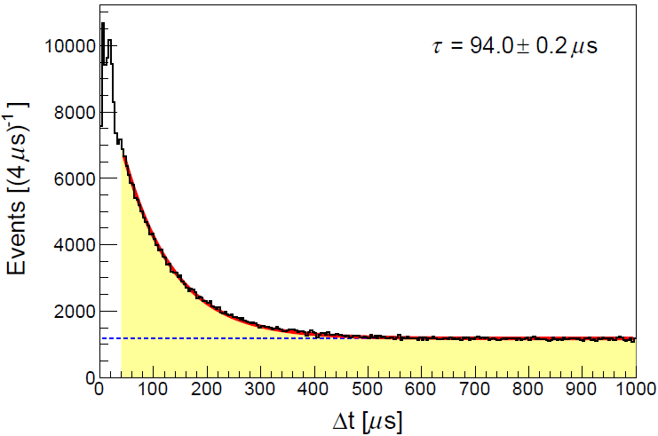
Fitting Δt for Correlated Events
We then sorted our IBD candidates into energy bins of 1 MeV.
In each bin, the positron-neutron Δt distribution was fitted with an exponential plus flat distribution,
This is how we extracted the time-correlated event rate as a function of the positron candidate energy.
Phys. Rev. Applied 13, 034028 (2020)
Correlated Events
Random Coincident Events

Slide 16
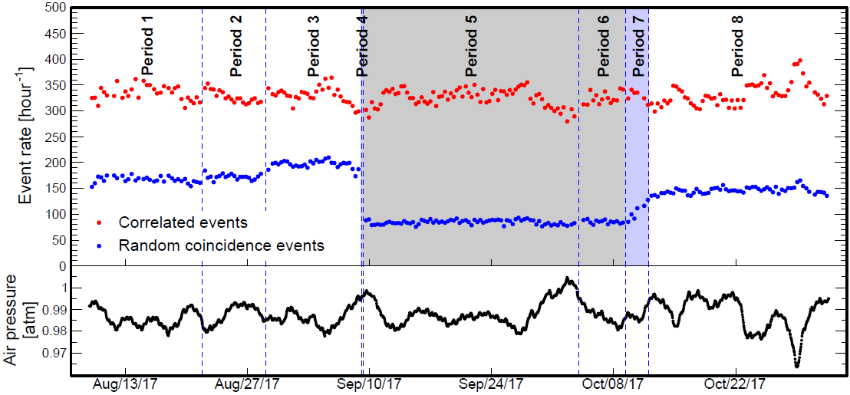
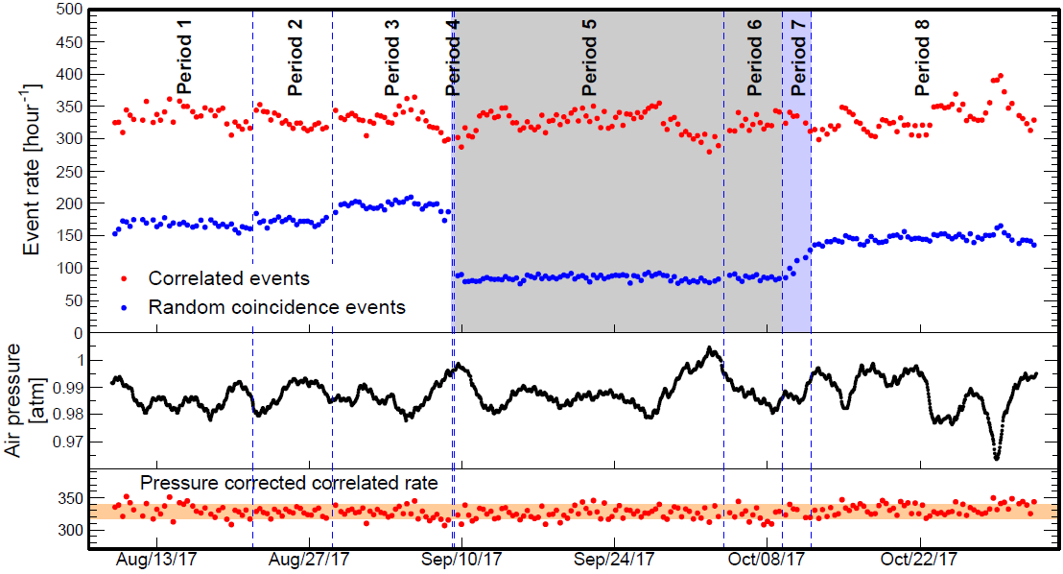
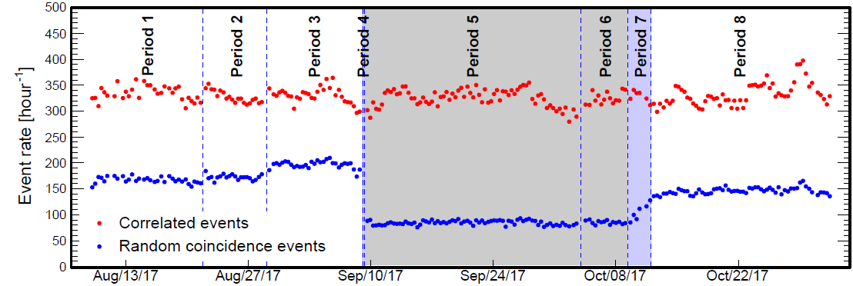
Time Correlated Fast Neutrons
Phys. Rev. Applied 13, 034028 (2020)
No topological selections applied.
Reactor-off
Random events with Δt < 500 μs
Most of the time correlated events are fast neutrons,
and their rate is independent of the reactor power.
The fast neutron rate is inversely correlated with atmospheric pressure.
After a pressure correction, we found that the average correlated rate in the reactor-off period was lower than in reactor-on by about 4 events/hour.
Which is consistent with the expected inverse beta decay rate.

Slide 17
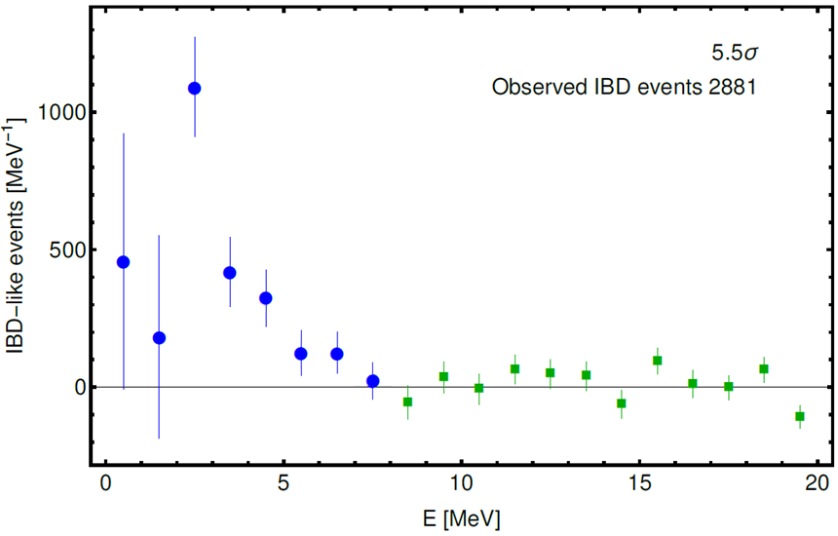
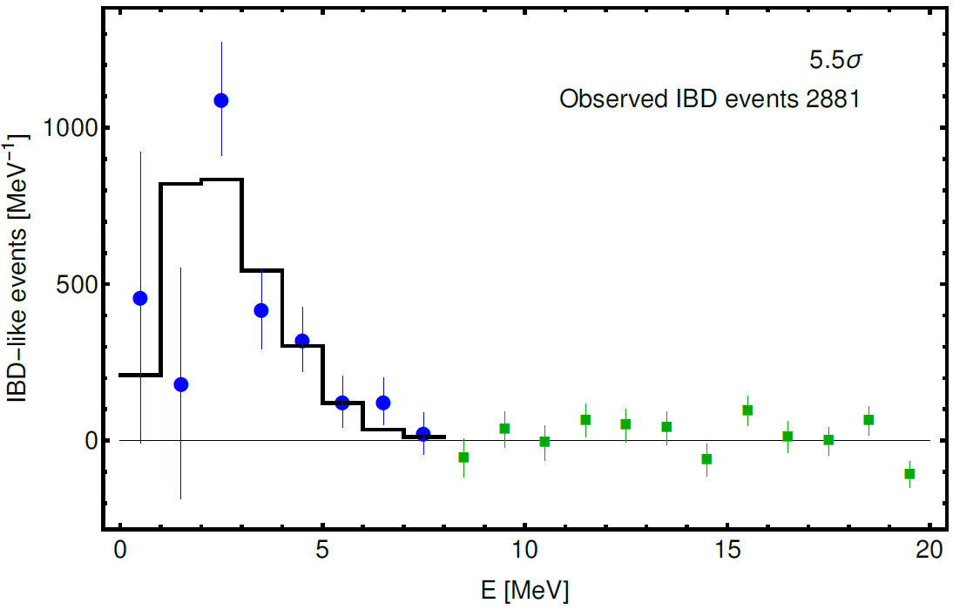
The IBD Analysis Results
To further eliminate the correlated background, we performed a reactor-off subtraction.
We used energy bins beyond the signal region (from 8 to 20 MeV) to scale the reactor-off absolute rate to match the reactor-on rate.
We fit this excess to the inverse beta decay spectrum from Monte Carlo (black histogram).
Phys. Rev. Applied 13, 034028 (2020)
The excess below 8 MeV are neutrino events.

Slide 18
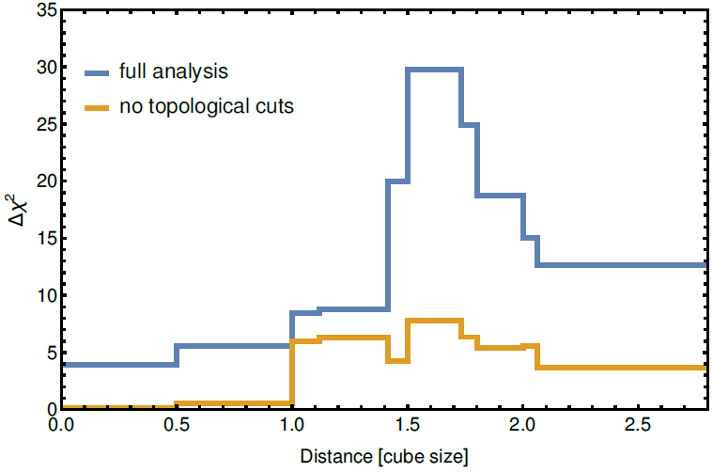
Topological Selection
The topological selections were essential to extracting a significant signal in MiniCHANDLER:
These selections will improve dramatically with the improved optics.
And, a larger detector will better contain the annihilation gammas and multiple proton recoils.
Signal Significance [Δχ²]

Slide 19
CHANDLER Future Prospects

Slide 20
Future Upgrades
Going from MiniCHANDLER to full CHANDLER, there are several known enhancements:
New optics: improves energy resolution, pattern recognition and background rejection.

Slide 21
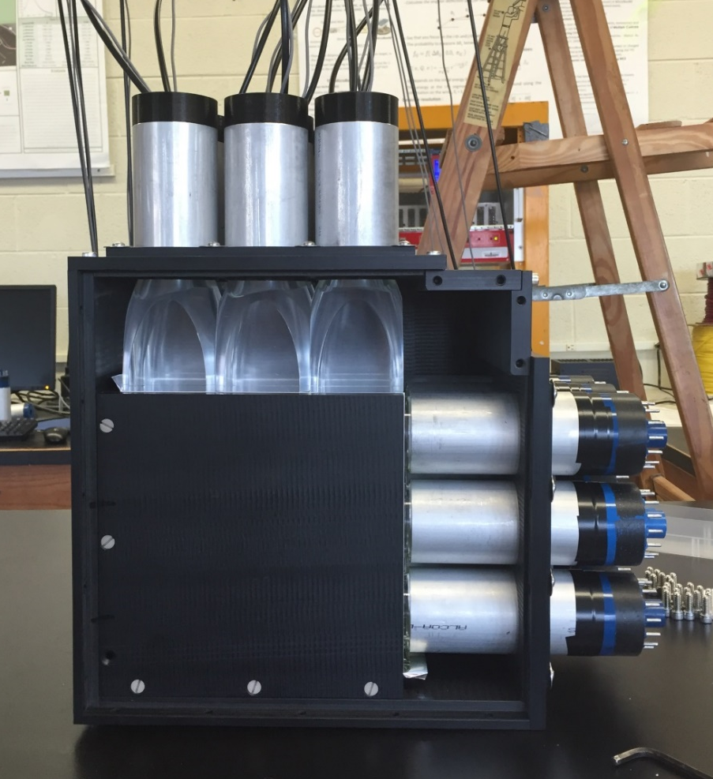
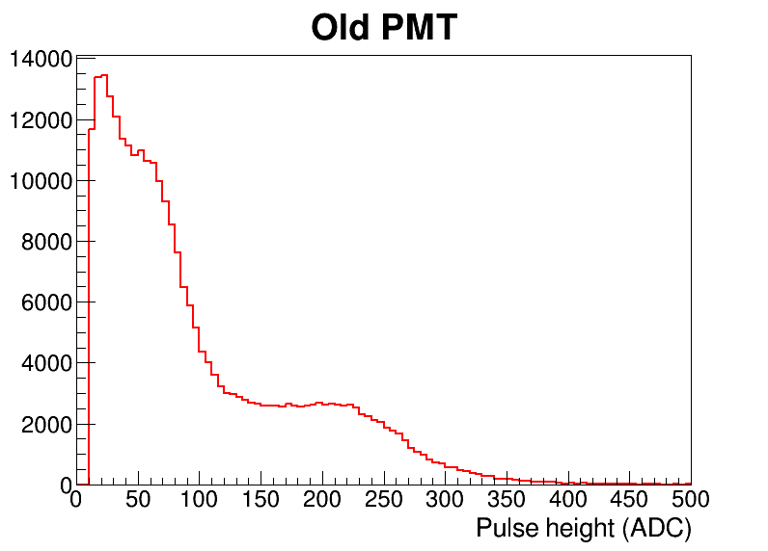
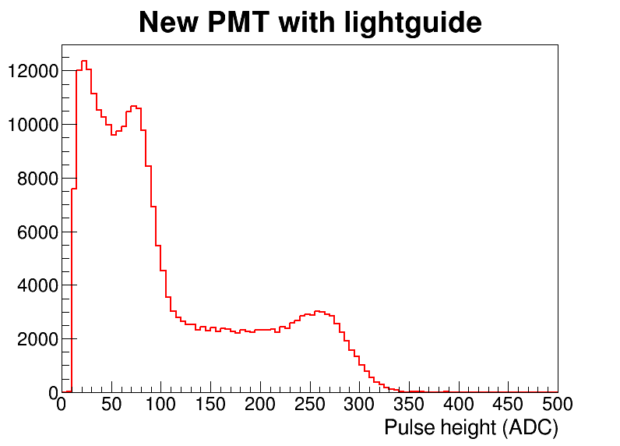
MiniCHANDLER Upgrades: New Optics
We rebuilt our MicroCHANDLER prototype with half new optics.
We used a ²²Na source to compare the energy response in the new and old optics.
The new light collection improves the energy resolution by at least a factor of 2.
The annihilation gamma Compton edge and continuum are now distinct features.
(As used in the original MiniCHANDLER)
511 keV
Compton Edge
511 keV
Compton Edge
1273 keV Compton Edge
1273 keV Compton Edge

Slide 22
Future Upgrades
Going from MiniCHANDLER to full CHANDLER, there are several known enhancements:
New optics: improves energy resolution, pattern recognition and background rejection.
Larger detector: faster event accumulation and better detection efficiency from neutron and annihilation gamma containment.
PMTs on four sides: improves the pattern recognition and the energy resolution.
Half cubes: increases ⁶Li tagging efficiency and lowers the random coincident background rate.

Slide 23
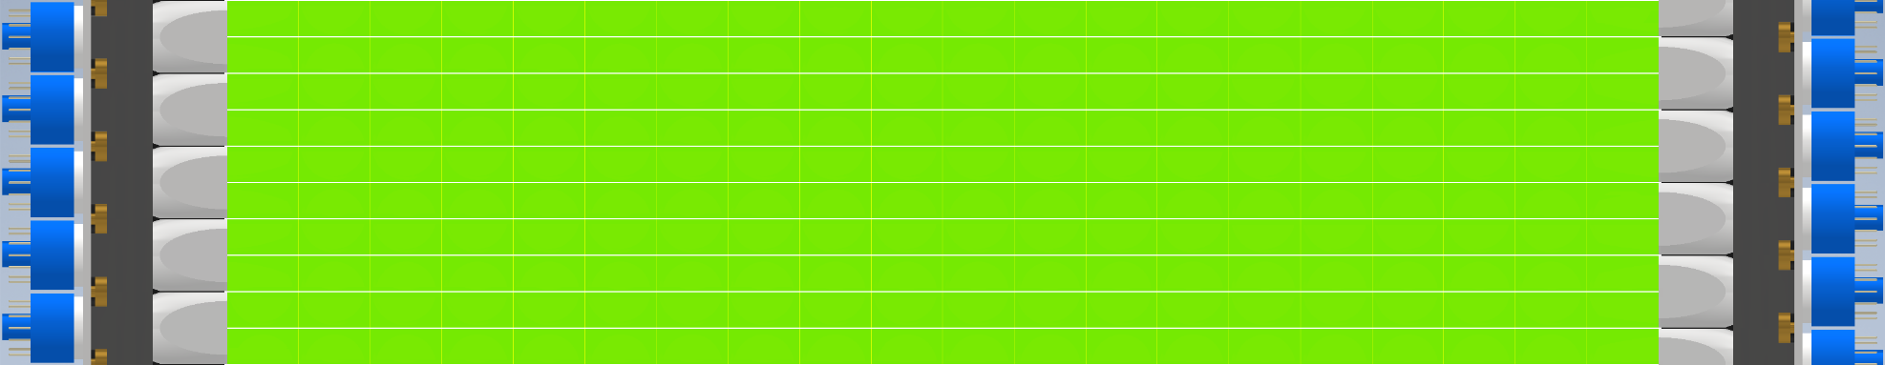
Half Cubes
The half cubes upgrade doubles the effective ⁶Li density in the detector.
The opposing PMTs are offset by a half-cube to take advantage of the extra spatial information.
Configuration | ⁶Li Capture
Full Cubes | 51%
Half Cubes | 69%
Time to 90% Capture
229 μs
120 μs
Volume for 90% Capture
37 cubes
24.5 cubes
The half cubes upgrade increases the ⁶Li capture efficiency by 35%, but it only increases the cost of the detector by only 12%.
Half cubes lowers the capture time and capture spatial separation, which reduces the random coincident background rate.

Slide 24
Future Upgrades
Going from MiniCHANDLER to full CHANDLER, there are several known enhancements:
New optics: improves energy resolution, pattern recognition and background rejection.
Larger detector: faster event accumulation and better detection efficiency from neutron and annihilation gamma containment.
PMTs on four sides: improves the pattern recognition and the energy resolution.
Half cubes: increases ⁶Li tagging efficiency and lowers the random coincident background rate.
Electronics upgrade: lowers cost, improves data quality and pattern recognition.

Slide 25
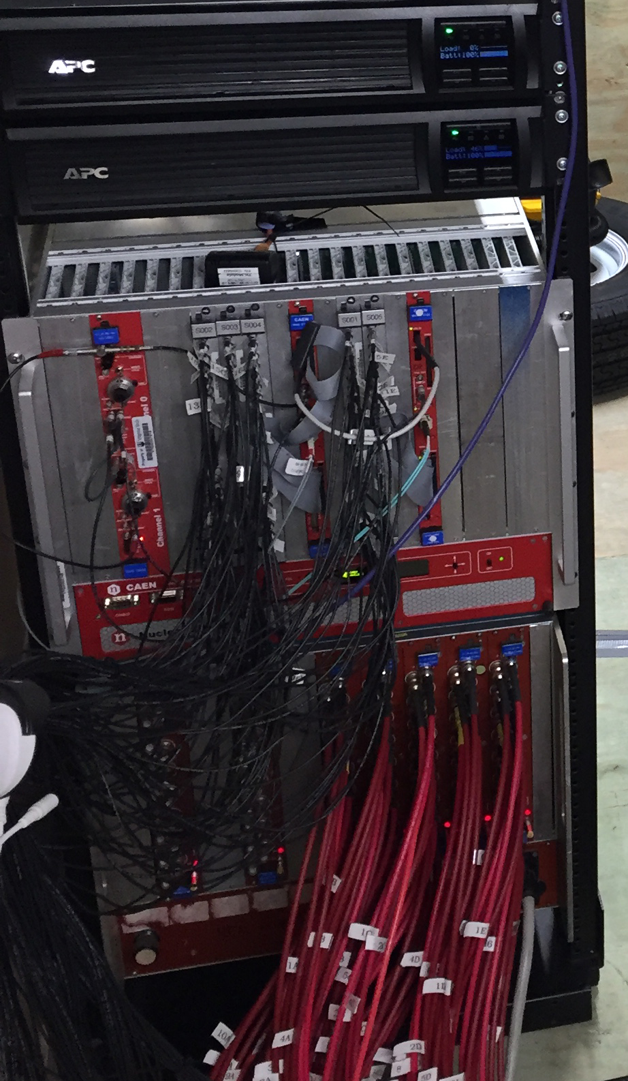
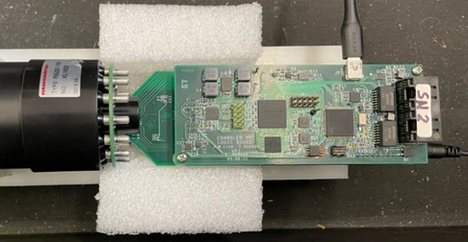
Electronics Upgrade
Old Electronics
We are pursuing a major upgrade to our electronics.
New Electronics
All-in-one PMT Base
Data Acquisition Electronics
This base puts the high voltage, ADC and a fully programmable trigger, all at the PMT.
  Uses power over Ethernet
  No channel-to-channel crosstalk
  No signal attenuation
  ADC dynamic range goes from 12 bits to 14 bits
  Dynamic trigger threshold for superimposed hits
  On-board, programmable neutron/positron ID
PMT High Voltage Power Supply

Slide 26
Final Thoughts
We’re upgrading MiniCHANDLER for a redeployment at North Anna this spring.
This upgrade includes new PMTs and light guides, a new voltage-divider base, and one plane of half cubes.
Unfortunately, we will not have the all-in-one base for this deployment; a consequence of the global semiconductor crisis.
This deployment will test improved topological selection criteria based on better energy resolution.
CHANDLER is one of two technologies selected for the Mobile Antineutrino Demonstrator project, a collaboration with Livermore National Lab.
We are approved to build a 650 kg CANDLER detector in 2024.

