Slide 1
Dark Photons – From the Galactic Center to Your Detector
Andrew Gustafson
In Collaboration with Varun Mathur, Ian Shoemaker, and Michael Graesser (LANL)
For CNP Day 2023

Slide 2
Outline
What is Dark Matter?
Our model and interactions
Existing constraints and how to avoid them
Schematic – Boosted Dark Photons from Dark Matter Annihilations
Dark matter distribution and dark photon fluxes
Boosted dark photon interactions
Event Rates at Detectors

Slide 3
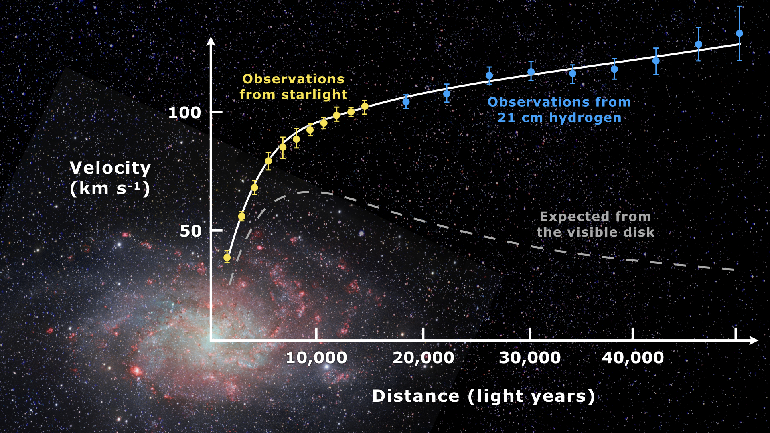
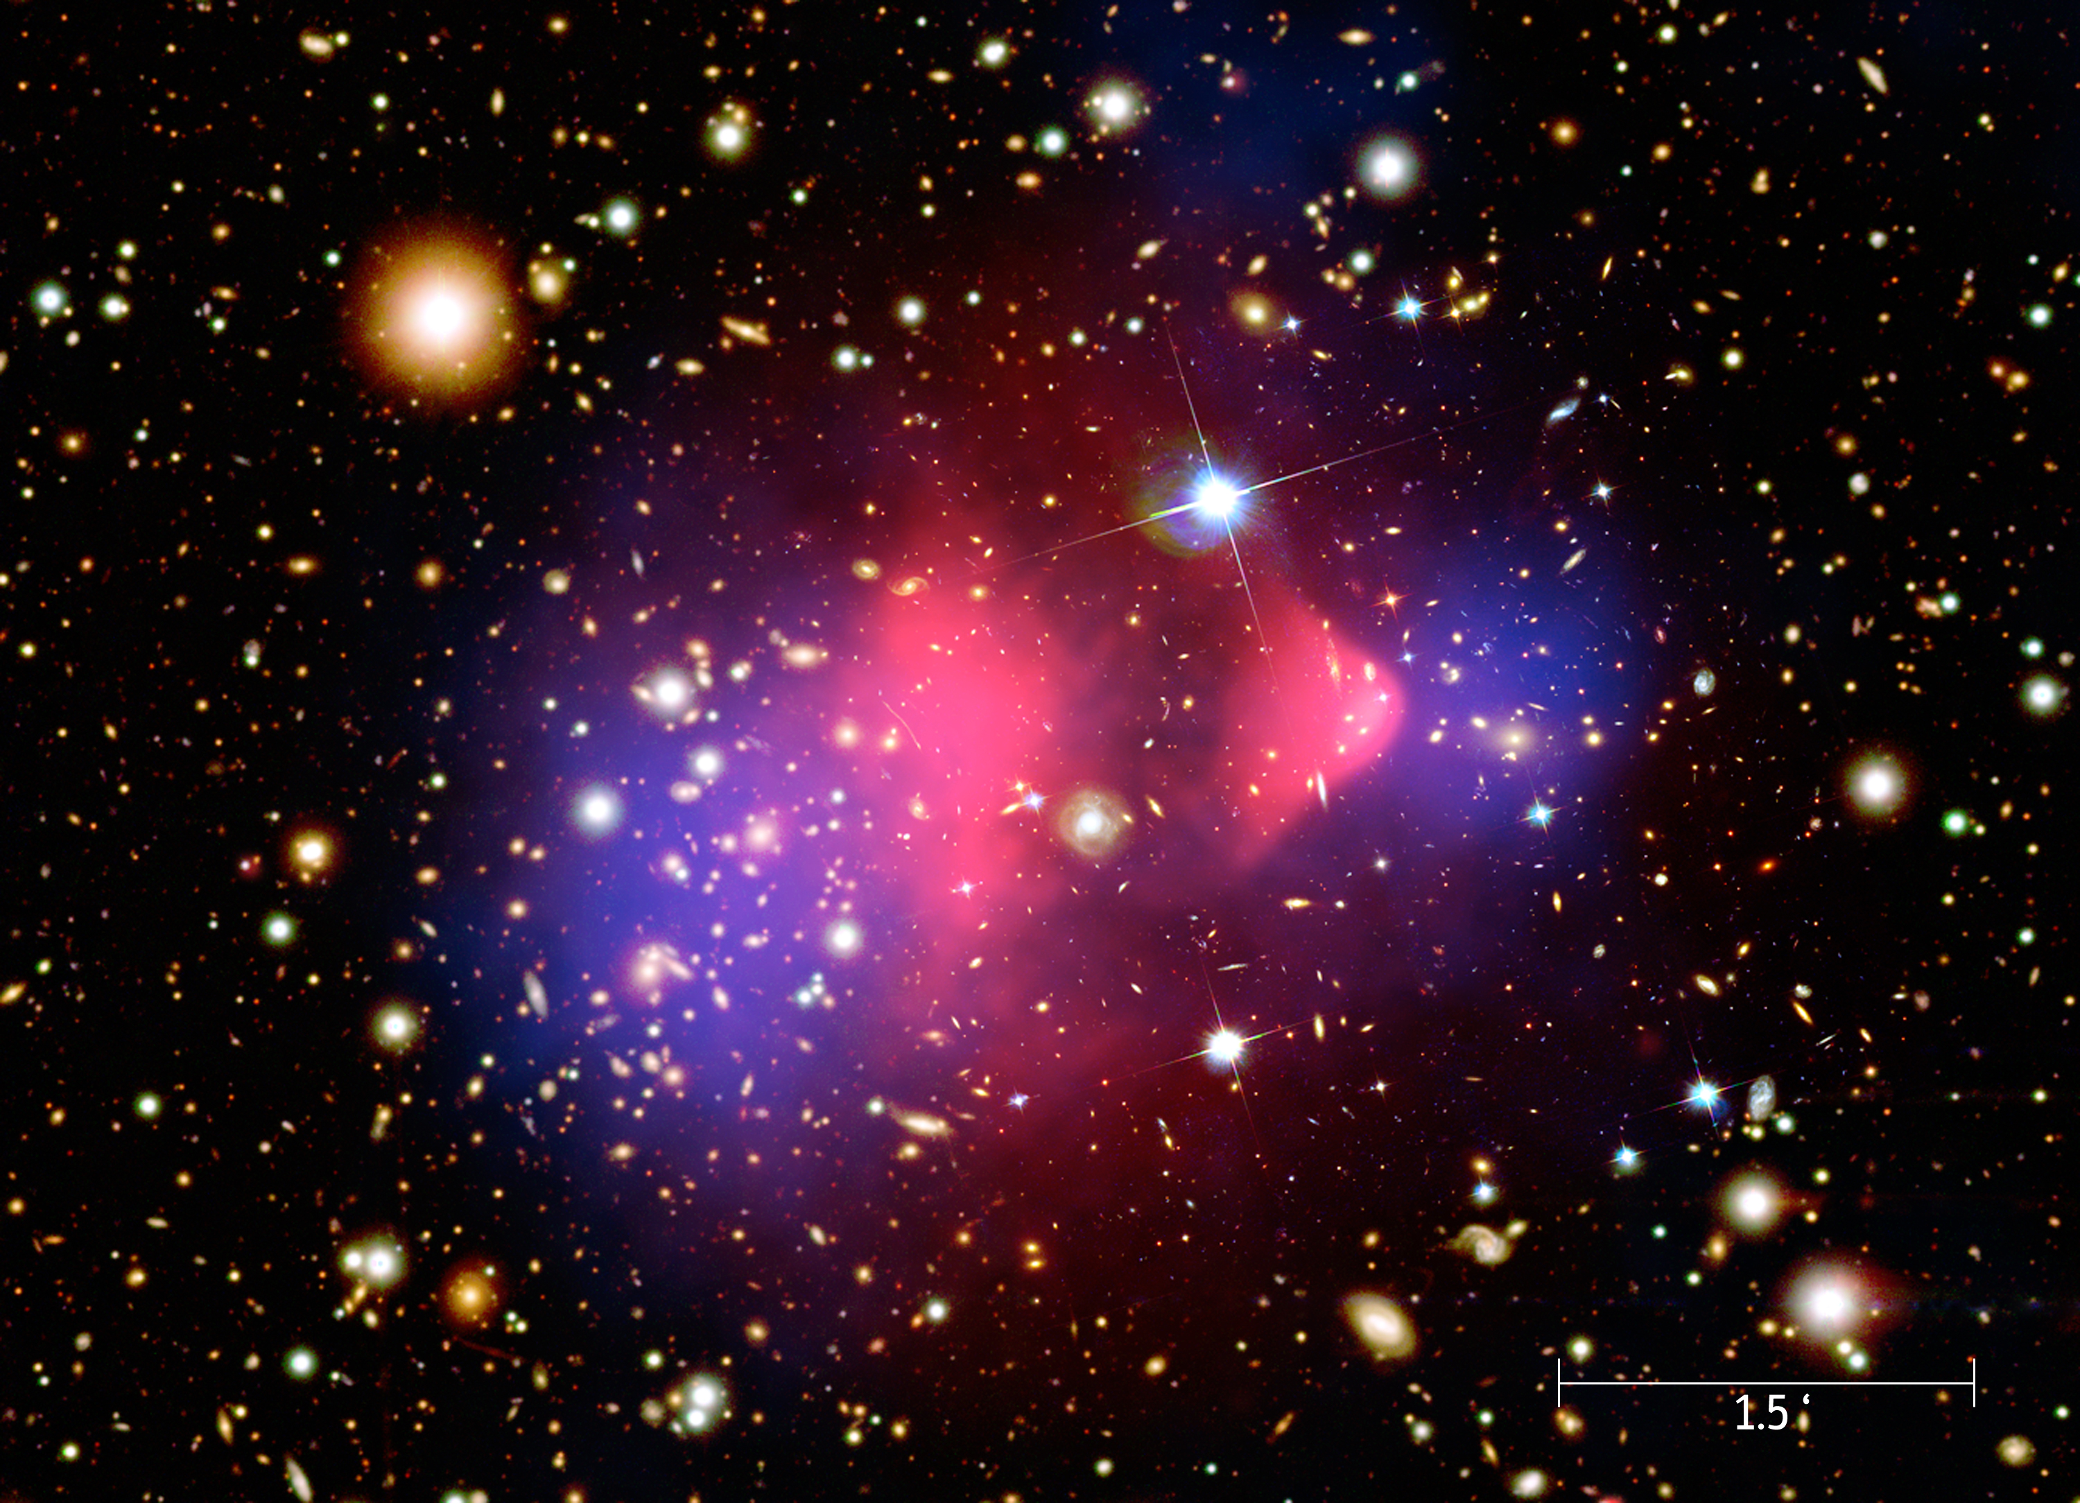
What is Dark Matter (DM)?
Has been observed in:
Galactic rotation curves
Gravitational lensing of galactic mergers
Structure formation
Cosmological gravitational curvature
Has not been observed in:
Direct detection experiments
Colliders
Indirect Detection Searches
Sizeable scattering in astrophysical scenarios
[1] Corbelli, E.; Salucci, P. (2000). "The extended rotation curve and the dark matter halo of M33". Monthly Notices of the Royal Astronomical Society. 311 (2): 441–447.
[2] Chandra X-Ray Observatory

Slide 4
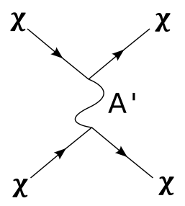
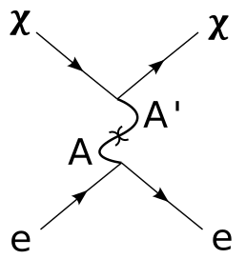
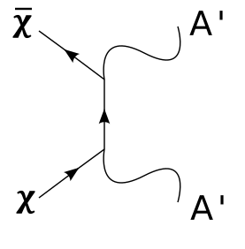
Our Model – Fermionic Dark Matter with a Dark Photon Mediator
$ℒ ⊃\overline{χ}\left(i∂_{μ}γ^{μ}−m_{χ}\right)χ$
$−\frac{1}{4}{F^{′}}^{μν}F_{μν}^{′}+\frac{1}{2}m_{A^{′}}^{2}{A^{′}}^{μ}A_{μ}^{′}$
$−g_{D}A_{μ}^{′}\overline{χ}γ^{μ}χ$
$−\frac{ε}{2}F^{μν}F_{μν}^{′}$
Dark Matter (DM) Kinematics
Dark Photon (DP) Kinematics
DM-DP Interactions
DP- Photon Kinetic Mixing
Time
Notes:
Put in Lagrangian. Explain why it is well motivated, give examples of the types of interactions that can occur (DM-DM scattering, DM-SM scattering, SM-DP production, DM-DM annihilation).

Slide 5
Existing Constraints : DM-DM Scattering
[3] Prateek Agrawal, Francis-Yan Cyr-Racine, Lisa Randall, and Jakub Scholtz, “Make dark matter charged again,” Journal of Cosmology and Astroparticle Physics 2017, 022 (2017).
How to evade these bounds:
Let $χ$ make up ~10% of the total dark matter density. These gravitational observations can have sizable uncertainties.
DM – DM scattering constrained by Bullet Cluster observations and the ellipticity of galactic DM halos [3].
Notes:
DM – DM interaction for Bullet Cluster and in CMB.
Long Range DM-DM/SM interactions for low masses
Coupling to Photons in Stars

Slide 6
Existing Constraints : DM-SM Scattering
How to evade these bounds:
Let $m_{χ}≲MeV$. Below this mass, galactic dark matter lacks the energy necessary to produce visible signals in detectors.
For CMB constraints, we need the cross-section to be small.
[4]Sensei Collaboration, “Direct-detection results on sub-gev dark matter from a new skipper CCD”, Phys. Rev. Lett. 125, 171802 (2020).
[5]M. A. Buen-Abad, R. Essig, D. McKeen, and Y.-M. Zhong, “Cosmological constraints on dark matter interactions with ordinary matter” Physics Reports 961, 1 (2022).
[6] A. Cruz and M. McQuinn, “Astrophysical plasma instabilities induced by long-range interacting dark matter” arXiv preprint arXiv:2202.12464 (2022).
DM – SM interactions constrained by direct detection experiments (i.e. SENSEI [4]) and CMB observations [5]. For low-mass dark photons, constraints from DM-Galactic B-field interactions [6] .
Notes:
DM – DM interaction for Bullet Cluster and in CMB.
Long Range DM-DM/SM interactions for low masses
Coupling to Photons in Stars

Slide 7
Existing Constraints : DM Solar Cooling
How to evade these bounds:
Let $m_{χ}≫T_{core}\left(𝒪\left(10 keV\right)\right)$, or pick $g_{D}ε$ small so there is little coupling to EM currents.
[7] S. Davidson, S. Hannestad, and G. Raffelt, JHEP 05, 003 (2000), arXiv:hep-ph/0001179.
If $m_{χ}<T_{core}$ in stars, then electromagnetic currents can produce $χ$ which will escape and lead to over-cooling [7]

Slide 8
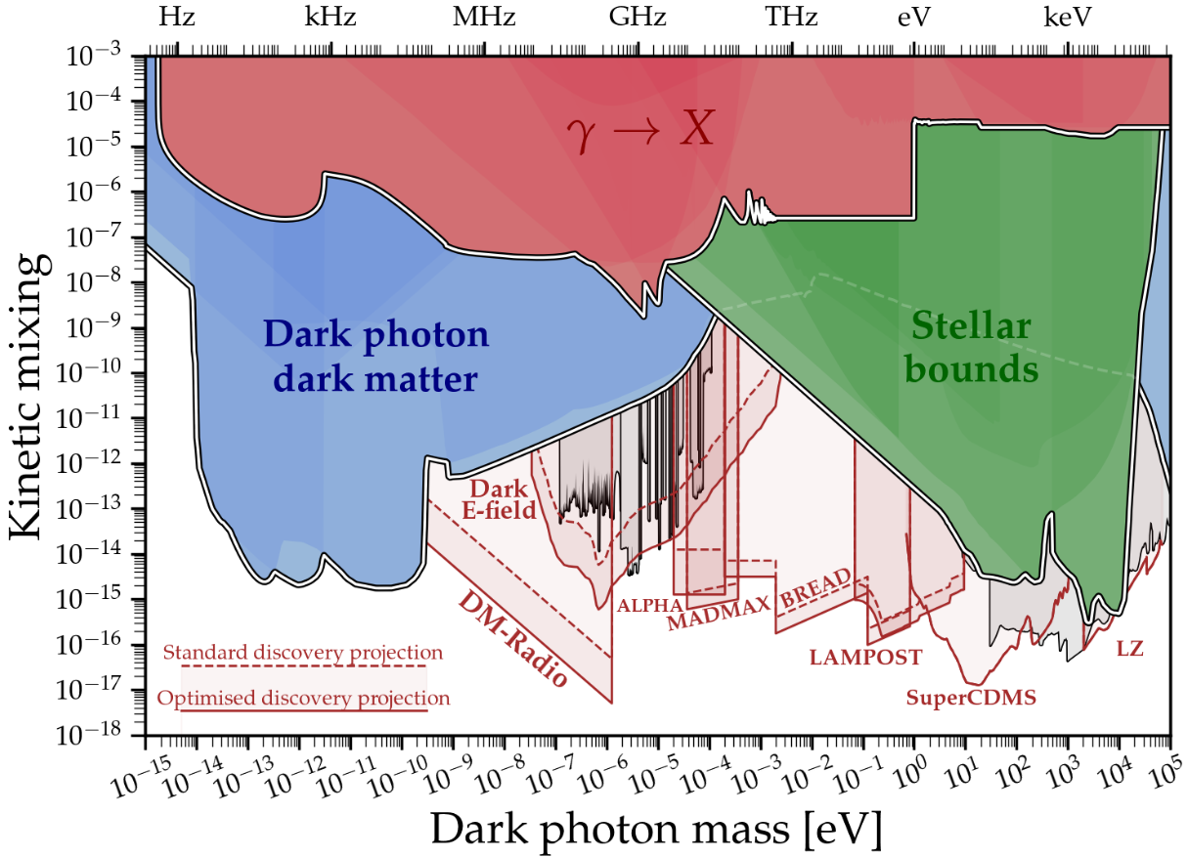
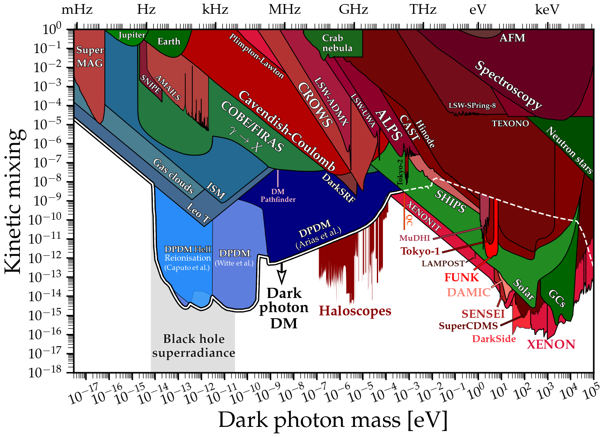
Existing Constraints : DP Mixing
For DPs that mix with SM photons, this can lead to DPs free-streaming out of the Sun (and other stars). Stellar cooling observations and direct detection constrains these models.
Constraints weaken when $m_{A′}<ω_{p}$ (the plasma mass)
[8] Andrea Caputo, Ciaran A. J. O’Hare, Alexander J. Mil- lar, and Edoardo Vitagliano, “Dark photon limits: a cook- book,” (2021), arXiv:2105.04565 [hep-ph].

Slide 9
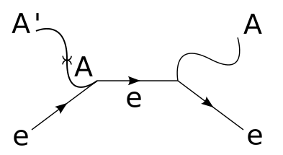
DM w/ Boosted DP - Schematic
Milky Way Halo
Terrestrial Detector
When $m_{χ}≫m_{A′}$ the DPs from annihilation act as Long-Lived Particles with galactic scale decay lengths
$$Φ_{A′}=\frac{1}{4π}\frac{<σv>}{2 m_{χ}^{2}}\int_{ }^{ }{dΩ}\int_{LOS}^{ }{ρ_{χ}^{2}}dx$$
Notes:
Explain the Boosted DP scenario, our current problems, what we hope we might avoid.

Slide 10
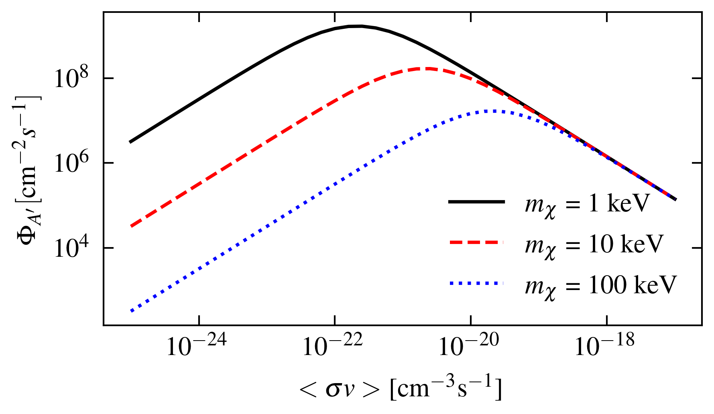
$χ$ Distribution And DP Flux
We let the $χ$ distribution follow an NFW profile with a time-dependent scaling.
$ρ_{χ}\left(r,t\right)=f\left(t\right)×ρ_{NFW}(r)$
After picking a value of $f_{i}=f(t=0)$, we can then time-evolve the distribution due to annihilations. Given our choice of $m_{χ}$ and $<σ v>$, we can then compute the flux of dark photons at Earth.

Slide 11
Dark Photon In-Medium Effects
In matter, dielectric properties lead to a modified photon propagator via a polarization tensor $Π$.
For transversely polarized photons in an isotropic, non-magnetic medium
$$Π_{T}=ω^{2}(1−n_{ref}^{2})$$
$$\sim {εq}^{2}∗\frac{1}{q^{2}−Π}$$
Mixing
Photon Propagator
On-shell condition
$$q^{2}=m_{A^{′}}^{2}$$
$$ε_{eff}\sim \frac{ε m_{A^{′}}^{2}}{m_{A^{′}}^{2}−Π}$$

Slide 12
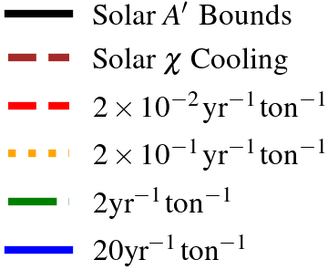
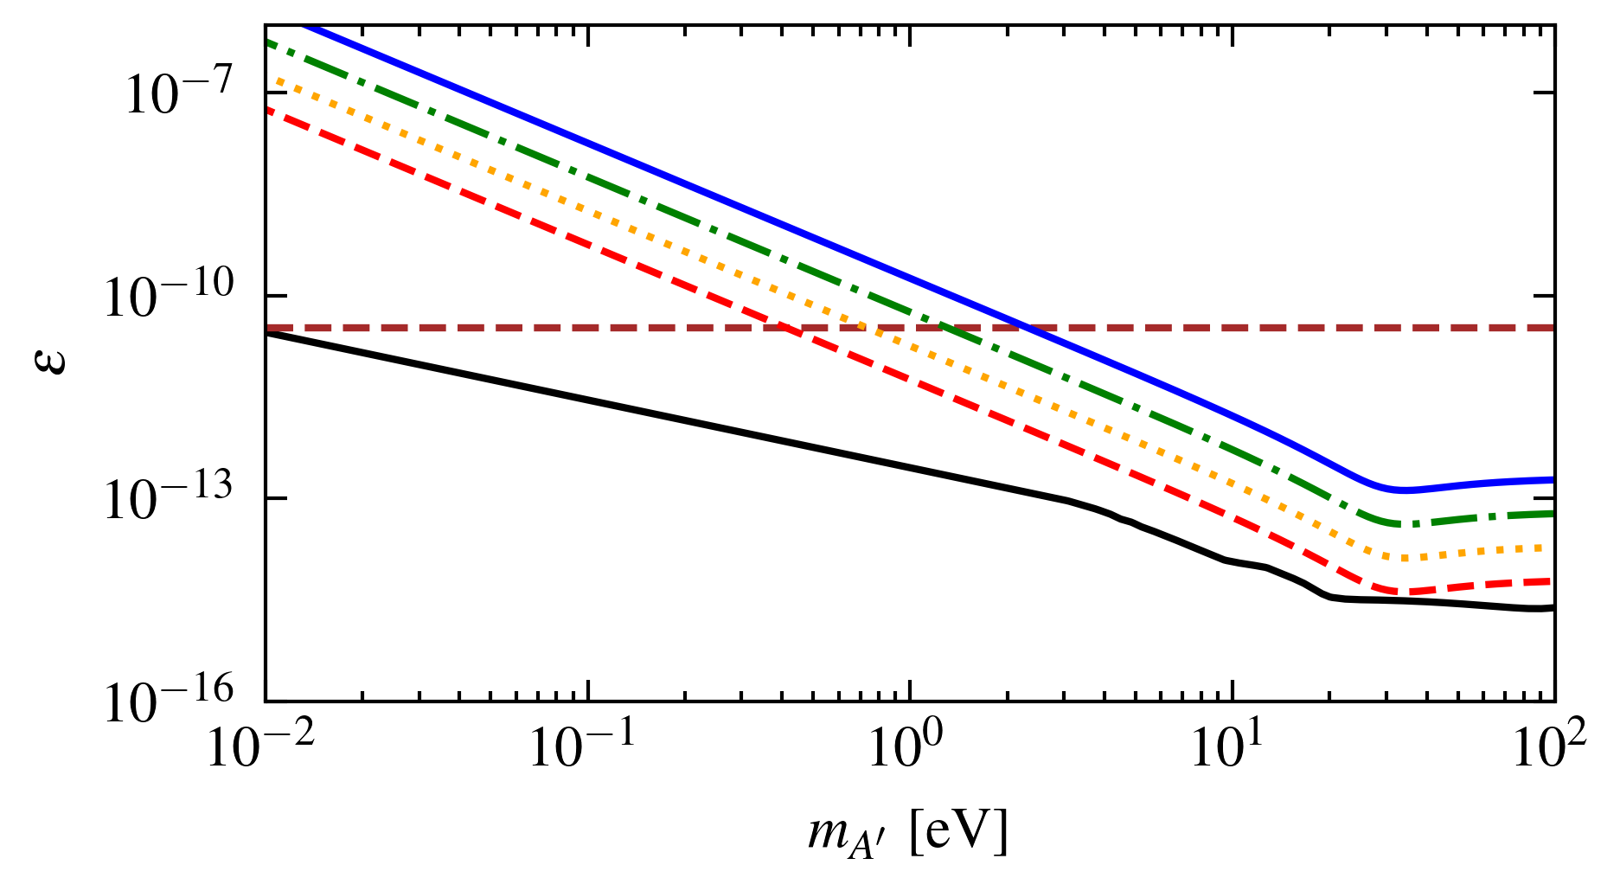
Results –Liquid Xenon/Argon Detectors
Liquid Xenon
Liquid Argon
$$f_{i}=0.1 ;m_{χ}=1 keV$$

Slide 13
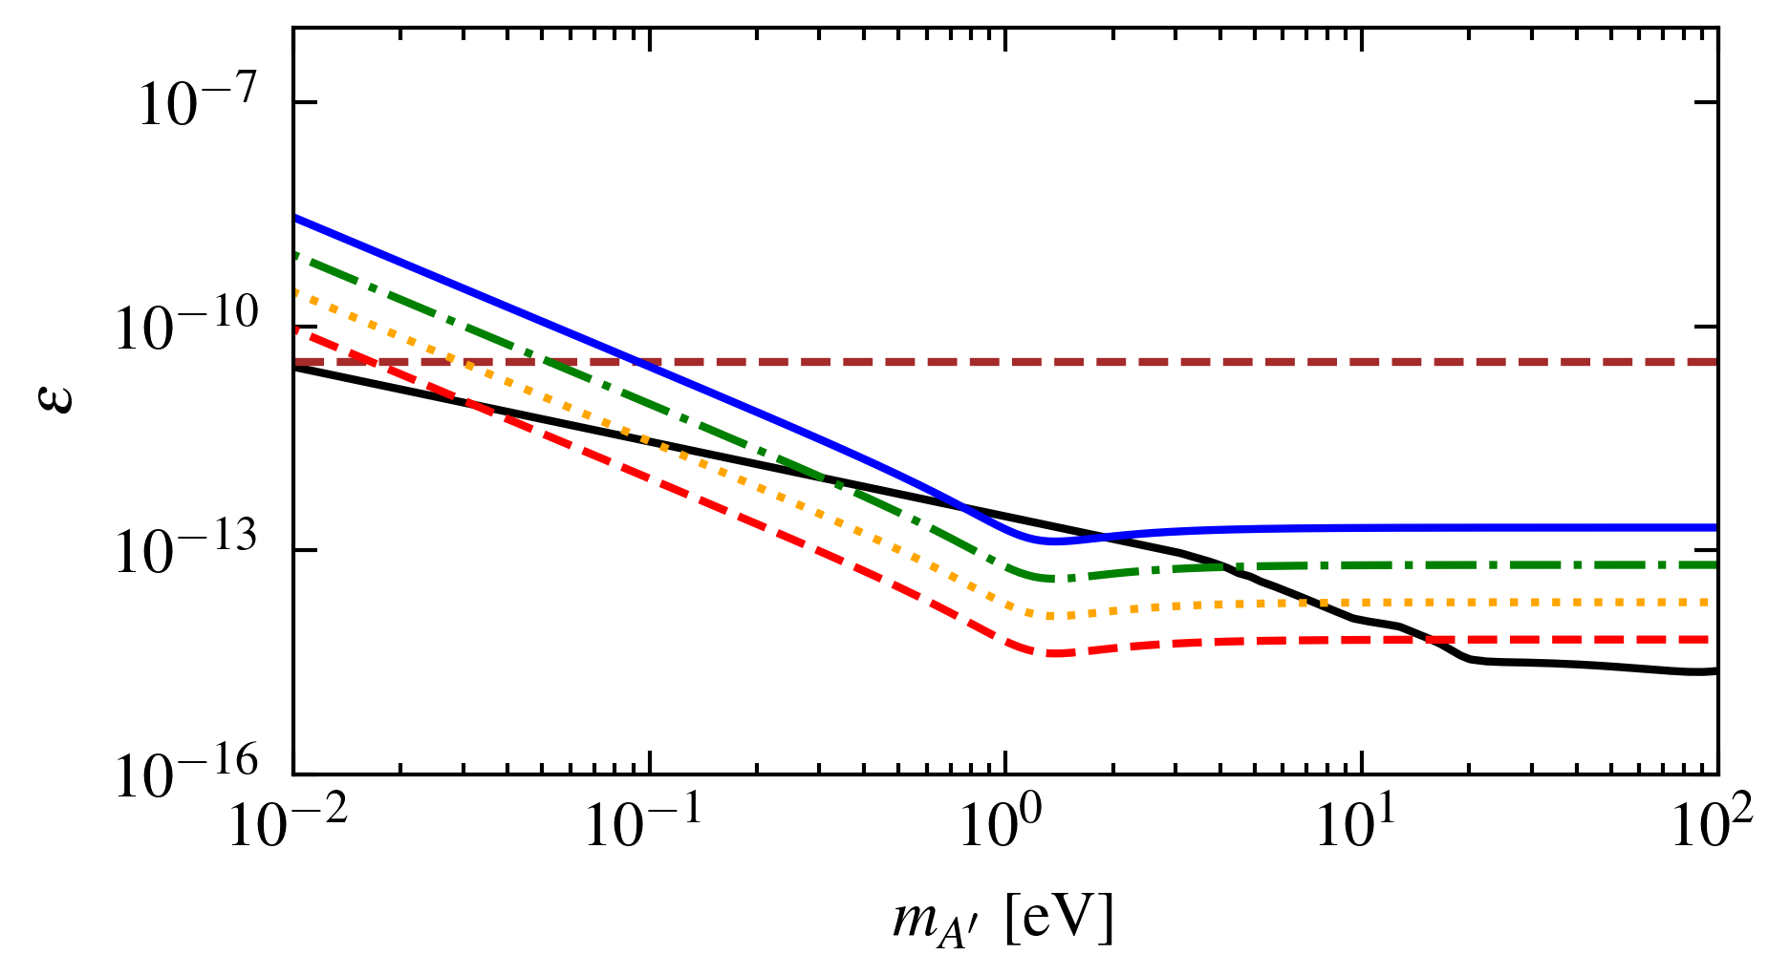
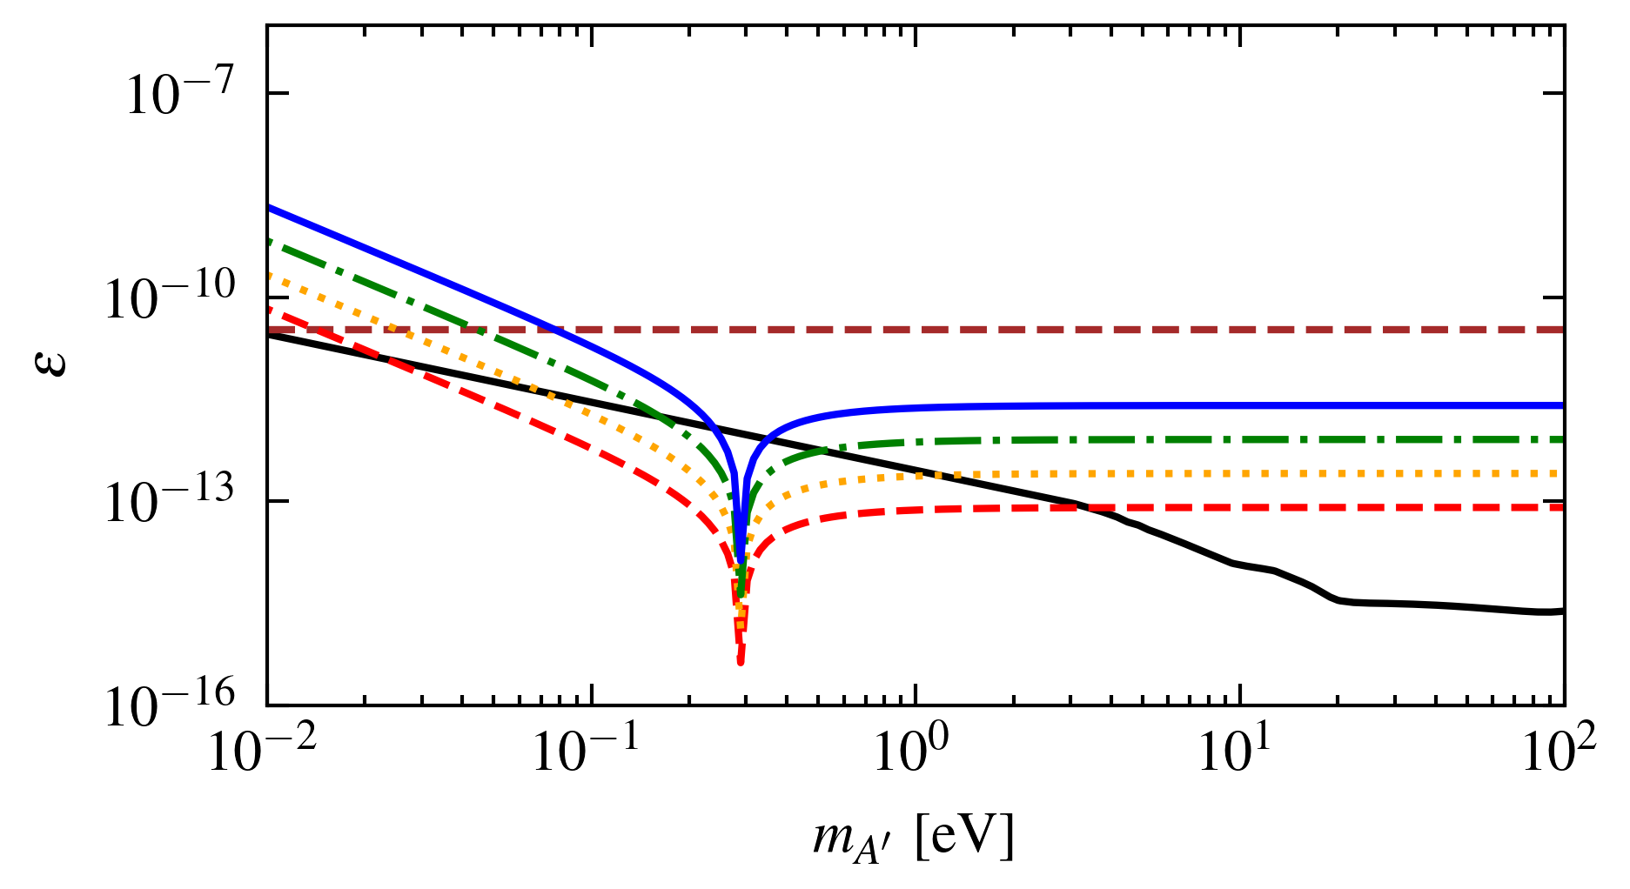
Results –Gaseous Detectors
Xenon $ρ=5 kg m^{−3}$
Helium $ρ=0.2 kg m^{−3}$
$$f_{i}=0.1 ;m_{χ}=1 keV$$

Slide 14
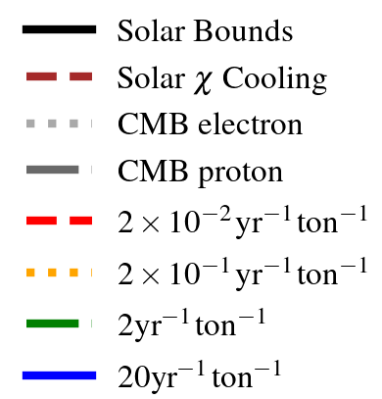
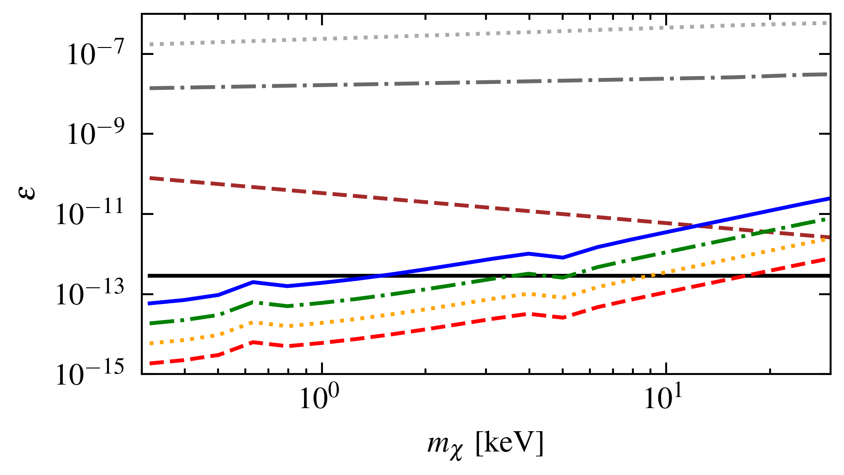
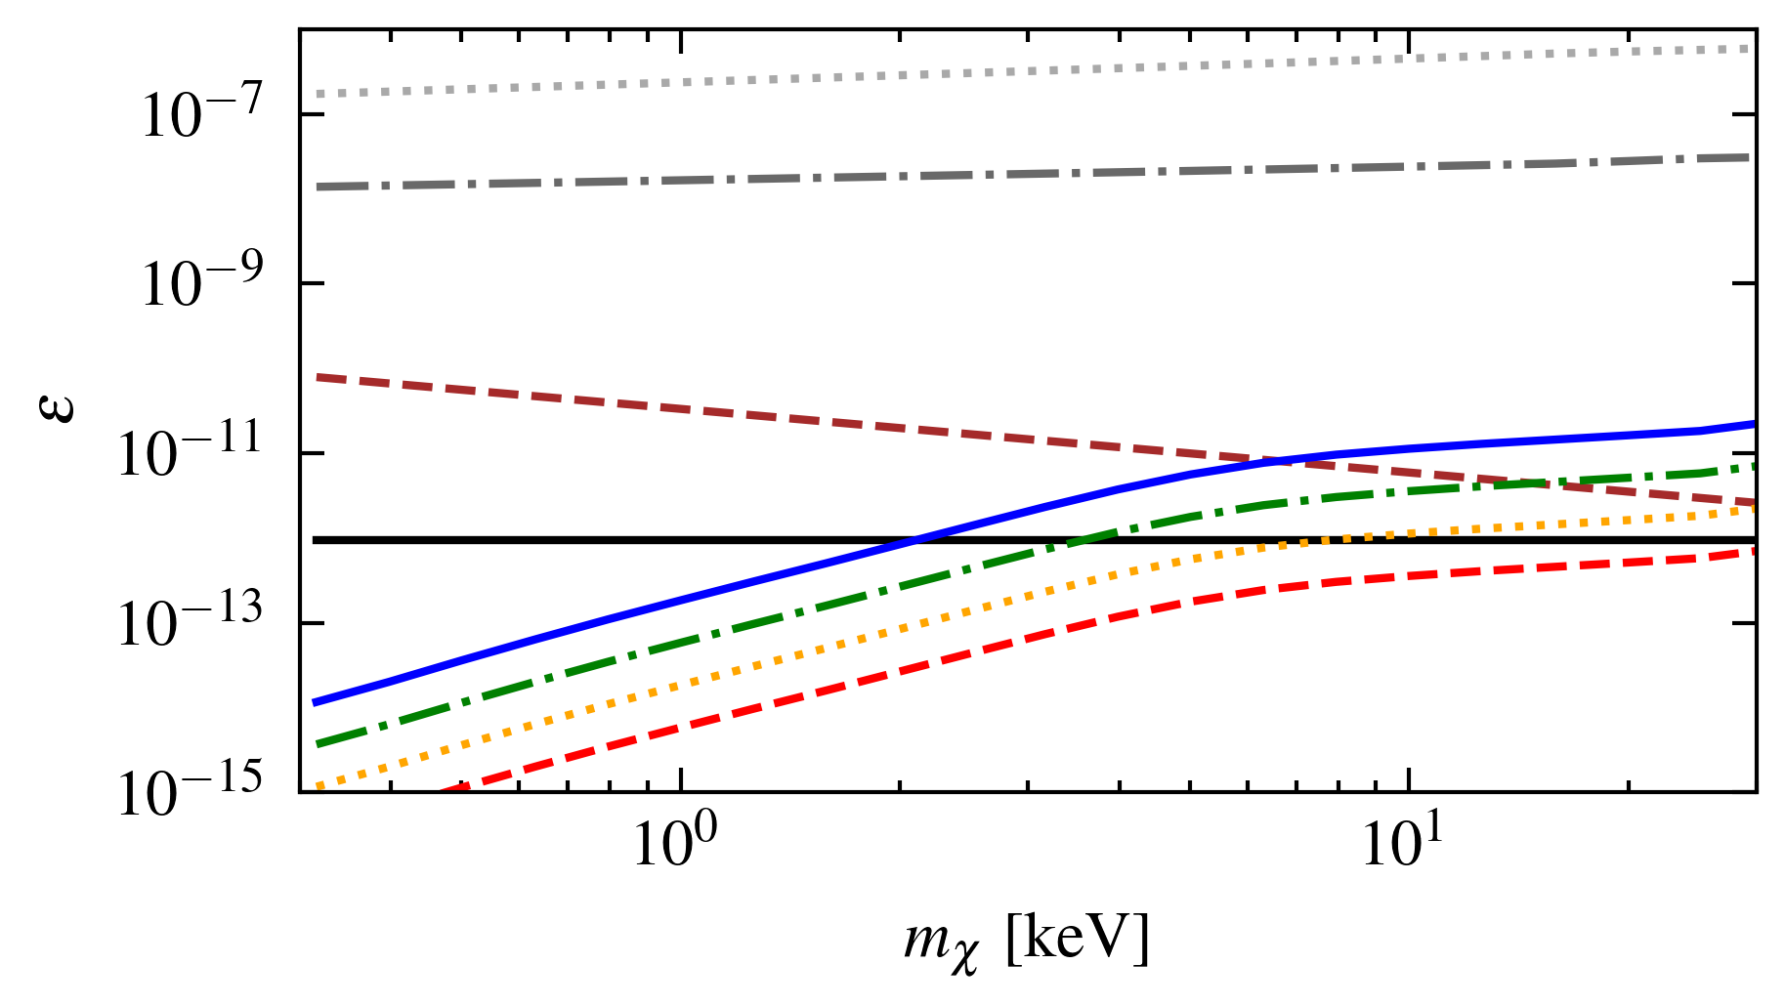
Results – Gaseous Detectors
Xenon $ρ=5 kg m^{−3}$, $m_{A′}=1eV$
Helium $ρ=0.2 kg m^{−3}$, $m_{A′}=0.3eV$
$$f_{i}=0.1$$

Slide 15
Conclusion
Here, we explore the indirect detection of keV dark matter annihilating into dark photons with an optimized annihilation cross section.
Future detectors can search for this signal if they have the following properties
Large Volumes and Low Densities
Gaseous detectors have less suppression from in-medium effects
Low Energy Thresholds and Good Energy Resolution
The signal will be a mono-energetic peak at the dark matter mass.
Good Spatial Resolution
Dark photons can interact anywhere within the detector, while most x-ray background will be on the detector edges

Slide 16
Thank You!

Slide 17
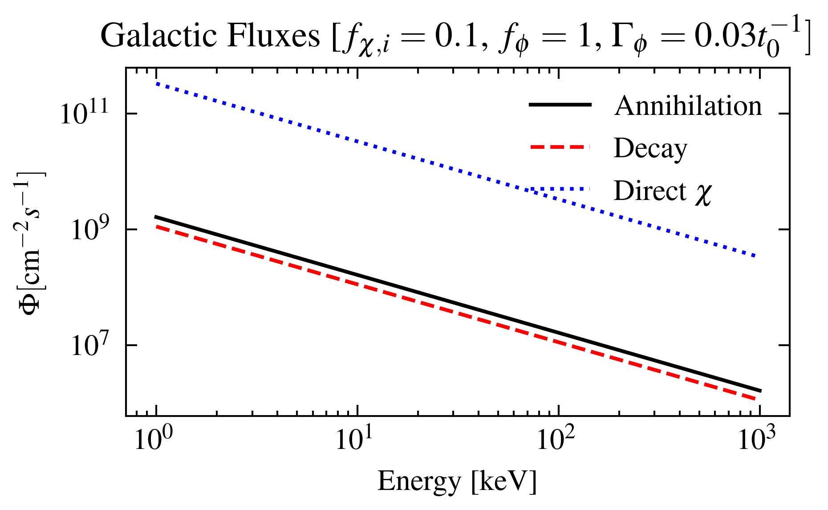
Bonus Slide – Decaying Dark Matter
An alternative model dark matter model could be a scalar $φ$ which decays into DPs
$$φ→A^{′}A′$$
This could produce a flux of similar magnitude to the annihilating case.

Slide 18
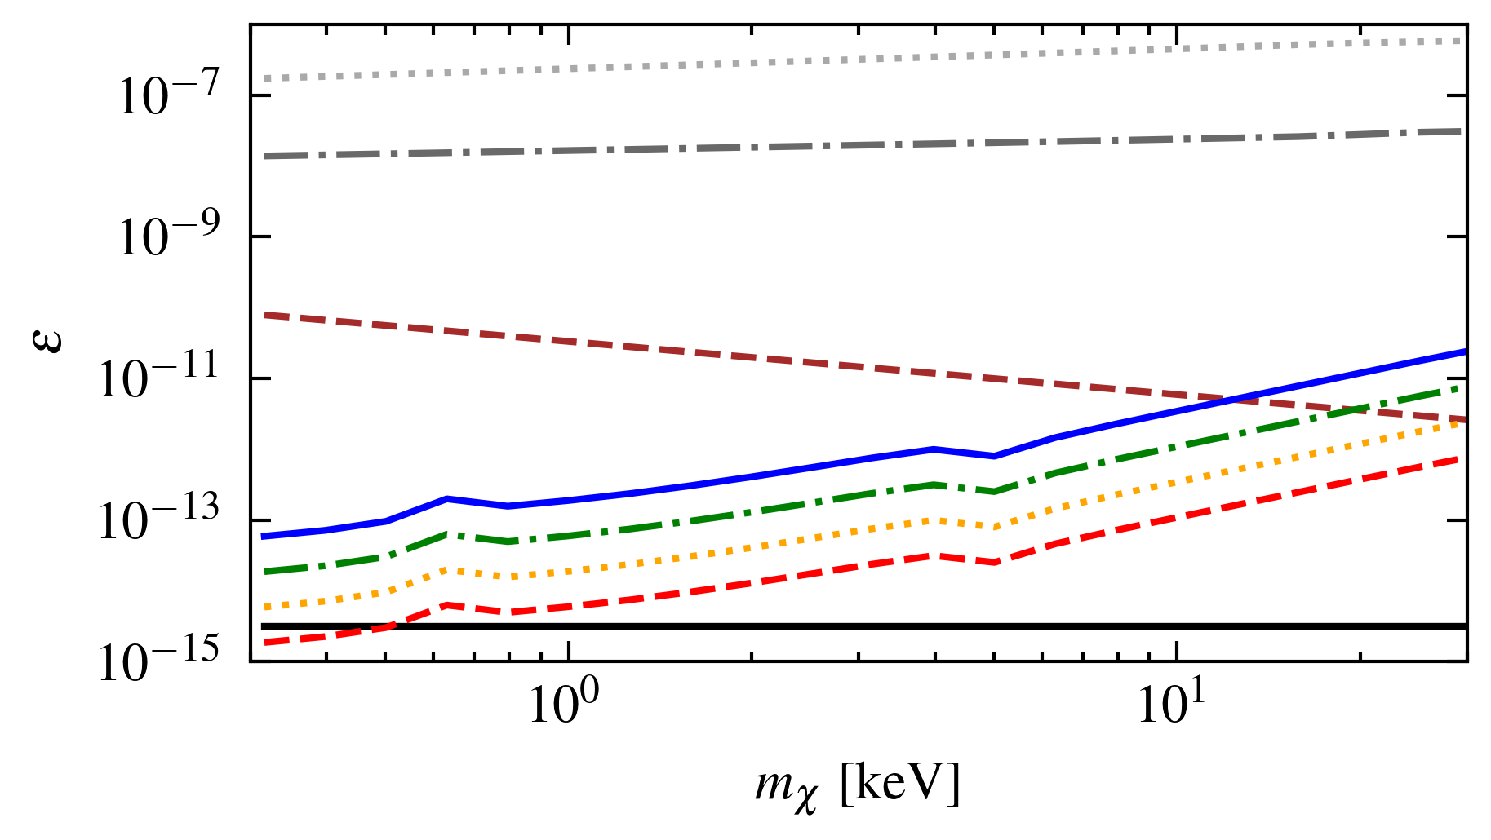
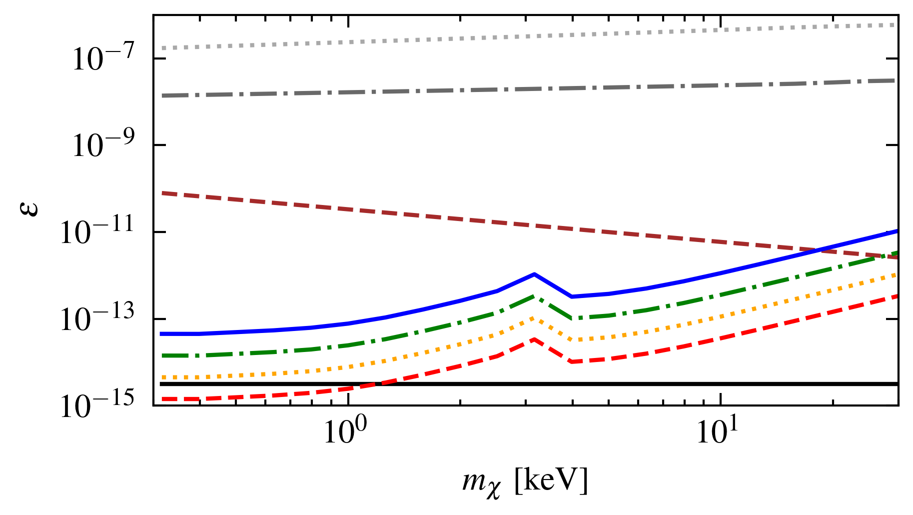
Results – Liquid Xenon/Argon Detectors
Liquid Xenon
Liquid Argon
$$f_{i}=0.1 ;m_{A′}=25 eV$$

