Slide 1
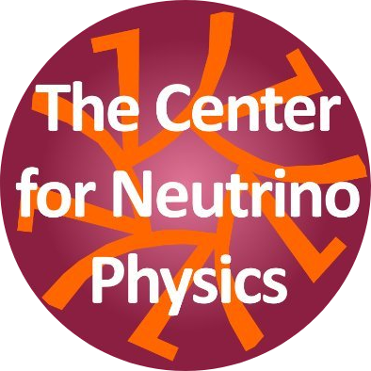
Probing Sterile Neutrinos in Supernovae
Garv Chauhan
Center for Neutrino Physics, Department of Physics, Virginia Tech
Based on arXiv : 2309.08560, 2312.abcde (in preparation)
Work with S. Horiuchi, P. Huber, I. M. Shoemaker
CNP Research Day
Dec 8, 2023

Slide 2
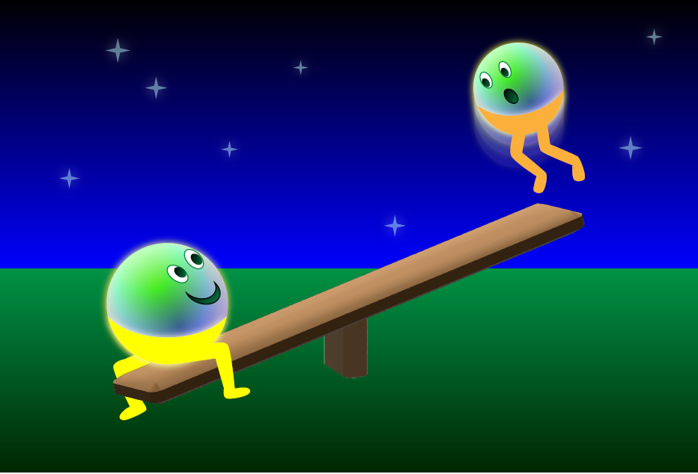
Neutrino Masses

Slide 3
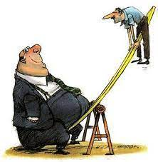
Sterile Neutrinos

Slide 4
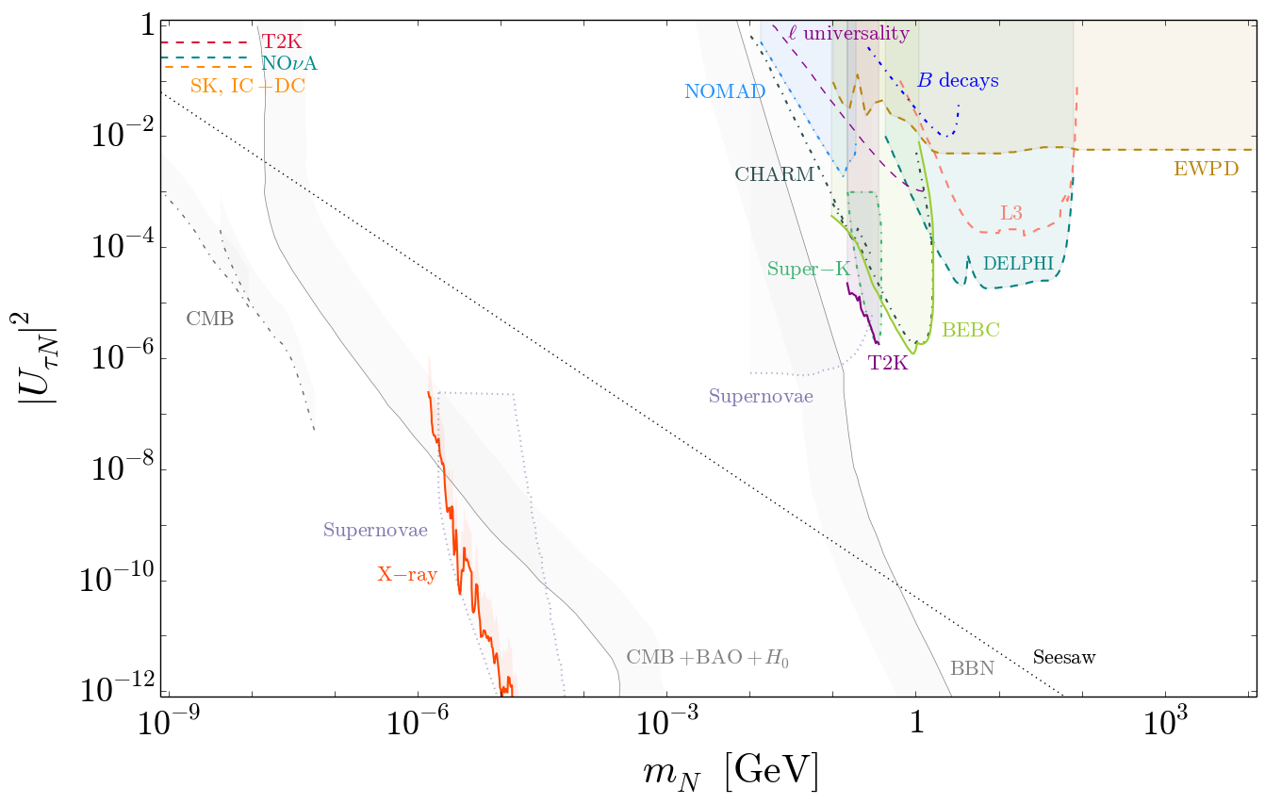
[Bolton, Deppisch, Dev (JHEP ’20)][Atre, Han, Pascoli, Zhang (JHEP ’09); Deppisch, Dev, Pilaftsis (NJP ’15); de Gouvea, Kobach (PRD ’16); Drewes, Garbrecht (NPB ’17)]

Slide 5
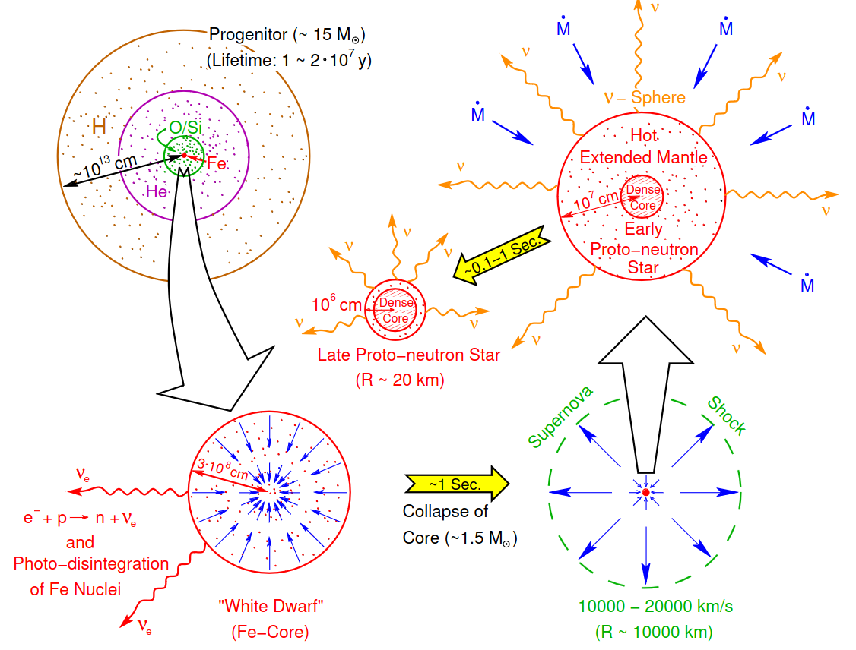
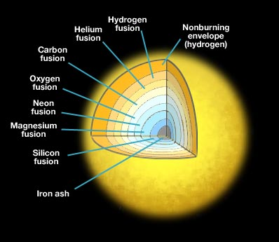
Supernova : factory
Core-collapse supernovae represent the most powerful sources of neutrinos in the Universe.
during the explosion, (anti)neutrinos of all the flavors are emitted with average E ∼ 15 MeV.
Can be used to probe fundamental properties of neutrinos and even …..
emission of exotic BSM particles!
[Burrows, 1990b]

Slide 6
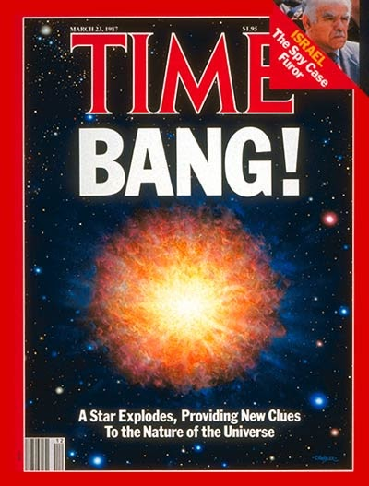
Energy Loss SN1987A
Light BSM particles produced in the SN core would constitute a novel channel of energy loss, shortening the duration of the neutrino burst.
SN 1987A neutrino signal ∼ 10 s, as expected from standard SN cooling scenario, excludes an additional energy drain associated with exotic particles
Constrain sterile states mixing with the active ones.
typical temperature T ∼ 30 MeV in the SN core, heavy sterile neutrinos might still be produced by the mixing with the active ones, suffering only a moderate suppression due to the Boltzmann factor.
[Janka 1702.08713, Raffelt ]

Slide 7
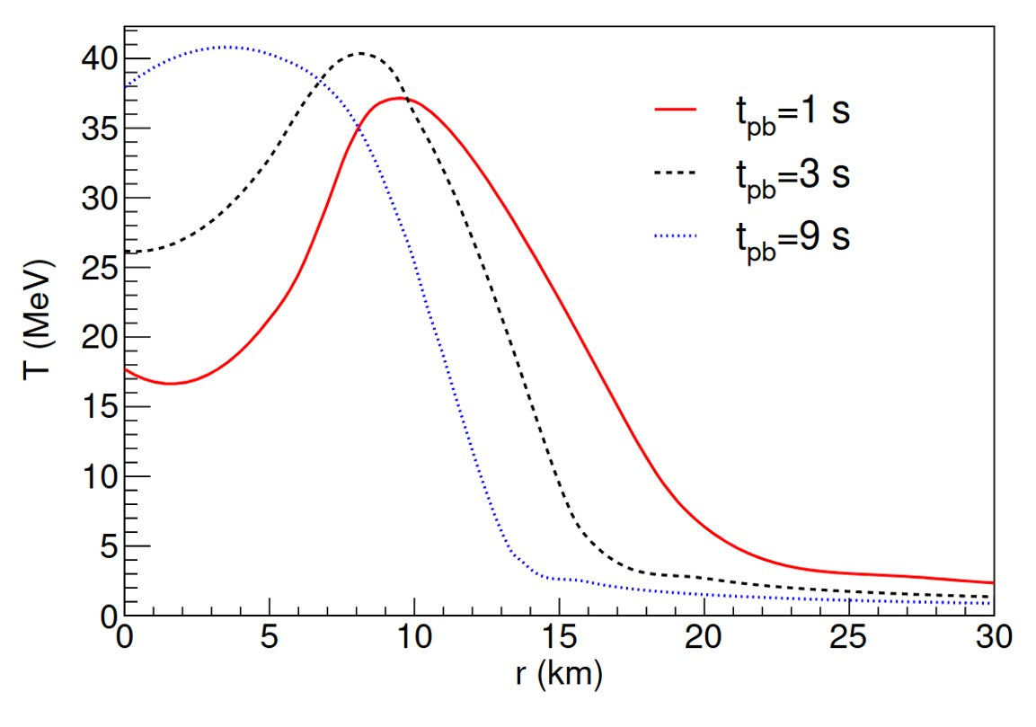
Energy Loss SN1987A
Observations constrain energy-loss rate per unit mass total luminosity bounds on active-sterile mixing
Raffelt Criterion : Bound applied locally for sterile neutrino production at a characteristic radius.
Integrated Luminosity Criterion : Bound on the total energy carried away by all sterile neutrinos produced at all radii
Mastrotaro, Mirizzi, Serpico, Esmaili JCAP 01 (2020)

Slide 8
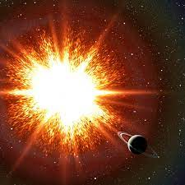
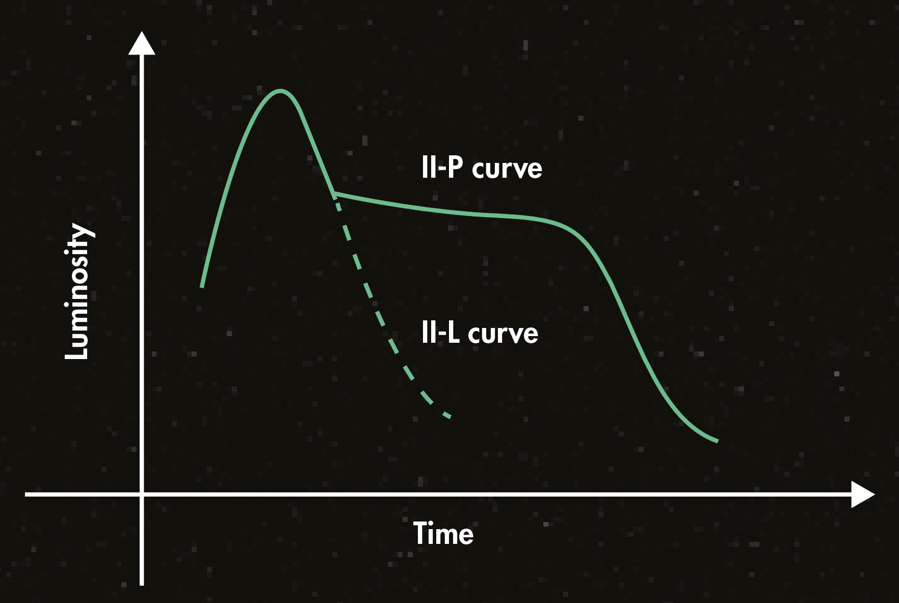
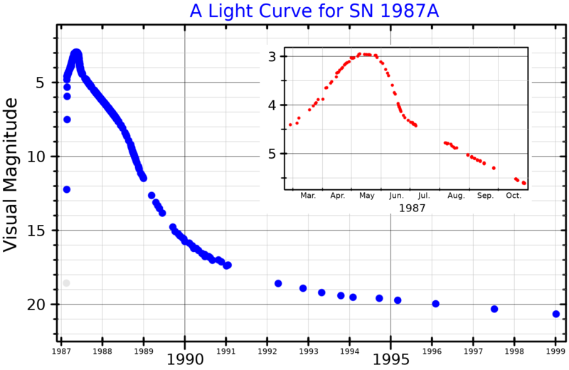
Low-energy SN : IIP or not IIP
There is a separate class of core-collapse SN with low-explosion energies : underluminous SN IIP
Based on the presence of characteristic plateau shape in their light curves , are termed SN IIP.
The brightness and duration of the plateau is determined mainly by the explosion energy, ejecta mass, nickel mass and progenitor radius.
Therefore, the explosion energy can be inferred given the spectrum and the light curves.

Slide 9
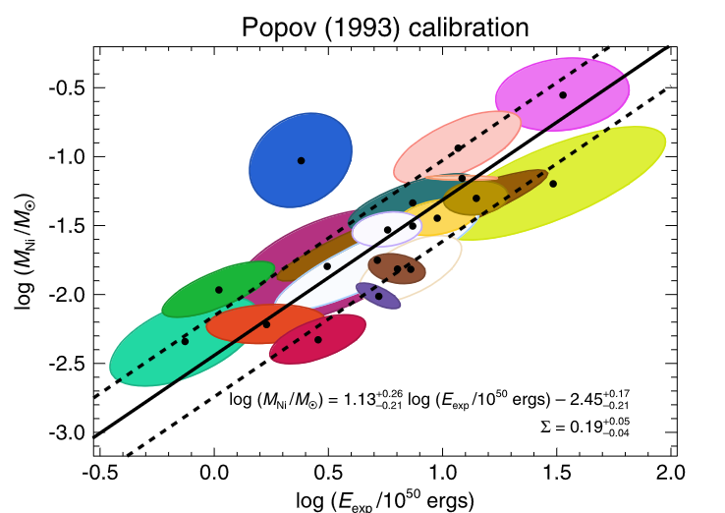
Low-energy SN
(Pejcha:2015 ,Muller:2017) use the fitting formulae and statistical inference along with quantifying the uncertainties, to infer the most likely explosion energy.
The inferred explosion energy ranges from
These reconstructed energies are in good agreement with expectations from the simulated low-energy SN.
But the sterile neutrinos produced in the core can deposit energies of a similar magnitude, and hence can be constrained from the observations of these low-energy SN
Muller,Prieto,Pejcha,Clocchiatti Astrophys.J. 841 (2017), Murphy,Mabanta,Dolence MNRAS 489(2019)
Caputo, Janka, Raffelt, Vitagliano PRL 128(2022)

Slide 10
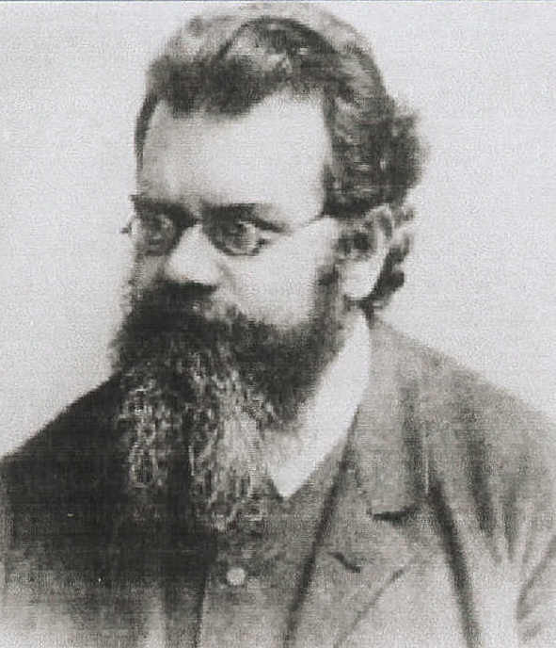
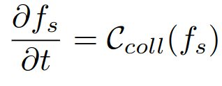
Boltzmann Transport
The evolution of sterile neutrino abundances is governed by the Boltzmann transport equation.
Assuming the medium is homogeneous and isotropic. This implies that the change in phase-space density will only be affected by the scatterings/pair-annihilation processes in the SN core.
Mastrotaro, Mirizzi, Serpico, Esmaili JCAP 01 (2020)

Slide 11
Energy Deposition
The sterile neutrino produced in SN core, decays outside the core but inside the mantle region, depositing energy into the SN envelope.
Caputo, Janka, Raffelt, Vitagliano PRL 128(2022)
For reference model, we use Garching group's SFHo-18.8 muonic model.
Peak Temps. : 30-40 MeV
Final NS mass :
Mirizzi, Tamborra, Janka, Saviano, Scholberg, Bollig RNC 39(2016), Bollig,Janka,Lohs,PInedo,Horowitz,Melson PRL 119(2017)

Slide 12
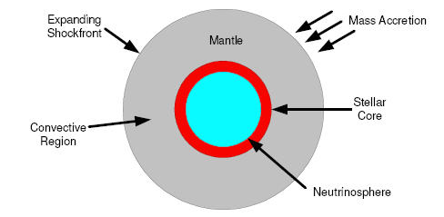
Energy Loss/Deposition
The sterile neutrino produced in SN core, decays outside the core but inside the mantle region, depositing energy into the SN envelope.
GC, Huber, Horiuchi, Shoemaker (arXiv : 2312.abcde)

Slide 13
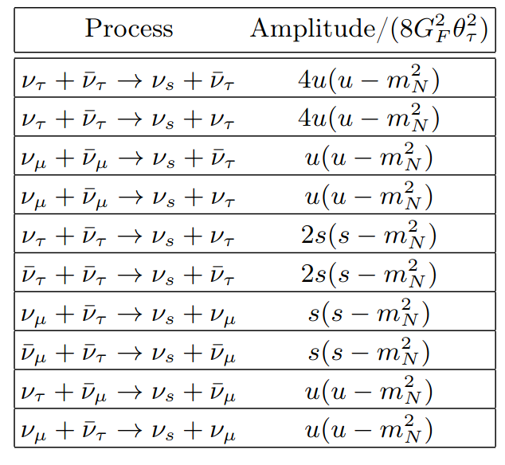
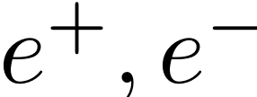
Sterile neutrino production
We assume that the sterile mixes dominantly with one flavor i.e
In a SN core, sterile neutrino can be produced by ddd d or neutrino pair annihilation and the inelastic scattering of (anti-) neutrinos.
But are degenerate in the hot proto-neutron star core,
Pauli-blocking will render pair-annihilation and inelastic scattering on the non-degenerate neutrino species, the dominant processes for sterile production.
Fuller,Kusenko,Petraki PLB 670(2009)

Slide 14
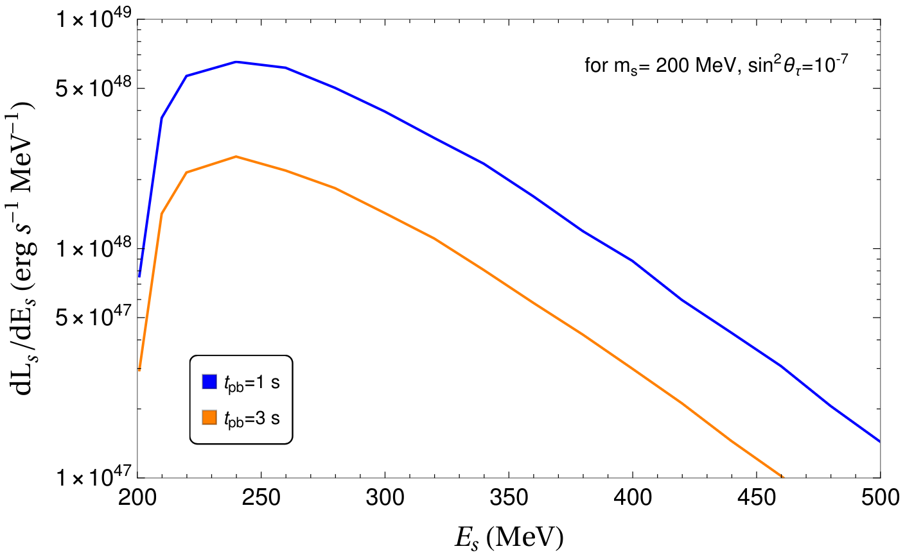
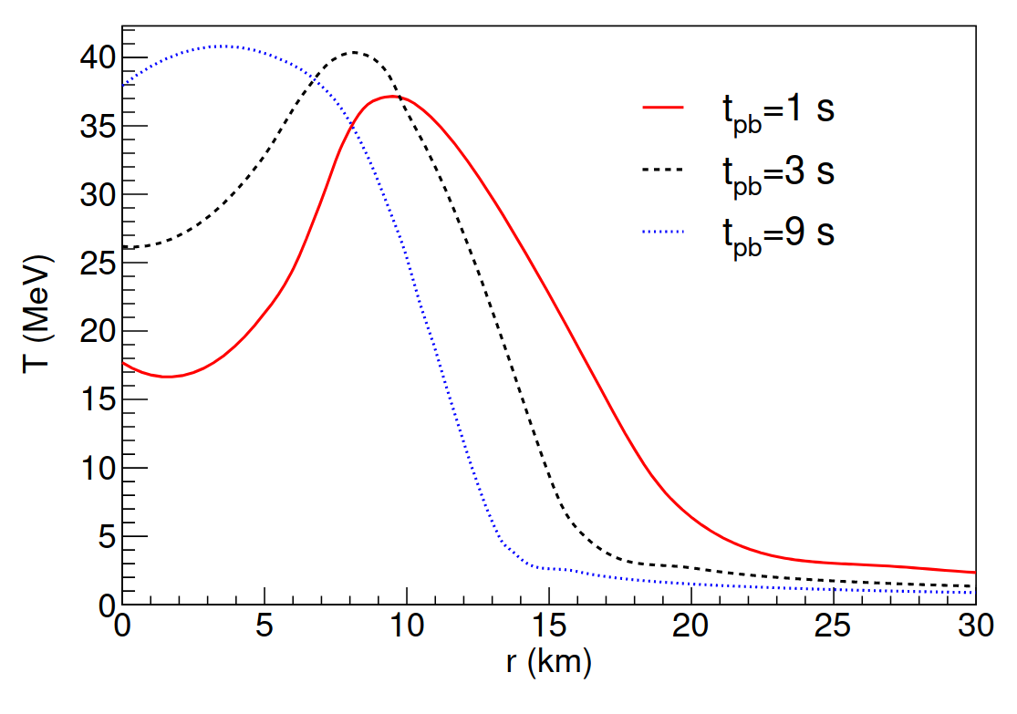
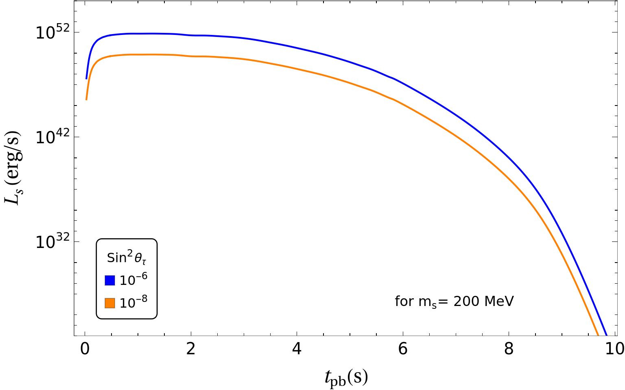
Sterile Production Rate
Mastrotaro, Mirizzi, Serpico, Esmaili JCAP 01 (2020)
GC, Huber, Horiuchi, Shoemaker (arXiv : 2309.08560)

Slide 15
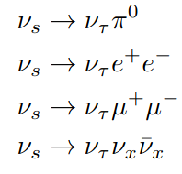
Energy Deposition
For mass range of interest and mixing only with , the charged-current processes are kinematically forbidden.
Only the visible decay modes deposit their energy, determined by
Atre,Han,Pascoli, Zhang JHEP 05(2009), Gorbunov,Shaposhnikov JHEP 10(2007)

Slide 16
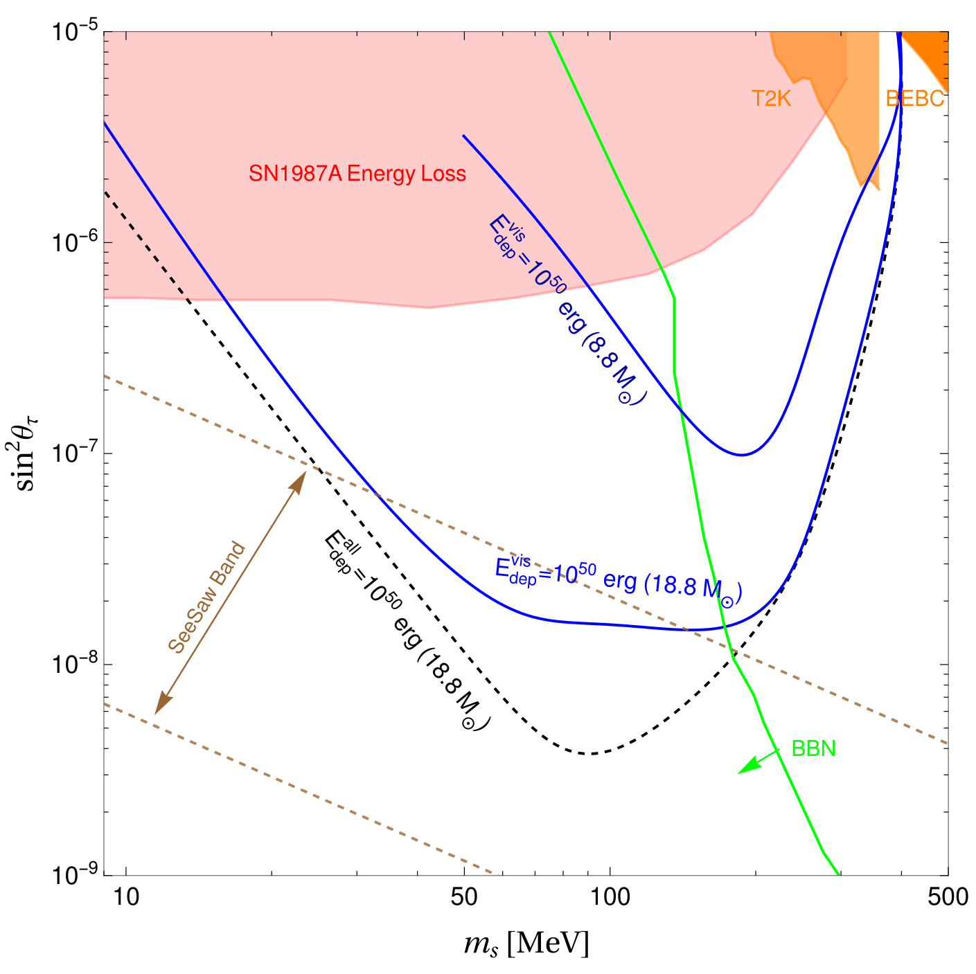
Result : Mass Mixing
GC, Huber, Horiuchi, Shoemaker (arXiv : 2309.08560)

Slide 17
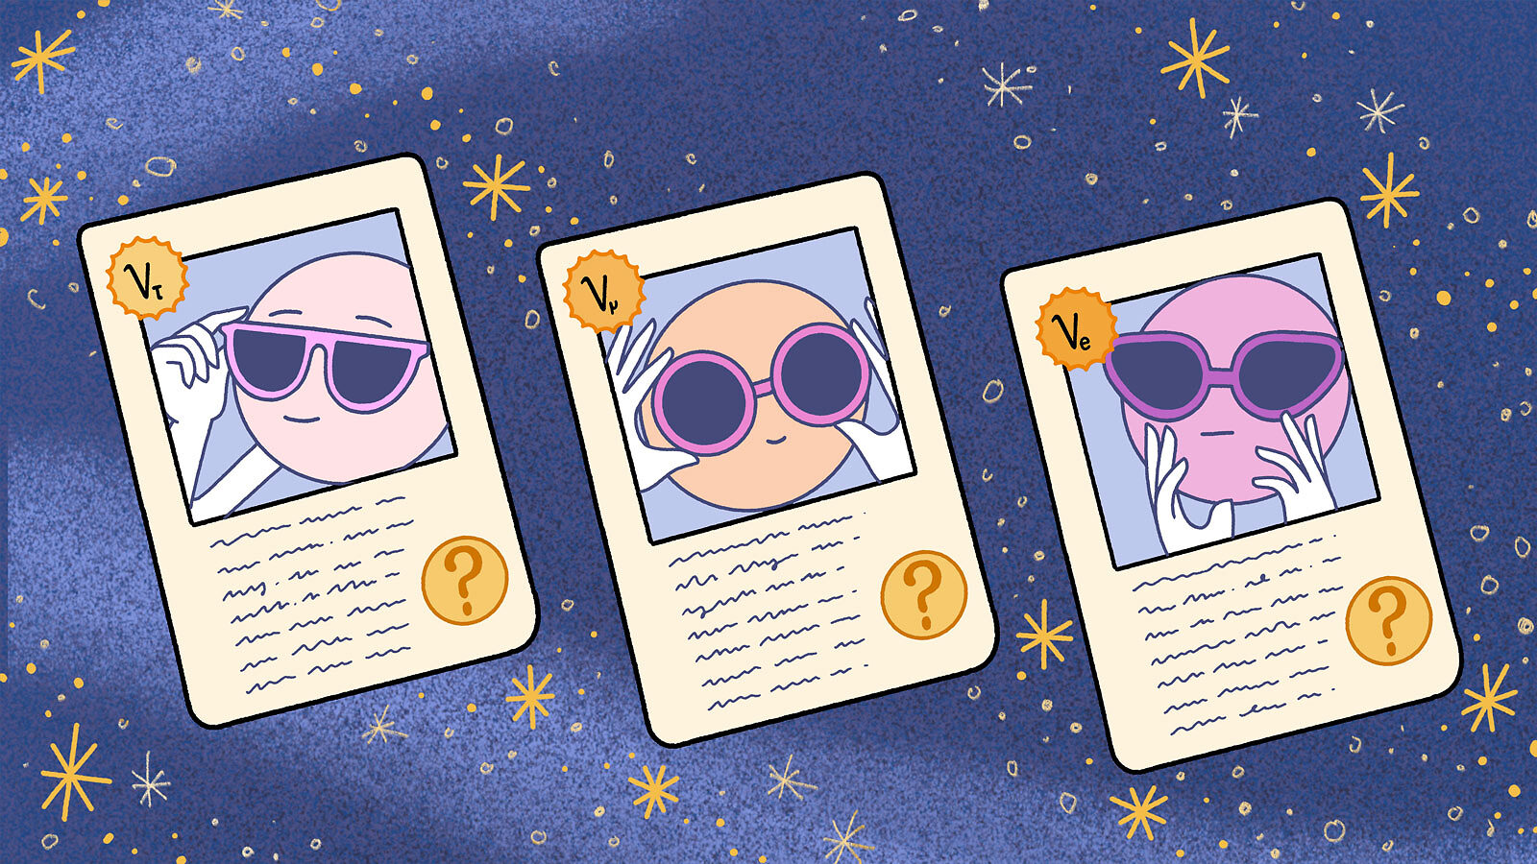
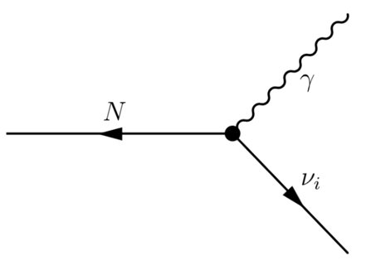
Dipole Portal
Sterile neutrinos might couple to SM through higher dimensional operator.
Might affect the electromagnetic properties of neutrino.
We study next most important operator called the "Dipole Portal"
We will be assuming flavor independent dipole portal coupling.

Slide 18
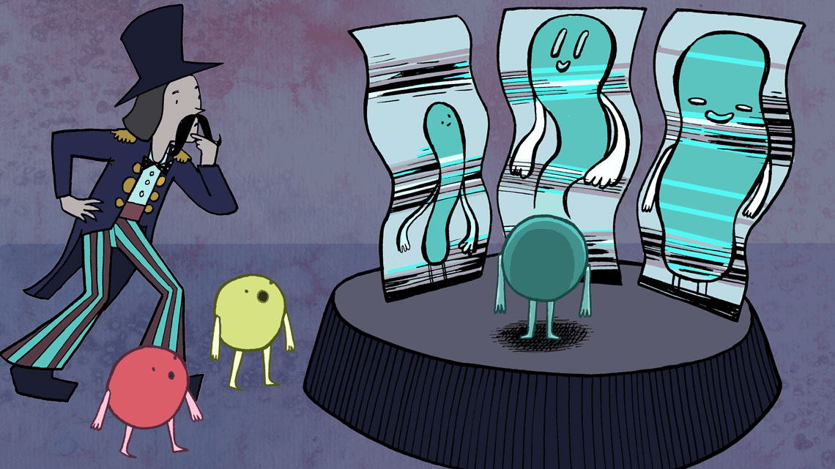
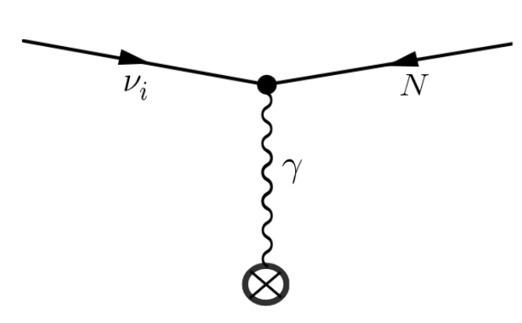
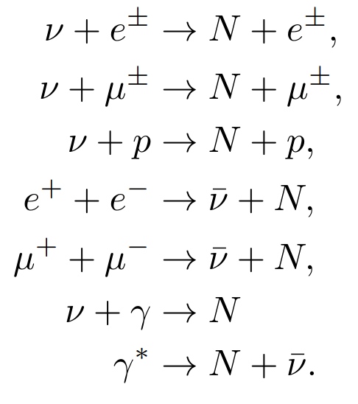
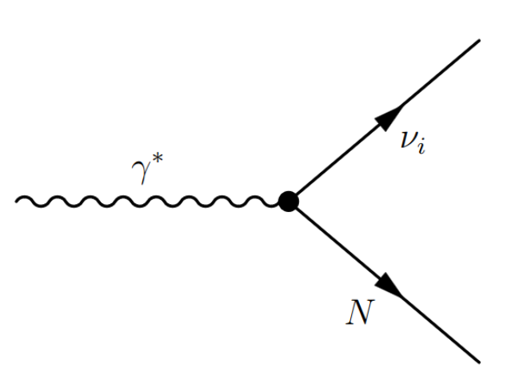
Dipole Portal : production
The following processes are involved in the production :

Slide 19
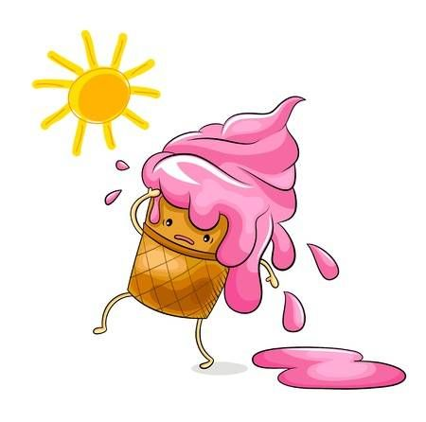
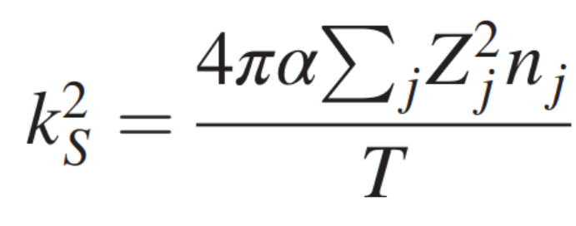
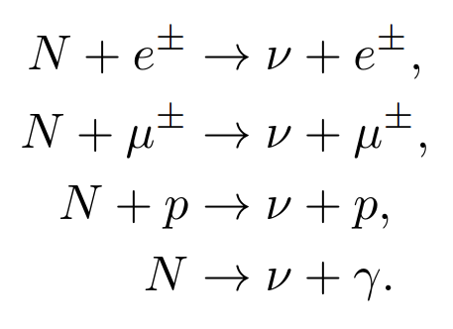
Dipole Portal : decay
Due to forward scattering, there is a singularity in the t-channel processes.
The following processes are involved in the decay :
GC, Huber, Horiuchi, Shoemaker (arXiv : 2312.abcde)

Slide 20
Dipole Portal : Raffelt vs. integrated luminosity
GC, Huber, Horiuchi, Shoemaker (arXiv : 2312.abcde)

Slide 21
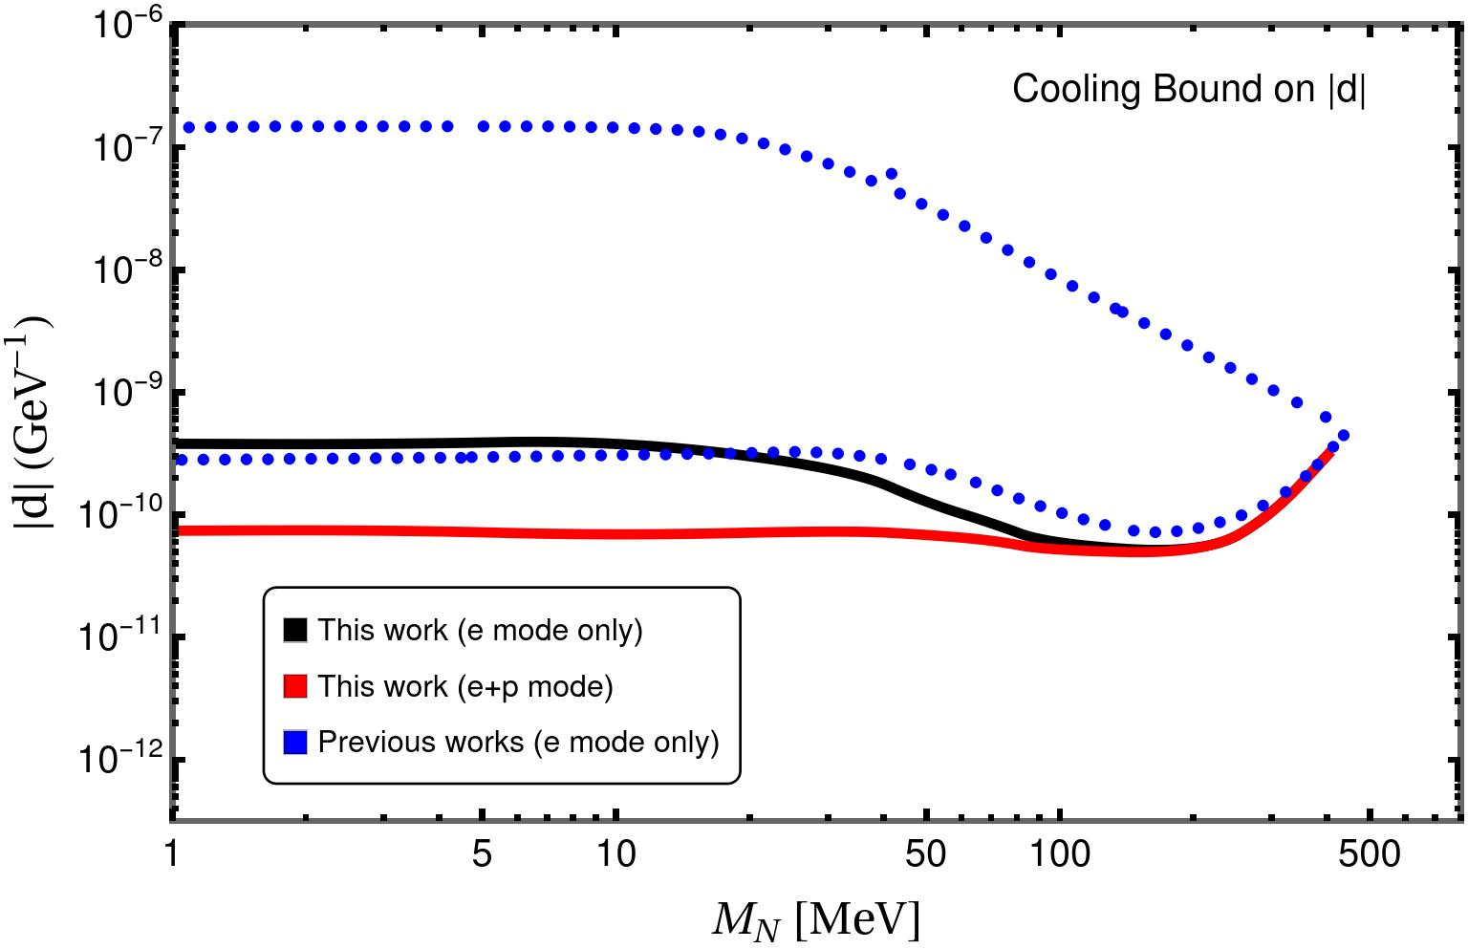
Dipole Portal : proton channel wins!
Contrary to previous literature, we find proton mode to be the most dominant. Two orders of magnitude stronger than scattering off electron.
GC, Huber, Horiuchi, Shoemaker (arXiv : 2312.abcde)

Slide 22
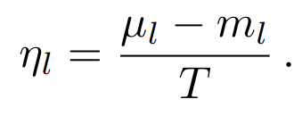
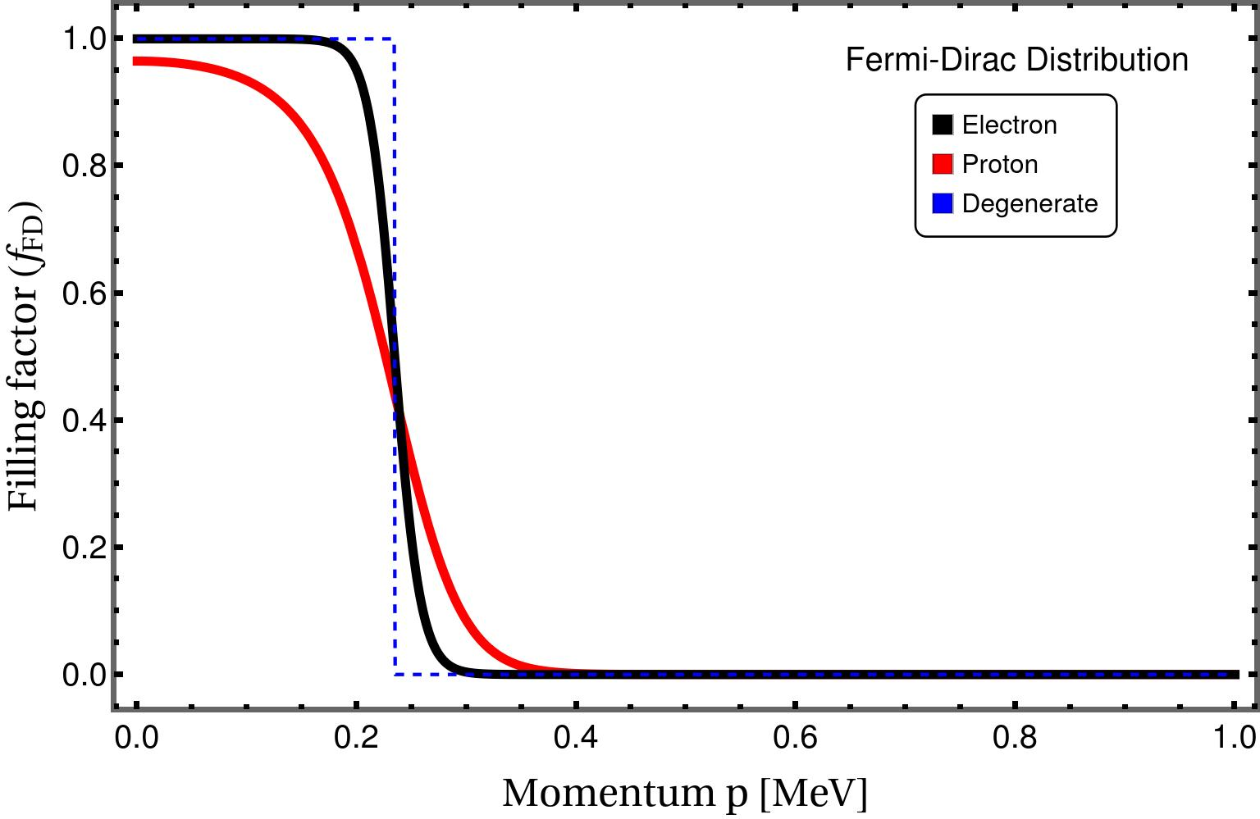
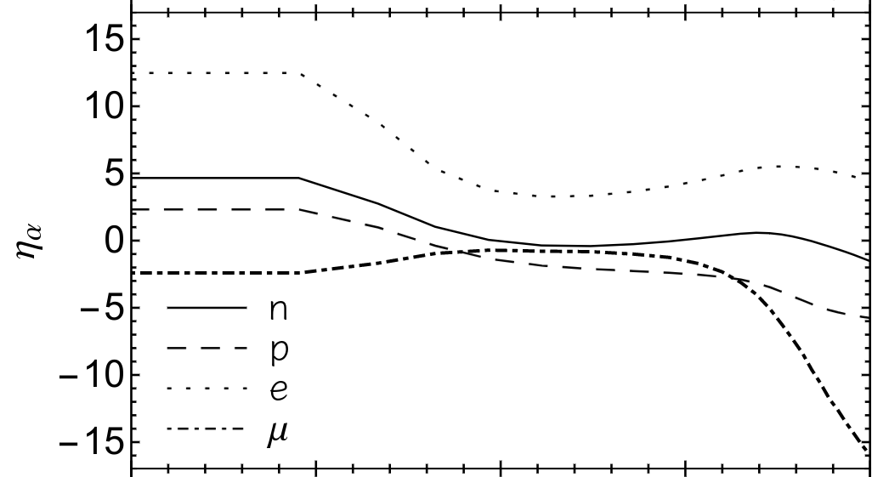
Dipole Portal : Why proton channel?
Contrary to previous literature, we find proton mode to be the most dominant. Two orders of magnitude stronger than scattering off electron.
GC, Huber, Horiuchi, Shoemaker (arXiv : 2312.abcde)

Slide 23
Dipole Portal : Final Result
GC, Huber, Horiuchi, Shoemaker (arXiv : 2312.abcde)

Slide 24
Summary
Usually energy loss argument from the observations of SN198A is used to constrain new physics.
Sterile neutrinos produced in core-collapse SNe can also deposit energy through their decays inside the SN envelope.
This energy deposition constrained from the observed SN IIP population
Leads to 2 orders of magnitude stringent constraints on tau mixing for masses 10-400 MeV
For Dipole portal, we find that underluminous SNIIP can help constrain the transition magnetic moment by an order of magnitude (conservatively!).
We find degeneracy effects for proton as stated previously in literature are absent and can help place even stronger bounds!
Thus, SN physics can continue to be a powerful tool to test new physics beyond SN1987A!

Slide 25
Thank you !

Slide 26
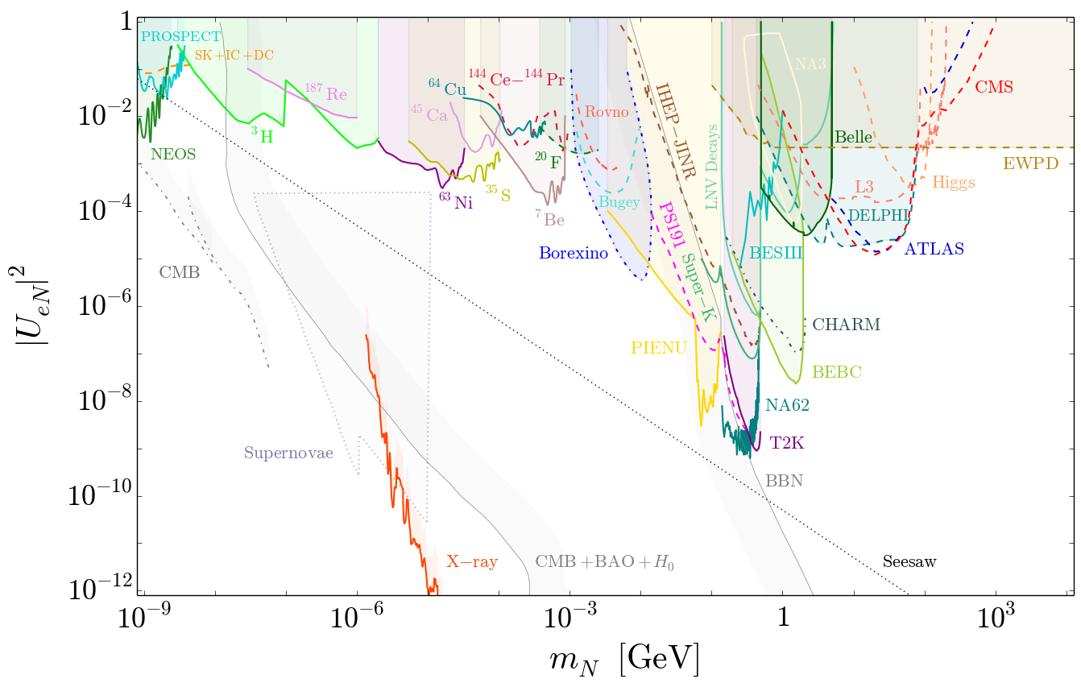
[Bolton, Deppisch, Dev (JHEP ’20)][Atre, Han, Pascoli, Zhang (JHEP ’09); Deppisch, Dev, Pilaftsis (NJP ’15); de Gouvea, Kobach (PRD ’16); Drewes, Garbrecht (NPB ’17)]

Slide 27
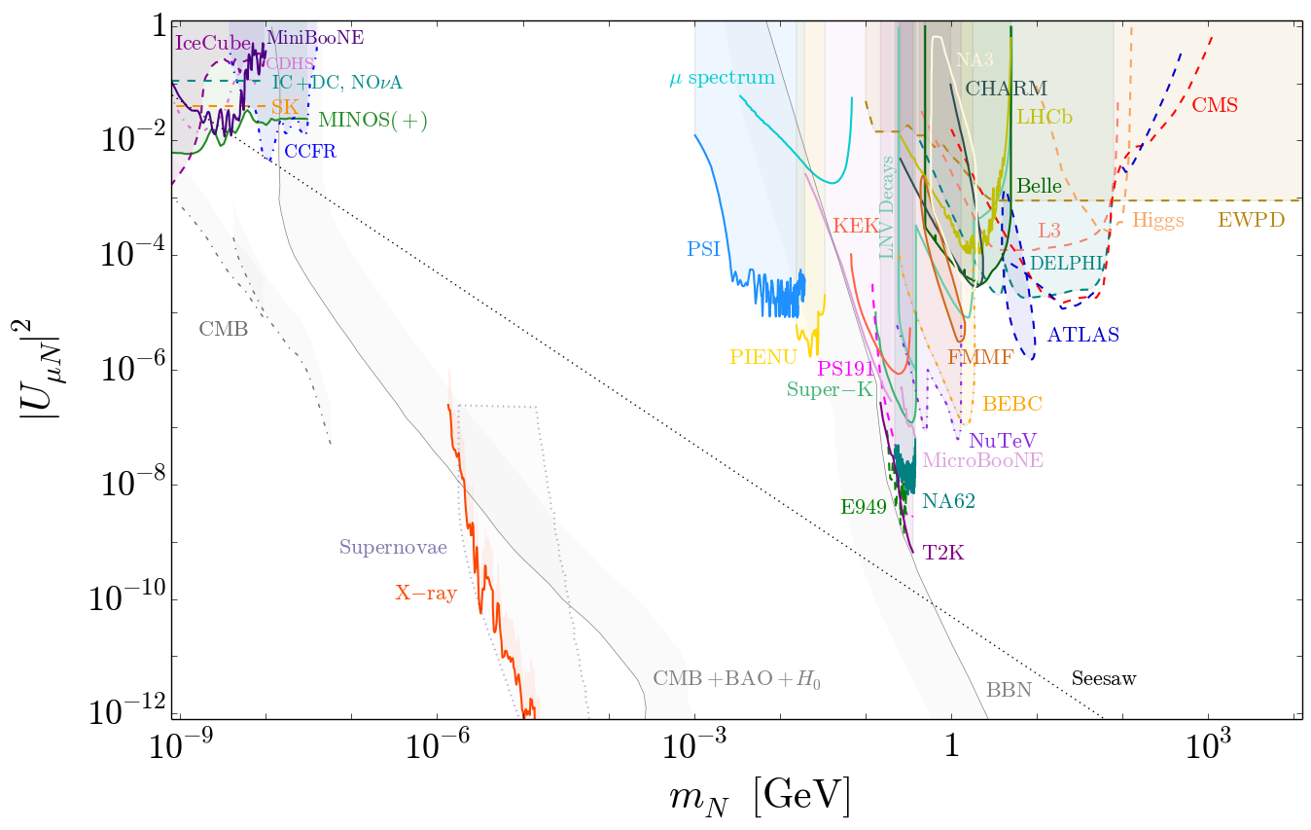
[Bolton, Deppisch, Dev (JHEP ’20)][Atre, Han, Pascoli, Zhang (JHEP ’09); Deppisch, Dev, Pilaftsis (NJP ’15); de Gouvea, Kobach (PRD ’16); Drewes, Garbrecht (NPB ’17)]

Slide 28
Secondary Neutrino Energies
For sterile masses above pion threshold, the decays are dominated by the pion mode, for which average secondary neutrino energy in COM frame is 54 MeV. For mixing angles of interest, such steriles decay far inside the envelope.
For sterile masses below the pion threshold, the decays are dominated by the 3-neutrino mode, with average neutrino energy 80 MeV. Such energetic neutrinos would have been trapped if produced near the core but for lighter steriles ( and relevant mixings), the average decay length is far outside the SN. Hence, a major portion of the neutrino energy will not be deposited and hence considering this channel as "invisible" is a good approximation.
From the above discussion, we can conclude that the branching ratio method is a good estimator of the actual energy deposition from sterile neutrino decays.

Slide 29
Ejecta Mass and Explosion Energies
Goldberg,Bildsten,Paxton Astrophys. J 841(2017)

