Slide 1

Separating longitudinal and transverse photon contributions in electroproduction
Harut Avakian (JLab)
  Electroproduction of hadrons in hard scattering
  Challenges in interpretation of exclusive processes
    separation of exclusive hadrons from semi-exclusive hadrons
    separation of transverse photon contributions from longitudinal
  Multiplicities vs Spin asymmetries
  Summary

Slide 2
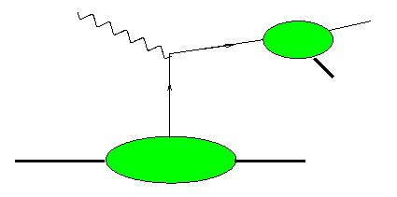
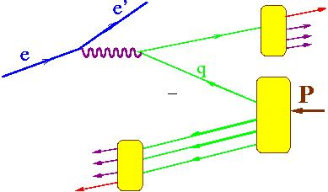
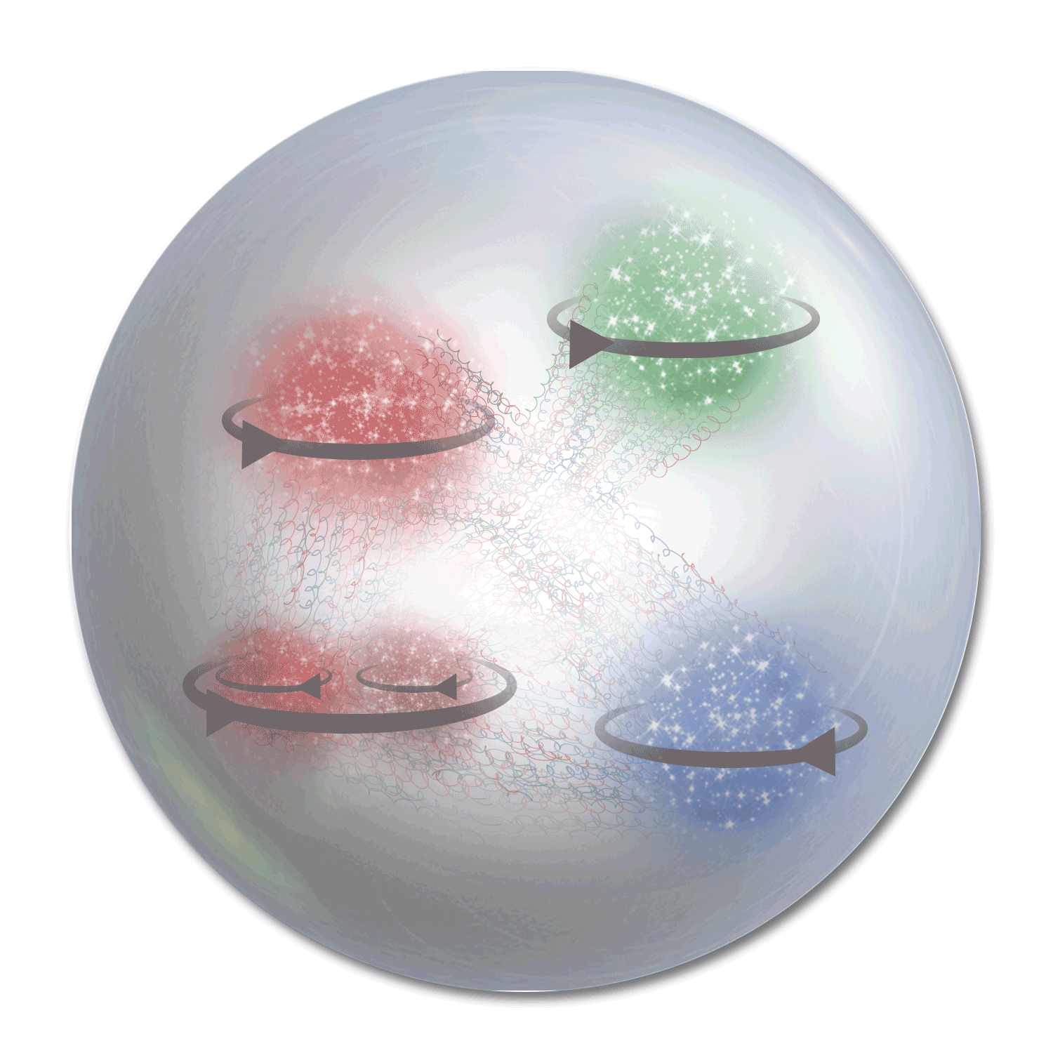
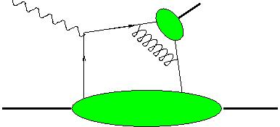


3D PDFs: Electroproduction of hadrons
Study
γ∗_{Τ}
h
Current Fragmentation Region (CFR)
x,Q²,z,P_{T},φ,φ_{S}
~1/Q⁴
TMD-FF
x_{F}>0
N
X
Flavor and polarization dependence of transverse momentum distributions
h
TMD-PDF
γ∗_{L}
DA
π,ρ,Κ.
x,Q²,t,φ,φ_{S} +φ,θ
~1/Q⁶
h
N
N,Δ,Λ,..
Flavor and polarization dependence of transverse space distributions
GPD
x_{F}<0
γ∗_{L/T}
h
Target Fragmentation Region (TFR)
X
N
correlations and entanglement of CFR and TFR, controlling CFR, allowing access to GPDs and GTMDs
N,Δ,Λ,..
Semi-exclusive production (Guo-Yuan)
Different non-perturbative objects may be involved with several independent variables involved
Cross contributions make studies based on a given set of assumptions challenging

Slide 3
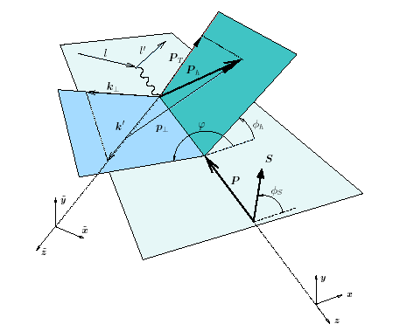
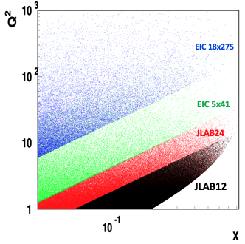




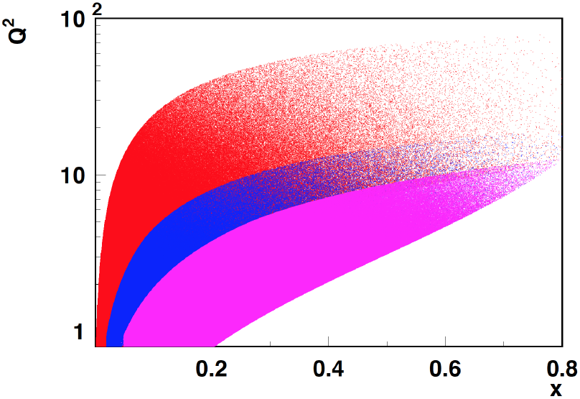
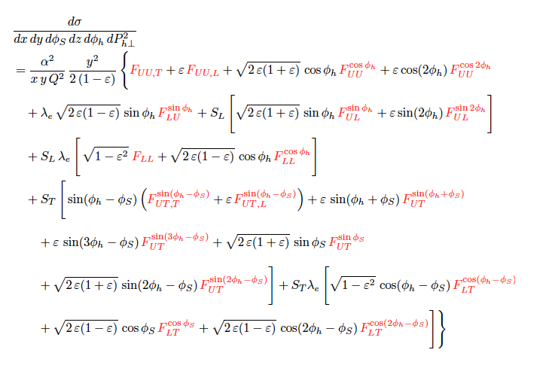
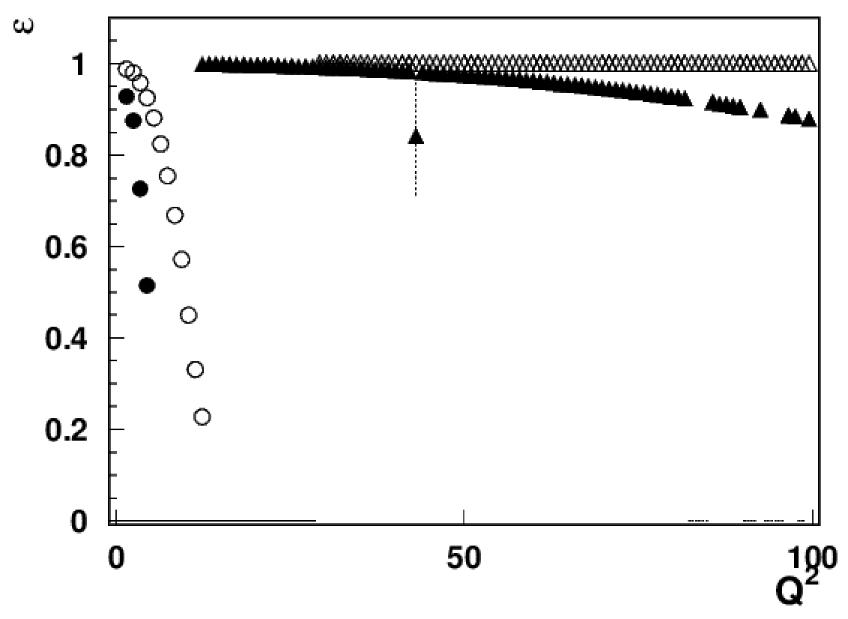
DIS kinematical coverage and observables
ν=E-E’
z=E_{h}/ν
p┴
P_{hT} = p┴ +z k┴
COMPASS
EIC
HERMES/JLab24
JLab12
EIC18x275
EIC5x41
JLab22/HERMES
JLAB12
x=0.3

Slide 4
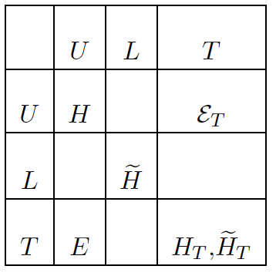
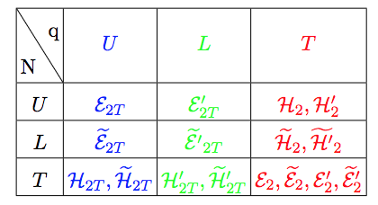

Exclusive hadron production in hard scattering
Twist2 GPDs
polarized quark
x_{F}>0 (current fragmentation)
x_{F} – fractional momentum in the CM frame
h
q’
FSI
x_{F}<0 (target fragmentation)
Twist3 GPDs
M.Constantinou
L
Quark qluon correlations described by higher twist 3D PDFs
Correlations of the spin of the target or/and the momentum and the spin of quarks, combined with final state interactions define the azimuthal distributions of produced particles in exclusive limit
OAM
M.Engelhardt
Lorce&Pasquini, arXiv:1208.3065

Slide 5
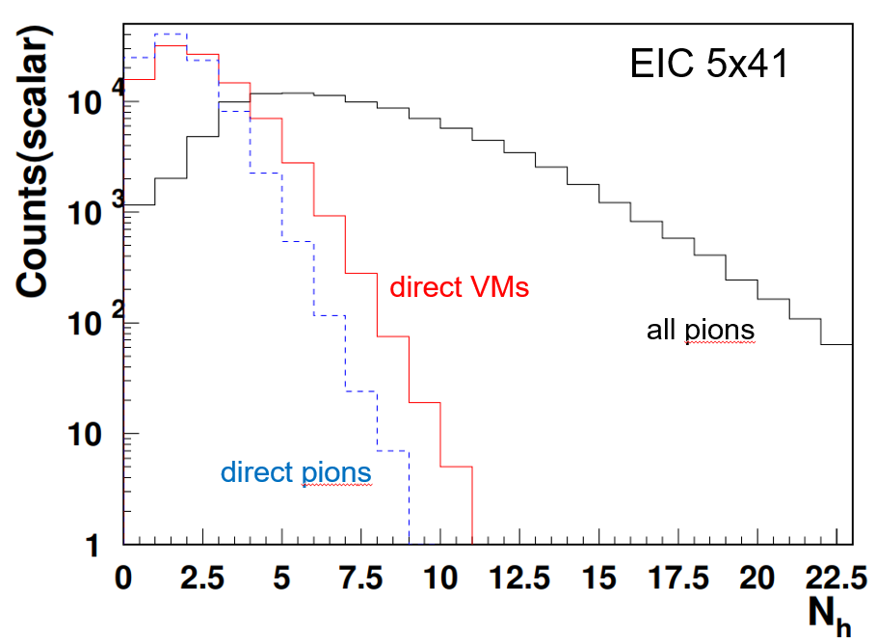
Theory-Experiment-Phenomenology
theory
…........
Fragmentation Function
→ probability to produce π+
exclusive events from hadronization?
…........
most significant
increases at higher energies
γ*_{L} and γ*_{T} → different dynamics
Notes:
lN\rightarrow l^\prime \omegaX

Slide 6
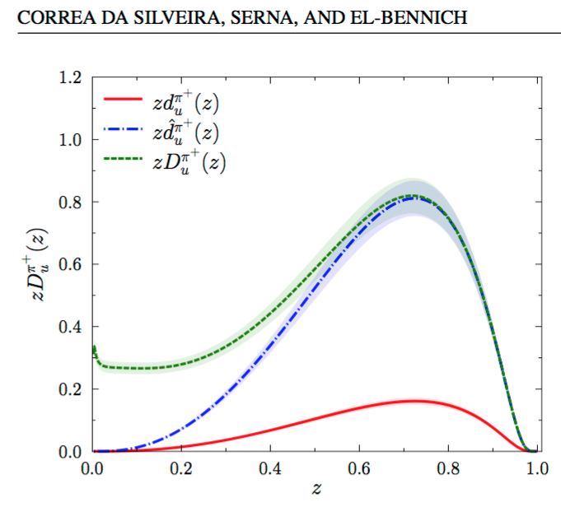
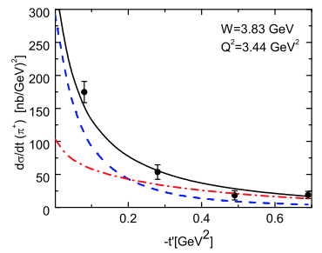
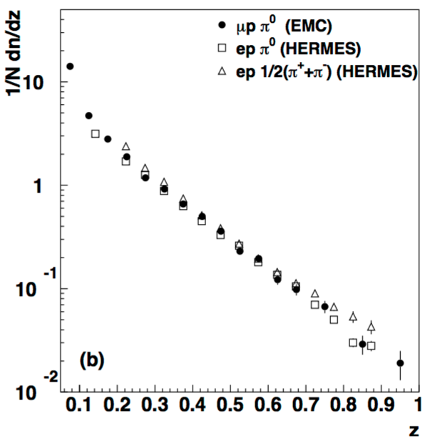
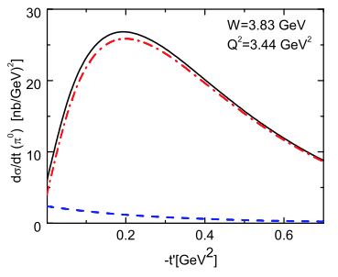
SIDIS limit vs Exclusive production
GK:ArXiv:1106.4897
PHYS. REV. C 111, 065204 (2025)
Models predict hadrons produced at large z
HERMES:0707.0222
longitudinal
Probabilities to produce pions in hadronization comparable (also large z)
Longitudinal x-section for π0 suppressed
Need separation of different dynamical mechanisms!!!

Slide 7
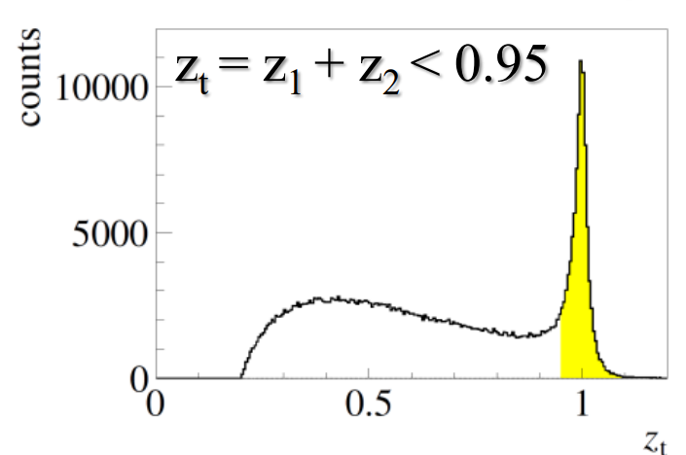
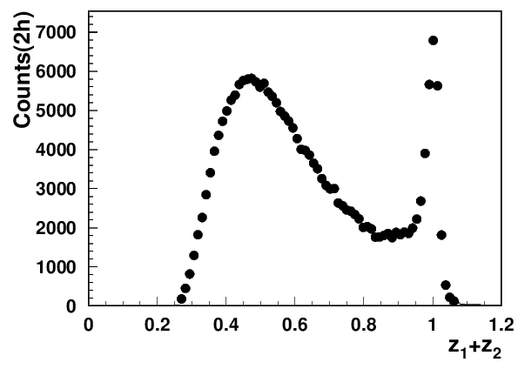
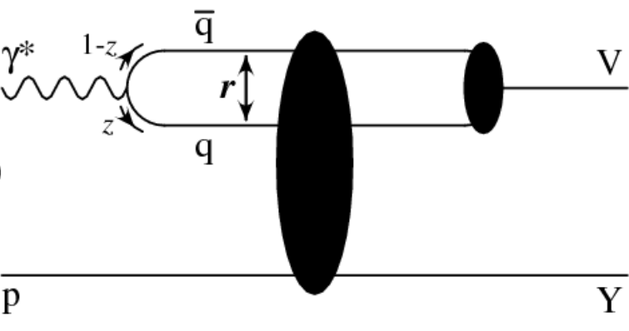
VMs at lower energies
What exactly are identified so far sources of “factorization breakdown” in SIDIS and where is the evidence that “few GeV” matters?
COMPASS 2h
CLAS12
Q²=2 GeV²
x=0.2
Diffractive VMs (ρ⁰)
CLAS12 measurements indicate the 2hadron exclusive sample is dominated by “diffractive rho0” produced at very small t
JLab provides possibility of detailed studies of those rhos, crucial for interpretation in terms of TMDs of SIDIS data in general, and for EIC in particular.
Estimated ~20% contributions from rho to charged pion SIDIS, consistent with ~10% of diffractive DIS in inclusive DIS
indication: most longitudinally polarized ρ⁰
note: higher the Q² lower is ε
Studies of exclusive processes require high resolution and multidimensional measurements !!!

Slide 8
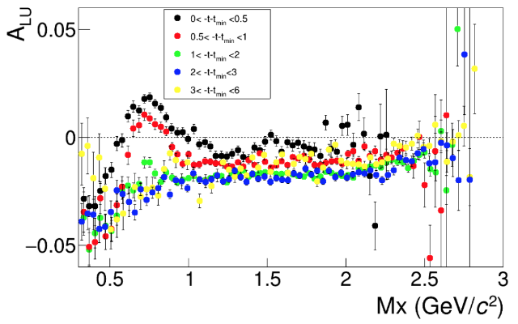
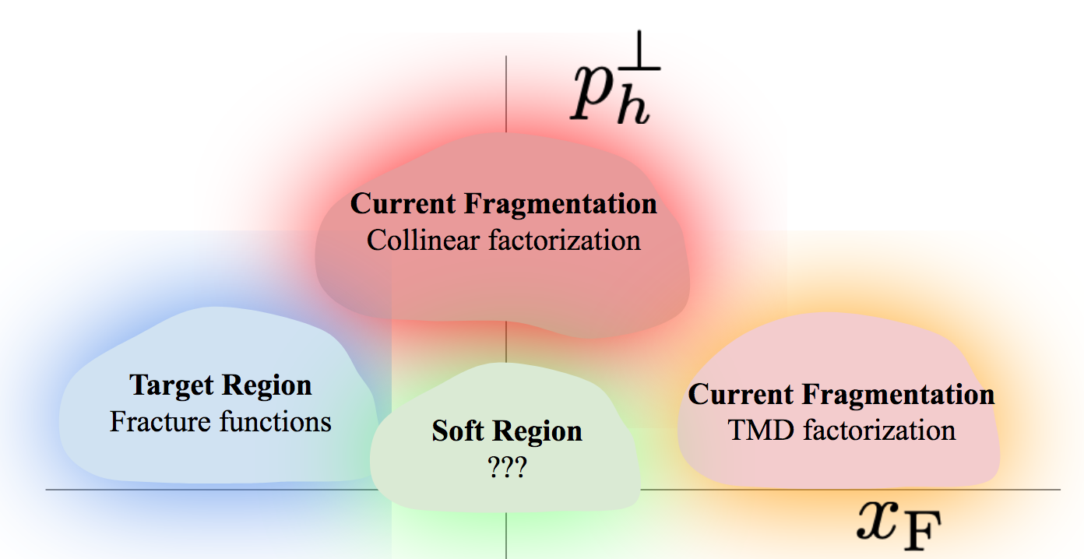
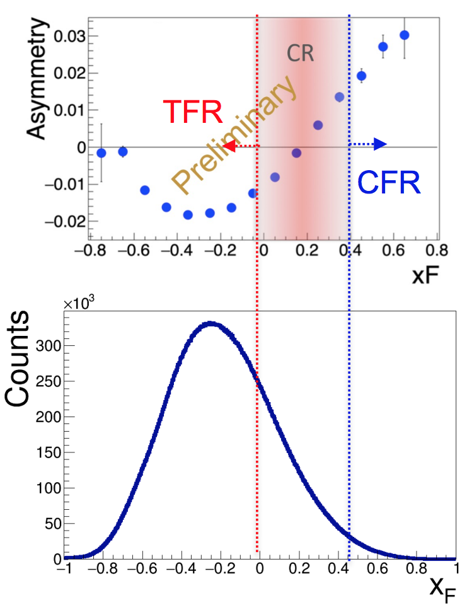
Separating target fragmentation at JLab
Separating Target Fragmentation Region TFR from Current fragmentation region (CFR)
F. Benmokhtar & Duquesne U.
“ρ-free” SIDIS
ep→e’pX
Major difference only for protons at small t!
With beams in polarized SIDIS typically always polarized, beam SSA can serve as a tool to separate
kinematical regions (CFR/TFR)
dynamical contributions
cut on M_{X} eliminate exclusive VMs
Negative sign of the SSA (plateau) defines the TFR dominance

Slide 9
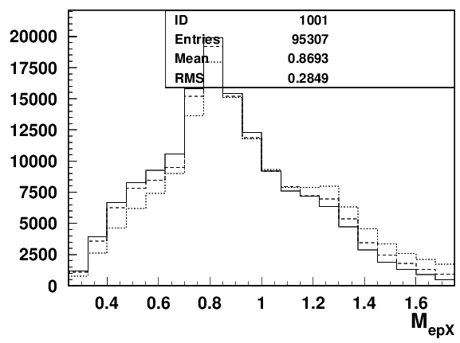
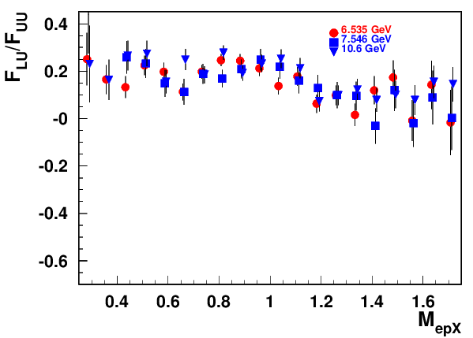
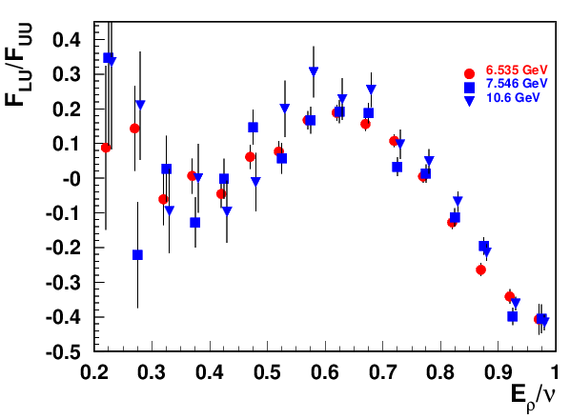
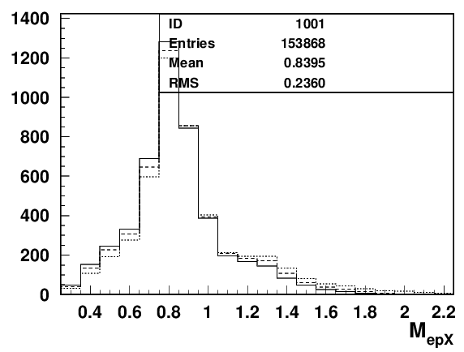
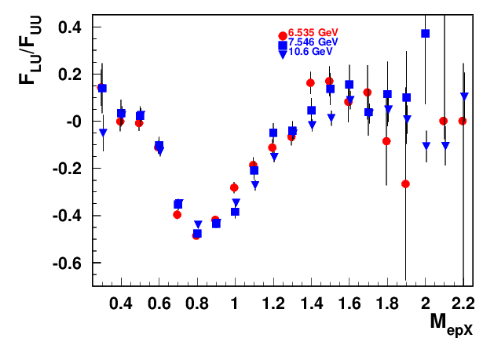
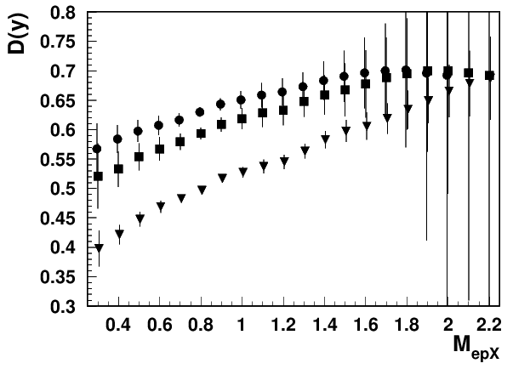
Exclusive π+π−: missing mass dependence
forward protons
forward rhos
Rhos dominate both exclusive dihadron samples, contributing differently depending on z

Slide 10




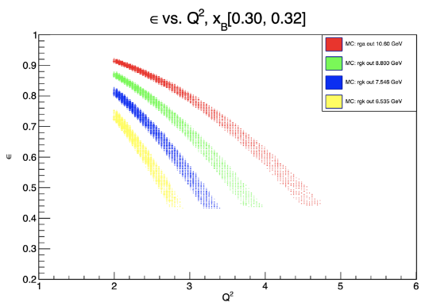

Studies of beam SSA ε-dependence in ep→e’hX
Semi-Inclusive:
ratio of longitudinal and transverse photon flux
+…
Hall-C E12-06-104
E12-23-014
Hall-B E12-16-010C
Wide ε-coverage needed!!!
Separation of contributions from longitudinal and transverse photons critical for interpretation
Higher the beam energy, bigger the longitudinal photon contributions CLAS12 accumulated data with 6.5, 7.5, 8.8 and 10.6 GeV allowing studies of ε-dependence

Slide 11
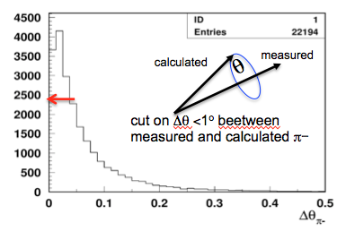


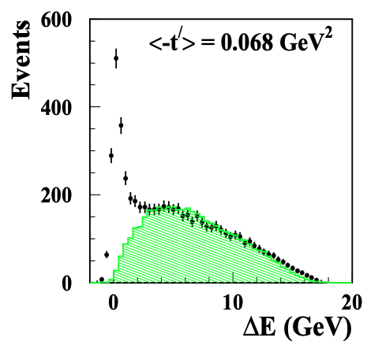
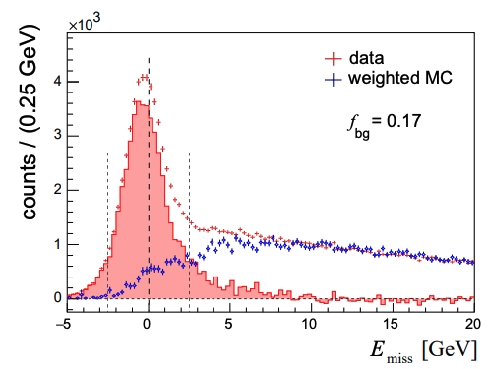
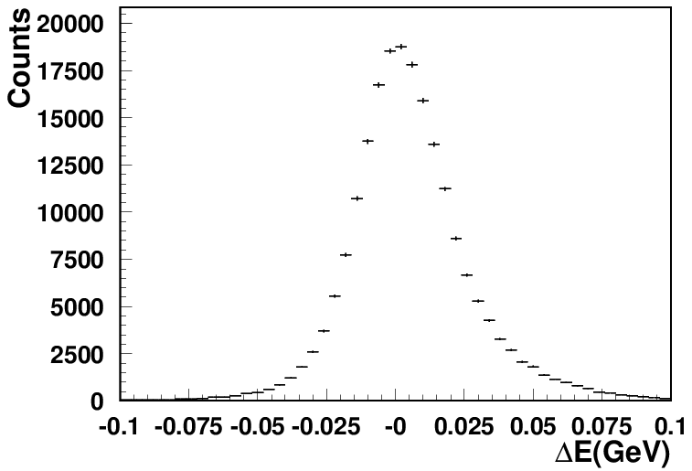
CLAS12 Experiments involved: Exclusive rhos
Exclusivity condition defined by the missing Energy:
CLAS12 (width <0.1GeV)
HERMES(width ~0.6GeV)
COMPASS(width ~2GeV)
~20% of data
hep-ex/0004023
dominated by transverse photons
what are cosθ distributions of those?
Guarantying the “exclusivity” requires good resolutions (gets worse at higher energies)
Subtraction procedure relays on normalization, based on exclusive limit of LUND-MC
All distributions have tails, indicating the RC may not be negligible
Extraction of SDMEs, will require validation in the multi-D space (significant samples)

Slide 12





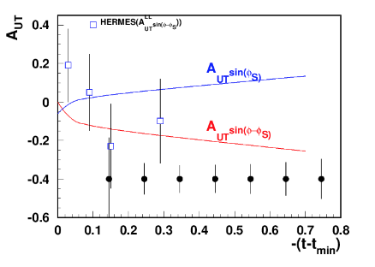
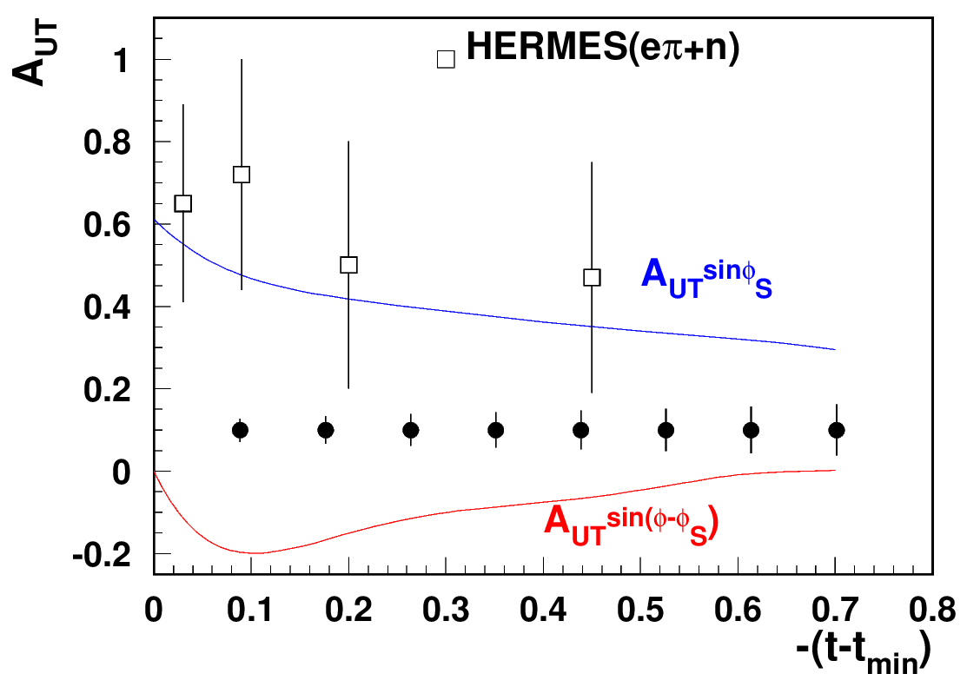
CLAS12 A_{UT}: exclusive hadrons with RGH
Significant transverse asymmetries predicted for exclusive π+
GK:ArXiv:1310.1472
exclusive (ep→e’pρ⁰)
suppressed
enhanced
RGH(100 days)
RGH(100 days)
Sivers SSA (GPD-E) or exclusive rho
predictions from Goloskokov&Kroll
GK:ArXiv:0906.0460
Exclusive processes help in understanding of longitudinal photon contributions
CLAS12, best positioned for measurements of exclusive processes, requiring combination of high statistics, good resolution and multiple observables

Slide 13
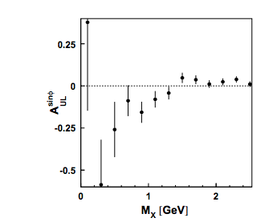

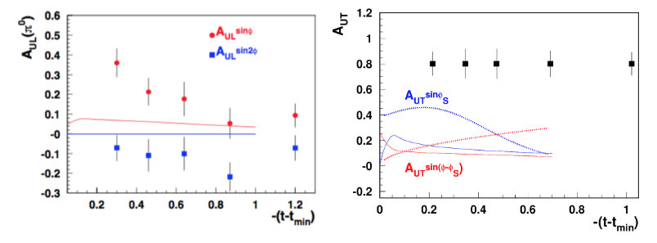
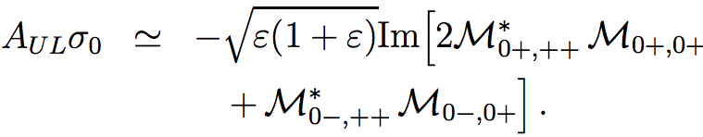
CLAS12 A_{UT}:exclusive π⁰
GK:ArXiv:1106.4897
HERMES
Significant transverse asymmetries predicted for exclusive π0
longitudinal
exclusive π+
longitudinal
enhanced
suppressed
Sort out large E~, needed to explain HERMES A_{UL}
What about HT GPDs?

Slide 14
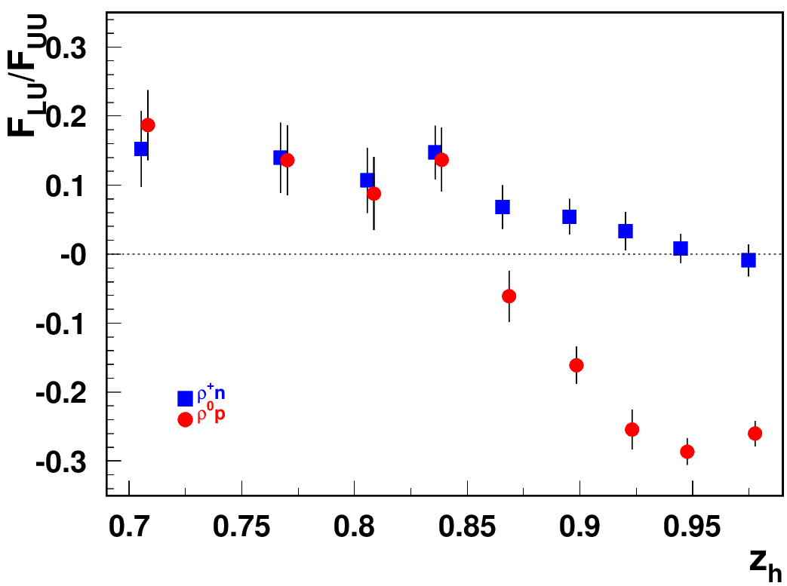
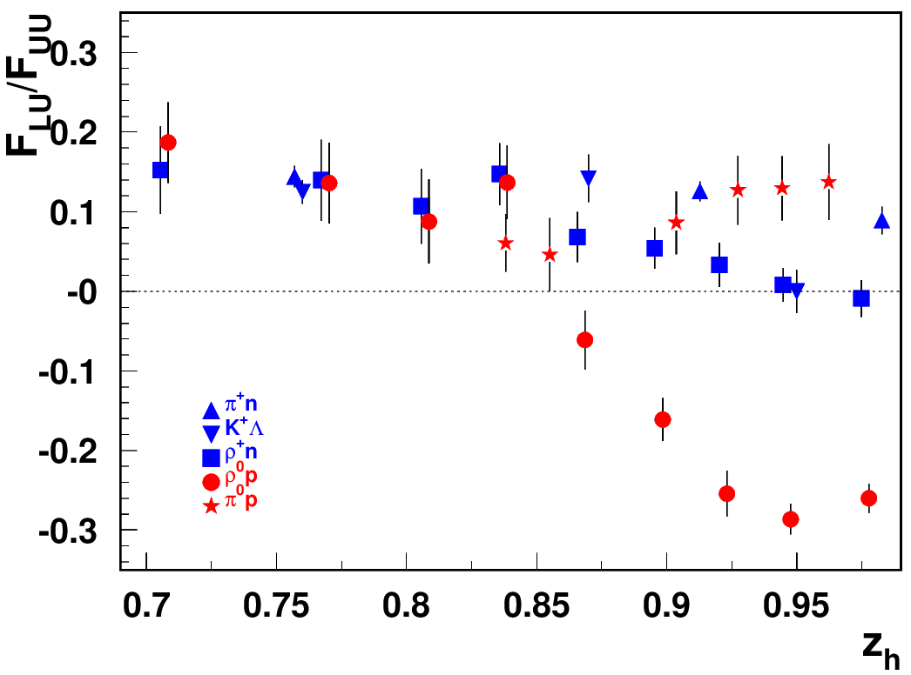
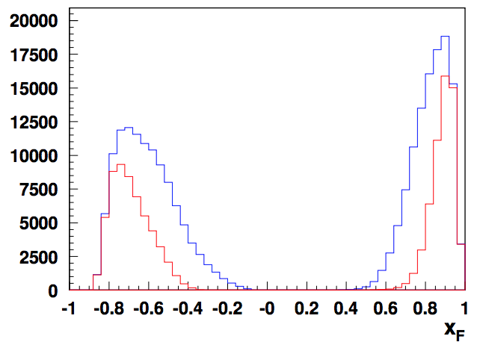
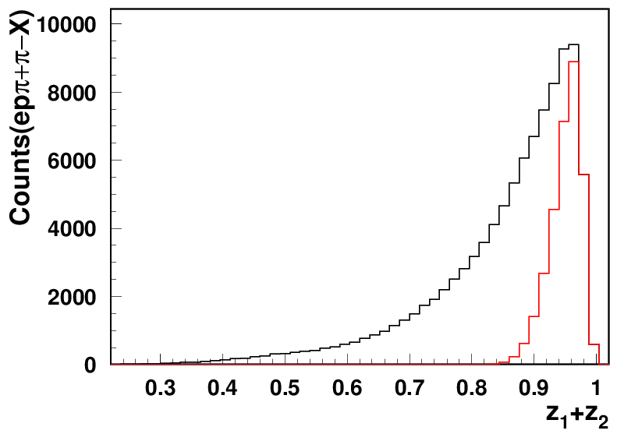
“diffractive” VMs: rapidity gap
G.Matousek (Duke) & N.Trotta (UCONN)
Beam SSA for exclusive states
ep→e’pρ⁰
ρ⁰
p
t<1
ρ⁰_{T}
t<0.5
Significant rapidity gap between protons (backward) and rho (forward)
ρ⁰_{L}
all exclusive ρ
longitudinal ρ
All exclusive hadrons dominated by u-quarks have the same SSA
ρ⁰_{L} and ρ⁰_{T} →2 different particles!!!
Identify kinematics of “diffractive” ρ⁰ by comparison with ρ⁺

Slide 15
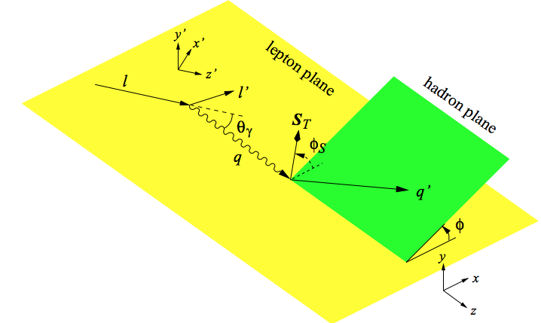

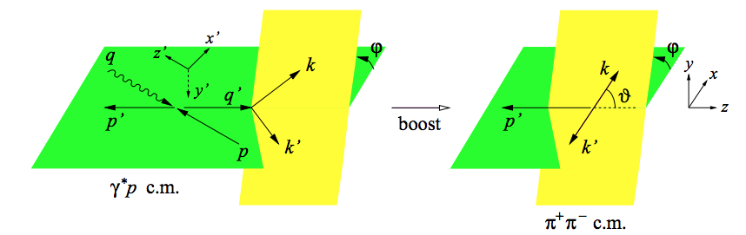
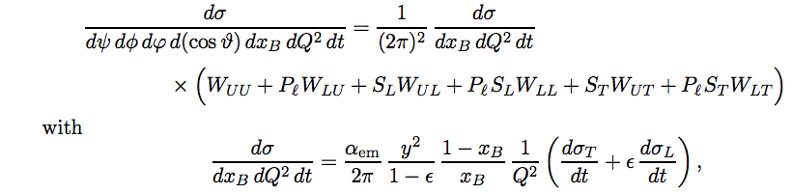
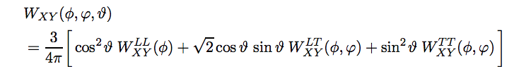
Structure functions case of VMs
Diehl: 0704.1565
More angles involved
helicities
beam and target polarizations
All W_{XY} depend on Q², x_{B} and t
longitudinal rho
transverse rho
interference between longitudinal and transverse ρ

Slide 16
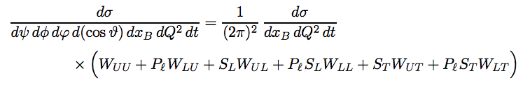

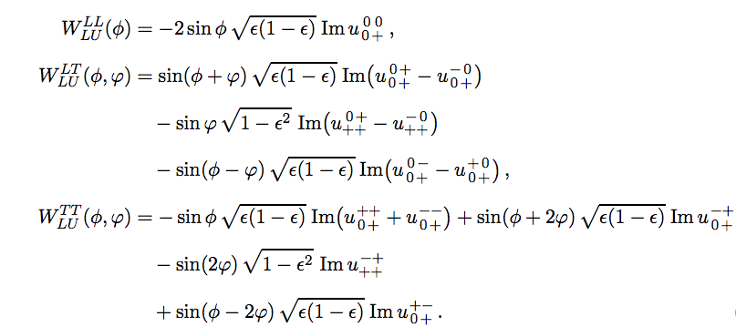
Structure functions: case of VMs
Diehl: 0704.1565
More angles involved
beam SSA involves several dynamical contributions
After integration over
two terms survive
Detector has acceptances in angles, and integration should account that to be interpretable by theory

Slide 17
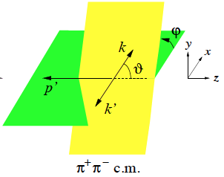
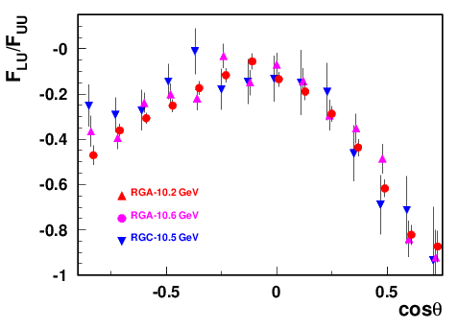



What we know about the longitudinal rho
longitudinal ρ→ source of info on γ∗_{L}
Has huge SSAs (negative for beam SSA)
CLAS12
ρ⁰_{T}
ρ⁰_{L}
CLAS12 PRELIMINARY
1 bin in ZEUS
Very challenging to measure
asymmetric decays hard to detect and identify
Interference of γ_{T}*→ρ_{L} and γ_{L}*→ρ_{L}
← measured 0 at HERMES/COMPASS
→Needed for L/T separation

Slide 18


Studies of ρ⁰ impact with longitudinally polarized NH₃ target
A.Bongallino (theory bands)
CLAS12 Preliminary
ep->e’p’π⁺π⁻
Need clear separation of hydrogen from NH₃
and “diffractive” exclusive ρ0s from exclusive π+π−
Exclusive rho, dominated by longitudinal photons introduces dilution to A₁ at lower x&Q² suppressing π+ DSA (decrease seem to be inconsistent with theory)
DSA is P-even, SSA is P-odd
longitudinal photon cross section is P-odd
→ contribution appears only in the SSA, a P-odd observable, and does not appear in DSA(→significant dilution in DSA)

Slide 19
Exclusive measurements with major impact
Measurements of Q²-dependence of exclusive rho at HERA
Main result: Cross section drops as ~1/Q⁴, L/T ratio increases slowly with Q²
Longitudinal photons start to dominate at very large Q² (low statistics, practically impossible multidimensional measurements )
Conclusion: Large power corrections to Leading Twist, complicating interpretation within GPD based phenomenology
Challenges: Separating exclusive from semi-exclusive, and longitudinal from transverse
Measurements of exclusive rho at HERMES and COMPASS
Main result: Extraction of SDMEs, small SSAs observed for polarized and unpolarized targets for rho, longitudinal photons start to dominate at very large Q² (low statistics, practically impossible multidimensional measurements )
Challenges: Separating exclusive from semi-exclusive, and longitudinal from transverse
Consequence→
Underestimating L/T ratios, exclusive ρ meson studies have been left on the sidelines of 3D structure investigations
No reliable MC simulations with polarization degrees of freedom available for exclusive hadrons, and VMs in particular

Slide 20
summary
Exclusive hadron production data accumulated by CLAS12 allowing detailed studies of variety of contributions, critical for providing adequate data for QCD based phenomenology for 3D studies (TMDs and GPDs/GTMDs?)
First data from longitudinally polarized target, confirms importance of sorting out longitudinal photon contributions in general, and the impact of longitudinal ρ⁰s, in particular.
Multidimensional measurements with high resolution, critical for separation of exclusive from semi-exclusive, with separation of different dynamical contributions to certain exclusive processes, validation by measurements of Q²-dependence are critical for proper interpretation of the data
Measurements of exclusive hadron production with longitudinally and transversely polarized targets will provide important input for GPD based phenomenology, also providing a critical input for pion SIDIS phenomenology

Slide 21
support slides

Slide 22



Exclusive processes: longitudinal rho at ZEUS
ZEUS diffraction 1/Q⁶ at low M_X
~20-30% of DDIS comes from rho
1/Q⁶ theory misses ~70-80% at low Q²
Kroll&Goloskokov
hep-ph/0611290
Departure from 1/Q⁶ attributed to large power corrections → expected to be more significant at lower CM energies!!

Slide 23


HERMES A_{UL}:”exclusive” pions
https://arxiv.org/pdf/hep-ex/0212039
https://arxiv.org/pdf/hep-ex/0112022
same sign for π+ and π- (ρ?)
SSA significant at small x, low Q² and relatively large t (indication of large E~!)

Slide 24





SDMEs: different combinations in experiment
Diehl: 0704.1565
More angles involved
sinusoidal modulations(~0 at COMPASS)
Valuable source of info on longitudinal photon!!!
Interference of γ_{T}*→ρ_{L} and γ_{L}*→ρ_{L}
cosine modulations(huge at COMPASS)
(>0 at COMPASS)
Interference of γ_{T}*→ρ_{T} and γ_{L}*→ρ_{T}
(~0 at COMPASS)

Slide 25




VM contributions
Yuri Kovchegov
in 80% cases one of the pions has <20% of the total momentum
CLAS12
Asymmetric decays of longitudinal rho lead to much smaller acceptance, more than order of magnitude

Slide 26






L/T separation in exclusive rho production at high energies
COMPASS: 2210.16932
more precisely
assuming →
SCHC
To evaluate need measurements of sinΦ and cosΦ moments, both very significant . The beam SSA sinΦ modulation inaccessible already at COMPASS/HERMES (suppressed as 1-ε)
The measurement of r₀₀⁸ require measurement of beam SSA ~

Slide 27

Exclusive rhos and SDMEs from COMPASS
corr. with r₁₀⁵ (Hermes) no corr (COMPASS)
corr. with r₁₋₁⁸ (Hermes) no corr (COMPASS)

Slide 28


Exclusive ρ contributions to π: P_{T}-dependence
“ρ-free” SIDIS
0.1<P_{T}<0.3, 0.4<z<0.6
Can change the pion SSAs, in particular at small PT
The same sign and size of π+ and π- SSA indicates the rho0 may not be properly subtracted(require detailed MC studies, which require proper SDMEs)
While VM contributions are ~20% in multiplicities in SSA they can be >100%
Detection of the target proton introduces much smaller bias on the inclusive charged pion SSA, than the exclusive rho contributions

Slide 29


VM contributions
Yuri Kovchegov
in 80% cases one of the pions has <20% of the total momentum
Asymmetric decays of longitudinal rho lead to much smaller acceptance
Similar but inverted distributions for e+e- decays

Slide 30










Exclusive dihadrons from CLAS12
all exclusive ρ
Q²=2 GeV²
Q²=3 GeV²
Q²=4 GeV²
x=0.2
longitudinal ρ
Q²=2 GeV²
Q²=3 GeV²
Q²=4 GeV²
Q²=5 GeV²
GK: arXiv:0708.3569
x=0.3
Q²=2 GeV²
Q²=3 GeV²
Q²=4 GeV²
Q²=5 GeV²
x=0.4
at lower x need higher z
The exclusive rho contributions in SIDIS (multiplicity) drop with Q² (~1/Q²)
At large z=z₁+z₂ the transverse photon contributions to ρ_{L} suppressed
Notes:
Lorenz invariant amplitudes

Slide 31









“ρ-free SIDIS” free: target proton bias
ep→e’ππX
ep→e’pππX
+ x_{Fproton}<0
ep→e’pππX
+ x_{Fproton}<0
+ M_{X}(epX)>1.05 GeV
x=0.3(0.25<x<0.35)
Q²=2 GeV²
Q²=3 GeV²
Q²=4 GeV²
While the detected proton introduces slight difference in the kinematic distributions, the cut on the proton missing mass makes significant impact (clear at large z).
Notes:
Lorenz invariant amplitudes

Slide 32



Studies of ρ⁰ impact with longitudinally polarized NH₃ target
Separating exclusive dihadrons
CLAS12 Preliminary
calculated
θ
measured
cut on Δθ <1º beetween measured and calculated π−
ep->e’p’π⁺π⁻
Require the angle of negative pions is within a degree from calculated from e’,p,π+ assuming exclusive e’,p,π+π- event.
Measurements of A_{LL} for ρ⁰ indicate very small values (with ~10-20% bck, likely negative ~ -2-10% ), and can be one of the reasons for higher A_{LL} with protons with a M_{X} cuts above 1.35 GeV (excluding exclusive ρ⁰ )
Request to theory→ evaluate the impact on g₁(x,k_{T}) with all A_{LL}s increasing 10-20%
Need clear separation of hydrogen from NH₃
and diffractive exclusive ρ0s from exclusive π+π−

Slide 33

DIS kinematical coverage and observables
ν=E-E’
z=E_{h}/ν
CLAS12
p┴
P_{hT} = p┴ +z k┴
EIC
x-slices to study Q²-dependence

Slide 34



Stringspinner rhos
|GL/GT|=0 -> fL=0:θ_{LT}=0
|GL/GT|=20 -> fL=0.995θ_{LT}=0
The pedestal in addition to cos^2\theta for longitudinal rho and sin^2\theta for transverse disappears for z→1. What exactly is that pedestal?

Slide 35







Structure functions case of VMs
Diehl: 0704.1565
helicities
cross section could be presented in terms of combinations of helicity amplitudes
unpol
long.pol
trans.pol
In the forward limit of small t
At leading twist the transition from a longitudinal photon to a longitudinal ρ becomes dominant, and transverse spin asymmetry can be defined as

Slide 36





MC studies
T. Hayward
C. Dilks
PYTHIA stringspinner
Consistent with week acceptance dep. for phi

Slide 37



Studies of ρ⁰ impact with longitudinally polarized NH₃ target
CLAS12 Preliminary
Need clear separation of hydrogen from NH₃
and diffractive exclusive ρ0s from exclusive π+π−
DSA is P-even, SSA is P-odd
longitudinal photon cross section is P-odd
→ contribution appears only in the SSA, a P-odd observable, and does not appear in DSA
ep->e’p’ρ⁰
With x10 less statistics than RGC, RGH can provide a significant measurement of ρ0 SSAs
Beam SSA (RGC summer)

Slide 38

Response from theory

Slide 39




A_{LL} studies of exclusive ρ⁰ : HERMES
A_{1ρ}=0.23 ± 0.14±0.02
1D plots can be really misleading need multi-D
For a proper extraction of multiplicities and spin-azimuthal modulations of exclusive ρs, clean separation is needed for ρ⁰, and longitudinally polarized ρ⁰ signal, in particular
At low P_{T}, where the background is smaller, the asymmetry indeed tend to be negative
Accounting of ρ⁰ will change the phenomenology of helicity distributions

Slide 40




SIDIS cross section: separating F_{UU,L}
Semi-Inclusive:
ratio of longitudinal and transverse photon flux
Hall-C E12-06-104
E12-23-014
Hall-B E12-16-010C
Separation of contributions from longitudinal and transverse photons critical for interpretation
EIC18x275
Wide ε-coverage needed!!!
EIC5x41
CLAS12
JLab24/HERMES
ep→e’πX
JLAB12
x=0.3
ep→e’π⁺π⁻X
At higher energies longitudinal photon contributions kinematically enhanced (at EIC 5 times bigger at Q²~10 )
JLab studies critical for EIC data interpretation
R=F_{UU,L}/F_{UU,T} depend on the process,
need for all relevant ones, in all kinematics!

