Slide 1


Trends, requirements, and research challenges for data management
Towards improved hadron femtography with hard exclusive reactions, edition IV, Jefferson Lab, 2025
30 July, 2025
Laura Biven
Chief Data Officer
Notes:
https://indico.phys.vt.edu/event/66
50 mins total

Slide 2




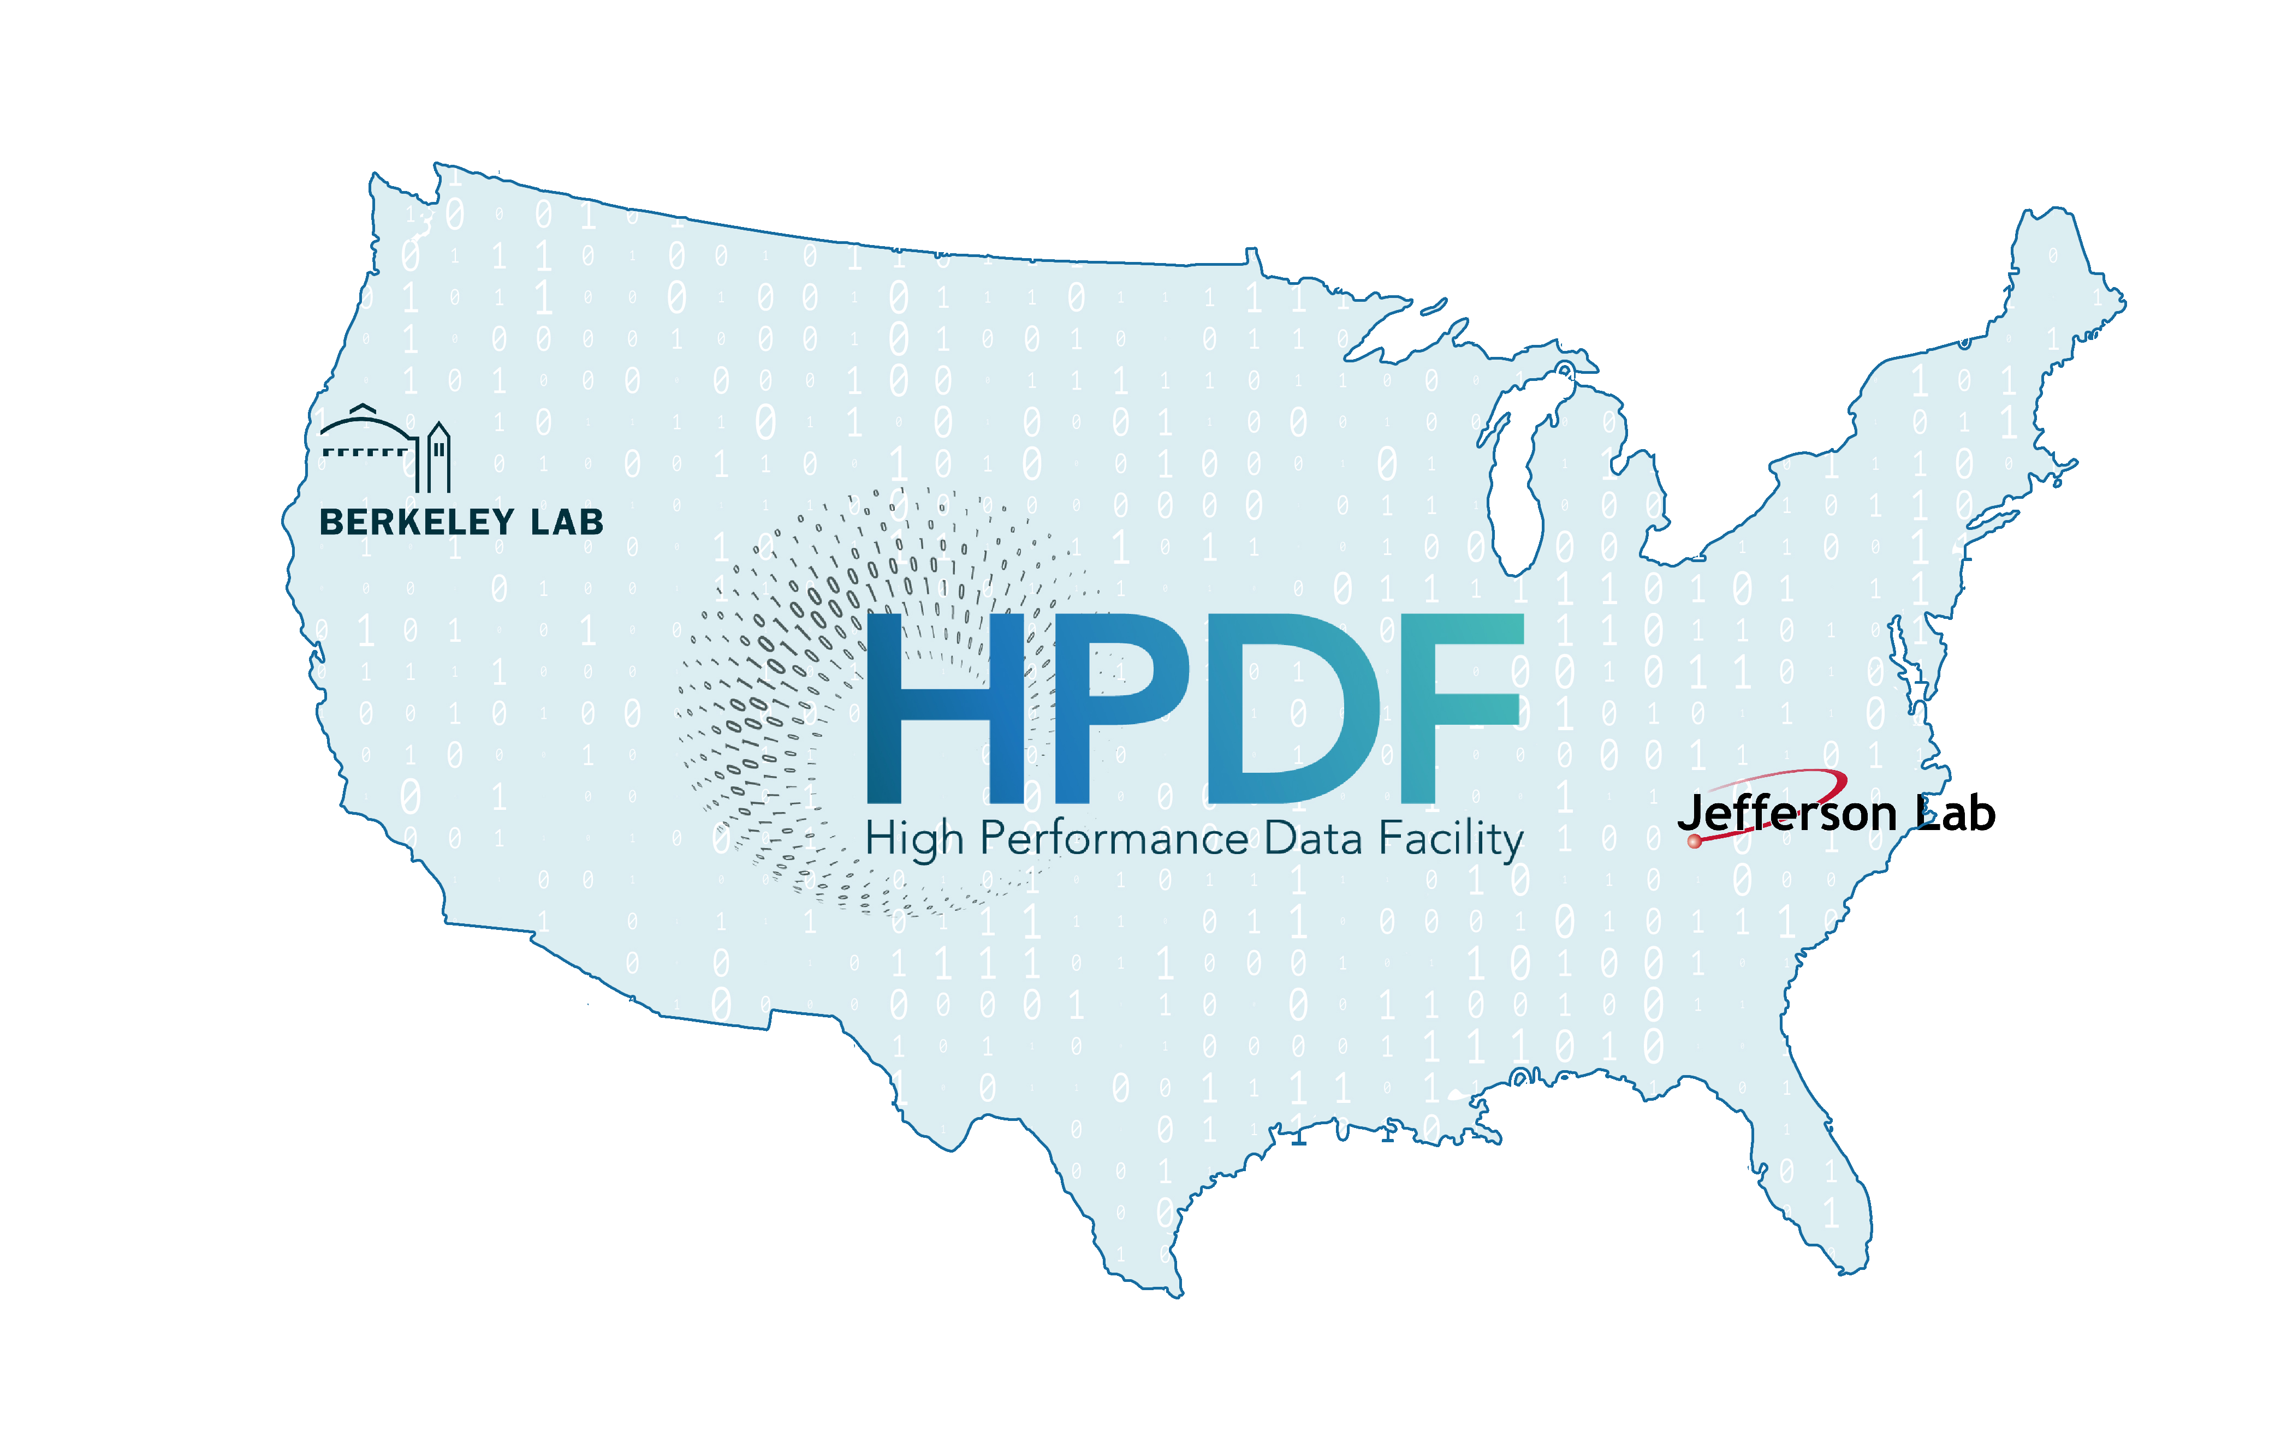



Laura Biven
Chief Data Officer biven@jlab.org
My interests:
Enhancing innovation and integrity in science through the data lens
Building data infrastructure for creative, inquisitive research

Slide 3
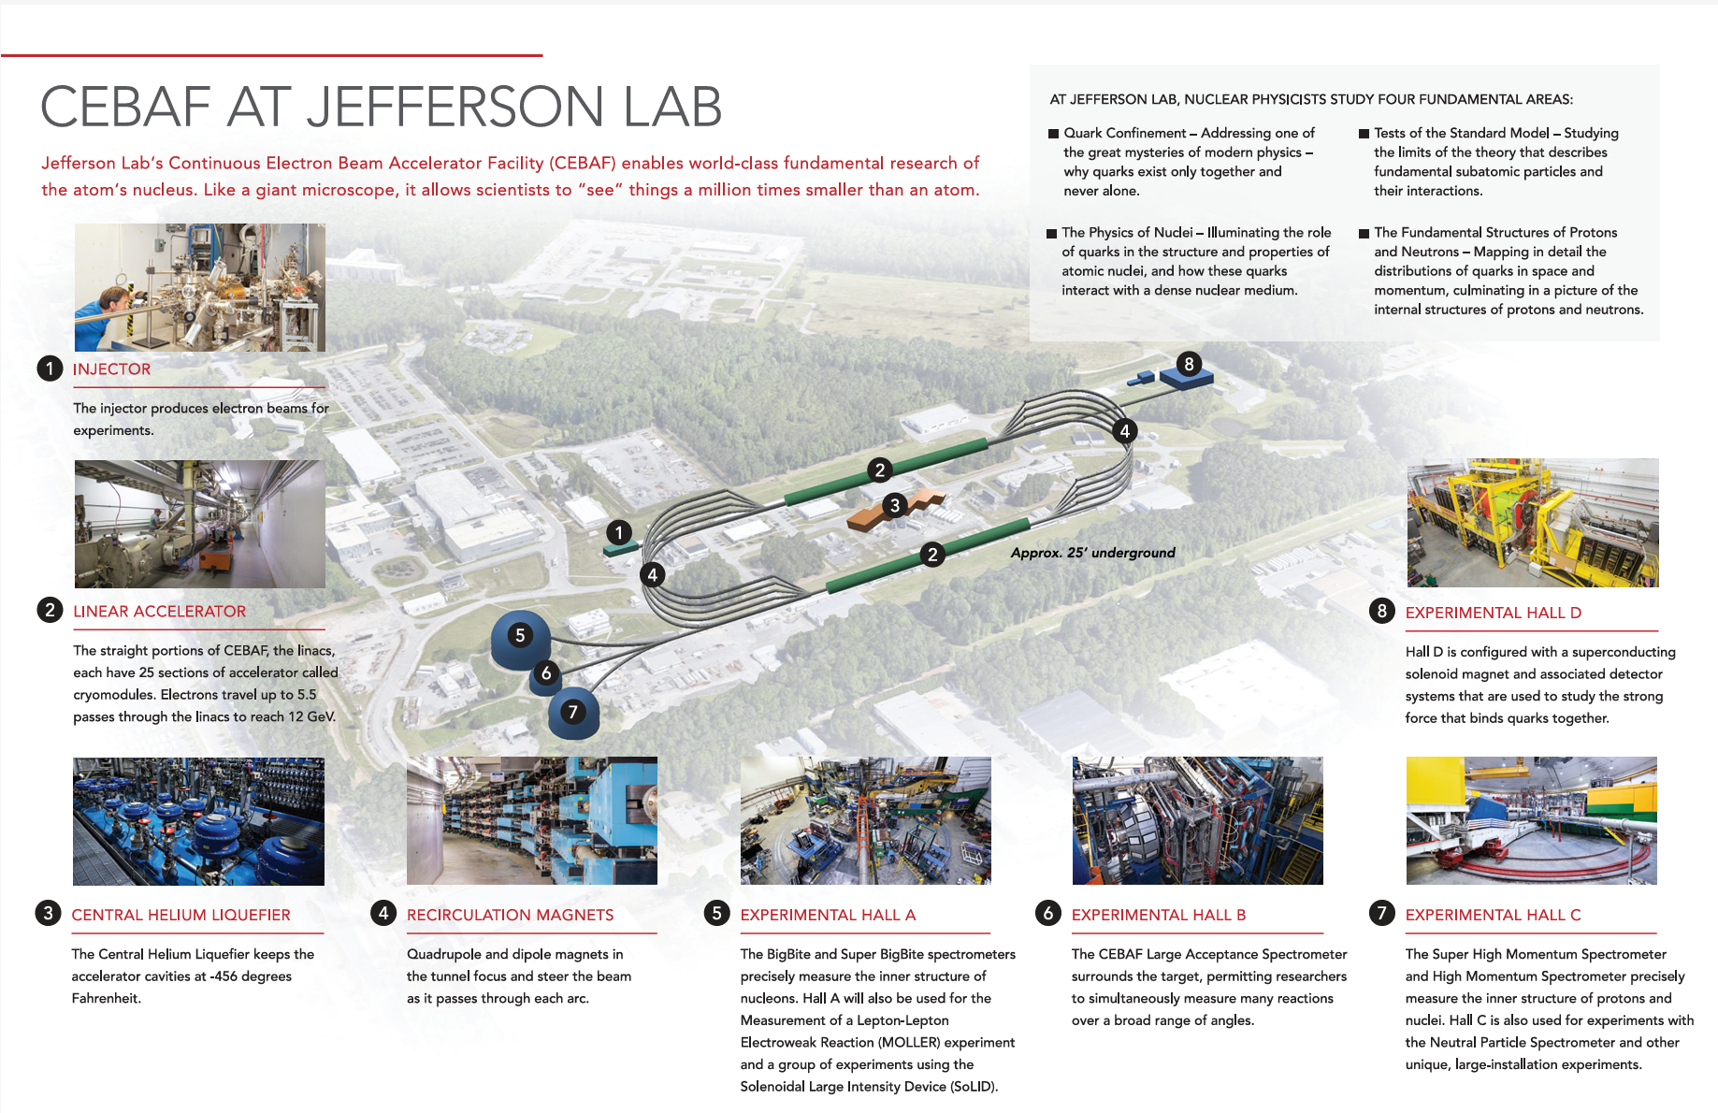
Jefferson Lab
Thomas Jefferson National Accelerator Facility (Jefferson Lab) is a U.S. Department of Energy Office of Science national laboratory. Scientists worldwide utilize the lab’s unique particle accelerator, known as the Continuous Electron Beam Accelerator Facility (CEBAF), to probe the most basic building blocks of matter - helping us to better understand these particles and the forces that bind them - and ultimately our world.
DOE Selected Thomas Jefferson National Accelerator Facility as the lead for its new High Performance Data Facility Hub. Jefferson Lab will partner with DOE’s Lawrence Berkeley National Laboratory to form a joint project team led by Jefferson Lab. The HPDF will be a computing and data infrastructure resource that will provide transformational capabilities for data analysis, networking and storage for the nation’s research enterprise.
https://www.jlab.org/
https://science.osti.gov/np/Facilities/User-Facilities/CEBAF
https://www.hpdf.science/

Slide 4
Outline
Context
Data and Compute Ecosystems
Laura’s Checklist
Thoughts for Data Management

Slide 5
Context

Slide 6
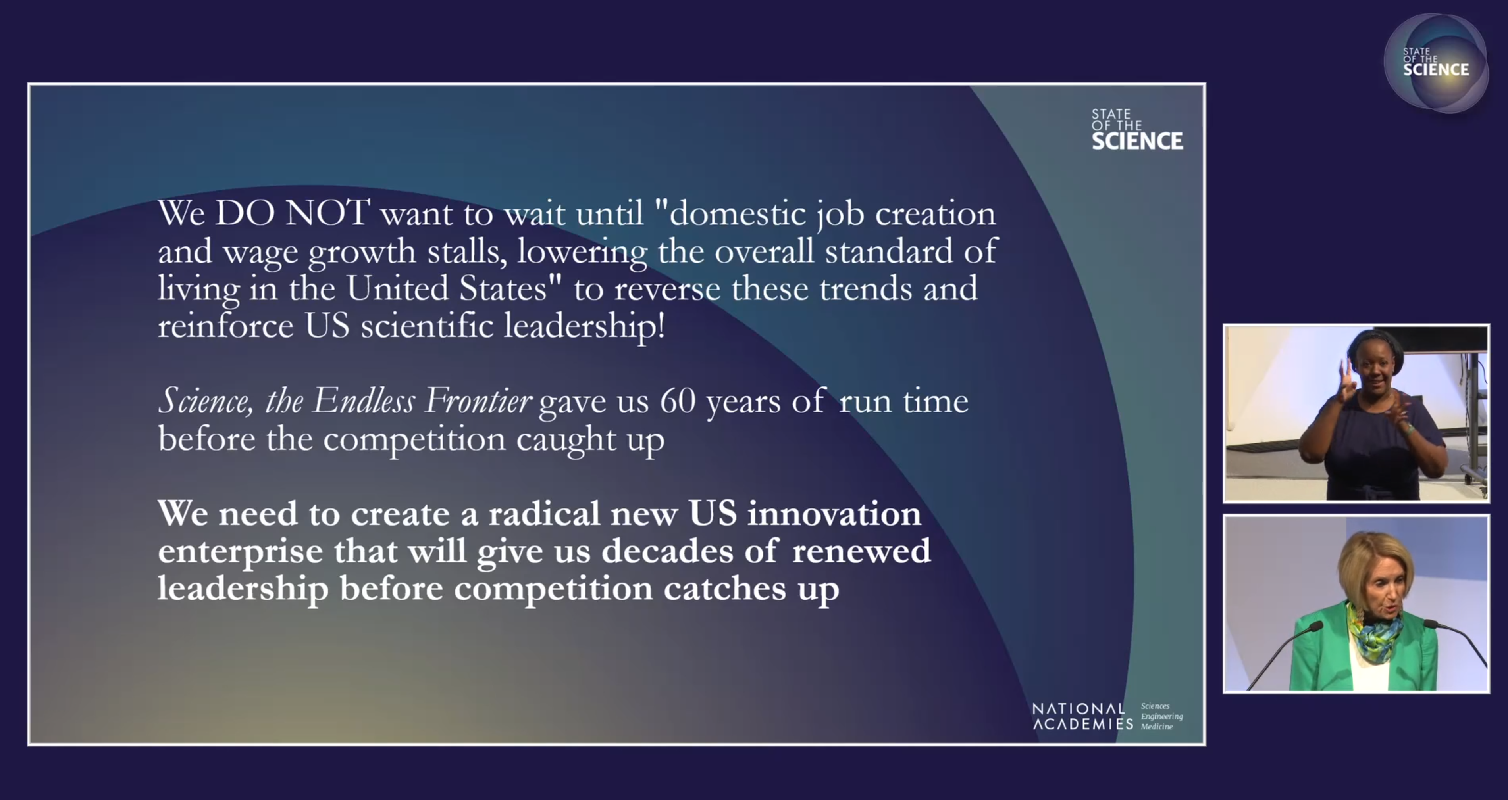
State of Science 2025 – Marcia McNutt

Slide 7
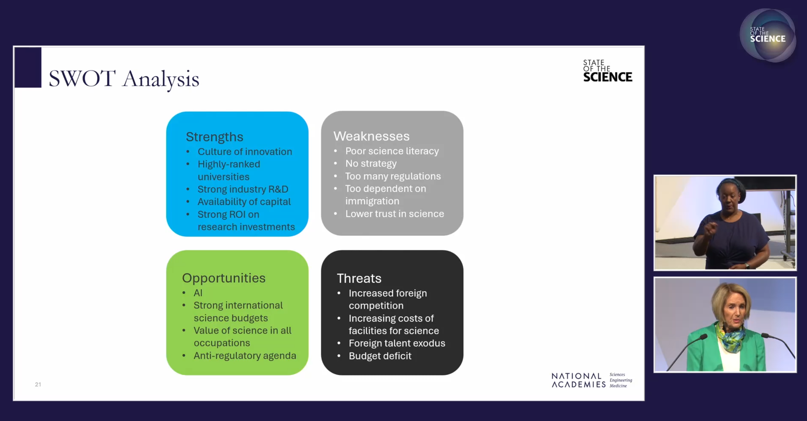
State of Science 2025 – Marcia McNutt

Slide 8

“The American Science Acceleration Project (ASAP) is a national initiative sponsored by Senator Heinrich and Senator Rounds to make American science ten times faster by 2030.”
https://www.heinrich.senate.gov/ASAP

Slide 9

“Our scientific enterprise should celebrate and incentivize
checking each other’s work…”
“…researchers must proactively communicate errors and uncertainties…”
https://www.whitehouse.gov/briefings-statements/2025/05/remarks-by-director-kratsios-at-the-national-academy-of-sciences/

Slide 10
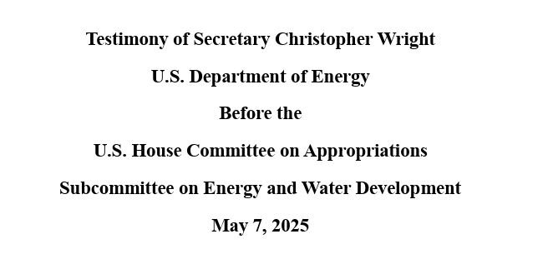
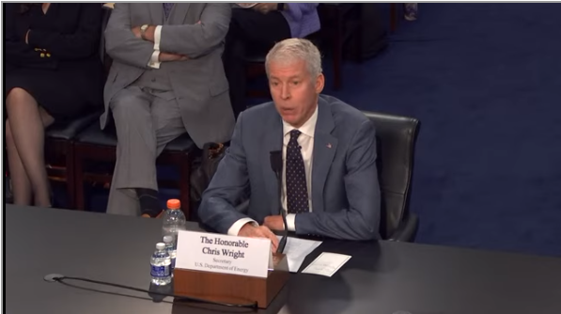
“When it comes to our National Labs, we are capable of doing more with less. We can both increase efficiency and drive innovation.”
--Chris Wright
https://docs.house.gov/meetings/AP/AP10/20250507/118188/HHRG-119-AP10-TTF-WrightC-20250507.pdf

Slide 11
“When it comes to our National Labs, we are capable of doing more with less. We can both increase efficiency and drive innovation.” *
--Chris Wright
https://docs.house.gov/meetings/AP/AP10/20250507/118188/HHRG-119-AP10-TTF-WrightC-20250507.pdf
* “I’m actually very open to expanding the lab budget back a little bit from where the current proposal is…”

Slide 12
H.R.1 - One Big Beautiful Bill Act (Public Law No: 119-21)
SEC. 50404. TRANSFORMATIONAL ARTIFICIAL INTELLIGENCE MODELS.
AMERICAN SCIENCE CLOUD.—The term ‘‘American science cloud’’ means a system of United States government, academic, and private sector programs and infrastructures utilizing cloud computing technologies to facilitate and support scientific research, data sharing, and computational analysis across various disciplines while ensuring compliance with applicable legal, regulatory, and privacy standards.
TRANSFORMATIONAL MODELS.—The Secretary of Energy shall—
(1) mobilize National Laboratories to partner with industry sectors within the United States to curate the scientific data of the Department of Energy across the National Laboratory complex so that the data is structured, cleaned, and preprocessed in a way that makes it suitable for use in artificial intelligence and machine learning models; and
(2) initiate seed efforts for self-improving artificial intelligence models for science and engineering powered by the data described in paragraph (1).

Slide 13
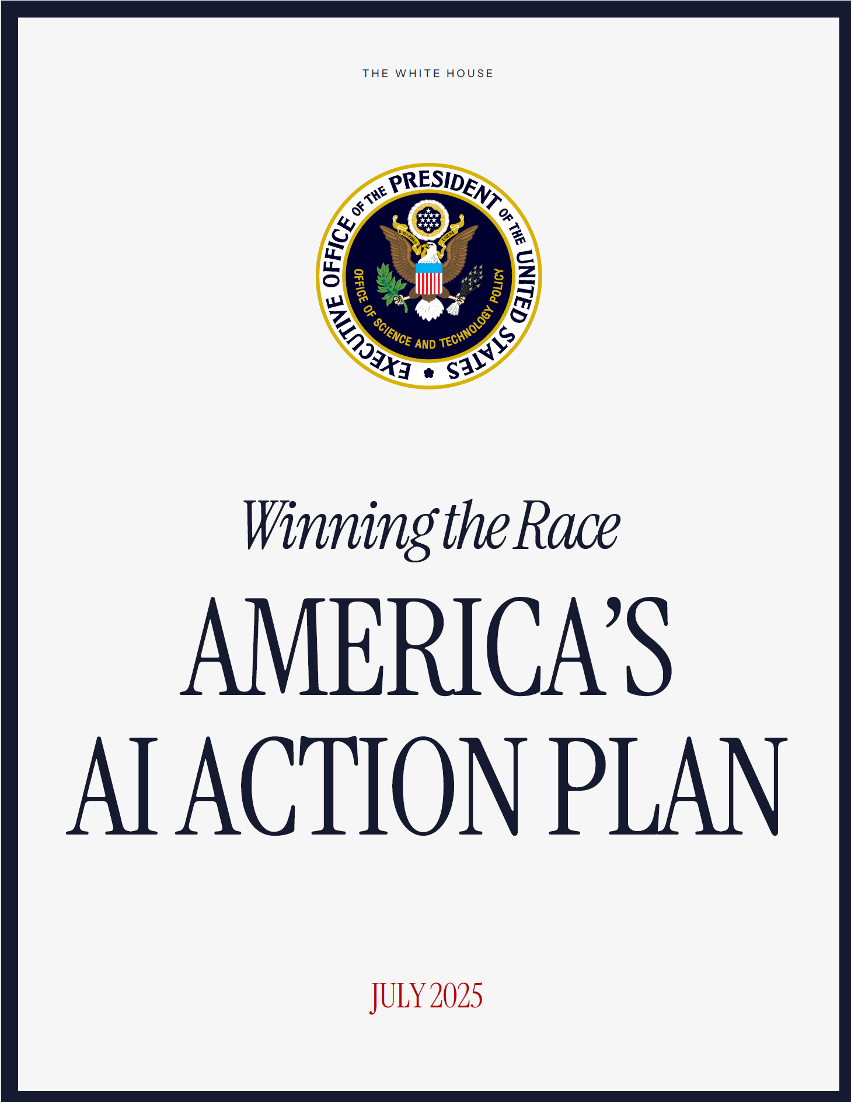
AI Action Plan
“Build World-Class Scientific Datasets
High-quality data has become a national strategic asset as governments pursue AI innovation goals and capitalize on the technology’s economic benefits. Other countries, including our adversaries, have raced ahead of us in amassing vast troves of scientific data. The United States must lead the creation of the world’s largest and highest quality AI-ready scientific datasets, while maintaining respect for individual rights and ensuring civil liberties, privacy, and confidentiality protections.
Recommended Policy Actions
Direct the National Science and Technology Council (NSTC) Machine Learning and AI Subcommittee to make recommendations on minimum data quality standards for the use of biological, materials science, chemical, physical, and other scientific data modalities in AI model training.”

Slide 14
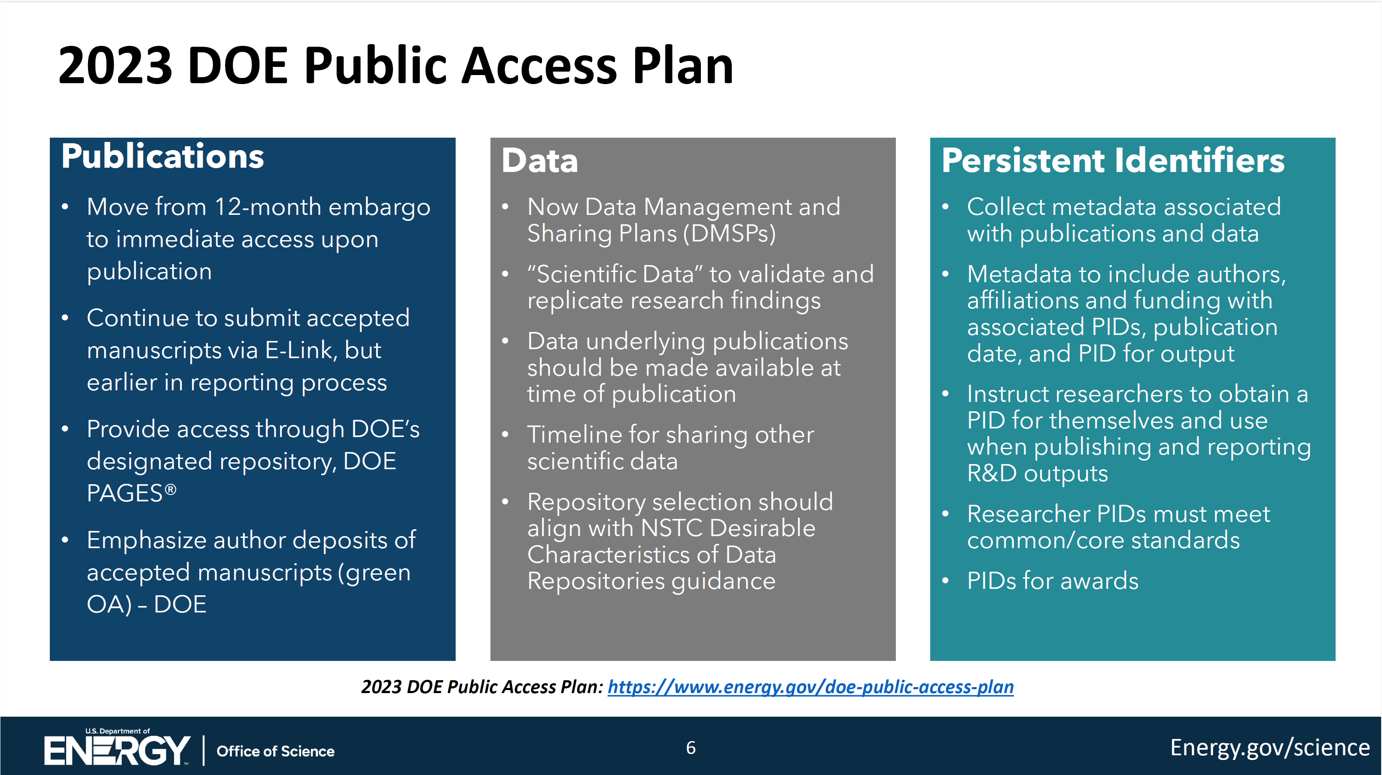
DOE O241.C New Requirements
Slide from Michael Cooke, ASCAC Jan 2025: https://science.osti.gov/ascr/ascac/Meetings/202501
Notes:
https://www.osti.gov/stip/about/supporting-documentation/2411C

Slide 15
Data and Compute Ecosystems

Slide 16
Data and Compute Ecosystem
Federated/ distributed physical and digital assets,
coordinated through shared services, policies, and standards
to realize prescribed and user-driven workflows and science campaigns.
Extensible, multi-purpose, no single node is essential
~~
Independently managed components, integrated by
FAIR services and governance
Notes:
This is my definition. Let me know what you think!
Add robust

Slide 17
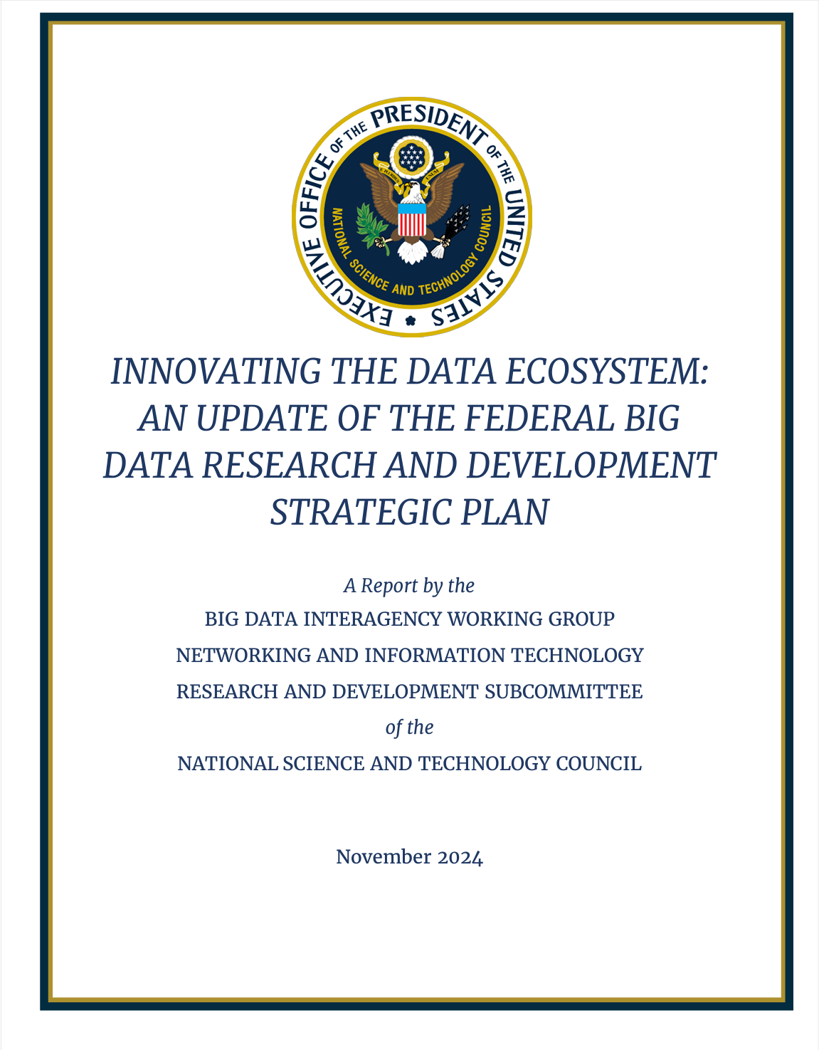
2024 Big Data Strategic Plan
“Vision: An adaptive data ecosystem built on large, diverse datasets that can effectively and efficiently support the extraction and analysis of information. This ecosystem spans the entire data lifecycle, enabling new capabilities for federal agencies and the nation.”
Strategy 1: Enhance the Reusability and Integrity of Data.
Strategy 2: Enable Innovative, User-driven Data Science.
Strategy 3: Develop and Enhance the Robustness of the Federated Ecosystem.
Strategy 4: Prioritize Privacy, Confidentiality, Ethics, and Security.
Strategy 5: Develop Necessary Expertise and Diverse Talent.
Strategy 6: Enhance U.S. Global Leadership.

Slide 18
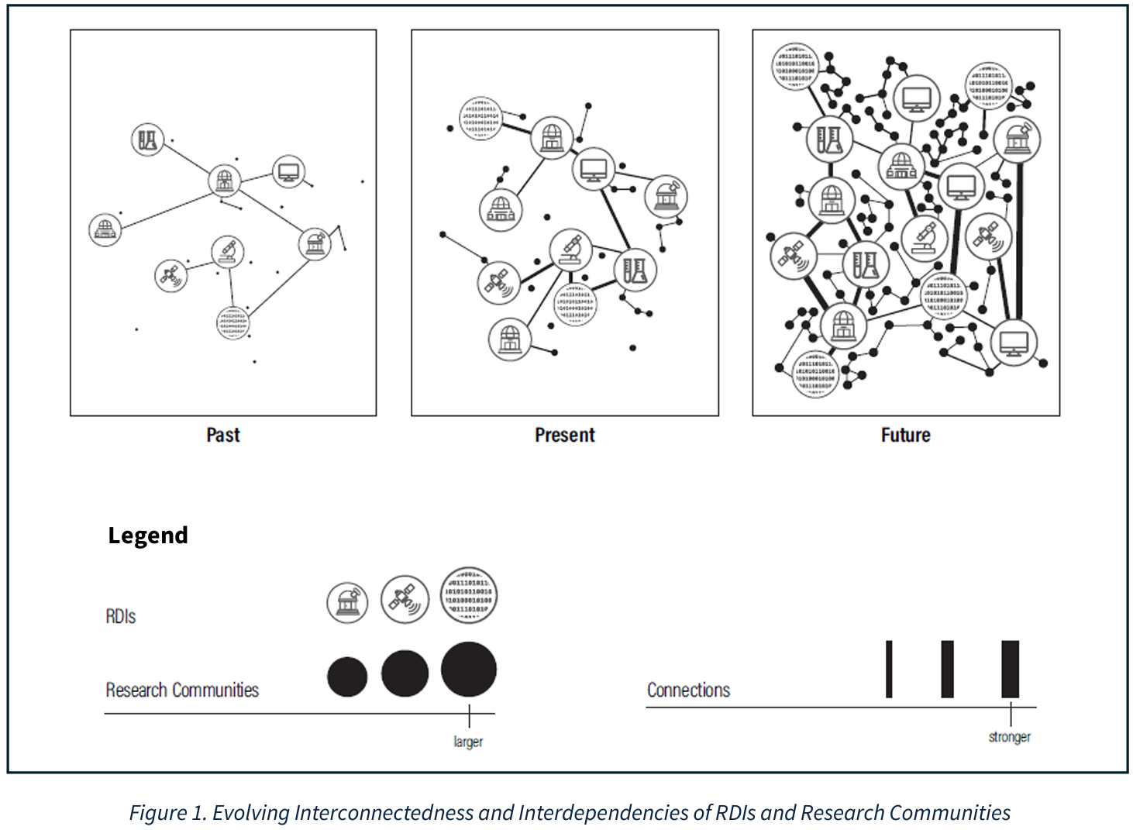
NATIONAL STRATEGIC OVERVIEW FOR RESEARCH AND DEVELOPMENT INFRASTRUCTURE
Key Policy Opportunities
Maintaining Strong and Integrated RDI Planning and Coordination
Ensuring RDIs Support a Flexible and Agile R&D Enterprise
Advancing RDI Capabilities to Support the Convergence of Disciplines and Sectors
Balancing RDI Openness with Security Needs

Slide 19
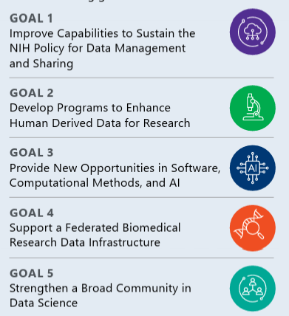
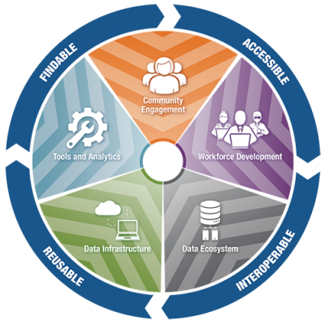
NIH Strategic Plan for Data Science
2018 Plan:
FAIR, Modern Biomedical Ecosystem
2025-2030 Plan:
Builds on 2018 plan

Slide 20
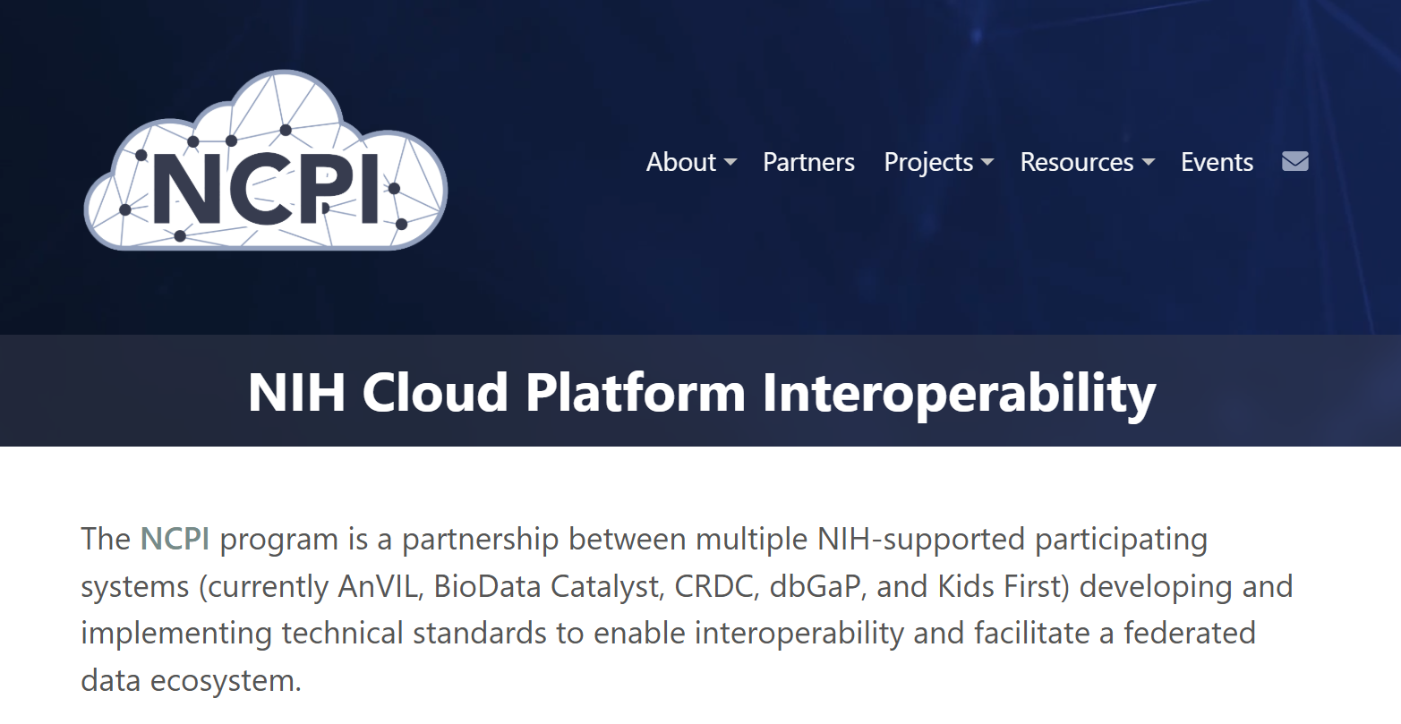
Slide courtesy of Richard Conroy
https://www.ncpi-acc.org/
Notes:
Integrating controlled access data
Correcting artificial siloes for genomics data

Slide 21
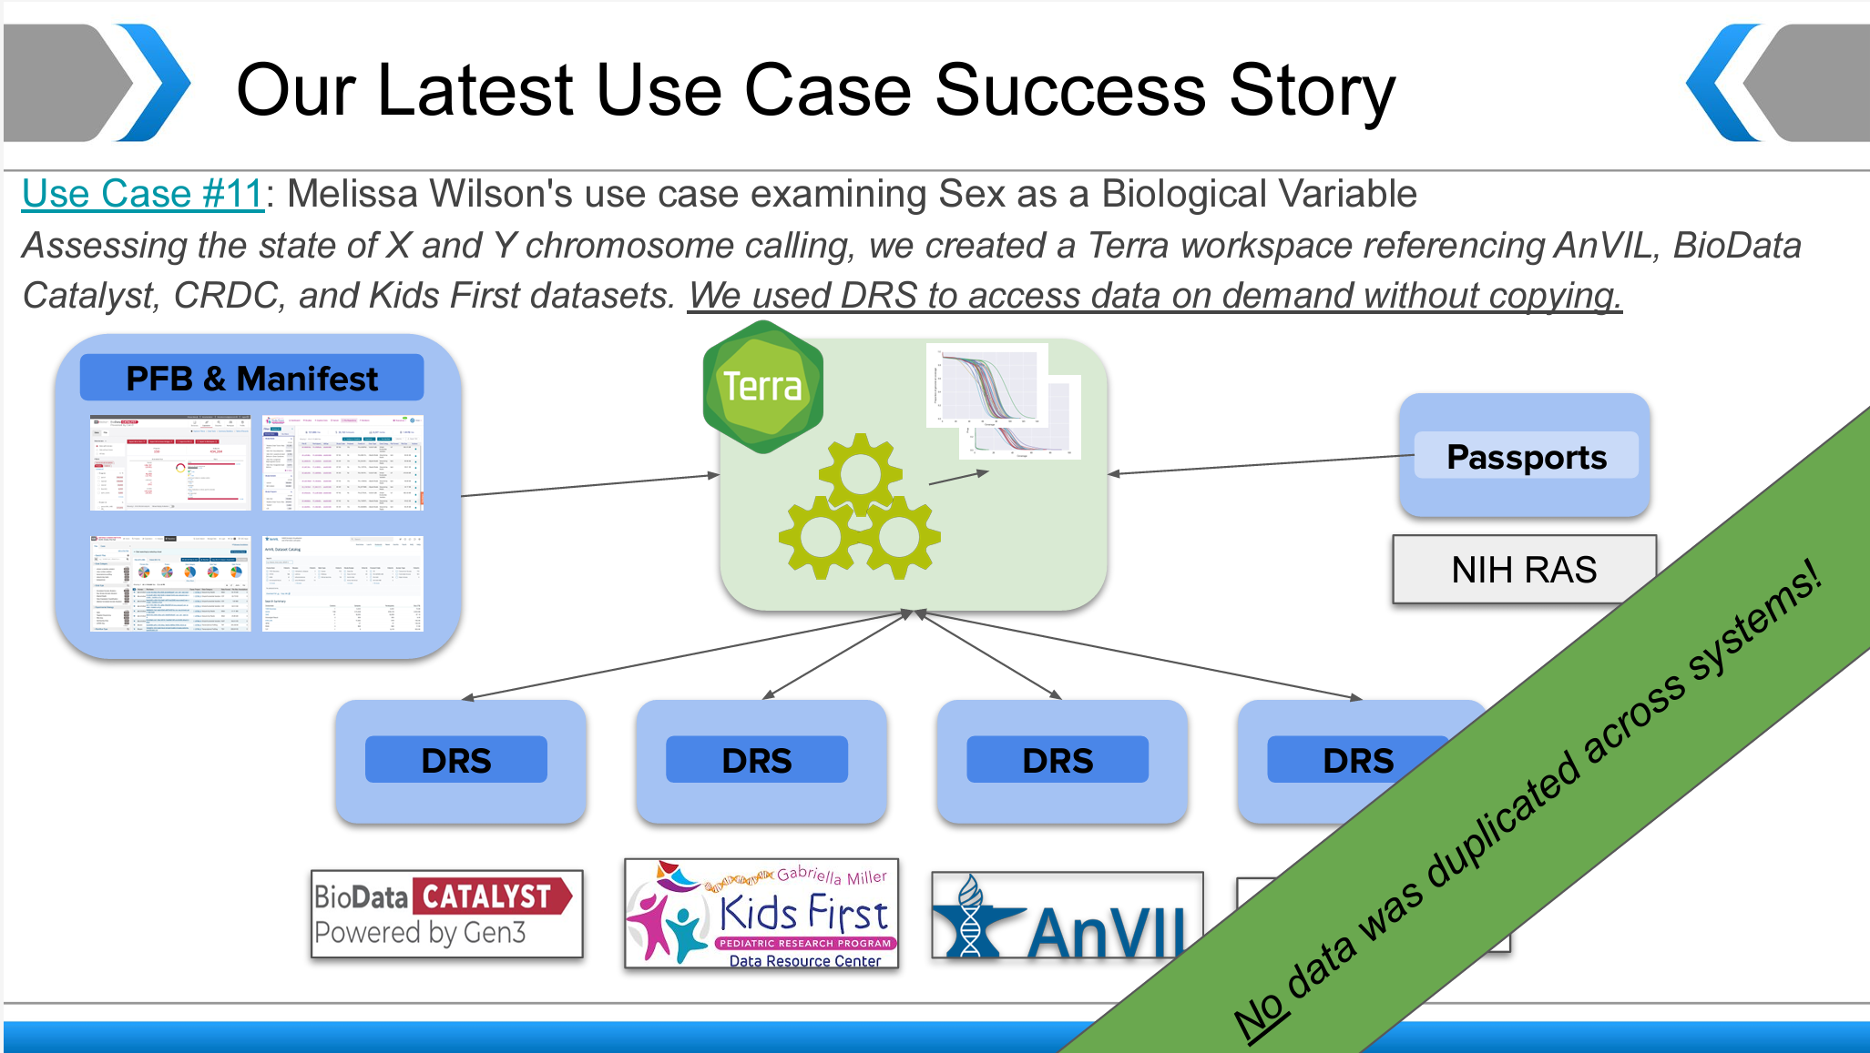
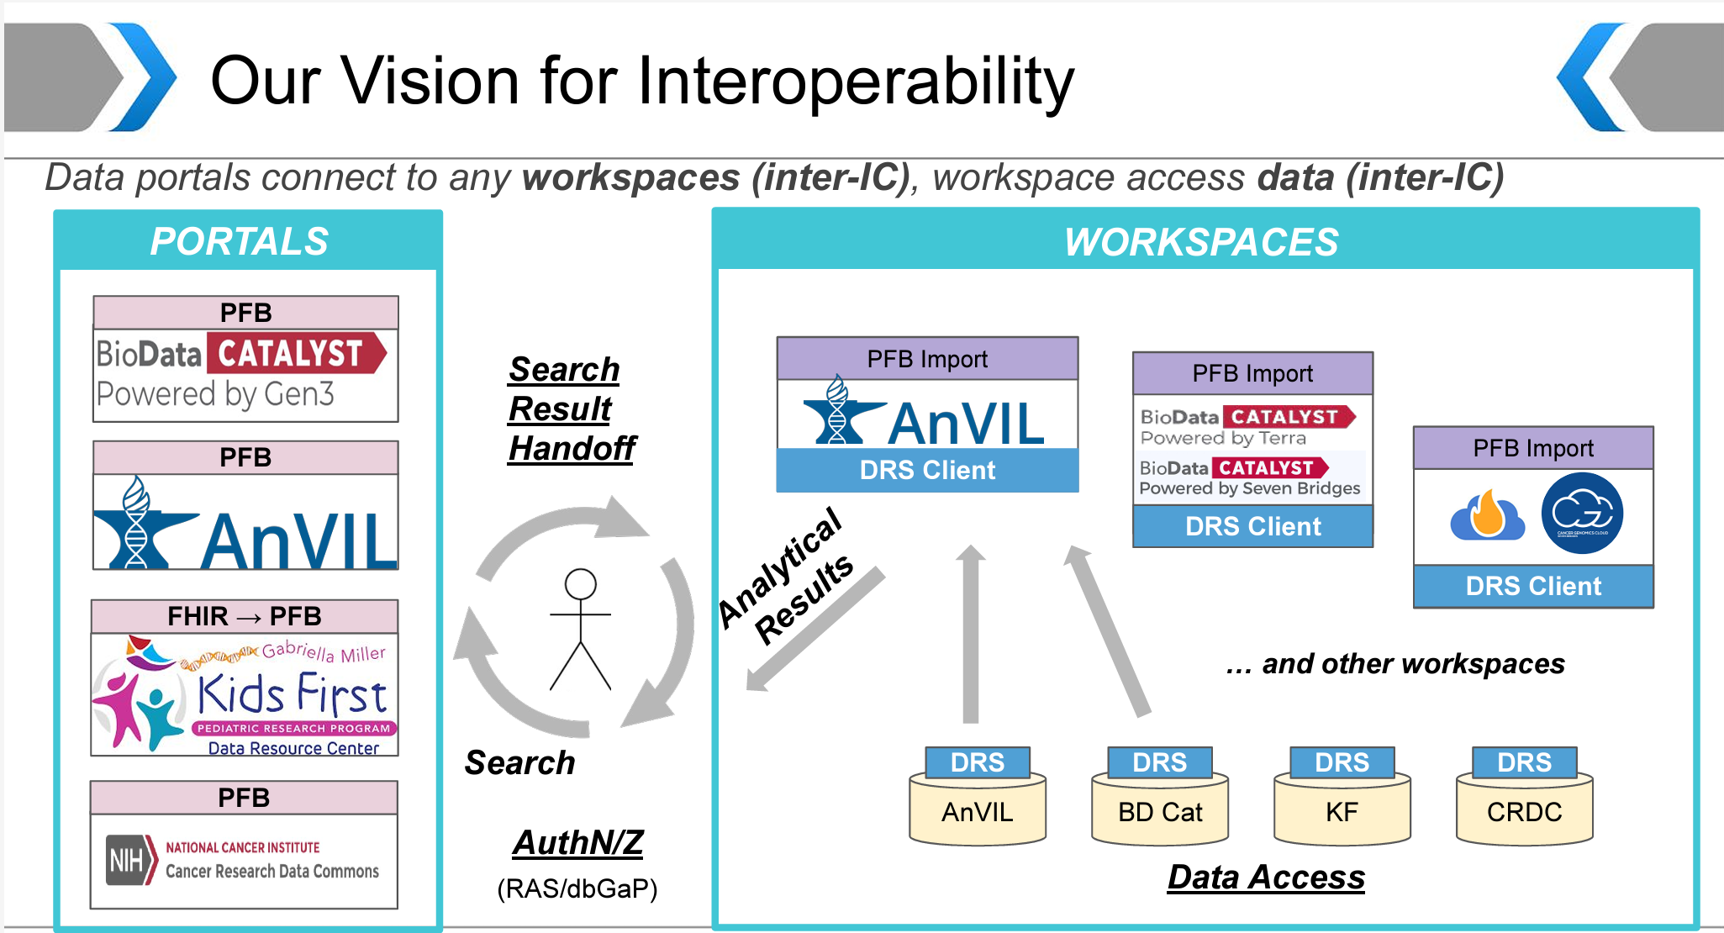
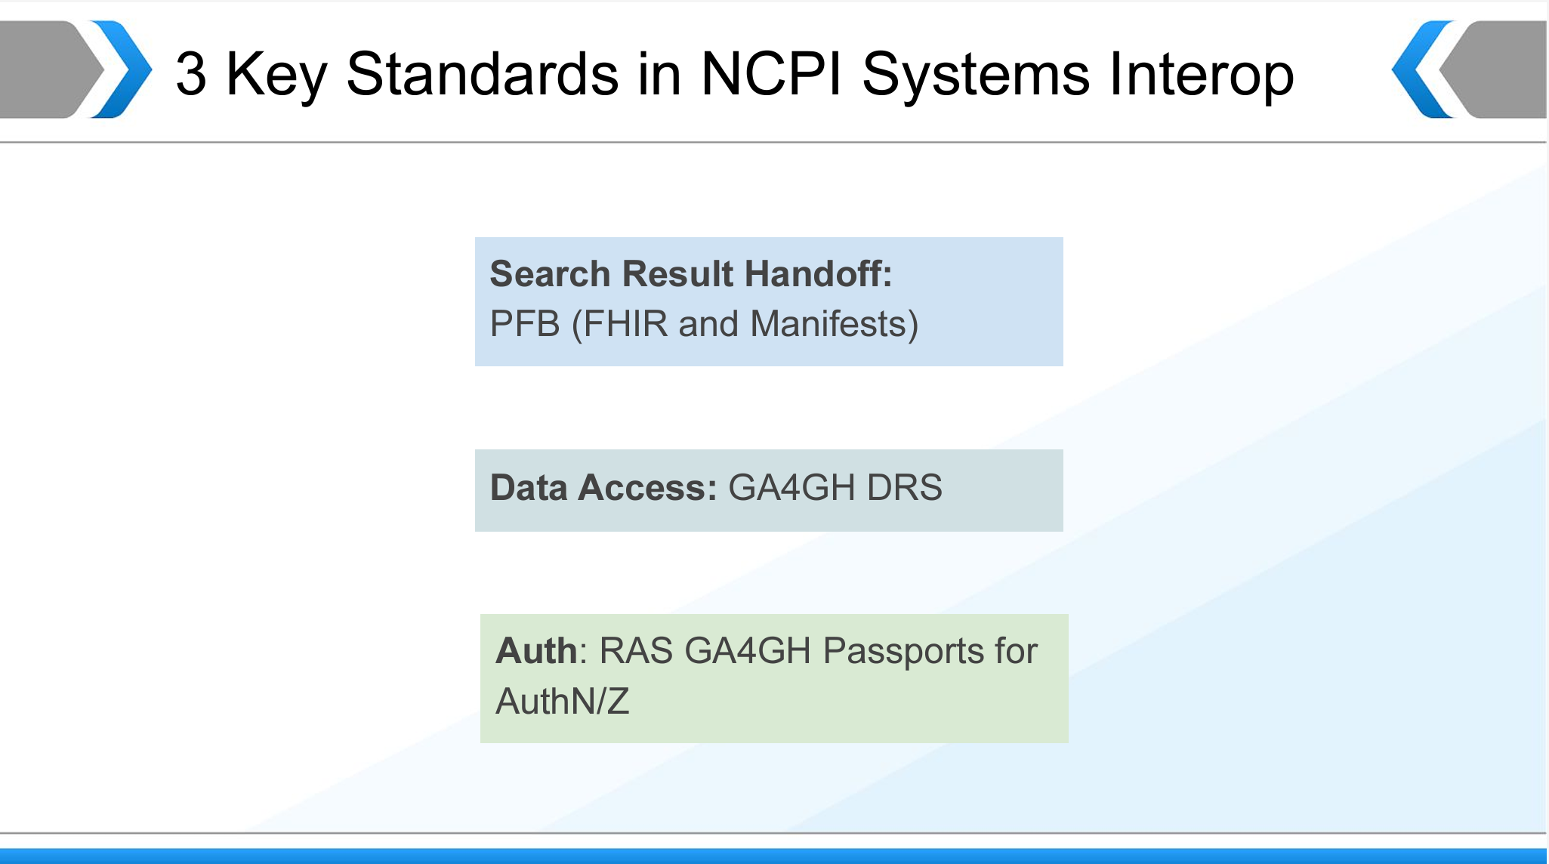

NIH Cloud Platform Interoperability (NCPI)
https://www.ncpi-acc.org/files/workshops/2021_Oct/2021-10-05_NCPI_Workshop.pdf
Slide courtesy of Richard Conroy

Slide 22
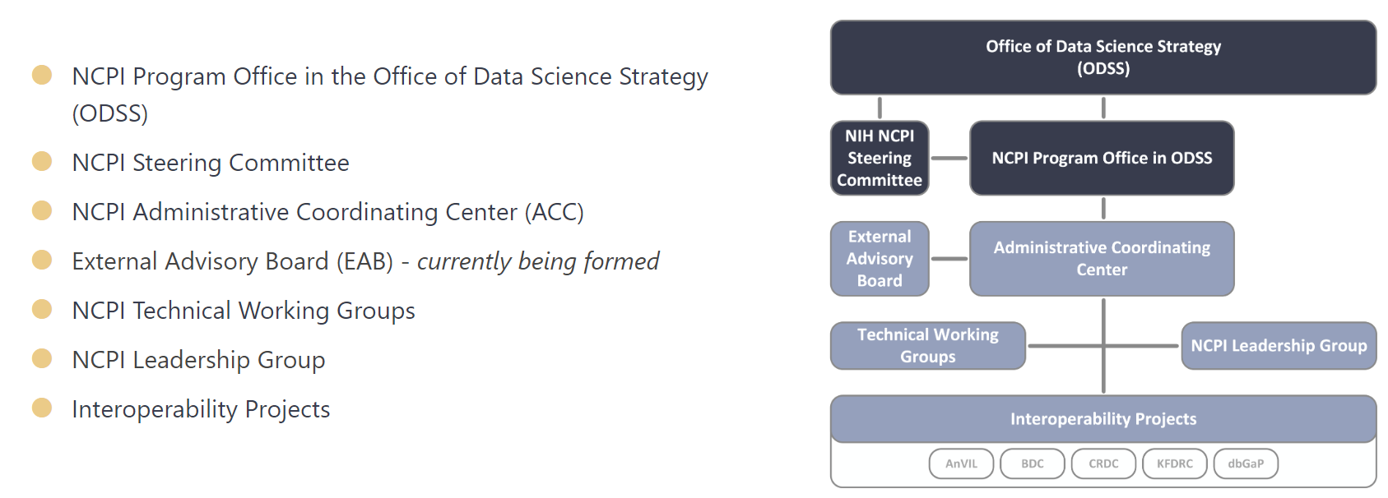
NIH Cloud Platform Interoperability (NCPI)
https://www.ncpi-acc.org/about
NIH Steering Committee is comprised of decision maker-federal sponsors for each of the participating systems (AnVIL, BDC, CRDC, KFDRC, dbGAP)
Slide courtesy of Richard Conroy

Slide 23

NAIRR Pilot Update
Katie Antypas
Office Director, Office of Advanced Cyberinfrastructure
National Science Foundation
April 2025
Notes:
Democratizing access to data, compute, AI resources

Slide 24
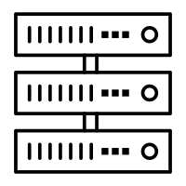




National AI Research Resource (NAIRR) – An infrastructure to drive US AI innovation, discovery, and national competitiveness
The challenge: To accelerate US global AI leadership and unlock the enormous AI opportunity across society we need 1) a skilled AI workforce and 2) to continue driving fundamental innovations.
Access to computing, data, models, software and expertise is a key enabling factor.
Industry investments alone will not be sufficient
The opportunity: Build a competitive AI ecosystem by enabling researchers and educators across the country to:
Drive national and regional AI innovation across sectors to spark new solutions, products, businesses and jobs
Train the AI workforce of the future
Envisioned NAIRR Architecture
Computing and software
Datasets and Models
Central Portal
Educational materials and training tools
User support and expertise
nairrpilot.org
Slide courtesy of Katie Antypas
Notes:
The demand for access to computing, data, models and user training is high and growing – NSF alone made 17,000 awards to AI related projects in the past 3 years

Slide 25


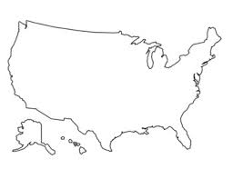




Pilot Year 1: We built the key foundations needed for the NAIRR
Portal
Establish strong govt-industry partnership
Integrate & deliver contributed resources
Establish single access point for US users
Expand AI research & education pathways
A new multi-lateral model based on voluntary in-kind contributions to bring the most advanced resources to US researchers
Back-end operations to loosely integrate and track all contributed resources: compute, data, models, expertise
Portal deployment, request process, on boarding, resource matching, support, training
Technical Demo Projects, NAIRR Secure, NAIRR Classroom, community workshops & outreach, data set contributions
14 agencies
26 industry and non-profit partners
80% of partner resources are engaged and being utilized
350 approved projects supporting over 1500 students across 43 states
Initiated over 20 funded projects and pilots
--> Focus of Y2
Results
Slide courtesy of Katie Antypas

Slide 26
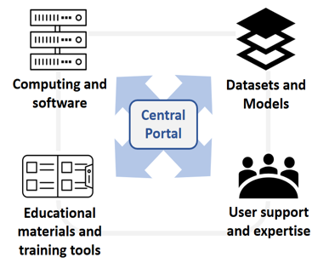
NAIRR Pilot Insights and Lessons From Year 1:
1. The public private partnership model is VERY advantageous
2. High demand for the array of NAIRR Pilot AI resources, including user training and support
3. Intensive coordination is key to connect partners, resources, and users
4. Access to trusted data and their integration are central challenges
5. Important to measure performance, impact, and success in an integrated manner along the way.
Vision for the NAIRR
National Goals
Accelerate AI innovation and AI driven science discovery
Expand US AI workforce
  Key Performance Points
  Easily accessible resources via a portal.
  Seamless integration of data, models, software & compute.
  Extensive support via expertise and training.
  Pilot Year 2 Plan
  Finalize design and governance blueprint
  Augment user support, training and operational efficiencies
  Build on lessons learned
  Develop metrics for NAIRR
Slide courtesy of Katie Antypas

Slide 27
2024 DOE Advanced Scientific Computing Advisory Committee (ASCAC) Facilities Subcommittee Recommendations
“Recommendation 2:
Science demands integration. We advocate viewing ASCR facilities not as isolated entities, but as integral components of a single, larger integrated computational Ecosystem, with a single governance model.”

Slide 28
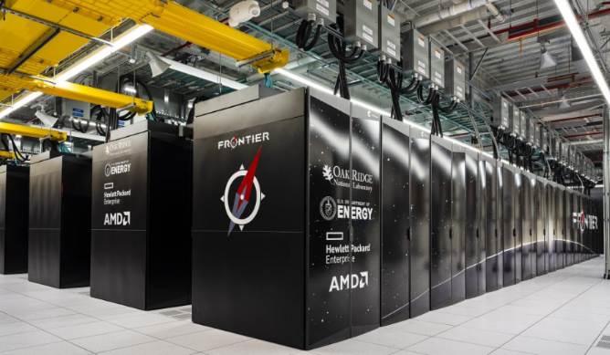

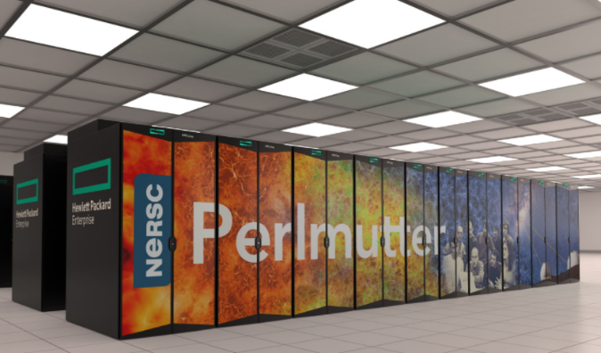

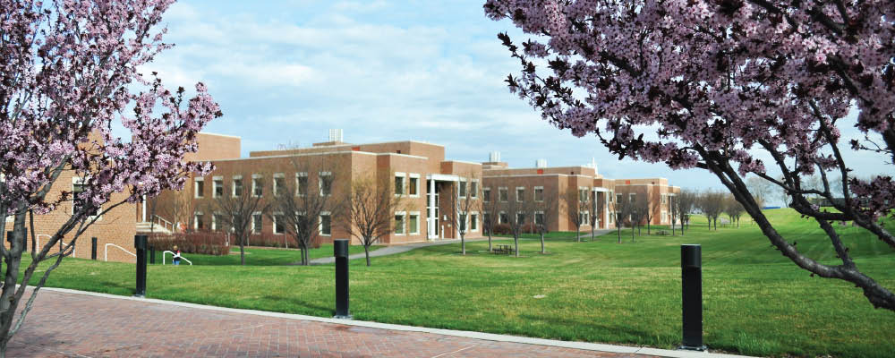
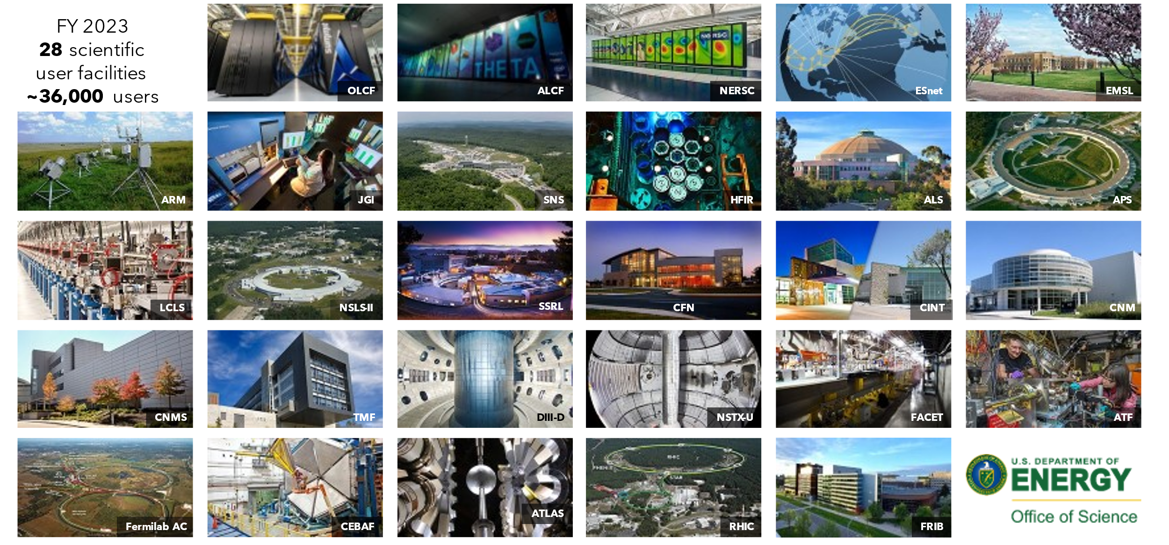
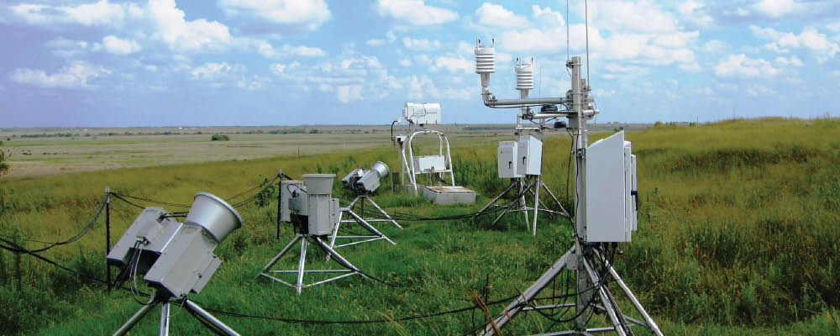
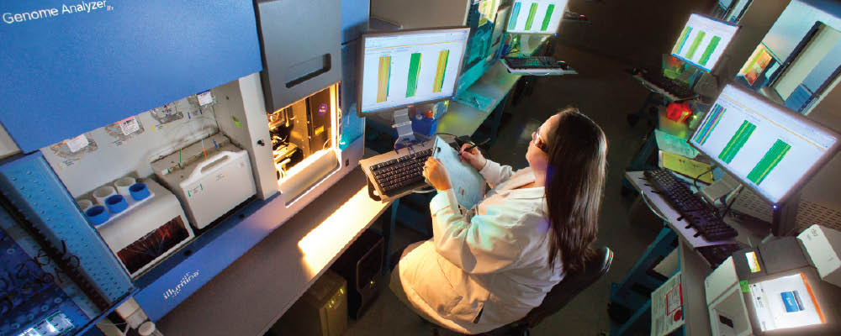
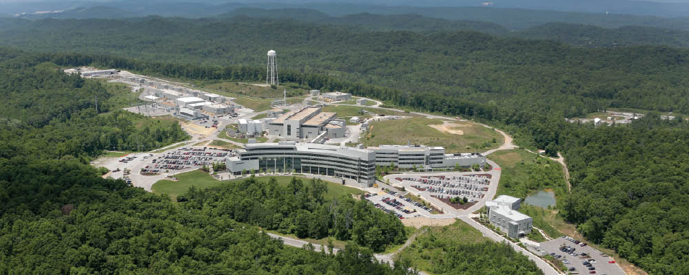

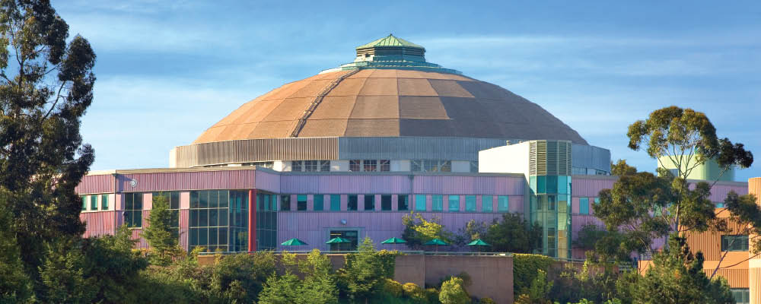
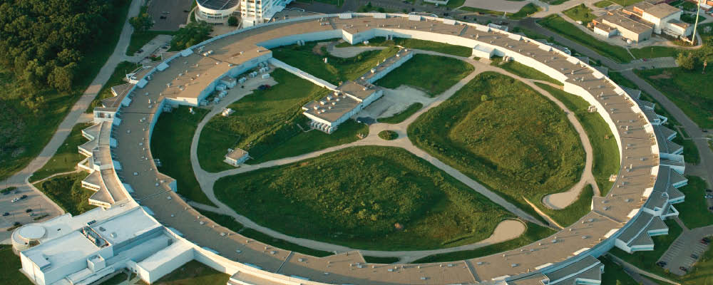
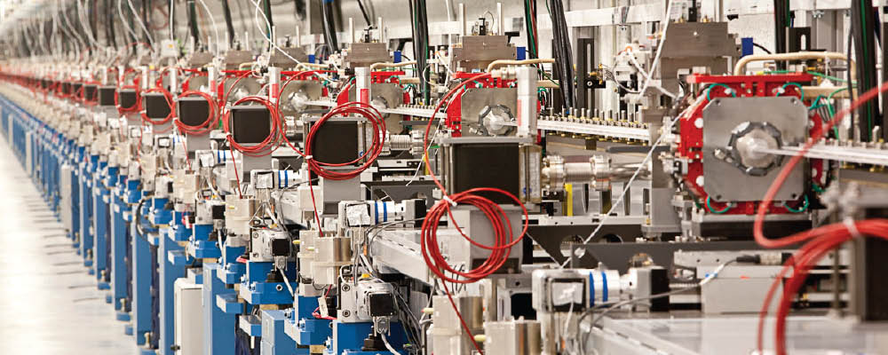
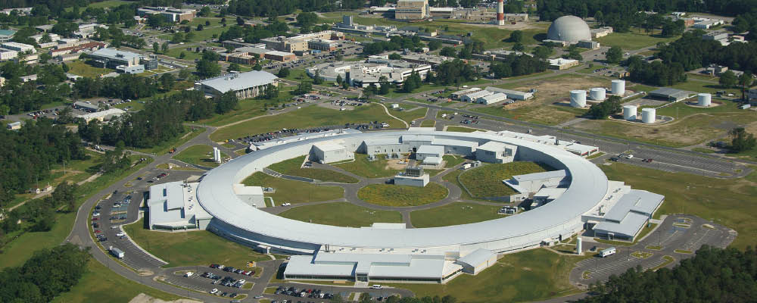
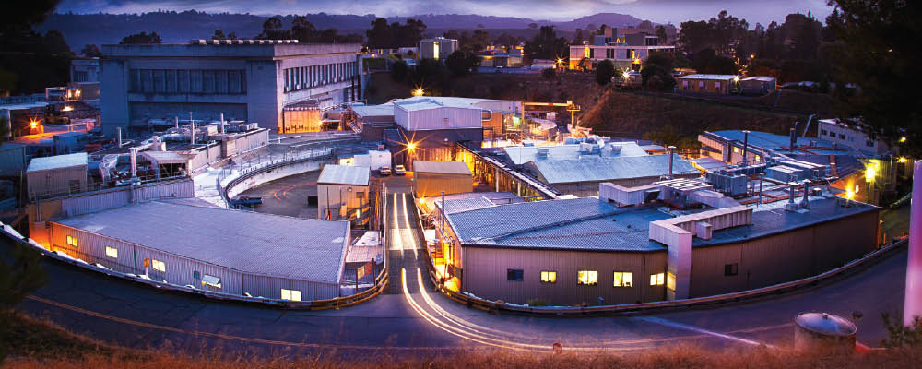
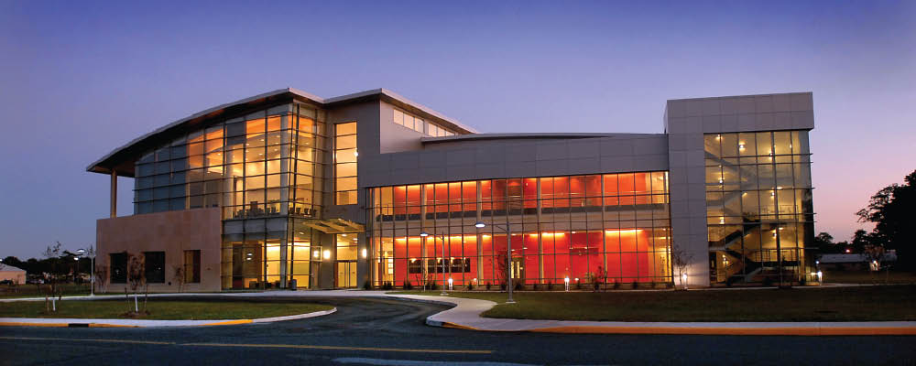
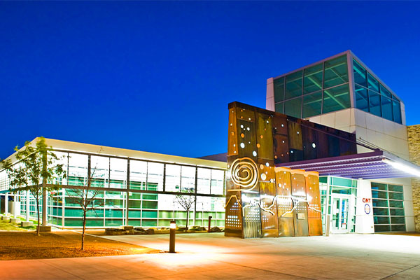
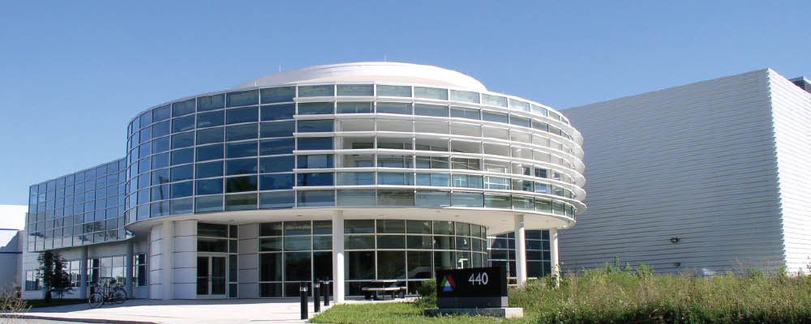
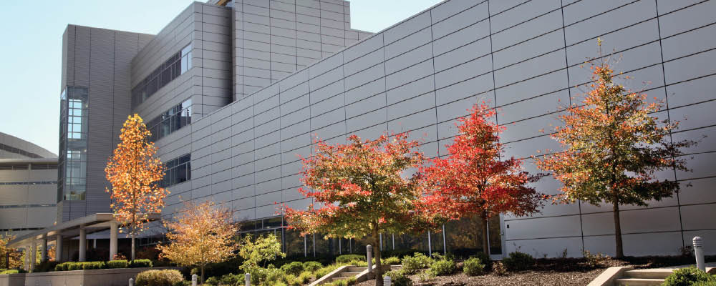

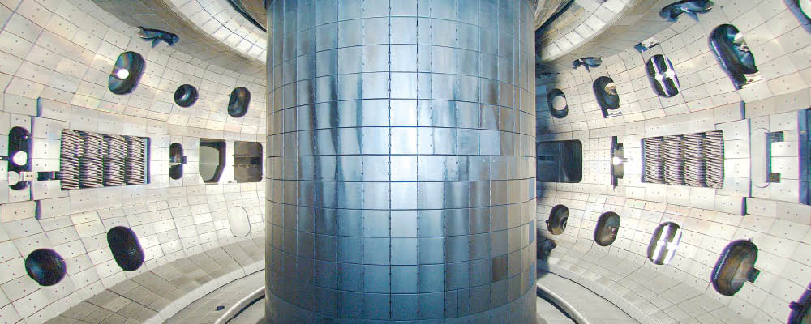
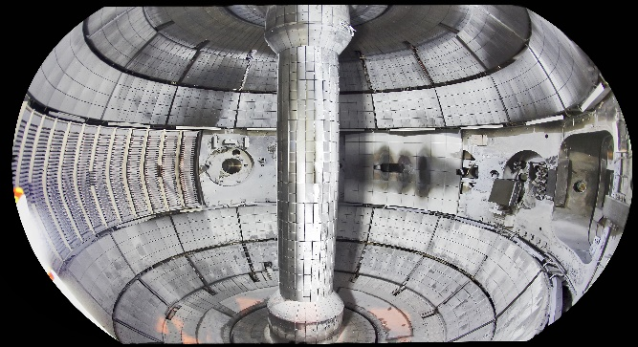
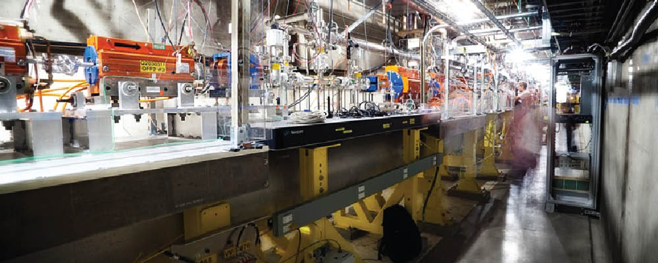
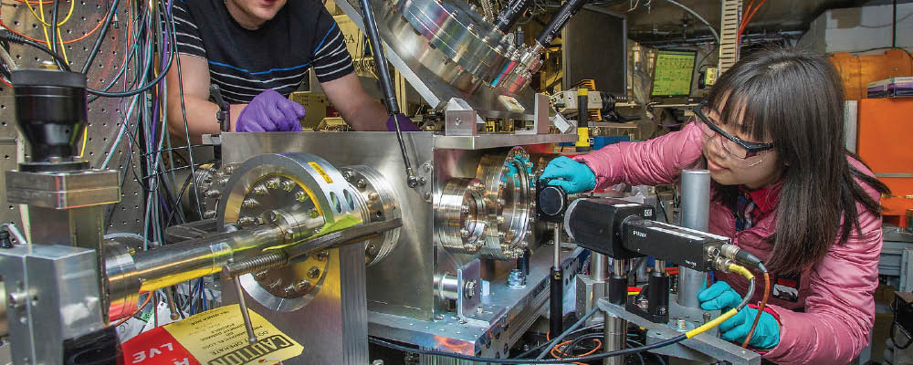
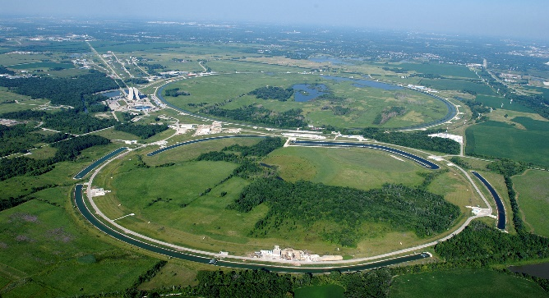
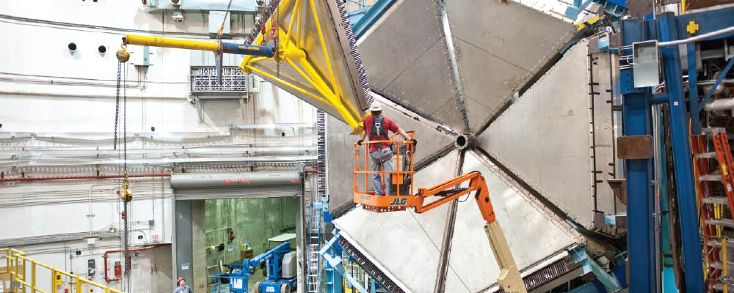

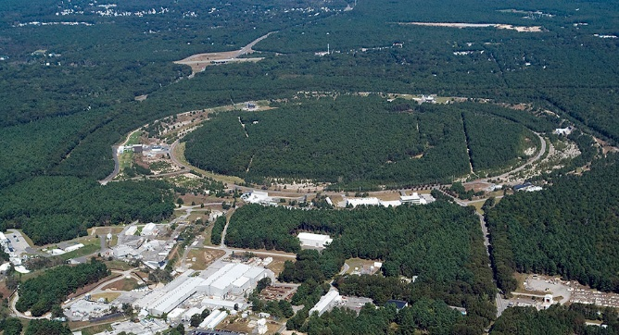
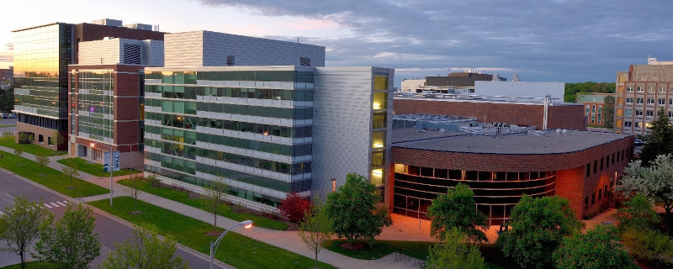

The Office of Science User Facilities
FY 2025
28 scientific
user facilities
>39,500 users
OLCF
ALCF
NERSC
ESnet
EMSL
ARM
JGI
SNS
HFIR
ALS
APS
LCLS
NSLS-II
SSRL
CFN
CINT
CNM
CNMS
TMF
DIII-D
NSTX-U
FACET
ATF
Fermilab AC
CEBAF
ATLAS
RHIC
FRIB
Notes:
Template Instructions: Please leave this slide as is.
Another User Facilities slide follows with further detail. Either of the slides could be used, or both.

Slide 29
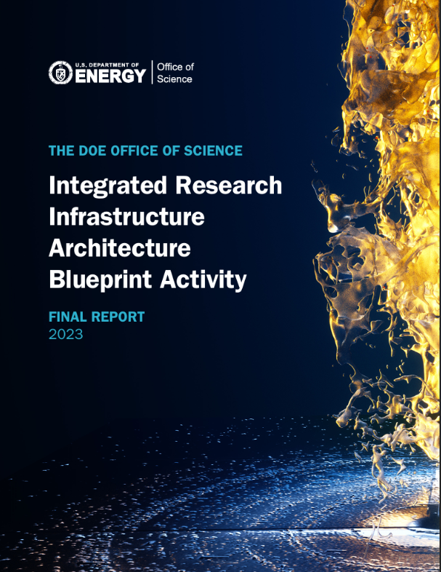
IRI / HPDF
“Integrated Research Infrastructure (IRI): To empower researchers to meld DOE’s world-class research tools, infrastructure, and user facilities seamlessly and securely in novel ways to radically accelerate discovery and innovation.”
“The complexity of scientific pursuits is increasing rapidly with aspects that require dynamic integration of experiment, observation, theory, modeling, simulation, visualization, machine learning (ML), artificial intelligence (AI), and analysis.”
Notes:
Capitalizing on integrating across the data lifecycle: Ecosystem includes instruments where data are born.

Slide 30
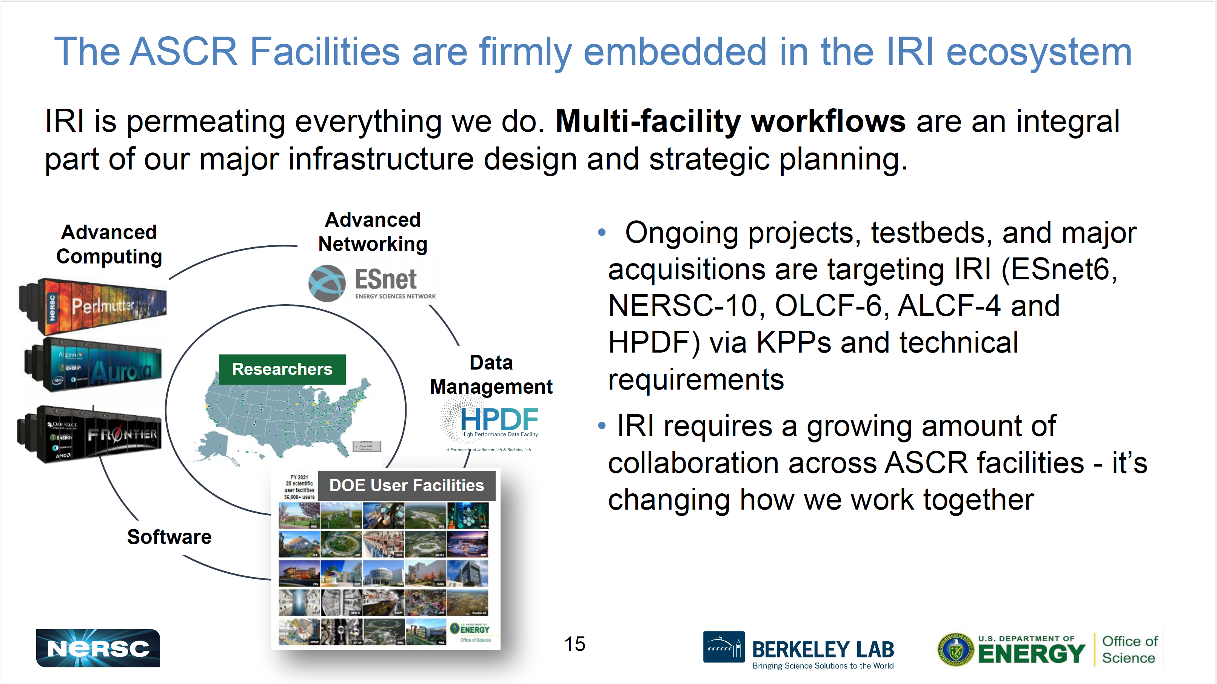
Slide courtesy of Debbie Bard

Slide 31
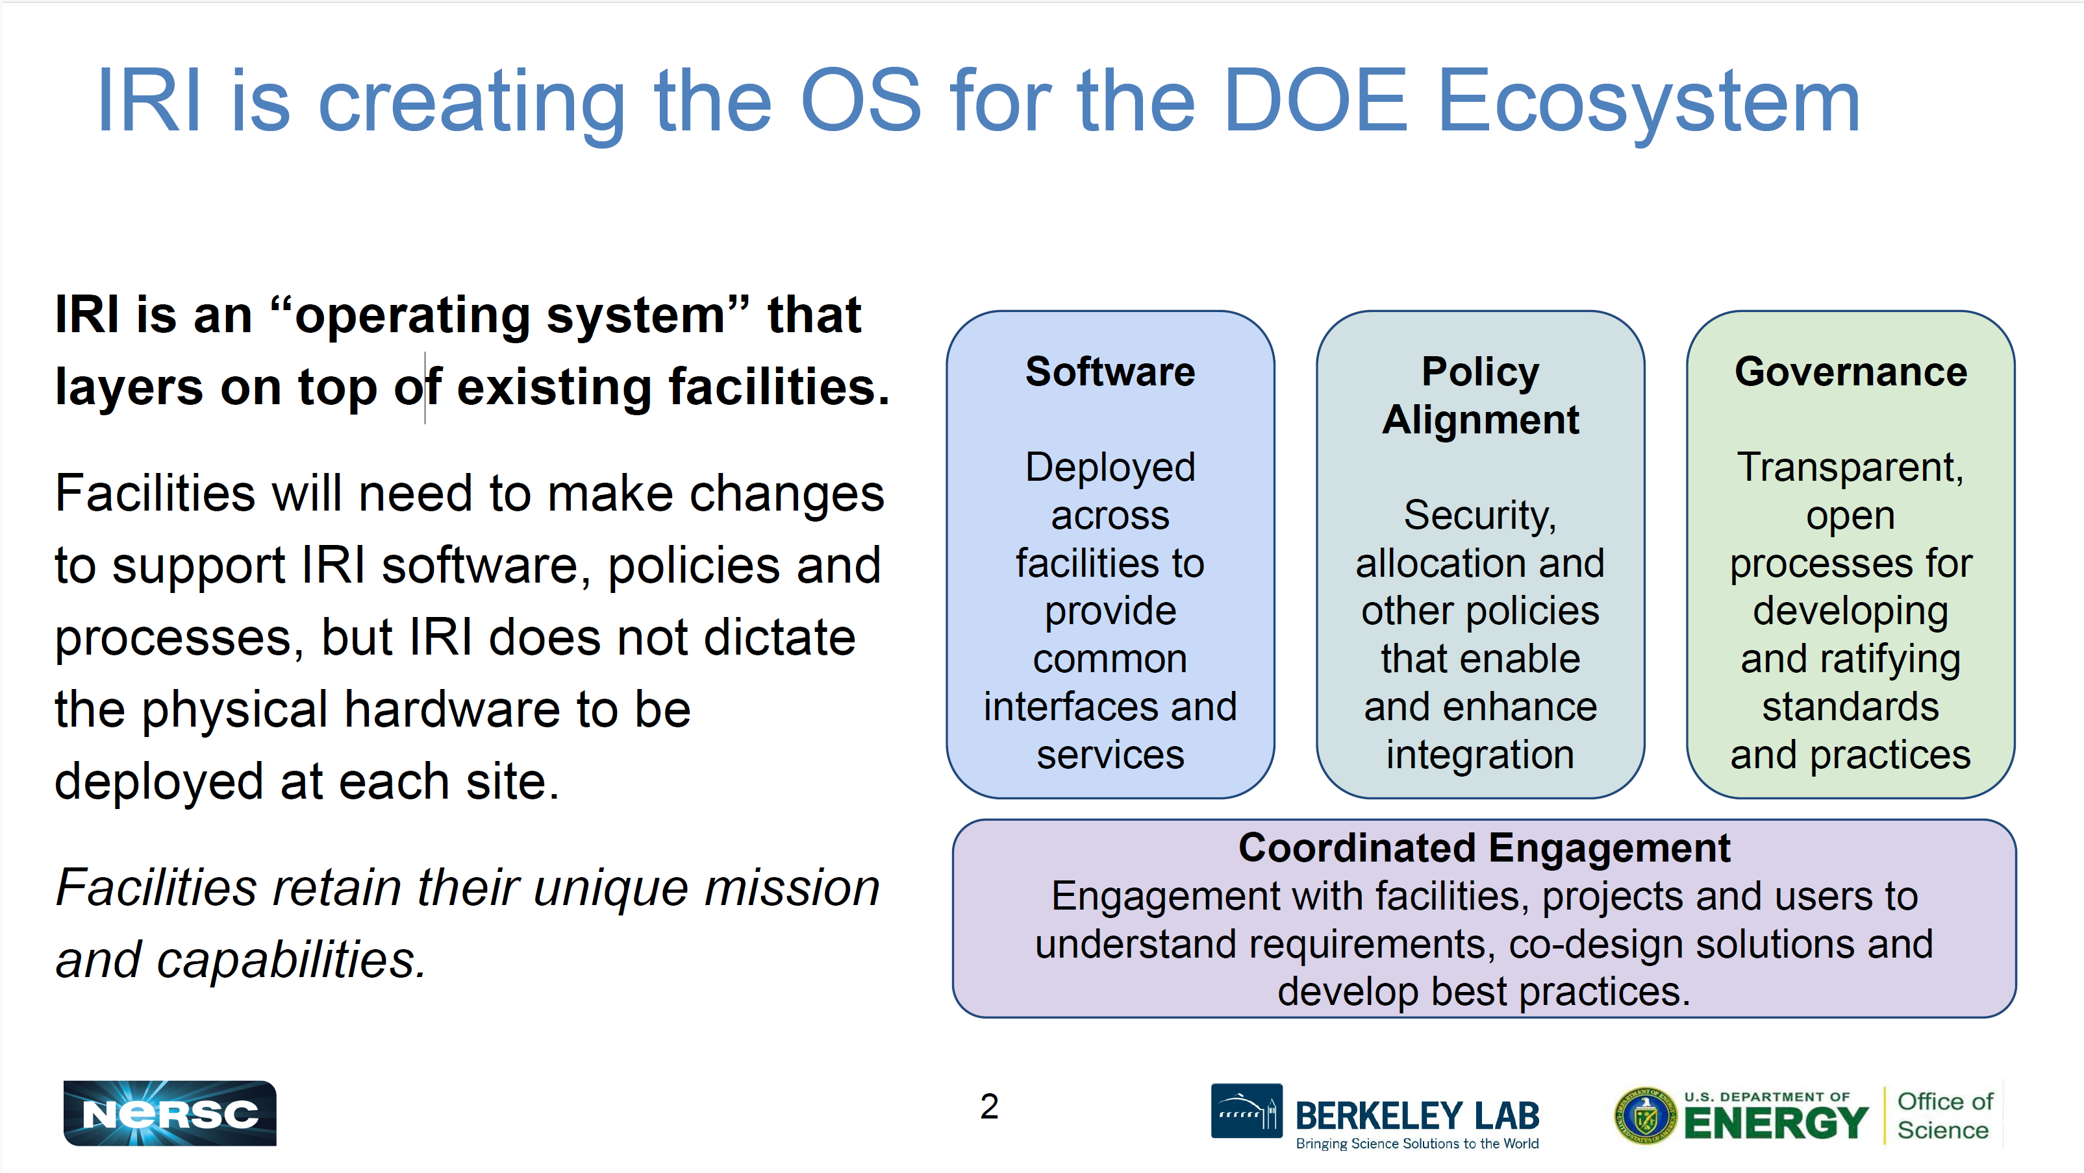
Slide courtesy of Debbie Bard

Slide 32
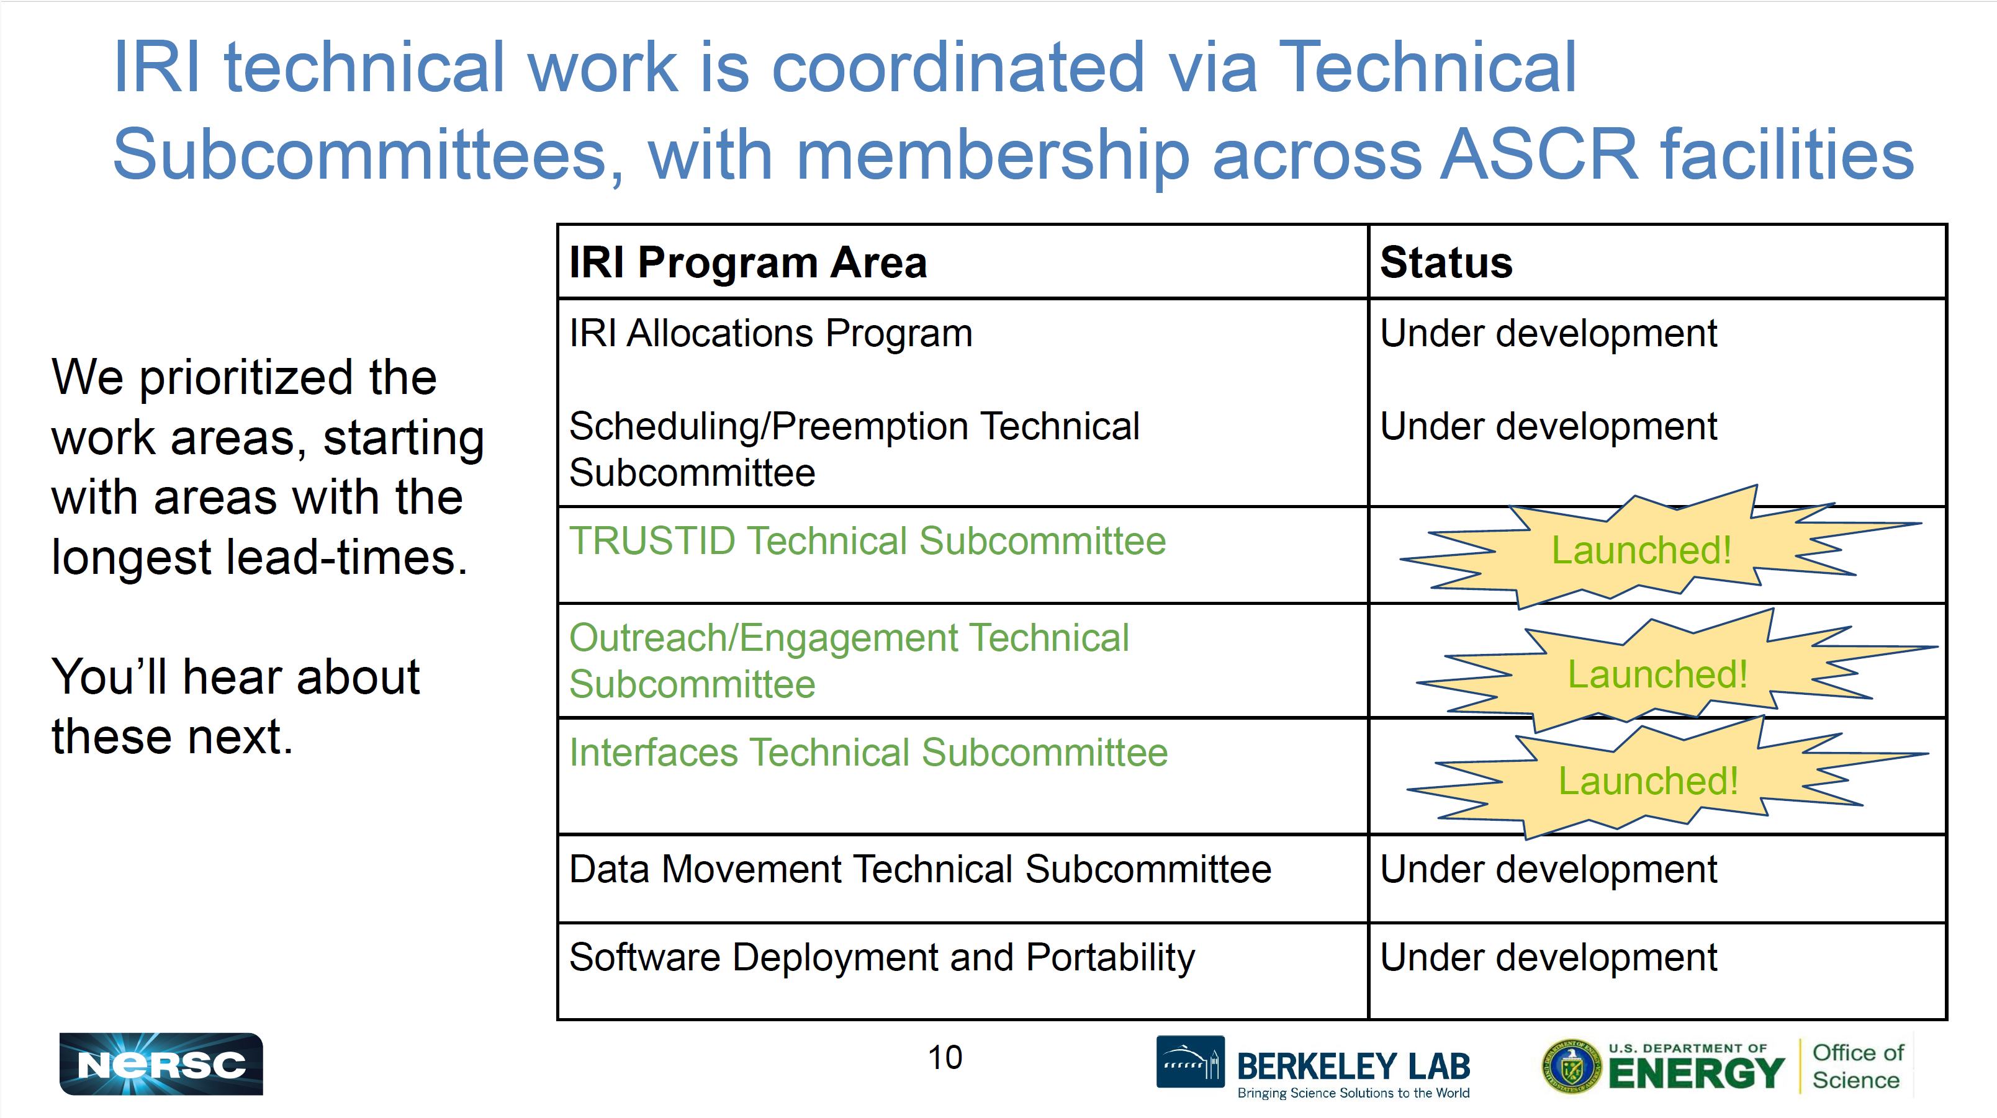
Slide courtesy of Debbie Bard

Slide 33
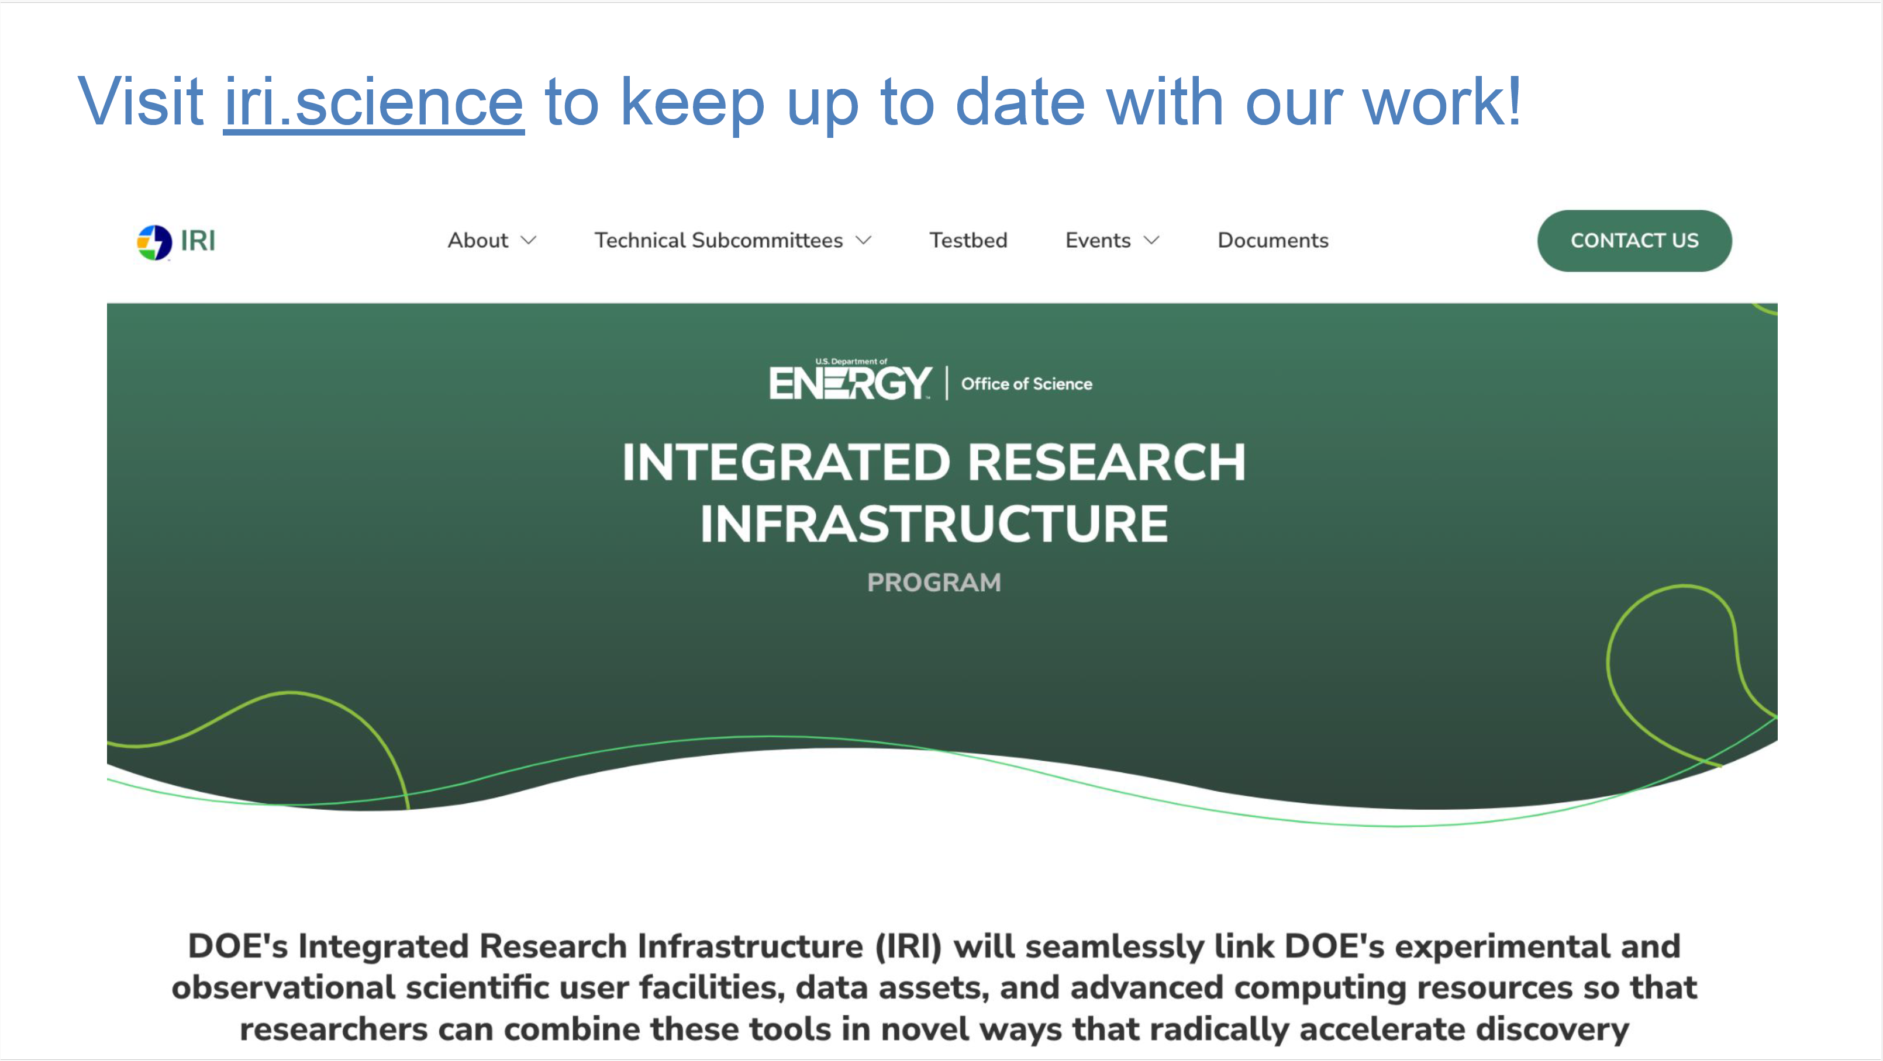

Slide 34
HPDF will support data lifecycle management
Refine
User Facilities
Science Gateways
Raw & Derived Data
Publish
Fulfill FAIR principles for scientific data
Share
Hub
Release
Acquire and Prepare
Ingest experimental, observational and reprocessed data using standard APIs
ESnet
Preserve
Long-term data curation and archiving
Tiered
Storage
Analyze
Transfer
Move and manage data
and dynamic data streams
Clean and Process
Scalable scientific and
AI/ML workflows
Compute
The HPDF Hub is a cutting-edge high-performance data platform that provides advanced storage, processing, and analytical services, empowering data-intensive research and AI-driven discoveries.
Slide courtesy of Kate Mace

Slide 35
The HPDF Project will design and deploy the first large-scale data infrastructure for DOE SC
HPDF Project will support & enable capabilities which address scientific requirements gaps for:
Data curation, repositories, & archives
Federation, searching, sharing, & collaboration
Varied data processing & analysis pipelines
Time-sensitive workloads
AI/ML workloads
HPDF Facility will operate the data infrastructure and innovate to meet the evolving needs of the community
ASCR Facilities
HPDF Facility
DOE SC Programs
(BER, BES, NP, FES, HEP, IP)
User Facilities
Science Projects
Data Repositories
Broader
Scientific
Community
ALCF
OLCF
NERSC
ESnet
System Management
& Maintenance
Allocation & Account Management
Facility Upgrades & Maintenance
Science Engagement
HPDF Project
User Support
Requirements & Workflow Readiness
DOE SC Partnerships
Early Co-design
Long-term Spokes
ASCR Ecosystem
HPDF Hardware & System (Vendor)
Provided & Integrated
Centers of Excellence
Final System Hardware
System Software & Management
Platform and Services
HPDF Platform Software & Data Services
Early
Access
Systems
Integration and Testing
Data Policy & Stewardship
Integrated Research Infrastructure
Artificial Intelligence Initiatives
Facilities
JLDC Build Out
B59 Build Out
Slide courtesy of Kate Mace

Slide 36

https://www.hpdf.science/

Slide 37
Laura’s Data and Compute Ecosystem Checklist

Slide 38
Key Aspects of a Data and Compute Ecosystem
(Laura’s running list)
Purpose and Value Proposition
Ready Applications
Reference Architecture (multiple levels)
FAIR Ecosystem Services
Principled, Full-lifecycle Approach to Data Management
Governance for the Interoperability Layer - Policy / incentives
Workforce for the Entire Lifecycle / Ecosystem

Slide 39
Key Aspects of a Data and Compute Ecosystem
(Laura’s running list)
Purpose and Value Proposition
Ready Applications
Reference Architecture (multiple levels)
FAIR Ecosystem Services
Principled, Full-lifecycle Approach to Data Management
Governance for the Interoperability Layer - Policy / incentives
Workforce for the Entire Lifecycle / Ecosystem
Guides design trade-offs
Leads to measures and metrics for risk, progress and success
Attracts and inspires users
Articulates new capabilities
Helps justify budgets

Slide 40
Key Aspects of a Data and Compute Ecosystem
(Laura’s running list)
Purpose and Value Proposition
Ready Applications
Reference Architecture (multiple levels)
FAIR Ecosystem Services
Principled, Full-lifecycle Approach to Data Management
Governance for the Interoperability Layer - Policy / incentives
Workforce for the Entire Lifecycle / Ecosystem
Describe workflow as graph of tasks (multi-scale)
Prepare for distributed computing and storage
Identify artifacts for provenance
Identify metadata for actionability
Data governance rules
Repositories for sharing
Relevant standards
Some of these take substantial effort and time

Slide 41
Key Aspects of a Data and Compute Ecosystem
(Laura’s running list)
What’s in and what’s out
Hardware components: compute, storage, network, instruments, edge devices,…
Software stacks
“Data logic” components: repositories, workspaces, analysis codes, APIs,…
PID granularity and connections
Organizational layer: delineation of management authorities, commercial platforms,…
Map the user experience / workflow across all levels
Importance of defining the “unit” component
Purpose and Value Proposition
Ready Applications
Reference Architecture (multiple levels)
FAIR Ecosystem Services
Principled, Full-lifecycle Approach to Data Management
Governance for the Interoperability Layer - Policy / incentives
Workforce for the Entire Lifecycle / Ecosystem
Notes:
Like a software stack
Think GIS layers for the ecosystem.

Slide 42
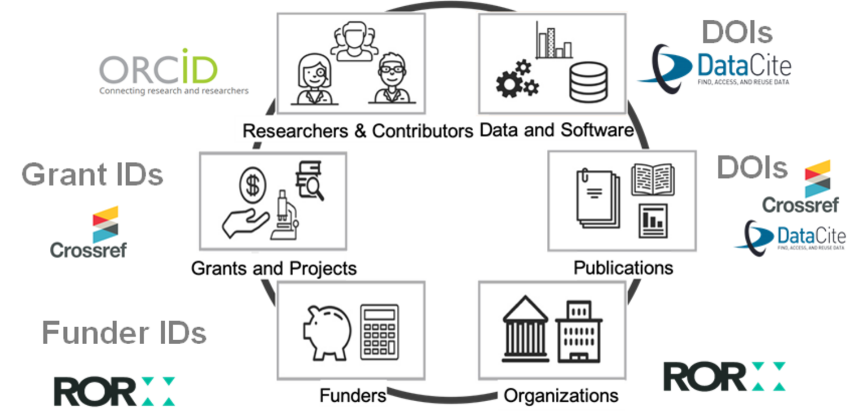
PID Layer
https://projects.tib.eu/pid-service/en/persistent-identifiers/persistent-identifiers-pids/
Notes:
https://www.niso.org/niso-io/2024/08/national-pid-strategies

Slide 43


Data Logic Layer: NCPI Example
Slides courtesy of Richard Conroy

Slide 44
Key Aspects of a Data and Compute Ecosystem
(Laura’s running list)
Purpose and Value Proposition
Ready Applications
Reference Architecture (multiple levels)
FAIR Ecosystem Services
Principled, Full-lifecycle Approach to Data Management
Governance for the Interoperability Layer - Policy / incentives
Workforce for the Entire Lifecycle / Ecosystem
Services outside the capability of any single node.
Services are standards + software
Catalogs
AuthN/Z
Search tools
Workflow orchestration
Provenance capture
…

Slide 45


FAIR Ecosystem Services
Interoperability of data, systems, policies,…

Slide 46
Key Aspects of a Data and Compute Ecosystem
(Laura’s running list)
Purpose and Value Proposition
Ready Applications
Reference Architecture (multiple levels)
FAIR Ecosystem Services
Principled, Full-lifecycle Approach to Data Management
Governance for the Interoperability Layer - Policy / incentives
Workforce for the Entire Lifecycle / Ecosystem
Lack of visibility up and down the data lifecycle.
Importance of repositories in bridging the “producer – user” singularity

Slide 47


Principled approaches to data management help the flow contextual information up/down the data lifecycle

Slide 48

Big Data: Pioneering the Future of Federally Supported Data Repositories Workshop Report
The envisioned future is a data ecosystem optimized for data science that is characterized by innovative, user-driven approaches to combining data for insights. This data ecosystem requires capabilities for integrating data across FSDRs and other data sources that are agile, routine, and broadly enabled.
Strong partnerships between FSDRs and the science research community to continually enhance the potential for discovery and provide benefit to society.
Integration of FSDRs into an internationally recognized, national-scale data and computing ecosystem to broaden participation and enable faster, easier, and more equitable access to data driven science.
Recognition and support for FSDRs as long-term infrastructure to provide continuity of service to the research community as well as a fertile environment for training future generations of scientists.
Participation by FSDRs in an interdisciplinary, national-scale community of repositories to enhance interoperability and achieve goals not otherwise obtainable from single data sources.
Foster a culture of continuous evaluation and improvement of FSDRs for greater scientific impact from data.
Notes:
https://www.nitrd.gov/pubs/NITRD-BDIWG-Workshop-FSDRs-2022.pdf

Slide 49
Key Aspects of a Data and Compute Ecosystem
(Laura’s running list)
Purpose and Value Proposition
Ready Applications
Reference Architecture (multiple levels)
FAIR Ecosystem Services
Principled, Full-lifecycle Approach to Data Management
Governance for the Interoperability Layer - Policy / incentives
Workforce for the Entire Lifecycle / Ecosystem
For each component of the ecosystem, support for interoperability is usually small compared to support for base mission.
Governance ensures alignment between interoperability goals and components’ goals.

Slide 50

Governance and Policy
“…the effectiveness, safety, and inclusivity of AI-driven research and practice requires the establishment of a distributed accountability regime in which all interest holders contribute to the responsible design, development, use, and oversight of technology.” -- Report from the Community Workshop
Toward an Ethical Framework for Artificial Intelligence in Biomedical and Behavioral Research: Transparency for Data and Model Reuse
“Effective data management and sharing has the potential to increase the pace of scientific discovery, promote more efficient and effective use of government funding and resources, and create a more equitable Federal scientific ecosystem through data sharing and preservation. Data management planning should be an integral part of research planning.” -- DOE Public Access Plan 2023

Slide 51
Key Aspects of a Data and Compute Ecosystem
(Laura’s running list)
Purpose and Value Proposition
Ready Applications
Reference Architecture (multiple levels)
FAIR Ecosystem Services
Principled, Full-lifecycle Approach to Data Management
Governance for the Interoperability Layer - Policy / incentives
Workforce for the Entire Lifecycle / Ecosystem
Diversified skills for
Data analysis
Data management
Data curation
Data repository management
Creation of FAIR services
Workflow operations
…

Slide 52


Reflects the diversity of roles across the ecosystem / across the lifecycle
Foundations of Analytics
Systems and Implementation
Data Science Project Design
Data Science in Practice
Professional Practice and Responsible Data Science

Slide 53
Data Management Drivers @Jlab
(Laura’s List)
Reproducible analysis workflows (which also train AI)
DOE Order 241.C
FAIR Data for cross-experiment data analysis and AI
HPDF Use Case
Future data and compute ecosystems

Slide 54
Data Management Drivers @Jlab
(Laura’s List)
Reproducible analysis workflows (which also train AI)
DOE Order 241.C
FAIR Data for cross-experiment data analysis and AI
HPDF Use Case
Future data and compute ecosystems
Purpose and Value Proposition
Ready Applications
Reference Architecture (multiple levels)
FAIR Ecosystem Services
Principled, Full-lifecycle Approach to Data Management
Governance for the Interoperability Layer - Policy / incentives
Workforce for the Entire Lifecycle / Ecosystem

Slide 55
Thank you
Laura Biven, PhD
Chief Data Officer
Jefferson Lab
biven@jlab.org
https://www.jlab.org/
orcid.org/0000-0002-5755-8449

