Slide 1


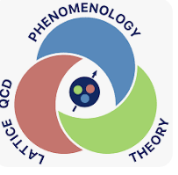
String based QCD:
Jlab and EIC
I. Zahed
Jlab 25’

Slide 2
Strings:
Spectroscopy, FFs, scattering

Slide 3
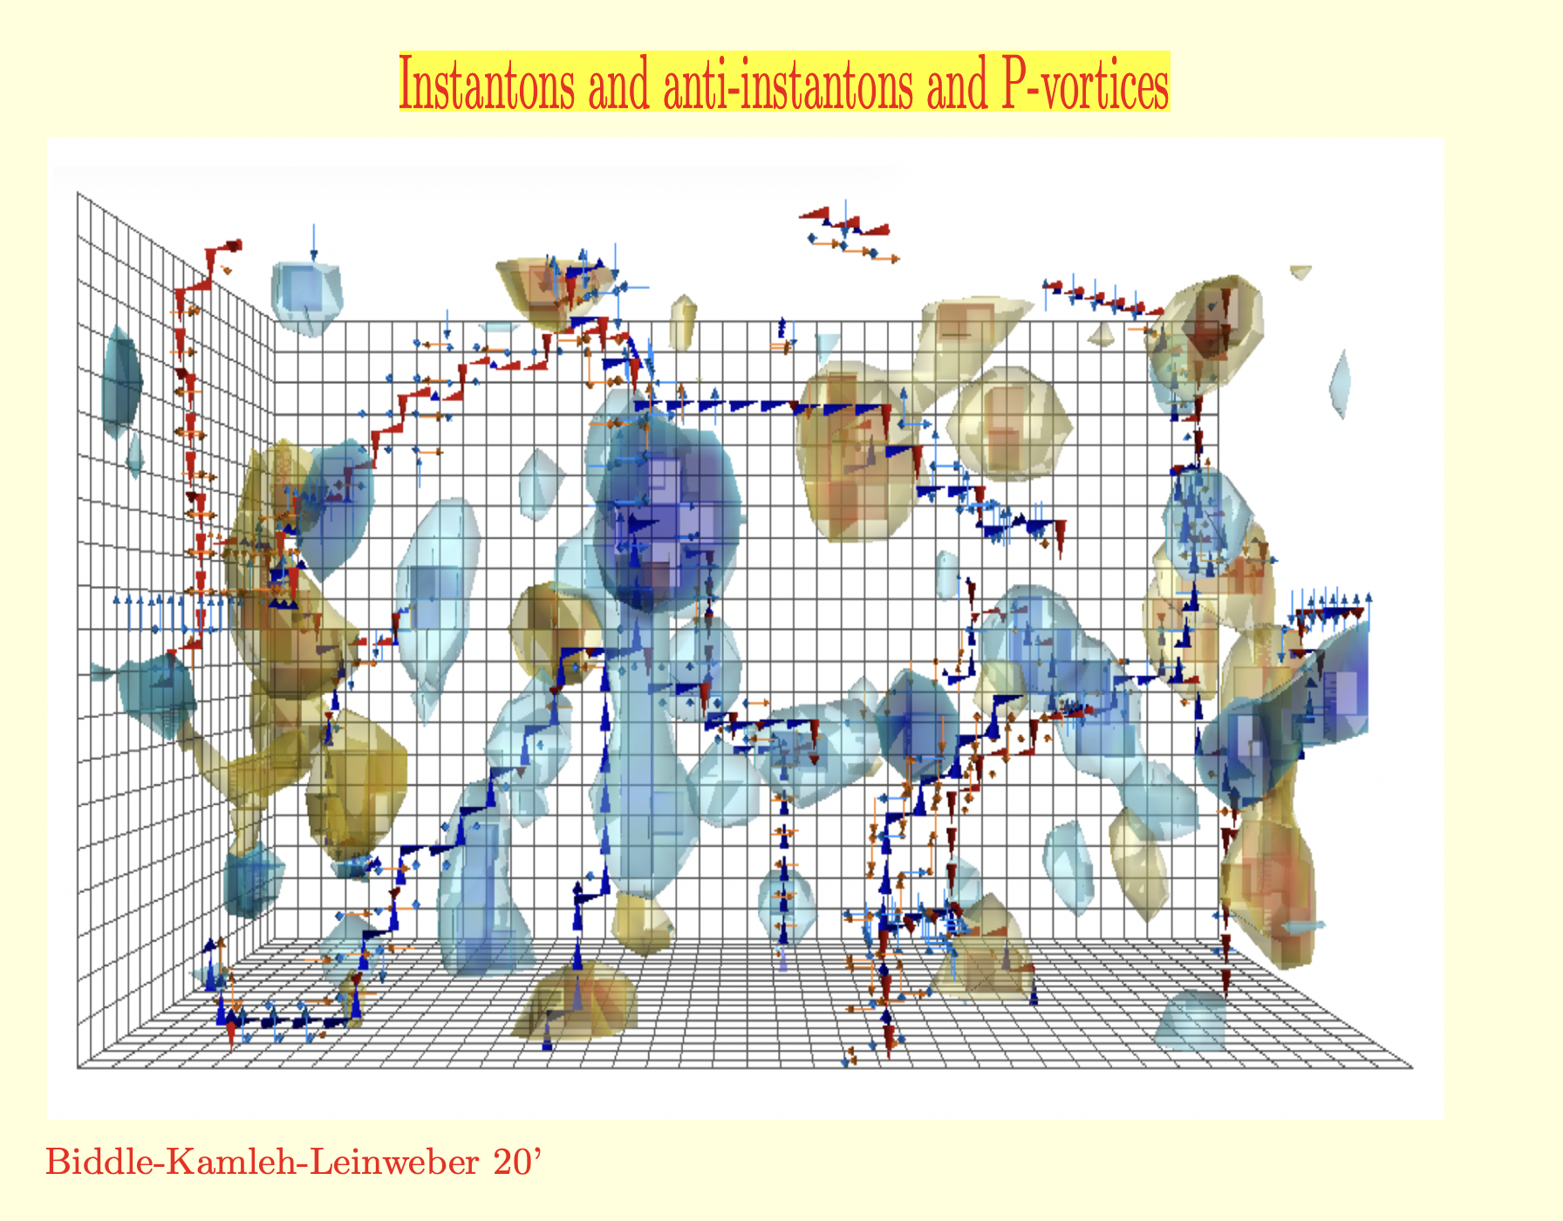
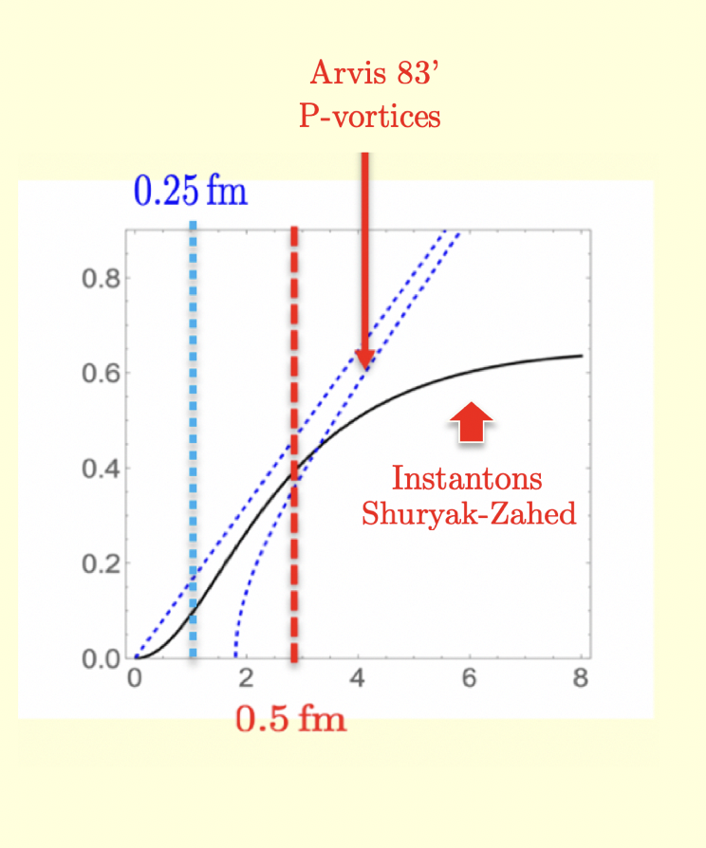
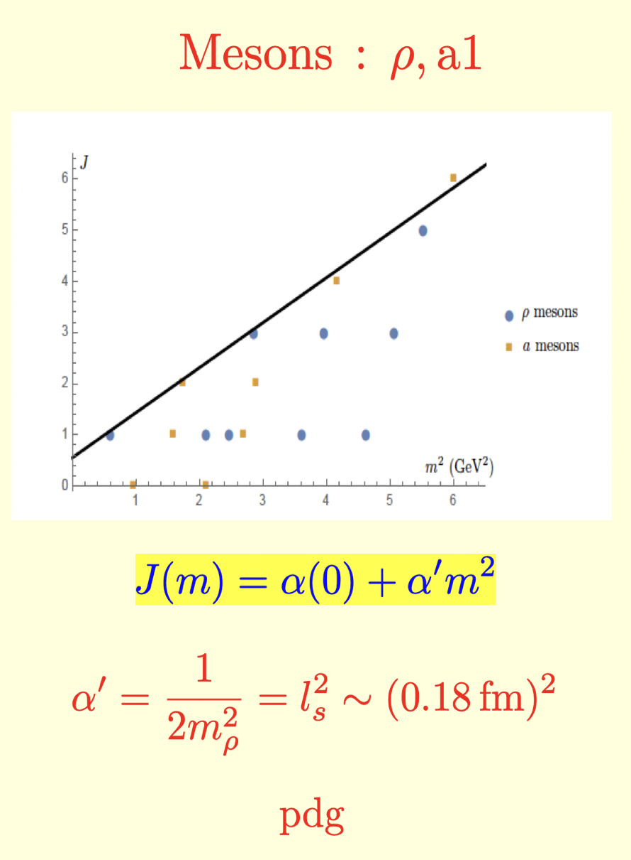
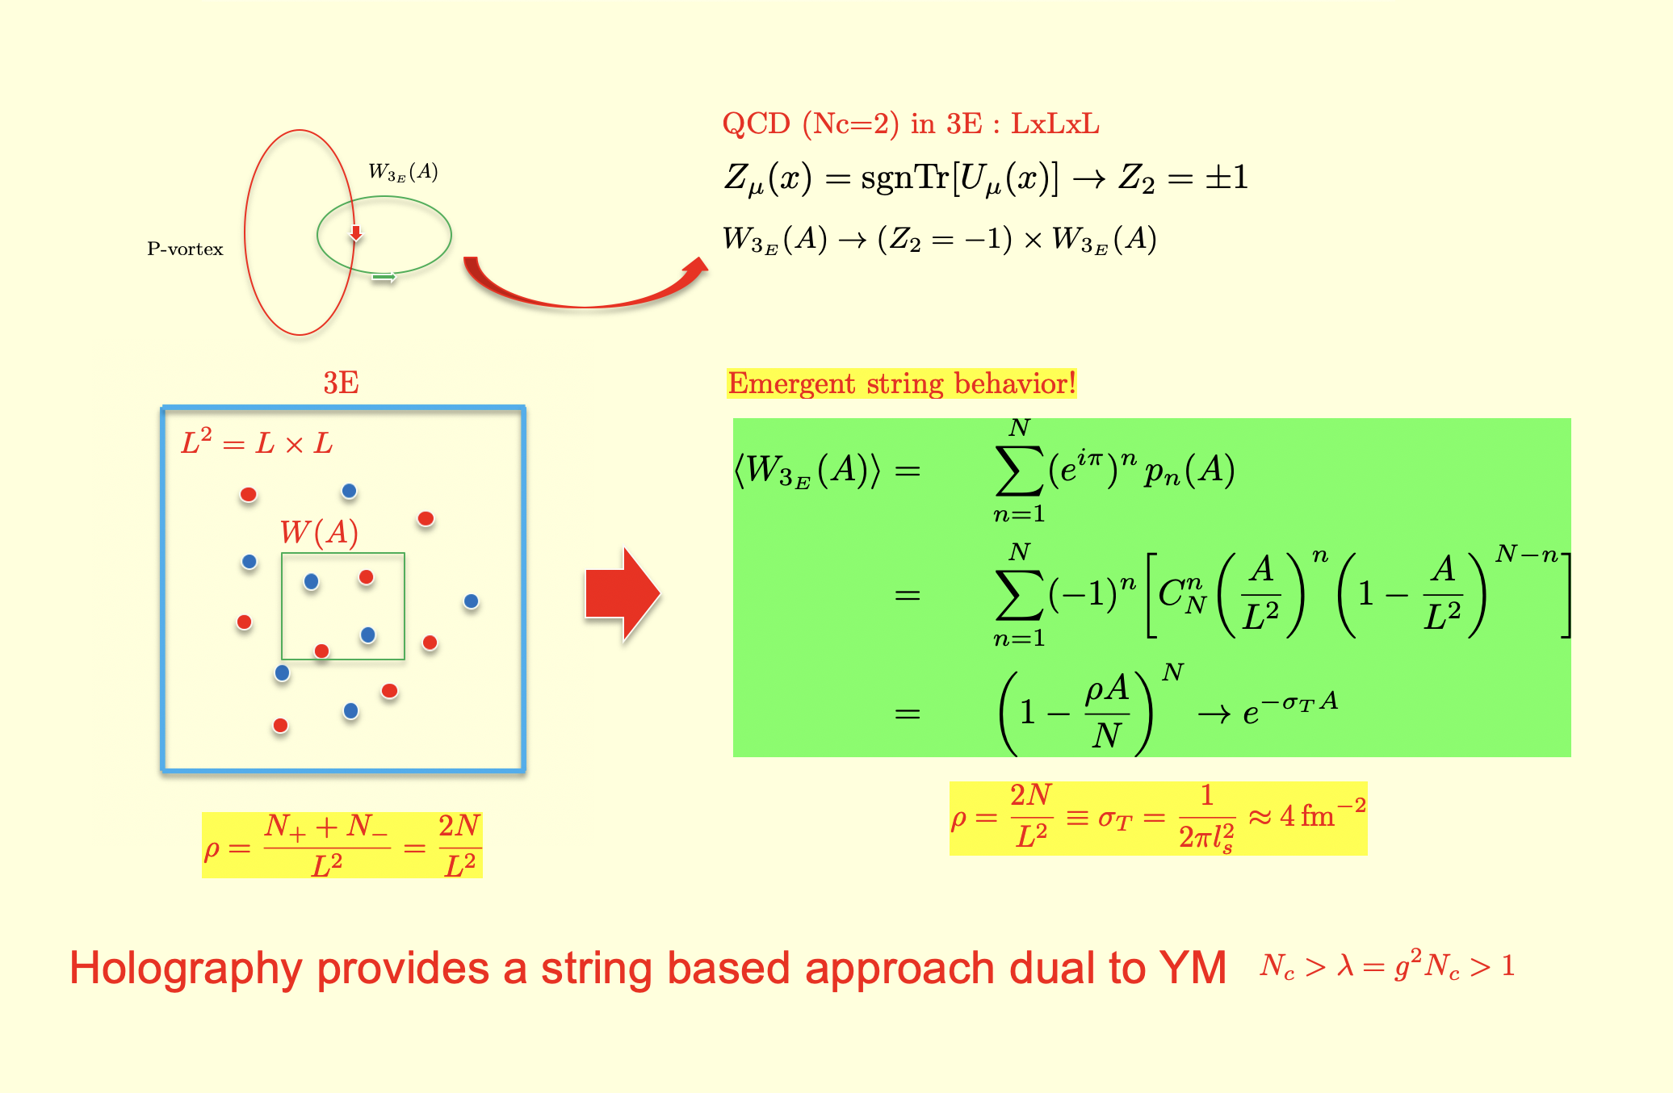
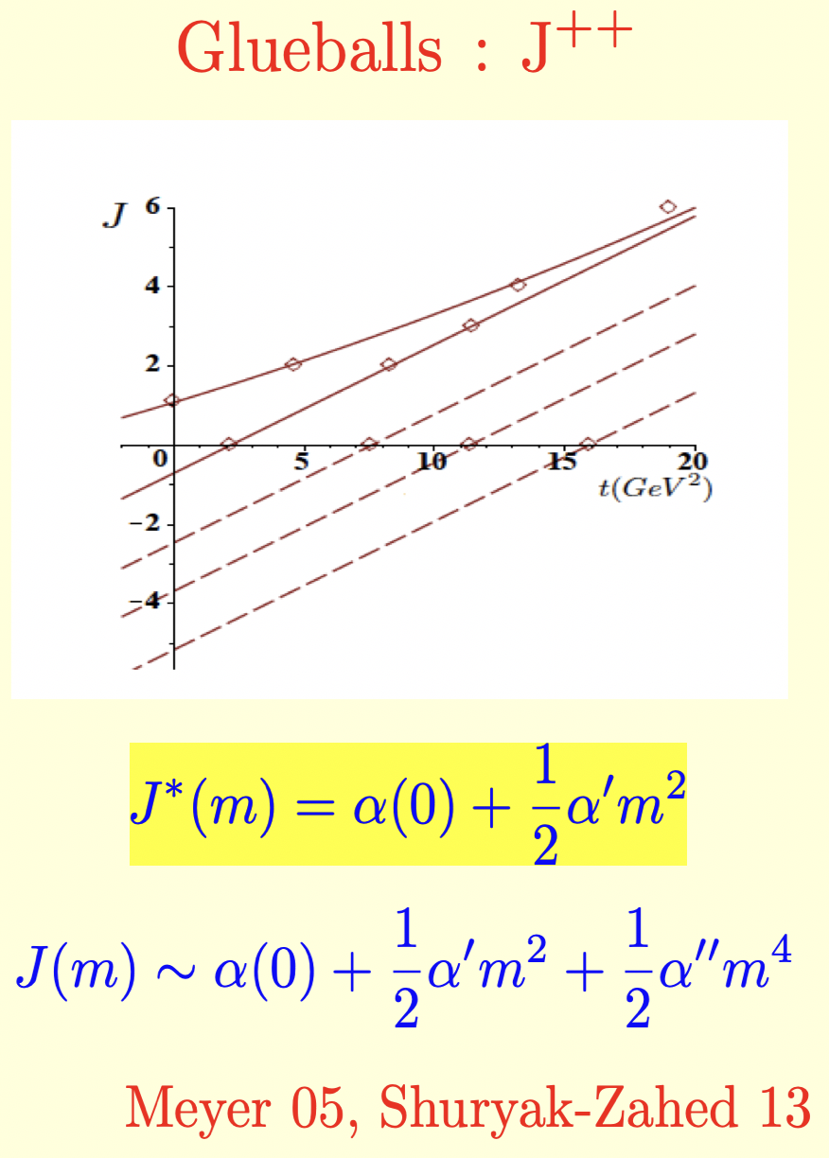
Emergent strings in QCD
Strings and spectroscopy

Slide 4
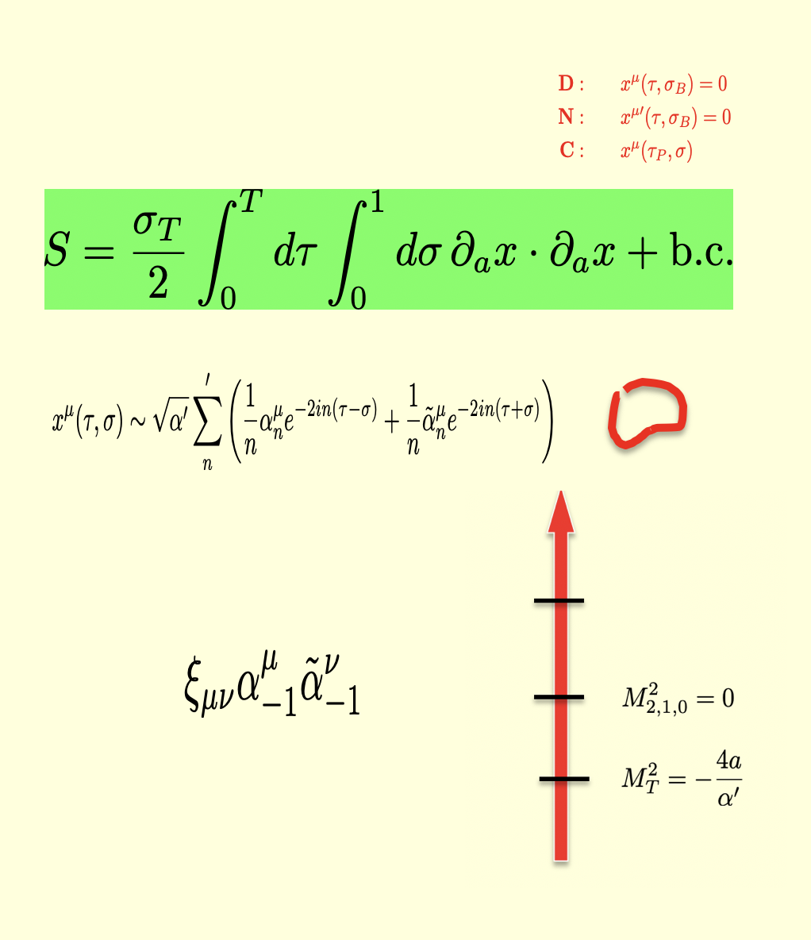
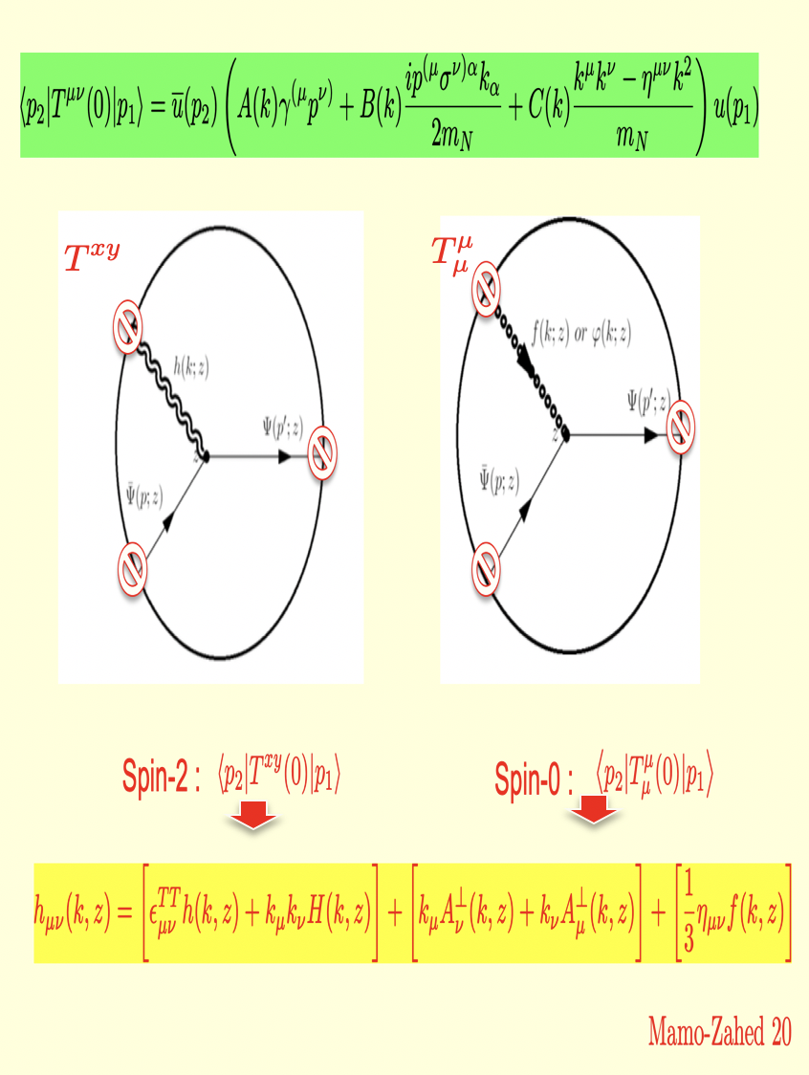
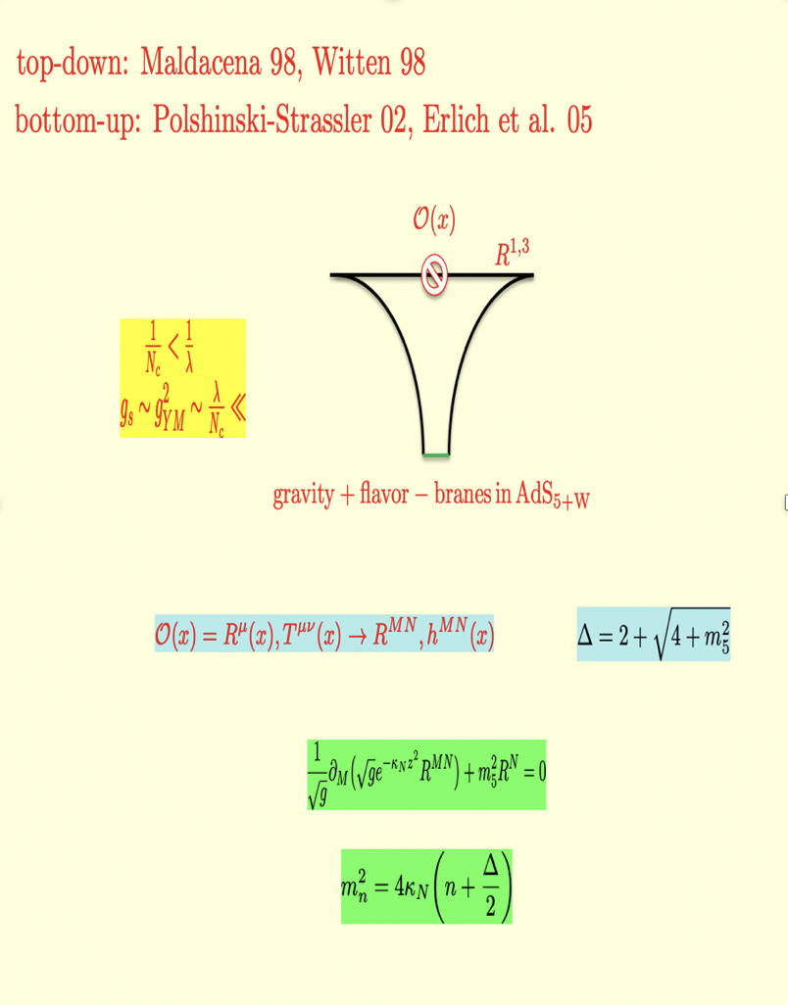
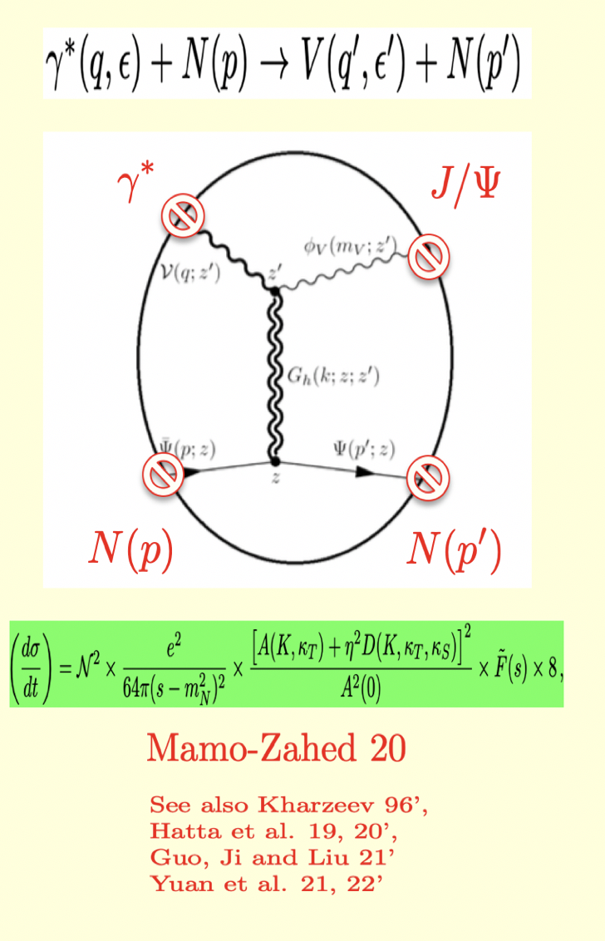
Quantum bosonic string and AdS
AdS/QCD: FF/Scattering

Slide 5
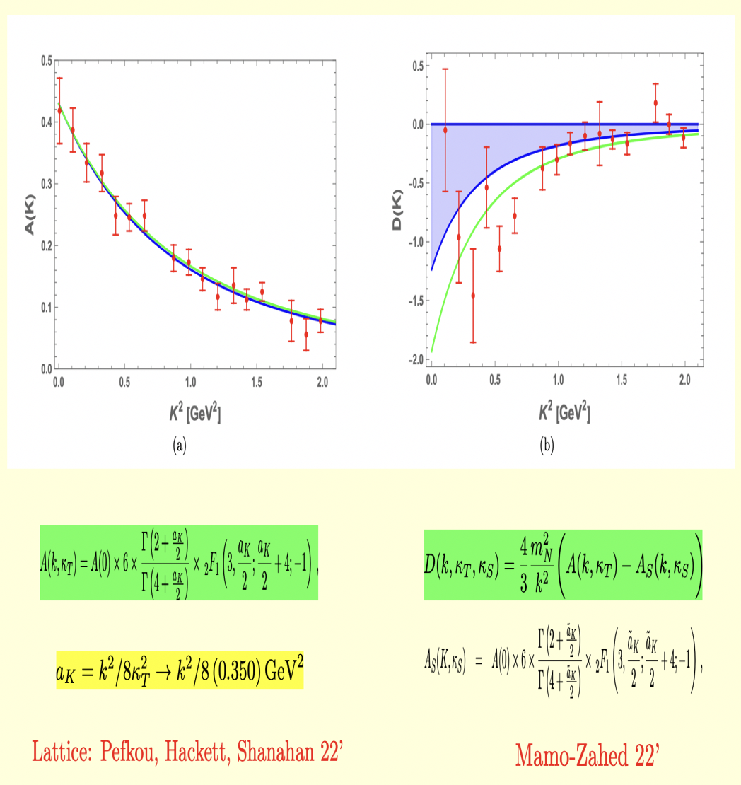
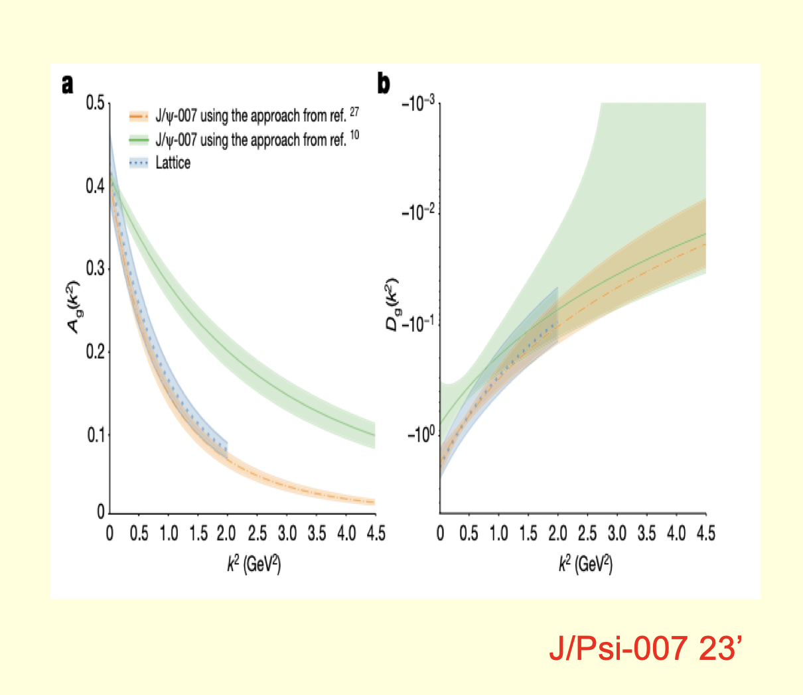
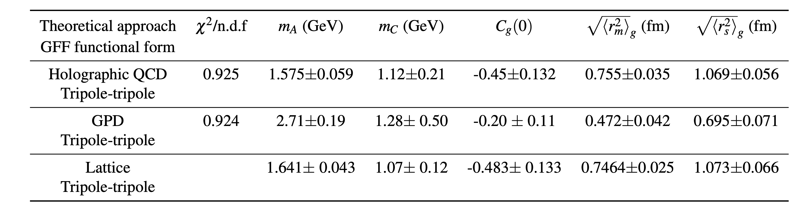
Gluon A-FF and D-FF vs Lattic QCD
Empirical FFs and radii 007
See also GlueX 19’

Slide 6
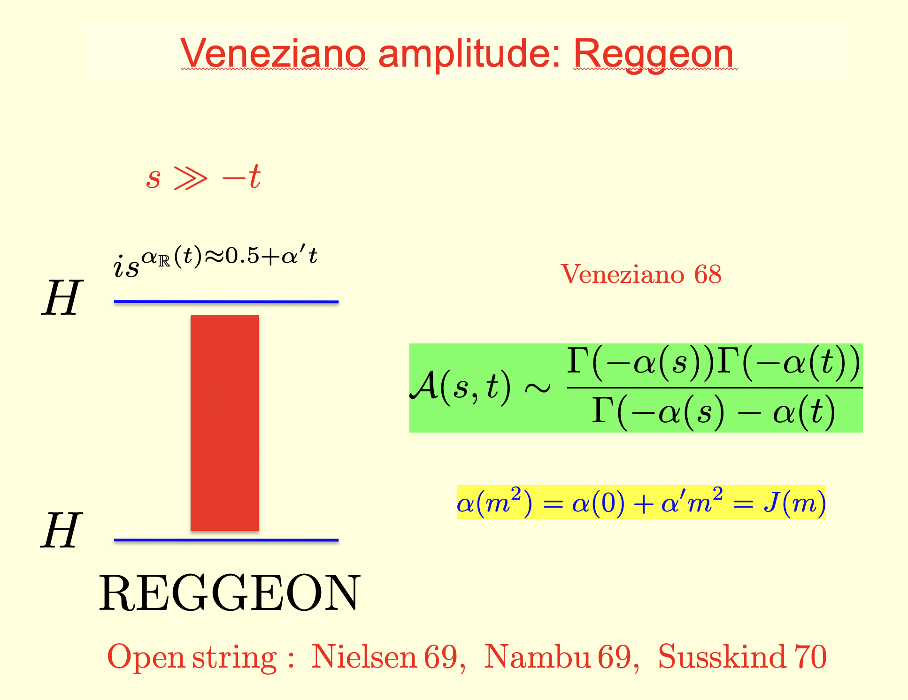
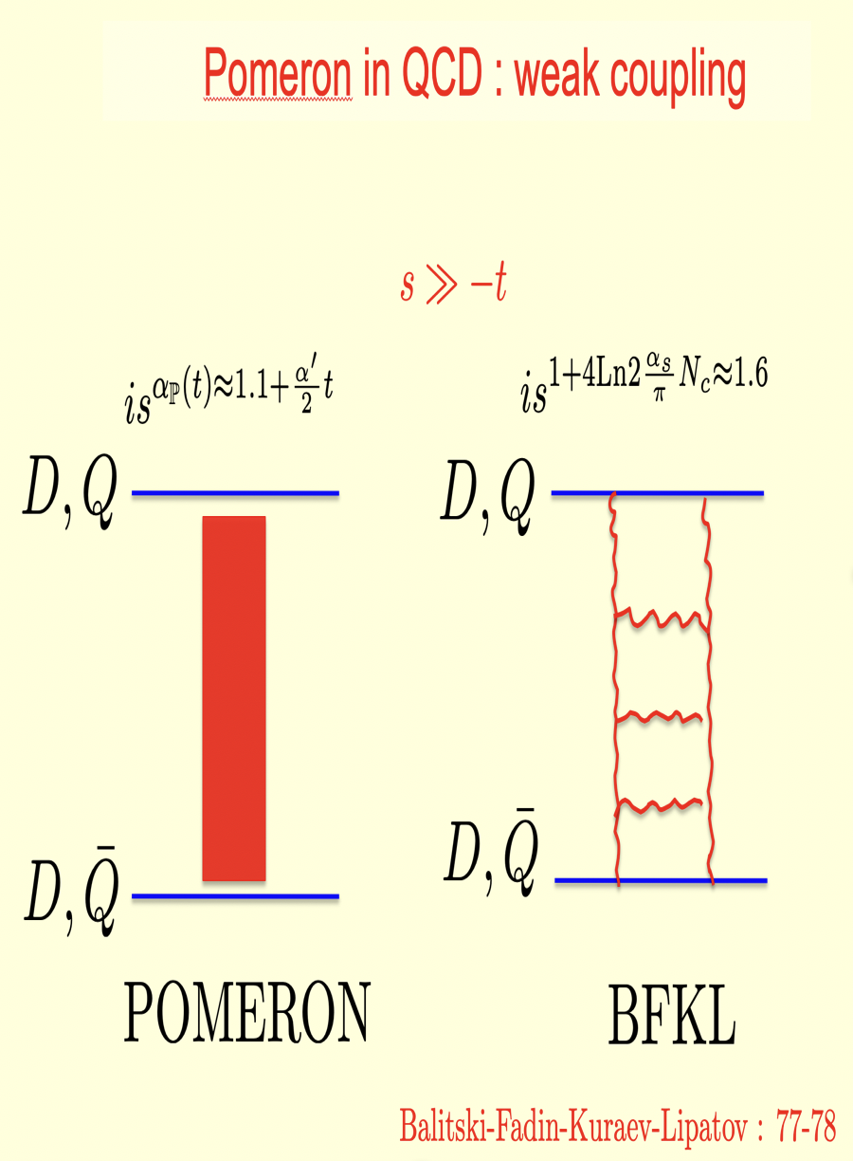
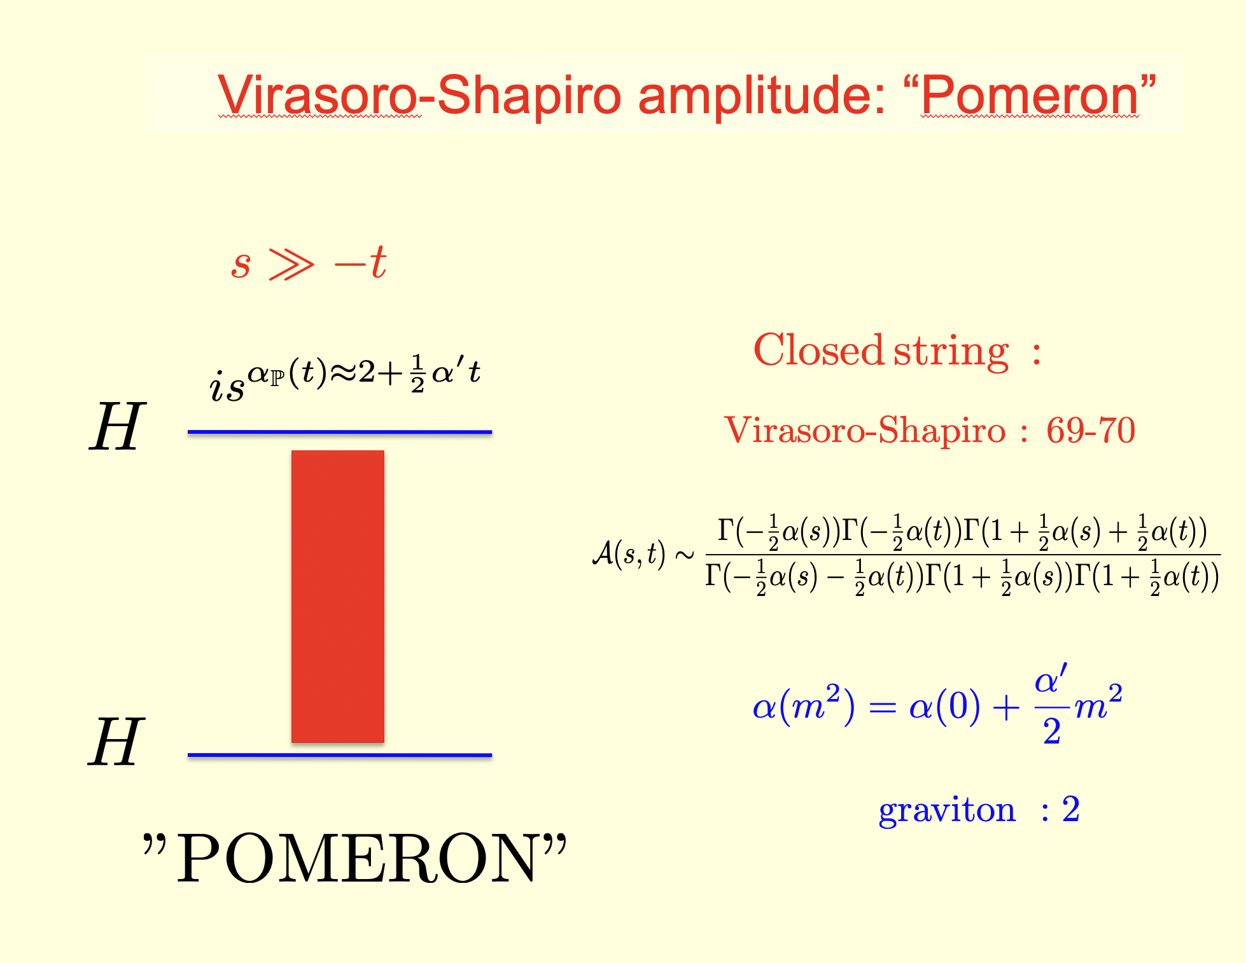
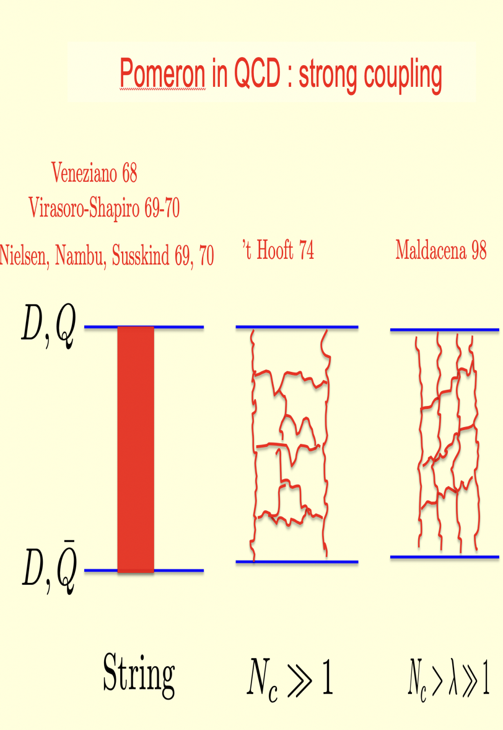
String Regge scattering: pre-QCD
String Regge scattering: post-QCD

Slide 7
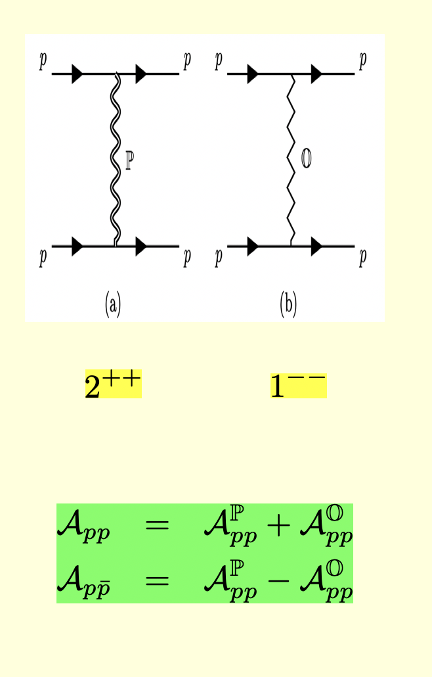
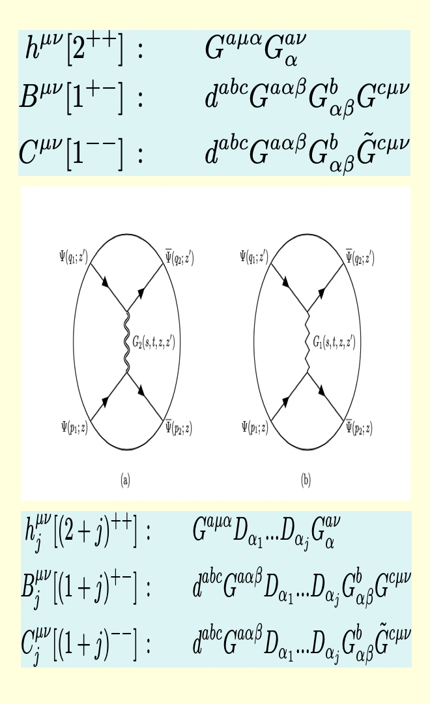
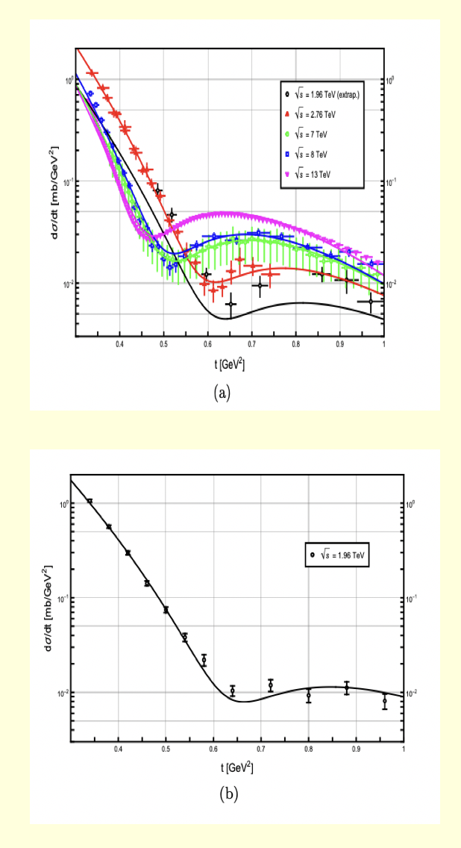
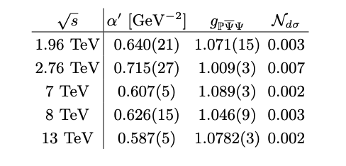
pp at large s
pp in AdS/QCD
AdS vs TOTEM/DO
pp
ppbar
Hechenberger-Mamo-Zahed 23’

Slide 8
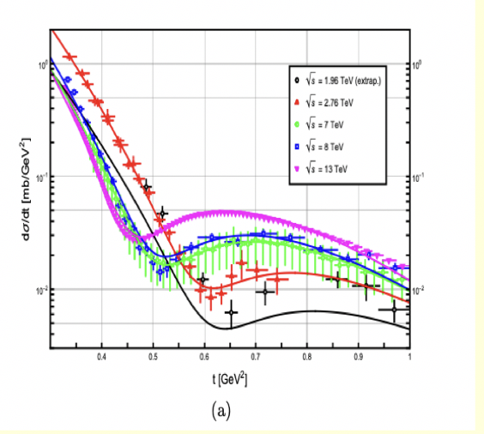
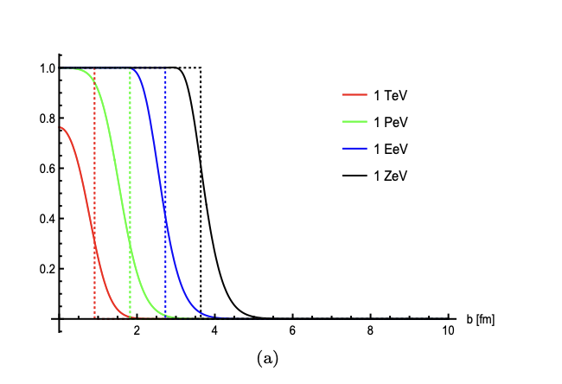
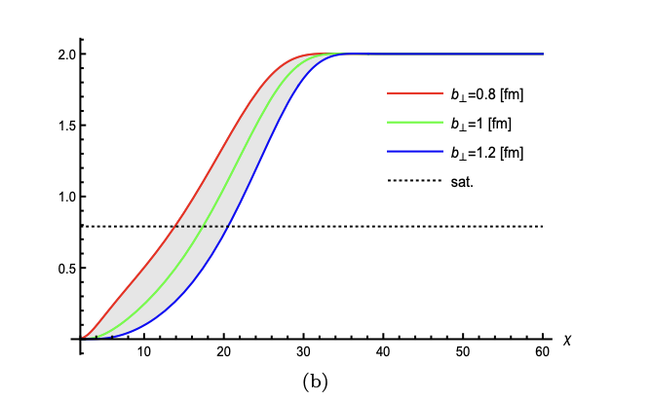
AdS/TOTEM/DO
Black-disc from strings
Saturation from strings
Hechenberger-Mamo-Zahed 23’

Slide 9
Strings: GPDs

Slide 10
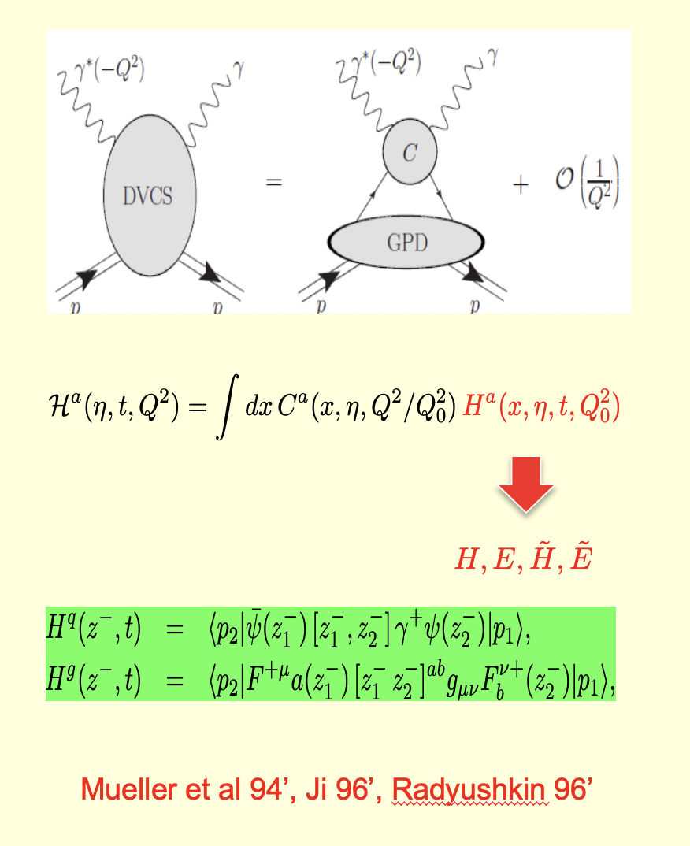
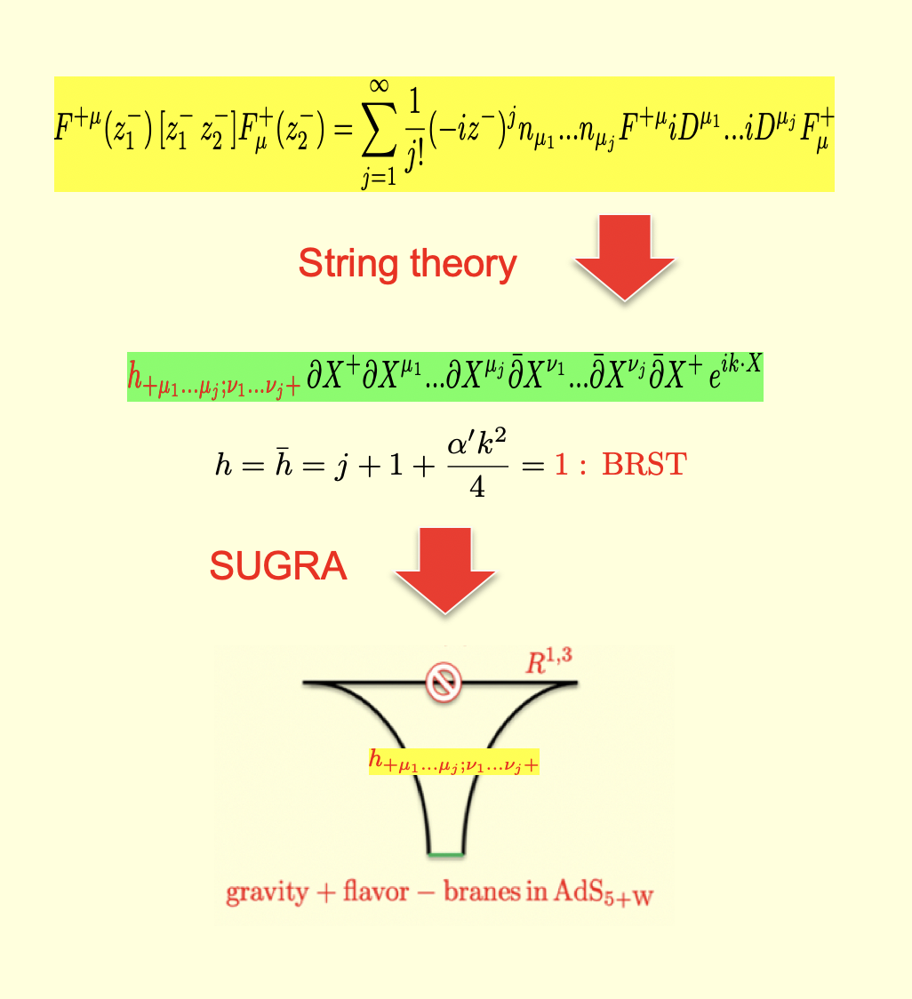
GPDs and light rays in DVCS
Light rays/strings

Slide 11
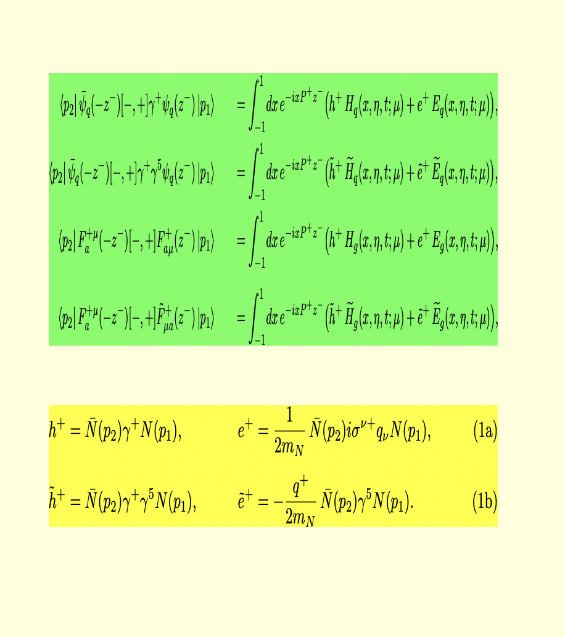
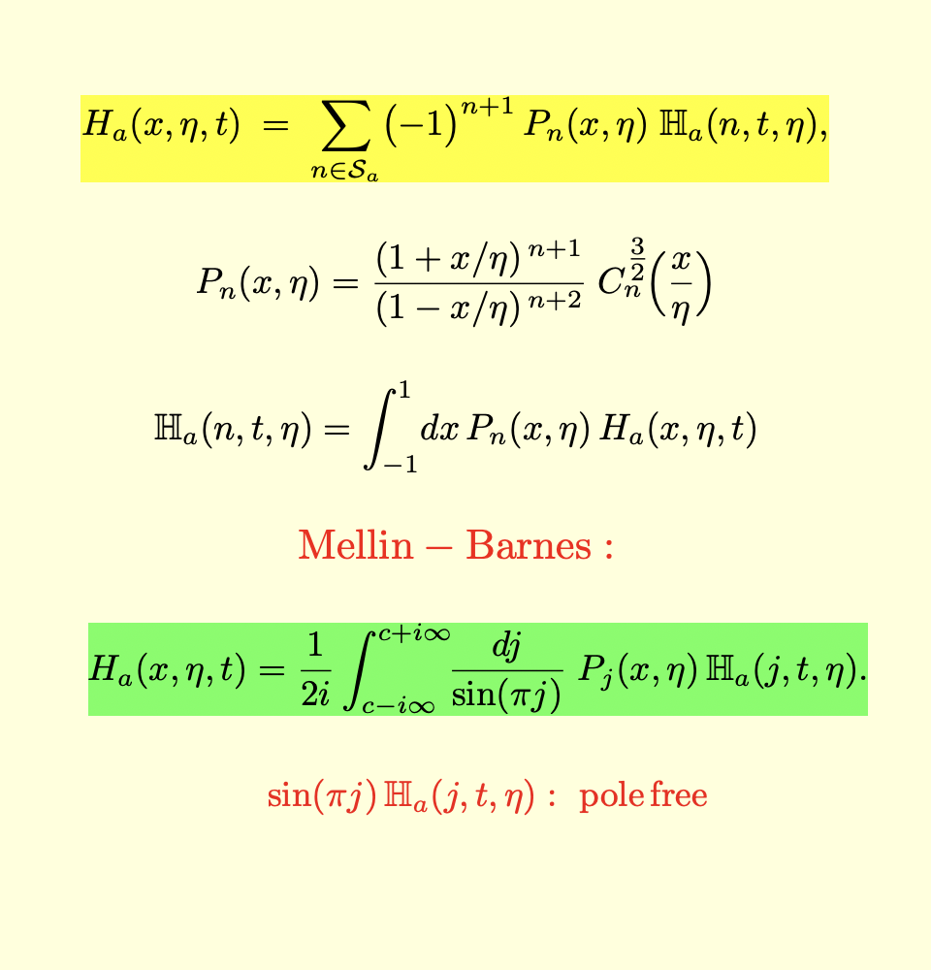
Unpolarized and polarized GPDs
GPDs conformal expansion
Radyushkin-Beletsky 05’
Muller-Schafer 06’
Guo-Ji-Santiago-Shiells-Yang 23’

Slide 12
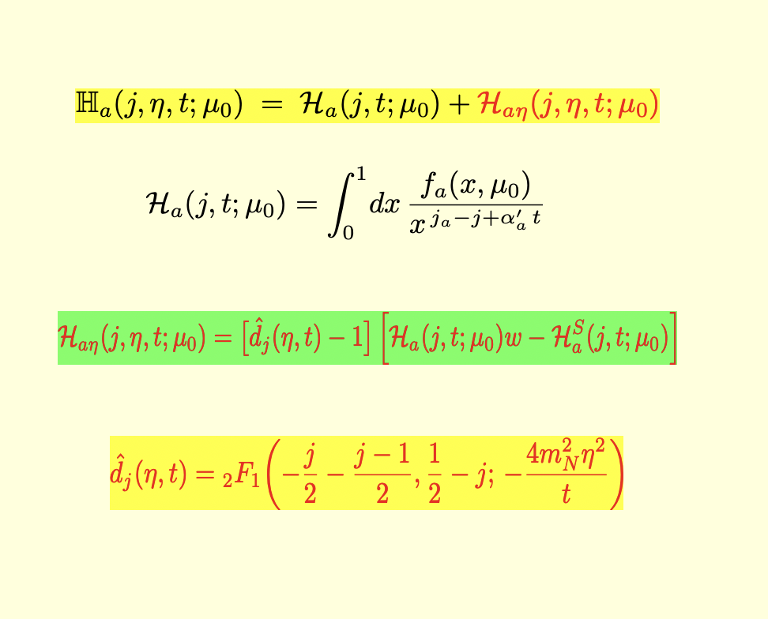
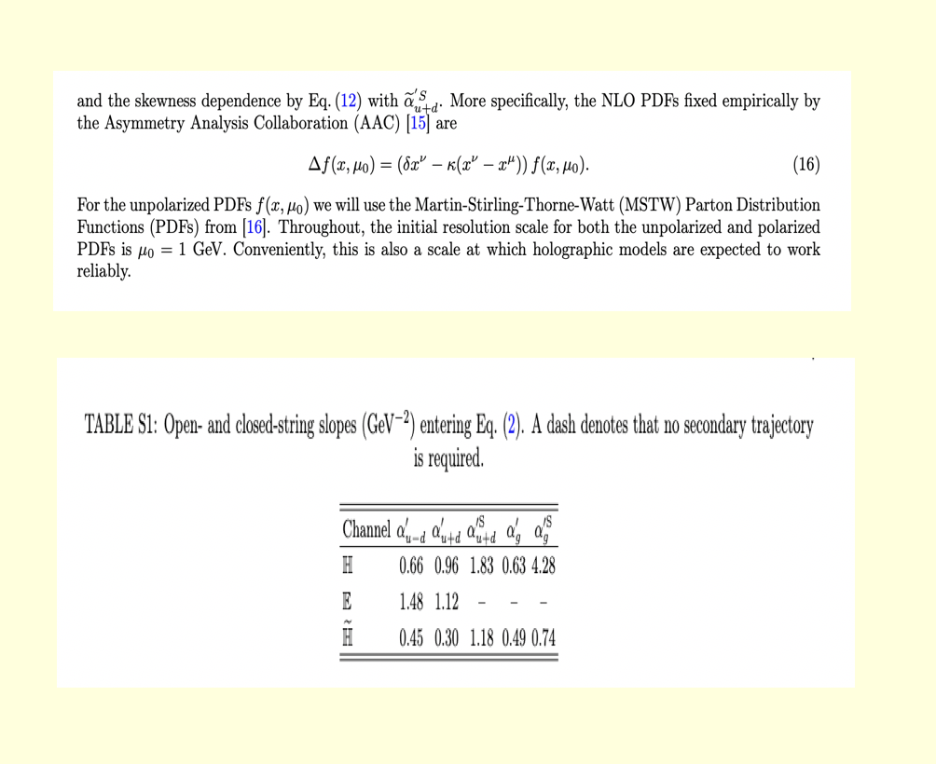
GPDs universal string parametrization:
any skewness
Regge parameters
Mamo-zahed 22’, 24’
Hechenberger-Mamo-Zahed 25’

Slide 13
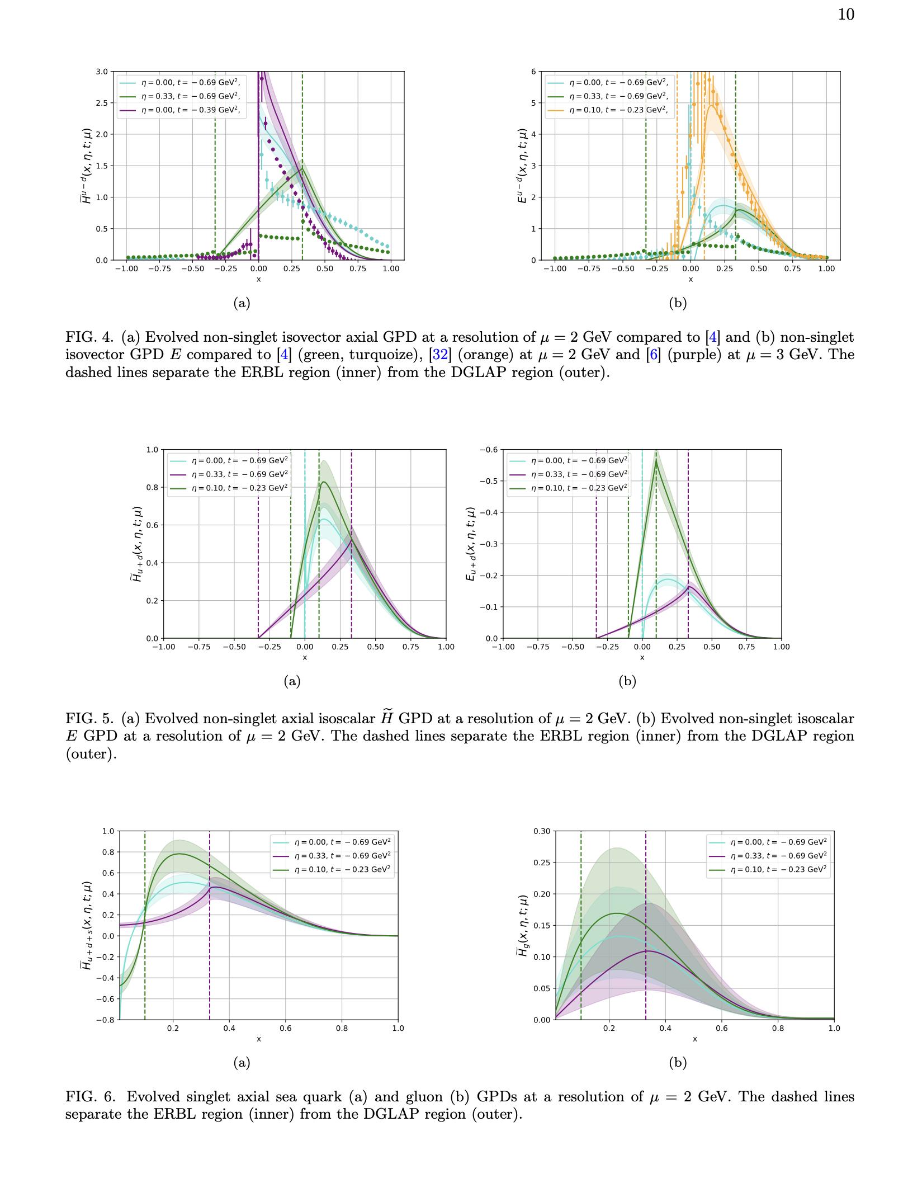
String based GPDs vs Lattice GPDs
Hechenberger-Mamo-Zahed 25’

Slide 14
Strings: Tomography

Slide 15
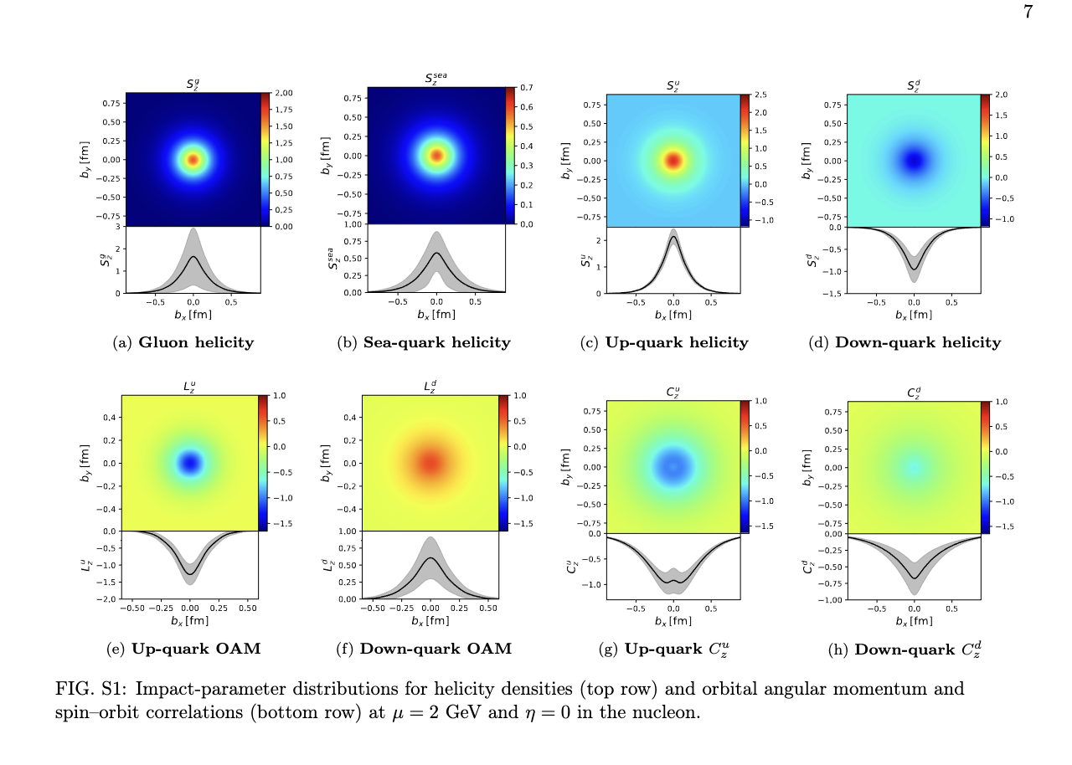
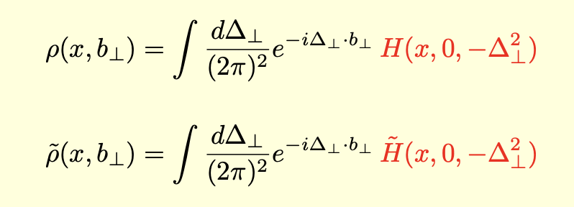
Spin transverse densities
Soper 77’, Burkhardt 03’
Hechenberger-Mamo-Zahed 25’

Slide 16
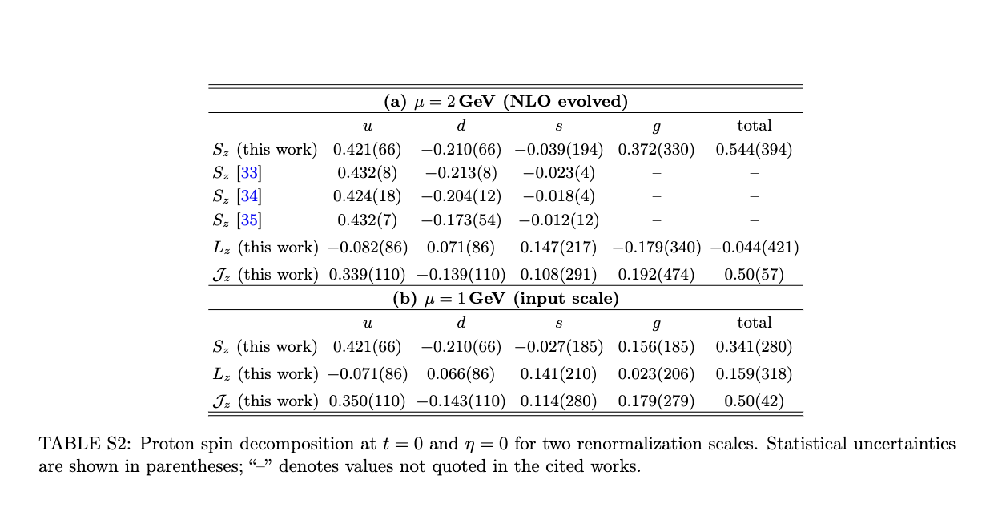
String based Ji spin budget
Ji spin decomposition
Ji 96’
Hechenberger-Mamo-Zahed 25’

Slide 17
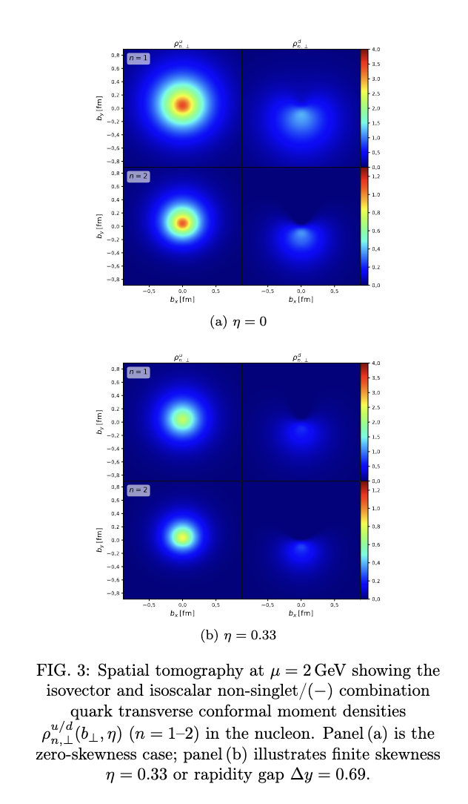
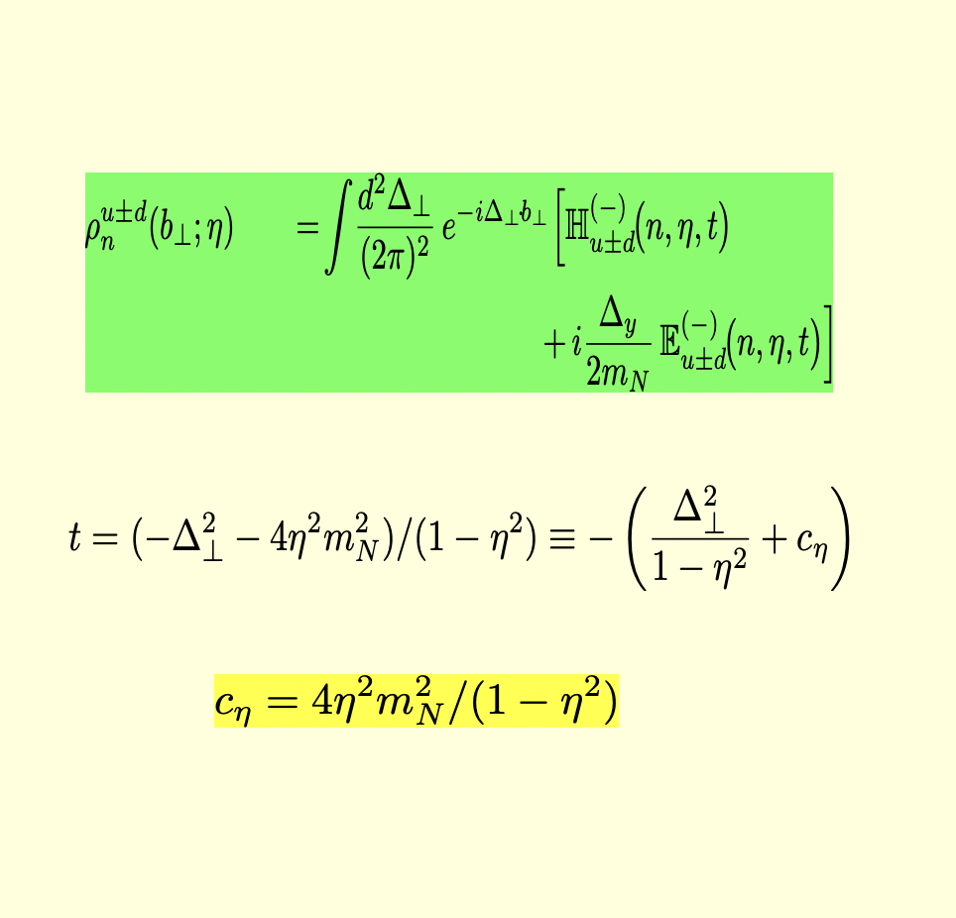
Rapidity warped tomography: n=1,2
Novel interpretation
Rapidity dependent T-densities

Slide 18
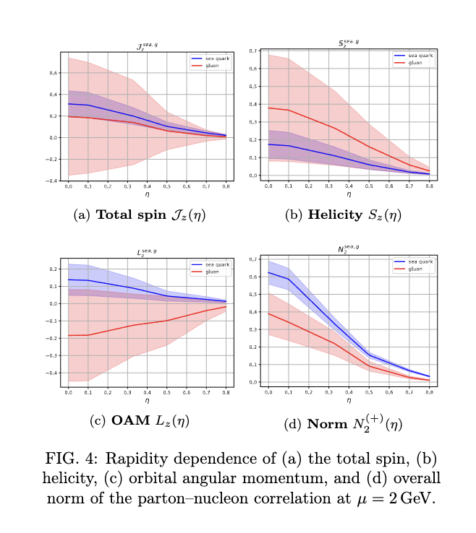
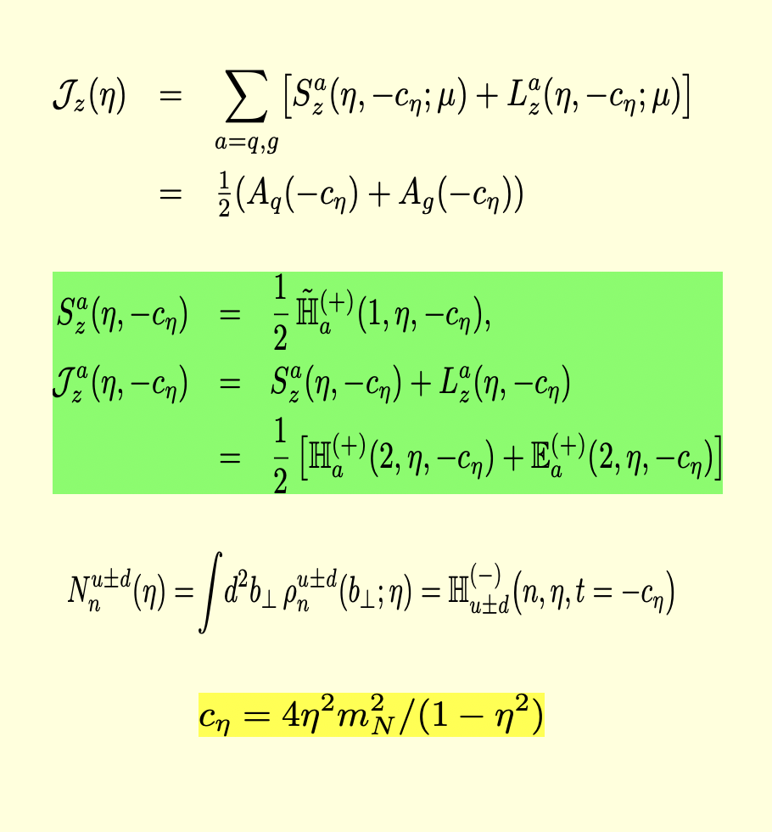
Novel interpretation
Rapidity warped spin contributions
Rapidity modified Ji spin
Hechenberger-Mamo-Zahed 25’

Slide 19
The string based QCD is useful:
Jlab and EIC

