Slide 1
Trace anomaly
QCD Higgs mechanism, proton mass, “negative pressure”, and quark confinement
Xiangdong Ji with Chen Yang
Towards improved hadron femtography with hard exclusive reactions, edition IV
Jefferson Lab, July 28, 2025

Slide 2
Outline
Trace anomaly and QCD “Higgs Mechanism”
Trace anomaly contribution to the proton mass
Trace anomaly in the momentum density current: the origin of “negative pressure”
Trace anomaly as the origin of quark confinement
Measuring the trace anomaly
Summary

Slide 3
Trace anomaly and QCD “Higgs Mechanism”
Ji & Yizhuang Liu, A. Schaefer Nucl.Phys.B 971 (2021) 115537

Slide 4
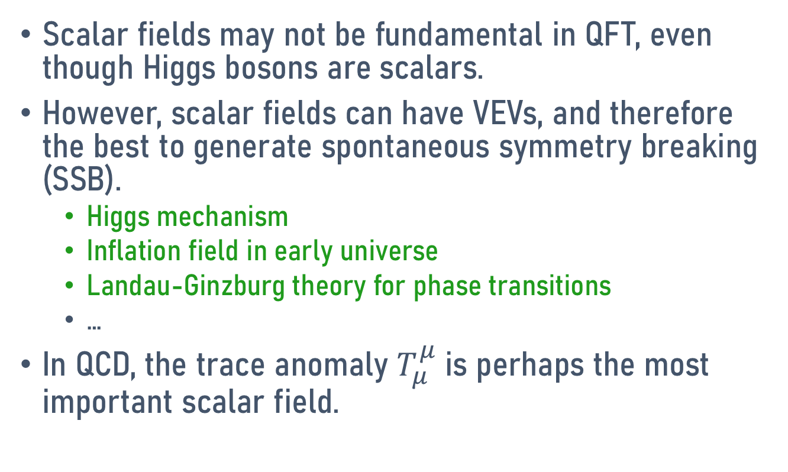
Role of scalars in QFT
Scalar fields may not be fundamental in QFT, even though Higgs bosons are scalars.
However, scalar fields can have VEVs, and therefore the best to generate spontaneous symmetry breaking (SSB).
  Higgs mechanism
  Inflation field in early universe
  Landau-Ginzburg theory for phase transitions
  …
In QCD, the trace anomaly $T_{μ}^{μ}$is perhaps the most important scalar field.

Slide 5
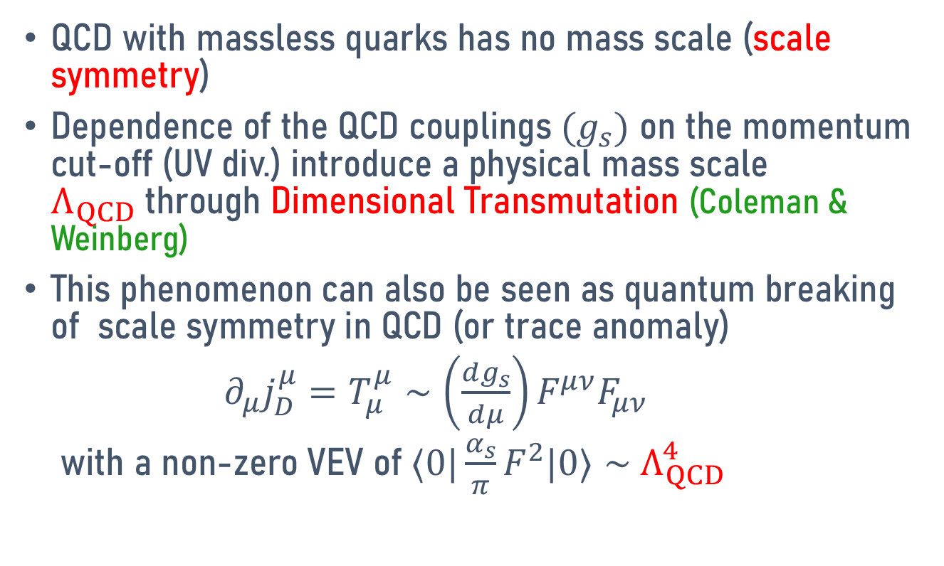
QCD trace anomaly
QCD with massless quarks has no mass scale (scale symmetry)
Dependence of the QCD couplings $(g_{s})$ on the momentum cut-off (UV div.) introduce a physical mass scale $Λ_{QCD}$through Dimensional Transmutation (Coleman & Weinberg)
This phenomenon can also be seen as quantum breaking of scale symmetry in QCD (or trace anomaly)
$∂_{μ}j_{D}^{μ}=T_{μ}^{μ}∼\left(\frac{dg_{s}}{dμ}\right)F^{μν}F_{μν}$
with a non-zero VEV of ${⟨0|\frac{α_{s}}{π}F}^{2}|0⟩∼$ $Λ_{QCD}^{4}$

Slide 6
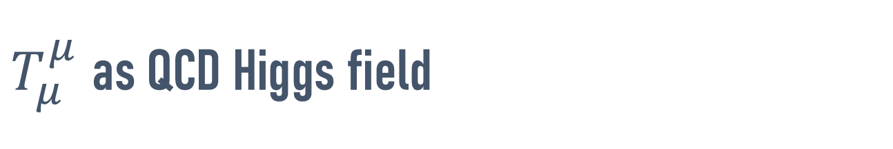
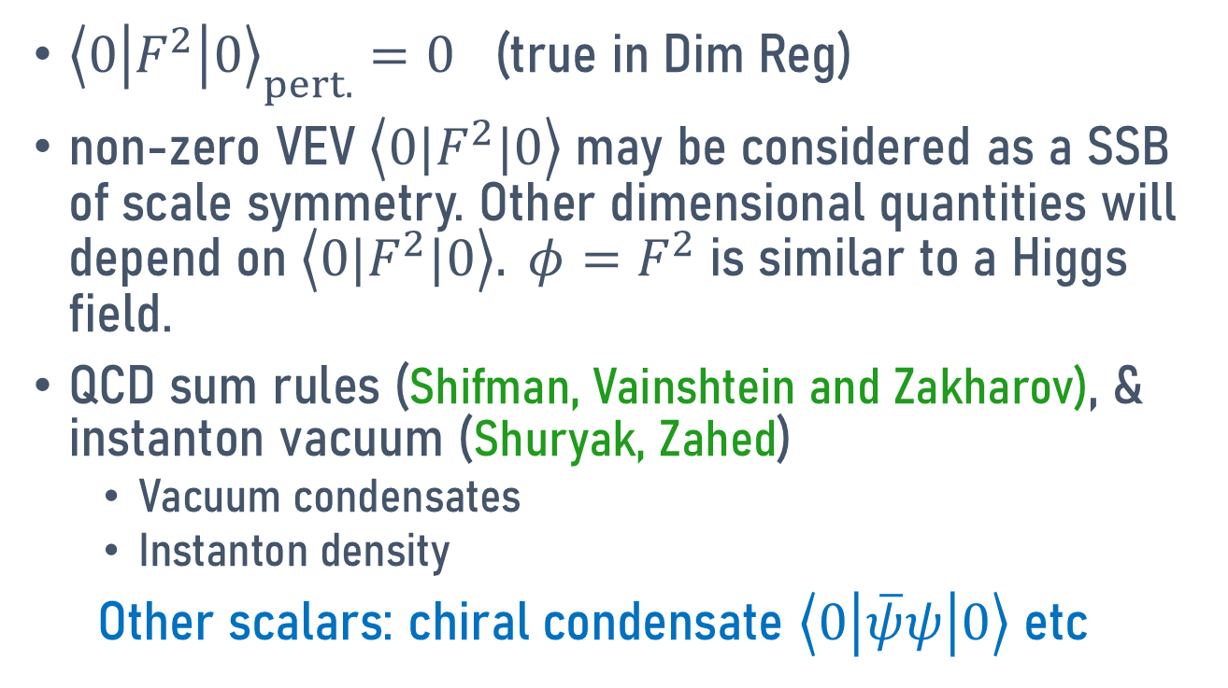
$T_{μ}^{μ}$as QCD Higgs field
${\left\langle 0\left|F^{2}\right|0\right\rangle }_{pert.}=0$ (true in Dim Reg)
non-zero VEV $\left\langle {0|F}^{2}|0\right\rangle$may be considered as a SSB of scale symmetry. Other dimensional quantities will depend on $\left\langle 0|F^{2}|0\right\rangle . {φ=F}^{2}$ is similar to a Higgs field.
QCD sum rules (Shifman, Vainshtein and Zakharov), & instanton vacuum (Shuryak, Zahed)
  Vacuum condensates
  Instanton density
Other scalars: chiral condensate $\left\langle 0\left|\overline{ψ}ψ\right|0\right\rangle$ etc

Slide 7

Relation to the proton mass
The hadron mass is related to $F^{2}$
$m_{H}^{2}∼\left\langle P\left|F^{2}\right|P\right\rangle$
this is also true for the Higgs theory.

Slide 8
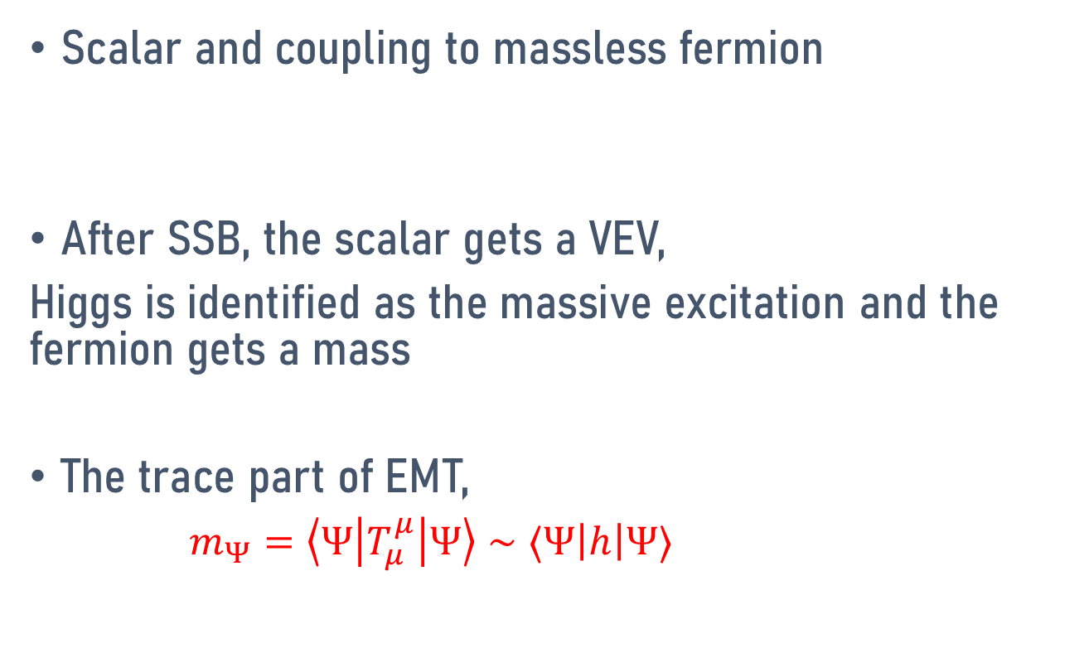
Higgs mechanism and fermion mass
Scalar and coupling to massless fermion
After SSB, the scalar gets a VEV,
Higgs is identified as the massive excitation and the fermion gets a mass
The trace part of EMT,
$m_{Ψ}=\left\langle Ψ\left|T_{μ}^{μ}\right|Ψ\right\rangle ∼⟨Ψ\left|h\right|Ψ⟩$

Slide 9
Trace anomaly as anomalous energy in the proton mass

Slide 10




Proton mass decomposition
Proton mass is the rest-frame energy ($E=Mc^{2}$)
Anomaly is part of the Renormalized Hamiltonian
Quark energy
Quark mass
Gluon kinetic energy
Trace anomaly

Slide 11
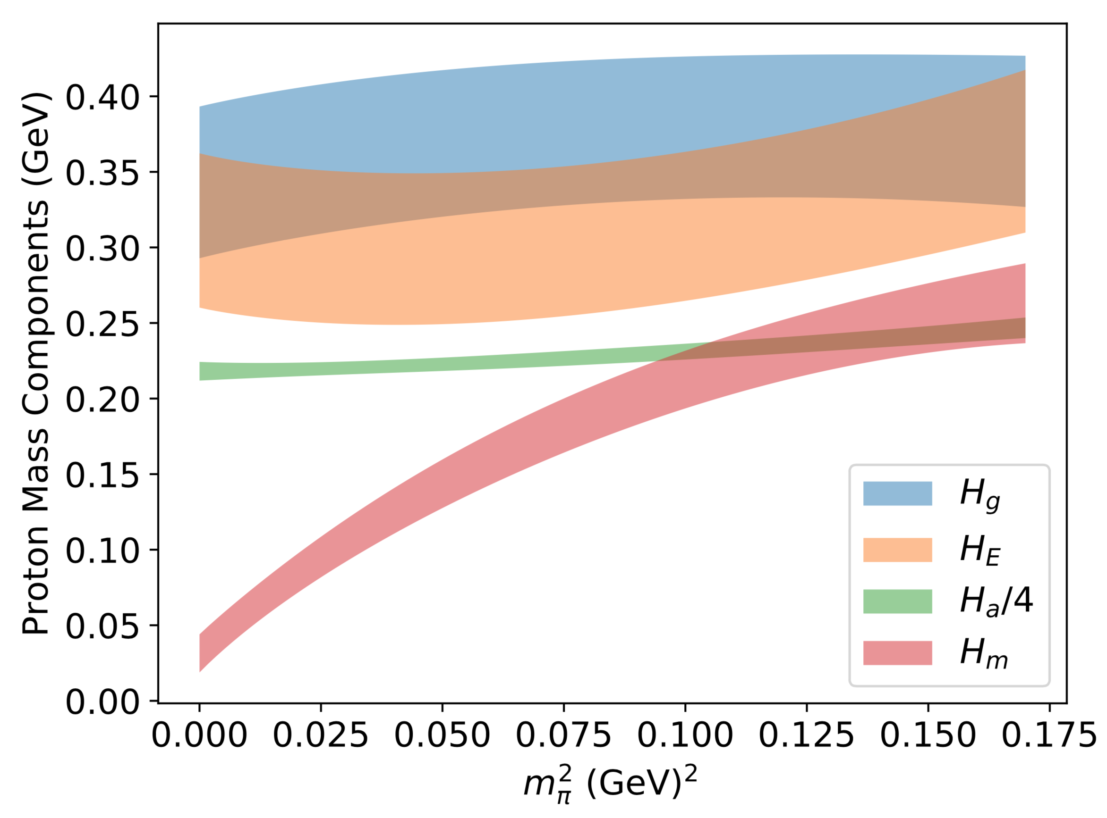
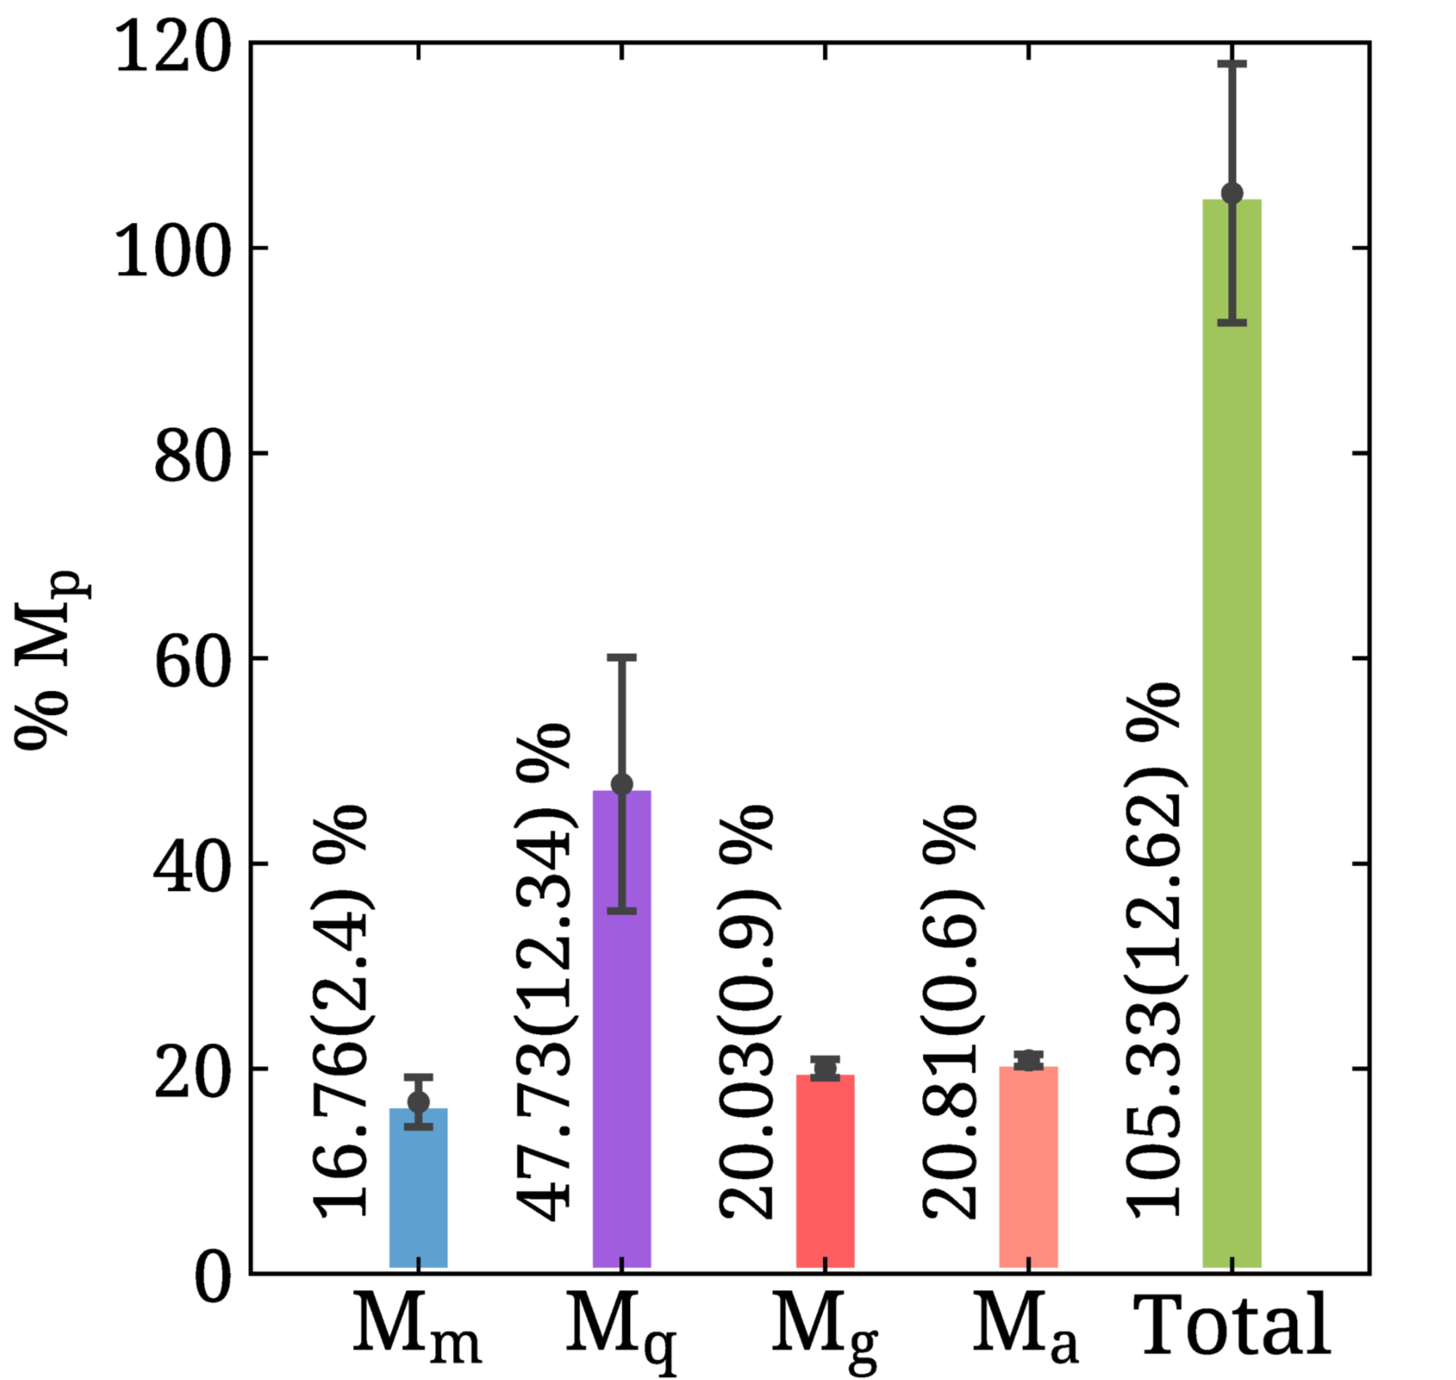
Proton mass on the lattice
Y.-B. Yang et al., (χQCD), PRL 121, 212001 (2018)
C. Alexandrou et al., (ETMC), PRL 119, 142002 (2017)
C. Alexandrou et al., (ETMC), PRL 116, 252001 (2016)
Trace anomaly only constrained through sum-rules not calculated directly.

Slide 12
Why the anomalous energy missing in one form of Dim Reg?
Anomaly contribution to the Hamiltonian is scheme and scale independent.
However, it has been claimed by Metz et al (Phys.Rev.D 102 (2020) 114042) “Anomaly does not contribute to the proton mass”
This is due to a renormalization scheme advocated by Hatta et al (JHEP 12 (2018) 008)
  While technically correct, this renormalization scheme mixes tensors of different ranks, and breaks Lorentz symmetry

Slide 14
Trace anomaly contribution to the momentum density current

Slide 15
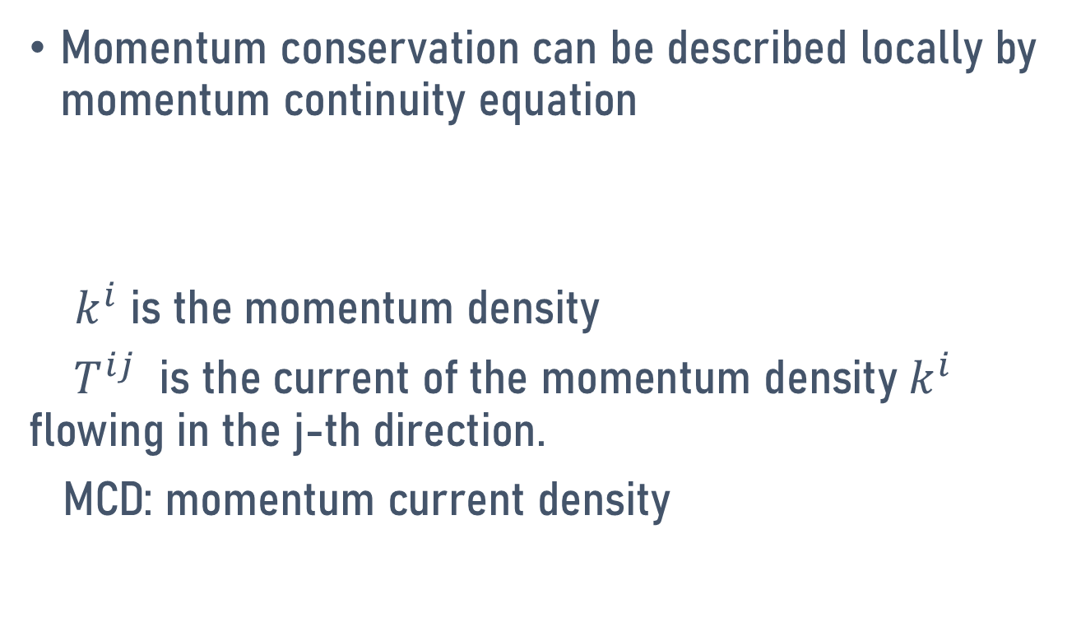
Momentum continuity equation
Momentum conservation can be described locally by momentum continuity equation
$k^{i}$ is the momentum density
${ T}^{ij}$ is the current of the momentum density $k^{i}$ flowing in the j-th direction.
MCD: momentum current density

Slide 16
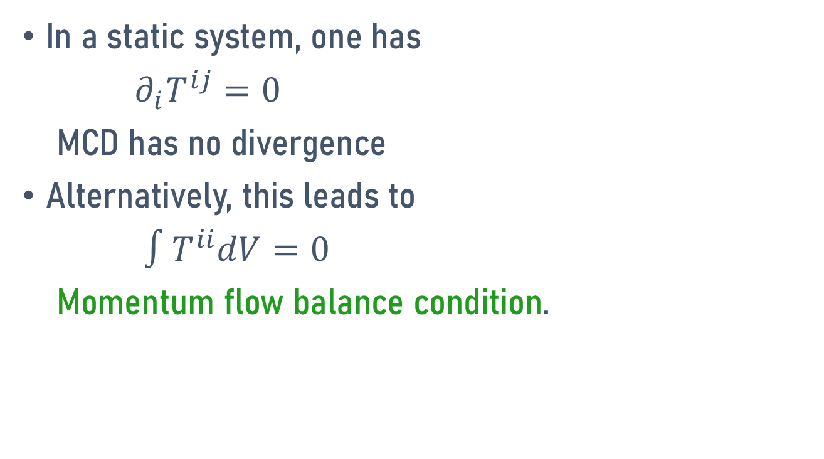

Static system and balance of momentum flow
In a static system, one has
$∂_{i}T^{ij}=0$
MCD has no divergence
Alternatively, this leads to
$∫T^{ii}dV=0$
Momentum flow balance condition.

Slide 17
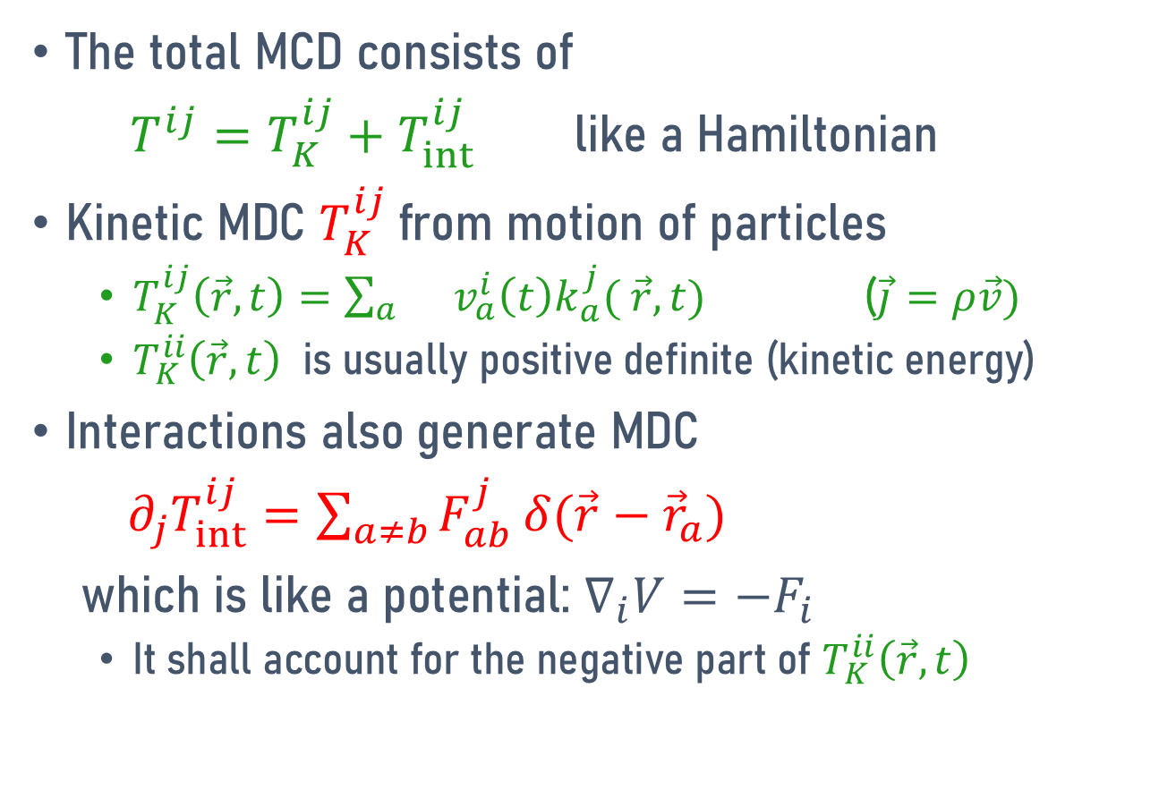
Physics contents of MCD
The total MCD consists of
$T^{ij}=T_{K}^{ij}+T_{int}^{ij}$ like a Hamiltonian
Kinetic MDC $T_{K}^{ij}$from motion of particles
  $T_{K}^{ij}\left(\vec{r}, t\right)={\sum_{a}{}v_{a}^{i}\left(t\right)k}_{a}^{j}( \vec{r},t)$ ($\vec{j}=ρ\vec{v})$
  $T_{K}^{ii}\left(\vec{r}, t\right)$ is usually positive definite (kinetic energy)
Interactions also generate MDC
${ ∂}_{j}T_{int}^{ij}=\sum_{a≠b}{F_{ab}^{j}}δ(\vec{r}−{\vec{r}}_{a})$
which is like a potential: $∇_{i}V=−F_{i}$
  It shall account for the negative part of $T_{K}^{ii}\left(\vec{r}, t\right)$

Slide 18
QCD Momentum density current :
Three contributions (Ji & Yang, e-Print: 2503.01991)
  Quark kinetic motion
  Gluon stress tensor
  Anomaly
  Anomaly contributes a “negative pressure” (Ji, K. Liu, etc)

Slide 19
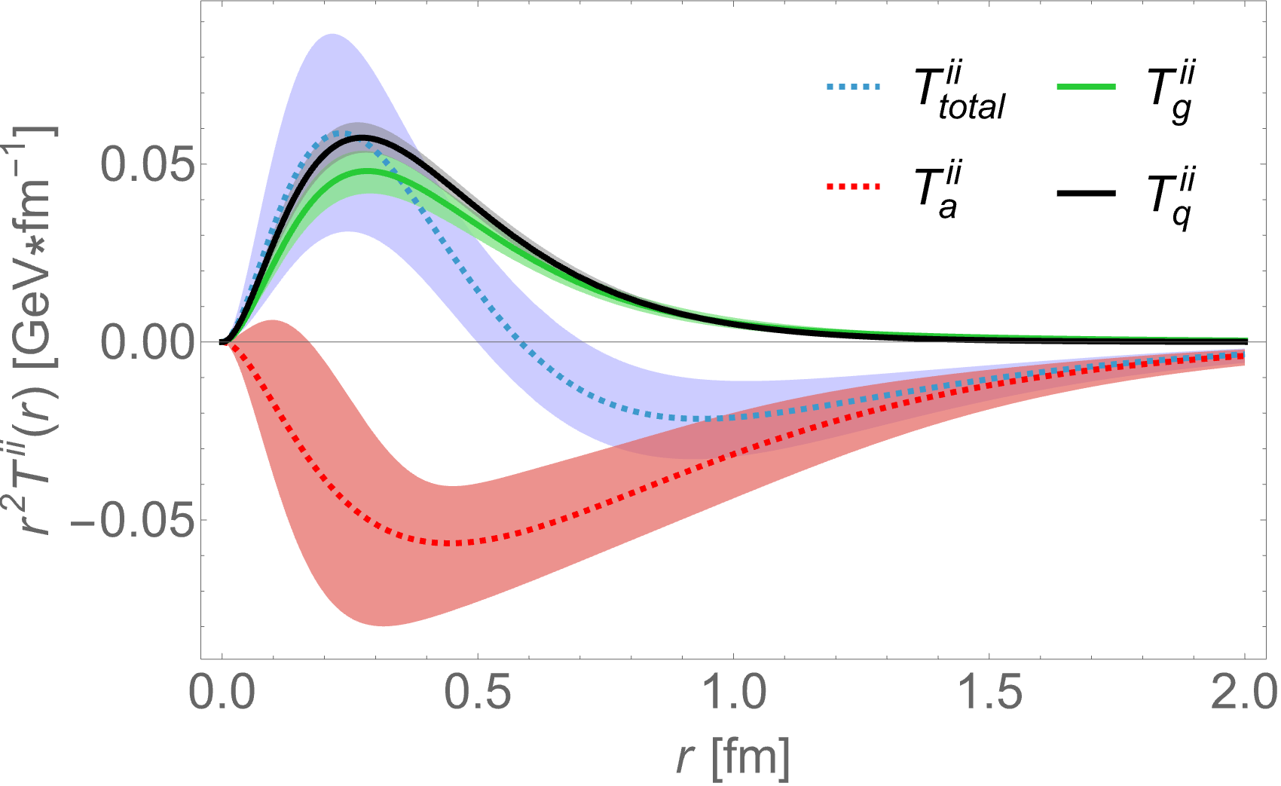
MCD in the nucleon

Slide 20
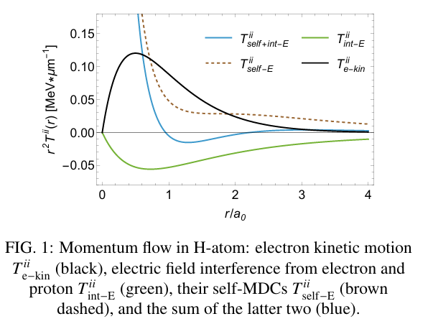
Why gluon tensor contribution is positive?
In H-atom, the electric field contribution is negative, accounts for the attractive interaction.
However, in the proton, the gluon contribution is positive, due to large radiative gluon contribution

Slide 21
Forces on the quarks in the nucleon

Slide 22
Pressure without forces: kinetic motion
Pressure has the unit of force/area
However, in the ideal gas, there is a pressure without force
  There is no interaction between particles.
  Force only appears when there is a wall or there is a pressure gauge.

Slide 23

Pressure without force: potential
The interaction contribution to momentum flow is similar to a potential
${ ∂}_{j}T_{int}^{ij}=\sum_{a≠b}{F_{ab}^{j}}δ(\vec{r}−{\vec{r}}_{a})$
only the derivative of MCD corresponds to a force.

Slide 24
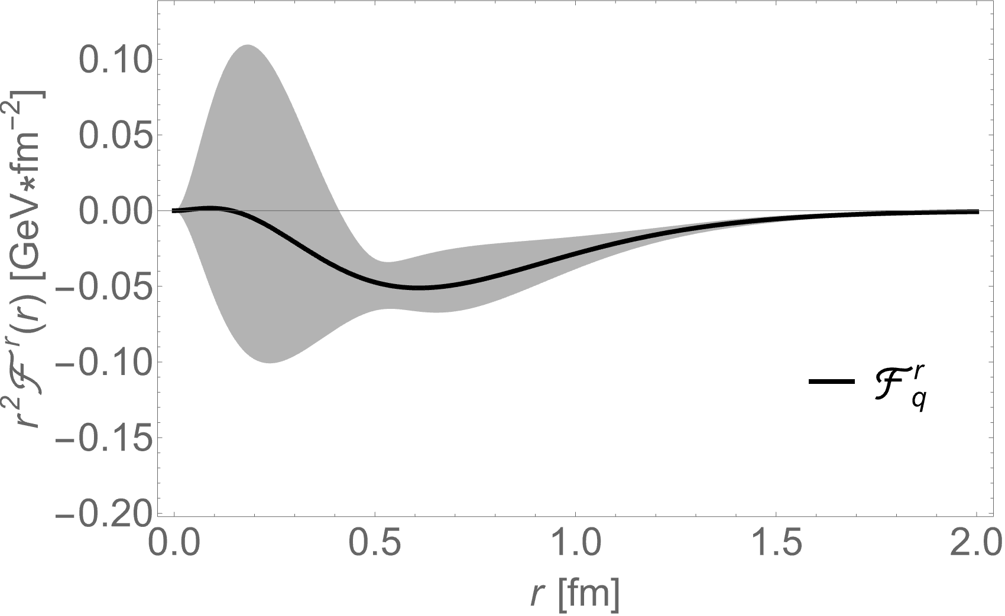
Force on the quarks in the nucleon
By taking derivative

Slide 25
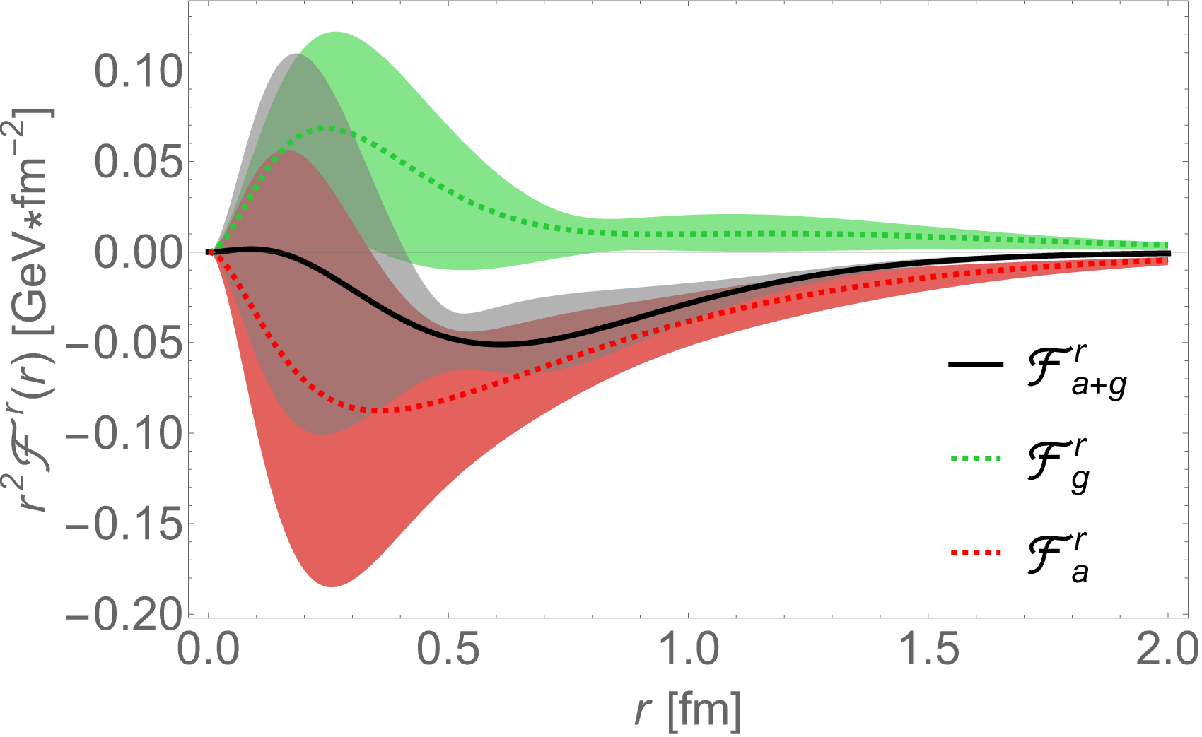

Where does the force come from?
Here $p_{a}(\vec{r})$ is indeed like a pressure term in a fluid, however, it is an external force for the quarks, not internal. It is more like an external potential term.

Slide 26
Anomaly and confinement
The anomaly force is strongly attractive.
we can calculate the average strength of the attraction
This strength is similar to the string tension!
Anomaly seems to be related to confinement
Ji, Liu, Schaefer, Nucl.Phys.B 971 (2021) 115537

Slide 27
Measuring the trace anomaly

Slide 28
Trace anomaly is twist-4
Trace anomaly is a twist-4 operator
  Twist = dim-spin = 4-0
Hard to measure directly though hard processes
Alternative: through conservation of EMT, the scalar form factors are related to twist-2 ones

Slide 29
Measuring A, B, C form factors
B seems small
A and C
  Quark contribution from DVCS etc
  GUMP global analysis
  Gluon contribution from threshold J/psi production
  Jlab Data

Slide 30
Summary
Trace anomaly is important mechanism to generate scale in strong interactions.
It can contribute to the mass of the proton through Higgs-like mechanism
It directly contribute ¼ of the hadron mass
It generates a negative potential which contributes to the negative pressure.
It generates a force on quarks similar to the confinement between heavy quarks.

