Slide 1





Exclusive $J/ψ$ with Gluex
By: Dr. Donavan Ebersole

Slide 2
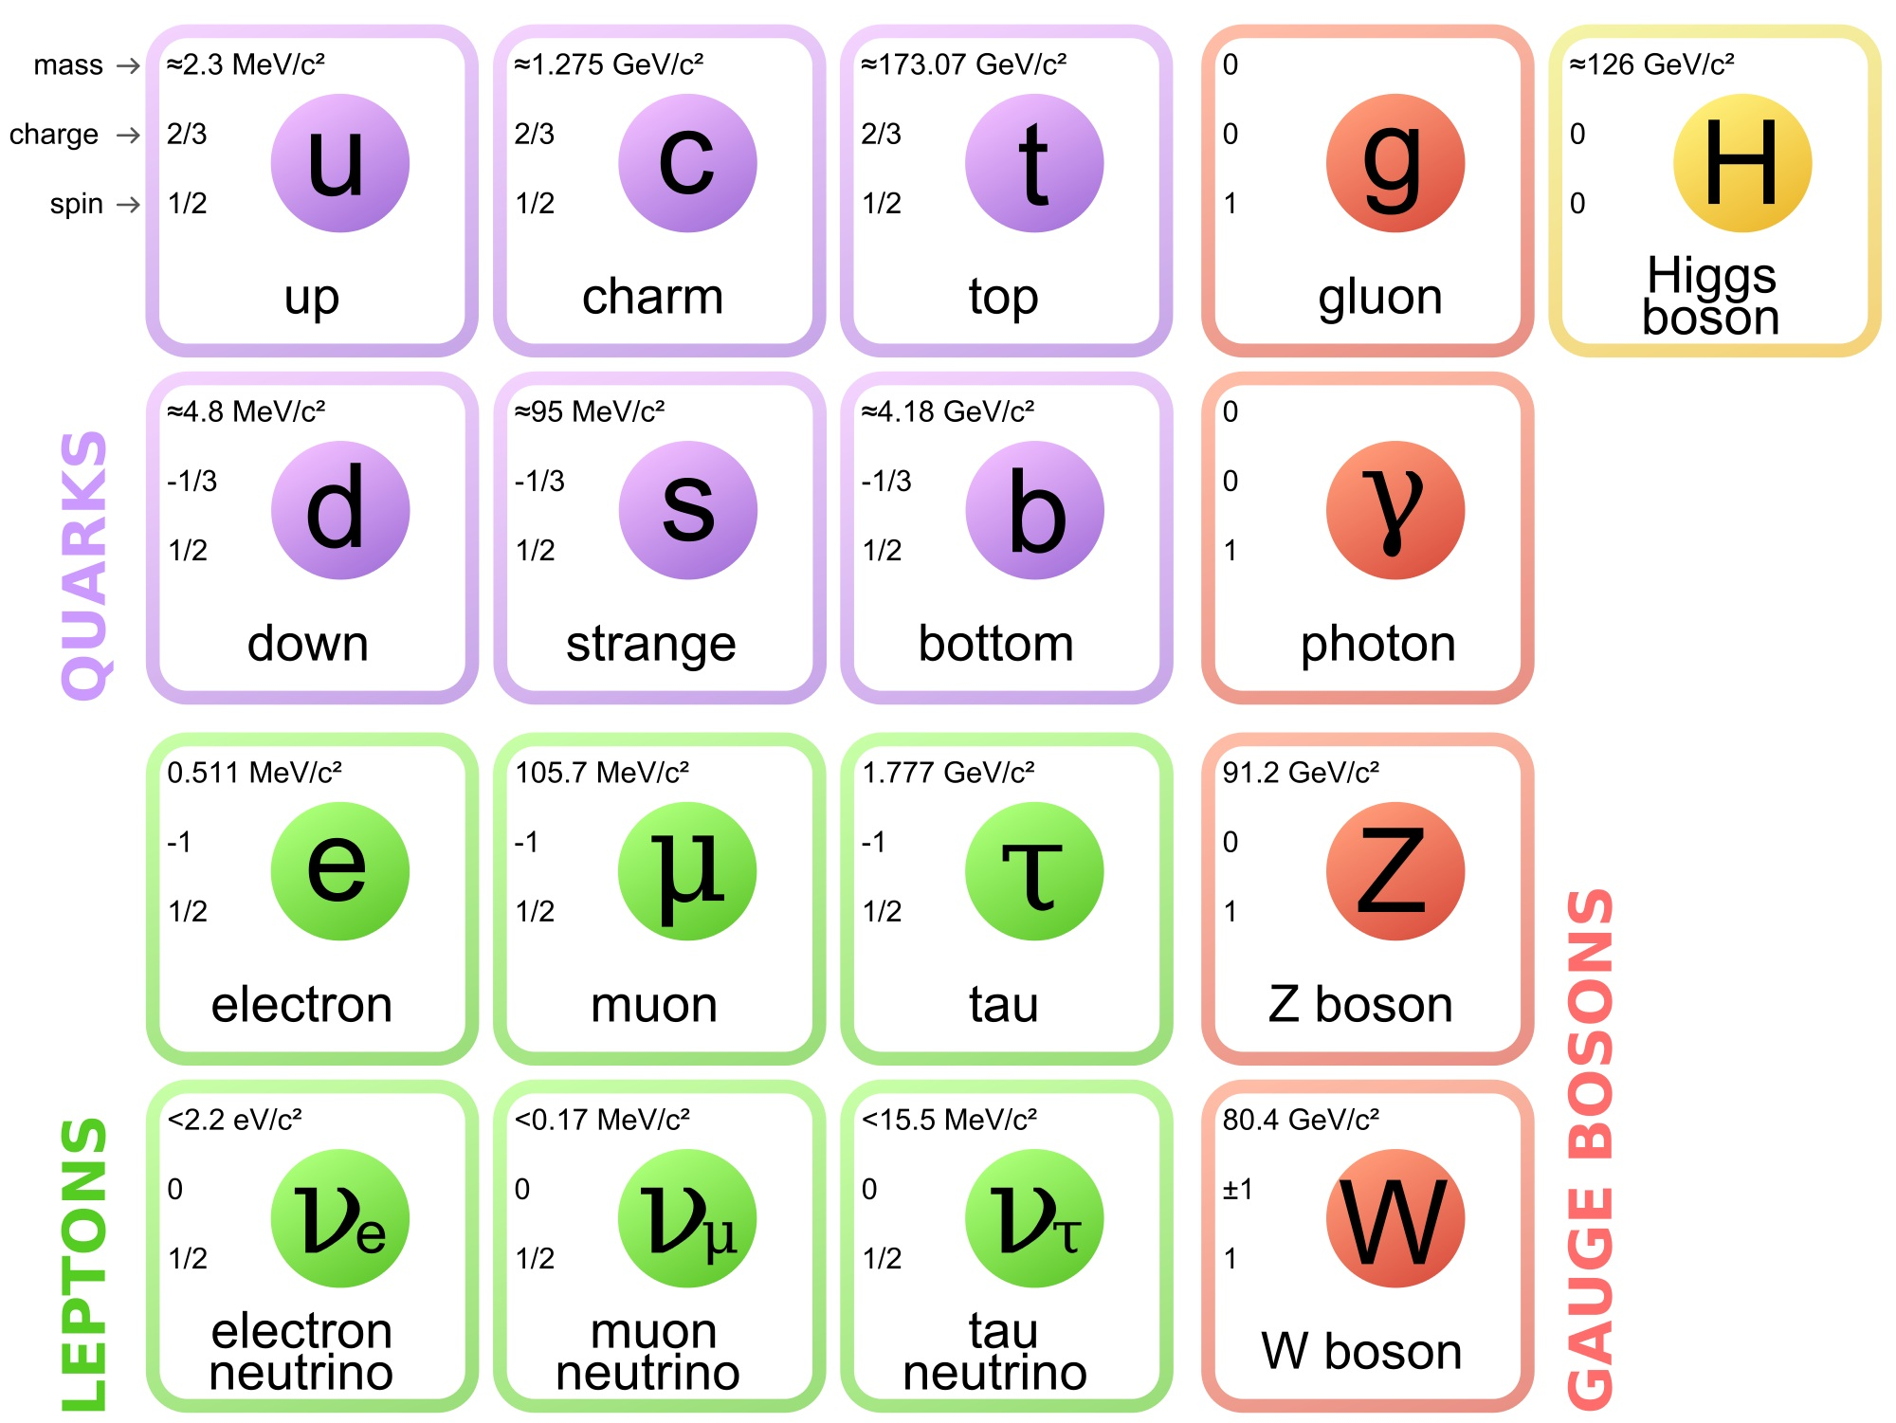
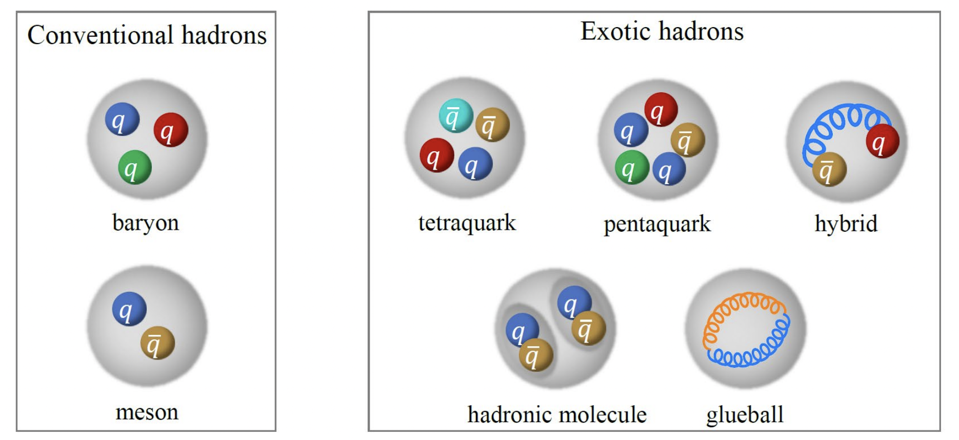
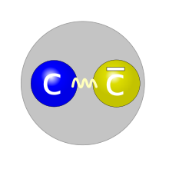
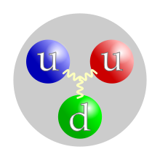
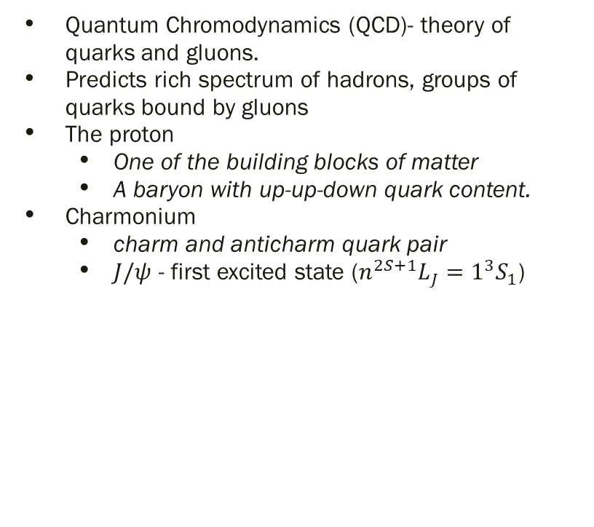
Quantum Chromodynamics
Quantum Chromodynamics (QCD)- theory of quarks and gluons.
Predicts rich spectrum of hadrons, groups of quarks bound by gluons
The proton
  One of the building blocks of matter
  A baryon with up-up-down quark content.
Charmonium
  charm and anticharm quark pair
  $J/ψ$ - first excited state ($n^{2S+1}L_{J}=1^{3}S_{1}$)
Proton
Charmonium- 𝑱/𝝍

Slide 3
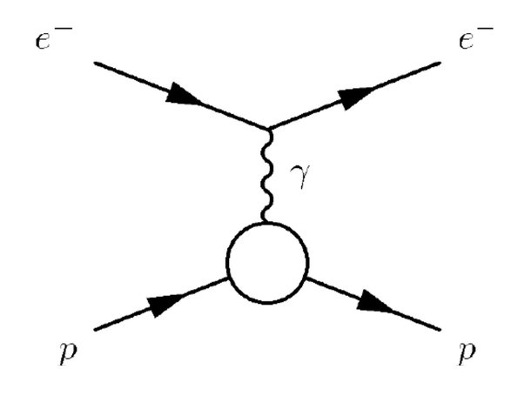
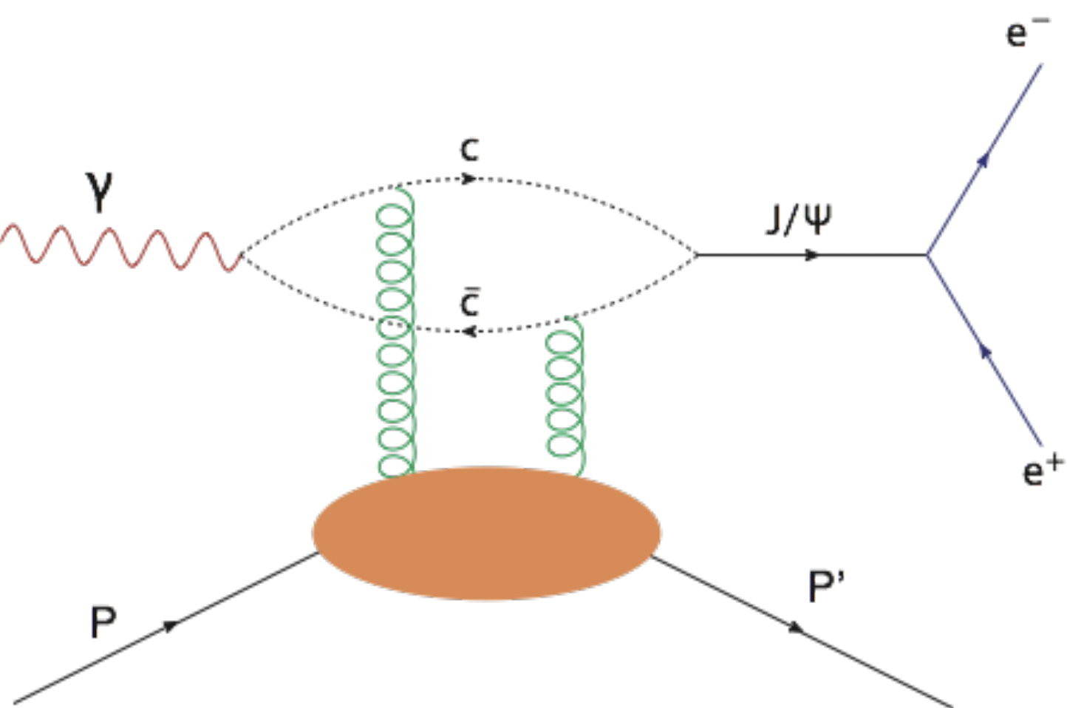
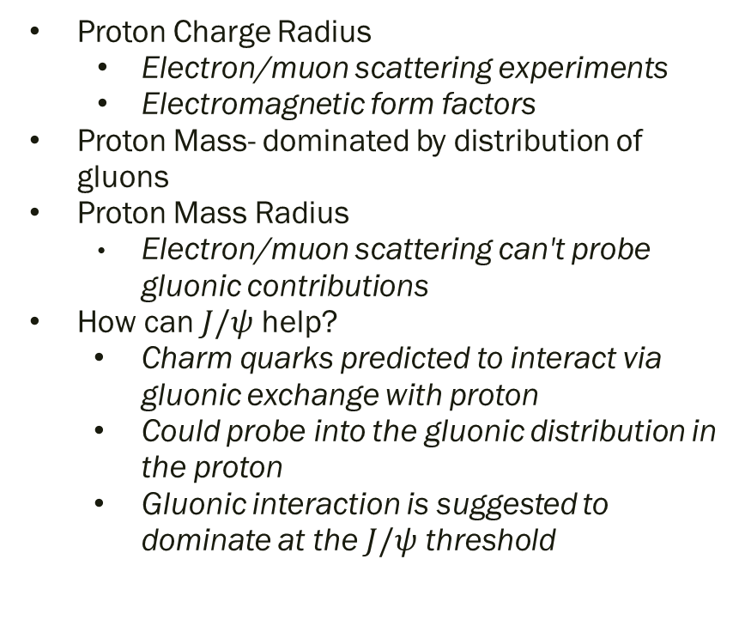
Proton Charge and Mass Radius
Proton Charge Radius
  Electron/muon scattering experiments
  Electromagnetic form factors
Proton Mass- dominated by distribution of gluons
Proton Mass Radius
  Electron/muon scattering can't probe gluonic contributions
How can $J/ψ$ help?
  Charm quarks predicted to interact via gluonic exchange with proton
  Could probe into the gluonic distribution in the proton
  Gluonic interaction is suggested to dominate at the $J/ψ$ threshold

Slide 4
Assumptions of Gluonic Interaction
Vector Meson Dominance
  Model describes photon-hadron interactions
  Suggests photons oscillate into vector meson (𝝆,𝝎,𝞍,J/𝜓) that interact with proton
  Possibly breaks down for heavier quarks
Factorization
  Assumes gluonic interaction can factorize into an upper, “hard” part and a lower, “soft” part
    “Hard” part- described by QCD
    “Soft” part- described by generalized parton distribution functions (GPDs)
Dominant interaction at Threshold
  Assumes no s-channel or loop contributions

Slide 5
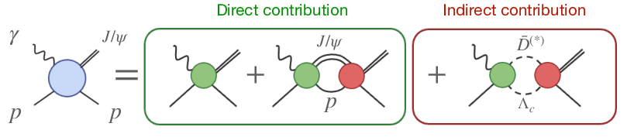
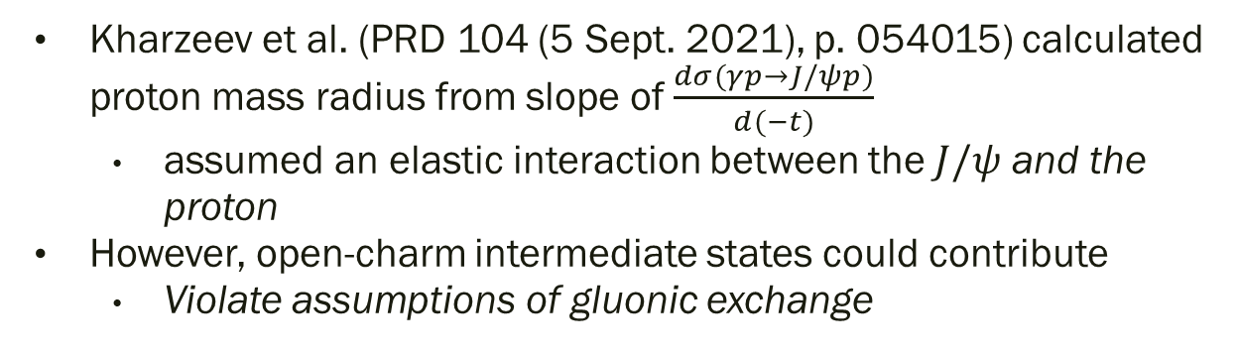
Models in $J/ψ$ Photoproduction Dynamics
JPAC arxiv:2305.01449 (2023)
Kharzeev et al. (PRD 104 (5 Sept. 2021), p. 054015) calculated proton mass radius from slope of $\frac{dσ(γp→J/ψp)}{d(−t)}$
  assumed an elastic interaction between the $J/ψ$ and the proton
However, open-charm intermediate states could contribute
  Violate assumptions of gluonic exchange

Slide 6
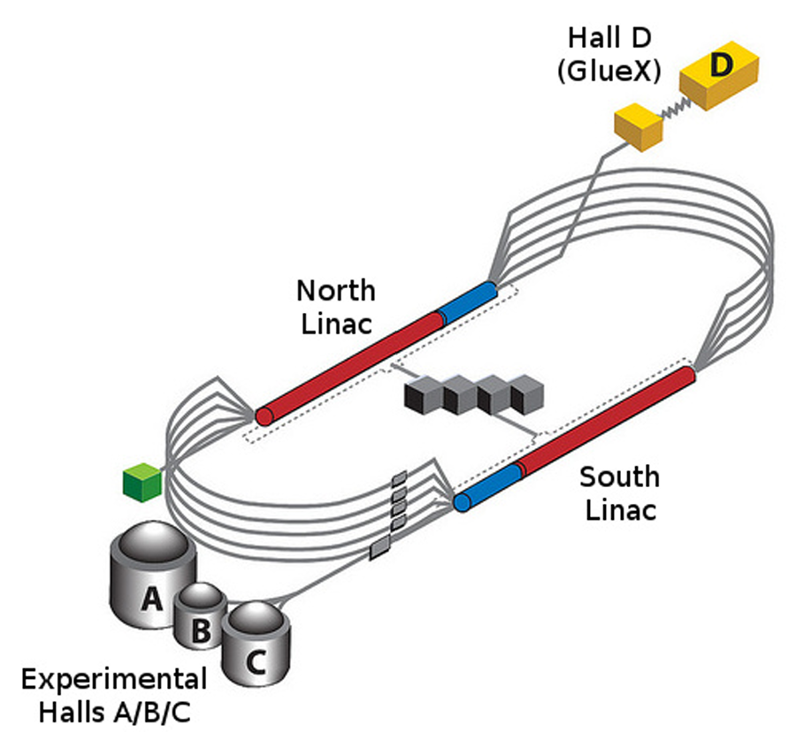
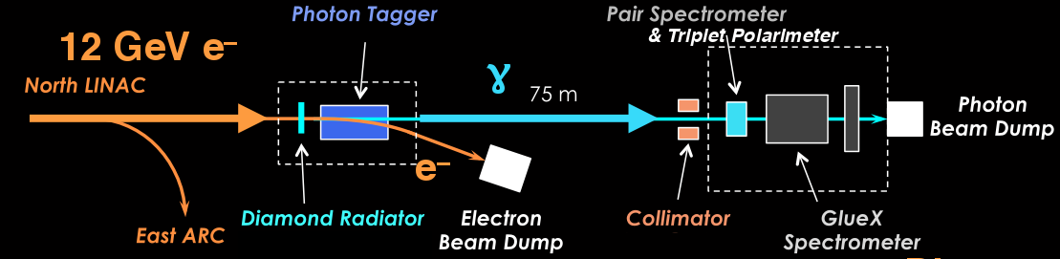
Thomas Jefferson National Accelerator Facility
A National Laboratory located in Newport News, Virginia
Hosts the Continuous Electron Beam Accelerator Facility (CEBAF)
GlueX located in Hall D
  Receives 12 GeV electrons after 5.5 turns through CEBAF
  Electron beam hits a diamond radiator
  Producing a linearly polarized beam of photons via Bremsstrahlung radiation

Slide 7
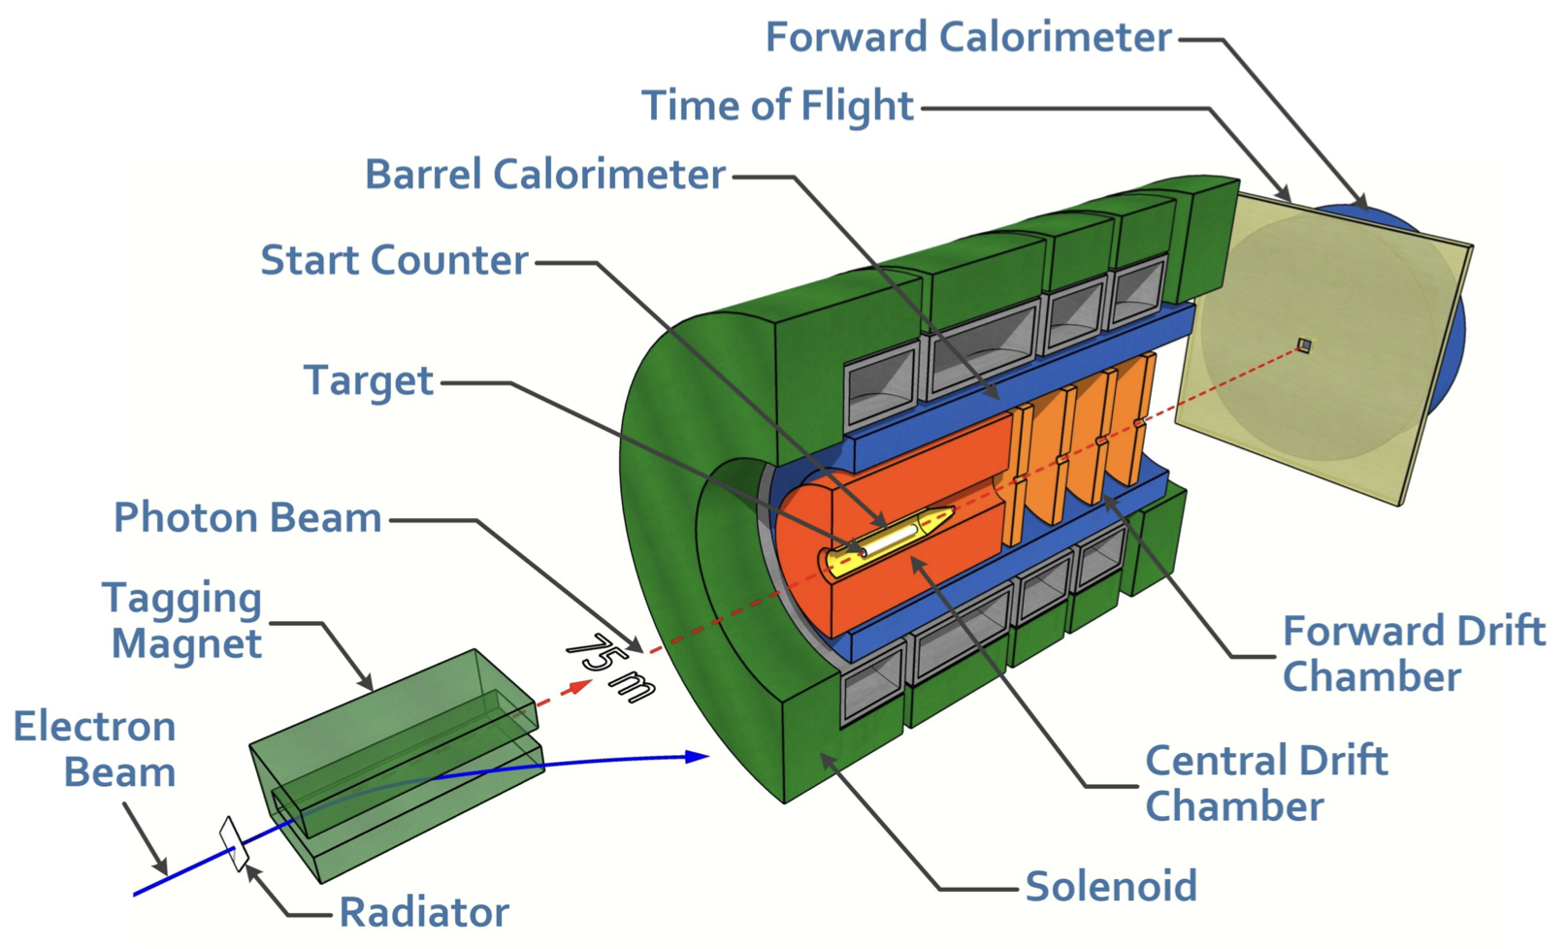
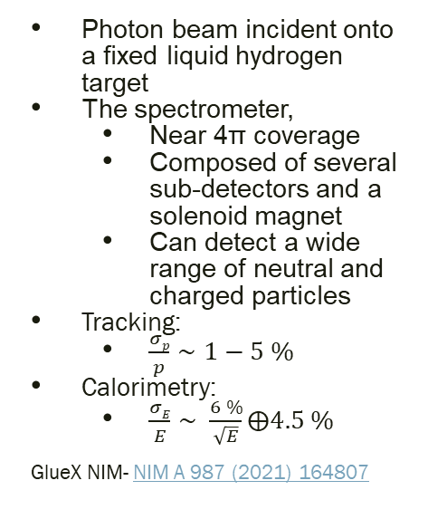
The GlueX Spectrometer
Photon beam incident onto a fixed liquid hydrogen target
The spectrometer,
  Near 4π coverage
  Composed of several sub-detectors and a solenoid magnet
  Can detect a wide range of neutral and charged particles
Tracking:
  $\frac{σp}{p}∼1−5 \%$
Calorimetry:
  $\frac{σE}{E}∼ \frac{6 \%}{\sqrt{E}}⨁4.5 \%$
GlueX NIM- NIM A 987 (2021) 164807

Slide 8
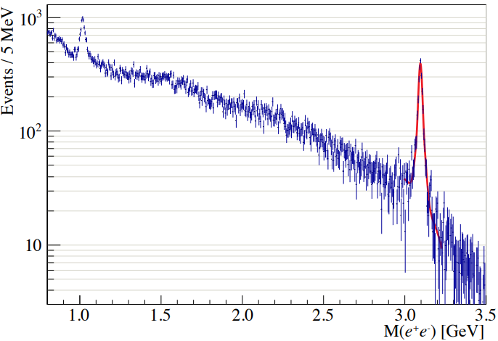
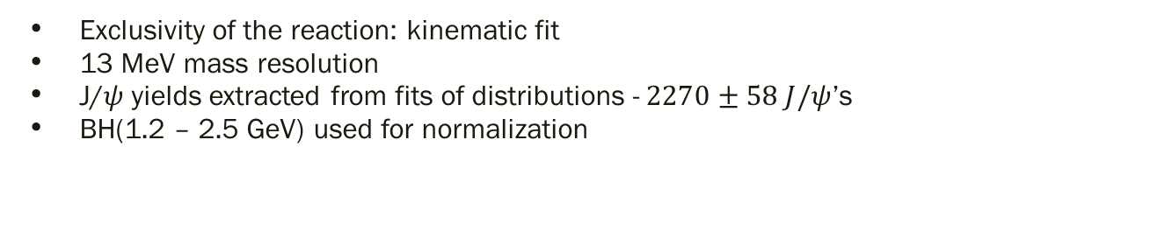
Exclusive $γp→J/ψp→ e^{+}e^{−}p$at GlueX
GlueX: Phys. Rev. C108, 025201 (2023)
Exclusivity of the reaction: kinematic fit
13 MeV mass resolution
J/𝜓 yields extracted from fits of distributions -$2270±58 J/ψ$’s
BH(1.2 – 2.5 GeV) used for normalization

Slide 9
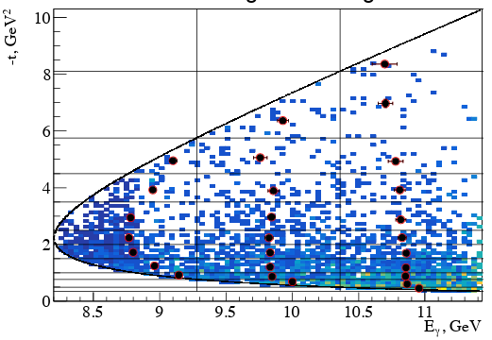
Threshold region coverage
GlueX: Phys. Rev. C108, 025201 (2023)
Event-by-event weighting by luminosity
Dots - mean energy and t-value for the corresponding bin
Results reported at mean energy for corresponding slice
Deviations due to bin averaging included in the systematic errors

Slide 10
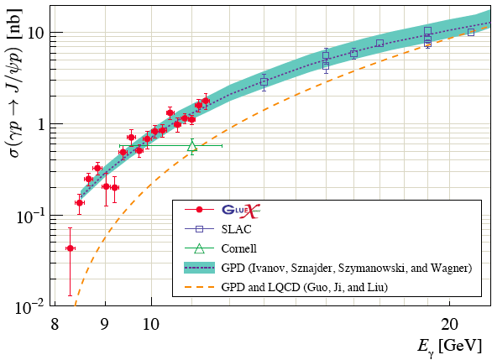
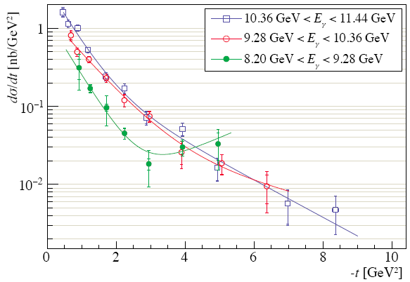
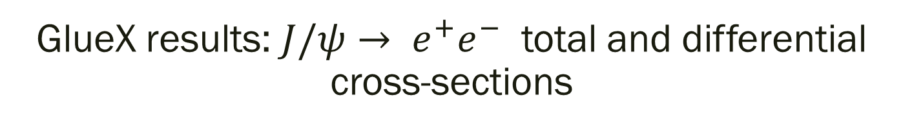
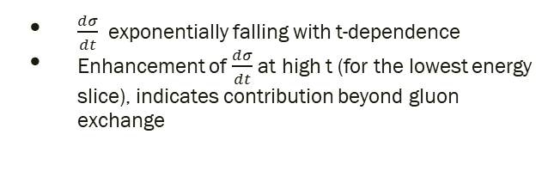
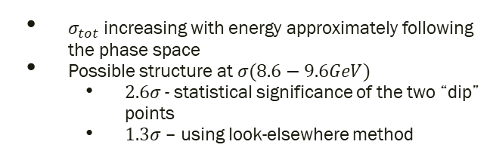
GlueX results: $J/ψ→ e^{+}e^{−}$ total and differential cross-sections
GlueX: Phys. Rev. C108, 025201 (2023)
GlueX: Phys. Rev. C108, 025201 (2023)
$σ_{tot}$ increasing with energy approximately following the phase space
Possible structure at $σ(8.6−9.6GeV)$
  $2.6σ$- statistical significance of the two “dip” points
  $1.3σ$– using look-elsewhere method
$\frac{dσ}{dt}$ exponentially falling with t-dependence
Enhancement of $\frac{dσ}{dt}$ at high t (for the lowest energy slice), indicates contribution beyond gluon exchange

Slide 11
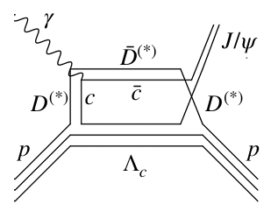
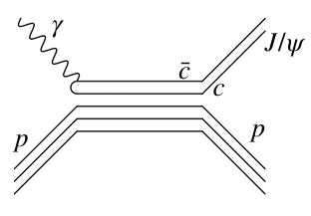
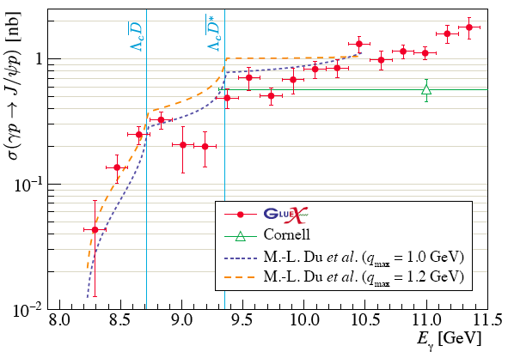
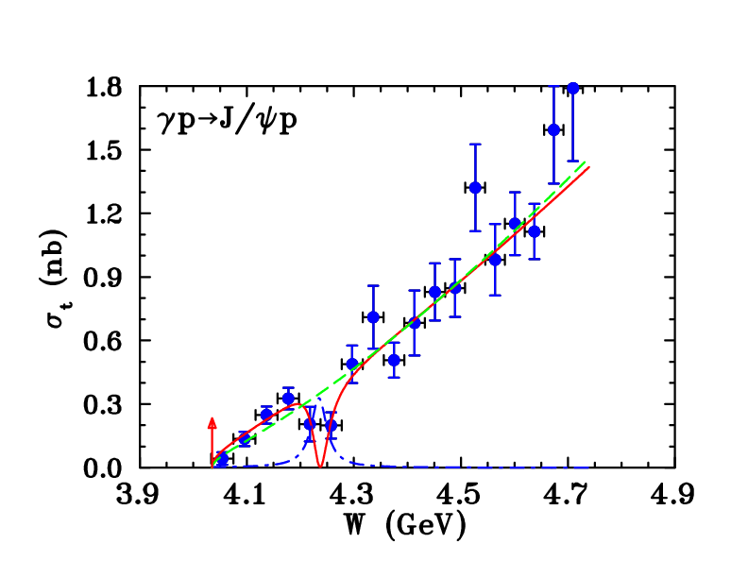
Other reaction mechanisms: open-charm, 5q exchange
GlueX: Phys. Rev. C108, 025201 (2023)
Du et al. EPJ C80 (2020)
Strakovsky et al. arxiv:2304.04924 (2023)

Slide 12
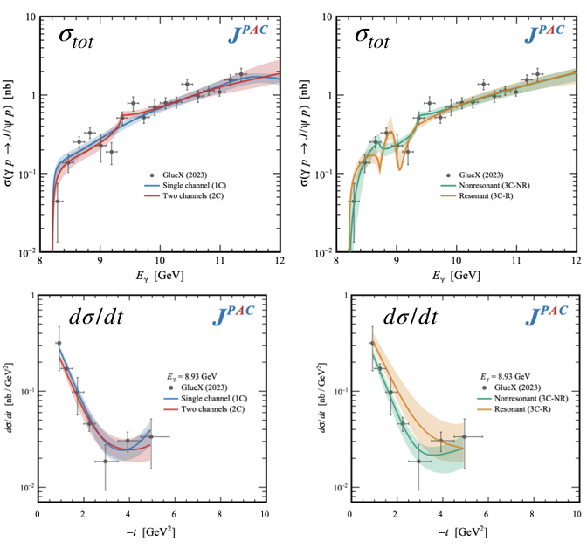
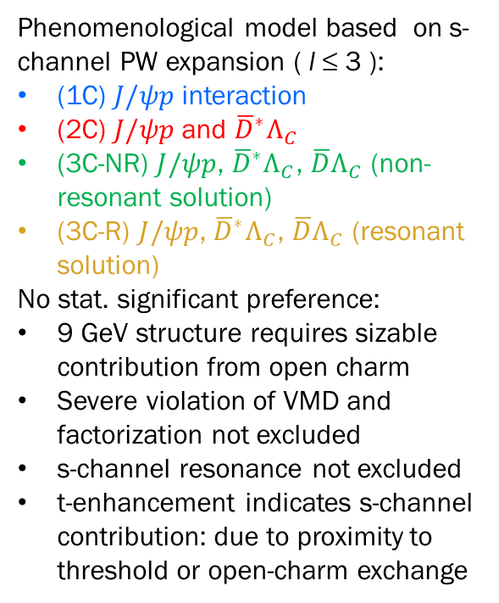
Gluon or charm exchange: JPAC interpretation
Phenomenological model based on s-channel PW expansion ( l ≤ 3 ):
(1C) $J/ψp$ interaction
(2C) $J/ψp$ and ${\overline{D}}^{∗}Λ_{C}$
(3C-NR) $J/ψp$, ${\overline{D}}^{∗}Λ_{C}$, ${\overline{D}Λ}_{C}$ (non-resonant solution)
(3C-R) $J/ψp$, ${\overline{D}}^{∗}Λ_{C}$, ${\overline{D}Λ}_{C}$ (resonant solution)
No stat. significant preference:
9 GeV structure requires sizable contribution from open charm
Severe violation of VMD and factorization not excluded
s-channel resonance not excluded
t-enhancement indicates s-channel contribution: due to proximity to threshold or open-charm exchange
JPAC arxiv:2305.01449 (2023)

Slide 13
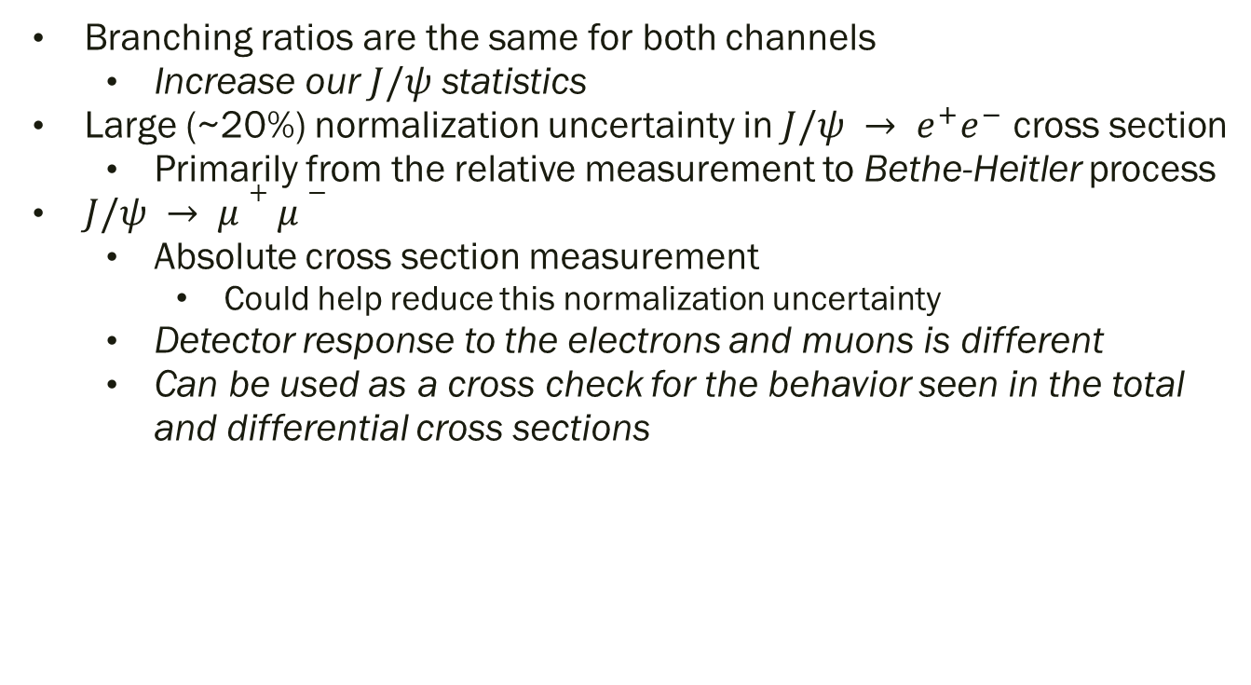
Why $J/ψ → μ^{+}μ^{−}$at GlueX?
Branching ratios are the same for both channels
  Increase our $J/ψ$ statistics
Large (~20%) normalization uncertainty in $J/ψ → e^{+}e^{−}$ cross section
  Primarily from the relative measurement to Bethe-Heitler process
$J/ψ → μ+μ−$
  Absolute cross section measurement
    Could help reduce this normalization uncertainty
  Detector response to the electrons and muons is different
  Can be used as a cross check for the behavior seen in the total and differential cross sections

Slide 14
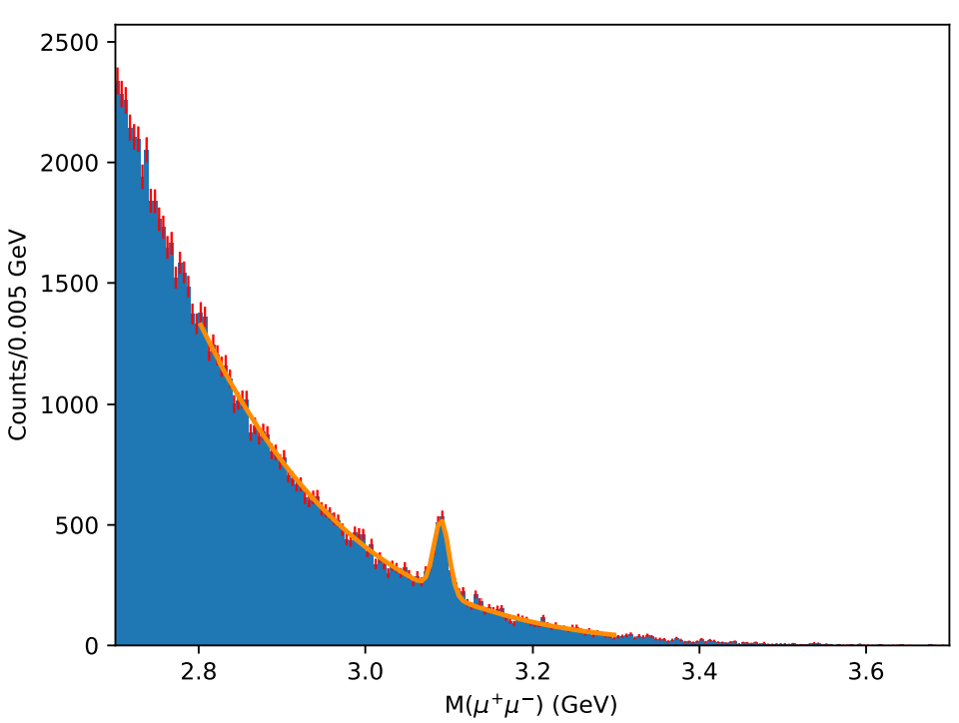

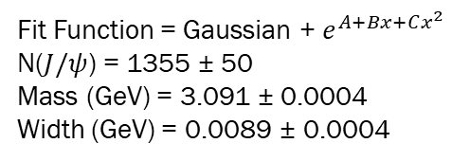
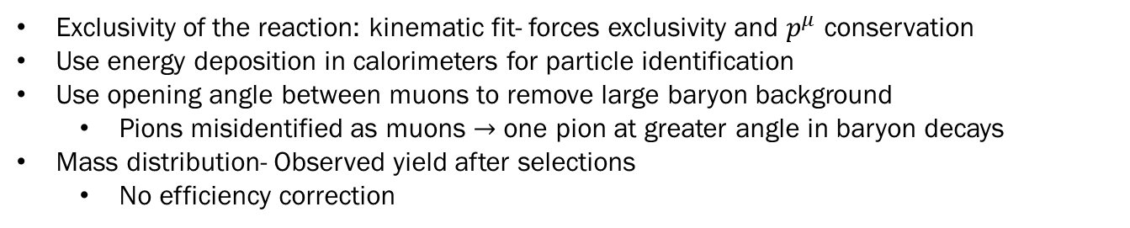
Exclusive $γp→J/ψp→ μ^{+}μ^{−}p$at GlueX
Fit Function = Gaussian + $e^{A+Bx+Cx^{2}}$
N($J/ψ$) = 1355 ± 50
Mass (GeV) = 3.091 ± 0.0004
Width (GeV) = 0.0089 ± 0.0004
Exclusivity of the reaction: kinematic fit- forces exclusivity and $p^{μ}$ conservation
Use energy deposition in calorimeters for particle identification
Use opening angle between muons to remove large baryon background
  Pions misidentified as muons $→$ one pion at greater angle in baryon decays
Mass distribution- Observed yield after selections
  No efficiency correction

Slide 15
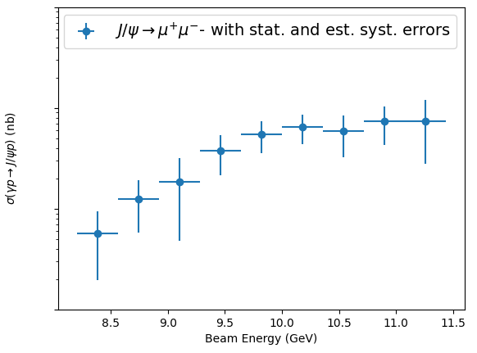
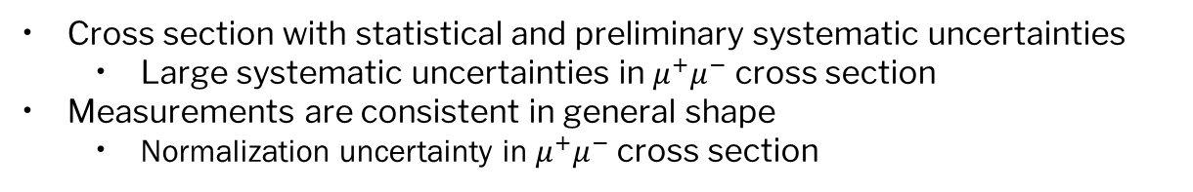
Comparing $e^{+}e^{−}$ and $μ^{+}μ^{−}$ cross sections
GlueX: Phys. Rev. C108, 025201 (2023)
Cross section with statistical and preliminary systematic uncertainties
  Large systematic uncertainties in $μ^{+}μ^{−}$ cross section
Measurements are consistent in general shape
  Normalization uncertainty in $μ^{+}μ^{−}$ cross section

Slide 16
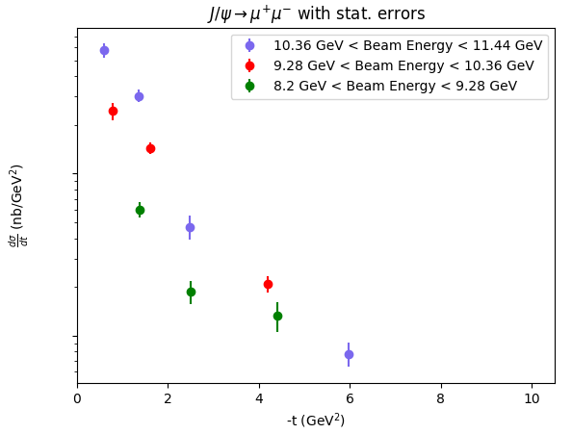
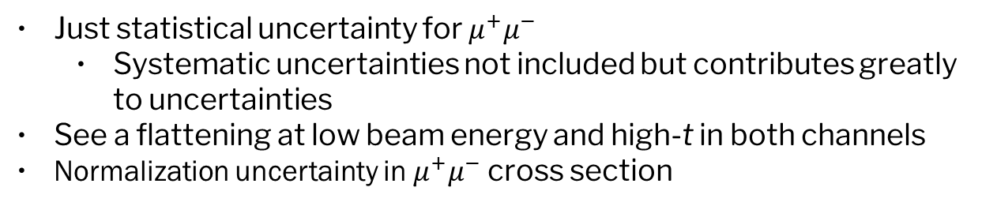
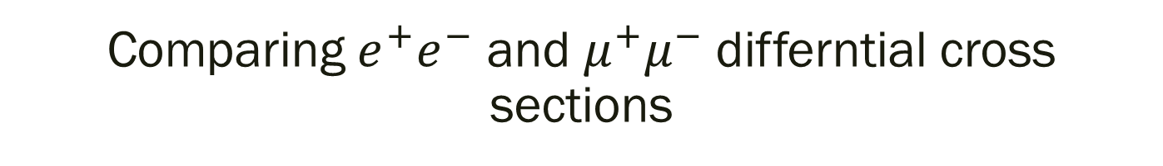
Comparing $e^{+}e^{−}$ and $μ^{+}μ^{−}$ differntial cross sections
GlueX: Phys. Rev. C108, 025201 (2023)
Just statistical uncertainty for $μ^{+}μ^{−}$
  Systematic uncertainties not included but contributes greatly to uncertainties
See a flattening at low beam energy and high-t in both channels
Normalization uncertainty in $μ^{+}μ^{−}$ cross section

Slide 17
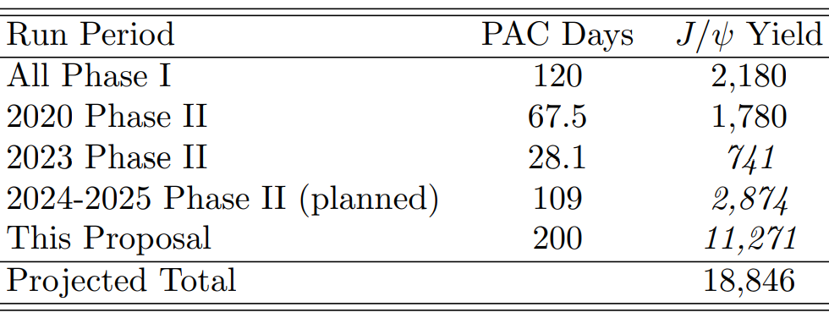
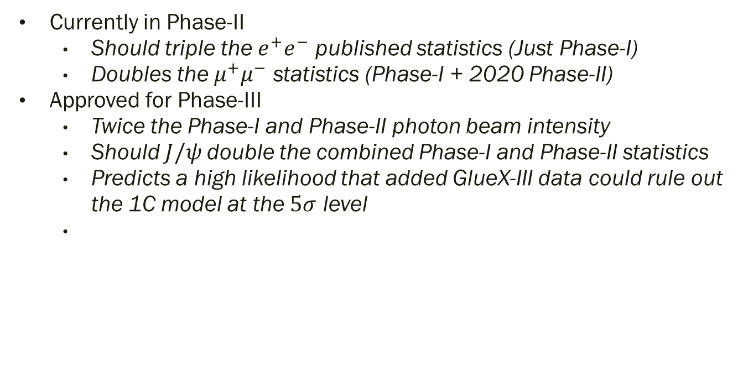
Future at GlueX- Approved Phase-III Proposal
Proposal # PR12-24-006 for PAC52
Currently in Phase-II
  Should triple the $e^{+}e^{−}$ published statistics (Just Phase-I)
  Doubles the $μ^{+}μ^{−}$ statistics (Phase-I + 2020 Phase-II)
Approved for Phase-III
  Twice the Phase-I and Phase-II photon beam intensity
  Should $J/ψ$double the combined Phase-I and Phase-II statistics
  Predicts a high likelihood that added GlueX-III data could rule out the 1C model at the $5σ$ level

Slide 18


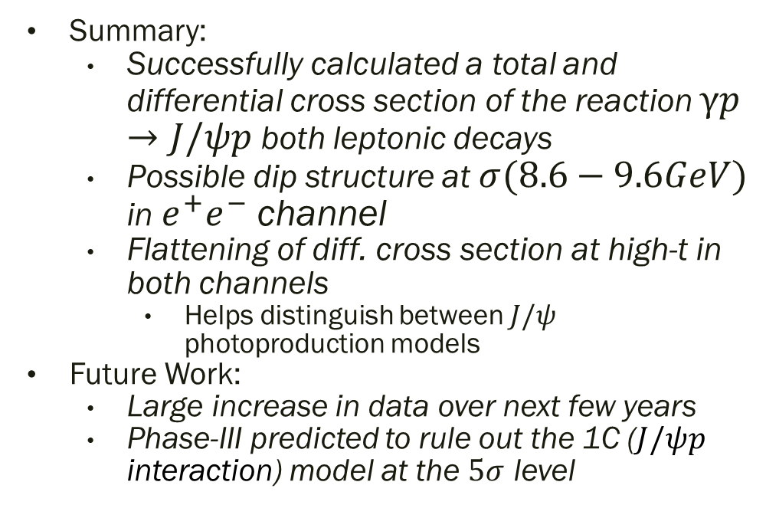
Summary
Summary:
  Successfully calculated a total and differential cross section of the reaction $γp→J/ψp$ both leptonic decays
  Possible dip structure at $σ(8.6−9.6GeV)$ in $e^{+}e^{−}$ channel
  Flattening of diff. cross section at high-t in both channels
    Helps distinguish between $J/ψ$ photoproduction models
Future Work:
  Large increase in data over next few years
  Phase-III predicted to rule out the 1C ($J/ψp$ interaction) model at the $5σ$ level
GlueX Acknowledgements:
http://gluex.org/thanks

Slide 19
Back up slides

Slide 20
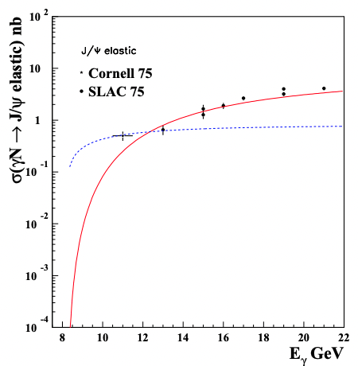
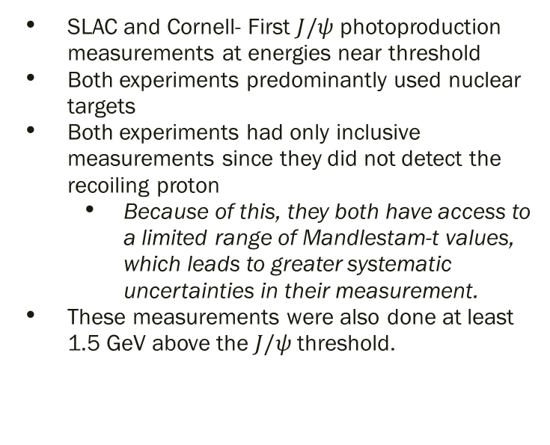
Previous Measurements: SLAC and Cornell
SLAC and Cornell- First $J/ψ$ photoproduction measurements at energies near threshold
Both experiments predominantly used nuclear targets
Both experiments had only inclusive measurements since they did not detect the recoiling proton
  Because of this, they both have access to a limited range of Mandlestam-t values, which leads to greater systematic uncertainties in their measurement.
These measurements were also done at least 1.5 GeV above the $J/ψ$ threshold.
Brodsky et al.: PLB 498 (2001), pp. 23–28

Slide 21
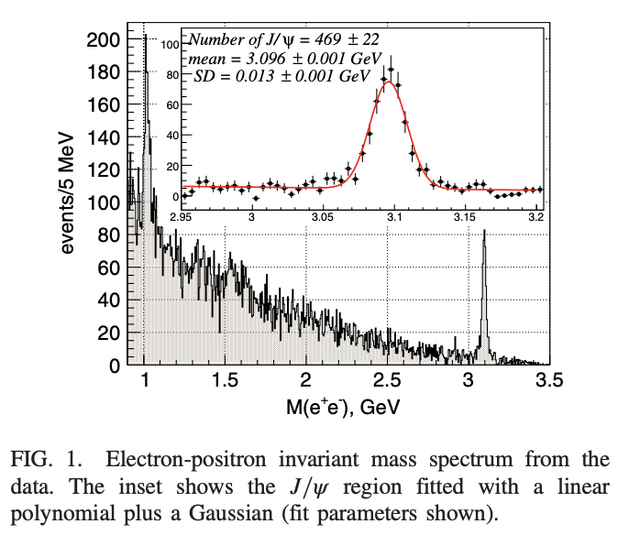
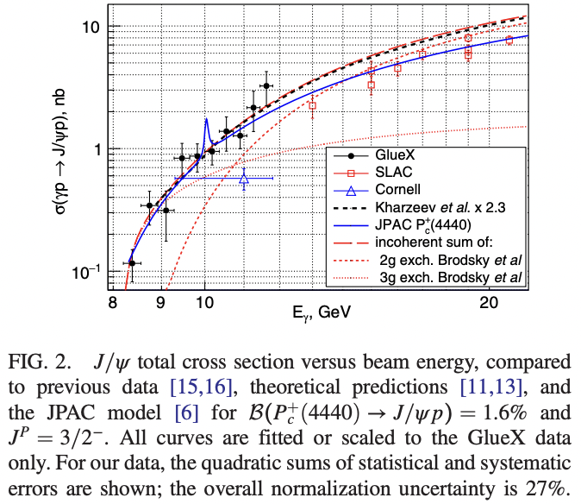
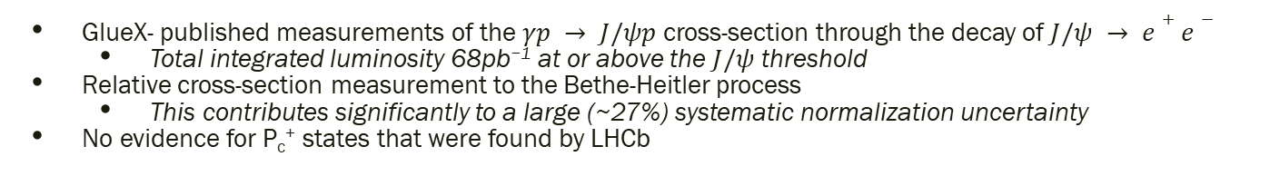
Previous Measurements: GlueX Collaboration (1st Publication)
GlueX- published measurements of the $γp → J/ψp$cross-section through the decay of $J/ψ → e+e−$
  Total integrated luminosity 68pb⁻¹ at or above the $J/ψ$ threshold
Relative cross-section measurement to the Bethe-Heitler process
  This contributes significantly to a large (~27%) systematic normalization uncertainty
No evidence for P_{c}⁺ states that were found by LHCb
GlueX: PRL 123 (7 Aug. 2019), p. 072001
GlueX: PRL 123 (7 Aug. 2019), p. 072001

Slide 22
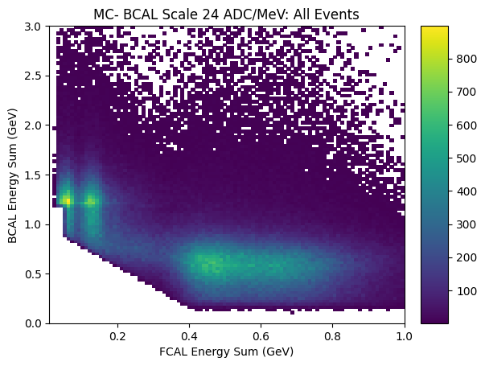

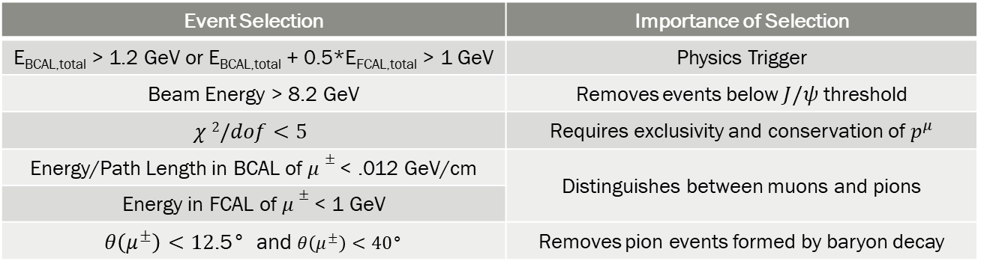
Data Used and Goal of Event Selections
Proposed exclusive reaction:
  $γp→J/ψp→μ^{+}μ^{−}p$
  Phase-I data: taken from 2017-2018
    a luminosity of 304 pb⁻¹ above the $J/ψ$ threshold
  Subset of Phase-II data: taken in 2020
    a luminosity of 321 pb⁻¹ above the $J/ψ$ threshold
Event Selection | Importance of Selection
E_{BCAL,total} > 1.2 GeV or E_{BCAL,total} + 0.5*E_{FCAL,total} > 1 GeV | Physics Trigger
Beam Energy > 8.2 GeV | Removes events below $J/ψ$ threshold
$$χ 2/dof<5$$ | Requires exclusivity and conservation of $p^{μ}$
Energy/Path Length in BCAL of $μ±$ < .012 GeV/cm | Distinguishes between muons and pions
Energy in FCAL of $μ±$ < 1 GeV
$θ\left(μ^{±}\right)<12$.5° and $θ\left(μ^{±}\right)<40$° | Removes pion events formed by baryon decay

Slide 23
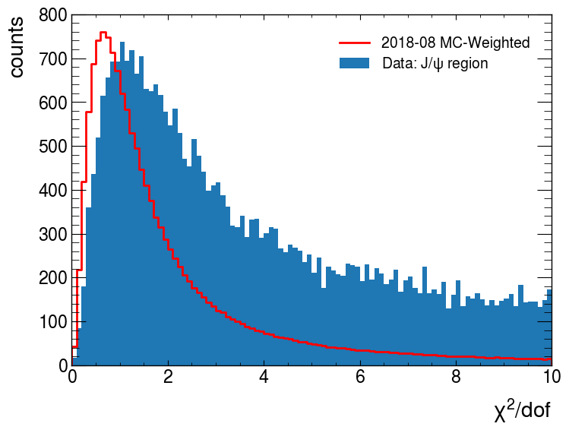
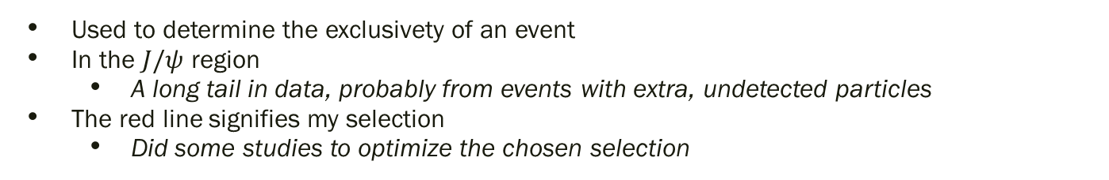
Event Selections- $χ^{2}/dof$
KEEP
Used to determine the exclusivety of an event
In the $J/ψ$ region
  A long tail in data, probably from events with extra, undetected particles
The red line signifies my selection
  Did some studies to optimize the chosen selection

Slide 24



Event Selections- BCAL and FCAL selections
New MC
KEEP
KEEP
With corrections to the MC simulations, much better matching in $J/ψ$ region
  Differences mostly from large pion background
  Make loose selections to mitigate differences
Keep events to the left of the red line

Slide 25



New θ cut- Theta Distributions
Comparing data to MC
  Muons tend to have smaller angles
Pions from baryon decay
  One pion has large $θ$ in the lab frame
  Expect the large angles to be from misidentified pions
  For instance:
    $γp→Δ^{++}π^{−}→ (π^{+}p)π^{−}$
    $γp→Δ^{0}π^{+}→ (π^{−}p)π^{+}$
    $γp→N^{∗}π^{+}→ (π^{−}p)π^{+}$
Theta Cut: θ(μ± )<12.5° and θ(μ∓)<40°

Slide 26






Previous Measurements: $J/ψ−007$Experiment
Located in Hall C of Jefferson Lab.
Inclusive measurement of $J/ψ$ differential cross section through
$J/ψ→ e+e−$
$$Duran, B., Meziani, ZE., Joosten, S. et al. Determining the$$
$$gluonic gravitational form factors of the proton. Nature 615, 813–816 (2023)$$

Slide 27


GlueX Phase-III
Plots of the $χ^{2}$ difference for 1C ($J/ψp$ interaction) and 2C ($J/ψp$ and ${\overline{D}}^{∗}Λ_{C}$) JPAC model
Shows a high likelihood that added GlueX-III data could rule out the 1C model at the $5σ$ level

Slide 28


