Slide 1

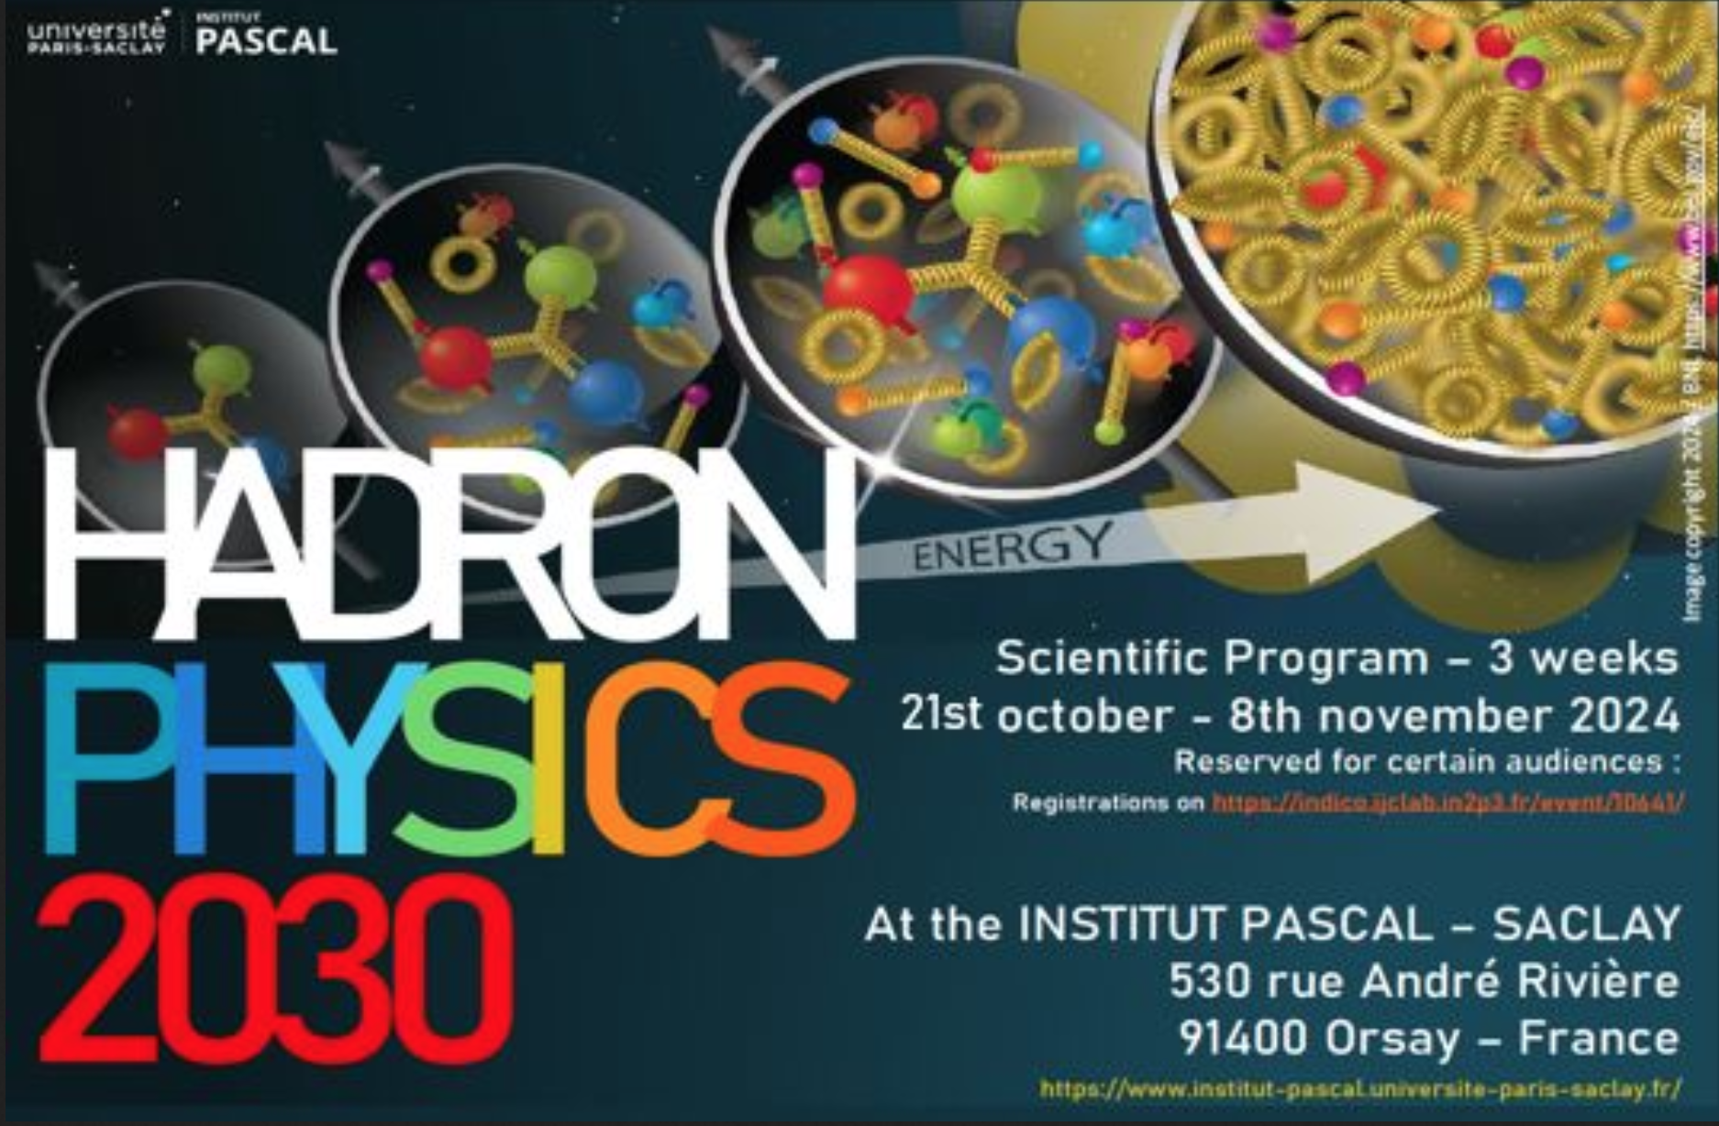
Measurements of Generalized Parton Distributions
with
Polarized and Unpolarized Positron Beams
GPDs @ Ce⁺BAF
Eric Voutier and the Jefferson Lab Positron Working Group
Université Paris-Saclay, CNRS/IN2P3/IJCLab, Orsay, France
(Jefferson Lab Positron Working Group) A. Accardi et al. EPJ A 57 (2021) 261
Towards Improved Hadron Femtography with Hard Exclusive Reactions (IVth)
July 28th-31st, 2025

Slide 2
JLab Positron Working Group
E. Voutier
The Positron Experimental Program at JLab represents today 8 approved proposals covering the 3 pillars of the JLab Positron White Paper and representing 471 days of single hall running.
NUMBER | TITLE | PHYSICS THEME | CONTACT PERSON | HALL | DAYS AWARDED | SCIENTIFIC RATING | PAC DECISION
PR12+23-002 | Beam Charge Asymmetries for Deeply Virtual Compton Scattering on the Proton at CLAS12 | GPDs | Eric Voutier | B | 100 | A- | C1
PR12+23-003 | Measurement of Deep Inelastic Scattering from Nuclei with Electron and Positron Beams to Constrain the Impact of Coulomb Corrections in DIS | MPE | Dave Gaskell | C | 9.3 | A- | C1
PR12+23-006 | Deeply Virtual Compton Scattering using a positron beam in Hall C | GPDs | Carlos Muñoz Camacho | C | 137 | A- | C1
PR12+23-008 | A Direct Measurement of Hard Two-Photon Exchange with Electrons and Positrons at CLAS12 | TPE | Axel Schmidt | B | 55 | A | C1
PR12+23-012 | A measurement of two-photon exchange in unpolarized elastic positron–proton and electron–proton scattering | TPE | Michael Nycz | C | 56 | A- | C1
PR12+24-005 | A dark photon search with a JLab positron beam | BSM | Bogdan Wojtsekhowski | B | 55 | A- | C1
PR12+25-006 | Meazsurement of Two-Photon Exchange in Electron-Neutron and Positron-Neutron Elastic Scattering | TPE | Eric Fuchey | C |  |  | C2
PR12+25-011 | Multi-Photon Effects in Inclusive and Semi-Inclusive Deep Inelastic Scattering | MPE | Tyler Hague | C | 58.5 | B+ | C1
C1 = Conditionally Approved with Technical Review by the Lab
C2 = Conditionally Approved with New Presentation to the PAC
Subscribe to the JLab Positron Working Group mailing list pwg@jlab.org
2/22
July 31st, 2025

Slide 3
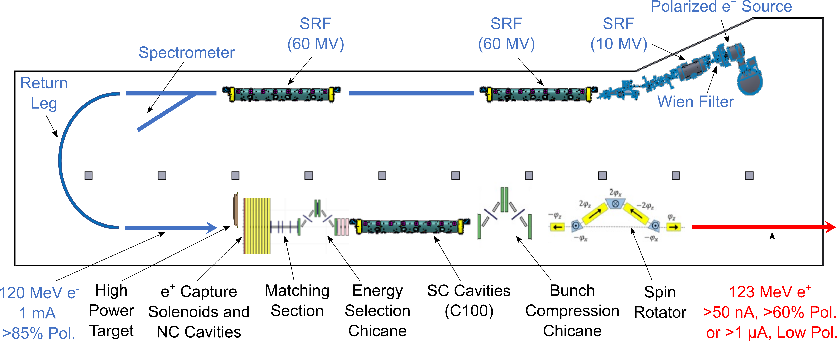
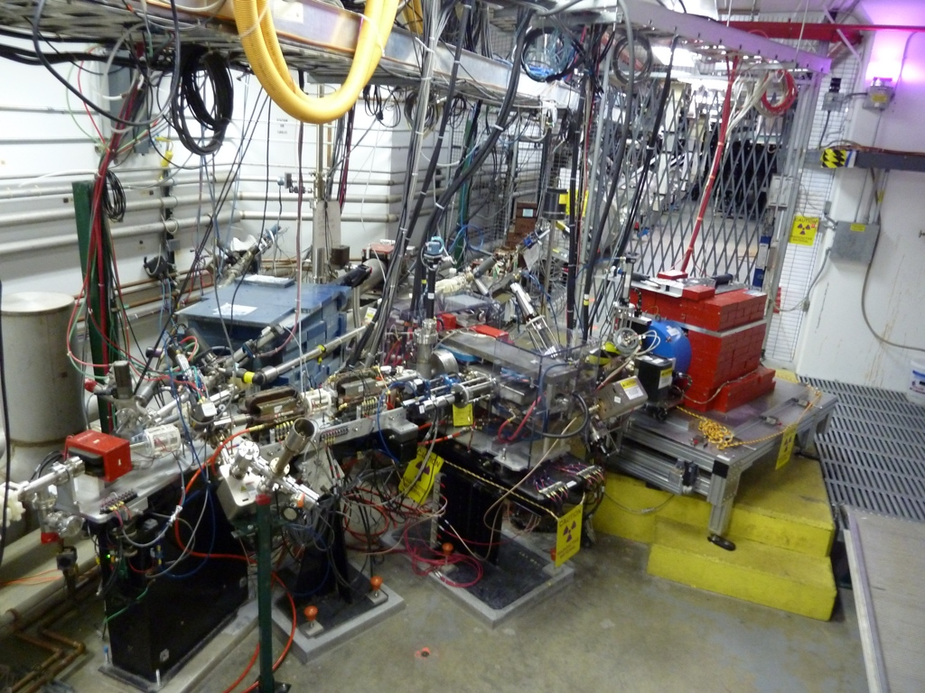
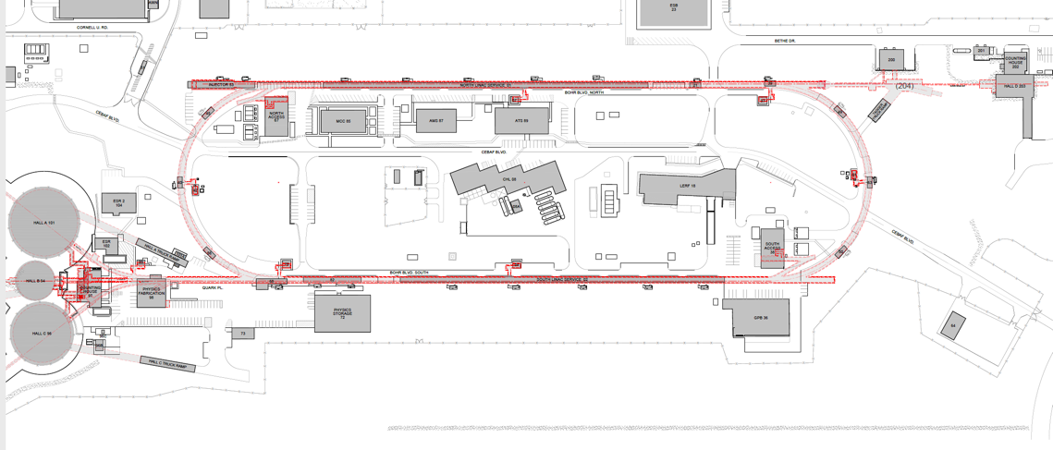
Outline
E. Voutier
Target Test Area
Generalized parton distributions
Deeply virtual Compton scattering
Conditionally approved measurements
e⁺-GPD program
Summary & outlook
123 MeV e⁺ Beam
Injected to NL
123 MeV e⁺
New Transport Line
along SL and West Arc
(Ce⁺BAF Working Group) J. Grames et al. JACoW IPAC2023 (2023) MOPL152; arXiv2309.15581
3/22
July 31st, 2025

Slide 4
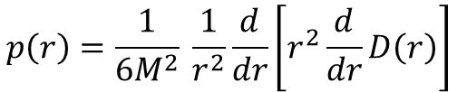
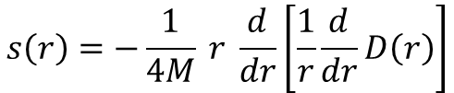
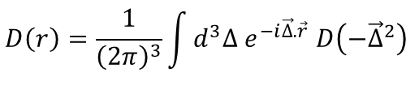
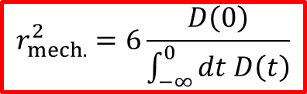
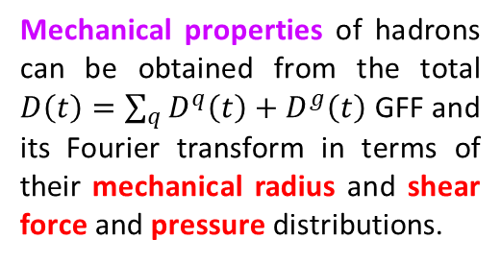
Generalized Parton Distributions
E. Voutier
Gravitational Form Factors
V.D. Burkert, L. Elouadrhiri, F.-X. Girod, C. Lorcé, P.E. Shanahan RMP 95 (2023) 041002
Experimental access to the Gravitational Form Factors (GFFs) of hadrons is the novel quest of the understanding of nucleon structure and dynamics.
GFFs may be probed indirectly in various exclusive processes: (Double) Deeply Virtual Compton Scattering, Time-Like Compton Scattering, Meson Production, J/Ψ production at threshold...
$\left\langle p′ | {\hat{T}}_{μν}^{q} | p\right\rangle =\overline{u}\left(p^{′},\vec{s}′\right) \left[M_{2}^{ q}\left(t\right) \frac{P_{μ}P_{ν}}{M}+J^{q}\left(t\right) \frac{i\left(P_{μ}σ_{να}+P_{ν}σ_{μα}\right)Δ^{α}}{2M}+D^{q}\left(t\right) \frac{Δ_{μ}Δ_{ν}−g_{μν}Δ^{2}}{4M}\right]u\left(p,\vec{s}\right)$
Mass/energy distribution
Angular momentum distribution
Forces & pressure distribution
Mechanical properties of hadrons can be obtained from the total $D\left(t\right)=\sum_{q}{D^{q}\left(t\right)}+D^{g}\left(t\right)$ GFF and its Fourier transform in terms of their mechanical radius and shear force and pressure distributions.
$$s\left(r\right)=−\frac{1}{4M} r \frac{d}{dr}\left[\frac{1}{r}\frac{d}{dr}D\left(r\right)\right]$$
$$D\left(r\right)=\frac{1}{{\left(2π\right)}^{3}}\int{d^{3}∆ e^{−i\vec{∆}.\vec{r}} D\left(−{\vec{∆}}^{2}\right)}$$
$$p\left(r\right)=\frac{1}{6M^{2}} \frac{1}{r^{2}}\frac{d}{dr}\left[r^{2}\frac{d}{dr}D\left(r\right)\right]$$
$$r_{mech.}^{2}=6\frac{D\left(0\right)}{\int_{−∞}^{0}{dt D\left(t\right)}}$$
4/22
July 31st, 2025

Slide 5
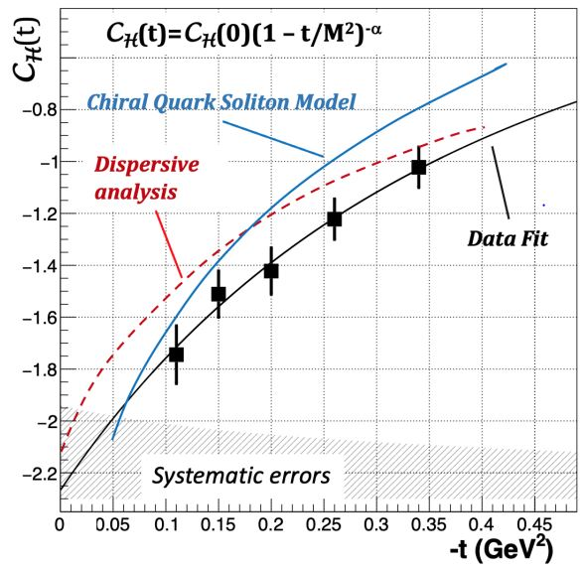
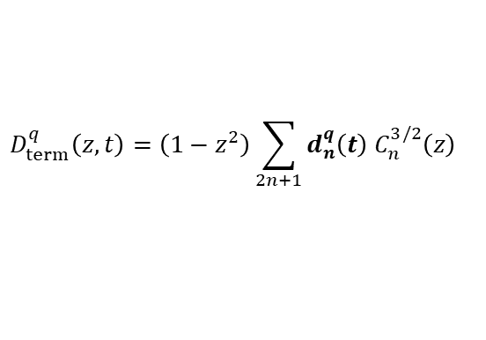
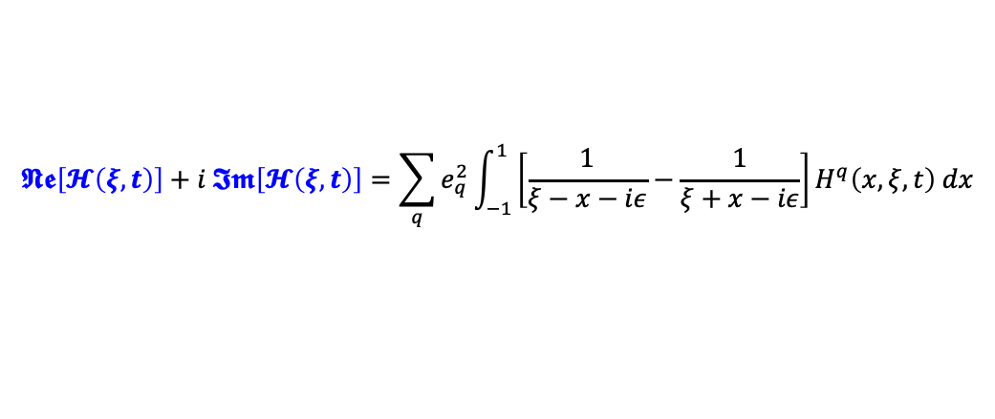

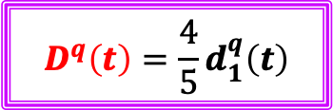
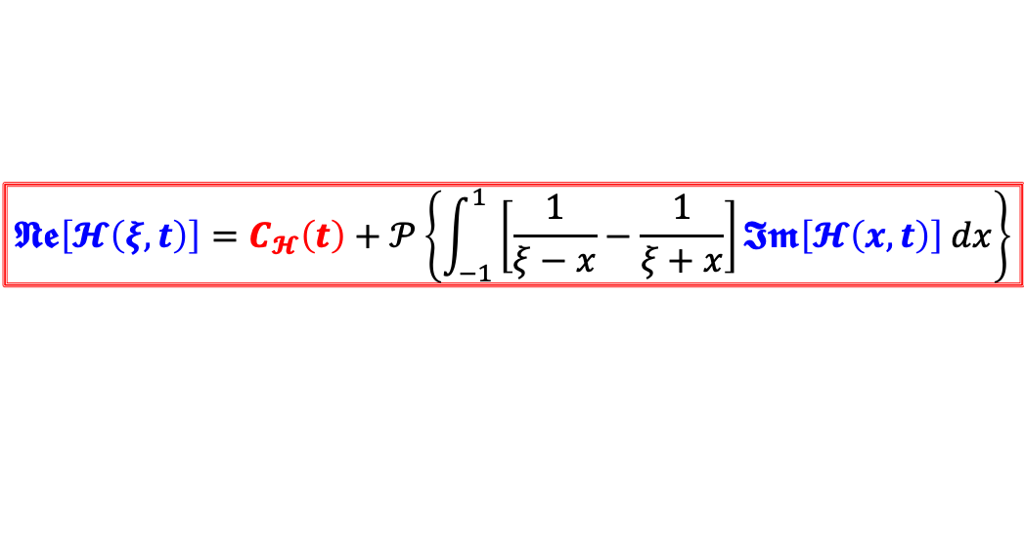
Generalized Parton Distributions
E. Voutier
Experimental Access to D(t)
V.D. Burkert, L. Elouadrhiri, F.-X. Girod, Nature 557 (2018) 39
GPDs are accessed through Compton Form Factors (CFFs) which real and imaginary parts are related by a fixed-t dispersion relation.
$$𝕹𝖊\left[𝓗\left(ξ,t\right)\right]+i 𝕴𝖒\left[𝓗\left(ξ,t\right)\right]=\sum_{q}{e_{q}^{2}}\int_{−1}^{1}{\left[\frac{1}{ξ−x−iε}−\frac{1}{ξ+x−iε}\right]H^{q}\left(x,ξ,t\right) dx}$$
V.D. Burkert et al. RMP 95 (2023) 041002
$$𝕹𝖊\left[𝓗\left(ξ,t\right)\right]=C_{𝓗}\left(t\right)+𝒫\left\{\int_{−1}^{1}{\left[\frac{1}{ξ−x}−\frac{1}{ξ+x}\right]𝕴𝖒\left[𝓗\left(x,t\right)\right] dx}\right\}$$
LO
Beam Charge
Beam Polarization
$$C_{ℋ}\left(t\right)=2\sum_{q}{e_{q}^{2}}\int_{−1}^{1}{\frac{D_{term}^{q}\left(z,t\right)}{1−z}} dz$$
$$D_{term}^{q}\left(z,t\right)=\left(1−z^{2}\right)\sum_{2n+1}{d_{n}^{q}\left(t\right) C_{n}^{3/2}\left(z\right)}$$
$$D^{q}\left(t\right)=\frac{4}{5}d_{1}^{q}\left(t\right)$$
5/22
July 31st, 2025

Slide 6
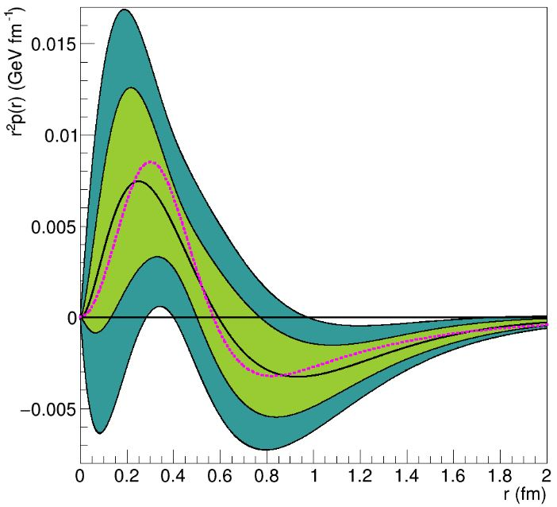
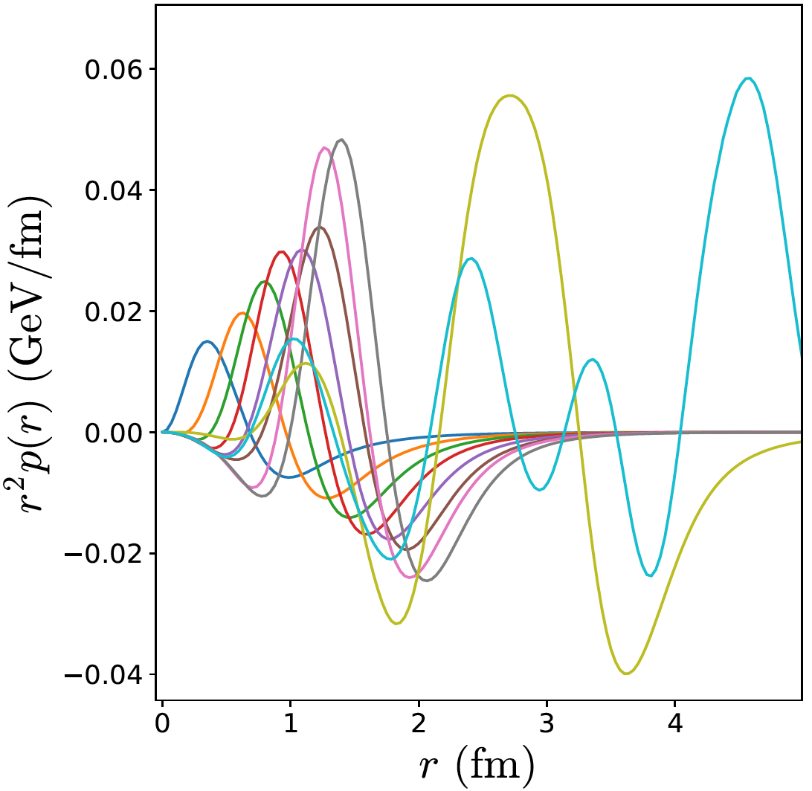
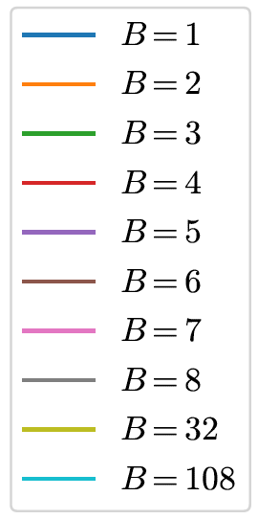
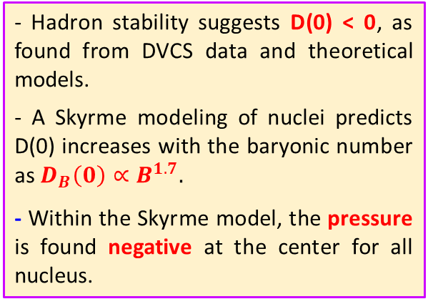

Generalized Parton Distributions
E. Voutier
Dynamical Imaging
V.D. Burkert @ HP2030 Y. Hatta @ HP2030
Measuring independently the real and imaginary parts of $𝓗$ provides access to D(t) and the mechanical properties of hadrons.
V.D. Burkert et al. RMP 95 (2023) 041002
A.G. Martin-Caro et al. PRD 110 (2024) 034002
$$r_{mech.}^{p}=0.634±0.057 fm< r_{E}^{p}$$
Data fit
χQSM
- Hadron stability suggests D(0) < 0, as found from DVCS data and theoretical models.
- A Skyrme modeling of nuclei predicts D(0) increases with the baryonic number as $D_{B}\left(0\right)∝B^{1.7}.$
- Within the Skyrme model, the pressure is found negative at the center for all nucleus.
Repulsive
pressure
Confining
pressure
Skyrme model evaluations
V.D. Burkert, L. Eloudrhiri, F.-X. Girod, Nature 557 (2018) 396
M.V. Polyakov, P. Schweitzer, IJMP A 33 (2018) 1830025 A.G. Martin-Caro, M. Huidobro, Y. Hatta PRD 108 (2023) 034014
6/22
July 31st, 2025

Slide 7
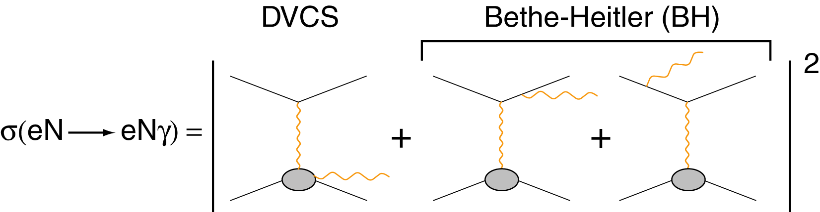
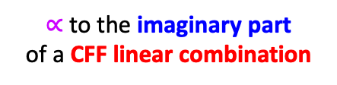



Deeply virtual Compton scattering
E. Voutier
Electro-Production of Photons
M. Diehl at the CLAS12 European Workshop, Genova, February 25-28, 2009
CFF = Compton Form Factors
$∝$ to the real part
of a CFF linear combination
$∝$ to the imaginary part
of a CFF linear combination
$${d^{5}σ}_{P0}^{e}={d^{5}σ}_{BH}+{d^{5}σ}_{DVCS}+P{ d}^{5}{\tilde{σ}}_{DVCS}−e \left[{d^{5}σ}_{INT}{+ P{ d}^{5}\tilde{σ}}_{INT}\right]$$
$∝$ to the real part
of a CFF bilinear combination
$∝$ to the imaginary part
of a CFF bilinear combination
$${d^{5}σ}_{PS}^{e}={d^{5}σ}_{P0}^{e}+S \left[{{P d}^{5}∆σ}_{BH}+\left({{Pd}^{5}∆σ}_{DVCS}+{ d}^{5}∆{\tilde{σ}}_{DVCS}\right)−e\left(P{d^{5}∆σ}_{INT}{+{ d}^{5}∆\tilde{σ}}_{INT}\right) \right]$$
Polarized electrons and positrons allow to separate the
unknown amplitudes of the cross section for electro-production of photons.
7/22
July 31st, 2025

Slide 8
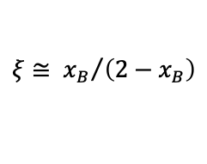




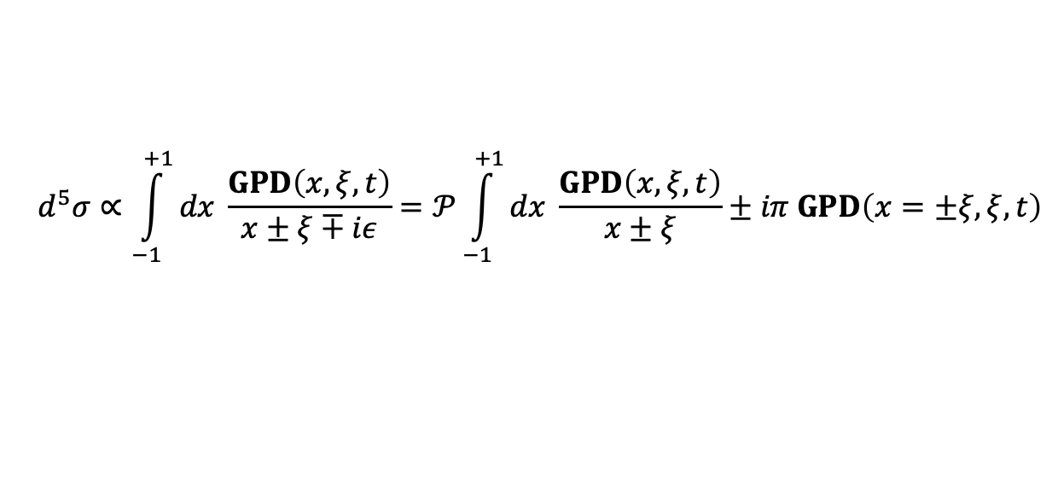
Deeply virtual Compton scattering
E. Voutier
Compton Form Factor
A.V. Belitsky, D. Müller, A. Kirchner, NPB 629 (2002) 323
GPDs enter the epγ cross section via the Compton Form Factors (CFFs) representing an integral over the intermediate quark longitudinal momentum.
$$\left(Q^{2},x_{B}\right)$$
$$ξ≅ {x_{B}}/{\left(2−x_{B}\right)}$$
$$d^{5}σ∝\int_{−1}^{+1}{dx \frac{GPD\left(x,ξ,t\right)}{x±ξ∓iε}=𝒫\int_{−1}^{+1}{dx \frac{GPD\left(x,ξ,t\right)}{x±ξ}}±iπ GPD\left(x=±ξ,ξ,t\right)}$$
GPDs
$${d^{5}\tilde{σ}}_{INT,DVCS}$$
$${d^{5}σ}_{INT,DVCS}$$
At twist-2 and leading α_{QCD}-order, the epγ reaction accesses the four chiral even and parton helicity conserving GPDs $\left\{H,\tilde{H},E,\tilde{E}\right\}$of the proton via the CFFs $\left\{ℋ,\tilde{ℋ},ℰ,\tilde{ℰ}\right\}.$
$$𝒞^{DVCS}= 4\left(1−x_{B}\right)\left[ℋℋ^{∗}+\tilde{ℋ}{\tilde{ℋ}}^{∗}\right]−x_{B}^{2}\left[ℋℰ^{∗}+ℰℋ^{∗}+\tilde{ℋ}{\tilde{ℰ}}^{∗}+\tilde{ℰ}{\tilde{ℋ}}^{∗}\right]− \left(x_{B}^{2}+{\left(2−x_{B}\right)}^{2}\frac{t}{4M^{2}}\right){ℰℰ}^{∗}− x_{B}^{2}\frac{t}{4M^{2}}\tilde{ℰ}{\tilde{ℰ}}^{∗}$$
$$𝒞^{INT}= F_{1}ℋ−ξ\left[F_{1}+F_{2}\right]\tilde{ℋ}− \frac{t}{4M^{2}}ℰ$$
8/22
July 31st, 2025

Slide 9
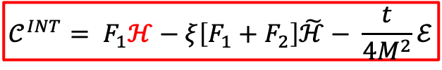
Deeply virtual Compton scattering
E. Voutier
Compton Form Factor
A.V. Belitsky, D. Müller, A. Kirchner, NPB 629 (2002) 323
GPDs enter the epγ cross section via the Compton Form Factors (CFFs) representing an integral over the intermediate quark longitudinal momentum.
$$\left(Q^{2},x_{B}\right)$$
$$ξ≅ {x_{B}}/{\left(2−x_{B}\right)}$$
$$d^{5}σ∝\int_{−1}^{+1}{dx \frac{GPD\left(x,ξ,t\right)}{x±ξ∓iε}=𝒫\int_{−1}^{+1}{dx \frac{GPD\left(x,ξ,t\right)}{x±ξ}}±iπ GPD\left(x=±ξ,ξ,t\right)}$$
GPDs
$${d^{5}\tilde{σ}}_{INT,DVCS}$$
$${d^{5}σ}_{INT,DVCS}$$
At twist-2 and leading α_{QCD}-order, the epγ reaction accesses the four chiral even and parton helicity conserving GPDs $\left\{H,\tilde{H},E,\tilde{E}\right\}$of the proton via the CFFs $\left\{ℋ,\tilde{ℋ},ℰ,\tilde{ℰ}\right\}.$
$$𝒞^{DVCS}= 4\left(1−x_{B}\right)\left[ℋℋ^{∗}+\tilde{ℋ}{\tilde{ℋ}}^{∗}\right]−x_{B}^{2}\left[ℋℰ^{∗}+ℰℋ^{∗}+\tilde{ℋ}{\tilde{ℰ}}^{∗}+\tilde{ℰ}{\tilde{ℋ}}^{∗}\right]− \left(x_{B}^{2}+{\left(2−x_{B}\right)}^{2}\frac{t}{4M^{2}}\right){ℰℰ}^{∗}− x_{B}^{2}\frac{t}{4M^{2}}\tilde{ℰ}{\tilde{ℰ}}^{∗}$$
$$𝒞^{INT}= F_{1}ℋ−ξ\left[F_{1}+F_{2}\right]\tilde{ℋ}− \frac{t}{4M^{2}}ℰ$$
Importance of the separation of the DVCS and INT reaction amplitudes for the determination of CFFs.
8/22
July 31st, 2025

Slide 10
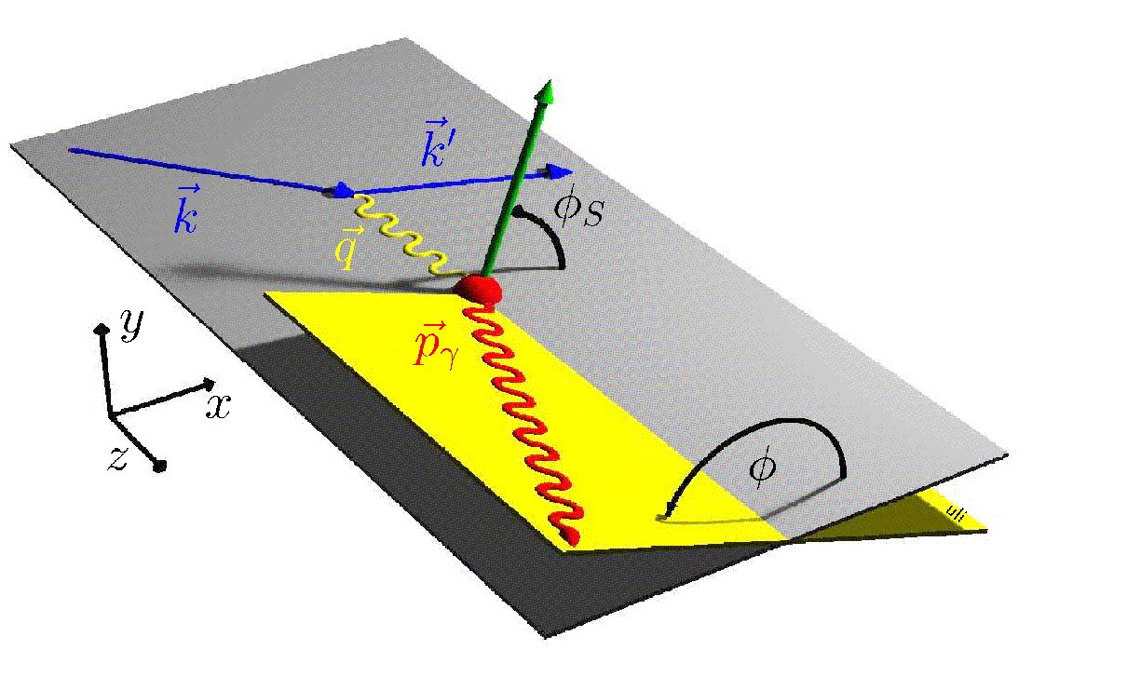
Deeply virtual Compton scattering
E. Voutier
Polarized Target
A.V. Belitsky, D. Müller, A. Kirchner, NPB 629 (2002) 323
The comparison of polarized electron and polarized positron scatterings off a polarized nucleon isolates the interference contribution (double spin charged observable) to the epγ process and accesses the real part of other CFF combinations.
These are new observables, more selective than the double spin observable measured for a single lepton beam charge.
ϕ
Longitudinally polarized target
$$𝒞_{L}^{INT}=\frac{x_{B}}{2−x_{B}}\left(F_{1}+F_{2}\right)\left[ℋ+\frac{x_{B}}{2}ℰ\right]+F_{1}\tilde{ℋ}−\frac{x_{B}}{2−x_{B}}\left[\frac{x_{B}}{2}F_{1}+{\frac{t}{4M^{2}}F}_{2}\right]\tilde{ℰ}$$
Perpendicularly polarized target
$${\left(2−x_{B}\right) 𝒞}_{P}^{INT}=\left({x_{B}^{2}F}_{1}−{\left(1−x_{B}\right)\frac{t}{M^{2}}F}_{2}\right)ℋ+\left(\frac{t}{4M^{2}}\left[{{\left(2−x_{B}\right)}^{2}F}_{1}+x_{B}^{2}F_{2}\right]+x_{B}^{2}F_{1}\right)ℰ−x_{B}^{2}\left(F_{1}+F_{2}\right)\left[\tilde{ℋ}+\frac{t}{4M^{2}}\tilde{ℰ}\right]$$
${\left(2−x_{B}\right) 𝒞}_{N}^{INT}=x_{B}\left(F_{1}+F_{2}\right)\left(x_{B}\left[ℋ+\frac{x_{B}}{2}ℰ\right]+\frac{t}{4M^{2}}ℰ\right)+\left[\frac{t}{4M^{2}}\left(1−x_{B}\right)F_{2}−x_{B}^{2}F_{1}\right]\tilde{ℋ}−x_{B}\left[\frac{x_{B}^{2}}{2}+\frac{t}{4M^{2}}\left({\left(2−x_{B}\right)F}_{1}+{x_{B}F}_{2}\right)\right]$ $\tilde{ℰ}$
Normally polarized target
9/22
July 31st, 2025

Slide 11
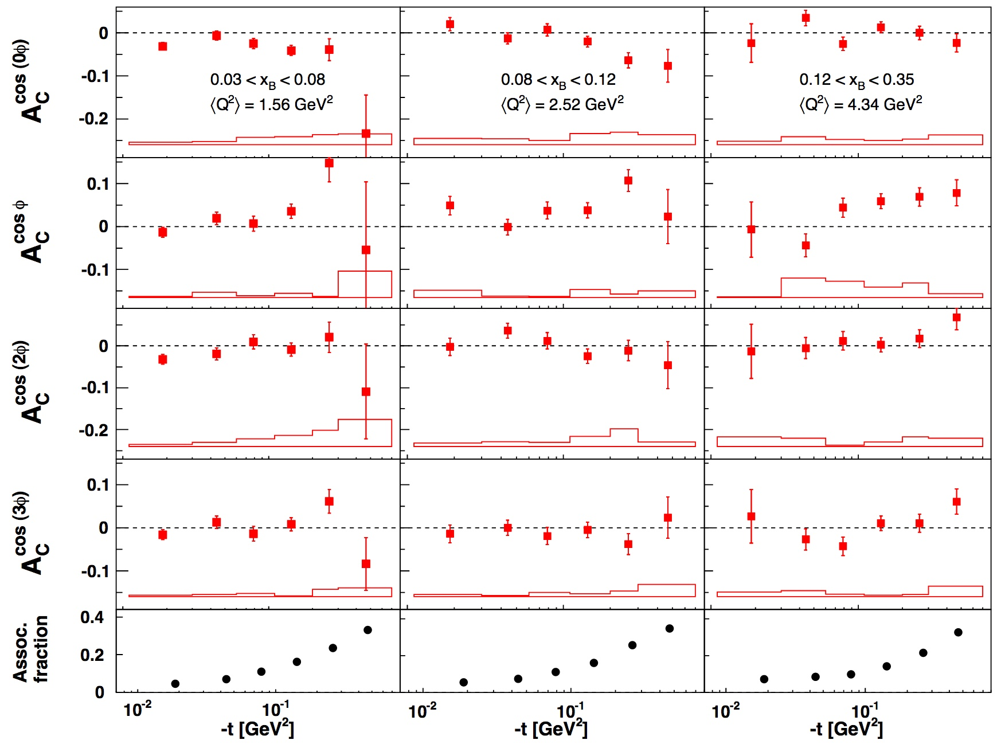
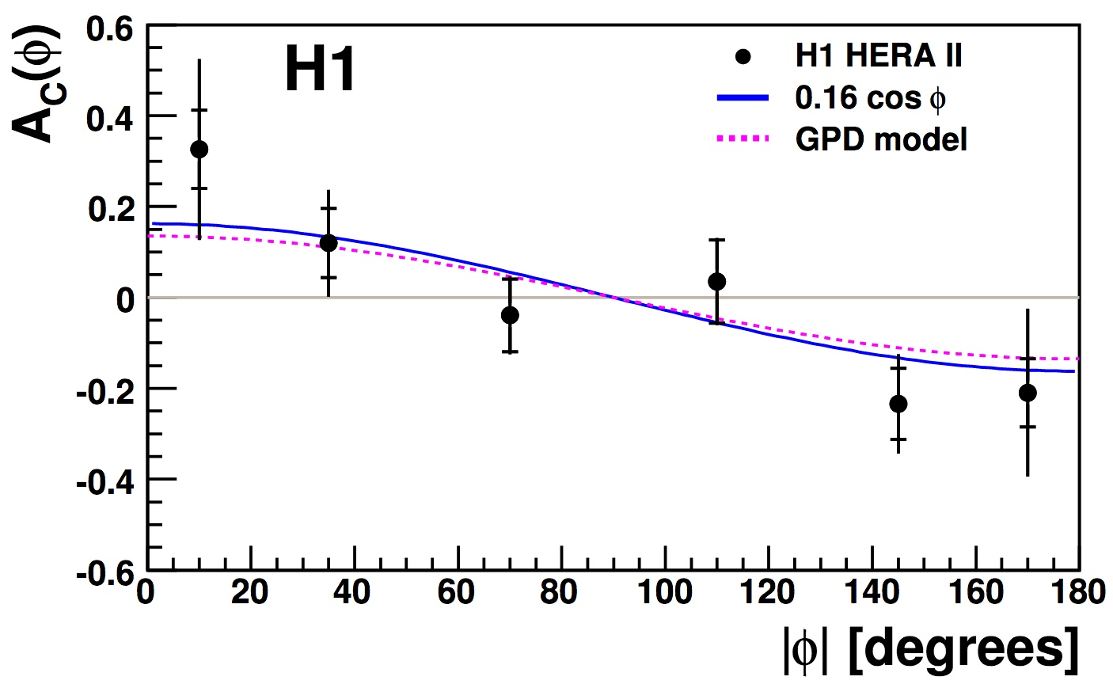
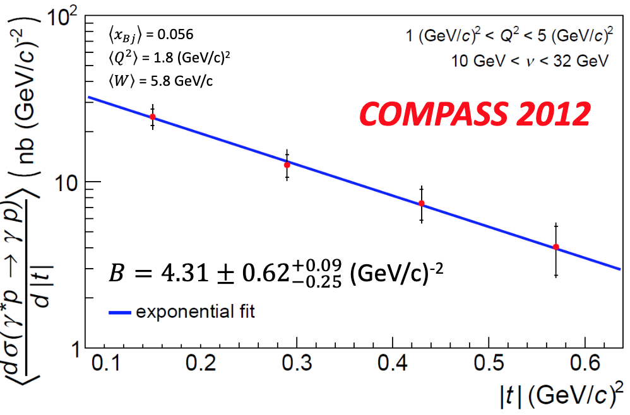

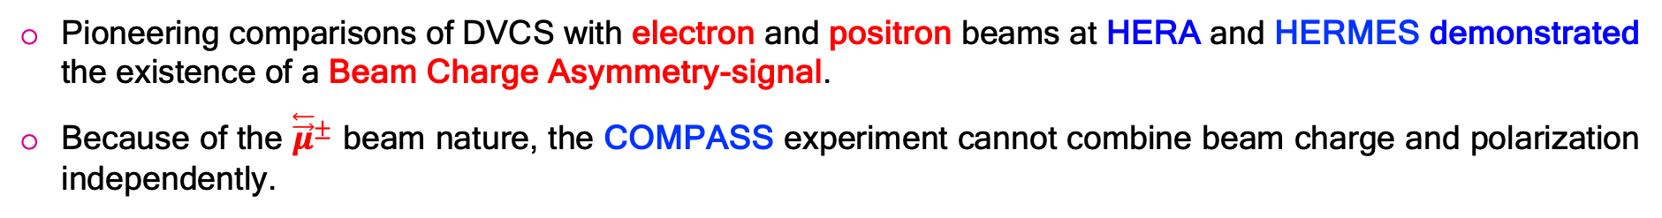
Deeply virtual Compton scattering
E. Voutier
Charge Asymmetries
Pioneering comparisons of DVCS with electron and positron beams at HERA and HERMES demonstrated the existence of a Beam Charge Asymmetry-signal.
Because of the ${\overset{⃖}{\vec{μ}}}^{±}$ beam nature, the COMPASS experiment cannot combine beam charge and polarization independently.
$${Σσ}_{∓P}^{±}=2\left({d^{5}σ}_{BH}+{d^{5}σ}_{DVCS}{− Pd^{5}\tilde{σ}}_{INT}\right)$$
(H1 Collaboration) F.D. Aaron et al. PLB 681 (2009) 391 (HERMES Collaboration) A. Airapetian et al. JHEP 06 (2008) 066 – 11 (2009) 083 – 07 (2012) 032
(COMPASS Collaboration) R. Akhunzyanov et al. PLB 793 (2019) 188
10/22
July 31st, 2025

Slide 12
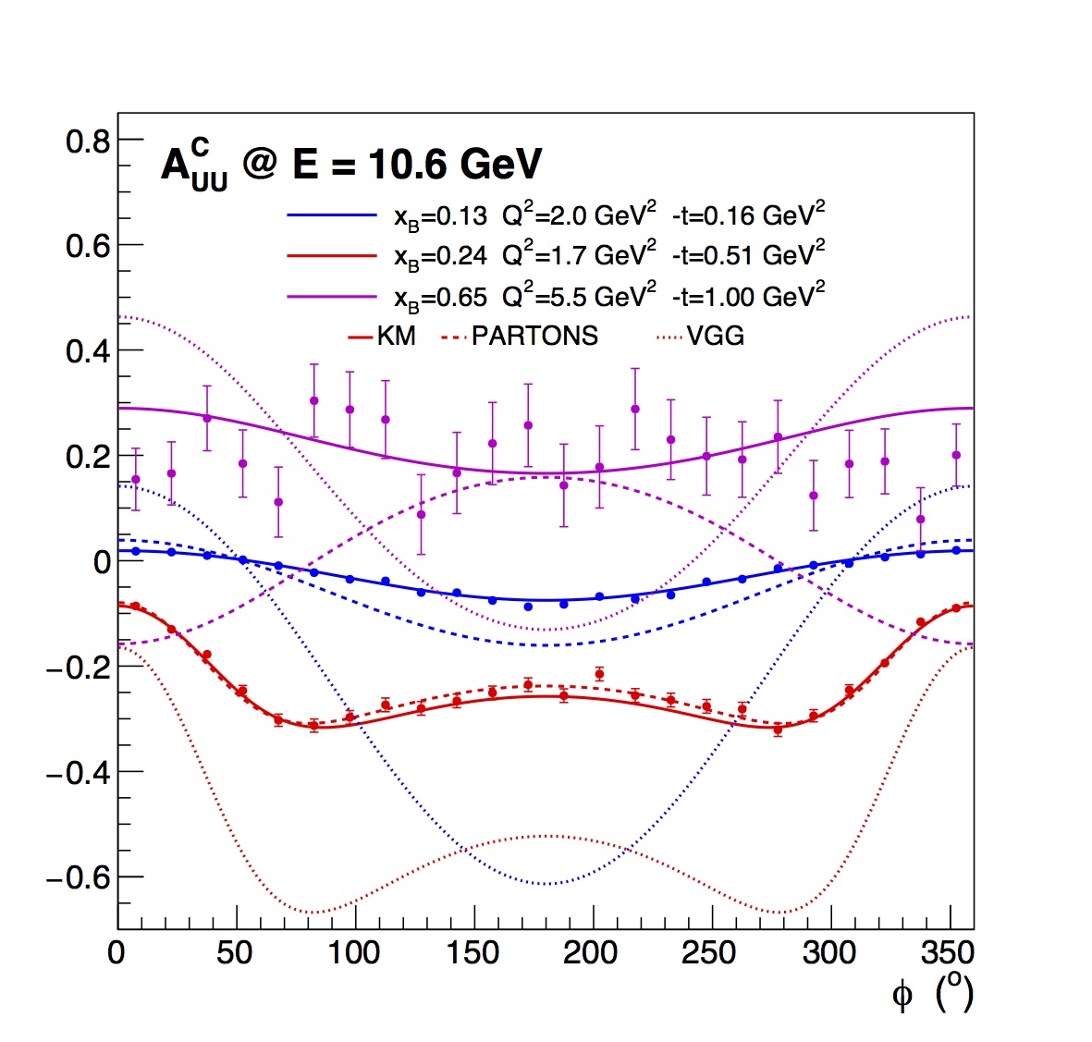
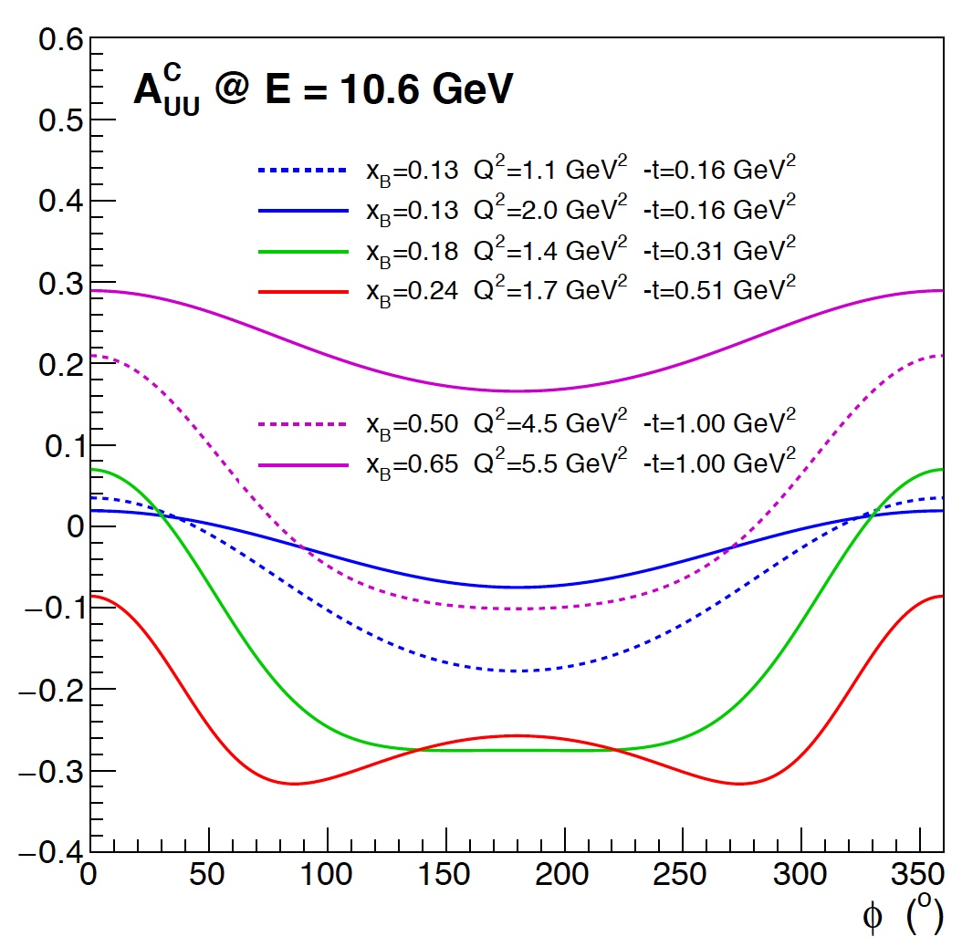
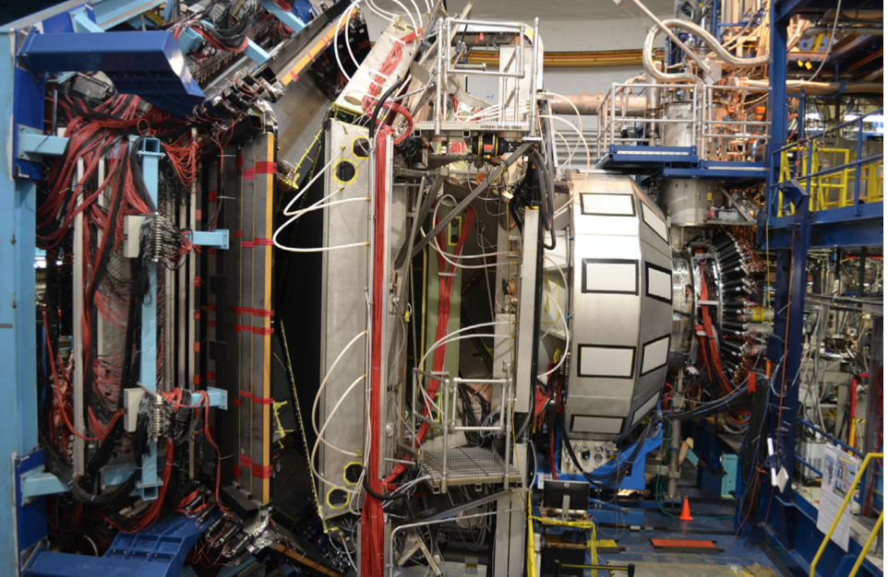
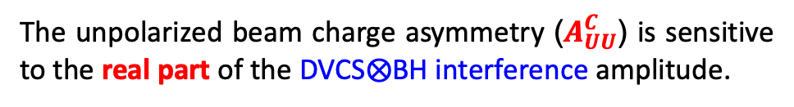
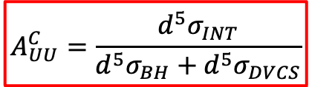
Conditionally Approved Measurements
E. Voutier
PR12+23-002
V.D. Burkert et al. EPJ A 57 (2021) 186 E. Voutier et al. PR12+23-002 (2023) arXiv:2309.14041
Measurements of Beam Charge Asymmetries (BCAs) with CLAS12 will provide a full set of new GPD observables.
$$A_{UU}^{C}=\frac{d^{5}σ_{INT}}{{d^{5}σ}_{BH}+{d^{5}σ}_{DVCS}}$$
The unpolarized beam charge asymmetry ($A_{UU}^{C}$) is sensitive to the real part of the DVCS$⨂$BH interference amplitude.
11/22
July 31st, 2025

Slide 13
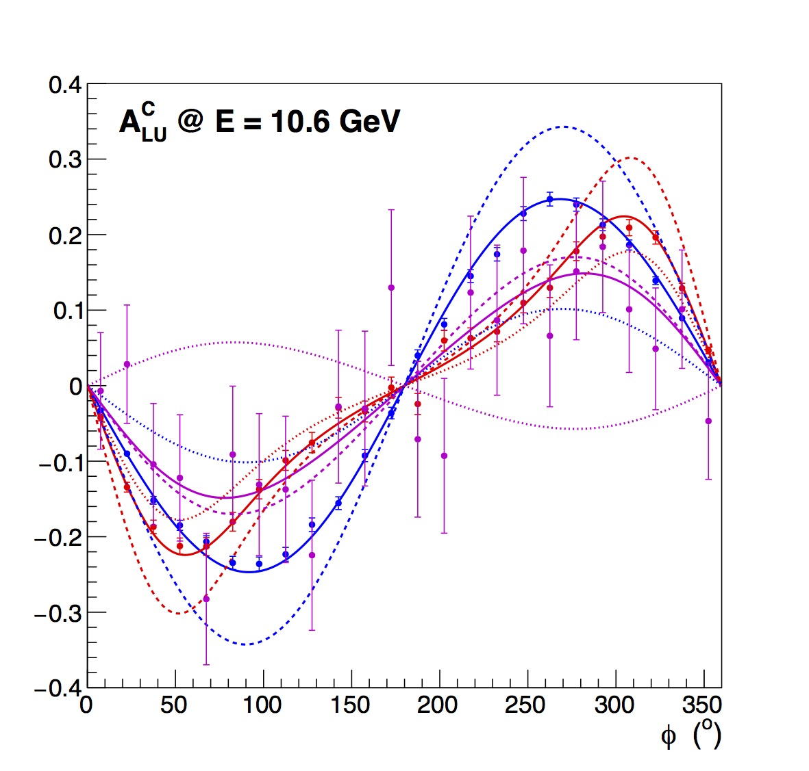
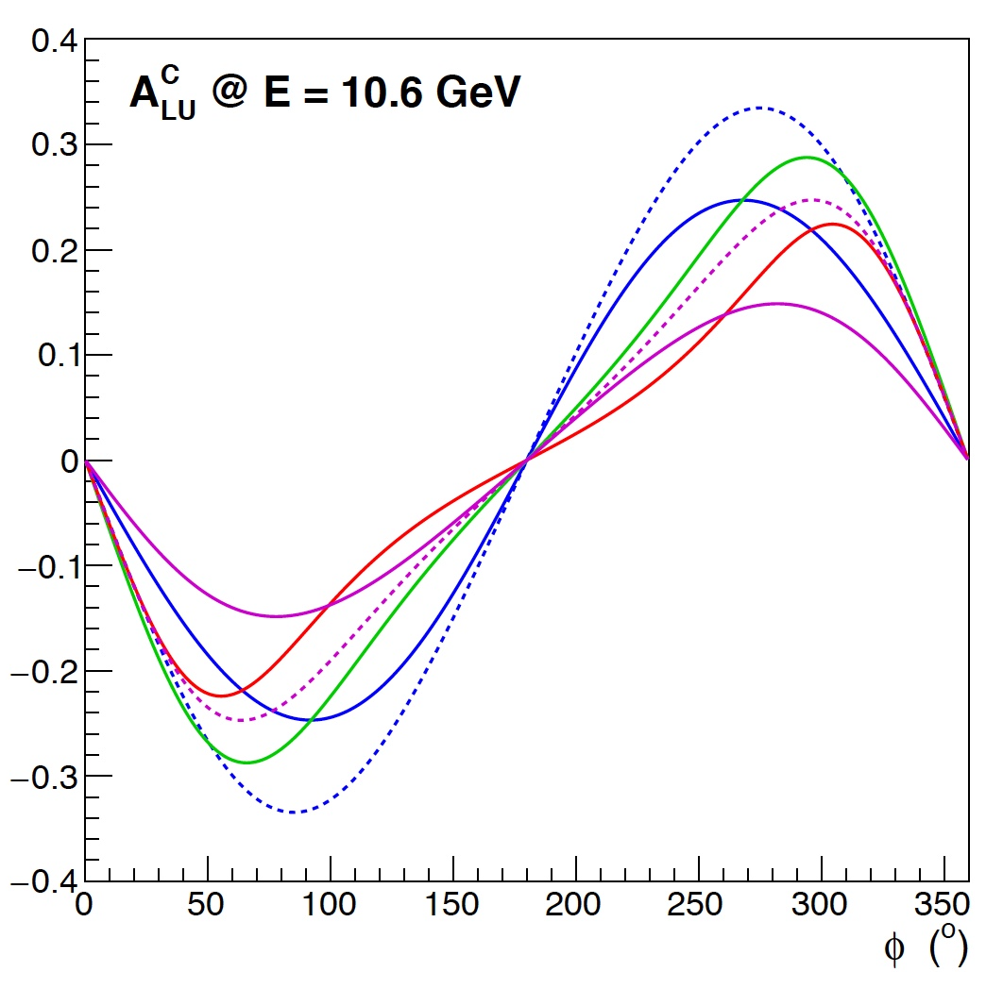
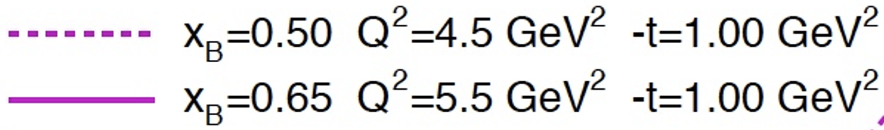
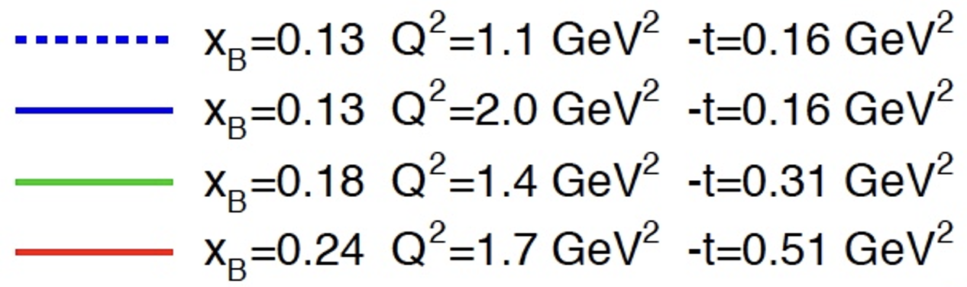
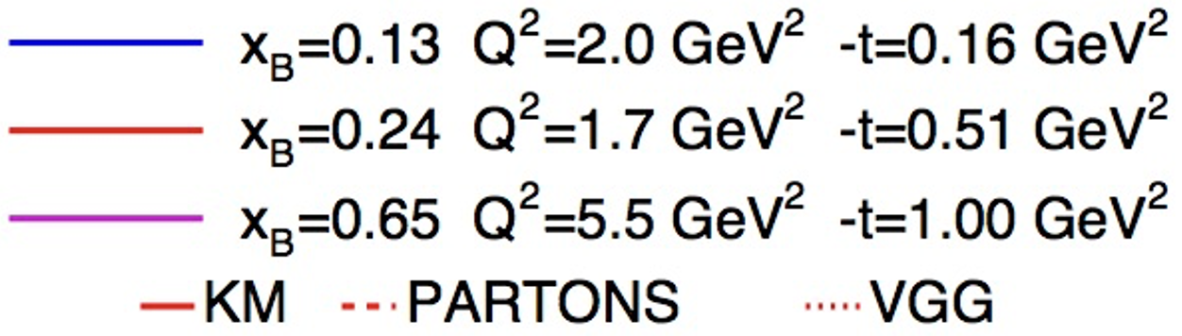
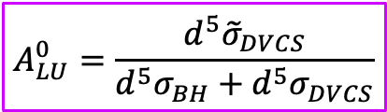
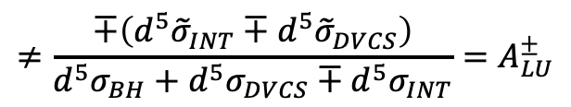
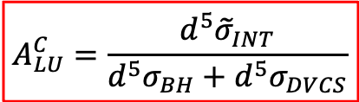

Conditionally Approved Measurements
E. Voutier
Polarized Beam Observables
E. Voutier et al. PR12+23-002 arXiv:2309.14041
Polarized BCAs ($A_{LU}^{C}$) access the imaginary part of of the interference amplitude, differently from the electron or positron BSAs.
The charge averaged BSA ($A_{LU}^{0}$) is a pure observable of higher-twists effects.
$$A_{LU}^{C}=\frac{d^{5}{\tilde{σ}}_{INT}}{{d^{5}σ}_{BH}+{d^{5}σ}_{DVCS}}$$
$$≠\frac{∓\left(d^{5}{\tilde{σ}}_{INT}∓d^{5}{\tilde{σ}}_{DVCS}\right)}{{d^{5}σ}_{BH}+{d^{5}σ}_{DVCS}∓{d^{5}σ}_{INT}}=A_{LU}^{±}$$
$$A_{LU}^{0}=\frac{d^{5}{\tilde{σ}}_{DVCS}}{{d^{5}σ}_{BH}+{d^{5}σ}_{DVCS}}$$
$$=0$$
at twist-2
12/22
July 31st, 2025

Slide 14
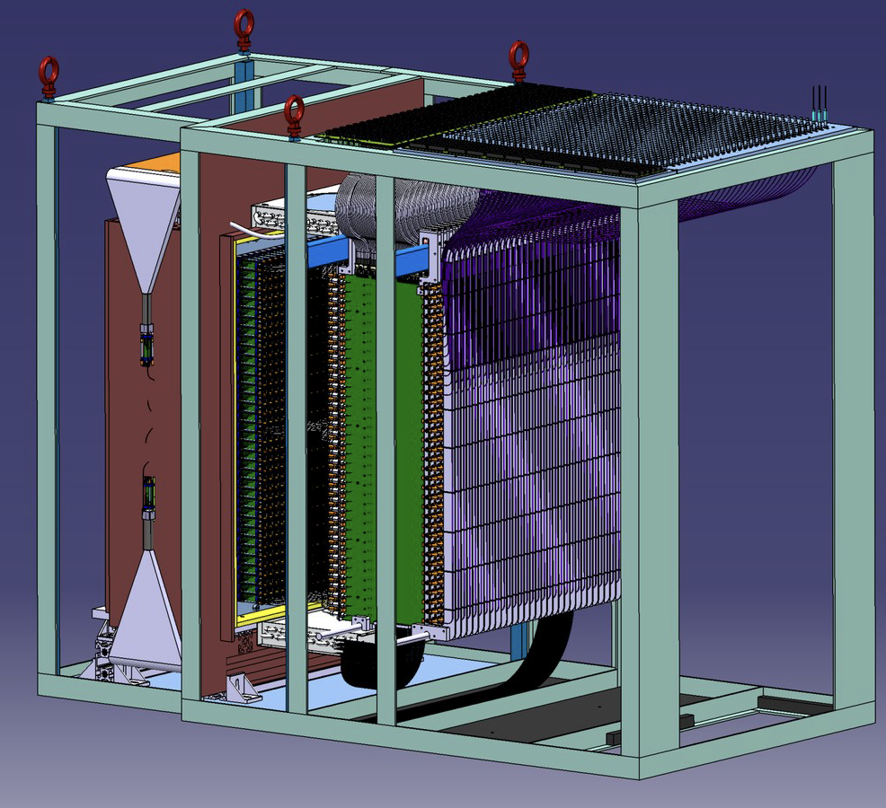
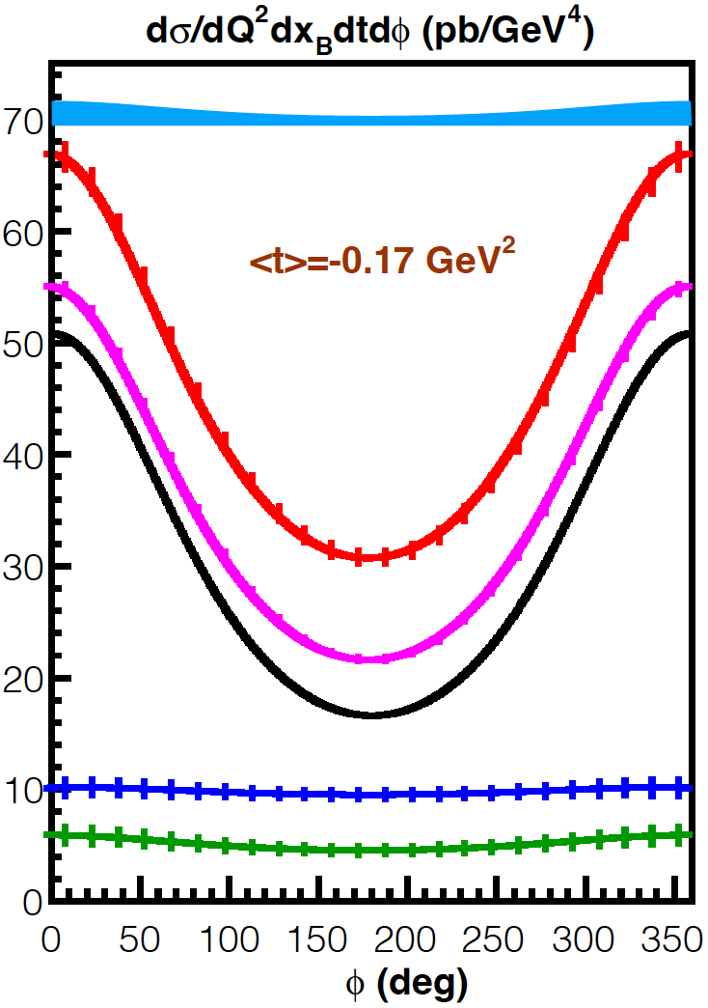
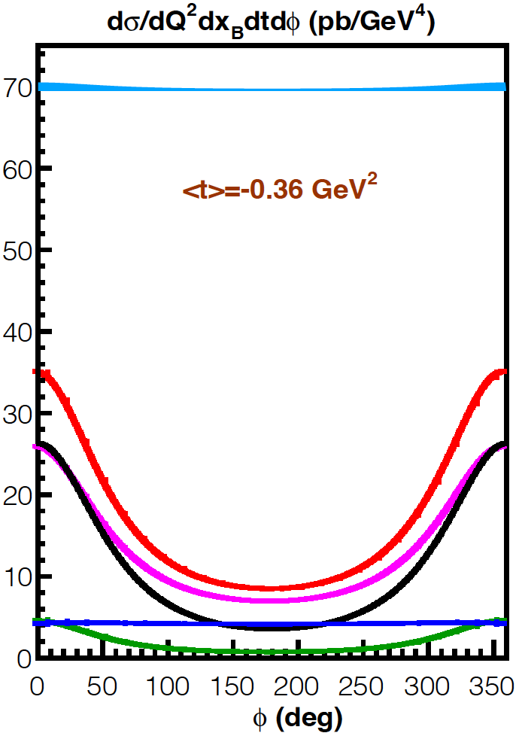
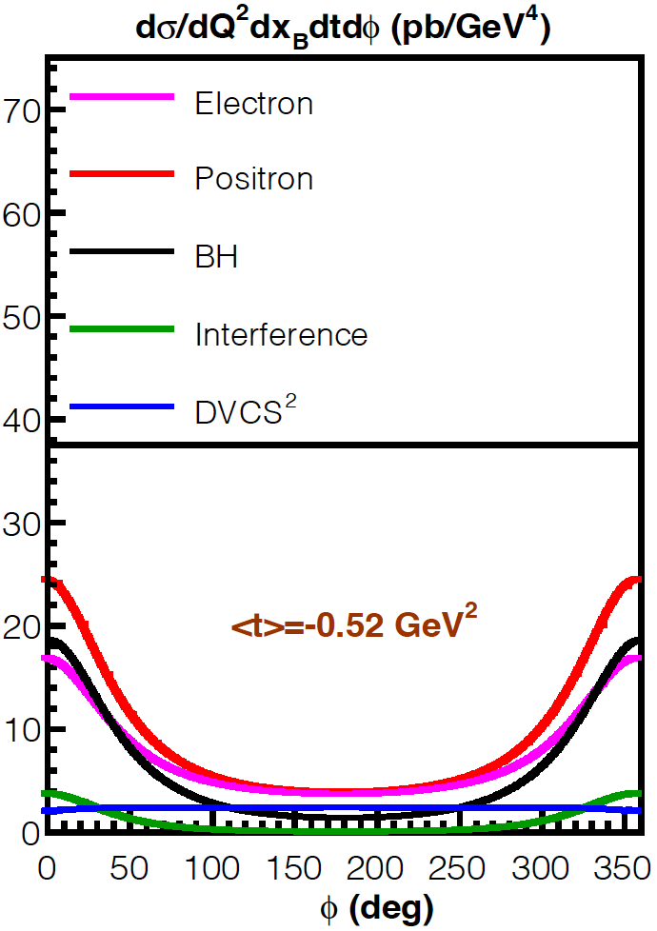
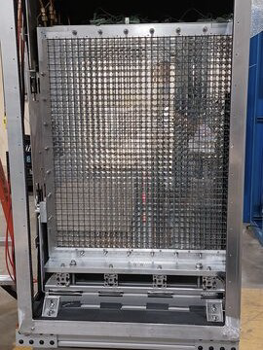

Conditionally Approved Measurements
E. Voutier
PR12+23-006
A. Afanasev et al. EPJ A 57 (2021) 300 C. Muñoz Camacho et al. PR12+23-006 (2023)
High precision measurements of the e⁺pγ unpolarized cross section with the Neutral Particle Spectrometer (NPS) to be combined with recently achieved e⁻pγ measurements to enable NLO analysis of observables at the twist-3 level.
$${d^{5}σ}_{00}^{±}={d^{5}σ}_{BH}+{d^{5}σ}_{DVCS}∓{d^{5}σ}_{INT}$$
1080 PbWO₄
crystal array
Front View
x_{B} = 0.36 Q² = 4.0 GeV²
13/22
July 31st, 2025

Slide 15
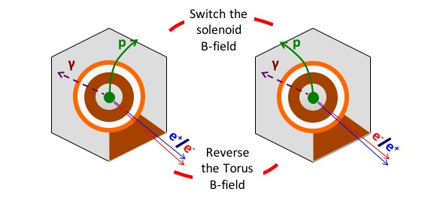
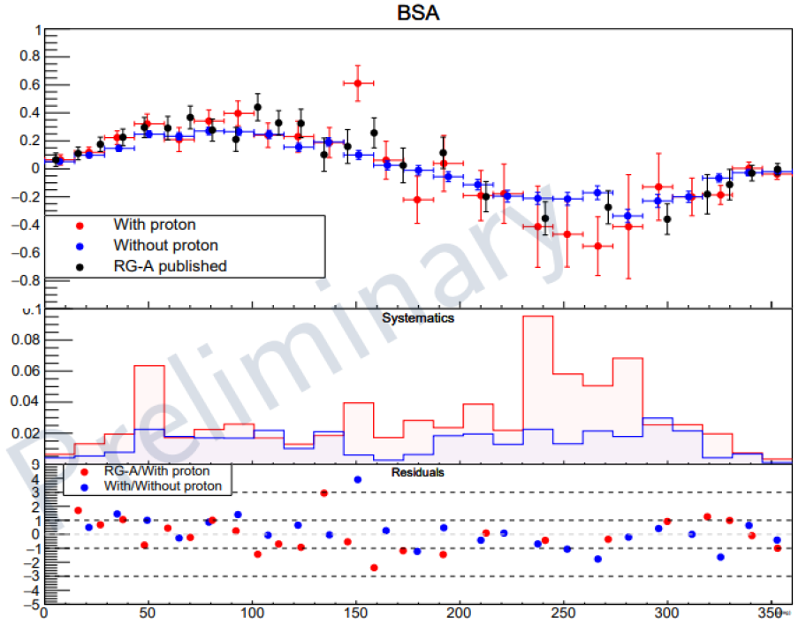
Conditionally Approved Measurements
E. Voutier
Control of Systematics
J.-S. Alvarado et al. CLAS Note 2024-003 J.-S. Alvarado, PhD Thesis (September 2025)
The physics of interest is extracted from the comparison of electron and positron observables which is more challenging than the comparison of helicity dependent observables for a given beam charge.
Different : data taking period, detector, and experimental conditions.
Machine learning techniques applied to DVCS events selection using a Boosted Decision Tree approach allows to measure BSAs within the eγ topology, improving kinematic coverage, statistics and reducing systematics.
- Cross section analysis in progress.
- Extension to polarized targets (BTA).
Switching the Torus and Solenoid polarities, electrons and positrons follow the same detector path contrary to protons.
14/22
July 31st, 2025

Slide 16
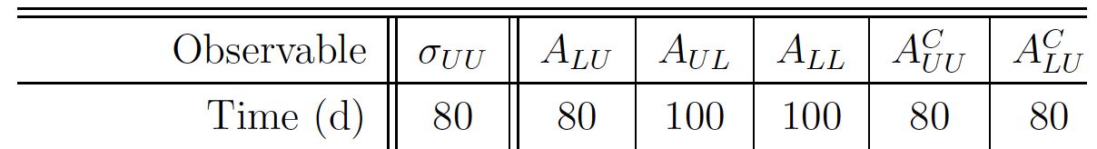
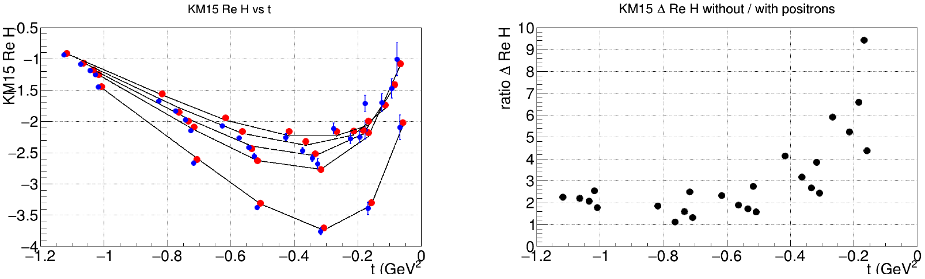

Conditionally Approved Measurements
E. Voutier
Impact of Positron Measurements (I)
K. Kumerički et al. NPB 841 (2010) 1 E.C. Aschenauer et al. JHEP 09 (2013) 093
The importance of positron beams for the determination of CFFs may be quantified in a model-dependent way depending on : the cross section model, the GPDs model, and the hypotheses of the fitting approach.
Fitting of$\left\{ℋ,\tilde{ℋ} \right\}$CFFs assuming model values for $\left\{ℰ,\tilde{ℰ} \right\}$CFFs.
Without e⁺
With e⁺
Same (x_{B} ,Q²)
Different t-kinematics
Purity of e⁺ observables
Reduction of CFF correlations
Reduction of CFF correlations
Improvement of the error on $𝕽𝖊\left[𝓗\right].$
15/22
July 31st, 2025

Slide 17



Conditionally Approved Measurements
E. Voutier
Impact of Positron Measurements (II)
H. Dutrieux, V. Bertone, H. Moutarde, P. Sznajder, EPJ A 57 (2021) 300
The existing DVCS world data set (H1, ZEUS, HERMES, JLab 6 GeV, COMPASS) is analyzed within a global fit based on an Artificial Neural Network procedure within PARTONS to extract CFFs.
The impact of projected CLAS12 BCA data on the proton is evaluated from a Bayesian reweighting analysis of CFFs.
$$𝕽𝖊\left[𝓗\right]$$
Improvement of the definition of the 68% confidence region for $𝕽𝖊\left[𝓗\right].$
16/22
July 31st, 2025

Slide 18


Conditionally Approved Measurements
E. Voutier
Impact of Positron Measurements (III)
C. Muñoz Camacho et al. PR12+23-006 (2023)
The combination of electron and positron measurements strongly reduce correlations between CFFs, from 94% without to 39% at the considered kinematics.
Electrons only
Electrons &
Positrons
Better determination of LT/LO $𝓗$and $\tilde{𝓗}.$
LT/LO
HT
NLO
17/22
July 31st, 2025

Slide 19







e⁺-GPD Program
E. Voutier
DVCS off Nuclei
S. Niccolai et al. EPJ A 57 (2021) 226 S. Fucini et al. EPJ A 57 (2021) 273
The real part of the Compton Form Factor E_{n}, of importance for the neutron GFFs and for flavor separation is hardly experimentally constrained without Beam Charge Asymmetry data.
DVCS off nuclei is an exciting tool to access nuclei GFFs and image the nuclear force using a recoil detector (ALERT) a large acceptance spectrometer (CLAS12) and high-energy electron and positron beams.
$$A_{UU}^{C}∝\frac{1}{F_{2}}ℜ𝔢\left[ξ{\tilde{H}}_{n}−\frac{t}{4M^{2}}E_{n}\right]$$
$ℜ𝔢\left[ℋ_{A}\left(ξ,t\right)\right] = \frac{1}{π}𝒫\int_{0}^{1}{\left[\frac{1}{ξ+x}+\frac{1}{x−ξ}\right]ℑ𝔪\left[H_{A}\left(x,x,t\right)\right] dx}+δ\left(t\right)$
e⁺ and e⁻ beams
e⁻ beam only
e⁺ and e⁻ beams
e⁻ beam only
³He
⁴He
18/22
July 31st, 2025

Slide 20





e⁺-GPD Program
E. Voutier
Double DVCS
S. Zhao et al. EPJ A 57 (2021) 240 K. Deja et al. PRD 107 (2023) 094035 J.S. Alvarado et al. PRC 111 (2025) 065205
The virtuality of the final photon in the DDVCS process enables uncorrelated exploration of the CFF phase-space, which is inaccessible to DVCS and TCS.
The SoLID spectrometer complemented with a muon detector (SoLIDμ) allows to access GPDs at $ξ′≠ξ$ and the real part of DDVCS CFFs for which no dispersion relation has been established.
$$A_{UU}^{C}≠A_{UU}^{μ^{±}}$$
$$A_{UU}^{C}$$
DVCS limit
TCS limit
SoLIDμ kinematic coverage
Beam Charge Asymmetry
M. Guidal, M. Vanderhaeghen, PRL 90 (2003) 012001
A.V. Belitsky, D. Müller PRL 90 (2003) 022001; PRD 68 (2003) 116005
19/22
July 31st, 2025

Slide 21




e⁺-GPD Program
E. Voutier
DVCS off Polarized Targets
N. Pilleux @ HP2030 S. Polcher Rafael @ HP2030
Similar to unpolarized targets, the lepton beam charge allows to separate the interference amplitudes from the DVCS and BH amplitudes, and provides an access to higher twist effects.
$∝$ to the imaginary part
of a CFF linear combination
Leading twist
Higher twist
$${d^{5}σ}_{PS}^{e}={d^{5}σ}_{P0}^{e}+S \left[{{P d}^{5}∆σ}_{BH}+\left({{Pd}^{5}∆σ}_{DVCS}+{ d}^{5}∆{\tilde{σ}}_{DVCS}\right)−e\left(P{d^{5}∆σ}_{INT}{+{ d}^{5}∆\tilde{σ}}_{INT}\right) \right]$$
$∝$ to the real part
of a CFF linear combination
$$𝒞_{L}^{DVCS}= 4\frac{1−x_{B}}{{\left(2−x_{B}\right)}^{2}}\left[ℋ{\tilde{ℋ}}^{∗}+\tilde{ℋ}ℋ^{∗}\right]−\frac{x_{B}^{2}}{{\left(2−x_{B}\right)}^{2}}\left[ℋ{\tilde{ℰ}}^{∗}+\tilde{ℰ}ℋ^{∗}+\tilde{ℋ}ℰ^{∗}+ℰ{\tilde{ℋ}}^{∗}\right]$$
$$−\frac{x_{B}}{{\left(2−x_{B}\right)}^{2}}\left(\frac{x_{B}^{2}}{2}+\left(2−x_{B}\right)\frac{t}{4M^{2}}\right)\left[ℰ{\tilde{ℰ}}^{∗}+{\tilde{ℰ}ℰ}^{∗}\right]$$
$$𝒞_{L}^{INT}=\frac{x_{B}}{2−x_{B}}\left(F_{1}+F_{2}\right)\left[ℋ+\frac{x_{B}}{2}ℰ\right]+F_{1}\tilde{ℋ}−\frac{x_{B}}{2−x_{B}}\left[\frac{x_{B}}{2}F_{1}+{\frac{t}{4M^{2}}F}_{2}\right]\tilde{ℰ}$$
How precise could be achieved a relative DVCS cross section measurement on a polarized target ?
20/22
July 31st, 2025

Slide 22
Summary & Outlook
E. Voutier
A unique experimental program with polarized and unpolarized positron beams at Jefferson Lab develops which will bring new observables of Generalized Parton Distributions and will provide the cleanest possible access to the real part of Compton Form Factors.
            Proton and neutron (DVCS, DDVCS)
            Nuclei (DVCS)
            Possibly polarized targets (DVCS)
The Ce⁺BAF R&D program is currently addressing the critical risk areas with the development of prototypes and test benches at LERF.
There are strong opportunities for an experimental physics program at LERF with electron and positron beams which could start as early as within 3 years.
Subscribe to the JLab Positron Working Group mailing list pwg@jlab.org
21/22
July 31st, 2025

Slide 23

Summary & Outlook
E. Voutier
Physics @ LERF
at very low beam energies
I_{e} < 10 mA P_{e} > 80% T_{e} < 10 MeV
I_{p} < 10 nA P_{p} < 60% T_{p} < 10 MeV
Nuclear physics
Nuclear astrophysics
Atomic physics
Material Science
Test of the Standard Model
Physics @ LERF
at low beam energies
I_{e} < 1 mA P_{e} > 80% T_{e} < 150 MeV
I_{p} > 50 nA P_{p} > 60% T_{p} < 123 MeV
I_{p} > 1 μA P_{p} < 10% T_{p} < 123 MeV
D. Cassidy (University College London) | J. Grames (Jefferson Lab)
D. Higinbotham (Jefferson Lab) | K. Jordan (Jefferson Lab)
T. Kutz (Universität Mainz) | A. Schmidt (George Washington University)
F. Selim (Arizona State University) | E. Voutier (Université Paris-Saclay)
International Workshop on Low Energy e$±$ Physics at Jefferson Lab
(LEEPP@JLab)
Newport News, November, 3rd-7th, 2025
https://www.ijclab.org/conference/LEEPP https://indico.jlab.org/event/964
Consider !
22/22
July 31st, 2025

