Slide 1
Gravitational form factors with DVCS
Volker D. Burkert
Jefferson Laboratory
Towards improved hadron femtography with hard exclusive reactions
Edition IV, Jefferson Lab, 28-July 31, 2025
Notes:
Thank you for the invitation to speak about the gravitational form factors with DVCS.

Slide 2
A brief history
Gravitational Interaction of Fermions,
I.Yu. Kobzarev, L.B. Okun,
Sov.Phys.JETP 16 (1963) 1343
Generalized parton distributions and strong forces inside nucleons and nuclei,
M.V. Polyakov, Phys.Lett.B 555 (2003) 57-62
Energy-Momentum Structure Form Factors of Particles,
Heinz Pagels, Phys. Rev. 144 (1966) 1250-1260
The pressure distribution inside the proton,
V.D. Burkert, L. Elouadrhiri, F.X. Girod,
Nature 557, 7705 (2018) 396-399
→ Brief intro, early results, status of the 12 GeV project, prospect of the 22 GeV upgrade.
Notes:
The gravitational structure of particles was theoretically discussed first in the mid 1960's.
It took 40 years before a path towards possible measurements could be devised, and another 15 years until first results from experimental data on the D-gravitational form factor were published in 2018.
In this talk I will briefly discuss the early results, the status at the 12 GeV and prospects for the 22 GeV energy upgrade of JLab.

Slide 3
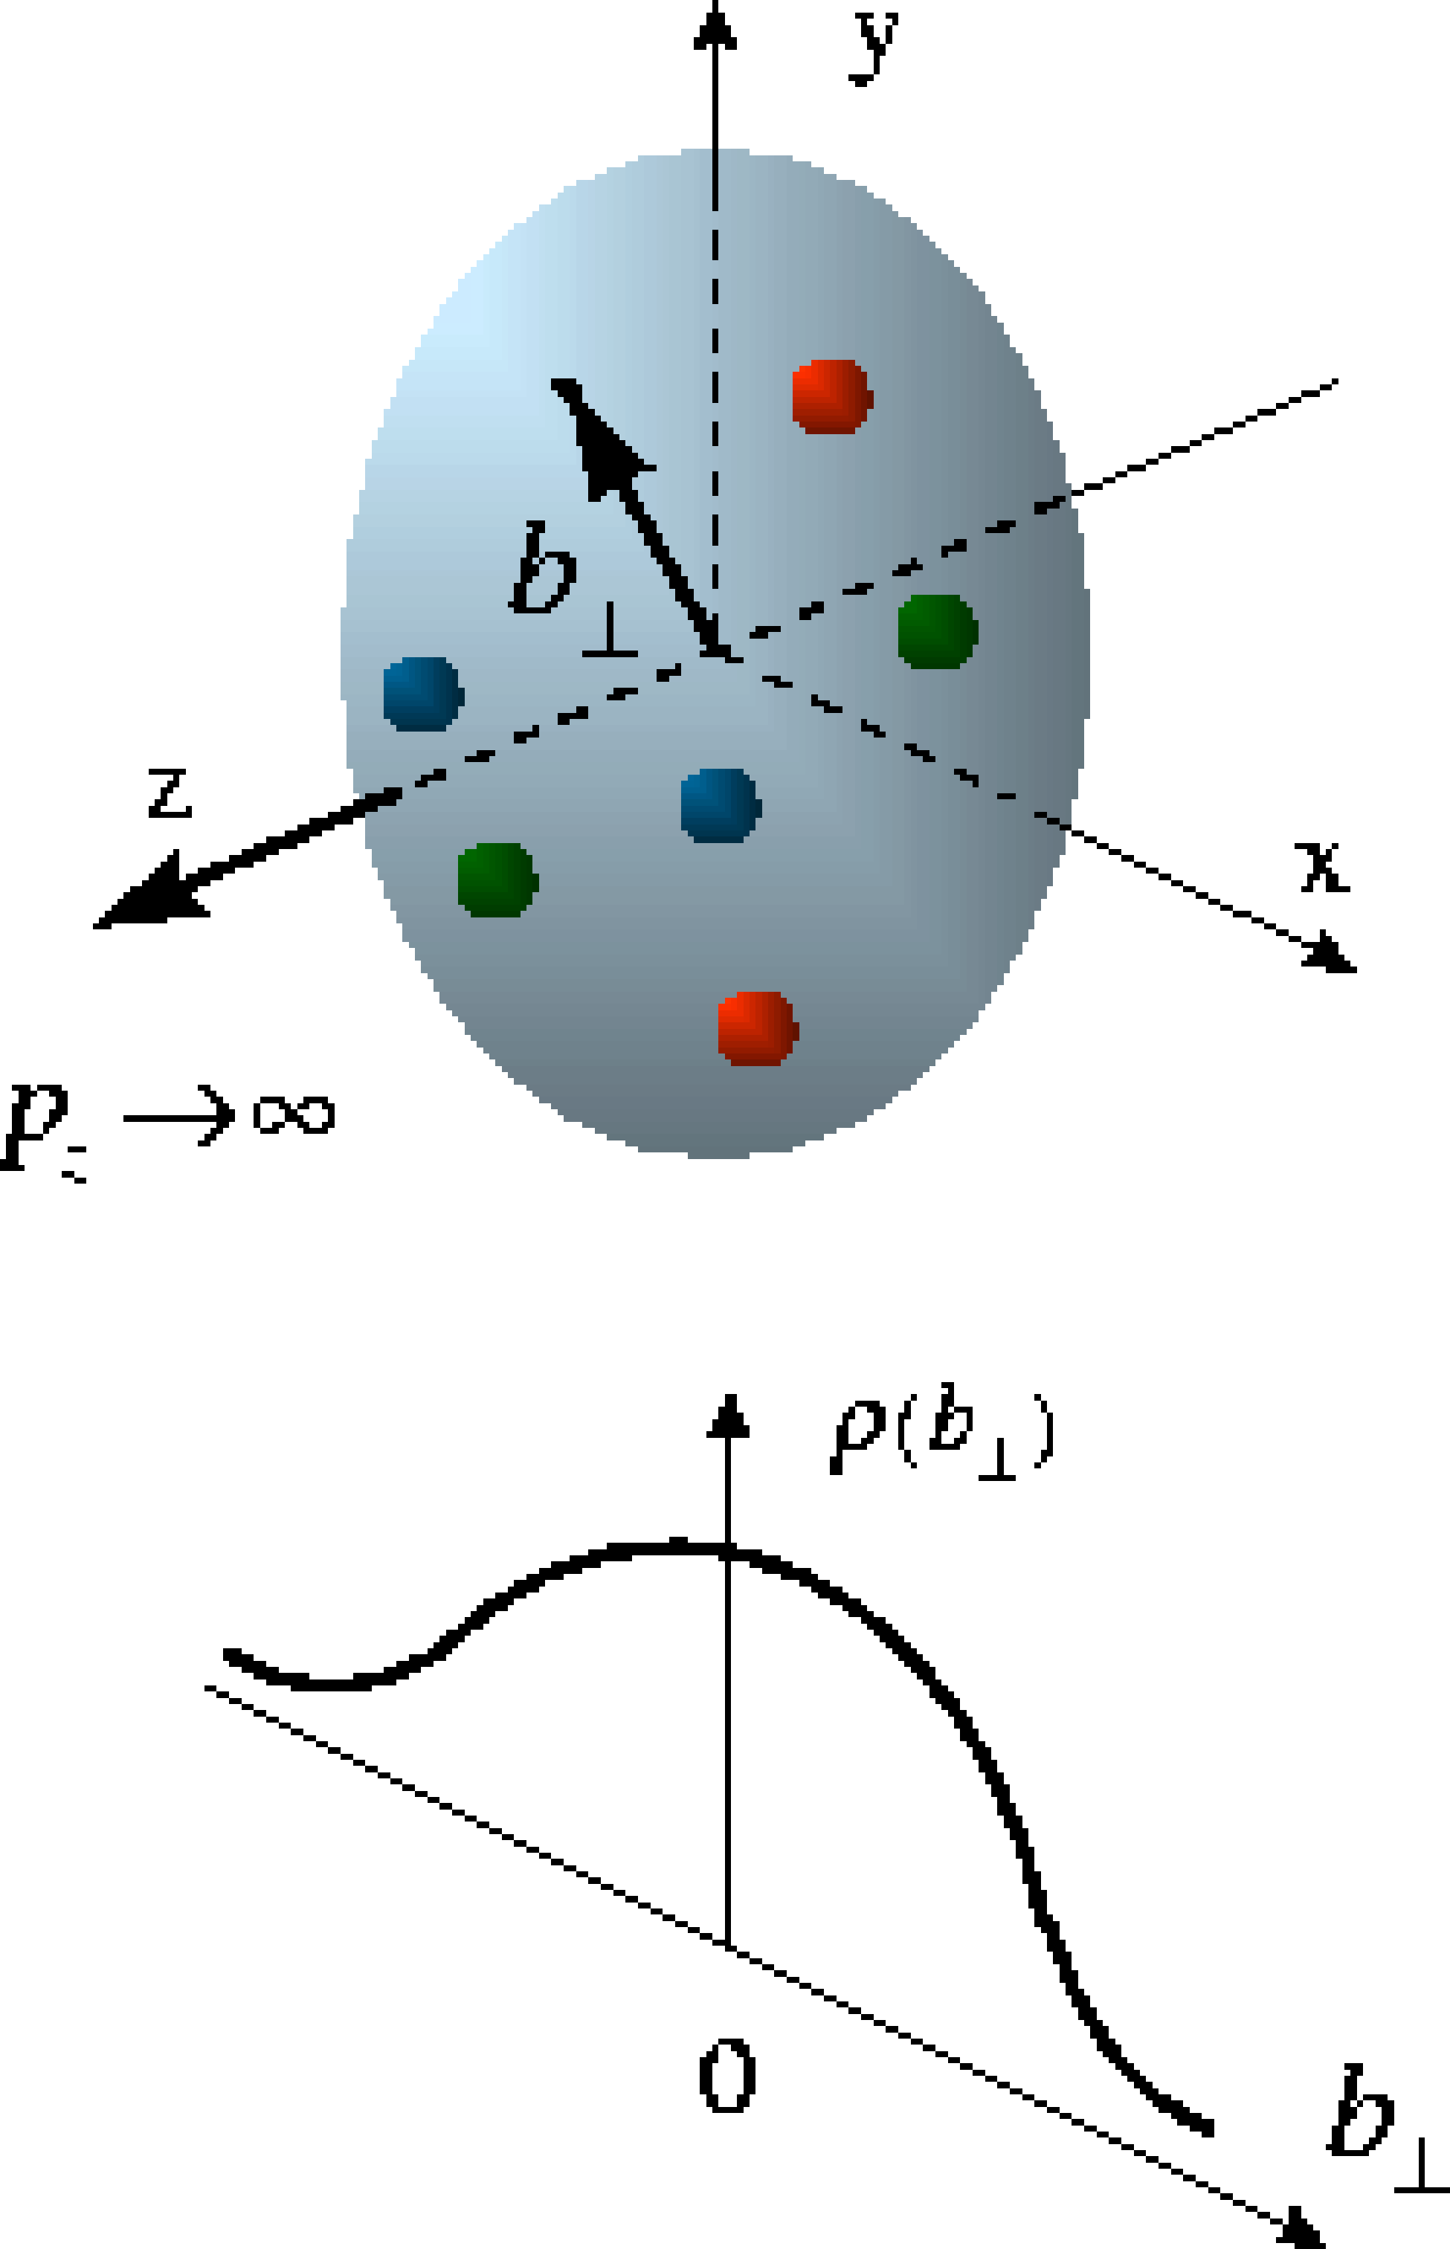
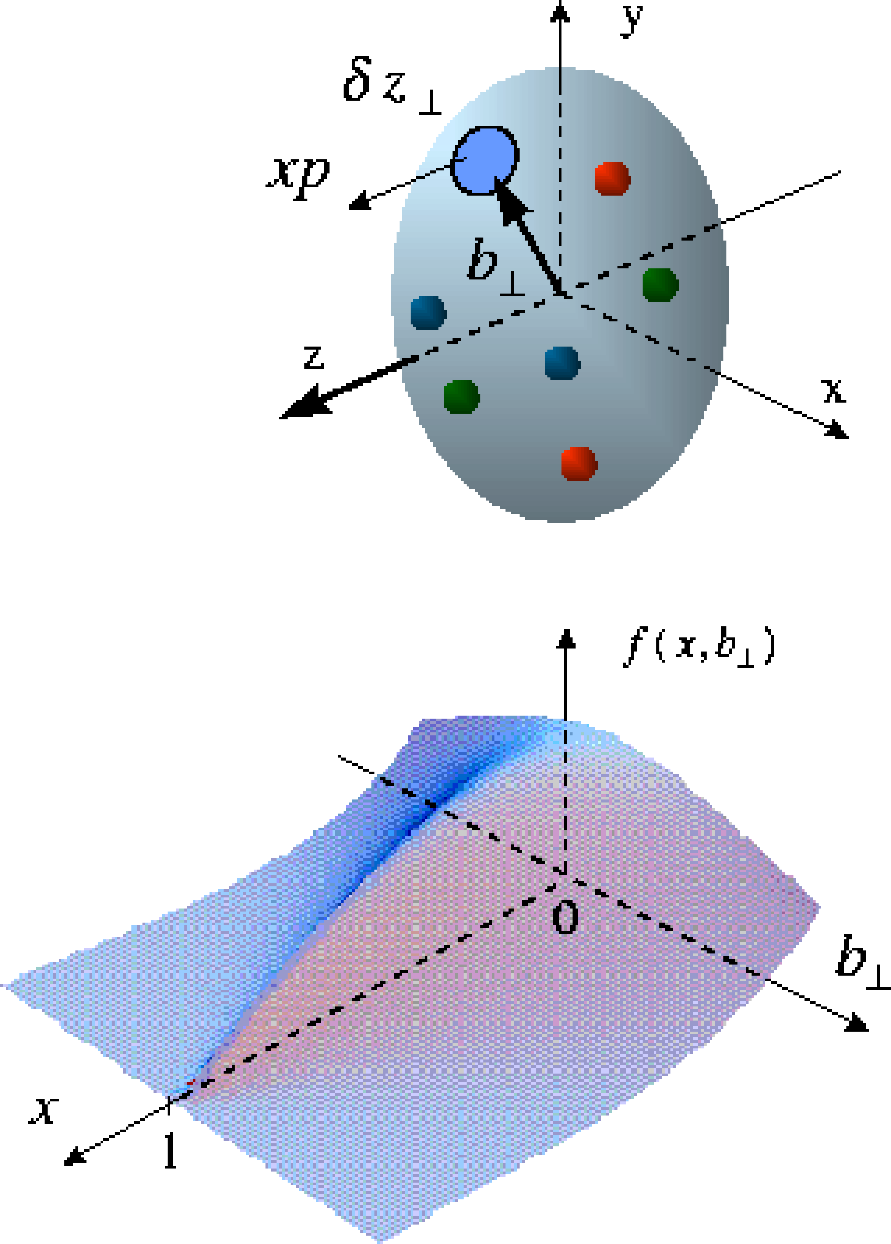
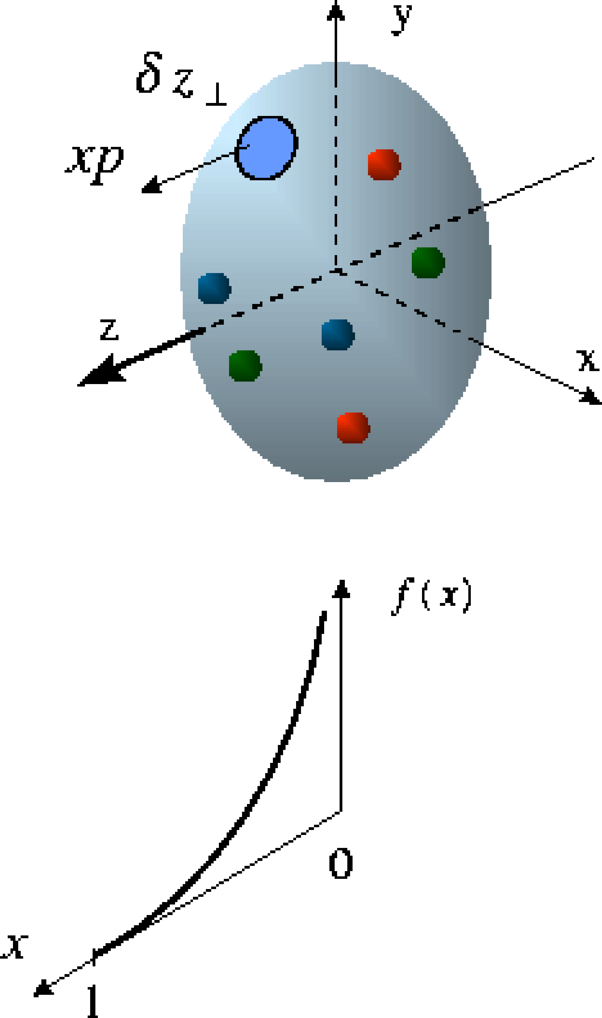
New science at the dawn of the 21st Century
A breakthrough in theory in the late 1990’s led to the interpretation of deeply exclusive processes in terms of fundamental 3-dimensional objects – the generalized parton distributions (GPDs)
D. Müller et al., F. Phys. 42,1994,
X. Ji, PRD 55 (1997) 7114
X. Ji, PRL 78 (1997) 610
A. Radyushkin, PRD 56 (1997) 5524
> 1954
> 2000
>1980’s
form
factors
→ Particle tomography at the quark level
Notes:
A breakthrough in theory in the 90's enabled interpretation of deeply exclusive processes in terms of fundamental 3-dimensional objects, the GPDs,
These well-known images illustrate what was learned from elastic electron-proton scattering starting in the 1950 and still today-- the electric charge and the current distribution in transverse impact parameter space.
The image on the right illustrates the quarks longitudinal momentum fraction and their helicities in the deep-inelastic scaling region
The image in the middle combines the left and right images represent the probability of finding a quark of momentum fraction x at an impact parameter b-perp.
--> Knowing the GPDs allows us to do particle tomography at the quark level.

Slide 4
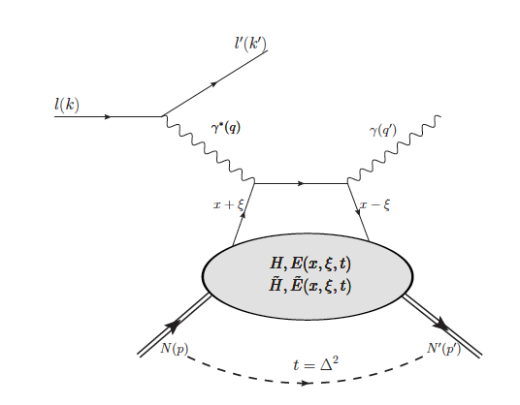
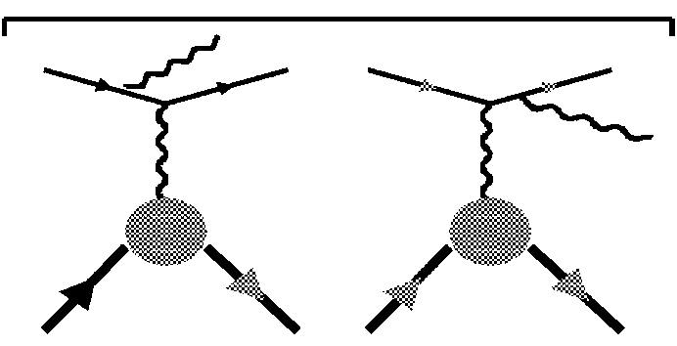

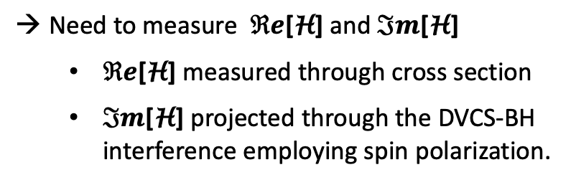

Particle tomography at the quark level
What are the tools to measure the GPDs ?
DVCS
Bethe-Heitler
In DVCS the relevant quantities are not GPDs but complex valued integrals of
GPDs, the Compton Form Factors (CFF).
F₁(t), F₂(t)
hard scattering
factorization
x_{B}
soft part
p’
ξ $≈$
Need to measure $ℜe$[H] and $ℑm$[H]
  $ℜe$[H] measured through cross section
  $ℑm$[H] projected through the DVCS-BH interference employing spin polarization.
2 - x_{B}
p
4 chiral even GPDs describe the soft part -
2 polarized and 2 unpolarized GPDs
Notes:
What are the tools to get info on GPDs? The most suitable process to date is Deeply Virtual Compton Scattering shown here. The upper part of the diagram is a hard scattering process. The bottom part contains the GPDs.
GPDs appear in the DVCS observables as complex valued Compton Form Factors defined here
The real part is encoded in the cross section. The imaginary part is projected out through the real Bethe-Heitler amplitude interfering with DVCS.

Slide 5
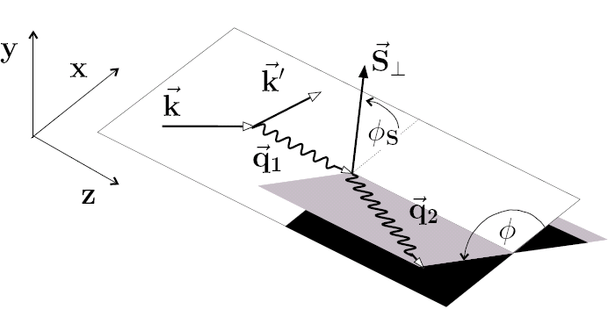


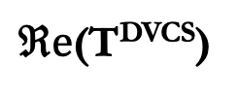
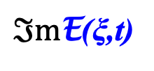

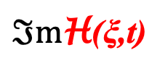
Isolating Compton Form Factors in DVCS
Polarized beam, unpolarized target:
~
$ℑ$mH(ξ,t)
Δσ_{LU} ~ sinφ $ℑ$m{F₁H + ξ(F₁+F₂)H +kF₂E}dφ
Unpolarized beam, trans. pol. target:
φ_{s}
Δσ_{UT} ~ cosφ sin(φ_{s}-φ)$ℑ$m{k(F₁E - F₂H )}dφ
$ℑ$mE(ξ,t)
Unpolarized cross section:
$ℜ$e(CFFs), separate h.t. contributions to DVCS
$ℜ$e(T^{DVCS})
Notes:
How do we isolate the Compton Form Factors in DVCS?
The Imaginary parts of the Compton Form Factors can be isolated through the interference of the real BH amplitude with the complex DVCS amplitude. In case of CFF H we employ the electron beam polarization to extract Im H.
In the case of CFF E we use the transverse polarized target for Im E as shown in this expression and measuring the azimuthal angle dependence of these interference terms. In the case of CFF E we need to measure also the azimuthal dependence of the event rate versus the spin orientation phi-s relative to the electron scattering plane.
The real parts of all CFFs are encoded in the differential cross section.

Slide 6

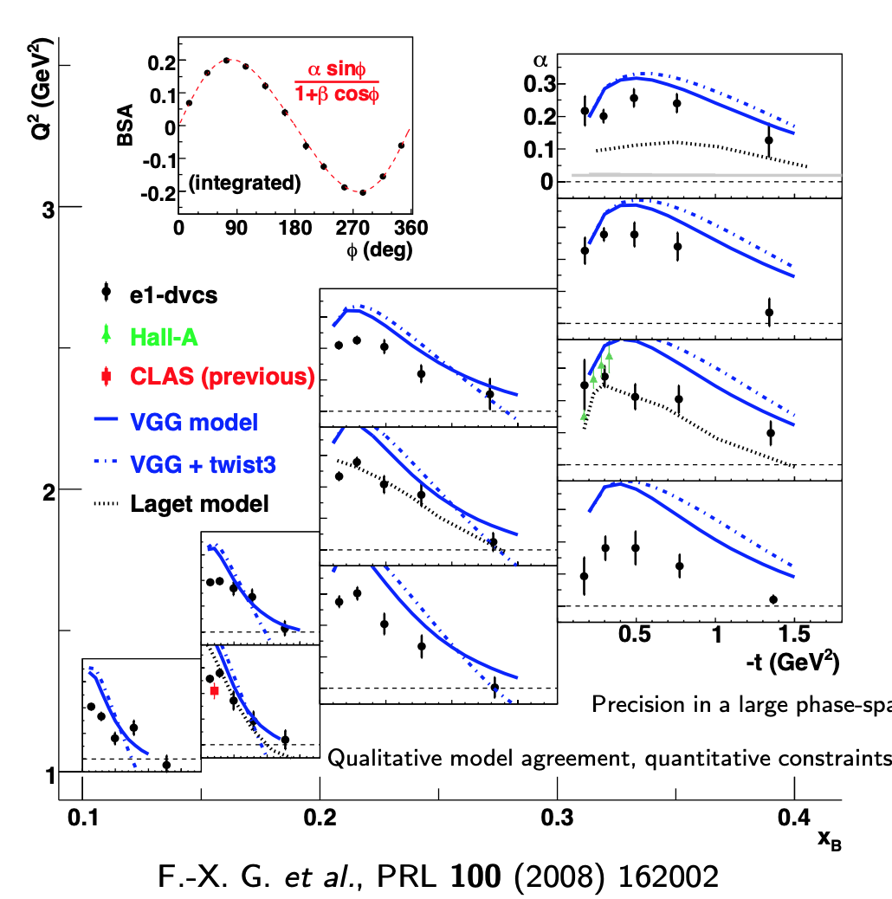
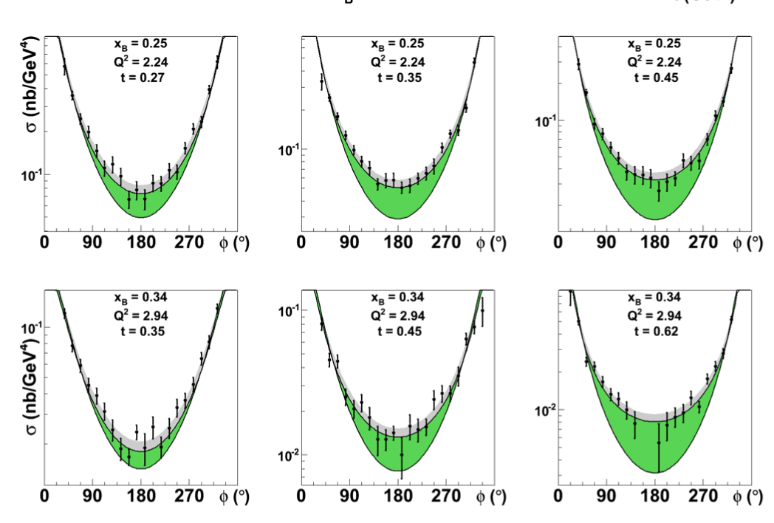
Sample DVCS cross sections & BSA
F.X. Girod et al. (CLAS), Phys. Rev. Lett. 100 (2008) 162002
H.S. Jo et al. (CLAS), Phys.Rev.Lett. 115 (2015) 21
→ Determine $ℑ$mH(ξ,t) and $ℜ$eH(ξ,t) at fixed ξ and t from fits to BSA and the diff. cross section
Notes:
Samples of the beam spin asymmetry are shown here. The inset shows the integrated azimuthal dependence of beam-spin asymmetry from the 6 GeV era.
The other graphs show the t-dependences for each Q2 and xB bin, where each point relates to the sin-phi moment of the BSA at specific Q2, xB, and t.
The right sides show the differential cross sections for specific kinematic values. The lower lines show the BH contributions, the green areas are from the DVCS contributions.
The combination of BSA and diff. cross sections allow for the determination of the $ℑm$ and Re parts of the CFF at fixed xi and t.

Slide 7
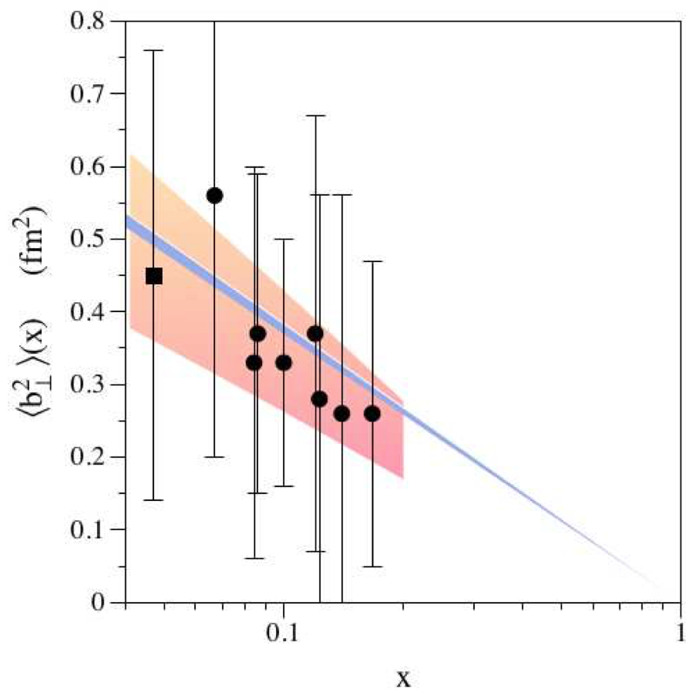
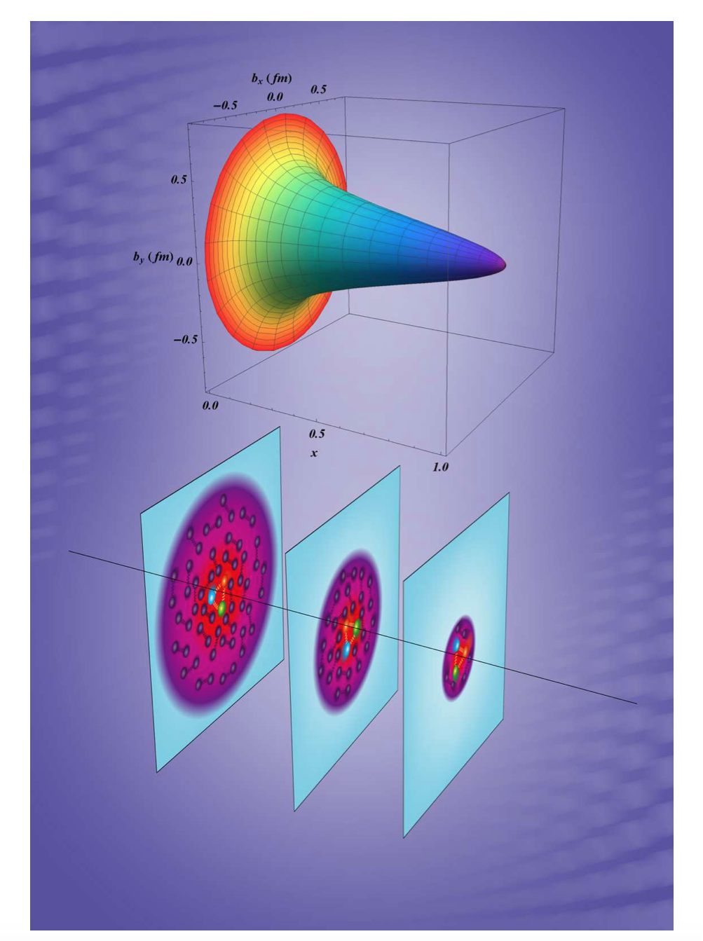
First quark image of the proton from DVCS
DVCS
← image in b_{T}² impact parameter and longitudinal momentum.
At x_{B} > 0.1 image is shaped by valence quark distributions,
At x_{B} < 0.1 quark-antiquark components.
CLAS
HERMES
Transverse impact parameter
3D image shows reduced → transverse impact parameter space for quarks at large x_{B}.
Quark momentum fraction x_{B}
R. Dupré, M. Guidal, M. Vanderhaeghen,
PRD 95, 011501(R) (2017)
→ Now we turn to the gravity-like connection of DVCS
Notes:
The DVCS data were first used to generate this 3D quark image of the proton.
Our interest here is about the gravity-like connection of DVCS that I now turn to.

Slide 8
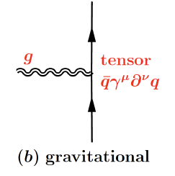
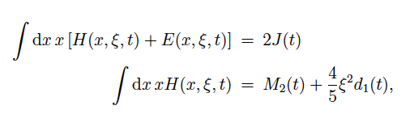
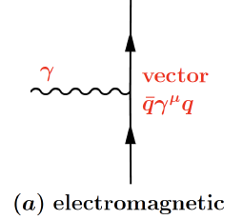
GPDs – GFFs Relations
Proton QCD matrix element of the Energy-Momentum Tensor contains three gravitational form factors (GFF) and can be written as:
M(t) : Mass/energy distribution inside proton
J (t) : Angular momentum distribution
d₁(t) : Forces and pressure distribution
p
G
G p p
J=2
p
Connections of GPDs and GFFs
γ
p
J=2
γγ p p
γ_{v}
p
GPDs not directly accessible → Compton FFs to determine the D-term
Notes:
To measure the gravitational properties of the proton we must analyze the proton’s matrix element of the energy momentum tensor.
It contains 3 form factors M2(t), J(t), and d₁(t) that are the gravitational form factors end encode the distribution of mass, angular momentum, and the distribution of forces and pressure in the proton.
They are written here for the quark part, but they apply to the gluon content of the proton as well.
The relations of the GPDs and the GFF are given in the 2nd x-moments of the H and E GPDs that we currently don’t know.
As discussed earlier we must define the so-called Compton FF as integrals of GPDs in x as the observables in DVCS.

Slide 9
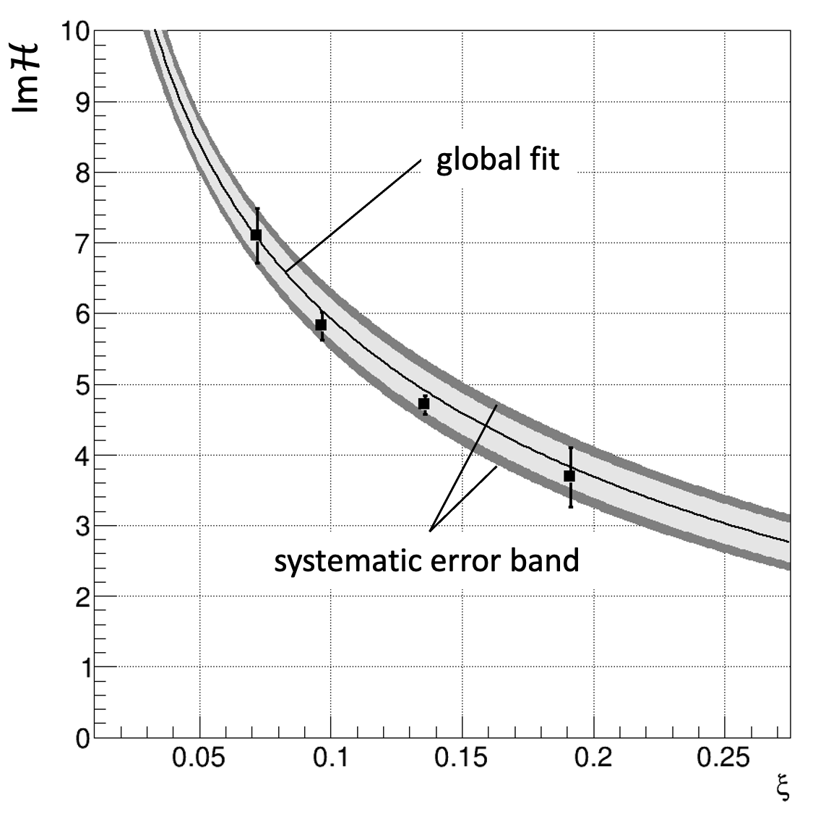
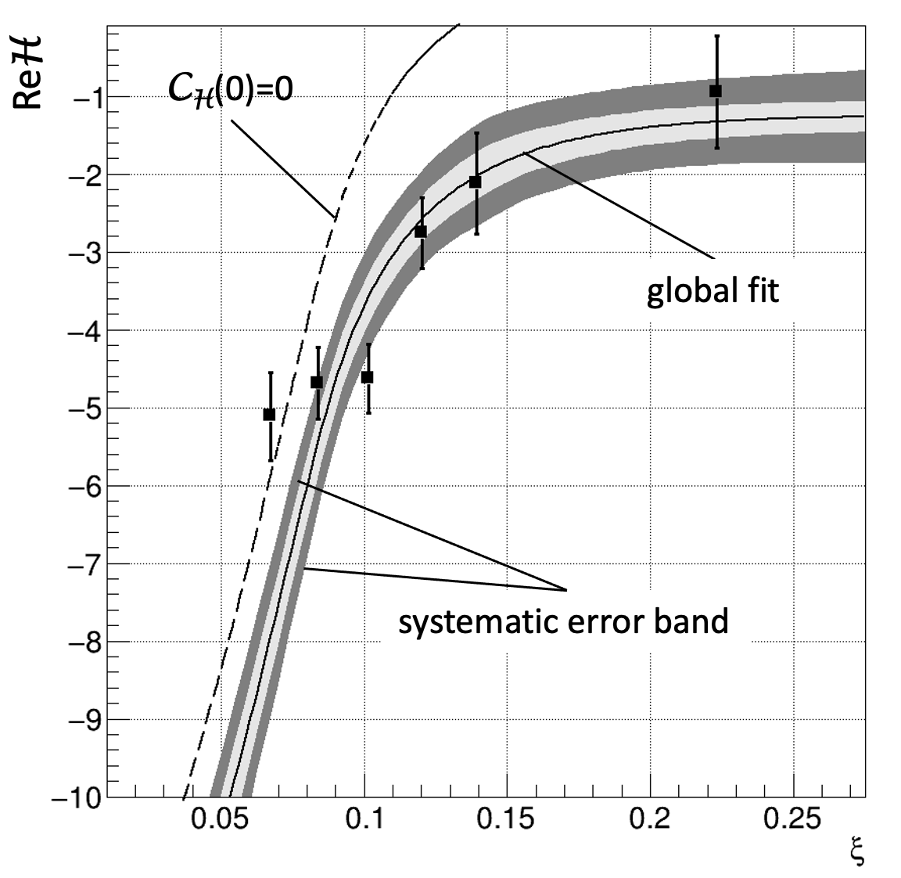
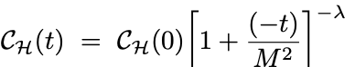
Extracting the D-term from CFF ImH and ReH
-t = 0.13 GeV²
Local kinematics fits:
Beam-Spin-Asymmetry from CLAS data to determine ImH(ξ,t)
Differential cross section from CLAS data to determine ReH(ξ,t)
Global parameterizations constrained by local data:
Subtracted dispersion relation constraint → ReH(ξ,t)
Pole-fit to t-dependence of C_{H}(t)
K. Kumericki et al, EPJ A 52, 159 (2016)
M. Diehl, D. Yu. Ivanov, EPJ C 52, 919 (2007)
C_{H}(t) +
Notes:
How do we determine the GFF D from the CFF H?
The left graph shows the measurements of Im(H) at fixed –t value and different ξι ϖαλυεσ.
Τηε χορρεσπονδινγ ρεαλ παρτσ αρε σηοων ιν τηε ριγητ γραπη. The central curves shows the global parameterization with the parameters fit to the measured values of CFF IM(H) at -t=0.13 in this example.
The real part of the parametrization CFF H is fitted to the data employing the subtracted dispersion relation.
Several –t values are used to obtain the t-dependence of the subtraction term
resulting in the first extraction of a finite value for the subtraction term C(0) in the DR.

Slide 10
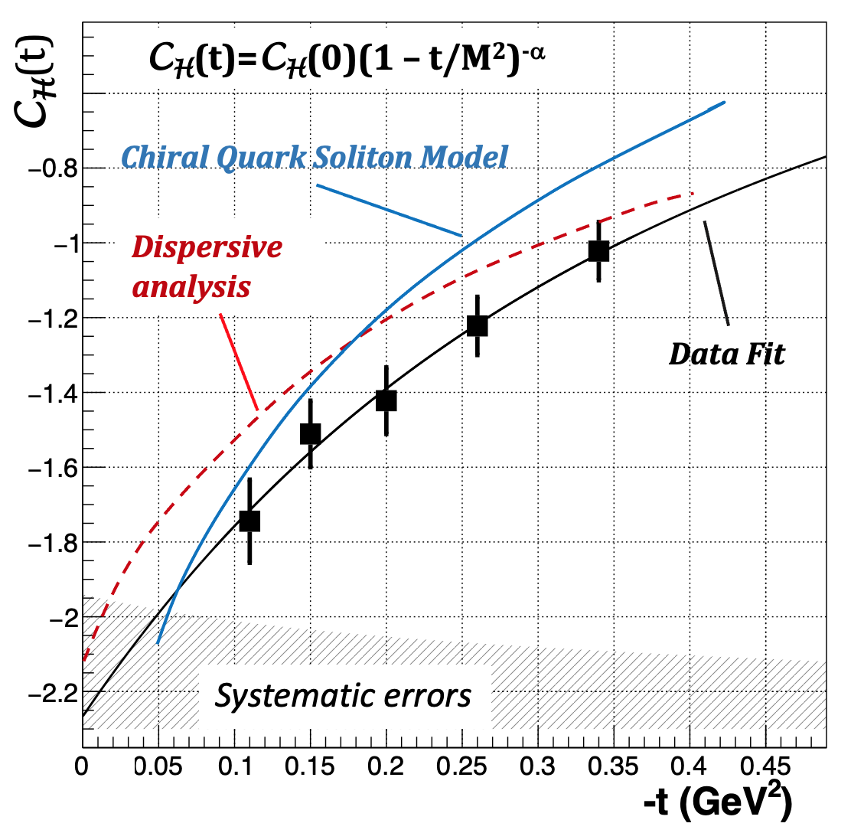
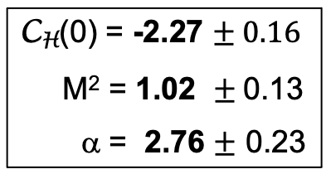
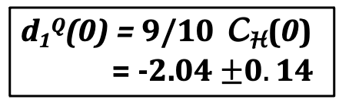
First extraction of C_{H}(t) and the proton D-term d₁(t)
C_{H}(0) = -2.27 $± 0.16$
M² = 1.02 $±$0.13
α = 2.76 $±$ 0.23
-1<z= x/ξ <1
C_{H}(t) =
d₁^{Q}(0) = 9/10 C_{H}(0)
= -2.04 $±0.14$
→ The D-term is negative!
Determine proton mechanical properties → relate the D-term to the Energy-Stress Tensor.
M. Polyakov, P. Schweitzer, Int.J.Mod.Phys.A 33 (2018) 26, 1830025
Notes:
From this we can determine the d1(0) term by relating CH(t) to the d¹_{q}(t) GFF resulting in the first extraction of the quark D-term.
The graph shows a comparison with two theory prediction, that agree with the data within the systematic uncertainties shown by the shaded band.
The most important result is that the D-term is negative, which is required for the intrinsic mechanical stability of the proton as we can see in the next slides.
Now we relate the D-term to the energy-stress tensor of the proton
The extracted subtraction term is related to the first coefficient in the Gegenbauer polynomial expansion d1(t), which is one of the gravitational form factors of the proton’s matrix element of the EMT in QCD.

Slide 11
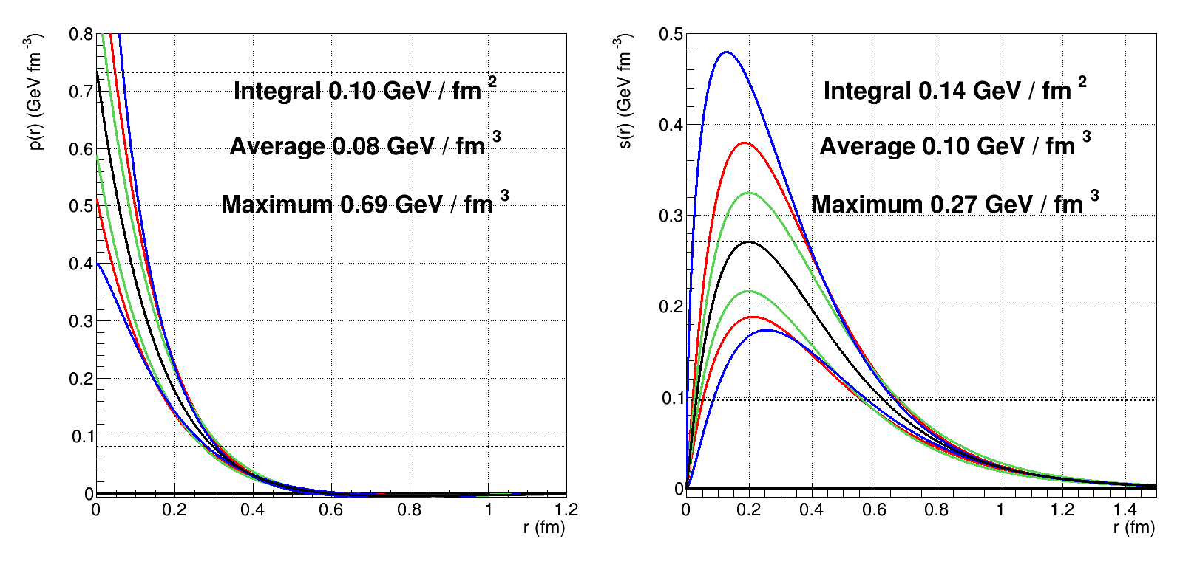
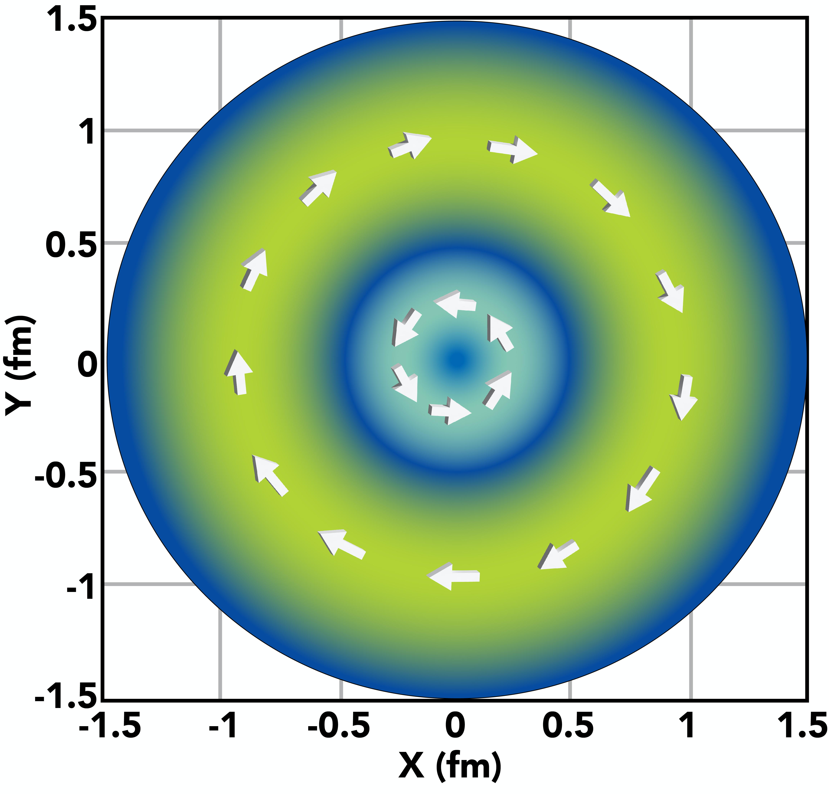

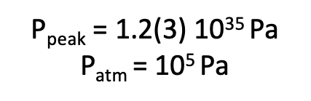

First results on quark pressure & stress in the proton
$∫r2p\left(r\right)dr$ = 0; M. v. Laue, Annalen Phys. (1911)
Tangential stress (r=0.6fm)
38x10³ Newton
Peak pressure: 0.73 GeV/fm³:
χQSM
repels
color fields
Data fit
attracts
color fields
P_{peak} = 1.2(3) 10³⁵ Pa
P_{atm} = 10⁵ Pa
r(p=0) $≈0.6 fm$
Notes:
The pressure distribution is shown here on the left on a linear scale. The peak value at r=0 is 0.73 GeV/fm³ which corresponds to 1.2x10³⁵ Pascal.
A more insightful way of showing the pressure is by scaling it by r². The inner part has a positive pressure that repels the color fields, while the outer part is negative, and attracting the color fields.
The integral must be = 0 (von Laue condition).
The black curve is the result of the global fit to the DVCS data.. The width of the light green band estimates systematic uncertainties.
At r ~ 0.6 fm, the pressure changes sign, that is comparable to the quark mechanical radius of ~0.6 3fm.

Slide 12
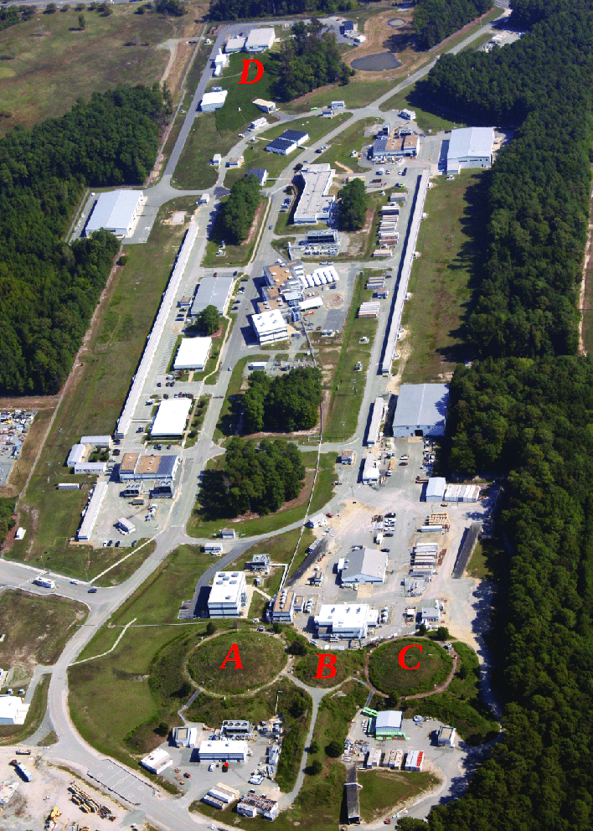
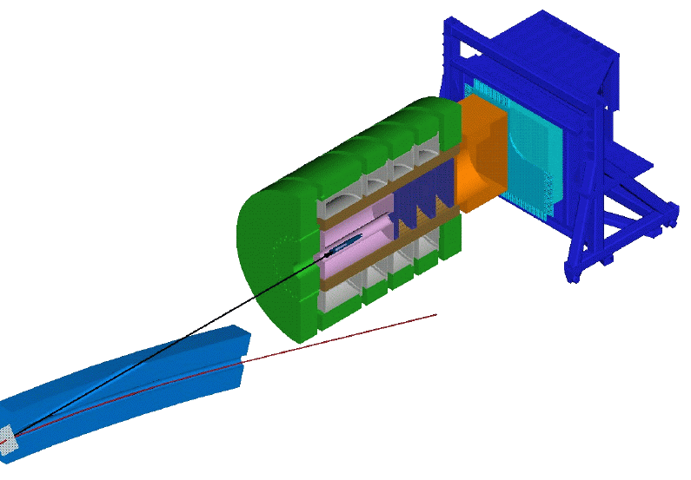
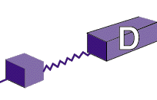
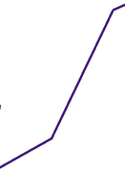
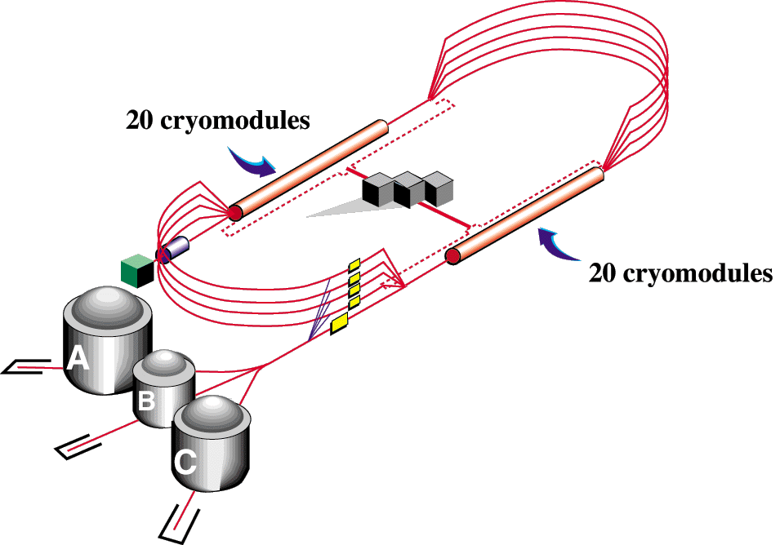


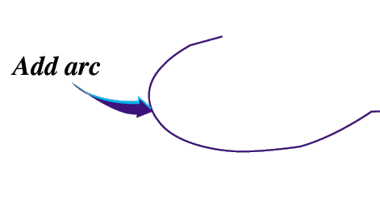


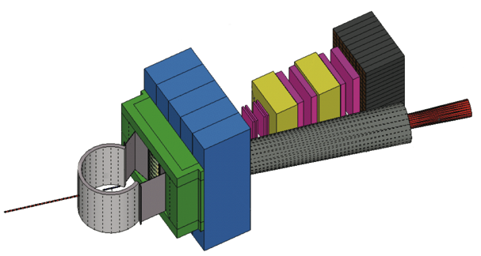
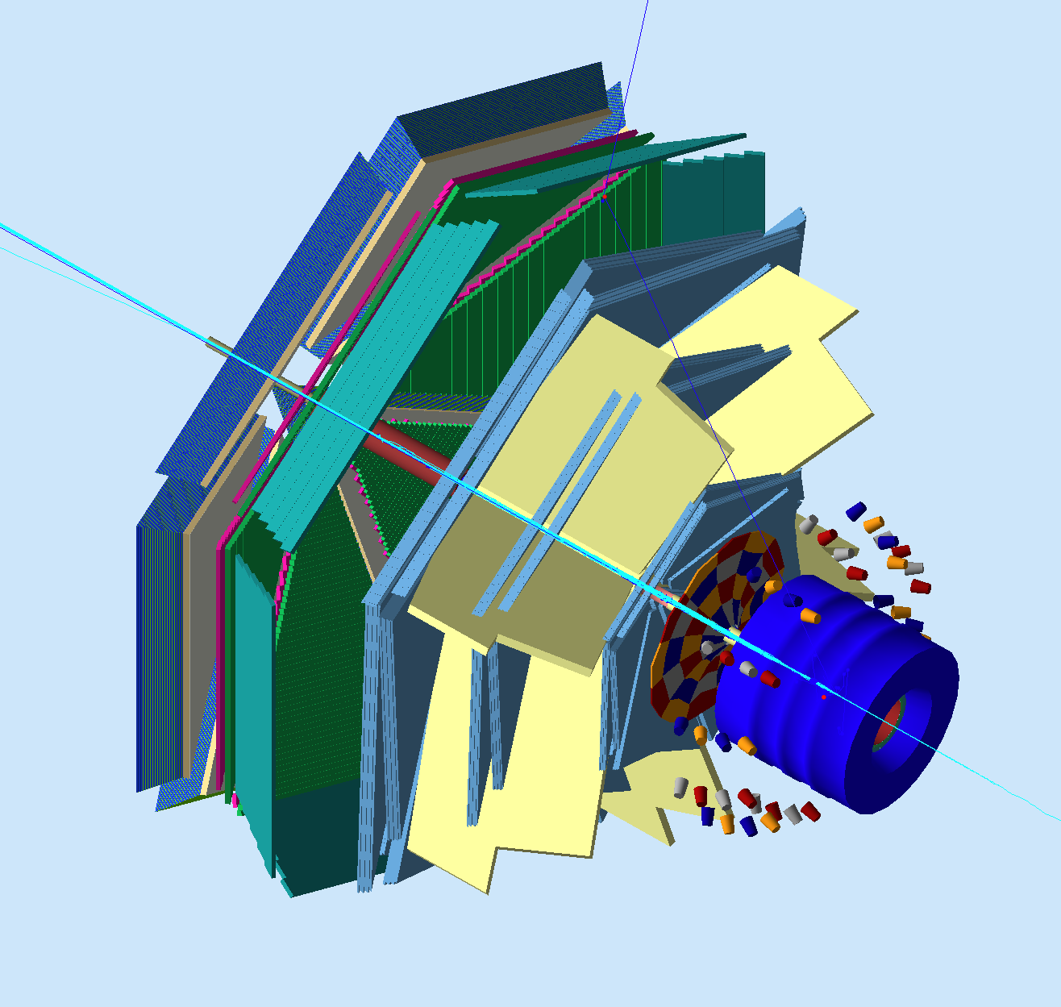
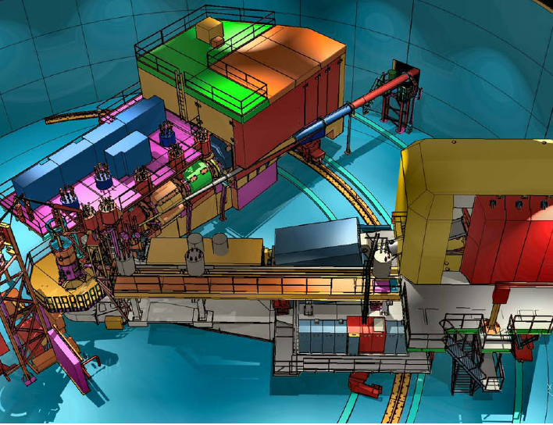
The Jefferson Lab Energy Upgrade
Maximum energy 12 GeV
New Experimental Hall D
CLAS12 in Hall B
SHMS in Hall C
SBS in Hall A
GlueX
CHL-2
HRS² + SBS
CLAS12
HMS + SHMS
Notes:
The data I discussed so far where all from the 6 GeV era of CEBAF and from the CLAS. The energy doubling that was completed in 2018 has a broad science program to study GPDs at higher energies and higher luminosity. Among others the CLAS12 detector was built specifically for the GPD program with 10 fold increase of luminosity compared to CLAS,

Slide 13
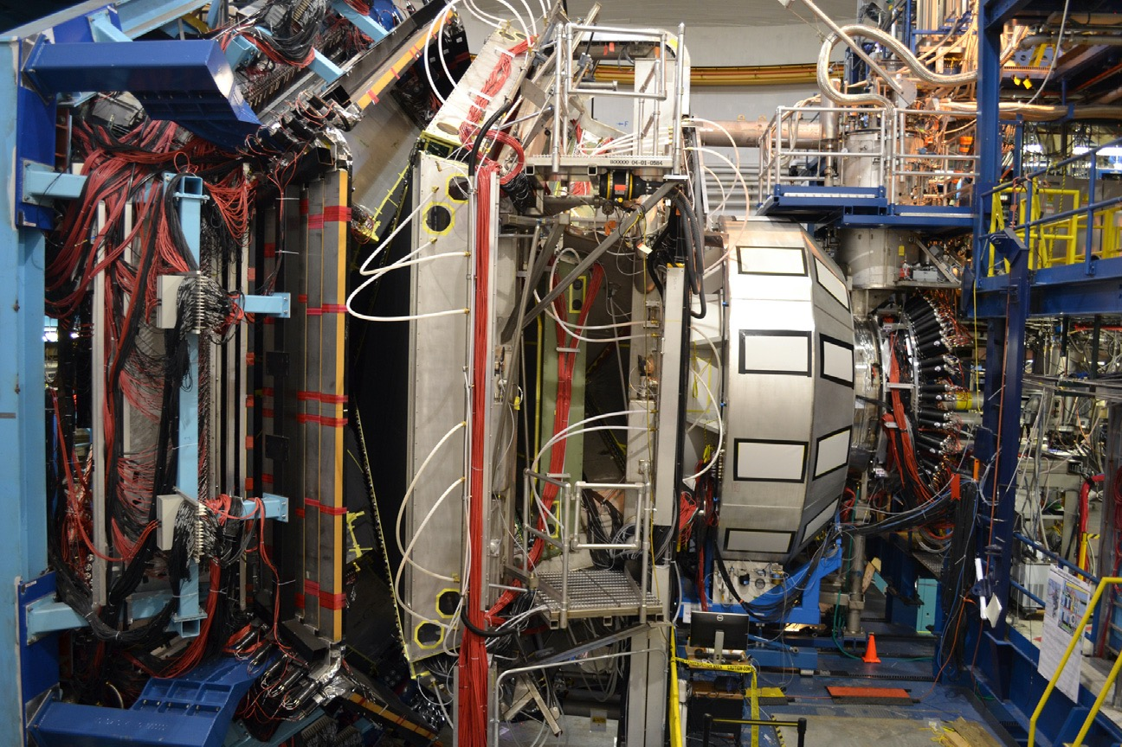


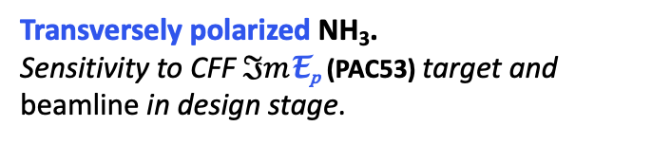
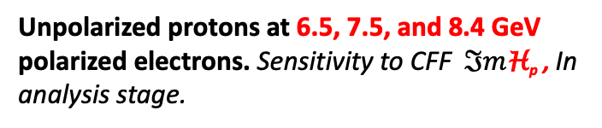
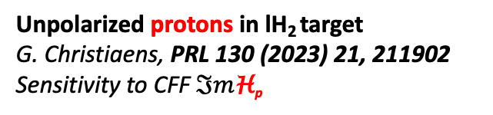

DVCS @ CLAS12
Status and prospects of DVCS measurements
Unpolarized protons in lH₂ target
G. Christiaens, PRL 130 (2023) 21, 211902
Sensitivity to CFF $ℑm$H_{p}
RG-A
L = 10³⁵cm⁻²sec⁻¹
RG-B
Unpolarized protons & neutrons in lD₂
A. Hobart, PRL 133 (2024) 21, 211903
Sensitivity to CFF $ℑm$E_{n}
RG-K
Unpolarized protons at 6.5, 7.5, and 8.4 GeV polarized electrons. Sensitivity to CFF $ℑm$H_{p} , In analysis stage.
RG-C
Longitudinally polarized NH₃/ND₃.
Sensitivity to CFF $ℑm$H_{p} in analysis stage
~
RG-H
Transversely polarized NH₃.
Sensitivity to CFF $ℑm$E_{p} (PAC53) target and beamline in design stage.
RG-L
DVCS on ⁴He target, sensitivity to CFF $ℑm$H_{He-4}
data taking ongoing
Notes:
Large batches of DVCS data have been taken at energies up to10.6 GeV with different targets.
The BSA for hydrogen target have already been published, and the cross-section data are being finalized. This slide should just give the scope of that data, picking kinematics with fixed t-values. But more kinematics points are in preparation that extend the x_{B} range to smaller values and enables use of larger t-ranges.
Data on neutron target have been taken and beam sin asymmetries have been accepted for Phys.Rev. Lett.
Data on long. polarized target have been taken.
Transverse polarized is important for CFF E , conditional approval, target and detectors being developed.
ALERT - DVCS on He3 is ready to start early 2025, sensitivity to He CFF H.

Slide 14
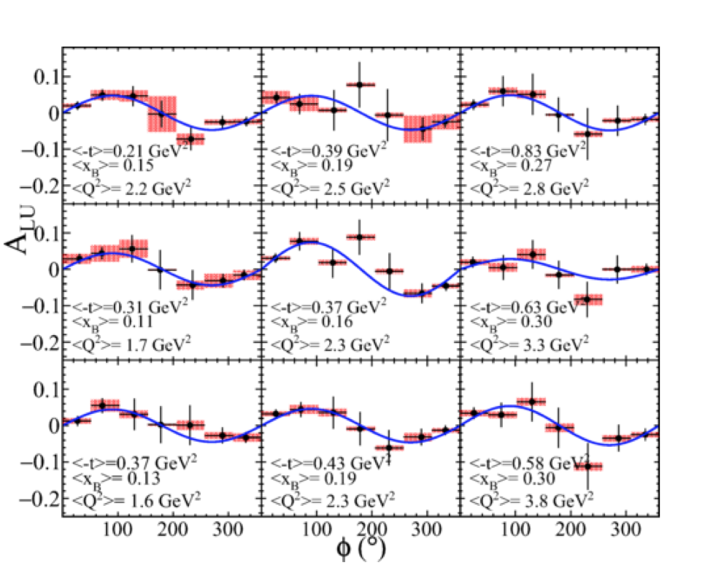
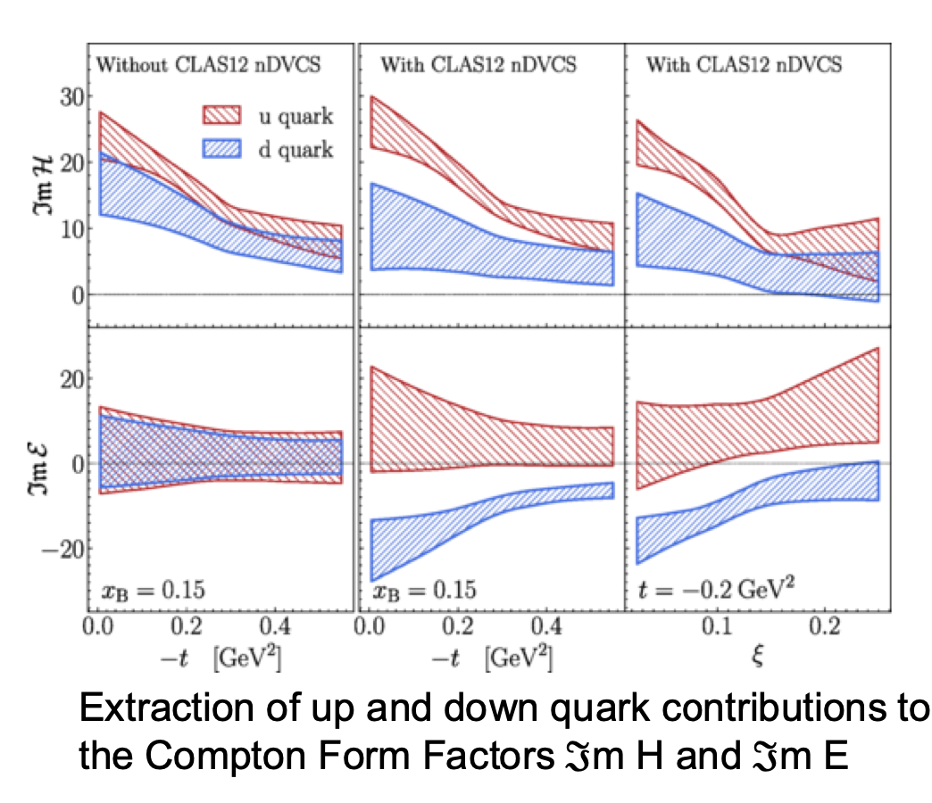


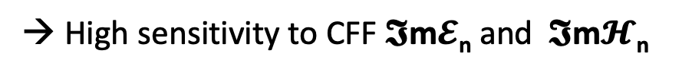
nDVCS @ 11GeV with CLAS12
RG-B
→ High sensitivity to CFF $𝕴$m$𝓔$_{n} and $𝕴$m$𝓗$_{n}
M. Čuić
A. Hobart, PRL 133 (2024) 21, 211903
$ℑ$m$ℋ$_{n}
and $ℑ$m$ℰ$_{n}
Notes:
The left graph shows beam-spin asymmetries on neutrons at different kinematics. Asymmetries are 5-10%.
The graph on the right shows DVCS sensitivity of the data to the Im H for u and d quark flavor.

Slide 15
DVCS-BH Beam spin asymmetry and DVCS cross section
Timothy Hayward
RG-A
25% of approved statistics
Sample diff. cross sections
Sangbaek Lee
Q²
-t = 0.33 GeV²
Q² = 1.10 – 3.5 GeV²
x_{B} = 0.07 – 0.25
Preliminary
x_{B}

Slide 16
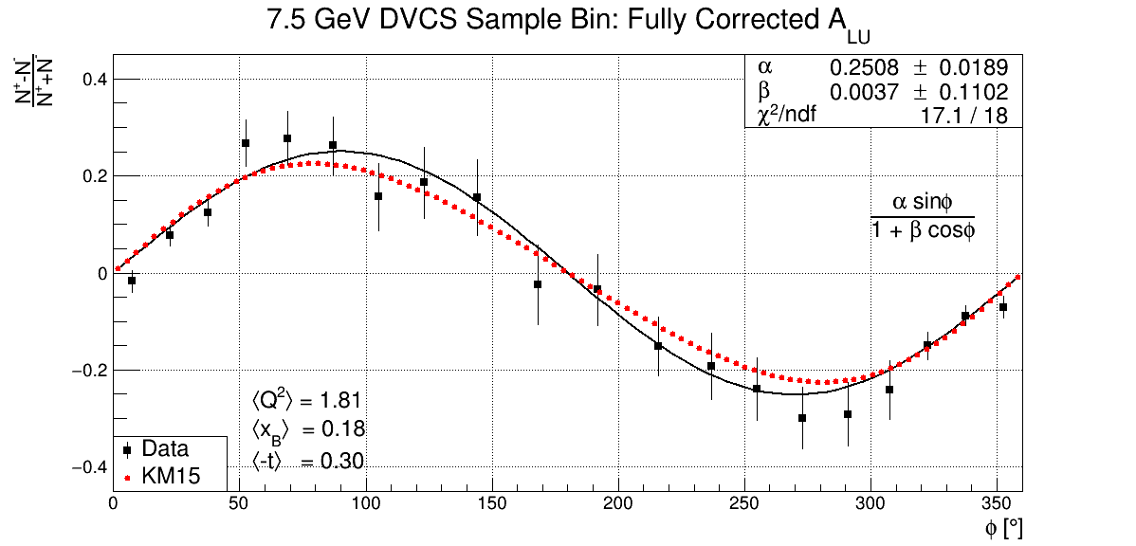
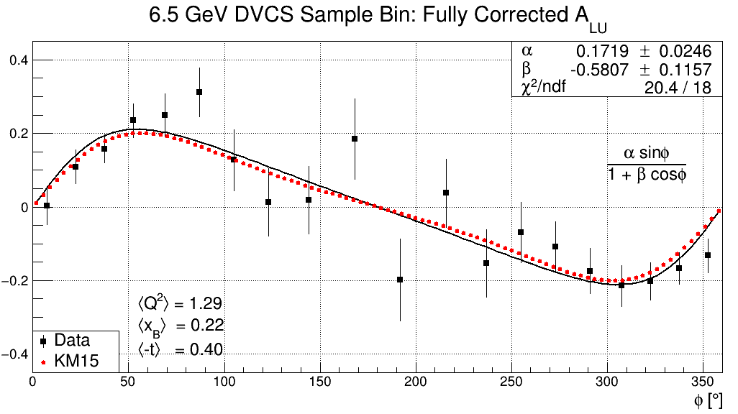
DVCS-BH samples of BSA @ 6.5, 7.5GeV
RG-K
10% of approved statistics
preliminary
Joshua Artem Tan
Notes:
These graphs show very preliminary analyses for the 6.5 and 7.5 GeV DVCS data with less than 10% of the approved beam time. Compared to KM model prediction.
The right graph shows data from 10.6 GeV energies, corresponding to about 25% of the approved experiment time.

Slide 17
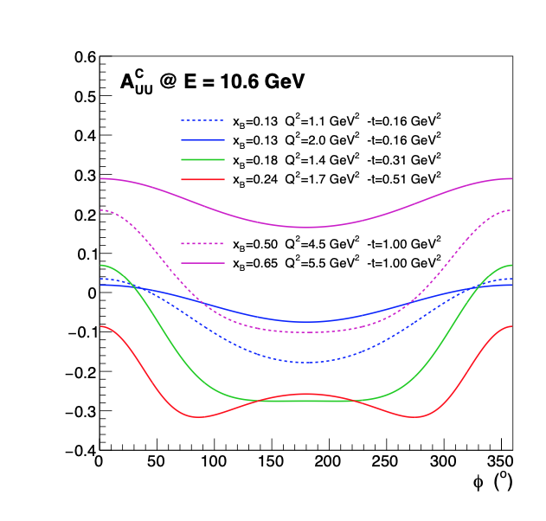
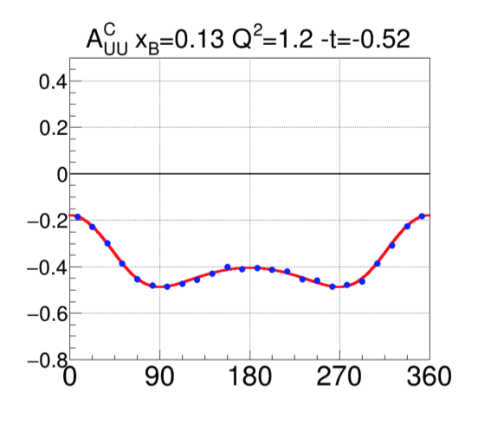
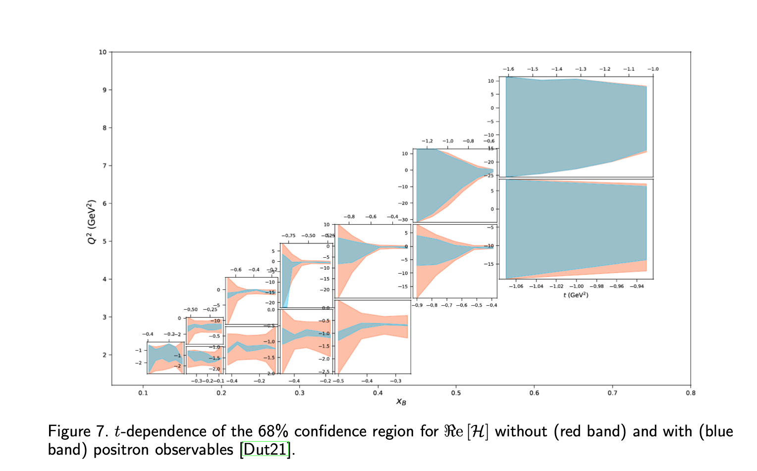
Positron-electron ➔ DVCS Re(H)
Eur.Phys.J.A 57 (2021) 6, 186
https://arxiv.org/pdf/2103.12651
e⁺ e⁻ charge asymmetry
φ [^{ο}]
Q²(GeV²)
Model calculations for charge asymmetries
x_{B}
Notes:
The availability of (polarized) positron beams provides strong sensitivity to the real part of CFF H through the positron-electron charge asymmetry measurement.
This is illustrated in the graph on the left in shows model calculations. Asymmetries are large and vary strongly for different kinematics.
Graph on the top shows the statistical uncertainties of a conditionally approved experiment.
The graphs on the bottom right show the impact of this measurement on the extraction of Re(H). The orange areas shrink to the blue ones.

Slide 18
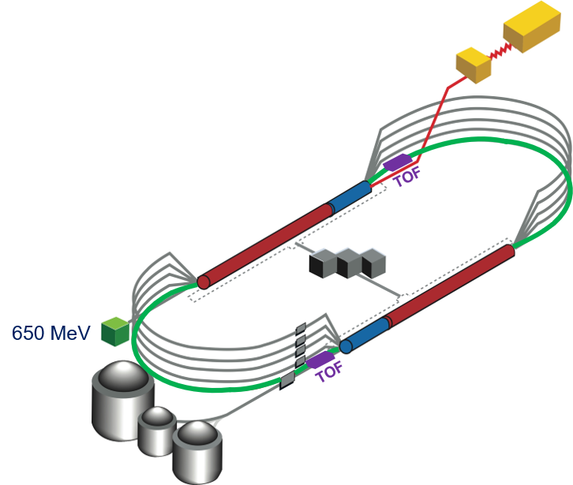
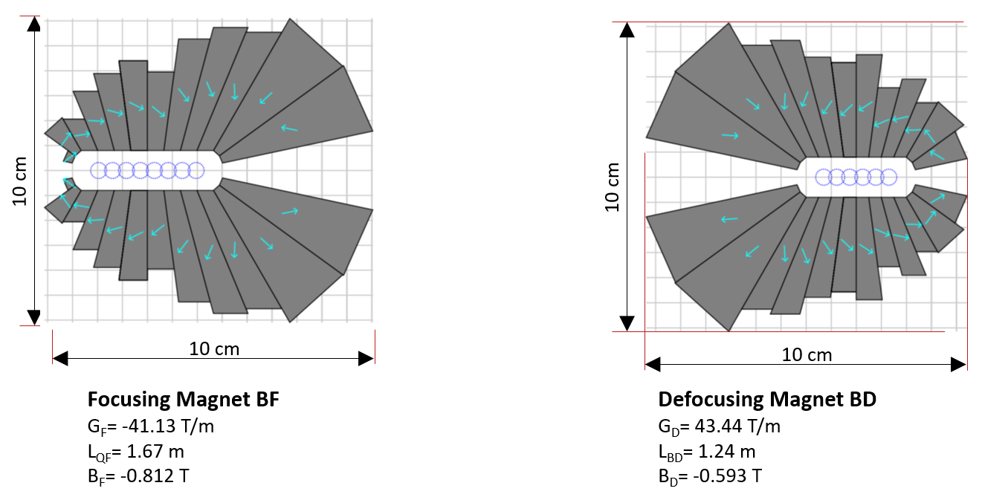
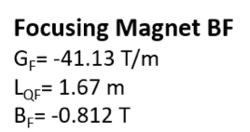

From CEBAF@12GeV to 22GeV
Strong Interaction Physics at the Luminosity Frontier with 22 GeV Electrons at Jefferson Lab, Eur.Phys.J.A 60 (2024) 9, 173; 2306.09360
→ Allows maintaining the high luminosity operation in external fixed target setup.
Notes:
An interesting energy extension is the proposed 22 GeV energy upgrade of the CEBAF accelerator. It makes use of a novel technology of permanent magnets that enable concentrated magnetic field with very different strength to live next to each other. To make use of this possibility the 2 highest energy arcs can be replaced with five FFA arcs that will transport electrons N times with dE = N x 2.2 GeV increase in energy. At 22 GeV the kinematics reach is significantly increased adding smaller xi and larger –t range with –t/Q^2 < 0.2.

Slide 19
Beam spin asymmetry A_{LU} (E=22 GeV)
From full simulations & reconstructions
F.X. Girod
2.6 < Q² < 11.5 GeV²
A_{LU} = αsinφ/(1 + βcos2φ)
`
0.15 < -t < 1.6 GeV²
0.07 < x_{B} < 0.36
Notes:
The simulated data were run through CLAS12 , reconstructed and analyzed in the t-range up to 1.6 GeV².
On the right graphs the extracted BSA are plotted for different x_{B} and Q² values showing small differences for the high and low Q2 indicating leading up to t=1.6GeV² where statistics ranges out.

Slide 20
The proton’s D^{q}(t) and pressure at 22 GeV
-t/Q² < 0.2
F.X. Girod
Fitting the dispersion relation to ImH, ReH
Fourier
transform
10⁻³
22 GeV
6 GeV
-t/Q² < 0.2
22 GeV
11 GeV
6 GeV
22 GeV will cover a large range in -t with sensitivity to existence of pressure domains.
Notes:
The quark D-term has been extracted from the CLAS12 simulated and reconstructed data as shown in the left graph. Using the same analysis to extract the D-term from the simulated data, i.e. fitting the dispersion relation to Im(H) and Re(H) and using a multipole parameterization of d₁(t).
There are markers for the lower energies at 6 and 11 GeV reachable with -t/Q2 < 0.2 cut.
The Fourier transform uses a single tri-pole moment. However, there is no guarantee that there are no more complex distributions that may indicate pressure domains at different values of the radius. A large range in -t is essential to search for these domains.

Slide 21

Summary
The gravitational structure of the proton present a broad experimental scope.
  Gravity couples to mass, spin, forces for both quarks and gluons → 6 FF
  First information on D^{q}(t), and now on gluon part (next talk).
DVCS@6GeV limitations in kinematic reach resulted in large systematic uncertainties.
  Limited range in ξ_{min} $≈$ 0.1 requiring extrapolations over significant range in the D.R.
  t-range limited to -t < 0.4 GeV² to reduce higher twist term.
DVCS@11 GeV partially remedies these limitations, but the limits in the covered ξ and –t ranges remain significant.
  First results on quark CFF $ℑ$m$ℰp$ from DVCS on transverse polarized proton target expected. (PAC53)
DVCS@22 GeV ξ_{min}$≈$ 0.03, −t_{max}= 1.8 GeV² extend the coverage in x and in –t significantly.
The gravitational structure of particles may become a comprehensive experimental program at JLab. The 22 GeV energy reach is an excellent match to reveal the underlying science.

