Slide 1
Optical Detection of Neutrons via CaF₂ for PALEOCCENE

Slide 2
PALEOCCENE collaboration
Krystal Alfonso, Gabriela R. Araujo, Laura Baudis, Nathaniel Bowden, Bernadette K. Cogswell, Anna Erickson, Michelle Galloway, Adam A. Hecht, Rathsara R. H. Herath Mudiyanselage, Patrick Huber, Igor Jovanovic, Giti A. Khodaparast, Brenden A. Magill, José Maria Mateos Melero,Thomas O'Donnell, Nicholas W. G. Smith, Felicia Sutanto, Nikita Vladimirov, Xianyi Zhang
2

Slide 3
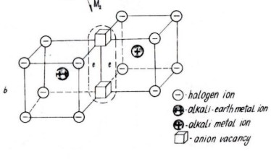
Color centers
F2 or M center
In ionic crystals (e.g. NaCl), anion vacancies trap electrons
Quantum mechanics in a square well → distinct energy levels
Individual color centers can be seen in visible light by fluorescence spectroscopy (NV in diamond, SiC)
Observed in a wide class of materials
J. Morris, B. J. Cowen, S. Teysseyre, A.A. Hecht, Computational Materials Science 172 (2020) 109293.
S. M. Pelka, Master Thesis, U. New Mexico 2017.

Slide 4
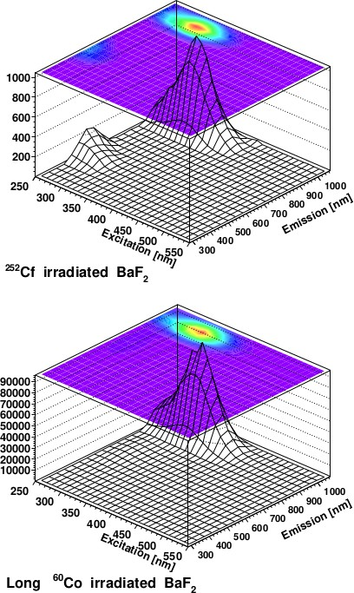
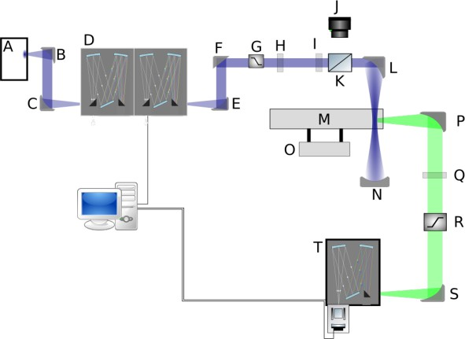
Prior Work
Color centers formed selectively by neutrons
Mosbacher et al, arXiv:1902.10668 irradiated a number of materials with neutrons and gammas to study bulk color center formation.
Similar results for Al₂O₃ and LiF₂
Nothing here with 500x higher dose of gammas
3

Slide 5
Image color centers (3D position resolved) prior and after exposure:
allows to subtract pre-existing color centers one-by-one
allows to tamper proof method for security applications
Requires micron-scale imaging of macroscopic volumes – large data rates.
B.Cogswell, A. Goel. PH, Phys. Rev. Appl. 16 (2021) 6, 064060.
K. Alfonso et al., arXiv:2203.05525.

Slide 6
Optical properties
Excitation and emission wavelength ranges for a selection of materials showing Radiation-Induced Luminescence (RIL)
UV excitations are not ideal
Selection is driven by available emission sources and detectors
Category:
A - RIL was observed only in the ²⁵²Cf irradiation and in none of the ⁶⁰Co irradiations
B - RIL observed for all irradiations, for which a neutron-induced signal was detected with a significance above 1σ
C - RIL observed for all irradiations
Adapted from:
Mosbacher et al, arXiv:1902.10668

Slide 7
Optical properties
Why CaF2:
reasonably well-studied
wavelengths well suited to existing equipment (no UV!)
Excitation and emission wavelength ranges for a selection of materials showing Radiation-Induced Luminescence (RIL)
UV excitations are not ideal
Selection is driven by available emission sources and detectors
Adapted from:
Mosbacher et al, arXiv:1902.10668

Slide 8
Experimental setup
Photoluminescence, PL, collected via HORIBA Jobin Yvon iHR550 spectrograph with a liquid nitrogen cooled CCD, HORIBA Jobin Yvon Symphony II with a filter to remove the 488 nm light used to stimulate the PL
All normalized measurements shown use the same control sample (sample 5) to set the baseline.
Each sample is measured prior to irradiation.

Slide 9
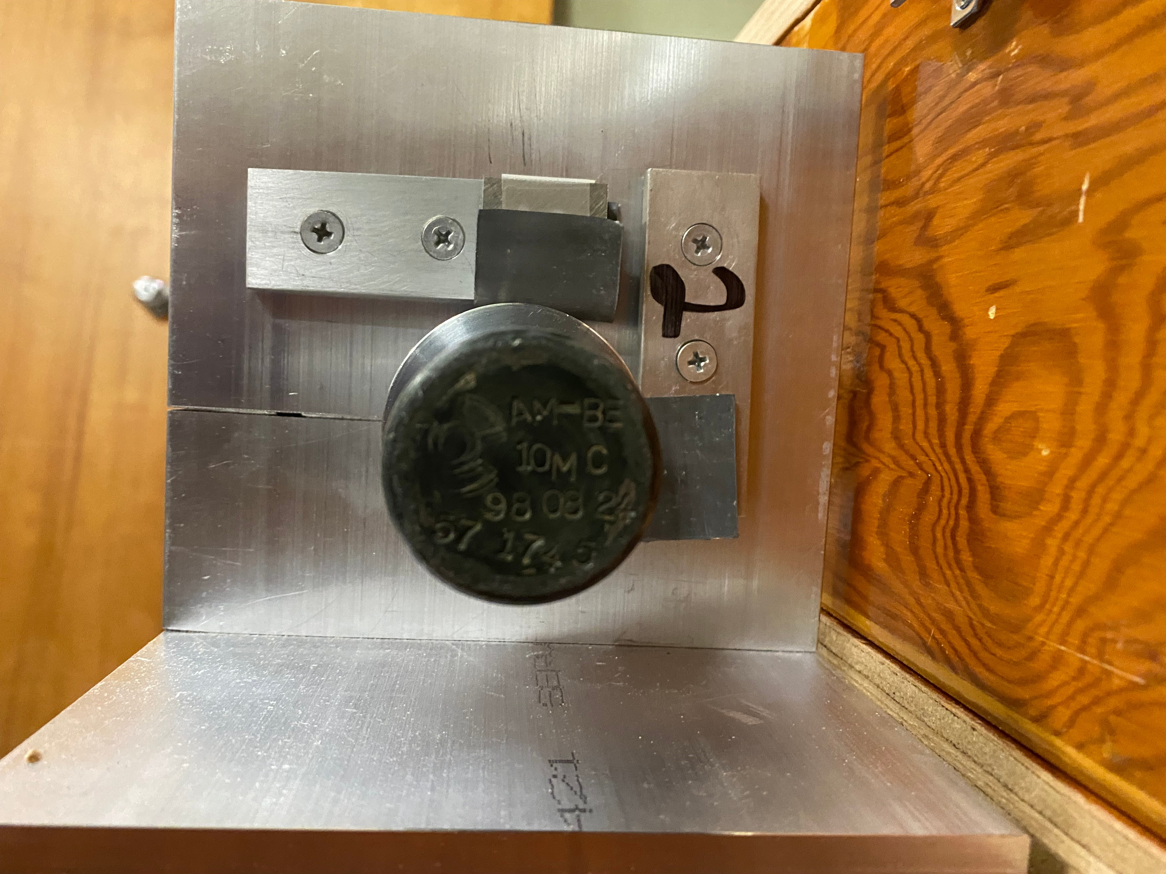
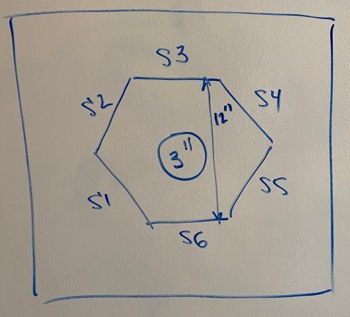
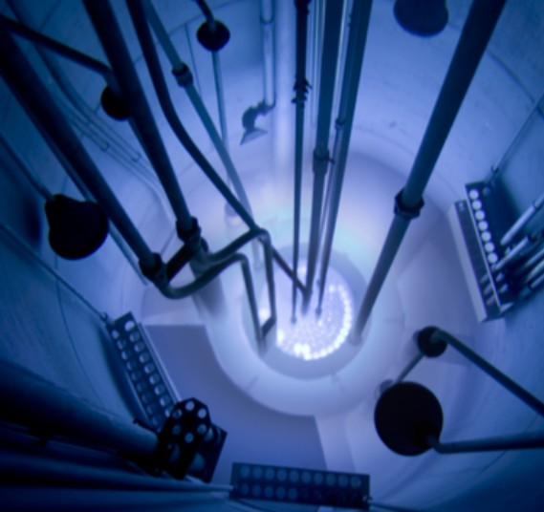
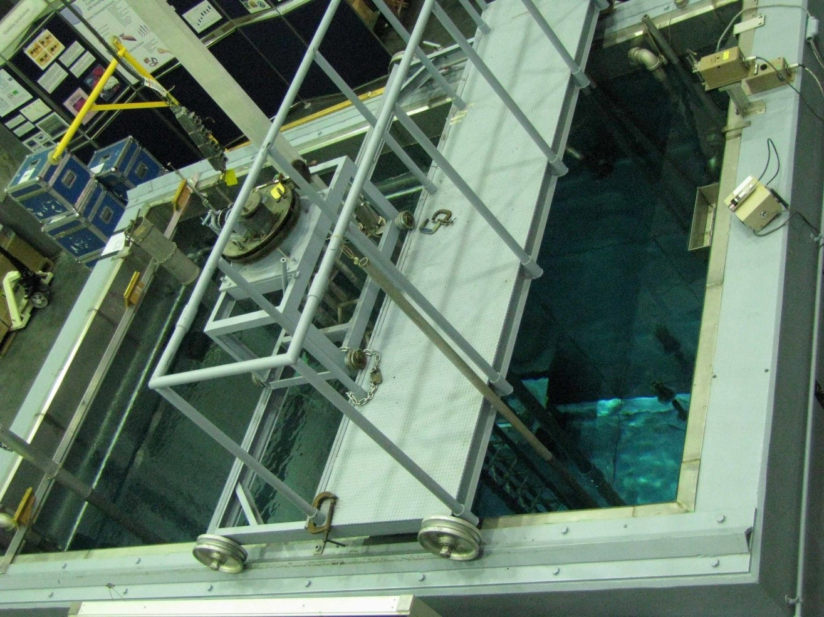
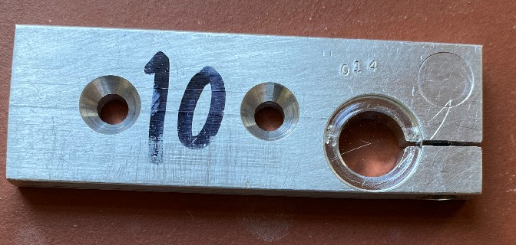
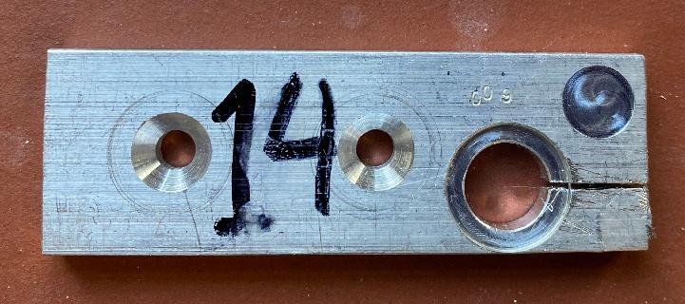
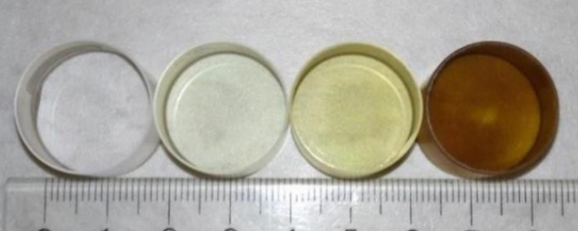
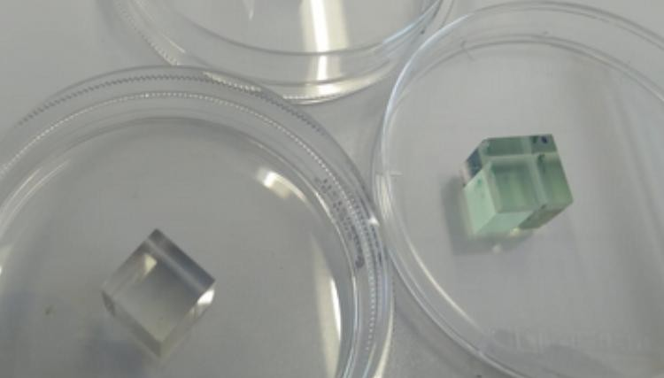
Georgia Tech AmBe source 50Ci
Virginia Tech
AmBe source 10mCi
Co-60 source 105mCi
Oregon State TRIGA reactor
Penn State
Co-60 irradiator
Prior work by University of New Mexico
Via the MTV consortium

Slide 10
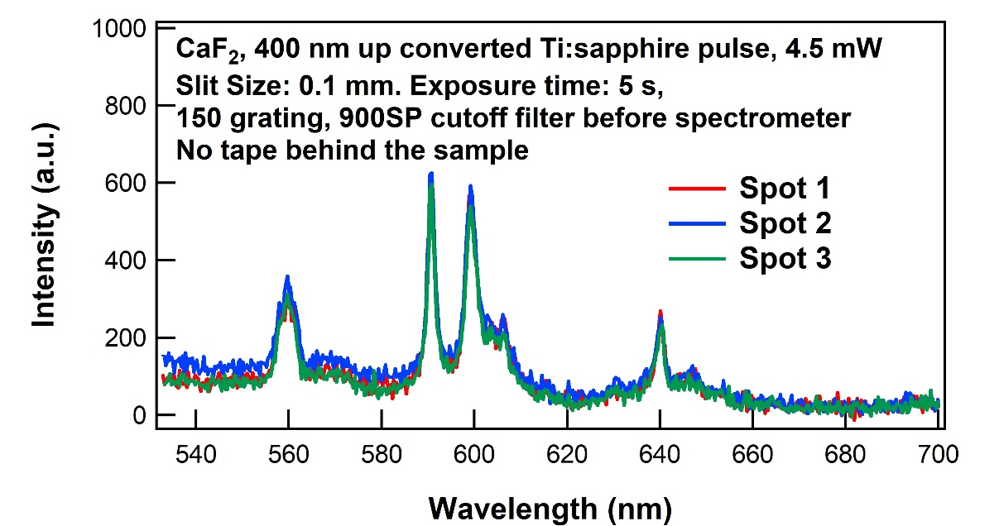
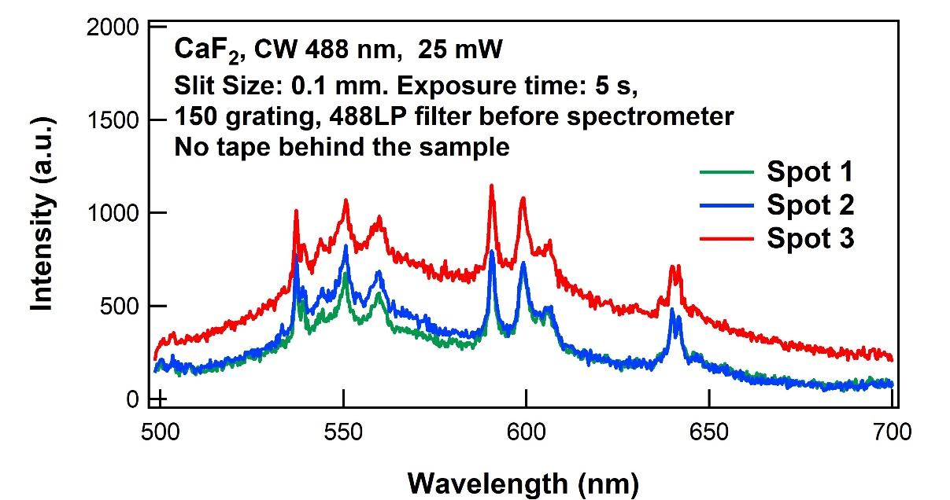
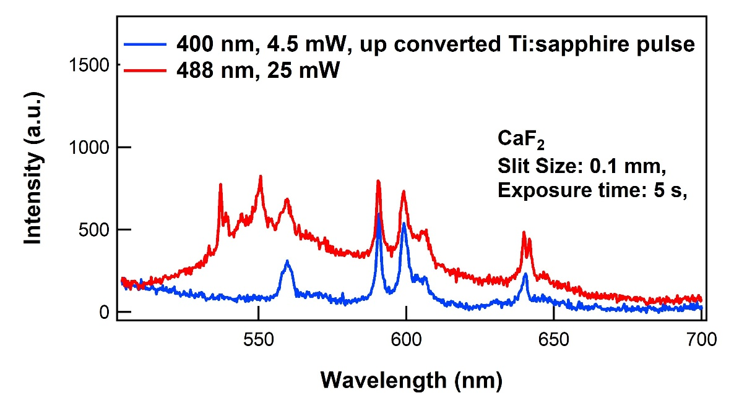
First test: unexposed CaF₂
Up converted Ti:sapphire pulse, 80 MHZ rep rate
488 nm CW laser
Comparison between CW and pulse

Slide 11
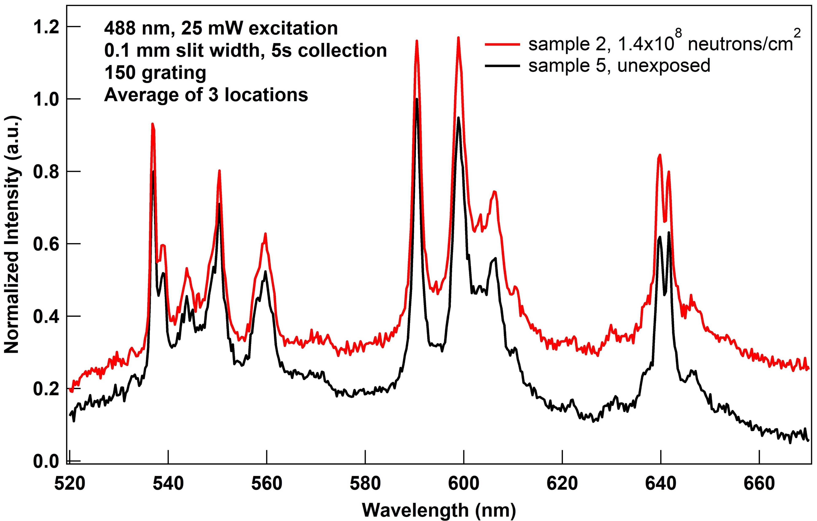
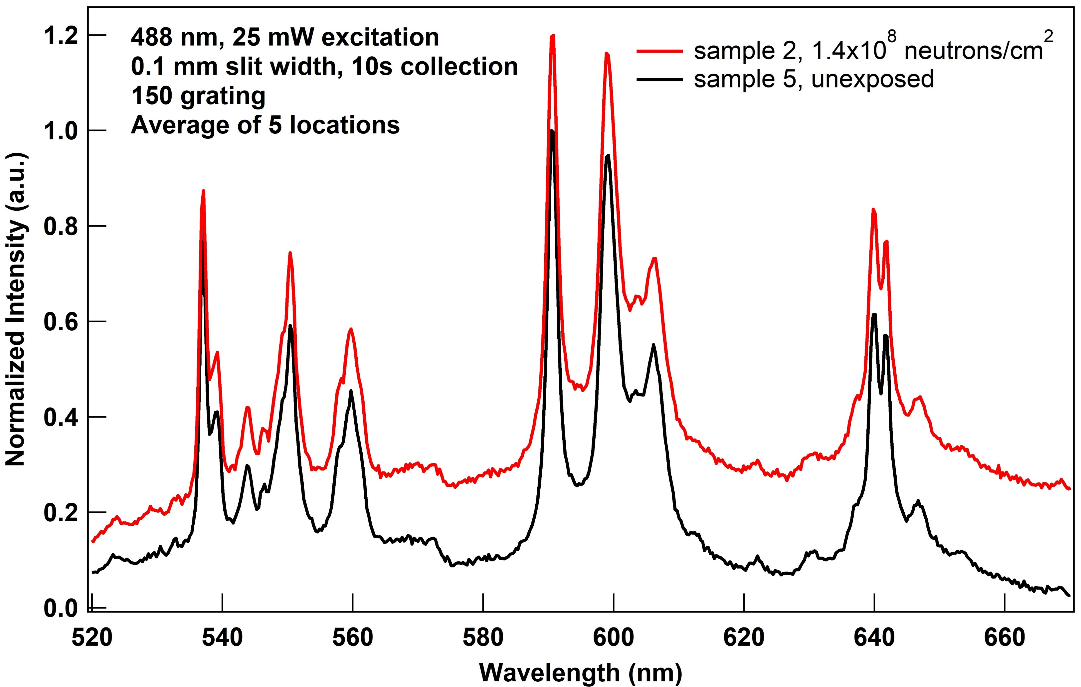
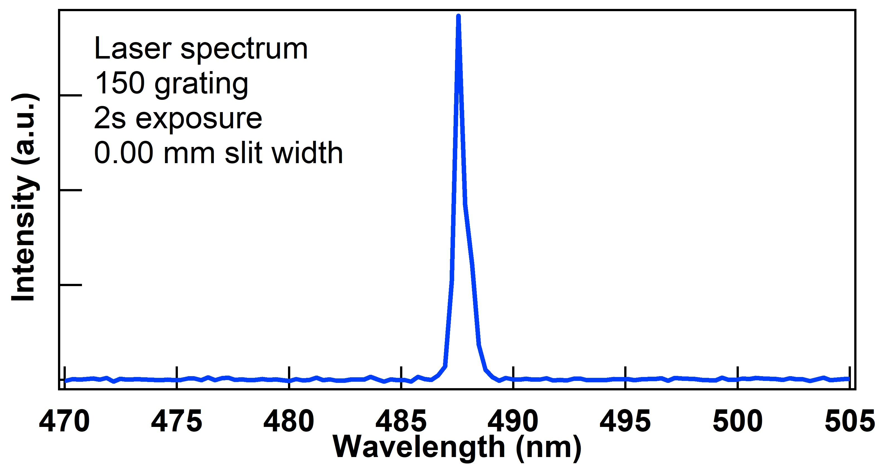
Effect of neutron irradiation on CaF₂
01/13/22
02/21/22
Exposed at VT via 10 mCi AmBe source with foil to block gamma rays
Normalized using an unexposed sample (5)
Spectrum of 488 nm laser as a check of Spectrometer accuracy

Slide 12
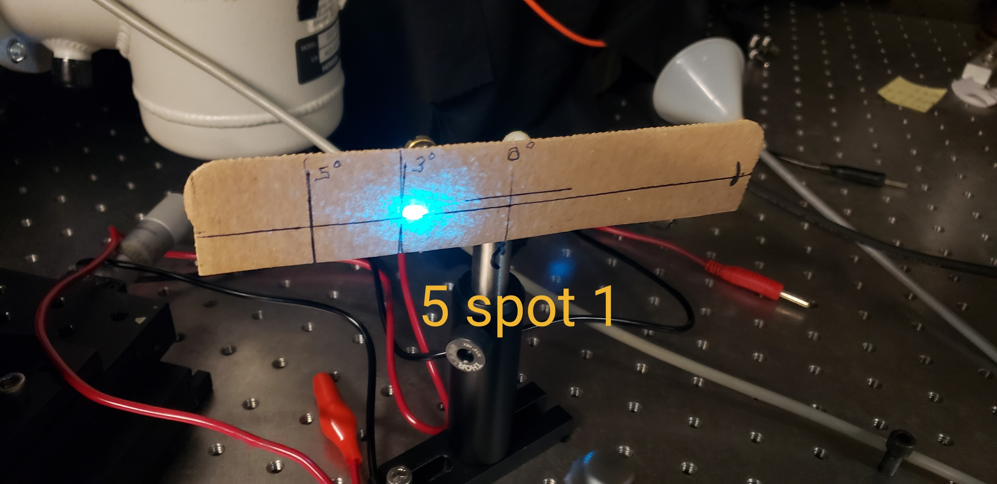
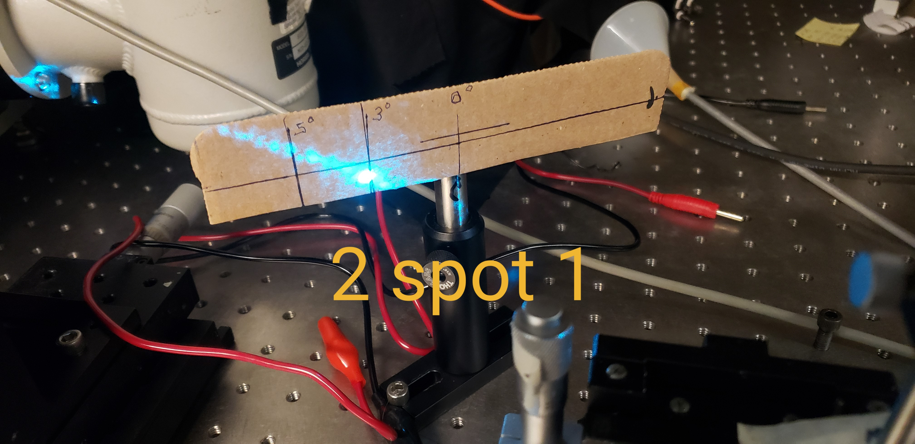
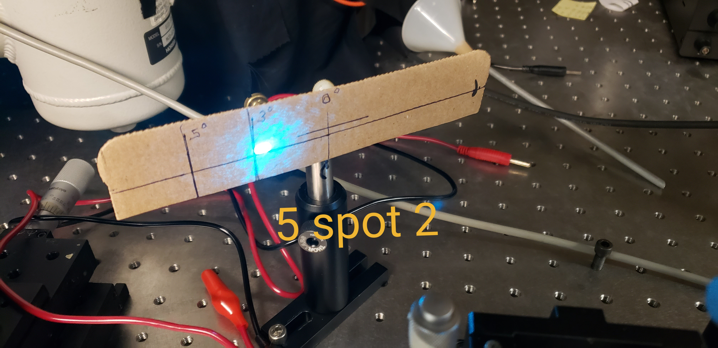
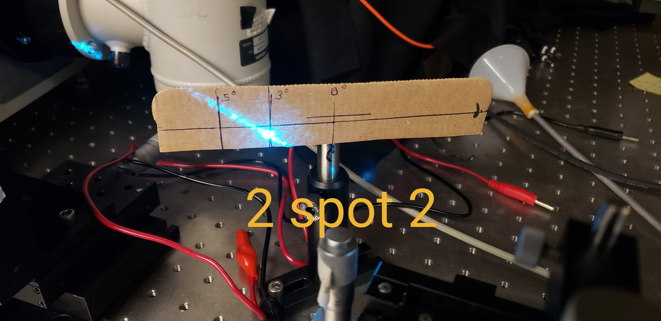
Comparison of light scattering by exposed (2) and unexposed (5) samples

Slide 13
Neutrons + Gamma Rays
Exposed at Georgia Tech using a 50Ci AmBe source
No lead shield to block gammas
Exposure doesn’t seem to change emissions greatly
Do gamma rays remove RIL?

Slide 14
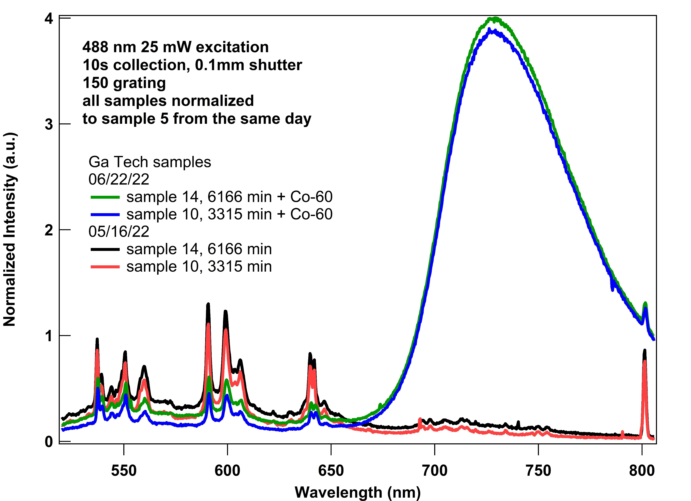
What about an even more intense gamma exposure?
Using Penn State Co-60 irradiation source (very bright)
The Co-60 exposure reduces the intensity of the color center peaks of both samples
Huge and broad peak around 725

Slide 15
Samples exposed to high neutron flux via Oregon State TRIGA reactor
Close up from 500 to 650 nm
All samples exposed in Oregon State TRIGA reactor
Long intense exposures seem to suppress PL that we see in the unexposed sample
New low-energy feature
Decreases in magnitude with longest exposure

Slide 16
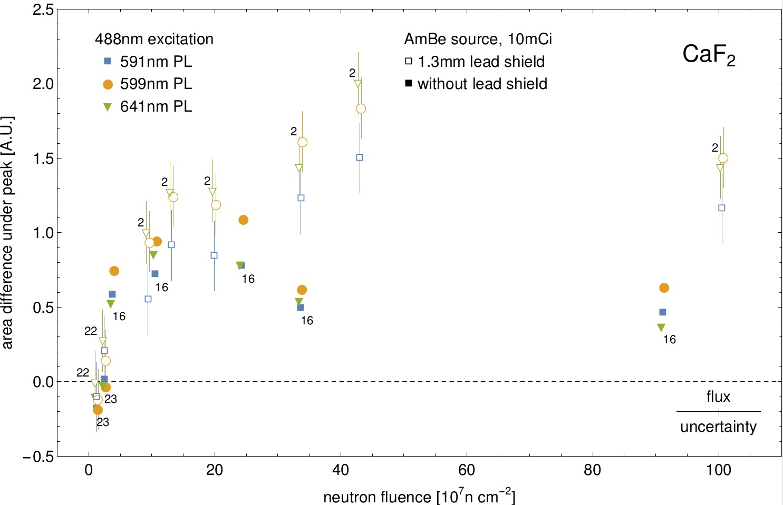
200 days of data
Flux calibration from Ni foil irradiation
Change in the area under PL peak vs fluence
Slope at a very low dose much steeper than at an intermediate dose.
Here is where almost all applications live!

Slide 17
Aging Response of Exposed CaF₂
1.5 years between first and last measurement
Samples exposed with AmBe source neutrons + gamma
All traces normalized using measurements of the same reference sample on the same day
590 nm peak shows the only notable change
- 11%
Signal seems stable overall

Slide 18
New samples and a puzzle
Samples are cubes of CaF₂ from different manufacturers
Sample size makes it hard to measure multiple spots
Sample 303 displays very large change in PL intensity after irradiation
Largest change we have ever observed
301 and 304 have no PL before or after irradiation!

Slide 19
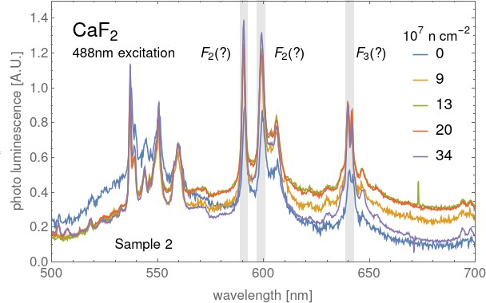
One sample at different neutron doses
Raman scattering
HORIBA Jobin Yvon iHR550 spectrograph with a liquid nitrogen cooled CCD, HORIBA Jobin Yvon Symphony II.

Slide 20
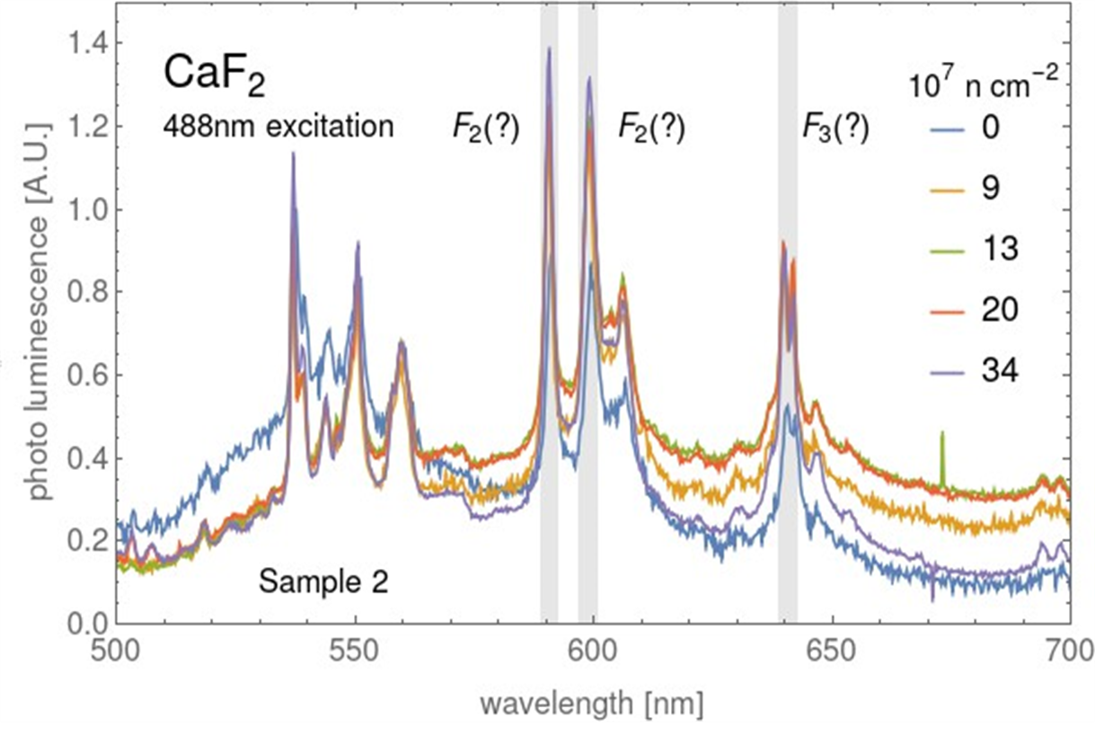
Could the peaks be from a different source?
Rare earth doped glasses show similar spectra
Sm3+ peaks in doped glasses are a good match for observed data
Umamaheswari, et. al. Photoluminescence properties of Sm3+ -doped SFB glasses for efficient visible lasers. Journal of Non-Crystalline Solids. 358. 782-787.(2012)

Slide 21
Low temperature vs Room Temperature in CaF₂ sample
709 nm, potential low-T PL
Sm3+ should show a 709 nm peak at 77 K
Intensity of PL from cryostat very low
Room temperature on the right axis
77K on the left axis
Small peak forming at 709 nm in 77K trace
Sm contaminants!?!

Slide 22
CaF₂ displays decreased luminescence after dose
Measured at 488 nm with a 25mW excitation and 0.1mm shutter for 10s
Neutron + gamma exposure
Unexposed PL is brighter
Can gamma exposure bleach samples?
Similar to reactor exposed samples but at much lower intensity?

Slide 23
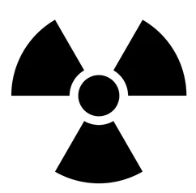
Fluorescence measurements during irradiation
Splitter
This splits the pulse in two for laser and secondary SiPM monitoring.
Laser
Laser Filter
Sample
Fluorescence Filters
Measurement
A 488 nm laser is pulsed at 2.56 MHz.
488/10 nm filter to get rid of non-laser light
The sample is placed in a holder designed to be inserted into radiation environments.
A 500> nm longpass filter is used to get rid of stray laser light. An additional 600/10 nm filter is used upstream.
Measurement is triggered at a 20kHz rate in sync with laser pulses.
Monitoring
A neutral density filter is used to reduce the laser light and send it off to a monitoring SiPM

Slide 24
Sources available
AmBe
15,000-18,000 alpha decays per neutron
40keV and 60keV photons with large branching fraction in each alpha decay
4MeV gamma for each neutron
VT source is 100 mCi
Co-60
Beta emitter
1.1 and 1.3MeV gamma in each decay
VT source is 105 mCi
=> dose rate (in terms of absorbed energy) is about 6000 times larger than from neutrons of the VT AmBe source

Slide 25
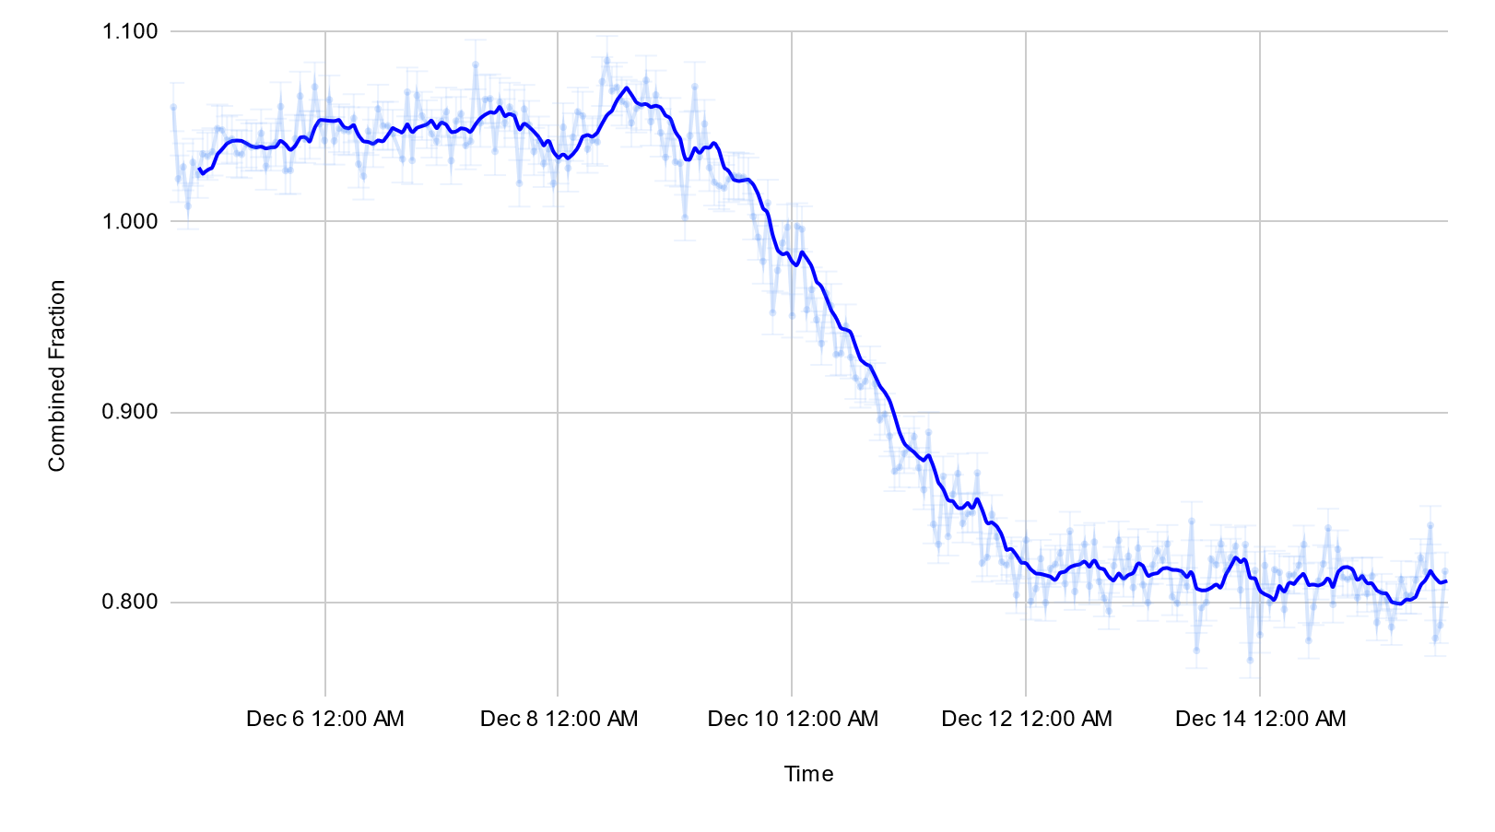
Preliminary results with CaF₂ cube
Exposure to neutron radiation very little increase to light output over time – interference from low energy gammas?
Gamma exposure to the cobalt source reduces light output at a much faster rate.
Gamma exposure shows permanent drop of 20% of light output compared to initial control run
Gamma exposure
Neutron exposure
Control
Preliminary

Slide 26
Summary
Doses of only 1-10% of previous studies
RIL at Sm3+ impurity sites
RIL persists over time!
We explore 11 orders of magnitude in neutron dose: no simple extrapolation from low dose to higher dose and vice versa
At low doses there is no interference between neutrons and gammas, different story at very high doses
Gamma exposure can bleach CaF₂
Future work: Flourescence measurements during irradiation, LiF, custom-grown samples, Sm2+ impurity sites

Slide 27
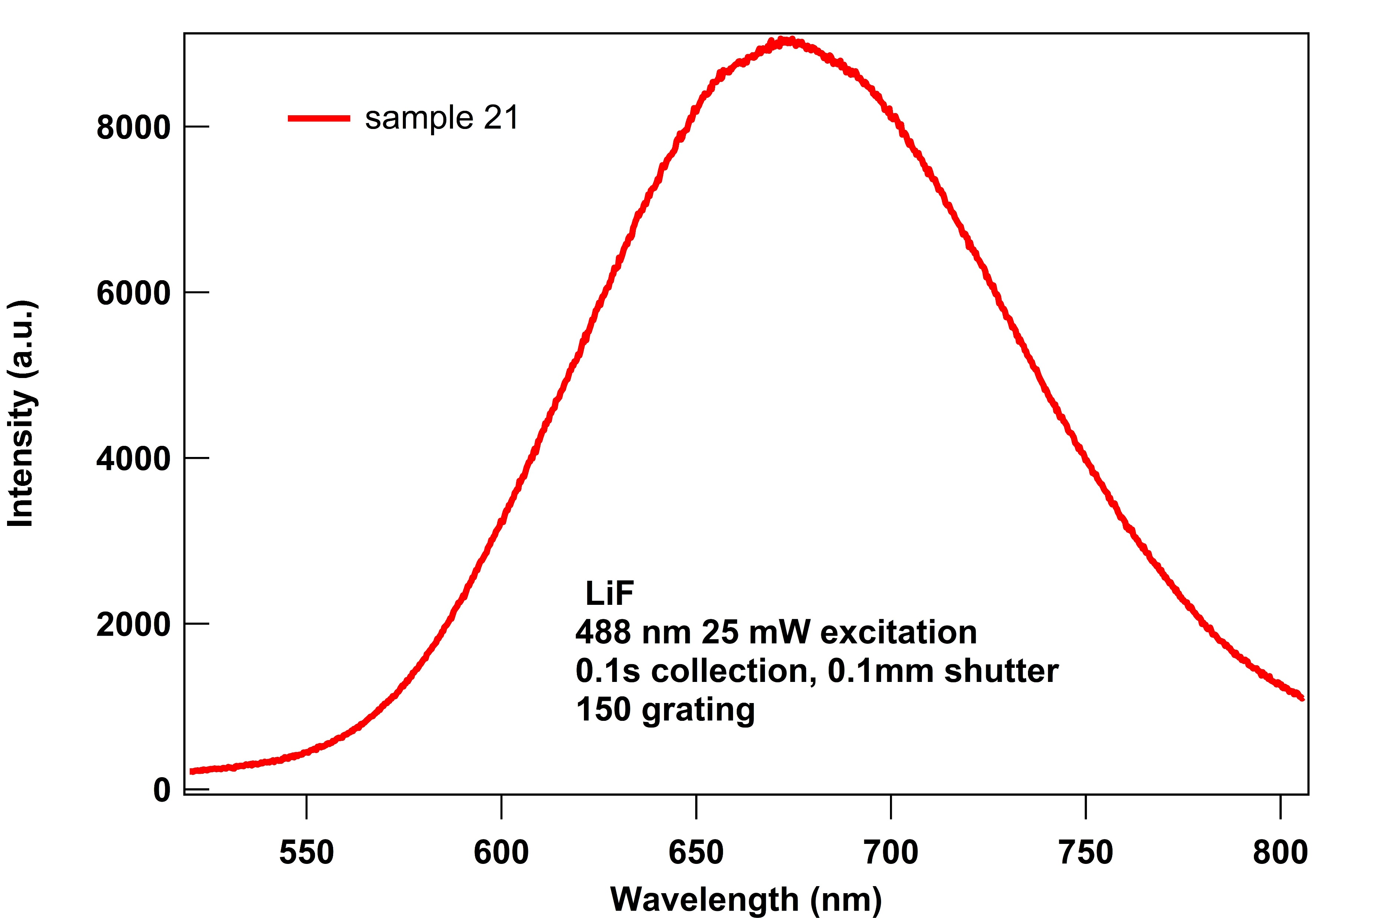
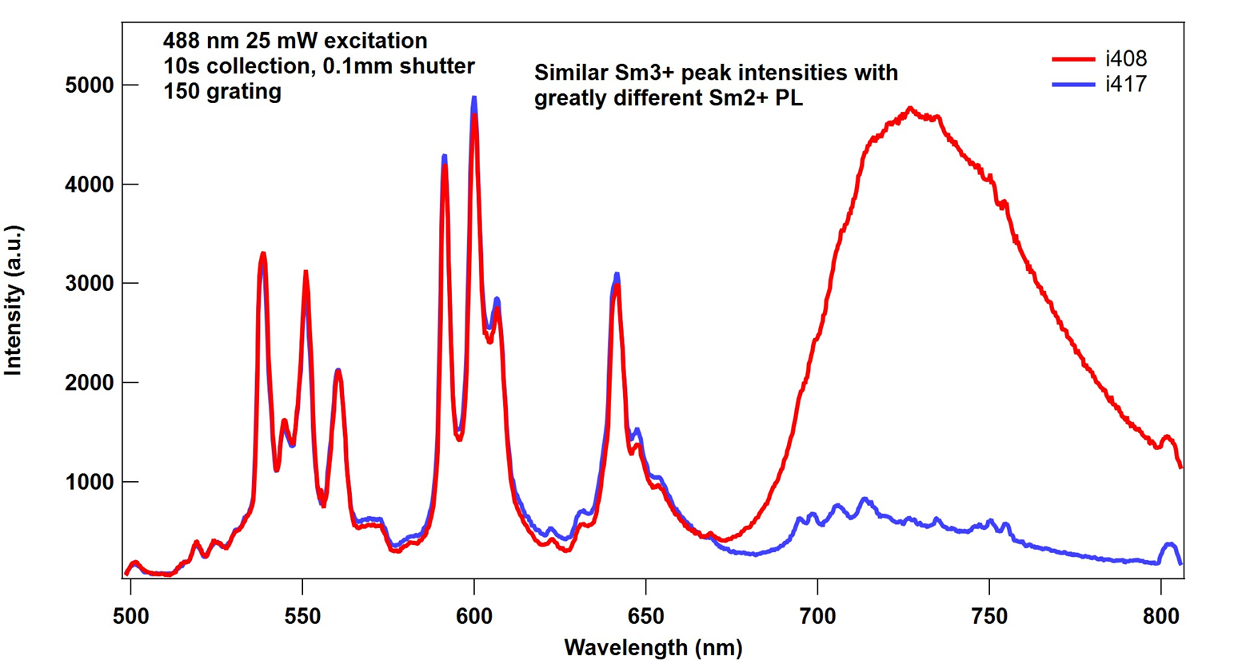
Summary
Future work: LiF, custom grown samples, Sm2+ impurity sites
#408
#417
LiF
CaF₂
Red emission

Slide 28
Summary
Doses of only 1-10% of previous studies
RIL at Sm3+ impurity sites
RIL persists over time (1.5 years tested)
We explore 11 orders of magnitude in neutron dose: no simple extrapolation from low dose to higher dose and vice versa
At low doses there is no interference between neutrons and gammas, different story at very high doses
Gamma exposure can bleach CaF₂
Future work: Flourescence measurements during irradiation, LiF, custom-grown samples, Sm2+ impurity sites, exploring annealing

