Slide 1
Towards a Prototype Paleo-Detector for Supernova Neutrino and Dark Matter Detection
Emilie LaVoie-Ingram
Advisor: Dr. Chris Kelso
University of North Florida
Mineral Detection of Neutrinos and Dark Matter Conference
January 9th, 2024

Slide 2
Outline
Introduction
Research motivations and goals
Backgrounds and mineral optimization
Methodology
Materials processing
Readout technology
Results and Discussion
What we discovered
Future work

Slide 3
Introduction

Slide 4
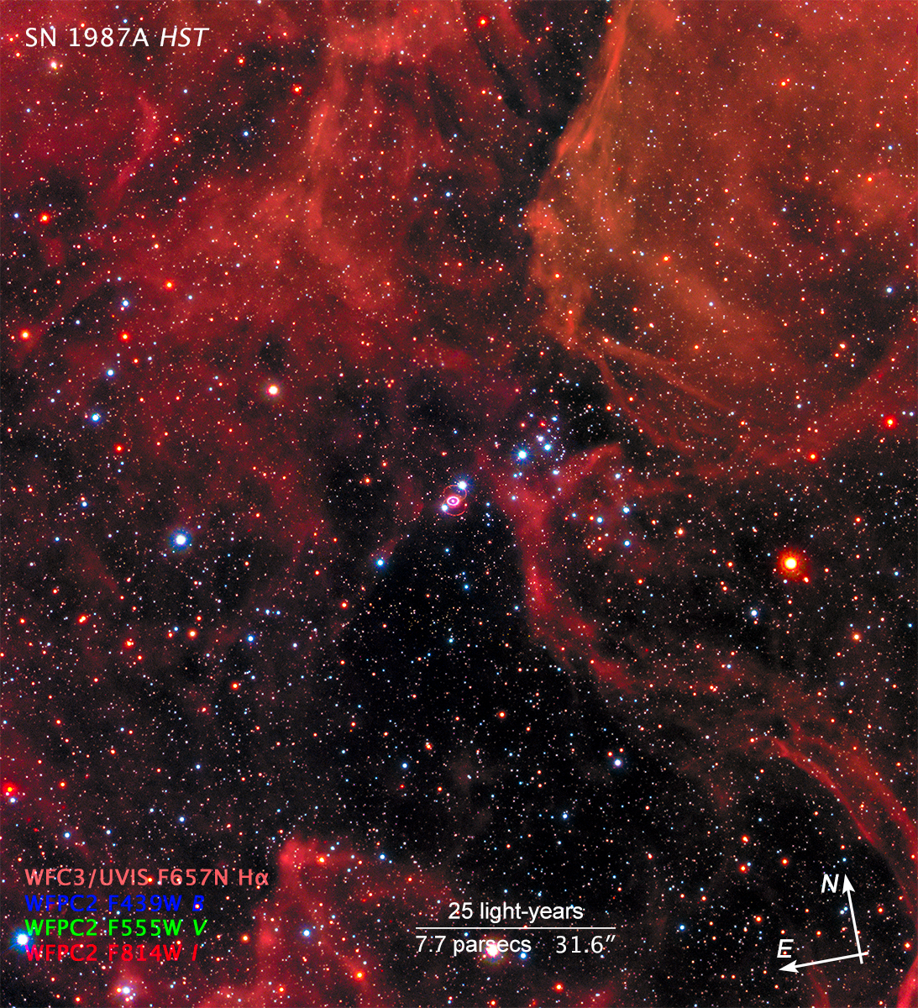
Supernova Neutrino Detection
Large Magellanic Cloud
Core-collapse supernovae are the strongest source of high-energy neutrinos in our universe
No direct measurement of a core-collapse supernova (CC SN) rate for the Milky Way Galaxy
Only supernova observed via neutrinos: 1987A
Paleo-detectors provide ability to probe for neutrino traces of CC SNe
CC SN rate can reveal information about our past
Star formation rates
Starburst periods
1987A supernova – Hubble and Chandra X-Ray Observatory
NASA Hubble

Slide 5
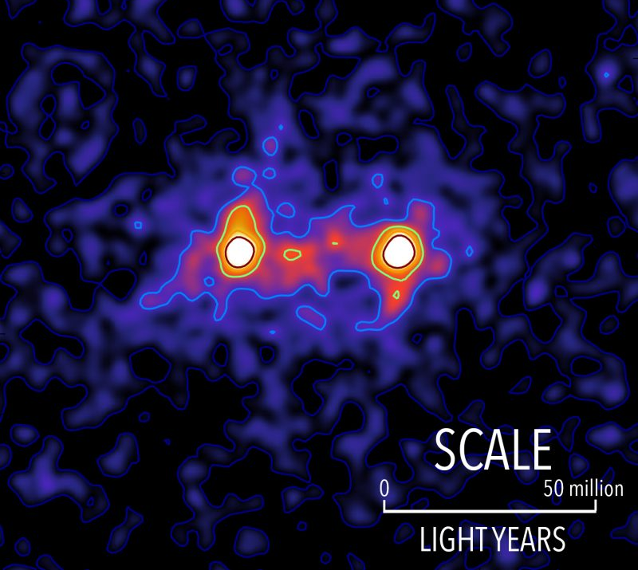
Dark Matter Detection
We can observe gravitational effects of a weakly interacting source of mass
Dark matter (DM) is a theory behind these effects
Weakly Interacting Massive Particle (WIMP)
Current day experiments rely on direct detection
Expensive
Long exposure times
Paleo-detectors provide timescales of > ${10}^{8}$ years into Earth’s past
Detection of WIMP DM can greatly contribute to our understanding of the universe
galaxies
dark matter
Dark matter occupying the space between galaxies. The locations of bright galaxies are shown by the white regions and the presence of a dark matter bridging the galaxies is shown in red. Image via RAS/ S. Epps & M. Hudson / University of Waterloo.

Slide 6
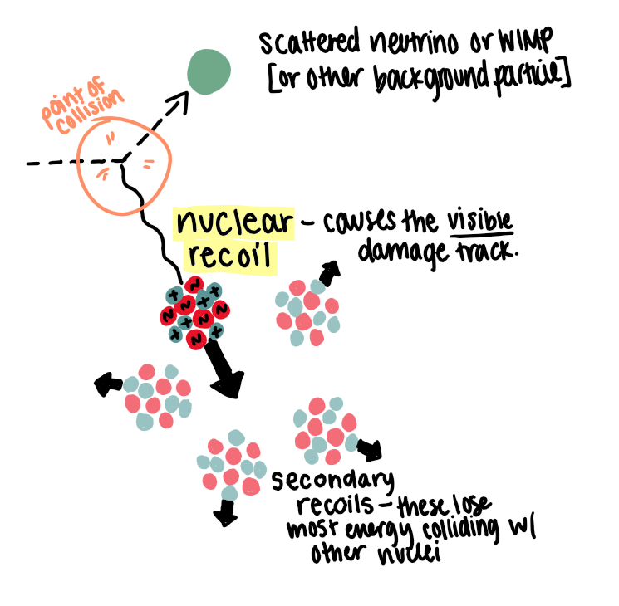
Paleo-Detectors
CC SN neutrinos and WIMP DM particles can cause nuclear recoils in ancient minerals found deep in Earth’s crust
Minerals: Solid State Nuclear Track Detectors (SSNTDs)
Nuclear recoil = ionization of crystal lattice
Nanometer-scale linear damage trail
Capable of preserving nuclear recoil damage tracks
Using ancient minerals as paleo-detectors is a proposed experimental technique to identify nuclear recoil damage tracks preserved for > ${10}^{8}$ years
Nuclear recoil damage tracks detectable with proper materials processing and/or readout technology

Slide 7
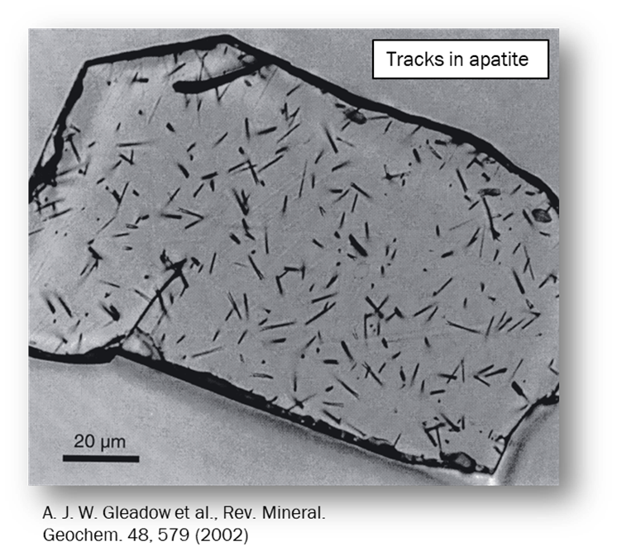
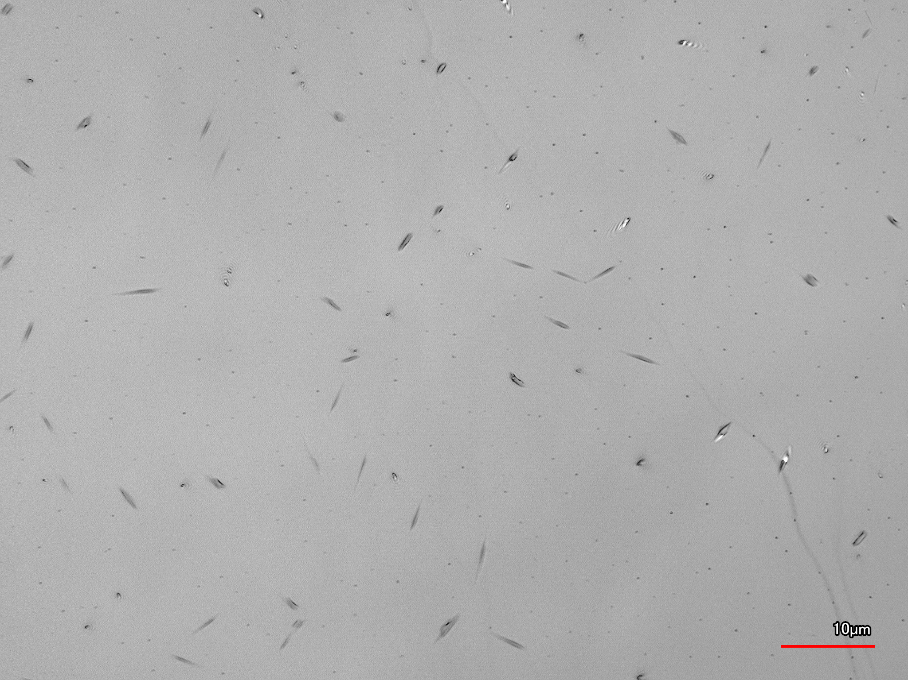
Paleo-Detectors
Linear crystal defects caused by nuclear recoils:
Tracks in halite (our research)

Slide 8
Modeling Nuclear Recoil Tracks in Minerals
Theoretical Track Length Spectrum
Tracks can be caused by various phenomena other than CC SNe and WIMP DM (Backgrounds)
Model the theoretical signal of backgrounds, CC SNe, and WIMP DM
Track length dependent on energy of recoil
Simulate recoils of different nuclei in target mineral over range of energies
Relationship between recoil energy and track length modeled by:
$$\left(\frac{dR}{dx}\right)=\sum_{T}{ξ_{T}\frac{{dE}_{R}}{{dx}_{T}}{\left(\frac{dR}{{dE}_{R}}\right)}_{T}}$$
Sum over all target nuclei
Stopping power of recoil
Interaction rate (# of tracks) per track length, exposure time, and mass
Recoil energy spectrum
S. Baum, T. D. P. Edwards, B. J. Kavanagh, P. Stengel, A. K. Drukier, K. Freese, M. Gorski, and C. Weniger, Physical Review D 101 (2020), 10.1103/PhysRevD.101.103017
Mass fraction of the target nuclei

Slide 9
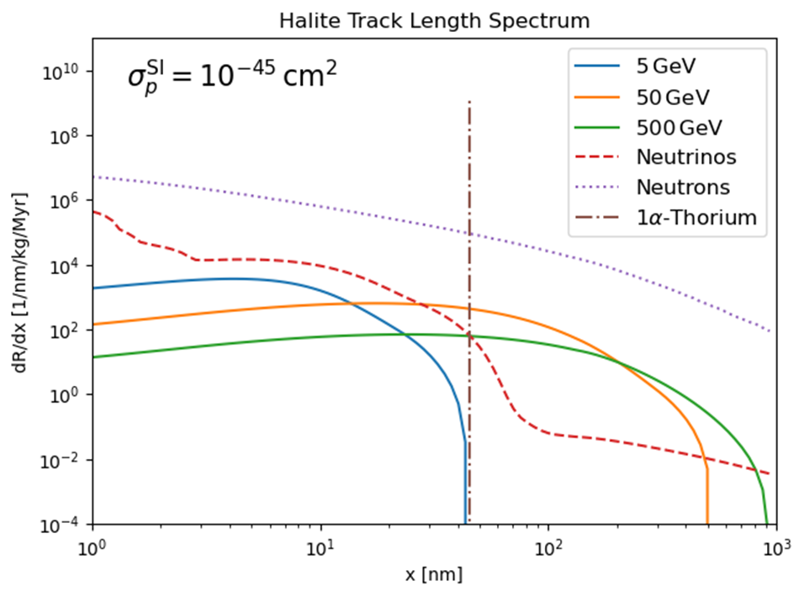
Reconstructing Nuclear Recoil Damage Tracks
Theoretical Track Length Spectrum
Interaction cross-section of DM
WIMP DM at masses of 5, 50, 500 GeV
Neutrino signal, including CC SNe
Interaction rate (# of tracks) per track length, target mass, and target exposure time
Radiogenic neutron signal
Thorium-alpha peak signal
Integrating over the interaction rate will give # of tracks
Track length

Slide 10
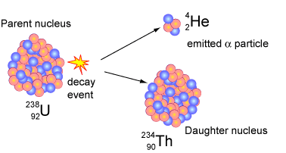
Backgrounds in Paleo-Detectors
Radioactive Decay
Most prominent source of tracks in most minerals
Spontaneous fission and alpha decays
Characteristic decay chains of a given energy (track length)
Potentially straightforward to neglect
Background influence determined by concentration of U-238 and mineral age
Australia Telescope National Facility

Slide 11
Backgrounds in Paleo-Detectors
Radioactive Decay
How can we lower the impact of the radioactive decay background?
Marine Evaporates and Ultra Basic Rocks (formed in mantle) have significantly less radioactive content compared to minerals found in Earth’s crust
Most prominent source of tracks in most minerals
Spontaneous fission and alpha decays
Characteristic decay chains of a given energy (track length)
Potentially straightforward to neglect
Background influence determined by concentration of U-238 and mineral age

Slide 12
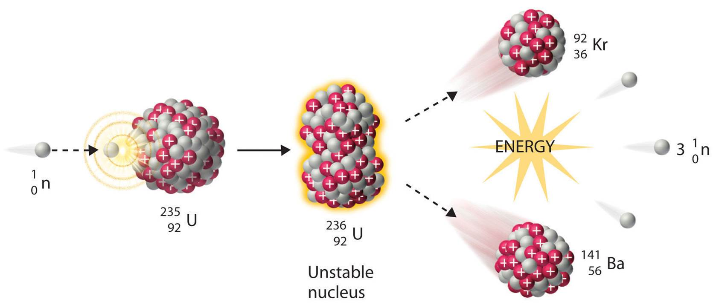
Backgrounds in Paleo-Detectors
Neutrons
Fast neutrons scattering off atomic nuclei
Spontaneous fission and alpha-neutron interactions
Cosmic muon interactions with atomic nuclei
Within target mineral and from surrounding minerals
Background influence determined by radioactive content, chemical composition of mineral, and depth of extraction
EU Science Hub

Slide 13
Backgrounds in Paleo-Detectors
Neutrons
How can we lower the impact of the neutron background?
Hydrogen is a great suppressant of fast neutrons in minerals.
Fast neutrons scattering off atomic nuclei
Spontaneous fission and alpha-neutron interactions
Cosmic muon interactions with atomic nuclei
Within target mineral and from surrounding minerals
Background influence determined by radioactive content, chemical composition of mineral, and depth of extraction

Slide 14
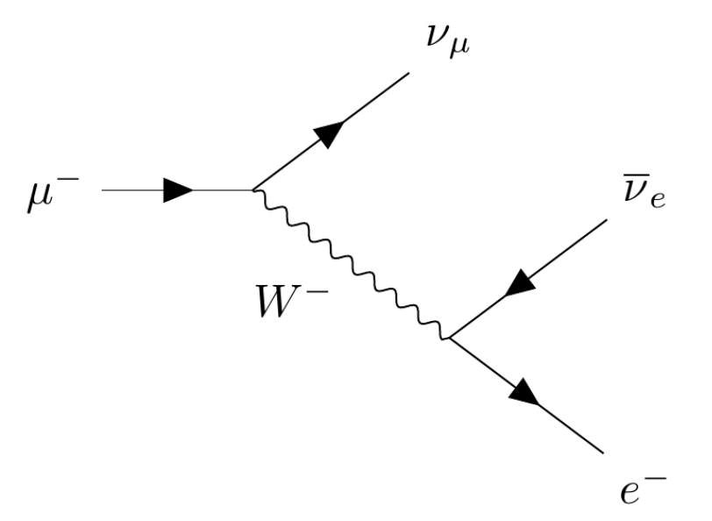
Backgrounds in Paleo-Detectors
Neutrinos
Cosmic muons, solar neutrinos, atmospheric neutrinos, Diffuse Supernova Neutrino Background (DSNB)
Direct and indirect interactions with nuclei
Cosmic muon background influence determined by depth of extraction and chemical composition
Additional neutrino backgrounds determined by estimated neutrino flux
Decay of a cosmic muon
(neutrino)
(cosmic muon)
(anti-neutrino)
(W-boson)
(electron)
Imperial College London

Slide 15
Backgrounds in Paleo-Detectors
Neutrinos
How can we lower the impact of the neutrino background?
The cosmic ray interaction significantly decreases as depth of target mineral underground increases.
Cosmic muons, solar neutrinos, atmospheric neutrinos, Diffuse Supernova Neutrino Background (DSNB)
Direct and indirect interactions with nuclei
Cosmic muon background influence determined by depth of extraction and chemical composition
Additional neutrino backgrounds determined by estimated neutrino flux

Slide 16
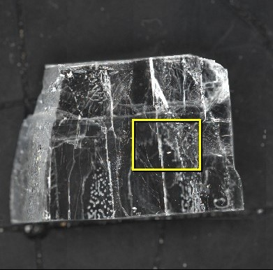
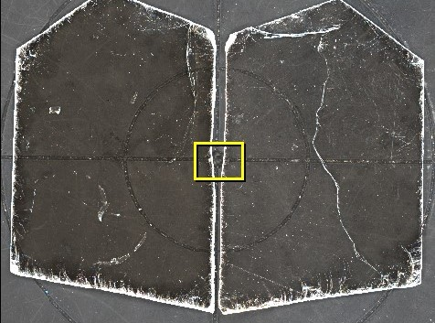
Mineral Optimization
Halite
Muscovite mica
Phlogopite mica
NaCl (rock salt)
Marine Evaporate
0.01 ppb U-238
Face-centered-cubic
Proposed in theoretical work
KAl₂ AlSi₃ O₁₀ (OH)₂
Ultra Basic Rock
0.1 ppb U-238
2-D monoclinic, dioctahedral
Extensive history as a SSNTD
KMg₃ AlSi₃ O₁₀ (OH)₂
Ultra Basic Rock
0.1 ppb U-238
2-D monoclinic, trioctahedral
Proposed in theoretical work

Slide 17
Mineral Optimization
Halite
Muscovite mica
Phlogopite mica
NaCl (rock salt)
Marine Evaporate
0.01 ppb U-238
Face-centered-cubic
Proposed in theoretical work
KAl₂ AlSi₃ O₁₀ (OH)₂
Ultra Basic Rock
0.1 ppb U-238
2-D monoclinic, dioctahedral
Extensive history as a SSNTD
KMg₃ AlSi₃ O₁₀ (OH)₂
Ultra Basic Rock
0.1 ppb U-238
2-D monoclinic, trioctahedral
Proposed in theoretical work

Slide 18
Research Goals
Overall goals of paleo-detector field
1. To use paleo-detectors to probe the neutrino signal from core-collapse supernovae within the Milky Way, and directly calculate the supernova rate of our galaxy
2. To use paleo-detectors to directly detect weakly interacting massive particle dark matter signals
Individual research goal
To advance experimental efforts of paleo-detector research and determine feasibility of our detection technique for characterizing backgrounds, in order to detect core-collapse supernovae and dark matter

Slide 19
Methodology

Slide 20
Methodology
REVEAL TRACKS
MEASURE TRACKS
RECONSTRUCT TRACKS
FIT MODELS

Slide 21
Methodology
Find the nanometer scale line defects within the bulk crystals
REVEAL TRACKS
MEASURE TRACKS
RECONSTRUCT TRACKS
FIT MODELS

Slide 22
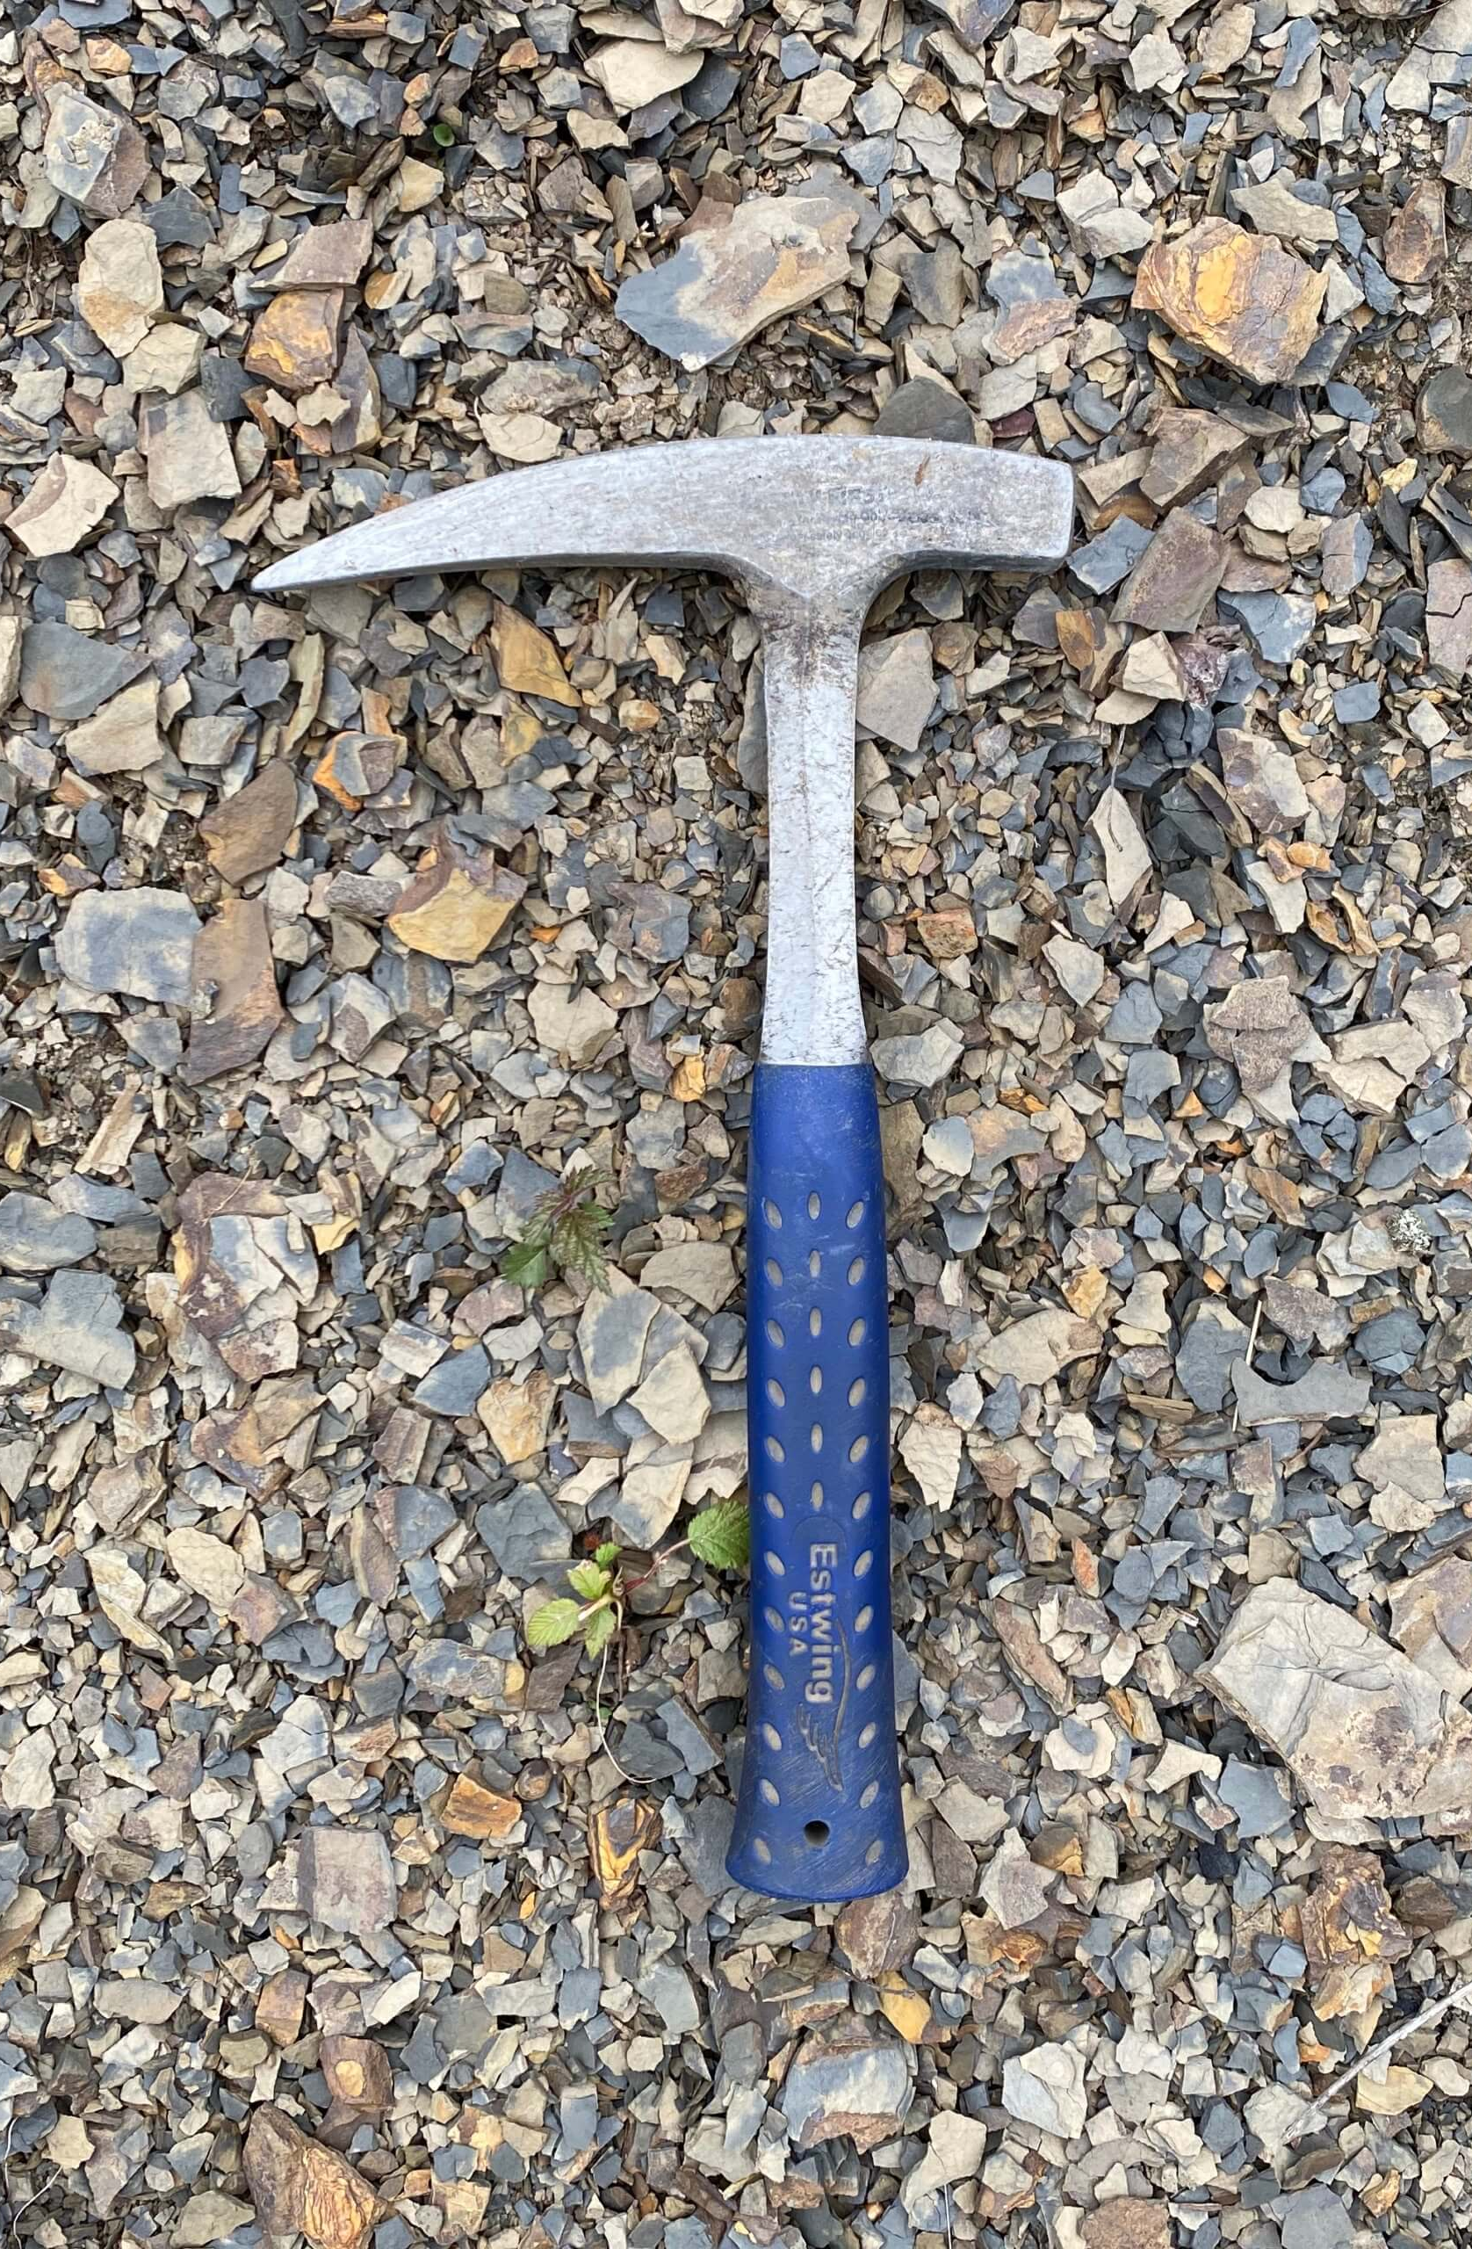
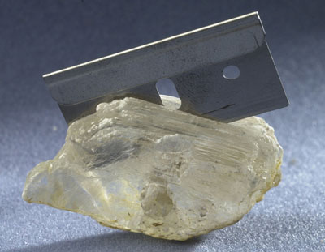
Revealing Nuclear Recoil Damage Tracks
Fossils of Parks Township
Sample Preparation
Cleavage of crystals: tendency to split into smooth surfaces along crystal planes
Dependent on a materials crystal structure
Halite – cleaved with a rock hammer into smaller cubic pieces
Micas – cleaved with tape or razor blade along layers
Tape is ideal due to cleaner cleave
Similar process to dry exfoliation of graphite:
University of Cambridge
J. Lee, et.al, “Electrical property of graphene and its application to electrochemical biosensing”, Nanomaterials 9, 2 (2019).

Slide 23
Revealing Nuclear Recoil Damage Tracks
Plasma Etching
Window looking into vacuum chamber
Kinetic-based etching process
Non-reactive argon gas ionized with radio-frequency discharge
Ion energy must be > than bonding energy
Attacks surface defects
Quick (~ 10 minutes for our samples)
Primary etching method in this research
sample
Argon plasma at 100 W power and 0.2 mbar pressure

Slide 24
Methodology
Find the nanometer scale line defects within the bulk crystals
REVEAL TRACKS
MEASURE TRACKS
RECONSTRUCT TRACKS
FIT MODELS
Measure the damage tracks and densities accurately

Slide 25
Measuring Nuclear Recoil Damage Tracks
Laser Confocal Microscopy
Atomic Force Microscopy
Tool used for surface topography measurement
Height information gained from reflected intensity from laser
Diffraction-limited resolution
High throughput (seconds)
Reliable history as a track readout technology
Measures surface topography based on surface-tip interaction forces
Nanometer-scale resolution
Low throughput (hours)
Used mostly for unetched surface characterization
Lens
Laser
Intensity
Measured laser deflection
Z-position
Cantilever – tip
Laser
Z-position
Sample surface
Sample surface

Slide 26
Methodology
Find the nanometer scale line defects within the bulk crystals
Transform measured tracks to original tracks, calculating length and orientation information
REVEAL TRACKS
MEASURE TRACKS
RECONSTRUCT TRACKS
FIT MODELS
Measure the damage tracks and densities accurately

Slide 27
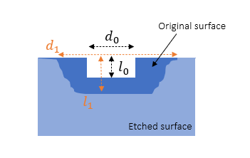
Reconstructing Nuclear Recoil Damage Tracks
Etching Rate Analysis
Measure rate of etching to convert measured tracks to approx. original track dimensions
Depth/diameter change over time
Etching is not always isotropic
Monitor pre-existing defects over etching time
Depth and width of cracks
Depth and diameters of pits
Rate measured in plasma etching only, with neglect to general surface etching
$$\frac{d_{1}−d_{0}}{t}>\frac{l_{1}−l_{0}}{t}$$
Mica:
$$\frac{d_{1}−d_{0}}{t}≈\frac{l_{1}−l_{0}}{t}$$
Halite:

Slide 28
Methodology
Find the nanometer scale line defects within the bulk crystals
Transform measured tracks to original tracks, calculating length and orientation information
REVEAL TRACKS
MEASURE TRACKS
RECONSTRUCT TRACKS
FIT MODELS
Measure the damage tracks and densities accurately
Compare experimental data to theoretical predictions and refine mathematical models

Slide 29
Reconstructing Nuclear Recoil Damage Tracks
Calculating an Exposure Time with Mineral Dating Methods
Mineral age = exposure time
Recrystallization in past can partially or fully erase tracks
Age is therefore time since last possible recrystallization
Exposure time for the observable tracks
Fission track dating is most common – neutron irradiation
Another method: alpha-recoil dating
Density of $α$-recoil tracks from U-238 $→$ Th-234 decay
Approximate concentrations of U-238 and Th-234
$$ρ_{α}=N_{υ}[C\left(U\right)λ\left(U\right)+C(Th)λ(Th)]R_{α}T$$
Decay constants $\left[\frac{ln⁡(2)}{half−life}\right]$ of U-238 and Th-234
Mineral age (exposure time)
Surface density of alpha-recoil tracks
# of atoms per volume
Percentage of U-238 and Th-234 in mineral
Maximum length of alpha-recoil tracks (range)
W. H. Huang and R. M. Walker, Science 155, 1103 (1967)

Slide 30
Results & Discussion

Slide 31
Experimental Parameters
Overview
Unetched surfaces analyzed with AFM
RMS roughness of halite: ~ 2 nm; RMS roughness of Muscovite mica: ~ 0.17 nm
Argon plasma etching successful at preferentially etching nuclear recoil tracks
Etching time: 10 minutes
Plasma power level: 100 Watts
Pressure: 0.2 millibar
Tracks imaged with laser confocal microscope at 150x magnification
($97.122 μm ×72.817 μm)$
Pixel resolution: ~ 0.0474 µm (maximum z-resolution = 0.4 nm)
Tracks detected and measured with automatic track detection code in Python

Slide 32
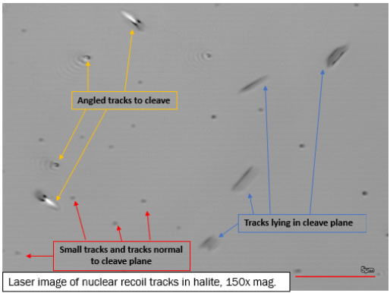
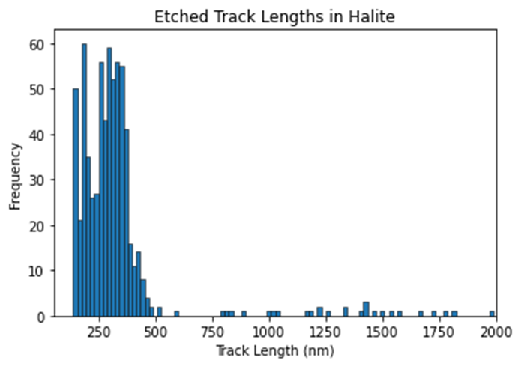
Halite Track Detector
Track Detection
Average surface density of tracks detected in halite:
$$ρ_{avg}=4.5 ×{10}^{6}{ cm}^{−2}$$
Average etching rate of halite calculated at ~ 14.47 nm/min (error ± 4.74 nm due to resolution of LCM)
Found by measuring pre-existing pits before and after etching

Slide 33
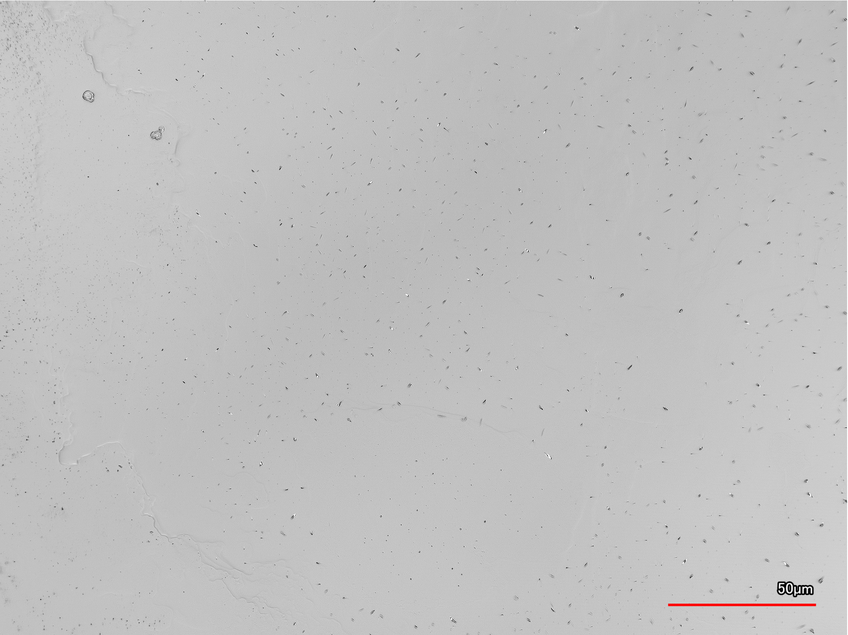
Halite Track Detector
Laser images of tracks in halite, taken with the laser confocal microscope at UNF’s MSERF

Slide 34
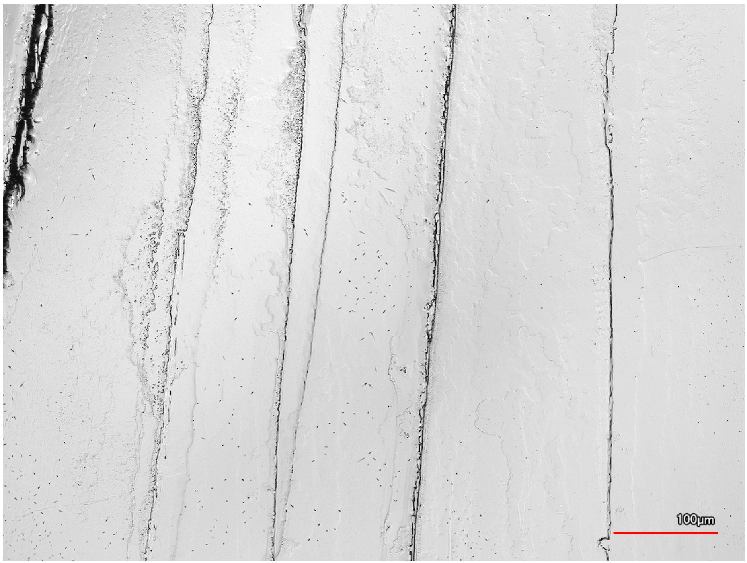
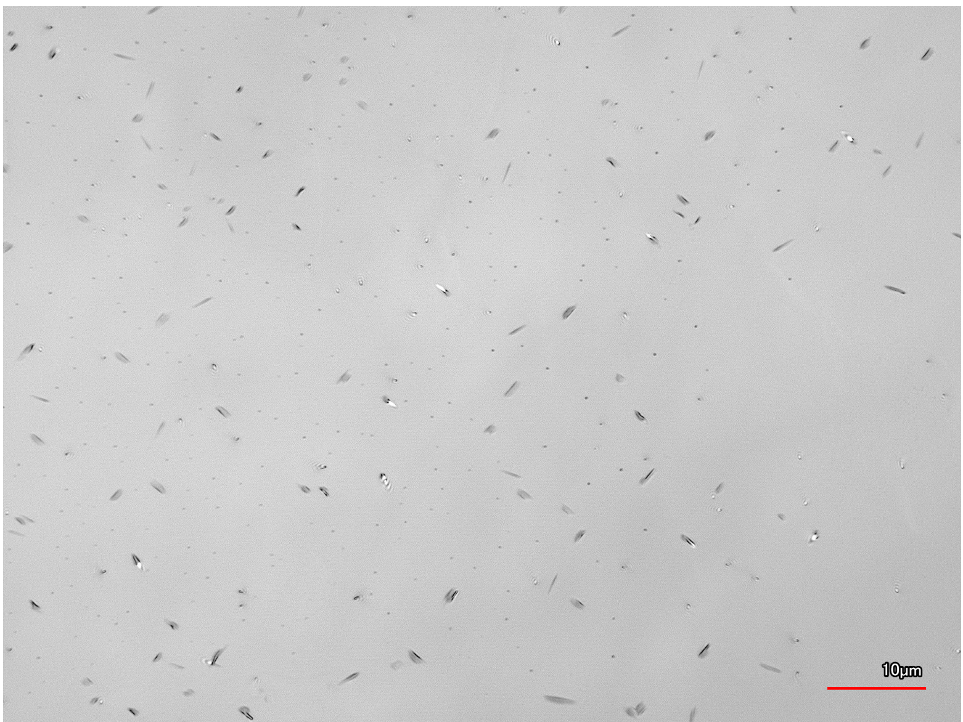
Halite Track Detector
Laser images of tracks in halite, taken with the laser confocal microscope at UNF’s MSERF

Slide 35
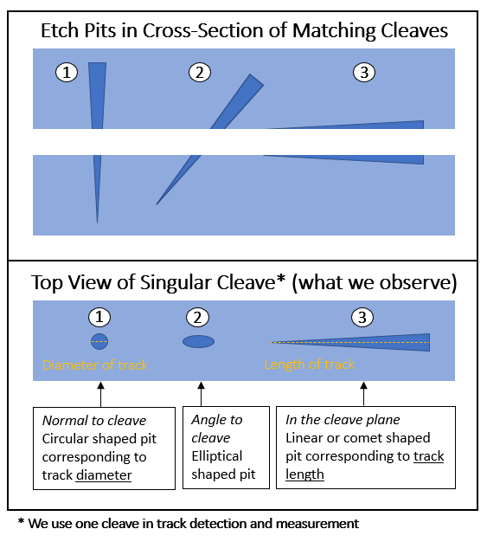
Halite Track Detector
Geometry of Track Etch Pits
Angle of track to cleave surface affects the measured length of track (partial v. full)
We only want to measure tracks lengths that are approximately true to the actual length
We can measure an aspect ratio to get information about orientation of track to cleave surface

Slide 36
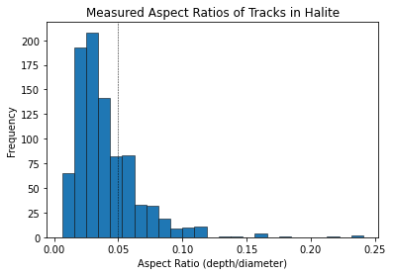
Halite Track Detector
Depth >>, > or ≈ diameter
Diameter >> depth
Geometry of Tracks
$$Aspect ratio=\frac{etch pit depth}{etch pit diameter}$$
Threshold estimated based on previous studies: 0.05
Norman M D Brown and Zhi Hui Liu. The etching of natural alpha-recoil tracks in mica with an argon rf-plasma discharge and their imaging via atomic force microscopy. Applied Surface Science, 93:89-100, 1996.
Moderator of noise (incorrect automatic detections and measurement of tracks through code)
Only an approximate method to remove tracks at ambiguous angles to cleave surface
Ideally, look at both sides of cleaves and sum the matching etch pit depths
diameter
diameter
diameter
depth
depth
depth
0.05 threshold for consideration in measurement

Slide 37
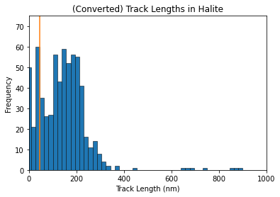
Halite Track Detector
Converting to Original Track Lengths
Etching rate and aspect ratio to convert to estimated in-plane track signal
We can measure tracks between 1 – 1000 nm, encompassing all possible backgrounds
Peak in data at characteristic Th + $α$ decay track length (orange line)
Decrease in track signal at ~ 200 nm
Track length of Th+$α$ peak (~45 nm)
Noise

Slide 38
Halite Track Detector
Theoretical Track Length Spectrum for Halite
Dominate background signals: Thorium + alpha peak and neutrons
True neutron and thorium background is ambiguous
Dependent on depth of mineral, radiogenic environment, and radioactive content
Can fit theoretical data to experimental data to estimate the true neutron and thorium signals
Neutron & Thorium backgrounds
Logarithmic scales
S. Baum, T. D. P. Edwards, B. J. Kavanagh, P. Stengel, A. K. Drukier, K. Freese, M. Gorski, and C. Weniger, Physical Review D 101 (2020), 10.1103/PhysRevD.101.103017

Slide 39
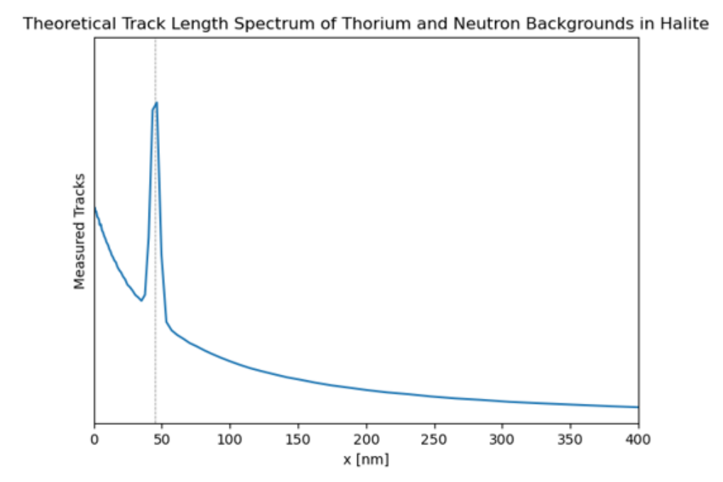
Halite Track Detector
Theoretical Track Length Spectrum for Halite
Neutron & Thorium backgrounds
Logarithmic scales

Slide 40
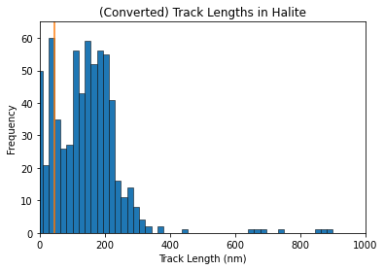
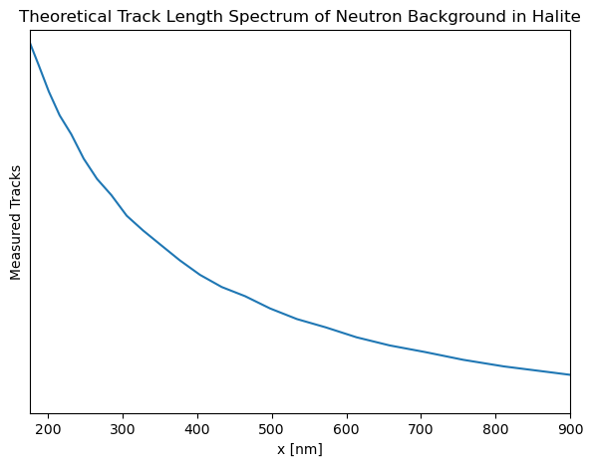
Halite Track Detector
Analysis of Experimental Data
We can use the tail of measured data to estimate amplitude of neutron background
Th+$α$ peak
↑ Interaction rate
↑ # of tracks

Slide 41
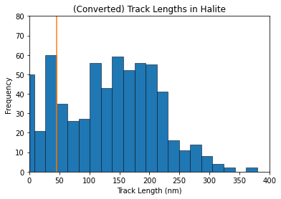
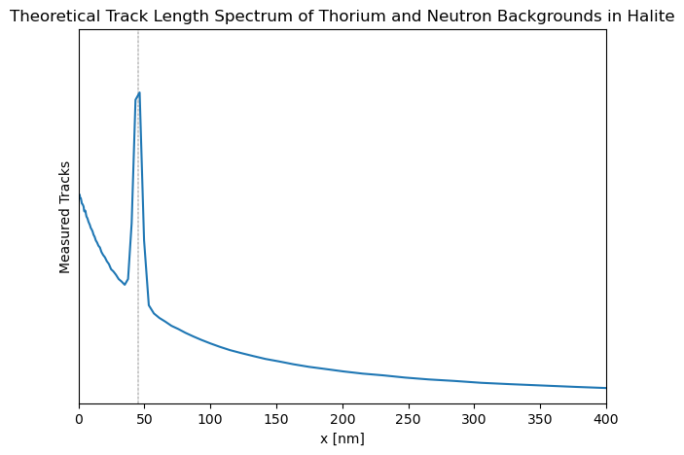
Halite Track Detector
Analysis of Experimental Data
Both plots: peak at Th-$α$ decay track length
Experimental data - track signal is suppressed at a certain point, but this is not reflected in theoretical data
Th+$α$ peak
Th + $α$ peak
↑ Interaction rate
↑ # of tracks
Neutron background

Slide 42
Halite Track Detector
Analysis of Experimental Data
Both plots: peak at Th-$α$ peak track length
Experimental data - track signal is suppressed at a certain point, but this is not reflected in theoretical data
Th+$α$ peak
Why does track signal decrease after this point?
Th + $α$ peak
↑ Interaction rate
↑ # of tracks
Neutron background

Slide 43
Halite Track Detector
Mathematical Model
$$\frac{1}{{1+ e}^{−cx}} × \left[ {A e}^{−\frac{1}{2} {\left(\frac{x −x_{0}}{σ}\right)}^{2}} + \left[ B × neutron background \right] \right]$$
c = slope of Sigmoid (efficiency function)
A = Amplitude of thorium background
$σ$= width of gaussian (range of track lengths included in background)
$x_{0}$ = characteristic ~ 45 nm track length of Th-$α$ peak
B = amplitude of neutron background

Slide 44
Halite Track Detector
Mathematical Model
$$\frac{1}{{1+ e}^{−cx}} × \left[ {A e}^{−\frac{1}{2} {\left(\frac{x −x_{0}}{σ}\right)}^{2}} + \left[ B × neutron background \right] \right]$$
c = slope of Sigmoid (efficiency function)
A = Amplitude of thorium background
$σ$= width of gaussian (range of track lengths included in background)
$x_{0}$ = characteristic ~ 45 nm track length of Th-$α$ peak
B = amplitude of neutron background
neutrons

Slide 45
Halite Track Detector
Mathematical Model
$$\frac{1}{{1+ e}^{−cx}} × \left[ {A e}^{−\frac{1}{2} {\left(\frac{x −x_{0}}{σ}\right)}^{2}} + \left[ B × neutron background \right] \right]$$
Gaussian Function (Th-$α$ peak)
Th-$α$ peak
c = slope of Sigmoid (efficiency function)
A = Amplitude of thorium background
$σ$= width of gaussian (range of track lengths included in background)
$x_{0}$ = characteristic ~ 45 nm track length of Th-$α$ peak
B = amplitude of neutron background

Slide 46
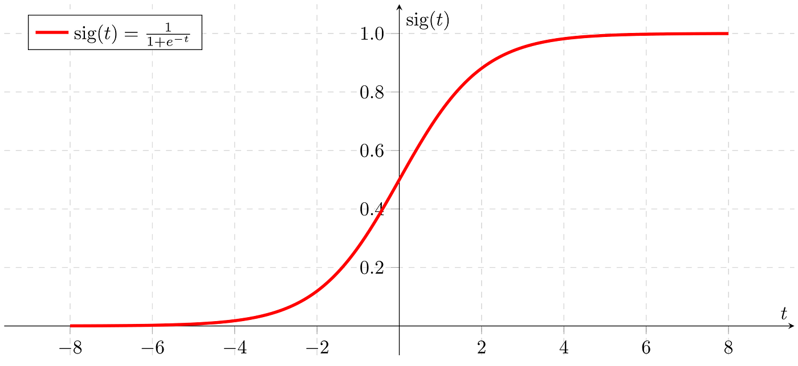
Halite Track Detector
Mathematical Model
$$\frac{1}{{1+ e}^{−cx}} × \left[ {A e}^{−\frac{1}{2} {\left(\frac{x −x_{0}}{σ}\right)}^{2}} + \left[ B × neutron background \right] \right]$$
Sigmoid Function (Efficiency Function)
c = slope of Sigmoid (efficiency function)
A = Amplitude of thorium background
$σ$= width of gaussian (range of track lengths included in background)
$x_{0}$ = characteristic ~ 45 nm track length of Th-$α$ peak
B = amplitude of neutron background

Slide 47
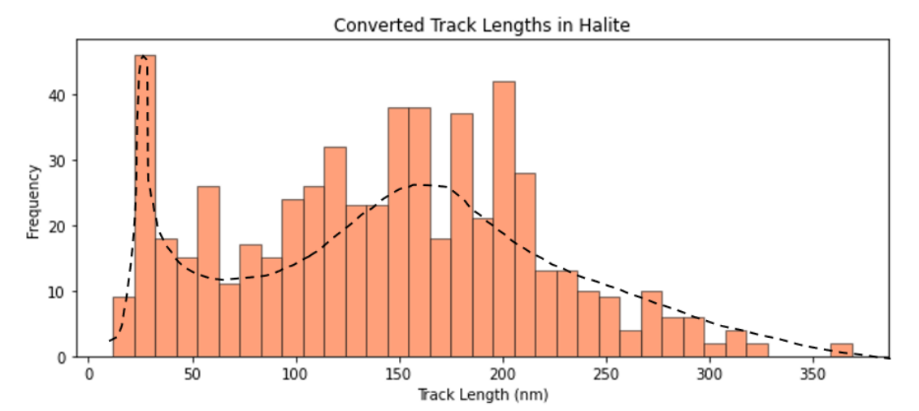
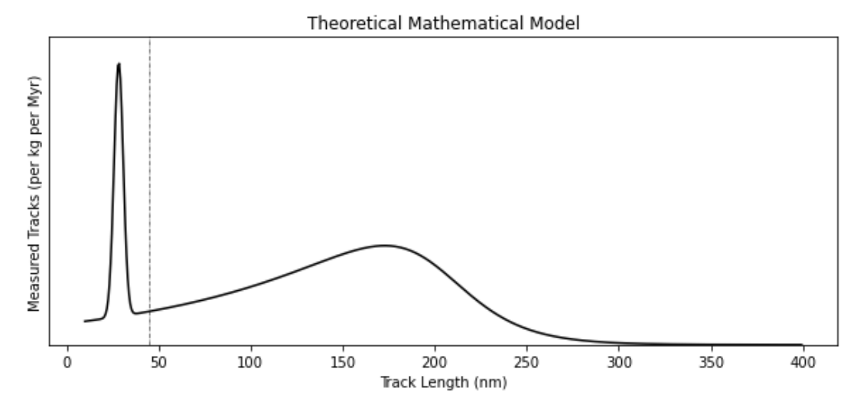
Halite Track Detector
Comparison of Qualitative Theoretical Model with Experimental Data:
Th+$α$ peak
↑ Interaction rate
↑ # of tracks
Neutron background dominates
Region of efficiency function impact

Slide 48
Halite Track Detector
Fitting our model to experimental data:
Iterated (via Python) through >${1.2 ×10}^{7}$ different variable combinations
Integrate over theoretical spectrum in chunks and compared counts to experimental histogram data
Used the chi-squared test to calculate the goodness of our theoretical model to experimental data
$Χ^{2}≤28 (degrees of freedom=number of bins −number of unknown variables$)
p-value: probability we would measure a chi-square test statistic as large or larger than what we derived

Slide 49
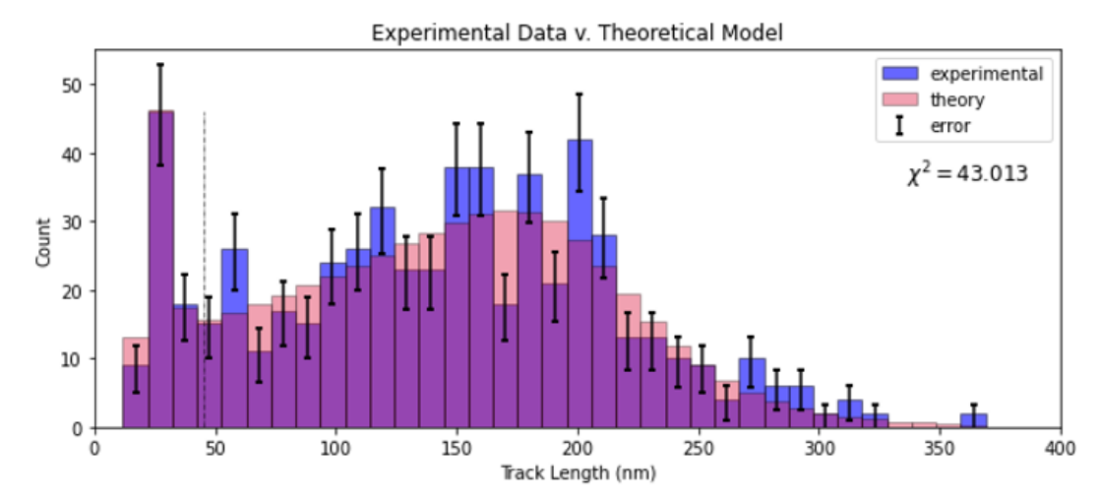
Halite Track Detector
Results of the chi-squared variable iterations:
$Χ^{2}=43.013$
Ideally, we want $≤28$
p-value = 0.4644 = 46.44% probability
A decent fit, but can be improved with more collection of experimental halite data
Want to repeat this process for Muscovite and Phlogopite mica

Slide 50
Halite Track Detector
Next steps for Halite (ongoing at UNF)
Collect a lot more experimental data
Calculate an exposure time for our halite samples
Depends on minimizing chi-squared test statistic (getting a better fit to experimental data)
Could verify with either fission track or alpha-recoil dating methods
Direct comparison between our mathematically fit model and theoretical works
Repeat for other minerals, etching methods, and readout technologies
Efficiency function will vary (or potentially be minimized) depending on these factors

Slide 51
Conclusion
Tracks (1 – 1000 nm) revealed in halite with argon plasma etching and laser confocal microscopy
Distribution of track lengths seem to follow theoretical track length spectra with added mathematical modeling to account for measurement and mineral uncertainties, and resolution limits
Overall
Established a basis for how to experimentally approach halite paleo-detector studies
Plasma etching technique and laser confocal microscopy readout is a feasible methodology to approach paleo-detector research given that:
More consideration is placed on mineral age and environment/depth of extraction
Mathematical models account for effects of readout resolution, etching effects, geometry of tracks, etc.
Potential for the establishment of an upper limit for the theoretical WIMP dark matter interaction cross-section
Supports the use of paleo-detectors for CC SNe detection

Slide 52
Questions?
Contact: emiliemarie000@gmail.com
This project was supported by the National Aeronautics & Space Administration through the University of Central Florida’s NASA FLORIDA SPACE GRANT CONSORTIUM.

Slide 53
Reconstructing Nuclear Recoil Damage Tracks
Calculating an Exposure Time with Mineral Dating Methods
Mineral age = exposure time
Recrystallization in past can partially or fully erase tracks
Age is therefore time since last possible recrystallization
Exposure time for the observable tracks
Fission track dating is most common – neutron irradiation
Another method: alpha-recoil dating
Density of $α$-recoil tracks from U-238 $→$ Th-234 decay
Approximate concentrations of U-238 and Th-234
$$ρ_{α}=N_{υ}[C\left(U\right)λ\left(U\right)+C(Th)λ(Th)]R_{α}T$$
Decay constants $\left[\frac{ln⁡(2)}{half−life}\right]$ of U-238 and Th-234
Mineral age (exposure time)
Surface density of alpha-recoil tracks
# of atoms per volume
Percentage of U-238 and Th-234 in mineral
Maximum length of alpha-recoil tracks (range)
W. H. Huang and R. M. Walker, Science 155, 1103 (1967)

Slide 54
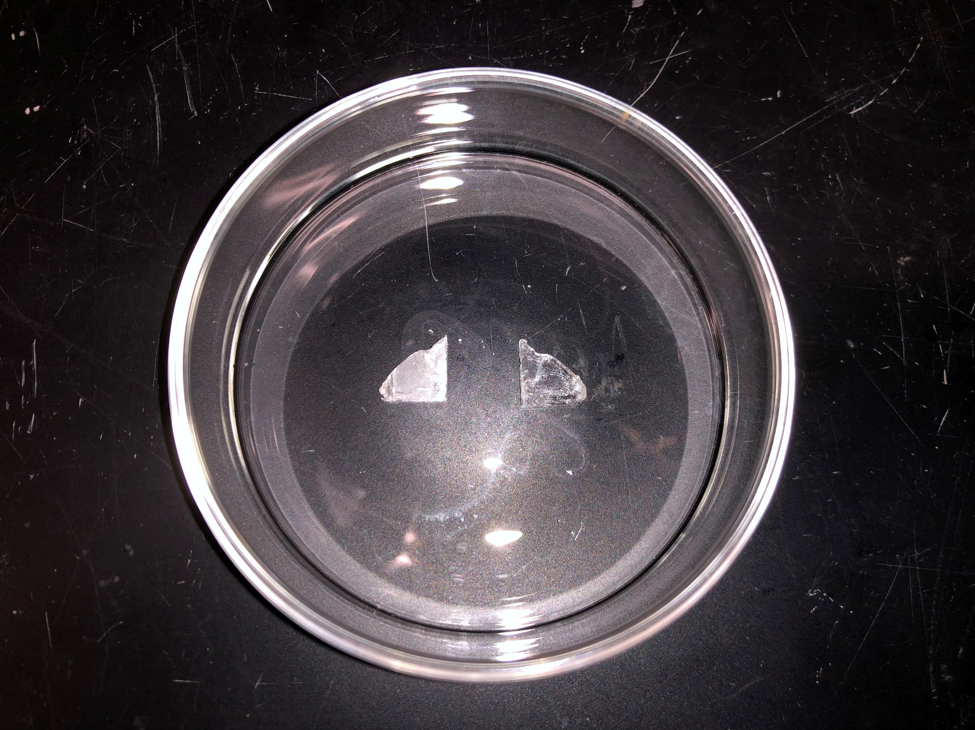
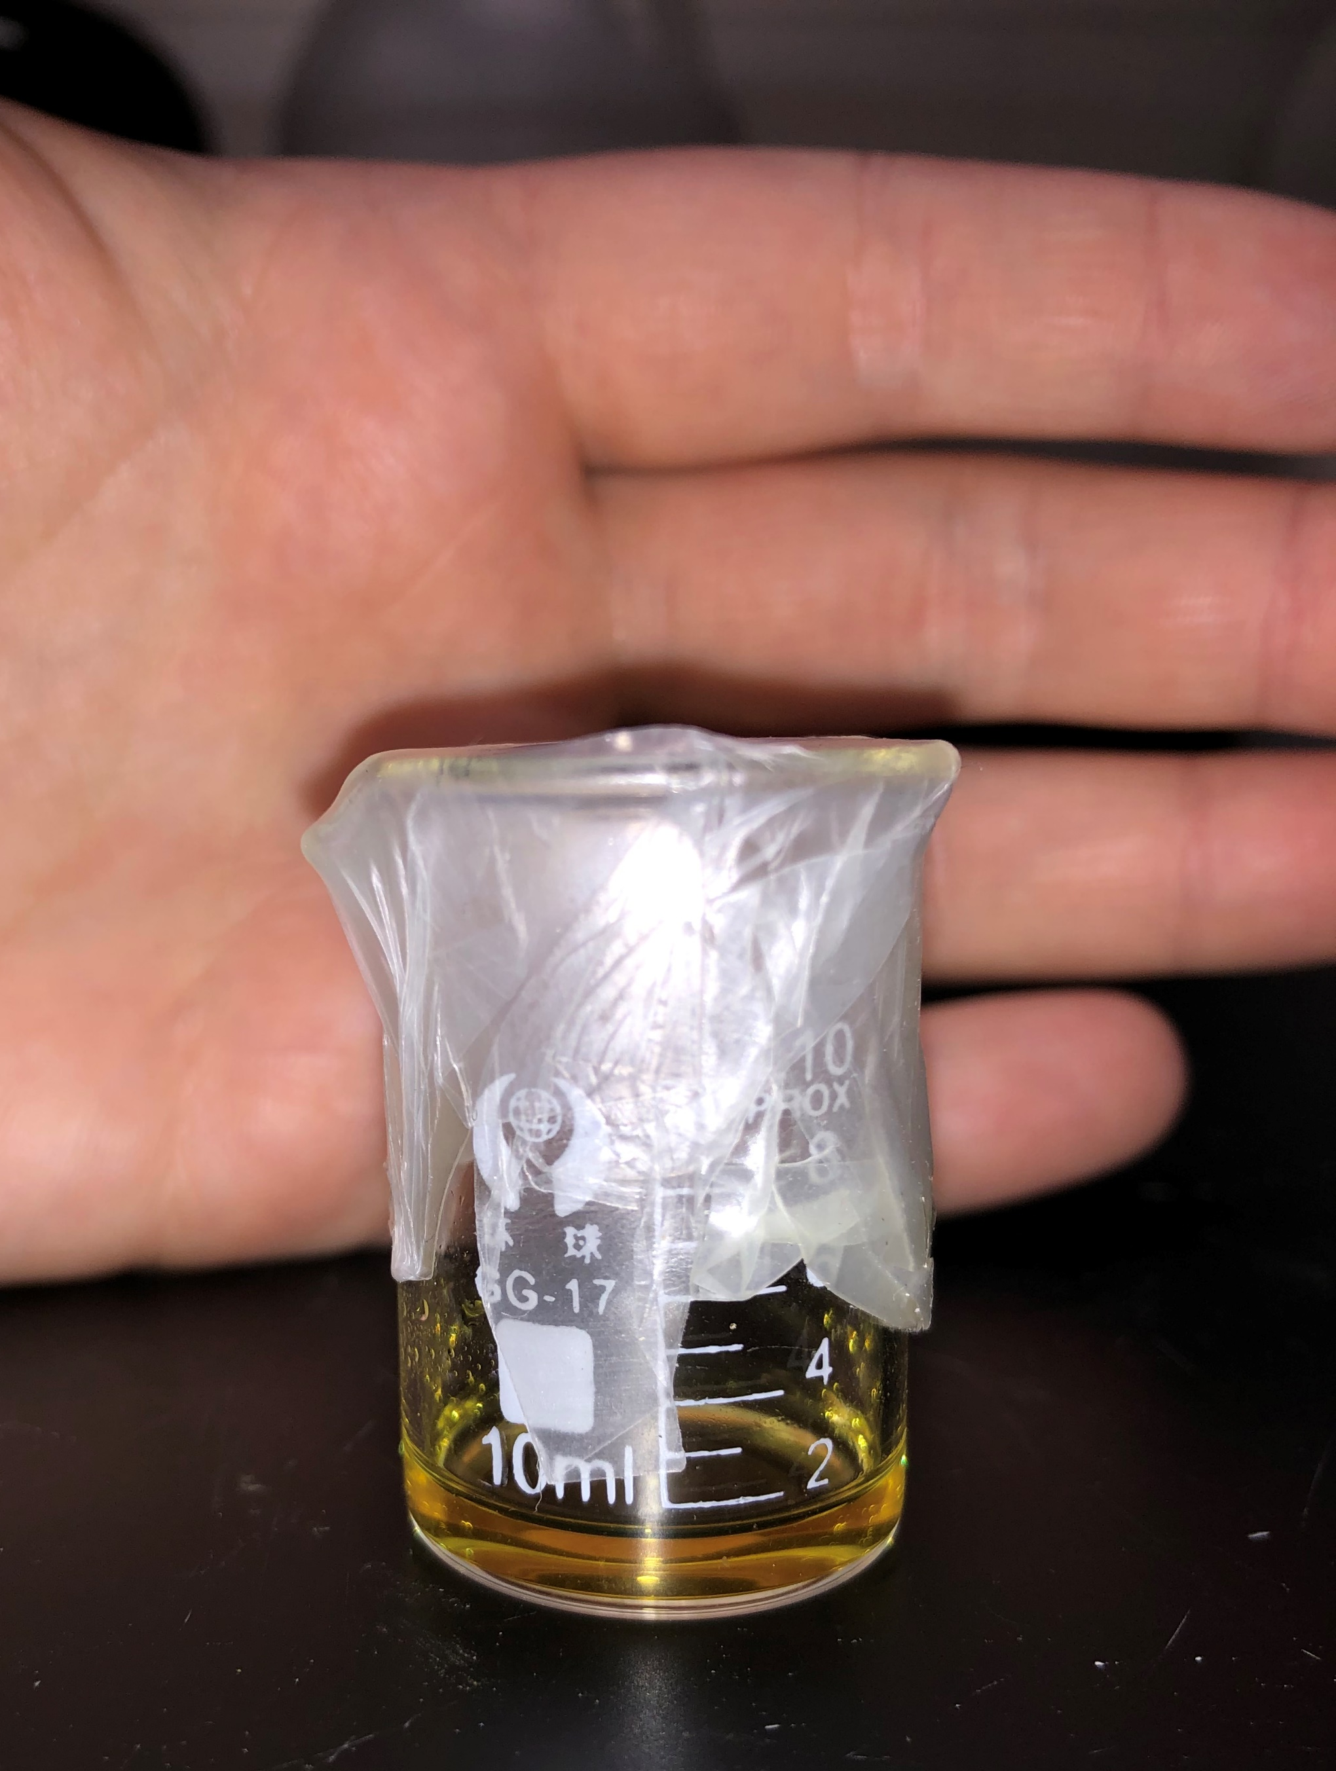
Revealing Nuclear Recoil Damage Tracks
Solution of ferric chloride and glacial acetic acid
Chemical Etching
Preferentially attacks and enlarges defects on sample surface
Track size: nanometers → micrometers
Halite: ferric chloride + glacial acetic acid
Micas: sodium hydroxide + water
Alternative method: hydrofluoric acid + water
Not used in this research
Chemical etching experiments not successful but will be a part of the future work of this project
Chemically etched (left) and unetched (right) halite

Slide 55
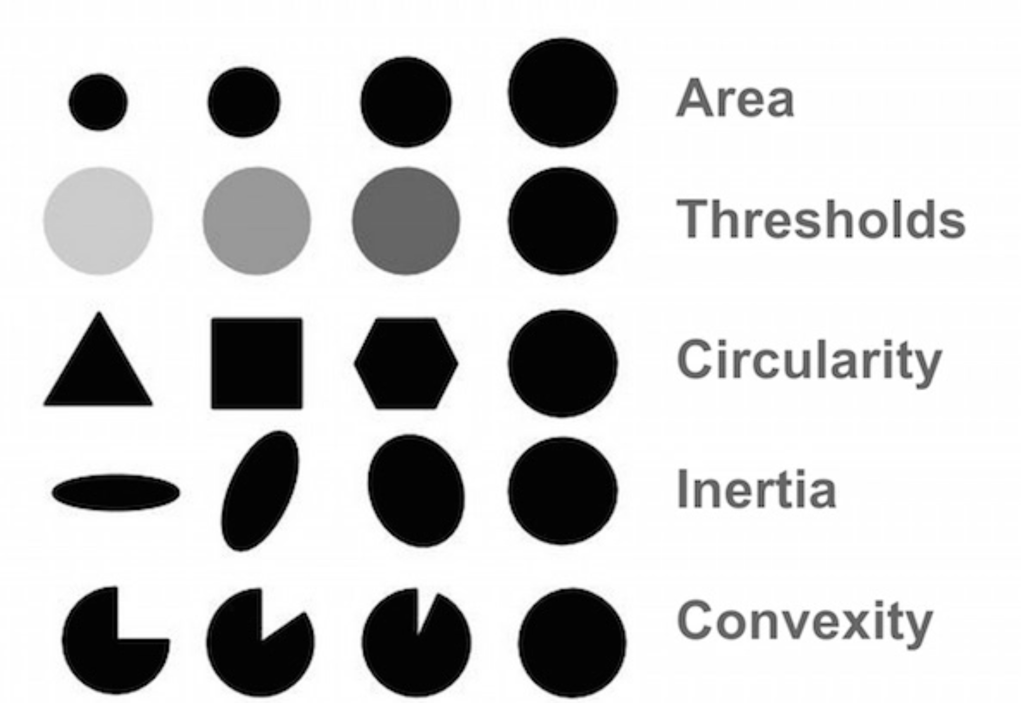
Reconstructing Nuclear Recoil Damage Tracks
Code output: detected tracks circled in a laser image of halite
Automatic Track Detection Code
Python code to automatically detect track-like shapes (‘blobs’) in greyscale images (OpenCV library)
Significantly cuts down time finding & measuring tracks
Shape detection can be filtered by
Pixel area
Color (contrast)
Circularity
Inertia Ratio
Convexity
Successful for images with little noise
Sometimes encounter incorrect detection or undetected tracks in noisy images
50 µm
= incorrect detection
= undetected

Slide 56
Reconstructing Nuclear Recoil Damage Tracks
Code output: detected tracks circled in a laser image of halite
Automatic Track Detection Code
Code input:
Greyscale laser image (no scale bar or labels!)
Height information per pixel in .csv format
User-given magnification (50 or 150)
Code output:
Statistical profile.csv
Number of tracks detected
Dimensions (diameter and depth) & aspect ratio
Various roughness calculations
Imaging parameters
‘Blob map’ (circled tracks and corresponding number to .csv output)
Histogram of track diameters and depth
50 µm
= incorrect detection
= undetected

Slide 57
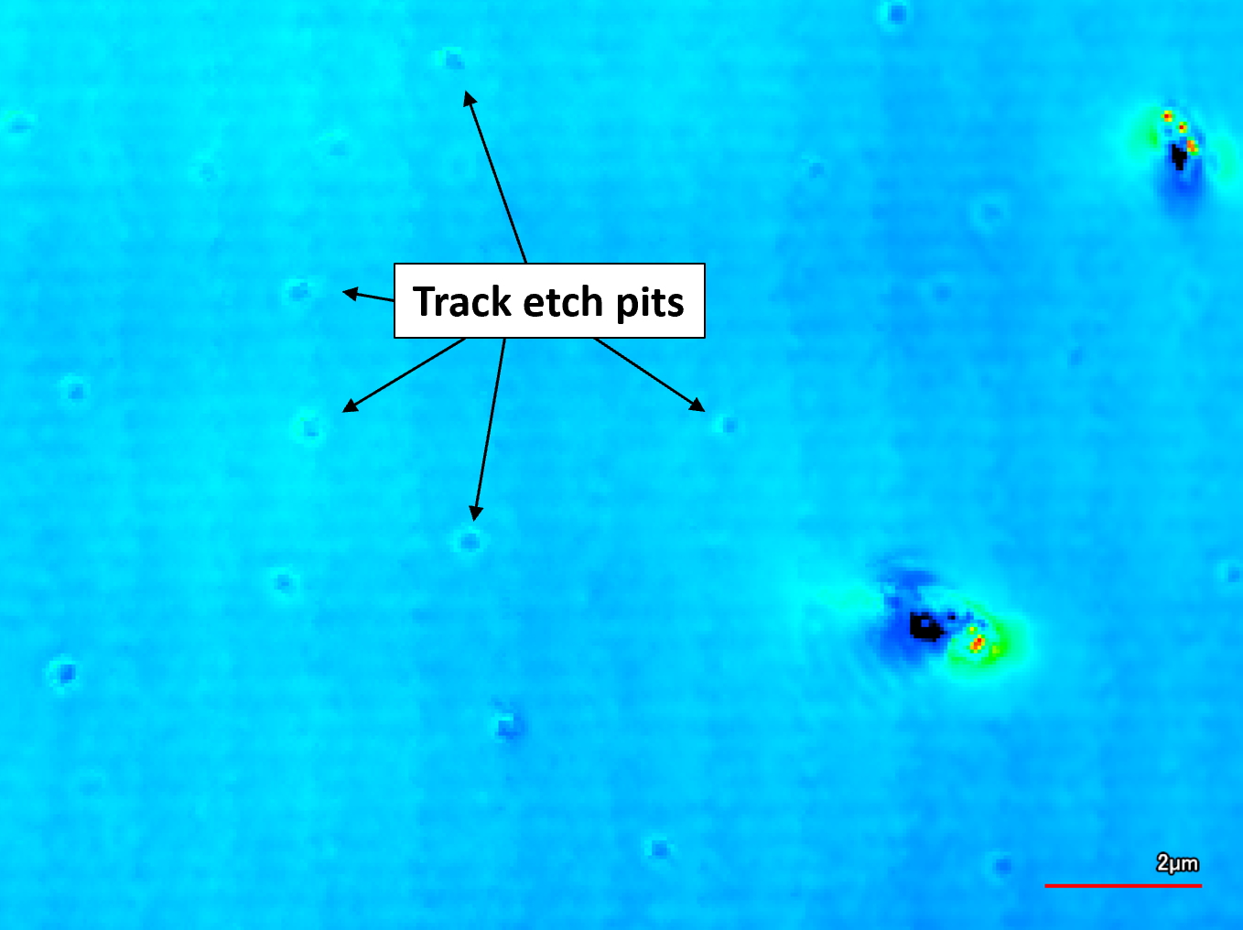
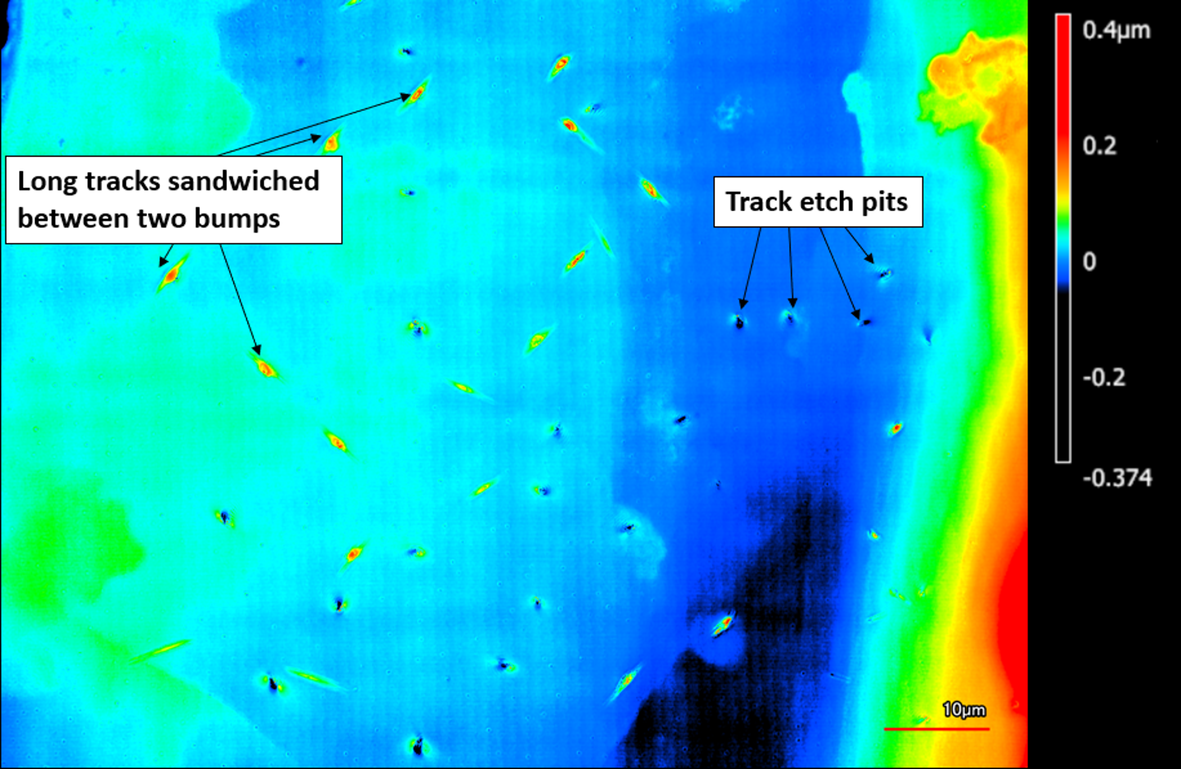
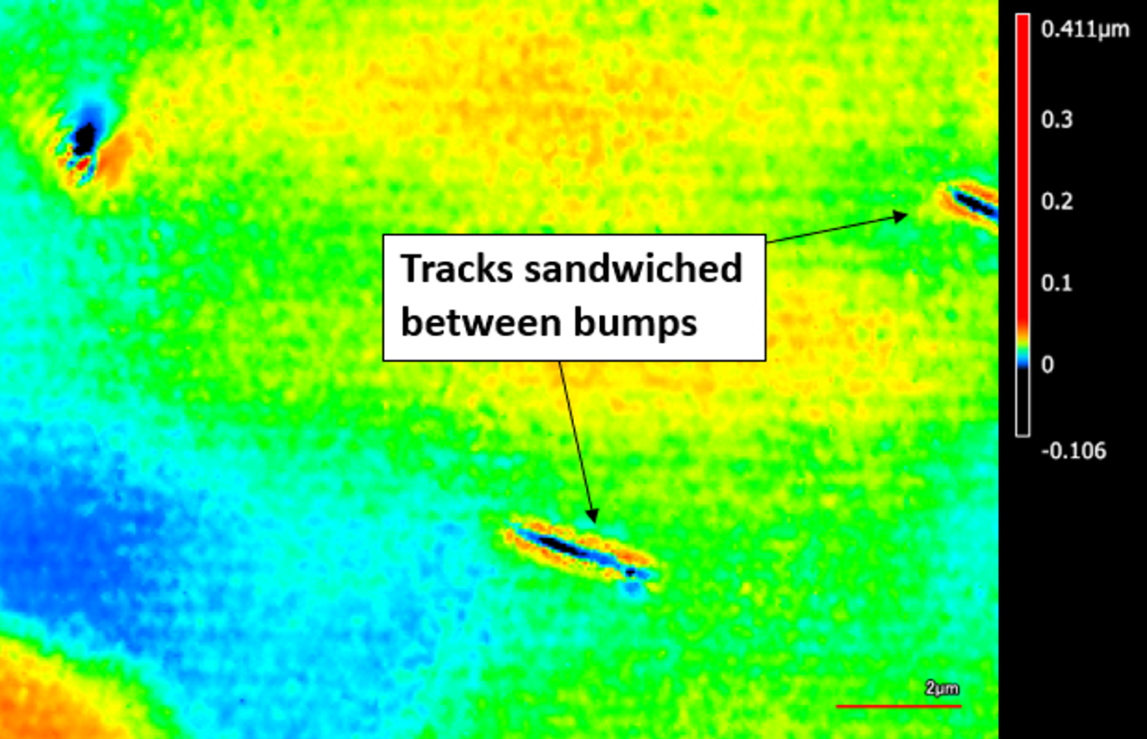
Appendix: Tracks in Halite

Slide 59
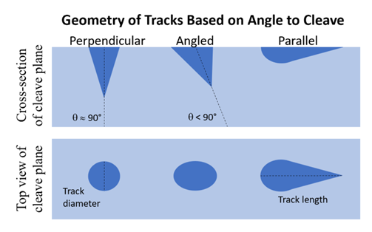
Appendix: Geometry of Tracks

Slide 60
Appendix: Tracks in Halite

Slide 61
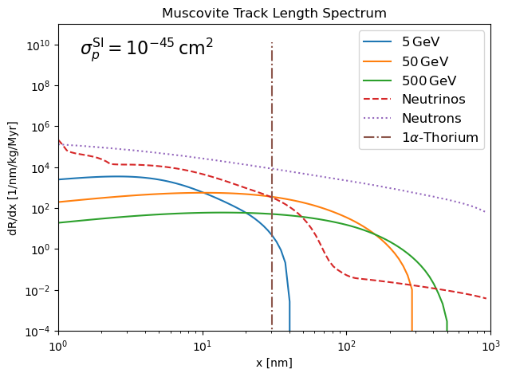
Appendix: Neutron Bkg & Hydrogen
No hydrogen
Hydrogen
$$10^{7} →10^{2}$$
$10^{5} →10^{2}$
(less dominating)

Slide 62
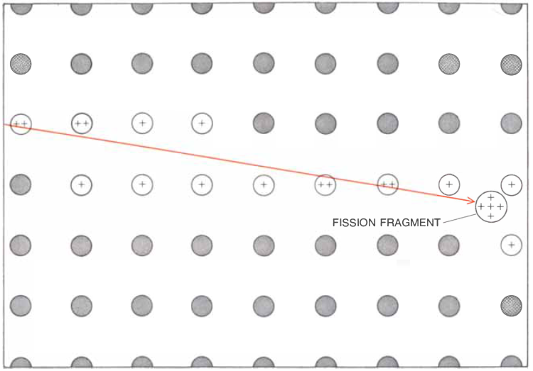
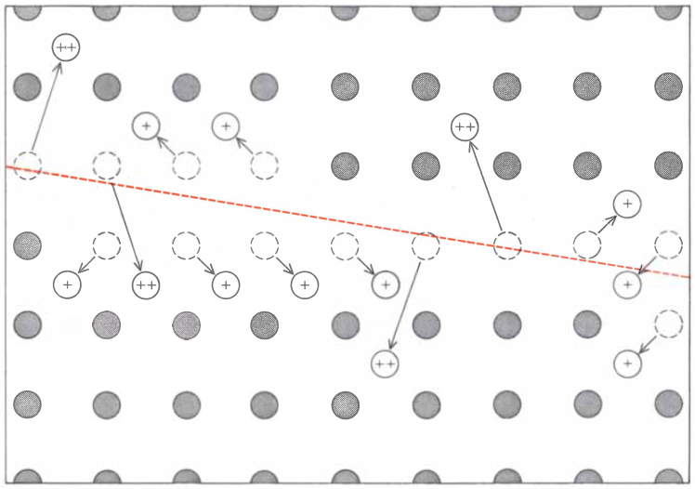
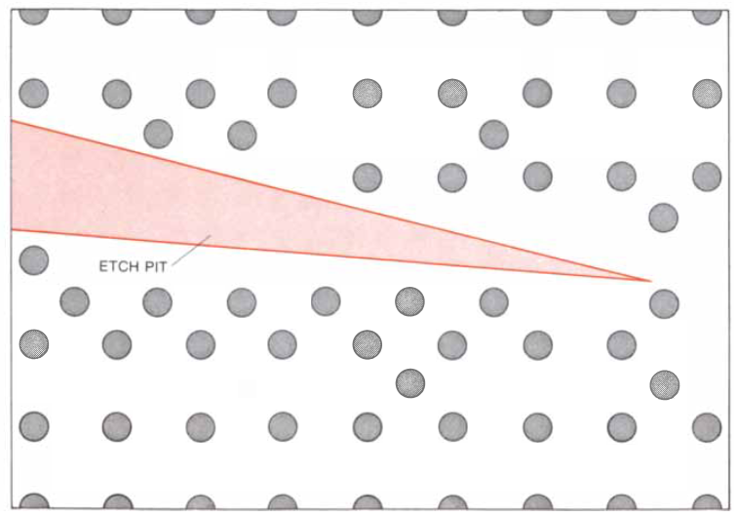
1
2
3
Only insulating minerals record fission
tracks; the free electrons in non-insulating sol­
ids restore the electrical neutrality of the
momentarily ionized atoms before disruption
of the lattice of the crystal can take place.
Fission tracks from spontaneous U-238 decay in zircon, imaged in transmission microscopy.
J. D. Macdougall, Scientific American 235, 114 (1976).

Slide 63
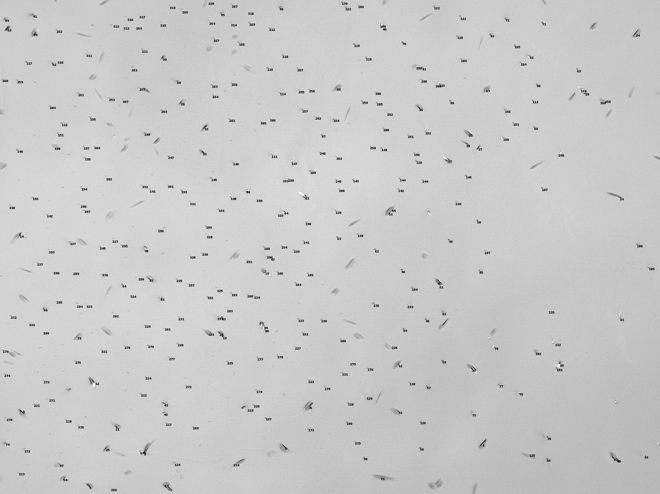
Halite Track Detector
Halite sample
Overview
Unetched surfaces analyzed with AFM (root mean squared roughness – 2 nm)
Argon plasma etching successful at preferentially etching nuclear recoil tracks on halite surfaces (10 minutes, 100 Watts, 0.2 mbar)
Tracks imaged with laser confocal microscope
Tracks detected and measured with the automatic track detection code in Python
Hundreds of tracks present ($ρ_{avg}=4.5 ×{10}^{6}{ cm}^{−2}$)
Map of tracks in halite detected with Python code. Laser image at 150x magnification.

Slide 64
Muscovite and Phlogopite Mica Track Detector
Overview
Nuclear recoil tracks revealed in Muscovite and Phlogopite mica
Muscovite track surface density: $ρ_{avg}=4.62 ×{10}^{2} {cm}^{−2}$
Not enough tracks identified in either mineral to conduct accurate analysis
Low track density could be attributed to:
Etching conditions
Mineral exposure time
Both minerals need much more experimental data
Promising minerals due to:
Extensive histories as SSNTDs
Hydrogen content on neutron background (if other contributing background factors are also controlled)
Tracks (circled) in Muscovite mica, imaged under the LCM at 150x mag.
Phlogopite
Muscovite

Slide 65
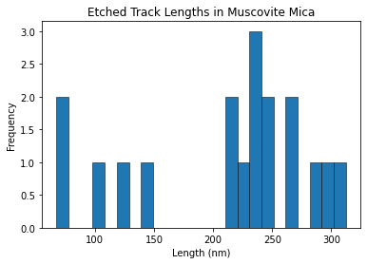
Muscovite Mica Track Detector
Tracks (circled) in Muscovite mica, imaged under the LCM at 150x magnification
Track Detection
Bin all tracks revealed in Muscovite mica:
Etching Rate
Average plasma etch rates of 7.27 nm/min along the cleave plane, and 2.66 nm/min normal to the cleave plane

Slide 66
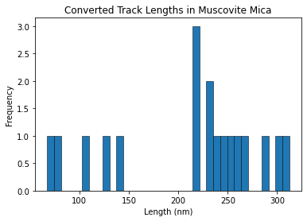
Muscovite Mica Track Detector
Comparison to Theoretical Data
Smallest detected track ~ 60 nm
Th-234 + $α$ decay tracks are ~ 31 nm in Muscovite mica
Cannot determine exposure time without an estimate of Th-234 + $α$ decay track density
Lack of tracks limits our ability to proceed with analysis
Can still produce a theoretical track length spectrum to aid future work
~ 60 nm

Slide 67
Phlogopite Mica Track Detector
Overview
Very new samples - no chemical etching experiments
Argon plasma etching does preferentially reveal tracks in Phlogopite mica
Very minimal data – not enough to have a clear picture on the feasibility of the mineral as a track detector
Track (circled) in Phlogopite mica, imaged under the LCM at 150x magnification
Phlogopite Muscovite

Slide 68
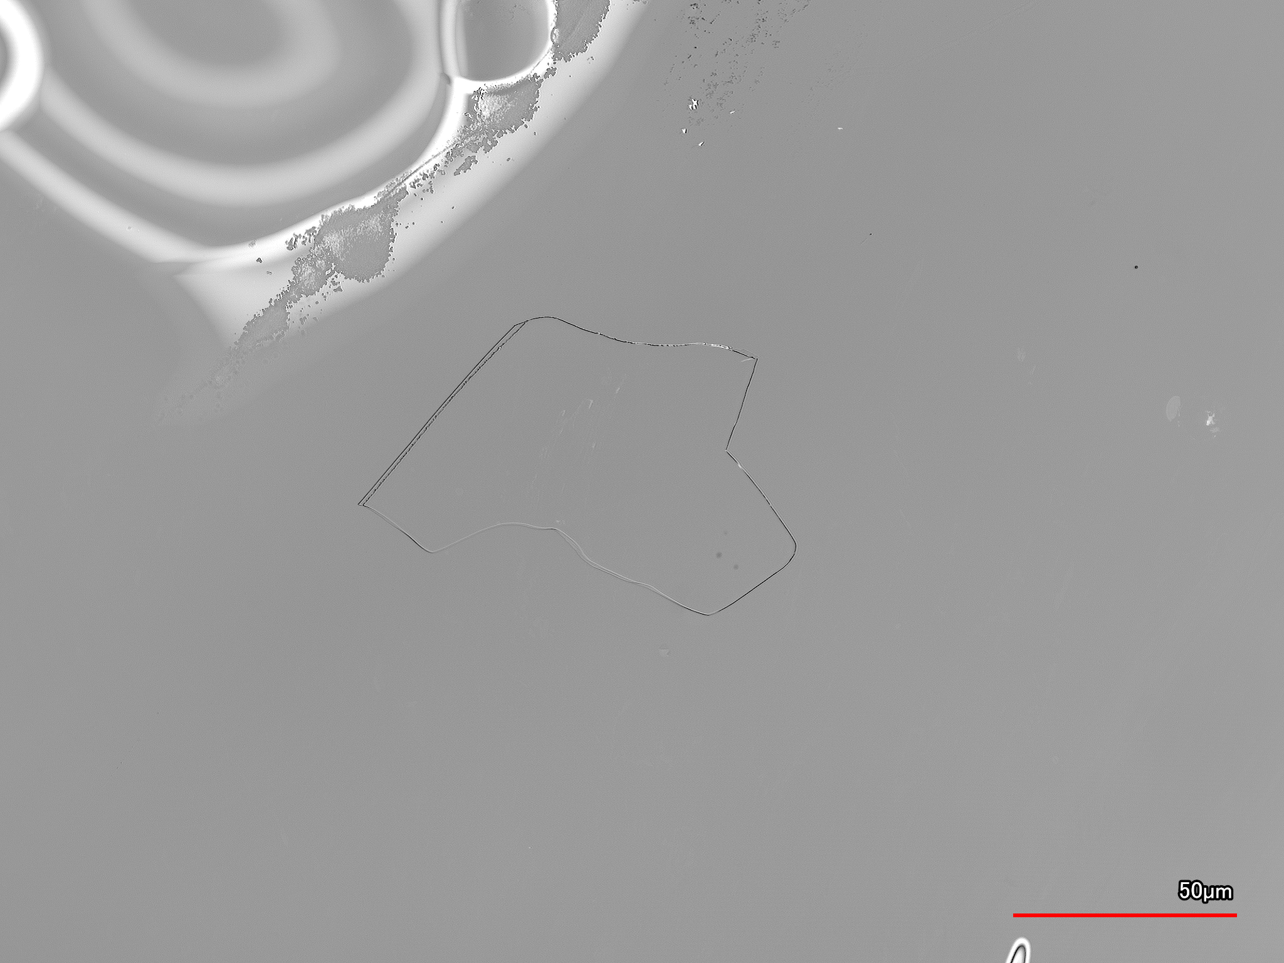
Phlogopite Mica Track Detector
Discussion
Less than 10 tracks able to be imaged and measured
Mostly due to optical properties of mineral
Scattering from lots of air/water bubbles under layers
Theoretically, Phlogopite should have more tracks than Muscovite due to lower hydrogen content
Could be a good mineral to determine effectiveness of revealing tracks, but Muscovite would be the better paleo-detector
Should absolutely be considered in future studies!

Slide 69
Muscovite Mica Track Detector
Discussion
Plasma etching – successful at revealing nuclear recoil damage tracks
Continuation of previous literature studying alpha-recoil tracks
Limitations presented due to minimum detectable track length and low track density
Possible incorrect etching rate
If majority of measured track are from spontaneous fission – could be due to zoning
Mica could not be etching enough
Limited access to information about where Muscovite mica came from
Could be a very young mineral, thus low track density
Reliable history as a SSNTD – still a mineral to use in future work
Neutron background suppressed significantly due to hydrogen content
Tracks (circled) in Muscovite mica, imaged under the LCM at 150x magnification
Phlogopite Muscovite

Slide 70
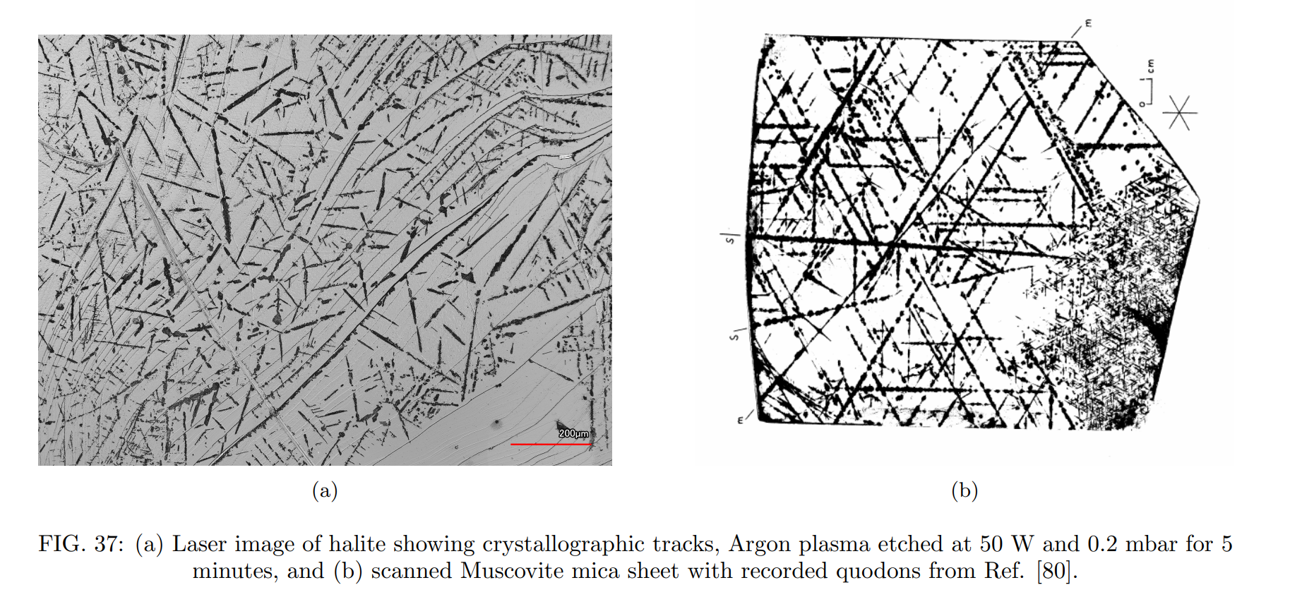
Quodons

Slide 71
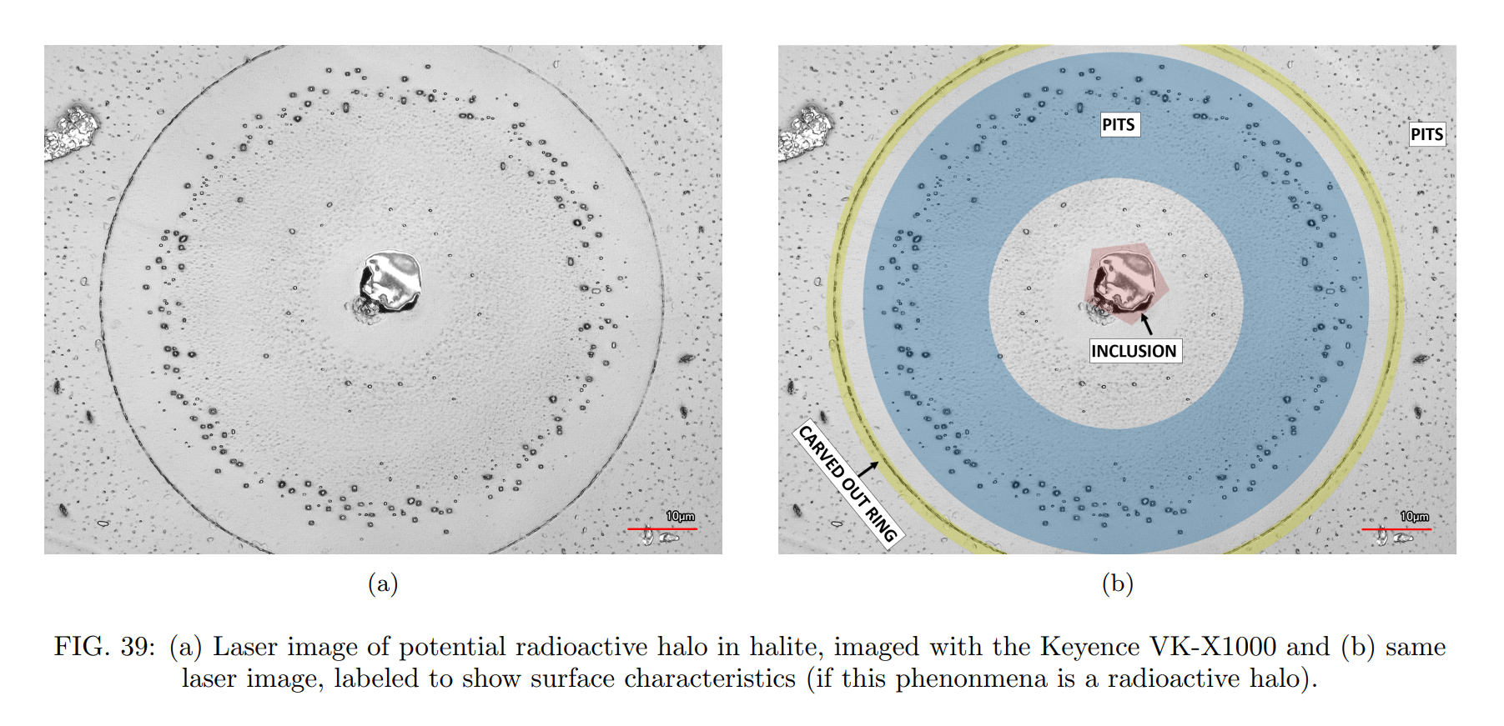
Radioactive Halos

Slide 72
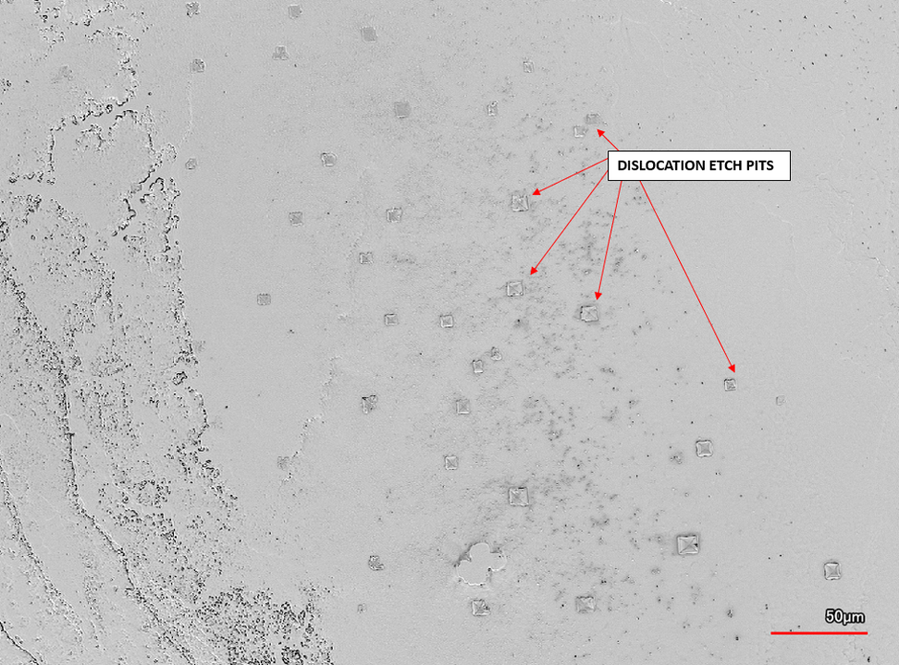
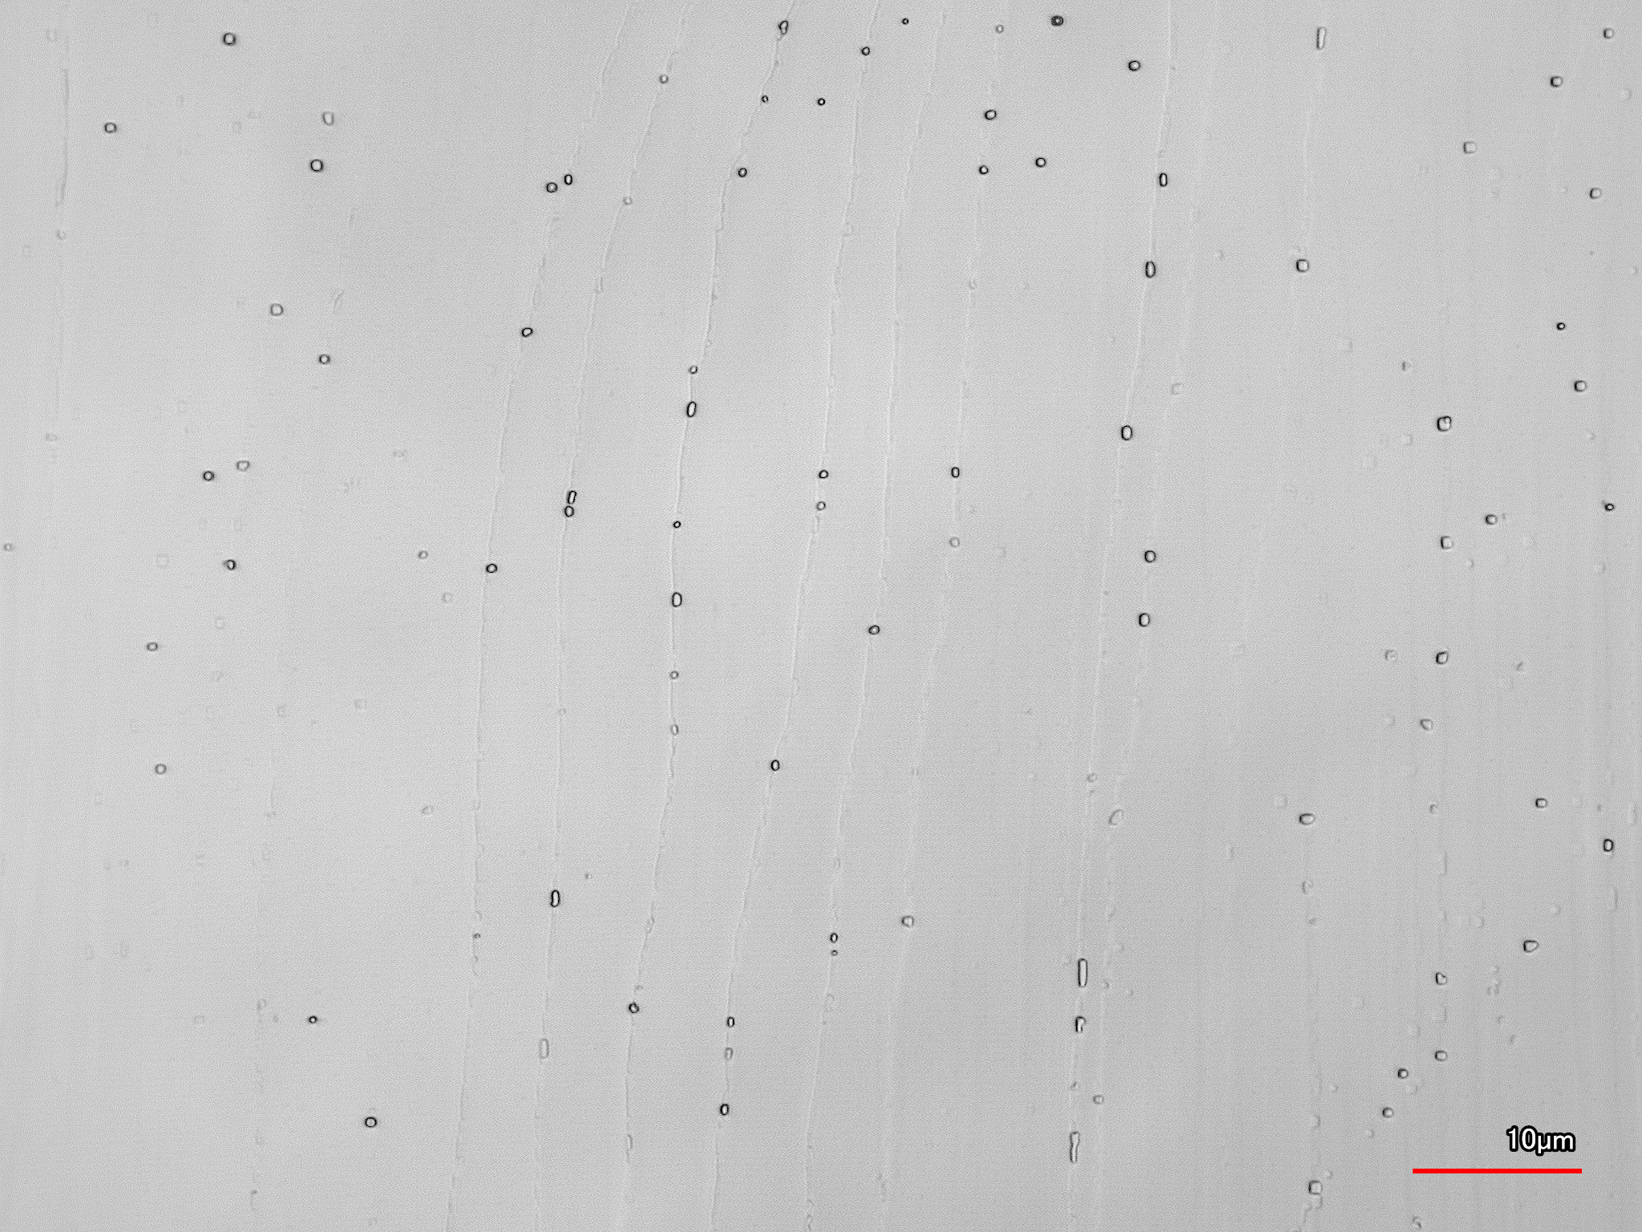
Appendix: Other Tracks in Halite

