Slide 1
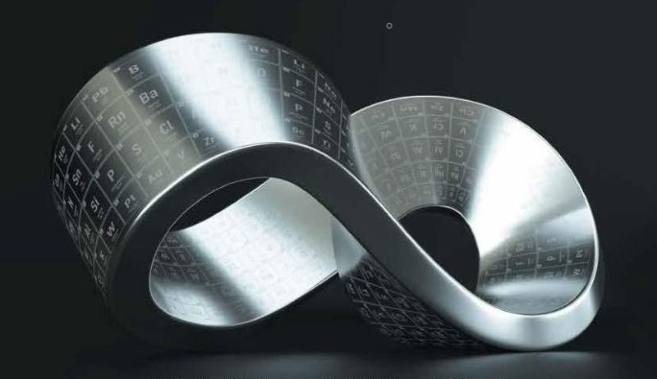
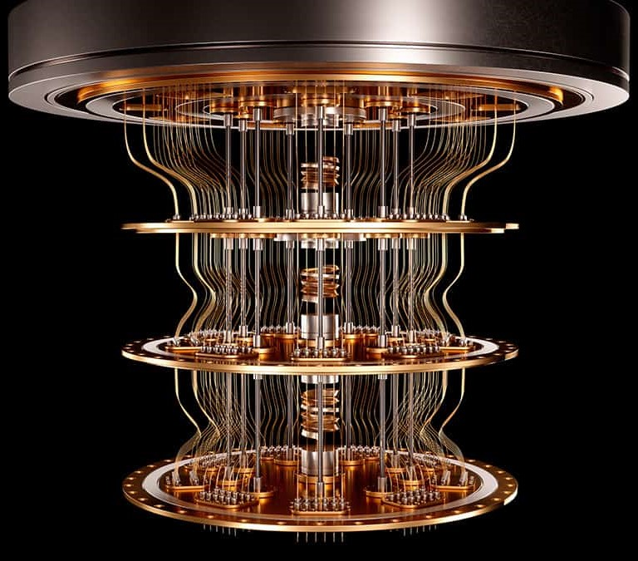
Understanding control and modulation of color center defects
Dec 1, 2023
Vsevolod Ivanov
VTNSI & Physics

Slide 2
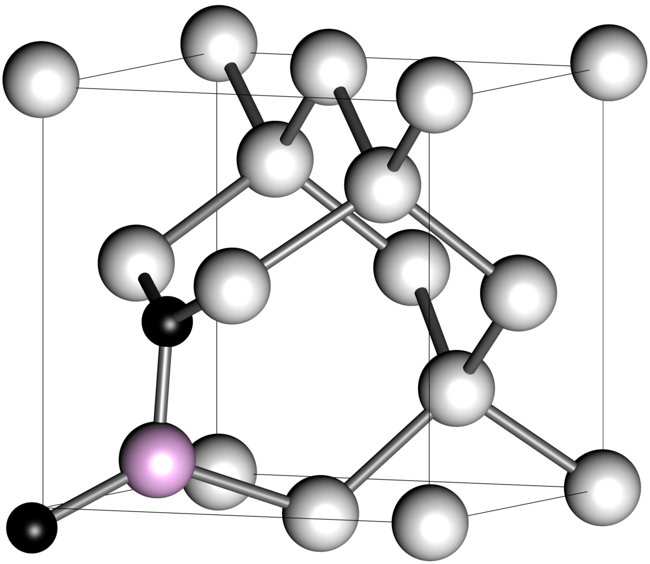
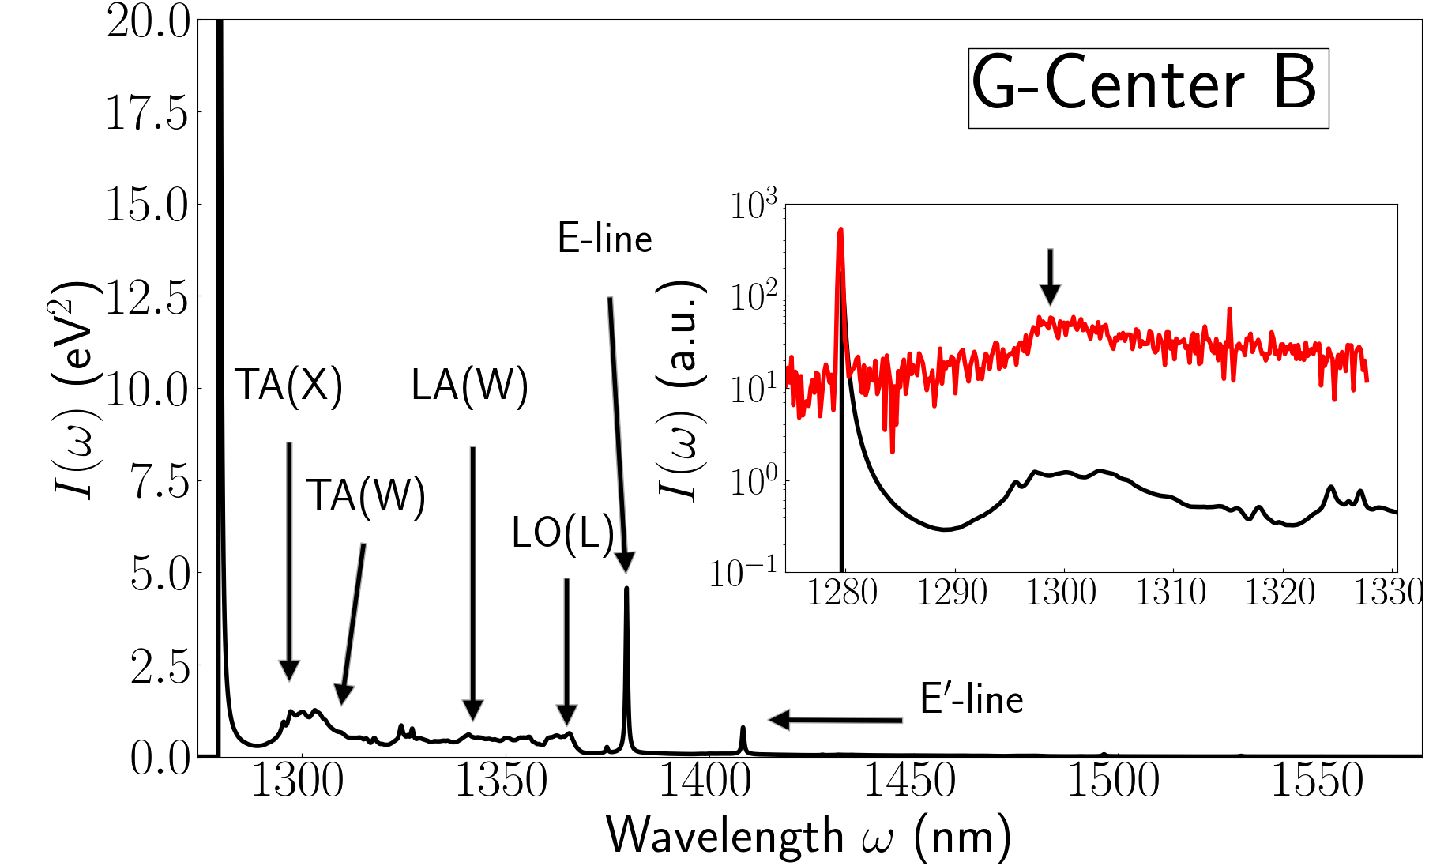
From First-Principles to Quantum Detection
My Background
Deterministic Creation
Formation Conditions
Defects/
Properties
Quantum Detection

Slide 3
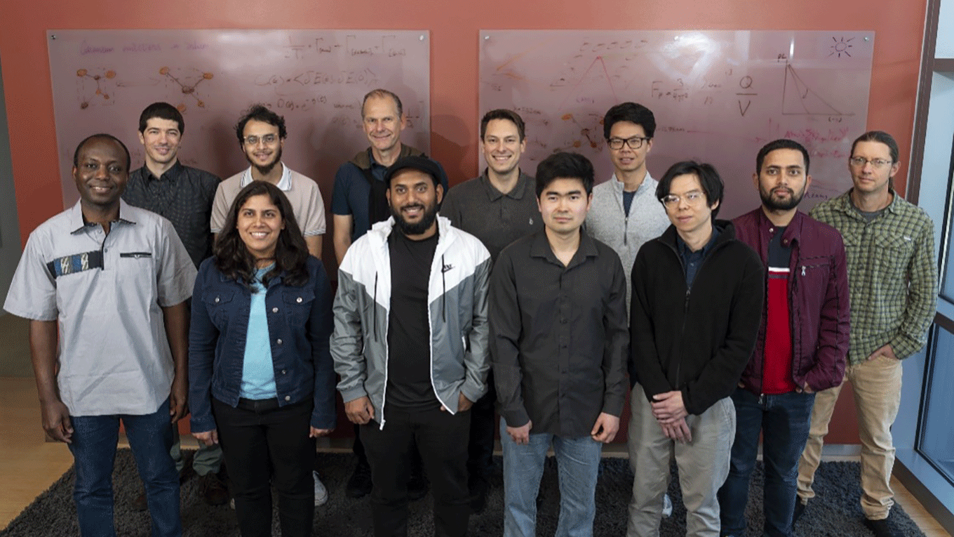
Silicon Defects Team
Publications
https://arxiv.org/abs/2307.05759
https://arxiv.org/abs/2303.16283
https://arxiv.org/abs/2209.11412
Communications Materials 4, 22 (2023) [arxiv:2203.13781]
Nature Communications 14, 3321 (2023)[arxiv:2301.06654]
Phys. Rev. Applied 20, 014058 (2023) [arxiv:2302.05814]
Opt. Express 31 (5) 8352-8362 (2023)
[doi.org/10.1364/OE.482311]
Phys. Rev. B 106, 134107 (2022) [arxiv:2206.04824]
Work was done in collaboration with the groups of:
Liang Tan, LBNL (Theory)
Thomas Schenkel, LBNL (Experiment)
Boubacar Kante, UC Berkeley (Experiment)

Slide 4
Outline
Introduction – Color Center Defects as Detectors
Color center defect types and detection strategies
Relevant defect properties we can compute
How Formation Conditions Impact Defect Properties
G-center structural isomers
Effect temperature and disorder on defect properties
Writing & erasing defects on demand
Defect Database & Future Work

Slide 5
Outline
Introduction – Color Center Defects as Detectors
Color center defect types and detection strategies
Relevant defect properties we can compute
How Formation Conditions Impact Defect Properties
G-center structural isomers
Effect temperature and disorder on defect properties
Writing & erasing defects on demand
Defect Database & Future Work

Slide 6
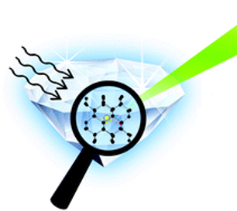
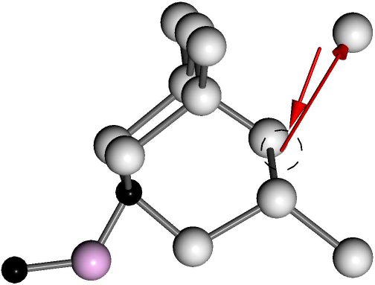
Detection Strategies for neutrons, neutrinos, and more!
Types of Color Centers
Vacancy – Host atom removed
Interstitial – element inserted into host gap
Substitutional – host atom replaced by element
Direct
Low energy but low detection density
Indirect
Works for dark defects but detection ambiguity
Formation
Don’t need prior defects but need ideal material

Slide 7
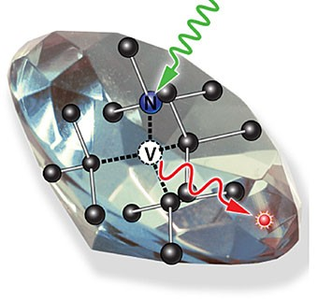
Defect Properties
Property
Application
Zero-phonon line (ZPL): The primary energy (frequency) of emitted photons emitted by the defect
Single-photon sources

Slide 8
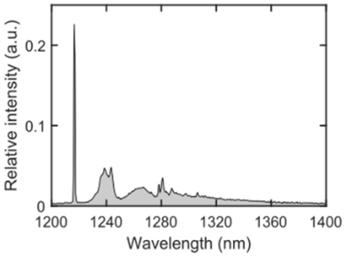
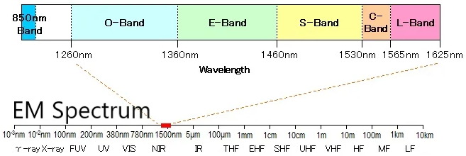
Defect Properties
Property
Application
Zero-phonon line (ZPL): The primary energy (frequency) of emitted photons emitted by the defect
Linewidth: How broad the ZPL peak is (range of emitted frequencies)
Transition dipole moment: How well the transition couples with light
Single-photon sources

Slide 9
Defect Properties
Property
Application
Zero-phonon line (ZPL): The primary energy (frequency) of emitted photons emitted by the defect
Linewidth: How broad the ZPL peak is (range of emitted frequencies)
Transition dipole moment: How well the transition couples with light
Single-photon sources
Energetics: Formation energy, ∆E for charge, isomers, local strain/disorder

Slide 10
Outline
Introduction – Color Center Defects as Detectors
Color center defect types and detection strategies
Relevant defect properties we can compute
How Formation Conditions Impact Defect Properties
G-center structural isomers
Effect temperature and disorder on defect properties
Writing & erasing defects on demand
Defect Database & Future Work

Slide 11
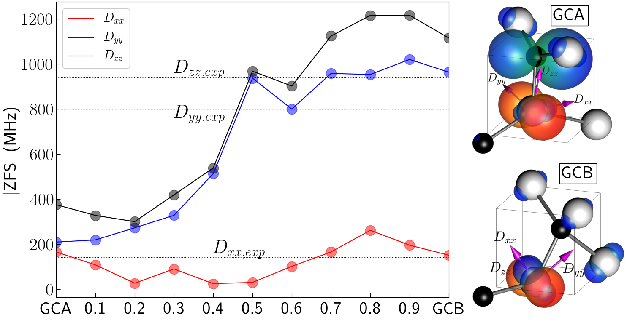
Defect structure & bonding determine properties
Optically Dark!
Optically Bright!
Phys. Rev. B 106, 134107 (2022) [arxiv.org/abs/2206.04824]

Slide 12
Defect structure & bonding determine properties
Optically Dark!
20 meV
Optically Bright!
Direct
Phys. Rev. B 106, 134107 (2022) [arxiv.org/abs/2206.04824]

Slide 13
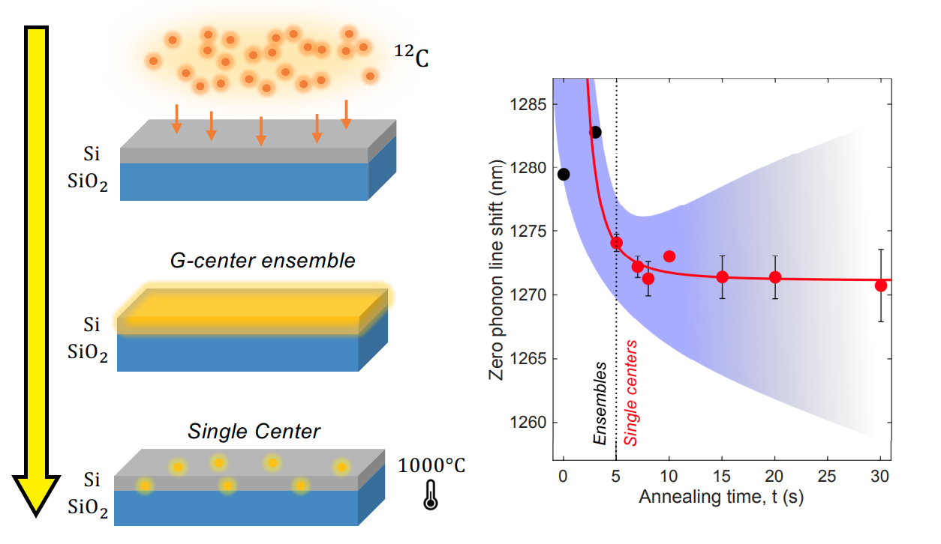
Temperature control of defect formation
Opt. Express 31 (5) 8352-8362 (2023)

Slide 14
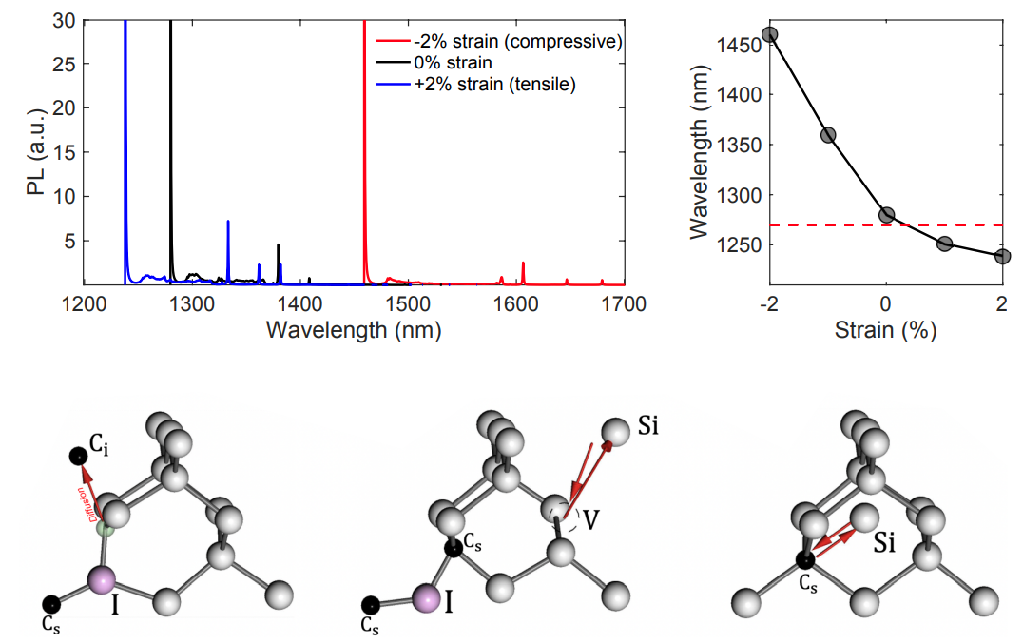
Temperature control of defect formation
Opt. Express 31 (5) 8352-8362 (2023)

Slide 15
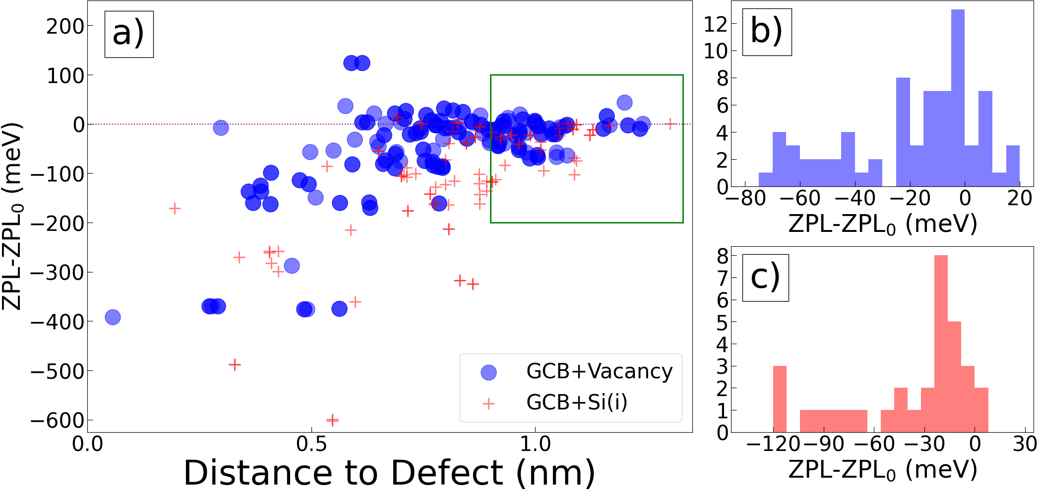
Defects in the presence of disorder (vacancies/interstitials)
Ion implantation step also damages the surrounding lattice → vacancies/interstitials
Disorder induces local strain, changing emitted photon energy.
Phys. Rev. Applied 20, 014058 (2023)

Slide 16
Defects in the presence of disorder (vacancies/interstitials)
Directional detection using induced strain
Indirect

Slide 17
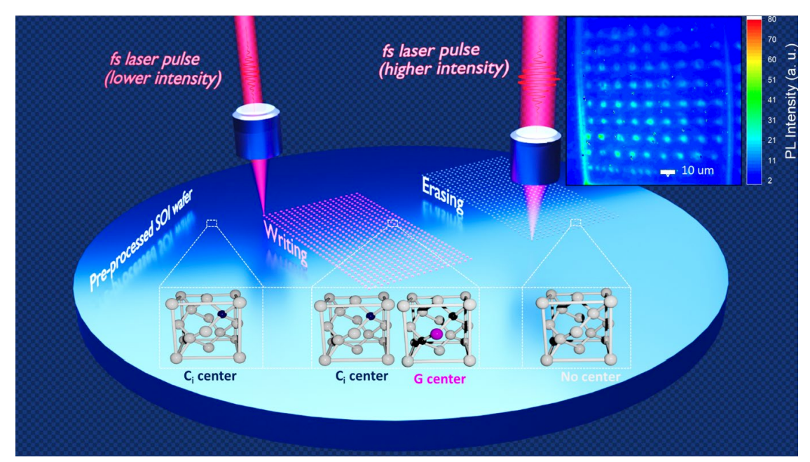
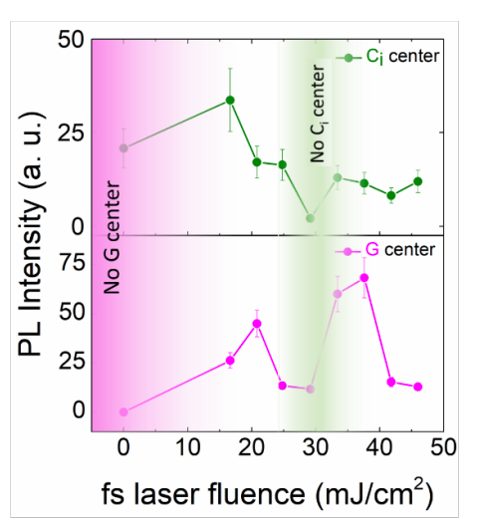
Writing and Erasing Defects
Introduce H into lattice → New Ci center observed! No G-centers!
https://arxiv.org/abs/2307.05759

Slide 18
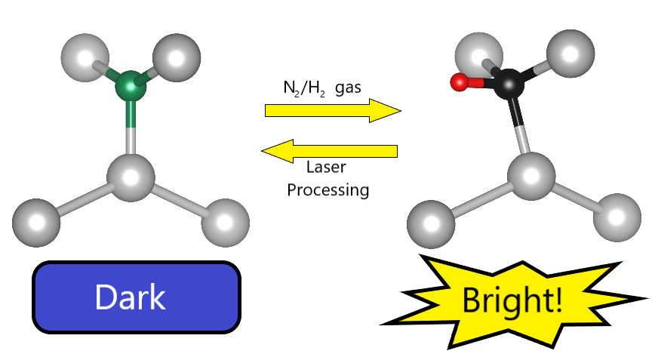
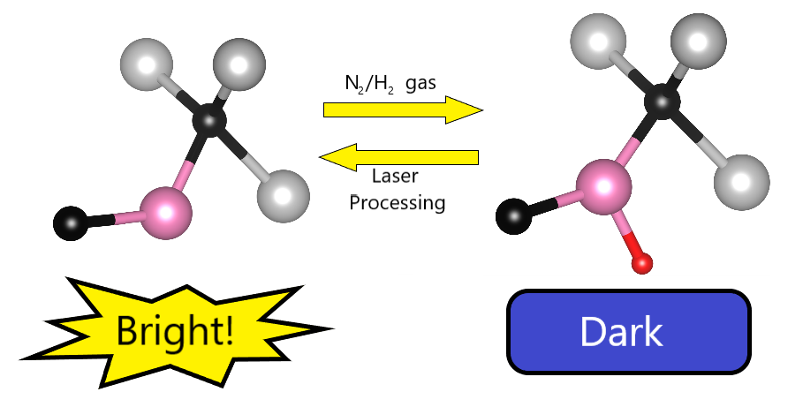
Writing and Erasing Defects
Ci-center (856 meV)
G-center (969 meV)
Forming gas + laser processing adds/removes H, turning defects ON/OFF
https://arxiv.org/abs/2307.05759

Slide 19
Writing and Erasing Defects
Ci - like
G - like
OR
Forming gas + laser processing adds/removes H, turning defects ON/OFF

Slide 20
Improve Indirect- and Formation-Based Detectors
add Forming Gas
Defect arrays → better positioning/ detection vs. single defects
Processing with forming gas → more variety of defects available in formation-based detection

Slide 21
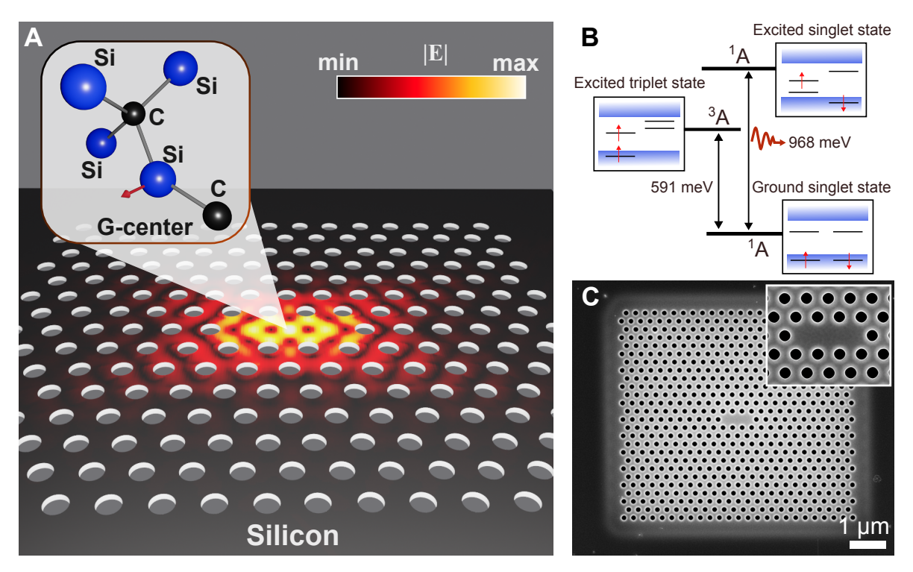
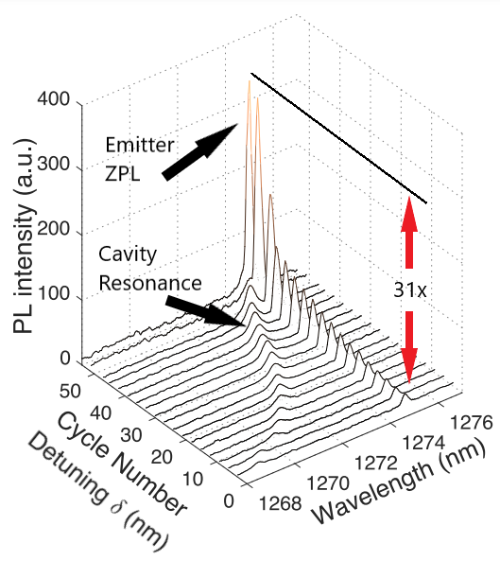
Defect emission enhancement in a nano-cavity
Nature Communications 14, 3321 (2023)

Slide 22
Outline
Introduction – Color Center Defects as Detectors
Color center defect types and detection strategies
Relevant defect properties we can compute
How Formation Conditions Impact Defect Properties
G-center structural isomers
Effect temperature and disorder on defect properties
Writing & erasing defects on demand
Defect Database & Future Work

Slide 23
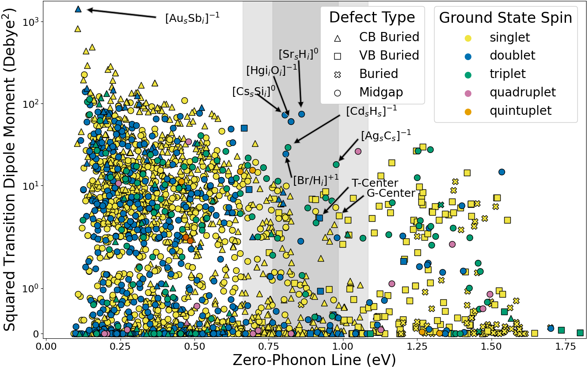
Database of Quantum Defects
~50,000 Multi-element defects →
Opportunities to explore elemental interactions & chemistry
Many new candidates for spin-photon interface (spin qubit) and bright single-photon sources!
quantumdefects.com

Slide 24
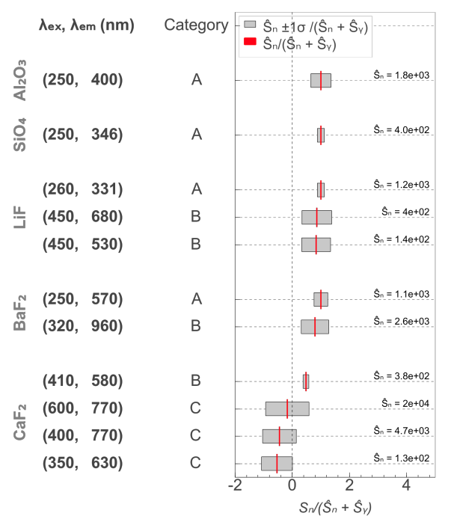
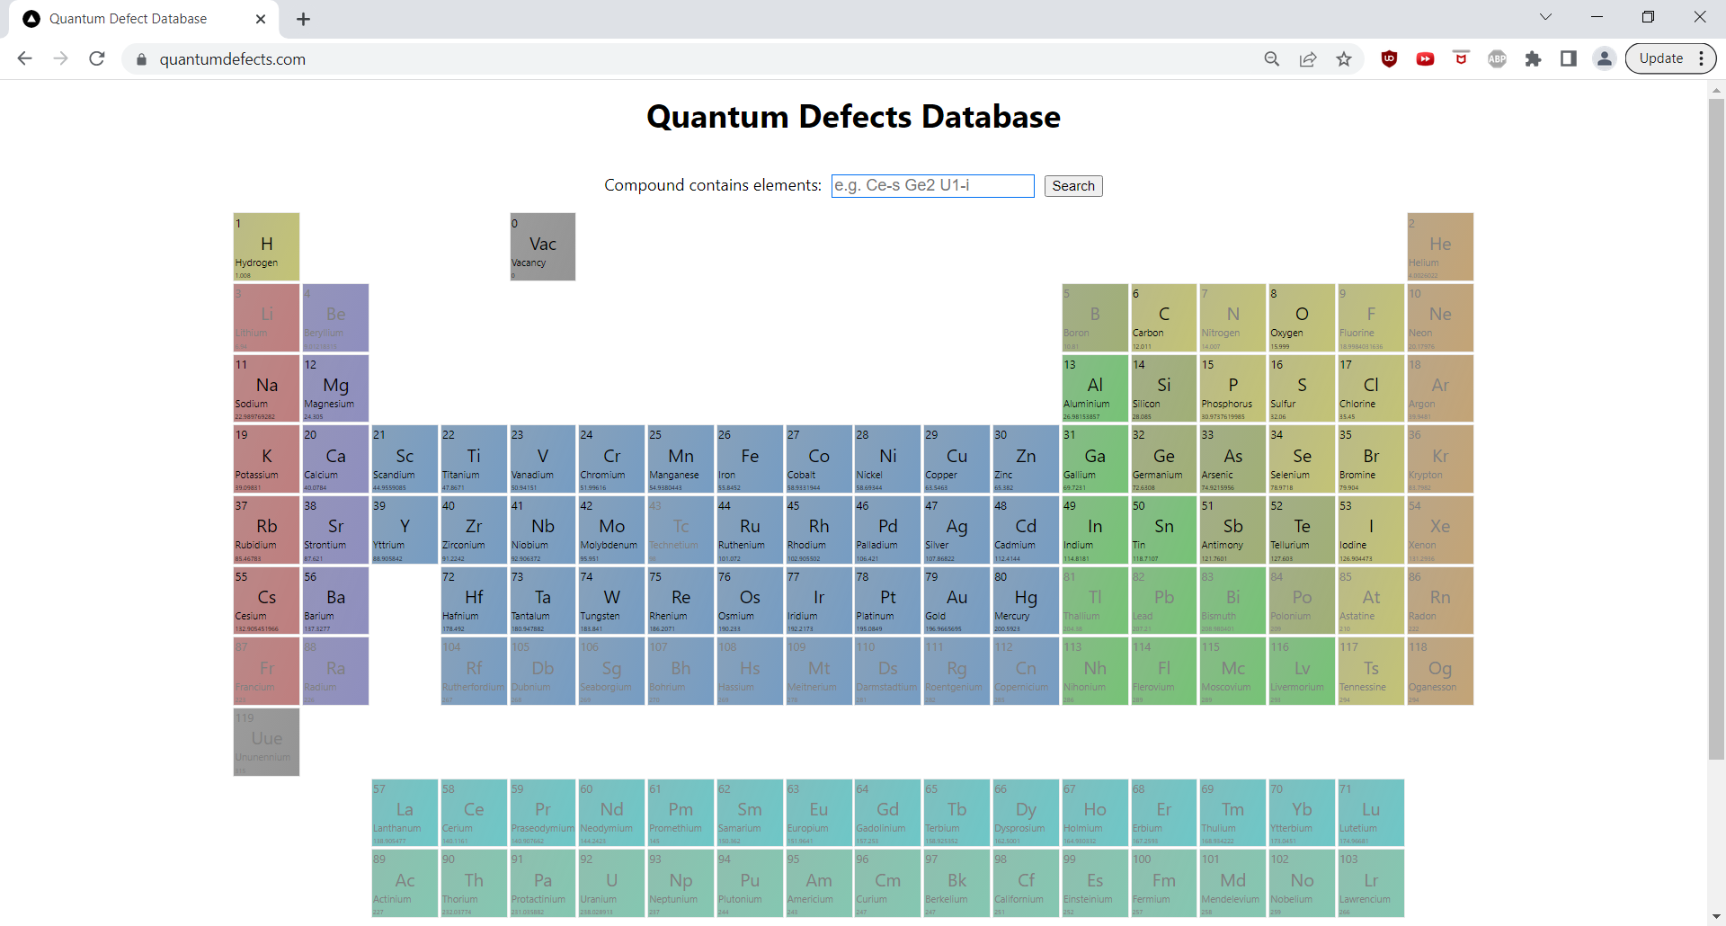
Database of Quantum Defects
arXiv:1902.10668 →
Phys. Rev. Applied 16, 064060x
quantumdefects.com

Slide 25
Thank you!
Website
condensedmatters.com
Email
vivanov@vt.edu

