Slide 1
Materials Selections for DM/Neutrinos Detections
Kai Sun*, Kathryn Ream** and Joshua Spitz**
* Department of Materials and Engineering &
**Department of Physics
University of Michigan, Ann Arbor, Michigan
Notes:
Every scientific theory relies on the scientific method
The concept of dark matter originated in the 1930’s when astronomer Fritz Zwicky
tracked the velocities of over 1,000 galaxies clustered together and observed that the
gravitational pull from visible matter alone wasn’t strong enough to keep the cluster
from flying apart. He posited that there must be matter that we can’t see—dark
matter—that contributes most of the gravitational force that holds everything in
place. Forty years later, astronomers Vera Rubin and Kent Ford found more evidence
of dark matter by studying the motion of stars within spiral galaxies. They found that
stars orbiting at the outer edges of these galaxies moved just as quickly as those at
the center, possibly due to a halo of dark matter providing an extra gravitational pull.
Most recently, a photograph of two colliding galaxies, nicknamed the Bullet Cluster,
exhibited a gravitational lensing effect—light that is bent due to immense gravity—
that could not be explained by visible matter alone. Scientists say that these
observations strongly point to the existence of dark matter, but exactly what that
matter is made of remains a mystery.
Nuclear recoils caused by interactions of Dark Matter or neutrinos can leave latent damage in the crystal structure of minerals. These damage features can be read out using a variety of modern microscopy techniques, ranging from optical (fluorescence) microscopy over X-ray microscopy at accelerator light sources to techniques with sub-nm spatial resolution such as He-ion beam or transmission electron microscopy. Natural as well as laboratory-manufactured minerals have been discussed as nuclear recoil detectors for a variety of applications. For example, using the damage features accumulated over 10 Myr -- 1 Gyr in natural "paleo-detector" mineral samples, one could measure astrophysical neutrino fluxes (from the Sun, supernovae, or cosmic rays interacting with the atmosphere) or search for a variety of Dark Matter candidates. Using signals accumulated over months to few-years timescales in laboratory-manufactured minerals, one could measure reactor neutrinos or use minerals as Dark Matter detectors, potentially with directional sensitivity. This workshop will bring together theoretical and experimental physicists, material scientists, and geologists to discuss the state of the art of the emerging field of Mineral Detection of Neutrinos and Dark Matter. Particular attention will be given to the progress and plans of experimental studies pursued by groups in Europe, Asia, and America towards unlocking the potential of natural and laboratory-manufactured minerals as passive recorders of keV-scale nuclear recoils.

Slide 2
Outline
Background of Detections of Neutrinos and Dark Matters
Direct Neutrinos and Dark Matters detections
DM/Neutrinos detectors: Diamond, Si, Ge, SiC, and graphene etc.
Mineral detectors
Our research on olivine
Summary
Notes:
Feebly interacting particles (FIPs) are subatomic particles defined by having extremely suppressed interactions with the Standard Model (SM) bosons and / or fermions. These particles are potential thermal dark matter candidates, extending the model of weakly interacting massive particles (WIMPs) to include weakly interacting sub-eV particles (WISPs) and others. FIP physics is also known as dark-sector physics.^{[1]}
Candidates[edit]
FIP candidates could be massive (FIMP / WIMP) or massless and coupled to the SM particles through some minimal coupling strength.^{[1]} The light FIPs are theorized to be dark matter candidates, and, they provide an explanation for the origin of neutrino masses and CP symmetry in strong interactions.^{[2]}
Neutrinos technically qualify as FIPs, but usually when the acronym "FIP" is used, it is intended to refer to some other, as-yet unknown particle.

Slide 3
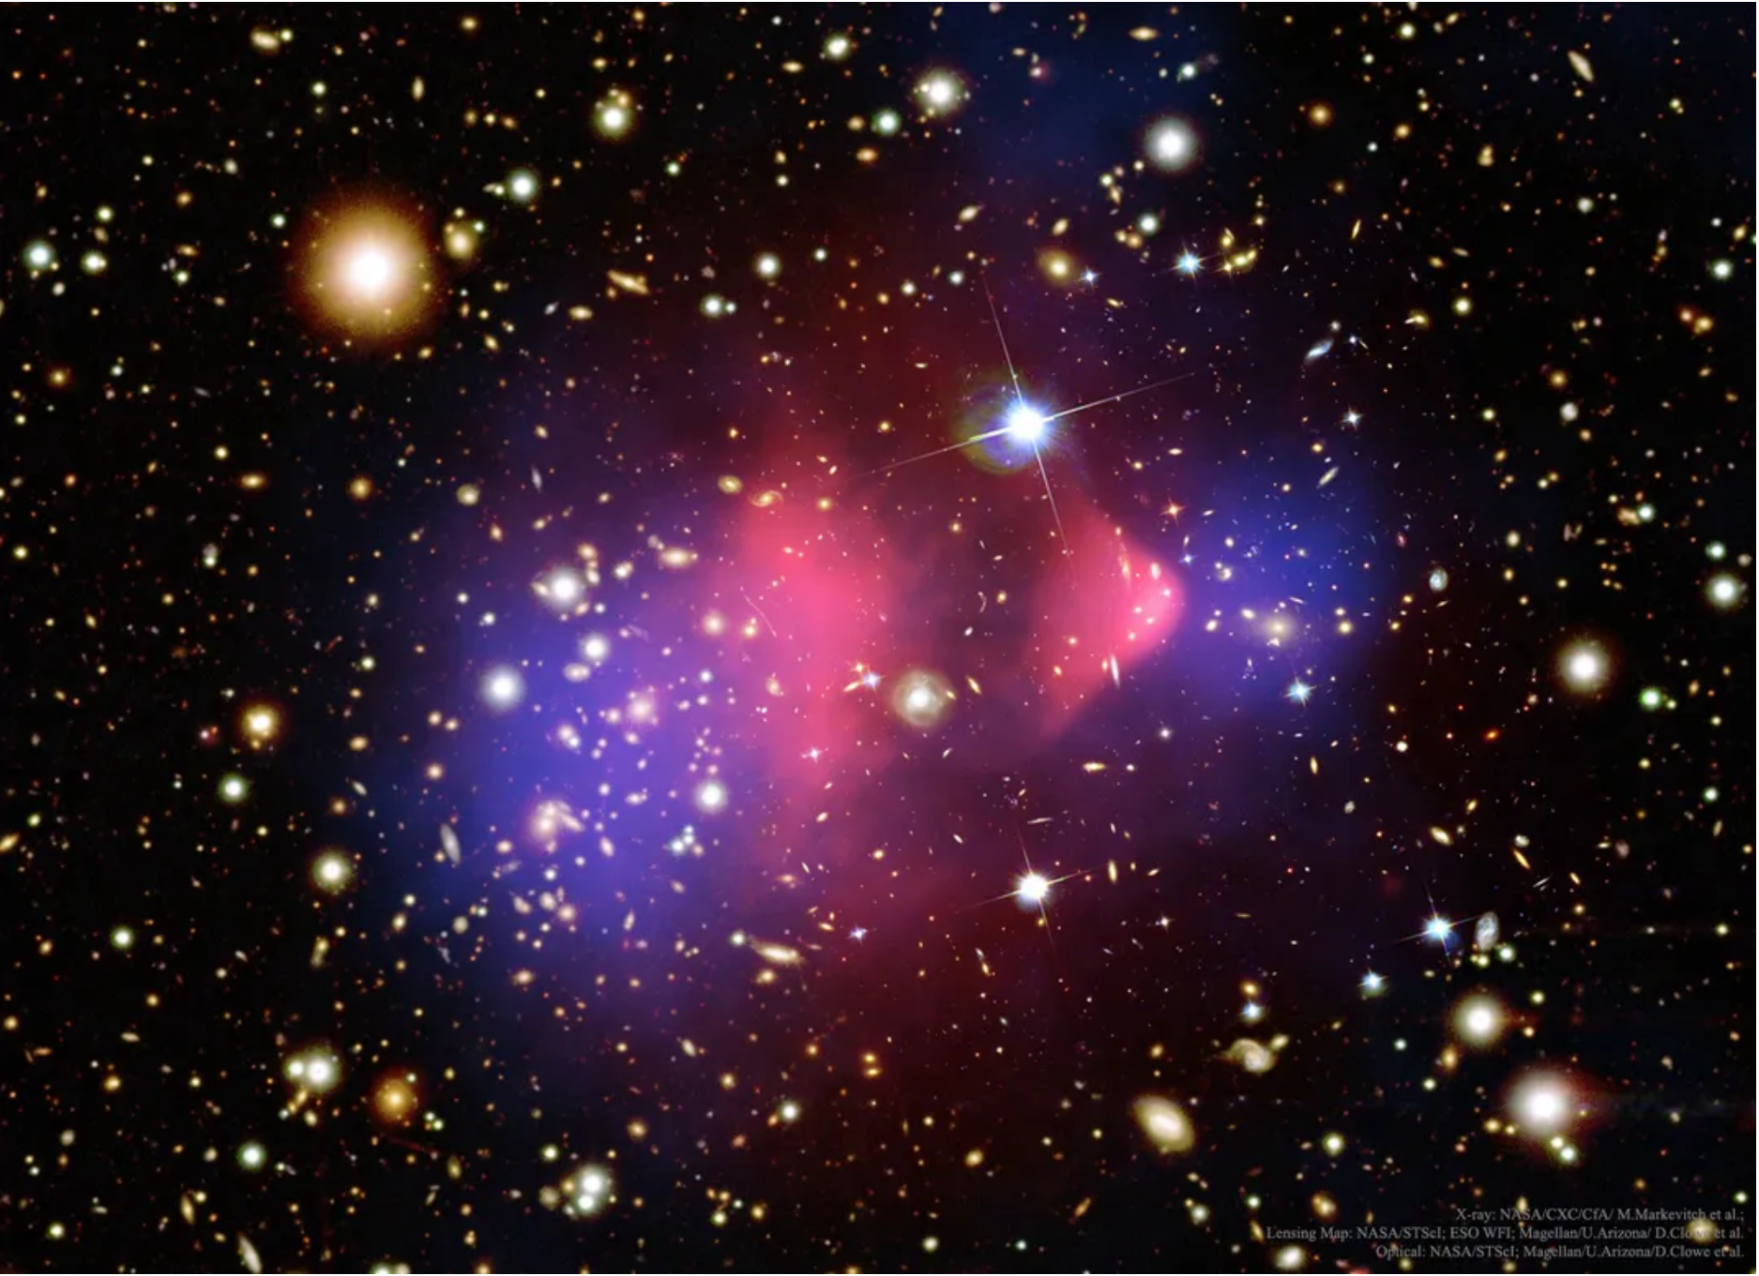
Dark Matters in the Universe
A massive cluster of galaxies, known as the Bullet Cluster, creates gravitational lens distortions of background galaxies in a way that has been interpreted as strong evidence that dark matter exists within.
The composite image was created by the Hubble, Chandra and Magellan telescopes, with pink depicting the X-rays emitted by hot gas, and blue depicting the suggested dark matter distribution.
Science, Feb. 3, 2020 by Emily Toomey

Slide 4
Background of Detections of Neutrinos and Dark Matters
Initial Idea: There is ample evidence for the existence of dark matter in the Universe: the observation that rotation curves of spiral galaxies stay flat at large radii instead of declining as expected from the gravitational potential provided only from visible matter.
Our Universe: On larger scales the fluctuations in the cosmic microwave background confirm that only 4.8% of the Universe is ‘ordinary’ matter while the rest is 25.8% dark matter, and 69% dark energy.
Dark matter has a “collisionless” nature, non-interacting, with “ordinary” matter --- ?.
“sterile’ neutrinos and the so-called weakly interacting massive particles (WIMPs, a term for particles that only interact through gravity and the weak force), are expected to have a mass from below GeV/c2 to several TeV/c2.
Unclear: It is still not clear what the nature of dark matter actually is.
There are three possible processes to detect dark matter/neutrinos: 1) astronomical signals from two dark matter particles self-annihilating (an indirect search),; 2) production at particle accelerators (ORNL); 3) scattering of a dark matter particle off a nuclei in a laboratory (direct searches).
Froborg and R Duffy, Annual modulation in direct dark matter searches, J. Phys. G: Nucl. Part. Phys. 47 (2020) 094002 (37pp)
Notes:
The idea was initially inferred by the observation that rotation curves of spiral galaxies stay flat at large radii instead of declining as expected from the gravitational potential provided only from visible matter [Babcock H W 1939 The rotation of the Andromeda Nebula Lick Obs. Bull. 19 41–51 [2] Rubin V C and Ford W K Jr 1970 Rotation of the Andromeda Nebula from a spectroscopic survey
of emission regions Astrophys. J. 159 379–403].
On larger scales the fluctuations in the cosmic microwave background confirm that only 4.8% of the Universe is ‘ordinary’ matter while the rest is 25.8% dark matter, and 69% dark energy [Planck Collaboration Ade P A R, Aghanim N et al 2016 Planck 2015 results - XIII. Cosmological
parameters Astron. Astrophys. 594 A13]

Slide 5
Direct Detections of DM/Neutrinos
Generation of nuclear recoils by WIMP has similarity to what we have been working on high energetic particles or neutron induced damages in materials.
Susana Cebrian, FIPs (Feebly-Interacting Particles) 2020, 31 August 2020
DM direct detection experiments in the low (< 10 GeV) mass range
Notes:
DM direct detection experiments in the low (< 10 GeV) mass range
weakly interacting massive particle (WIMP)

Slide 6
Direct Detections of Neutrinos and Dark Matters
Susana Cebrian, FIPs 2020, 31 August 2020
We will only focus on solid state detectors
Notes:
In the case of direct searches most experiments are counting experiments in the sense that they try to reduce or identify all potential background and then count potential events in their signal region. Another approach is the search for a modulation of the overall event rate in the region of interest. Such a modulation is expected due to the rotation of the Earth around the Sun.

Slide 7
Direct Detection of DM
S. Cebrian, PIPs 2020, 31 August 2020

Slide 8
Low Mass DM: Si Detectors
Seems to be in a vacuum
S. Cebrian, PIPs 2020, 31 August 2020

Slide 9
Low Mass DM: Si Detectors
S. Cebrian, PIPs 2020, 31 August 2020

Slide 10
Silicon Detector of Neutrinos and Dark Matters
Daily and annual modulation rate of low mass dark matter in silicon detectors
Abolfazl Dinmohammadi, Matti Heikinheimo, Nader Mirabolfathi, Kai Nordlund, Hossein Safari, Sebastian Sassi, and Kimmo Tuominen
Low threshold detectors with single-electron excitation sensitivity to nuclear recoil events in solid-state detectors are also sensitive to the crystalline structure of the target and, therefore, to the recoil direction via the anisotropic energy threshold for defect creation in the detector material.
Investigate the effect and the resulting daily and annual modulation of the observable event rate for dark matter mass range from 0.2 to 5 GeV/c2 in a silicon detector.
It shows that the directional dependence of the threshold energy and the motion of the laboratory result in modulation of the event rate which can be utilized to enhance the sensitivity of the experiment.
Demonstrate that the spin-independent interaction rate in silicon is significant for both high and low dark matter masses. For low-mass dark matter, They show that the average interaction rate in silicon is larger than germanium, making silicon an important target for identifying dark matter from backgrounds. They found 8 and 12 hours periodicity in the time series of event rates for silicon detector due to the 45-degree symmetry in the silicon crystal structure.
--- In Theory Only
https://doi.org/10.48550/arXiv.2301.06592

Slide 11
Low Mass DM: Ge Detectors
S. Cebrian, PIPs 2020, 31 August 2020

Slide 12
Low Mass DM: Si and Ge Bolometers
S. Cebrian, PIPs 2020, 31 August 2020
Notes:
A bolometer is a device for measuring radiant heat by means of a material having a temperature-dependent electrical resistance.

Slide 13
Low Mass DM: Ge Bolometers
S. Cebrian, PIPs 2020, 31 August 2020

Slide 14
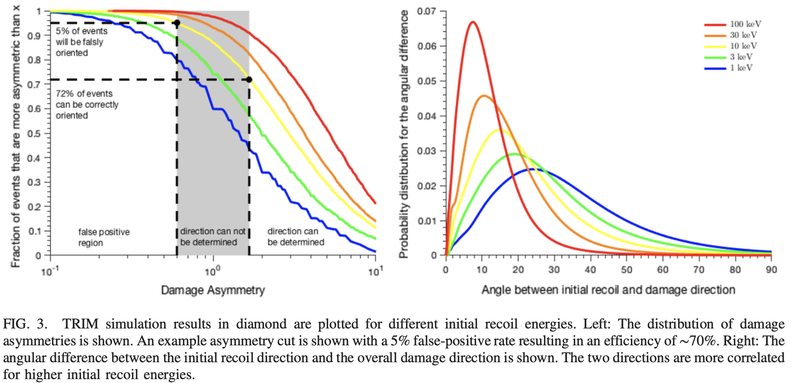
Low Mass DM: Diamond Detectors
Diamond is a prototypical brittle ceramic and has long been of scientific and technological interest because of its exceptional mechanical, optical, and thermal properties.
Measurement of nanoscale ~50nm strain generated from defects in diamond.
SURJEET RAJENDRAN et al. PHYSICAL REVIEW D 96, 035009 (2017)
Diamond detectors
Notes:
The WIMP or neutrino-induced nuclear recoil is detected using real-time charge, phonon, or photon collection. The directional signal, however, is imprinted as a durable sub-micron damage track in the lattice structure.
the key technical challenge will be identifying the mm3 region within the crystal where the WIMP scattering event occurred.
using high-purity lab-grown diamond crystal for the detection of sub–giga electron volt dark matter. Diamond targets can be sensitive to both nuclear and electron recoils from dark matter scattering in the mega-electron-volt and above mass range as well as to absorption processes of dark matter with masses between sub–electron volts to tens of electron volts. Compared to other proposed semiconducting targets such as germanium and silicon, diamond detectors can probe lower dark matter masses via nuclear recoils due to the lightness of the carbon nucleus.

Slide 15
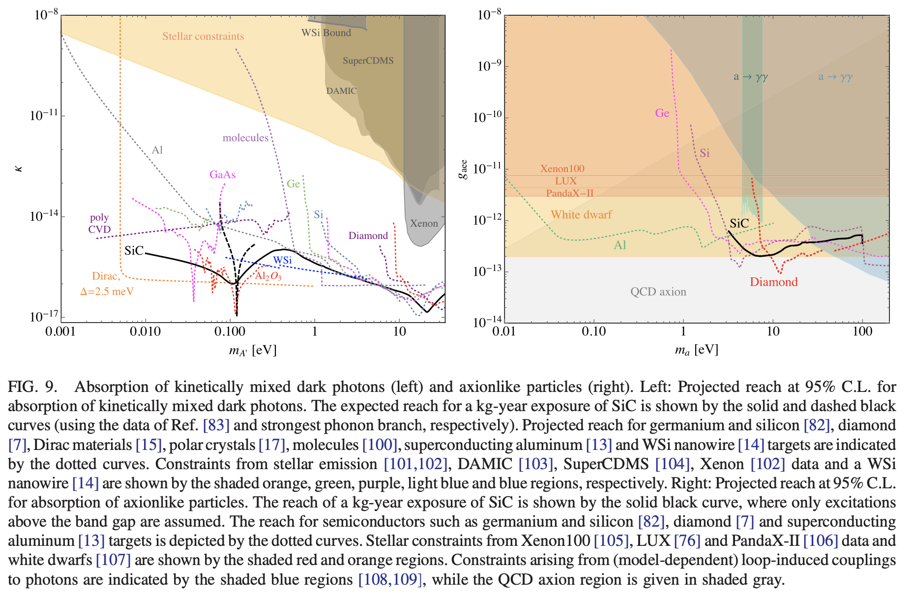
Low Mass DM: SiC Detectors with Comparison to Others
SiC has properties similar to both silicon and diamond but has two key advantages: (i) it is a polar semiconductor which allows sensitivity to a broader range of dark matter candidates; and (ii) it exists in many stable polymorphs with varying physical properties and hence has tunable sensitivity to various dark matter models
Silicon carbide detectors for sub-GeV dark matter, S.M. Griffin et al., PHYSICAL REVIEW D 103, 075002 (2021)

Slide 16
Low Mass DM: CaWO₄ Scintillator Bolometers
S. Cebrian, PIPs 2020, 31 August 2020

Slide 17
Low Mass DM: KTaO₃ Detector
Design a novel concept for using the ferroelectric Potassium Tantalate (KTO) material as a tuning element in haloscopes based on coupled microwave cavities. In this line, the structures used in the Relic Axion Detector Exploratory Setup (RADES) group are based on several cavities that are connected by metallic irises, which act as interresonator coupling elements.
On the use of ferroelectric material in the detection of dark matter axions
J.M. García Barceló,^{∗,a} A. Álvarez Melcón,ª S. Arguedas Cuendis,^{b} A. Díaz-Morcillo,ª B. Gimeno,^{c} A. Kanareykin,^{d} A.J. Lozano-Guerrero^{,a} P. Navarro,ª and W. Wuensch^{e}
ªDepartment of Information and Communications Technologies, Technical University of Cartagena, 30203 - Cartagena, Spain
^{b}Institut de Ciències del Cosmos, Universitat de Barcelona (UB-IEEC), 08028 - Barcelona, Catalonia, Spain
^{c}Instituto de Física Corpuscular (IFIC), CSIC-University of Valencia, 46980 - Valencia, Spain
^{d}Euclid Techlabs, LLC, Bolingbrook, IL (Is developing devices for TEMs to improve their temporal resolution. eEuropean Organization for Nuclear Research (CERN), 1211 Geneva 23, Switzerland

Slide 18
Low Mass DM: Paleo-Detectors (Mineral Detectors)
Susana Cebrian, FIPs (Feebly-Interacting Particles) 2020, 31 August 2020

Slide 19
Low Mass DM: Other Detectors
Mica as mentioned by Patrick
S. Cebrian, PIPs 2020, 31 August 2020

Slide 20
Our Research
Olivine Detector for Neutrinos/DMs

Slide 21
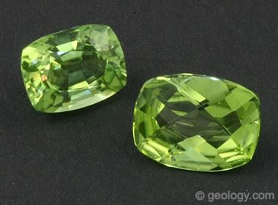
Why Olivine?
Olivine is the name given to a group of silicate minerals that have a generalized chemical composition of A₂SiO₄. In that generalized composition, "A" is usually Mg or Fe, but in unusual situations can be Ca, Mn, or Ni.
A magnesium iron silicate olivine mineral with the chemical formula (Mg,Fe)₂SiO₄ is a type of nesosilicate or orthosilicate.
It is the primary component of the Earth's upper mantle, a common mineral in Earth's subsurface, but weathers quickly on the surface. It is a ubiquitous phase in the Solar System.
Olivine is a gemstone namely peridot. Peridot serves as a birthstone for the month of August.
Olivine Minerals
Mineral | Chemical Composition
Forsterite | Mg₂SiO₄
Fayalite | Fe₂SiO₄
Monticellite | CaMgSiO₄
Kirschsteinite | CaFeSiO₄
Tephroite | Mn₂SiO₄

Slide 22
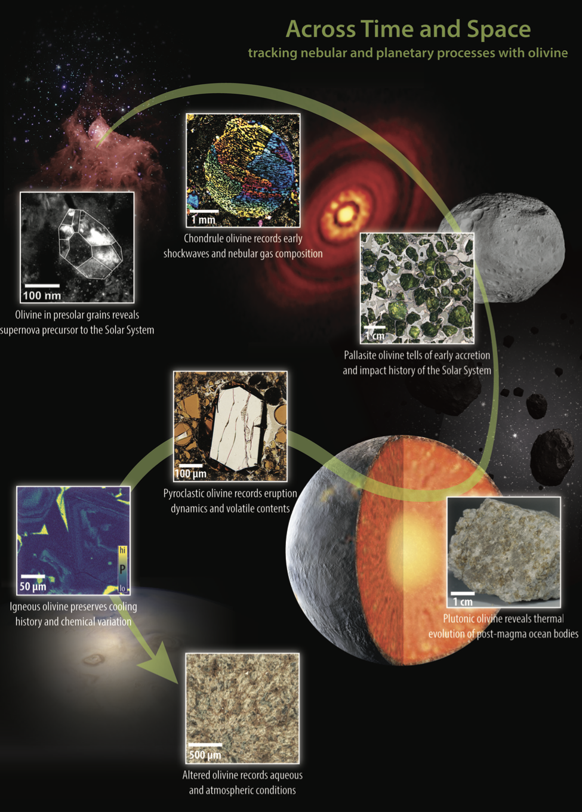
Olivine Featured by Elements in 2023
Recommended by Prof. Rod Ewing from Stanford
Across Time and Space
Tracking nebular and planetary processes with olivine.
Olivine occurs across the galaxy, from Earth to extraterrestrial bodies including the Moon, Mars, and asteroids, to particles of comet dust and distant debris disks.

Slide 23
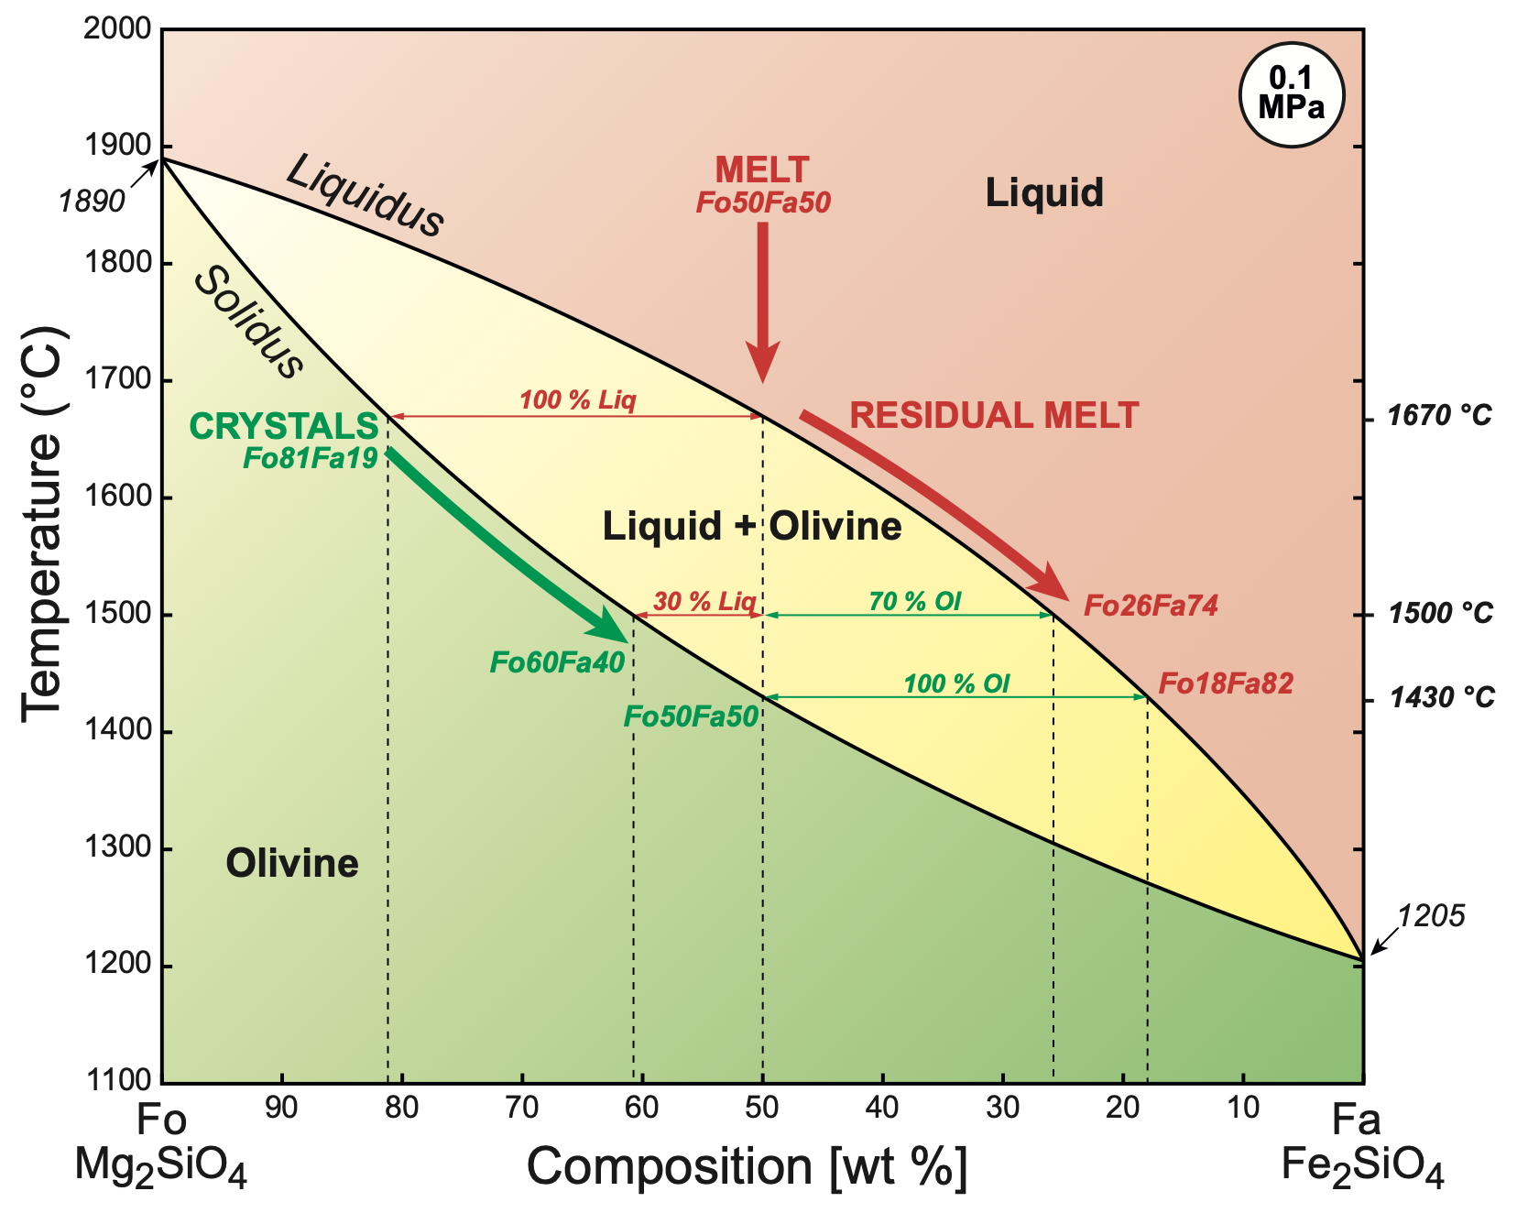
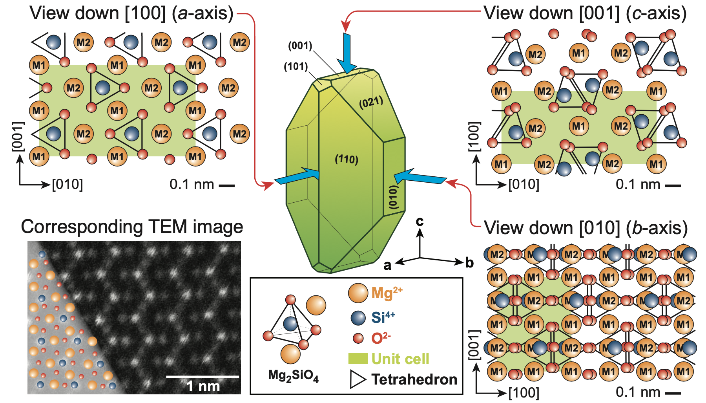
Olivine Featured by Elements in 2023
Olivine—The Little Green Science Machine, Benoît Welsch1, Emily C. First1, Philipp Ruprecht2, and Michael C. Jollands
Elements, Vol. 19, pp. 138–143 (2023)
Atomic structure of olivine assuming pure forsterite and viewed parallel to the three principal crystallo- graphic axes a, b, and c, in the Pbnm space group. the real ionic radii are Mg²⁺: 0.72 Å; Si^{4+:} 0.26 Å; and O²⁻: 1.38 Å.
Binary phase diagram of Mg2SiO4–Fe2SiO4 at 0.1 MPa (Bowen NL, Schairer JF (1935) The system MgO-FeO-SiO2. American Journal of Science s5-29: 151-217)

Slide 24
Olivine Featured by Elements in 2023
Olivine has an orthorhombic crystal structure: sg: Pbnm, a = 0.475 nm, b = 1.020 nm, c = 0.598 nm.
Properties: The density of olivine increases with its Fe content, from 3.3 to 4.4 g/cm3, and its melting point decreases, from 1890 °C in pure forsterite to 1205 °C in pure fayalite in the simple system MgO–FeO–SiO₂ at atmospheric pressure.
To study the Earth and other planetary bodies, we must understand olivine; when and where it forms, how it crystallizes and deforms, and how it responds to changing environmental conditions in the Earth’s interior, on the surface, and in space.
In some ways, olivine has driven the evolution of the Solar System and likely beyond.
Olivine is a fundamental building block in the universe: it is found in a wide range of terrestrial rocks, lunar samples, and meteorites, and has been detected on Mercury, Venus, Mars, and asteroids as well as in debris disks outside of our own Solar System.
Olivine is our bridge across time and space.
Statements from Elements, Vol. 19 (2023)

Slide 25
Fission Tracks in Olivine Minerals
A fission track is a zone of intense damage formed when fission ($α$-decays) fragments pass through a solid. A track is tens of angstroms in diameter and about 10–20 μm in length.
A fission track in its natural state can only be observed with a TEM directly, but a suitable chemical etchant can enlarge the damage zone so that it can be observed and counted with an optical microscope, usually at × 1000–1500 magnification.
Those features must be recognized and excluded from the study of DM/Neutrino effects on olivines
Notes:
When an atom of ²³⁸U fissions spontaneously, the nucleus breaks into two lighter nucli, one averaging about 90 atomic mass units and the other about 135 atomic mass units, with the liberation of about 200 MeV of energy. The two highly charged nuclei recoil in opposite directions and disrupt the electron balance of the atoms in the host mineral lattice or glass along their path. This disruption of electron charge causes the mutual repulsion and displacement of the resulting positively charged ions from their normal structural positions in the host material. The result is a zone of damage that defines the fission track.

Slide 26
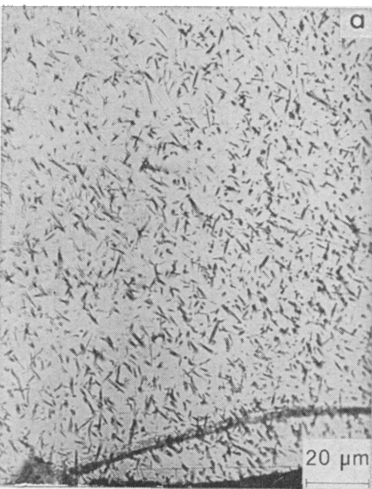
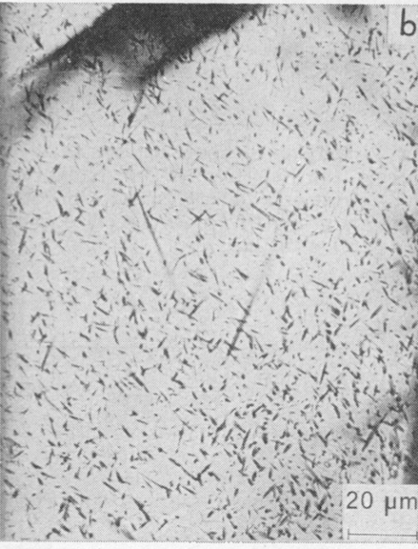
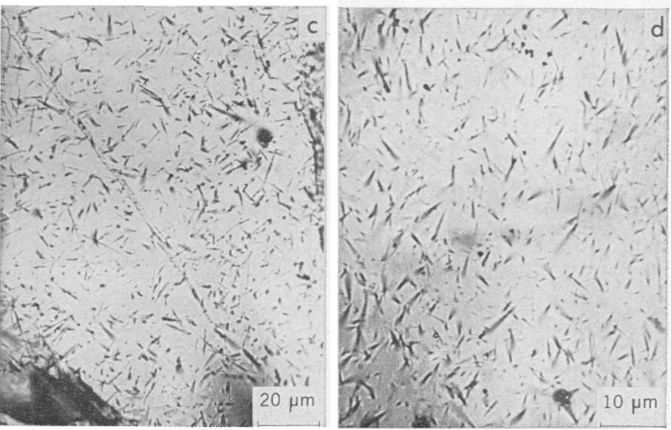
Fossil Cosmic-ray Tracks in Olivine
a
b
c
d
Fossil cosmic-ray tracks due to iron-group nuclei in olivines: (a and b) from the Patwar meteorite; (c and d) in lunar regolith grains from the Apollo 12 mission. Part c shows sample 12028,68 (double core); part d shows sample 12041, 11 (surface scoop). Tracks were revealed by etching with WN at its boiling point for 5 hours. Tracks were decorated with 0.25 unit of silver.
Olivines: Revelation of Tracks of Charged Particles, Science, 174 (1971) 287.

Slide 27
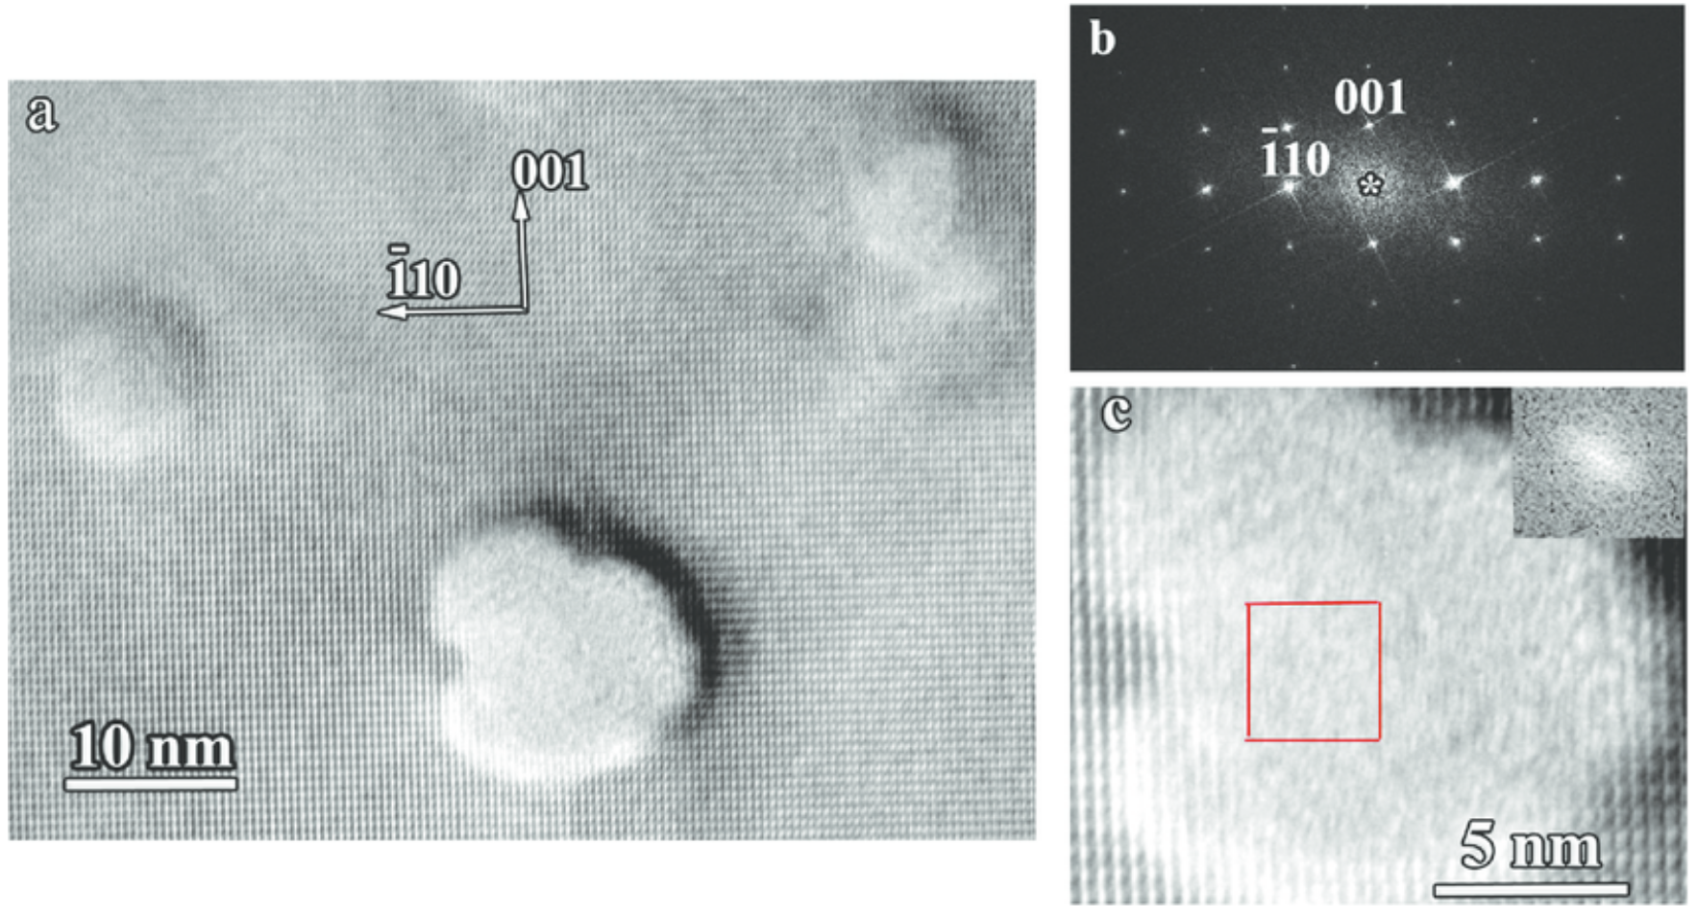
Radiation Effects on Microstructures of Olivine
--- Heavy Ion Tracks
Ion Tracks in Olivine by TEM
HRTEM image of ion tracks in olivine irradiated with 11.1 MeV nucleon −1 Au ions. (a) Track cross-section, (b) FFT pattern of the olivine matrix in [110] zone axis, (c) enlarged image of the track core with FFT pattern from marked area (inset).
10.3847/0004-637X/829/2/120 The Astrophysical Journal, 829, 120 (2016).
Notes:
We could figure out the generation of tracks in olivines under different ion beam conditions.

Slide 28
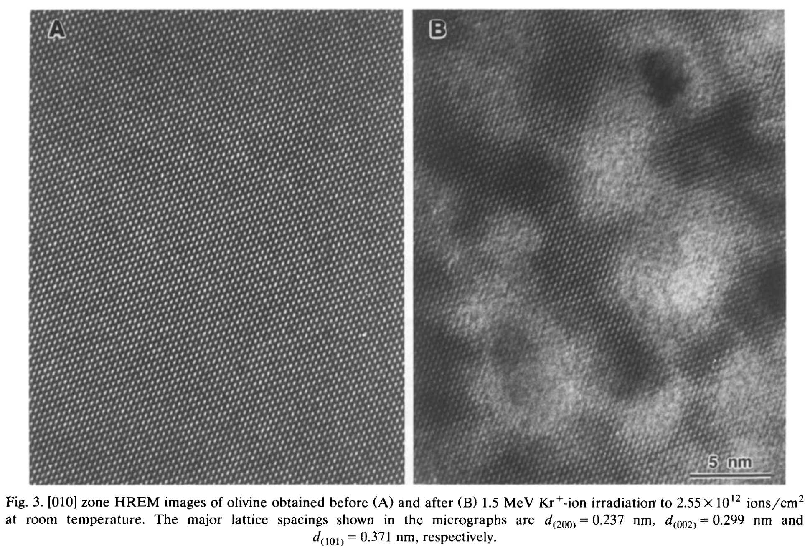
Radiation Effects on Microstructures of Olivine
--- Heavy Ion Irradiation Induced Amorphization
Thin foils of olivine [(Mg_{0.88}Fe_{0.12})₂SiO₄] are completely amorphized at room temperature by a 1.5 MeV Kr⁺-ion irradiation after a dose of 5.3 × 10¹⁴ ions/cm².
HRTEM study of displacement cascade damage in krypton-ion-irradiated silicate - olivine L.M. Wang, M.L. Miller and R.C. Ewing, Ultramicroscopy 51 (1993)339-347

Slide 29
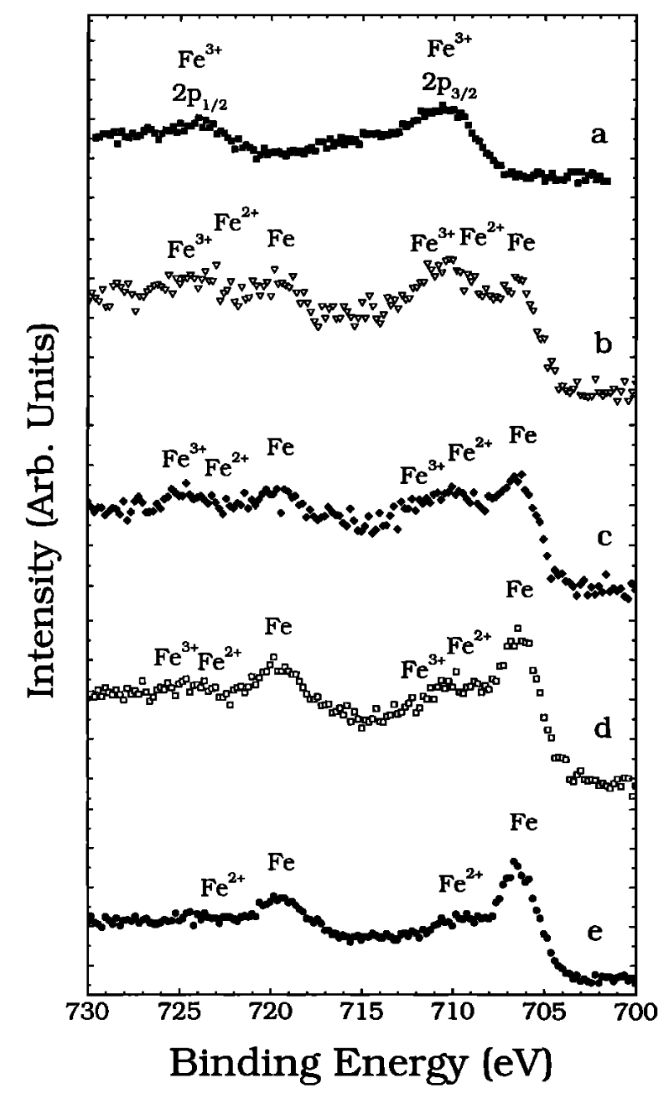
Radiation Effects on Microstructures of Olivine
--- Light Ion Irradiation Induced Surface Modification
Detail of XPS spectrum in the Fe-2p region, showing reduction of iron in olivine as a function of the fluence of 4 keV helium ions. Features to the high binding energy side of the prima• transitions are shake-up peaks.
The olivine surface is composed of Fe³⁺ before ion bombardment. Iron begins to reduce from the surface ferric oxide(Fe ) to olivines native ferrous oxide(Fe ) and metallic iron(Fe).
Iron spectra are shown for (b) 5 x 10¹⁶He/cm², (c)1 x 10¹⁷He/cm², and (d) 2 x 10¹⁷He/cm². (e)After 4x10¹⁷He/cm² most of the iron oxide has been chemically reduced, leaving a residual amount of Fe²⁺ and Fe³⁺.
--- Simulating Solar Wind effect on the surfaces of numerals.
C.A. Dukes et al., JOURNAL OF GEOPHYSICAL RESEARCH, VOL. 104, NO. El, PAGES 1865-1872, JANUARY 25, 1999

Slide 30
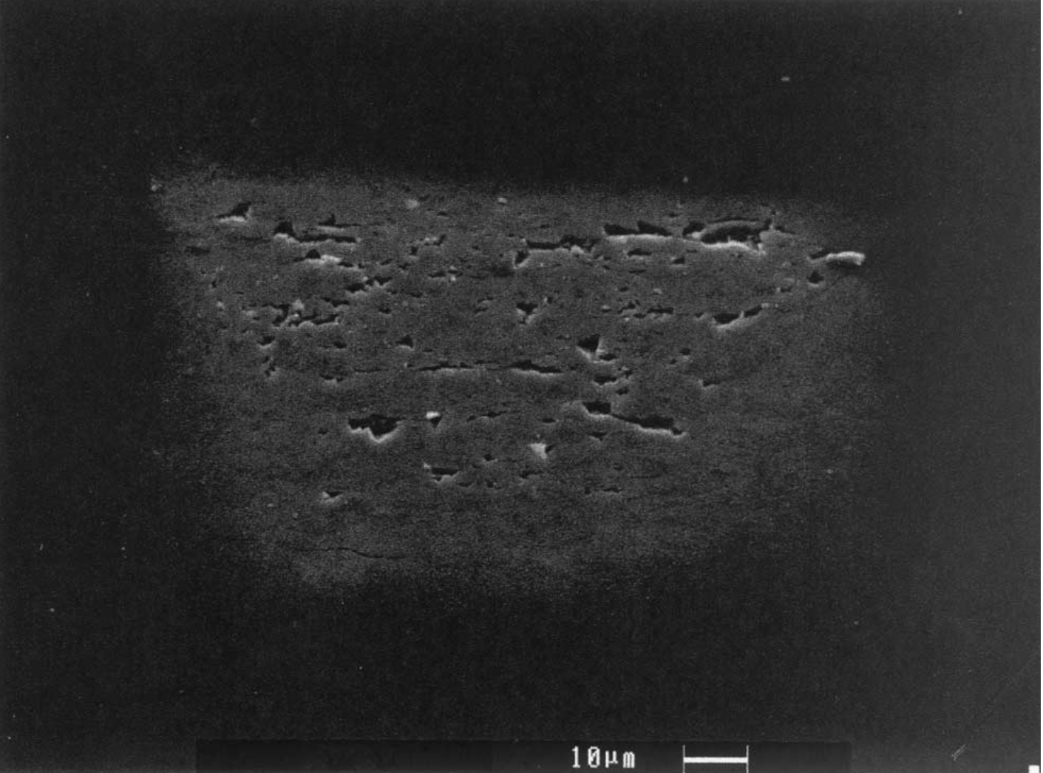
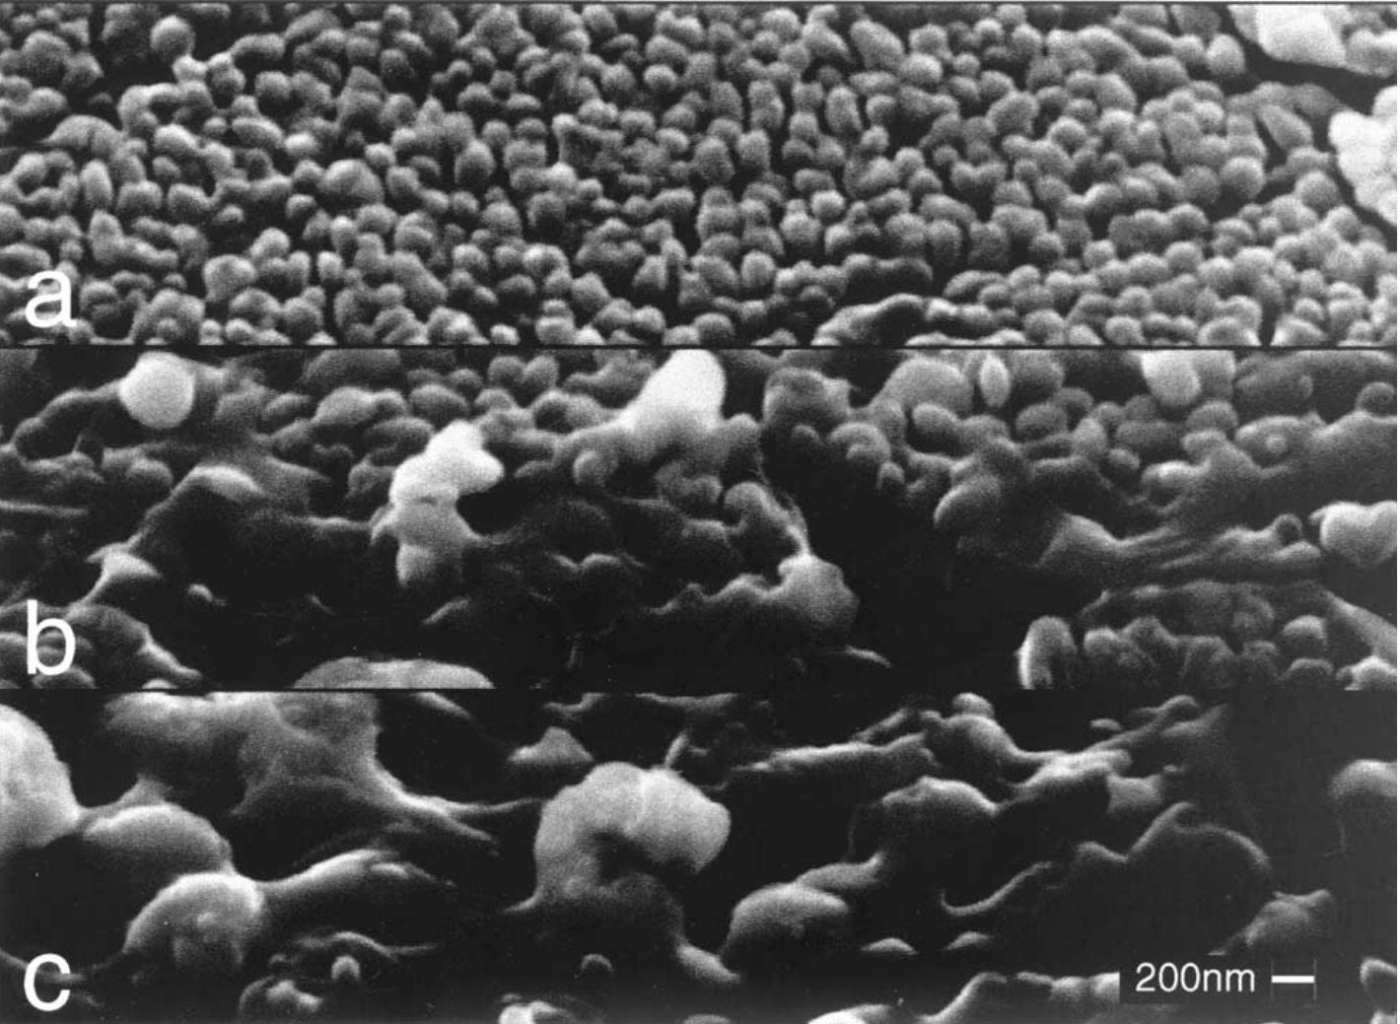
Radiation Effects on Microstructures of Olivine
--- Electron-beam Irradiation
Electron beam induced chemical fractionations from electrostatic discharges leading to the breakdown of the dielectric lattice: The irradiated areas are slightly enriched in MgO, whereas the deposits are enriched in SiO₂.
SEM image (tilt angle of 60°) of olivine surface (10% Fa–90% Fo) scanned 4 times on a 100 um x 100 um area with a 60-nA beam (Q =180 pC/um² and T =30 s).
SEM images (tilt angle of 60°) of surface microstructures inside 100 um x 100 um irradiated zones, scanned (a) 4, (b) 20, and (c) 30 times (Q =180 pC/um² and T = 30 s).
Such processes could be responsible for significant space weathering of interplanetary dust particles and regoliths of planetary surfaces. In the interplanetary medium, 10-keV range electrons are carried by the solar wind.
L. LEMELLE, L. BEAUNIER, S. BORENSZTAJN, M. FIALIN, and F. GUYO, Destabilization of olivine by 30-keV electron irradiation: A possible mechanism of space weathering affecting interplanetary dust particles and planetary surfaces, Geochimica et Cosmochimica Acta, Vol. 67, No. 10, pp. 1901–1910, 2003.

Slide 31
Strategy
Starting from small pieces of peridot samples
“Raw” natural mineral
SEM+EDS: Composition measurement
XRM: 3D imaging of the perfection of the sample.
FIB/SEM: Site-specified TEM specimen sampling
STEM/TEM: Defect structures and chemistry analysis.
Annealed natural mineral
XRM: 3D imaging of the perfection of the sample.
FIB/SEM: Site-specified TEM specimen sampling
STEM/TEM: Defect structures and chemistry analysis
Perform ion irradiation and then analyze he sample again..
Work with large pieces of peridot samples

Slide 32
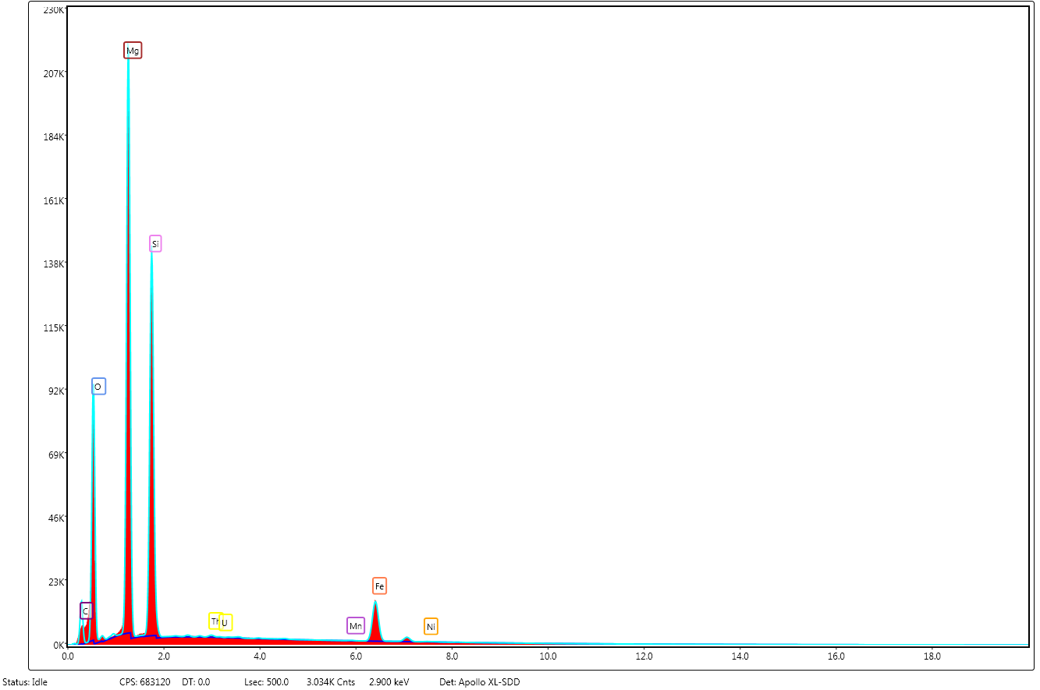
Preliminary Data
Mg_{1.6}Fe_{0.4}(SiO₄)
Element | Weight % | Atomic % | Weight %
C K* | 19.65 | 30.39 | -
O K | 32.71 | 37.98 | 40.78
Mg K | 24.29 | 18.55 | 30.28
Si K | 16.22 | 10.73 | 20.22
Th M | 0.02 | 0 | -
U M | 0.06 | 0 | -
Mn K | 0.05 | 0.02 | -
Fe K | 7 | 2.33 | 8.72
SEM EDS data
*C from the coating for excluding charging effect.

Slide 33
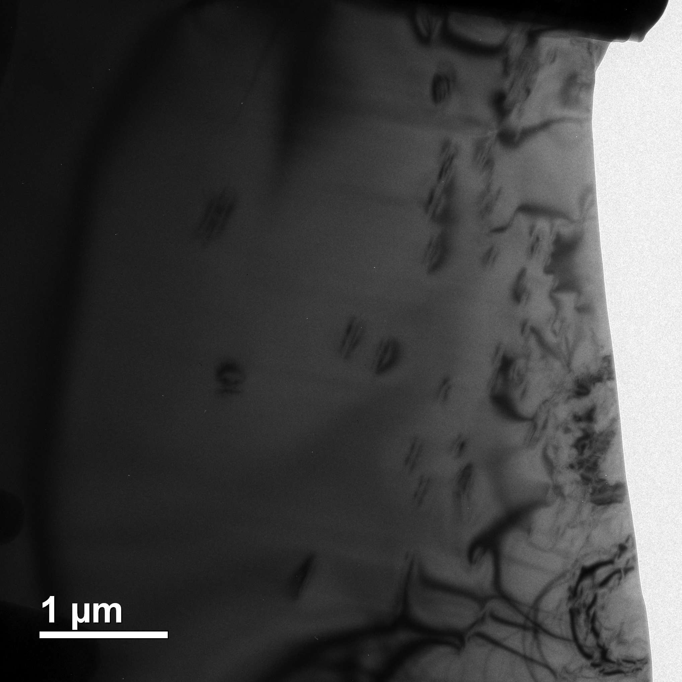
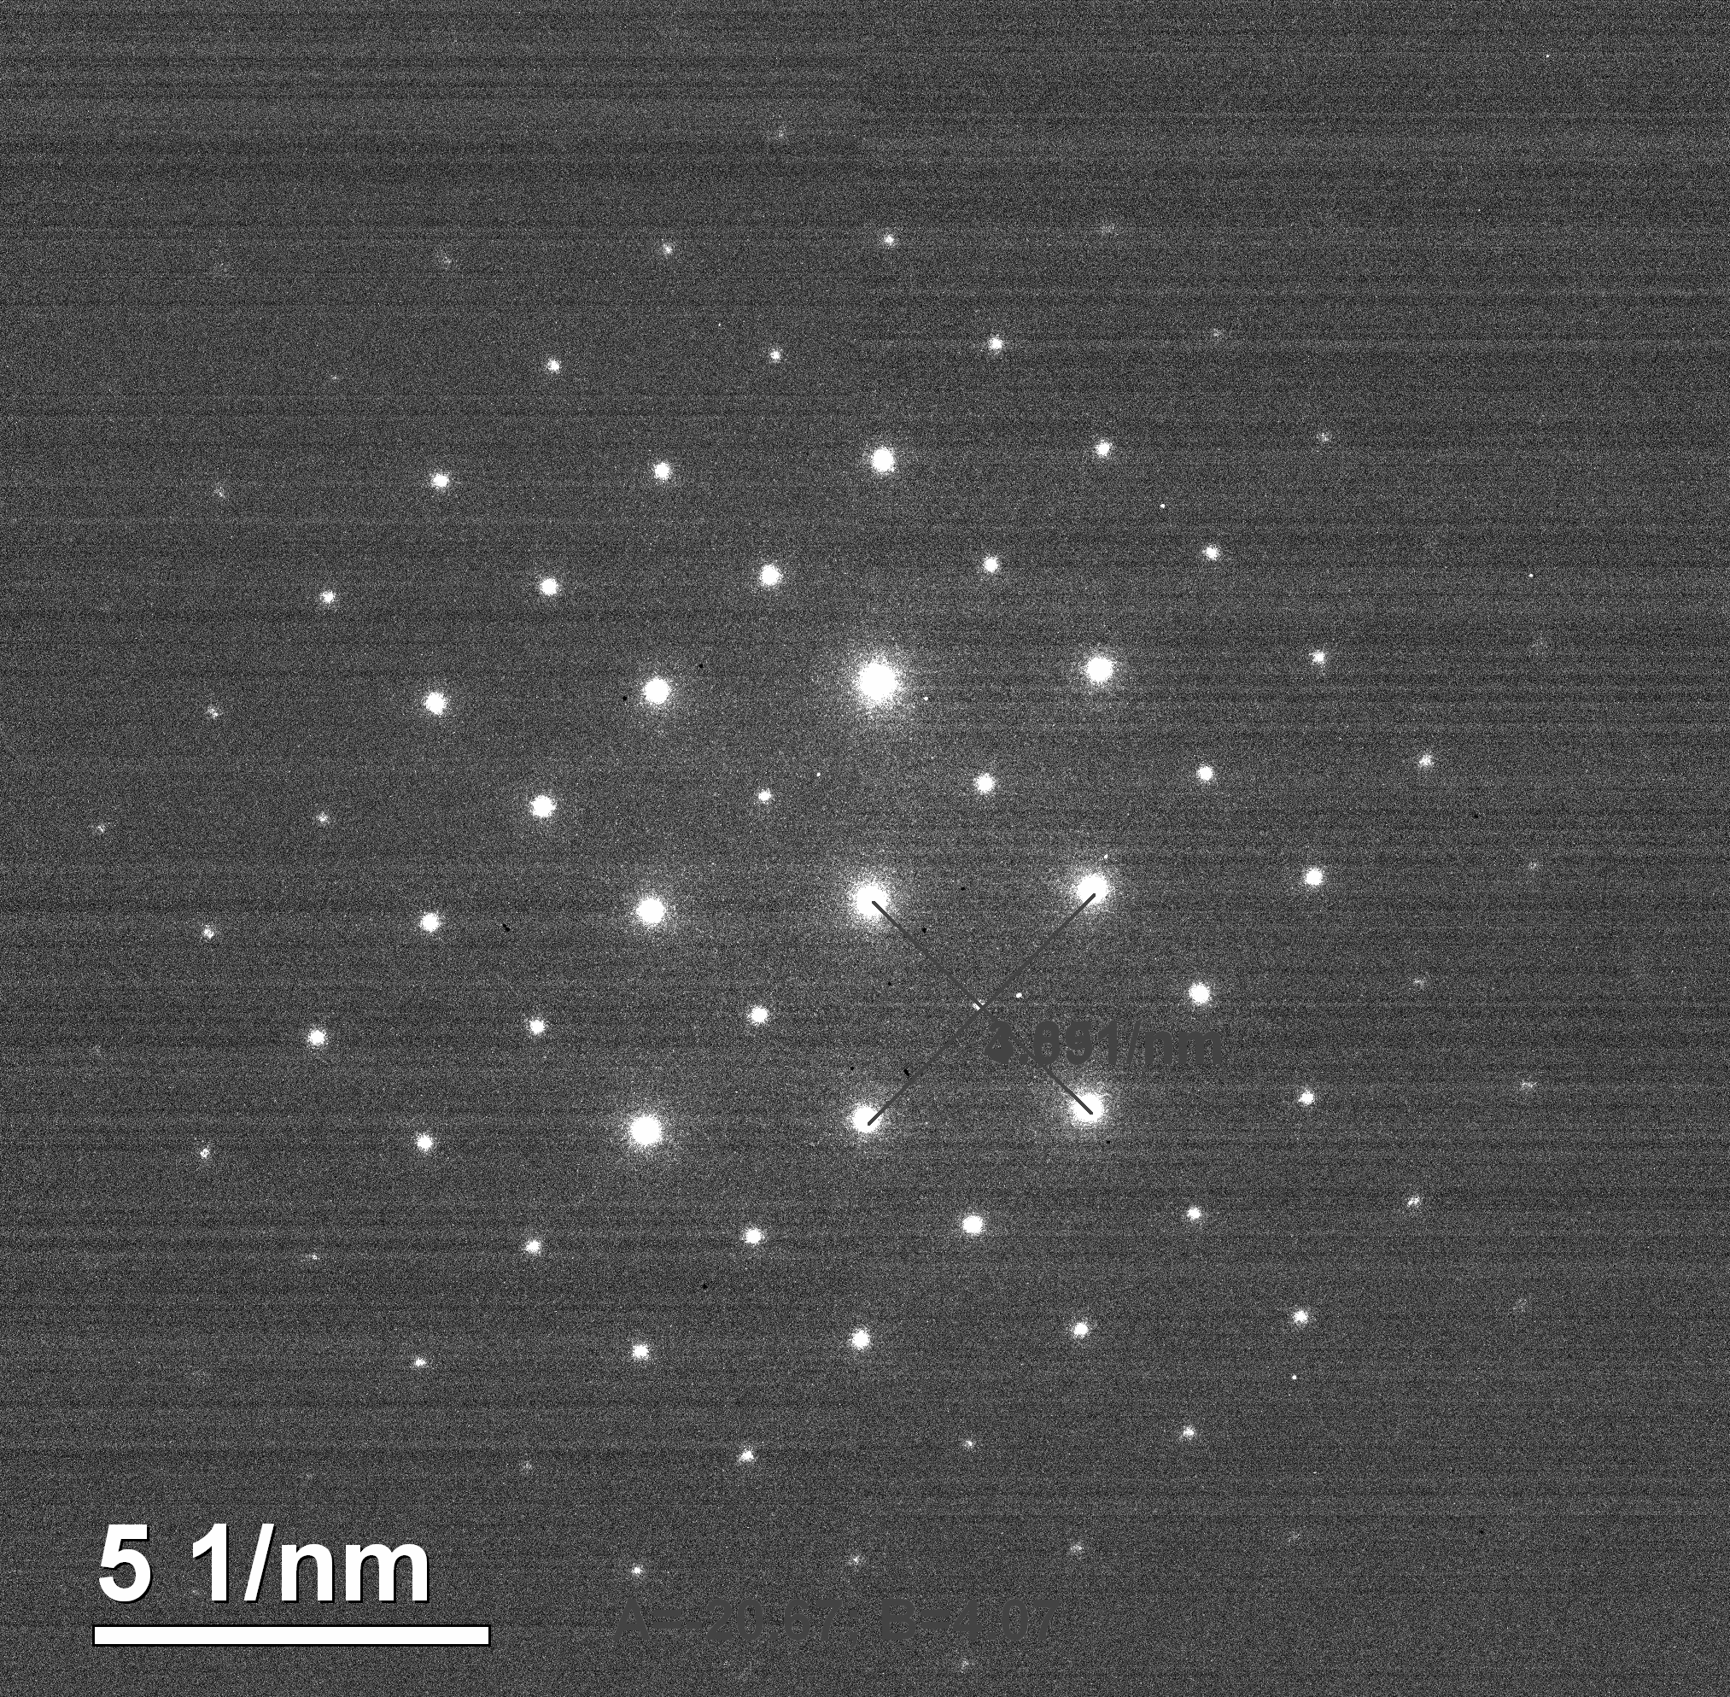
Preliminary Data
TEM Bright-field image showing some defects
TEM SAED along [010]

Slide 34
Preliminary Data-X-ray Tomography

Slide 35
Preliminary Data-X-ray Tomography
Showing cavities associated with heavy element atoms possibly Th and U.

Slide 36
Summary and Future Plan
Detectors for direct DM/Neutrinos detections are reviewed. Some of the research were just from theory.
No research has studied the microstructures of the detectors irradiated by neutrinos/DM directly -- Direct detection using indirect methods
We have been working on olivine using several material characterization techniques. More research will be performed according to our strategy plan.

