Slide 1
A cosmic-ray harvest in the dried-out Mediterranean basin
Lorenzo Caccianiga INFN – Milano lorenzo.caccianiga@mi.infn.it
Claudio Galelli, Lorenzo Apollonio, Paolo Magnani, Alessandro Veutro, Federico Maria Mariani

Slide 2
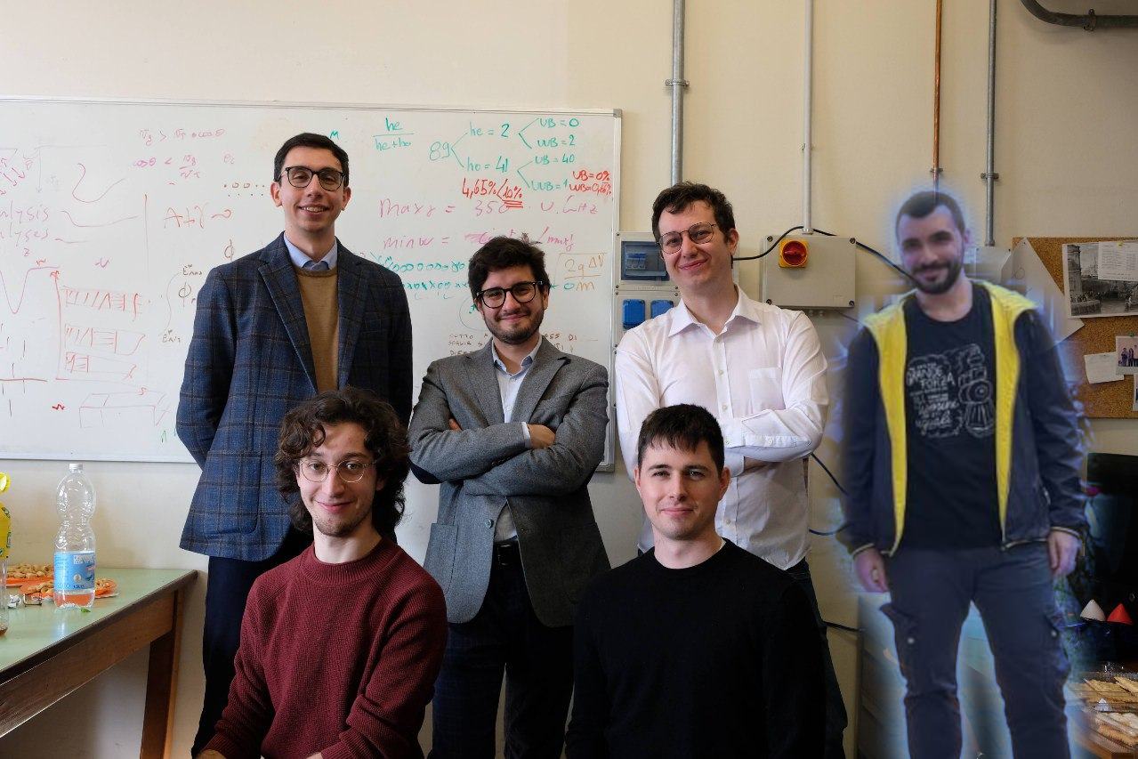
The Milan group
We mainly work on UHECR within the Pierre Auger Observatory collaboration, having fun with Paleo detectors!
Claudio Galelli, former Phd Student
Currently post-doc at the Paris Obsevatory
Alessandro Veutro, former Master student currently PhD student in Rome on KM3NeT
Federico Mariani, PhD student
Paolo Magnani, Master student
Lorenzo Apollonio, PhD student

Slide 3
Claudio Galelli, Lorenzo Apollonio, Paolo
Lorenzo Caccianiga INFN – Milano lorenzo.caccianiga@mi.infn.it
Claudio Galelli, Lorenzo Apollonio, Paolo Magnani, Alessandro Veutro,
Federico Maria Mariani

Slide 4
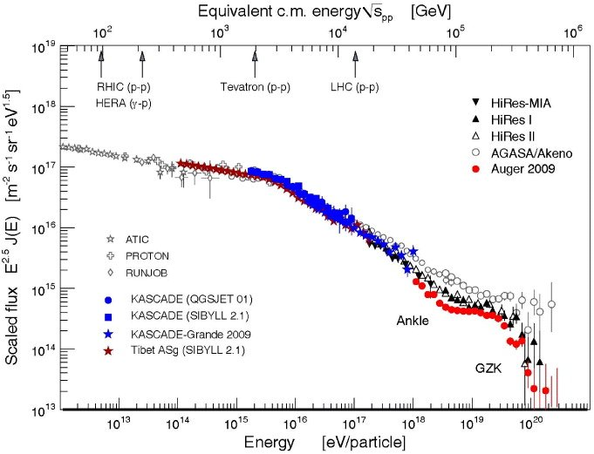
Cosmic rays
Ranging from few GeV to hundreds of EeV (1 EeV= 10¹⁸ eV)
Most energetic particles known
They produce extensive air showers of secondary particles when they interact with the atmosphere: in these showers are muons, neutrons and neutrinos
primary cosmic rays mostly charged particles and are deflected by galactic (and extragalactic) magnetic fields, and thus delayed wrt to neutral particles
cosmic rays in the TeV-PeV region associated to supernova remnants, higher energy may be accelerated by compact objects (magnetars?)
Evidence for extragalactic origin above few EeV (AGN or starburst galaxies?).

Slide 5
Why digging?
Why should we use paleo detectors
when we have much more refined detectors?
They can reach a very large exposure, even with a small sample
possibly larger than we could ever build artificially
They can measure the fluxes of astroparticles in the past
One of the very few chances of studying any astrophysical emission in the past

Slide 6
How do we investigate the past of the universe?
True on cosmological scales, but how can we investigate the past of our Galaxy, or even of the proximity of our solar system?

Slide 7
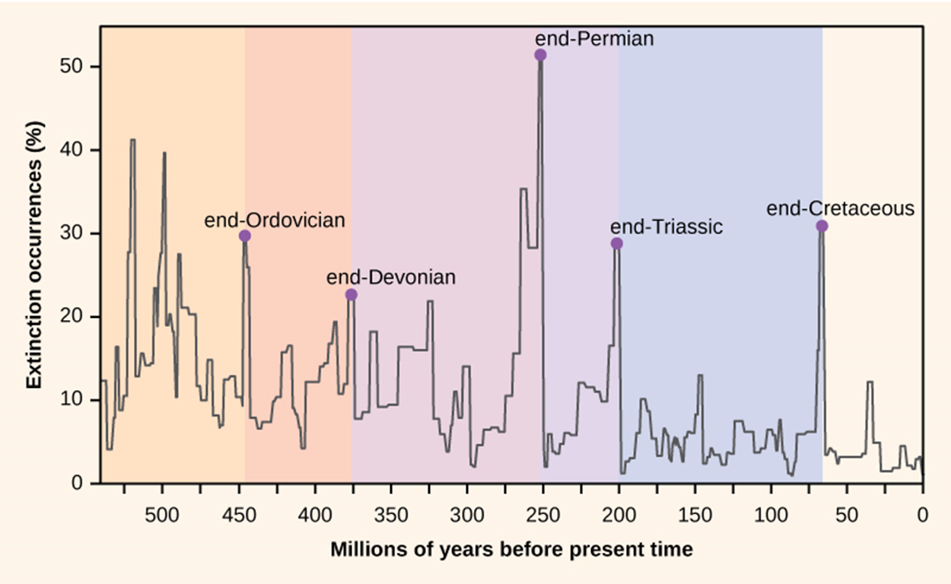
Mass extinctions: caused by nearby astrophysical events?
It was suggested in various occasion that a nearby catastrophic astrophysical event might be the cause of some of the various mass extinctions that happened on Earth
gamma emission from SN or GRB could have depleted the ozone layer, causing harmful UV radiation to kill surface-living species (or making them evolve quicker)
some extinctions show however that also deep-sea and deep-underground creatures were affected. It was suggested that it might be the effect of elevated muon (and/or neutron?) fluxes induced by a burst of primaries
such a flux might easily have left tracks in paleo-detectors

Slide 8
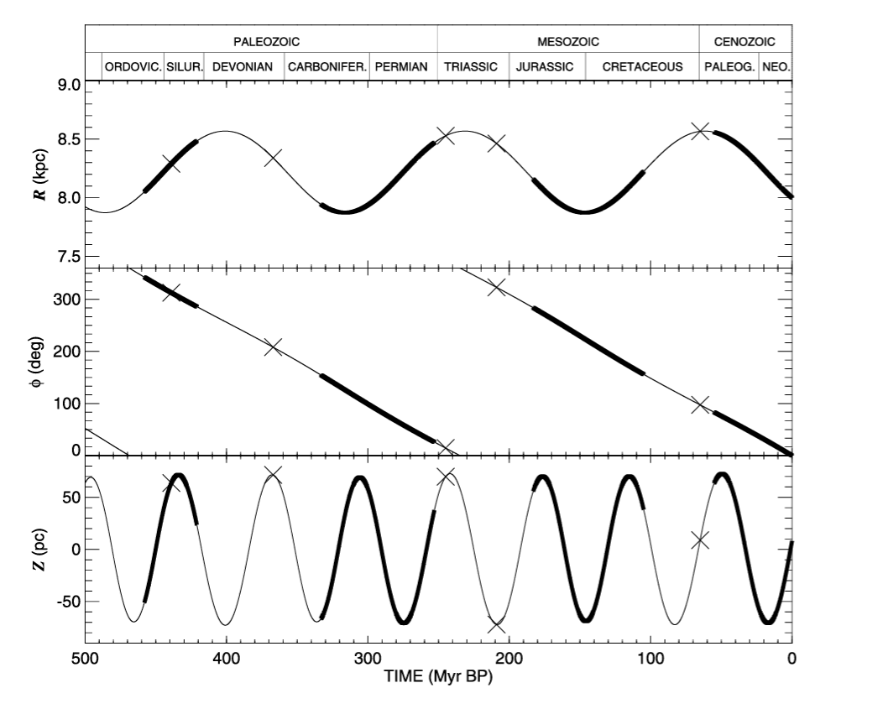
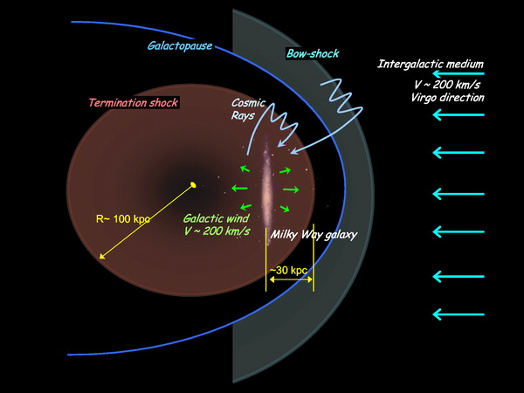
Mass extinctions: caused by nearby astrophysical events?
The possible 62Myr periodicity in mass extinctions might be correlated to the motion of the solar system in the Galaxy?
D. R. Gies and J. W. Helsel 2005 ApJ 626 844DOI 10.1086/430250
Mikhail V. Medvedev and Adrian L. Melott 2007 ApJ 664 879DOI 10.1086/518757
Atri and Melott Geophys. Res. Lett., 38, L19203, doi:10.1029/2011GL049027

Slide 9
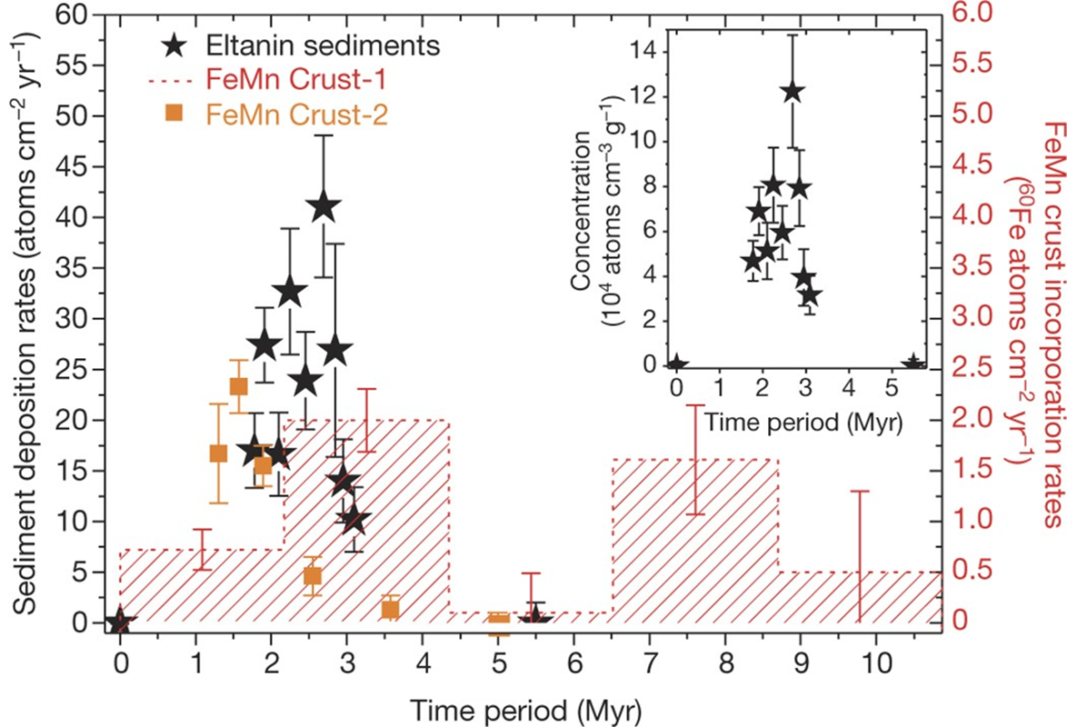
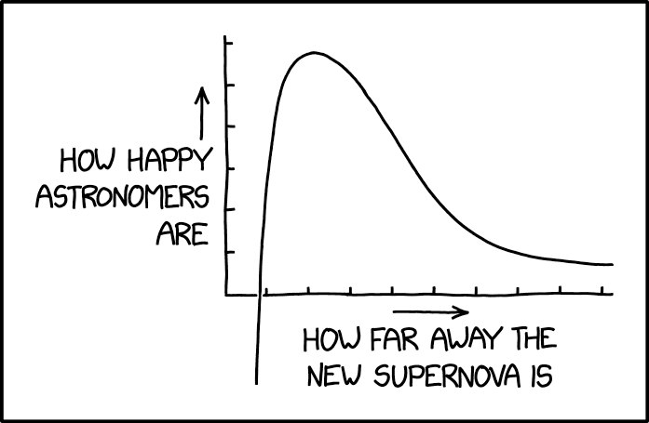
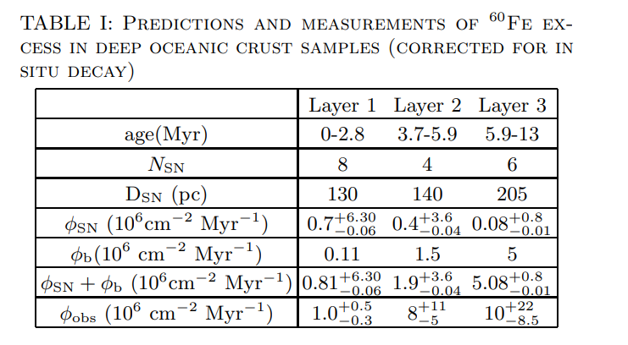
Traces of recent and close supernovae events
⁶⁰Fe deposit on oceanic crust
Identified as trace of close (100-200 pc) supernovae in the recent (few Myr) past
K. Knie, G. Korschinek, T. Faestermann, E. A. Dorfi, G. Rugel and A. Wallner, «60Fe Anomaly in a Deep-Sea Manganese Crust and Implications for a Nearby Supernova Source,» Phyis. Rev. Lett., vol. 93, n. 17, p. 171103, 2004.

Slide 10
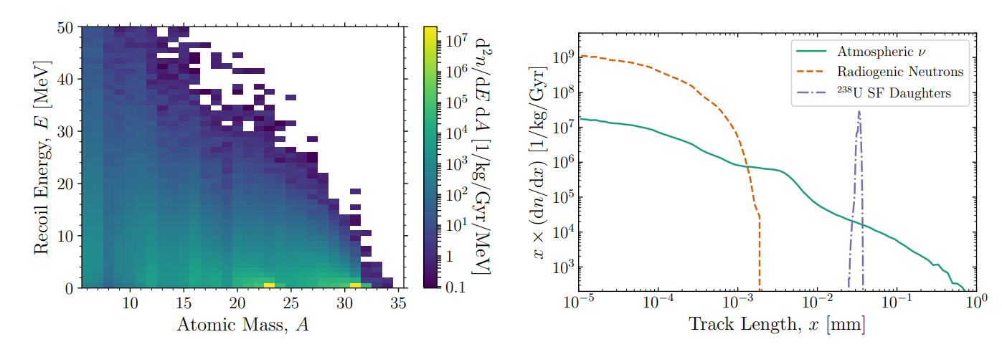
Paleo-detectors for cosmic rays
Cosmic rays are always measured through the secondary particles they generate, amongst them there are the atmospheric neutrinos:
J. R. Jordan, S. Baum, P. Stengel, A. Ferrari, M. C. Morone, P. Sala and J. Spitz, «Measuring Changes in the Atmospheric Neutrino Rate over Gigayear Timescales,» Phys. Rev. Lett., vol. 125, n. 23, p. 231802, 2020
Halite

Slide 11
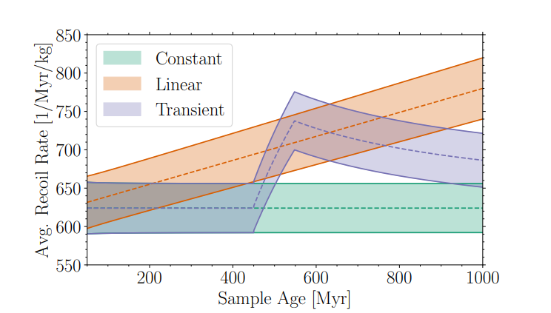
Paleo-detectors for cosmic rays
Atmospheric neutrinos might be able to trace an evolution of the flux of cosmic rays and search for long transients (100 Myr)
For shorter transients a different approach might be better (see after)
The ability of measuring CR transients depends on where the transients are located: cosmic rays are charged particles and are thus delayed by magnetic fields
Depending on their rigidity, they might even be trapped inside the Galactic Magnetic Field (GMF)
Exception: if sufficiently close and/or energetic neutrons can arrive to Earth.
decay length ~9 kpc * (E [EeV])
J. R. Jordan, S. Baum, P. Stengel, A. Ferrari, M. C. Morone, P. Sala and J. Spitz, «Measuring Changes in the Atmospheric Neutrino Rate over Gigayear Timescales,» Phys. Rev. Lett., vol. 125, n. 23, p. 231802, 2020

Slide 12
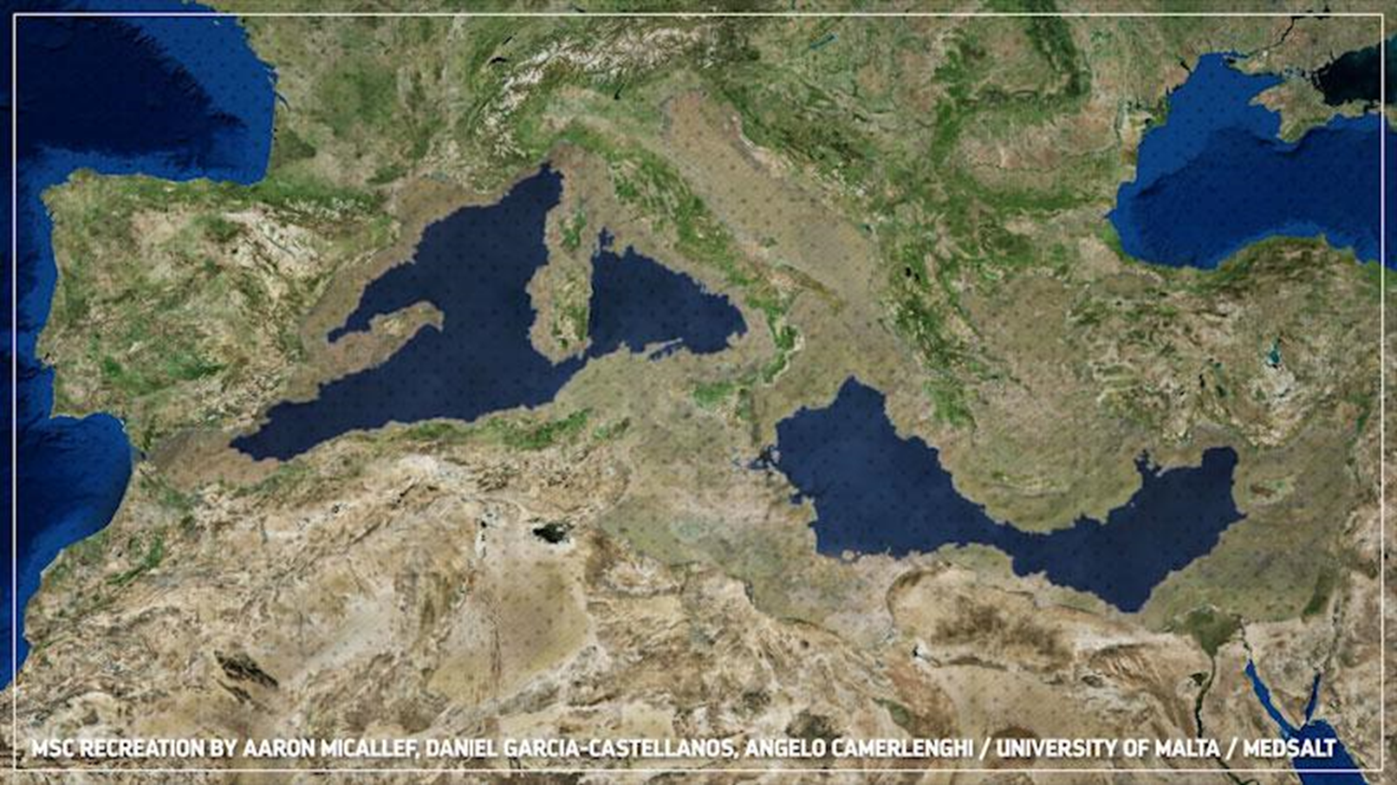
The exposure problem
A part from atmospheric neutrinos, also the other components of EAS can produce nuclear recoils (much easier!) -> the problem is to know the exposure time of the mineral to the air
We will focus on muons as they are the most penetrating component of EAS, a part from neutrinos (we’re going to consider also neutrons in the near future) and are less affected by small overburdens
We need to know the geological history of the sample
An option: the messinian salinity crisis.
The mediterranean sea evaporates quicker than rivers can compensate
In normal conditions, it receives constantly water from the Atlantic ocean
Roughly 6 Myr the precursor of the Gibraltar strait closed up due to tectonic movements
A large part of the mediterranean sea evaporated in the following few tens/hundreds of kyrs

Slide 13
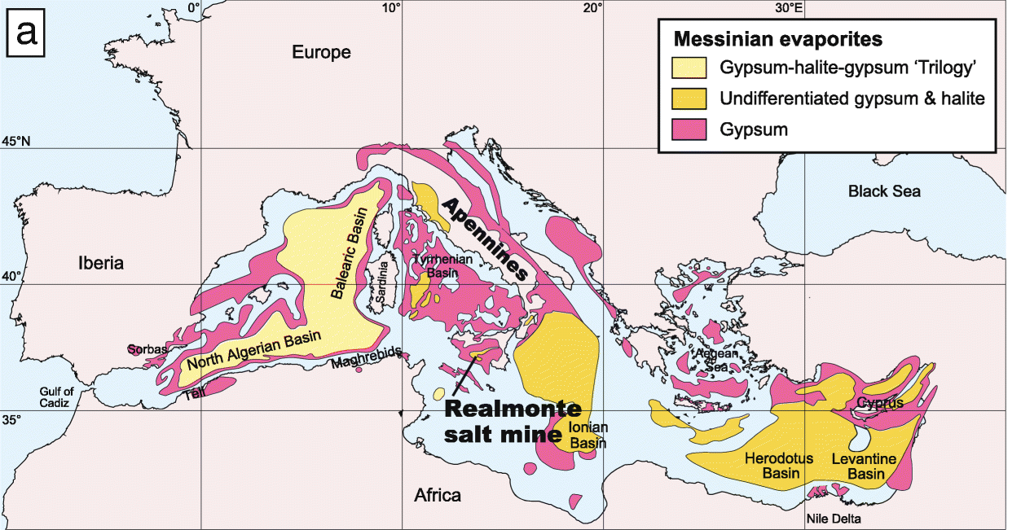
Messinian salinity crisis
A huge amount of evaporites was produced, mostly halite [NaCl] and gypsum [CaSO4 2(H2O)]
These minerals have been exposed directly to cosmic rays for ~300 kyr
The Gibraltar strait opened again, and the mediterranean basin was quickly flooded («Zanclean flood») again
<5.6 Myr ago
5.6-5.3 Myr ago
<5.3 Myr ago
Isaji, Y., Yoshimura, T., Kuroda, J. et al. Biomarker records and mineral compositions of the Messinian halite and K–Mg salts from Sicily. Prog Earth Planet Sci 6, 60 (2019). https://doi.org/10.1186/s40645-019-0306-x

Slide 14
Simulating the tracks
Measured muon flux at sea level
Muon flux below 1500 m of water
Expected muon flux from a SN at 20/50 pc [1]
Pass the muon through a Halite block in Geant 4 (with physics list QSGP_BERT_HP)
Nuclear recoils
SRIM/Paleopy
[1] B. C. Thomas and A. M. Yelland, Terrestrial effects of nearby supernovae: Updated modeling, The Astrophysical Journal 950, 41 (2023).

Slide 15
Simulating the tracks
Integrate on a 10g mass the signal for 270 kyr, the background for 5.6 Myr (background underwater muons for 5.3 Myr)

Slide 16
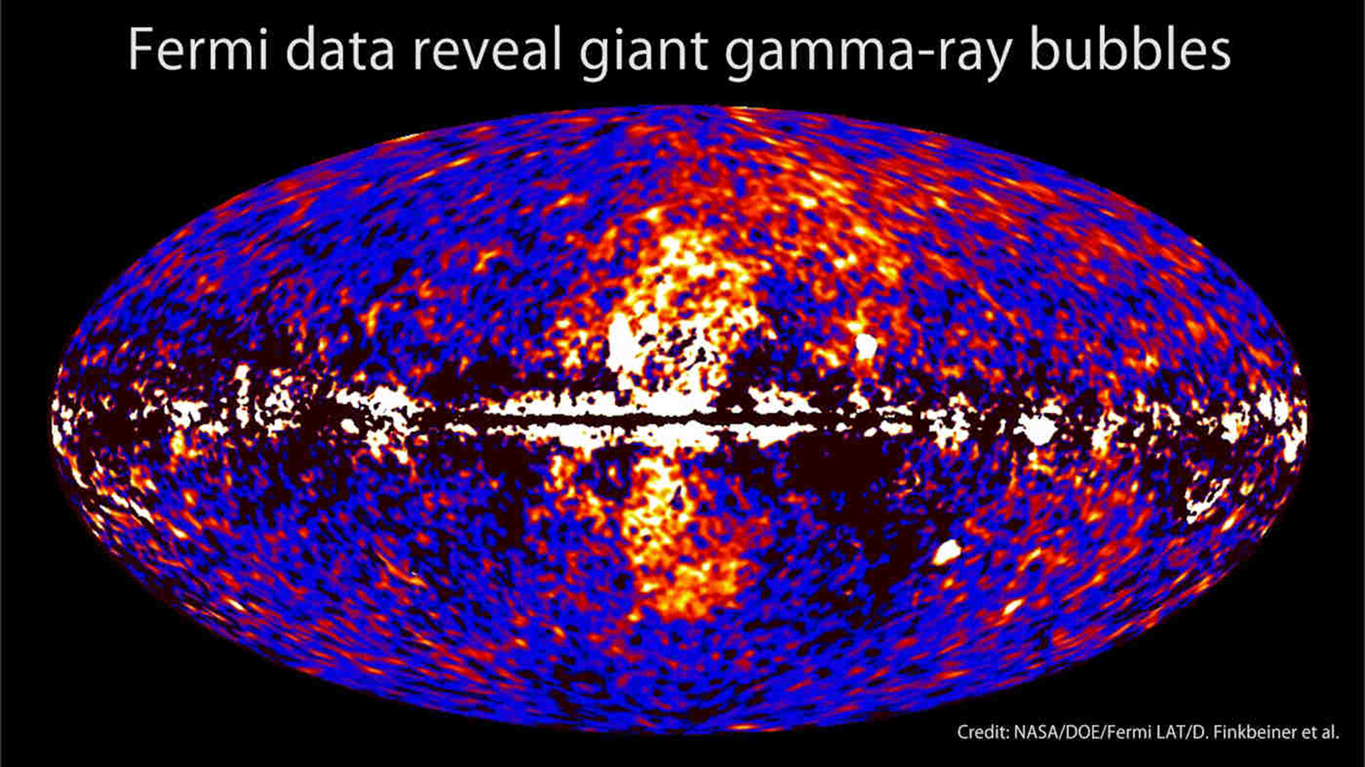
A tantalizing coincidence: Fermi Bubbles (and their age)
The observation of bubble-like structure perpendicular to the galactic plane in gamma showed that our Galaxy might have been active in the recent past
Is it possible that this activity was associated to high energy cosmic ray emission?
Some studies date these structures at 5-6 Myr
Problem: cosmic ray delay and shielding due to galactic magnetic fields in reaching Earth
M. Su and D. P. Finkbeiner, "EVIDENCE FOR GAMMA-RAY JETS IN THE MILKY WAY," Astrophys. Journal, vol. 753, no. 61, 2012.
R. Zhang and F. Guo, «Simulating the Fermi Bubbles as Forward Shocks Driven by AGN Jets,» Astrophys. Journal, vol. 894, n. 117, 2020.
M. Su, T. Slatyer and D. Finkbeiner, «GIANT GAMMA-RAY BUBBLES FROM FERMI-LAT: ACTIVE GALACTIC NUCLEUS ACTIVITY OR BIPOLAR GALACTIC WIND?,» Astrophys. Journal., vol. 724, p. 1044, 2010.

Slide 17
Conclusions (for astrophysicists and biologists)
- The measurement of tracks due to secondary cosmic rays can shed a light on the (relatively recent) history of the neighborhood of our solar system and, perhaps, of our Galaxy.
- Wrt other astroparticles, cosmic rays have the advantage of being shieldable: if one can find a mineral with the right geological history, we can investigate specific periods of time.
- An example is the Messinian salinity crisis: evaporites produced in that event were exposed for a specific period of time
- The number of transient events happened in the past near our planet could be related to different events in the biosphere.

Slide 18
Conclusions (for people interested only in MDvDM)
- CR-induced tracks should be more common and longer than the ones induced by neutrinos and dark matter
It should be an even lower-hanging fruit than atmospheric neutrinos
- Searching for this kind of tracks can greatly benefit the experimental path to MDvDM:
We can show that we can indeed see astroparticle tracks in natural minerals
We can show that our track length simulations are correct at least in this regeme (or correct them if they are not)
We can show that we have control on one of the backgrounds for neutrino and DM measurements
We can use for MDvDM samples that are not necessarily completely shielded from CR if we can model the background well enough.
Even having just a couple of these tasks completed could increase the concreteness of the MDvDM proposals and enhance funding opportunities

Slide 19
Next steps
Theoretical part:
Simulate the cosmic ray neutrons for the Messinian scenario
Consider other seabed minerals that can be exposed rather than Halite
Search for other opportunities apart from the Messinian (e.g. other sea evaporations, minerals produced or exposed in volcanic eruptions…)
Coordinate with information from cosmogenic nuclides
Experimental part:
Identify cosmic ray tracks in Halite samples currently exposed to cosmic rays
Study annealing effects in Halite
Verify that the measurements fit the predictions (or correct models accordingly)
Find suitable messinan Halite sample and recover them (possibly from multiple sites)
Measure tracks and obtain the flux of cosmic rays 5.5 Myr ago!
Repeat with suitable samples from other periods

Slide 20
Backup Slides

Slide 21
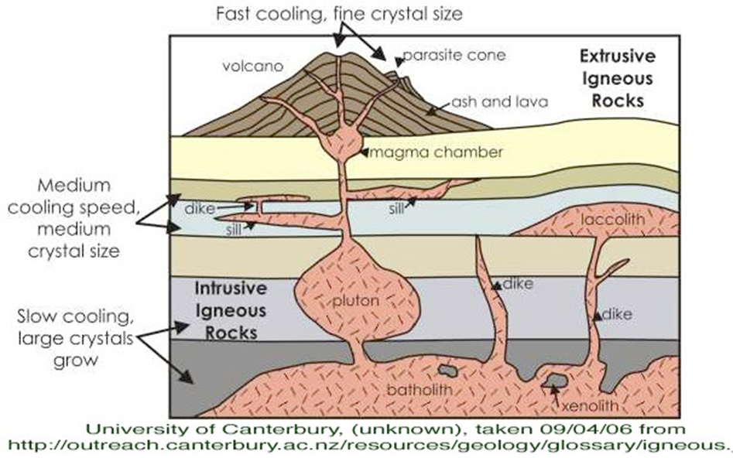
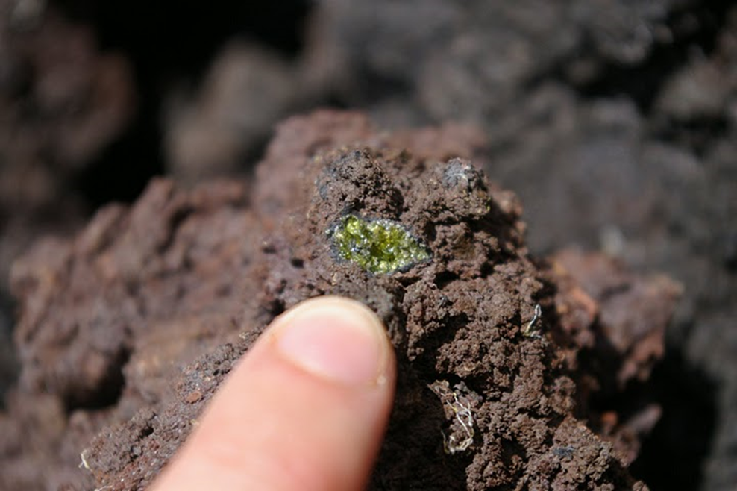
Xenoliths

Slide 22
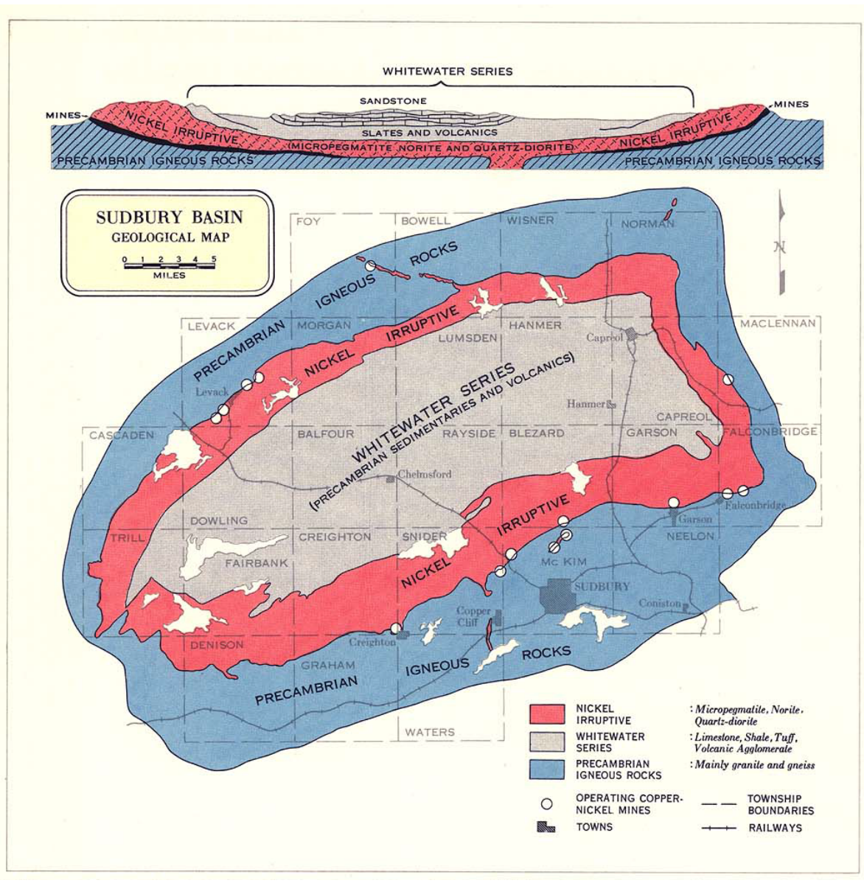
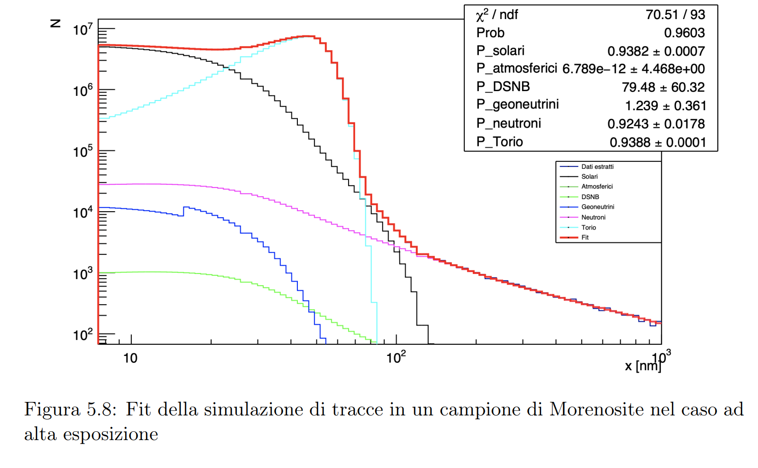
Sudbury

Slide 23
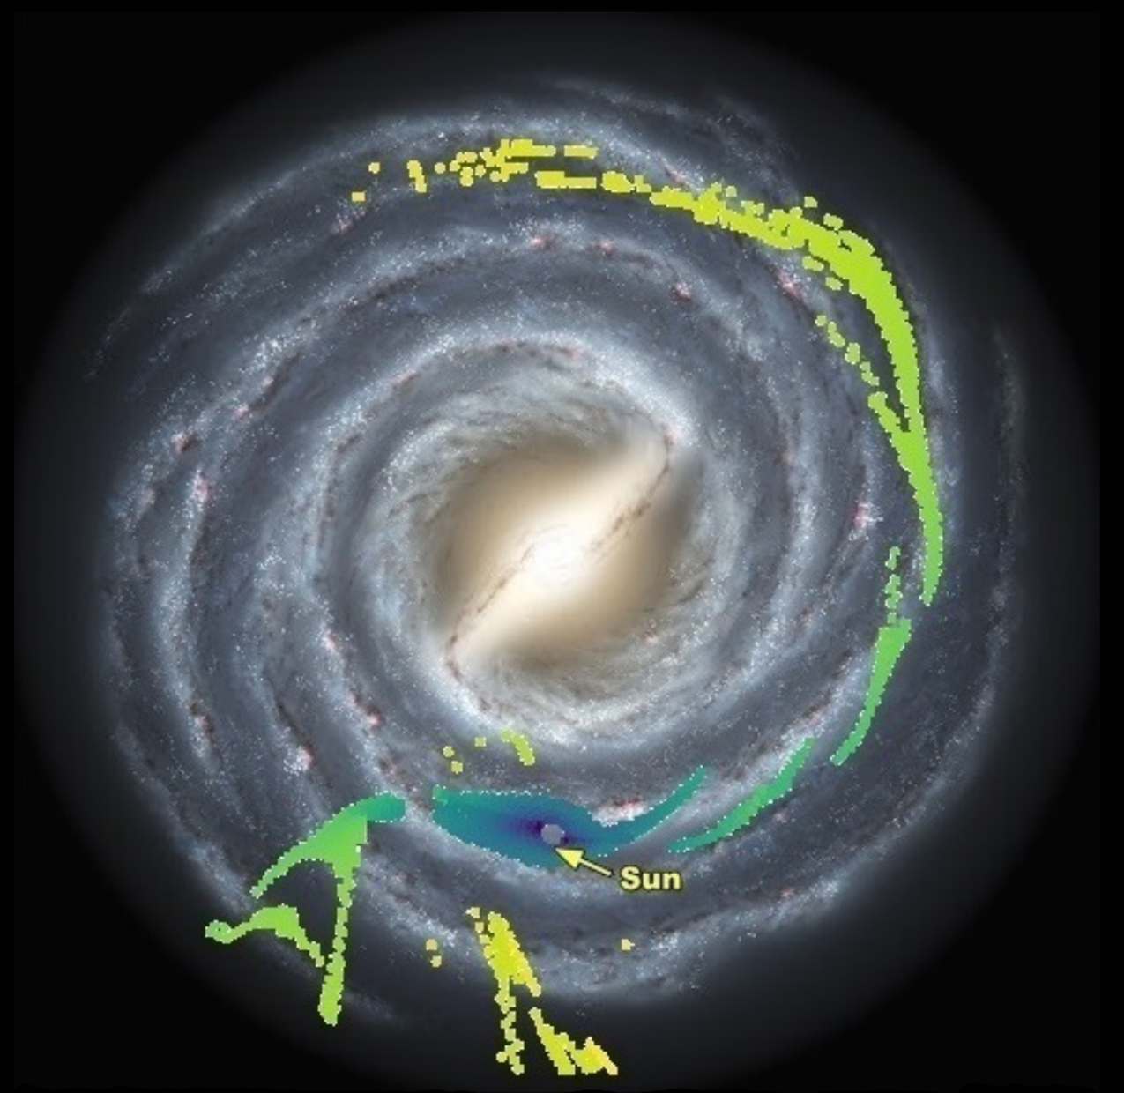
Cosmic ray delay in Galactic Magnetic Field
Measuring the GMF (and even more extragalactic magnetic fields) is a difficult task, obtained through measurements of starlight polarization, Faraday rotation measure (RM) and synchrotron emission.
Different models exist, which can disagree strongly on the direction of the deflection, but usually agree at least on the order of magnitude of its absolute value
Delay is rarely considered -> need for dedicated simulations
Below a certain rigidity likely a transition from ballistic to diffuse propagation occur
10⁵
Delay of 1EeV protons
JF12 field (regular only)
10⁴
10³
10²
10
Years
BSc A. Veutro

Slide 24
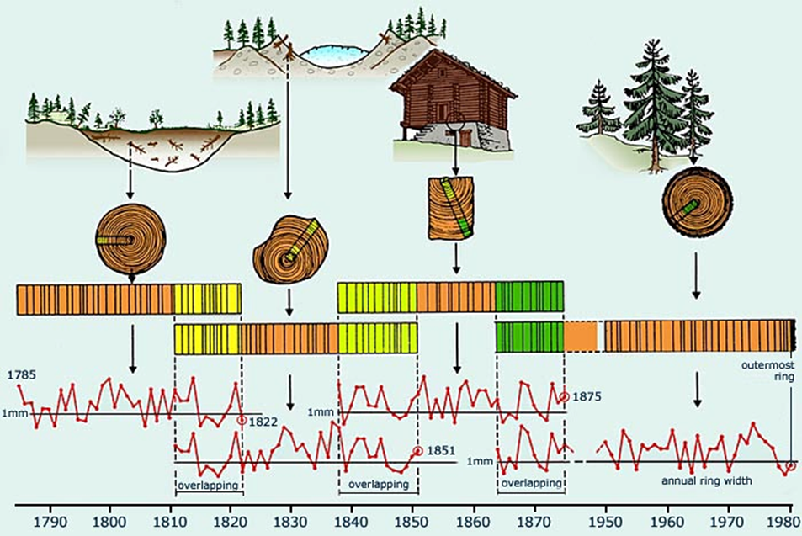
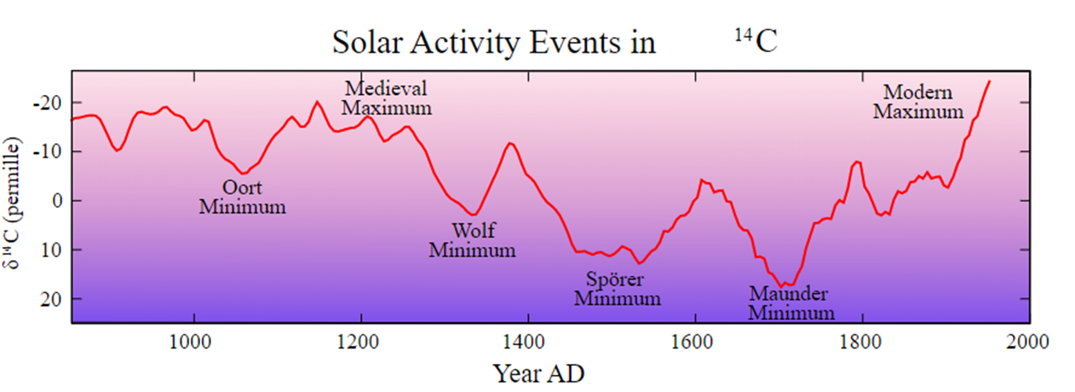
¹⁴C evolution in atmosphere
¹⁴C is produced by cosmic rays in atmosphere
production is dominated by low energy cosmic rays that are strongly affected by solar activity
the rate of ¹⁴C is of huge interest for calibrating the dating technique
one of the most powerful method to track ¹⁴C abundance (with a o(yr) precision!) is to use dendrochronology (limited to few kyr)

Slide 25
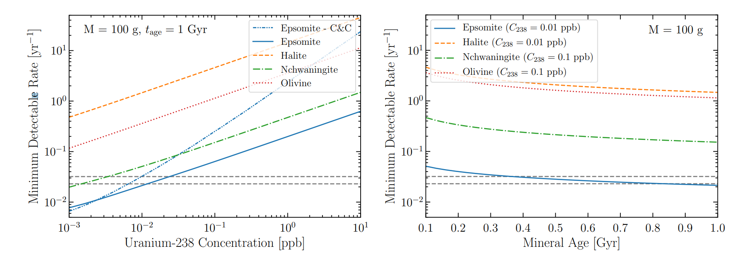
Paleo-detectors for supernova neutrinos
Supernova neutrinos have a high flux but for a very short (10s) time
It has been proposed that paleo-detectors might be able to measure the rate of SN in our Galaxy
S. Baum, T. D. P. Edwards, B. J. Kavanagh, P. Stengel, A. K. Drukier, K. Freese, M. Gorski and C. Weniger, «Paleodetectors for Galactic supernova neutrinos,» Phys. Rev. D, vol. 101, n. 10, p. 19, 2020

Slide 26
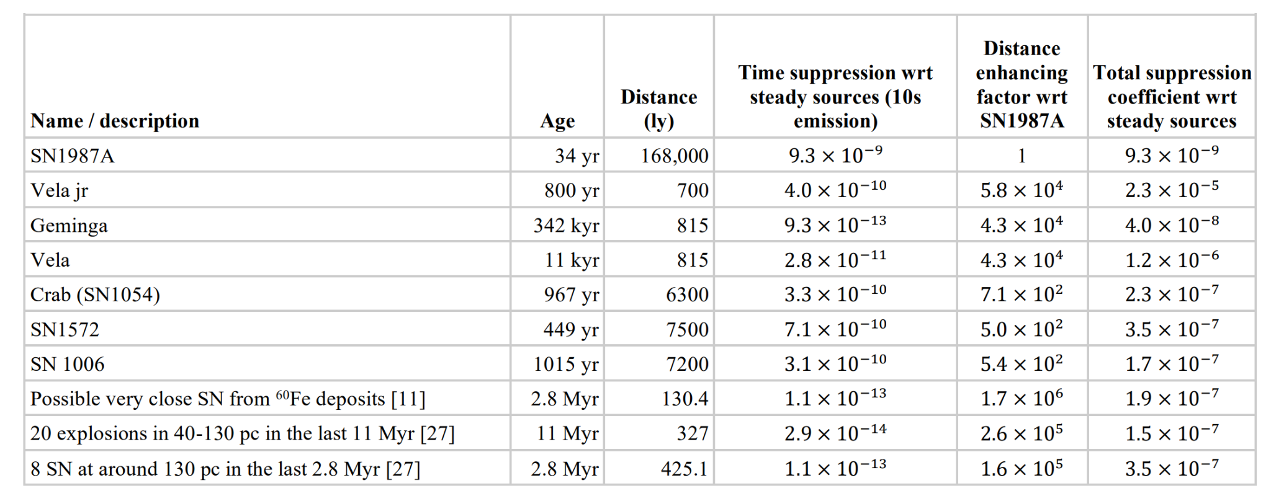
Paleo-detectors for supernova neutrinos
what about a single sn event? Need to be close and recent to have any chance of having a decent S/N

Slide 27
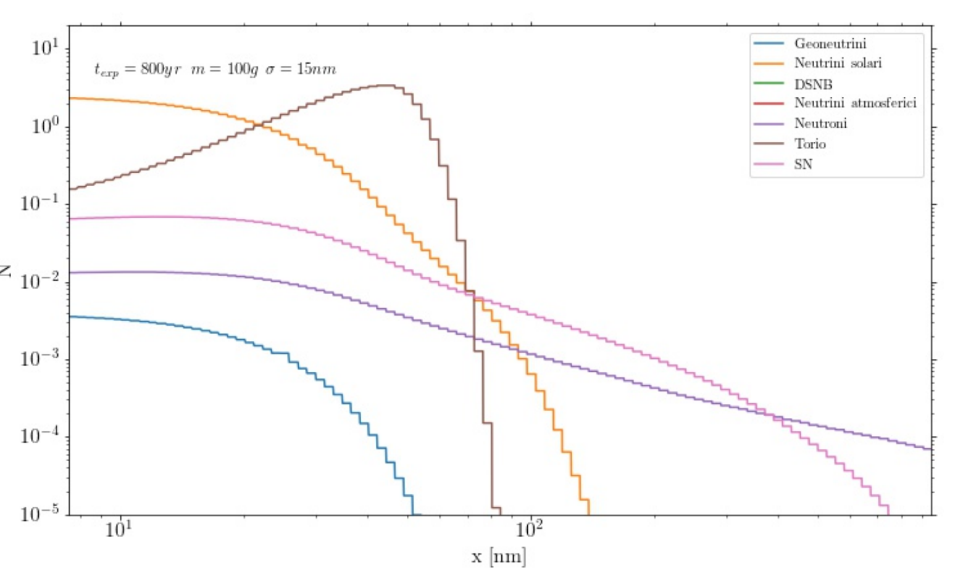
Paleo-detectors for supernova neutrinos
PRELIMINARY
BSc Lorenzo Apollonio, unpublished
Desperate need to scan large volumes!

