Slide 1
REU… but for TYC students and faculty?
Brittney VornDick, PhD
Durham Technical Community College
Durham, NC
Chesapeake Section & NC Section of AAPT Fall 2024 Meeting
Jefferson Lab, VA

Slide 2
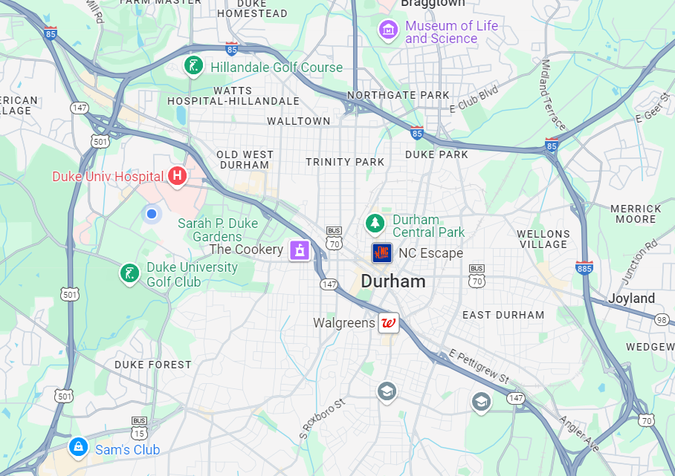



5.5 miles
12 mins
0.5 miles
2 mins

Slide 3
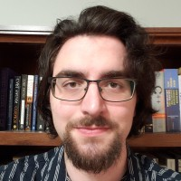
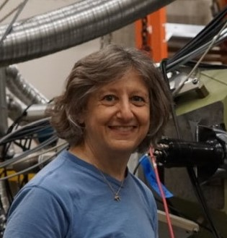
Start of Collaboration…
Seth Reiman, former student at Durham Tech
Researched with Dr. Diane Markoff at NCCU in Spring 2023
Researched with Dr. Matousek at Duke during Summer 2023
  Published Paper in Proceedings of Science “Measuring Transversity in Di-Hadron Correlations with the ePIC Detector”
Currently a student at University of Michigan
Dr. Diane Markoff, Professor at NC Central University
Met Dr. Markoff back in graduate school at Virginia Tech through acquaintance in early 2010s.
Started a dialogue of making a pathway for Durham Tech to NCCU.
Spearheaded the NP-RENEW Grant started in 2024

Slide 4
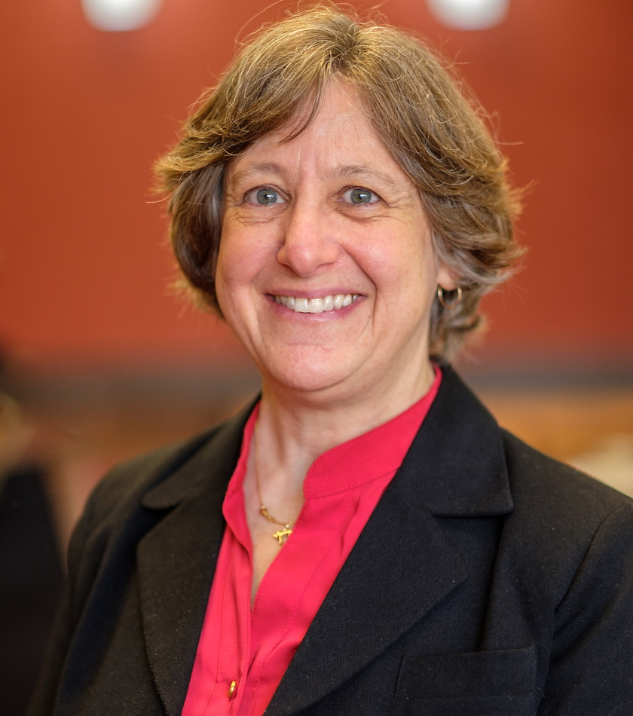
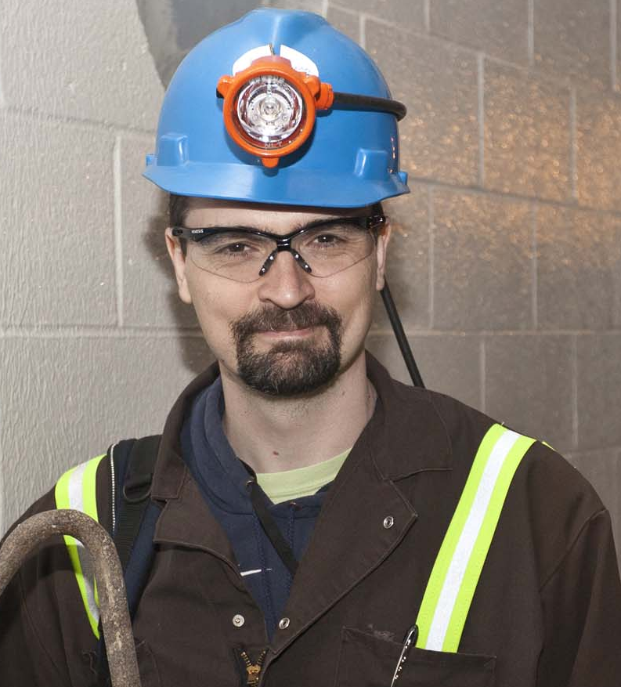
Grant
Dr. Diane Markoff at NC Central University
Dr. Reyco Henning at University of NC, head of TUNL DEI committee
NP-RENEW Grant: Expanding the NCCU Participation in Experimental, Low-Energy, Nuclear Physics Research at TUNL – this grant supports undergraduates and post bacs that are underrepresented in physics (two-year college students, students of color, LGBTQ+, women, and even TYC faculty members).
TUNL PIER plan (Promoting Inclusive and Equitable Research)- included promoting participation by regional community college faculty to expand opportunities for TUNL research.

Slide 5
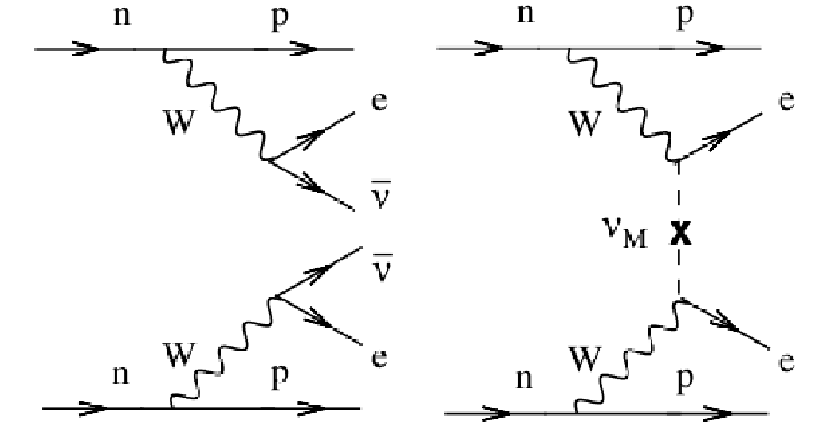
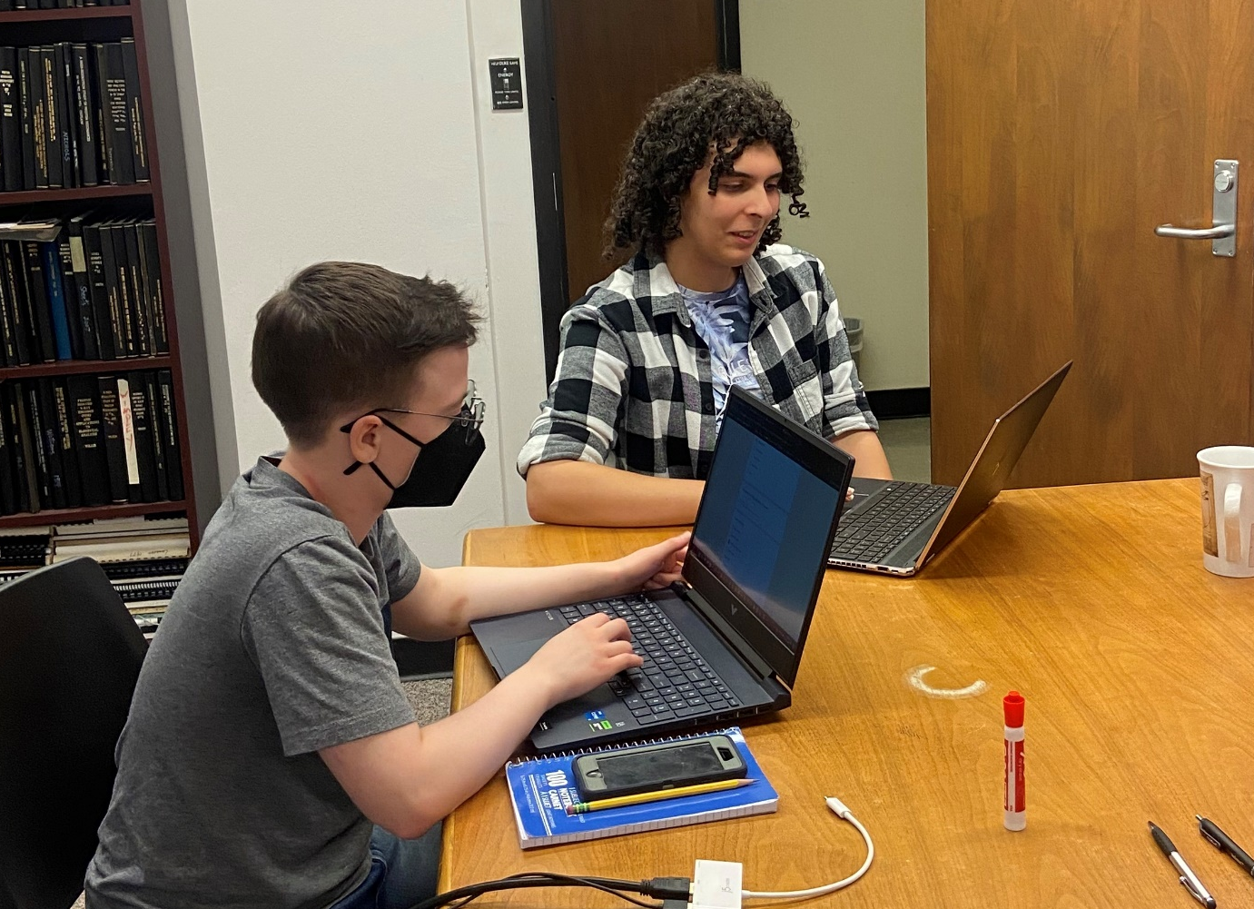
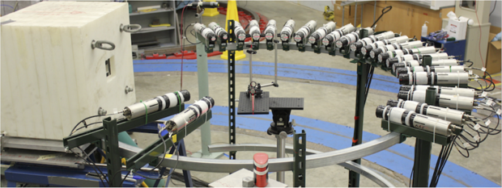
The Students…
Durham Tech had 2 students attend
  Arthur Davis- now at UNC Chapel Hill studying Math and Physics
  Mack Bertrand- now at University of Rochester studying Physics and Music Composition
Arthur Davis
Barbeau Group
Supervised by Charlie
Determination of scintillator detector response used in quenching factor measurements at the Tandem lab.
Mack Bertrand
Barbeau Group
Supervised by José Colon Riviera
Used Geant4 to simulate a
liquid scintillator detector exposed to a Co-60 source.

Slide 6
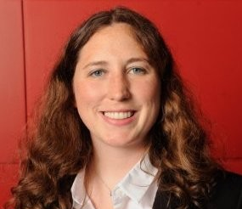
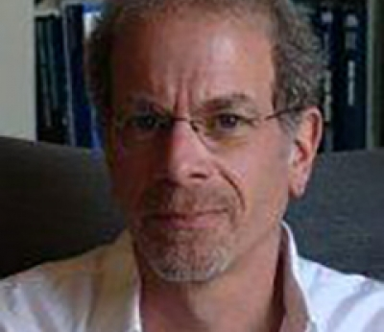
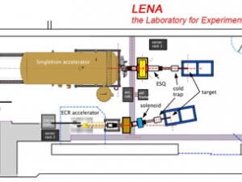
Me
Only Full-time Physics Instructor at Durham Tech
LENA (Laboratory of Experimental Nuclear Astrophysics) Research Group
Advisor- Dr. Art Champagne, UNC-Chapel Hill
Used Computational Fluid Dynamics in AutoCad to look at fluid flow for cooling the targets.
Advised a graduate student, Evan, on a camera mount to see the spot size on the target.

Slide 7
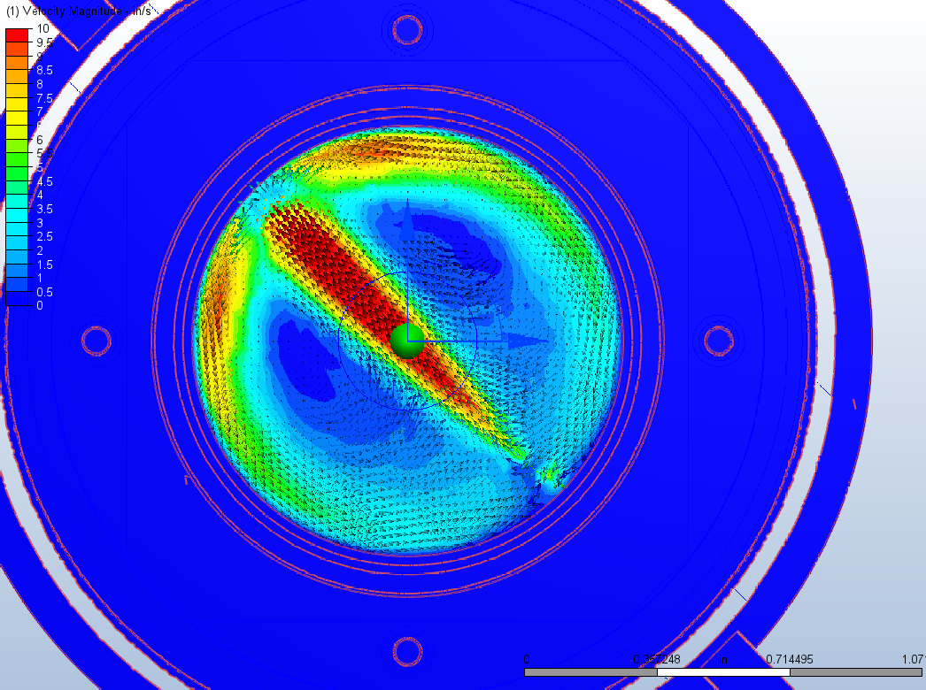
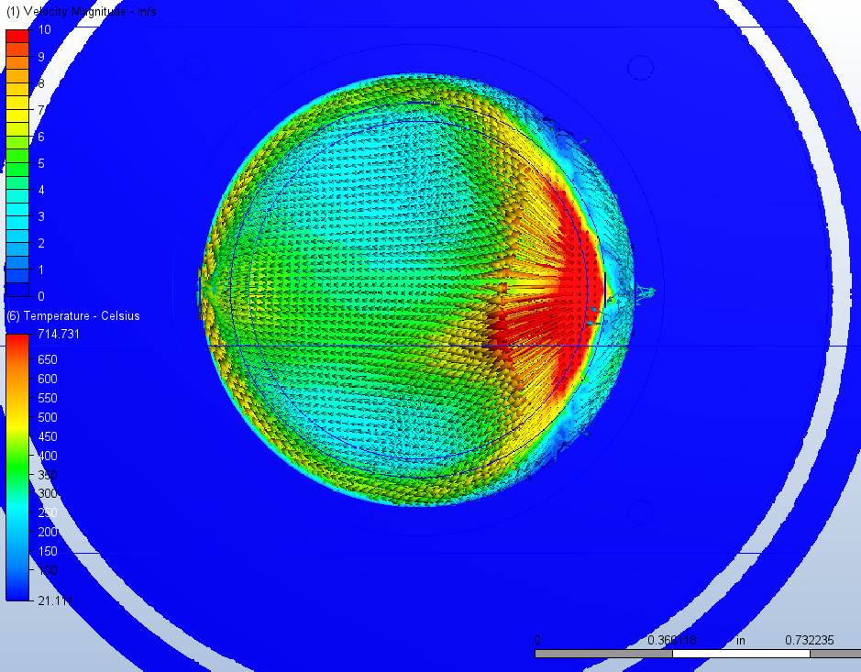
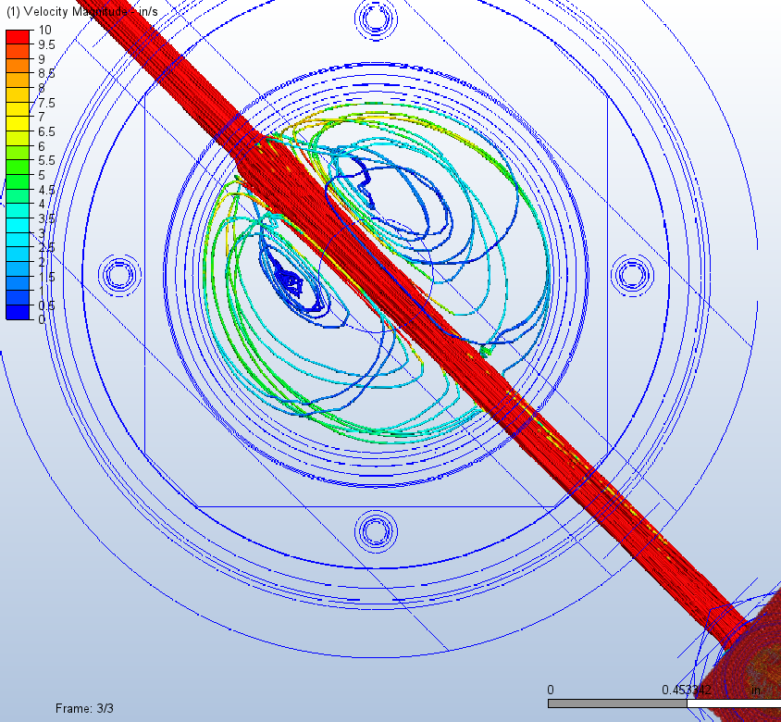
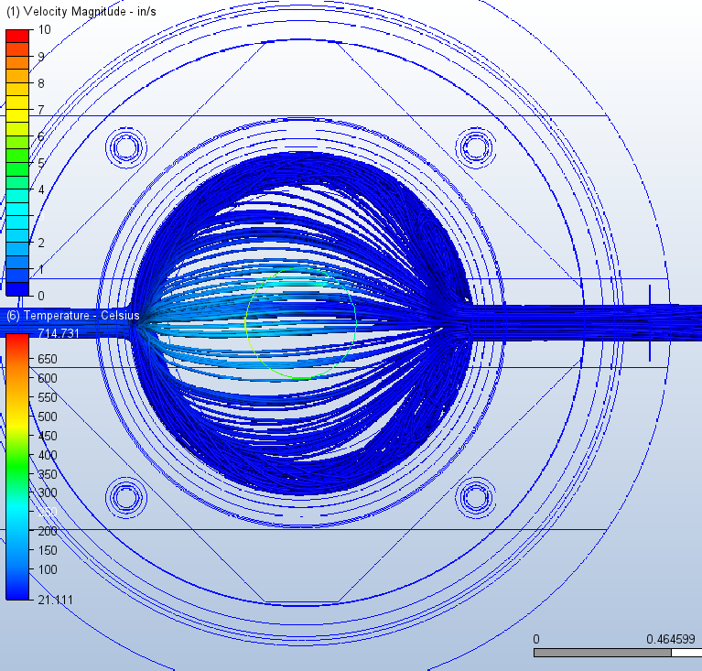
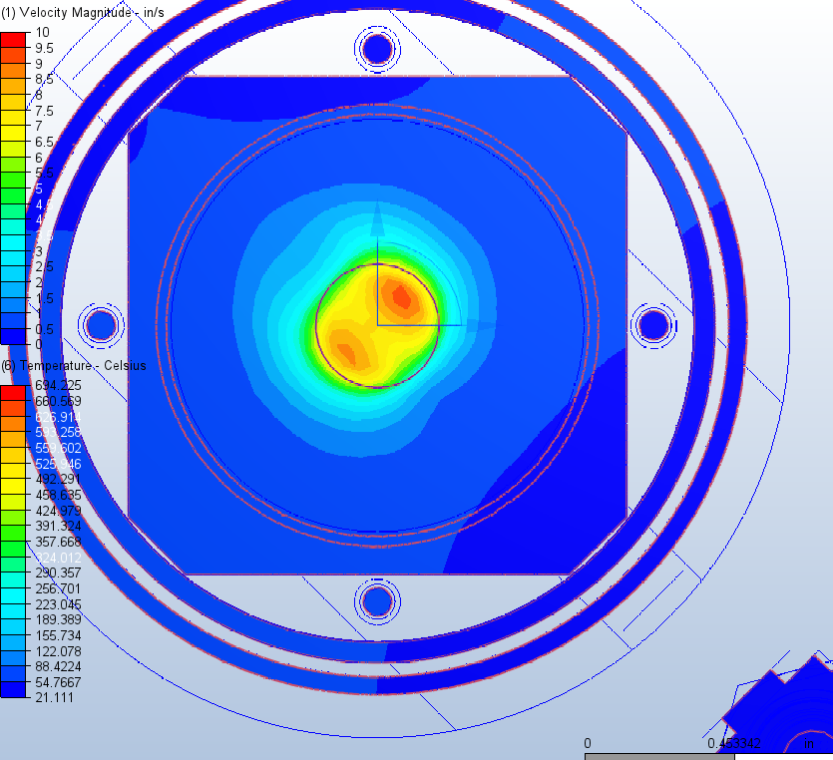
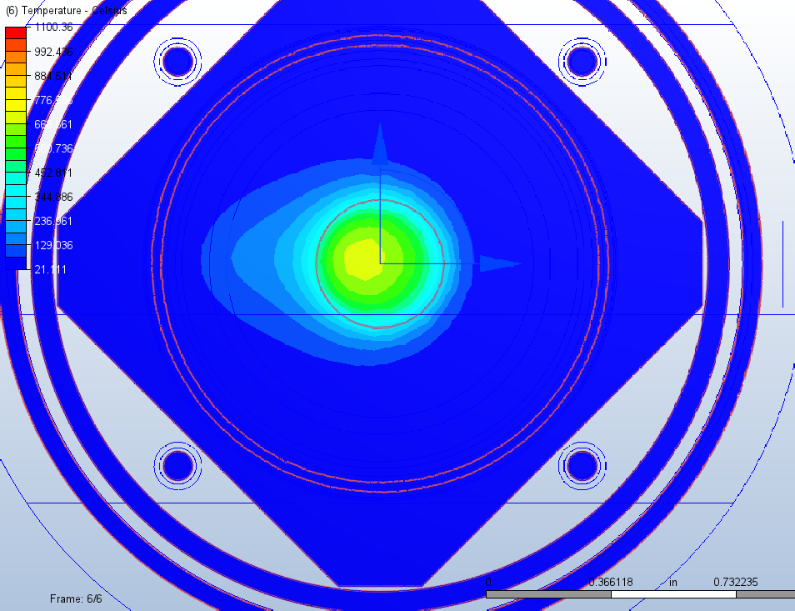
Old Target Design
New Target Design
575 W
0.5 gal/min

Slide 8
Overall Good Experience
Students:
  Gained research and programming skills
  Met other students who are in the TUNL REU program
  Made connections with faculty and students at UNC, Duke, NCCU, and NCSU.
  They walked away still interested in Nuclear Physics. Yay!
  One has been asked to come back next summer, if they are interested!
Me:
  Gained new skills working with AutoCad
  Insight to discuss with students and bring into the classroom
  Helped where I was needed with graduate students
  Gender Minorities Luncheon
  Conversations with undergrad and graduate students
    Discussions about teaching career with graduate students
  Learning to get back into the swing of research and the community after 10 years absent.
  Have two new ID badges and another office ☺
  Creating a pathway for students to navigate and network.

Slide 9


Thank you!
Brittney VornDick vorndickb@durhamtech.edu
tunl.duke.edu
Diane Markoff dmarkoff@NCCU.EDU
Reyco Henning rhenning@unc.edu (questions about the PIER program)

