Slide 1
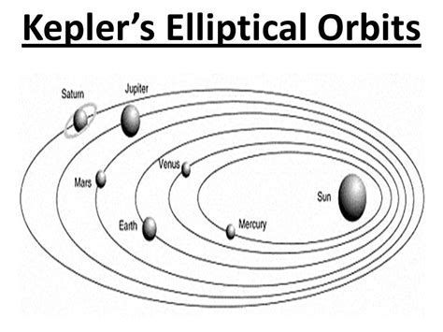
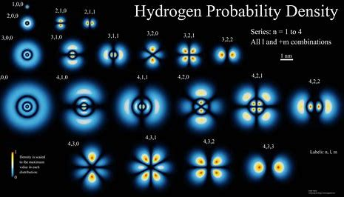
James Freericks, Department of Physics
Georgetown University
Work funded by the AFOSR and Georgetown
A simple approach to determining planetary orbits
Quantum solutions

Slide 2
The conventional way to determine Kepler orbits is complicated. For example, we sketch how Goldstein does this.

Slide 3
Goldstein derivation
Hamilton equation of motion: $\dot{r}=\frac{p_{r}}{m}$ and $\dot{p_{r}}=F_{eff}=\frac{L^{2}}{{mr}^{3}}−\frac{k}{r^{2}}$ , $\dot{θ}=\frac{L}{mr^{2}}$ , and $\dot{L}=0$
So, we have $\ddot{r}=\frac{L^{2}}{m^{2}r^{3}}−\frac{k}{{mr}^{2}}$. Multiply by $\dot{r}$ and integrate to yield: $\frac{1}{2}{\dot{r}}^{2}=E−\frac{L^{2}}{2m^{2}r^{2}}+\frac{k}{mr}$ ,
with $E$ the energy (arising as an integration constant).
We have $\frac{mr^{2}}{L} dθ=dt$, so $\dot{r}=\sqrt{2E−\frac{L^{2}}{m^{2}r^{2}}+\frac{2k}{mr}}=\frac{dr}{dθ}\frac{L}{mr^{2}}$, rearranging, we have
$$dθ=dr\frac{L}{mr^{2}}\frac{1}{\sqrt{2E−\frac{L^{2}}{m^{2}r^{2}}+\frac{2k}{mr}}}$$

Slide 4
Goldstein derivation (part II)
$$\int_{θ_{0}}{dθ}=\int_{r_{0}}{dr}\frac{L}{mr^{2}}\frac{1}{\sqrt{2E−\frac{L^{2}}{m^{2}r^{2}}+\frac{2k}{mr}}}$$
$$θ−θ_{0}=−arc\cos{\frac{\frac{L^{2}}{mkr}−1}{\sqrt{1+\frac{2EL^{2}}{mk^{2}}}}}$$
So that
$$\frac{1}{r}=\frac{mk}{L^{2}}\left(1+\sqrt{1+\frac{2EL^{2}}{mk^{2}}}\cos\left(θ−θ_{0}\right)\right)$$

Slide 5
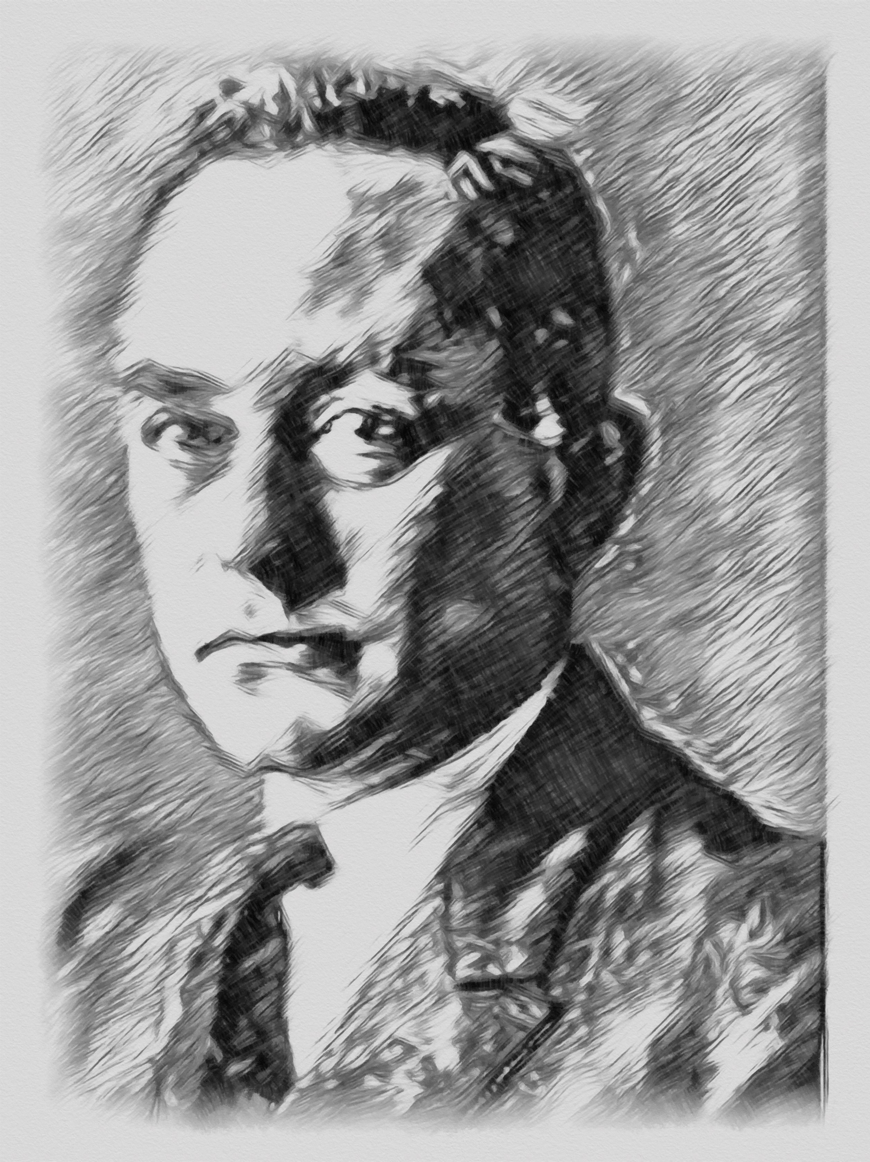
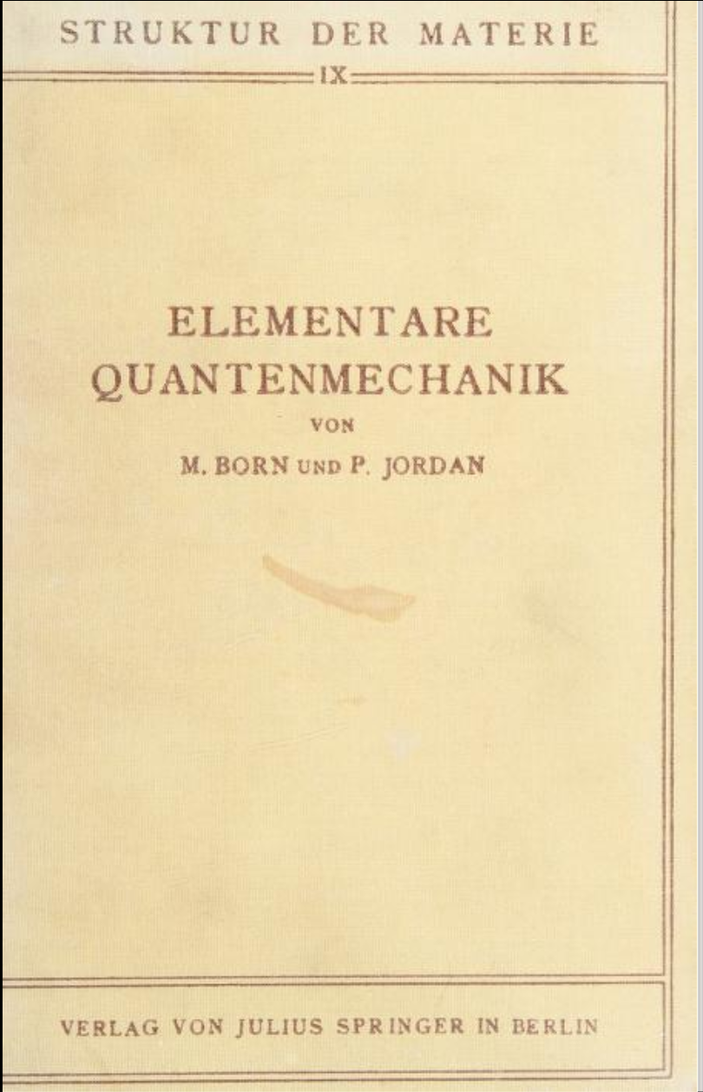
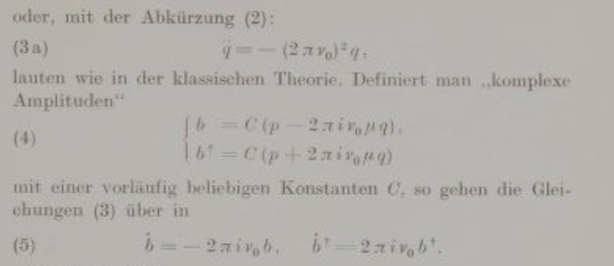
The idea for a simplification comes from an unlikely source: Born and Jordan’s Elementare Quantenmechanik (1930)

Slide 6
New derivation
Hamilton equation of motion: $\dot{r}=\frac{p_{r}}{m}$ and $\dot{p_{r}}=F_{eff}=\frac{L^{2}}{{mr}^{3}}−\frac{k}{r^{2}}$ , $\dot{θ}=\frac{L}{mr^{2}}$ , and $\dot{L}=0$
Define $A=p_{r}+\frac{α}{r}+β$, then choose $α$ and $β$ so that the radial equations of motion are decoupled:
$$\dot{A}={\dot{p}}_{r}−\frac{α}{r^{2}} \dot{r}=\frac{L^{2}}{{mr}^{3}}−\frac{k}{r^{2}}−\frac{α}{mr^{2}} p_{r}=−\frac{α}{mr^{2}}\left(p_{r}−\frac{L^{2}}{αr}+\frac{mk}{α}\right)$$
So that $α=±iL$ , $β=∓i\frac{mk}{L}$ , and $\dot{A}=∓i\frac{L}{mr^{2}} A=∓i \dot{θ} A$ . Then we have
$$A\left(θ\right)=A_{0}e^{iθ}, A^{∗}\left(θ\right)=A_{0}^{∗}e^{−iθ} , and A\left(θ\right)=p_{r}+\frac{iL}{r}−\frac{imk}{L}$$

Slide 7
New derivation (part II)
$$A\left(θ\right)=A_{0}e^{iθ}, A^{∗}\left(θ\right)=A_{0}^{∗}e^{−iθ}, and A\left(θ\right)=p_{r}+\frac{iL}{r}−\frac{imk}{L}$$
If we set the constants at the point of closest approach $r_{0}$ we have $A_{0}=i\left(\frac{L}{r_{0}}−\frac{mk}{L}\right)$
We remove $p_{r}$ by taking the difference:
$$\frac{iL}{r}−\frac{imk}{L}=\frac{1}{2}\left(A\left(θ\right)−A^{∗}\left(θ\right)\right)=i\left(\frac{L}{r_{0}}−\frac{mk}{L}\right)\cos\left(θ−θ_{0}\right)$$
Or
$$\frac{1}{r}=\frac{mk}{L^{2}}+\left(\frac{1}{r_{0}}−\frac{mk}{L^{2}}\right)\cos\left(θ−θ_{0}\right)$$

Slide 8
Using this approach of decoupling the differential equations is a much simpler derivation, requiring no complex integrations

Slide 9
Energy
We have ${\frac{p_{r}^{2}\left(t\right)}{2m}+\frac{L^{2}}{2mr^{2}}−\frac{k}{r}+\frac{mk^{2}}{2L^{2}}=\frac{1}{2m}A}^{∗}\left(t\right)A\left(t\right)={\frac{1}{2m}\left|A_{0}\right|}^{2}=constant$
So, energy is conserved, automatically in this approach

Slide 10
Relation to quantum mechanics
We found $A=p_{r}+\frac{iL}{r}−\frac{imk}{L}$ and $A^{∗}=p_{r}−\frac{iL}{r}+\frac{imk}{L}$
If we make them operators, with $[\hat{r}, {\hat{p}}_{r}]=iℏ$, then
$$\frac{1}{2m}{\hat{A}}^{†}\hat{A}=\frac{1}{2m} \left({\hat{p}}_{r}−\frac{iL}{\hat{r}}+\frac{imk}{L}\right)\left({\hat{p}}_{r}+\frac{iL}{\hat{r}}−\frac{imk}{L}\right)=\frac{{{\hat{p}}_{r}}^{2}}{2m}+\frac{iL}{2m}\left[{\hat{p}}_{r},\frac{1}{\hat{r}}\right]+\frac{L^{2}}{2m{\hat{r}}^{2}}−\frac{k}{ \hat{r}}+\frac{mk^{2}}{2L^{2}}$$
$$=\frac{{{\hat{p}}_{r}}^{2}}{2m}+\frac{L^{2}+ℏL}{2m{\hat{r}}^{2}}−\frac{k}{ \hat{r}}+\frac{mk^{2}}{2L^{2}}=\hat{H}−E_{l}$$
This is the solution of the hydrogen atom for a fixed angular momentum state, if we let $L=ℏl$.

Slide 11
So, the simplified treatment of the classical orbit also provides a neat connection to the quantum solution. Pretty cool. Thank you Born and Jordan!

Slide 12
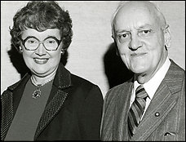
Thanks to
Leanne Doughty Jason Tran

