Slide 1

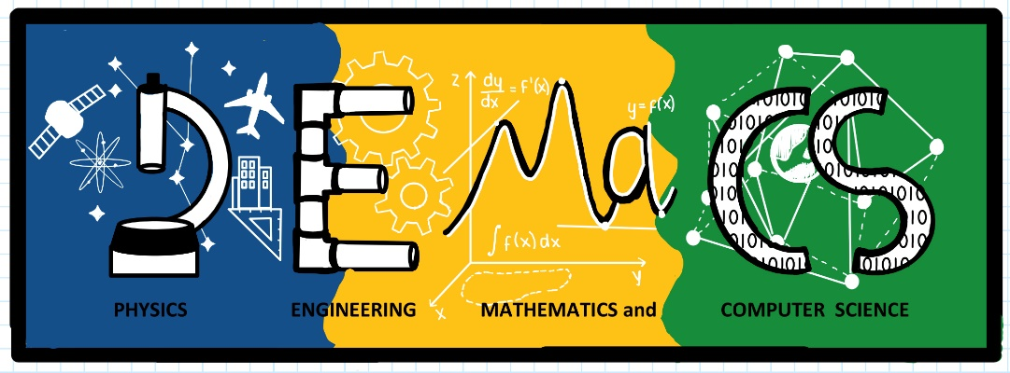

A Pilot Engineering Intro Course for the Early Engagement
of First-Year Engineering Physics Majors
Qi Lu, Yuriy Markushin, Mohammad A. Khan
Division of Physics, Engineering, Mathematics, and Computer Science (PEMaCS)
Delaware State University

Slide 2
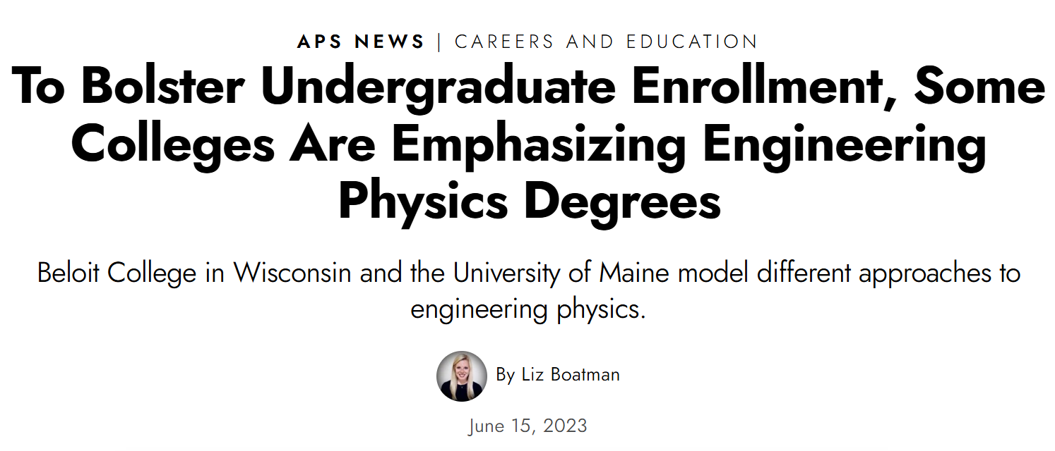
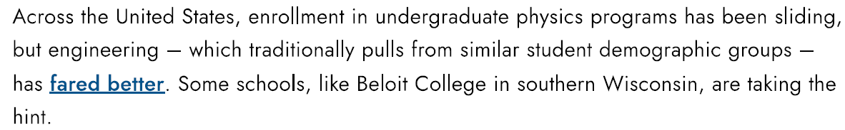
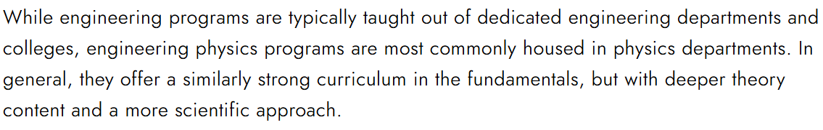
A Nationwide Trend…

Slide 3
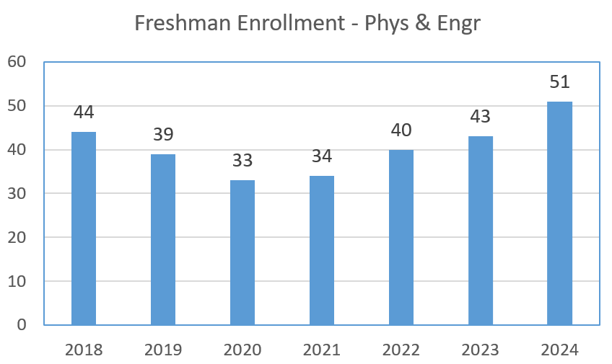
Physics and Engineering at DSU – Background and Numbers
2012
2018
Dept. of Physics &
Pre-Engineering
Dept. of Physics &
Engineering
Division of Physics, Engineering, Mathematics and Computer Science
We can do better!
Freshmen 4-year graduation rate ~20%
90% African American students
Two programs:
BS Engr Physics & BS Physics
Three tracks: Electrical Engineering, Bioengineering, Optical Engineering
Freshman physics majors < 10%
13 full-time faculty members
(one fully administrative)
adjuncts and teaching assistants

Slide 4
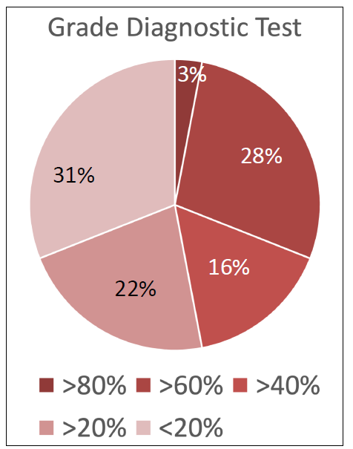
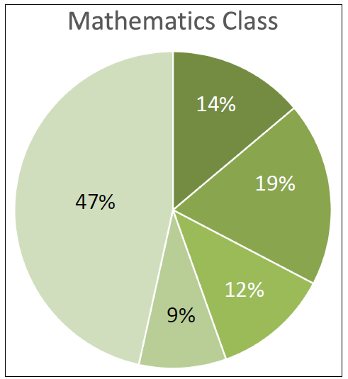
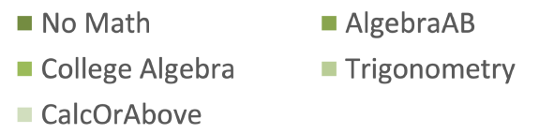
Freshmen Math Readiness in 2023 – Summary Report by Dr. Planchon
Outcome of a diagnostic math test
Only algebra and college algebra concepts
To assess the math placement vs the math skills.

Slide 5
Considerations…
The main goals are to build up student skills and have them feel belonging to the same cohort/department.
Classes in our major: Most of our incoming students are only taking PHYS200 class in their first year. We should propose at least 2-3 classes in our major (not counting General Physics I) in their first semester.
Math skills: Students should work on their mathematics skills outside of the remedial mathematics classes (Algebra / Coll. Algebra / Trig.). How to place our students in the same sections to enhance their sense of belonging?
Computer Science/Eng. Physics: Some students will change major to computer science based on their interest. The first-year experience should have some classes in common between ENGR/PHYS and CS so it is easier for students to change between majors.

Slide 6
Redesign the First Year Experience
First Year Pilot Courses
  Introduction to Engineering Design I & II
  Modeling the World I & II
  Research Seminar and Professional Development I & II
Skills to know after Year 1 (Engineering/Computer Science)
  Team Building
  Critical thinking and Problem-solving
  Data analysis & basic graphs
  Basic electronics programming flow
  Basic prototyping of electronics
  Basics of optical and bioengineering
  Machine Learning/AI-based projects
  Communication skills and logical reasoning

Slide 7
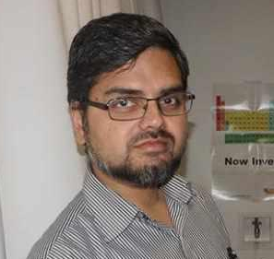

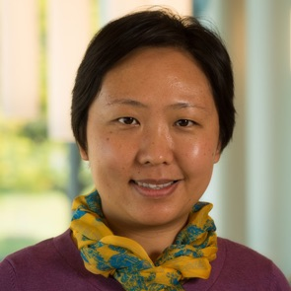
Introduction to Engineering Design I
– A Pilot Course for First-Year Engineering Physics Majors
Mohammad A. Khan
Circuit Design and Prototyping
Electrical Engineering Design
Yuriy Markushin
MATLAB Onramp
System and Controls
Qi Lu
Excel Basics and Data Visualization
Bioengineering Design

Slide 8
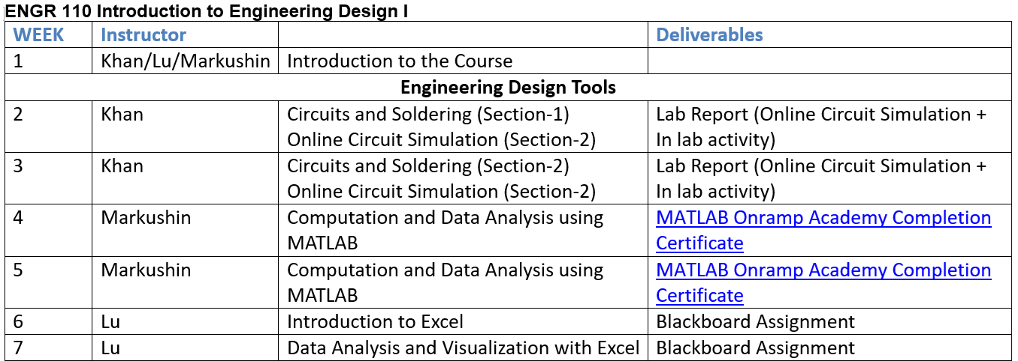
Course Outline (I)

Slide 9
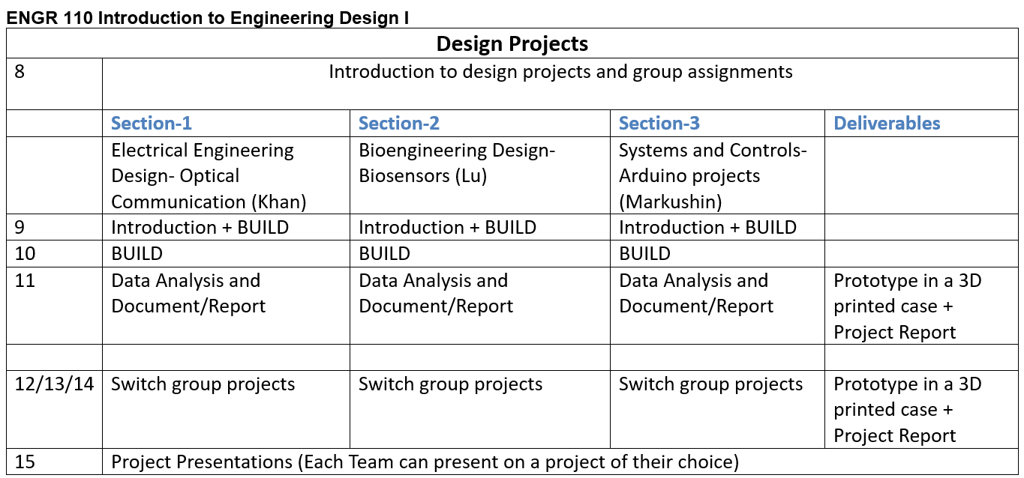
Course Outline (II)

Slide 10
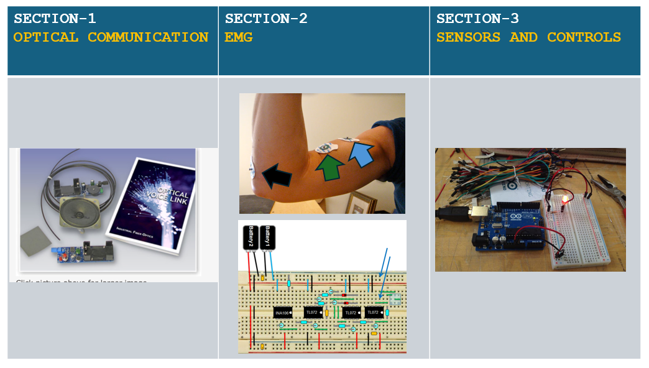
Design Projects

Slide 11
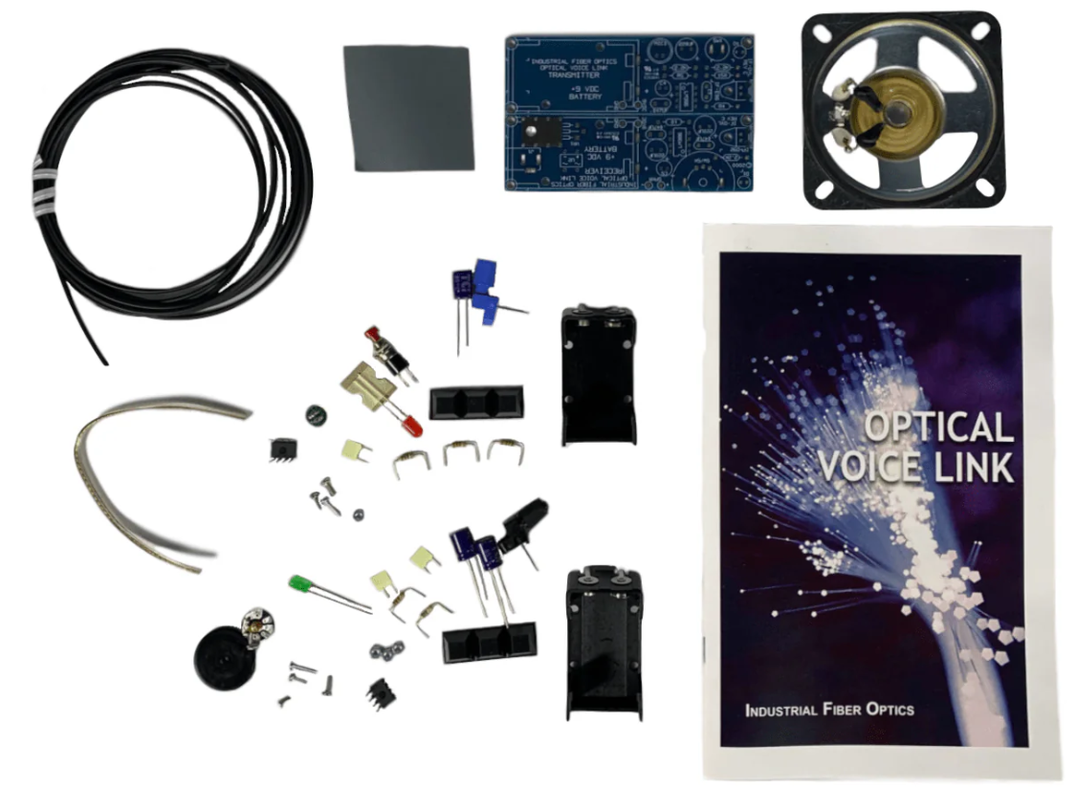
Section 1 - Optical Voice Link Kit
With this kit, you will assemble a fiber-optics system capable of transmitting your voice from microphone to speaker using a light beam guided by a fiber cable. No prior knowledge of fiber optics is necessary.

Slide 12
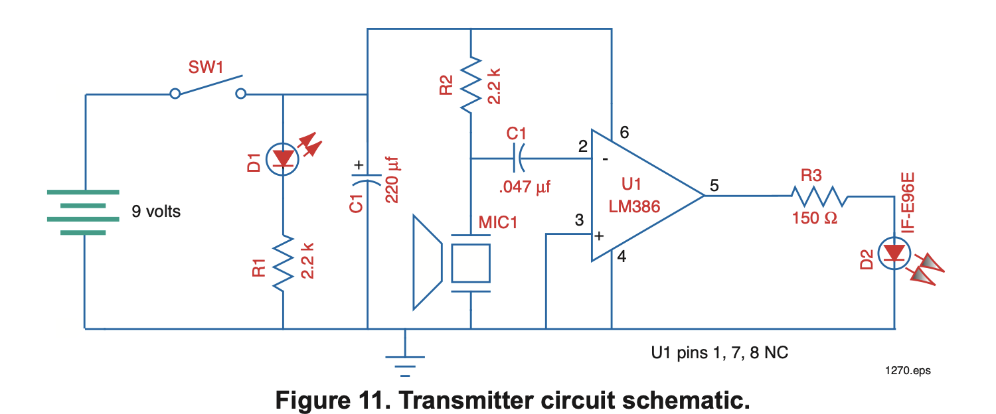
Transmitter Circuit Schematic

Slide 13
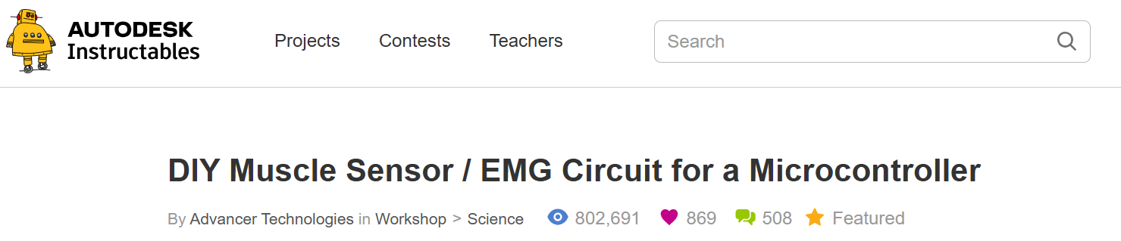
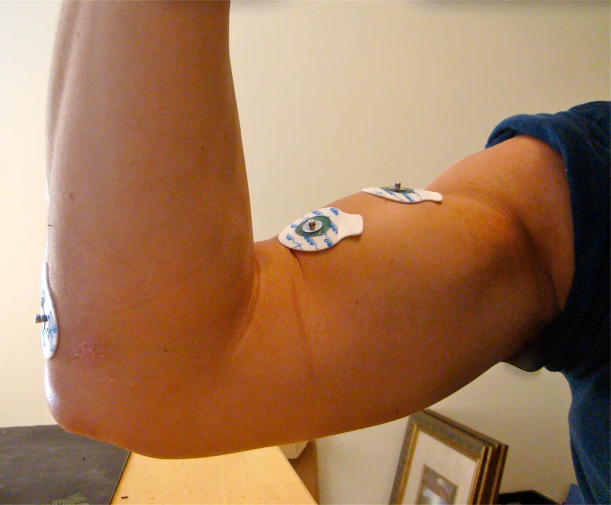
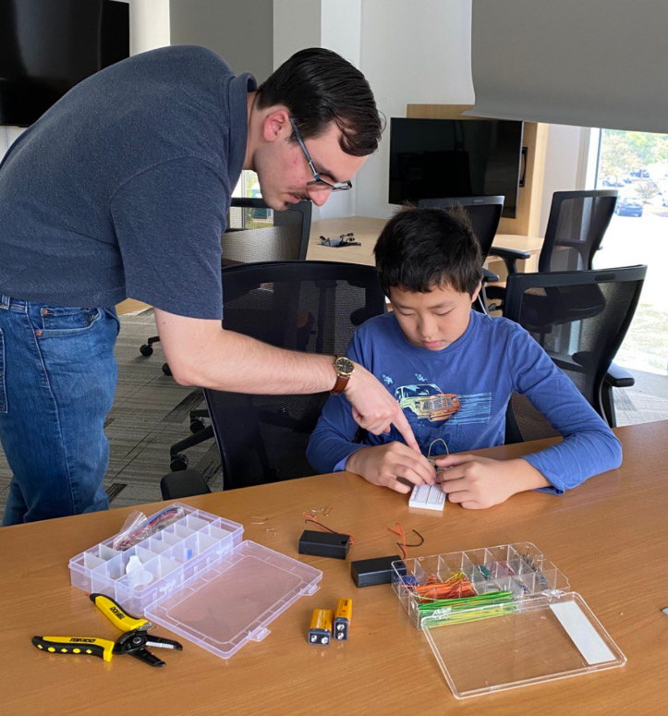
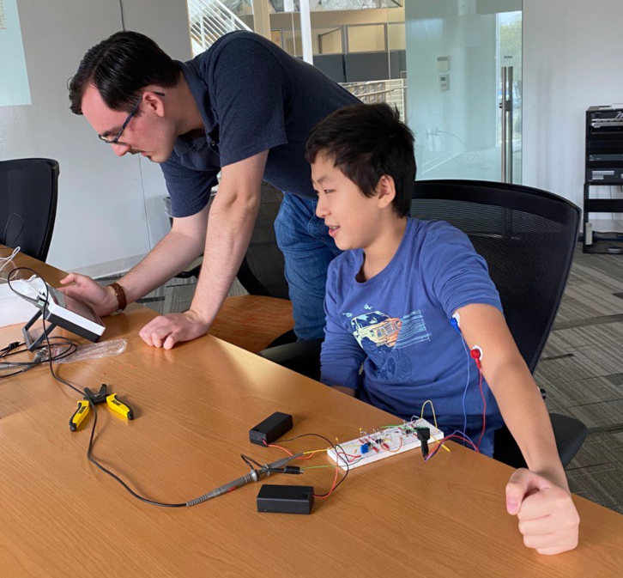
Section 2 - EMG Muscle Sensor

Slide 14
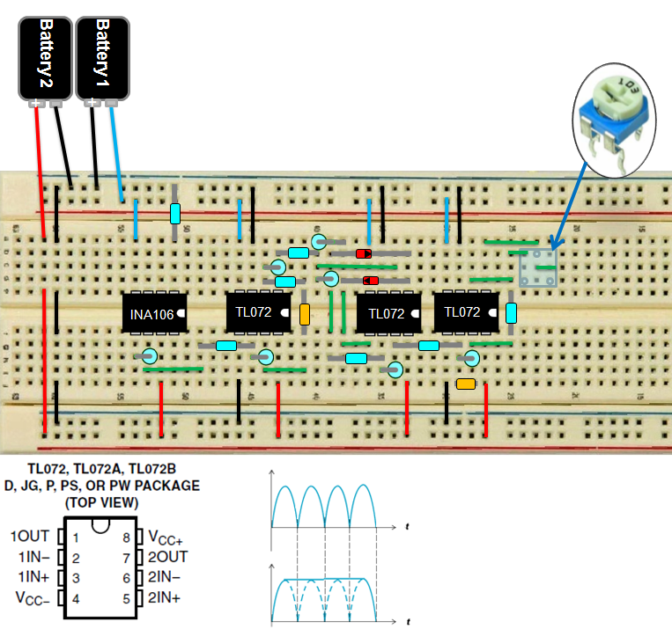
Electromyography EMG Circuit Design
Signal acquisition
Signal conditioning (amplification, rectification, smoothing + amplification

Slide 15
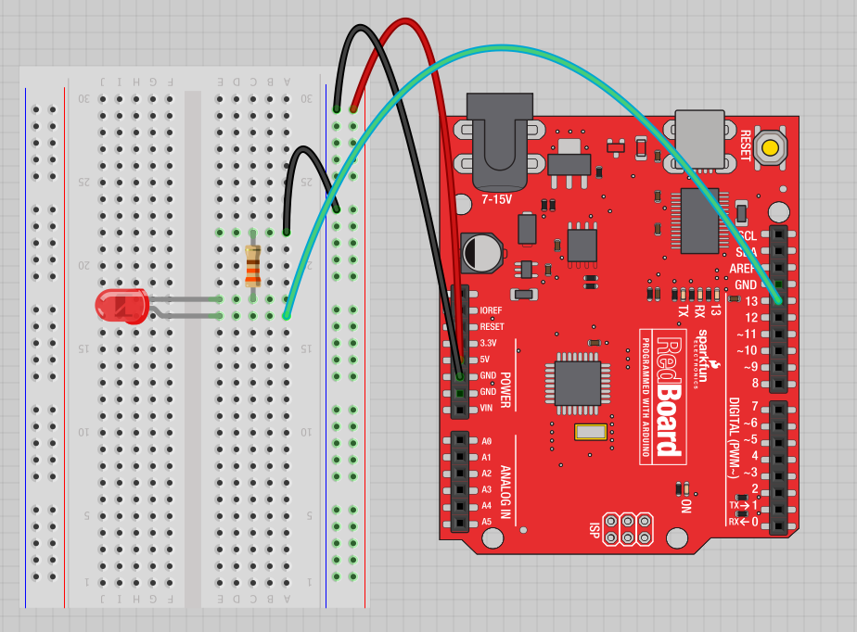
Section 3 - Sensors and Controls- Arduino Board
Move the green wire from the power bus to pin 13 (or any other Digital I/O pin on the Arduino board.
Image created in Fritzing

Slide 16
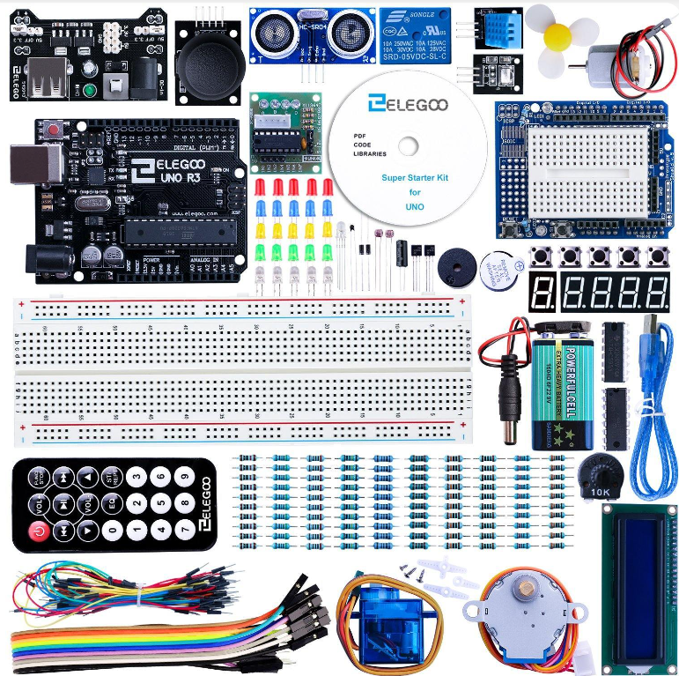
ELEGOO UNO Project Super Starter Kit

Slide 17
A few simple challenges
Let’s make LED#13 blink!
Challenge 1a – blink with a 200 ms second interval.
Challenge 1b – blink to mimic a heartbeat
Challenge 1c – find the fastest blink that the human eye can still detect…
1 ms delay? 2 ms delay? 3 ms delay???

Slide 18
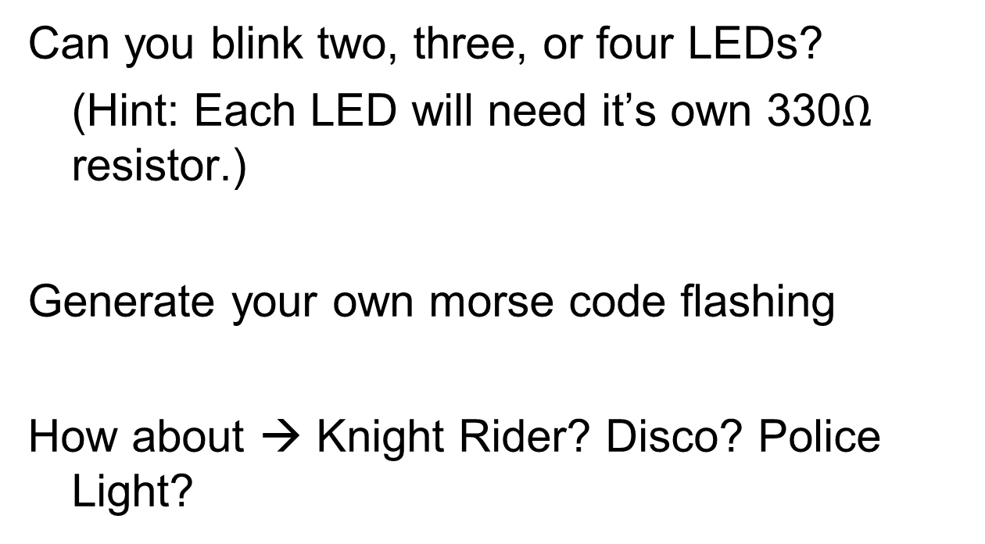
Try adding other LEDs

Slide 19
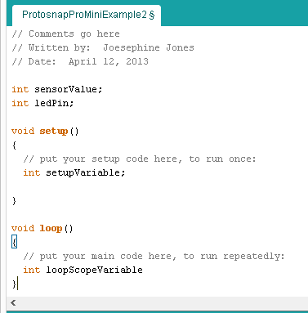
Programming Concepts: Variables
Variable Scope
Global
---
Function-level

Slide 20

Physics teachers, please be prepared to teach programing and electronics!

