Slide 1
Teaching K-12 Particle Physics as an Advocate: A Personal Journey into Radio Wave Science and Technology Research
Ronald H. Freeman, PhD
Space Operations & Support Technical Committee, AIAA

Slide 2
Contents
Background
Atmospheric - Low Earth Orbital Radio Communications
Introduction—Instructional Context
Lunar Exospheric Radio Communications
Conclusion

Slide 3
The sun is the main source of space weather. Naturally occurring space radiation is always with us. It occurs when atoms, ions, or subatomic particles are accelerated to high velocity by processes such as solar particle events from the Sun. Disrupted propagation of radio signals emitted by satellites, disruptions in telecommunications, GPS position, aviation, and sometimes Earth’s ground electric power. Analyses of historical blackout events in the United States indicate that even short blackouts, which occur several times during a year in the United States, sum up to an annual economic loss between $104B and $164 B.

Slide 4
NOAA. The TEC in the ionosphere is modified by changing solar Extreme Ultra-Violet radiation, geomagnetic storms, and the atmospheric waves that propagate up from the lower atmosphere. The propagation of radio waves is affected by the ionosphere.
Global Ionosphere: The Total Electron Content (TEC) is the total number of electrons present along a path between a radio transmitter and receiver. Radio waves are affected by the presence of electrons.
The TEC in the ionosphere is modified by changing solar Extreme Ultra-Violet radiation, geomagnetic storms, and the atmospheric waves that propagate up from the lower atmosphere.
The first of its kind coupled Whole Atmosphere Model and Ionosphere Plasmasphere Electrodynamics Model (WAM-IPE Model) is now part of the Space Weather Prediction Center’s (SWPC) suite of forecast tools and has expanded space weather forecasts
The Total Electron Content (TEC) is the total number of electrons present along a path between a radio transmitter and receiver. Radio waves are affected by the presence of electrons. The more electrons in the path of the radio wave, the more the radio signal will be affected. For ground to satellite communication and satellite navigation, TEC is a good parameter to monitor for possible space weather impacts.

Slide 5
Introduction—Instructional Context

Slide 6
Lunar Exospheric Radio Communications Example1---November 26, 2018
Notional Mars Architecture
Cubesats on MartianMissions

Slide 7
Examples of dust-related damage of mechanisms per Apollo 17 de-briefing reports.

Slide 8
Dust particles lifted from the surface of the regolith and levitating, immersed in the interstellar or interplanetary plasma, are electrically charged and, therefore, are associated with the plasma through electric and magnetic fields
Dust particles lifted from the surface of the regolith and levitating, immersed in the interstellar or interplanetary plasma.
Electrically charged and, associated with the plasma through electric and magnetic fields.
Dust can be considered as a collection of isolated particles (“dust-in-plasma”)
Plasma containing charged dust particles referred to as a “dust plasma”, has properties determined by the ratio of three characteristic length scales: dust grain size a, Debye length, and dust density.
Dust plasma medium includes plasma flows, secondary particles, photoelectrons, levitating dust particles of regolith, as well as the extremely rarefied atmosphere of the Moon.
A collisionless exosphere of the Moon, which can extend to several hundred kilometers above the surface

Slide 9
Lunar charging environment: The lunar surface is subject to the solar wind plasma, and ultraviolet and soft x-ray radiation that can vary over the course of a lunar day.

Slide 11
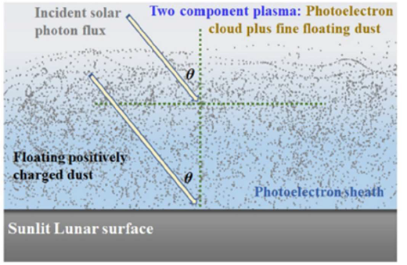
The physics of “dust-in-plasma” (PoD) The photoelectron sheath and floating fine positively charged dust particles constitute a two-component dusty plasma in the sunlit lunar regolith’s vicinity.

Slide 12
When lunar dust does enter inside the plasma sheath, Das et al. (2016) [3] explained the ion drag force and neutral drag force caused by the plasma are negligibly smaller than the electrostatic force. Therefore, charged particles interact with the spacecraft within the confines of the plasma sheath, while the interaction between dust with plasma, neglected.

Slide 13
When lunar dust does enter inside the plasma sheath, Das et al. (2016) [3] explained the ion drag force and neutral drag force caused by the plasma are negligibly smaller than the electrostatic force. Therefore, charged particles interact with the spacecraft within the confines of the plasma sheath, while the interaction between dust with plasma, neglected.

Slide 14
A novel combination of active and passive technologies integrated into the hardware surface to alleviate dust contamination.
Leveraging two specific technologies, the Electrodynamics Dust Shield (EDS) active technology and Work Function Matching Coating (WFM) passive technology
Developed by NASA for rigid surfaces, a new high performance materials such as the Carbon Nanotube (CNT) flexible fibers to develop a spacesuit-integrated dust cleaning system.

Slide 15
Conclusion
Research Journalism posits an engaged science teacher within a community where knowledge-sharing is valued independent of age, background, or competency.
Visual models provide a scaffolding platform for interpreting data and observing data patterns (with modifiers provided by atmosphere/ magnetosphere and material science substitutes).
System reliability models processes, disruptive patterns prompts further science forecasting threshold limits per Alert Warnings (Total Electron Counts).
Uncertain problem domains require methods for characterization.

Slide 16
Thank you
ronaldhoracefreeman@gmail.com
www.lunaropsjournal.org

