Slide 1
Outcome of A Summer High School Quantum Program :
Maajida L.C. Murdock
Mathematics Department
Randallstown High School
Department of Physics & Engineering Physics, Morgan State University
The Chesapeake and North Carolina Sections of the
American Association of Physics Teachers
Fall 2024
Saturday, October 19, 2024
Thomas Jefferson National Accelerator Facility Newport News, VA.

Slide 3
This proposed program included
Three Community Recruitment Workshops during the academic year
Workshop 1 – April 6, 2024 (Pre-Eclipse campus event)
Workshop 2 – May 18, 2024
Workshop 3 – June 29, 2024 (Parents Orientation)
(2) Five-week Summer Academic Accelerator Program including Hands-on Field Experience.
iQuEST served 22 students
Comprised of underrepresented minority students each from rising 9th , 10th , 11th, and 12th grades, respectively.
(3) Following-up academic year mentoring program

Slide 4
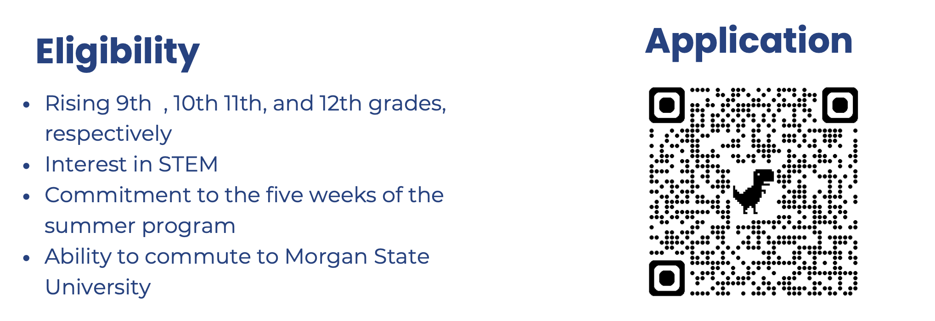
Early recruitment of students was critical

Slide 5
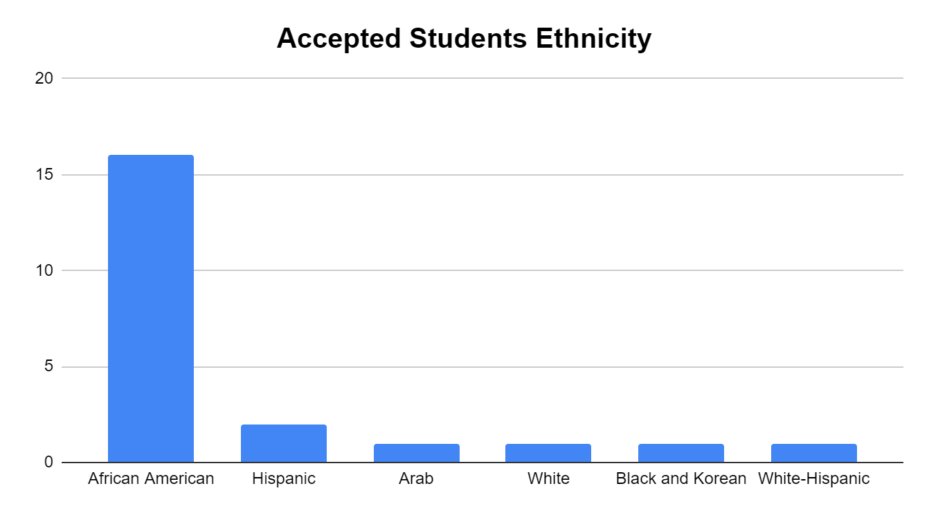

Slide 6
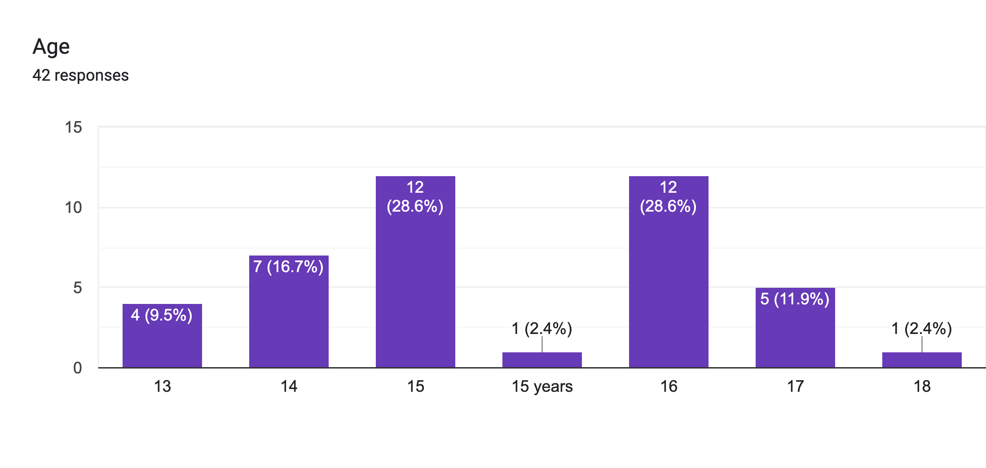
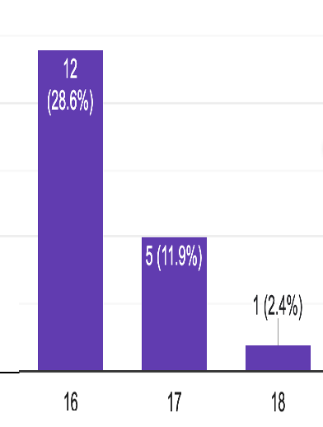

Slide 7
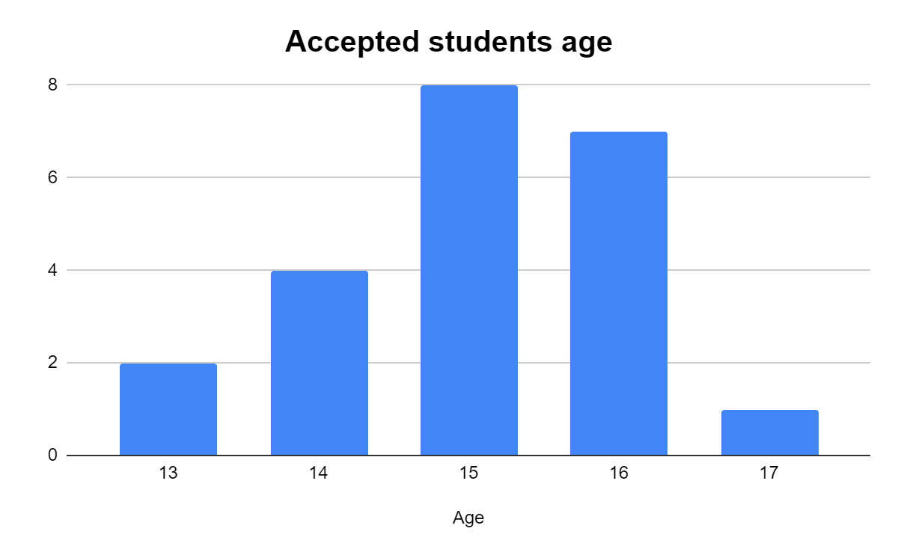

Slide 8
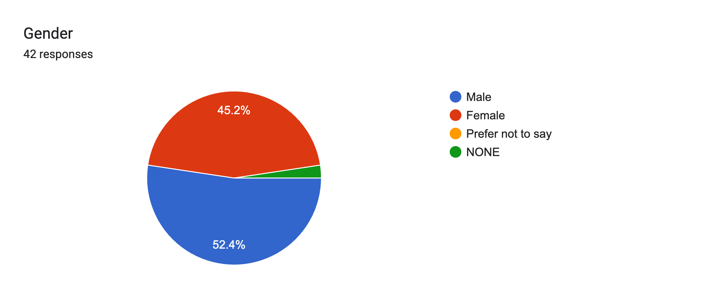
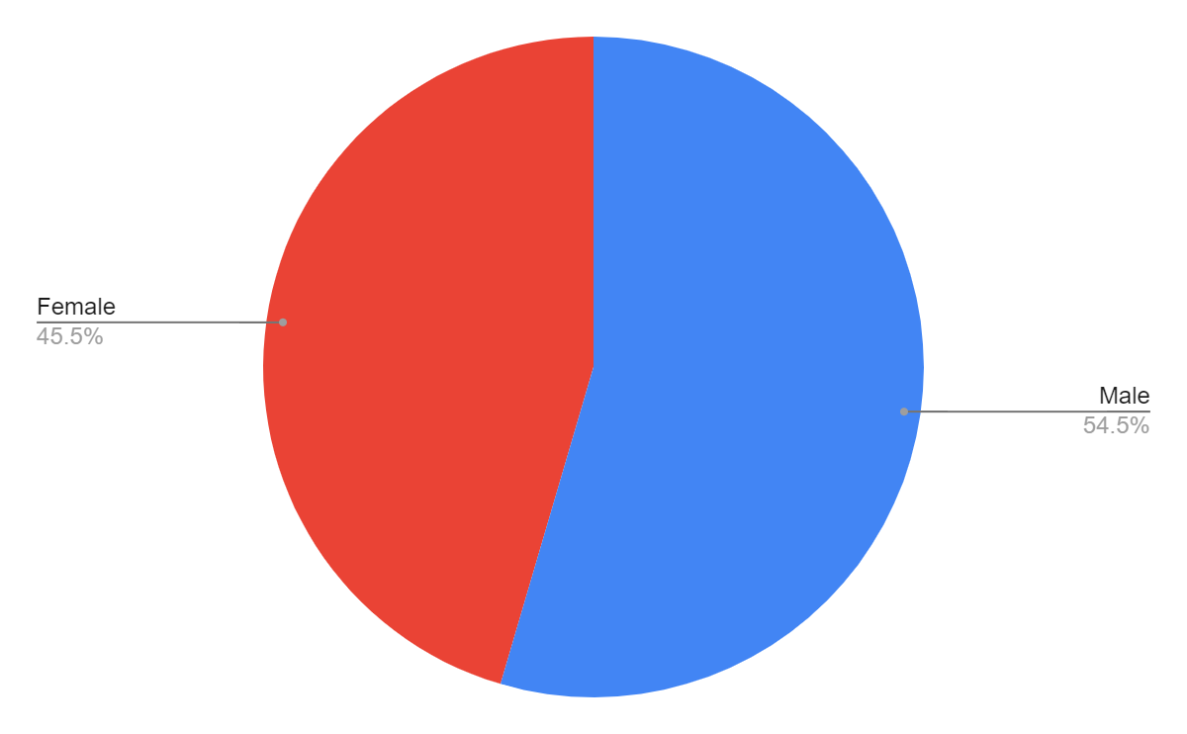
22 Accepted

Slide 9
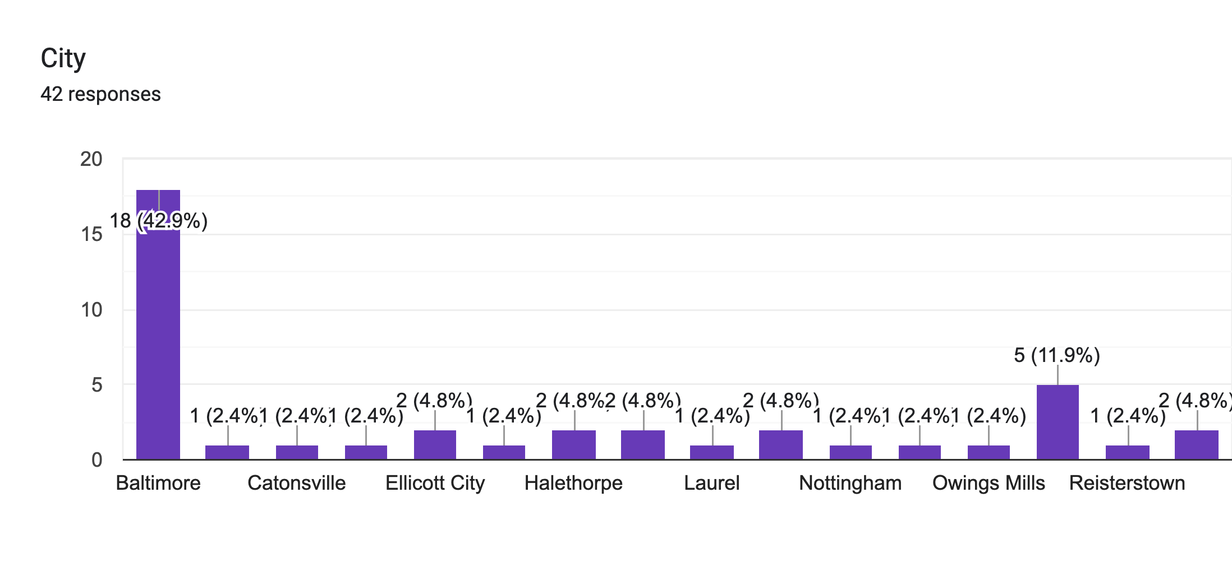

Slide 10
iQuEST Summer 2024 Academic Accelerator Program:
Summer Supplemental STEM education will include
(1) readiness assessment tools in mathematics
(2) fundamentals of reading, composition, and communication, and
(3) introductory courses in Quantum Physics.
(4) Guided through the Scientific Method by designing their own project and incorporating the process of innovation. Students work in teams to develop quantum-based products to address real world problems.
(5) Hands-on Field Experiences: Three In-person and virtual field
trips are important to inform students of the interdisciplinary nature
of quantum jobs and careers.

Slide 11
iQuEST Daily Agenda:
Program Dates :July 01 - August 02 2024
Time | Activity
8:00 – 9:50 | Check-in/ Breakfast
9:00 - 10:20 | Math A / English B
10:20 – 10:30 | Break
10:30 – 11:50 | Math B/ English A
11:50 – 12:50 | Lunch
12:50 – 1:00 | Transition to Afternoon Sessions
1:00 – 3:50 | Quantum Science
3:50 – 4:00 | Closing Review
4:00 – 5:00 | Study Hall/Departure

