Slide 1
Learning gains using Kahoot!
WITH STUDENT GENERATED QUESTIONS
Sithy Maharoof, Ph.D.
North Carolina and Chesapeake Joint AAPT Chapter Meeting, VA
10/19/2024

Slide 2
Purpose
Investigate the effect of using Kahoot! in introductory physics courses w/student generated questions.

Slide 3
Agenda
What led to my work?
About Kahoot!
Assessments and Outcomes
Conclusions
What’s Next?
References

Slide 4
What led to this work?
Poor performance in conceptual questions on exams!!
3 Unit exams on one final exam.
40% of the grade on exams comes from conceptual questions!

Slide 5
Class Sizes
Small class sizes ~ 20 students/class
No physics program.
Serves the other programs like Bio Medical Engineering and Chemistry.

Slide 6
Kahoot! - What is it?
A game-based student response system.
Students don't need registration.
Free version is available with limited functionality.
Students access using their mobile devices.

Slide 7
Kahoot!, an Interactive Engagement? DEMO
Classroom with IE
Classroom with Traditional Lectures
Increased interaction.
Immediate feedback.
Competitive.
Rely on lectures.
Passive students.
No interaction.
Notes:
1. Kahoot encourages active participation from all students, as it's engaging and interactive.
2. Competitive nature of Kahoot adds an element of excitement.
3. Allowing students to develop questions for Kahoot encourages active reading and comprehension.

Slide 10
Implementation and Assessment
FCI test was administered on week 2 of the semester.
Two Kahoot Games were incorporated.
Student-generated questions were included.
FCI test was administered on week 13 of the semester.
Analyzed the differences between pre- and post-test results.
Force Concept Inventory = FCI
Notes:
FCI = Force Concept Inventory - a well-tested multiple-choice questions on mechanics.

Slide 11
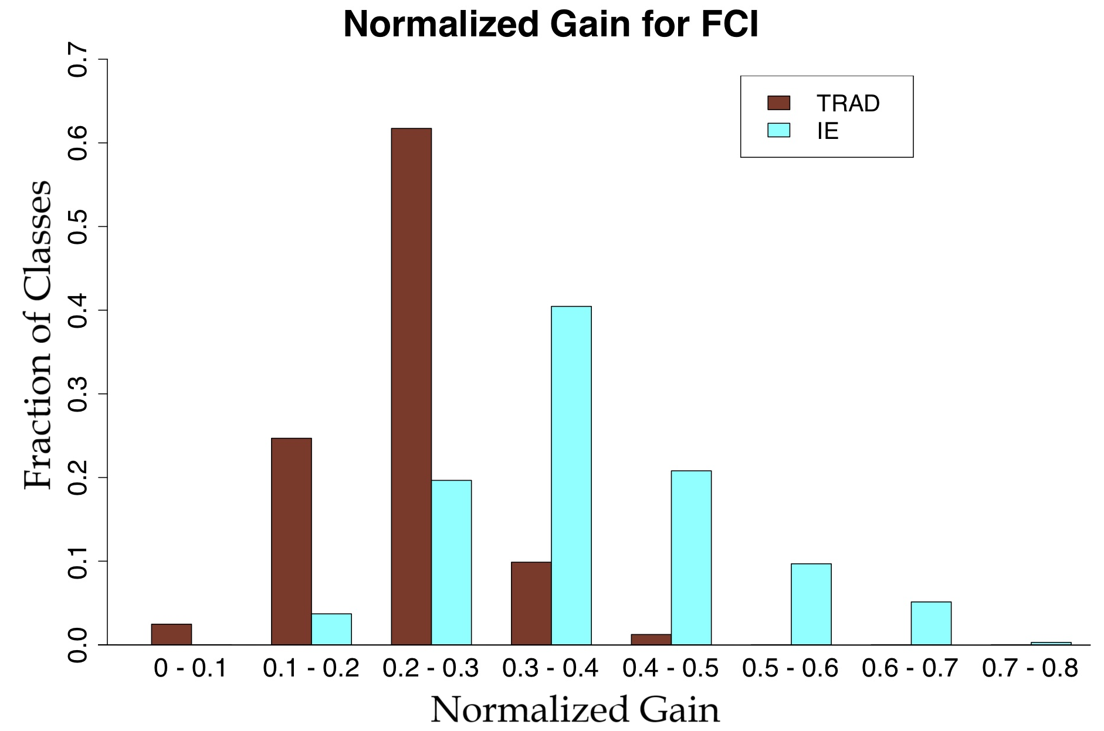
Traditional Lecture vs. Interactive Engagement
The courses that used interactive techniques shows increased gains in the FCI scores.
The Normalized Gains from 31,000 students in 450 physics classes, published in 63 papers. (Korff, et al.)
References
FCI Test Ref. 4
This graph Ref. 3
Notes:
Source of this graph:
Am. J. Phys. 84, 969–974 (2016)
https://doi.org/10.1119/1.4964354

Slide 12
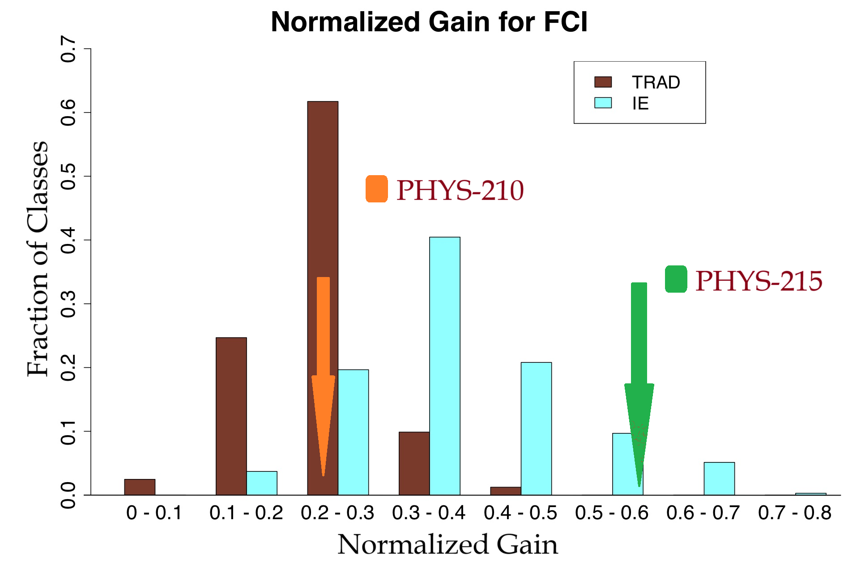
Results and Discussion
Drastically different results for the two classes!
Possible Influencing Factors:
Math skills levels.
Prior physics experiences.
PHYS-210: Algebra-based Physics
PHYS-215: Calculus-based Physics

Slide 13
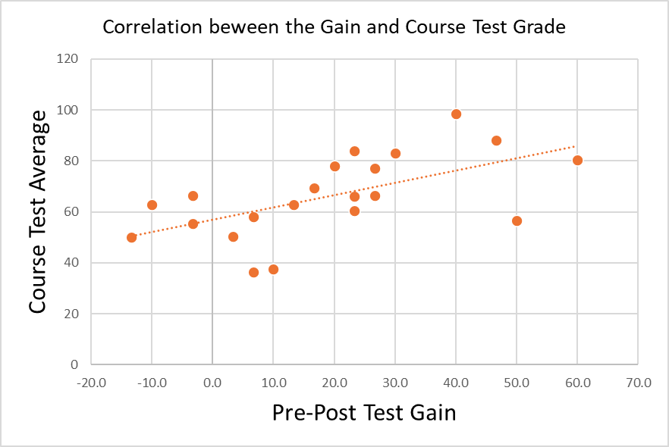
Other Observations
Pre-post test gains are correlated with the course exam grades!
FCI Gains can predict student success in the course!
Correlation Co-efficient = 0.59

Slide 14
Conclusions and Future Work
Kahoot Game’s impact on gains is inconclusive.
FCI test gains are indicative of course success.
Recent work suggested additional concept practice can help with increased gains. (Paul et al.)
Future work will focus on enhancing Kahoot integration.

Slide 16
References
[1] Hake, R. (1998). Interactive-engagement versus traditional methods: A six-thousand-student survey of mechanics test data for introductory physics courses. American Journal of Physics, 66, 64-74. doi: 10.1119/1.18809
[2] Hestenes, D., Well, M., & Swackhamer, G. (1992). Force concept inventory (FCI). The Physics Teacher, 30, 141-158.
[3] Korff V. K., Archibeque B., Gomez K. A., Heckendorf T., McKagan S. B., Sayre E. C., . . . Sorell, L. (2016). Secondary analysis of teaching methods in introductory physics: A 50 k-student study. American Journal of Physics 84, 969. doi.org/10.1119/1.4964354
[4] Physport: Supporting physics teaching with research-based resources. (n.d.). Retrieved July 18, 2016, from https://www.physport.org
[5] Paul Justice et al 2019 Eur. J. Phys. 40 055702. doi: 10.1088/1361-6404/ab2135

