Slide 1
Physics Identity of Undergraduate Women
George Mason University Research Team
Jessica Rosenberg, PI
Associate Professor of Physics & Astronomy
Ben Dreyfus, co-PI
Instructional Professor of Physics & Astronomy
Nancy Holincheck, co-PI
Assistant Professor of STEM Education
Laura M. Akesson
Graduate Research Assistant

Slide 2
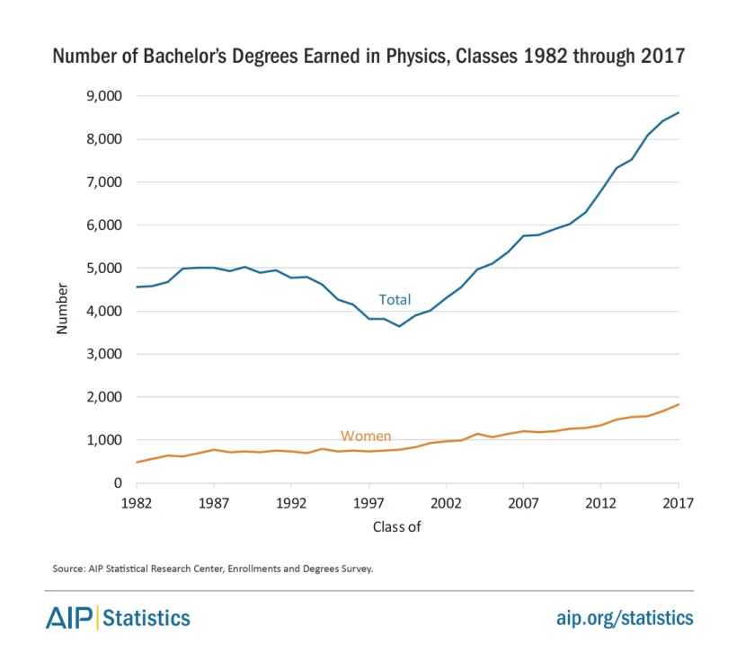
Pion Project:
This project examines the role of mentorship, leadership, and career conceptualization in the development of physics identity and belonging of undergraduate women in physics.
This material is based upon work supported by the National Science Foundation (NSF) Improving Undergraduate STEM Education (IUSE) Project # 2044232

Slide 3
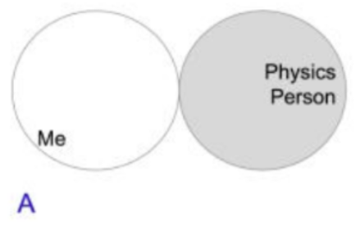
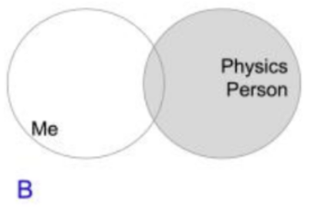
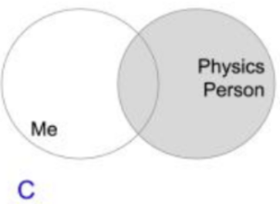
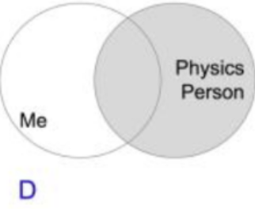
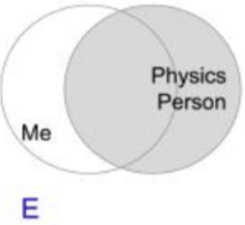
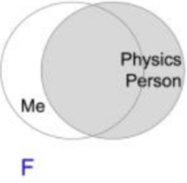
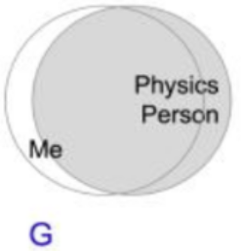
Abstract
Students with a strong science identity have a higher likelihood of choosing a science career and are more likely to demonstrate persistence in STEM courses and careers. Preliminary findings of an ongoing qualitative survey analysis of 120 undergraduate women in Physics will be presented. The following research questions are being investigated:
How do undergraduate women explain their self-assessment of their own physics identity?
What are undergraduate women’s conceptions of what it means to be a physics person?

Slide 4
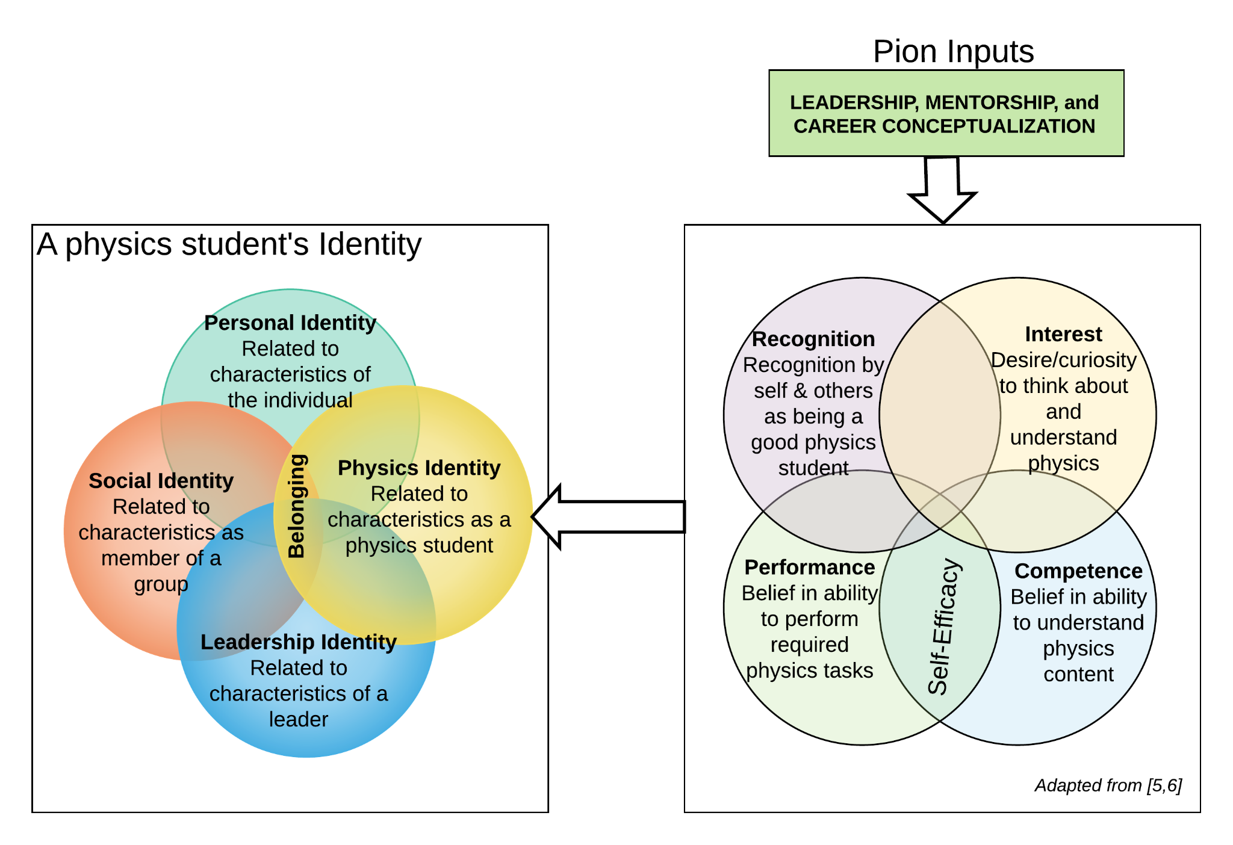
STEM Identity: why it matters
Motivation and persistence (Oyserman, 2015)
More likely to have positive beliefs about their competence (Perez, et. al. 2014)
Perceived costs (eg. time spent studying) more worthwhile
For women: high STEM identity provide a buffer against the experience of sexism (Kuchynka, et. al. 2017)
Psychology: A story that we create for ourselves (Pollman and Miller, 2010)
Sociology: Past, present, & future; ethnicities, races, religions, genders, sexual orientations, life histories, current realities…people have multiple identities (Alsup 2006, Gee, 2000)

Slide 5
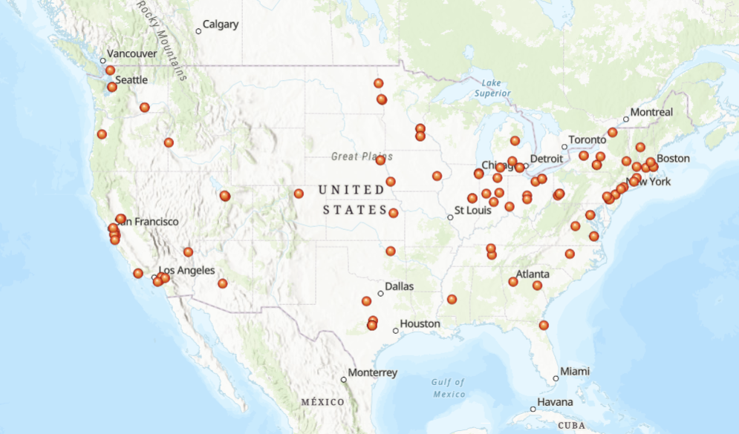
Conference(s) for Undergraduate Women in Physics
Recruited survey participants from CUWiP attendees across US
n=120

Slide 6
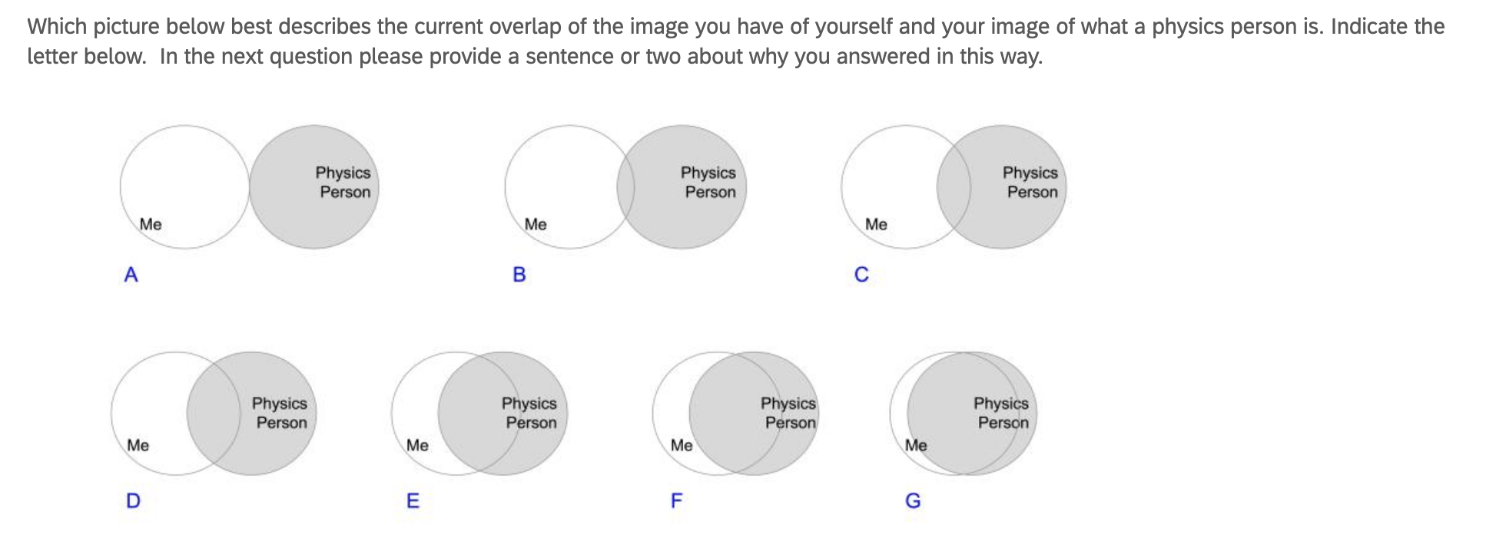
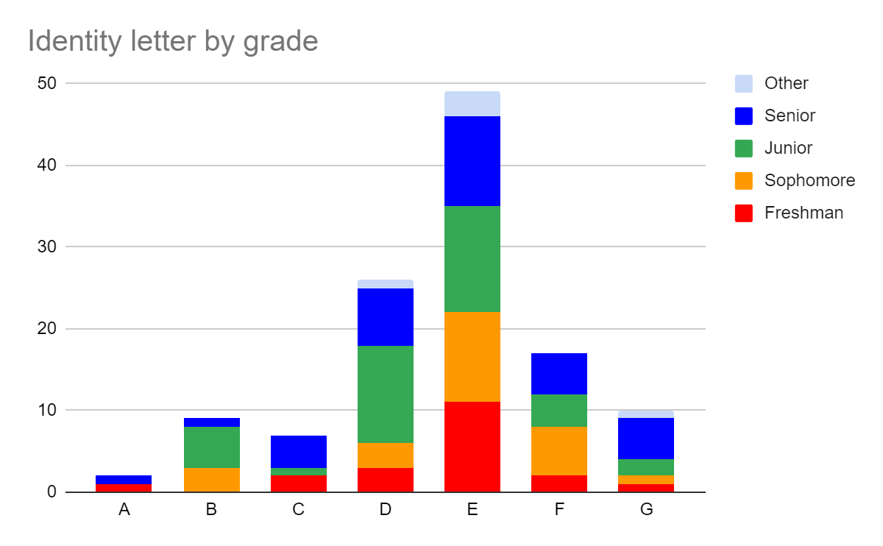
Which picture below best describes the current overlap of the image you have of yourself and your image of what a physics person is. Indicate the letter, and provide a sentence of two about why you answered this way.

Slide 7
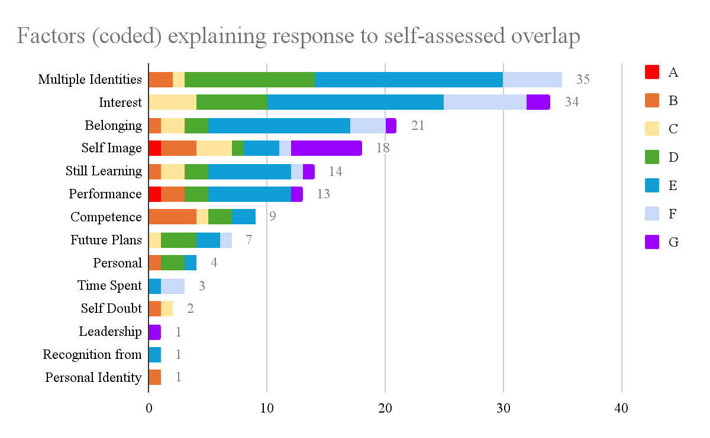
Link

Slide 8
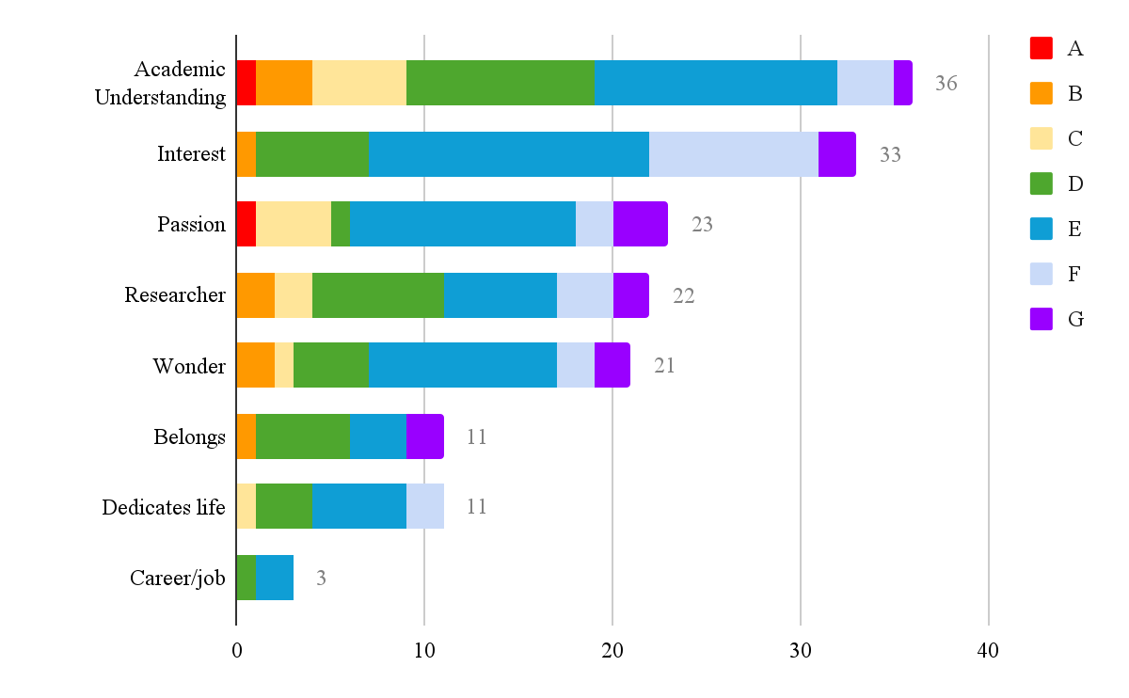
2. What does it mean to be a physics person?
Gap between undergraduate women’s actual identities and designated identities
5
13
12
34
designated identities
5
21
gap
⇒ Persistence
Belonging
actual identities
(McDonald et. al. (2019))
Notes:
If you include competence (9) in the academic understanding overlap, it would add 2. So 13->22; 5->7.
Thus, educational choices can be viewed as a way to close the gap between a student’s actual and designated identities; measuring this gap may be useful for predicting persistence, as it connotes the likelihood that effort toward one’s goal will be well-spent or wasted. (McDonald, et. al. 2019)

Slide 9
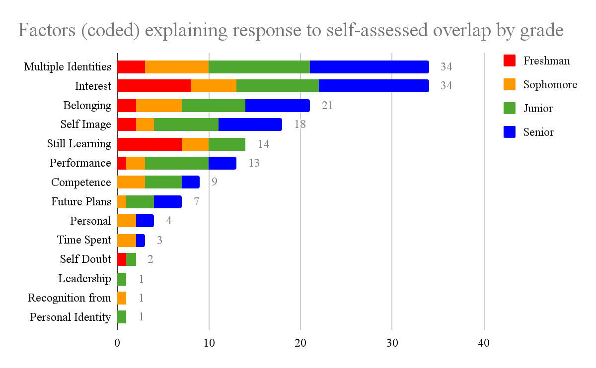
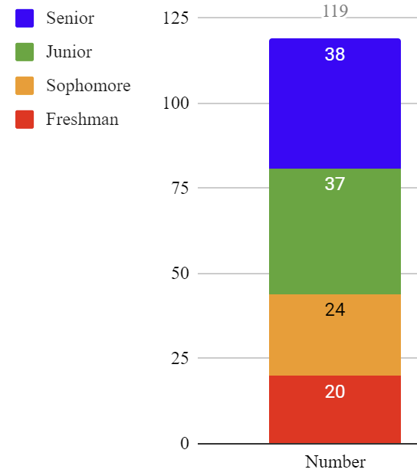
Identity development over time (undergrad women)
Q: Is belonging a senior thing? (Hazari says yes). This data says not for these women.
Q: Were competence and performance more of a freshman thing? (Alqvist et. al.) Again, this data says not for these women.
Link

Slide 10
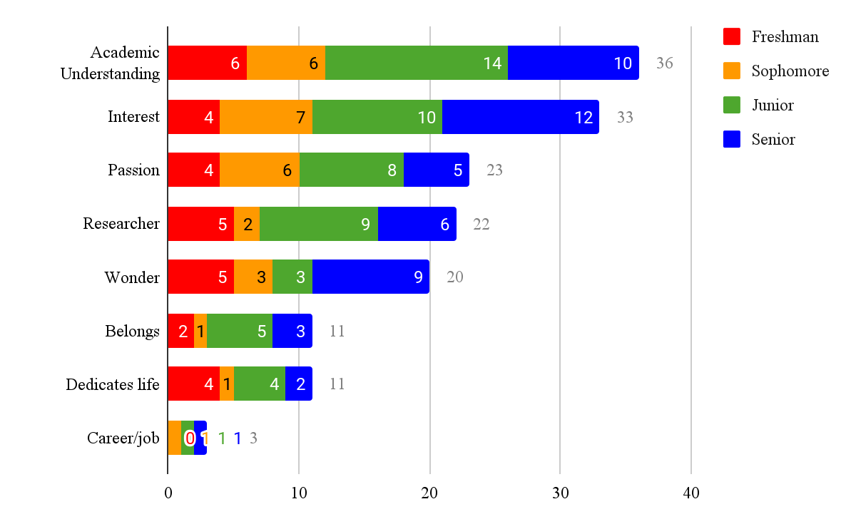
Physicist definition over time (undergrad women)

Slide 11
Future plans? Leadership?
Quantitative (𝝌²) analysis revealed no statistically significant results comparing Physics Identity (A-G responses) with:
Future plans: 86 (71%) responded “Graduate School (STEM)”
Leadership: numbers too low
Self-Identity was correlated with coded explanations for question 1 (calibration was correct!)
Qualitative analysis of 31 corresponding interviews ongoing/forthcoming

Slide 12
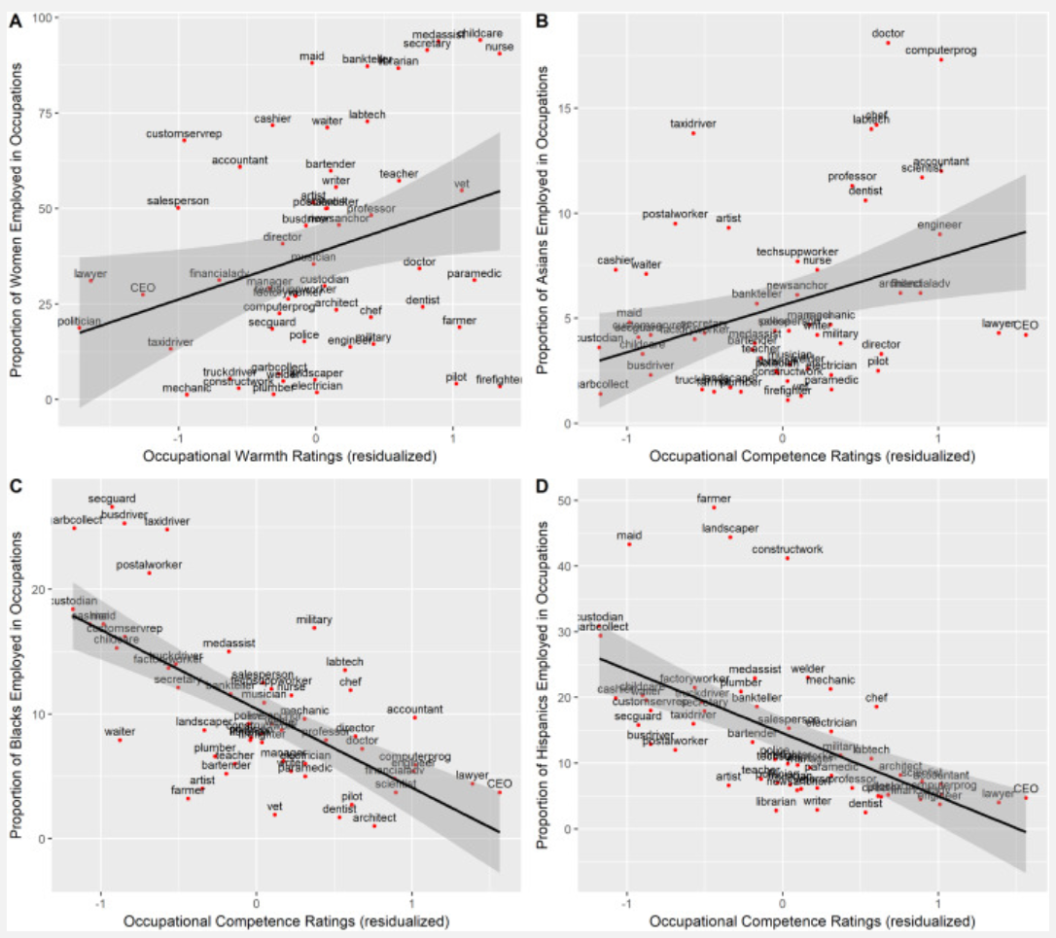
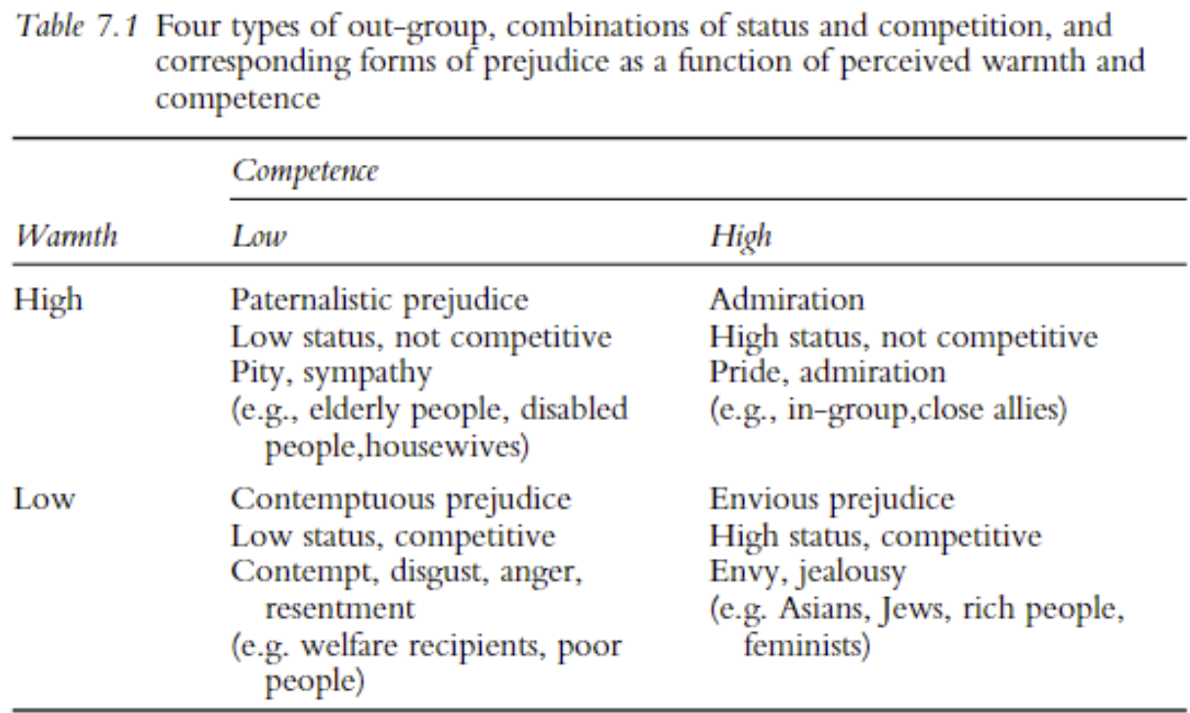
Discussion: Stereotype Content Model
Fiske, 2002.
He, J. et. al. (2019)

Slide 13
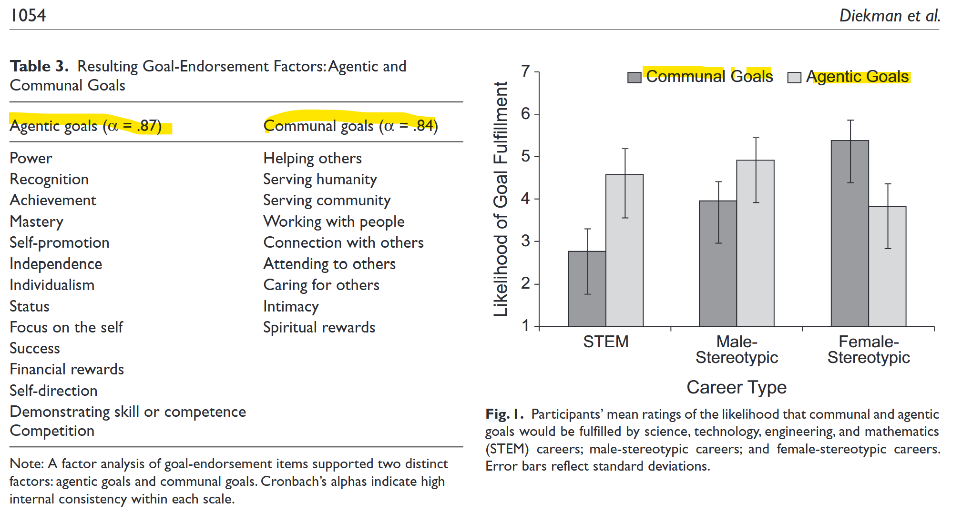
Discussion (cont.)
For URMs: Connections between interests in STEM and their racial/ethnic backgrounds and communities
For women: communal goals of greater importance. (Diekman et. al. 2010)

Slide 14
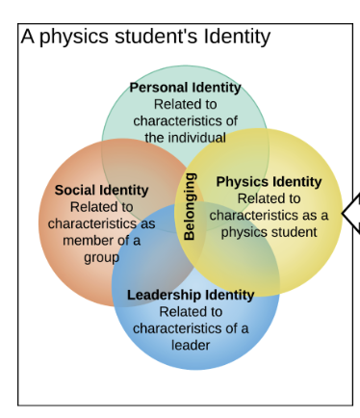
Conclusions
Physics identity for undergraduate women is complex
Data from self-selected CUWiP attendees (perhaps lessening the Physics identity)
Omissions should not be taken as non-factors; interviews may shed more light here
Psychological and Sociological frameworks may be useful
K-12 plays a significant role
For women and other URM in physics, community in Physics needs to be examined.
How can this be addressed by
explicit norm-setting (culture establishment)
curriculum and instruction?
Notes:
Community: do my multiple identities fit/exist within the physics community? Sense of belonging. Is my interest worth

