Slide 1

Deeper Understanding Through Problem Posing
Michael Peterson
Triangle Math and Science Academy
mpeterson@tmsacademy.org

Slide 2
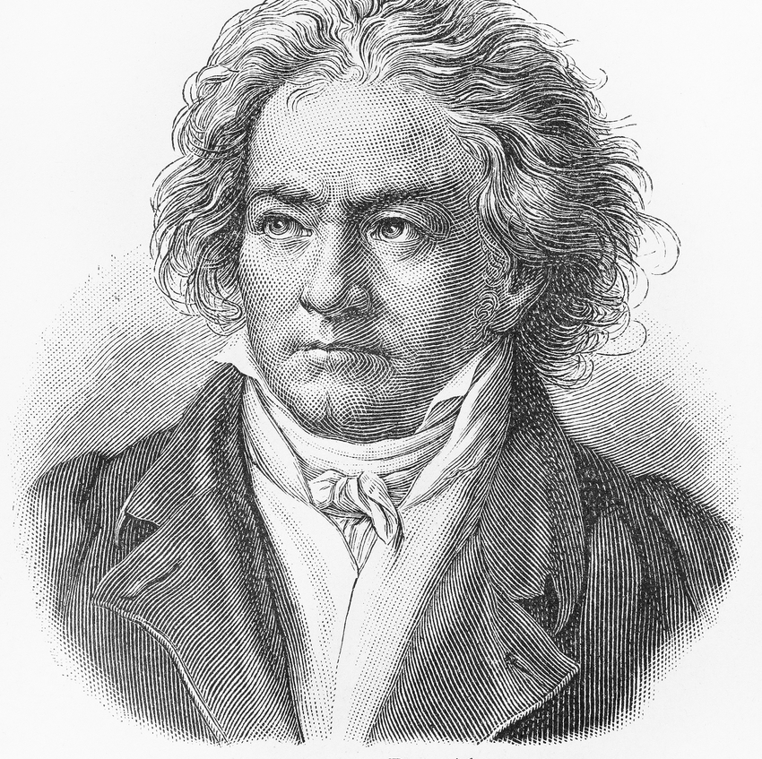
Inspiration
In 1819, Anton Diabelli invited 51 prominent composers to submit one variation to a waltz he had composed.
Beethoven submitted 33.
Beethoven’s were the most original of all the entries.
Even after seeing Beethoven’s compositions, composers of the time submitted much tamer variations.
Hattie (2023) Problem-posing increases creativity: ES 0.62

Slide 3
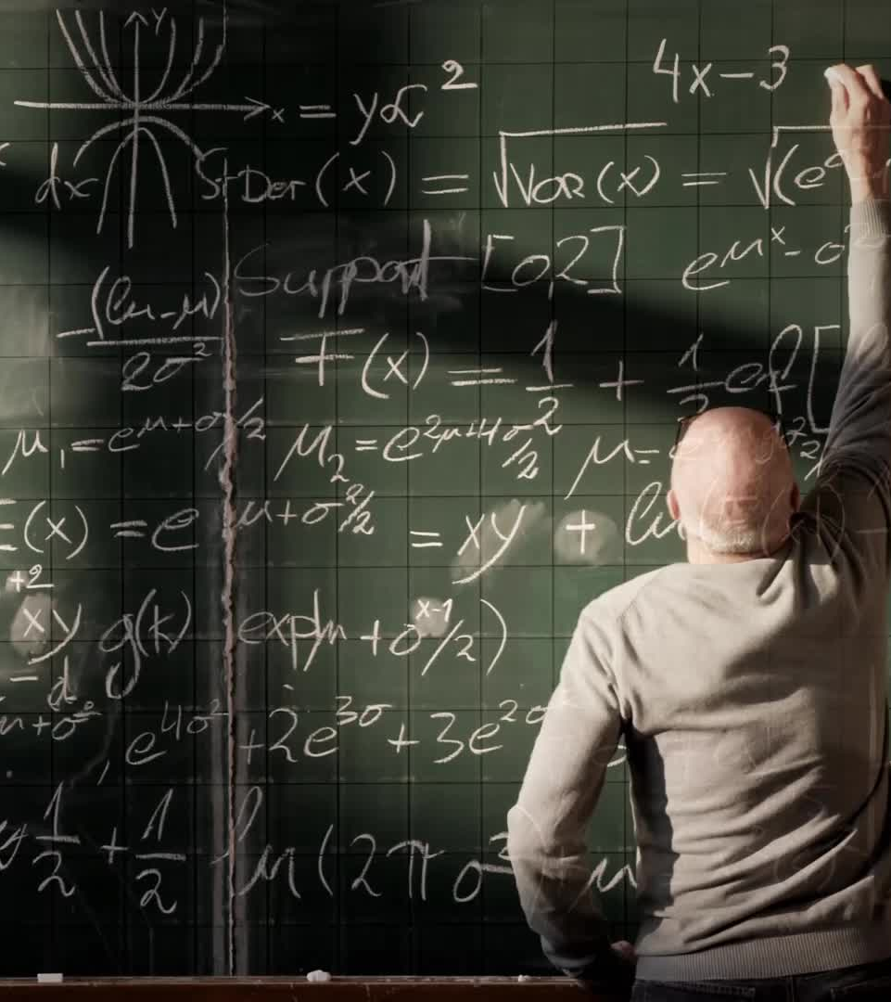
Rationale
Problem-posing ability related to problem-solving ability (Calabrese et al., 2022)
Problem-posing is considered a critical thinking skill requiring higher-order thinking, imagination, and active learning (NCTM, 2000)

Slide 4
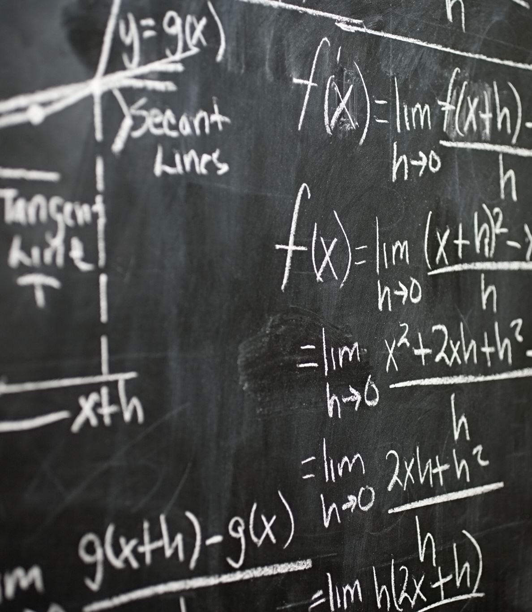
Objective
To determine if problem-posing increases AP Mechanics C achievement.

Slide 5
Problem-Posing Research
2010
Ergun found that it had a positive effect on first-year university physics achievement.
2014
Rosli, Capraro, and Capraro conducted a meta-analysis on problem posing and its effect on mathematics achievement. They found a positive effect. ES: 1.31.
2022
Calabrese, Capraro, and Thomson conducted a systematic review and found that results were mixed for math achievement, and more research was needed.
2022
Yet, in 2022, Wang, Walkington, and Rouse conducted a meta-analysis and again found a positive effect. ES: 0.64
2002
Mestre demonstrated
Problem posing could be used as an assessment

Slide 6
Procedure
For each AP Mechanics C unit:
Students completed a series of free response questions.
Then for review, each student designed a University-level practice problem with 5 parts.
Students switched problems and solved their partners’ problems.
Two physics instructors graded the difficulty level of the designed problem. Scale: 1 - 5
Criteria:
  Class example with minor changes
  Combining class examples
  Algebraic
  Calculus
  Graphing
  Multiple objects
  Incline
At the end of the unit, students took an AP Mechanics C unit exam, 50 percent multiple choice (n = 24), 50 percent free response (n = 3).

Slide 7
Analyses
Using R Core Team (2013). R: A language and environment for statistical computing, the following analyses were conducted:
Box Q-Q Plot to identify any outliers. None found.
Descriptive statistics and distribution plots for both problem posing and assessment.
Bayesian machine learning was used to determine the magnitude and direction of arc causation.

Slide 8
Descriptive Statistics
Problem-posing Score:
N=15
Median: 3.00
Mean: 3.18
Std. dev.: 1.4
Min.: 1
Max.: 5
AP Unit Exam:
N=15
Median: 56.00
Mean: 54.91
Std. dev.: 8.65
Min.: 43.0
Max.: 67.0

Slide 9
Random/Generated Bayesian Network (bnlearn)
Nodes: 2
Correlation: 0.58
Arcs: Strength* Direction
Problem-posing → Physics Achievement: 0.77 0.5
Physics Achievement → Problem-posing: 0.77 0.5
* Maximum strength is 1.

Slide 10
Bayesian Network Plot
0.77
Problem-Posing
Physics Achievement
0.77

Slide 11
Results
Problem-posing leads to better physics understanding and in turn better physics understanding leads to better problem-posing.
Problem-posing can be used as both a tool to increase physics understanding and as an assessment to measure student physics understanding.
Because prior understanding leads to better problem posing, I recommend its use as a review tool.

Slide 12

Future Directions
Conduct a comparison study using a larger sample.
Conduct a study with problem posing imbedded in the unit assessment.

Slide 13
Thank you!

Slide 14
References
Brandt, A. (2022). Beethoven and Divergent Thinking. Creativity Research Journal, Vol. 36(1), 98-115.
Calabrese, J. E., Capraro, M.M., & Thomson, C.G. (2022). The relationship between problem posing and problem solving: A systematic review. International Educational Studies. Vol.(15(4), 1 – 8.
Ergun, H. (2010). The effect of problem posing on problem solving in introductory physics course. Journal of Navel Science and Engineering, Vol. 6(3), 1 – 10.
Hattie, J. (2023) Visible Learning: The Sequel. Routledge. London.
Mestre, J. (2002). Probing adults’ conceptual understanding and transfer of learning via problem posing. Journal of Applied Developmental Pshychology, Vol 23(1), 9-50.
National Council of Teachers of Mathematics. (2000). Principles and standards for school mathematics. Reston, VA.
R Core Team (2021). R: A language and environment for statistical computing. R Foundation for Statistical Computing, Vienna, Austria. URL https://www.R-project.org/
Rosli, R., Capraro, M. M, & Capraro, R.M. (2014). The effects of problem posing on student mathematical learning: A meta-analysis. International Education Studies, Vol. 7(13), 227- 241.
Scutari, M. (2010). Learning Bayesian Networks with the bnlearn R Package. Journal of Statistical Software, 35(3), 1-22.
Wang, M. Walkington, C., & Rouse, A. (2022). A meta-analysis on the effects of problem-posing in mathematics education on performance and dispositions. Investigation in Mathematics Learning Vol. 14(4), 265-287.

