Slide 1
Revamping Introductory Physics for Life Sciences
Jency Sundararajan,
Physics, University of Virginia

Slide 2
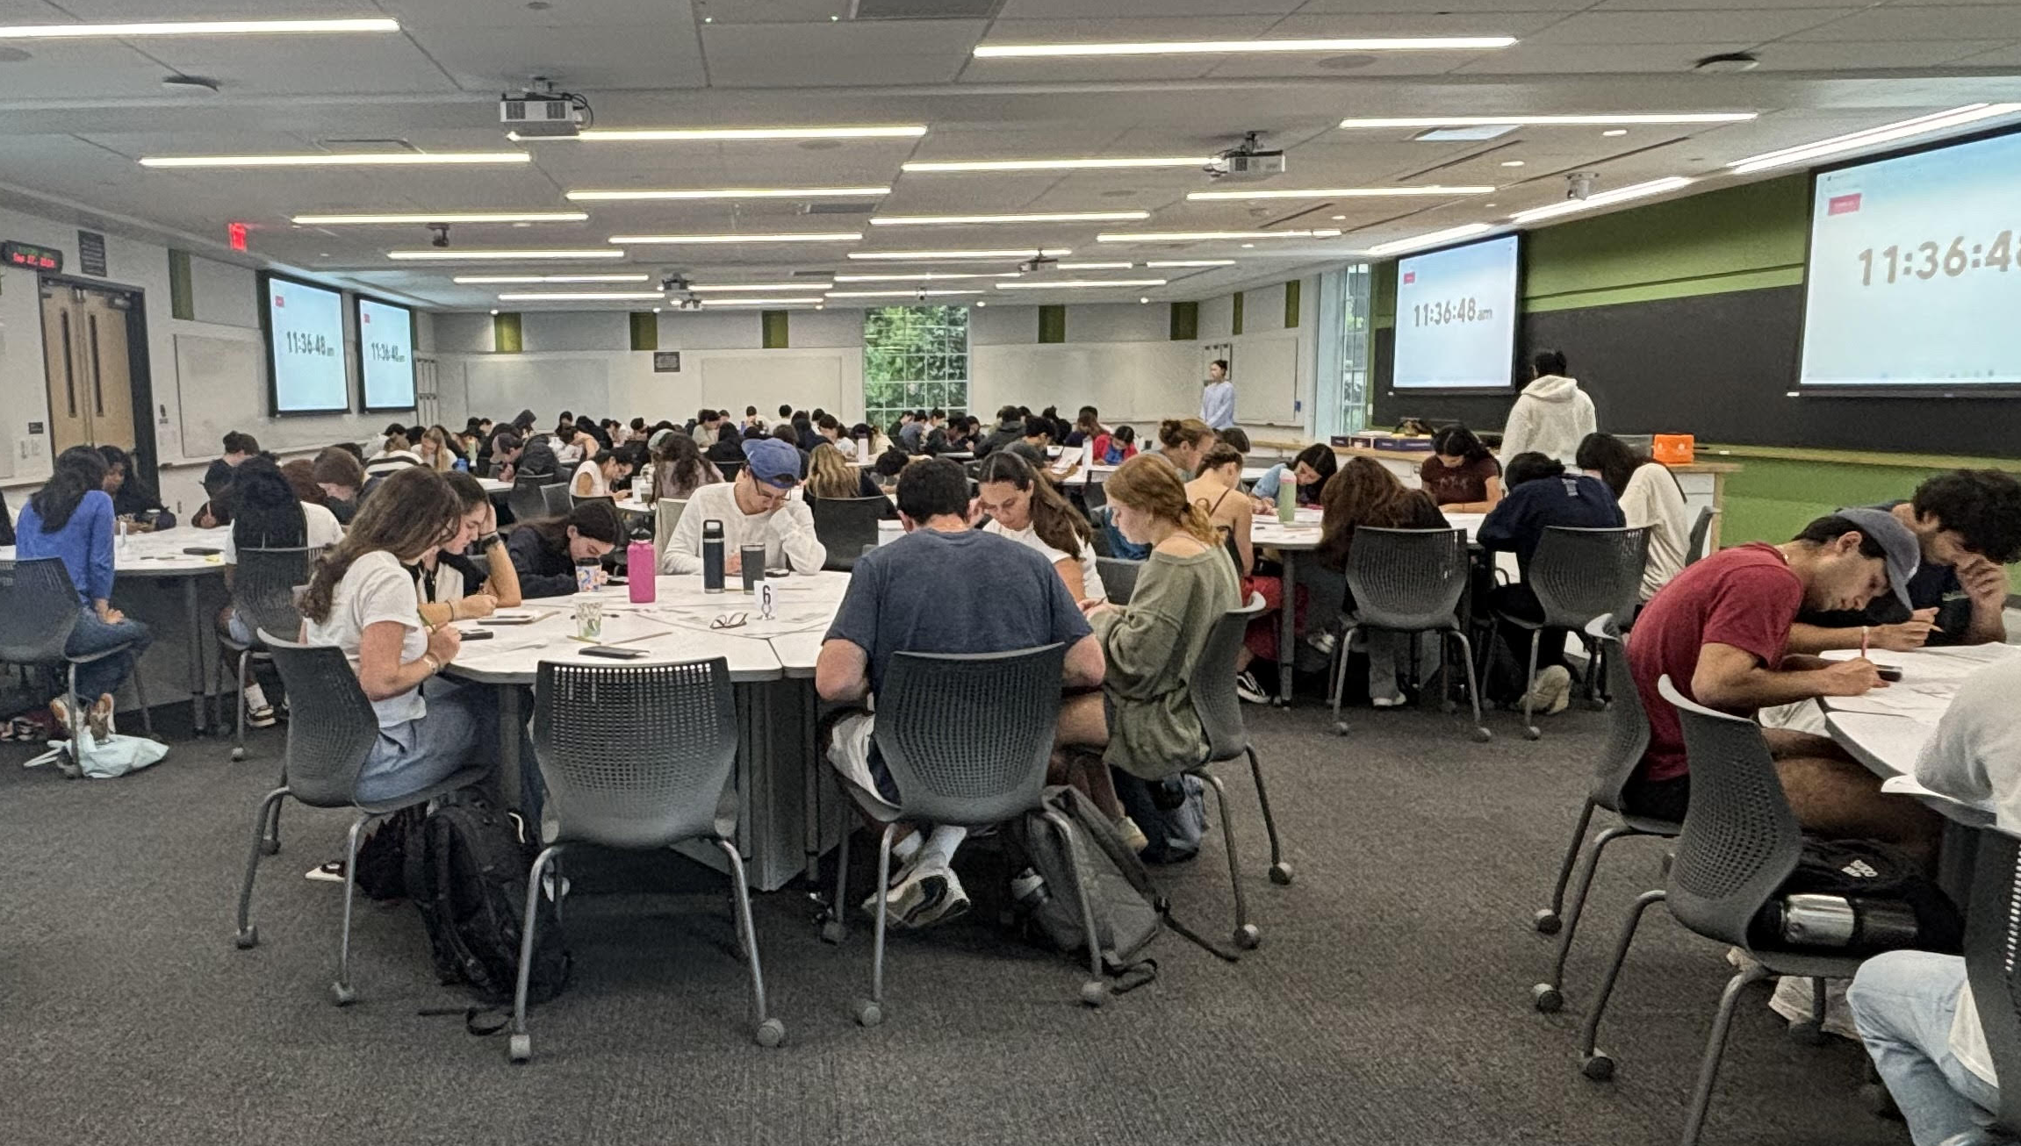
Background
Course: Physics for Pre-health
Enrollment: 6 sections of 110 students each
(660 students)
Classroom: 15 round tables of 9 students at each table
Lecture format:
Traditional until Spring 2022
Active Learning since Fall 2022
ALM outcomes:
Increased student participation and engagement
Better course performance and student evaluations
Project – Summer 2024:
Making it more relevant – striking the balance between physics concepts and biological applications
4 UTAs per section
1 GTA per instructor

Slide 3
Instructional Challenges
Students' perception:
Physics is more challenging and demanding
Emphasis on critical thinking over memorization
Apply acquired knowledge in real-world contexts
Bridging the gap – Physics and Biology
Main motivation:
Desire to excel in standardized entrance exams for health profession
Prioritize achieving high grades over gaining a good understanding of the concepts and applications.

Slide 4
Aim of the Project
Address the disconnect between physics topics and biological applications by providing the students with a platform to identify the connection and freely discuss their views on where they can find it applicable.
Address student’s passive mindset and approach to learning physics by cultivating a sense of belonging and promoting student responsibility to contribute to learning the material collaboratively via active participation and engaging in extensive field related discussions for better understanding.

Slide 5
Specific Activities
Modifying lecture worksheets to enhance student learning.
Crafting a pool of multiple-choice questions aimed at assessing student understanding.

Slide 6
Lecture Worksheets (30)
2022-2024: Typically, a 4-page worksheet on concept discussion, equations, problems and conceptual questions
Modification: Adding a section highlighting the biological application and one corresponding problem illustrating the application

Slide 7
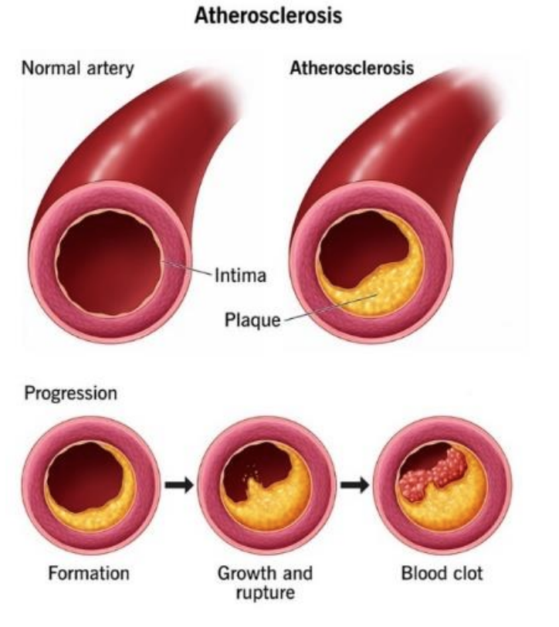
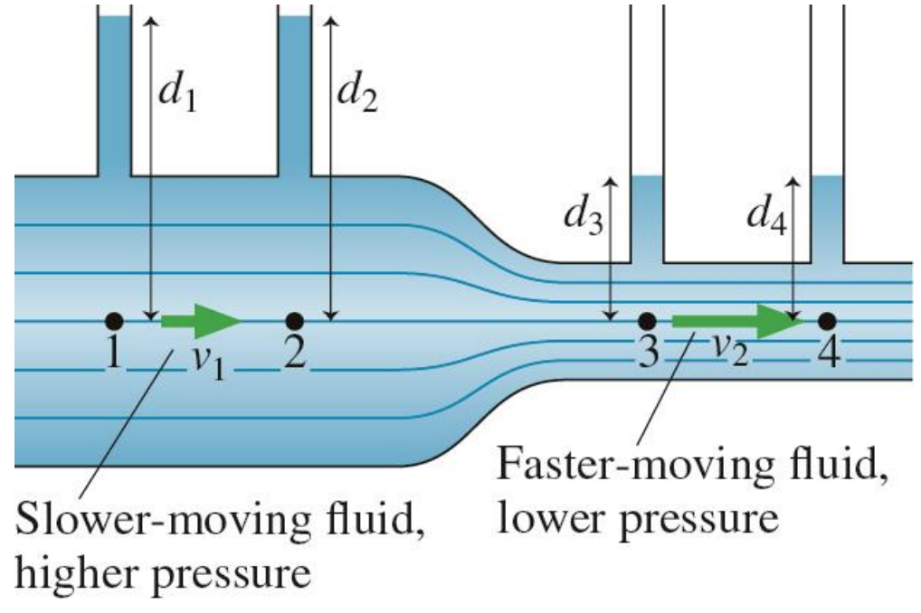
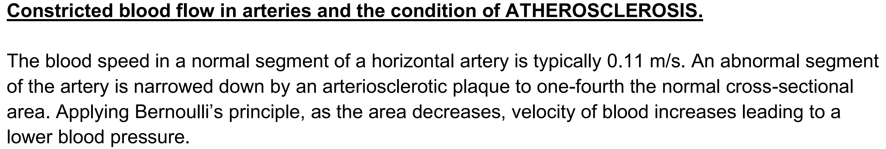
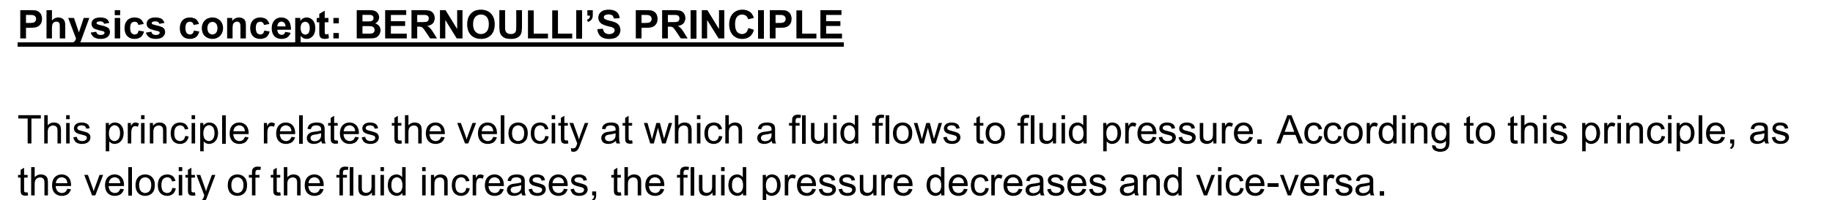

Slide 8
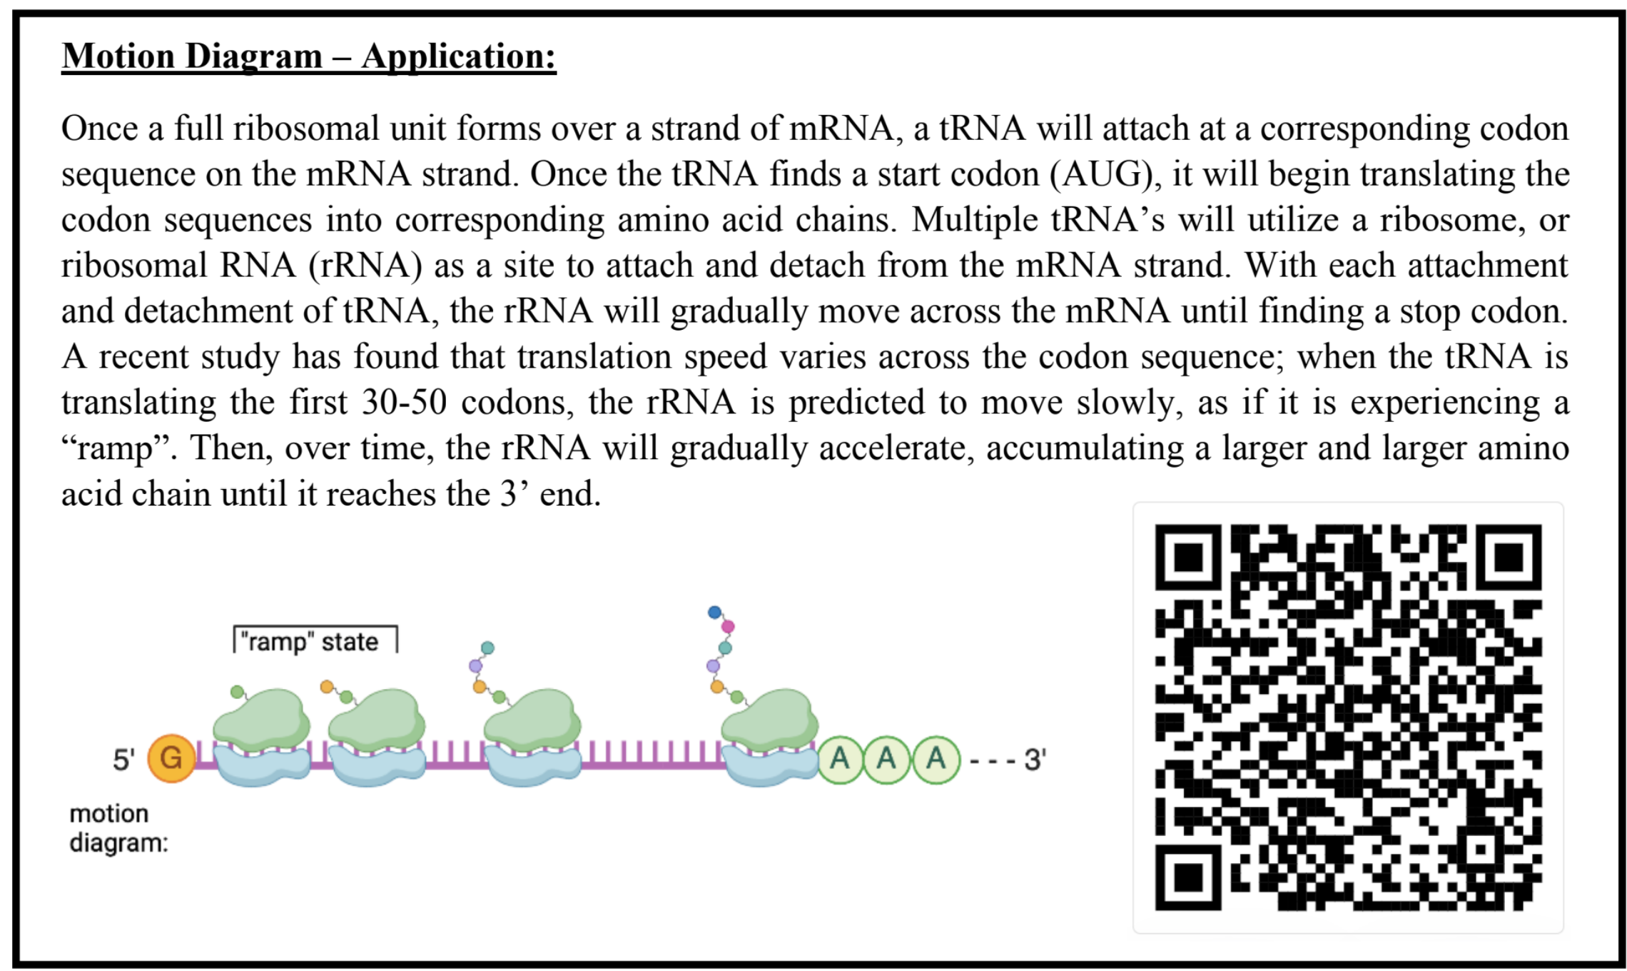
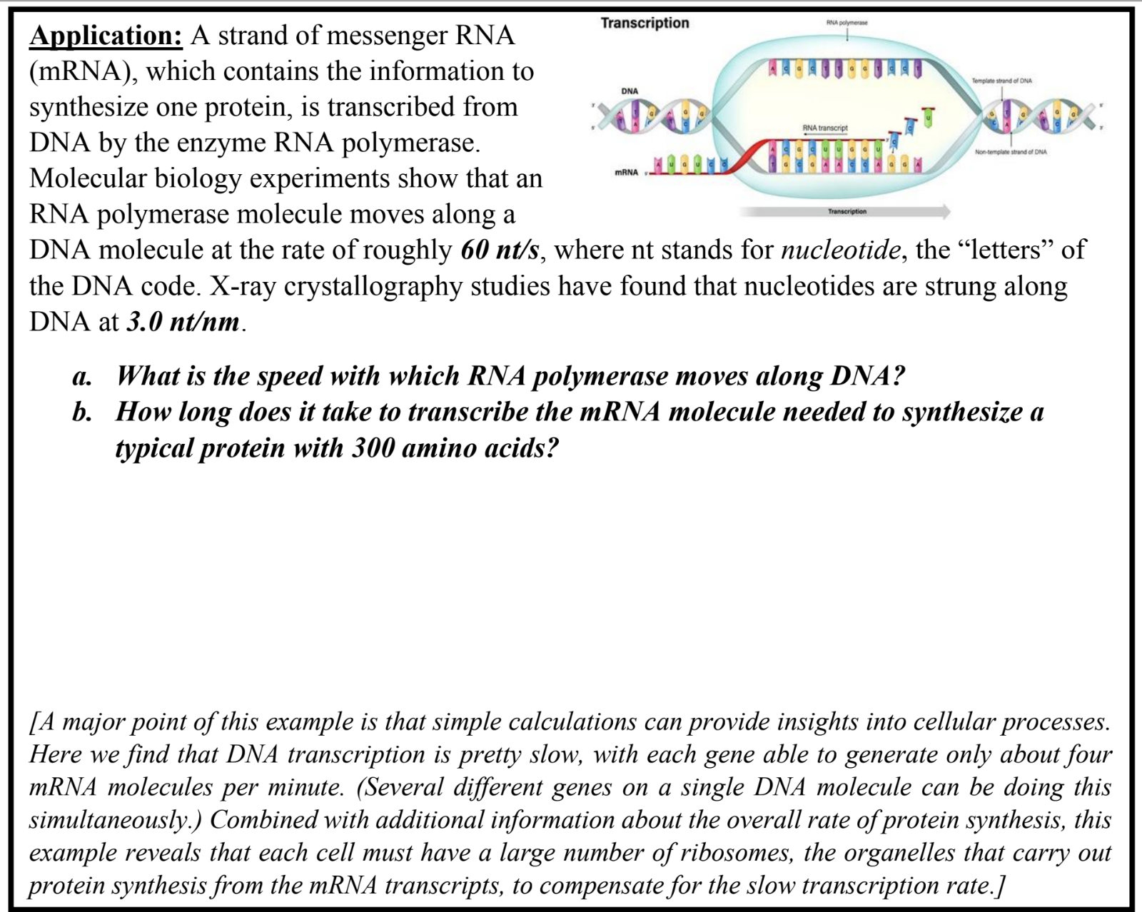
Samples

Slide 9
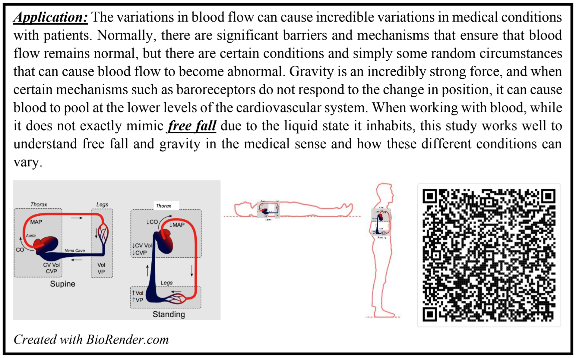
Samples

Slide 10
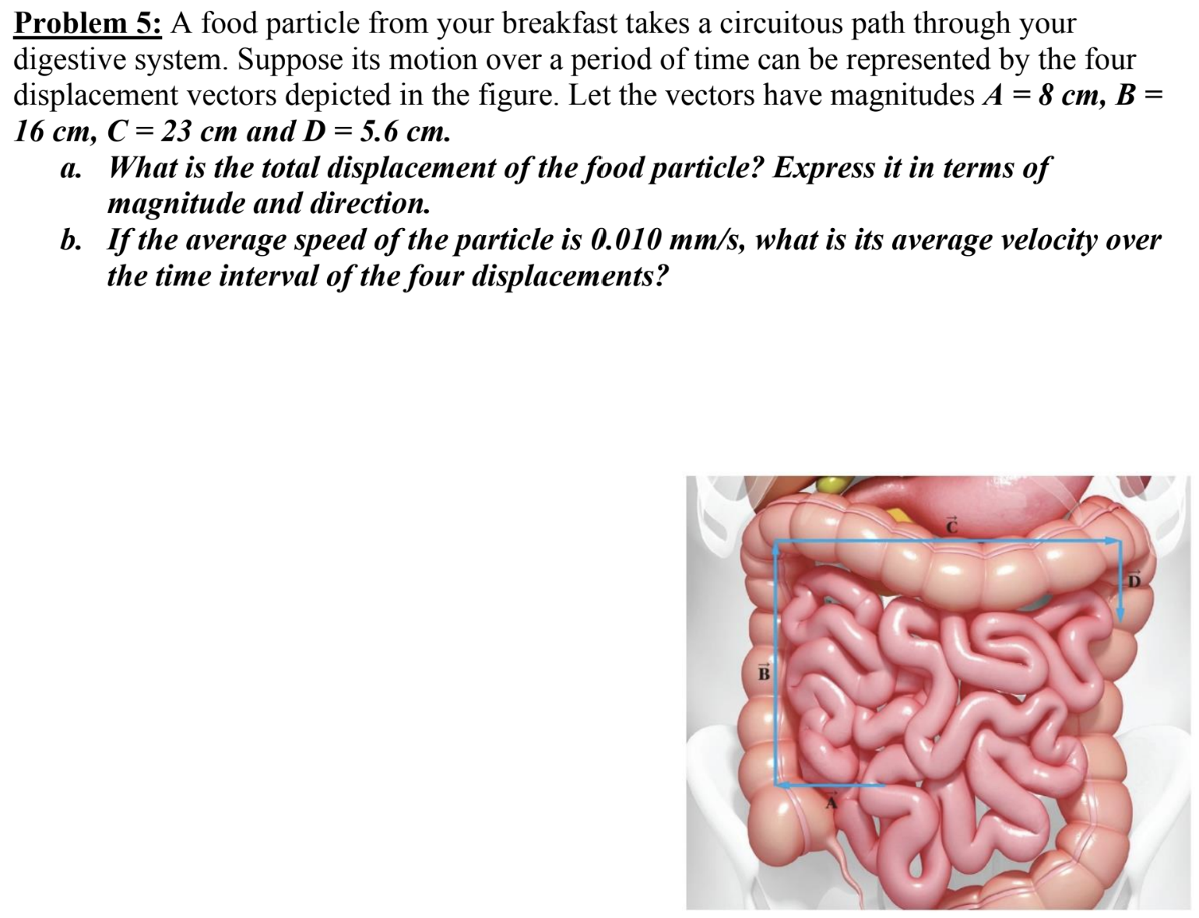
Samples

Slide 11
Weekly Quizzes
Weekly conceptual quiz on Canvas
10 multiple choice questions, with a total of 10 quizzes conducted throughout the semester.
On-going work: Creating a question bank comprising 7-10 questions for each of the 15 chapters covered in this course.
Weekly assessment to evaluate student understanding.

Slide 12
Anticipated Impacts
Improved student participation during lecture
Learning by sharing the acquired knowledge
Increased sense of belonging in the course
Better academic performance

Slide 13
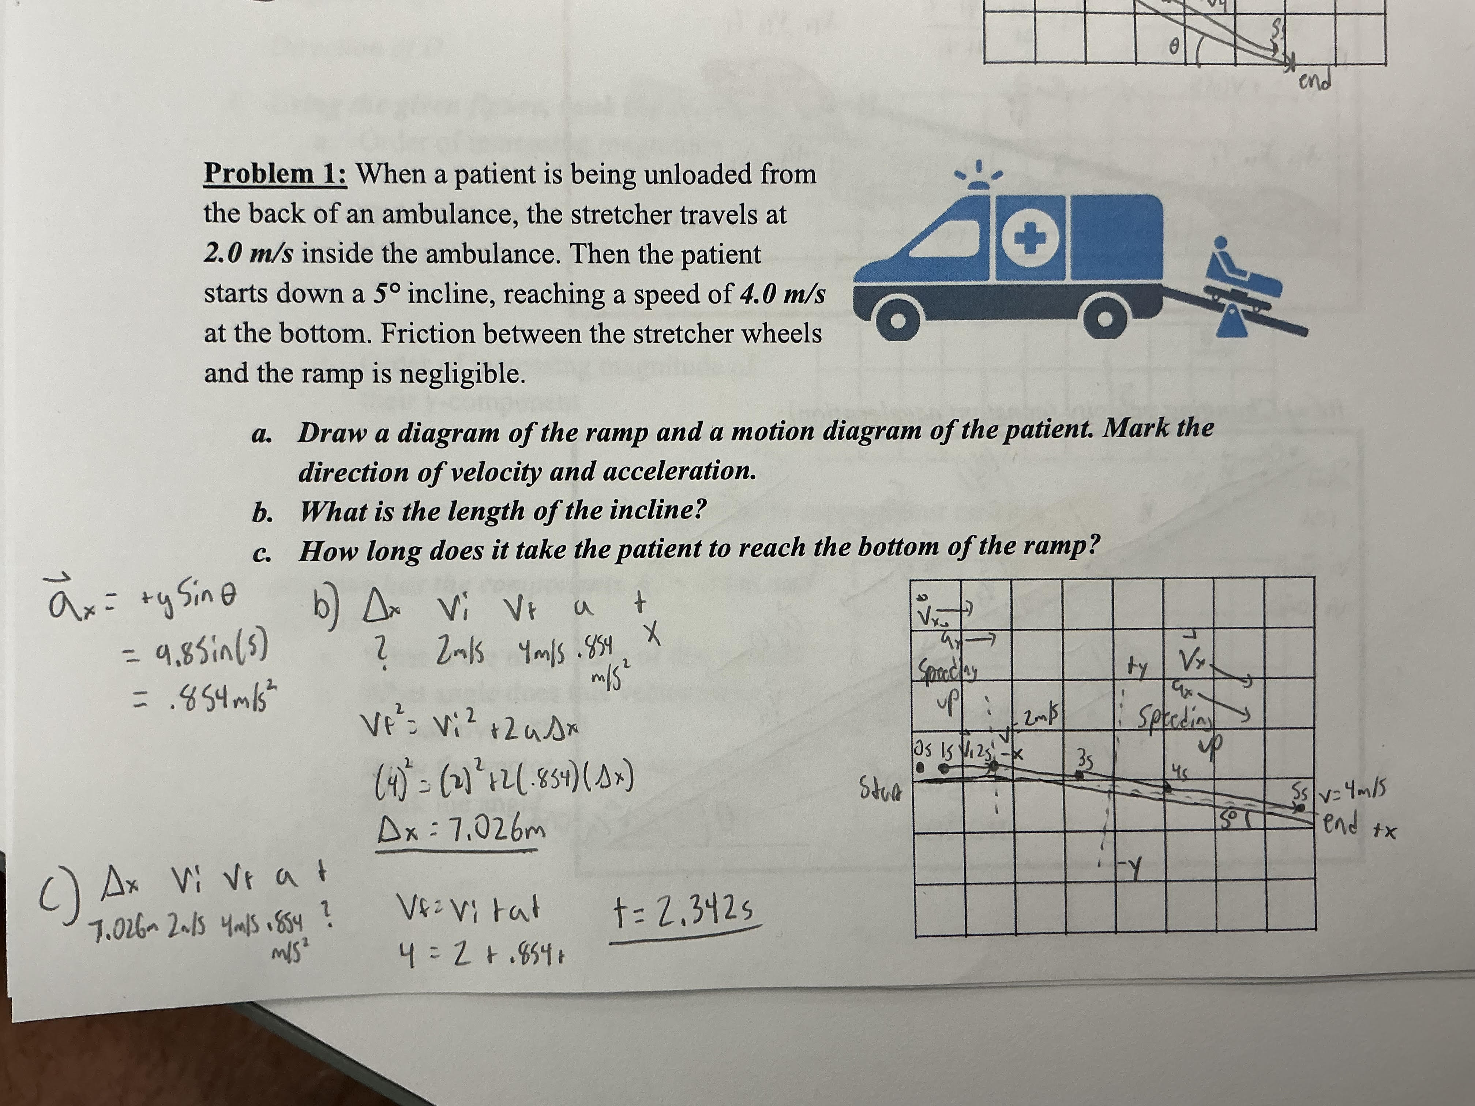
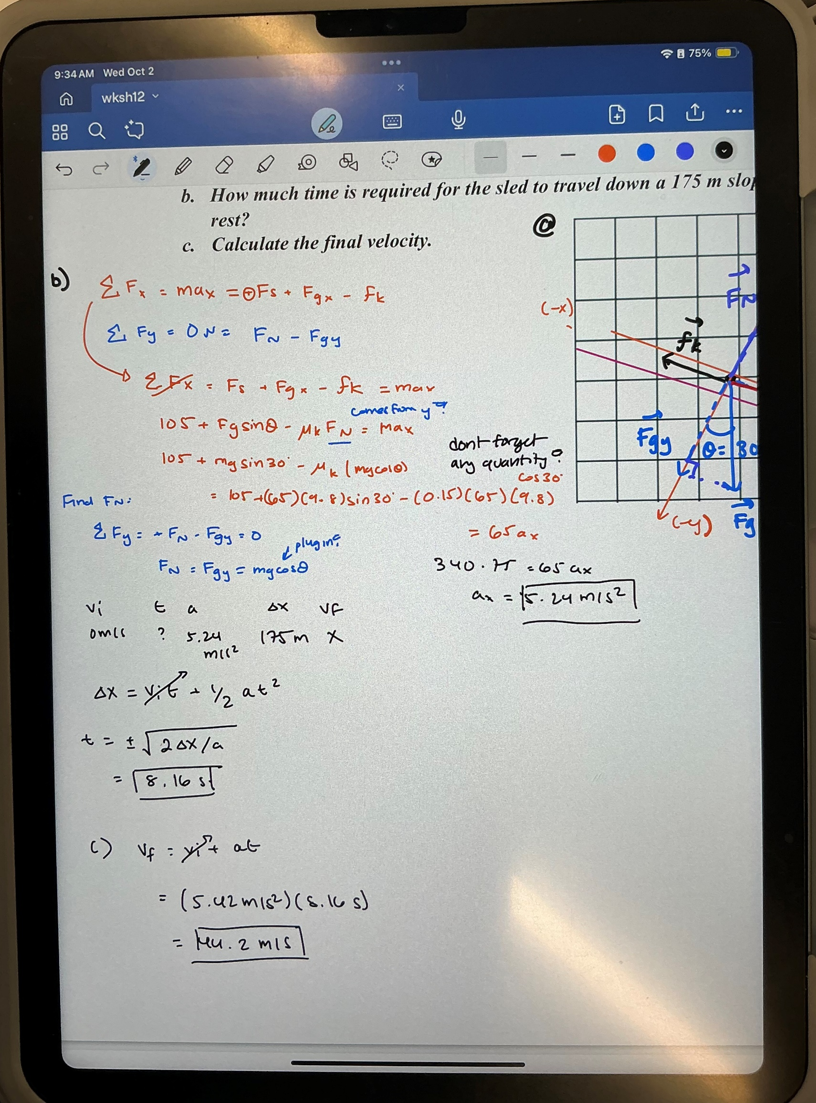
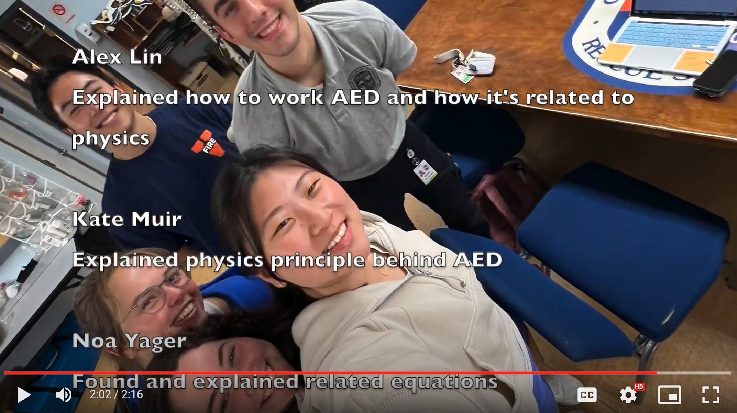
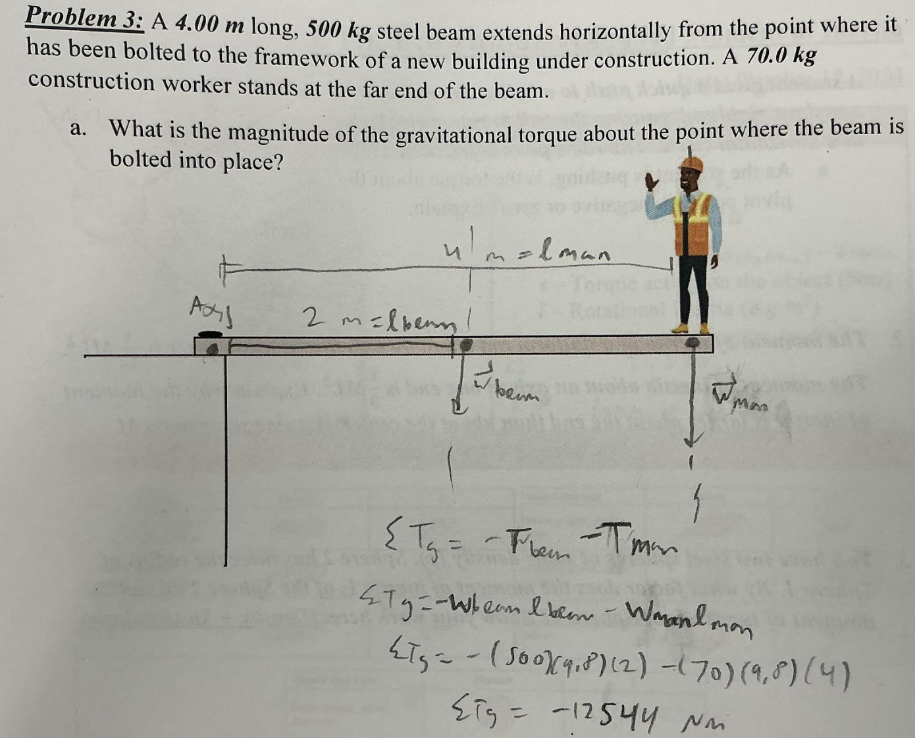
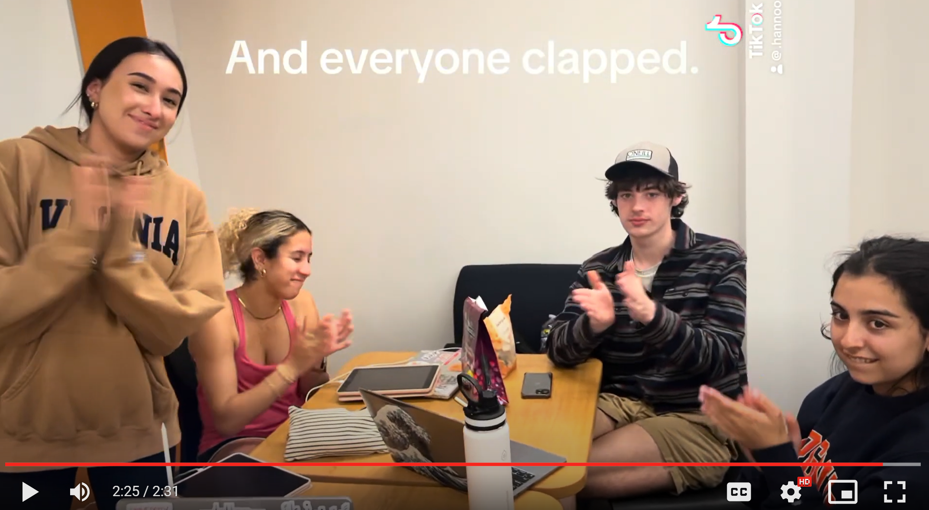
Anticipated Impacts

Slide 14
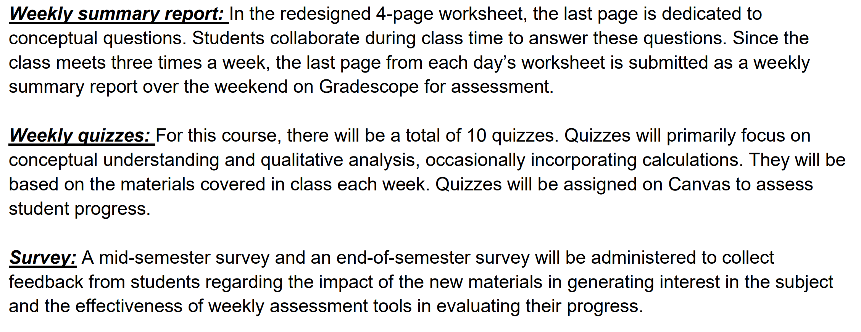
Evaluate Impact

Slide 15

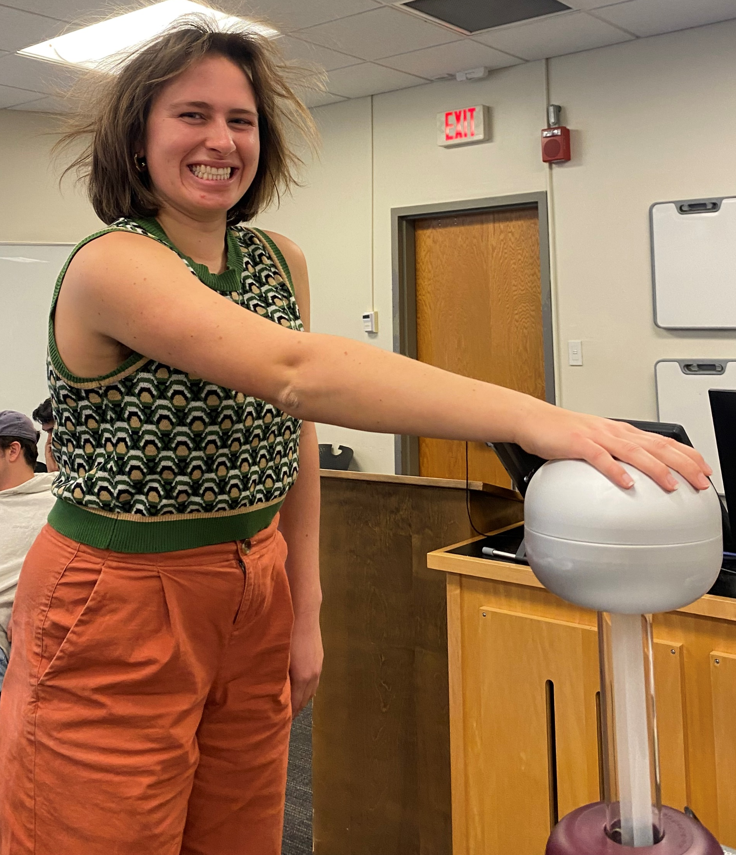
Acknowledgement
Sammy Finnegan, Pre-health UG student
Prof. Ann MASSEY, Biology
UVA Learning Technology incubator GRANT
UVA Inclusive Excellence GRANT

