Slide 1
Quantum Concepts for High School and College
Jessica Rosenberg, Nancy Holincheck, Ben Dreyfus

Slide 2
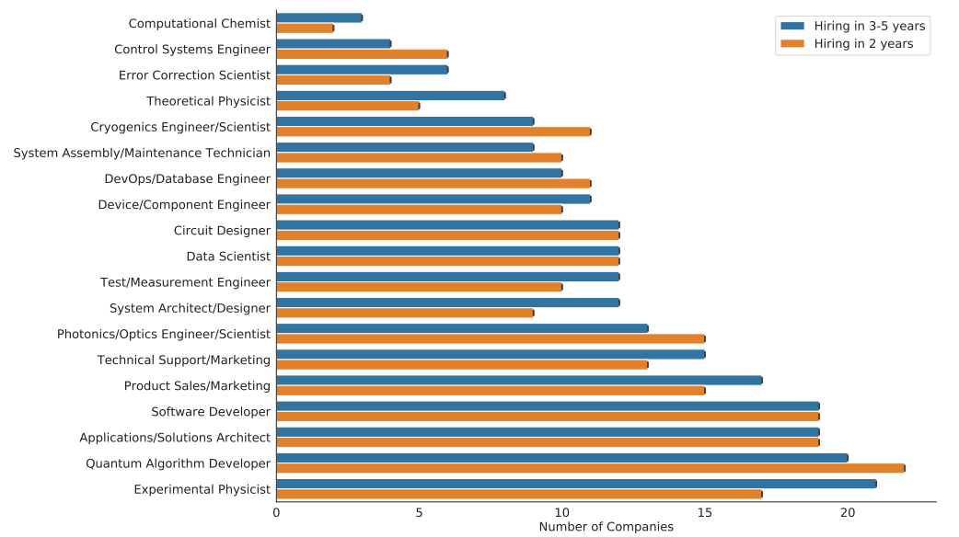
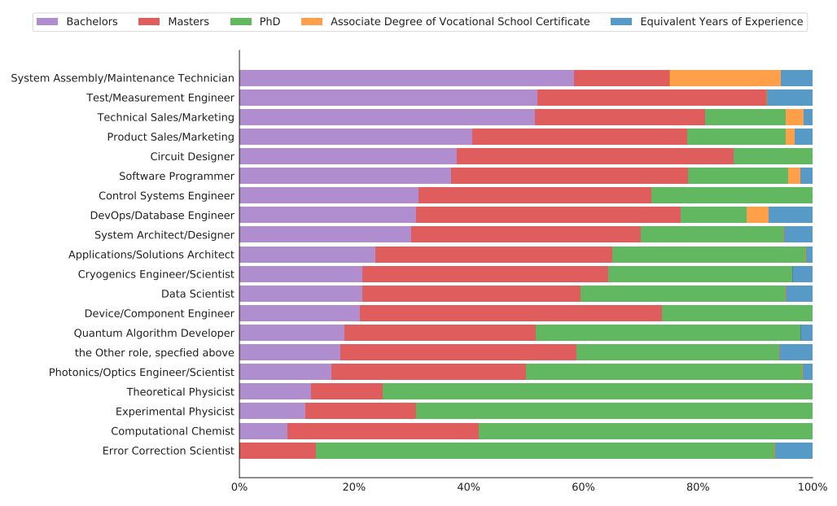
Who does Industry Expect to Hire?
Hughes et al 2021, http://arxiv.org/abs/2109.03601

Slide 3
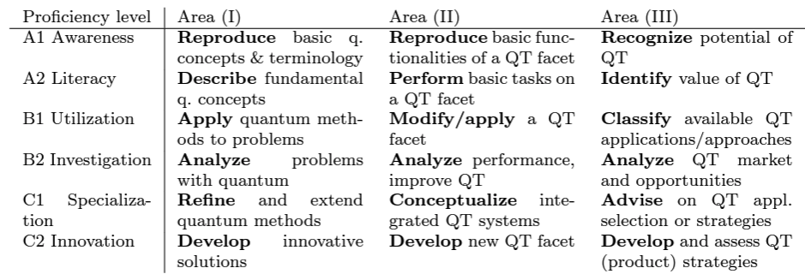
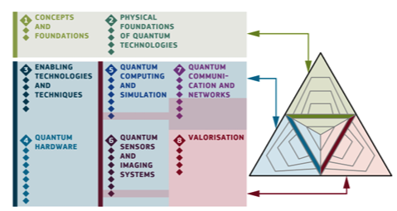
Greinert et al. 2024, arXiv.2410.07692

Slide 4
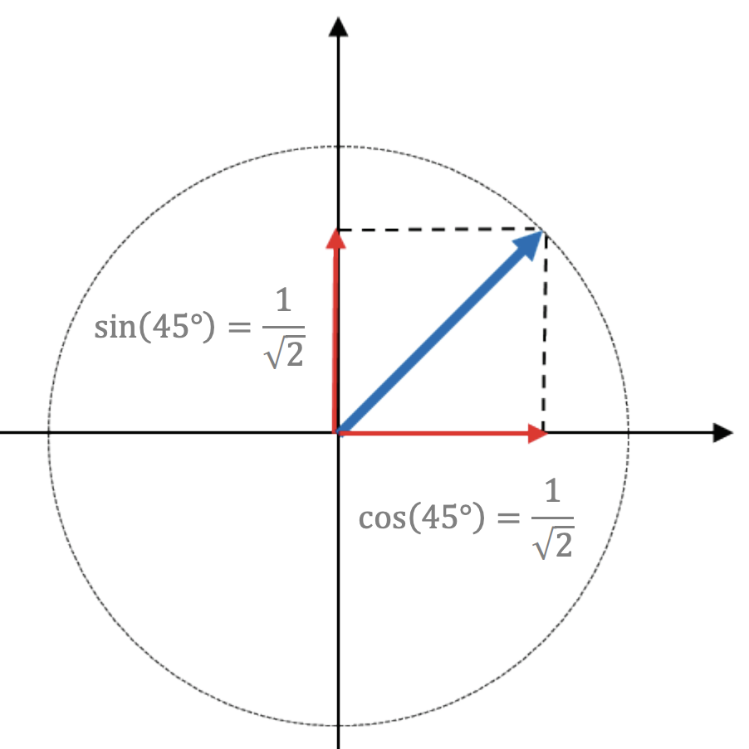
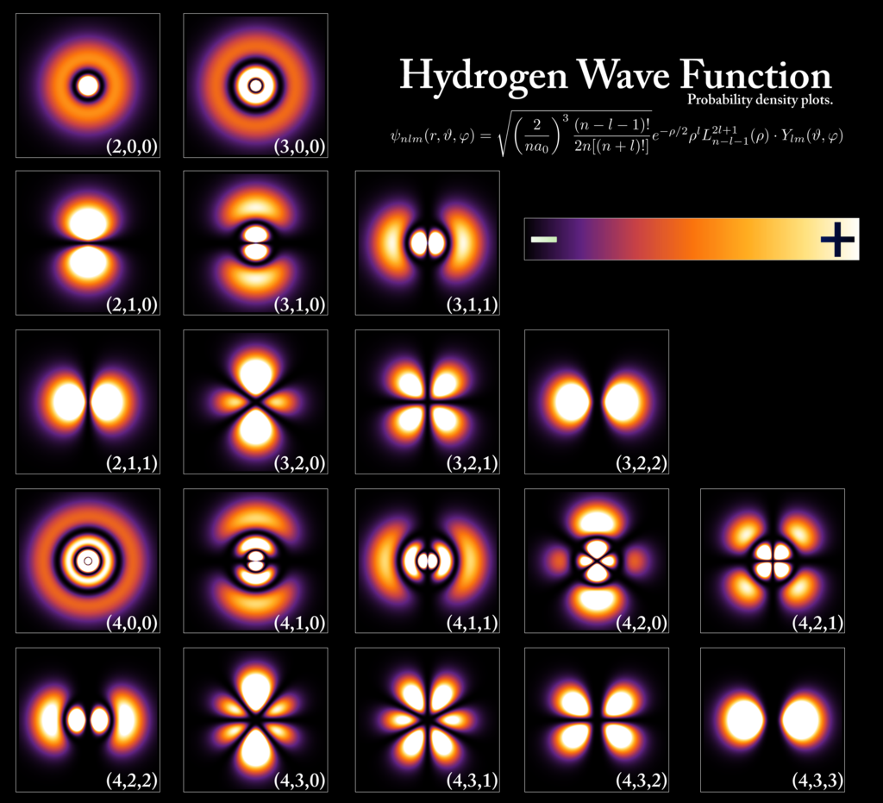
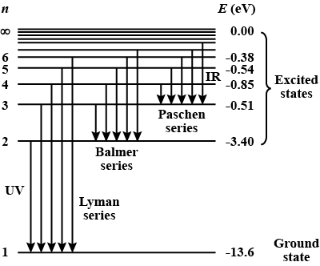
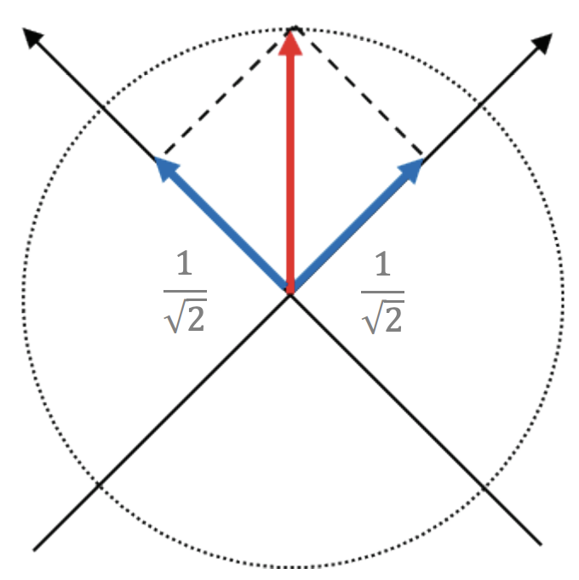
Quantum State: A quantum state is a mathematical representation of a physical system, such as an atom, and provides the basis for processing quantum information.

Slide 5
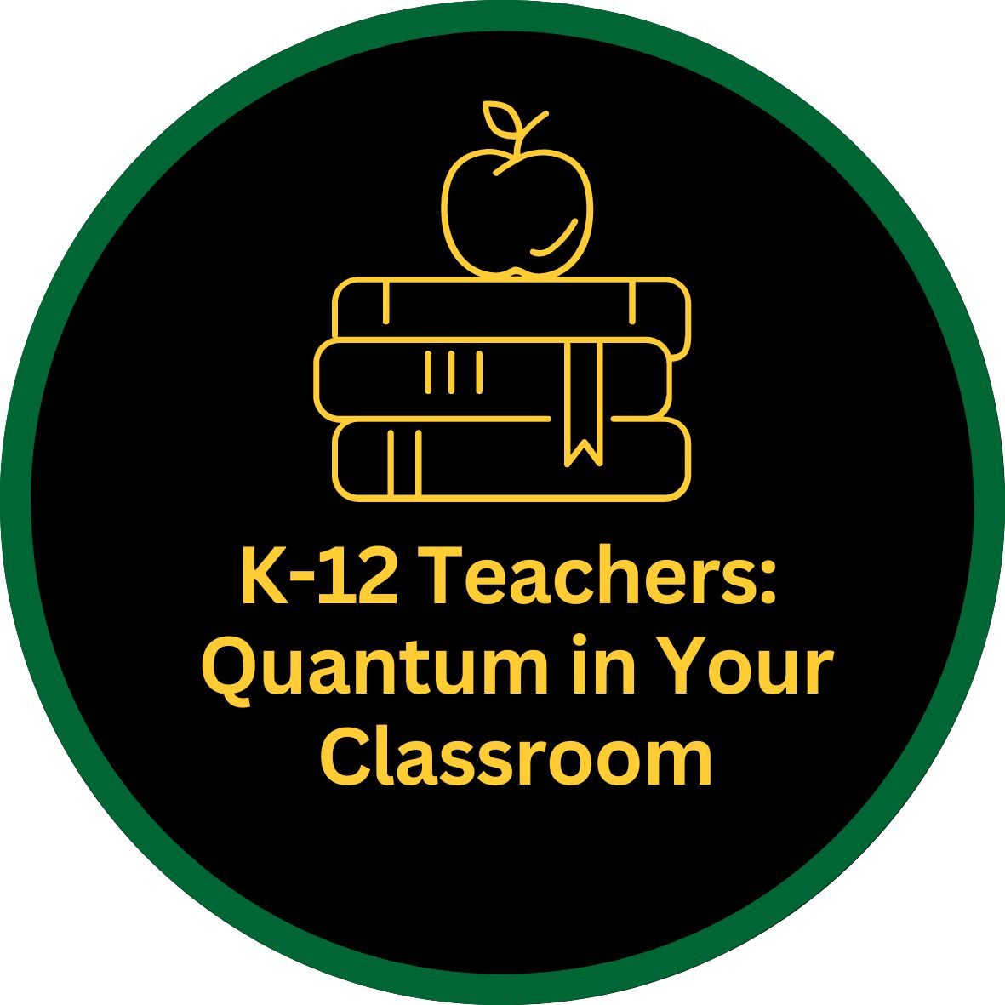
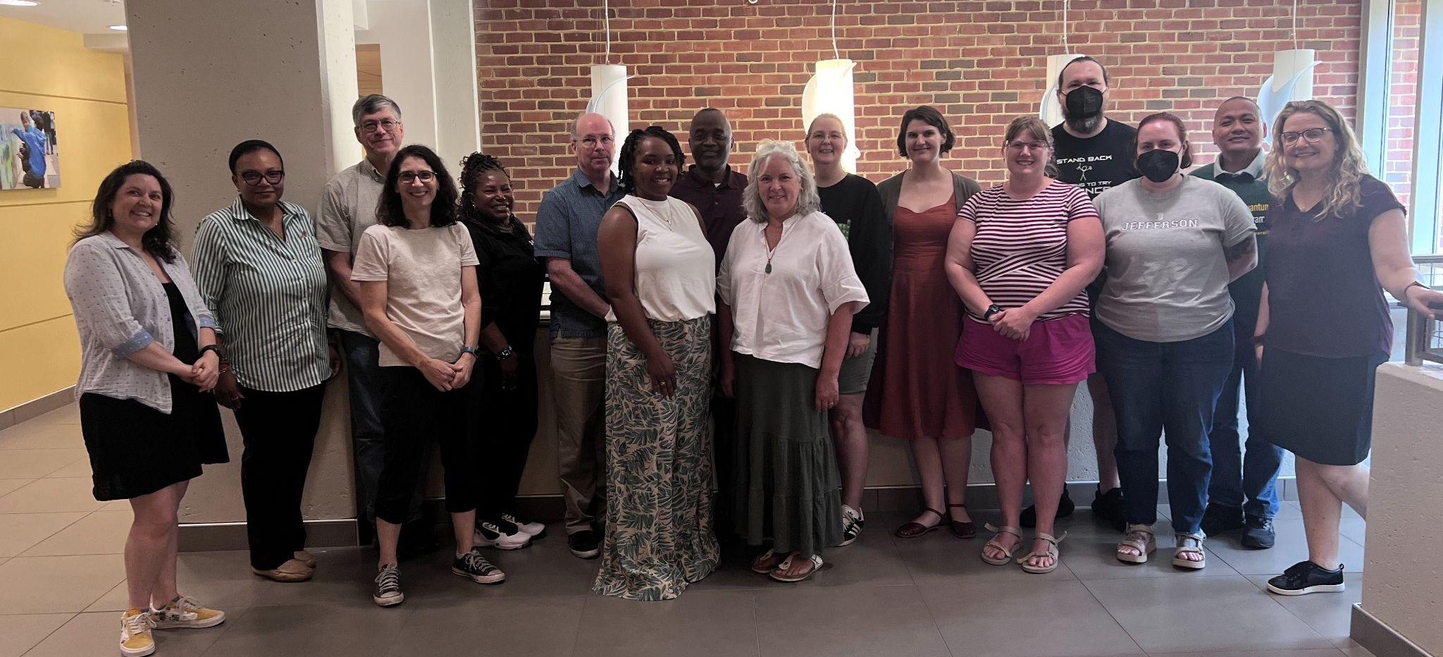
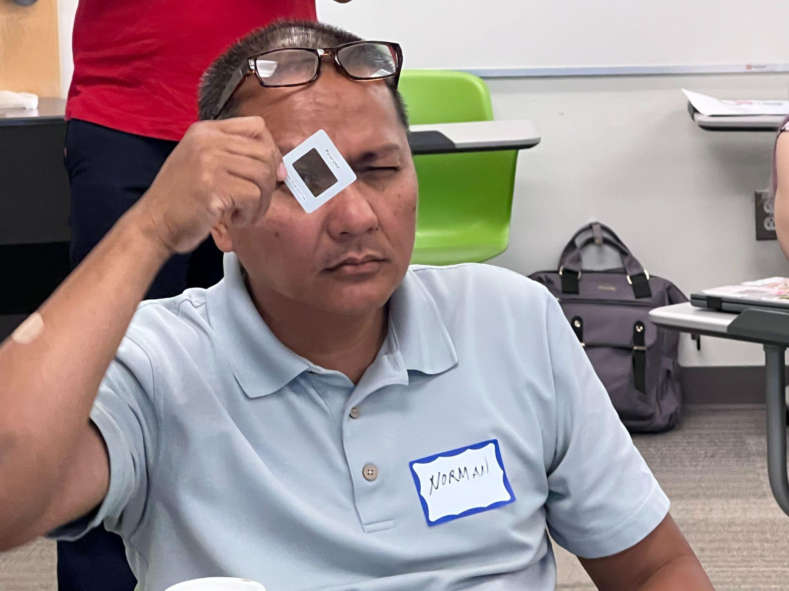
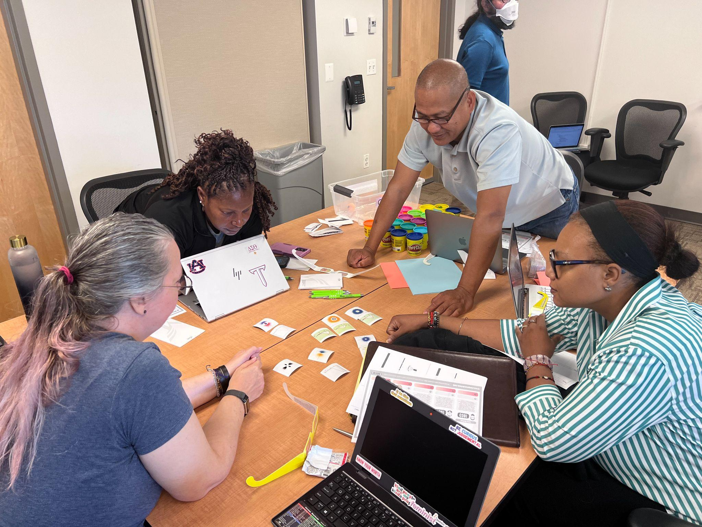
Quantum Professional Learning and Curriculum Development for Secondary Teachers
Recruited 14 chemistry, physics, and computer science computer science teachers from across the DC-MD-VA region
Teachers engaged in professional learning around quantum concepts and applications
Teachers worked in disciplinary groups to develop curricular resources to use in their teaching

Slide 6
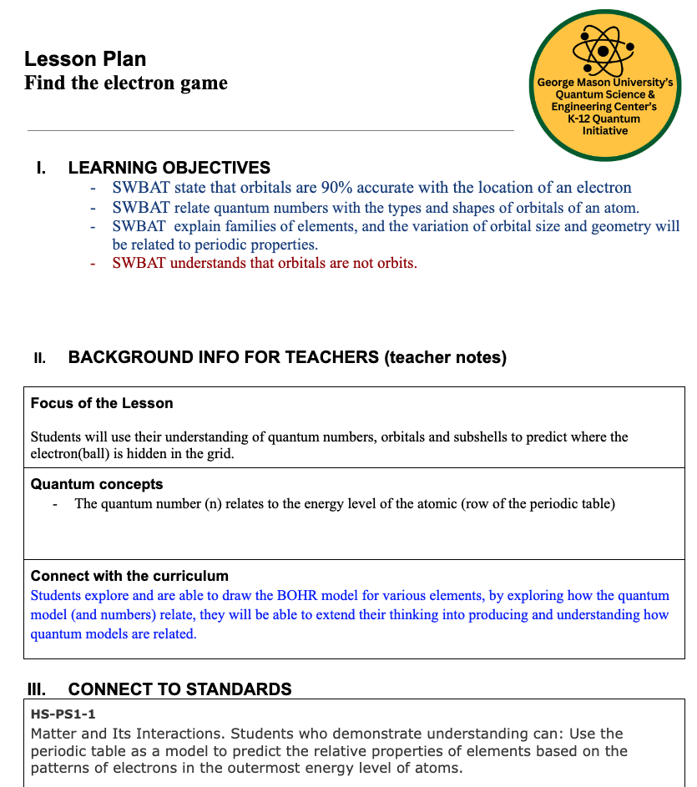
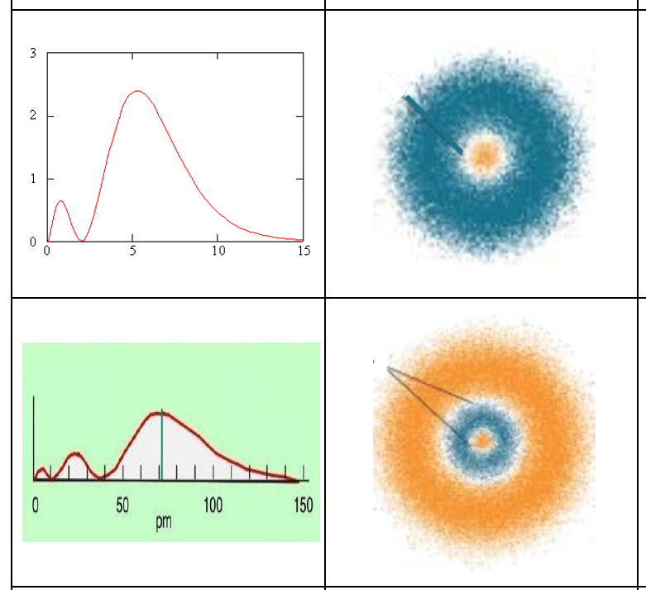
Christina Cameron
Bishop Ireton HS
Quantum in Chemistry

Slide 7
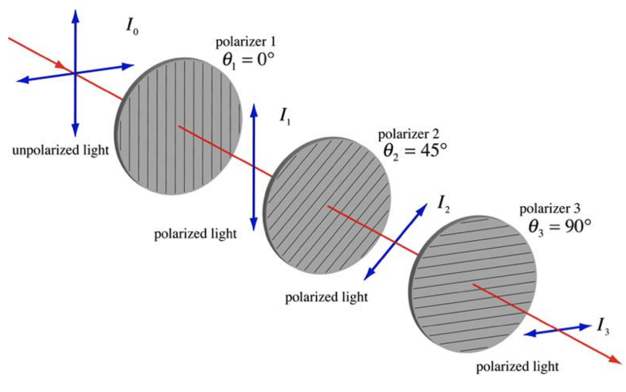
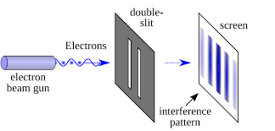
Quantum Measurement
How do we know… quantum edition

Slide 8
Let’s play another game!
Gomoku / Five-in-a-Row - Quantum Entanglement Edition
Object of the Game
Be the first player to achieve five stones of one’s own color in a row, wherein said row may be vertical, horizontal, or diagonal.
For every five stones placed by a single player, the player must entangle at least twice.
Challenge:
Combine both versions of the game! All rules apply! Each turn will need both a decision about measurement and a decision about entanglement. Good luck!

Slide 9
Photoelectric effect: Demonstration
Guiding question: What is (are) the factor(s) affecting the photoelectric effect?
Demonstration:
Different types of light will be used on the top plate of a negatively charged electroscope:
White light (with different intensities), UV-A light (Black light), UV-C light (germicide light)
For each sources of light, observe the motion of the arm of the charged electroscope, if any.
Notes:
Note: the slides are designed for a whole class demonstration set up. The lesson plan will provide option to either do this a a rotation between work stations or as a group activity (lab).

Slide 10
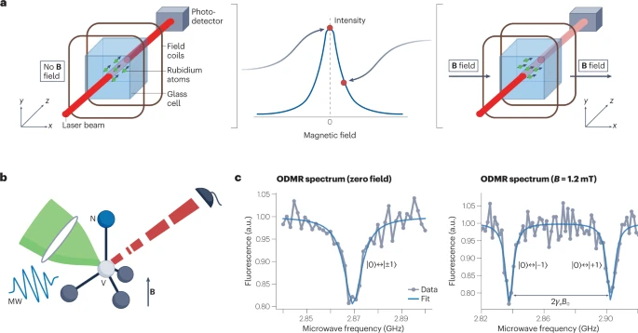
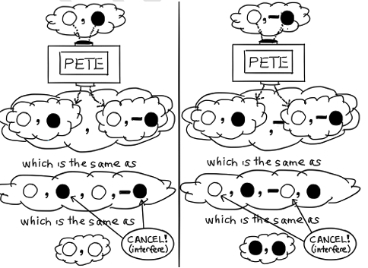
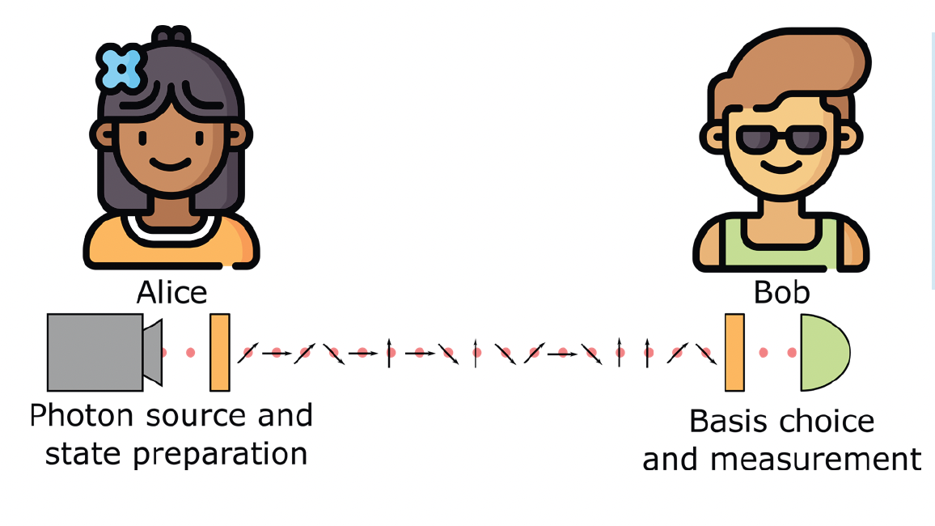
Quantum Applications:
Sensing, Communications, Computing
Q is for Quantum, Terry Rudolph
Institute for Quantum Computing, U. Waterloo

Slide 11
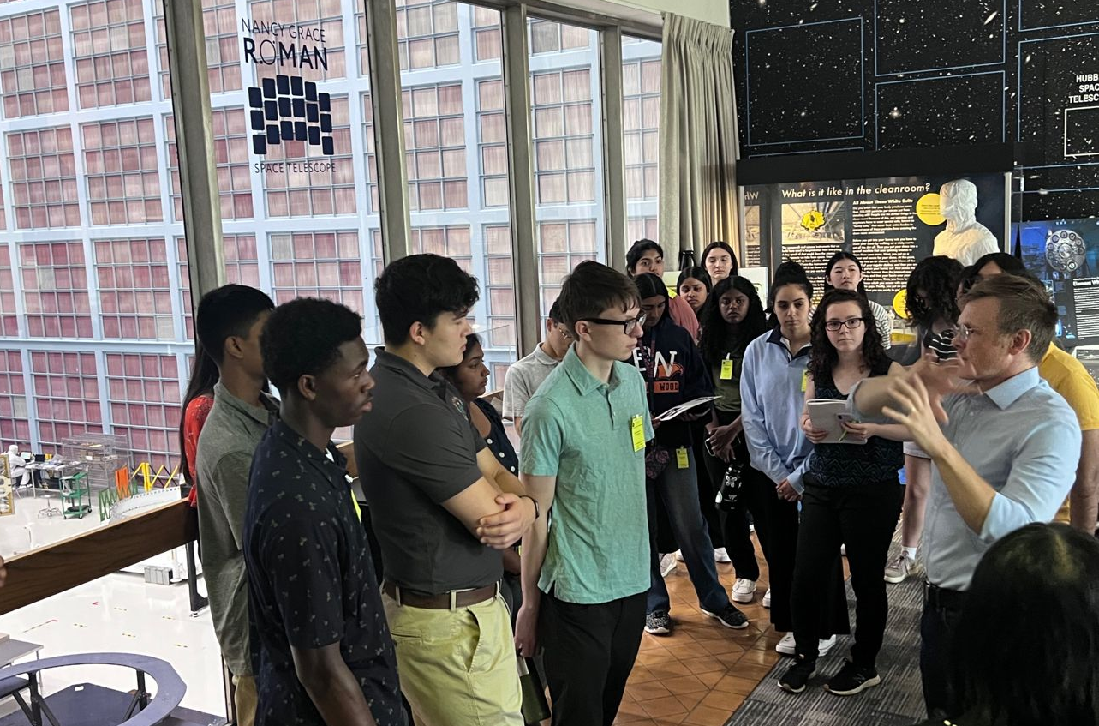
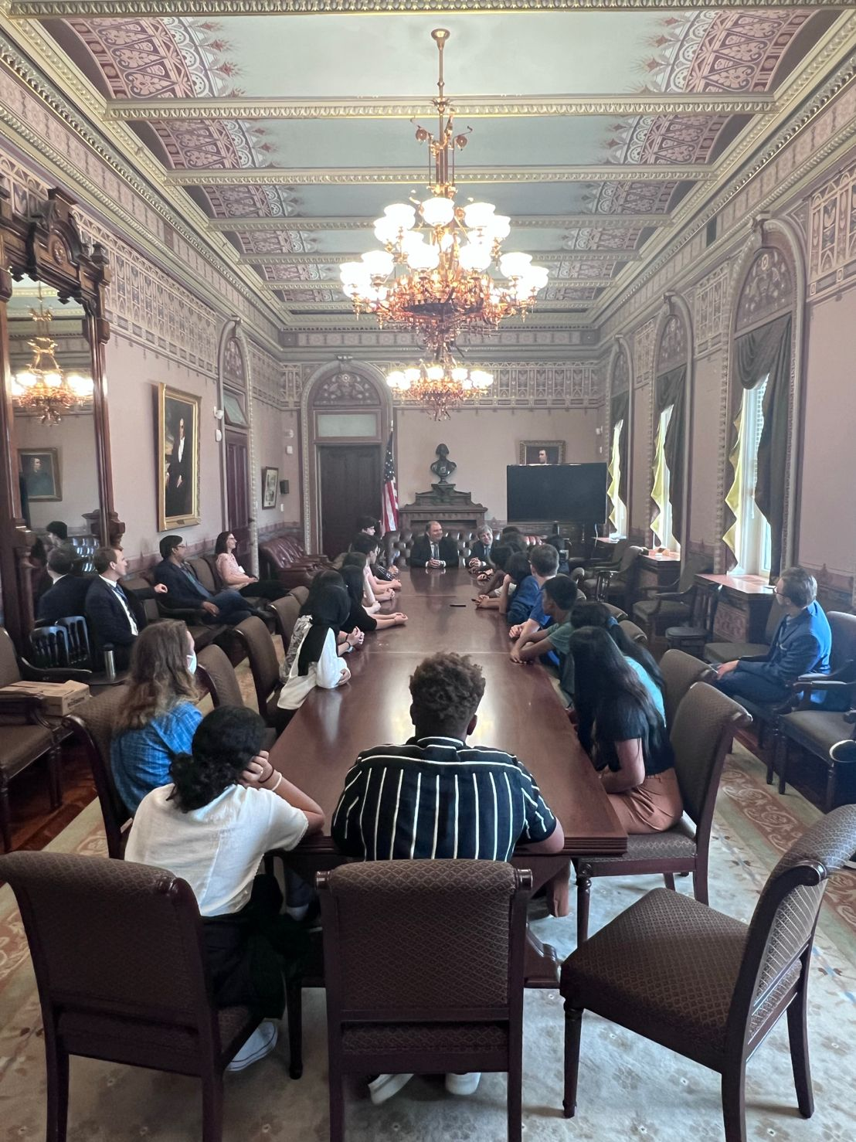
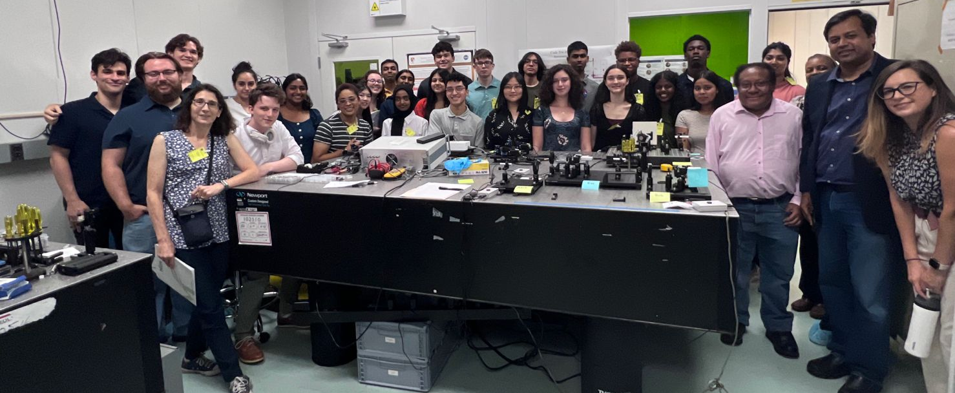
Quantum Immersion for High School Students
2 weeks online learning key concepts and about careers and applications 1 week immersive career-focused in-person
“My perspective has shifted and I can see myself looking into Quantum Cryptography.”
“It has deepened my interest in STEM”
“I feel like I could incorporate quantum into medicine which is really exciting.”

Slide 12
Why do we care… quantum edition
Attempts at Quantum Supremacy in the Analysis of Particle Systems
Detection of Dark Matter with Quantum Sensing
QRYPT HAVEN: A Post-Quantum Cryptography Company
Improving Awareness of Space Debris through Quantum Sensing and Quantum Computing
Quantum Internet and Future Uses
Quantum Corners: Improving Emergency Response with Smart Traffic Management and Quantum Sensors
Quantum Teleportation and its Applications in Communication
Personalizing Cancer Treatment with Quantum Machine Learning
Can Quantum Sensor Solve Patient with PTSD in Sleep?
Quantum Testbeds for Machine Learning Algorithms
Pollution in our Oceans: Applications of Quantum Sensing
Sustainable Climate: Taking Action with Renewable Energy

Slide 13
Conclusions
Students need to understand how we know about quantum
For the most part, a first discussion of the technologies does not require a lot of math
Students need to see how quantum science is being applied to communications, sensing, and computing
Students can think about the applications of these technologies to important problems
Digging into a question that is interesting to them gets students more engaged and interested

