Slide 1
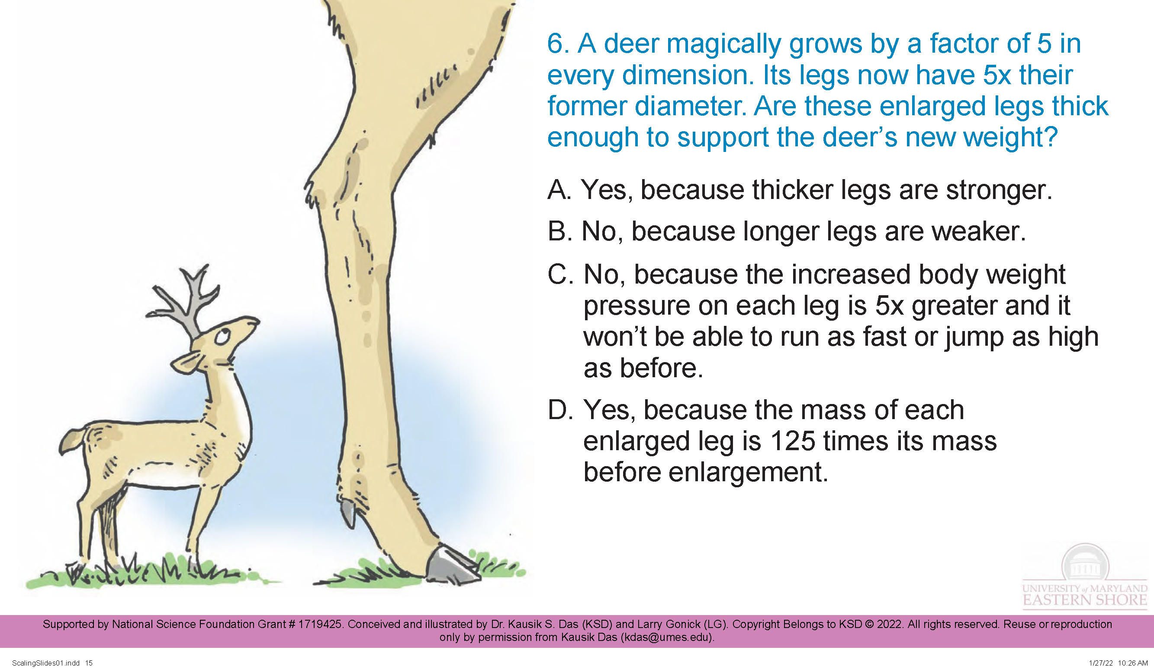

Integrating Evolutionary Biology into Physics Classroom: Scaling, Dimension, Form and Function
Dr. Kausik S Das
University of Maryland Eastern Shore

Slide 2

Surface area to volume ratio:
Volume: V ~ l³
Surface Area: A ~ l²
A/V ~ 1/l

Slide 3
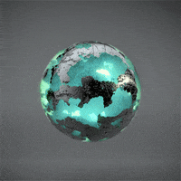
Mentimeter
Surface area to volume ratio:
Volume: V ~ l³
Surface Area: A ~ l²
A/V ~ 1/l

Slide 4
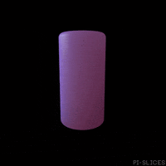
Mentimeter
Surface area to volume ratio:
Volume: V ~ l³
Surface Area: A ~ l²
A/V ~ 1/l

Slide 5
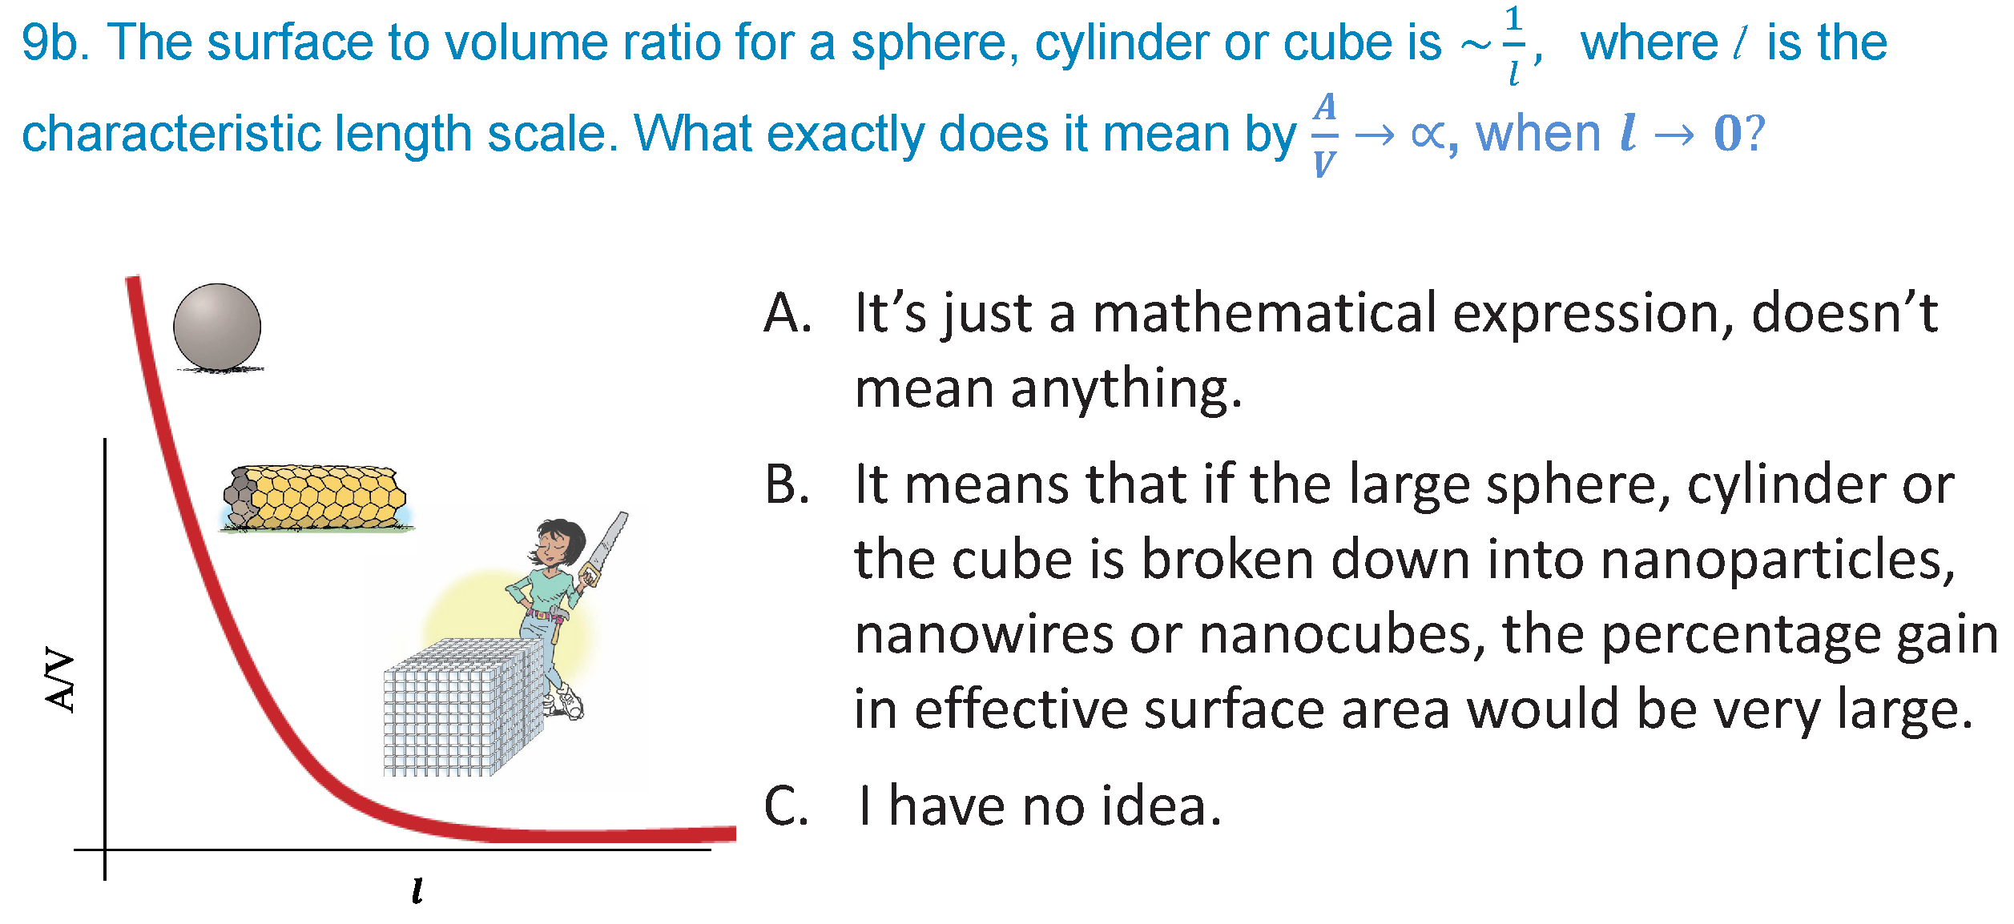
Volume: V ~ L³
Surface Area: A ~ L²

Slide 6
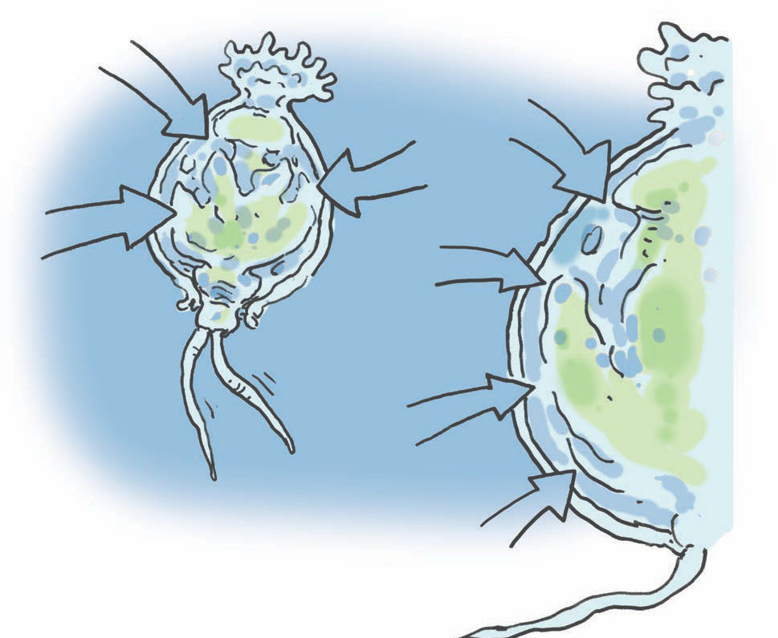
Rotifers breathe oxygen through their skin!
O
2
O₂
O₂
O
2
O
O₂
0.5 mm

Slide 7
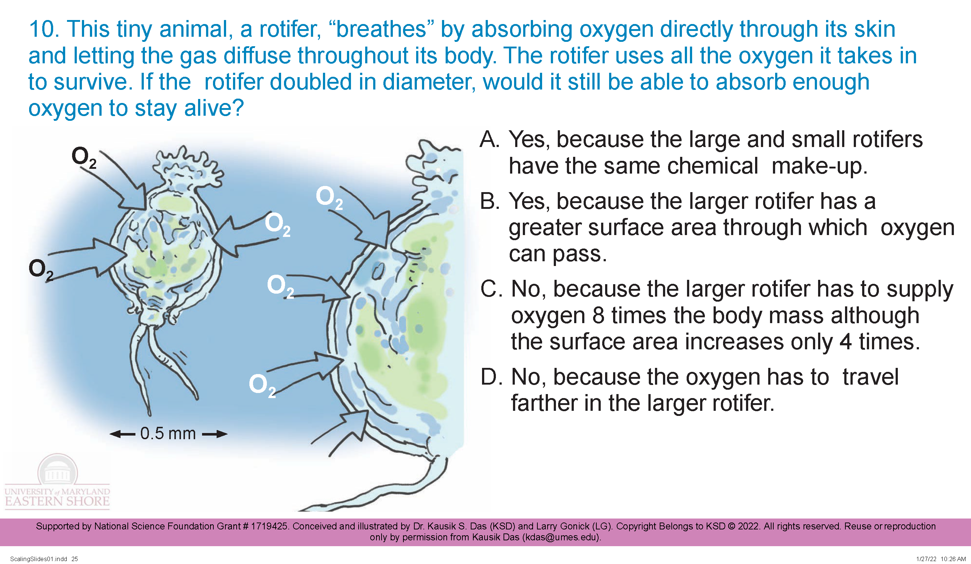

Mentimeter
Rotifers breathe oxygen through their skin!

Slide 8
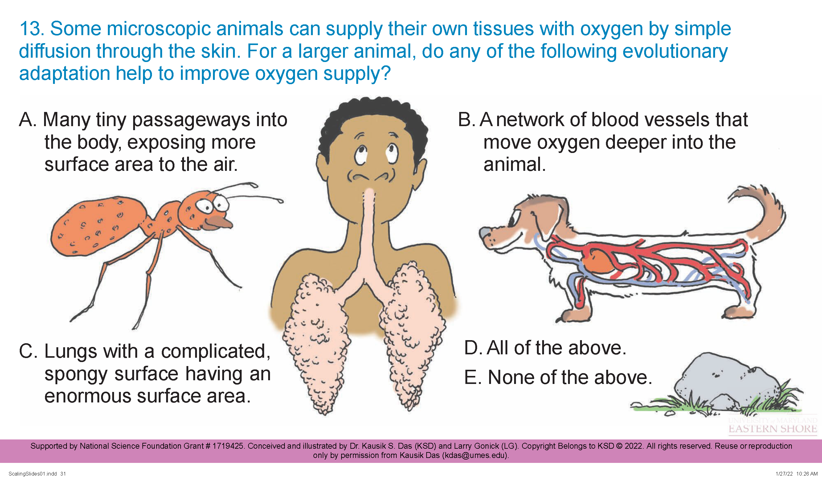
Mentimeter
Rotifers breathe oxygen through their skin!

Slide 9
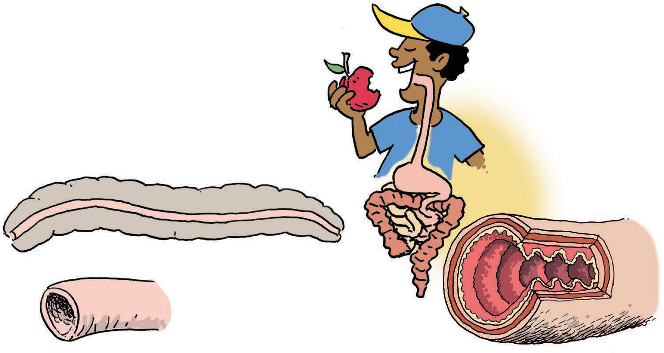
Earthworms have a straight intestine with smooth wall!
worm
intestine

Slide 10
human
intestine
worm
intestine
worm
intestine

Slide 11

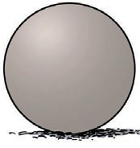
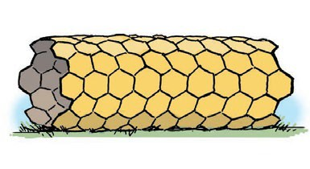
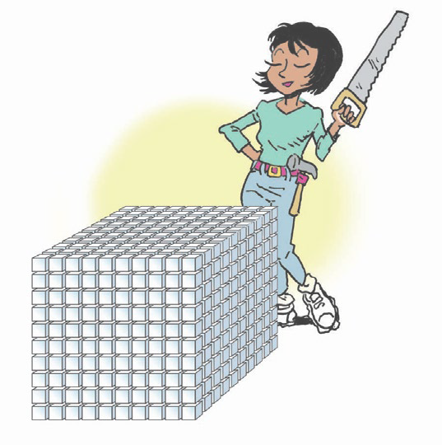
A/V
𝒍
human
intestine
worm
intestine
worm
intestine

Slide 12
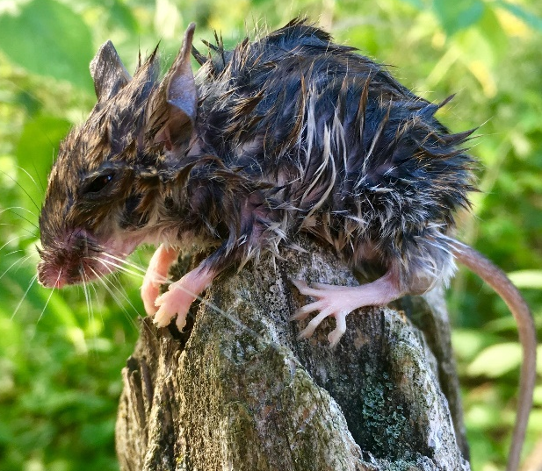
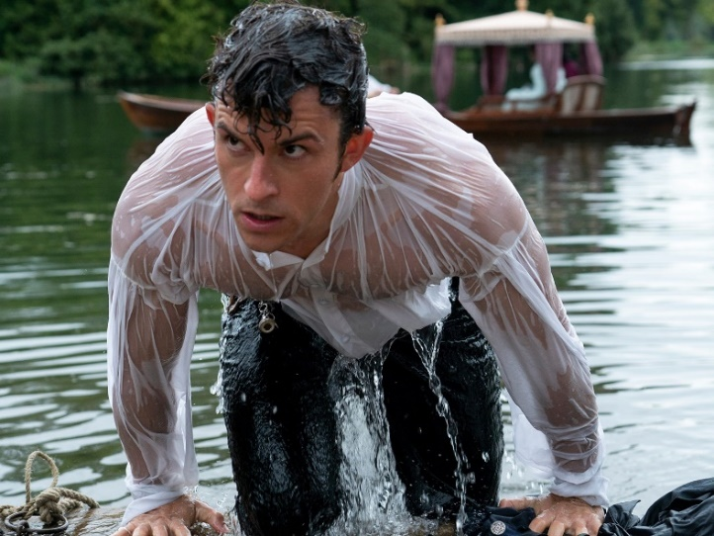
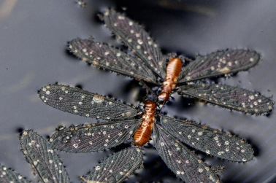
A/V
𝒍

Slide 13
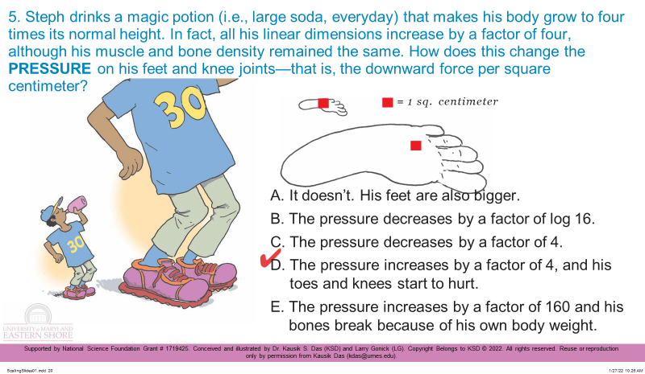

Slide 14
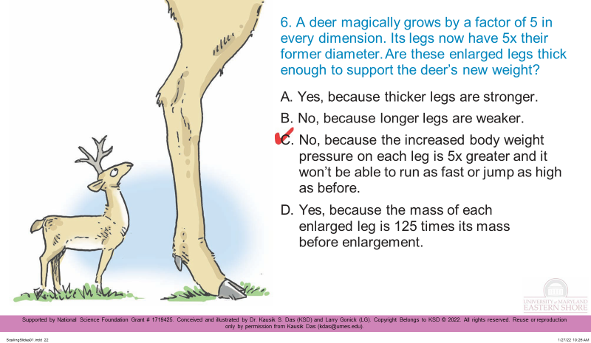

Slide 15
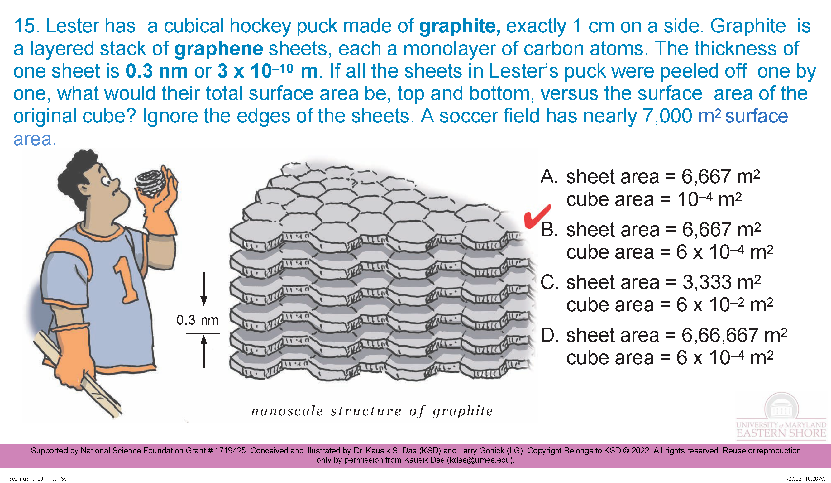
Mentimeter

Slide 16
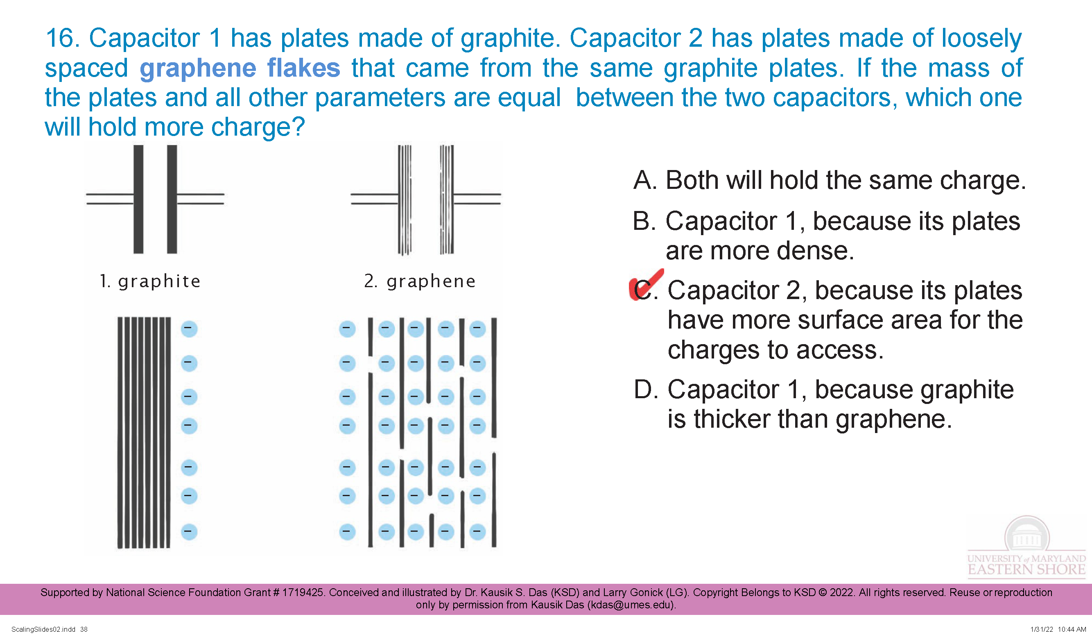
Mentimeter

Slide 17
Questions?

