Slide 1
Coefficient of Performance (COP) of a Stirling Refrigerator
Spring 2024 Meeting
Saturday 19 October 2024
Carl E. Mungan, Physics Department
U.S. Naval Academy, Annapolis MD
Jefferson Lab, Newport News VA
Chesapeake Section of AAPT

Slide 2
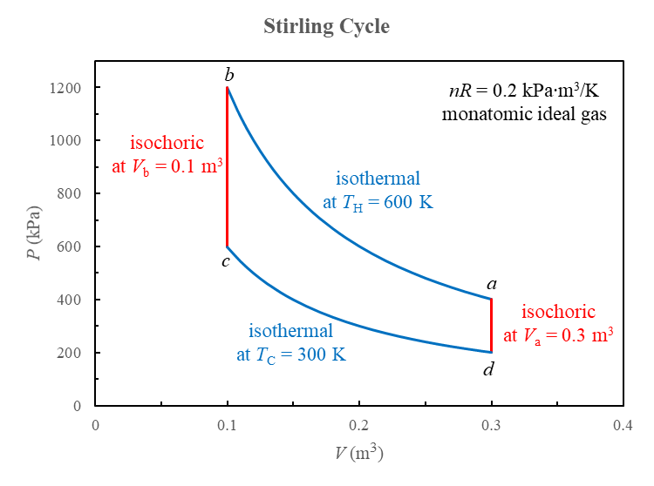

Slide 3
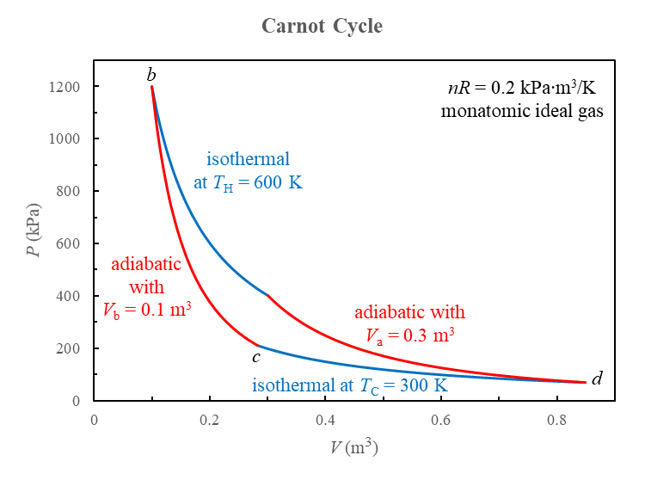
a

Slide 4
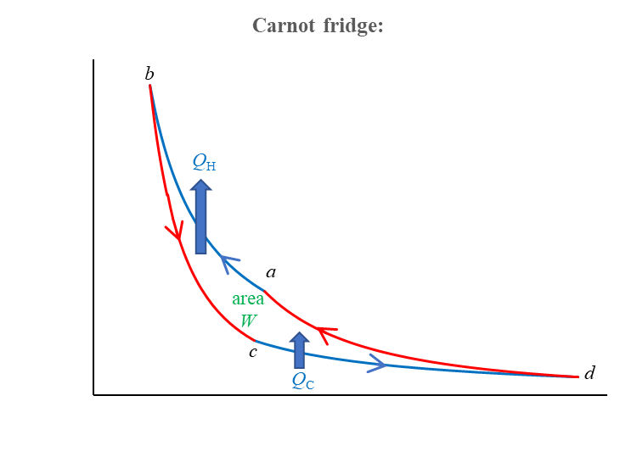
P
ambient surroundings
at T_{H}
Q_{H}
W
monatomic
ideal
gas
electric
power supply
what we pay
Q_{C}
what we want
sample compartment
at T_{C}
V

Slide 5
good refrigerator performance: lots of what we want relative to what we pay
energy balance per cycle:

Slide 6
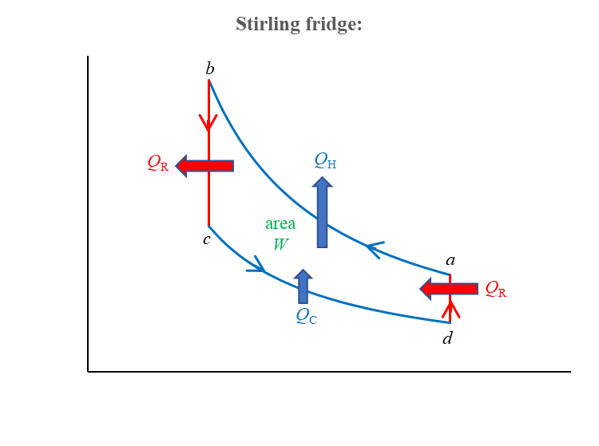
scheme #1—reversible with regenerator
ambient surroundings
at T_{H}
P
Q_{H}
Q_{R}
W
monatomic
ideal
gas
electric
power supply
regenerator
what we pay
Q_{R}
Q_{C}
what we want
sample compartment
at T_{C}
V

Slide 7
What is a regenerator?
It is a heat exchanger that stores and releases heat on demand.
Consider step bc when the ideal gas is cooled:
gas enters
at T_{H}
gas leaves
at T_{C}
Reverse the flow for step da when the ideal gas is heated.
Thus the regenerator functions like a set of intermediate temperature
reservoirs. (Ideally an infinite number of them.)

Slide 8
again what we want relative to what we pay:
but for an isothermal step:
and V_{a} / V_{b} = V_{d} / V_{c} for either isochoric (Stirling) or adiabatic (Carnot) connecting steps

Slide 9
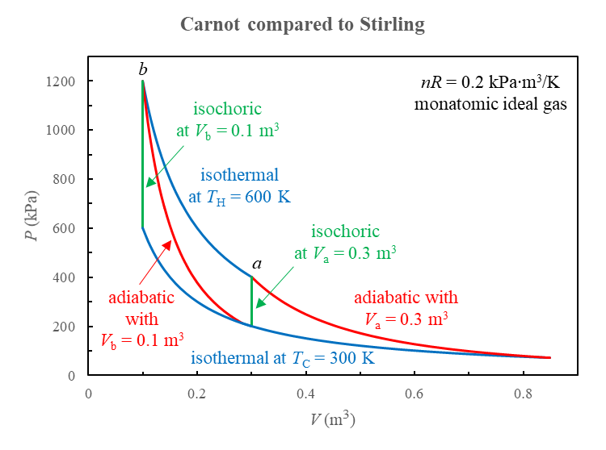
Carnot: isothermal (blue) + adiabatic (red) steps
Stirling: isothermal (blue) + isochoric (green) steps
same Q_{H}, Q_{C}, and W for the Carnot and Stirling cycles!

Slide 10

scheme #2—irreversible without regenerator
ambient surroundings
at T_{H}
step ab
Q_{H}
step da
Q'_{H}
W
monatomic
ideal
gas
electric
power supply
step bc
Q'_{C}
step cd
Q_{C}
sample compartment
at T_{C}

Slide 11
the COP is reduced from the Carnot value
because of the irreversible isochoric steps

Slide 12

Comments and questions are welcome!
email: mungan@usna.edu
webpage: usna.edu/Users/physics/mungan
where you can find further results in
EJP 38, 055101 (2017) and 41, 058002 (2020)

