Slide 1
Cultural Backgrounds and Classroom Dynamics: Adjusting to U.S. Teaching as an International Graduate Teaching Assistant
Nishchal Thapa Magar, Jessica L. Rosenberg, Jill K. Nelson, Nancy Holincheck

Slide 2
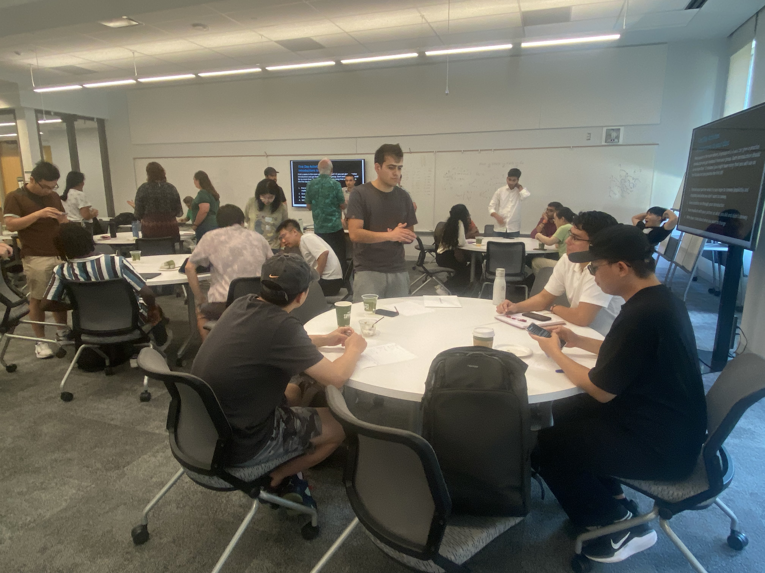
What is Gateway2STEM?
Gateway2STEM is an NSF-funded
project
The goal is to establish active
and collaborative learning
Project supports faculty, GTAs,
and learning assistants in actively engaging students

Slide 3
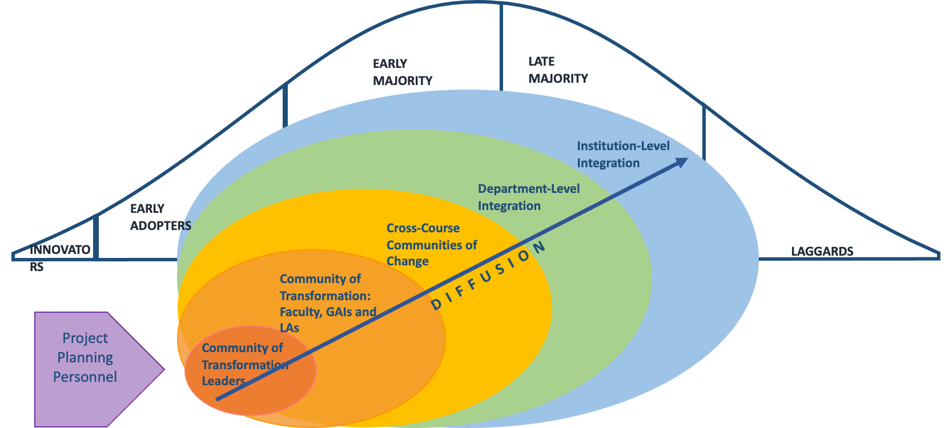
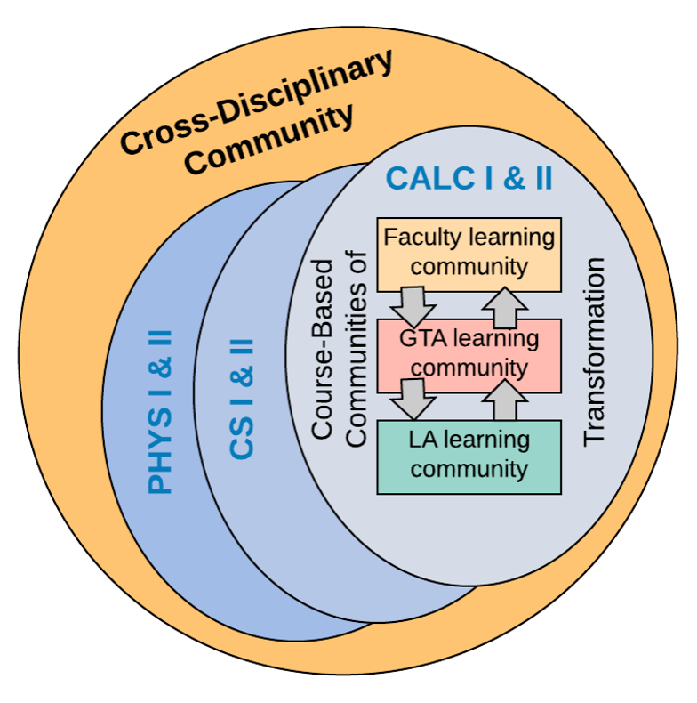
The Gateway2STEM Goal: Make large undergraduate courses more active
Implementation:
Active learning across Math, Physics, and CS
The Idea
Notes:
Math, Bob and Marrie

Slide 4
Introduction
International Graduate Teaching Assistants (IGTAs) have lived and been educated in another country
The diverse cultures of these countries, both generally and in terms of education systems, can influence experiences of IGTAs
People raised in a particular country/culture are socialized by the culture (Hofstede, G. 2011)
IGTA's cultural background can impact their approach teaching

Slide 5
Hofstede’s Cultural Dimensions
Six dimensions of Hofstede’s framework:
Power Distance
Individualism versus Collectivism
Motivation towards Achievement and Success
Uncertainty Avoidance
Long Term versus Short Term Orientation
Indulgence versus Restraint
Initially intended for business contexts, but also holds significant implications for education
Notes:
Power Distance: Egalitarian vs Embraces Hierarchy
Individualism versus Collectivism
Motivation towards Achievement and Success
Uncertainty Avoidance: Comfortable with Ambiguity vs. Follows a Well-Defined Path
Long Term versus Short Term Orientation: Short Term Goals First or Put Long Term Goals First
Indulgence versus Restraint : Happiness Can Be Bad vs Happiness is Always Good

Slide 6
Data Sources and Analysis Methods
IGTAs who are teaching recitations/labs and had attended the Gateway2STEM workshop were selected for interviews
Majority of IGTAs were male from various parts of Asia, with one female, and one Canadian
Country | China | Bangladesh | India | Iran | Uzbekistan | Canada | US
IGTAs | 4 | 4 | 1 | 1 | 1 | 1 | 8 GTAs
Notes:
7 IGTAs and 4 GTAs were re-interviewed again during summer 2024

Slide 7
Frequency of code usage (Dedoose)

Slide 8
Power Distance
Large Power Distance
(East Asia and Indian Subcontinent)
Teacher-centered education
Older people are both respected and feared
Subordinates expect to be told what to do
Small Power Distance
(German and English-speaking Western Countries)
Student-centered education
Older people are neither respected nor feared
Subordinates expect to be consulted

Slide 9
Power Distance in Classroom
Large Power Distance
Teachers may be an authority figure
Teachers may be respected and feared
Teachers may expect students to do what they say without explanation
Small Power Distance
Teacher may be more approachable
Teacher may be challenged
Students may be expected to ask questions
Notes:
And our data shows that most of our IGTAs come from high power distance country.
This cultural distance related to power distance may not be explicitly understood by IGTAs, but it will impact how they interact.

Slide 10
Power Distance
In IGTAs home country, teachers are viewed with high authority
Teachers are like parental figures
Students are hesitant to question them
Students cannot challenge grades
“From a cultural perspective this might be the most challenging aspect for me. In my home country, students are afraid of their teachers. So, I think it’s somewhat different here. They are not afraid and keep asking questions.”- IGTA
“We have the saying that your teacher as on the same level as of respect as your Dad, like in traditional Uzbekistan.”- IGTA

Slide 11
Power Distance
In some IGTAs’ home countries, like China, there is more adaptation to Western-style education
Foreign teachers are heired
Students are taught American history
Students can earn U.S. university degrees through collaborative cross-education programs
“I attended a private high school with an American-style education. We took the SAT instead of the Chinese university exam and could choose AP courses. Students had more opportunities to interact, especially in STEM classes.” - IGTA

Slide 12
Power Distance
In the US classroom,
Teachers are approachable
Students are questioning and challenging
Open, informal communication between students and teachers
Professors are willing to offer assistance when needed
“Most professors were available to talk and help. When they were on campus, they often kept their doors open, and you could knock and ask questions. They were usually very open to offering assistance.” – GTA

Slide 13
Individualism versus Collectivism
Individualism
(German and English-speaking Western Countries)
“I” – consciousness
Task prevails over relationship
Purpose of education is learning how to learn
Collectivism
(East Asia and Indian Subcontinent)
“We” – consciousness
Relationship prevails over task
Purpose of education is learning how to do

Slide 14
Individualism versus Collectivism in Classroom
Individualism
Teacher maybe “I” – consciousness
Teaching style might promote inquiry, reflection, and critical thinking through engaging and interactive methods
Collectivism
Teacher maybe “We” – consciousness
Teaching style might emphasize rote memorization and group harmony over individual understanding

Slide 15
Individualism versus Collectivism
IGTAs, “We” - consciousness
GTAs, “I” - consciousness
“Actually, in my culture, family is trying to control students' future career, they are trying to make the students choose their career , what the family wants them to choose.” - IGTA
“I'm a first-generation student and my family. The only influence they had on my education is that they weren't economically able to send me to school, I had to find my own way from undergrad to now. So, they didn't have much influence.” - GTA

Slide 16
Individualism versus Collectivism
Purpose of education
IGTAs, “Learning how to do”
GTAs, “Learning how to learn”
“Their schoolteachers used to give them a problem sheet and they used to give them solutions. And all they would do was just go through the solutions, so they never really developed the art of thinking.” – Foreign Classroom
“In my recitation, students come and do not ask for solutions, they come and work in group to solve problems.” – U.S. Classroom

Slide 17
Preliminary Conclusions
Power distance reflects the significant differences in teacher-student relationships between cultures
Understanding power distance can help tailor PD for IGTAs, focusing on adapting to open, student-centered teaching in U.S. classrooms
IGTAs focus on “learning how to do” with teacher guidance, while U.S. GTAs emphasize “learning how to learn” with independence
Adapting PD for IGTAs can help them navigate student-centered and independent learning environments effectively

Slide 18
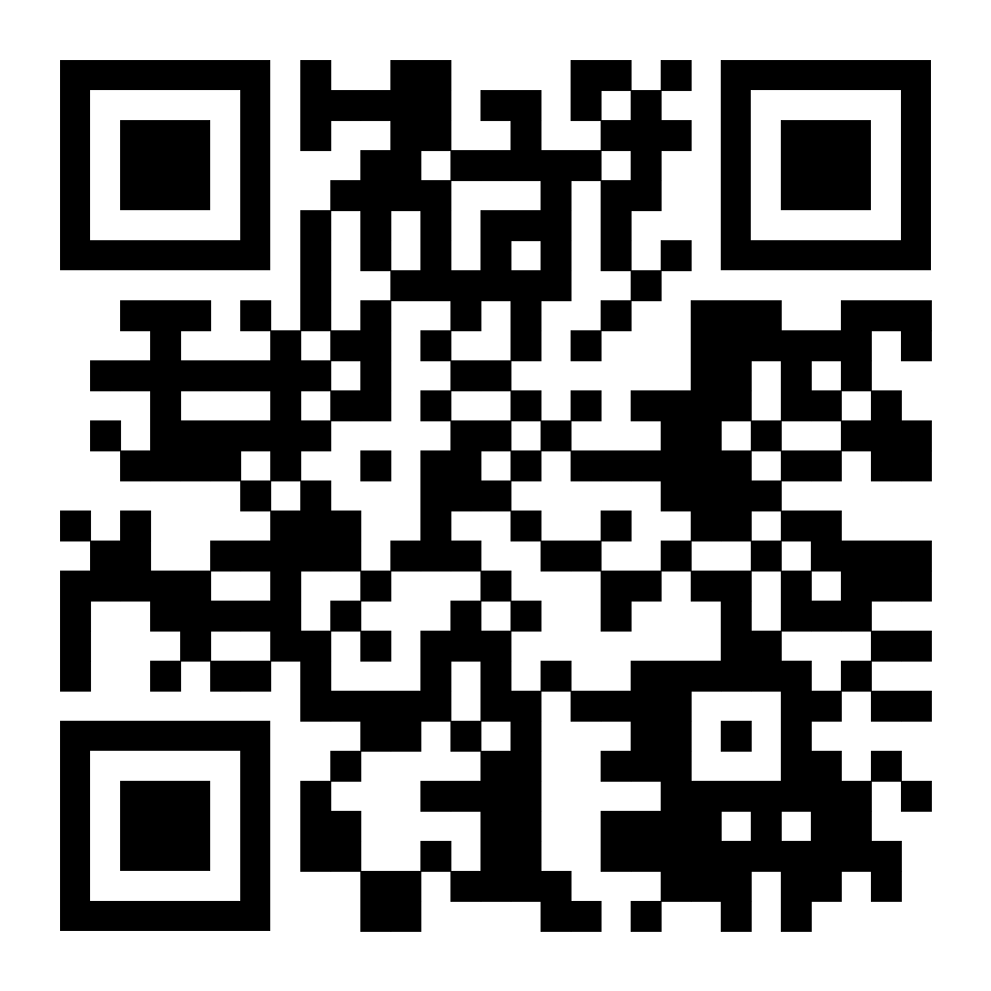
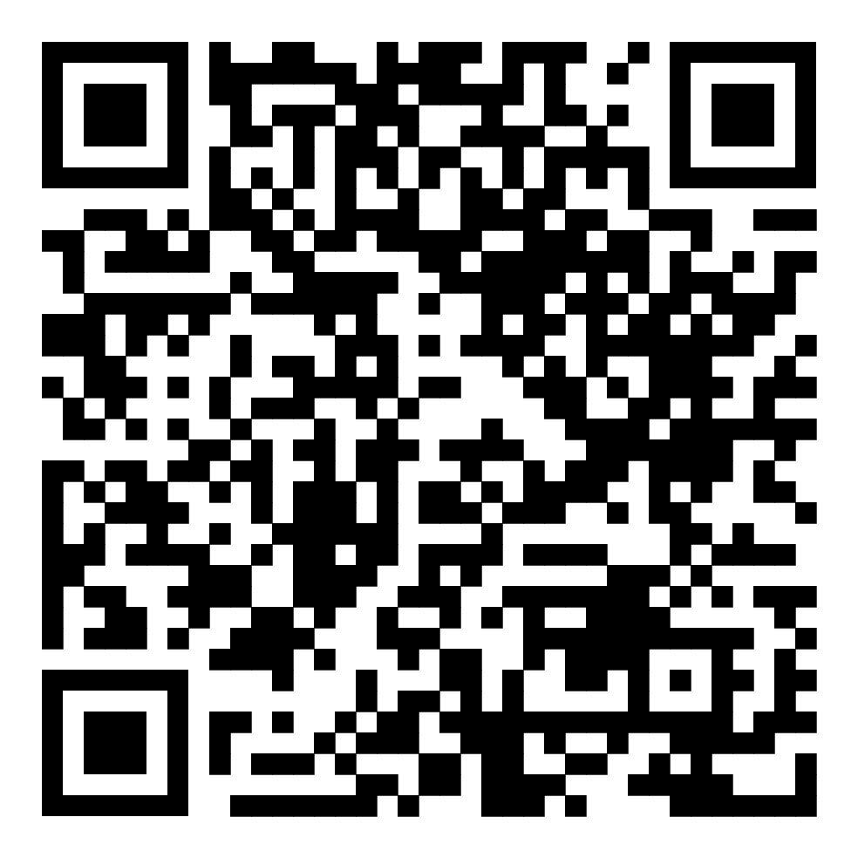
Thank you! nthapama@gmu.edu
Gateway2STEM website:
https://gstem.research.gmu.edu
Video about the Gateway2STEM project:
https://www.youtube.com/watch?v=n4gBld5GFhk

