Slide 1
Physics and Dance: Using Dance Analogies to Teach Physics, and Vice Versa
Arthur Baum, Myers Park High School

Slide 2
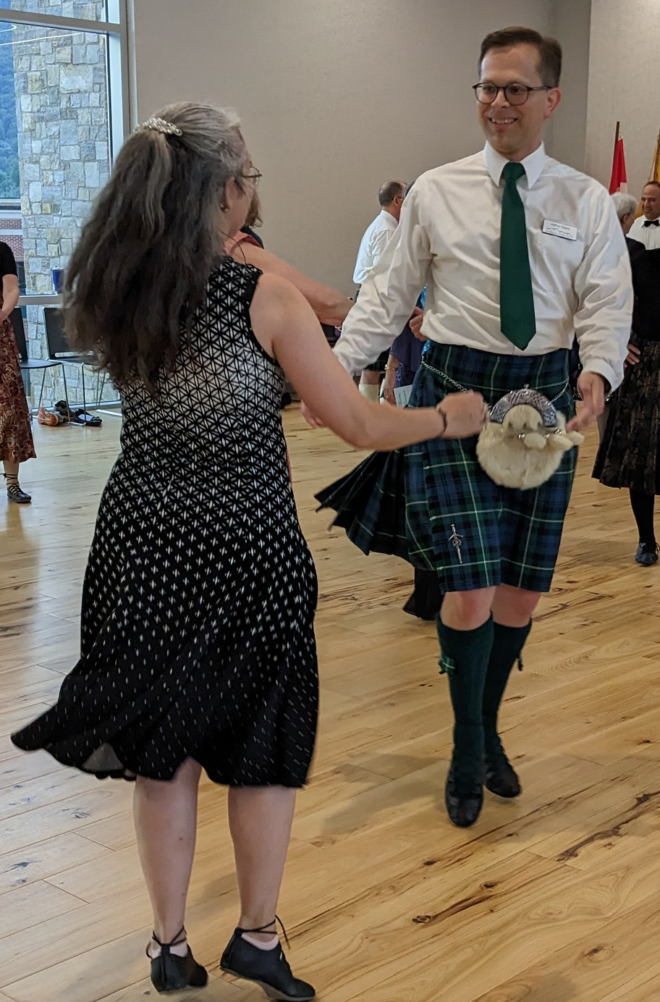
My Background: Physicist and Folk Dancer
Physics Major
High School Physics Teacher (AP, IB, Honors)
Scottish Country Dancer
Scottish Country Dance Teacher
How do my teaching interests align and intersect?

Slide 3
Using Dance to Teach Physics

Slide 4
Textbook Example: Grand Jeté
Fig. 9-6. Halliday Resnick & Walker 7th ed., adapted from The Physics of Dance, Kenneth Laws, Schirmer Books, 1984

Slide 5
Using Dance in Physics Class
Electric Circuits: Alternating and Direct Current
Open and closed circuits
Drift velocity
Presence of charge carriers throughout the circuit
Sun and Moon Dance (Philip Sadler, Harvard-Smithsonian CFA)
Relative positions of sun and moon
Seasons and phases of the moon
Changes in sunrise, sunset, and lengths of day and night

Slide 6
Teaching About Dance in Physics Class
Newton’s Laws, Force as an Interaction
Frame (waltz hold)
Strong arms (Scottish country dance turns and circles)
Torque and the Waltz
“You push with both hands, you push with this one and pull with that one”
Balanced force at one point of contact, unbalanced at the other
Analogy to an electric motor

Slide 7
Using Physics to Teach Dance

Slide 8
Physics Analogies in Dance Class
Right-hand rule (kids latch onto)
Immediately understand direction to face in dance class
More likely to remember and apply rule in physics class
Centripetal force (turning partner with 1 or 2 hands)
Strong arms vs. “giving weight”
Instruction to pull slightly toward yourself (gets you around turns faster)
Ladder problem (strathspey traveling step)
Lengthen your step by sitting into it

Slide 9
Strathspey Traveling: Like a Ladder Problem
Physics Stack Exchange
https://physics.stackexchange.com/questions/415140/why-cant-a-ladder-sliding-down-a-wall-go-faster-than-light

Slide 10
Physics Analogies in Dance Class
Right-hand rule (kids latch onto)
Immediately understand direction to face in dance class
More likely to remember and apply rule in physics class
Centripetal force (turning partner with 1 or 2 hands)
Strong arms vs. “giving weight”
Instruction to pull slightly toward yourself (gets you around turns faster)
Ladder problem (strathspey traveling step)
Lengthen your step by sitting into it
Move like the pendulum of a clock (strathspey setting step)
Lift and gracefully place your foot—not a flick!

Slide 11
Strathspey Setting: Like a Clock Pendulum
Encyclopedia Britannica
https://www.britannica.com/technology/pendulum
Royal Scottish Country Dance Society
https://www.youtube.com/TheRSCDS

Slide 12
Polka, Teacups, and the Right-hand Rule
Scottish Country Dancer Magazine
Issue 36, Spring 2023, Page 2

Slide 13
The Queen City Salute

Slide 14
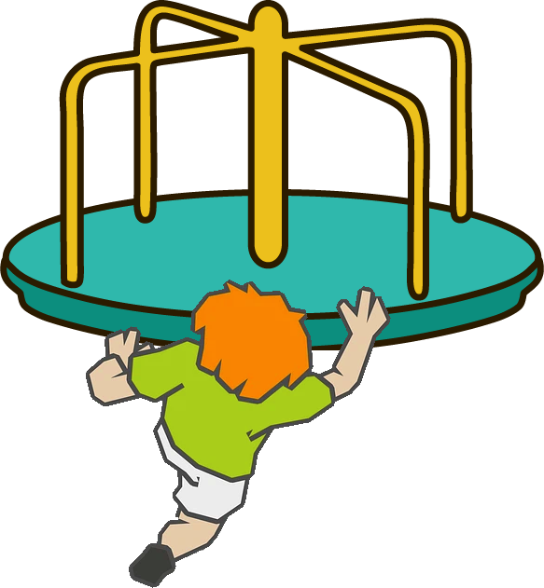
The Queen City Salute
Objects moving in a straight line still have angular momentum

Slide 15
Just for fun: St. Andrews SCD Summer School

Slide 16
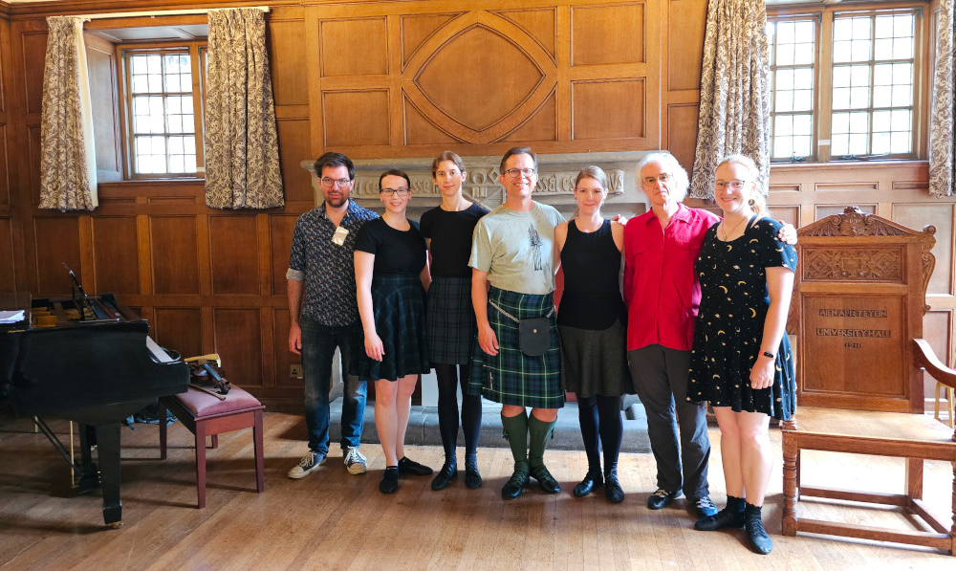
Ghost Particles: A Neutrino Dance
https://my.strathspey.org/dd/dancevideo/10932/

